Slide 1

Coupled Flow and Mechanics Simulations using the Fracture Displacement-Pressure Basis Function Method for Highly Fractured Rock
Institute of Fluid Dynamics
Giulia Conti, Daniel Stalder, Patrick Jenny
Institute of Fluid Dynamics, ETH Zurich
InterPore 2026

Slide 2
Goal: Hydro-Geomechanical Simulations of Highly Fractured Rock
Geomechanical Simulations
Deformation of rock
Shear displacement
Tensile opening
Flow Simulations
Porous fractured rock
Transport
Efficient solvers needed for highly fractured rock
Few degrees of freedom per fracture
Fracture Displacement Basis Function Method
(FDBF)
Conti G., Matthai S., Jenny P., 2025, Int. J. Rock Mech. Min. Sci.
Conti G., Matthai S., Jenny P., 2026, submitted
Pressure Basis Function Method
Stalder D., Cao S., Meyer-Masetti D., Jenny P., 2026, in preparation
Western Norway
Odling, N.E., 1997, Journal of Structural Geology
InterPore 2026
Notes:
preexisting fractures
We developed a method which needs only very few degrees of freedom pre fracture, which makes it very efficient. For the mechanics we called it the ... And a colleague of mine is working on a very similar method for the pressure. In this talk I will present the method for the mechanics and then briefly talk about the pressure and the coupling.

Slide 3
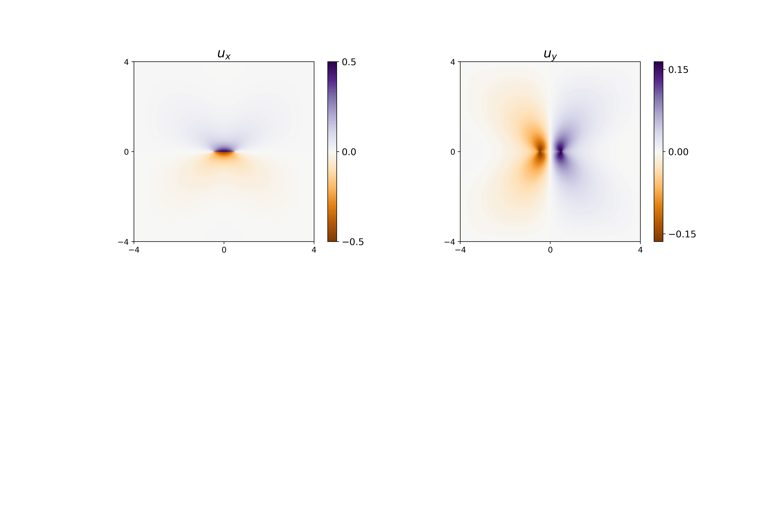
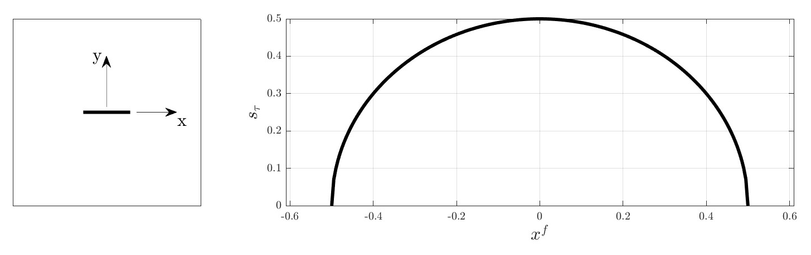
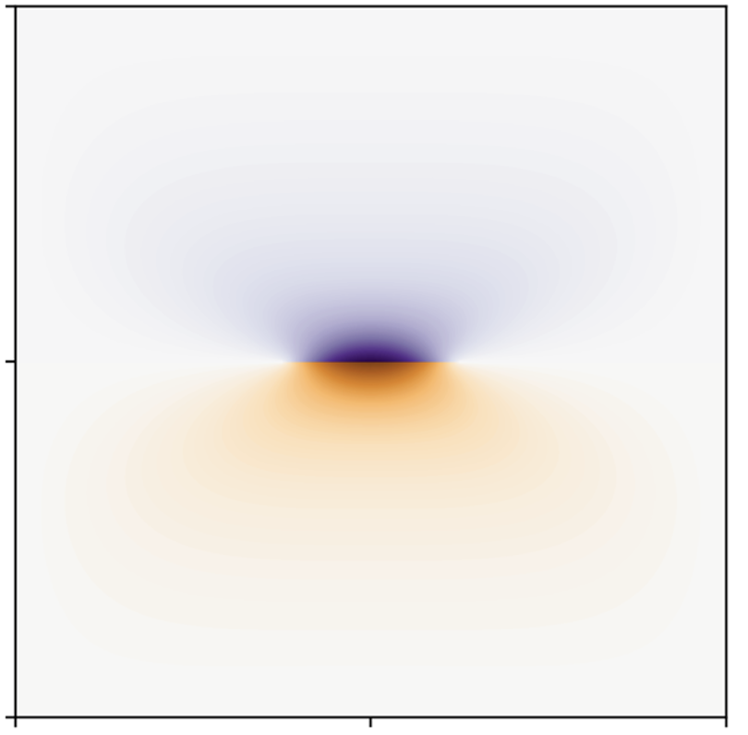
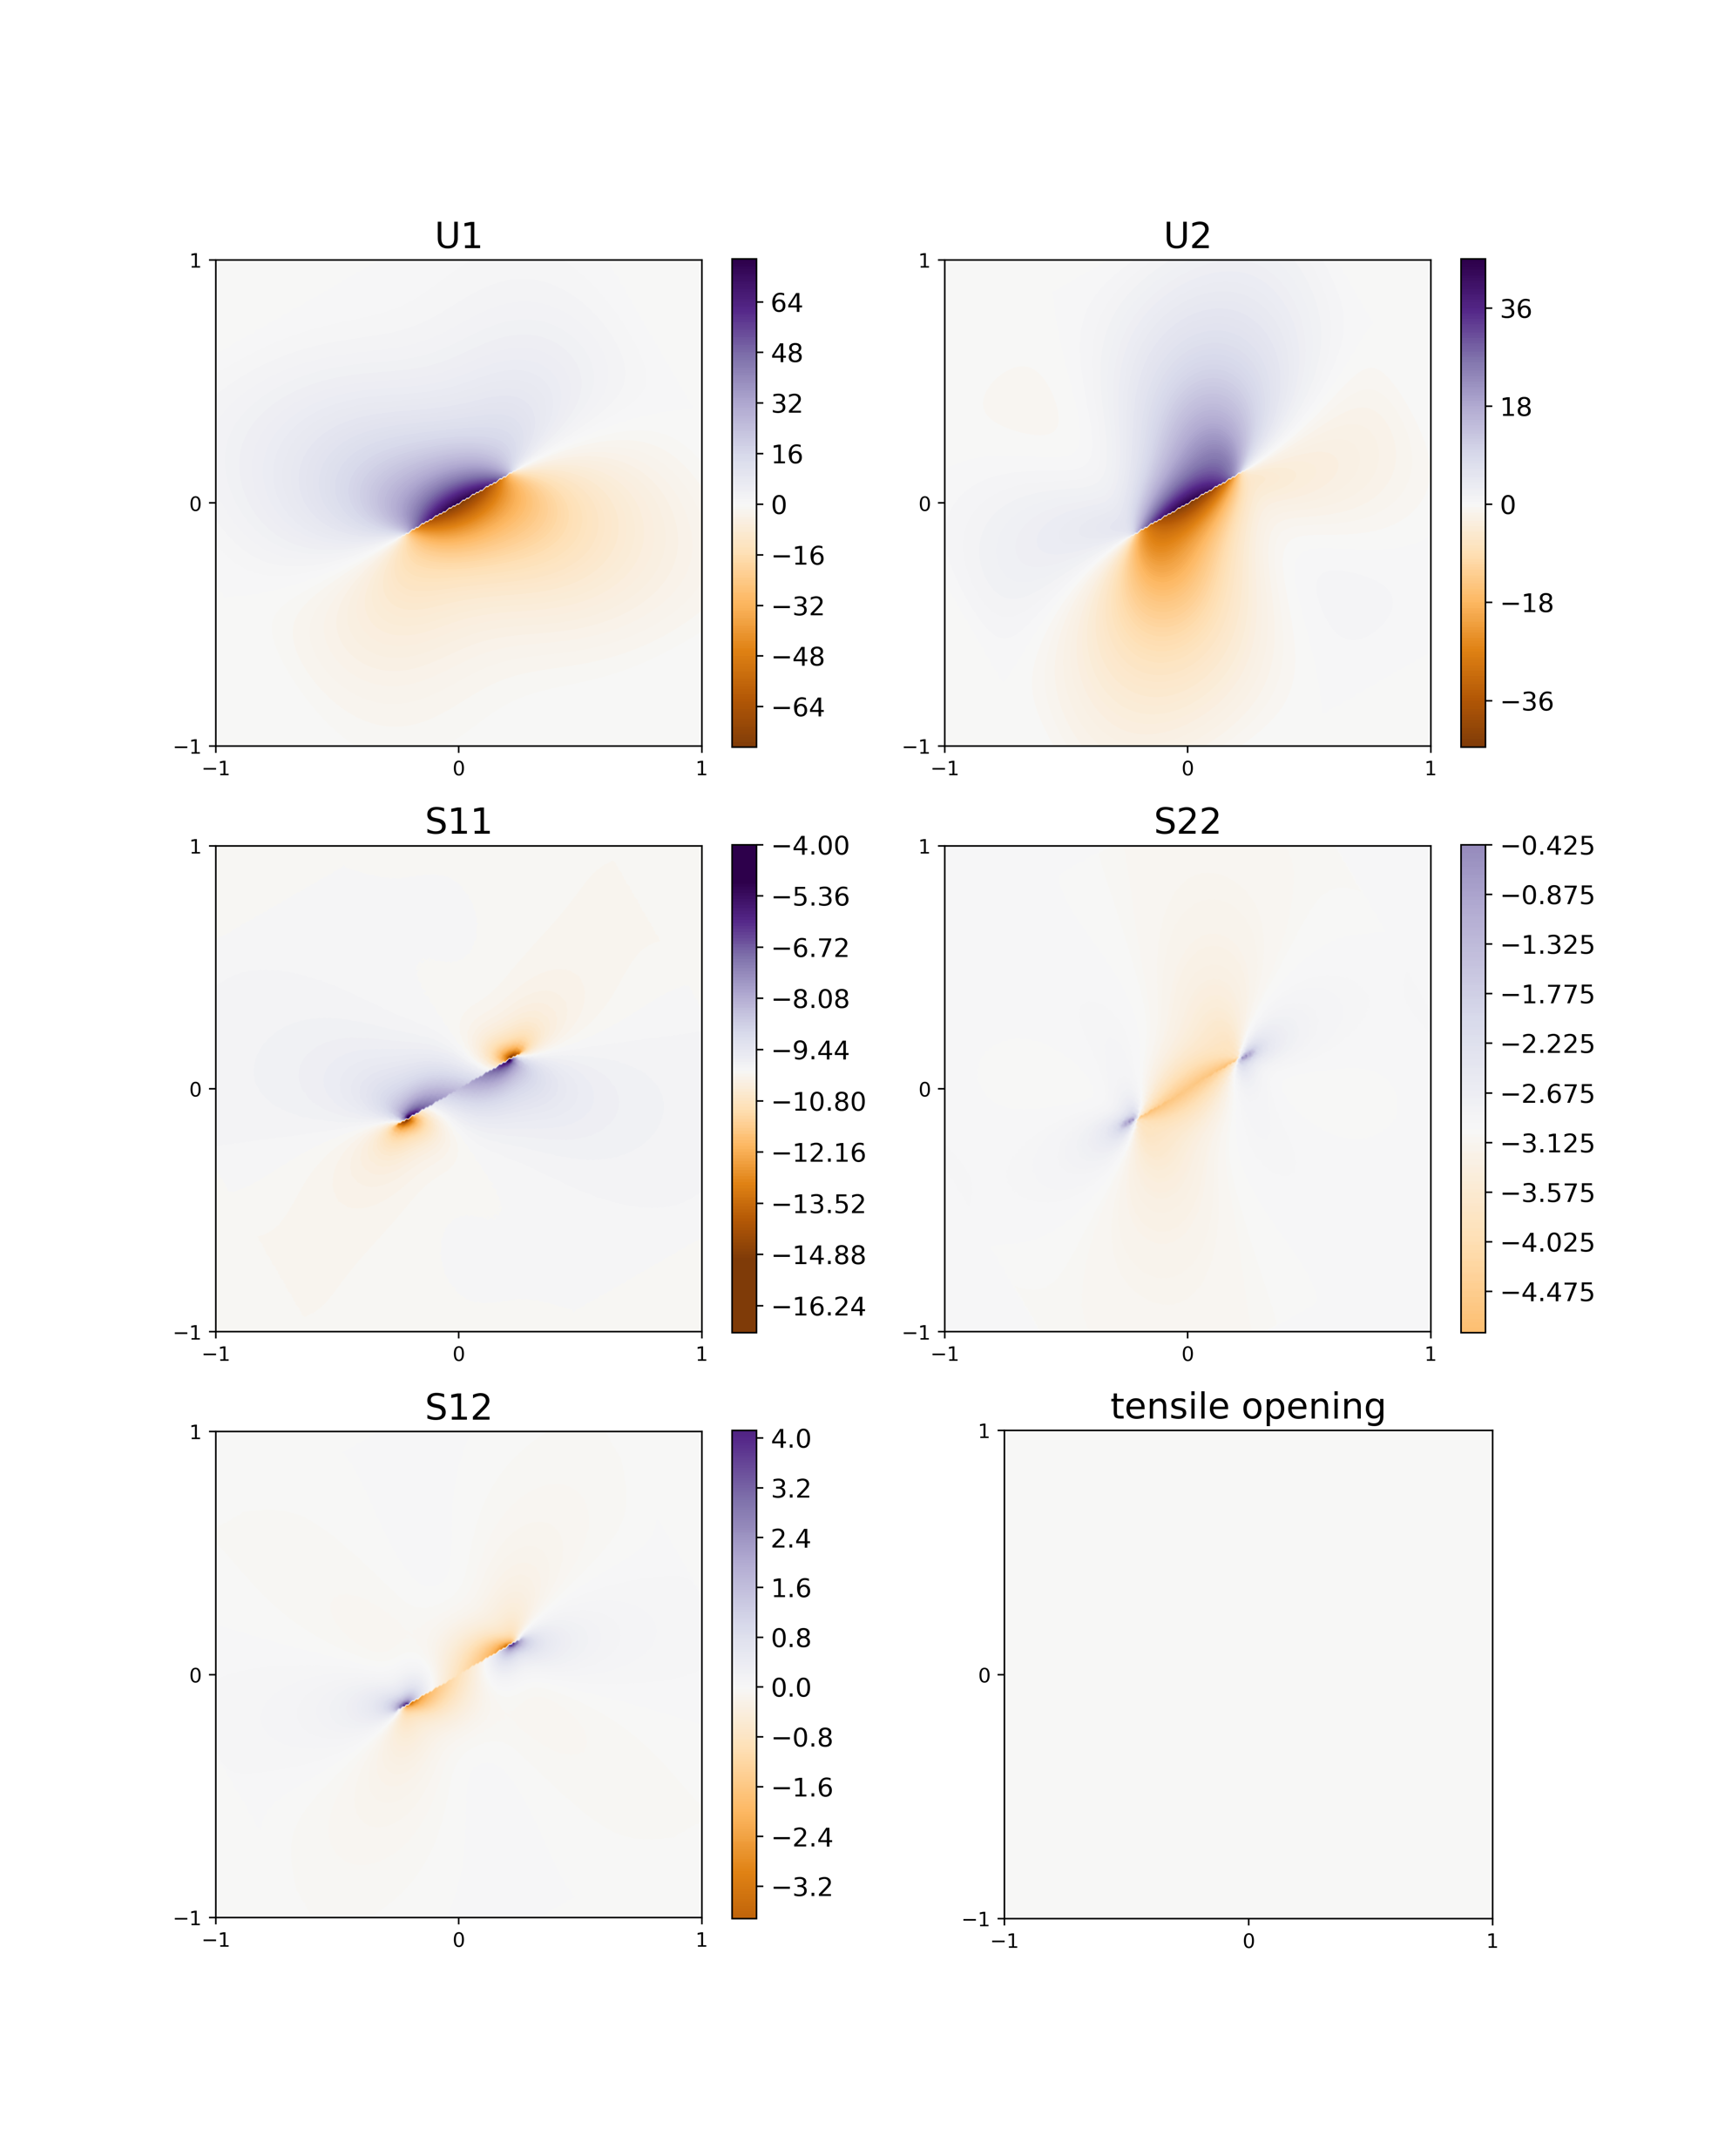
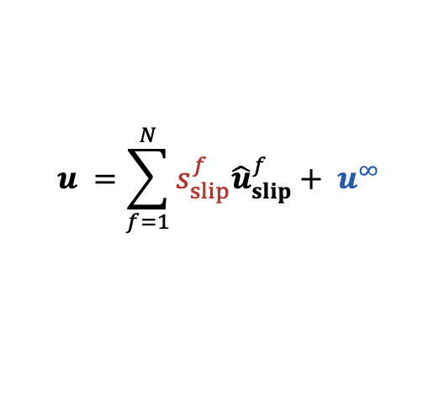
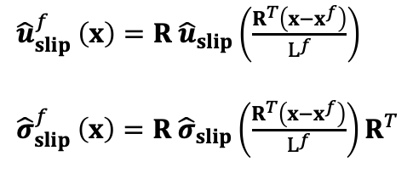

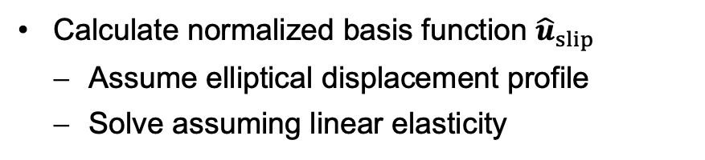

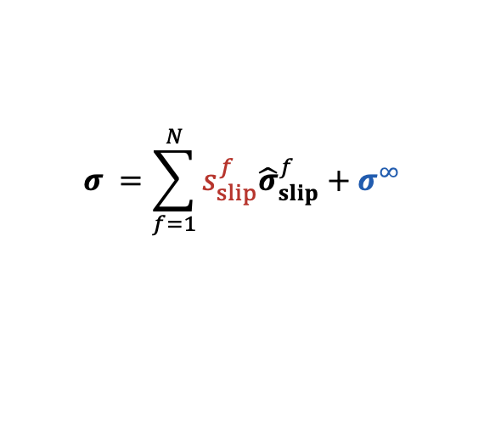
FDBF 1. Step: Find Unit Basis Function for Shear Slip ${\hat{u}}_{slip}$
Displacement and stress fields:
$$u =\sum_{f=1}^{N}{s_{slip}^{f}{\hat{u}}_{slip}^{f}}+ u^{∞}$$
$$σ =\sum_{f=1}^{N}{s_{slip}^{f}{\hat{σ}}_{slip}^{f}}+{ σ}^{∞}$$
basis function
shear slip
Calculate normalized basis function ${\hat{u}}_{slip}$
Assume elliptical displacement profile
Solve assuming linear elasticity
$$∇⋅σ=0, σ=λ\left( ∇⋅u\right)I+G(∇u+{∇u}^{T})$$
Compute fracture specific BF
$${\hat{u}}_{slip}$$
$${\hat{u}}_{slip}^{f}$$
${{\hat{u}}_{slip}^{f}}_{ }\left(x\right)=R^{ }{\hat{u}}_{slip}\left(\frac{R^{T}\left(x−x^{f}\right)}{L^{f}}\right)$
${{\hat{σ}}_{slip}^{f}}_{ }\left(x\right)=R^{ }{\hat{σ}}_{slip}\left(\frac{R^{T}\left(x−x^{f}\right)}{L^{f}}\right)R^{T}$
InterPore 2026
Notes:
To find basis functions we will make the assumption that we know shape of slip profile
Transformation
Since we assume that the problem is linear, we can describe the displacement field u as a superposition of some fracture specific basisfunctions and their weigths which are the shear displacements. First step is to compute our basis functions. For that we look at the simple case of an horizontal fracture in the field and we will asssume/impose an elliptical slip profile and the displacement at infinity to be 0. We can solve for the displacecement in the field assuming linear elasticity and using the finite volume method. The resulting displacement field will be the basis function u hat

Slide 4


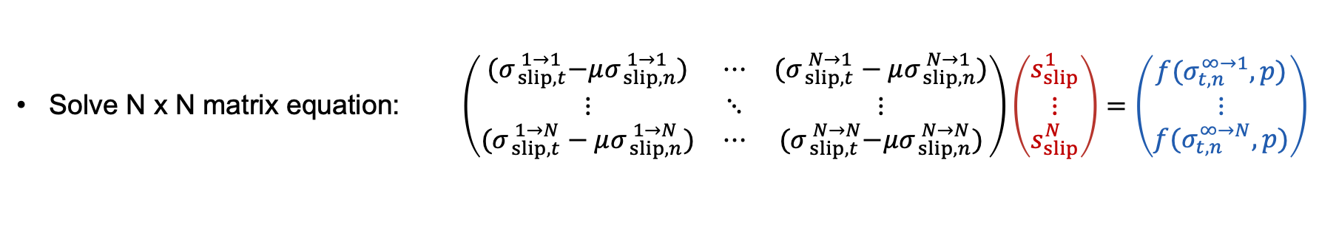
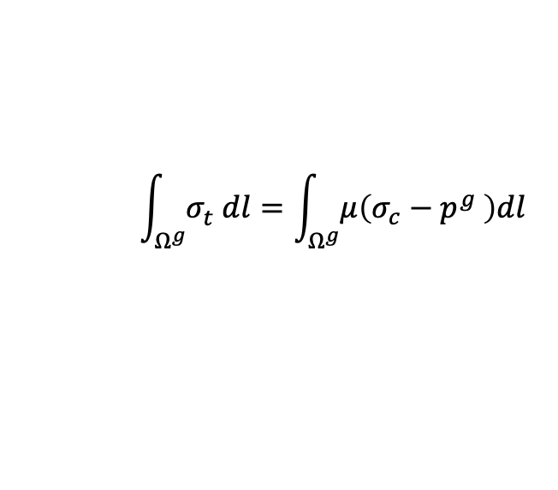


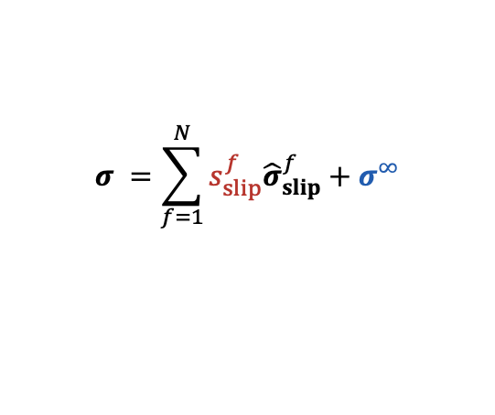
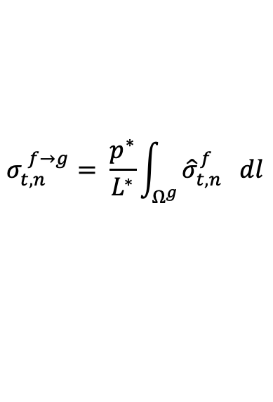

FDBF 2. Step: Find Shear Displacement
$$u =\sum_{f=1}^{N}{s_{slip}^{f}{\hat{u}}_{slip}^{f}}+ u^{∞}$$
Condition for shear slip $|σ_{t}^{ }| >μ(σ_{c}^{ }−{p^{ }}^{ })$
$${ \int_{Ω^{g}}^{ }{σ_{t}^{ } dl}=\int_{Ω^{g}}^{ }{μ\left(σ_{c}^{ }−{p^{g}}^{ }\right)dl}}_{ }^{ }$$
$$σ =\sum_{f=1}^{N}{s_{slip}^{f}{\hat{σ}}_{slip}^{f}}+{ σ}^{∞}$$
$$σ_{xx}^{f}$$
$$σ_{t,n}^{ f→g}= \frac{p^{∗}}{L^{∗}}\int_{Ω^{g}}^{ }{{{\hat{σ}}_{t,n}^{f}}_{ } dl}$$
$$f$$
$$σ_{t,n}^{g}=F({ \hat{σ}}_{slip, t}^{f→g},{ \hat{σ}}_{slip, n}^{f→g},{ s}_{slip}^{f},{\hat{σ}}_{t,n}^{∞→g})$$
$$g$$
Solve N x N matrix equation: $\left(\begin{matrix}{(σ}_{ slip,t}^{ 1→1}−μσ_{ slip,n}^{ 1→1}) & ⋯ & (σ_{ slip,t}^{ N→1}−μσ_{ slip,n}^{ N→1}) \\ ⋮ & ⋱ & ⋮ \\ (σ_{ slip,t}^{ 1→N}−μσ_{ slip,n}^{ 1→N}) & ⋯ & {(σ}_{ slip,t}^{ N→N}−μσ_{ slip,n}^{ N→N})\end{matrix}\right)\left(\begin{aligned}s_{slip}^{1} \\ ⋮ \\ s_{slip}^{N}\end{aligned}\right)=\left(\begin{aligned}{f(σ}_{t,n}^{∞→1},p) \\ ⋮ \\ {f(σ}_{t,n}^{∞→N},p)\end{aligned}\right)$
Same procedure for tensile opening: 2N x 2N matrix
N: # fractures
Interaction
coefficients
shear slip
„Boundary conditions“
InterPore 2026
Notes:
Shear stress and normal are rewritten using our ansatz, so as a superposition of all the fracture specific basisfunctions. So essentially the shear stress is the summation over all the fractures of the induced force of fractures f on fracture g and the corrisponding weight/shear slip.
INDUCED FORCE BY FRACTURE F ON FRACTURE G. SO WE INTEGRATE OER THE SHEAR AND NORMAL STRESS INDUCED BY F ALONG G.

Slide 5
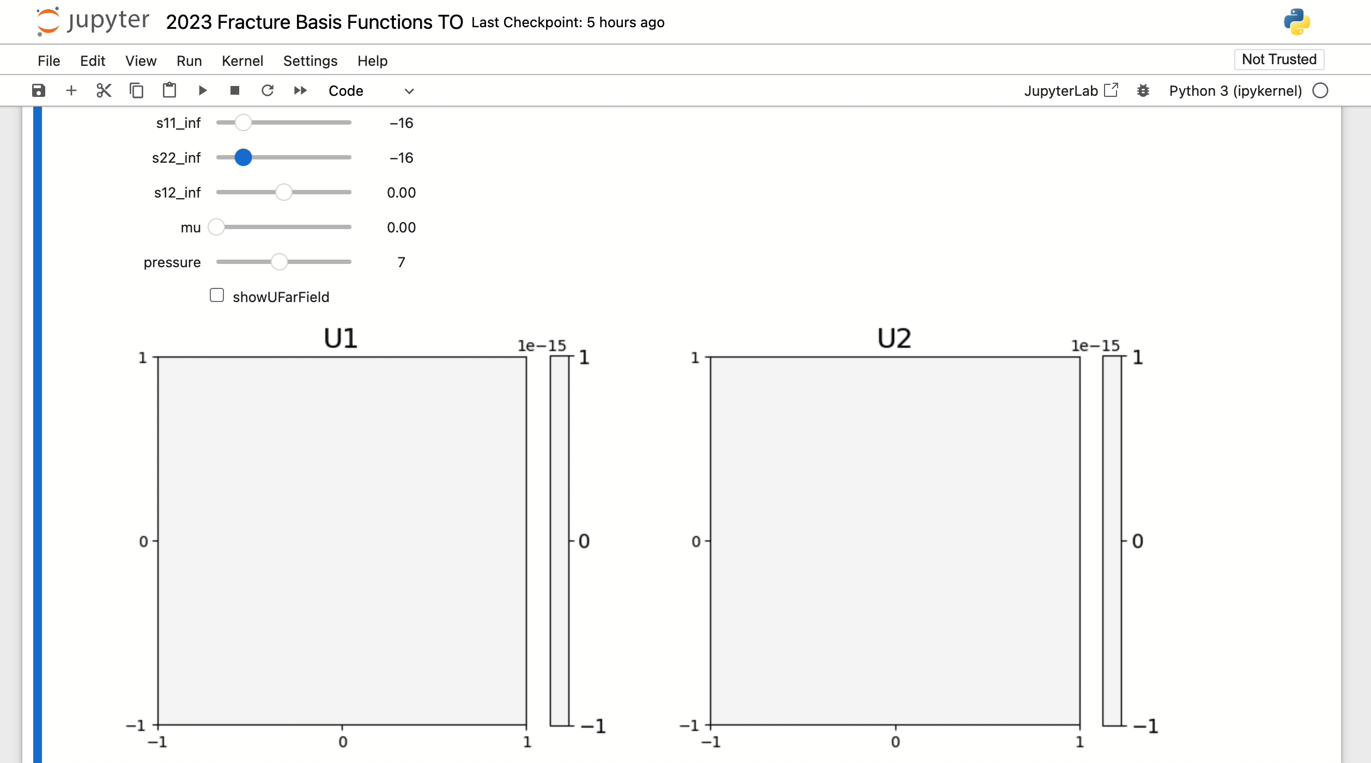
Example: 33 Fractures
InterPore 2026

Slide 6
33-Fracture Test Case – Displacement and Stress Fields
8‘000‘000 dof
66 dof
InterPore 2026

Slide 7
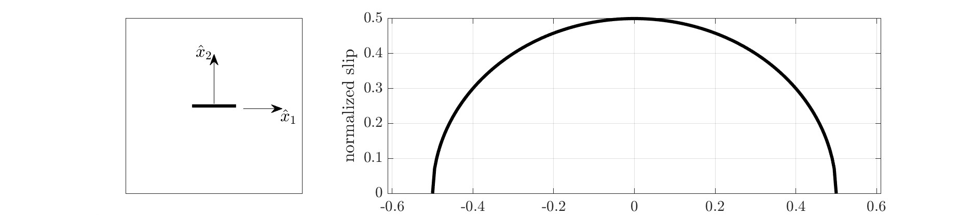
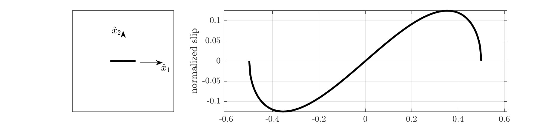
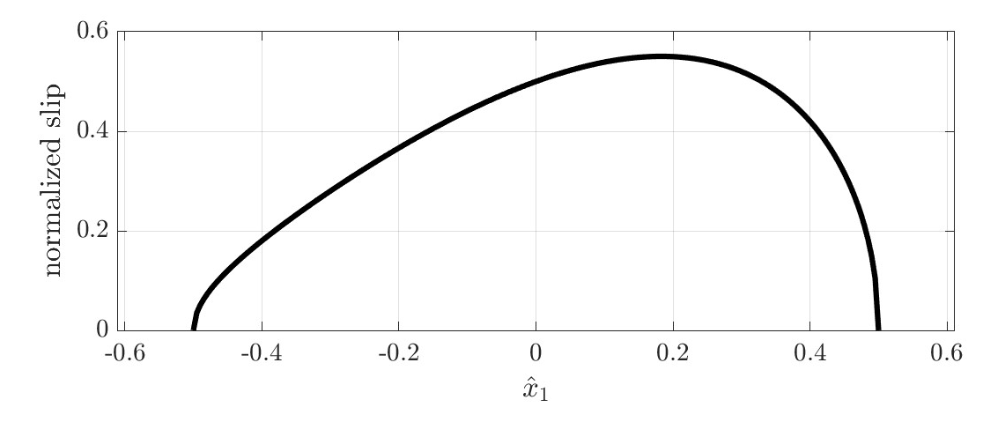
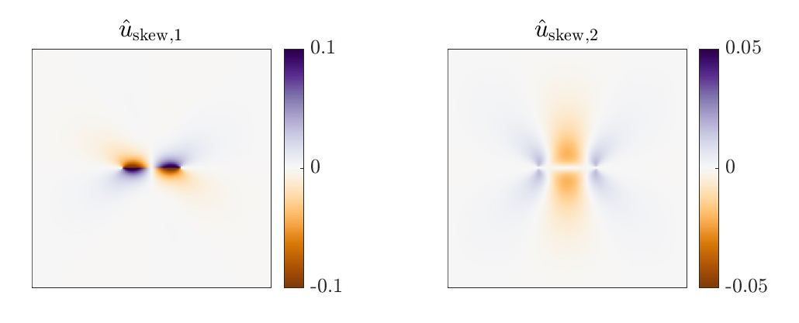
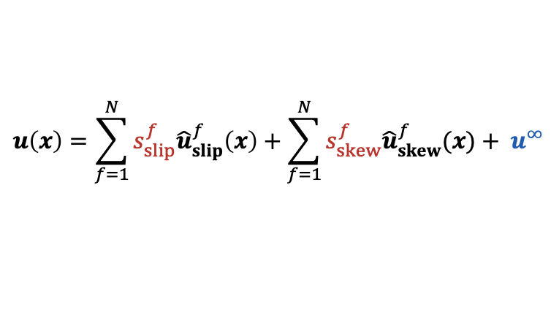
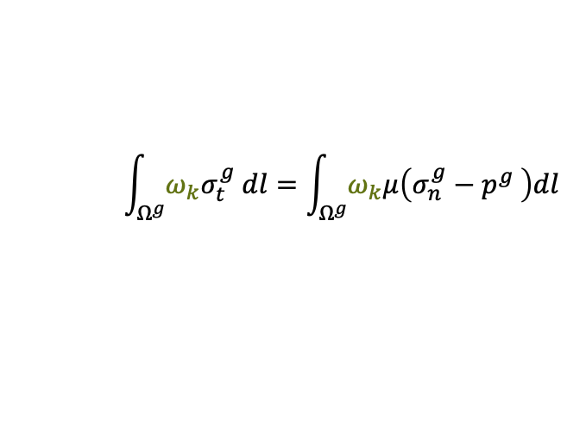
FDBF with Skewness
Displacement field:
$$u\left(x\right)=\sum_{f=1}^{N}{s_{slip}^{f}{\hat{u}}_{slip}^{f}\left(x\right)}+\sum_{f=1}^{N}{s_{skew}^{f}{\hat{u}}_{skew}^{f}(x)}+ u^{∞}$$
+
=
$${ \int_{Ω^{g}}^{ }{{ω_{k}σ}_{t}^{g} dl}=\int_{Ω^{g}}^{ }{ω_{k}μ\left(σ_{n}^{g}−{p^{g}}^{ }\right)dl}}_{ }^{ }$$
Solve using Galerkin Method:
# Degrees of freedom for shearing = 2x number of fractures
InterPore 2026

Slide 8
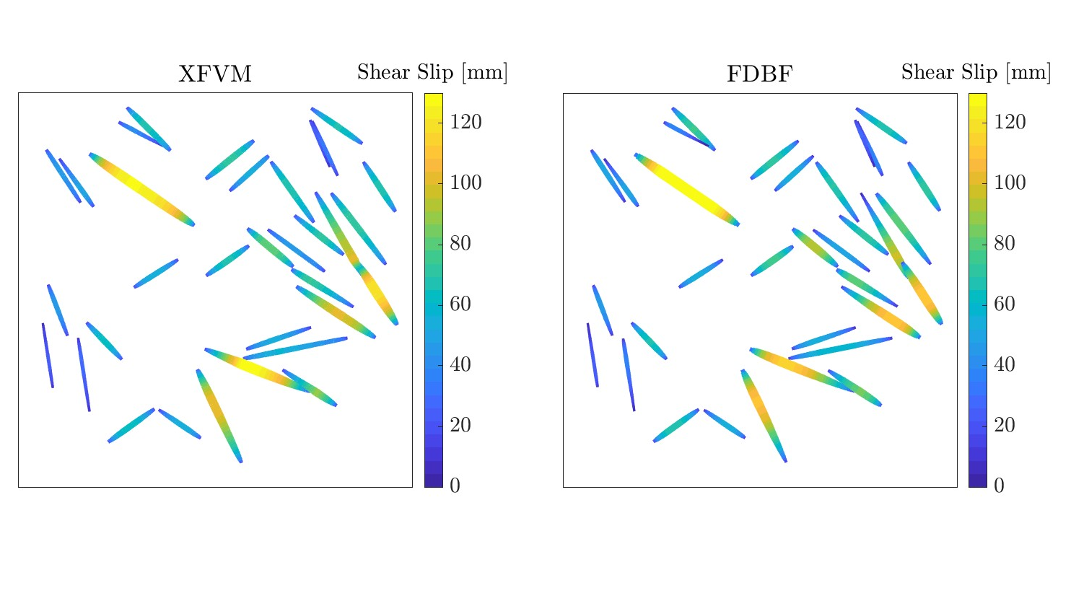
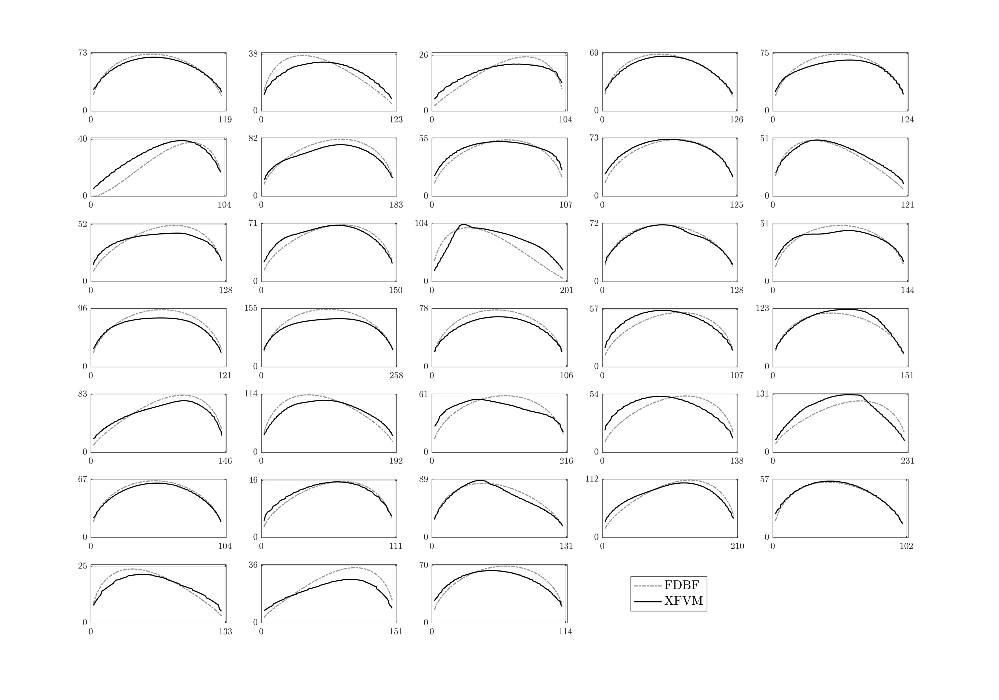
33-Fracture Test Case – Shear Displacement
InterPore 2026

Slide 9
44-Fracture Test Case - Displacement
Splitting at intersections
Example: 44 fractures → 51 segmented fractures
InterPore 2026

Slide 10
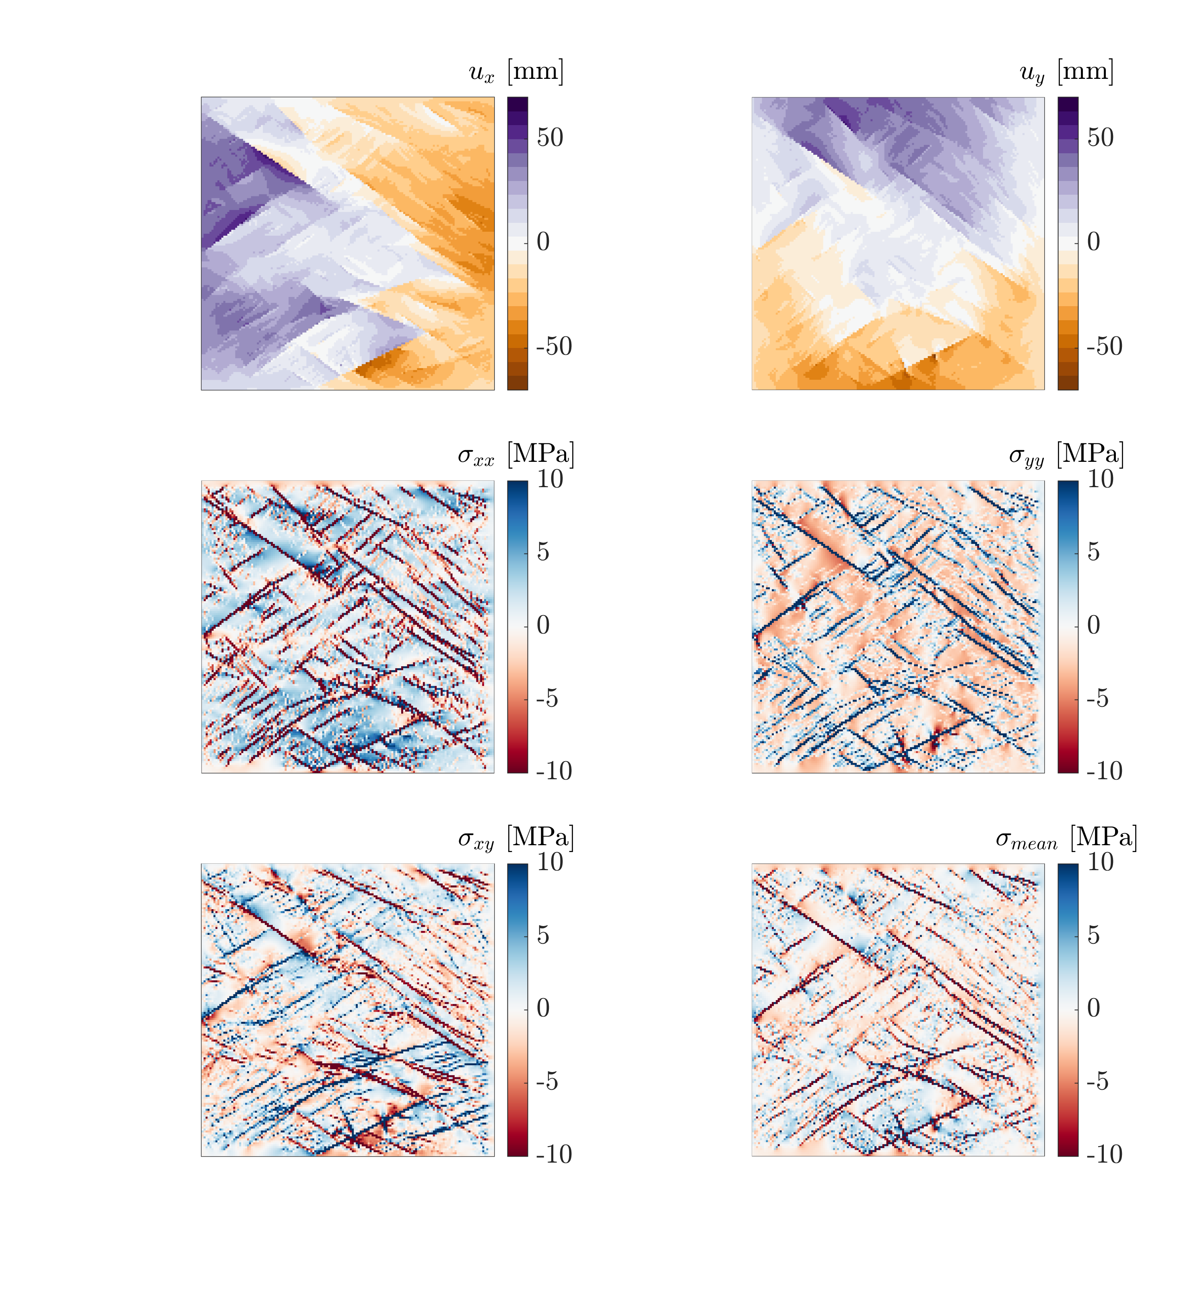
4051 Fractures
5600 fractures after splitting at intersections
InterPore 2026

Slide 11
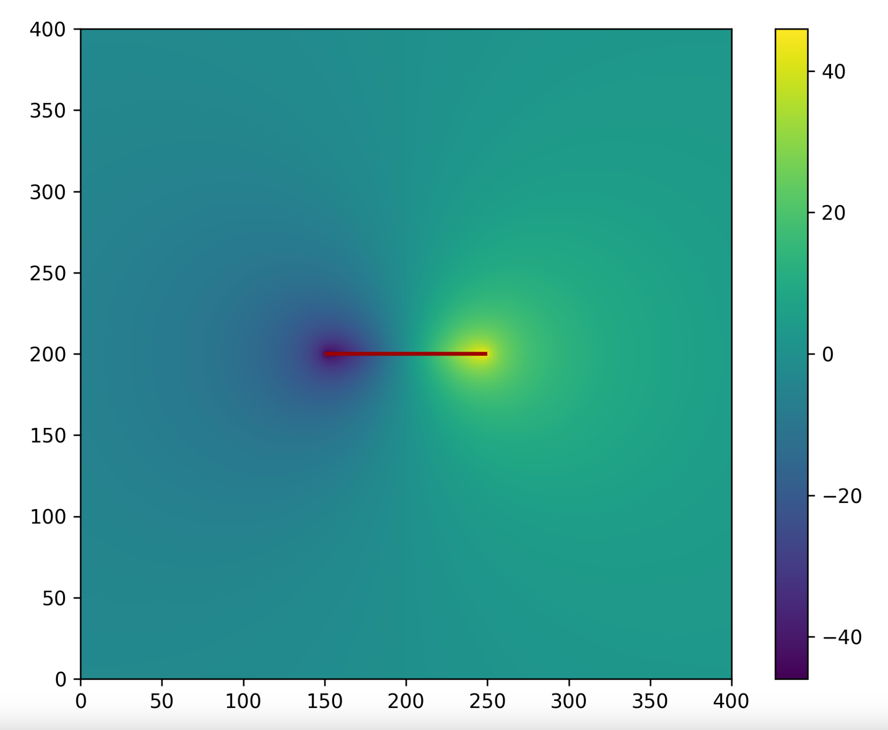


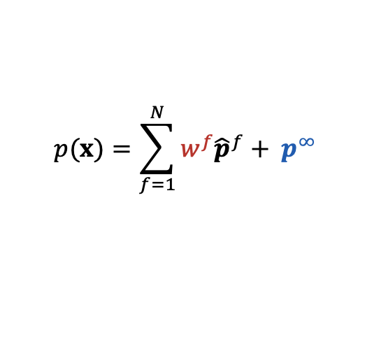
„Same“ Method for Flow
Daniel Stalder
MS03
Efficient Flow and Transport in Fractured Porous Media using the Basis Function Method
Friday 12:20 PM – 12:35 PM
Pressure
Basis function
Assumption: all fractures have same distribution of sources and sinks
Weights $w_{ }^{f}$
found via the far field pressure drop over the fracture
$$p(x)=\sum_{f=1}^{N}{w_{ }^{f}{\hat{p}}_{ }^{f}}+ p^{∞}$$
basis function
weight
$${\hat{p}}_{ }^{f}$$
$p\left(x_{start}^{f}\right)−p\left(x_{end}^{f}\right)=0$ or $p\left(x_{start}^{f}\right)−p\left(x_{end}^{f}\right)=F(a^{f})$
InterPore 2026

Slide 12
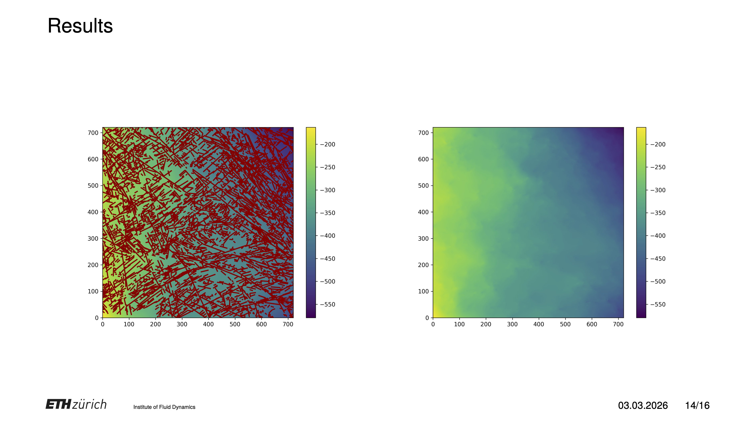
Results: Pressure Field
InterPore 2026

Slide 13
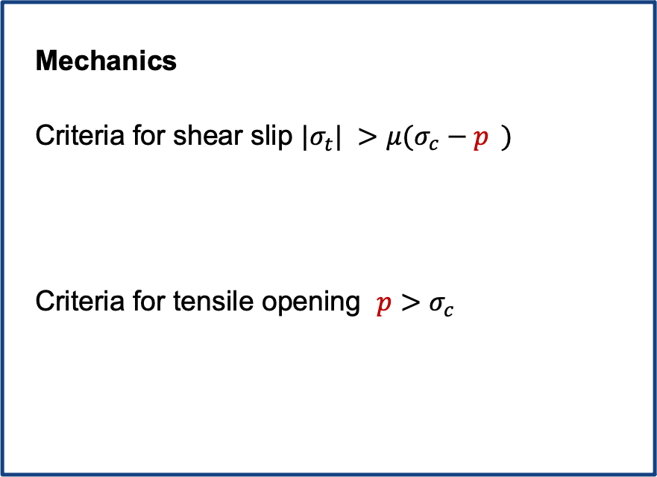

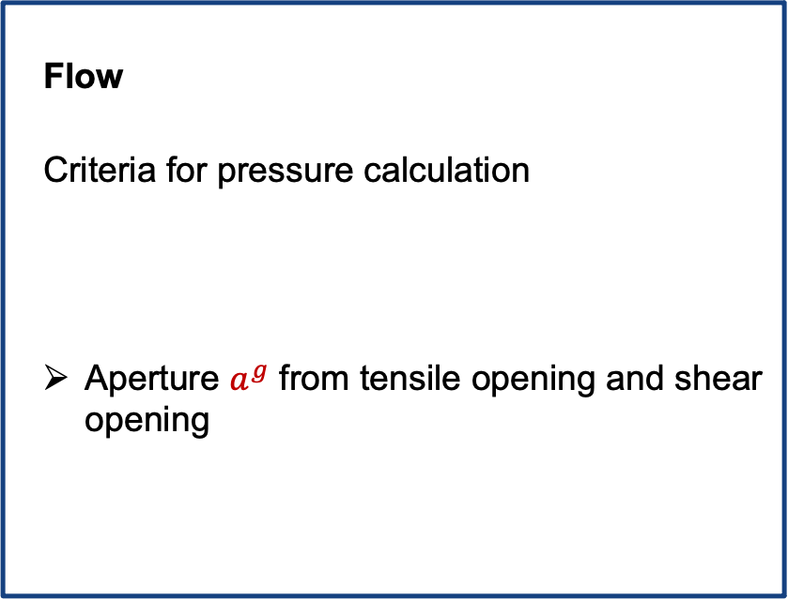
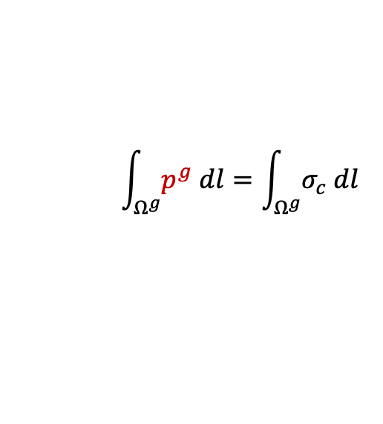
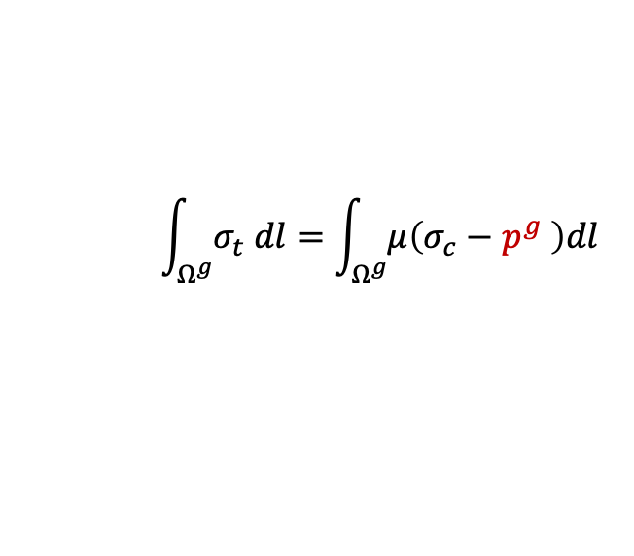
Coupling
Mechanics
Criteria for shear slip $|σ_{t}^{ }| >μ(σ_{c}^{ }−{p^{ }}^{ })$
Criteria for tensile opening $p>σ_{c}^{ }$
Flow
Criteria for pressure calculation
Aperture $a^{g}$ from tensile opening and shear opening
$${ \int_{Ω^{g}}^{ }{σ_{t}^{ } dl}=\int_{Ω^{g}}^{ }{μ\left(σ_{c}^{ }−{p^{g}}^{ }\right)dl}}_{ }^{ }$$
$p\left(x_{start}^{g}\right)−p\left(x_{end}^{g}\right)=F(a^{g})$
$${ \int_{Ω^{g}}^{ }{p^{g} dl}=\int_{Ω^{g}}^{ }{σ_{c}^{ } dl}}_{ }^{ }$$
Iterative coupling and checking the shear and tensile opening criteria at every iteration to determine mechanically active fractures
InterPore 2026

Slide 14
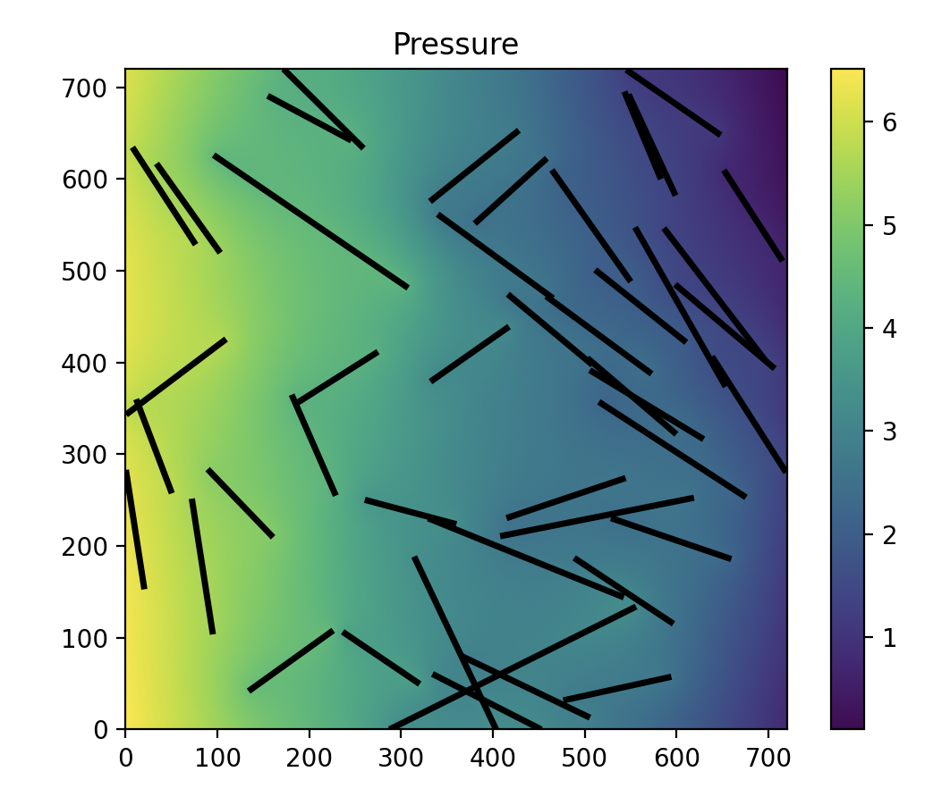
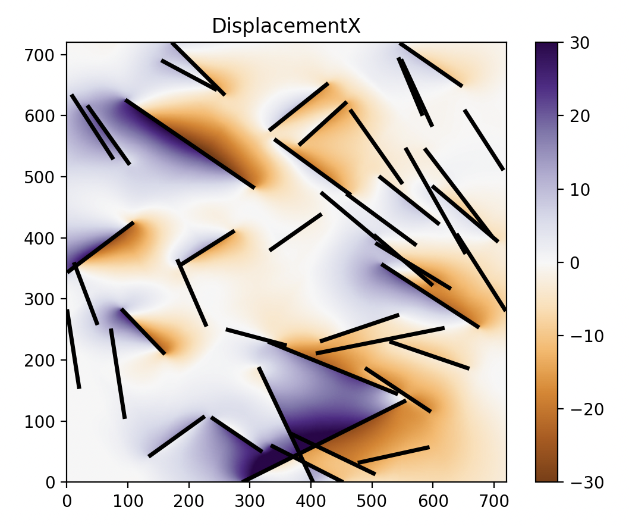
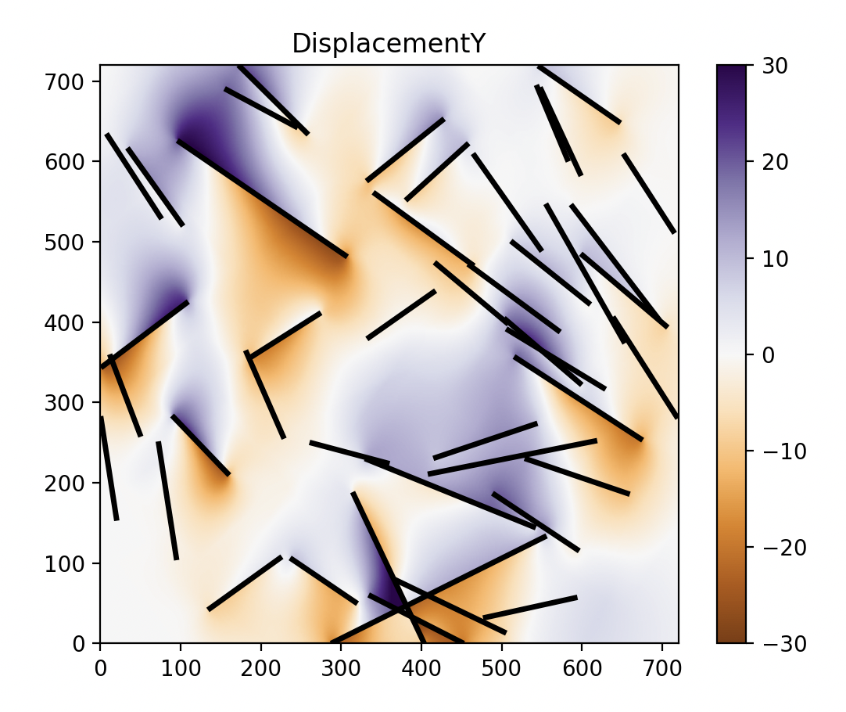
Preliminary Results
InterPore 2026

Slide 15

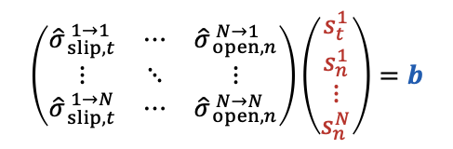
Summary
Mechanics and Flow calculation
Basis functions are calculated only once and then mapped
Only few dof per fracture → very efficient
Captures fracture interaction
$$\left(\begin{matrix}{\hat{σ}}_{ slip,t}^{ 1→1} & ⋯ & {\hat{σ}}_{ open,n}^{ N→1} \\ ⋮ & ⋱ & ⋮ \\ {\hat{σ}}_{ slip,t}^{ 1→N} & ⋯ & {\hat{σ}}_{ open,n}^{ N→N}\end{matrix}\right)\left(\begin{matrix}\begin{aligned}s_{t}^{1} \\ s_{n}^{1}\end{aligned} \\ ⋮ \\ s_{n}^{N}\end{matrix}\right)=b$$
Outlook:
Coupled simulations of highly fractured rock
Well injection test cases
Conti G., Matthai S., Jenny P., 2025, Fracture Displacement Basis Function (FDBF) Method for Efficient Geomechanical Calculations of Fractured Rock, Int. J. Rock Mech. Min. Sci.
InterPore 2026

Slide 16
Coupled Flow and Mechanics Simulations using the Fracture Displacement-Pressure Basis Function Method for Highly Fractured Rock
Institute of Fluid Dynamics
Giulia Conti, Daniel Stalder, Patrick Jenny
Institute of Fluid Dynamics, ETH Zurich
InterPore 2026

