Slide 1



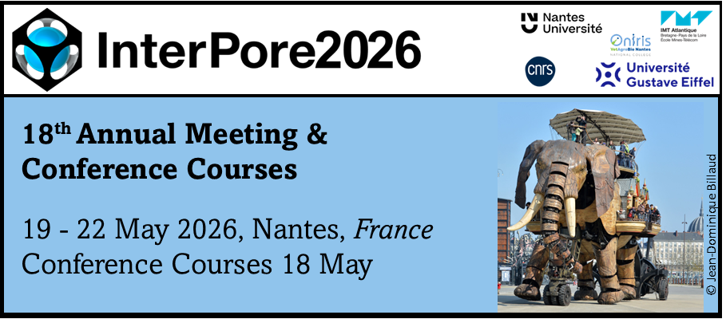
Thermo-Hydraulic Modeling of Freeze-Thaw Processes in Fractured Porous Media
Jia-Jing Linª, Chuanyin Jiangª, Chin-Fu Tsang^{a,b}, Auli Niemiª, Patrik Vidstrand^{c}, Qinghua Leiª
ª Department of Earth Sciences, Uppsala University, Uppsala, Sweden
^{b} Lawrence Berkeley National Laboratory, Berkeley, USA
^{c} Rock Engineering Research Foundation, Stockholm, Sweden

Slide 2
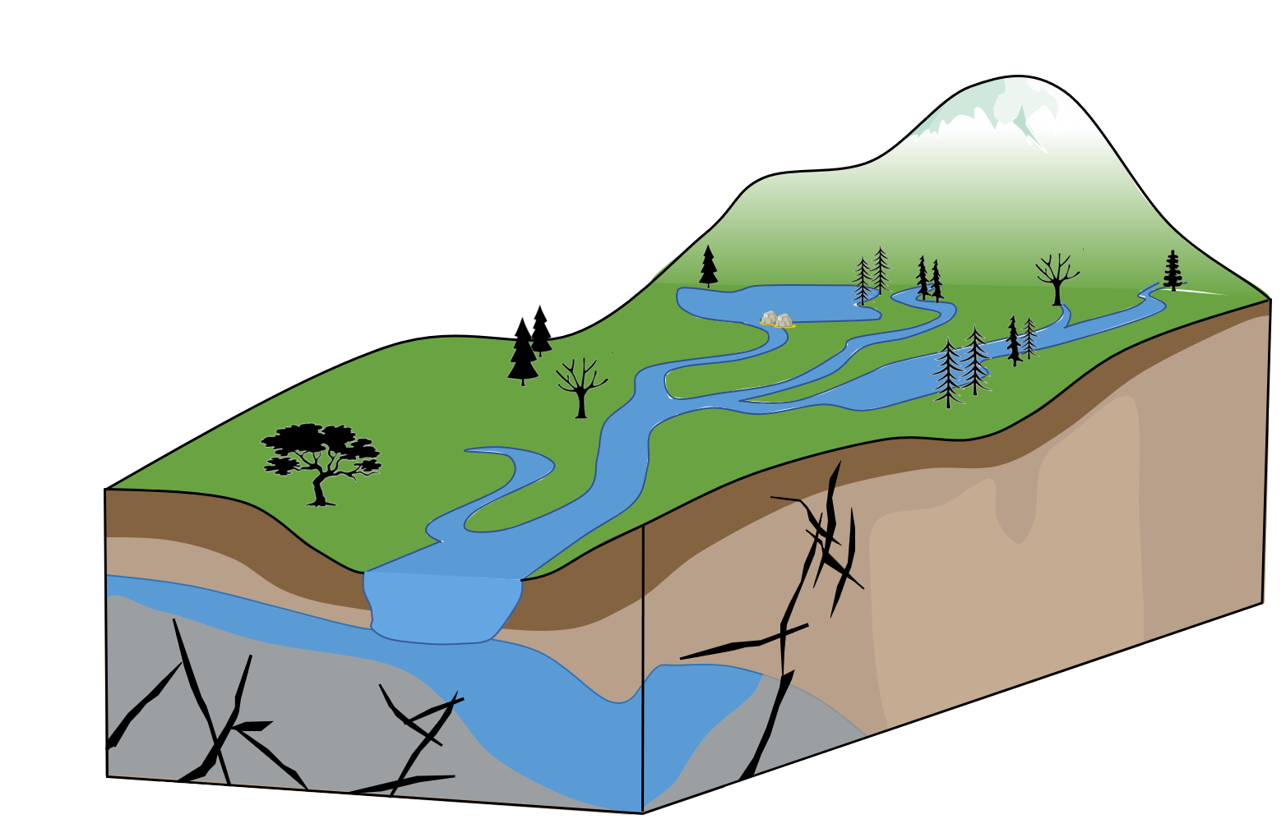
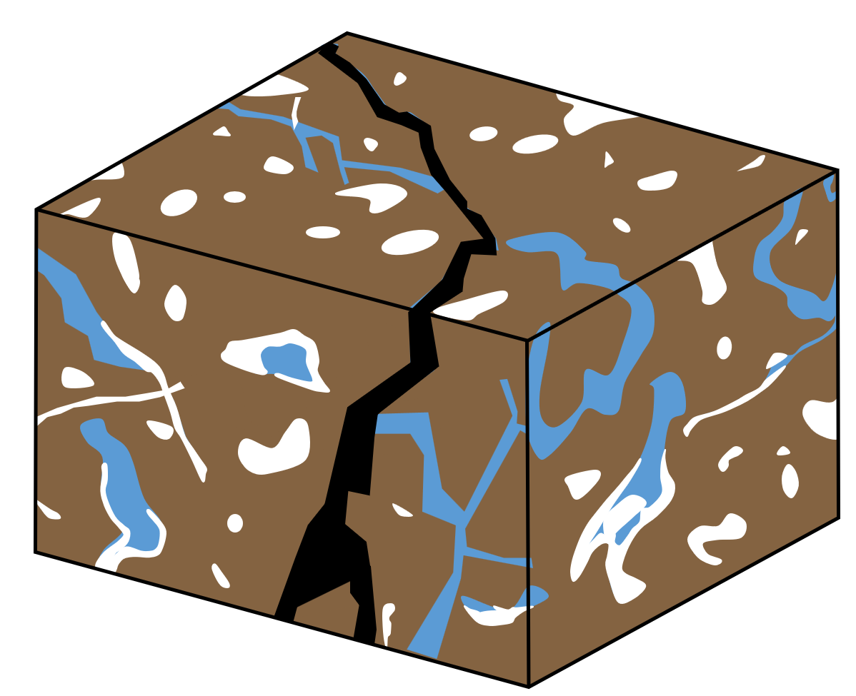
Water flow and ice formation in fractured media
Fracture
Matrix
Water
Bedrock
Permafrost
Ice
Fault
Fault

Slide 3
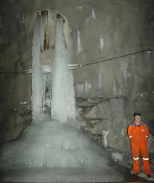
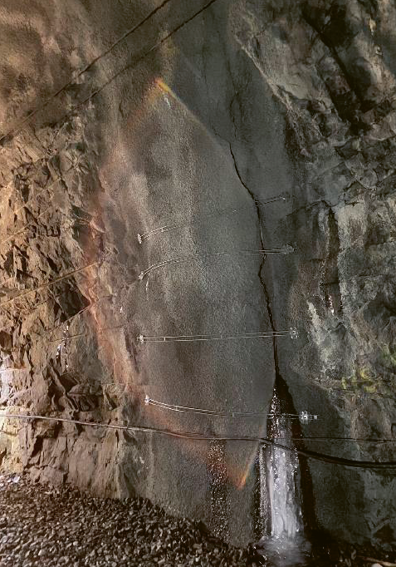
Field observations
(Andrén 2023)
Crack
Leakage

Slide 4
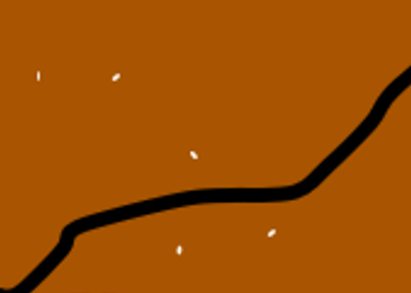
Water flow and heat transfer
Thermal conduction
Matrix
Fracture
Matrix-fracture heat transfer
Thermal convection

Slide 5
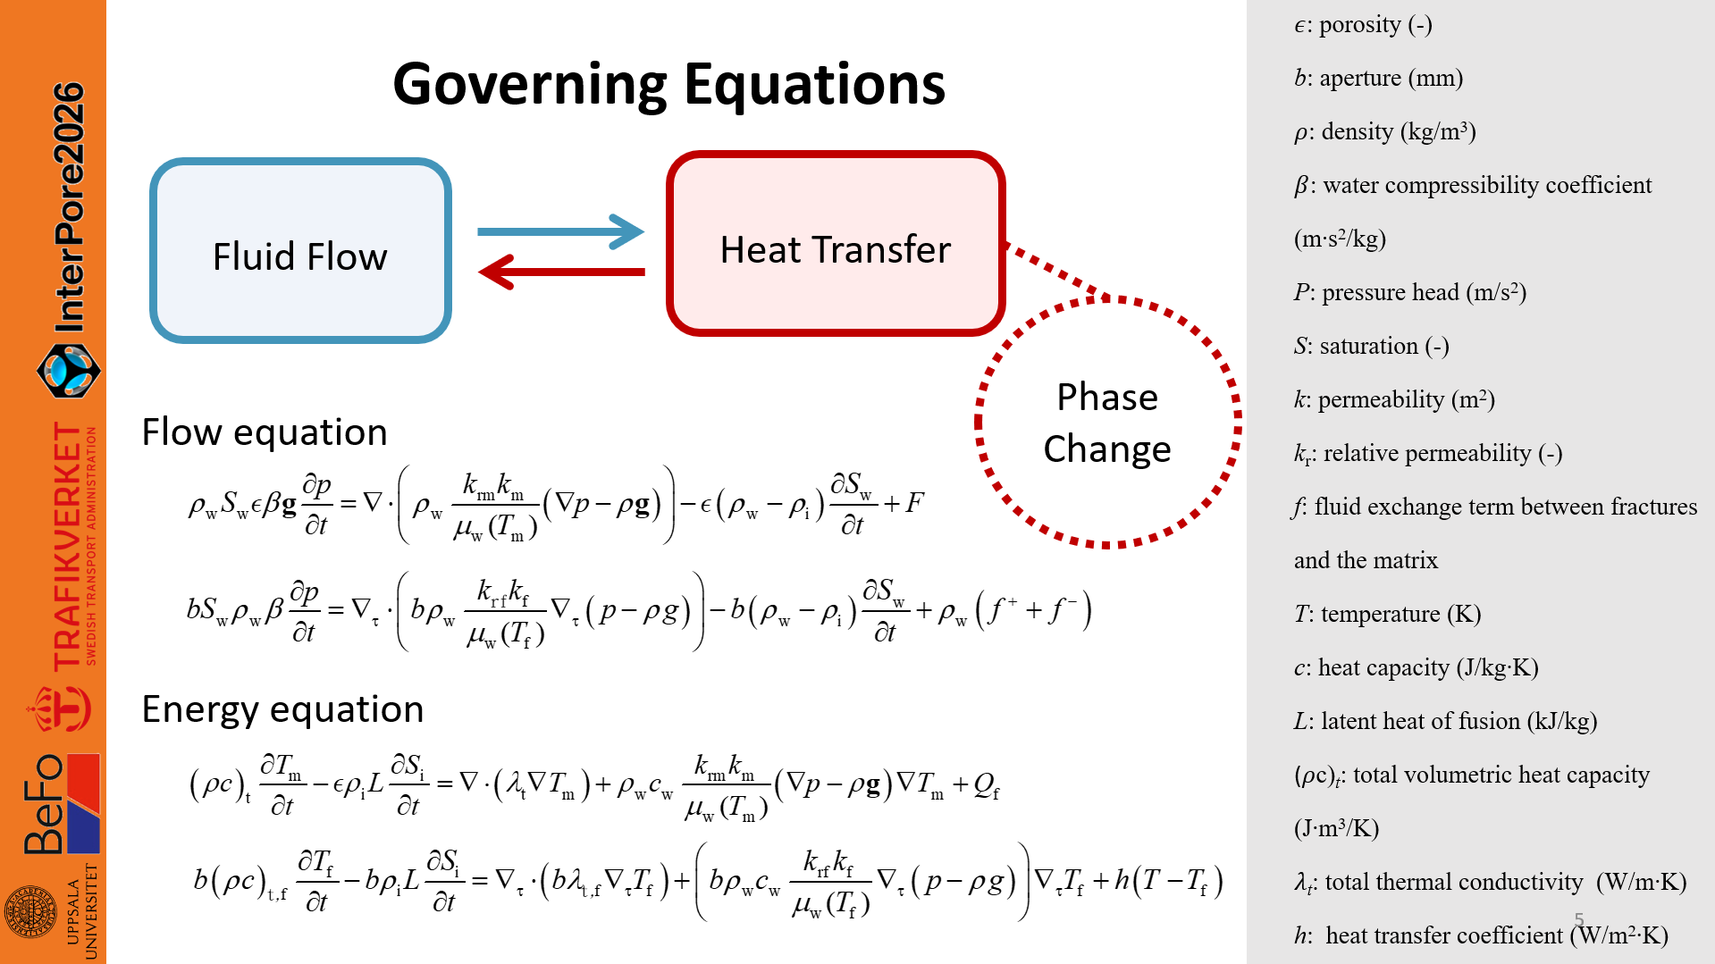

Slide 6
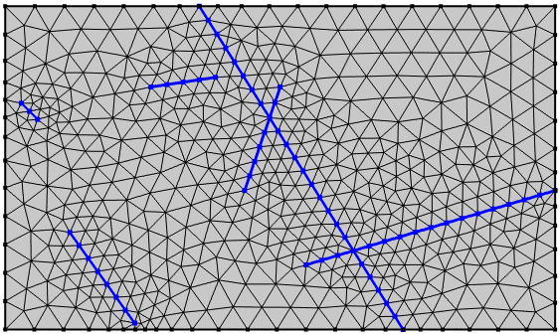
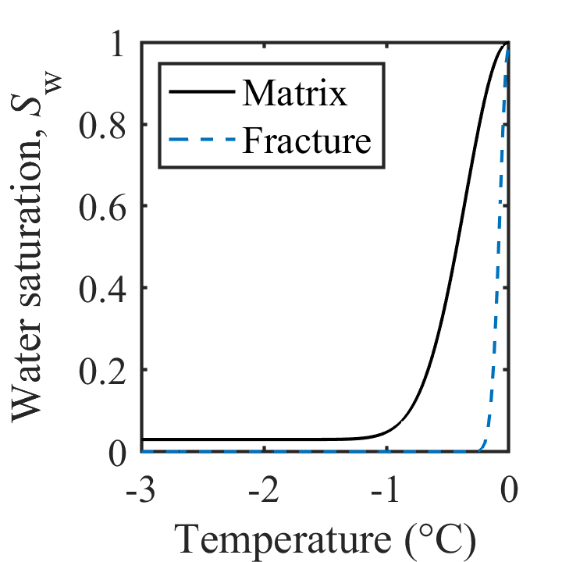
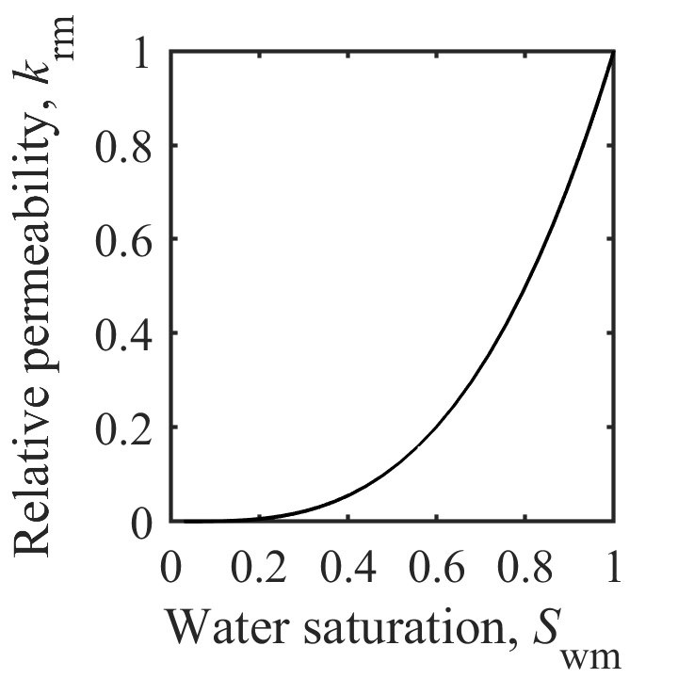
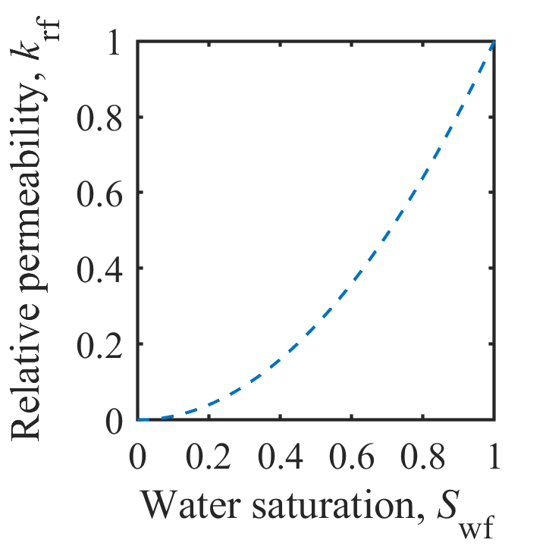
Model representation
Joint node / Mesh node
Joint element
Finite element
Mesh node
Constitutive relationship

Slide 7
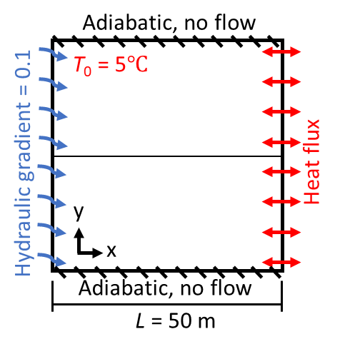
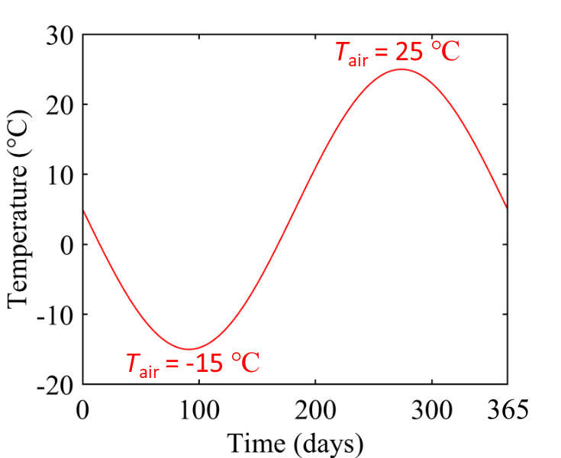

Thermal conduction vs convection
The relative contributions of
conduction and convection vary with flow conditions and thermal dynamics.
Fracture
6
Aperture = 0.1 mm
Aperture = 0.6 mm
Aperture = 2.0 mm
Conduction
dominates
Interaction of conduction and convection
Convection
dominates
4
2
0
Temperature (℃)
-2
-4
-6

Slide 8
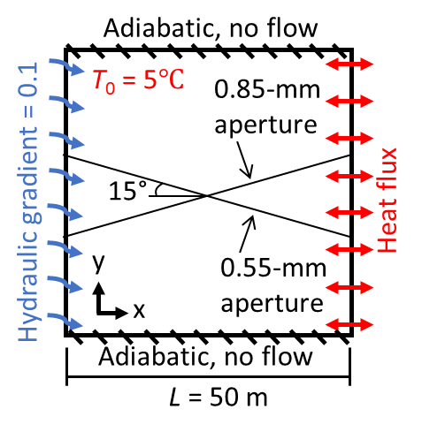
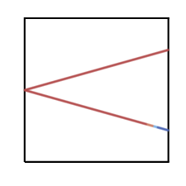
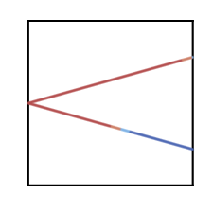


0.85-mm aperture
Flow reorganization
0.55-mm aperture
43 days
117 days
185 days
Melt first
197 days
0.85-mm aperture
T_{f}
10 m
Freeze
Melting through
y
0.55-mm aperture
convection
x
conduction

Slide 9
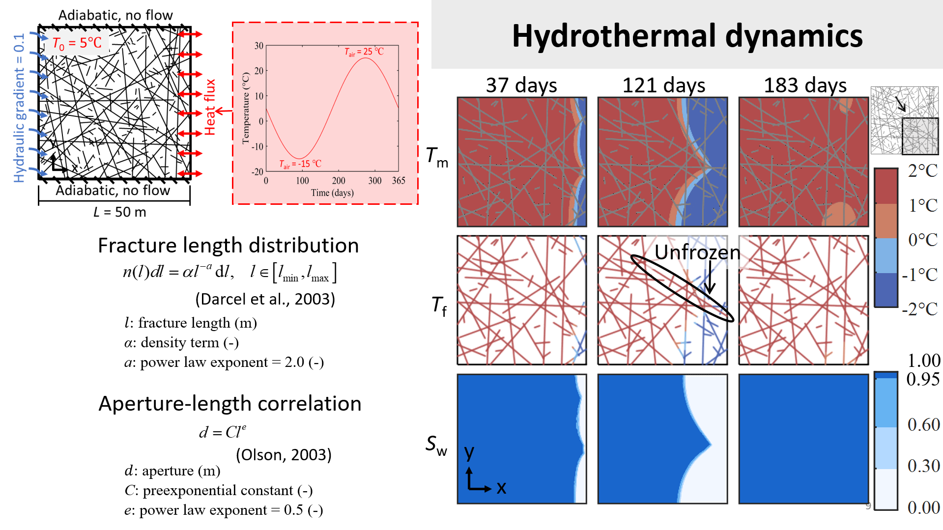

Slide 10
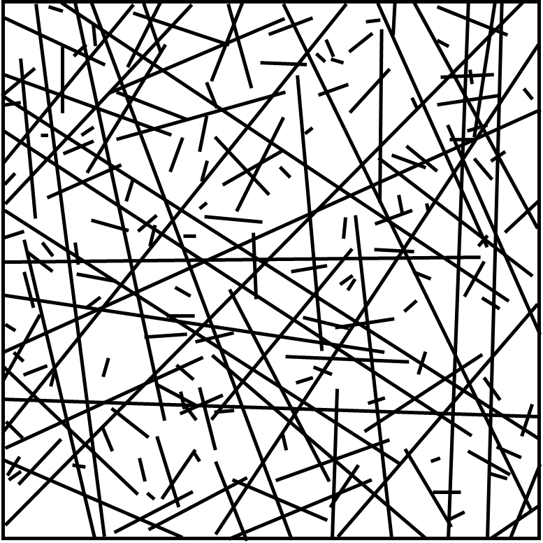

Evolution of outlet flow
Outlet
point
Aperture
(mm)
Outflow rate
(m²/s)
1
1
0.9
0.9
Freezing-driven flow concentration in larger fracture pathways
2
1.3
3
3
0.2
0.2
4
4
0.5
0.5
5
5
0.8
0.8
6
6
0.3
0.3
7
7
0.7
0.7
8
1.4
9
9
0.3
0.3
25 days
121 days
183 days
10
10
1.2
1.2
Ice forms due to poor connectivity

Slide 11
Conclusion
Importance of the geometric characteristics of fracture networks
(e.g., fracture length, connectivity, and aperture distribution)
Large fractures do not necessarily remain active if they are poorly connected, whereas well-connected networks promote the development of system-spanning pathways that control flow and thermal evolution.
Self-reinforcing feedback behavior
Early freezing of secondary pathways reduces flow partitioning into branches, enhancing channelization along major pathways, which in turn suppresses freezing front propagation.
Lin J-J., Jiang C., Tsang C-F., Niemi A., Vidstrand P., Lei Q. A coupled thermo–hydraulic model with phase change and local thermal nonequilibrium for simulating freeze–thaw dynamics in fractured porous media. International Journal of Heat and Mass Transfer. (under review).

Slide 12
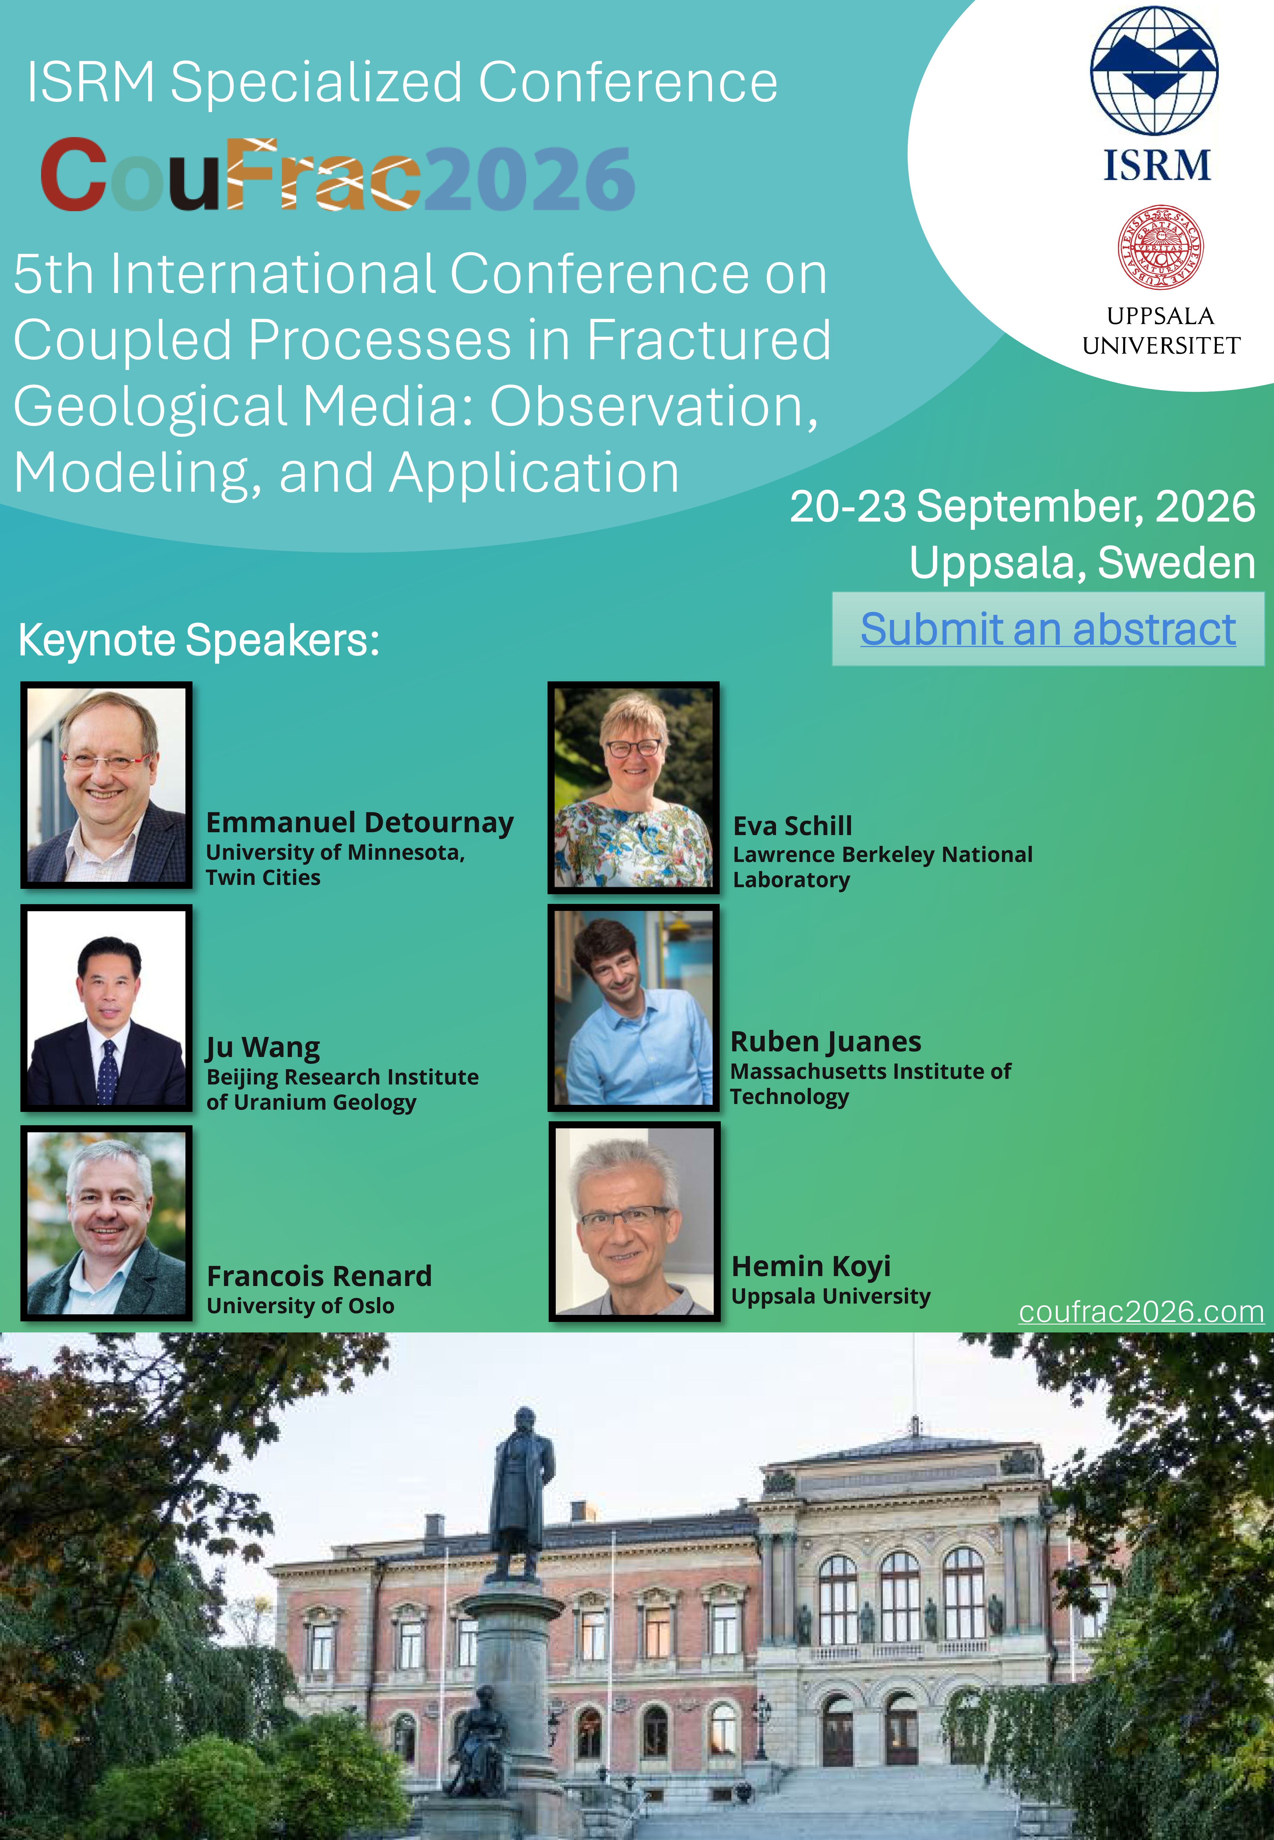
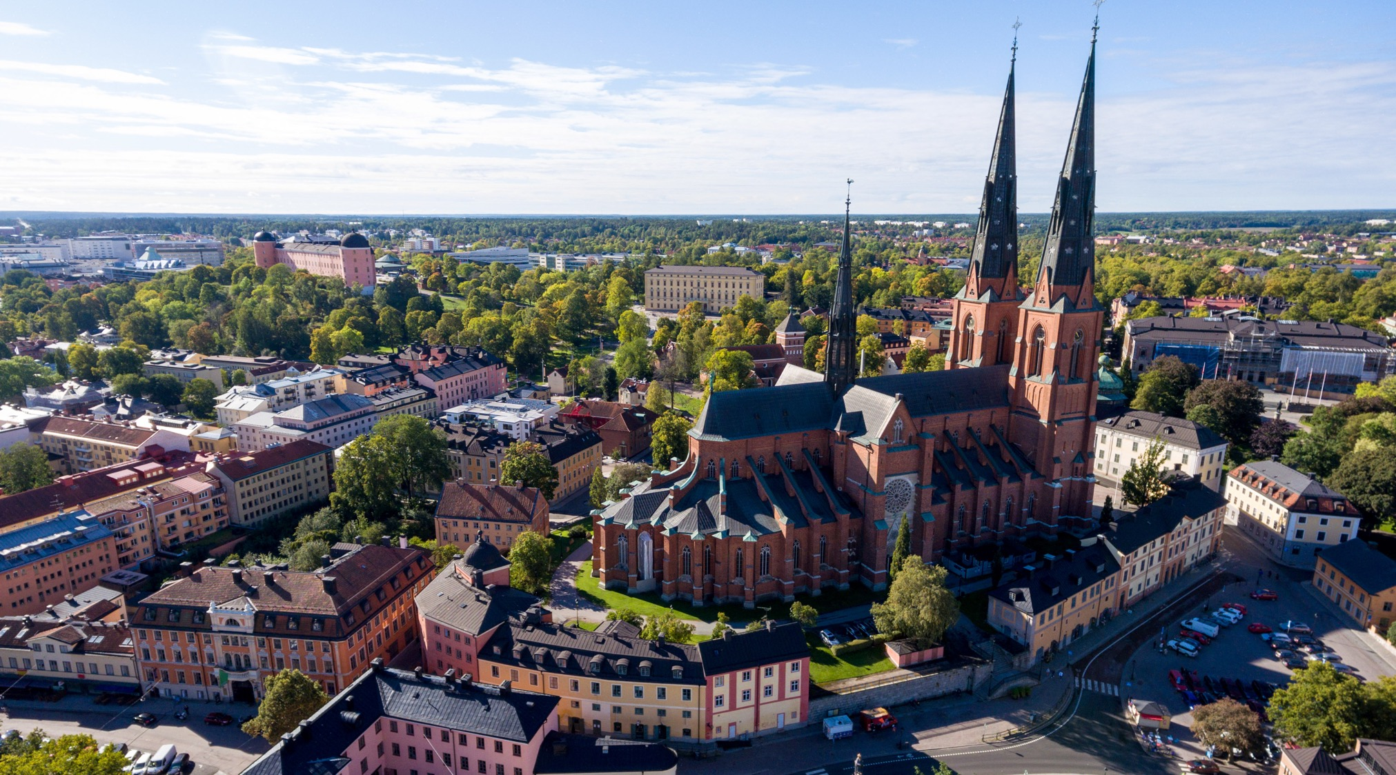
CouFrac2026 – ISRM Specialized Conference
5th International Conference on Coupled Processes in Fractured Geological Media, Uppsala, Sweden, 21-23 Sep 2026
www.coufrac2026.com

Slide 13


THANK YOU
Jia-Jing, Lin
jia-jing.lin@geo.uu.se

