Slide 1




Thermo-Hydraulic Modeling of Freeze-Thaw Processes in Fractured Porous Media
Jia-Jing Linª, Chuanyin Jiangª, Chin-Fu Tsang^{a,b}, Auli Niemiª, Patrik Vidstrand^{c}, Qinghua Leiª
ª Department of Earth Sciences, Uppsala University, Uppsala, Sweden
^{b} Lawrence Berkeley National Laboratory, Berkeley, USA
^{c} Rock Engineering Research Foundation, Stockholm, Sweden

Slide 2
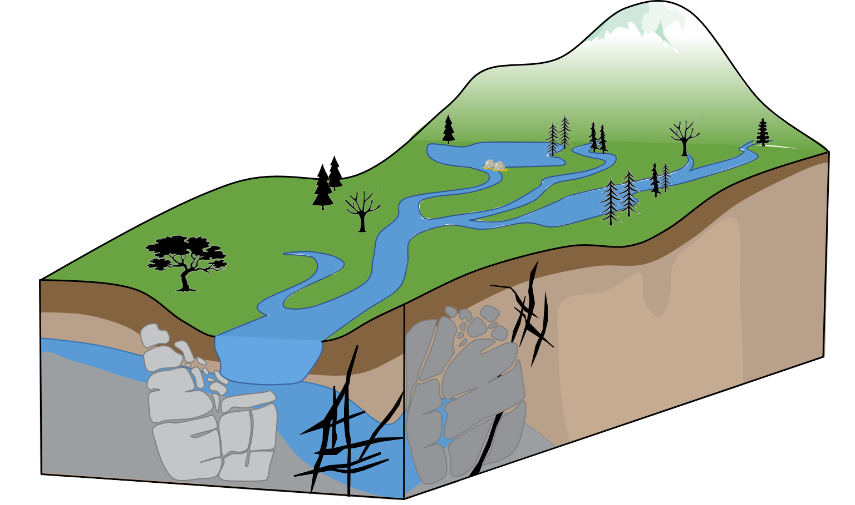
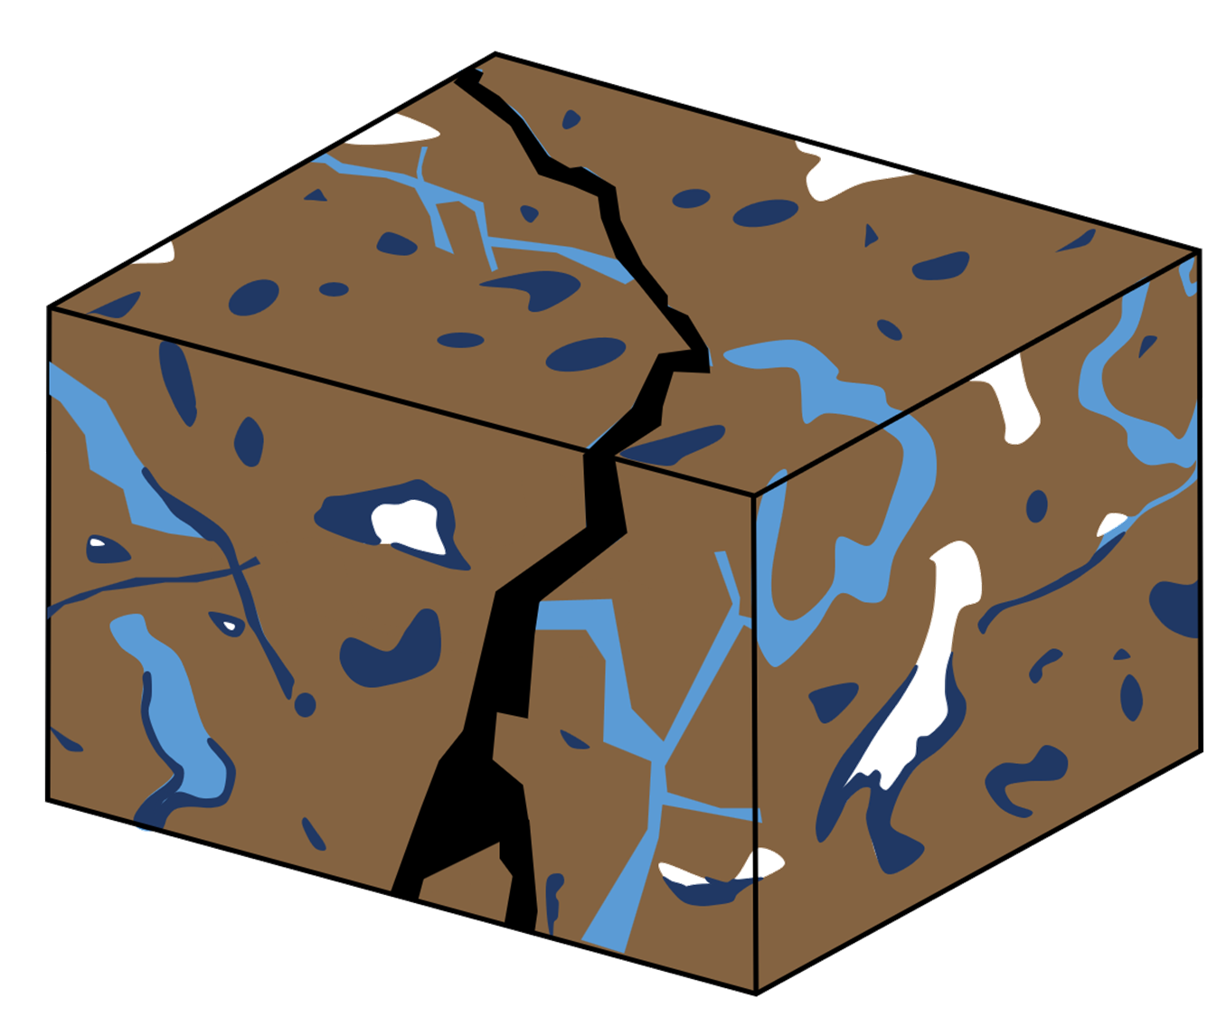
Flow and ice formation in fractured media
Fracture
Matrix
Pore
Water
Fault zone
Bedrock
Permafrost
Ice
Fault
Joint

Slide 3
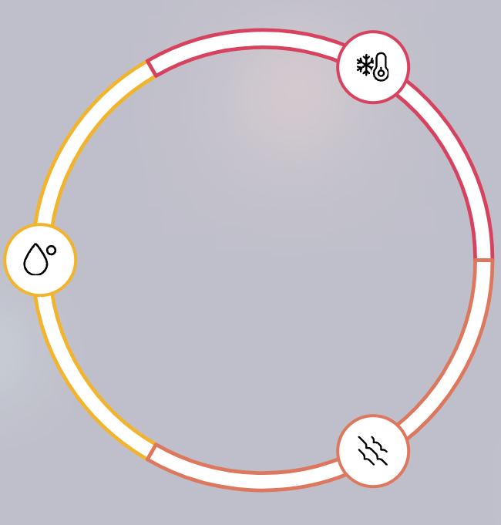
Temperature
?
Fracture
Matrix
Pore
Water
Water
Fracture
Ice
Fault

Slide 4
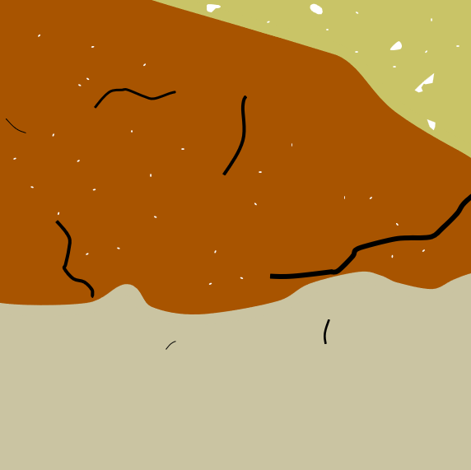

Thermal conduction vs convection
Thermal conduction
Hydro and thermal gradient
Fracture
Matrix
Fracture
Matrix-fracture heat transfer
Thermal convection

Slide 5
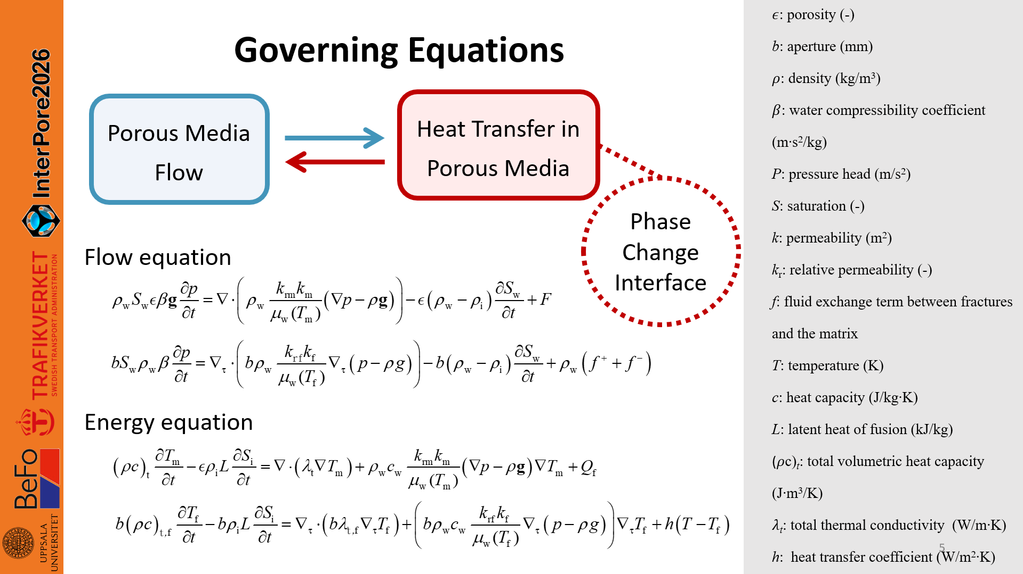

Slide 6
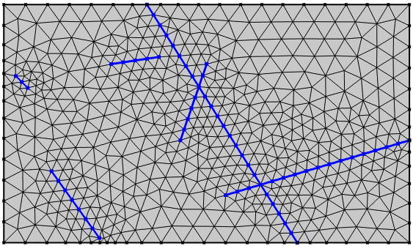
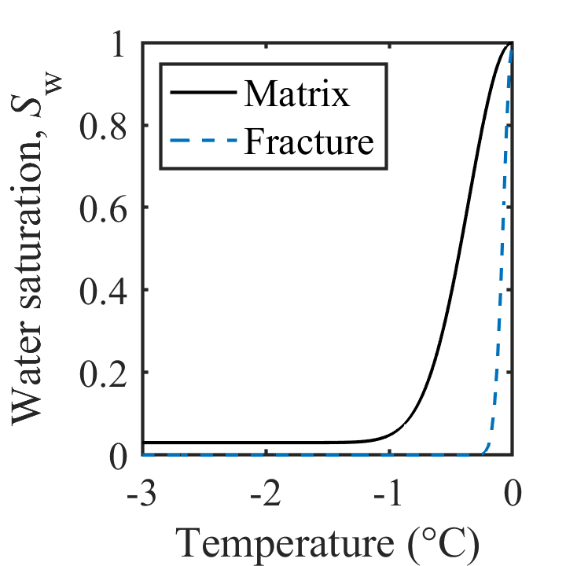
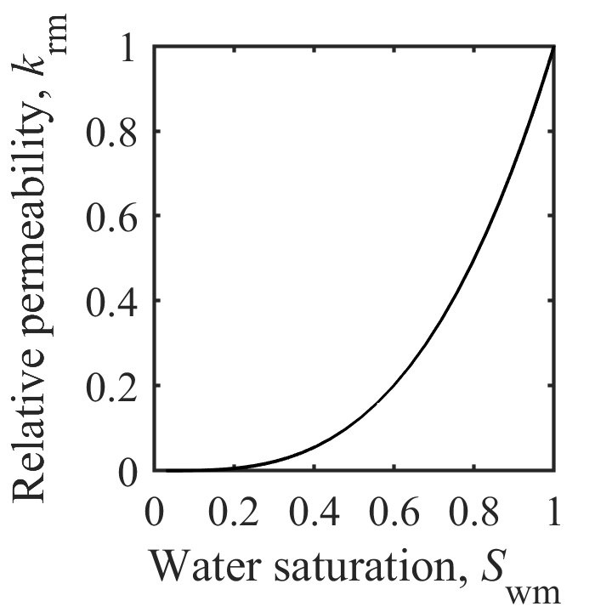
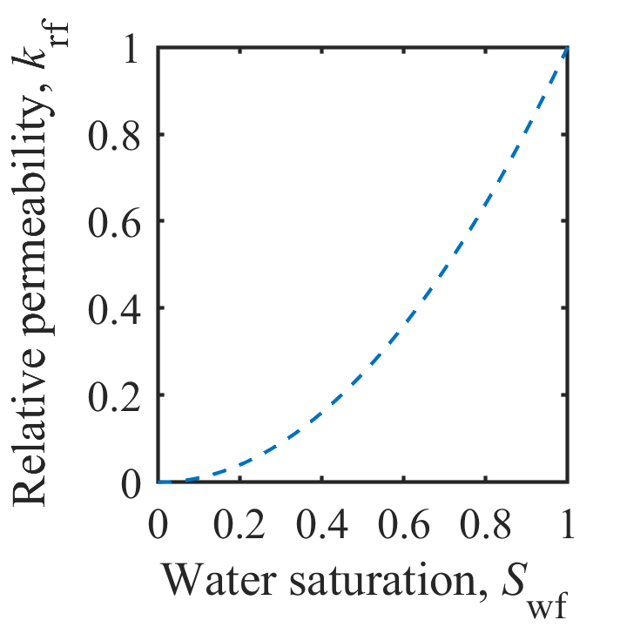
Coupling parameters
Fracture
Matrix
Joint node / Mesh node
Joint element
Finite element
Mesh node

Slide 7
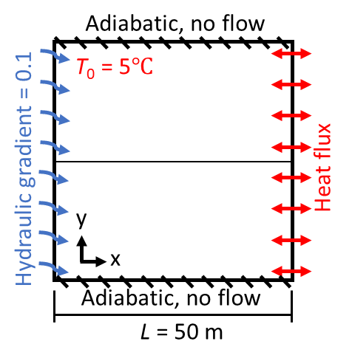
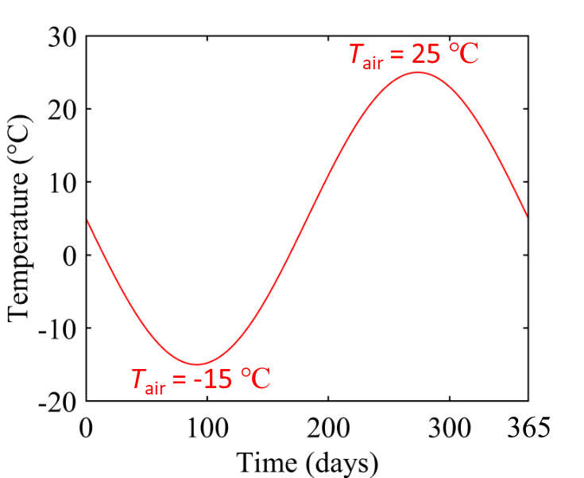

Thermal conduction vs convection
The relative contributions of
conduction and convection vary with flow conditions and thermal dynamics.
Fracture
6
Aperture = 0.1 mm
Aperture = 0.6 mm
Aperture = 2.0 mm
Conduction
dominates
Interaction of conduction and convection
Convection
dominates
4
2
0
Temperature (℃)
-2
-4
-6

Slide 8
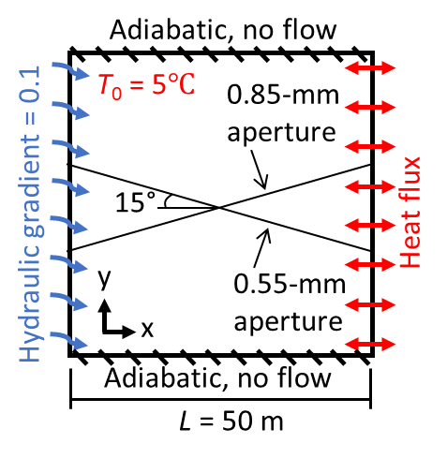
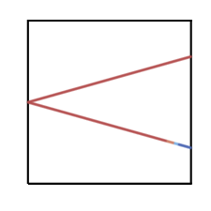
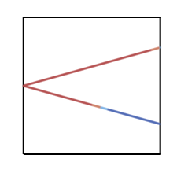
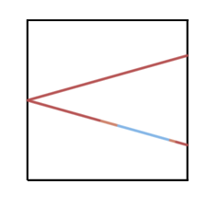

0.85-mm aperture
Flow reorganization
0.55-mm aperture
43 days
117 days
185 days
Melt first
197 days
0.85-mm aperture
T_{f}
10 m
Freeze
Melting through
y
0.55-mm aperture
convection
x
conduction

Slide 9
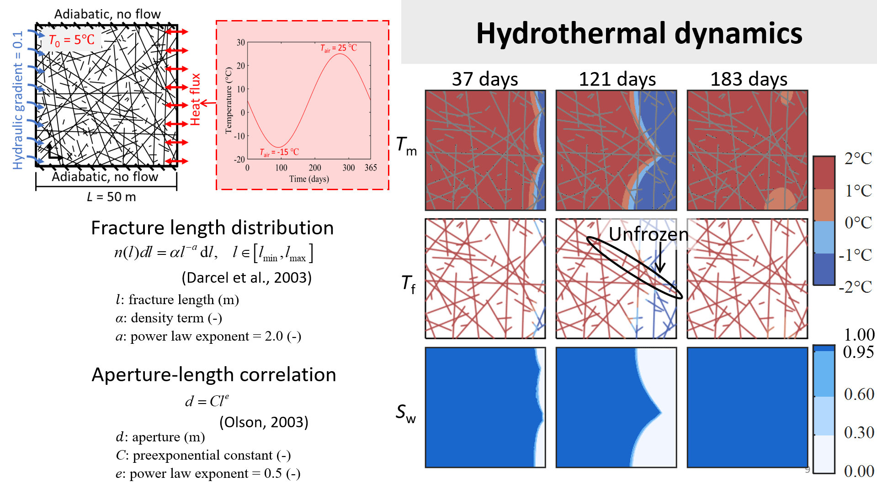

Slide 10
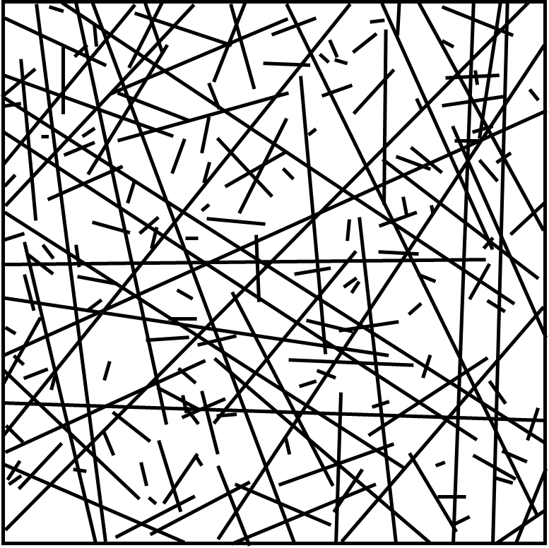

Evolution of outlet flow
Outlet
point
Aperture
(mm)
Outflow rate
(m²/s)
1
1
0.9
0.9
Freezing-driven flow concentration in larger fracture pathways
2
1.3
3
3
0.2
0.2
4
4
0.5
0.5
5
5
0.8
0.8
6
6
0.3
0.3
7
7
0.7
0.7
8
1.4
9
9
0.3
0.3
25 days
121 days
183 days
10
10
1.2
1.2
Ice forms due to poor connectivity

Slide 11
Conclusion
Importance of the geometric characteristics of fracture networks
(e.g., fracture length, connectivity, and aperture distribution)
Large fractures do not necessarily remain active if they are poorly connected, whereas well-connected networks promote the development of system-spanning pathways that control flow and thermal evolution.
Self-reinforcing feedback behavior
Early freezing of secondary pathways reduces flow partitioning into branches, enhancing channelization along major pathways, which in turn suppresses freezing front propagation.
Additional details can be found in our manuscript
Lin J-J., Jiang C., Tsang C-F., Niemi A., Vidstrand P., Lei Q. A coupled thermo–hydraulic model with phase change and local thermal nonequilibrium for simulating freeze–thaw dynamics in fractured porous media. International Journal of Heat and Mass Transfer. (under review).

Slide 12
Reference
McKenzie JM, Voss CI, Siegel DI. Groundwater flow with energy transport and water–ice phase change: Numerical simulations, benchmarks, and application to freezing in peat bogs. Adv Water Resour. 2007;30(4):966-983.
Carman PC. Fluid flow through a granular bed: Transactions of the Institution of Chemical Engineers. Published online. 1937.
Darcel, C., Bour, O., & Davy, P. Cross‐correlation between length and position in real fracture networks. Geophysical Research Letters, 2003. 30(12).
Olson, J. E. Sublinear scaling of fracture aperture versus length: an exception or the rule?. Journal of Geophysical Research: Solid Earth, 2003. 108(B9).

Slide 13


THANK YOU
Jia-Jing, Lin
jia-jing.lin@geo.uu.se

