Slide 1


A Comparative Study of Fine-scale and Multi-scale Finite-Volume and Finite-Element Methods for Coupled Poroelastic Problmes
Mahsa Mehrazar
Cornelis Vuik
Mohammed Al Kobaisi
Hadi Hajibeygi
21, May, 2026

Slide 2
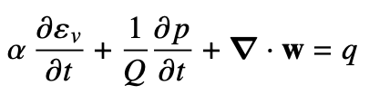





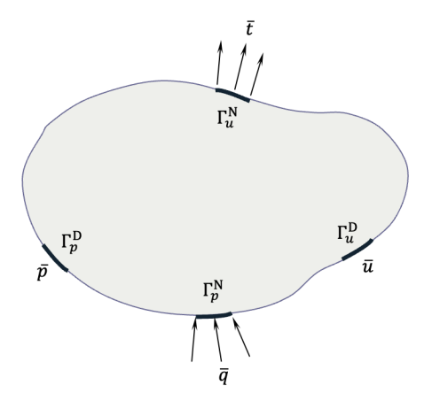

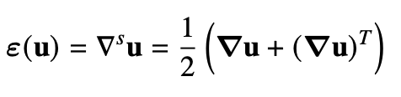
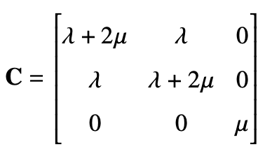


Hydro-Mechanical Governing Equations

Slide 3
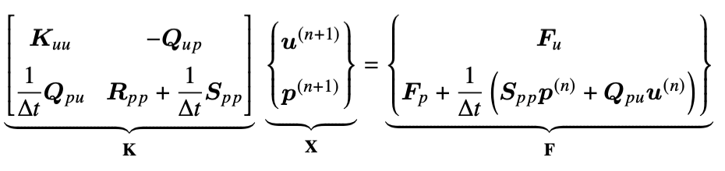
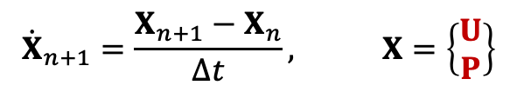
Linear System
$${\dot{X}}_{n+1}=\frac{X_{n+1}−X_{n}}{Δt}, X=\left\{\begin{matrix}U \\ P\end{matrix}\right\}$$
Fully implicit Euler method

Slide 4























FVM Staggered Discretization
FEM Galerkin Discretization
Pressure CV
$$u_{8}$$
$$u_{6}$$
$$u_{i,j+1}$$
N
4
$$u_{7}$$
3
$$u_{i+1,j+1}$$
$$u_{5}$$
$$p_{12}$$
$$p_{11}$$
$$p_{i−1,j}$$
W
$$p_{i,j }$$
$$u_{2}$$
$$e$$
E
$$u_{4}$$
$$u_{i,j}$$
$$u_{i+1,j}$$
$$u_{1}$$
$$u_{3}$$
S
$$p_{9}$$
$$p_{10}$$
1
2
$$Δy$$
$$p_{i−1,j−1}$$
$$p_{i,j−1 }$$
$$Δx$$
Stress CV
Cell-centered Pressure
Vertex-centered (Nodal) Displacement & Stress
Nodal Displacement & Pressure

Slide 5
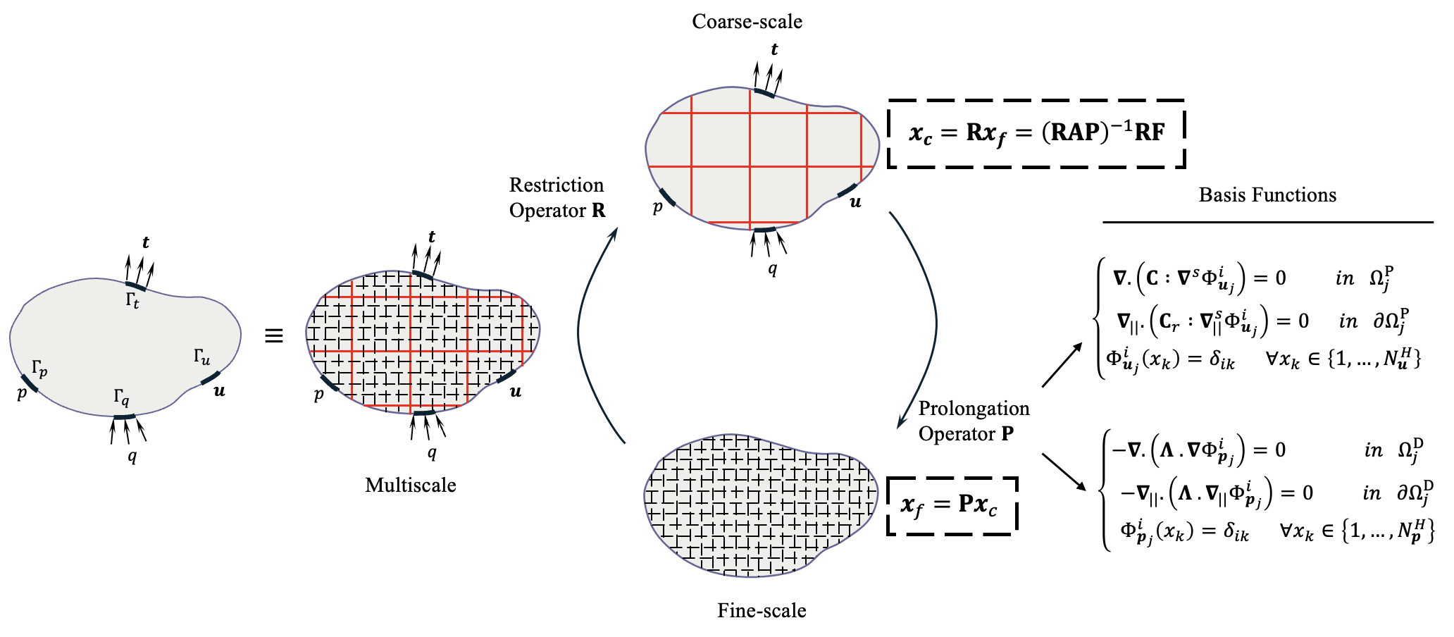
The Multiscale Framework
Coarsening Ratio
$↓$ Finer resolution & more accurate results

Slide 6


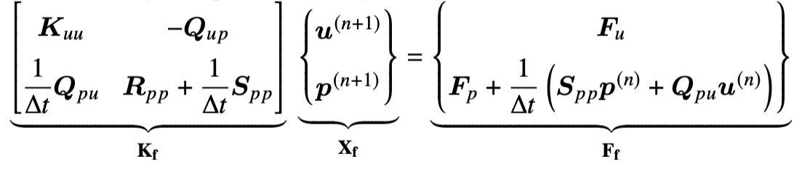


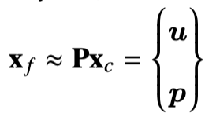

The Multiscale Framework
Coarse Scale
Fine Scale
Generate coarse grid for
displacement (Primal)
& pressure (Dual) independently,
Define fine-scale mesh,
Discretize using FV & FE on staggered or nodal grid,
Set boundary conditions and material properties,
Basis Function construction,
For each time step $n$, do
Assemble Prolongation P & Restriction R from locally computed basis functions,
&
upscaling
Assemble fine-scale fully implicit system,
Solve coarse system,
Reconstruct fine-scale solutions,
Approximate fine-scale solution,
downscaling
End for

Slide 7
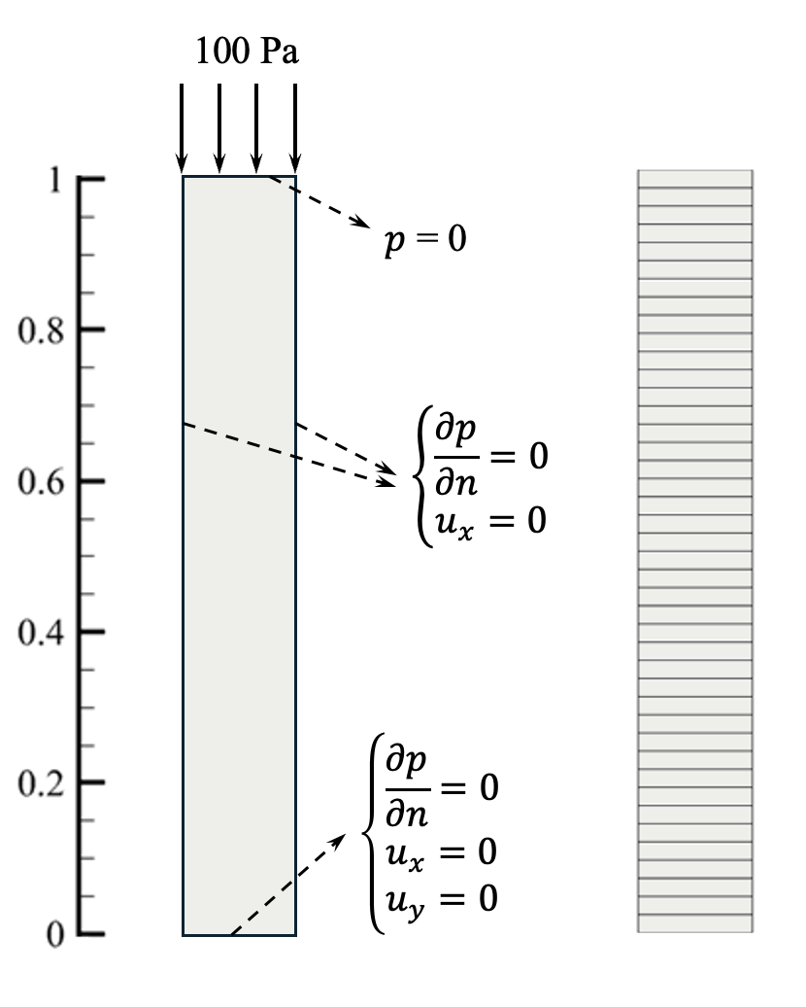
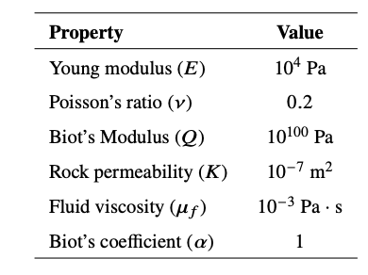

Numerical Simulation Results
1D Terzaghi Benchmark
1 $×$42 fine-scale mesh

Slide 8
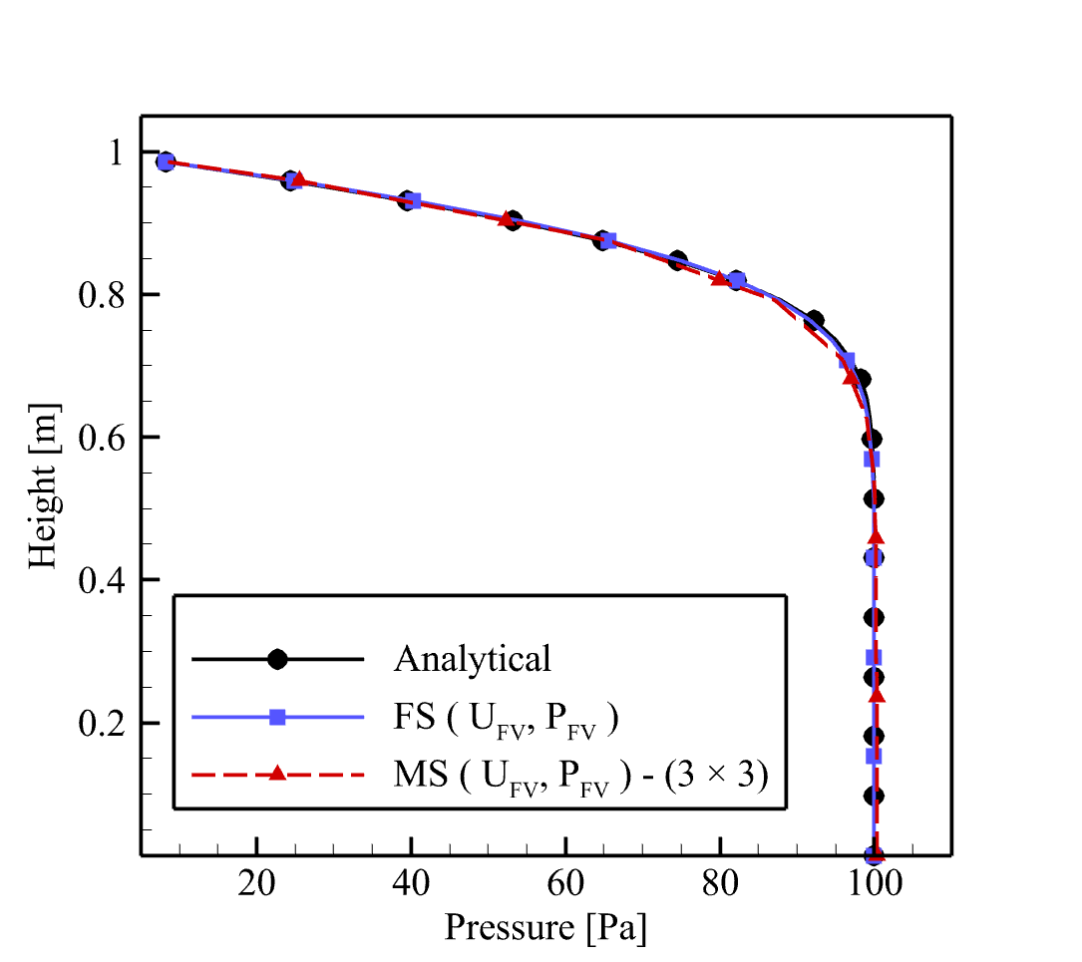
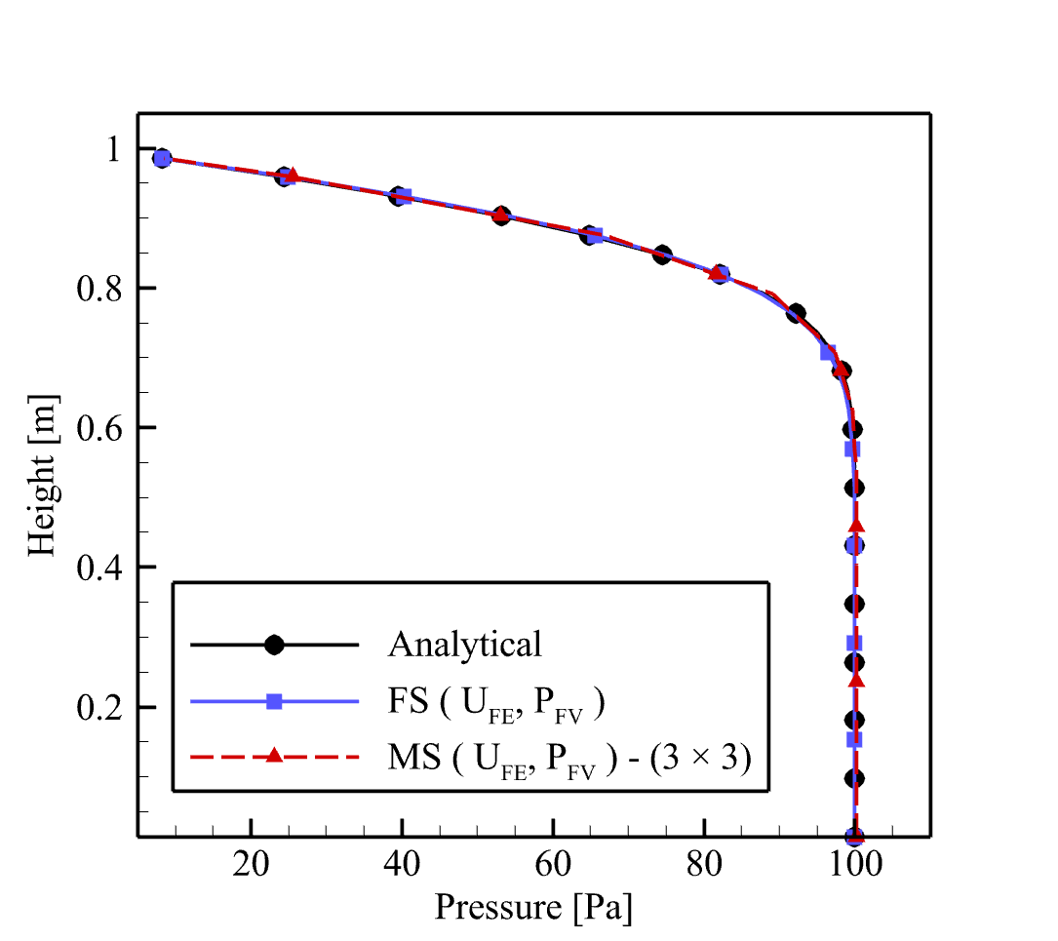
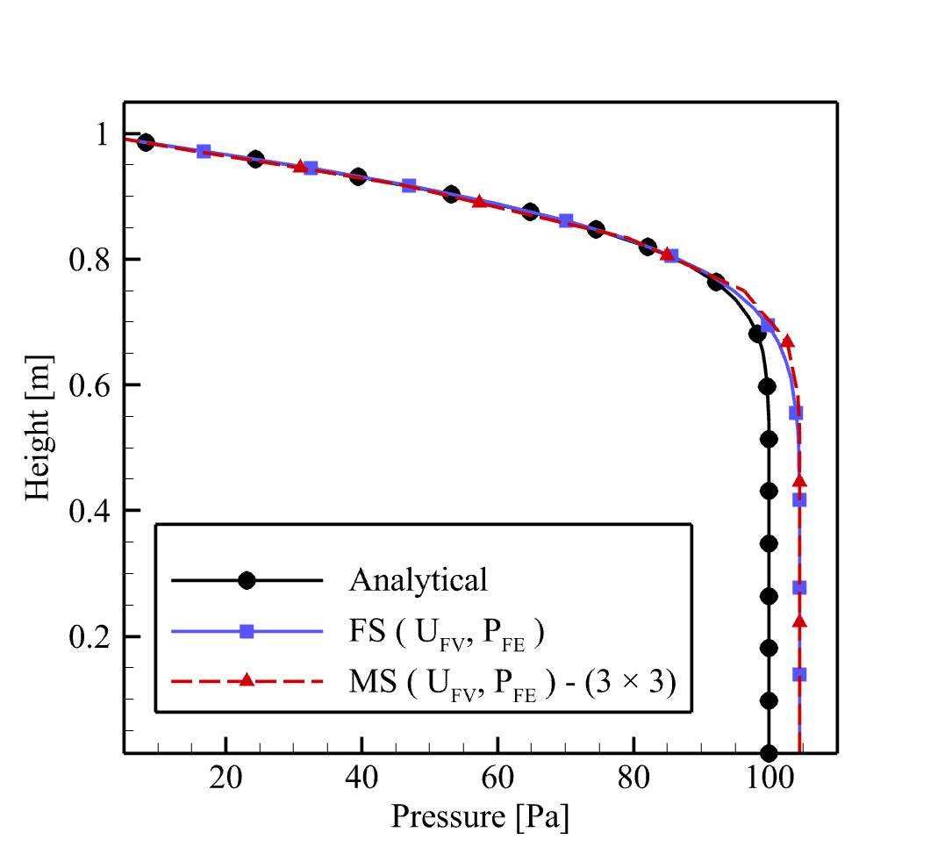
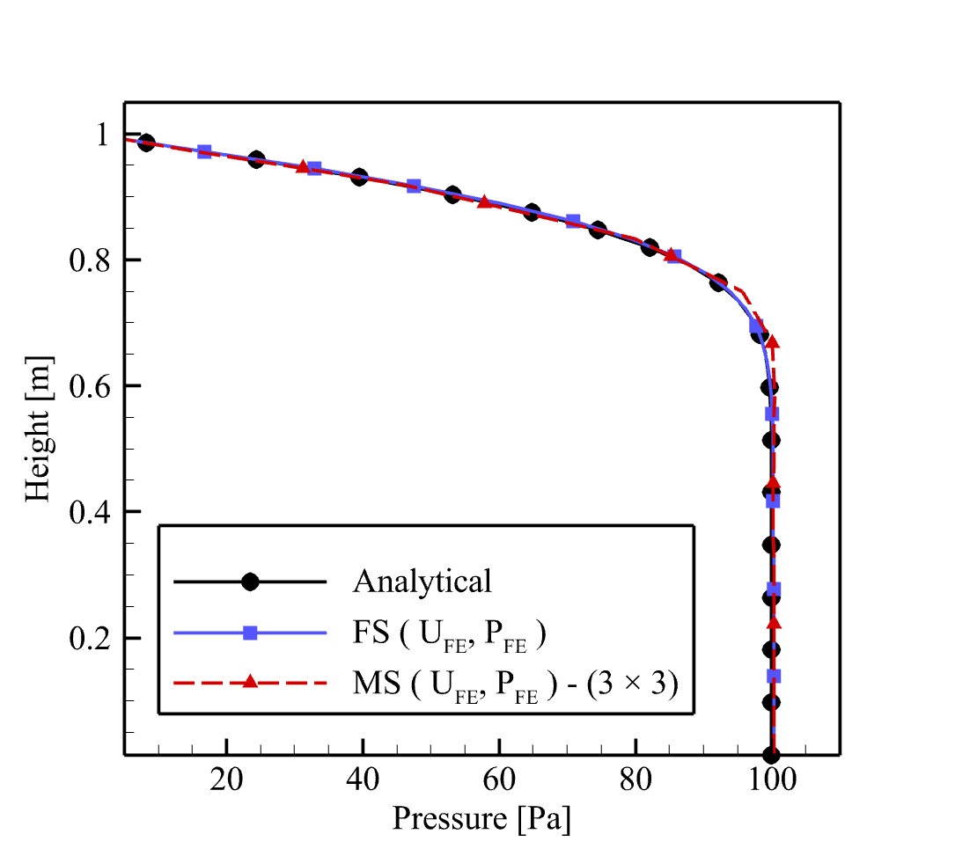
Numerical Simulation Results
Pressure Distribition along Terzaghi Column
MS: Coarsening Ratio of 3

Slide 9
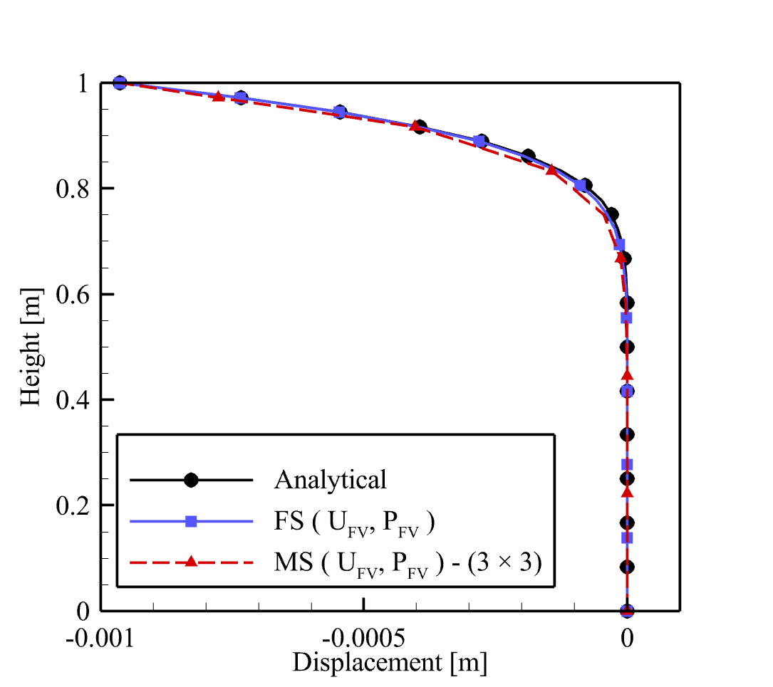
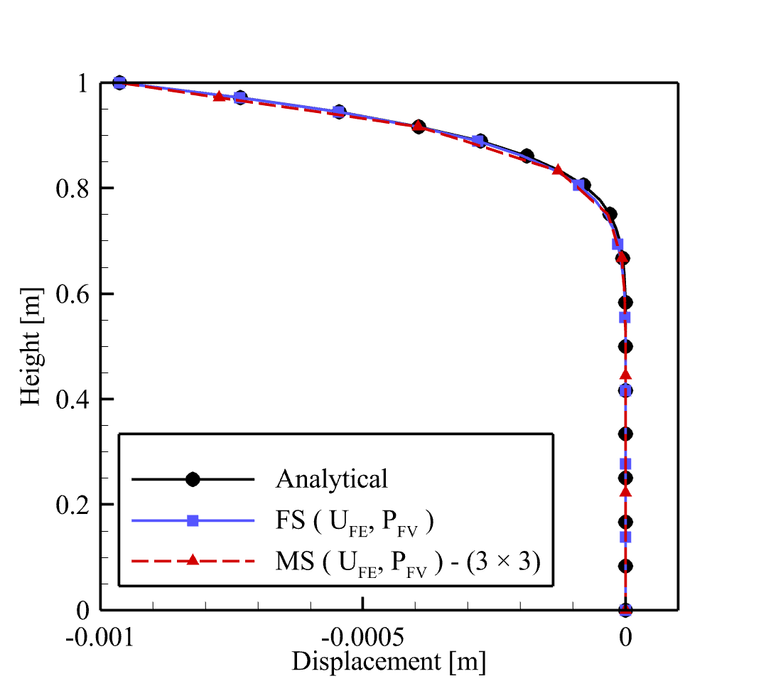
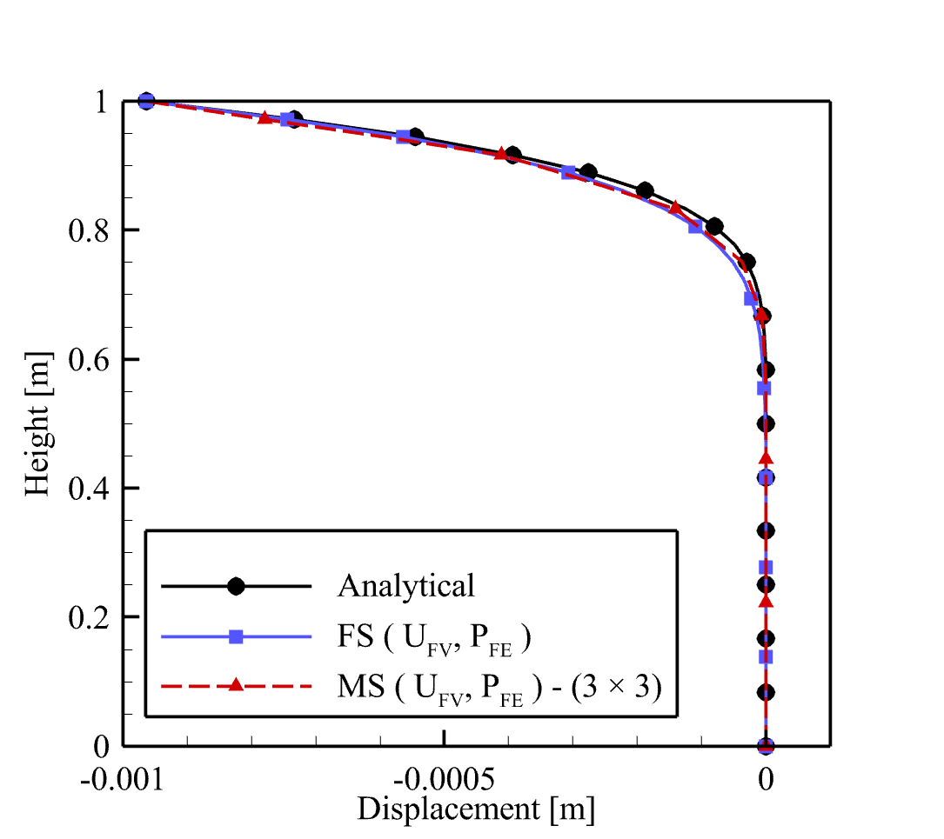
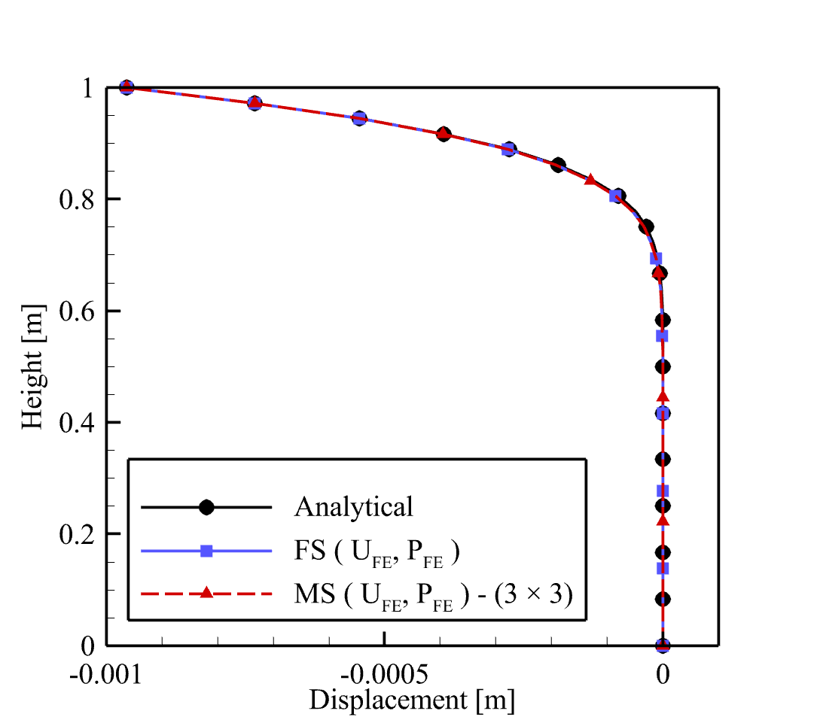
Numerical Simulation Results
Displacement Distribition along Terzaghi Column
MS: Coarsening Ratio of 3

Slide 10
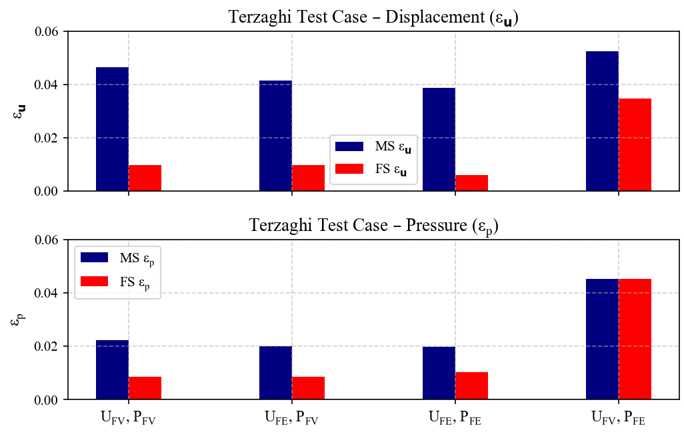
Numerical Simulation Results
Comparison of the multiscale (MS) and fine-scale (FS) solutions against the analytical solution for displacement and pressure errors under different variable formulations.

Slide 11
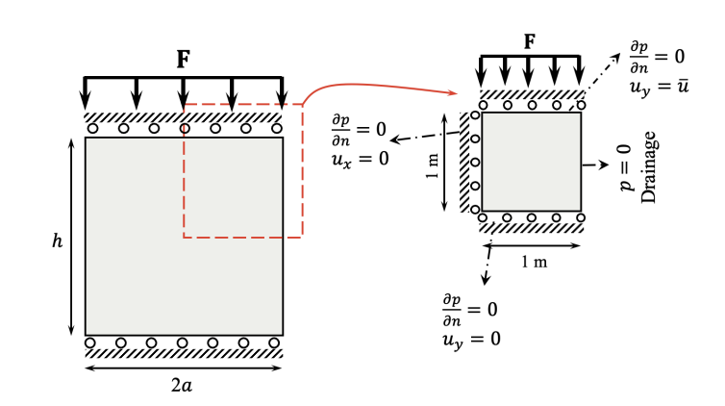
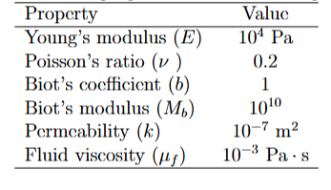
Numerical Simulation Results
2D Mandel Benchmark

Slide 12
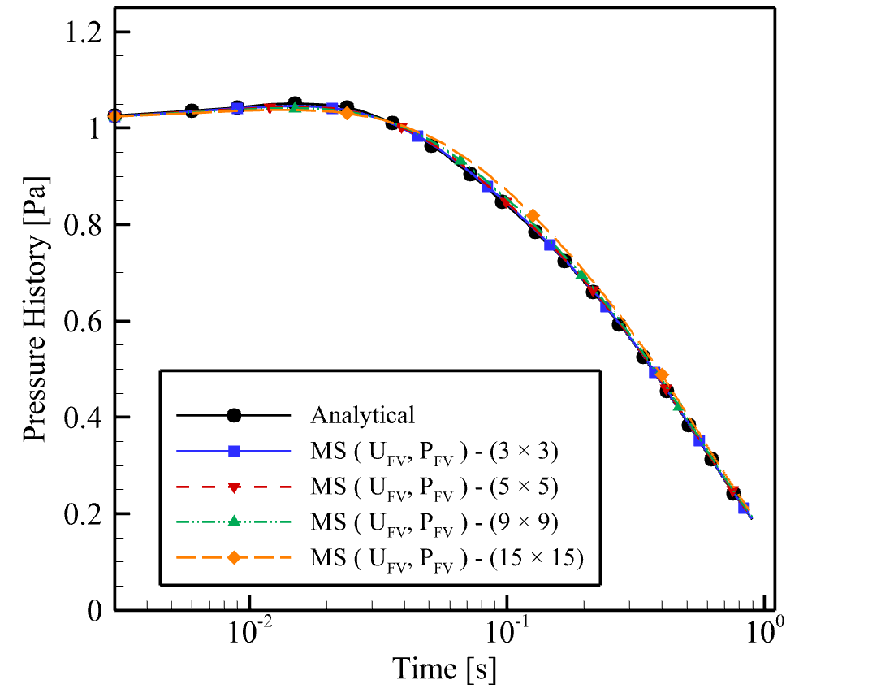
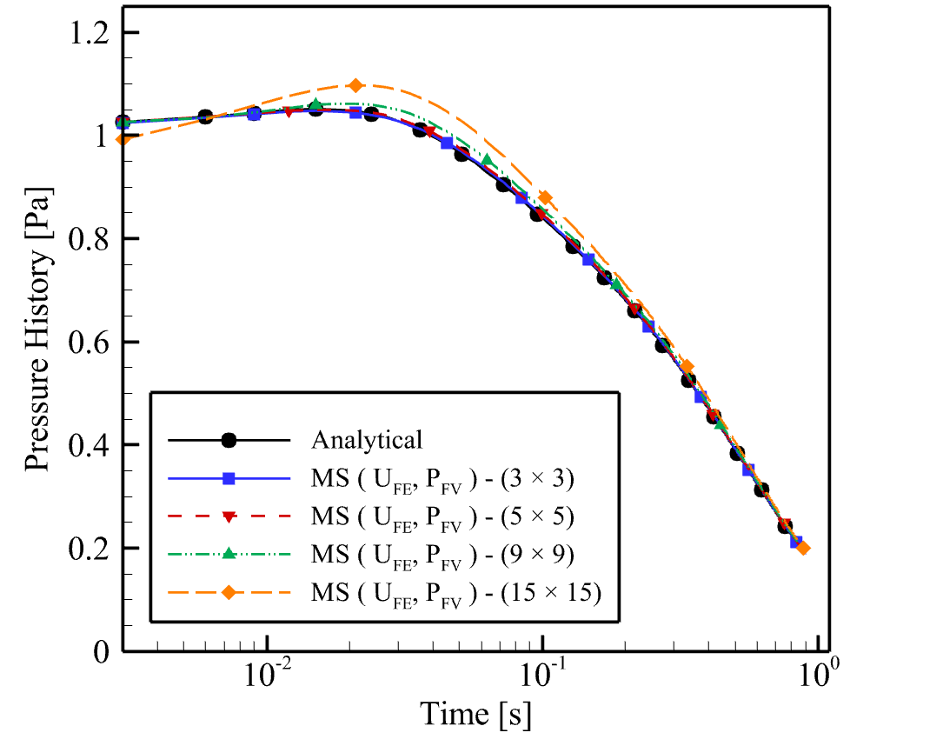
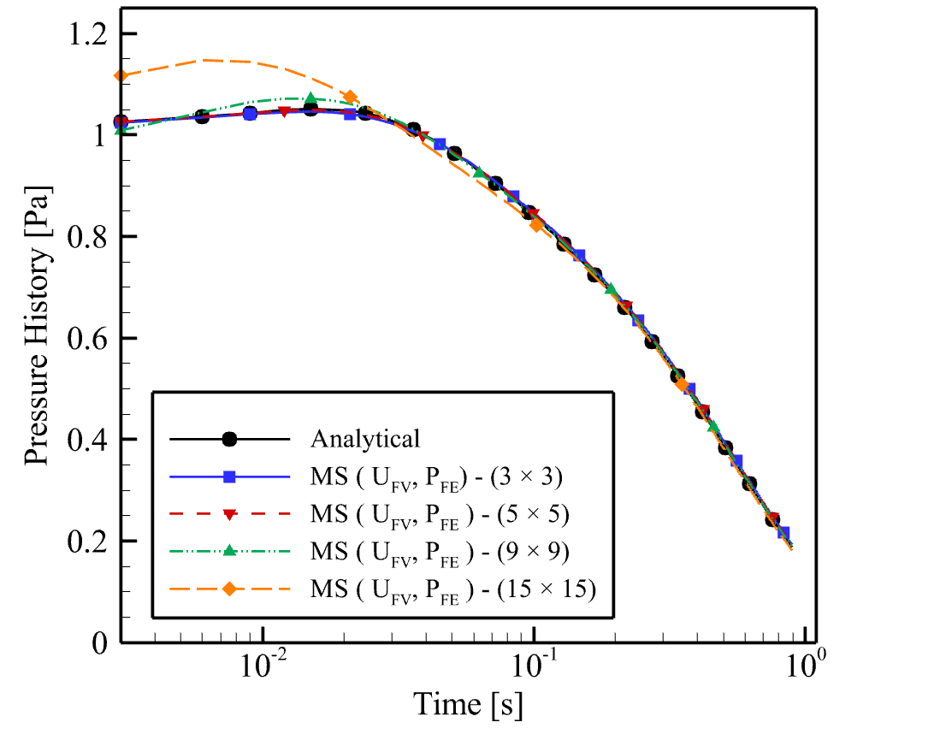
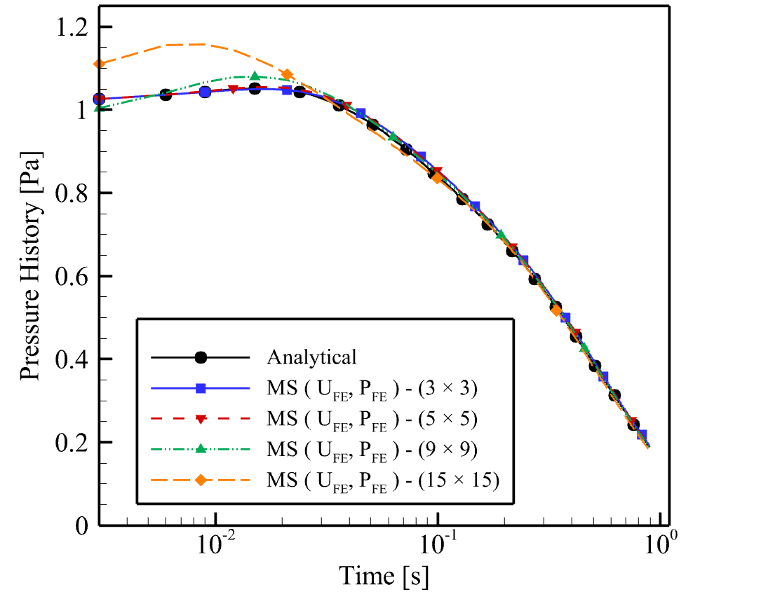
Temporal Variation of Pore Pressure @ domain central point
Numerical Simulation Results

Slide 13
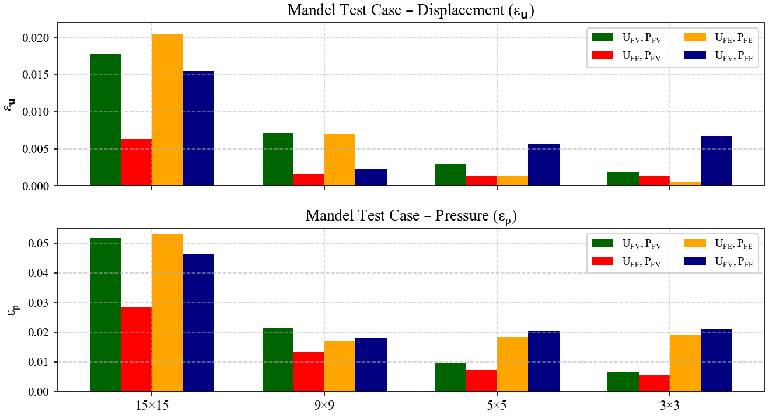
Numerical Simulation Results

Slide 14
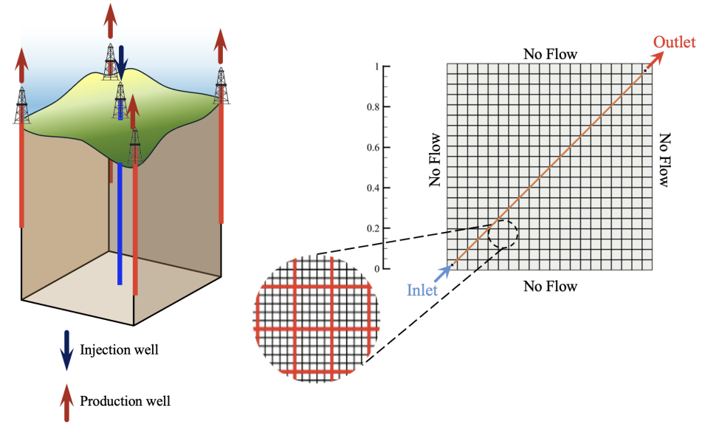
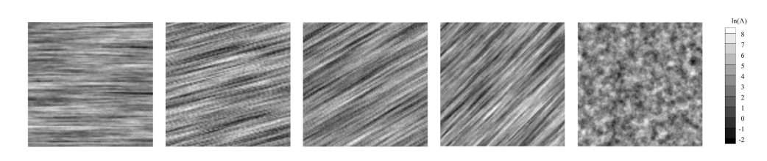

Numerical Simulation Results
Diagonal I-P
𝜃 = 0 ◦ 15◦ 30◦ 45◦
non-directional
Natural logarithm of the heterogeneous mobility field ln(Λ) of 20 realizations

Slide 15
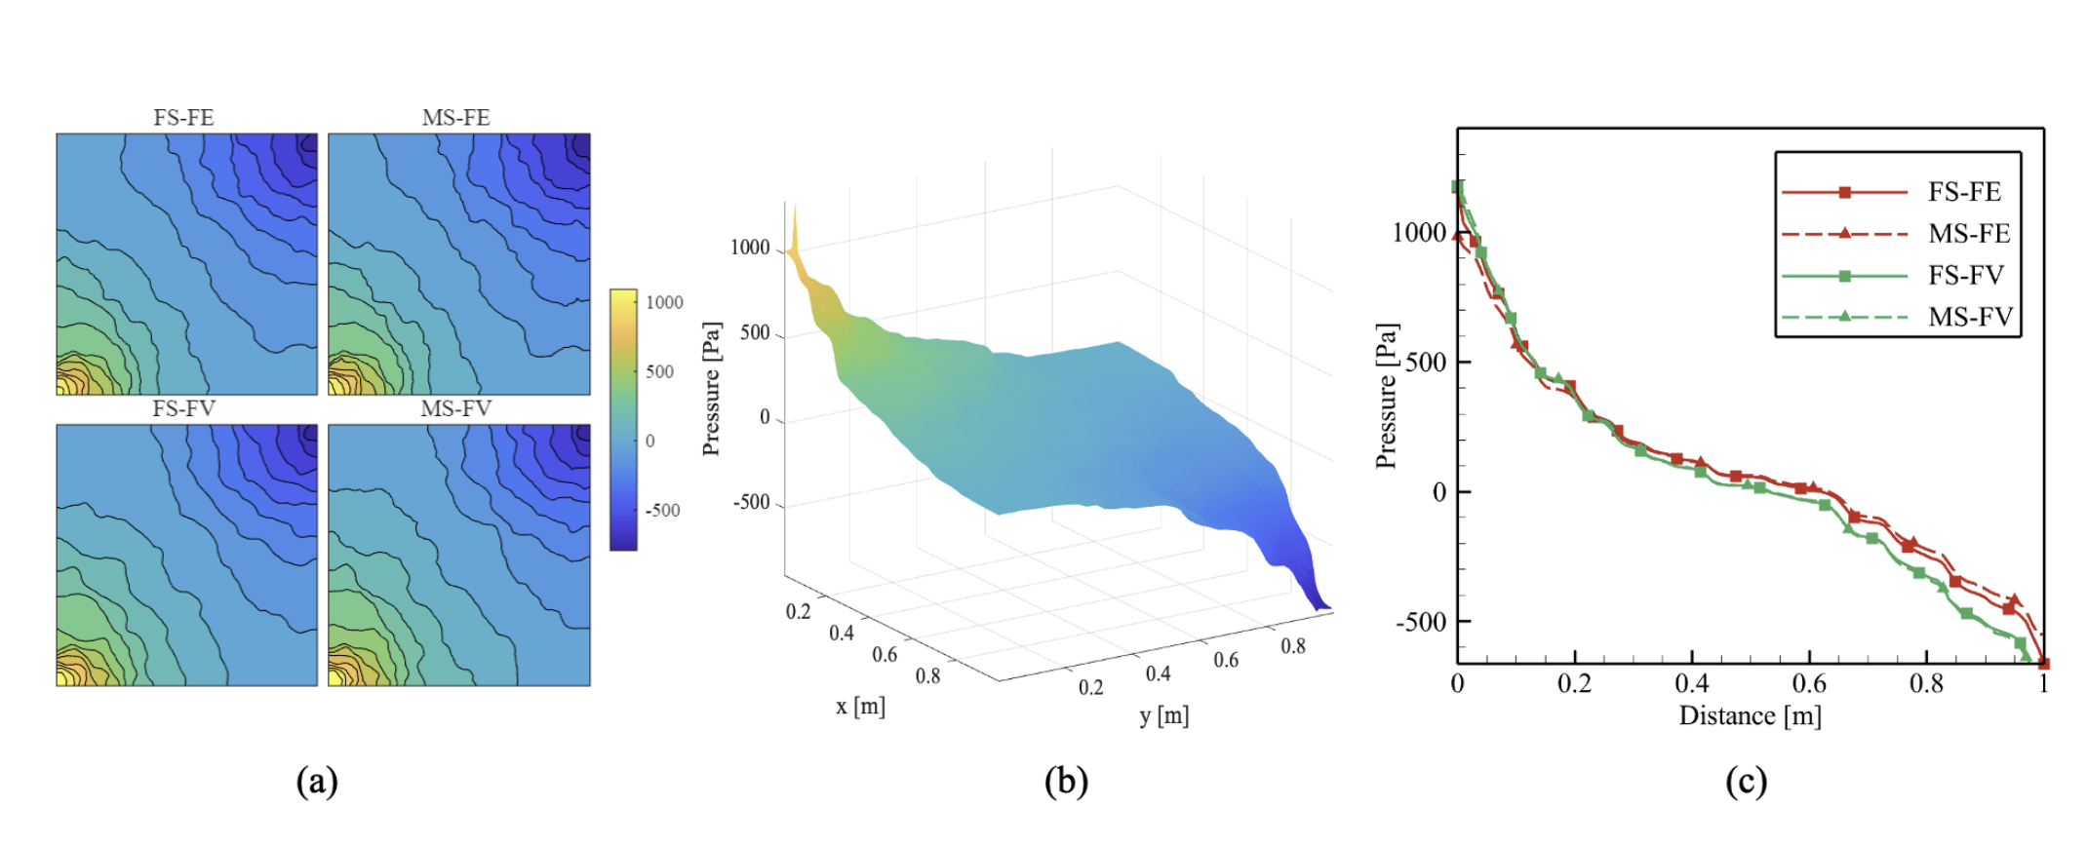
Numerical Simulation Results
MS: Coarsening ratio of 5
Pressure fields for a test case with irregularly distributed heterogeneity; (a) contour maps obtained with the FS-FE, MSFE, FS-FV, and MSFV schemes, (b) corresponding 3D pressure surface, and (c) pressure profile along the diagonal line connecting the injection and production wells. The MS simulations use a coarsening ratio of 5 × 5 . Pressure along the well-to-well line is evaluated by linear interpolation, with distance normalized from 0 to 1.

Slide 16
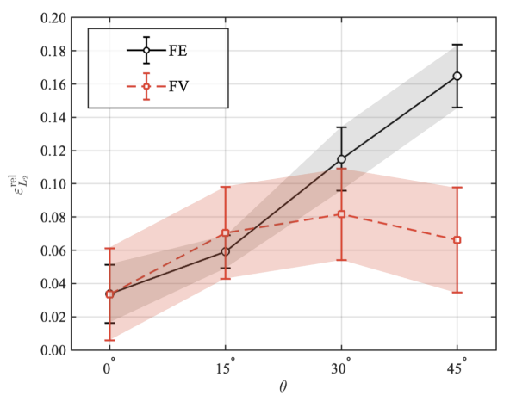
Numerical Simulation Results

Slide 17
Conclusions
Both the MSFV and MSFE formulations accurately reproduce fine-scale reference solutions across all benchmark tests, demonstrating the robustness of the unified multiscale framework.
The FV formulation on a staggered grid guarantees local mass and stress conservation and remains stable even under high coarsening ratios. The FE formulation provides smooth displacement fields thanks to its continuous interpolation.
The hybrid combination, using finite elements for displacement and finite volumes for pressure, offers the best overall balance: lowest errors, good conservation, and competitive computational cost.
For anisotropic heterogeneous flow problems, the FV-based multiscale is more robust to varying permeability orientations.

Slide 18



Q & A
Thanks for your attention!
m.mehrazar@tudelft.nl

