Slide 1
Coupled Hyperbolic Approach to Solve Buoyant Two-Phase Flow and Transport in Heterogeneous Porous Media
Armin Riess ¹², Rasim Hasanzade ³, Hamdi Tchelepi ¹, Patrick Jenny ²
¹ Stanford University
² ETH Zurich
³ Chevron Corporation
Notes:
Welcome to my presentation
I will be presenting a completely novel hyperbolic approach for solving two-phase flow and transport in porous media
This method was first published in 2023 and I presented it at the InterPore conference last year.
In the first part of my presentation I will give an overview of this method, then I’ll show how we have since adapted it for more general problems

Slide 2

Motivation
Fully implicit methods: expensive
Sequential methods: require small time steps
Armin Riess, Rasim Hasanzade, Hamdi Tchelepi, Patrick Jenny
2/16
Notes:
I’ll start with the motivation for this new approach
Methods that currently exist, like fully implicit or sequential methods are expensive or require small time steps
because large systems of tightly coupled linear equations have to be solved globally: expensive

Slide 3
Motivation
Fully implicit methods: expensive
Sequential methods: require small time steps
Goal
Tightly coupled, explicit flow and transport scheme
Two phases
Suited for ACTI and GPUs
Armin Riess, Rasim Hasanzade, Hamdi Tchelepi, Patrick Jenny
2/16
Notes:
We want a new method that is explicit, works for two phases, and is suited for ACTI (adaptive time integration) and computations on GPUs

Slide 4
Motivation
Fully implicit methods: expensive
Sequential methods: require small time steps
Goal
Tightly coupled, explicit flow and transport scheme
Two phases
Suited for ACTI and GPUs
Method
Hyperbolic system based on Euler equations
Time integration with adapted Riemann solver
Armin Riess, Rasim Hasanzade, Hamdi Tchelepi, Patrick Jenny
2/16
Notes:
The method I will be presenting uses a hyperbolic system based on the Euler equations with additional source terms
Solved with an adapted Riemann solver

Slide 5
Motivation
Fully implicit methods: expensive
Sequential methods: require small time steps
Goal
Tightly coupled, explicit flow and transport scheme
Two phases
Suited for ACTI and GPUs
Method
Hyperbolic system based on Euler equations
Time integration with adapted Riemann solver
Vision
Adaptive in space and time
For complex problems in 3D
Suited for GPUs
Armin Riess, Rasim Hasanzade, Hamdi Tchelepi, Patrick Jenny
2/16
Notes:
In the future, we want to extend the solver for adaptive meshes and adaptive time integration
For complex problems in 3d
Also the method is very promising for computations on GPUs, this will have to be implemented

Slide 6
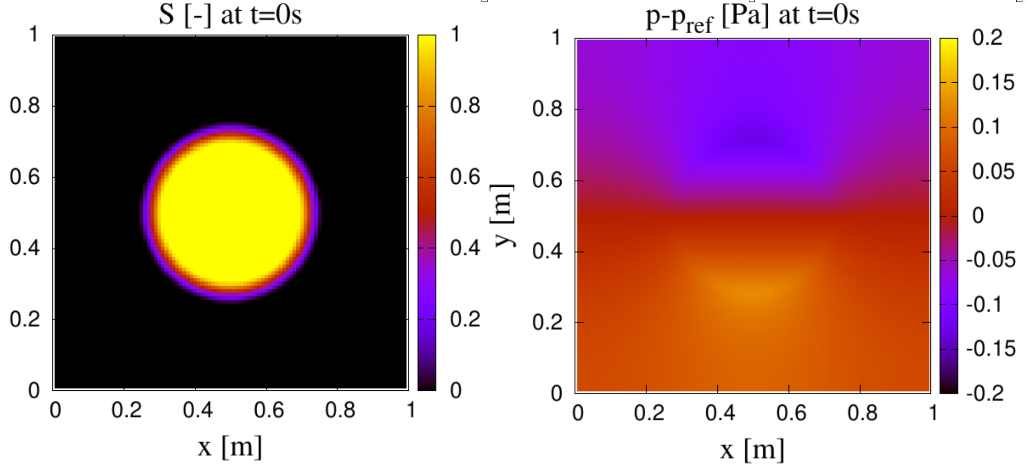
Motivation
Armin Riess, Rasim Hasanzade, Hamdi Tchelepi, Patrick Jenny
3/16
Notes:
This is an example problem we want to solve. A plume of a heavy phase surrounded by a lighter phase under the effect of gravity.

Slide 7
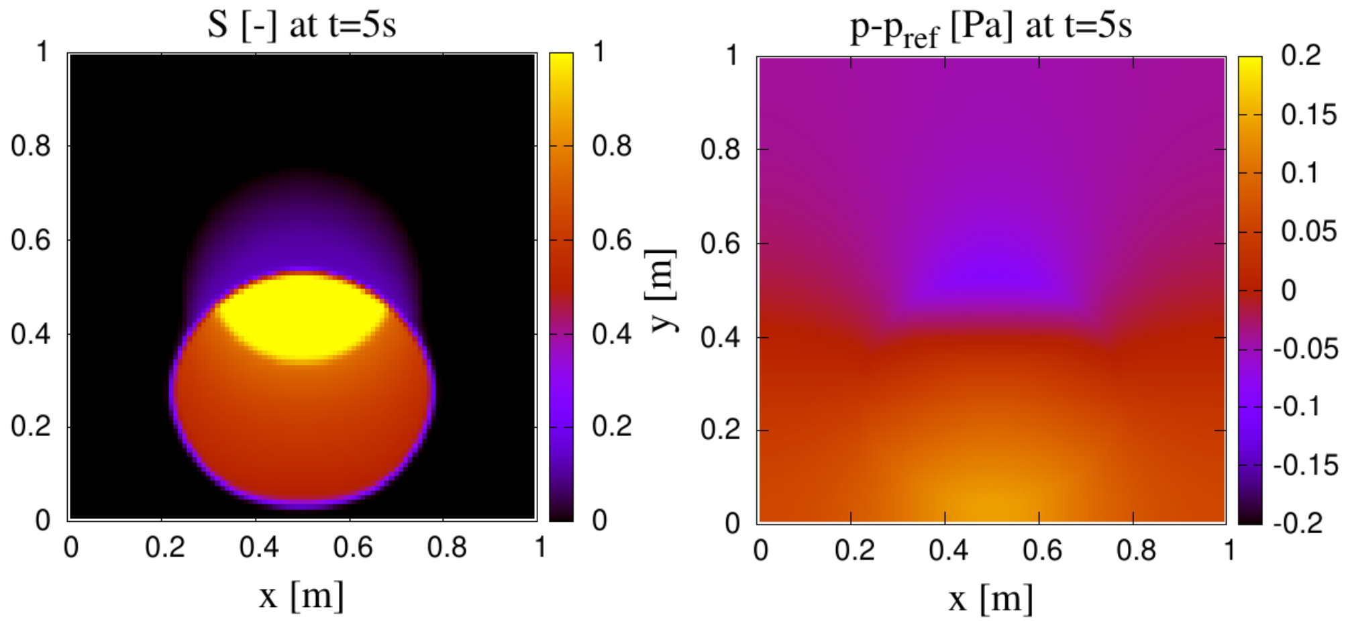
Motivation
Armin Riess, Rasim Hasanzade, Hamdi Tchelepi, Patrick Jenny
3/16

Slide 8
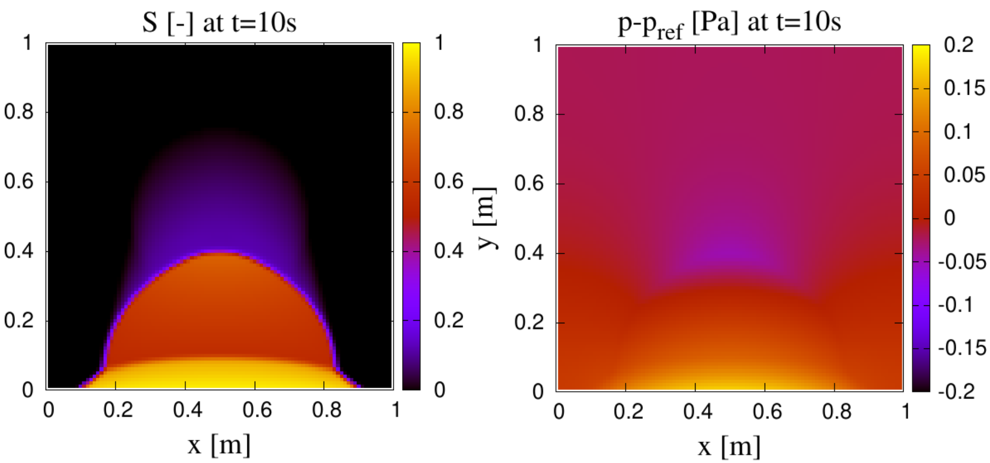
Motivation
Armin Riess, Rasim Hasanzade, Hamdi Tchelepi, Patrick Jenny
3/16

Slide 9


Classical System for Two-Phase Flow and Transport
Armin Riess, Rasim Hasanzade, Hamdi Tchelepi, Patrick Jenny
3/16
Notes:
We start with the classical system for simulating this. We have a divergence free velocity that given by Darcy’s law
The velocity is given by the pressure gradient and a gravity term

Slide 10
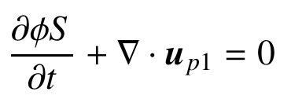


Classical System for Two-Phase Flow and Transport
Armin Riess, Rasim Hasanzade, Hamdi Tchelepi, Patrick Jenny
3/16
Notes:
and the transport of the saturation.

Slide 11
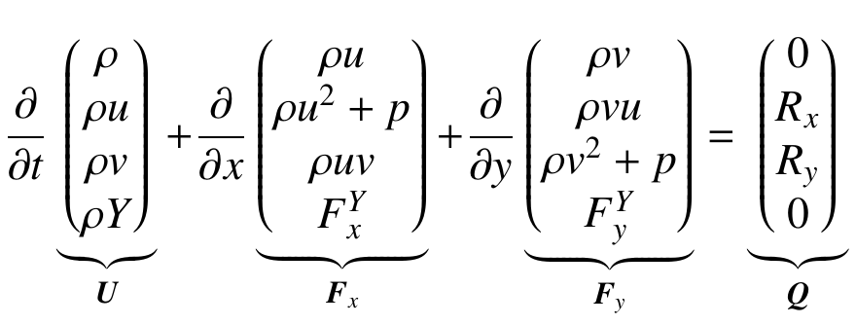
New: Hyperbolic System for Flow and Transport
0
0
Armin Riess, Rasim Hasanzade, Hamdi Tchelepi, Patrick Jenny
4/16
Notes:
Now we get to the new system. It is based on the Euler equations. By themselves they don’t have anything to do with flow in porous media, but with a few tricks we can incorporate these laws.

Slide 12

New: Hyperbolic System for Flow and Transport
$$p=c^{2}ρ$$
0
0
Armin Riess, Rasim Hasanzade, Hamdi Tchelepi, Patrick Jenny
4/16
Notes:
The pressure is defined through the isothermal equation of state, from the density rho and a sound speed c
This is very important: neither of these have any physical meaning. rho is an algorithmic variable related to some reference density, that we can also choose as a parameter. It has nothing to do with the physical densities of the phases.
c is also a parameter of the method and constant. Gas theory tells us that for small Mach numbers (less than .3), the flow is nearly incompressible, which is what we want. Therefore, we have to choose c such that the Mach number is small.
For incompressibility, we also want to avoid large fluctuations in the density. So we can require that the difference between the largest and the smallest density value is small relative to the reference density.

Slide 13
New: Hyperbolic System for Flow and Transport
$$p=c^{2}ρ$$
0
0
Armin Riess, Rasim Hasanzade, Hamdi Tchelepi, Patrick Jenny
4/16
Notes:
If this is the case, the continuity equation simplifies to the divergence free velocity field.

Slide 14

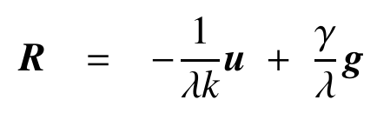
New: Hyperbolic System for Flow and Transport
$$p=c^{2}ρ$$
Armin Riess, Rasim Hasanzade, Hamdi Tchelepi, Patrick Jenny
4/16
Notes:
Next, we include Darcy’s law. We introduce a source term in the momentum balance, which is derived from Darcy’s law.

Slide 15
New: Hyperbolic System for Flow and Transport
$$p=c^{2}ρ$$
Armin Riess, Rasim Hasanzade, Hamdi Tchelepi, Patrick Jenny
4/16
Notes:
When this source term dominates these other terms, we can rearrange the momentum balance and get Darcy’s law

Slide 16

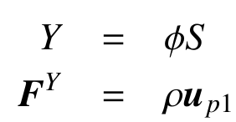
New: Hyperbolic System for Flow and Transport
$$p=c^{2}ρ$$
Armin Riess, Rasim Hasanzade, Hamdi Tchelepi, Patrick Jenny
4/16
Notes:
The equation for the saturation transport is hyperbolic, so we simply include it as a fourth equation.
Just like that, we have managed to pack all the governing laws into this hyperbolic system.

Slide 17
New: Hyperbolic System for Flow and Transport
$$p=c^{2}ρ$$
Good approximation if:
Low Mach number
Small relative density differences
Source Terms dominate
Armin Riess, Rasim Hasanzade, Hamdi Tchelepi, Patrick Jenny
4/16
Notes:
During the derivation, we made three assumptions
Choose c large enough to get a small Mach number.
Choose the reference density large enough so the relative density differences are small
This gives us incompressibility.
And we need the source terms to dominate.
We have control over these assumptions through our choice of c and rho_ref
There is a trade-off between accuracy and cost
Equivalent to darcy, but solve full system
From here only numerical error

Slide 18





Numerical Scheme: Approximate Riemann Solver
$$p=c^{2}ρ$$
$$Ω_{3}$$
$$F_{y_{1→3}}$$
$$Ω_{1}$$
$$Ω_{2}$$
$$F_{x_{1→2}}$$
Armin Riess, Rasim Hasanzade, Hamdi Tchelepi, Patrick Jenny
6/16
Notes:
We have the system, now we have to solve it.
For this project, we use a FVM with a regular cartesian mesh. To update the cells, we want to know how much flows across the interfaces over the course of the next time step. So we want to know the fluxes at the interfaces slightly in the future. This is done with a Riemann solver.

Slide 19
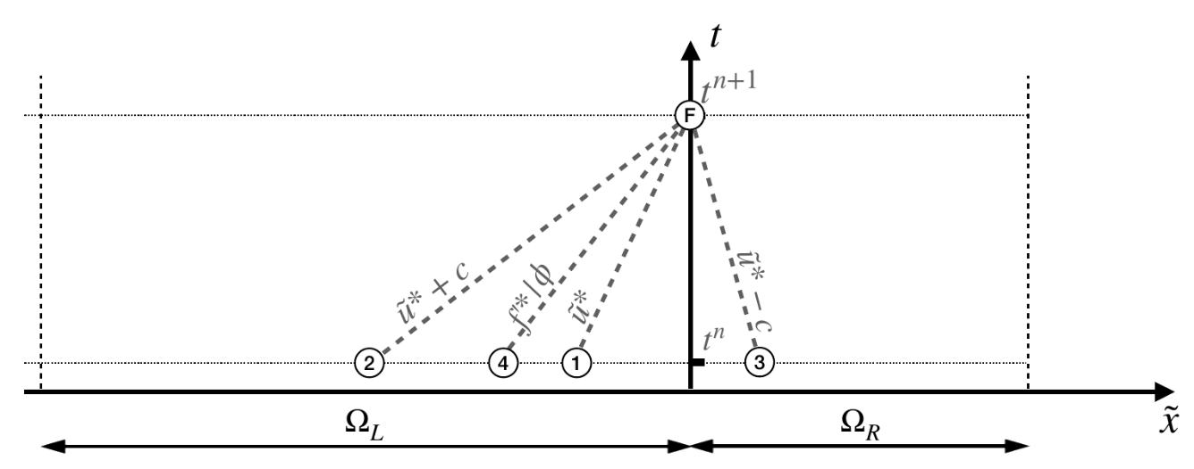
Numerical Scheme: Approximate Riemann Solver
$$p=c^{2}ρ$$
$$Ω_{3}$$
$$F_{y_{1→3}}$$
$$Ω_{1}$$
$$Ω_{2}$$
$$F_{x_{1→2}}$$
Armin Riess, Rasim Hasanzade, Hamdi Tchelepi, Patrick Jenny
6/16
Notes:
We simplify the problem at the interfaces to a homogeneous 1d problem. So let’s say we look at a flow in the x direction, we ignore the flux term in the y direction and the source term.
Explain xt diagram
Now, according to the method of characteristics, we find four characteristic lines and four Riemann invariants. The Riemann invariants can be calculated from the values in the cell.
Invariants are not constant
They are assumed to be constant along the characteristics, so we calculate them from the values at the current time step, propagate them to the interface and then use them to calculate the flux at the interface, in the future.

Slide 20
Numerical Scheme: Approximate Riemann Solver
$$p=c^{2}ρ$$
$$Ω_{3}$$
$$F_{y_{1→3}}$$
$$Ω_{1}$$
$$Ω_{2}$$
$$F_{x_{1→2}}$$
Characteristics-based Riemann solver:
Cheap
Robust
Accurate
Suited for GPUs
Armin Riess, Rasim Hasanzade, Hamdi Tchelepi, Patrick Jenny
6/16
Notes:
This solver is cheap, robust, and accurate.
Also, because the cell updates only depend on the fluxes from the neighbours, all computations are local and can be done in parallel.

Slide 21
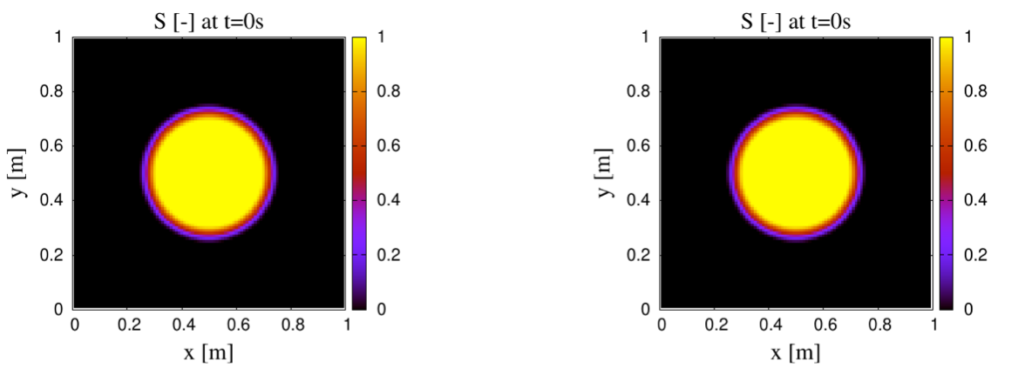
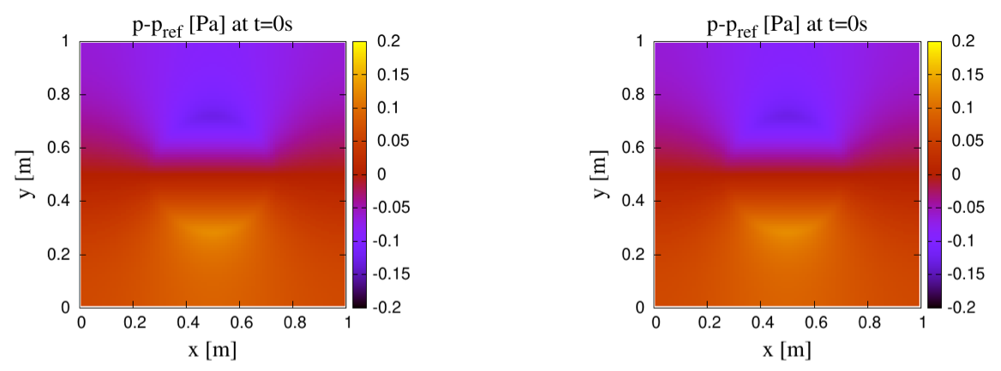
Case 1: 2D Plume
fully implicit
new method
[P. Jenny, R. Hasanzade, H. Tchelepi.
JCOMP, 2023]
Armin Riess, Rasim Hasanzade, Hamdi Tchelepi, Patrick Jenny
7/16

Slide 22
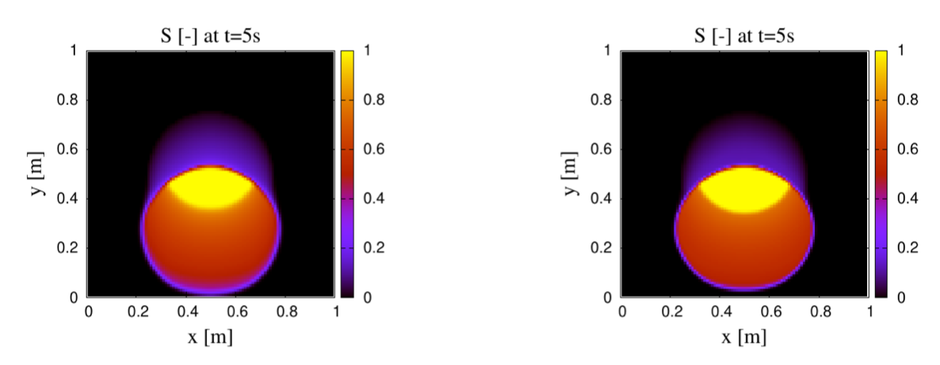
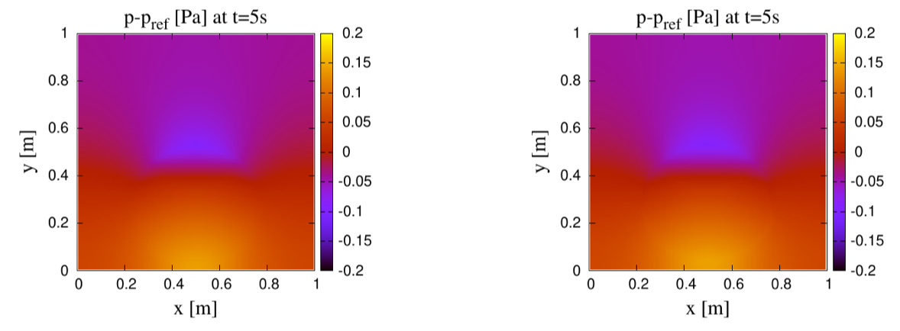
Case 1: 2D Plume
fully implicit
new method
[P. Jenny, R. Hasanzade, H. Tchelepi.
JCOMP, 2023]
Armin Riess, Rasim Hasanzade, Hamdi Tchelepi, Patrick Jenny
7/16

Slide 23
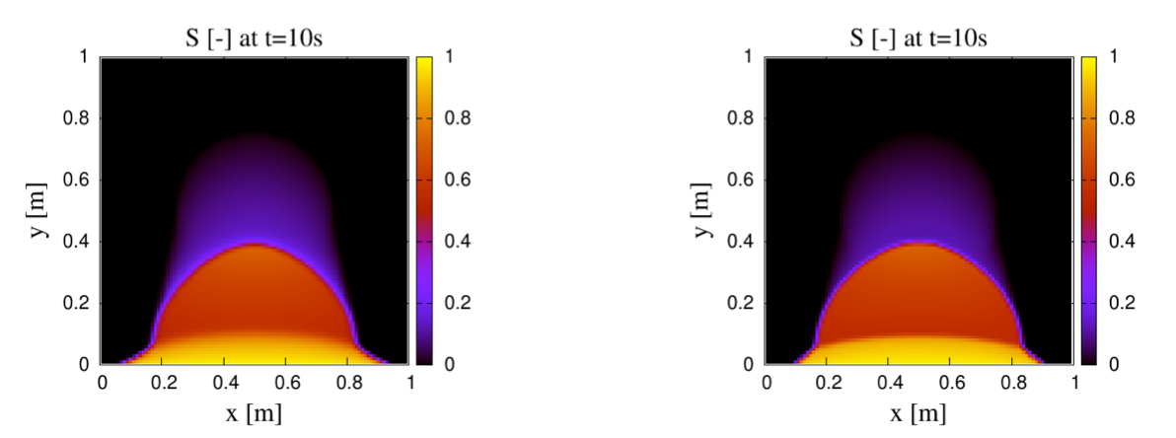
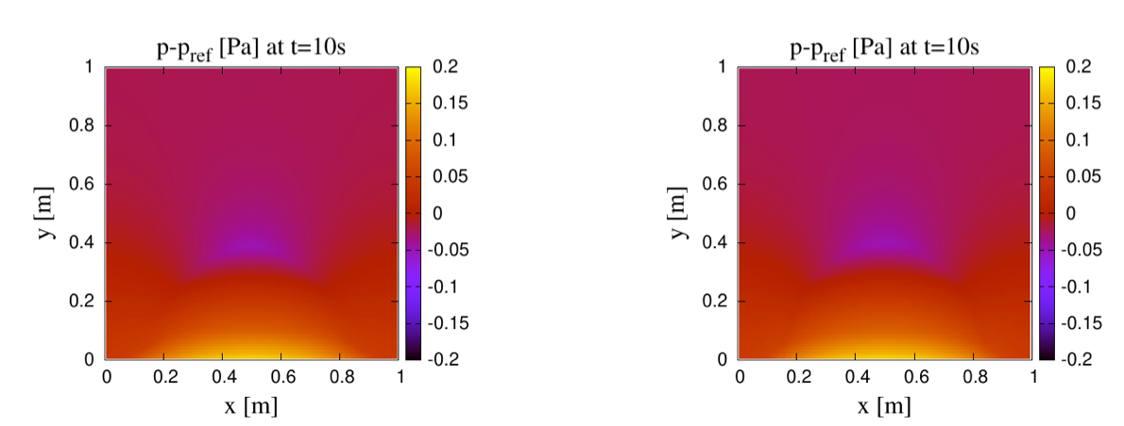
Case 1: 2D Plume
fully implicit
new method
[P. Jenny, R. Hasanzade, H. Tchelepi.
JCOMP, 2023]
Armin Riess, Rasim Hasanzade, Hamdi Tchelepi, Patrick Jenny
7/16

Slide 24
Case 1: 2D Plume
fully implicit
new method
[P. Jenny, R. Hasanzade, H. Tchelepi.
JCOMP, 2023]
Hyperbolic vs Standard Simulator
Very good agreement
Sharper shocks with hyperbolic simulator
Armin Riess, Rasim Hasanzade, Hamdi Tchelepi, Patrick Jenny
7/16
Notes:
With a homogeneous permeability, very good agreement, sharper shocks

Slide 25
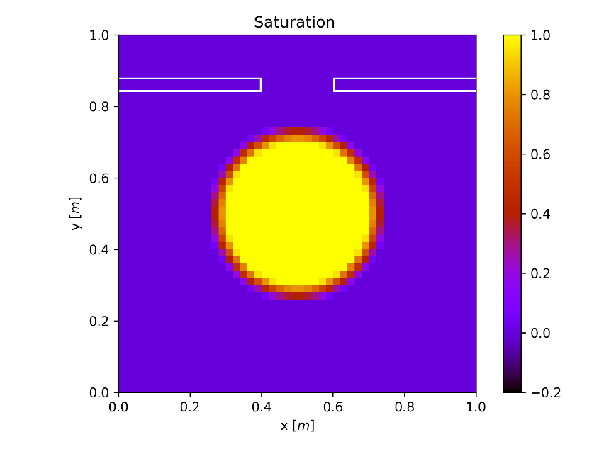
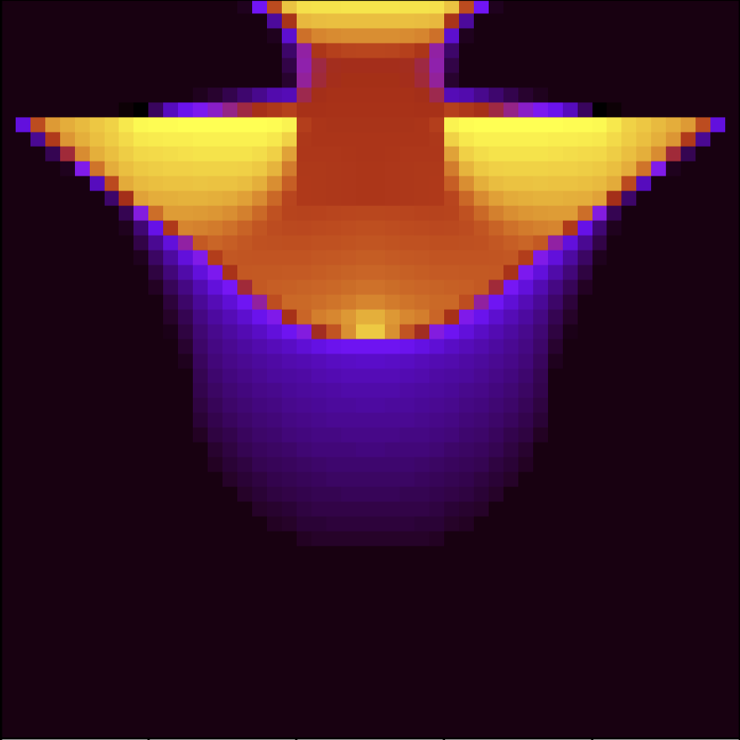
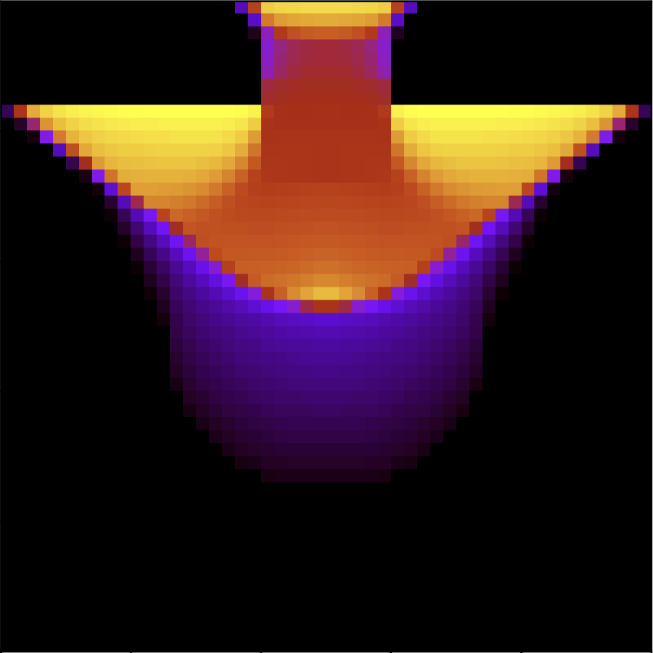
Case 2: 2D Plume with Shale
initial saturation
approximate Riemann solver
Armin Riess, Rasim Hasanzade, Hamdi Tchelepi, Patrick Jenny
8/16
Notes:
So far, I only showed what was published in the original paper from 2023. Now, I’ll talk about my work.
Let’s introduce inhomogeneous permeability. Again, plume, rising, this time, with nearly impermeable shales.

Slide 26
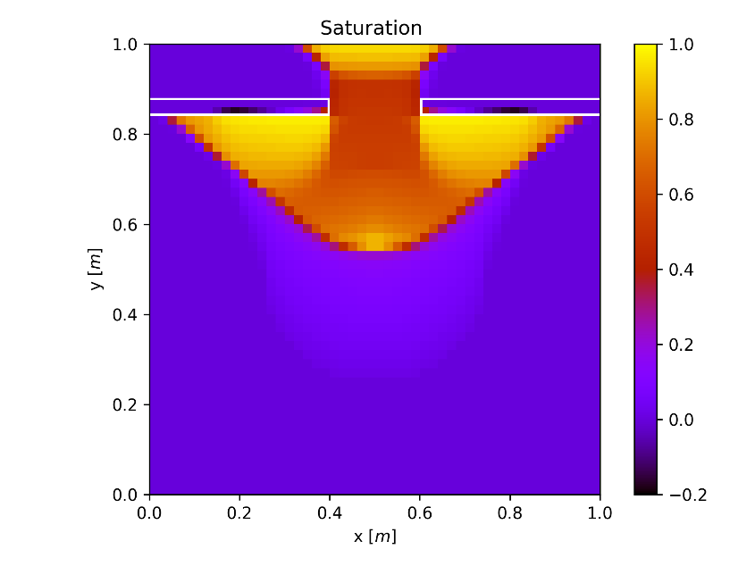
Case 2: 2D Plume with Shale
initial saturation
new method
Armin Riess, Rasim Hasanzade, Hamdi Tchelepi, Patrick Jenny
8/16
Notes:
Oh no! Fluid passes into the shale, saturation becomes negative. Something is wrong
The problem is the large source term. Like I said, the Riemann solver ignores the source term, but this leads to a different system with different fluxes. In fact, we made the assumption of a large source term, so we cannot ignore it. We have to adapt the solver.

Slide 27

Case 2: 2D Plume with Shale
initial saturation
new method
Armin Riess, Rasim Hasanzade, Hamdi Tchelepi, Patrick Jenny
8/16
Notes:
Oh no! Fluid passes into the shale, saturation becomes negative. Something is wrong
The problem is the large source term. Like I said, the Riemann solver ignores the source term, but this leads to a different system with different fluxes. In fact, we made the assumption of a large source term, so we cannot ignore it. We have to adapt the solver.

Slide 28
Case 2: 2D Plume with Shale
Artifacts at shale surface
Hypothesis: Due to source terms
Fix: Adapt Riemann solver
initial saturation
new method
Armin Riess, Rasim Hasanzade, Hamdi Tchelepi, Patrick Jenny
8/16
Notes:
Oh no! Fluid passes into the shale, saturation becomes negative. Something is wrong
The problem is the large source term. Like I said, the Riemann solver ignores the source term, but this leads to a different system with different fluxes. In fact, we made the assumption of a large source term, so we cannot ignore it. We have to adapt the solver.

Slide 29



Rankine-Hugoniot-Riemann (RHR) solver
$$p=c^{2}ρ$$
$$Δx$$
$$R_{x}Δx$$
Armin Riess, Rasim Hasanzade, Hamdi Tchelepi, Patrick Jenny
9/16
Notes:
The source term exists everywhere in the domain.
Now, instead of deriving different characteristics for the inhomogeneous problem, we can apply the source term in such a way that we restore homogeneous conditions at the interfaces. We take the effect of the source term on the whole cell and place it in a single point at the cell center.

Slide 30
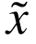

Rankine-Hugoniot-Riemann (RHR) solver
$$p=c^{2}ρ$$
$$Δx$$
$$R_{x}Δx$$
$$ρ(u^{2}+c^{2})$$
Armin Riess, Rasim Hasanzade, Hamdi Tchelepi, Patrick Jenny
9/16
Notes:
This leads to a jump that splits the cell into two halves. In these halves, the cell values are perturbed. We can find the values on both sides of the jump through the Rankine-Hugoniot jump conditions, hence the name. These perturbed values are then used with the normal Riemann solver.
Because the source term now only exists in the cell centers, we don’t have to worry about it anymore at the interfaces.
Area around interface source free
Also honors conservation

Slide 31




Rankine-Hugoniot-Riemann (RHR) solver
$$p=c^{2}ρ$$
$$Δx$$
$$R_{x}Δx$$
$$ρ(u^{2}+c^{2})$$
$$R_{x}Δx$$
$$ρ_{R}(u_{R}^{2}+c^{2})$$
$$ρ_{L}(u_{L}^{2}+c^{2})$$
$$R_{x}Δx$$
Armin Riess, Rasim Hasanzade, Hamdi Tchelepi, Patrick Jenny
9/16
Notes:
This leads to a jump that splits the cell into two halves. In these halves, the cell values are perturbed. We can find the values on both sides of the jump through the Rankine-Hugoniot jump conditions, hence the name. These perturbed values are then used with the normal Riemann solver.
Because the source term now only exists in the cell centers, we don’t have to worry about it anymore at the interfaces.
Area around interface source free
Also honors conservation

Slide 32
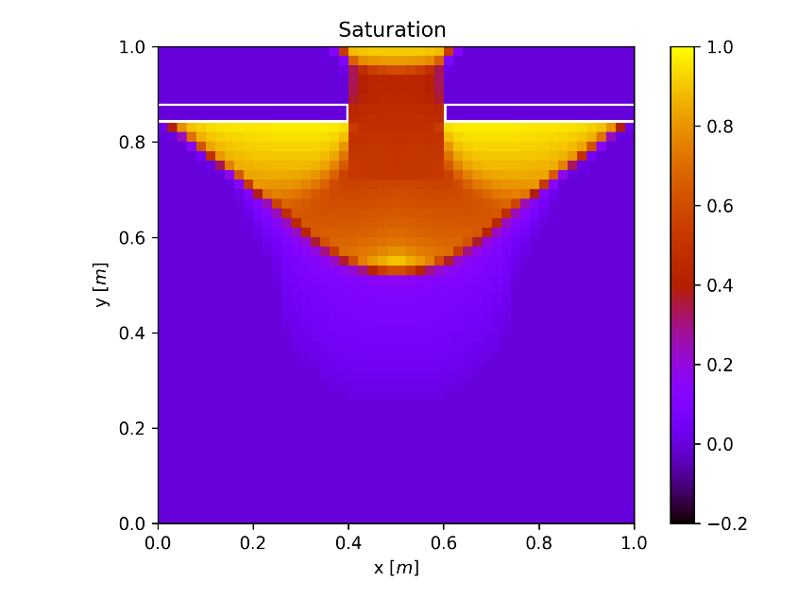
Case 2: 2D Plume with Shale
initial saturation
approximate Riemann
solver
Rankine-Hugoniot-
Riemann solver
Armin Riess, Rasim Hasanzade, Hamdi Tchelepi, Patrick Jenny
10/16
Notes:
Now, the shales look much better.

Slide 33
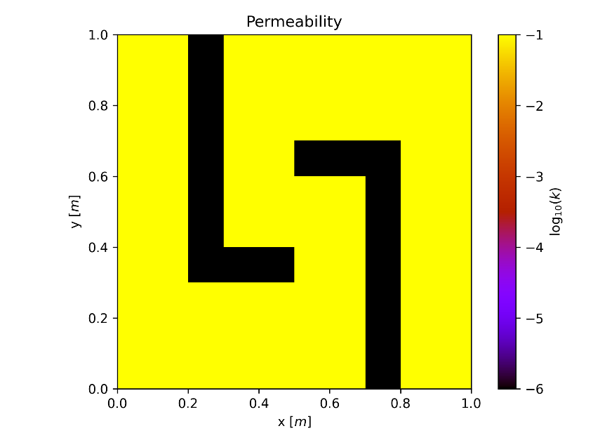
Case 3: Meander
Armin Riess, Rasim Hasanzade, Hamdi Tchelepi, Patrick Jenny
11/16
Notes:
This test shows even more clearly why this adaptation of the solver is necessary.
We have a pressure driven flow, again nearly impermeable shales. We inject the phase from the left.

Slide 34
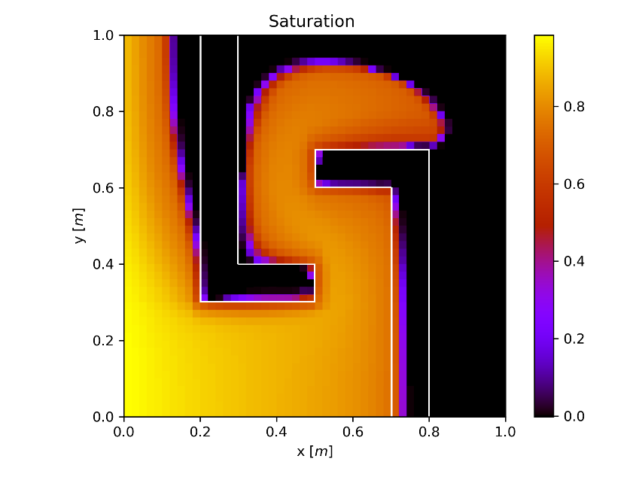
Case 3: Meander
approximate
Riemann
solver
Armin Riess, Rasim Hasanzade, Hamdi Tchelepi, Patrick Jenny
11/16
Notes:
With the approximate Riemann solver, the fluid goes into the shales.

Slide 35
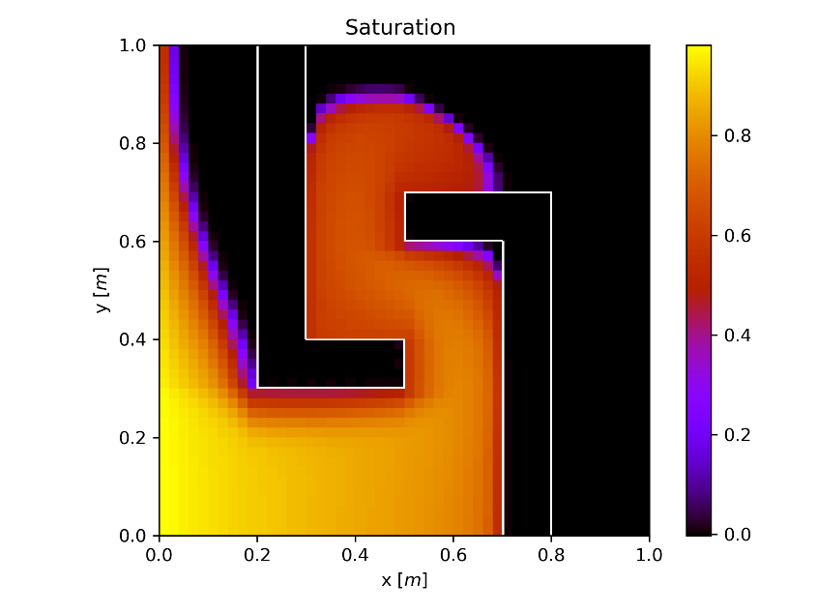
Case 3: Meander
approximate
Riemann
solver
Rankine-
Hugoniot-
Riemann
solver
Armin Riess, Rasim Hasanzade, Hamdi Tchelepi, Patrick Jenny
11/16
Notes:
With the adapted solver, this does not happen.

Slide 36
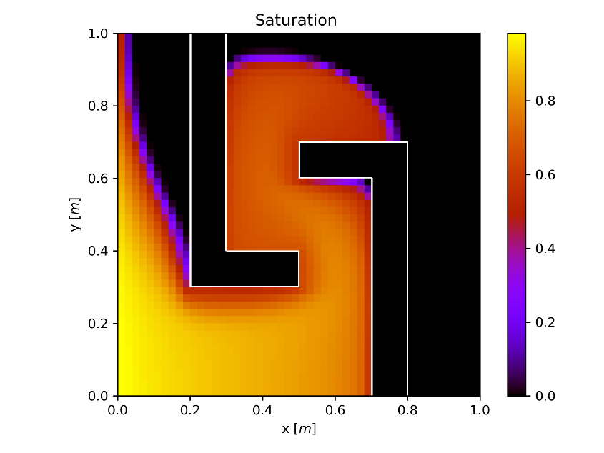
Case 3: Meander
approximate
Riemann
solver
Rankine-
Hugoniot-
Riemann
solver
Implicit
Method
Armin Riess, Rasim Hasanzade, Hamdi Tchelepi, Patrick Jenny
11/16
Notes:
However, when we compare this again to the implicit method, there are some differences. The fluid does not spread out as much.

Slide 37

Rankine-Hugoniot-Riemann (RHR) solver
$$p=c^{2}ρ$$
$$Δx$$
$$R_{x}Δx$$
$$ρ(u^{2}+c^{2})$$
$$ρ_{R}(u_{R}^{2}+c^{2})$$
$$ρ_{L}(u_{L}^{2}+c^{2})$$
$$R_{x}Δx$$
$$R_{x}Δx$$
Armin Riess, Rasim Hasanzade, Hamdi Tchelepi, Patrick Jenny
12/16
Notes:
This leads to a jump that splits the cell into two halves. In these halves, the cell values are perturbed. We can find the values on both sides of the jump through the Rankine-Hugoniot jump conditions, hence the name. These perturbed values are then used with the normal Riemann solver. Because the source term now only exists in the cell centers, we don’t have to worry about it anymore at the interfaces.

Slide 38
Rankine-Hugoniot-Riemann (RHR) solver
$$p=c^{2}ρ$$
$$Δx$$
$$R_{x}Δx$$
$$ρ(u^{2}+c^{2})$$
$$ρ_{R}(u_{R}^{2}+c^{2})$$
$$ρ_{L}(u_{L}^{2}+c^{2})$$
$$R_{x}Δx$$
$$R_{x}Δx$$
Armin Riess, Rasim Hasanzade, Hamdi Tchelepi, Patrick Jenny
12/16
Notes:
This leads to a jump that splits the cell into two halves. In these halves, the cell values are perturbed. We can find the values on both sides of the jump through the Rankine-Hugoniot jump conditions, hence the name. These perturbed values are then used with the normal Riemann solver. Because the source term now only exists in the cell centers, we don’t have to worry about it anymore at the interfaces.

Slide 39
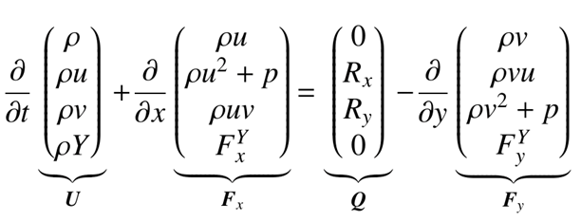
Rankine-Hugoniot-Riemann (RHR) solver
$$p=c^{2}ρ$$
$$Δx$$
$$R_{x}Δx$$
$$ρ(u^{2}+c^{2})$$
$$ρ_{R}(u_{R}^{2}+c^{2})$$
$$ρ_{L}(u_{L}^{2}+c^{2})$$
$$R_{x}Δx$$
$$R_{x}Δx$$
Armin Riess, Rasim Hasanzade, Hamdi Tchelepi, Patrick Jenny
12/16
Notes:
This leads to a jump that splits the cell into two halves. In these halves, the cell values are perturbed. We can find the values on both sides of the jump through the Rankine-Hugoniot jump conditions, hence the name. These perturbed values are then used with the normal Riemann solver. Because the source term now only exists in the cell centers, we don’t have to worry about it anymore at the interfaces.

Slide 40



Rankine-Hugoniot-Riemann (RHR) solver
$$p=c^{2}ρ$$
$$Δx$$
$$Q_{x}^{+}Δx$$
$$ρ(u^{2}+c^{2})$$
$$ρ_{R}(u_{R}^{2}+c^{2})$$
$$ρ_{L}(u_{L}^{2}+c^{2})$$
$$R_{x}Δx$$
$$Q_{x}^{+}Δx$$
Armin Riess, Rasim Hasanzade, Hamdi Tchelepi, Patrick Jenny
12/16
Notes:
This leads to a jump that splits the cell into two halves. In these halves, the cell values are perturbed. We can find the values on both sides of the jump through the Rankine-Hugoniot jump conditions, hence the name. These perturbed values are then used with the normal Riemann solver. Because the source term now only exists in the cell centers, we don’t have to worry about it anymore at the interfaces.
This is not as straightforward as it looks here, because the source term is applied ahead of the flux calculation, so we don’t know this flux at the current time step.
Instead, we use a weighted average of the previously calculated fluxes. This works reasonably well.

Slide 41
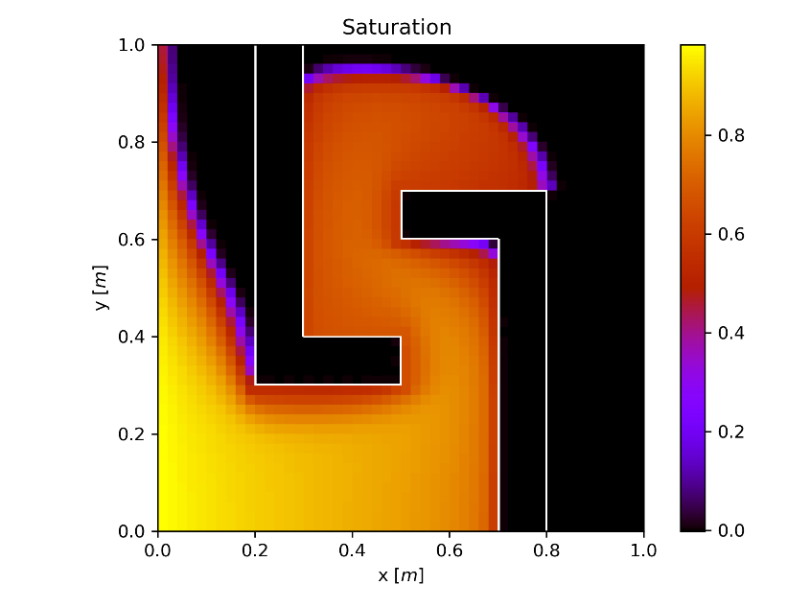
Case 3: Meander
approximate
Riemann
Solver
RHR Solver
Implicit
Method
RHR Solver
with additional
Source Term
Armin Riess, Rasim Hasanzade, Hamdi Tchelepi, Patrick Jenny
13/16
Notes:
However, when we compare this again to the implicit method, there are some differences. The fluid does not spread out as much.

Slide 42
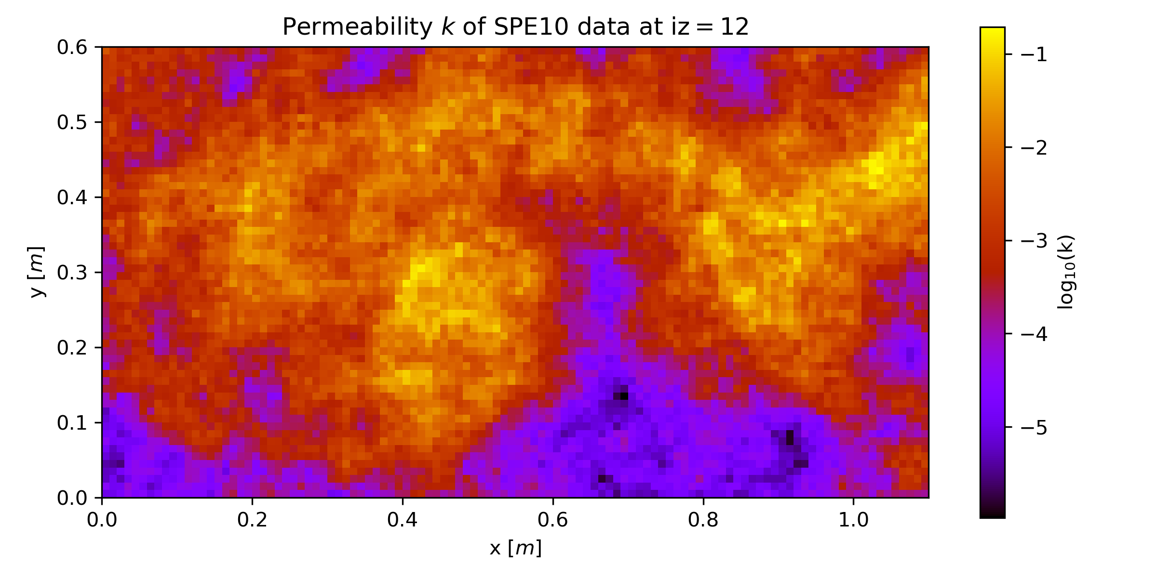
Case 4: SPE10 Top Layer
Armin Riess, Rasim Hasanzade, Hamdi Tchelepi, Patrick Jenny
14/16
Notes:
However, when we compare this again to the implicit method, there are some differences. The fluid does not spread out as much.

Slide 43
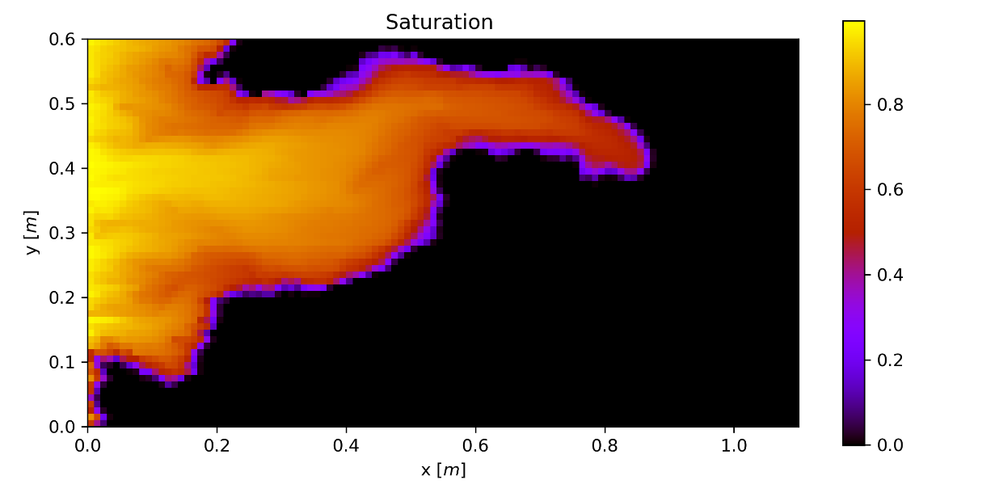

Case 4: SPE10 Top Layer
RHR Solver
with additional
Source Term
Implicit
Method
Armin Riess, Rasim Hasanzade, Hamdi Tchelepi, Patrick Jenny
14/16
Notes:
However, when we compare this again to the implicit method, there are some differences. The fluid does not spread out as much.

Slide 44
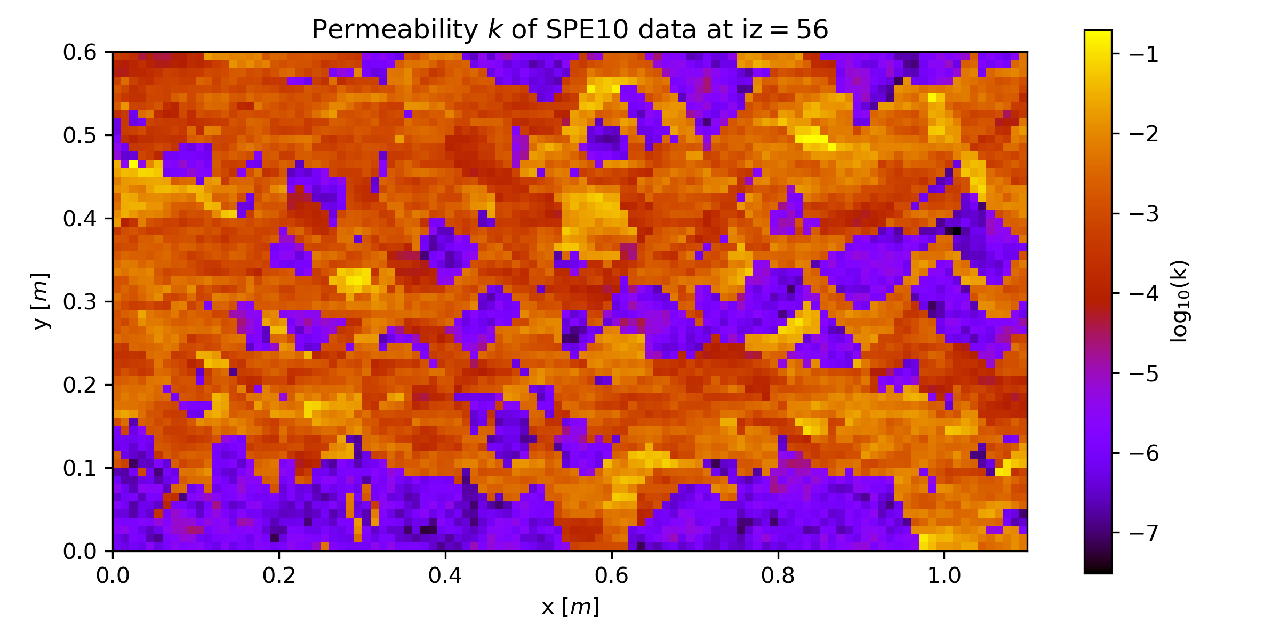
Case 5: SPE10 Bottom Layer
Armin Riess, Rasim Hasanzade, Hamdi Tchelepi, Patrick Jenny
15/16
Notes:
However, when we compare this again to the implicit method, there are some differences. The fluid does not spread out as much.

Slide 45
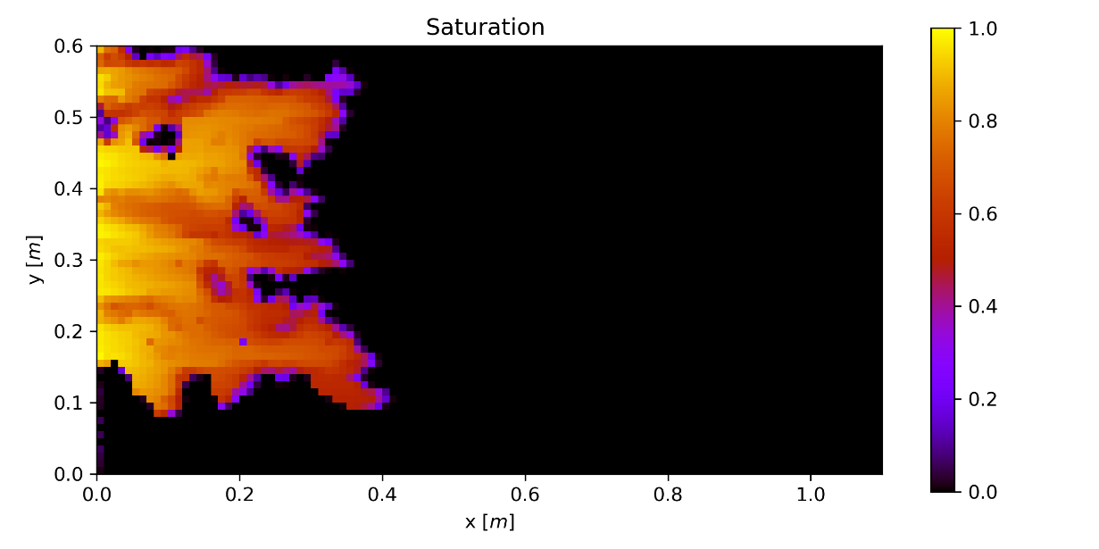
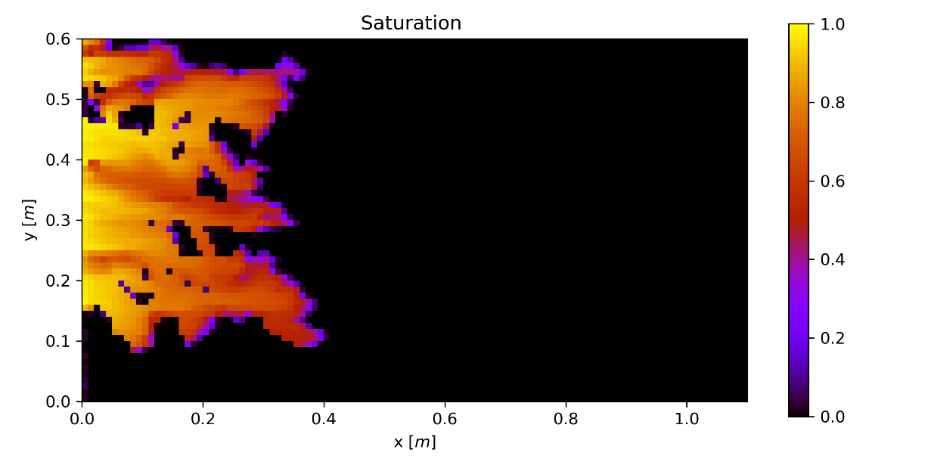
Case 5: SPE10 Bottom Layer
RHR Solver
with additional
Source Term
Implicit
Method
Armin Riess, Rasim Hasanzade, Hamdi Tchelepi, Patrick Jenny
15/16
Notes:
However, when we compare this again to the implicit method, there are some differences. The fluid does not spread out as much.

Slide 46
Conclusions
System of hyperbolic conservation laws describe coupled flow and transport
Shale layers can be included thanks to RHR solver
Two-dimensional effects with additional source term
Proposed solution algorithm is well-suited for GPUs
Armin Riess, Rasim Hasanzade, Hamdi Tchelepi, Patrick Jenny
16/16

