Slide 1


Adityra Sahoo, Dr. Raka Mondal
Multiscale homogenization-based transport modeling of porous composite proton exchange membranes for maximum charge transport.
Abstract ID: 75
Associate Professor, Indian Institute of Petroleum and Energy, Visakhapatnam

Slide 2

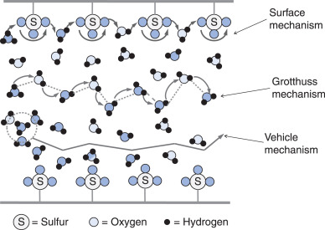
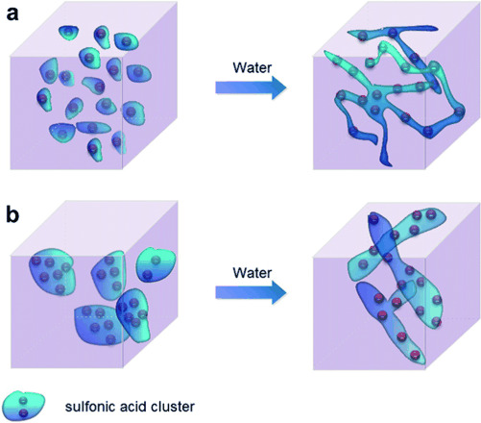
The route for solution: Microphase segregation
Transport mechanism
Objective: Network of Bigger water channels without short-circuiting
The challenges:
Theoretical: Optimized directive for size modulation.
Experimental: Post-treatment optimization of pristine/ composite membrane.
Attempt to achieve better alternative from Nafion
(a) Commercial option ~ Poor ionic cluster
Image Source: https://skill-lync.com/student-projects/week-6-fuel-cell-powered-vehicle-model-34
Water permeable region
Size of Ionic channels: 1-50 nm,
Walls (polymeric backbone) as obstacles
(b) Improved micro-phase segregation ~ Efficient ionic network ~ improved ion transport
Ref: DOI:10.1007/s12034-009-0042-8

Slide 3
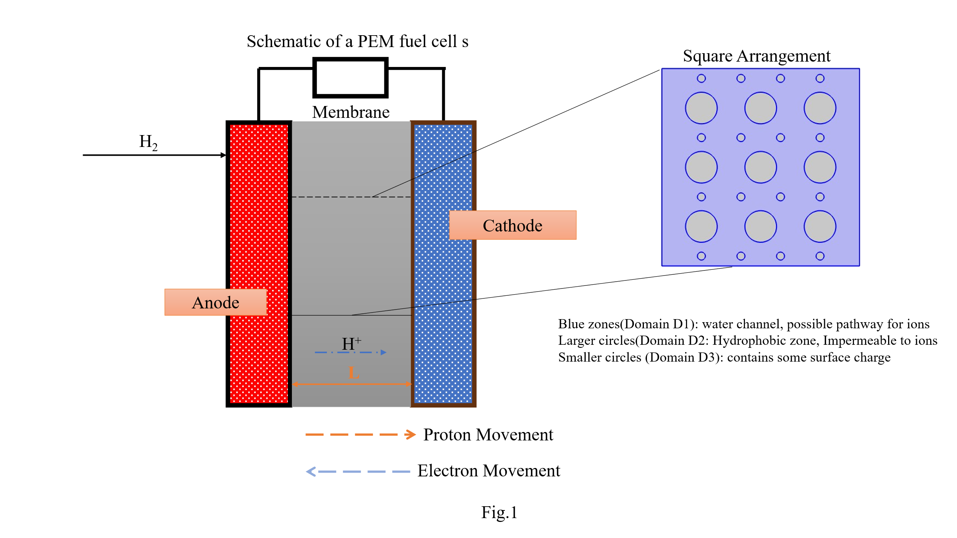
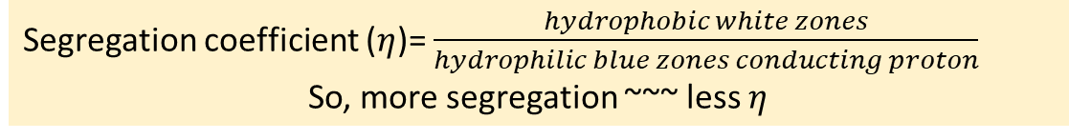
Fundamental insights of impact of size and orientation of micro-phase segregation
Macroscopic approach
proton vehicles in whole membrane
Solves for: effective flux
Limitation: membrane as continuum, effective properties considered, Localised variation ignored
Molecular simulation: Effective but requires very high computational load.
Current approach:
Mesoscale: solution for momentum, mass and electrophoretic transport with localised variation; space averaging
Diffusive-convective-electroosmotic flux of proton through blue zones
White areas – hydrophobic zones, impermeable to ions
Blue zones – water channel, the possible pathway of ions
Advantage:
Accurate prediction of conductivity with structural and operational changes
Segregation coefficient ($η$)= $\frac{hydrophobic white zones}{hydrophilic blue zones conducting proton}$
So, more segregation ~~~ less $η$

Slide 4
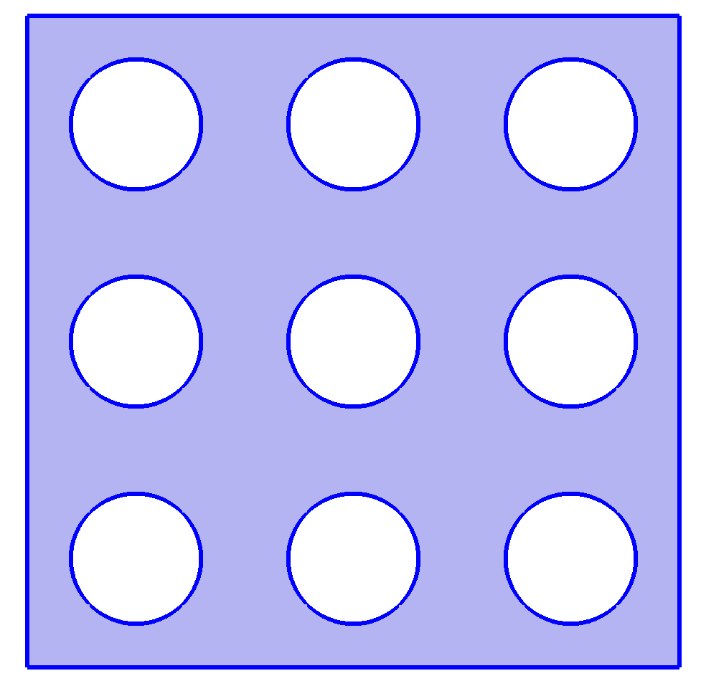
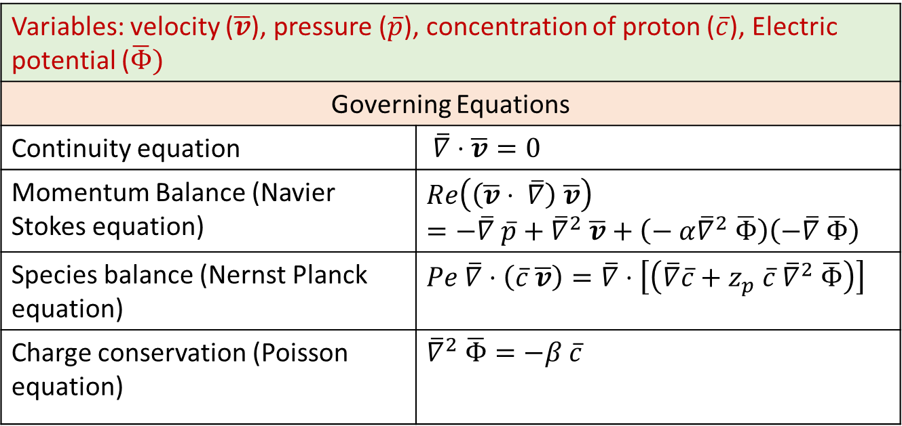
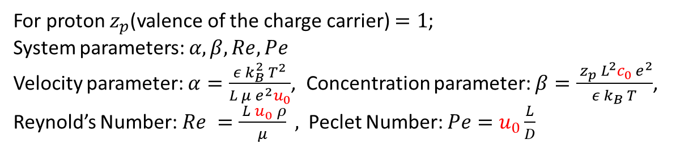
Background
2-dimensional zonal arrangement
Variables: velocity ($\overline{v}$), pressure ($\overline{p}$), concentration of proton ($\overline{c}$), Electric potential ($\overline{Φ})$ | Governing Equations
Governing Equations
Continuity equation | $\overline{∇}⋅\overline{v}=0$
Momentum Balance (Navier Stokes equation) | $$Re\left(\left(\overline{v}⋅ \overline{∇}\right) \overline{v}\right)=−\overline{∇} \overline{p}+{\overline{∇}}^{2} \overline{v}+\left(− α{\overline{∇}}^{2} \overline{Φ}\right)\left(−\overline{∇} \overline{Φ}\right)$$
Species balance (Nernst Planck equation) | $$Pe \overline{∇}⋅\left(\overline{c} \overline{v}\right)=\overline{∇}⋅\left[\left(\overline{∇}\overline{c}+z_{p} \overline{c} {\overline{∇}}^{2} \overline{Φ}\right)\right]$$
Charge conservation (Poisson equation) | ${\overline{∇}}^{2} \overline{Φ}=−β \overline{c}$
For proton $z_{p}$(valence of the charge carrier) $=1$;
System parameters: $α, β, Re, Pe$
Velocity parameter: $α=\frac{ε k_{B}^{2} T^{2}}{L μ e^{2}u_{0}}$, Concentration parameter: $β=\frac{ z_{p} L^{2}c_{0} e^{2}}{ε k_{B} T}$,
Reynold’s Number: $Re =\frac{ L u_{0} ρ}{μ} ,$Peclet Number: $Pe=u_{0}\frac{L}{D}$

Slide 5
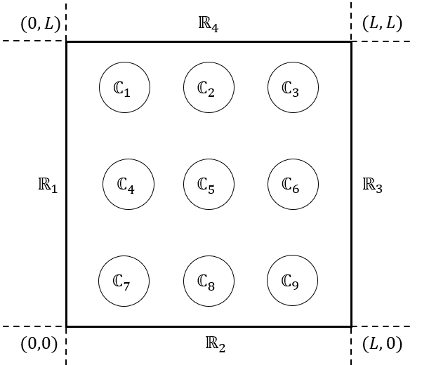

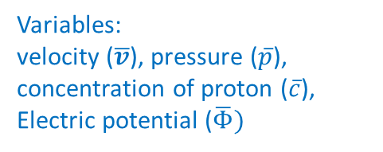
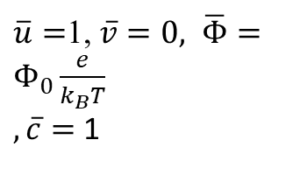
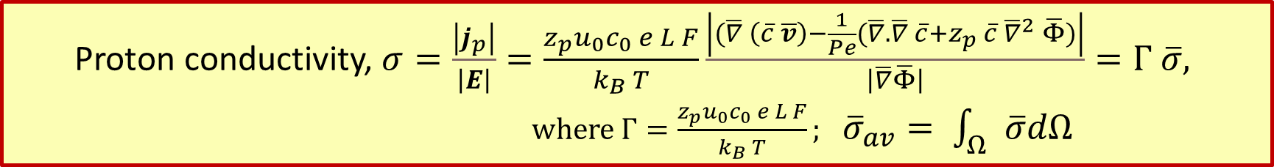




System conditions and proton conductivity
$\overline{v}$ $, \overline{Φ}, \overline{c}$ periodic
(0,1)
(1,1)
Flow of water + proton
R₃
boundary:
Outlet/ sink of proton from
Cathode side
R₁ boundary:
Inlet of proton from
Anode side
$\overline{u}=$1, $\overline{v}=0,$ $\overline{Φ}=Φ_{0}\frac{e}{k_{B}T}$
$, \overline{c}=$ 1
$\overline{∇}⋅\overline{v}=0$, $\overline{Φ}=0,\overline{∇}\overline{c}=0$
$$\overline{y}$$
Variables:
velocity ($\overline{v}$), pressure ($\overline{p}$), concentration of proton ($\overline{c}$), Electric potential ($\overline{Φ})$
(0,0)
$$\overline{x}$$
(1,0)
$\overline{v}$ $, \overline{Φ}, \overline{c}$ periodic
Proton conductivity, $σ=\frac{\left|j_{p}\right|}{\left|E\right|}=\frac{z_{p}u_{0}c_{0} e L F}{k_{B} T}\frac{\left|(\overline{∇} \left(\overline{c} \overline{v}\right)−\frac{1}{Pe}(\overline{∇}.\overline{∇} \overline{c}+z_{p} \overline{c} {\overline{∇}}^{2} \overline{Φ})\right|}{\left|\overline{∇}\overline{Φ}\right|}=Γ \overline{σ},$
where $Γ=\frac{z_{p}u_{0}c_{0} e L F}{k_{B} T};$ ${\overline{σ}}_{av}= \int_{Ω}{\overline{σ}dΩ}$

Slide 6
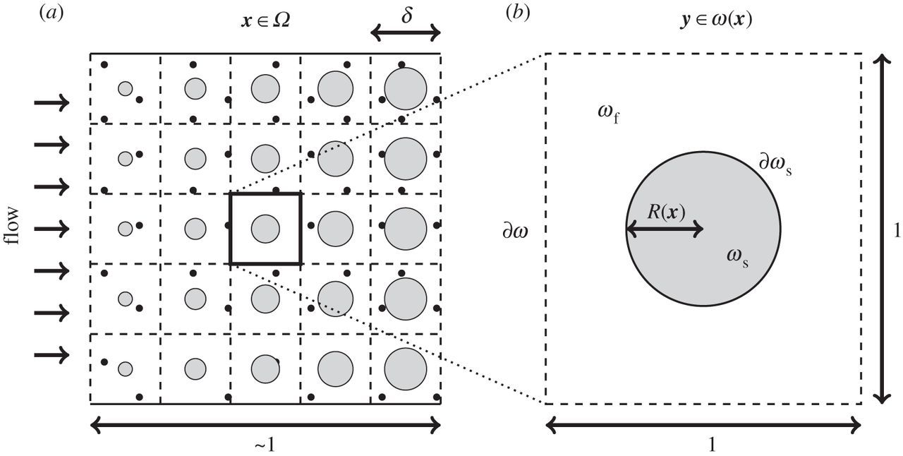
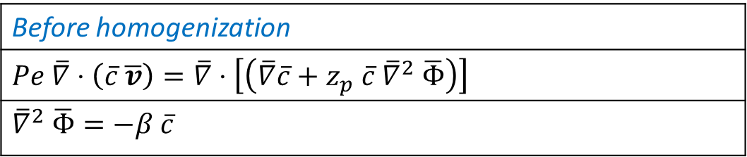
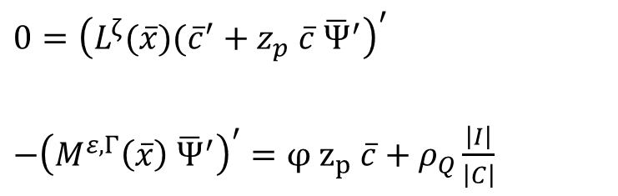
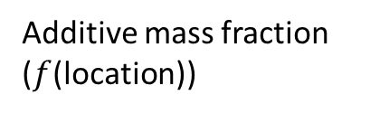
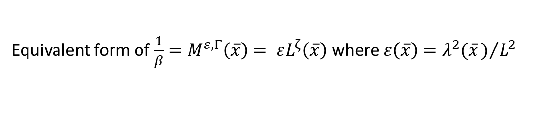
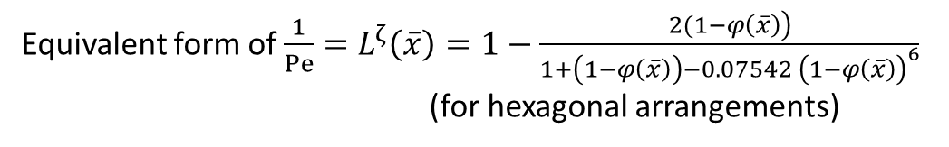
Composite Electrochemical membrane: application of homogenization theory
Situation: uniform/ non-uniform distribution of additives, charged obstacles in the proton flow-path
Strategy: Use of Homogenised Nernst-Planck-Poisson equation for composite PEM membranes
Before homogenization
$$Pe \overline{∇}⋅\left(\overline{c} \overline{v}\right)=\overline{∇}⋅\left[\left(\overline{∇}\overline{c}+z_{p} \overline{c} {\overline{∇}}^{2} \overline{Φ}\right)\right]$$
${\overline{∇}}^{2} \overline{Φ}=−β \overline{c}$
Homogenized Nernst-Planck-equation without convection
$0={\left(L^{ζ}(\overline{x})({\overline{c}}^{′}+z_{p} \overline{c} {\overline{Ψ}}^{′}\right)}^{′}$
$−{\left(M^{ε, Γ}\left(\overline{x}\right) {\overline{Ψ}}^{′}\right)}^{′}=φ z_{p} \overline{c}+ρ_{Q}\frac{\left|I\right|}{\left|C\right|}$
Homogenized Poisson equation
interfacial area
cell volume
Additive mass fraction ($f$(location))
Surface charge
Equivalent form of $\frac{1}{Pe}=L^{ζ}\left(\overline{x}\right)=1−\frac{\left.2(1−φ\left(\overline{x}\right)\right)}{1+\left(1−φ\left(\overline{x}\right)\right)−0.07542 {\left(1−φ\left(\overline{x}\right)\right)}^{6}}$ (for hexagonal arrangements)
Equivalent form of $\frac{1}{β}=M^{ε, Γ}\left(\overline{x}\right)= εL^{ζ}\left(\overline{x}\right)$where $ε\left(\overline{x}\right)=λ^{2}(\overline{x})/{L^{2}}$

Slide 7
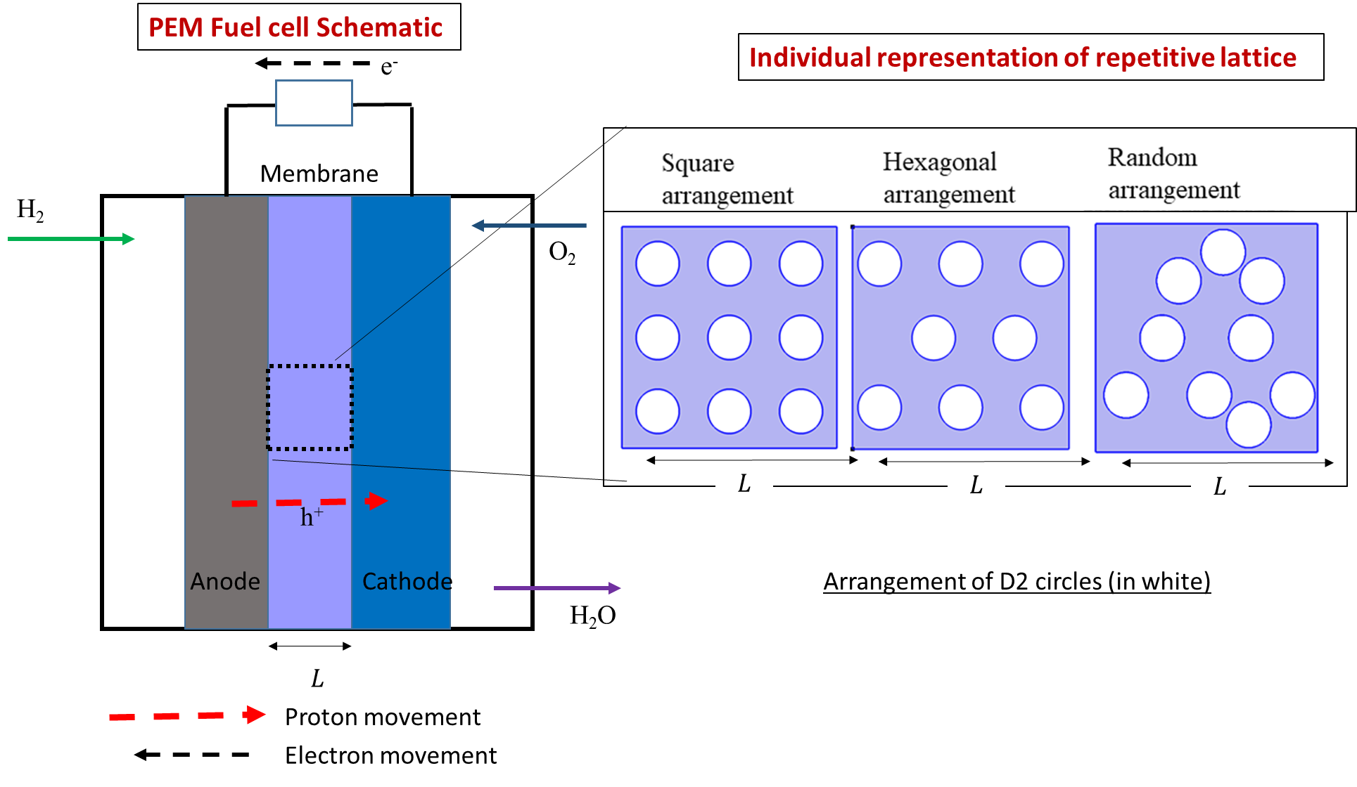
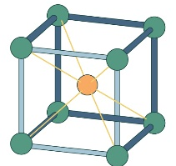

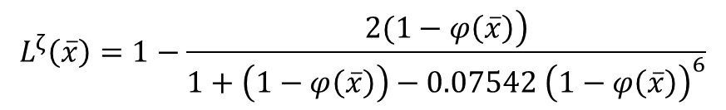
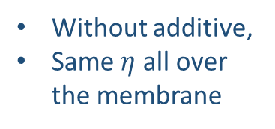
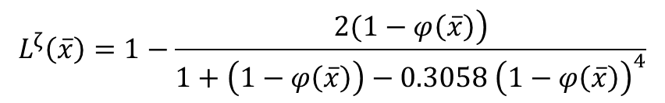

Conductivity prediction for membranes without additives
$φ\left(\overline{x}\right)$ Additive dosage (mass/mass) which can be a function of $x$
Equivalent form of $L^{ζ}\left(\overline{x}\right)$
Without additive,
Same $η$ all over the membrane
Square pitch
$$L^{ζ}\left(\overline{x}\right)=1−\frac{\left.2(1−φ\left(\overline{x}\right)\right)}{1+\left(1−φ\left(\overline{x}\right)\right)−0.3058 {\left(1−φ\left(\overline{x}\right)\right)}^{4}}$$
Hexagonal pitch
$$L^{ζ}\left(\overline{x}\right)=1−\frac{\left.2(1−φ\left(\overline{x}\right)\right)}{1+\left(1−φ\left(\overline{x}\right)\right)−0.07542 {\left(1−φ\left(\overline{x}\right)\right)}^{6}}$$
Proton conductivity decreases along with segregation coefficient
Cubic pitch
$L^{ζ}\left(\overline{x}\right)=1−\frac{3(1−φ\left(\overline{x}\right))}{1+\left(1−φ\left(\overline{x}\right)\right)−0.3914 {\left(1−φ\left(\overline{x}\right)\right)}^{10/3}}$

Slide 8
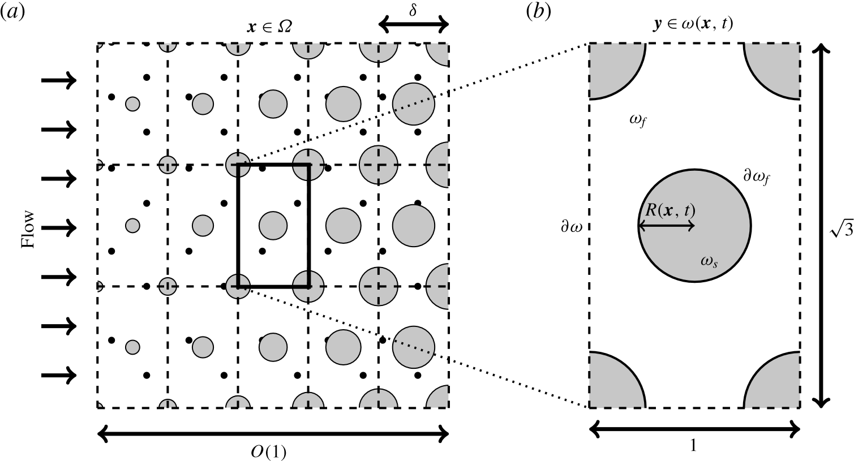

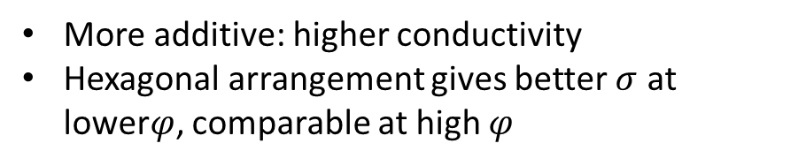
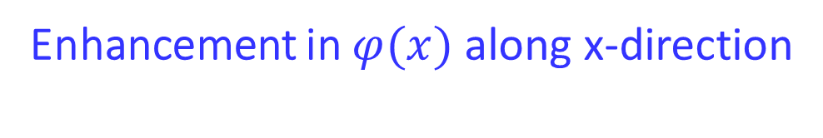
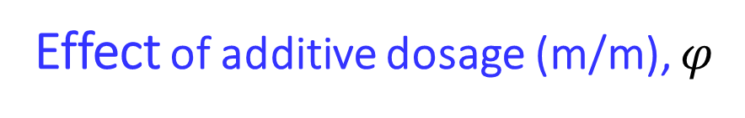
Effect of additive dosage (m/m), $φ$
Enhancement in $φ(x)$ along x-direction
Increasing additive dosage along x-axis: higher conductivity
At lower mean of $φ(x),$higher additive gradient along $x$gives same conductivity.
More additive: higher conductivity
Hexagonal arrangement gives better $σ$ at lower$φ$, comparable at high $φ$

Slide 9
Experimental validation with SPEEK-Zirconium membranes
Parameter | Value | Units | Description
ε_{r} | 80 | – | Dielectric constant of water
q | 1.60 × 10⁻¹⁹ | C | Charge of a proton
ε_{o} | 8.854 × 10⁻¹² | F/m | Permittivity of free space
k_{B} | 1.38 × 10⁻²³ | J/K | Boltzmann constant
ρ | 1000 | kg/m³ | Density of water
 | 0.001 | Pa·s | Viscosity of water
L | 160 × 10⁻⁶ | m | Membrane thickness
D_{w} | 1.30 × 10⁻¹⁰ | m²/s | Diffusivity of water
Excellent agreement between developed membranes and models

Slide 10
Conductivity prediction for membranes with different orientation of additives
Velocity parameter: $α=\frac{ε k_{B}^{2} T^{2}}{L μ e^{2}u_{0}}$, Concentration parameter: $β=\frac{ z_{p} L^{2}c_{0} e^{2}}{ε k_{B} T}$, Reynold’s Number: $Re =\frac{ L u_{0} ρ}{μ} ,$Peclet Number: $Pe=u_{0}\frac{L}{D}$
Variation of average ionic conductivity
Variation of proton conductivity for different geometries (a) Hydrophobic-square & filler-square (b ) hydrophobic-hexagonal & filler–hexagonal (c) hydrophobic–square & filler-hexagonal (d) hydrophobic-hexagonal & filler-square
For maximum ionic conductivity hydrophobic-hexagonal & filler–hexagonal arrangement is best
Diffusive flux become nominal in this case, increasing the electromigration effect strongly
For futuristic membranes, choose the operating conditions based on these parametric behavior.

Slide 11
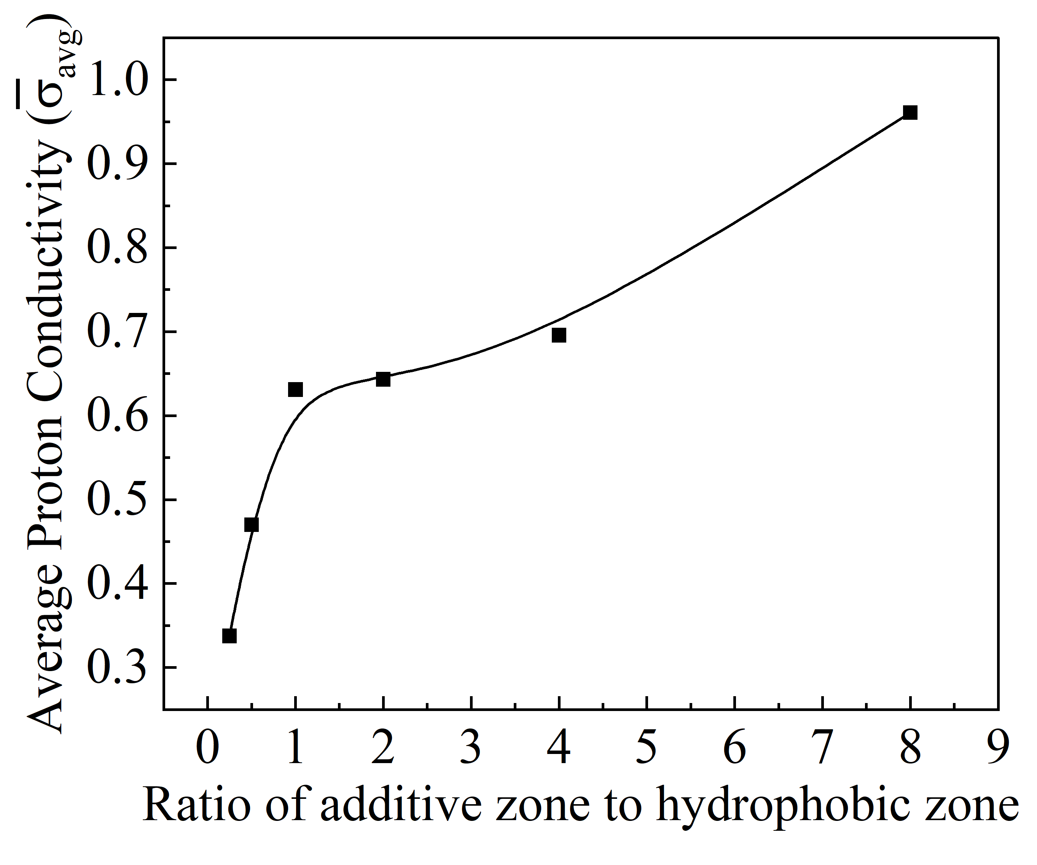
Effect of surface charge and size of additive on ionic conductivity
By increasing the additive size with respect to additive enhances the conductivity, limited by experimental difficulty
Negative surface charge enhances the ionic conductivity manifold

Slide 12
Conclusion
Mesoscale modelling successfully predicted proton transport in PEM membranes.
Optimized micro-phase segregation improved ionic conductivity.
Hexagonal arrangements showed the best transport performance.
Additive dosage, size, and surface charge enhanced conductivity.
Experimental results validated the developed model successfully.

Slide 13




F1, Tech Horizon Building, Chemical Engineering,
IIPE, Visakhapatnam
+91-9932631600
rakam.che@iipe.ac.in/ rakamukherjee10@gmail.com

