Slide 1


Flow-induced surface charge heterogeneity
and its impact on cation exchange
A coupled PNP Stokes - surface-exchange COMSOL study
Shahar Shahror, Yael Mishael, Nimrod Schwartz
Hebrew University of Jerusalem · Soil & Water Sciences
May 2026

Slide 2
Motivation
Same chemistry, same surface -different reported rates.
Ion-exchange kinetics are central to many natural and technological systems
• Soils · K⁺ / NH₄⁺ release, heavy-metal mobilization under leaching
• Membranes · selectivity, breakthrough, kinetically limited
• Electrochemical interfaces under flow · batteries, fuel cells, biosensors
These systems are commonly described using fitted rate coefficients
The puzzle
“….Desorption varied with flow rate and since by definition the desorption rate coefficient is constant a new term, apparent desorption rate coefficient was defined for each flow rate in the system…”
Sparks et al., Soil Sci. Soc. Am. J. 44: 1205-1208 (1980)
Flow-induced surface charge heterogeneity & cation exchange kinetics · S. Shahror, Y. Mishael, N. Schwartz · HUJI
2 / 13

Slide 3








Ion Exchange at the Solid Liquid Interface
A conceptual view of cation exchange between the flowing solution and reactive surface sites.
$${Cl}^{1−}$$
Advection
Diffusion
Electromigration
Surface reaction
$${Ca}^{2+}$$
$${Cl}^{1−}$$
$${Ca}^{2+}$$
$${Ca}^{2+}$$
$$K^{+}$$
Negatively charged patch
$${Cl}^{1−}$$
$${Ca}^{2+}$$
$$K^{+}$$
Existing approaches typically emphasize different parts:
solution transport
surface chemistry
electrokinetic transport
Flow-induced surface charge heterogeneity & cation exchange kinetics · S. Shahror, Y. Mishael, N. Schwartz · HUJI
3 / 13

Slide 4
Ion Exchange at the Solid Liquid Interface
A conceptual view of cation exchange between the flowing solution and reactive surface sites.
$${Cl}^{1−}$$
Advection
Diffusion
Electromigration
Surface reaction
$${Ca}^{2+}$$
$${Cl}^{1−}$$
$${Ca}^{2+}$$
$${Ca}^{2+}$$
$$K^{+}$$
Negatively charged patch
$${Cl}^{1−}$$
$${Ca}^{2+}$$
$$K^{+}$$
Existing approaches typically emphasize different parts:
solution transport
surface chemistry
electrokinetic transport
these processes are rarely coupled in one framework
Flow-induced surface charge heterogeneity & cation exchange kinetics · S. Shahror, Y. Mishael, N. Schwartz · HUJI
3 / 13

Slide 5

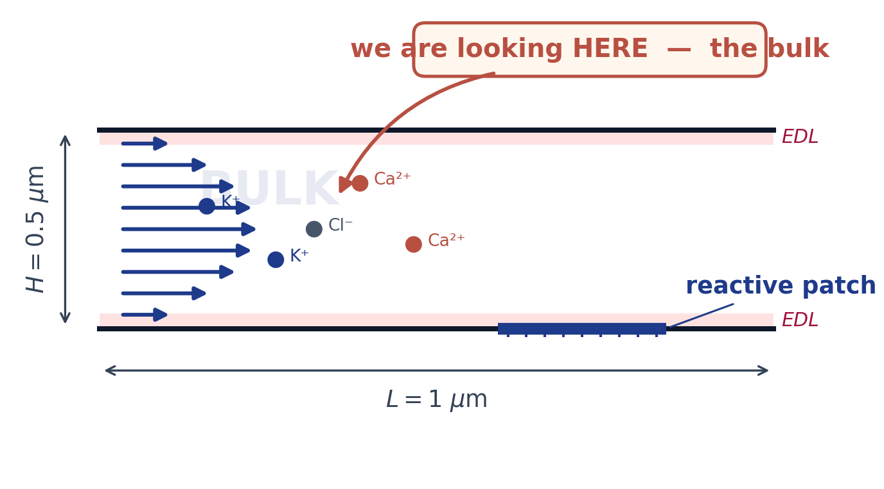













Our model · general Overview
2-D microchannel · Poisson-Nernst-Planck.
$${Cl}^{1−}$$
$${Ca}^{2+}$$
$$K^{+}$$
$${Cl}^{1−}$$
$${Ca}^{2+}$$
$${Ca}^{2+}$$
Negatively charged patch
$${Cl}^{1−}$$
$${Ca}^{2+}$$
$$K^{+}$$
$$K^{+}$$
$$K^{+}$$
$$K^{+}$$
$$K^{+}$$
$$K^{+}$$
$${Cl}^{1−}$$
$${Cl}^{1−}$$
$$K^{+}$$
$${Ca}^{2+}$$
$$K^{+}$$
Negatively charged patch
$${Cl}^{1−}$$
$${Ca}^{2+}$$
$${Ca}^{2+}$$
$$K^{+}$$
$$K^{+}$$
$${Ca}^{2+}$$
$$K^{+}$$
$$K^{+}$$
Flow-induced surface charge heterogeneity & cation exchange kinetics · S. Shahror, Y. Mishael, N. Schwartz · HUJI
4 / 13

Slide 6
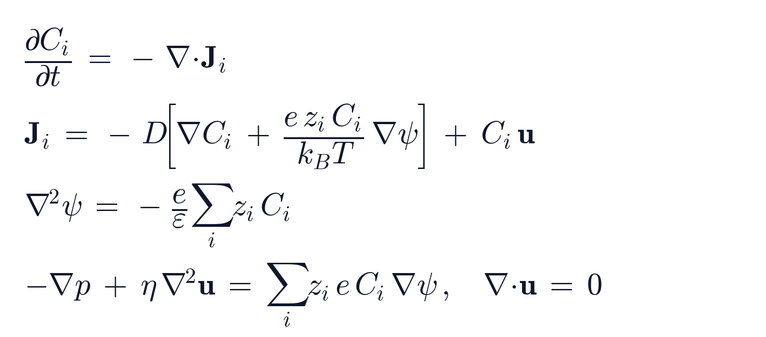





Our model · the bulk
2-D microchannel · Poisson-Nernst-Planck.
flux: diffusion + electromigration + advection
$$K^{+}$$
$${Cl}^{1−}$$
$${Cl}^{1−}$$
Nernst-Planck
$${Ca}^{2+}$$
$${Cl}^{1−}$$
$${Ca}^{2+}$$
$${Ca}^{2+}$$
$$K^{+}$$
Negatively charged patch
$${Cl}^{1−}$$
$${Cl}^{1−}$$
→ ions move by diffusion, drift in the field, and with the flow.
$${Ca}^{2+}$$
$${Ca}^{2+}$$
$$K^{+}$$
→ Pressure-driven flow, solving Hagen-Poiseuille.
Poisson - charges set the potential
Flow-induced surface charge heterogeneity & cation exchange kinetics · S. Shahror, Y. Mishael, N. Schwartz · HUJI
5 / 13
Notes:
Relation between potential and the space charged density

Slide 7
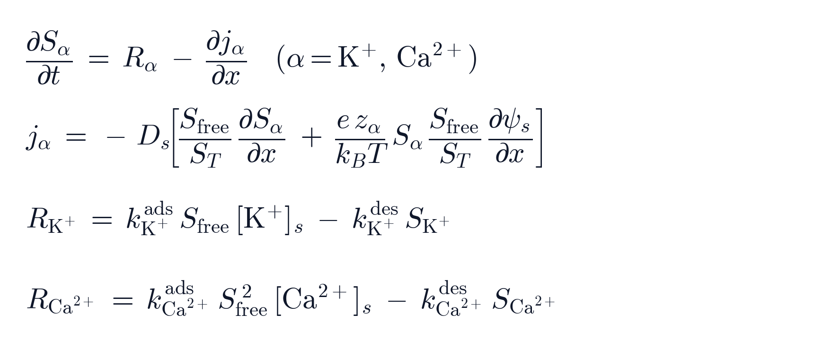
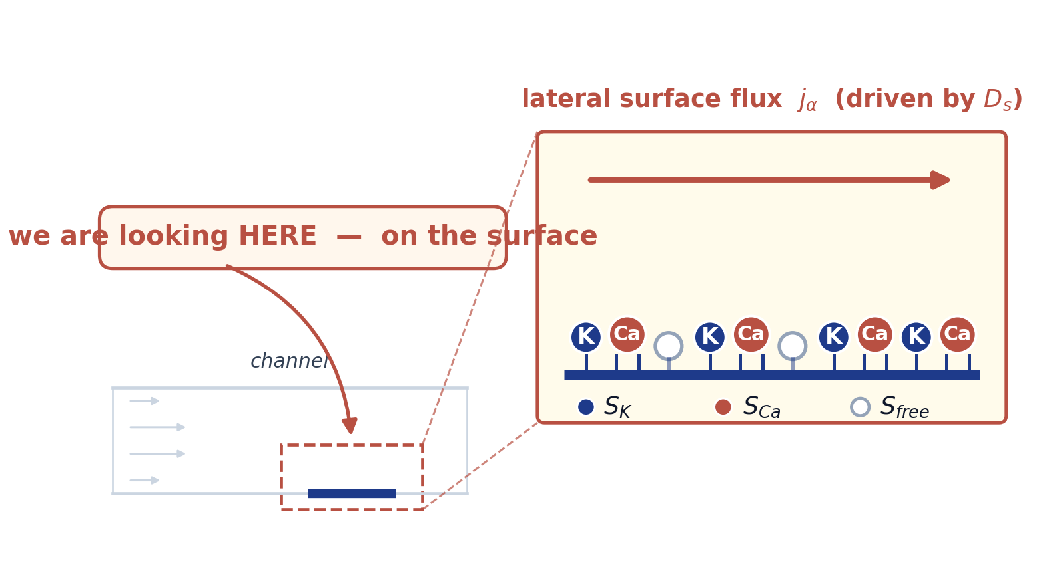







Our model · the surface
Maxwell-Stefan style cross-flux · Dₛ in the tangential transport.
vertical flux: reaction kinetics
K⁺ exchange
$$K^{+}$$
Ca²⁺ exchange
$$K^{+}$$
→ Ca²⁺ binds two sites, giving the squared site dependence.
evolution of surface species (K⁺, Ca²⁺ )
$$K^{+}$$
-
-
$$K^{+}$$
$$K^{+}$$
$$K^{+}$$
$$K^{+}$$
$$K^{+}$$
$$K^{+}$$
$$K^{+}$$
$${Ca}^{2+}$$
$${Ca}^{2+}$$
$${Ca}^{2+}$$
$${Ca}^{2+}$$
⁺
²⁺
-
→ the number of K⁺ (or Ca²⁺) sites changes due to reaction.
Flow-induced surface charge heterogeneity & cation exchange kinetics · S. Shahror, Y. Mishael, N. Schwartz · HUJI
6 / 13

Slide 8
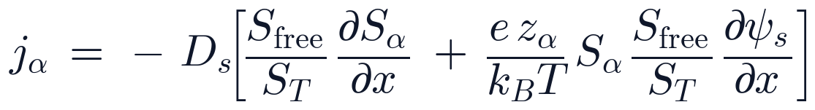
Our model · the surface
Maxwell-Stefan style cross-flux · Dₛ in the tangential transport.
vertical flux: reaction kinetics
K⁺ exchange
$$K^{+}$$
Ca²⁺ exchange
$$K^{+}$$
→ Ca²⁺ binds two sites, giving the squared site dependence.
evolution of surface species (K⁺, Ca²⁺ )
$$K^{+}$$
-
-
$$K^{+}$$
$$K^{+}$$
$$K^{+}$$
$$K^{+}$$
$$K^{+}$$
$$K^{+}$$
$$K^{+}$$
$${Ca}^{2+}$$
$${Ca}^{2+}$$
$${Ca}^{2+}$$
$${Ca}^{2+}$$
⁺
²⁺
-
→ the number of K⁺ (or Ca²⁺) sites changes due to reaction and tangential flux and.
Werkhoven et al., Phys. Rev. Lett. 120, 264502 (2018)
tangential flux: diffusion + electromigration
Flow-induced surface charge heterogeneity & cation exchange kinetics · S. Shahror, Y. Mishael, N. Schwartz · HUJI
6 / 13

Slide 9
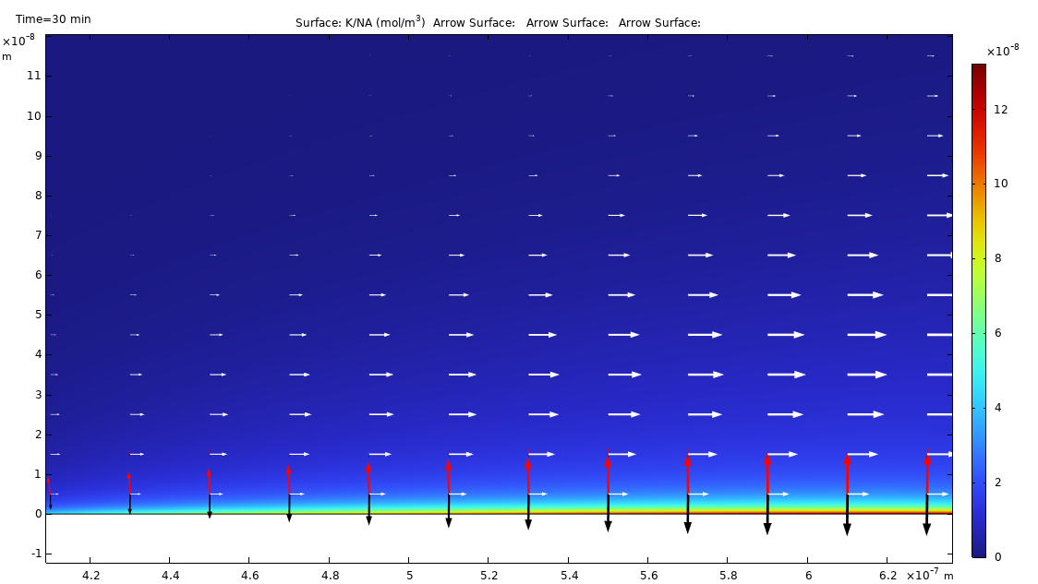
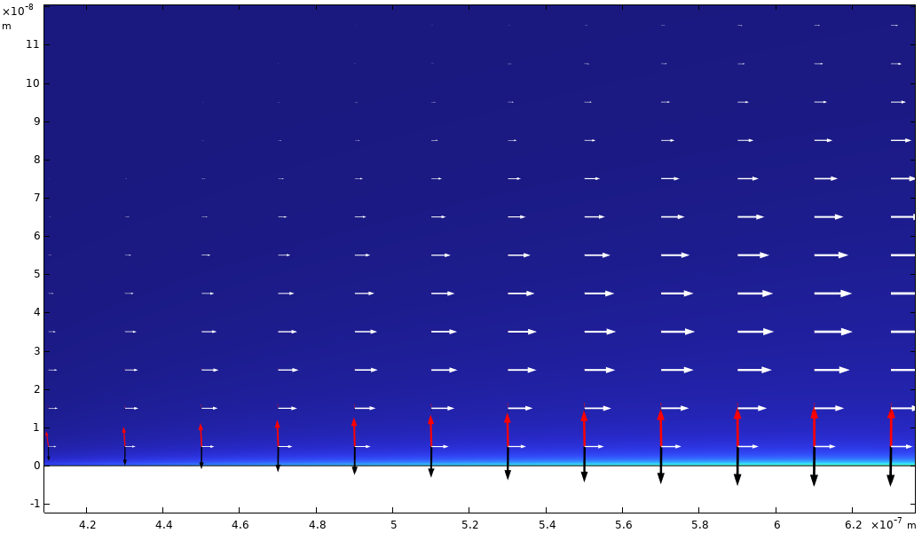

Results · K+ concentration gradients and ion-flux maps
K+ concentration gradients with diffusion, electromigration, and advection flux vectors near the reactive patch.
K⁺ ($\frac{mol}{m^{3}}$)
t = 50 min
t = 300 min
red · diffusion black · electromigration white · advection
Flow-induced surface charge heterogeneity & cation exchange kinetics · S. Shahror, Y. Mishael, N. Schwartz · HUJI
7 / 13

Slide 10
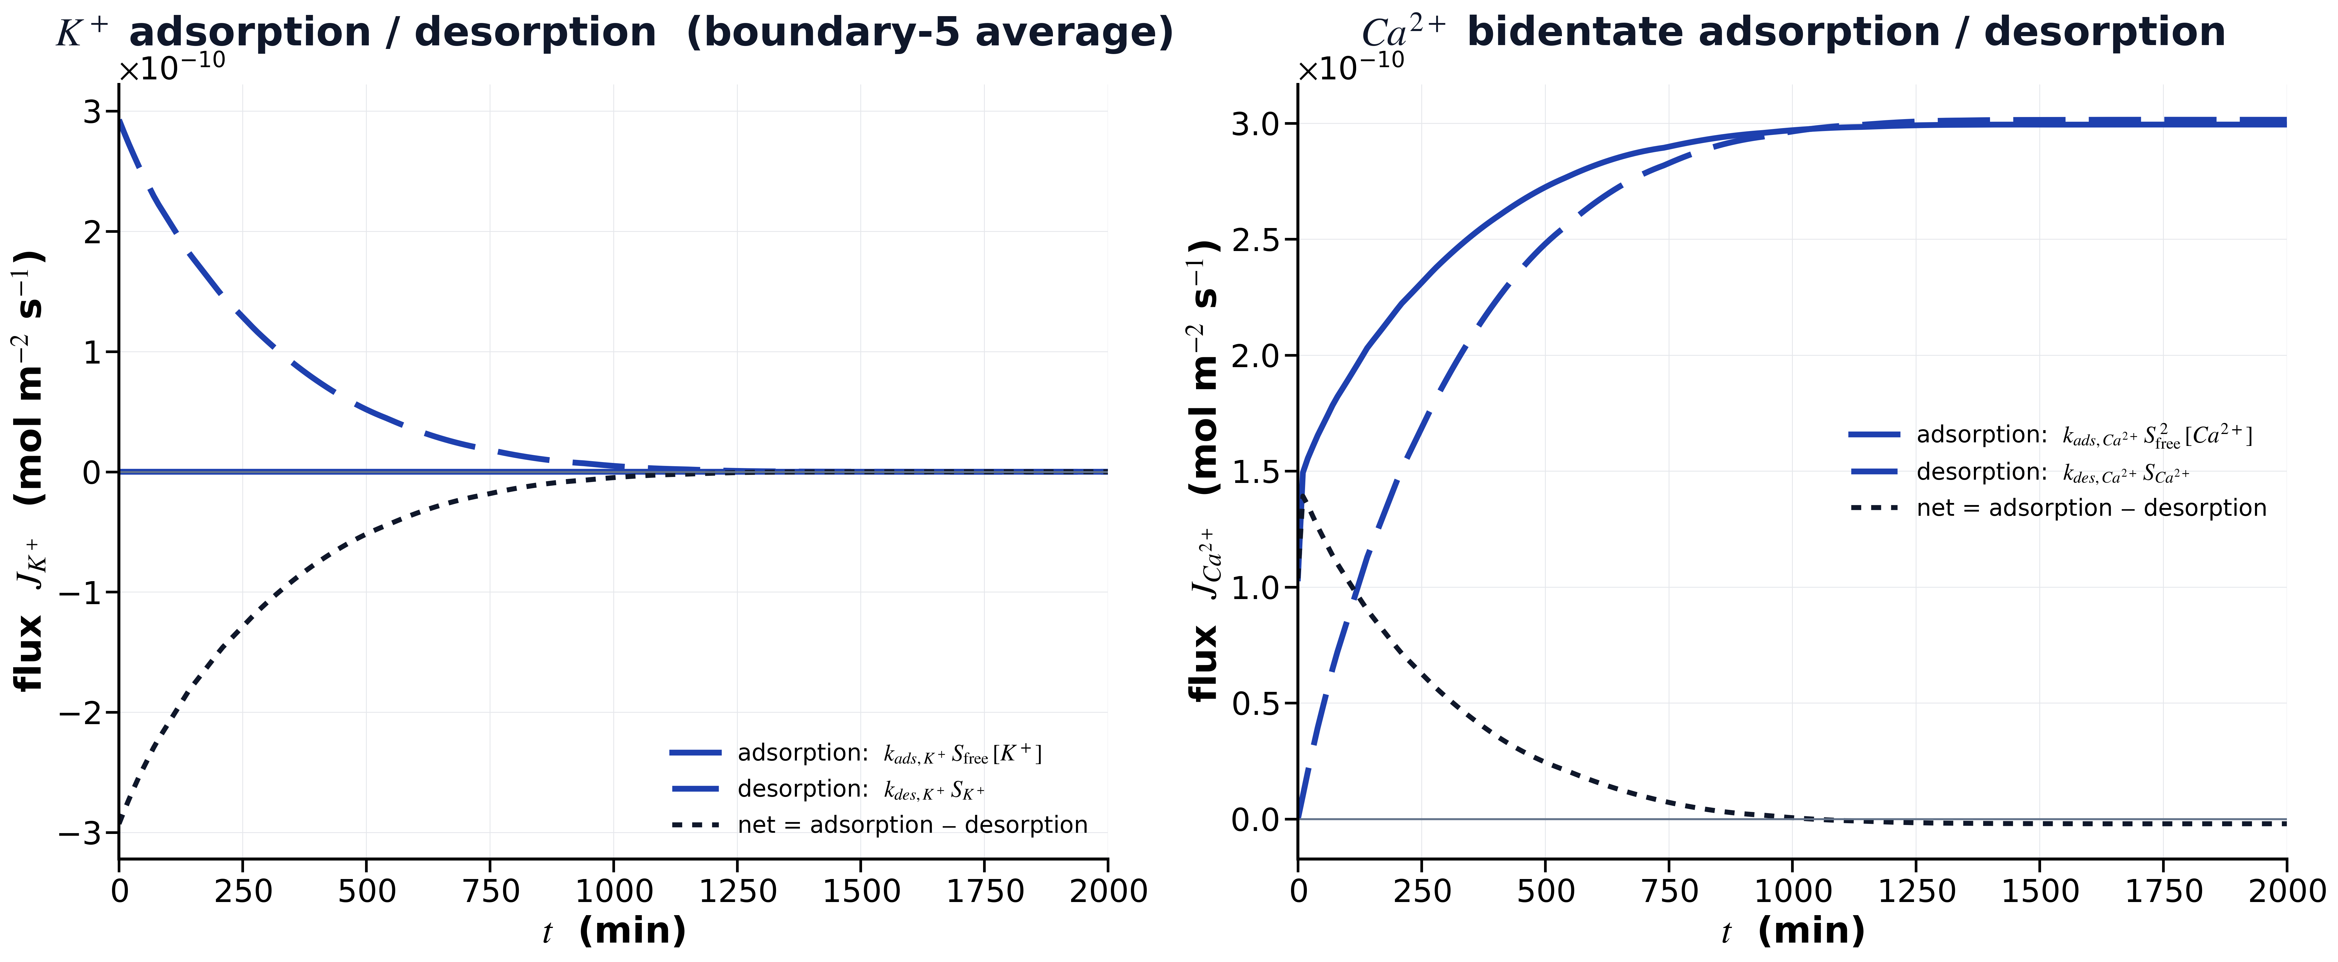
Results · Surface Kinetics
K⁺ and Ca²⁺ desorption and re-adsorption rates. The 1000-min mark is the kinetic window.
• (a): K⁺ adsorption/desorption rate over time at the surface.
• (b): Ca²⁺ adsorption/desorption rate over time at the surface.
Flow-induced surface charge heterogeneity & cation exchange kinetics · S. Shahror, Y. Mishael, N. Schwartz · HUJI
8 / 13

Slide 11
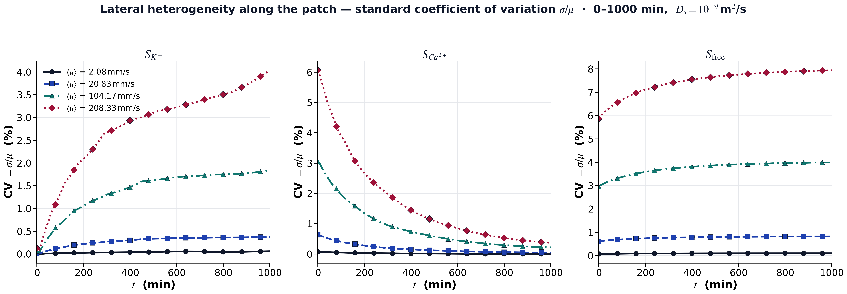
Results · Surface heterogeneity along the reactive patch
Coefficient of variation (CV) computed along the reactive patch for $S_{K^{+}}​$​, $S_{Ca^{+2}}$​ and $S_{free}​$.
Heterogeneity increases with flow velocity for all surface species.
$S_{Ca^{2+}}$and $S_{free}$develop the strongest spatial variability along the reactive patch.
Flow-induced surface charge heterogeneity & cation exchange kinetics · S. Shahror, Y. Mishael, N. Schwartz · HUJI
9 / 13

Slide 12
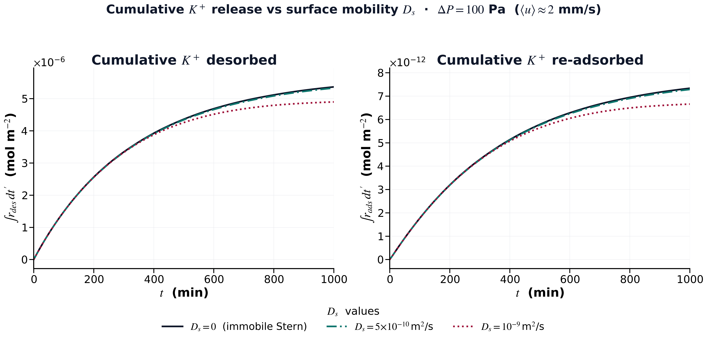
Results · Surface exchange dynamics under flow
Cumulative K+ desorption and re-adsorption for different surface mobilities ($D_{s}$)
Flow-induced surface charge heterogeneity & cation exchange kinetics · S. Shahror, Y. Mishael, N. Schwartz · HUJI
10 / 13

Slide 13
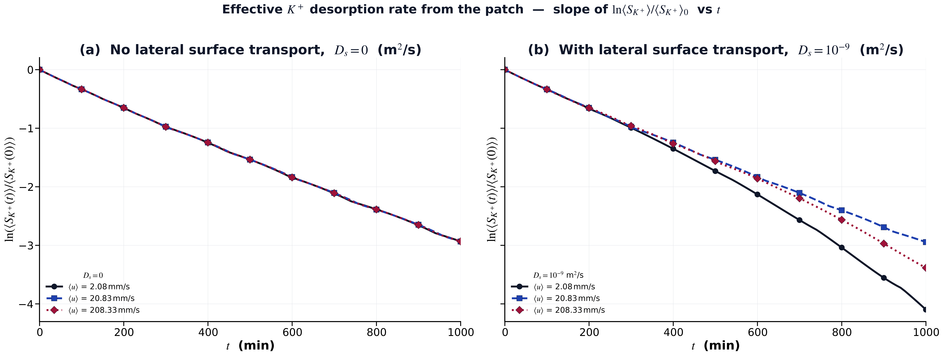
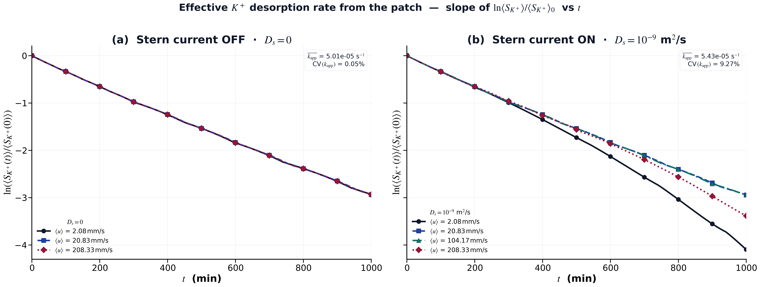
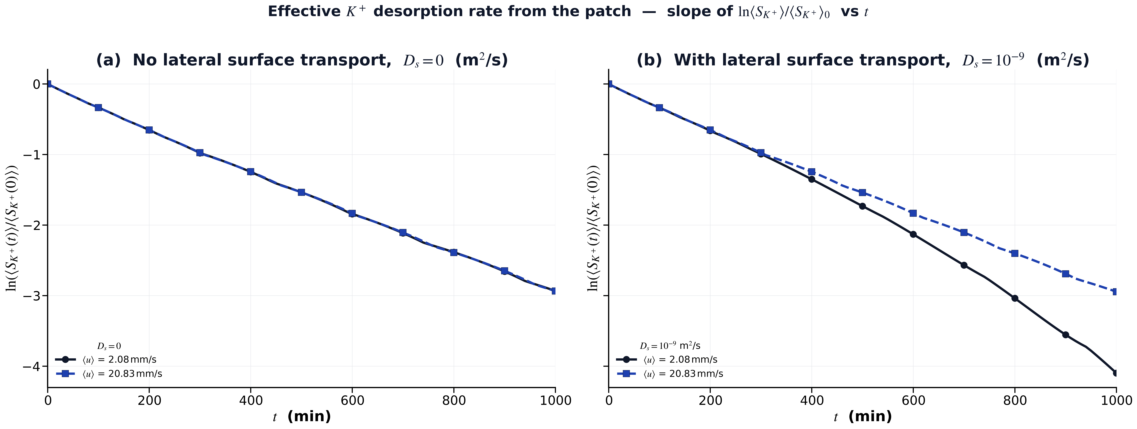



Flow-dependent apparent desorption kinetics
Desorption rate coefficient for different flow velocities.
(a) No lateral surface transport, $D_{s}=0$
(b) With lateral surface transport, $D_{s}=10^{−9}\frac{m^{2}}{s}$
Without lateral surface transport ($D_{s}=0$), the apparent desorption rate is nearly flow-independent.
Enabling surface transport introduces strong flow dependence in the fitted apparent kinetics.
Flow-induced surface charge heterogeneity & cation exchange kinetics · S. Shahror, Y. Mishael, N. Schwartz · HUJI
11 / 13

Slide 14
Conclusions · interpreting fitted kinetic rates
Three key observations from the coupled model
Flow changes the local chemical environment along the reactive patch, altering both ion distributions and surface composition.
Surface heterogeneity is generated by the coupled system, rather than imposed as a fixed surface property.
Apparent kinetic coefficients are not purely intrinsic and may include contributions from transport-coupled interfacial dynamics.
Flow-induced interfacial heterogeneity affects the measured exchange kinetics.
Flow-induced surface charge heterogeneity & cation exchange kinetics · S. Shahror, Y. Mishael, N. Schwartz · HUJI
12 / 13

Slide 15
Thank you
Questions, comments, ideas are welcome.
shahar.shahror@mail.huji.ac.il

