Slide 1


A new experimental approach for the analysis of surface energies in porous ceramic membranes for hydrogen applications
Interpore 2026
Claudiu Savulescu^{1,2}, Anne Timmermans^{1,2}, Diletta Giuntini^{1,2}, Joris Remmers^{1,2}, Maja Ruecker ^{1,2,3,*}
1 Eindhoven University of Technology
2 Eindhoven Institute For Renewable Energy Systems
3 Max Planck Institute for Polymer Research
*m.rucker@tue.nl
Mechanical Engineering, Energy Technology

Slide 2
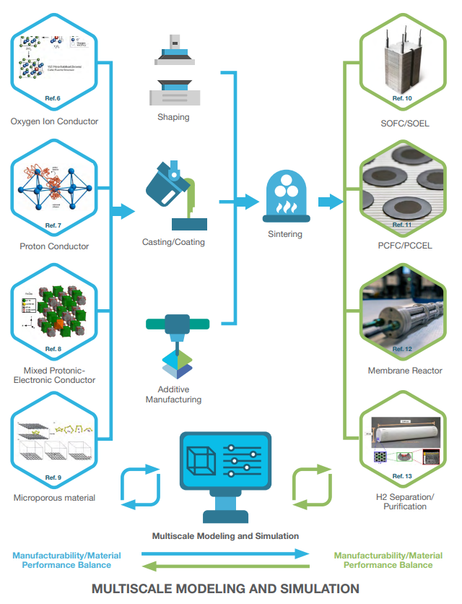
Ceramic membranes for hydrogen separation
(Giuntini, Ivanova, Ruecker, 2025, HER)

Slide 3
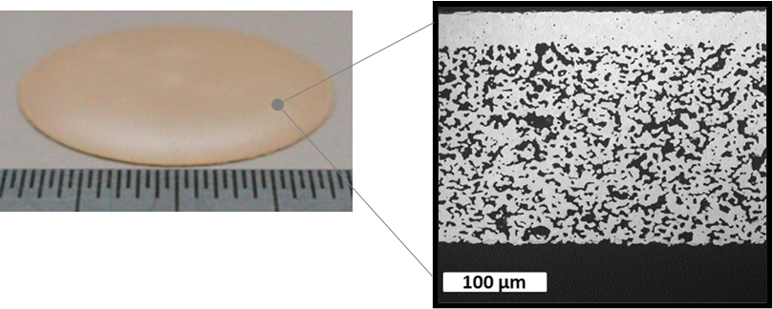
Ceramic membranes for hydrogen separation

Slide 4
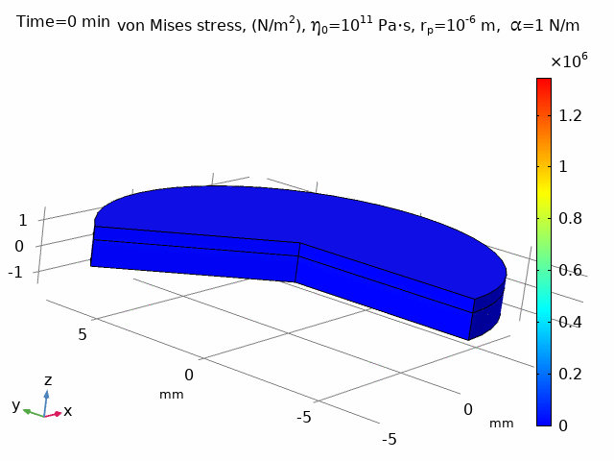
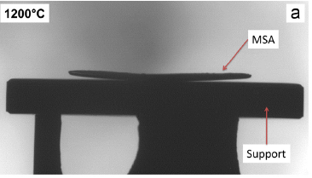
Ceramic membranes for hydrogen separation

Slide 5
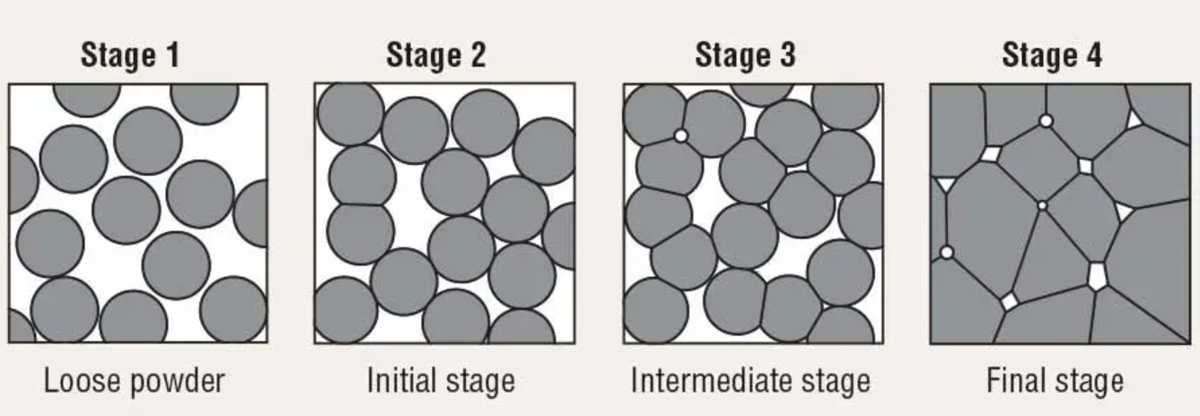
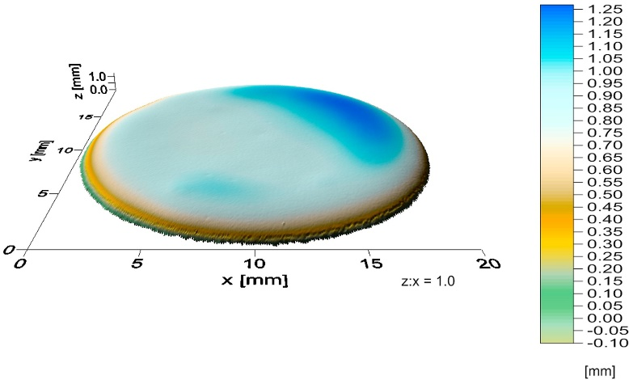
Surface energy minimization: the driving force

Slide 6
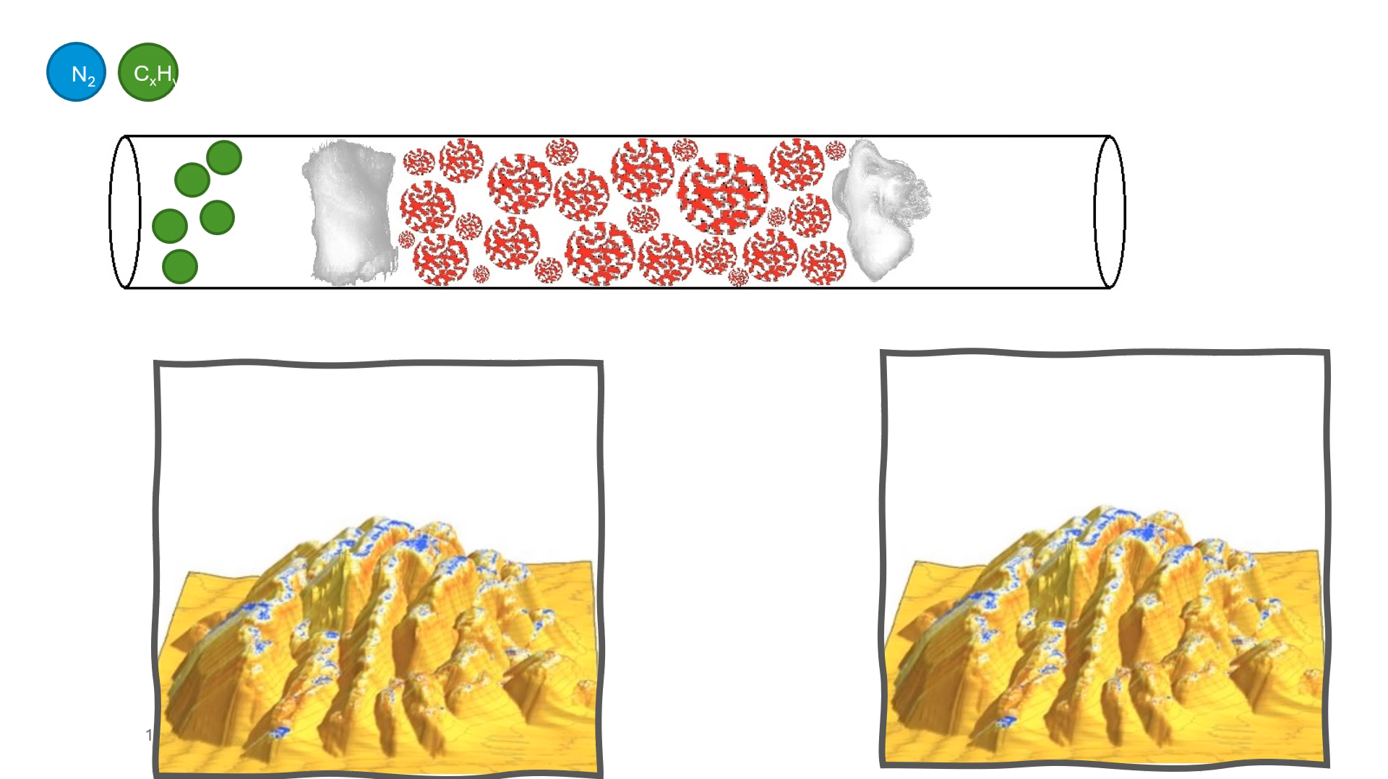
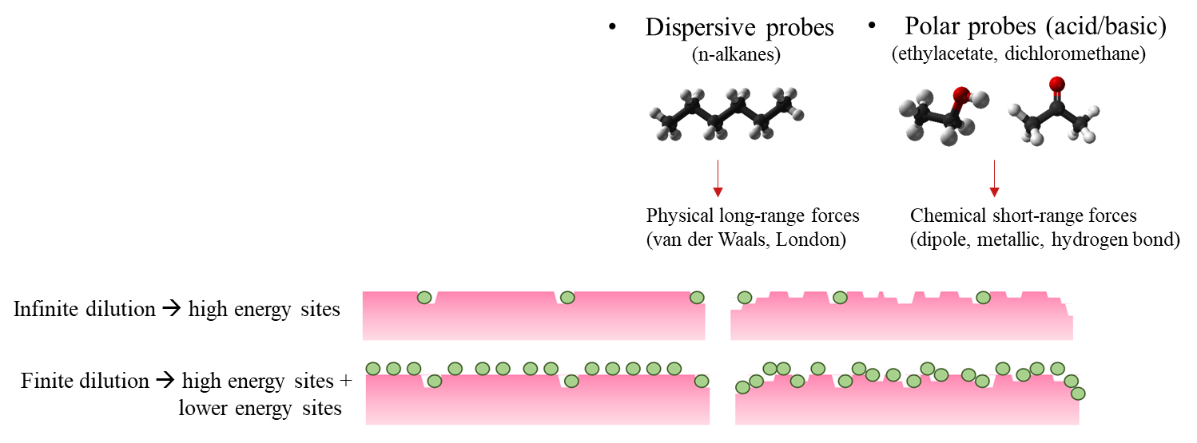
Inverse gas chromatography – a technique to measure surface energies

Slide 7
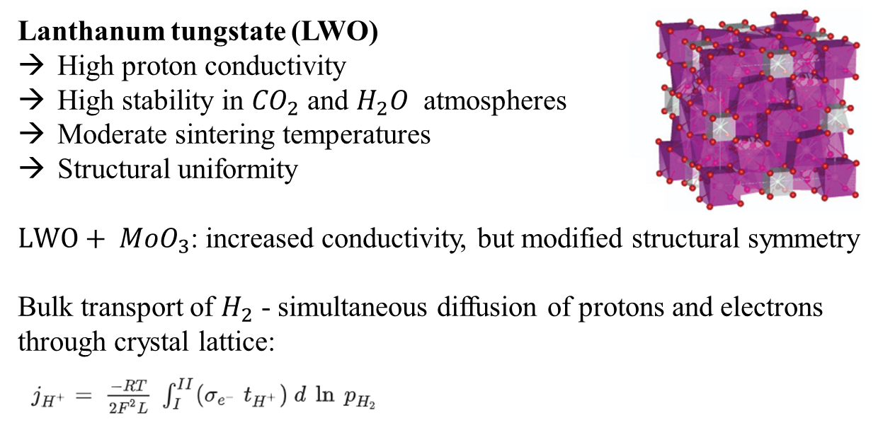
Langthanum Tangstate – our test material
(Magraso et al., 2009, Dalton Trans.)

Slide 8
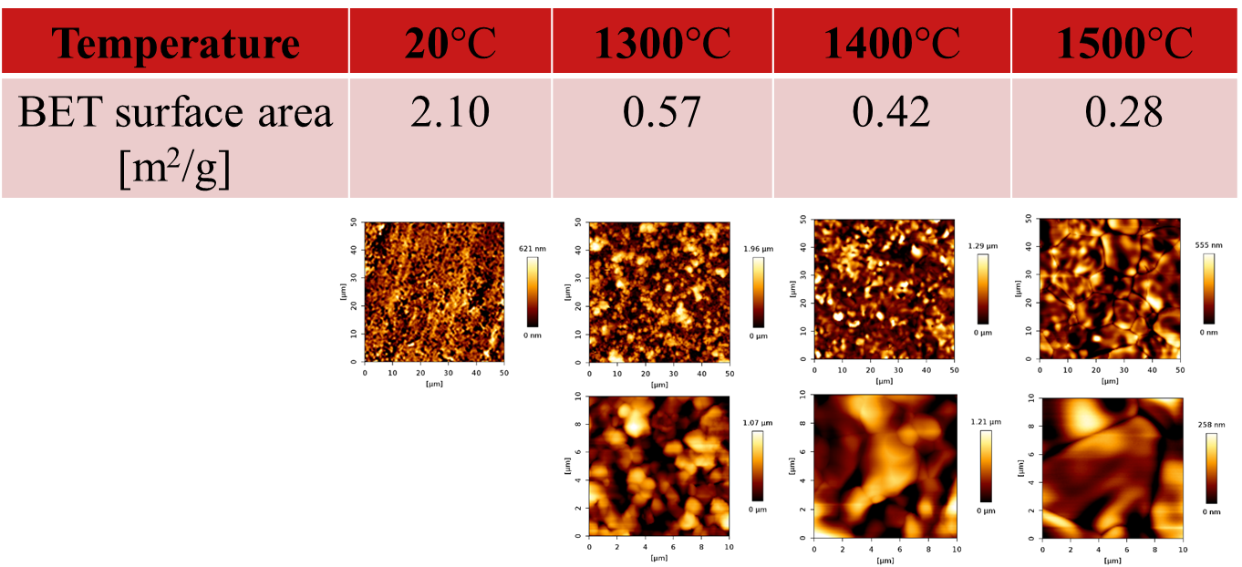
Surface area changing during sintering

Slide 9
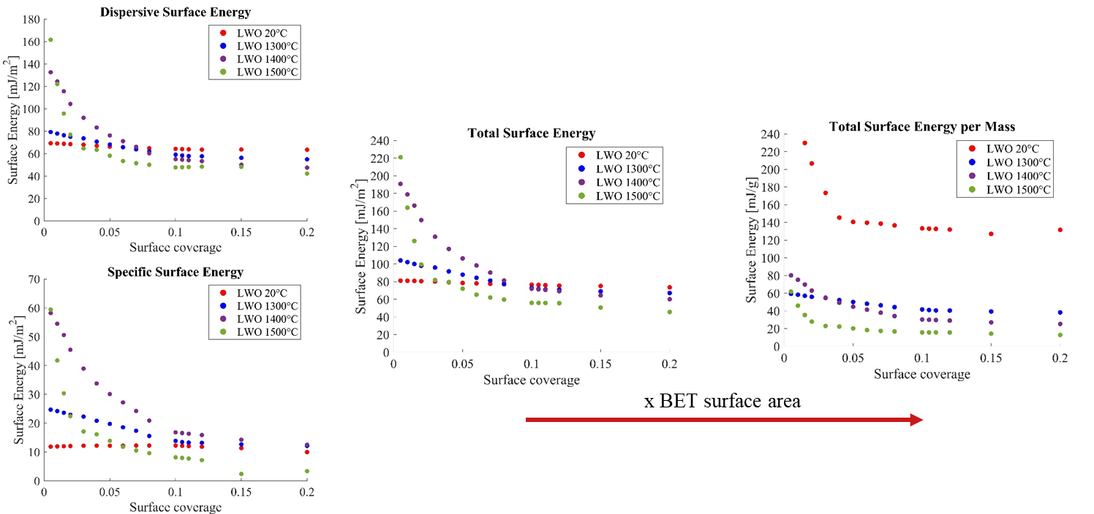
Surface energy changing during sintering

Slide 10
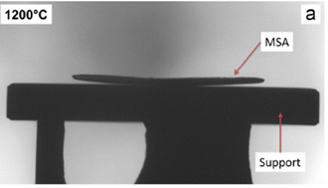
Conclusions
We are able to observe surface energy minimization during sintering with iGC:
surface area of the particles decreases with increasing sintering temperature
surface energy distributions vary, indicating a change in the crystalline assembly at the surface
The goal:
Identify driving physics, to predict membrane performance from the initial powder composition

Slide 11

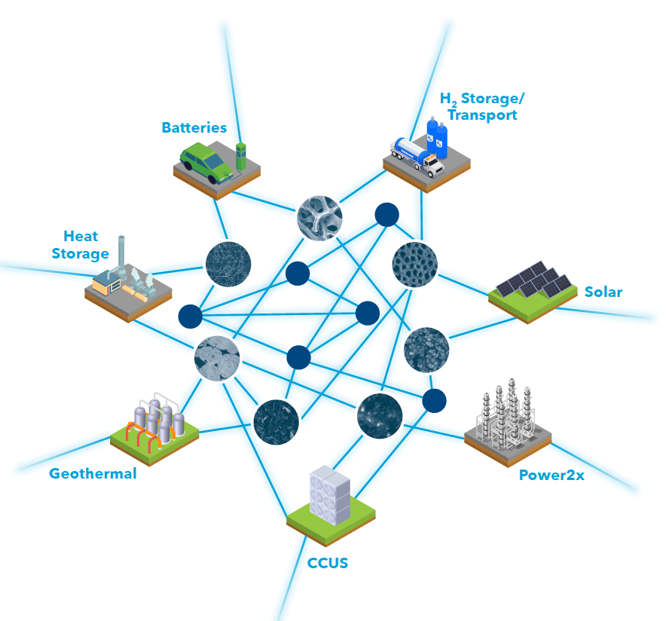
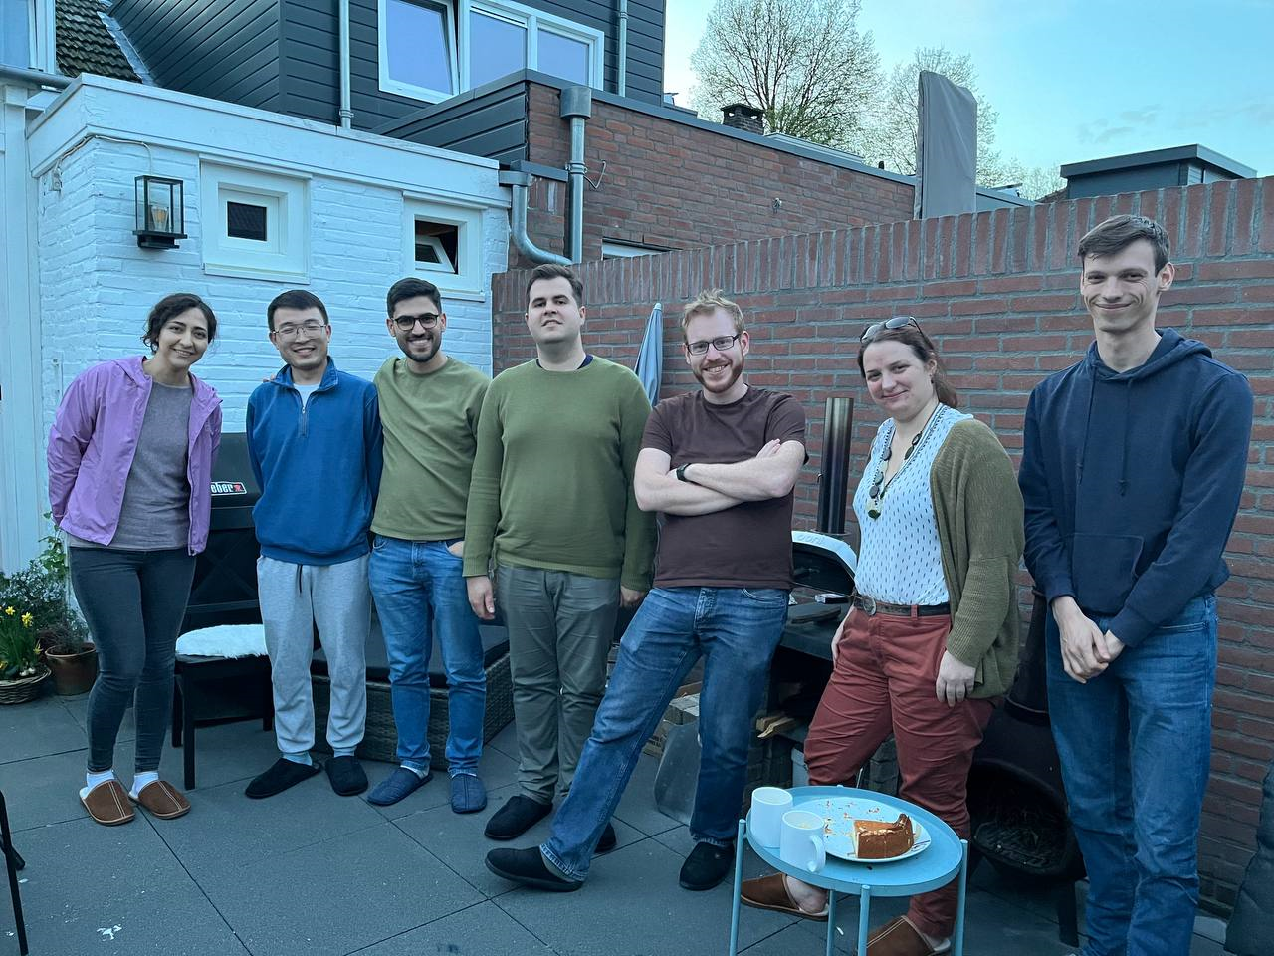
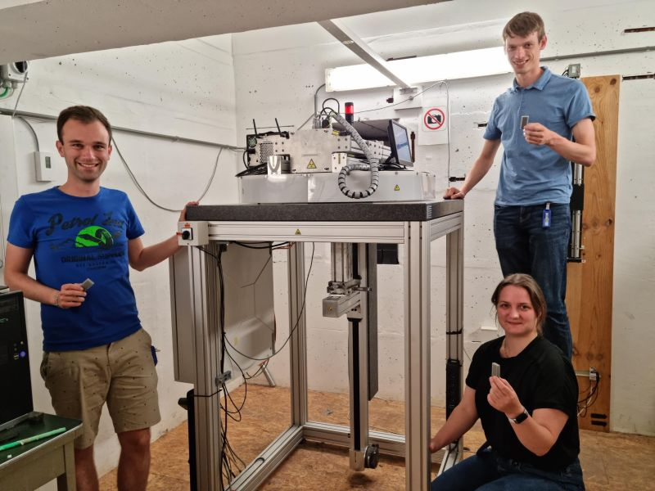
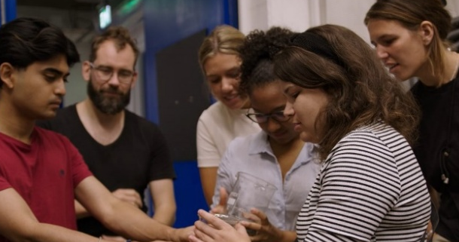







MOPS: Multiscale Operations in Porous Systems Thank you for listening!

Slide 12
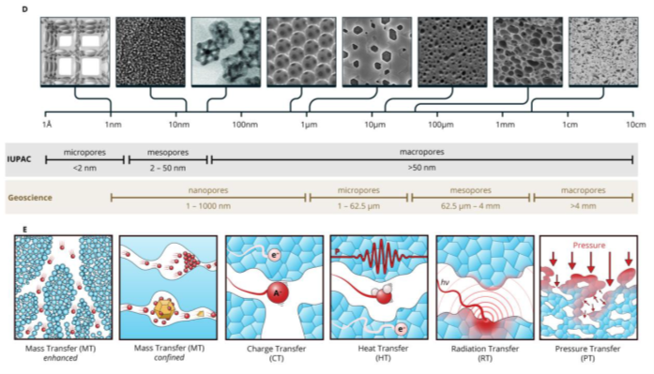
Porous materials for energy applications
(Faber et a., Science, 2025)

