Slide 1



Evaporation of Microfluidic Pore Networks with Formation of Colloidal Liquid Bridges
Jinchi Zhang, Rui Wu, Evangelos Tsotsas, Abdolreza Kharaghani
Otto von Guericke University Magdeburg
4-6 March 2026
DECHEMA-Haus, Frankfurt am Main
Notes:
Hello everyone! Today, I’d like to share our research on Evaporation of Microfluidic Pore Networks with Formation of Colloidal Liquid Bridges

Slide 2
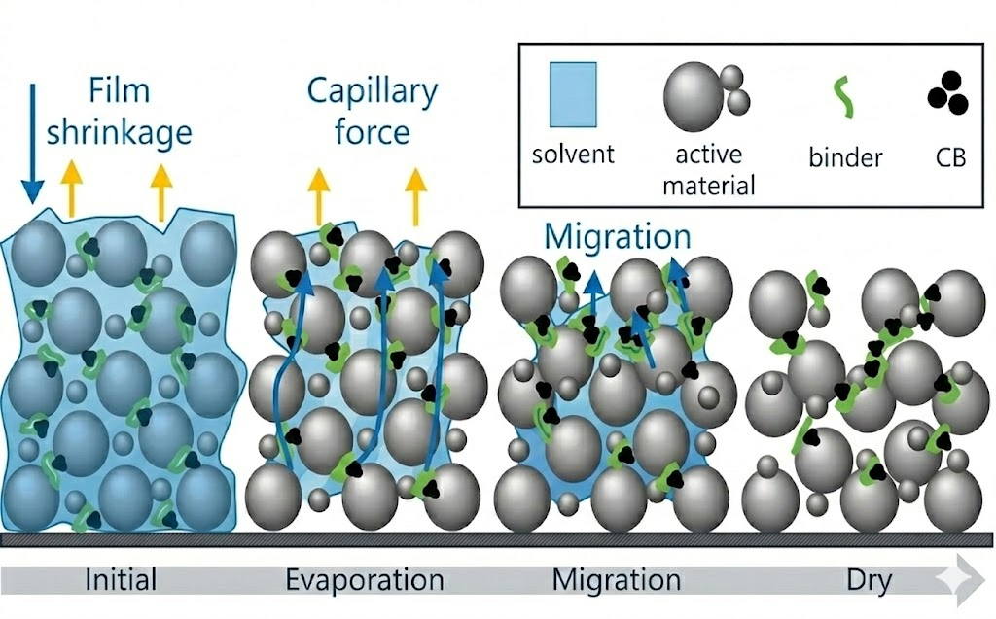
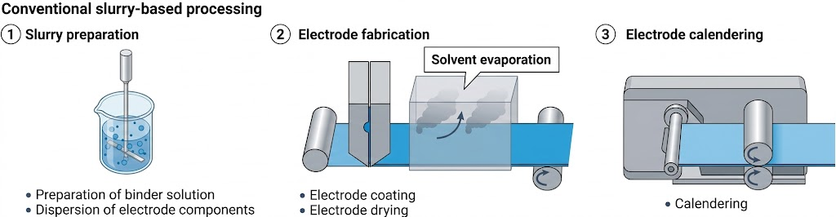
Introduction
Drying of particle-containing liquids is a common step in many industrial processes.
During drying, evaporation drives particle migration and non-uniform deposition, which directly affects the final microstructure.
Understanding this process is important for controlling material properties.
Notes:
Drying particle-containing liquids is a common step in many industrial processes.
During drying, evaporation causes particles to move and deposit unevenly, which directly affects the final microstructure.
Battery electrode preparation is a good example. During drying of a wet electrode, the active material first form a porous framework, while the remaining solutes continue to move inside. Their final deposition determines the electrode’s structure, mechanical property, and electrochemical performance.
Therefore, understanding how particles move during evaporation is a key scientific basis for improving electrode manufacturing quality.

Slide 3
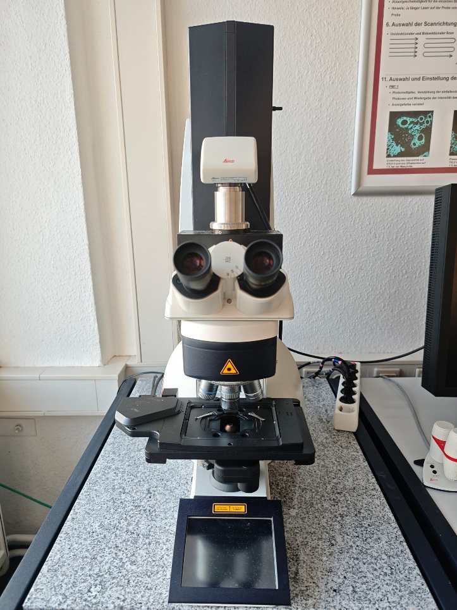
Experimental Setup
Materials: PDMS chips (20-30/30-40/40-50 μm, -charged); Carboxylated fluorescent particles (1 μm, -40mV); Aminated fluorescent particles (1 μm, +9mV)
Drying Conditions:
Drying rates: Ambient convection control (open/semi-closed/fully closed containers), corresponding to total drying time ≈ 20 min/1 h/4 h.
Particle concentration: 25, 50, 75 μg/mL
NaI concentration: 0.01M, 0.1M, 1M, 2M
Environment: Room temperature, indoor humidity
Observation: Optical microscope and Confocal Laser Scanning Microscope
CLSM
Notes:
To study how particles move and deposit in a porous medium during drying, we designed PDMS microfluidic chips and used two types of fluorescent particles with different charges.
After filling the chips with particle solution, we mainly observed the evaporation process using a confocal microscope. We controlled the drying rate by placing the chips in different containers to change convection. The resulting evaporation times were about 20 minutes, 1hour, and 4 hours.
Regular optical microscopes were mainly used to observe changes in the liquid phase, since particles are hard to see clearly with normal optical microscopes.

Slide 4
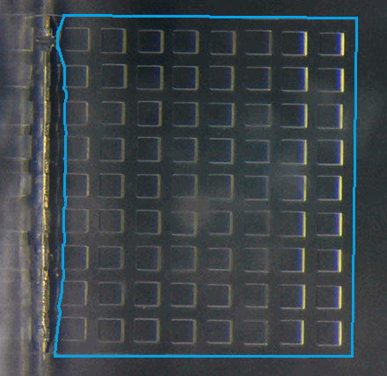
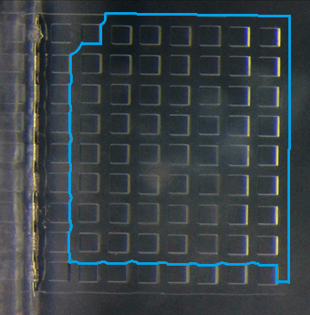
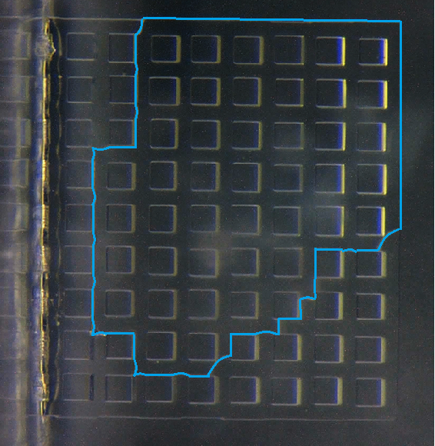
Results and discussion
Drying of pure water in PDMS chips
Opening
Pure water drying in chip: consistent gas invasion paths, reproducible phenomena
Capillary valve effect (gas phase preferentially enters larger pores), maintains consistent invasion paths
Only small channel size variations, different evaporation rates and local wettability alter the evaporation pathway
Example conditions: pure water, channels size 30–40 μm
Notes:
We first observed the drying of pure water in the chips without any particles.
We repeated the experiments at different drying rate and found that the movement of the gas–liquid interface was generally similar each time.
There are two main reasons for this behavior. First, the capillary valve effect: under the same conditions, the gas phase enters larger channels first, which keeps the invasion path mostly consistent. Second, because the channel sizes are not very different, small variations in evaporation rate and contact angle at different locations can slightly change the invasion path.
Overall, the gas phase invasion shows a similar global path but with some local differences.

Slide 5
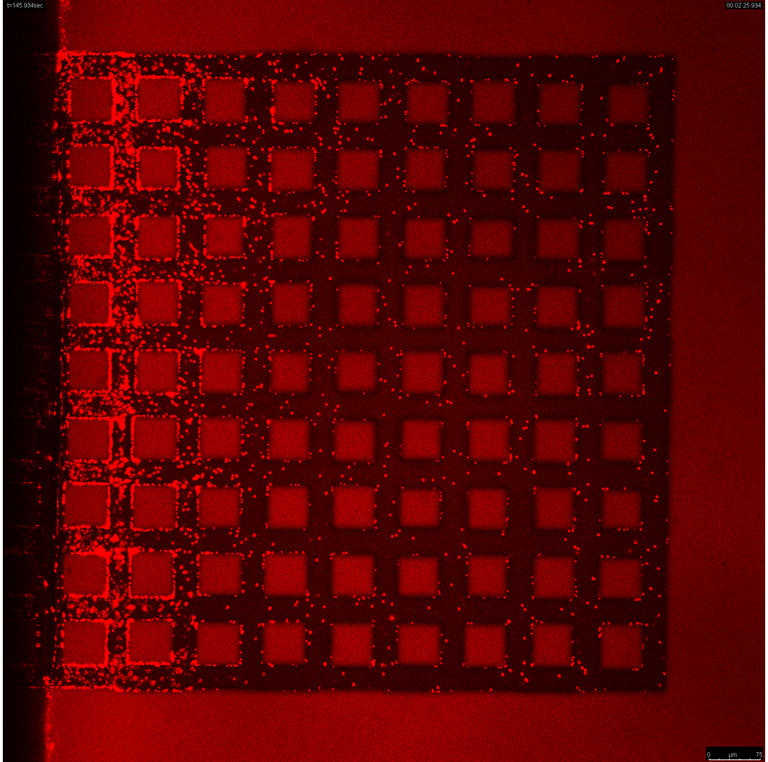
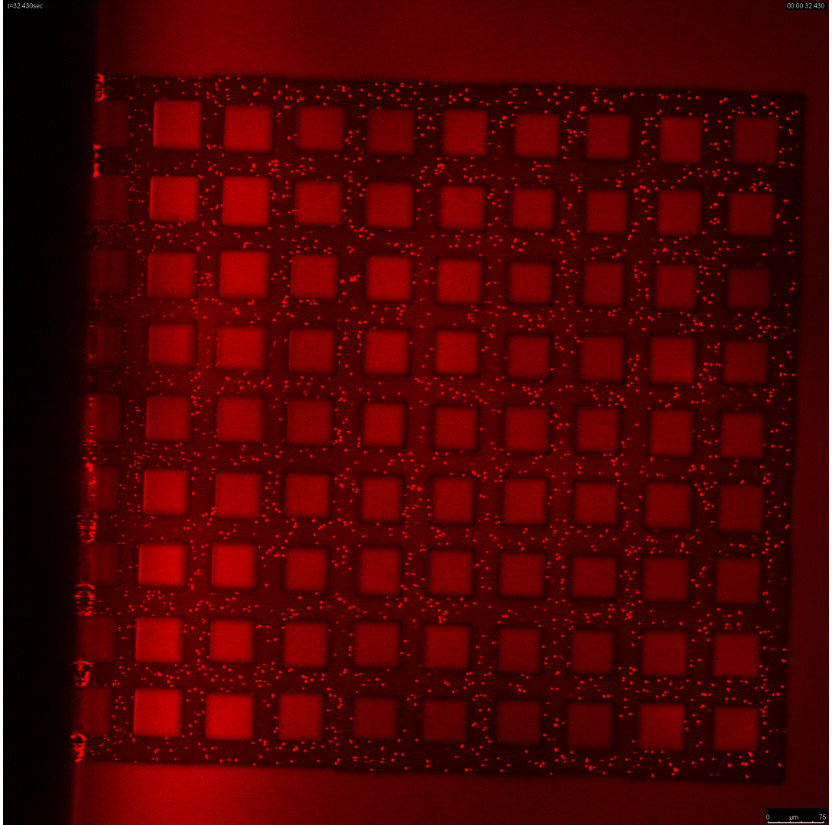
Results and discussion
Drying of aminated particle suspension in PDMS chips
Opening
Aminated particle suspension
Carboxylated particle suspension
Positively charged (+9mV)
Negatively charged (-40mV)
Opposite charge to the chip surface
Same charge as the chip surface
Notes:
When we performed experiments using positively charged particles, we observed that, compared with pure water evaporation, the evaporation paths became almost random and irregular, making the process difficult to reproduce. When the particles and the chip carried opposite charges, the particles were only pushed by the moving liquid–gas interface, eventually depositing nearby or adhering to the walls.
The drying process with carboxyl particles is more interesting. Although, like aminated particles, the evaporation paths were almost random and irreproducible compared with pure water, but we observed key differences. When the particles and the chip carried the same charge, the particles were not only pushed by the moving liquid–gas interface but also transported by the inner flow within the liquid. Moreover, particle deposition has distinct patterns, they mostly deposited at the intersections of two liquid–gas interfaces or after being isolated within the liquid.

Slide 6
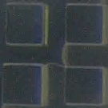
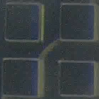
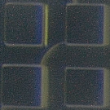
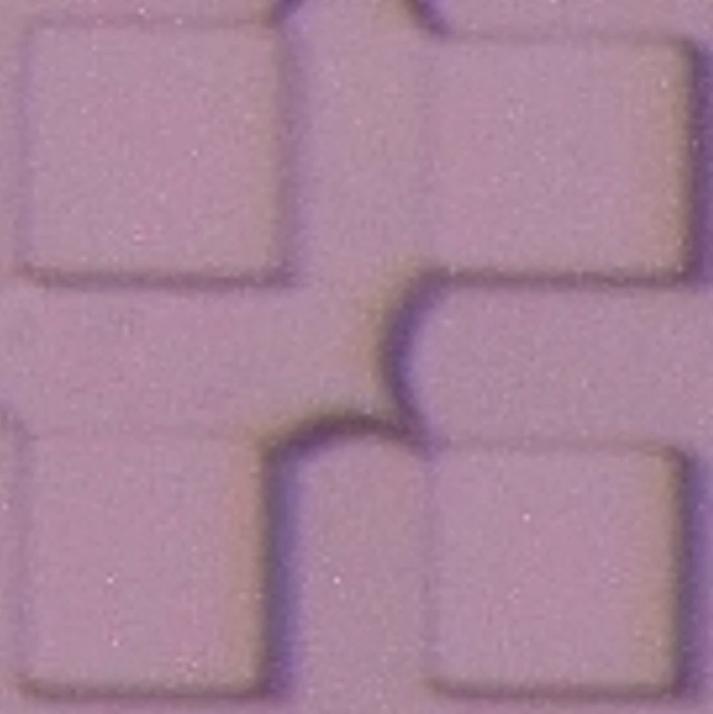
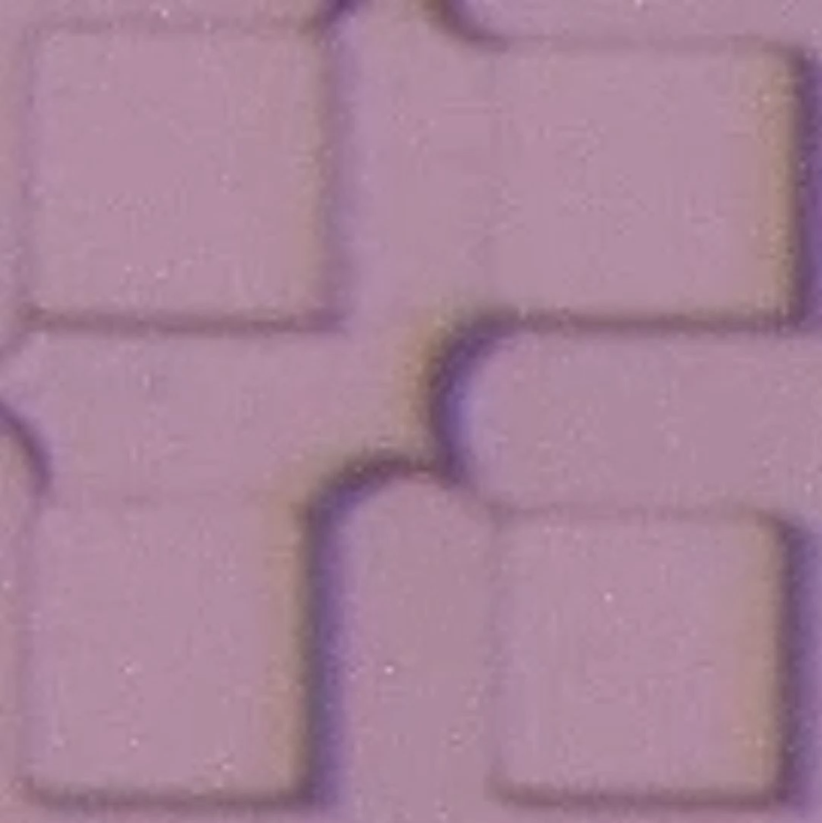
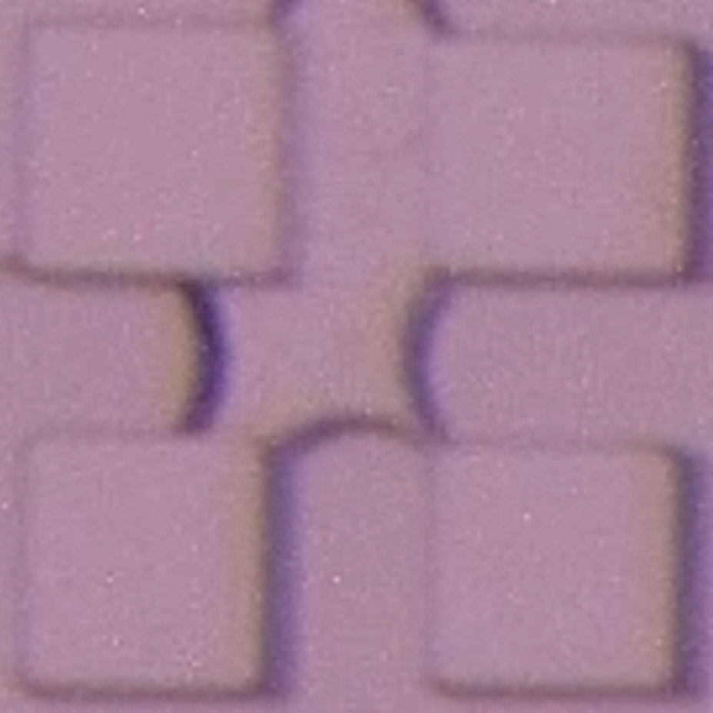
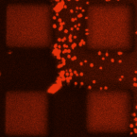
Results and discussion
The existence of colloidal liquid bridges
pure water
t = 0 s
t = 15 s
t = 74 s
with particle
t = 0 s
t = 42 s
t = 249 s
Colloidal liquid bridges affect the gas-liquid phase displacement.
Notes:
It is interesting to note that during the evaporation of the carboxylated particle suspension, the change in gas–liquid phase distribution is actually influenced by the presence of colloidal liquid bridges.
As we can see here, the colloidal liquid bridge stops the gas invasion and forces it to take another path. It’s totally different form pure water group, where the liquid bridge breaks fast.
So, colloidal liquid bridges represent a new feature in evaporation within porous media, and they are the main focus of the following part of this work.

Slide 7
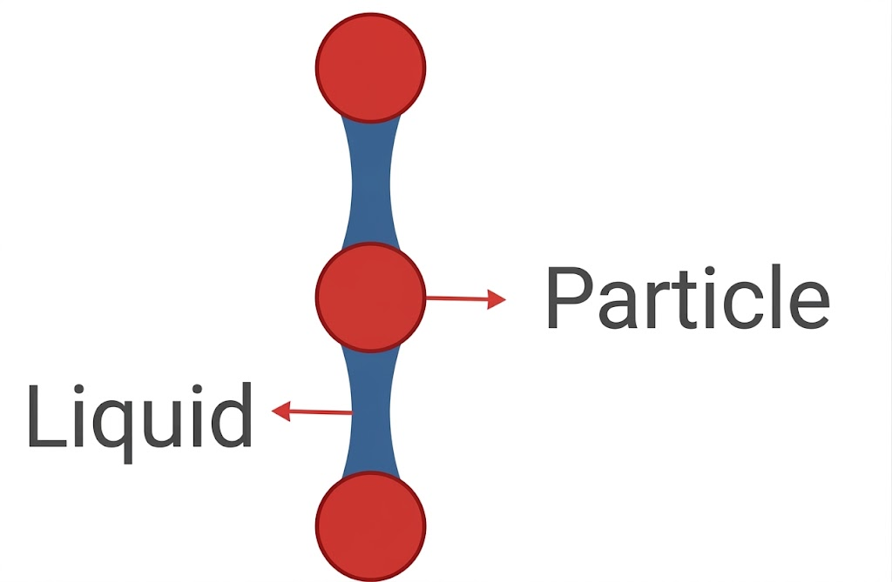
Results and discussion
Mechanism of formation of colloidal liquid bridges
Solid
Gas
Solid
Gas
Liquid
Liquid
Particle clusters hinder the movement of the gas-liquid interface
High capillary pressure between interparticle liquid bridges prevents gas invasion
The formation of colloidal liquid bridges forces the gas phase to instead invade pore or throats at other locations
Notes:
As colloidal liquid bridges play a crucial role in evaporation within porous media, understanding their formation mechanism is therefore essential. From our experimental, we found that when two gas–liquid interfaces approach each other vertically, densely packed particles near the interfaces create steric hindrance. This restricts both particle movement and interface motion, and trapping particles between the two interfaces. This is because gaps between particles are much smaller than the pore or throats, so when gas tries to invade these tiny gaps between particles, it experiences very high capillary pressure, preventing gas further invasion. This leads to the formation of a stable colloidal liquid bridge. Once a colloidal liquid bridge is formed, it forces the gas to invade other pore or throats instead of this location.

Slide 8
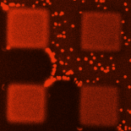
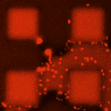
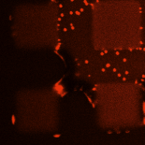
Results and discussion
The Role of Interparticle Force
C_{NaI} = 10 mM
C_{NaI} = 100 mM
C_{NaI} = 2 M
At low ionic strength, interparticle repulsion maintains particle spacing, allowing the assembly to resist liquid bridge rupture through compression and rearrangement.
With increasing ionic strength, electrostatic repulsion is gradually screened, interparticle force shifts from repulsion to attraction. Intense particle aggregation suppresses colloidal liquid bridge formation.
Notes:
However, during the evaporation of aminated particle suspensions, similar structures of particle accumulation at the interface can also be found, but the formation of stable colloidal liquid bridges is rarely observed. We believe that this is related to the particle interactions. To test this, we added sodium iodide to tune the particle interaction.
At low ionic strength, interparticle repulsion maintains particle spacing, allowing the assembly to resist liquid bridge rupture through compression and rearrangement.
With increasing ionic strength, electrostatic repulsion is gradually screened, interparticle force shifts from repulsion to attraction. At 100 mM ionic strength, particles start to form loose or partial aggregates, and liquid bridges can form between particle aggregates. At higher salt concentration, the attraction becomes too strong that particles rapidly form dense and irreversible aggregates, hinder the formation of colloidal liquid bridges.

Slide 9
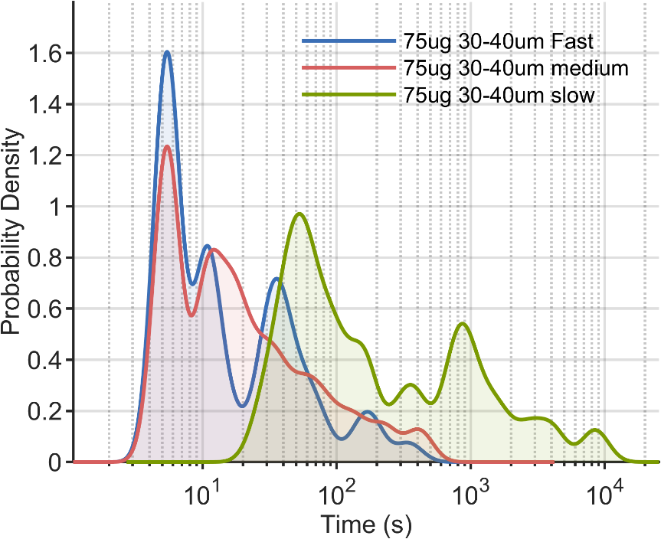
Results and discussion
Factors influencing colloidal liquid bridges
The particle concentration at the gas–liquid interface directly influences the formation of colloidal liquid bridges.
Evaporation rate mainly determines the particle concentration at the gas–liquid interface.
The evaporation rate affect the lifetime of colloidal liquid bridges: slower evaporation significantly prolongs it, while fast and intermediate evaporation yield similar lifetimes.
Notes:
And the main factor influencing the formation of colloidal liquid bridges is the particle density at the gas–liquid interface. The higher the particle concentration near interfaces, the more likely a colloidal liquid bridge will form.
The particle density at the interface is strongly affected by the evaporation rate. Particles can be transported to the interface by internal flows generated by evaporation, or they can be captured by the moving interface itself. Increasing the evaporation rate promotes both of processes.
And evaporation rate also affects the lifetime of colloidal liquid bridges. As shown in the figure, under slow drying conditions, colloidal liquid bridges live significantly longer, while under the other two conditions, their lifetimes show only little difference. This suggests that bridge lifetime is controlled by a certain critical condition, which is related to the evaporation rate.

Slide 10
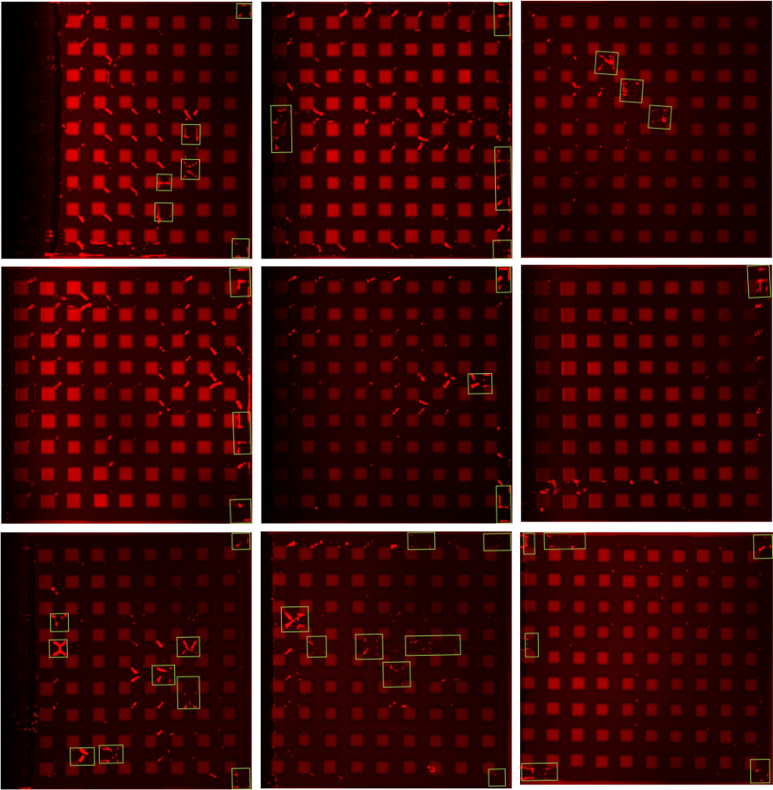
Result and discussion
Impact of colloidal liquid bridges on deposition patterns
75ug/L
25ug/L
Particles are primarily deposited through two ways.
Formation and rupture of colloidal liquid bridges
Fast
Formation of isolated liquid clusters.
Lower evaporation rate and concentration suppress linear-shaped deposition.
Slow
Under slow evaporation, deposition via isolated liquid clusters increases.
Notes:
The presence of colloidal liquid bridges also affects the final particle deposition. There are two main deposition ways related to the colloidal liquid bridge. Fist one is through the formation and rupture of the bridges, which can be seen at the corner of microcolumn. And the other one is through the formation of isolated liquid clusters, which can be seen inside the green box.
This deposition process is also influenced by evaporation rate and particle concentration. Experiments show that when evaporation rate and particle concentration decrease, the number of linear-shape deposition is reduced. On the other hand, under slow evaporation, more particles deposit through forming isolated liquid clusters.

Slide 11
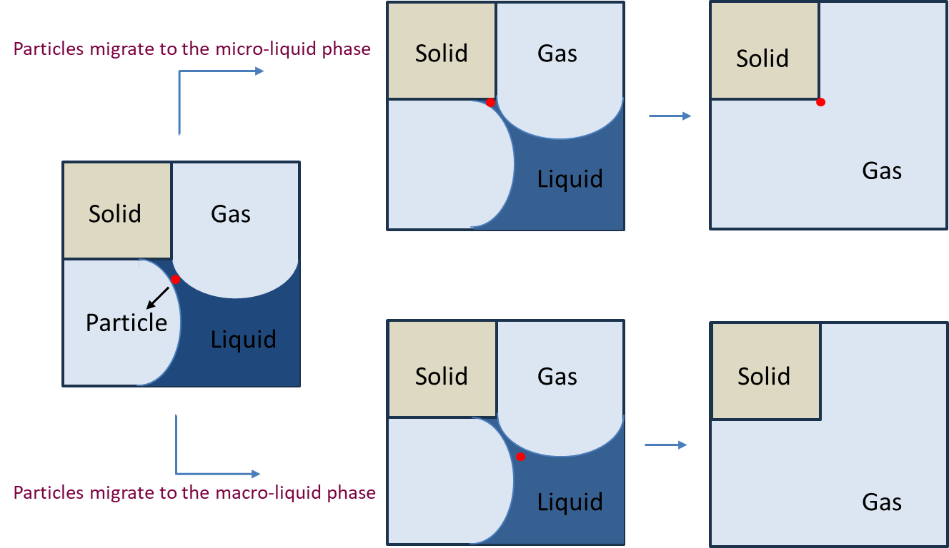
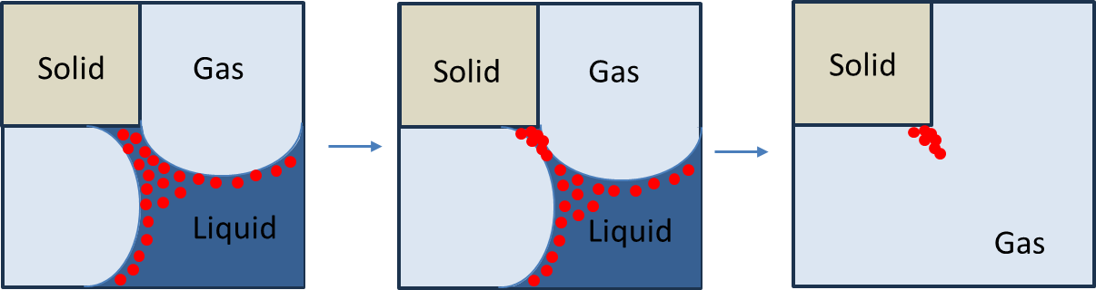
Results and discussion
Mechanisms of particle deposition
Low particle density at the gas–liquid interface
High particle density at the gas–liquid interface
Notes:
Let’s use a simple model to explain how liquid bridges affect particle deposition.
As you can see in the slide, when the particle concentration at the interface is low, particles between two gas–liquid interfaces can move around quite freely. If a particle moves toward to the solid, it will likely deposit there, forming a point-like deposition. But if it moves toward the bulk liquid region, no deposition occurs there.
And when the particle concentration is high, colloidal liquid bridges will form. When these bridges break, some particles are left, resulting in linear-shaped deposition.

Slide 12
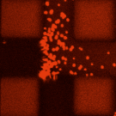
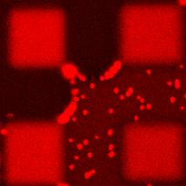
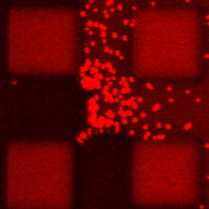
Results and discussion
Effect of evaporation rate on meniscus curvature
Fast
Slow
decrease in the curvature
of the gas-liquid interface
Solid
Gas
Solid
Gas
Liquid
Liquid
Example conditions: particle concentration 75 μg/ml, channels size 40–50 μm
Notes:
In addition, evaporation rate affects particle deposition not only by changing the particle concentration at the interface, but also by influencing the curvature of the gas–liquid interface. As shown in the slide, we clearly observed that the curvature of the interface increases as the evaporation rate increases. A higher curvature means that when two gas–liquid interfaces approach each other vertically, the volume where they interact is larger, allowing more particles to be accommodated. This also increases the likelihood of forming colloidal liquid bridges, which can lead to more particle deposition.

Slide 13
Results and discussion
The effect of variations in evaporation rate
Gas
Gas
P_{b}
P_{g}
P_{b}
P_{g}
P_{a}
P_{a}
Capillary Flow
Capillary Flow
Liquid
Liquid
Fast Evaporation
Slow Evaporation
For both case
Evaporation rate: v_{a} < v_{b} (lower mass transfer resistance in b)，the descending interface is in a (not in b), due to the capillary valve effect.
Liquid is transported from a to b, faster liquid transport from a to b enlarges both the a-b pressure drop and the interfacial pressure difference at b.
$According to ΔP=σ·K$, an increase in interfacial pressure difference leads to an increase in liquid-gas interface curvature.
Notes:
We can understand why a faster drying rate gives a larger interface curvature as follows. As shown in the figure, evaporation rate at a is larger than b, due to the lower mass transfer resistance. But the interface that moves down is a, because of capillary-valve effect.
As a result, liquid flows from a to b, faster liquid transport from a to b enlarges both the a-b pressure drop and the interfacial pressure difference at b.
According to the Young–Laplace equation, a larger pressure difference means a larger interface curvature. Therefore, faster evaporation leads to a larger interface curvature.

Slide 14
Summary
Particles strongly influence evaporation by altering gas-phase invasion into the liquid. The formation and rupture of colloidal bridges temporarily stabilizes the gas–liquid interface, hindering its motion and redirecting the invasion pathway.
Moderate interparticle repulsion is necessary for colloidal liquid bridge formation. Their formation and rupture are mainly controlled by particle concentration at the gas–liquid interface, which depends strongly on the evaporation rate.
Colloidal liquid bridges govern final particle deposition—through formation and rupture at high evaporation rates, and through the formation and full drying of isolated liquid clusters at low evaporation rates.
Notes:
In summary, this study gives us several conclusions.

Slide 15


Thank you for your attention!
By: Jinchi Zhang (jinchi.zhang@ovgu.de)
www.tvt.ovgu.de

