Slide 1
Improving the Representation of Mineral Nucleation in Reactive Transport Models
Helge Hellevang¹, Mohammad Nooraiepour¹, Cornelius Fischer²,
Sergi Molins³, Nikolaos Prasianakis⁴
1. University of Oslo
2. Helmholtz Zentrum Dresden
3. LBNL
4. PSI

Slide 2
Background
In macroscopic RT-models, surfaces are considered uniform with averaged properties. When considering neo-formation of minerals, mineral nucleation models, such as the classical nucleation theory (CNT) is also macroscopic and averaged.
The substrate is on the other hand NOT uniform, and we know that microscopic (nanoscopic) features to various extent control rates of heterogeneous nucleation.
At present – both deterministic or probabilistic nucleation models are used to estimate extent of nucleation and crystal growth in pore- and continuum-scale numerical models – none of these are taking into account the sub-microscale features that may explain the macroscopic rate of nucleation, and observed macroscopic variations.

Slide 3
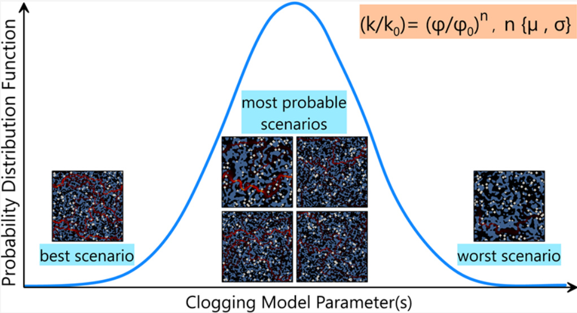
Background
A deterministic nucleation model:
All nucleation parameters have fixed values for one specific surface.
All (macroscopically) identically surfaces will always get the same number of nuclei.
In pore-scale reactive transport model, each node will have a nucleation rate determined by the local T, Ω, etc.
A probabilistic nucleation model:
Each surface area will have a probability of nucleation, but nucleation is not guaranteed as is the case with the deterministic model.
The probability is calculated based on CNT (different models exists)
Monte-Carlo simulations using a probabilistic model may provide uncertainty estimates on number of crystallites, surface coverage, and effects on fluid flow and mechanical properties.

Slide 4
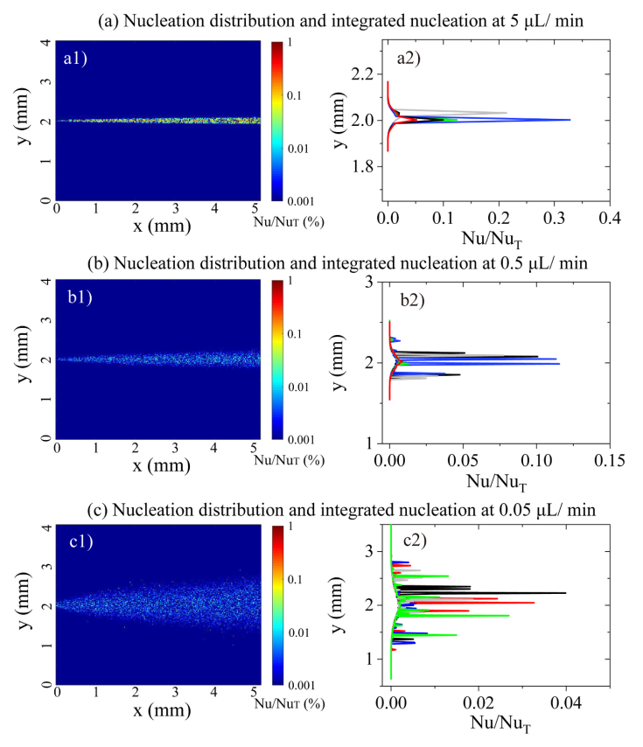
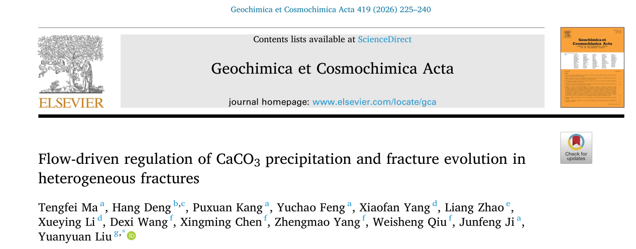
Background
Lower flow rates => broader saturation fronts and more stochastic nature of precipitation

Slide 5
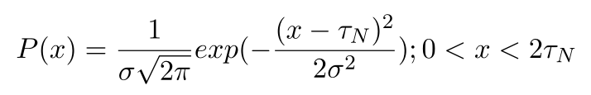
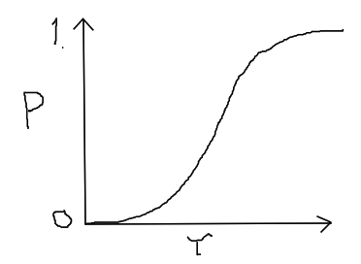
Background
The Gaussian Induction Time (GIT) model:
Pros:
+ Provides a model for the randomness of spatial distribution of secondary crystals
+ The model correctly approaches the deterministic averaged induction time (nucleation rate) on the long-term and for large systems.
+ Can explain clustering of crystals.
Cons:
- The symmetric Gaussian PDF has not been experimental verified, and it is only assumed that the process is random.
τ = 1/J

Slide 6
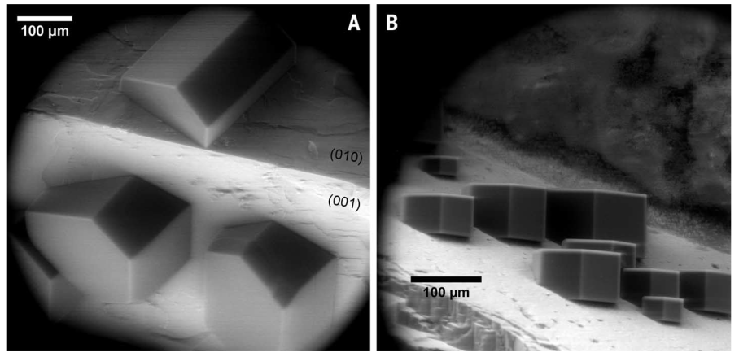
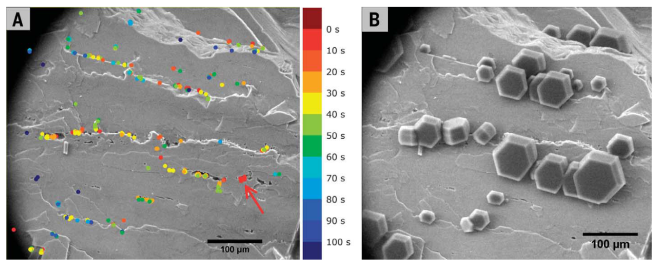
Role of active sites (steps, kinks, pits, etc) on nucleation rates
Kiselev et al 2017 demonstrated that:
1. Heterogeneous nucleation is probabilistic, but macroscopic rates can be determined by active surface sites.
2. Density of active sites determines the number of nuclei formed.
=> If we can determine the number of active surface sites, we can also predict the macroscopic number of nuclei (crystallites) that form.
Kiselev et al. 2017. Science 355.

Slide 7
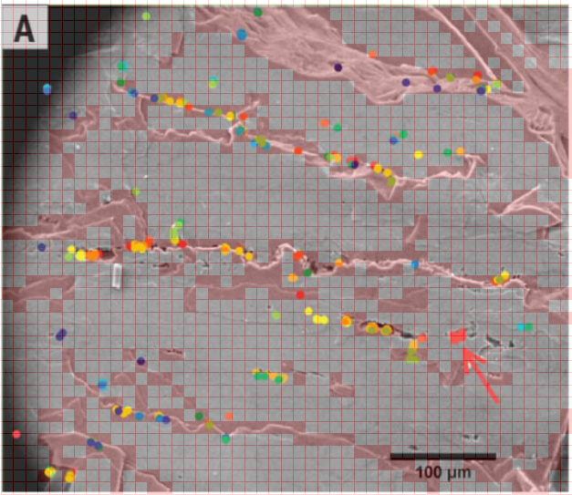
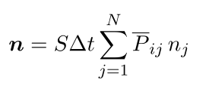

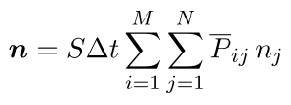
Integration of nucleation probailities from discrete surface sites
Nr. stable nuclei (crystallites) at a surface with N different types of active sites:
: nucleation rate (mean probability)
Total number of crystallites if M different polymorphs can form at the same time:

Slide 8
Benefits of a new nanoscopic point of view
A nanoscopic point of view will shift the focus to the very mechanisms that control (explain) macroscopic RT.
Approaching deterministic modeling – variations that was considered completely random in e.g., GIT-model, can now be better constrained.
Uncertainty of heterogeneous nucleation rates in macro-scale RTMs can be reduced. High-reactive surfaces (e.g., weathered or cleaved surfaces exposing high-energi faces or steps) will dominate nucleation and leading to e.g., local clustering of secondary precipitates.
Can potentially shed light on polymorph-selectivity during heterogeneous nucleation. The effect of e.g., lattice match (lattice strain) on different polymorphs will vary.

Slide 9
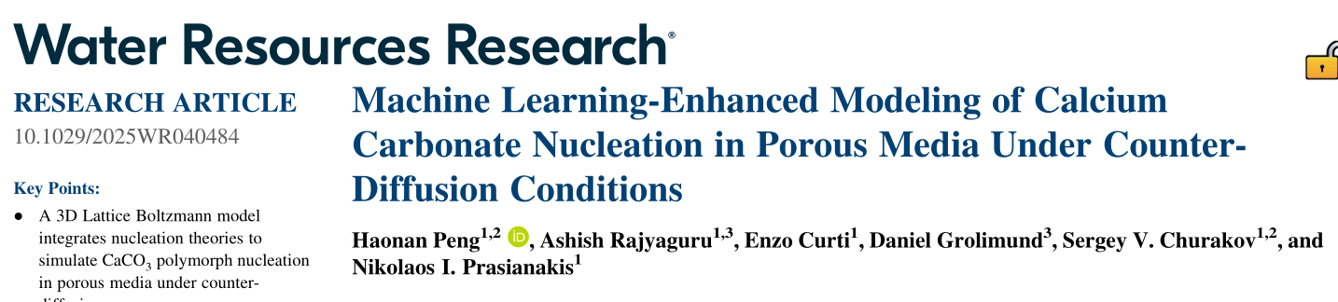
What is needed?
Approximations on the number of active sites (steps, kinks, defects, …) can be made based on laboratory observations and numerical simulations.
Mean probabilities of nucleation and distribution of nuclei on different active sites can be found experimentally (micro-macro experiments).
Combining numerical simulations and ML in surrogate models to speed up calculations and allow estimates of macro-scale flow properties and uncertainties.

Slide 10
Ongoing research
Nucleation of Baryte (BaSO4) on mica (Batch and AFM-study).
100X supersaturation
No preferential nucleation in grooves or steps – uniform (random) distribution on the (001) basal plane of mica.
May need atomistic simulations to explain the lack of preferential nucleation on the high-energy sites.

Slide 11
Ongoing research
Nucleation of Baryte (BaSO4) on glass slides, polished and sanded
100x supersaturation
Random distribution of Baryte on the polished glass
Local growth of baryte on certain areas on sanded glass slides
Surface-area effect or solution effect?

Slide 12
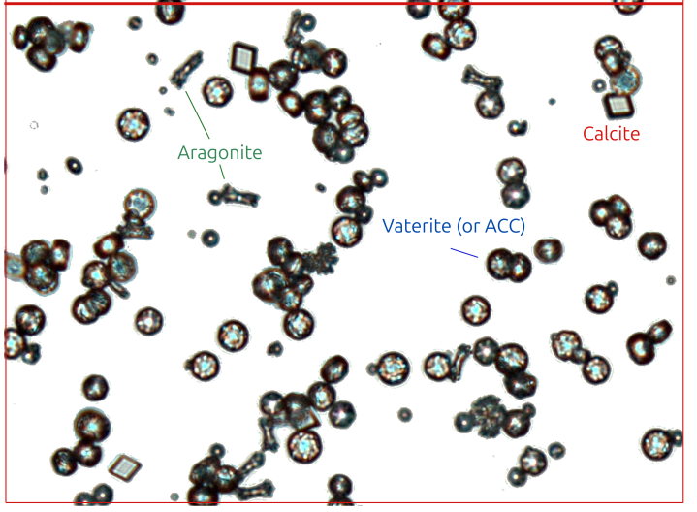
Ongoing research
Nucleation of CaCO3x on polished glass slides. ~177x supersaturation
Random distribution of CaCO3 on the polished glass
3 polymorphs +amorphous CC formed at the same time?
What is causing the given distribution of polymorphs and ACC on the glass?
Next: AFM and batch studies on CaCO3 on Kf and mica

Slide 13



Thank you for your attention!
helghe@geo.uio.no

