Slide 1


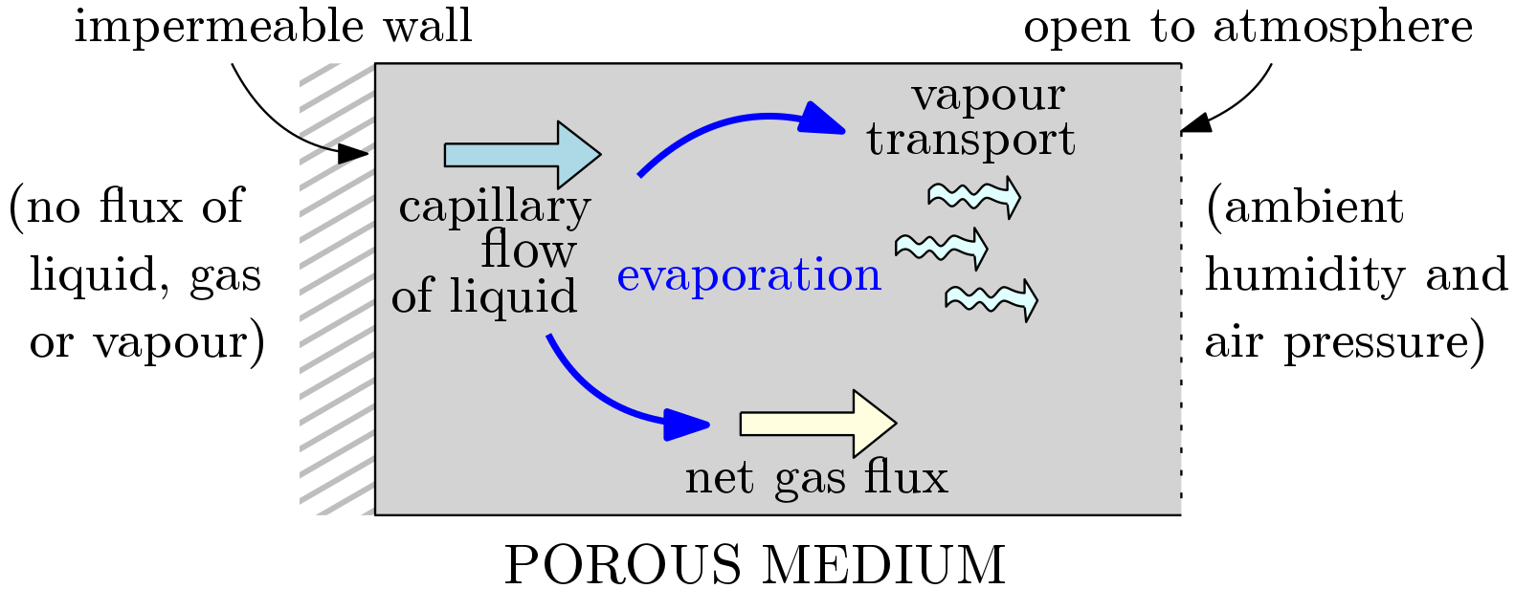
Mathematical modelling of evaporation in capillary porous media
Dr Ellen Luckins, University of Warwick
InterPore 2026 - Nantes

Slide 2
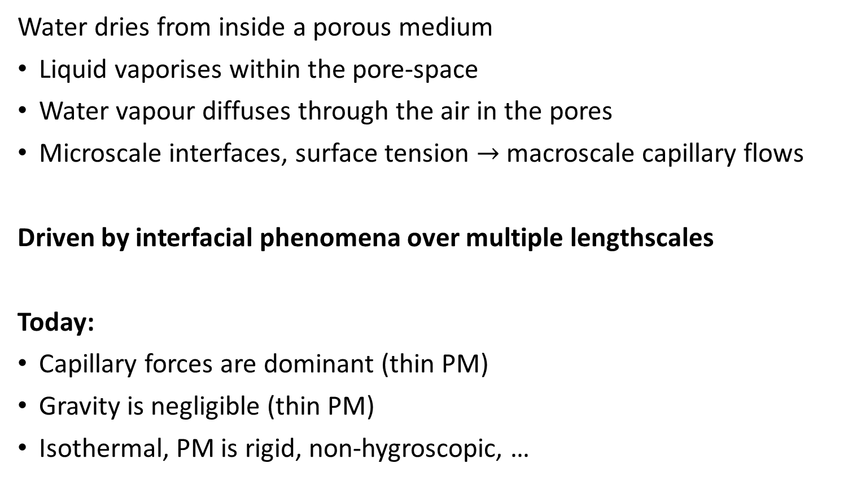
Drying in capillary porous media
Water dries from inside a porous medium
Liquid vaporises within the pore-space
Water vapour diffuses through the air in the pores
Microscale interfaces, surface tension $→$ macroscale capillary flows
Driven by interfacial phenomena over multiple lengthscales
Today:
Capillary forces are dominant (thin PM)
Gravity is negligible (thin PM)
Isothermal, PM is rigid, non-hygroscopic, …

Slide 3
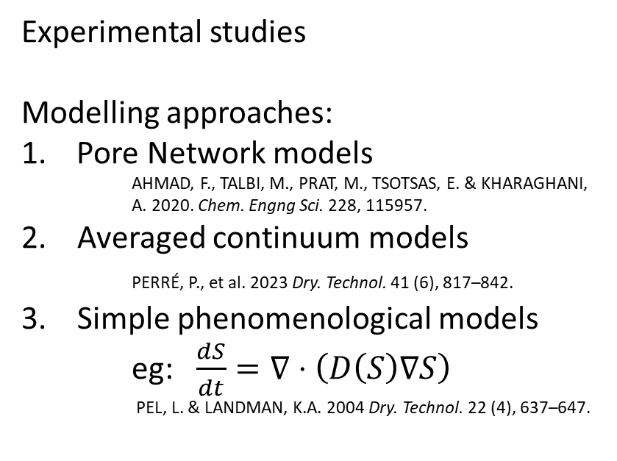
What do we know?
Experimental studies
Modelling approaches:
Pore Network models
  AHMAD, F., TALBI, M., PRAT, M., TSOTSAS, E. & KHARAGHANI, A. 2020. Chem. Engng Sci. 228, 115957.
2. Averaged continuum models
PERRÉ, P., et al. 2023 Dry. Technol. 41 (6), 817–842.
3. Simple phenomenological models
eg: $\frac{dS}{dt}=∇⋅\left(D\left(S\right)∇S\right)$
PEL, L. & LANDMAN, K.A. 2004 Dry. Technol. 22 (4), 637–647.
difficult!
expensive; can’t simulate a full PM
expensive; have to assume constitutive laws
not clear when these are valid; what BCs to impose?
TALBI, M. & PRAT, M. 2021 Phys. Rev. E 104 (5), 055102.
PERRÉ, P., et al. 2023 Dry. Technol. 41 (6), 817–842.
Today:
Asymptotic analysis of averaged continuum models
  Derive simple models systematically – know when they are valid, consistent BCs
  Keep constitutive laws general – understand when their properties matter
EK Luckins. Mathematical modelling of drying capillary porous media. Journal of Fluid Mechanics. 2025;1017:A6.

Slide 4
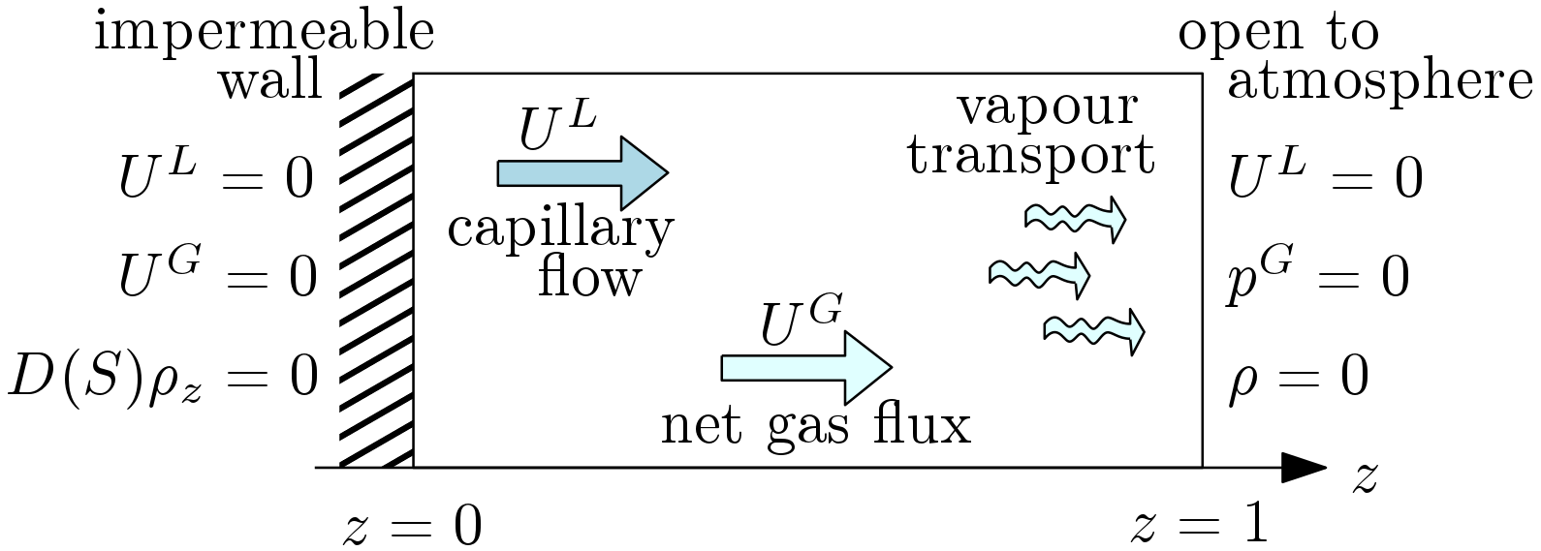
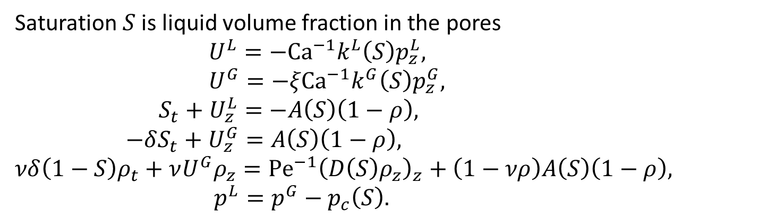
Averaged continuum model
Saturation $S$ is liquid volume fraction in the pores
$U^{L}=−Ca^{−1}k^{L}\left(S\right)p_{z}^{L},$
$U^{G}=−ξCa^{−1}k^{G}\left(S\right)p_{z}^{G},$
$S_{t}+U_{z}^{L}=−A\left(S\right)\left(1−ρ\right),$
$−δS_{t}+U_{z}^{G}=A\left(S\right)\left(1−ρ\right),$
$νδ\left(1−S\right)ρ_{t}+νU^{G}ρ_{z}=Pe^{−1}{\left(D\left(S\right)ρ_{z}\right)}_{z}+\left(1−νρ\right)A\left(S\right)\left(1−ρ\right),$
$p^{L}=p^{G}−p_{c}\left(S\right).$
Generalised Darcy’s laws
Conservation of mass
Vapour transport
Capillary pressure
Whitaker, S. 1977 Simultaneous heat, mass, and momentum transfer in porous media: a theory of drying. In Advances in Heat Transfer, vol. 13, pp. 119–203. Elsevier.

Slide 5
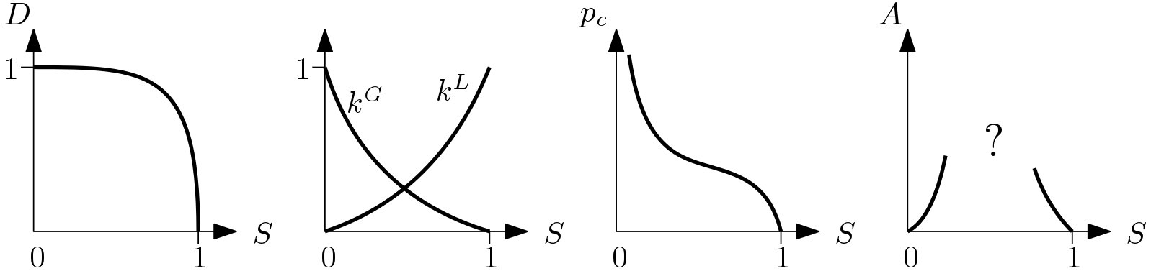
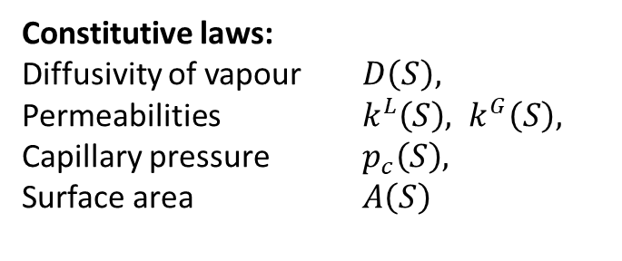
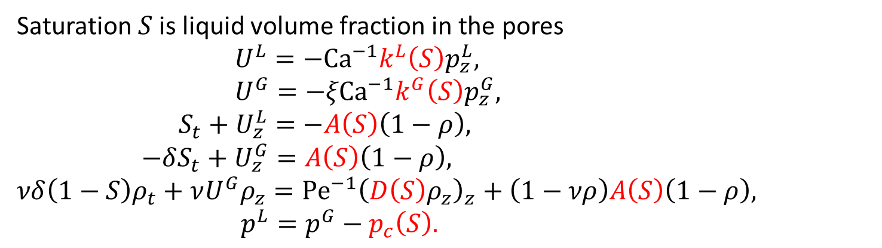
Averaged continuum model
Saturation $S$ is liquid volume fraction in the pores
$U^{L}=−Ca^{−1}k^{L}\left(S\right)p_{z}^{L},$
$U^{G}=−ξCa^{−1}k^{G}\left(S\right)p_{z}^{G},$
$S_{t}+U_{z}^{L}=−A\left(S\right)\left(1−ρ\right),$
$−δS_{t}+U_{z}^{G}=A\left(S\right)\left(1−ρ\right),$
$νδ\left(1−S\right)ρ_{t}+νU^{G}ρ_{z}=Pe^{−1}{\left(D\left(S\right)ρ_{z}\right)}_{z}+\left(1−νρ\right)A\left(S\right)\left(1−ρ\right),$
$p^{L}=p^{G}−p_{c}\left(S\right).$
Constitutive laws:
Diffusivity of vapour $D\left(S\right),$
Permeabilities $k^{L}\left(S\right), k^{G}\left(S\right),$
Capillary pressure $p_{c}\left(S\right),$
Surface area $A\left(S\right)$

Slide 6
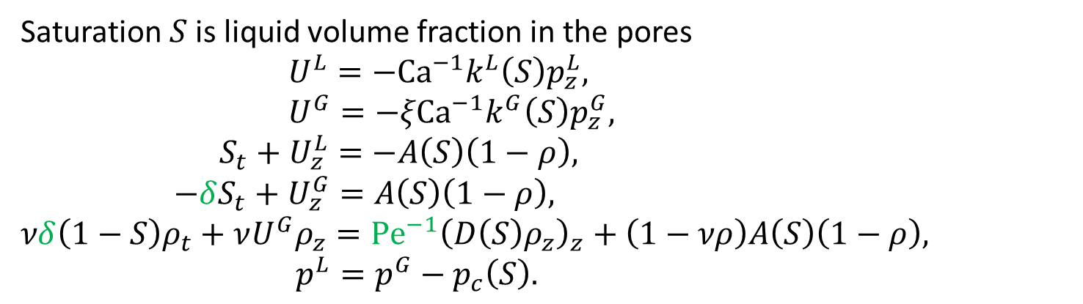
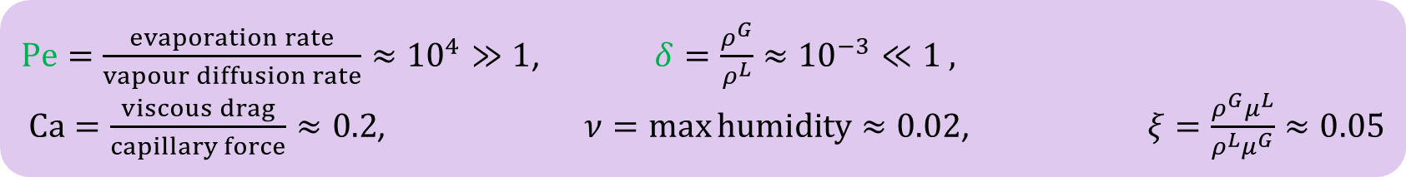
Averaged continuum model
Saturation $S$ is liquid volume fraction in the pores
$U^{L}=−Ca^{−1}k^{L}\left(S\right)p_{z}^{L},$
$U^{G}=−ξCa^{−1}k^{G}\left(S\right)p_{z}^{G},$
$S_{t}+U_{z}^{L}=−A\left(S\right)\left(1−ρ\right),$
$−δS_{t}+U_{z}^{G}=A\left(S\right)\left(1−ρ\right),$
$νδ\left(1−S\right)ρ_{t}+νU^{G}ρ_{z}=Pe^{−1}{\left(D\left(S\right)ρ_{z}\right)}_{z}+\left(1−νρ\right)A\left(S\right)\left(1−ρ\right),$
$p^{L}=p^{G}−p_{c}\left(S\right).$
Constitutive laws:
Diffusivity of vapour $D\left(S\right),$
Permeabilities $k^{L}\left(S\right), k^{G}\left(S\right),$
Capillary pressure $p_{c}\left(S\right),$
Surface area $A\left(S\right)$
$Pe=\frac{evaporation rate}{vapour diffusion rate}≈{10}^{4}≫1$, $δ=\frac{ρ^{G}}{ρ^{L}}≈{10}^{−3}≪1 ,$
$Ca=\frac{viscous drag}{capillary force}≈0.2$, $ν=\max{humidity}≈0.02$, $ξ=\frac{ρ^{G}μ^{L}}{ρ^{L}μ^{G}}≈0.05$

Slide 7
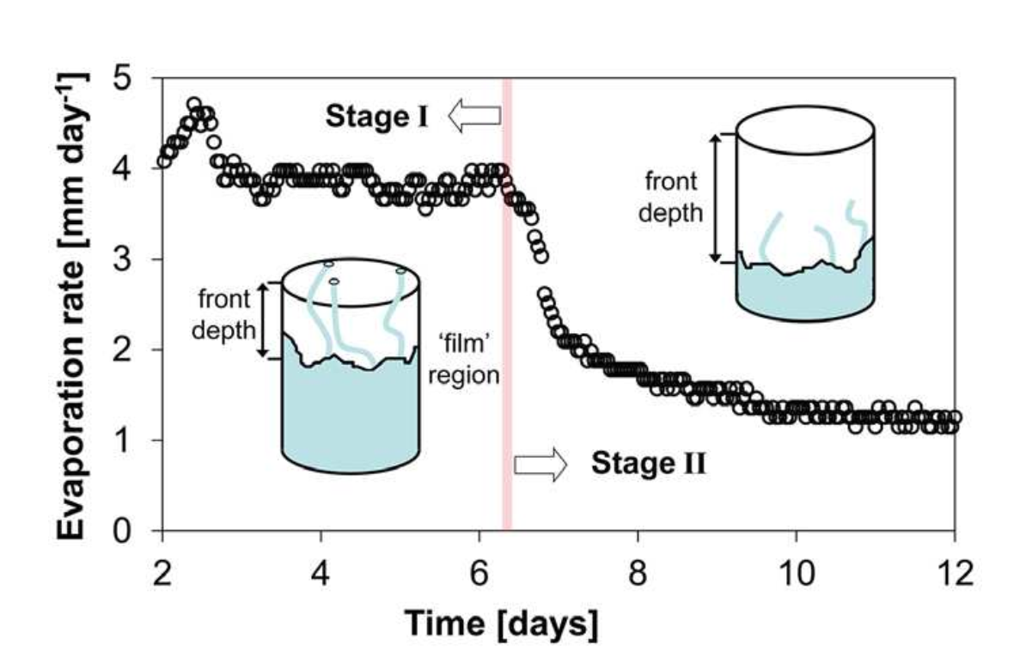
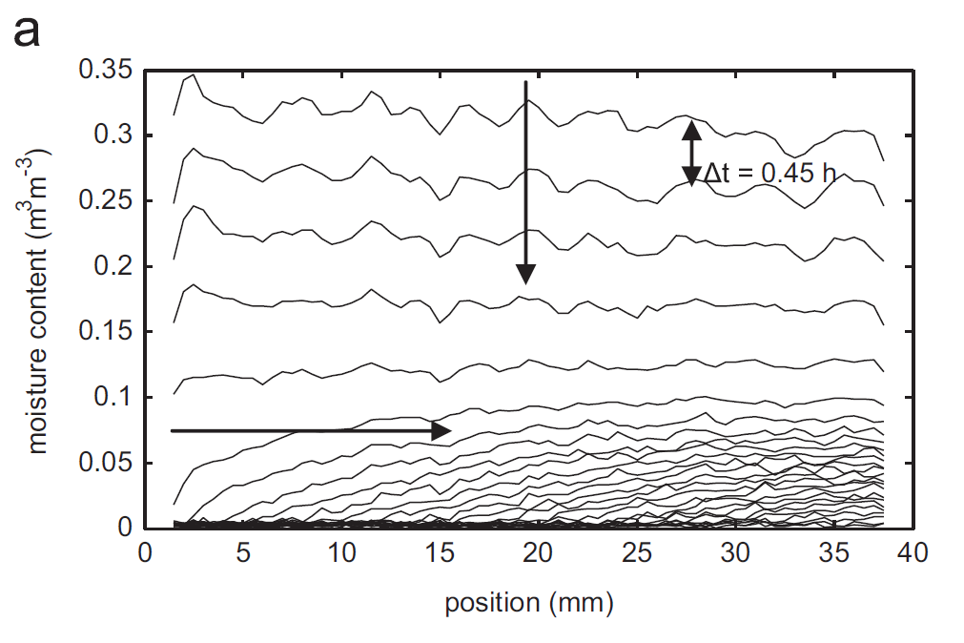
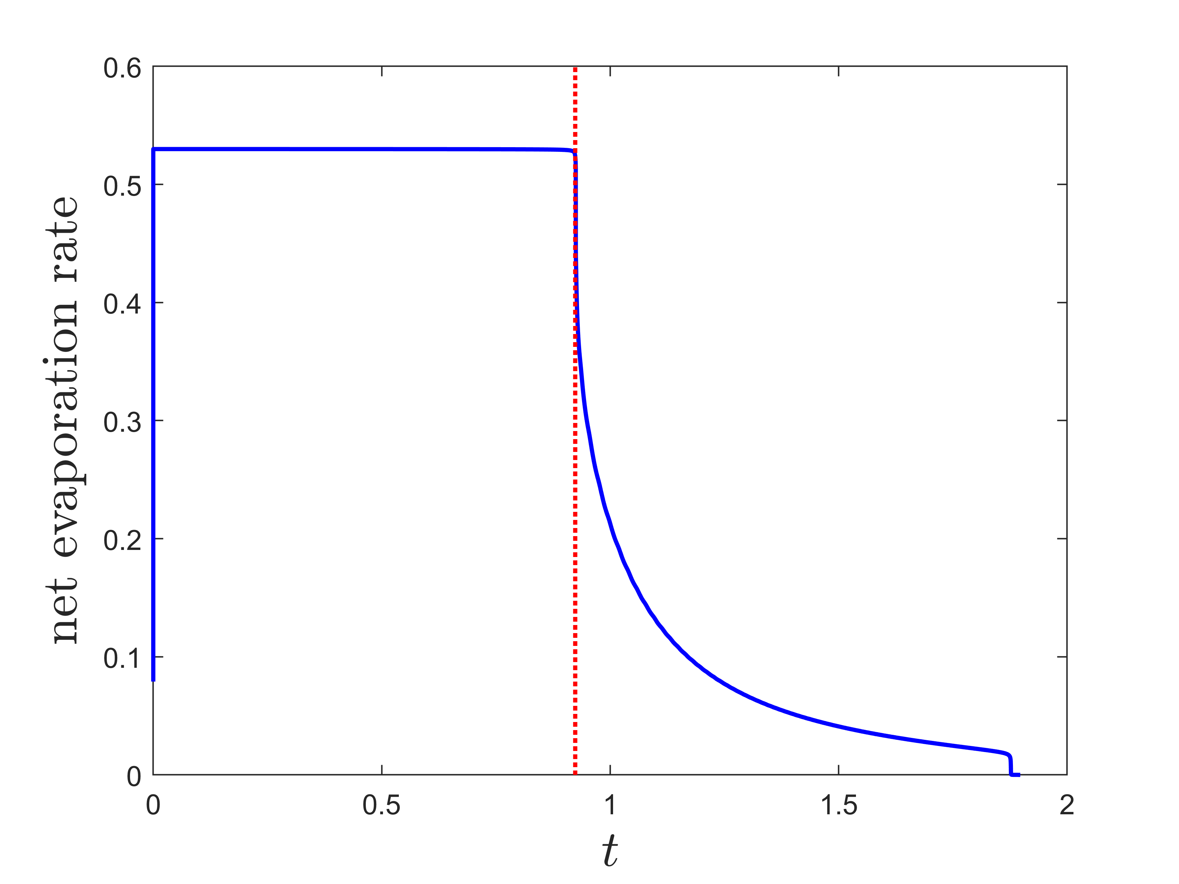
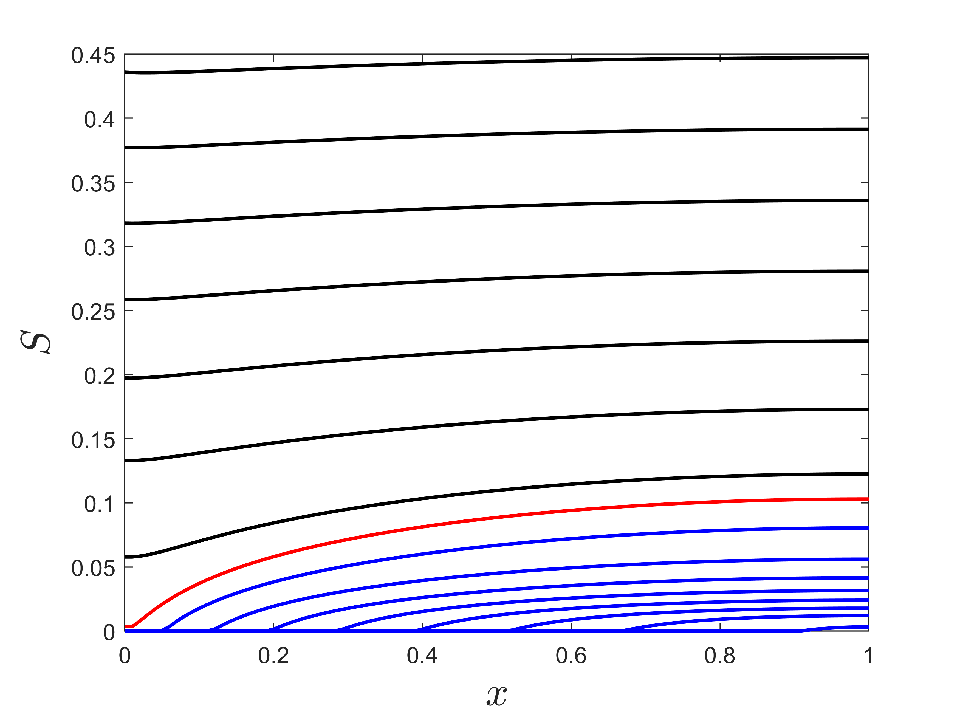

Two drying stages:
What is the net drying rate?
When is the transition to stage 2?
Adapted from Or, D, Lehmann, P, Shahraeeni, E & Shokri, N (2013) Vadose Zone Journal, 12(4)
Gupta, S, Huinink, H P, Prat, M, Pel, L & Kopinga, K (2014) Chem. Eng. Sci. 109, 204–211.
$$z$$

Slide 8
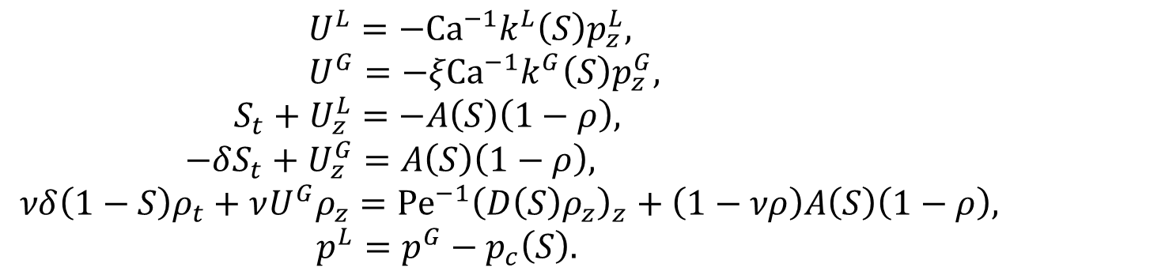
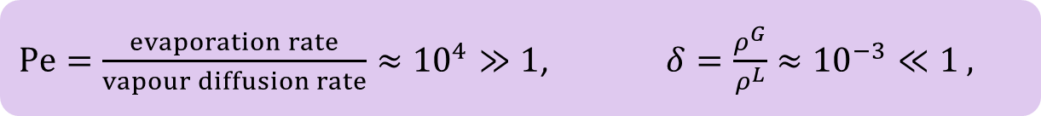
Asymptotic analysis
Idea: take advantage of the big/small parameters to systematically simplify the problem
(the simplified model has error the size of the small parameters)
$Pe=\frac{evaporation rate}{vapour diffusion rate}≈{10}^{4}≫1$, $δ=\frac{ρ^{G}}{ρ^{L}}≈{10}^{−3}≪1 ,$
$U^{L}=−Ca^{−1}k^{L}\left(S\right)p_{z}^{L},$
$U^{G}=−ξCa^{−1}k^{G}\left(S\right)p_{z}^{G},$
$S_{t}+U_{z}^{L}=−A\left(S\right)\left(1−ρ\right),$
$−δS_{t}+U_{z}^{G}=A\left(S\right)\left(1−ρ\right),$
$νδ\left(1−S\right)ρ_{t}+νU^{G}ρ_{z}=Pe^{−1}{\left(D\left(S\right)ρ_{z}\right)}_{z}+\left(1−νρ\right)A\left(S\right)\left(1−ρ\right),$
$p^{L}=p^{G}−p_{c}\left(S\right).$

Slide 9
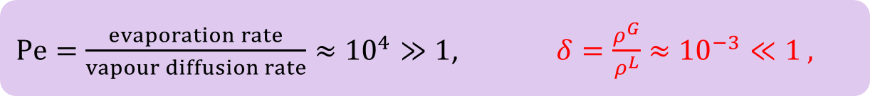
Asymptotic analysis
Idea: take advantage of the big/small parameters to systematically simplify the problem
(the simplified model has error the size of the small parameters)
$Pe=\frac{evaporation rate}{vapour diffusion rate}≈{10}^{4}≫1$, $δ=\frac{ρ^{G}}{ρ^{L}}≈{10}^{−3}≪1 ,$
$U^{L}=−Ca^{−1}k^{L}\left(S\right)p_{z}^{L},$
$U^{G}=−ξCa^{−1}k^{G}\left(S\right)p_{z}^{G},$
$S_{t}+U_{z}^{L}=−A\left(S\right)\left(1−ρ\right),$
$−δS_{t}+U_{z}^{G}=A\left(S\right)\left(1−ρ\right),$
$νδ\left(1−S\right)ρ_{t}+νU^{G}ρ_{z}=Pe^{−1}{\left(D\left(S\right)ρ_{z}\right)}_{z}+\left(1−νρ\right)A\left(S\right)\left(1−ρ\right),$
$p^{L}=p^{G}−p_{c}\left(S\right).$

Slide 10
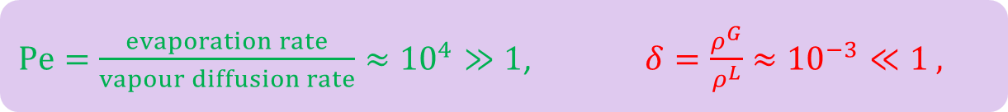

Asymptotic analysis
Idea: take advantage of the big/small parameters to systematically simplify the problem
(the simplified model has error the size of the small parameters)
Left with $ρ=1$ (saturation vapour density) everywhere – no evaporation!
$Pe=\frac{evaporation rate}{vapour diffusion rate}≈{10}^{4}≫1$, $δ=\frac{ρ^{G}}{ρ^{L}}≈{10}^{−3}≪1 ,$
$U^{L}=−Ca^{−1}k^{L}\left(S\right)p_{z}^{L},$
$U^{G}=−ξCa^{−1}k^{G}\left(S\right)p_{z}^{G},$
$S_{t}+U_{z}^{L}=−A\left(S\right)\left(1−ρ\right),$
$−δS_{t}+U_{z}^{G}=A\left(S\right)\left(1−ρ\right),$
$νδ\left(1−S\right)ρ_{t}+νU^{G}ρ_{z}=Pe^{−1}{\left(D\left(S\right)ρ_{z}\right)}_{z}+\left(1−νρ\right)A\left(S\right)\left(1−ρ\right),$
$p^{L}=p^{G}−p_{c}\left(S\right).$

Slide 11
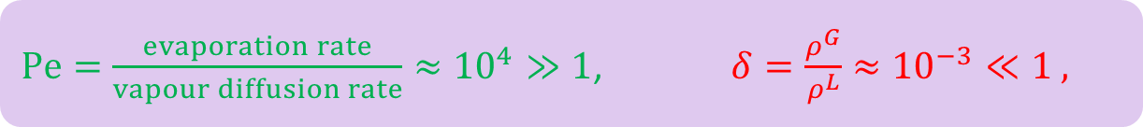

Asymptotic analysis
Idea: take advantage of the big/small parameters to systematically simplify the problem
(the simplified model has error the size of the small parameters)
Left with $ρ=1$ (saturation vapour density) everywhere – no evaporation!
To get any evaporation there must be a thin boundary layer at the surface where diffusion becomes important
$Pe=\frac{evaporation rate}{vapour diffusion rate}≈{10}^{4}≫1$, $δ=\frac{ρ^{G}}{ρ^{L}}≈{10}^{−3}≪1 ,$
$U^{L}=−Ca^{−1}k^{L}\left(S\right)p_{z}^{L},$
$U^{G}=−ξCa^{−1}k^{G}\left(S\right)p_{z}^{G},$
$S_{t}+U_{z}^{L}=−A\left(S\right)\left(1−ρ\right),$
$−δS_{t}+U_{z}^{G}=A\left(S\right)\left(1−ρ\right),$
$νδ\left(1−S\right)ρ_{t}+νU^{G}ρ_{z}=Pe^{−1}{\left(D\left(S\right)ρ_{z}\right)}_{z}+\left(1−νρ\right)A\left(S\right)\left(1−ρ\right),$
$p^{L}=p^{G}−p_{c}\left(S\right).$

Slide 12
Stage I – constant rate period
With this boundary layer structure
only evaporation in the BL

Slide 13
Stage I – constant rate period
With this boundary layer structure
only evaporation in the BL slower net evaporation

Slide 14
Stage I – constant rate period
With this boundary layer structure
only evaporation in the BL slower net evaporation slower liquid flow

Slide 15
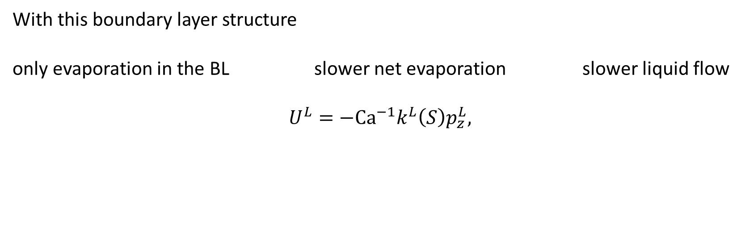
Stage I – constant rate period
With this boundary layer structure
only evaporation in the BL slower net evaporation slower liquid flow
$$U^{L}=−Ca^{−1}k^{L}\left(S\right)p_{z}^{L},$$

Slide 16
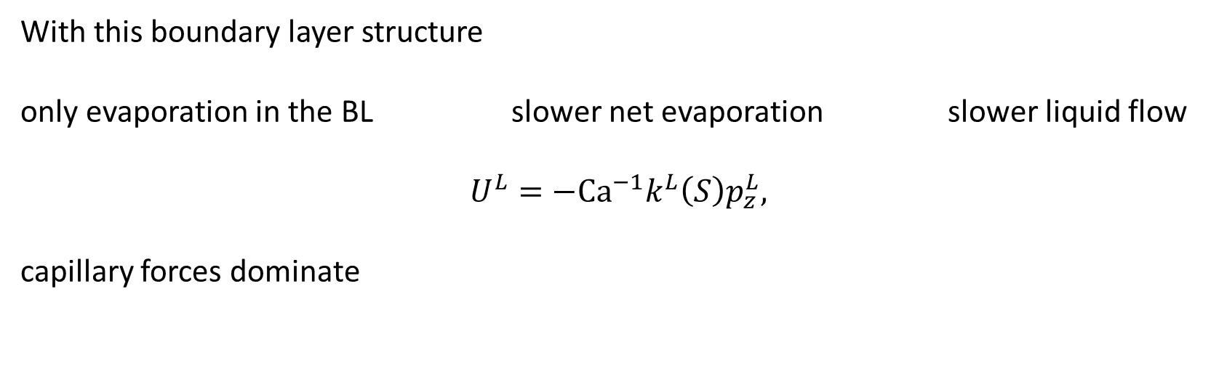
Stage I – constant rate period
With this boundary layer structure
only evaporation in the BL slower net evaporation slower liquid flow
$$U^{L}=−Ca^{−1}k^{L}\left(S\right)p_{z}^{L},$$
capillary forces dominate

Slide 17
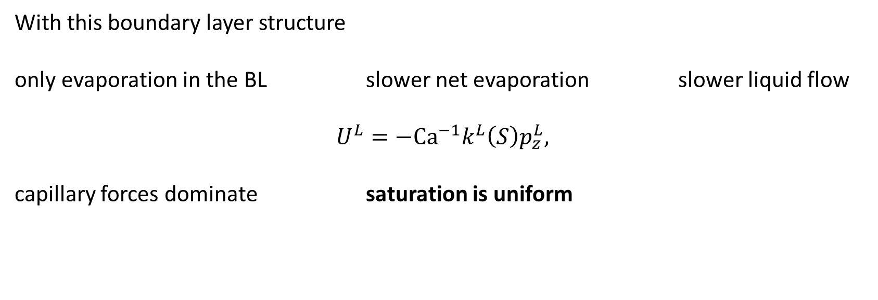
Stage I – constant rate period
With this boundary layer structure
only evaporation in the BL slower net evaporation slower liquid flow
$$U^{L}=−Ca^{−1}k^{L}\left(S\right)p_{z}^{L},$$
capillary forces dominate saturation is uniform

Slide 18
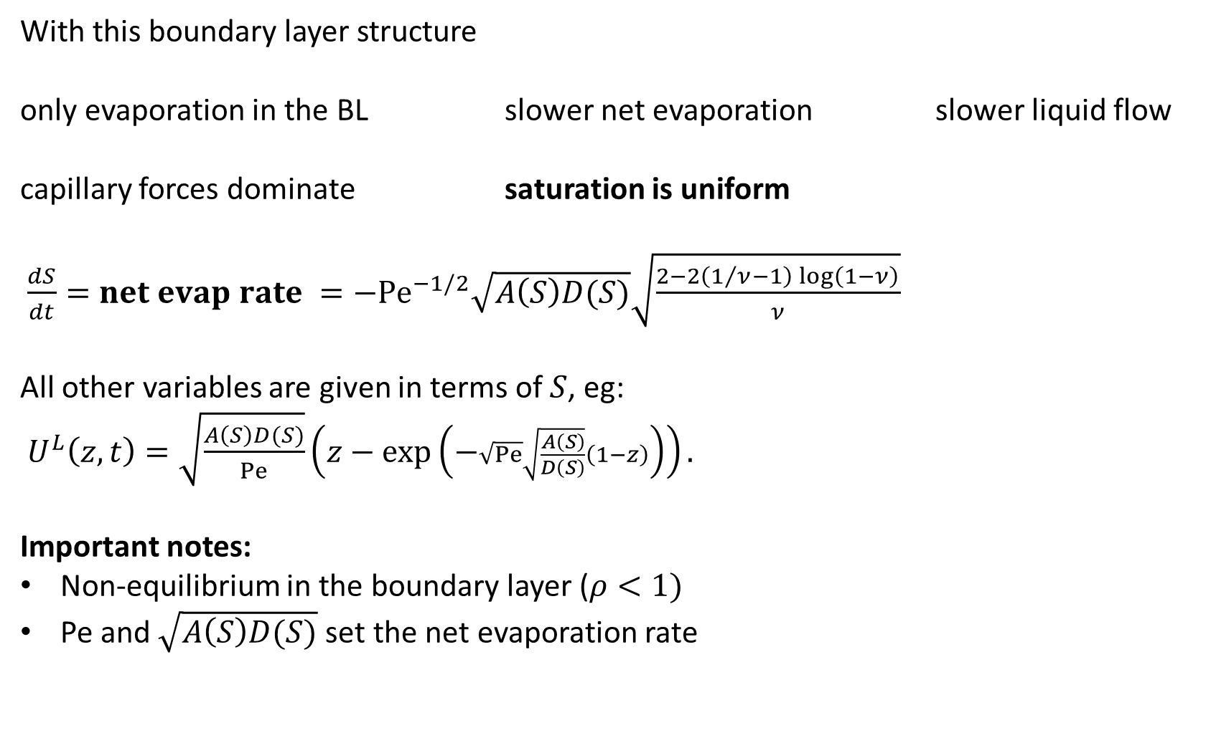
Stage I – constant rate period
With this boundary layer structure
only evaporation in the BL slower net evaporation slower liquid flow
capillary forces dominate saturation is uniform
$\frac{dS}{dt}=net evap rate =−Pe^{−1/2}\sqrt{A\left(S\right)D(S)}\sqrt{\frac{2−2\left(1/ν−1\right)\log\left(1−ν\right)}{ν}}$
All other variables are given in terms of $S$, eg:
$U^{L}\left(z,t\right)=\sqrt{\frac{A\left(S\right)D(S)}{Pe}}\left(z−\exp\left(−\sqrt{Pe}\sqrt{\frac{A\left(S\right)}{D\left(S\right)}}\left(1−z\right)\right)\right).$
Important notes:
Non-equilibrium in the boundary layer ($ρ<1)$
Pe and $\sqrt{A\left(S\right)D(S)}$set the net evaporation rate
Outer region
Boundary
layer

Slide 19
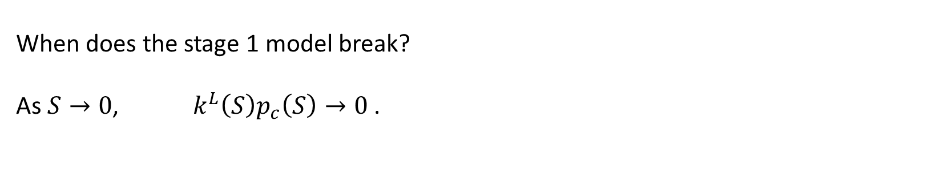
The transition point
When does the stage 1 model break?
As $S→0$, $k^{L}\left(S\right)p_{c}\left(S\right)→0$.

Slide 20

The transition point
When does the stage 1 model break?
As $S→0$, $k^{L}\left(S\right)p_{c}\left(S\right)→0$.
We had: $U^{L}=−Ca^{−1}k^{L}\left(S\right)p_{z}^{L},$
Viscous drag forces balance the capillary force, slowing the flow and ending stage 1
Estimate the transition point:
$S=S_{crit}$ so that $k^{L}\left(S_{crit}\right)p_{c}\left(S_{crit}\right)∼Ca U^{L}$

Slide 21

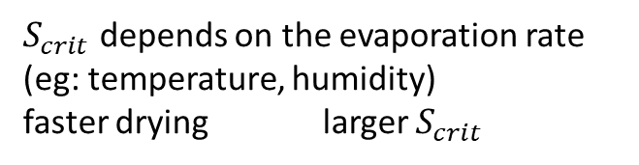
The transition point
When does the stage 1 model break?
As $S→0$, $k^{L}\left(S\right)p_{c}\left(S\right)→0$.
We had: $U^{L}=−Ca^{−1}k^{L}\left(S\right)p_{z}^{L},$
Viscous drag forces balance the capillary force, slowing the flow and ending stage 1
Estimate the transition point:
$S=S_{crit}$ so that $k^{L}\left(S_{crit}\right)p_{c}\left(S_{crit}\right)=Ca Pe^{−1/2}$
$S_{crit}$ depends on the evaporation rate (eg: temperature, humidity)
faster drying larger $S_{crit}$

Slide 22
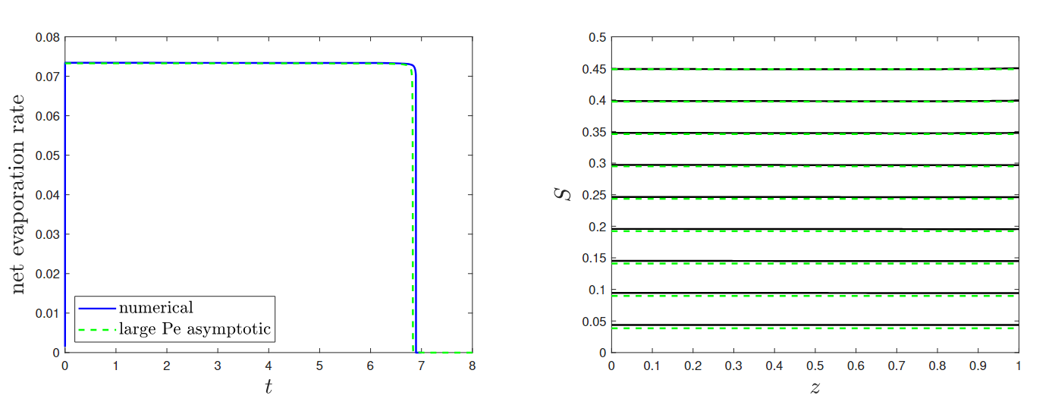
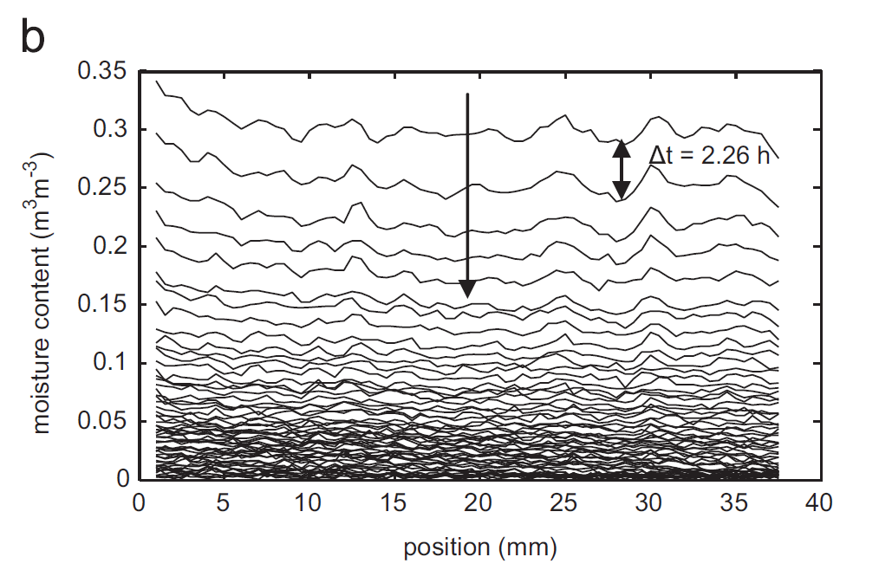
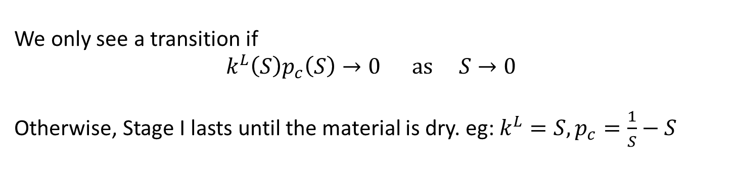
The transition point
We only see a transition if
$$k^{L}\left(S\right)p_{c}\left(S\right)→0 as S→0$$
Otherwise, Stage I lasts until the material is dry. eg: $k^{L}=S, p_{c}=\frac{1}{S}−S$
Gupta, S, Huinink, H P, Prat, M, Pel, L & Kopinga, K 2014 Paradoxical drying of a fired-clay brick due to salt crystallization. Chemical Engineering Science 109, 204–211.

Slide 23
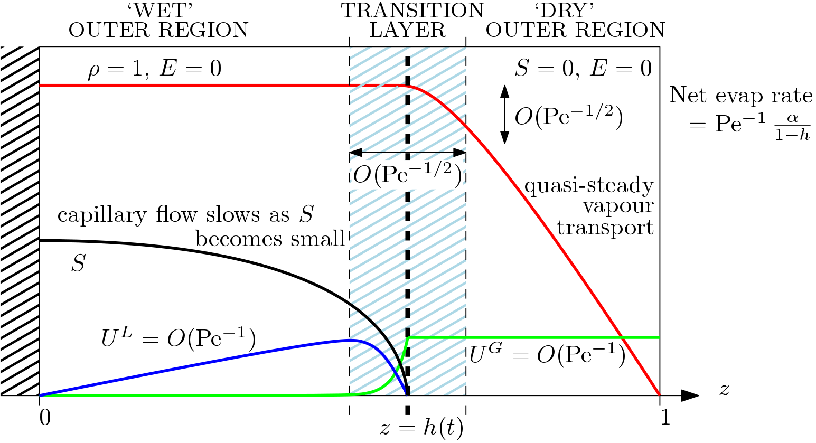
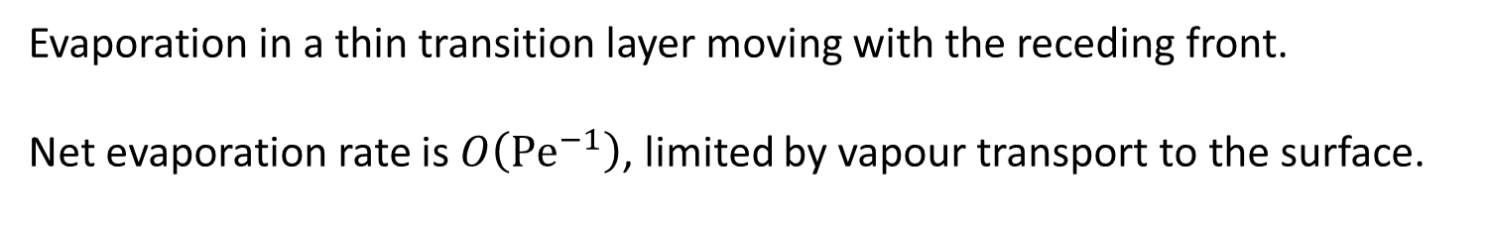
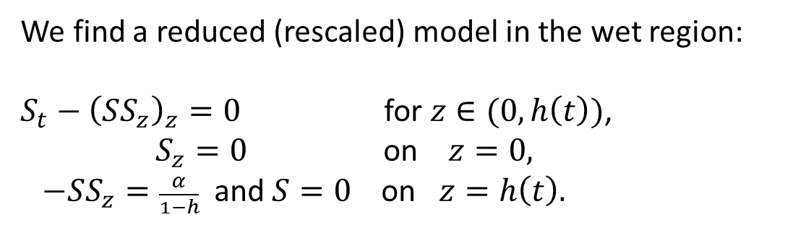
Stage II – receding front period
Evaporation in a thin transition layer moving with the receding front.
Net evaporation rate is $O\left(Pe^{−1}\right)$, limited by vapour transport to the surface.
We find a reduced (rescaled) model in the wet region:
$S_{t}−{\left(SS_{z}\right)}_{z}=0$ for $z∈(0,h\left(t\right))$,
$S_{z}=0$ on $z=0,$
$−SS_{z}=\frac{α}{1−h}$ and $S=0$ on $z=h\left(t\right).$

Slide 24
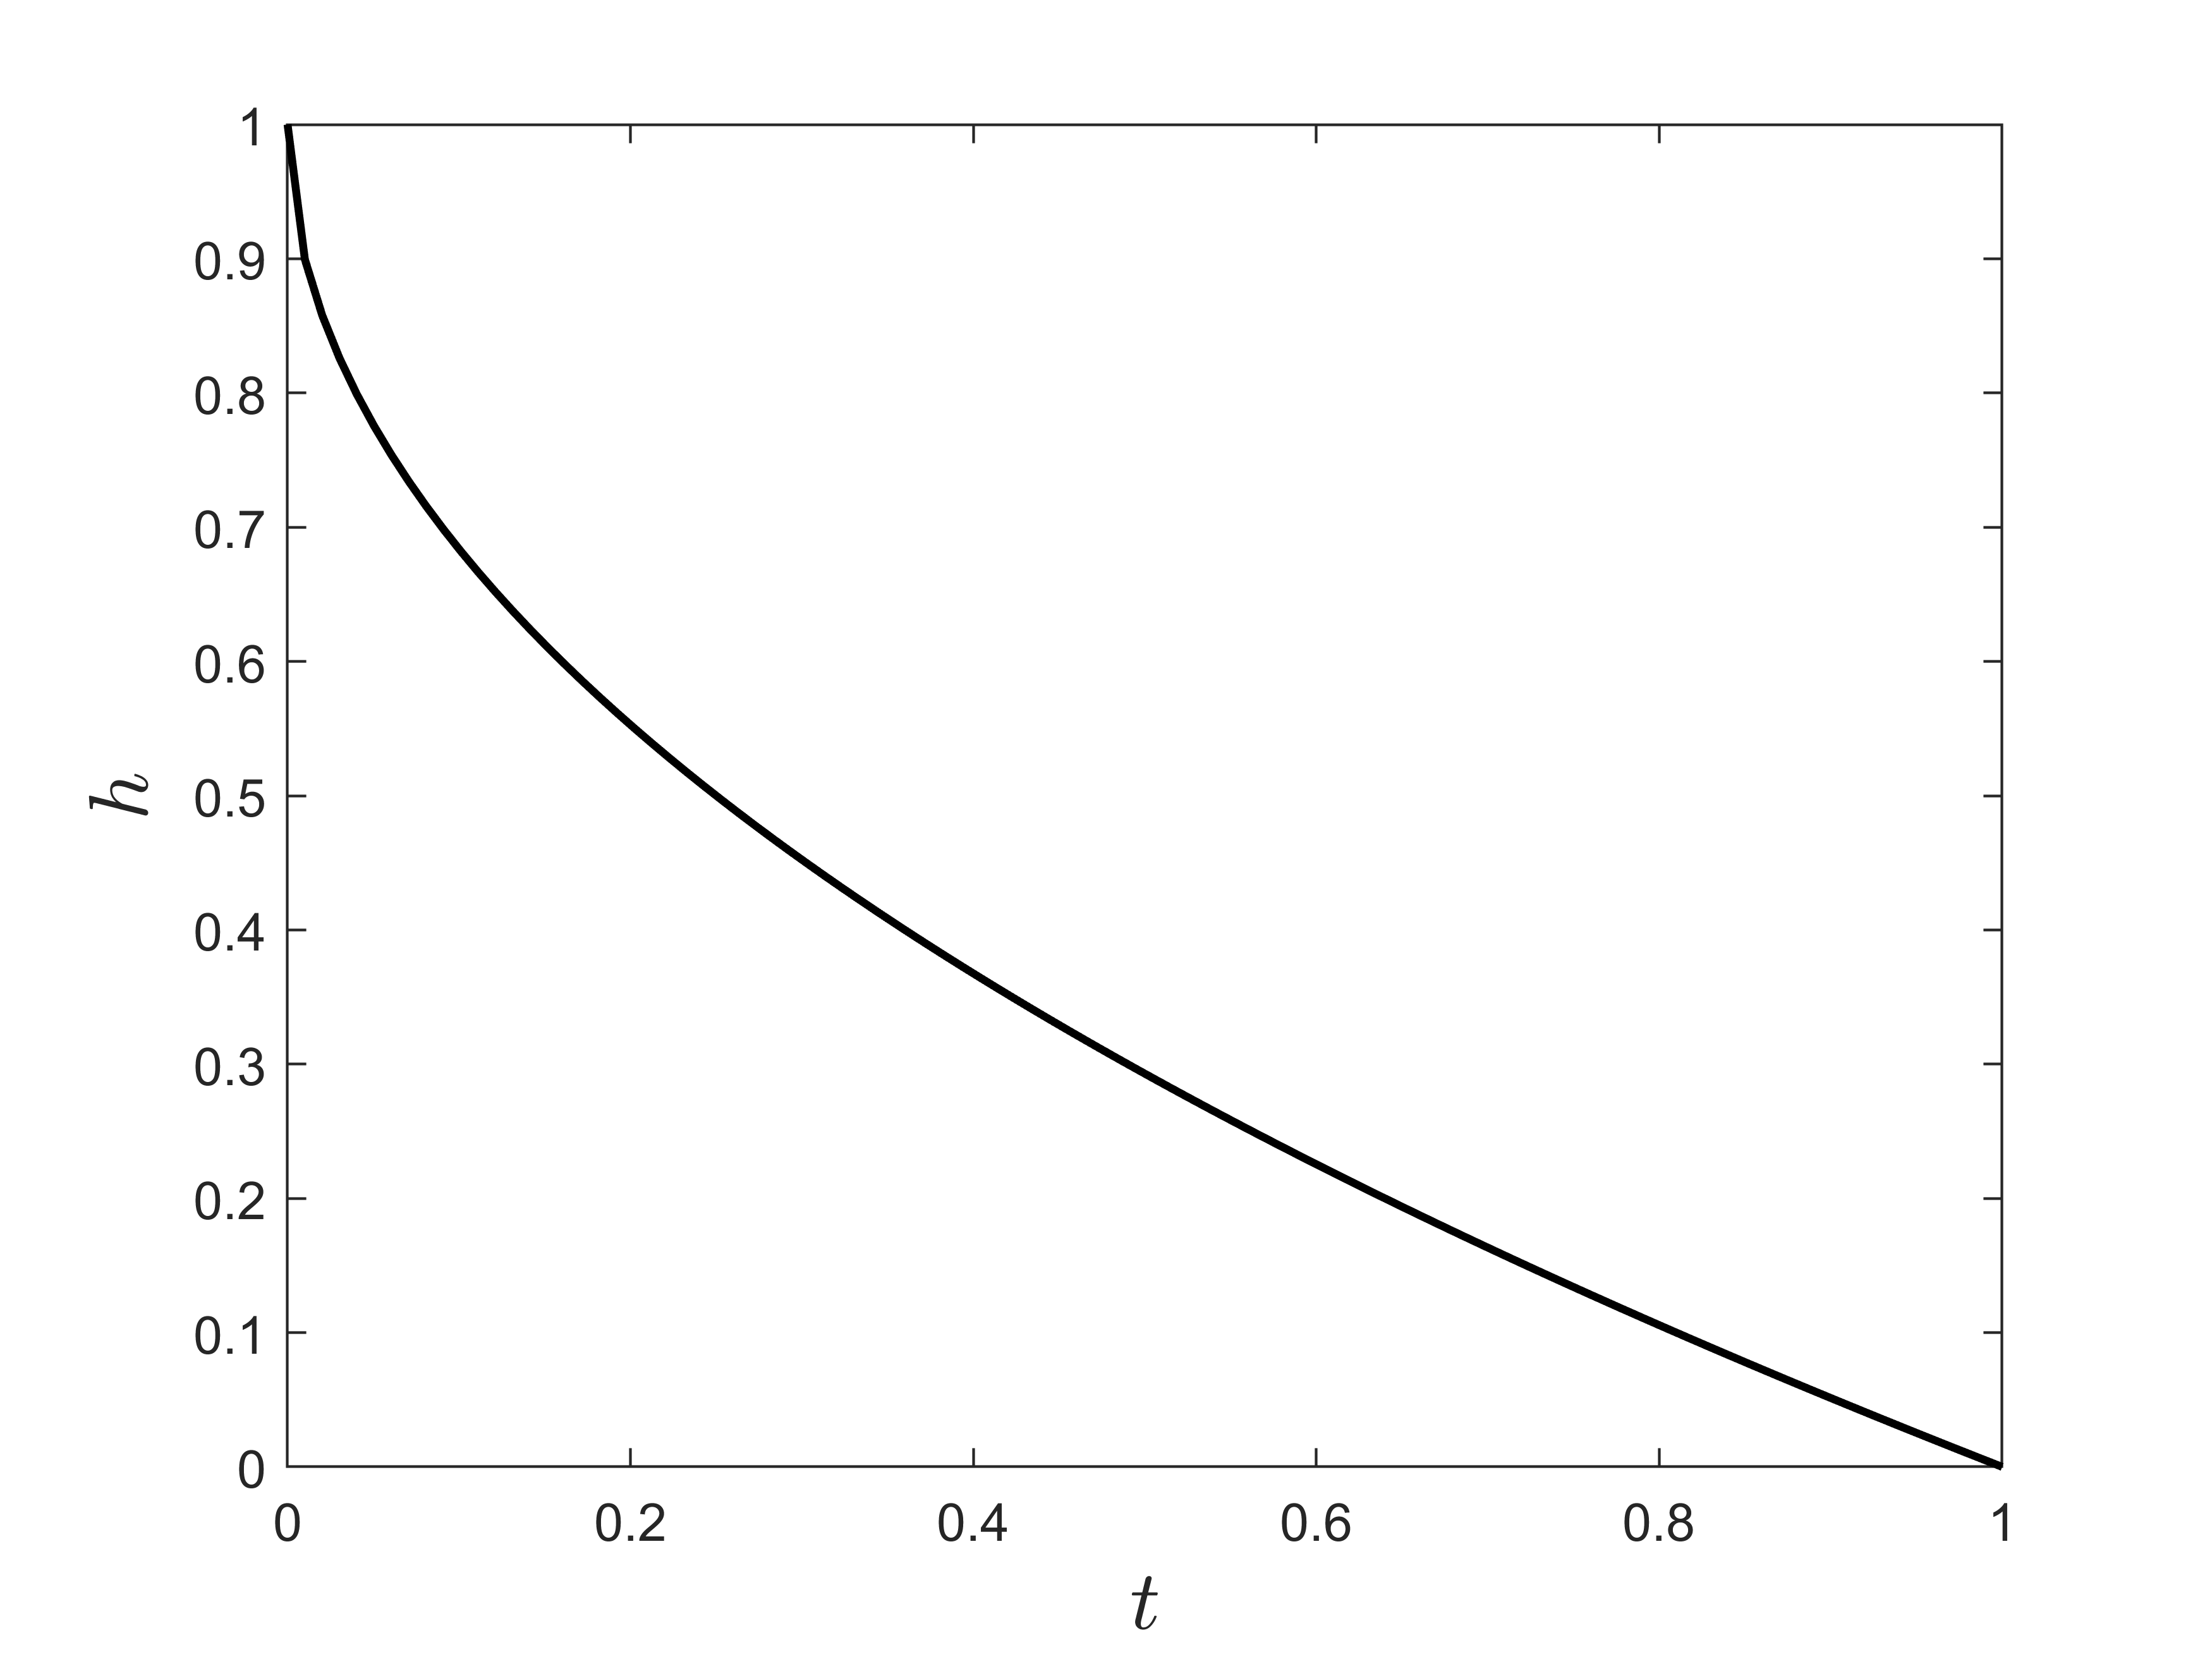
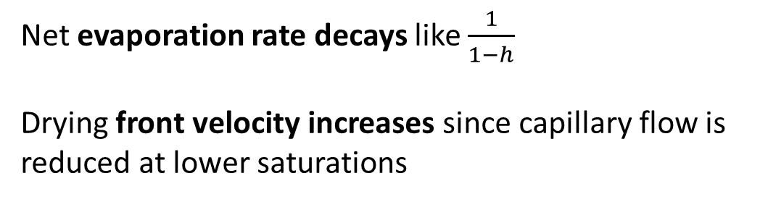
Stage II – receding front period
No liquid flow:
\
Net evaporation rate decays like $\frac{1}{1−h}$
Drying front velocity increases since capillary flow is reduced at lower saturations

Slide 25
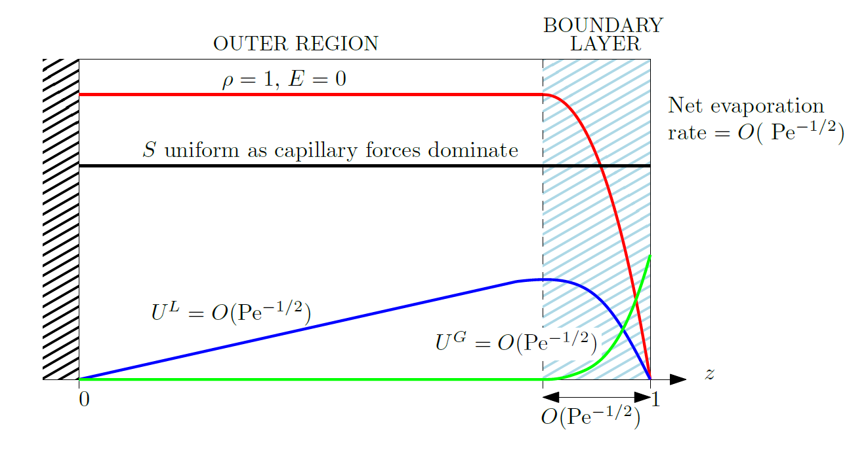
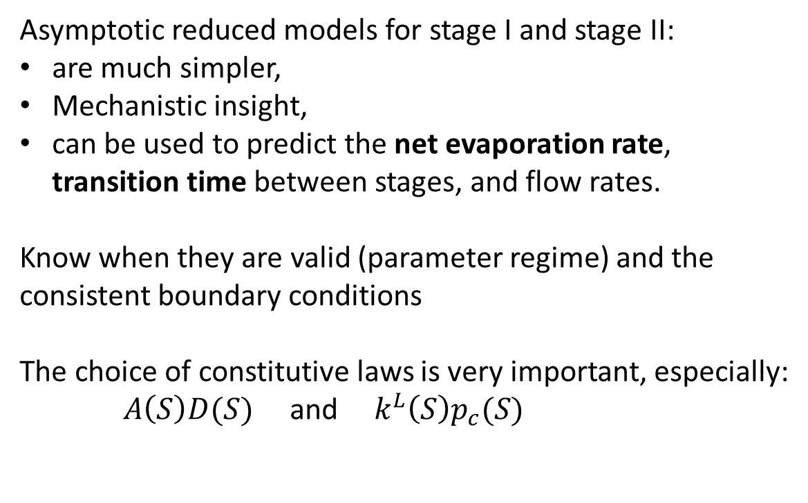
Summary
Asymptotic reduced models for stage I and stage II:
are much simpler,
Mechanistic insight,
can be used to predict the net evaporation rate, transition time between stages, and flow rates.
Know when they are valid (parameter regime) and the consistent boundary conditions
The choice of constitutive laws is very important, especially:
$A\left(S\right)D(S)$ and $k^{L}\left(S\right)p_{c}(S)$
EK Luckins. Mathematical modelling of drying capillary porous media. Journal of Fluid Mechanics. 2025;1017:A6.
Stage I
Stage II

Slide 26
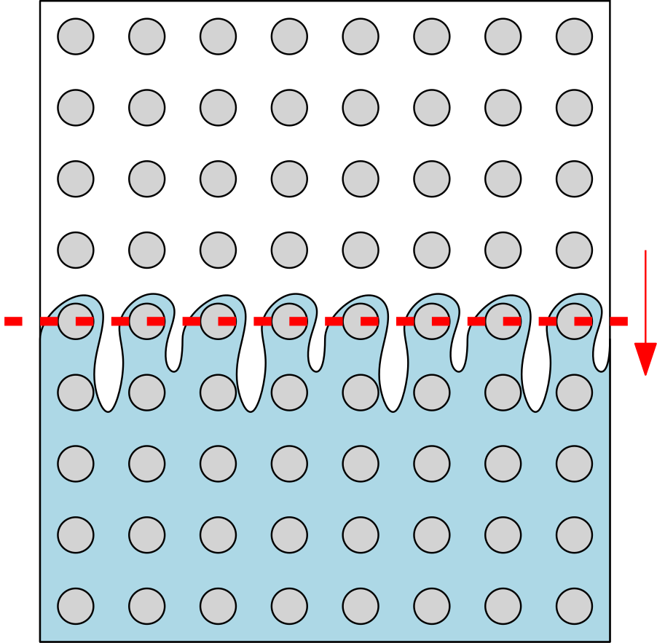
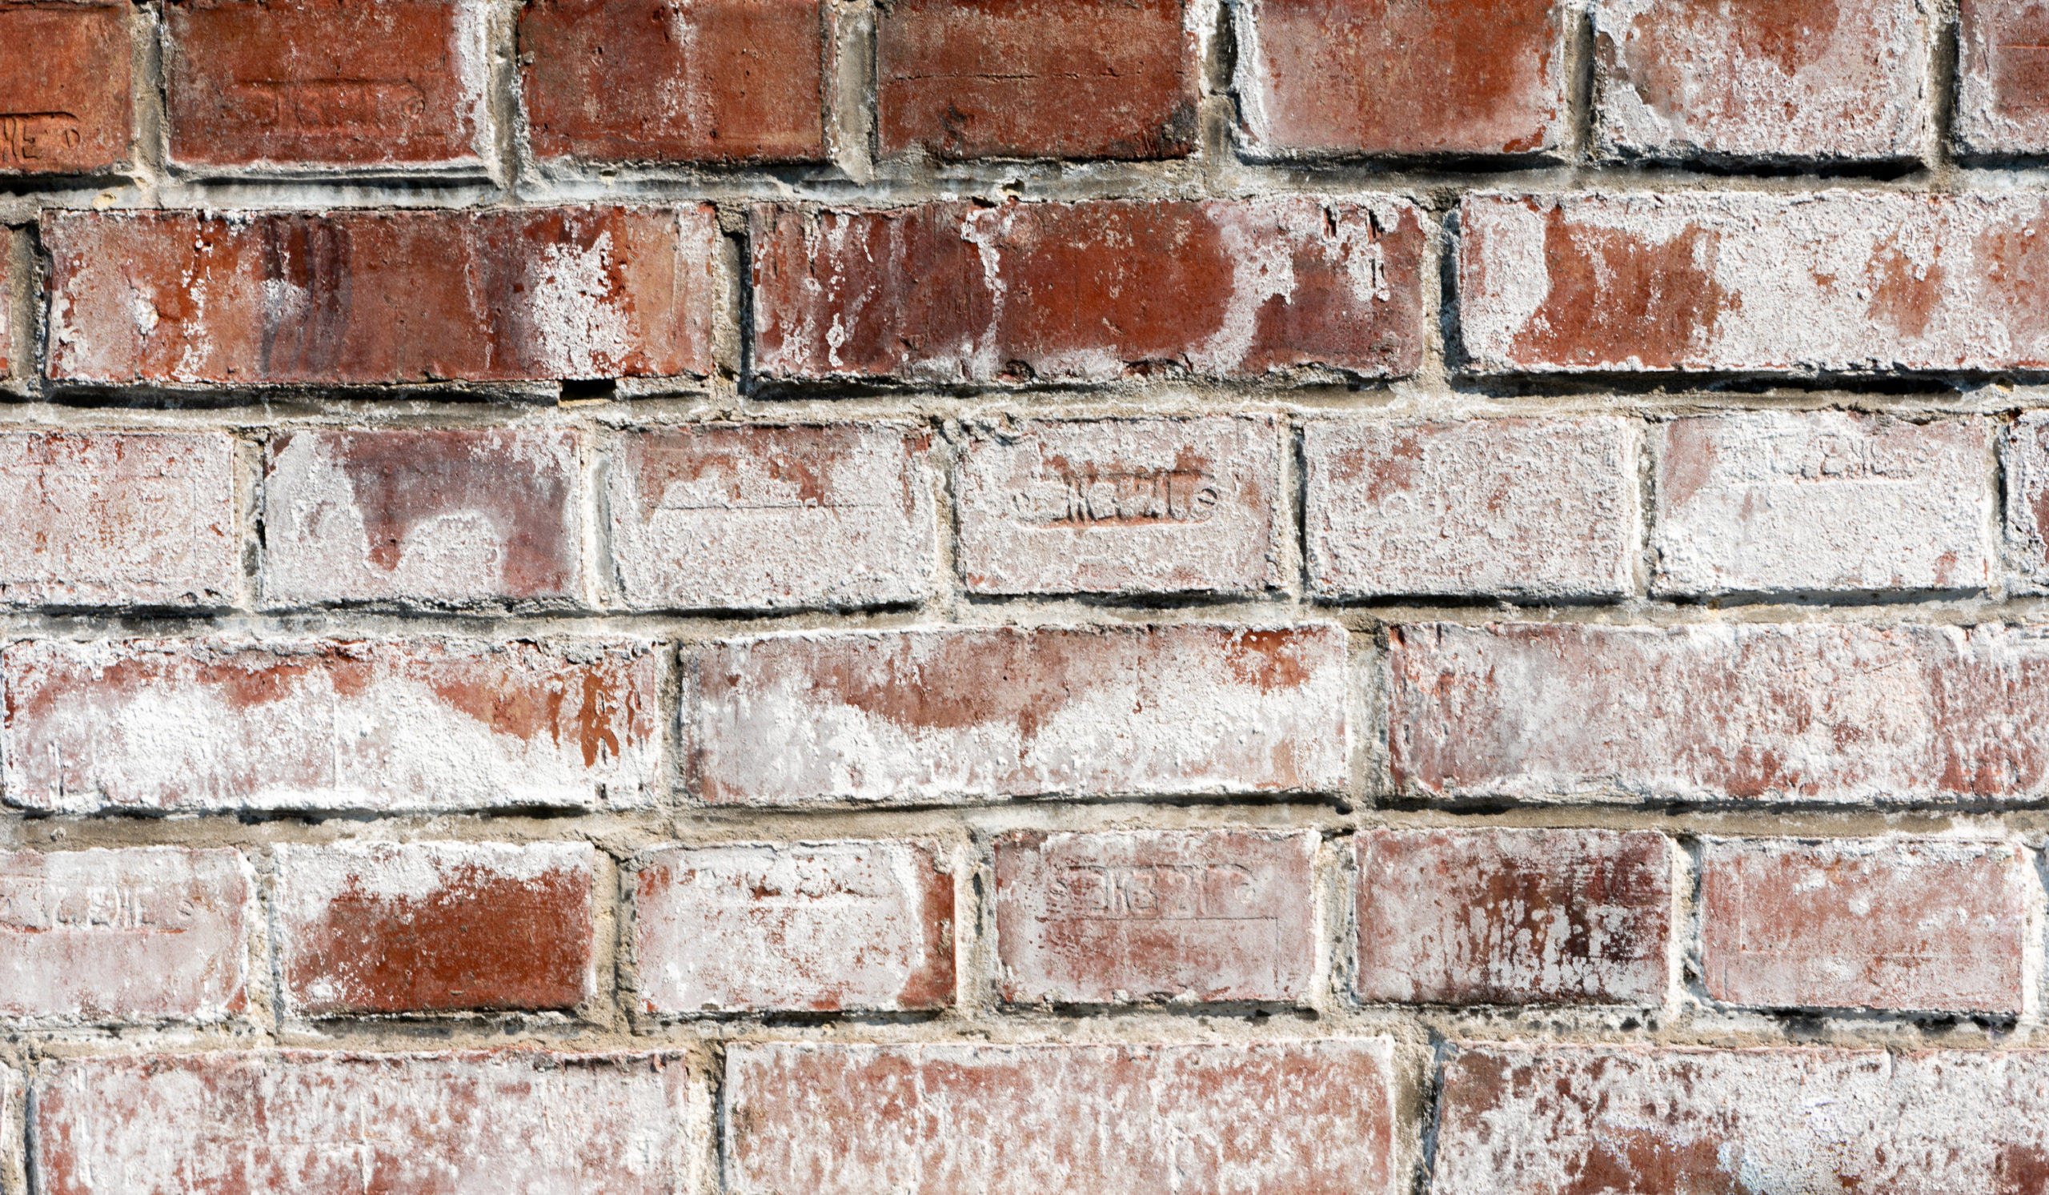
What next? What else?
Next steps:
The effect of gravity
If there is salt (or eg: colloids), where does it end up?

Slide 27
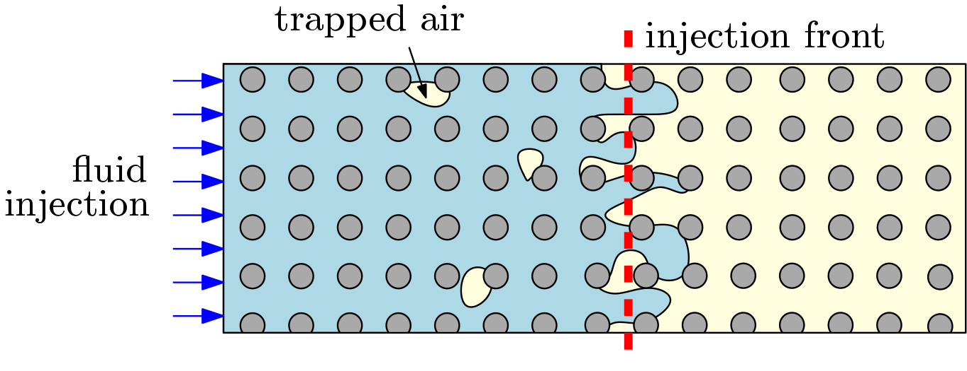
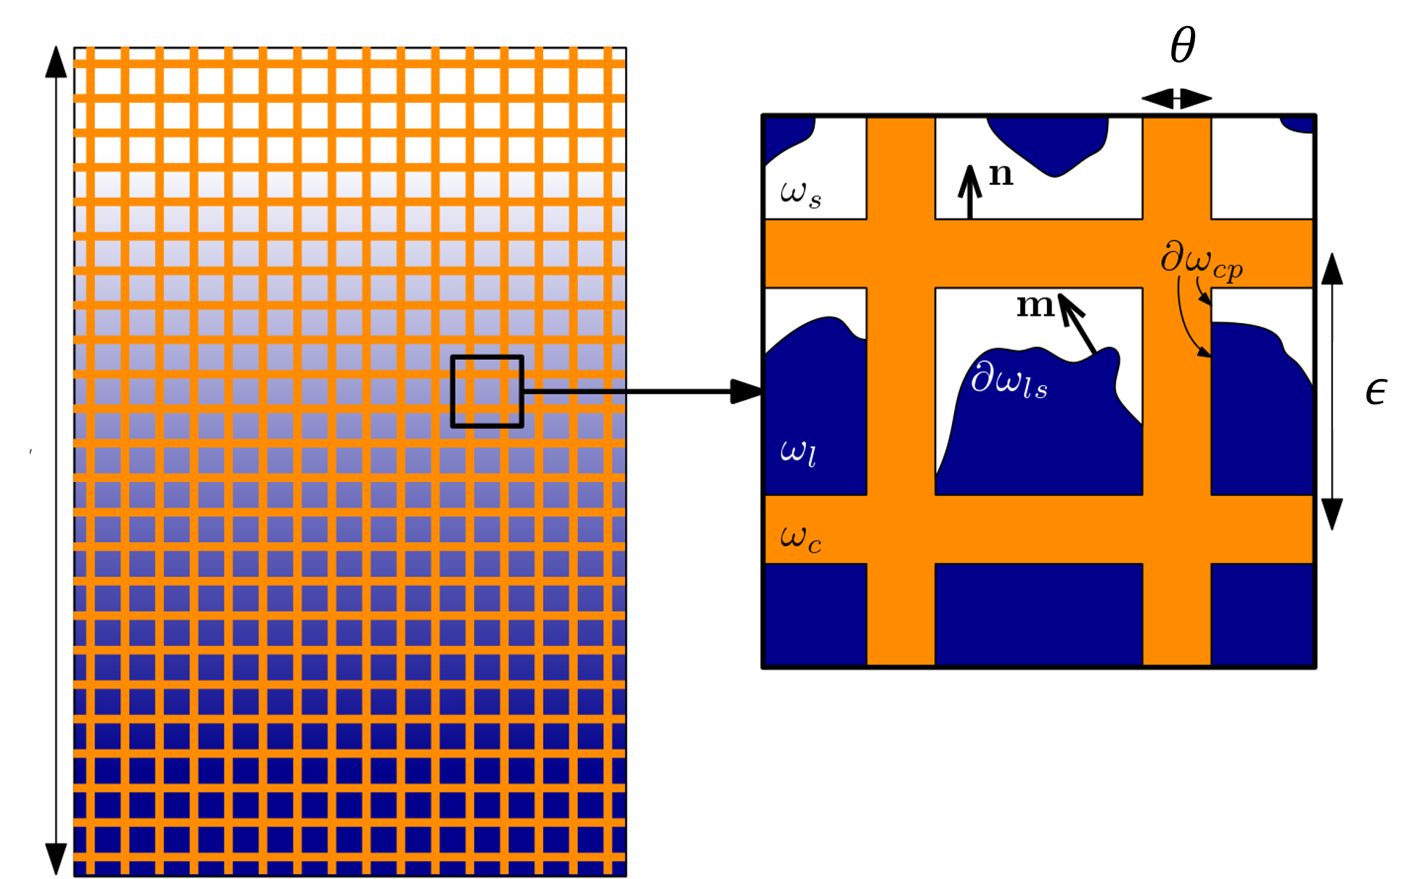
What next? What else?
Next steps:
The effect of gravity
If there is salt (or eg: colloids), where does it end up?
I’m also interested in:
Imbibition and forced imbibition
Air-trapping during flooding of porous media
Freezing and melting within porous structures
Please get in touch!
ellen.luckins@warwick.ac.uk
Questions?

