Slide 1


UMR 5295
CLOSED PHYSICALLY BASED DYNAMIC CAPILLARY PRESSURE FOR TWO PHASE FLOW IN POROUS MEDIA
D. LASSEUX,
I2M, CNRS, Univ. Bordeaux
33405 TALENCE Cedex France
F. J. VALDES-PARADA,
Universidad Autonoma Metropolitana-Iztapalapa
09340 MEXICO D.F., Mexico
didier.lasseux@cnrs.fr
InterPore 2026 – Nantes – 19-22May 2026

Slide 2
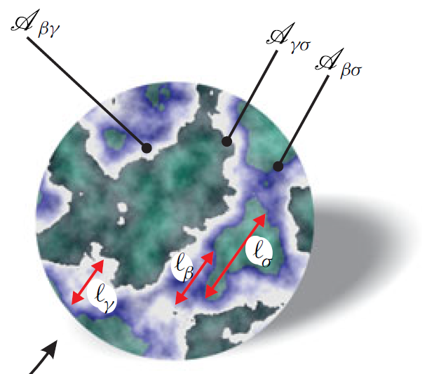
1. Context - Objective
Context: Immiscible two-phase (creeping) flow in homogeneous porous media
β -phase
Applications: - oil recovery (Muskat & Meres, 1936),
- flow in packed bed reactors,
- hydrology,
- flow in biological tissues,
- drying of porous materials,
- gas–water management in fuel cells …
- CCS, H₂ storage.
σ -phase
(solid)
Pore-scale description Macroscopic model
γ -phase
2

Slide 3

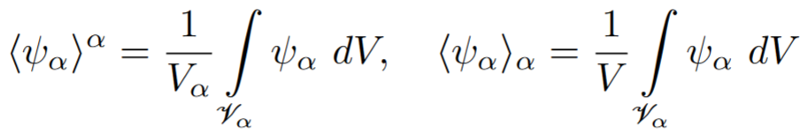
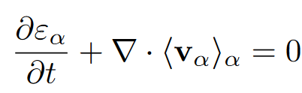


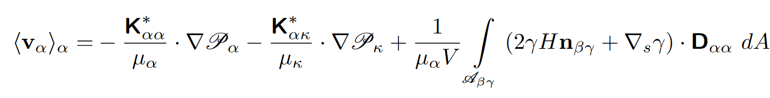





1. Context – Objective (cont’d)
Recall: closed flow model at the REV scale
Averages:
,
,
,
: solution of a closure problem on a (periodic) REV
(Lasseux & Valdés-Parada, JFM, 2022, 944, A43)

Slide 4
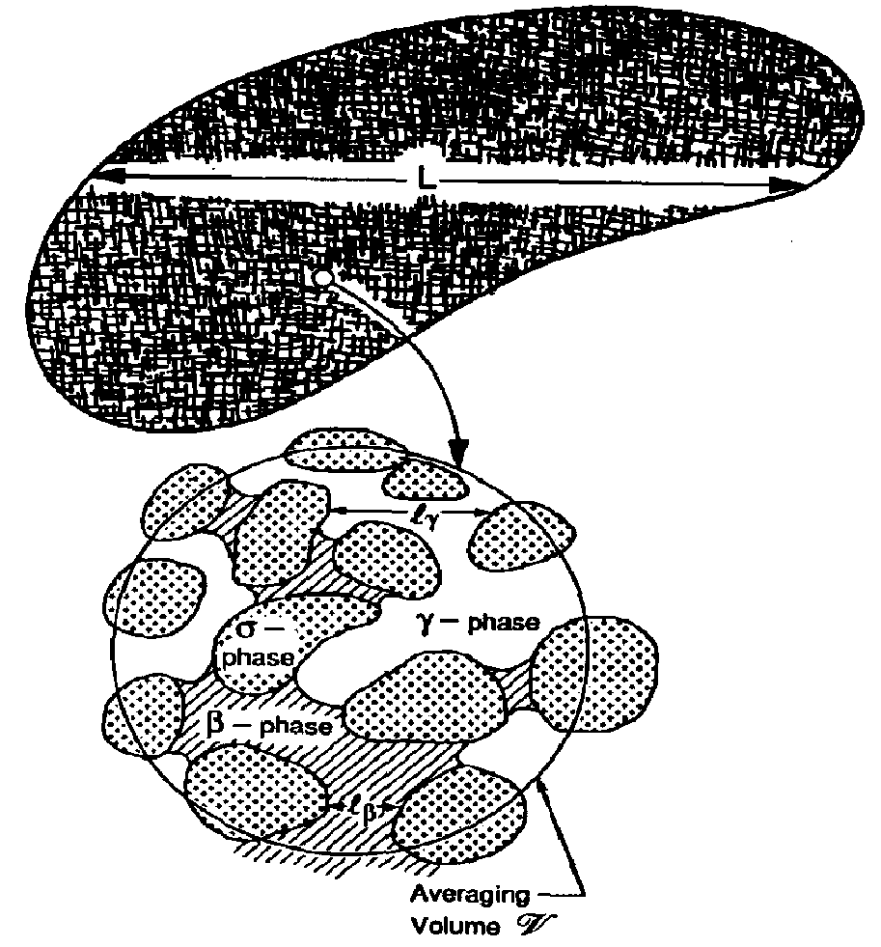






1. Context – Objective (cont’d)
Macroscopic scale
Number of unknowns: 6 ( )
Number of equations: 5
Need a closure equation:
the macroscopic capillary pressure
Muskat & Meres, 1936: equilibrium
Hassanizadeh & Gray, 1990; 1993
(REV scale)

Slide 5
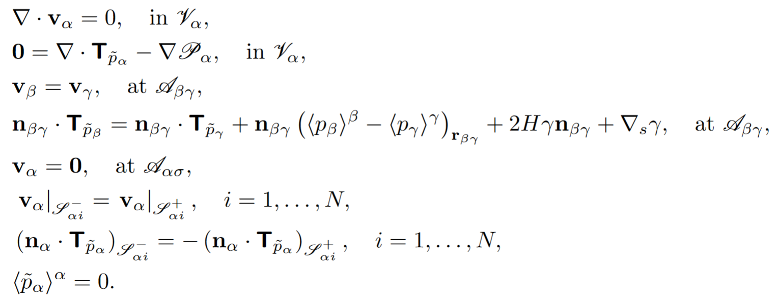
2. Pore-scale problem
On REV (periodic)

Slide 6
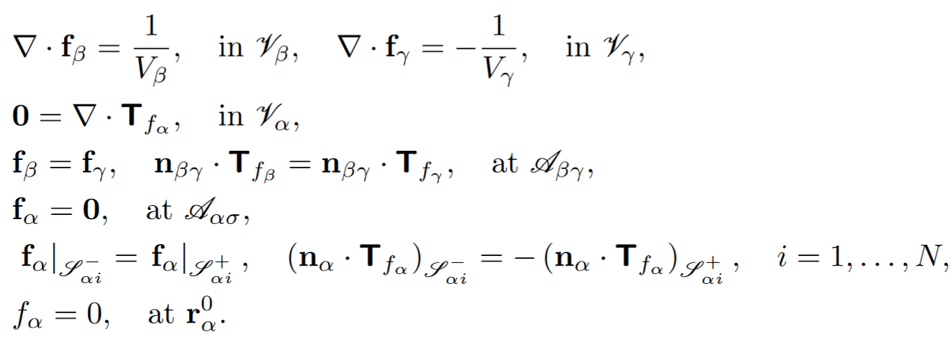
3. Upscaling and macroscale model
The adjoint problem (for the pressures)

Slide 7


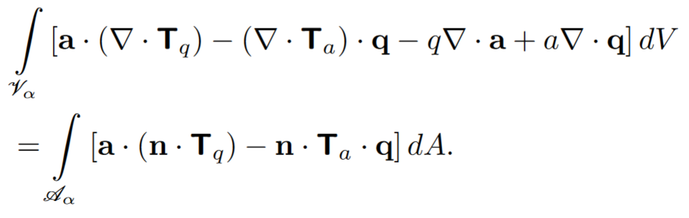


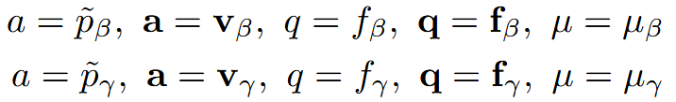
3. Upscaling and macroscale model (cont’d)
Combination of the physical and adjoint problems: Green’s formula
and arbitrary (sufficiently regular)
Take successively :

Slide 8
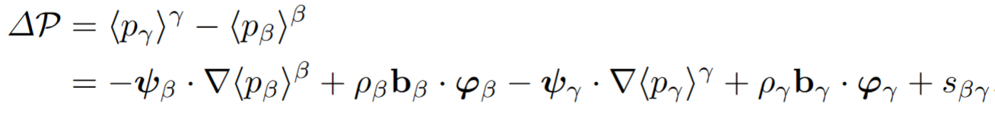
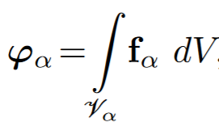
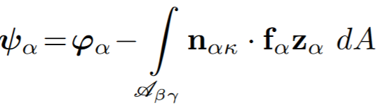

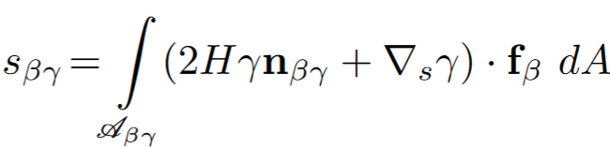

3. Upscaling and macroscale model (cont’d)
Dynamic capillary pressure Upscaled Equation (UE):
Position relative to the -phase center
of mass in the REV
Note: equilibrium
(Lasseux & Valdés-Parada, JFM, 2023, 959, R2)

Slide 9
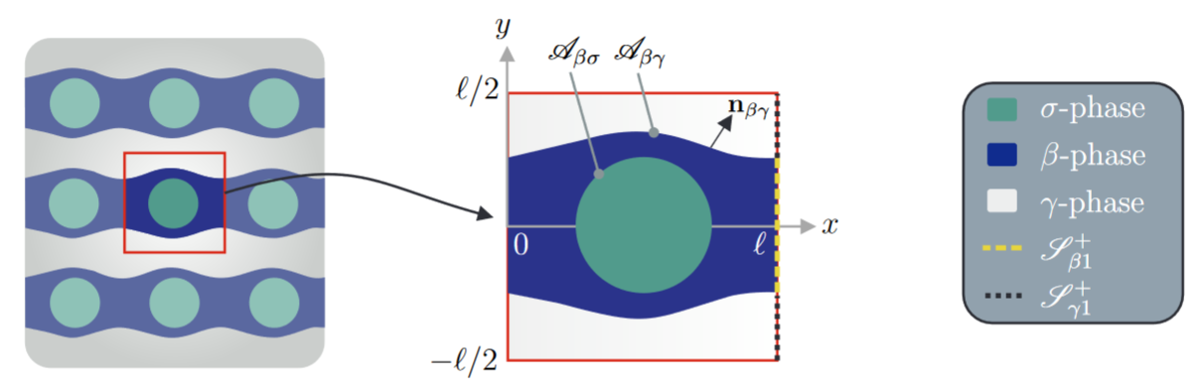

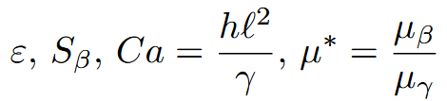
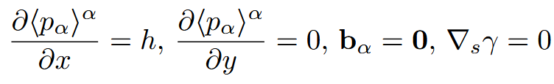
4. Some results
2D configuration
Perform DNS (pore-scale flow problem) and compute
Solve the adjoint, compute effective coefficients and
from the Upscaled Equation (UE)
Use a Boundary Element Method (BEM) to solve both problems
Parameters:

Slide 10
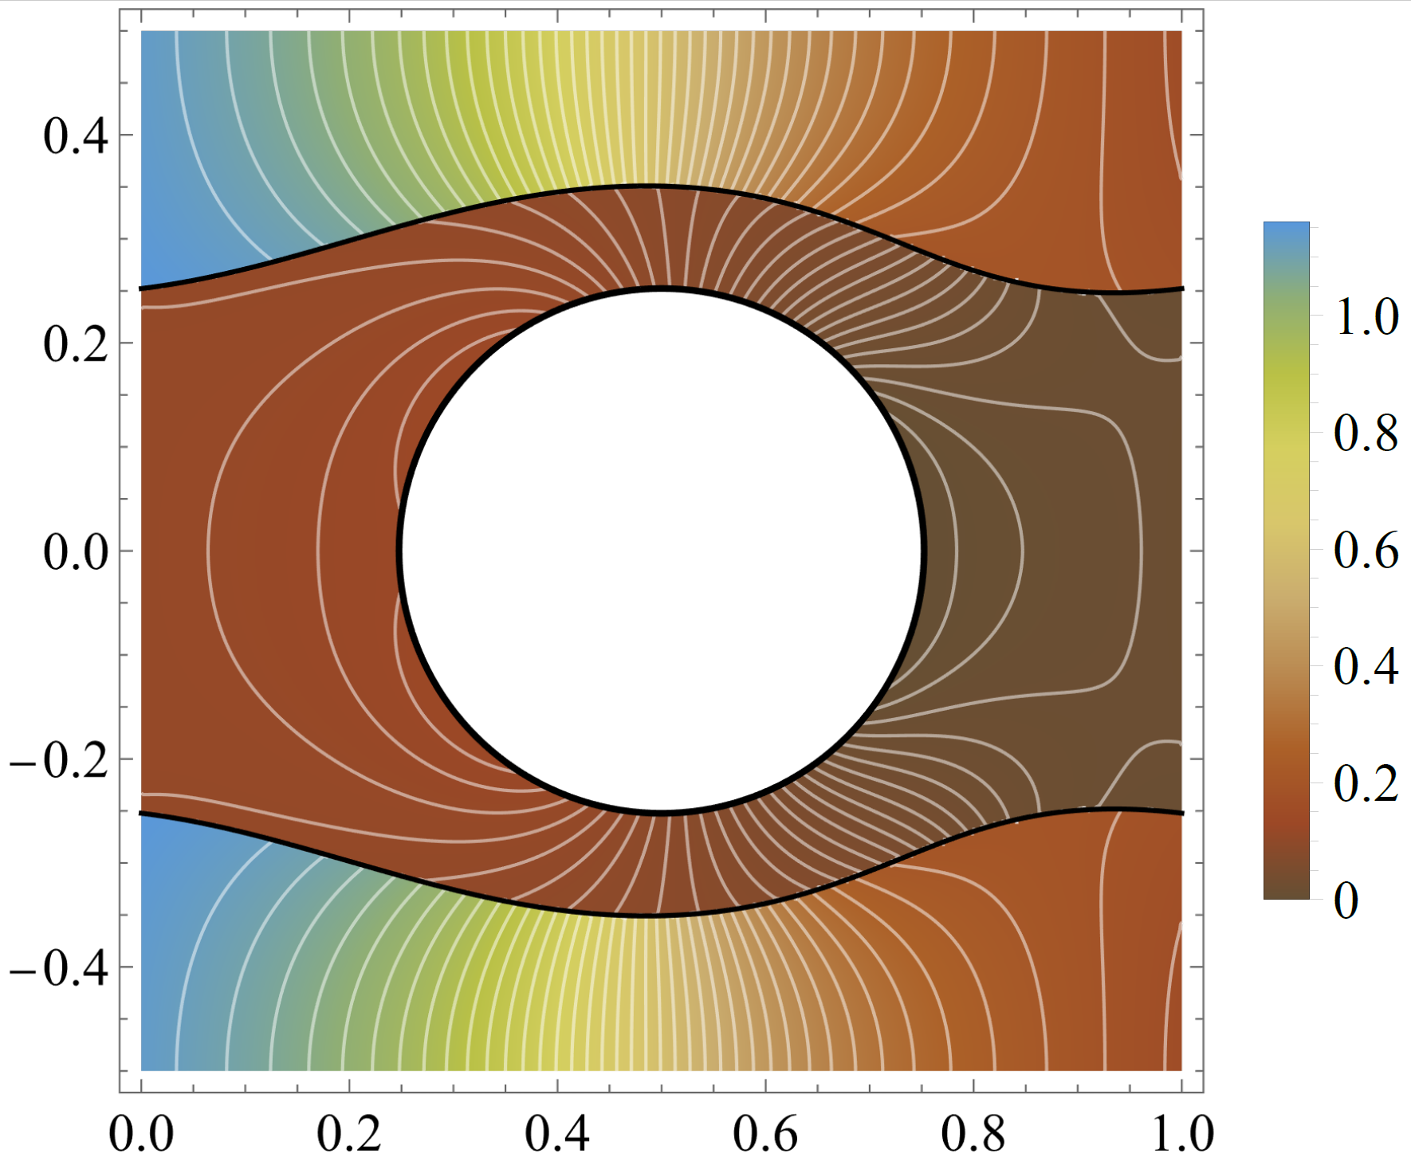




4. Some results (cont’d)
Pore-scale pressure fields in a unit cell
-phase (non-wetting)
-phase
(solid)
-phase (wetting)

Slide 11

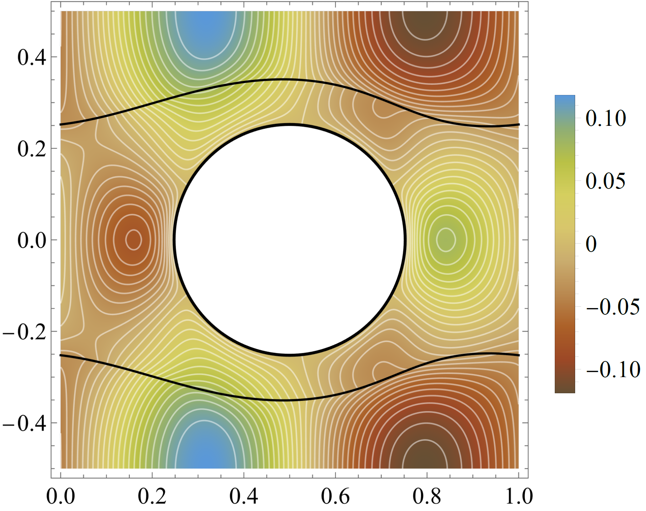
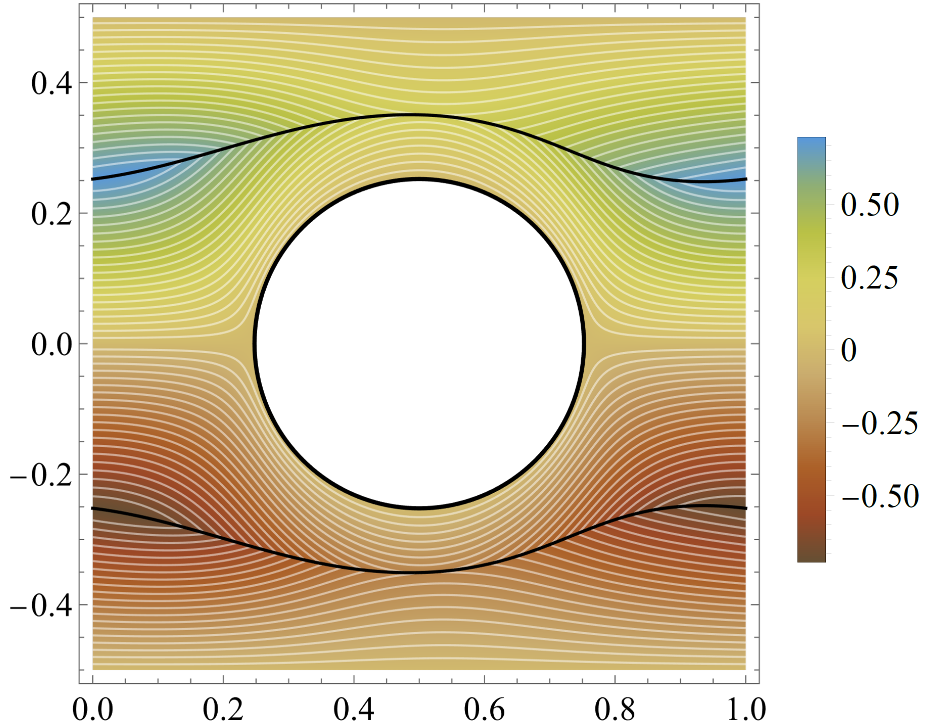


4. Some results (cont’d)
Adjoint variable fields in a unit cell
γ
σ
σ
β

Slide 12

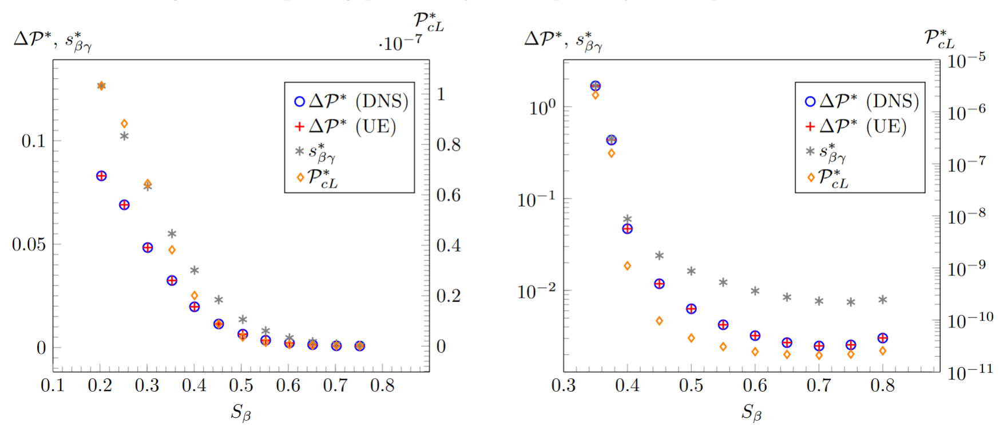


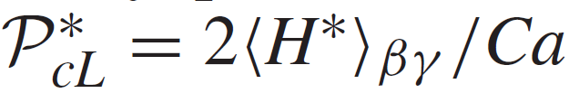
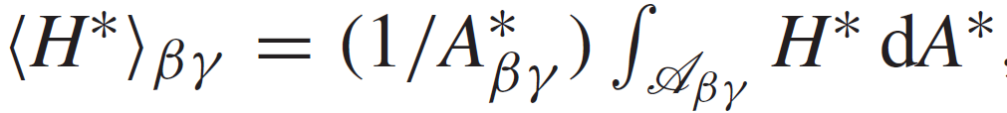
4. Some results (cont’d)
Steady-state
,

Slide 13
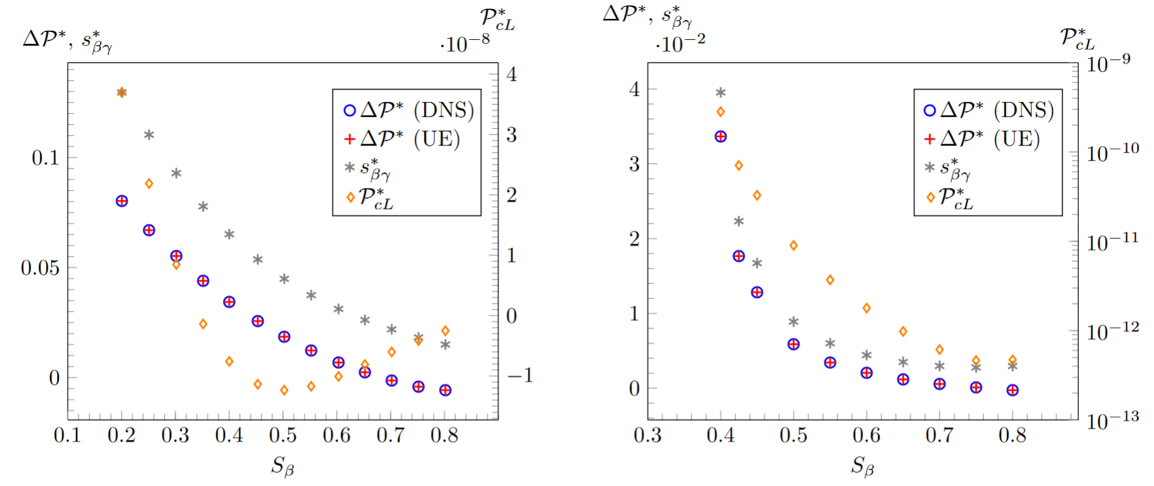


4. Some results (cont’d)
Steady-state

Slide 14
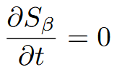
5. Conclusions
- A closed upscaled equation is obtained for the macroscopic
dynamic capillary pressure for two-phase flow in porous media.
- No additional assumptions than those formulated at the pore-scale level are made
(interfaces are not necessarily steady at the pore-scale).
- All effective coefficients are predicted from the solution of an adjoint problem
over a REV.
- It includes effects of surface tension, macroscopic pressure gradients
and volume forces in each phase.
- The Laplace capillary pressure is retrieved at equilibrium ( is not sufficient).
- It is consistent and validated by DNS.
- Extension to cases of generalised Newtonian flows and non-negligible inertia
(Sanchez-Vargas et al., JFM, 2023, 970, A9).

