Slide 1




Unsaturated Flow and Solute Transport: Effects of Soil Heterogeneity and Gravity Finger Formation
Yajaira A. CASTILLO¹, Marco DENTZ¹, Juan J. HIDALGO¹
¹Institute of Environmental Assessment and Water Research (IDAEA - CSIC), Barcelona, Spain

Slide 2
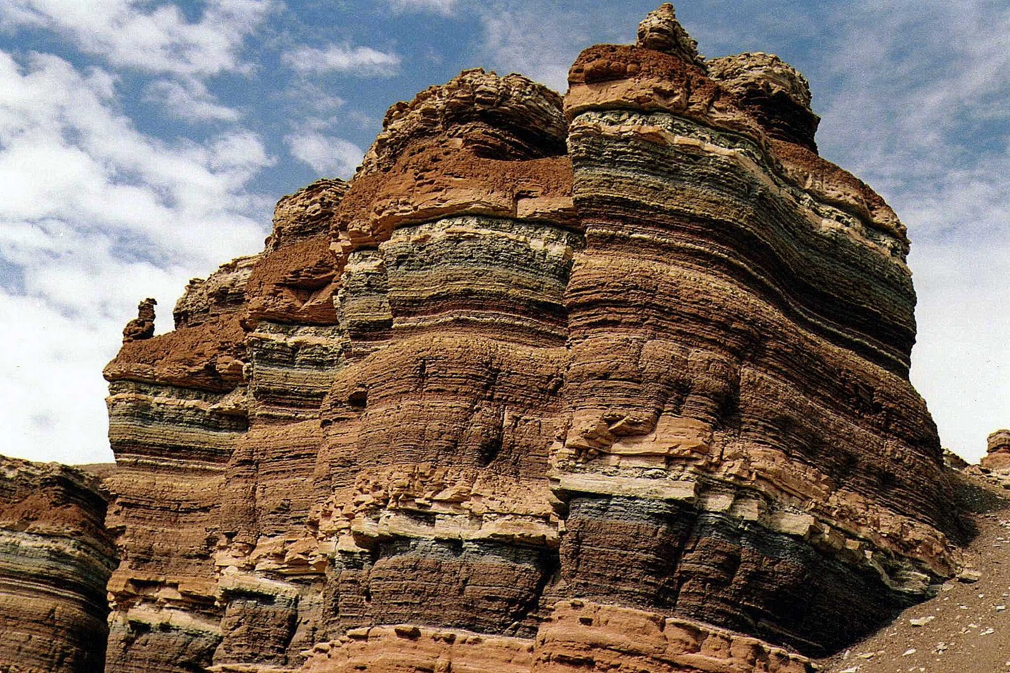
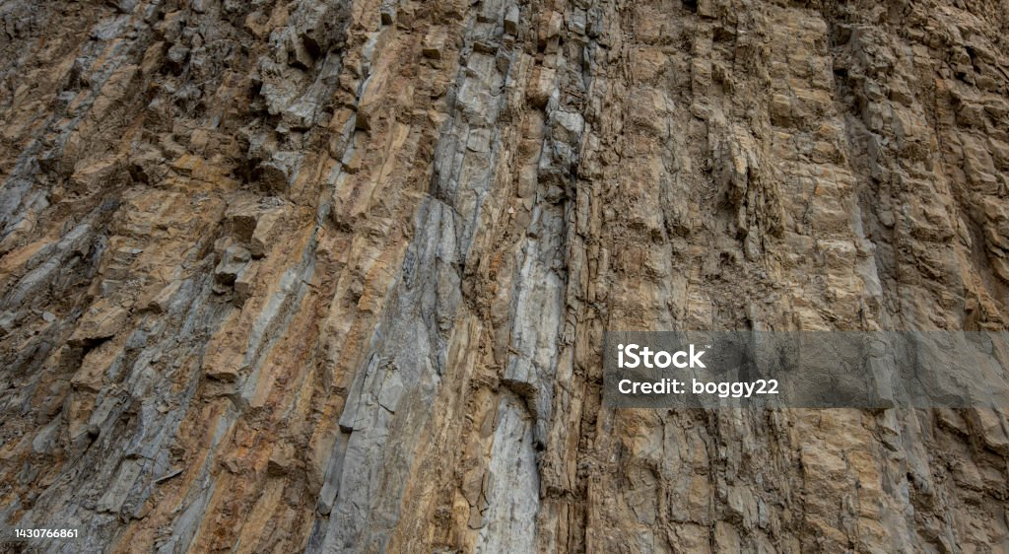
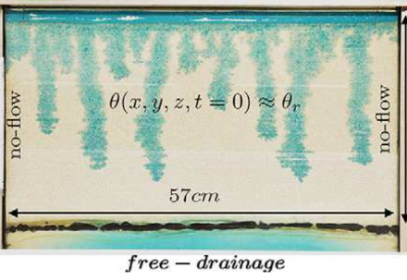
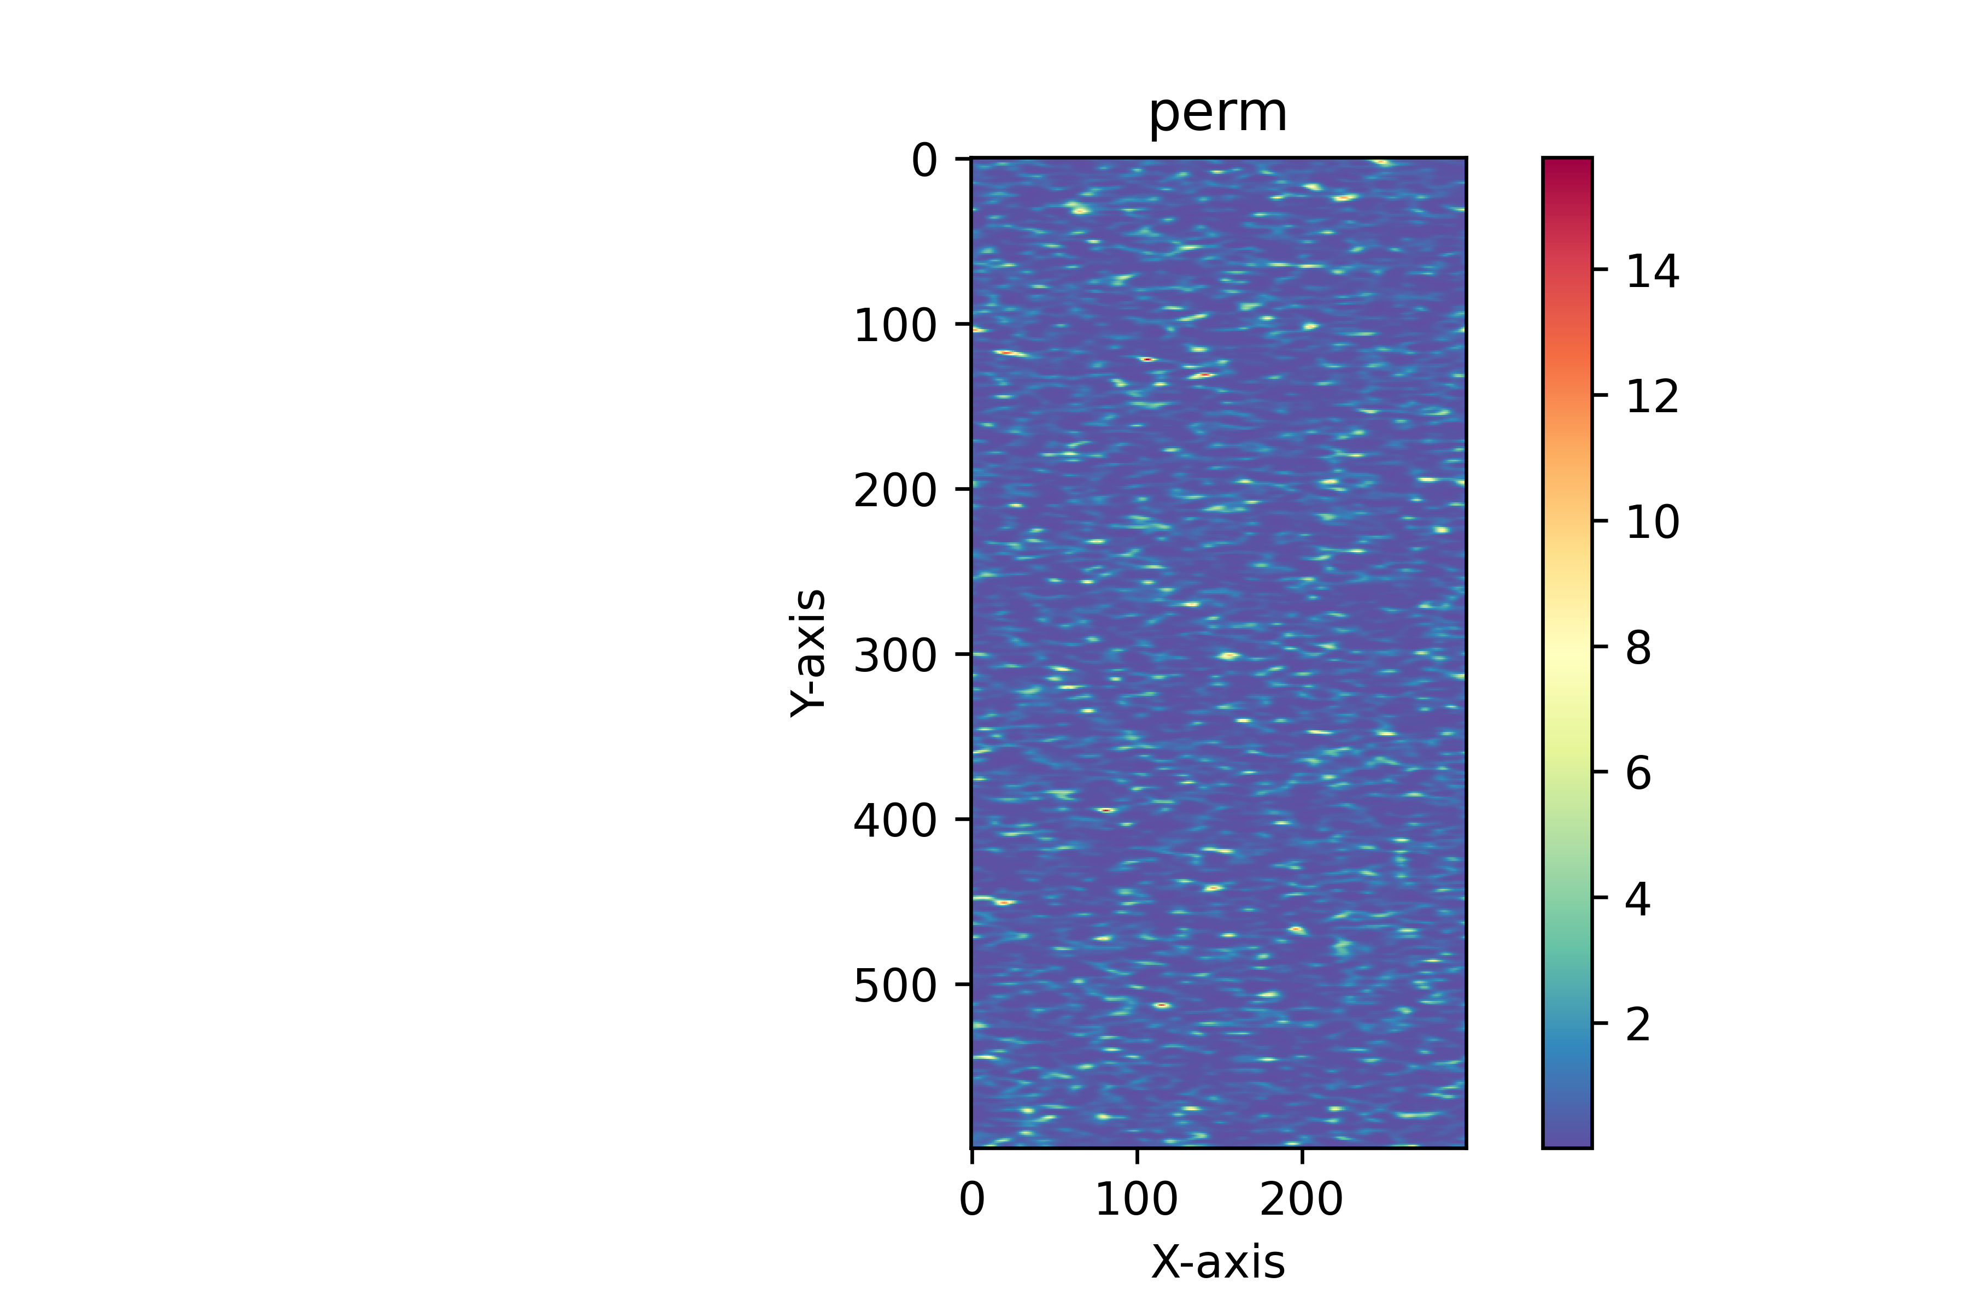
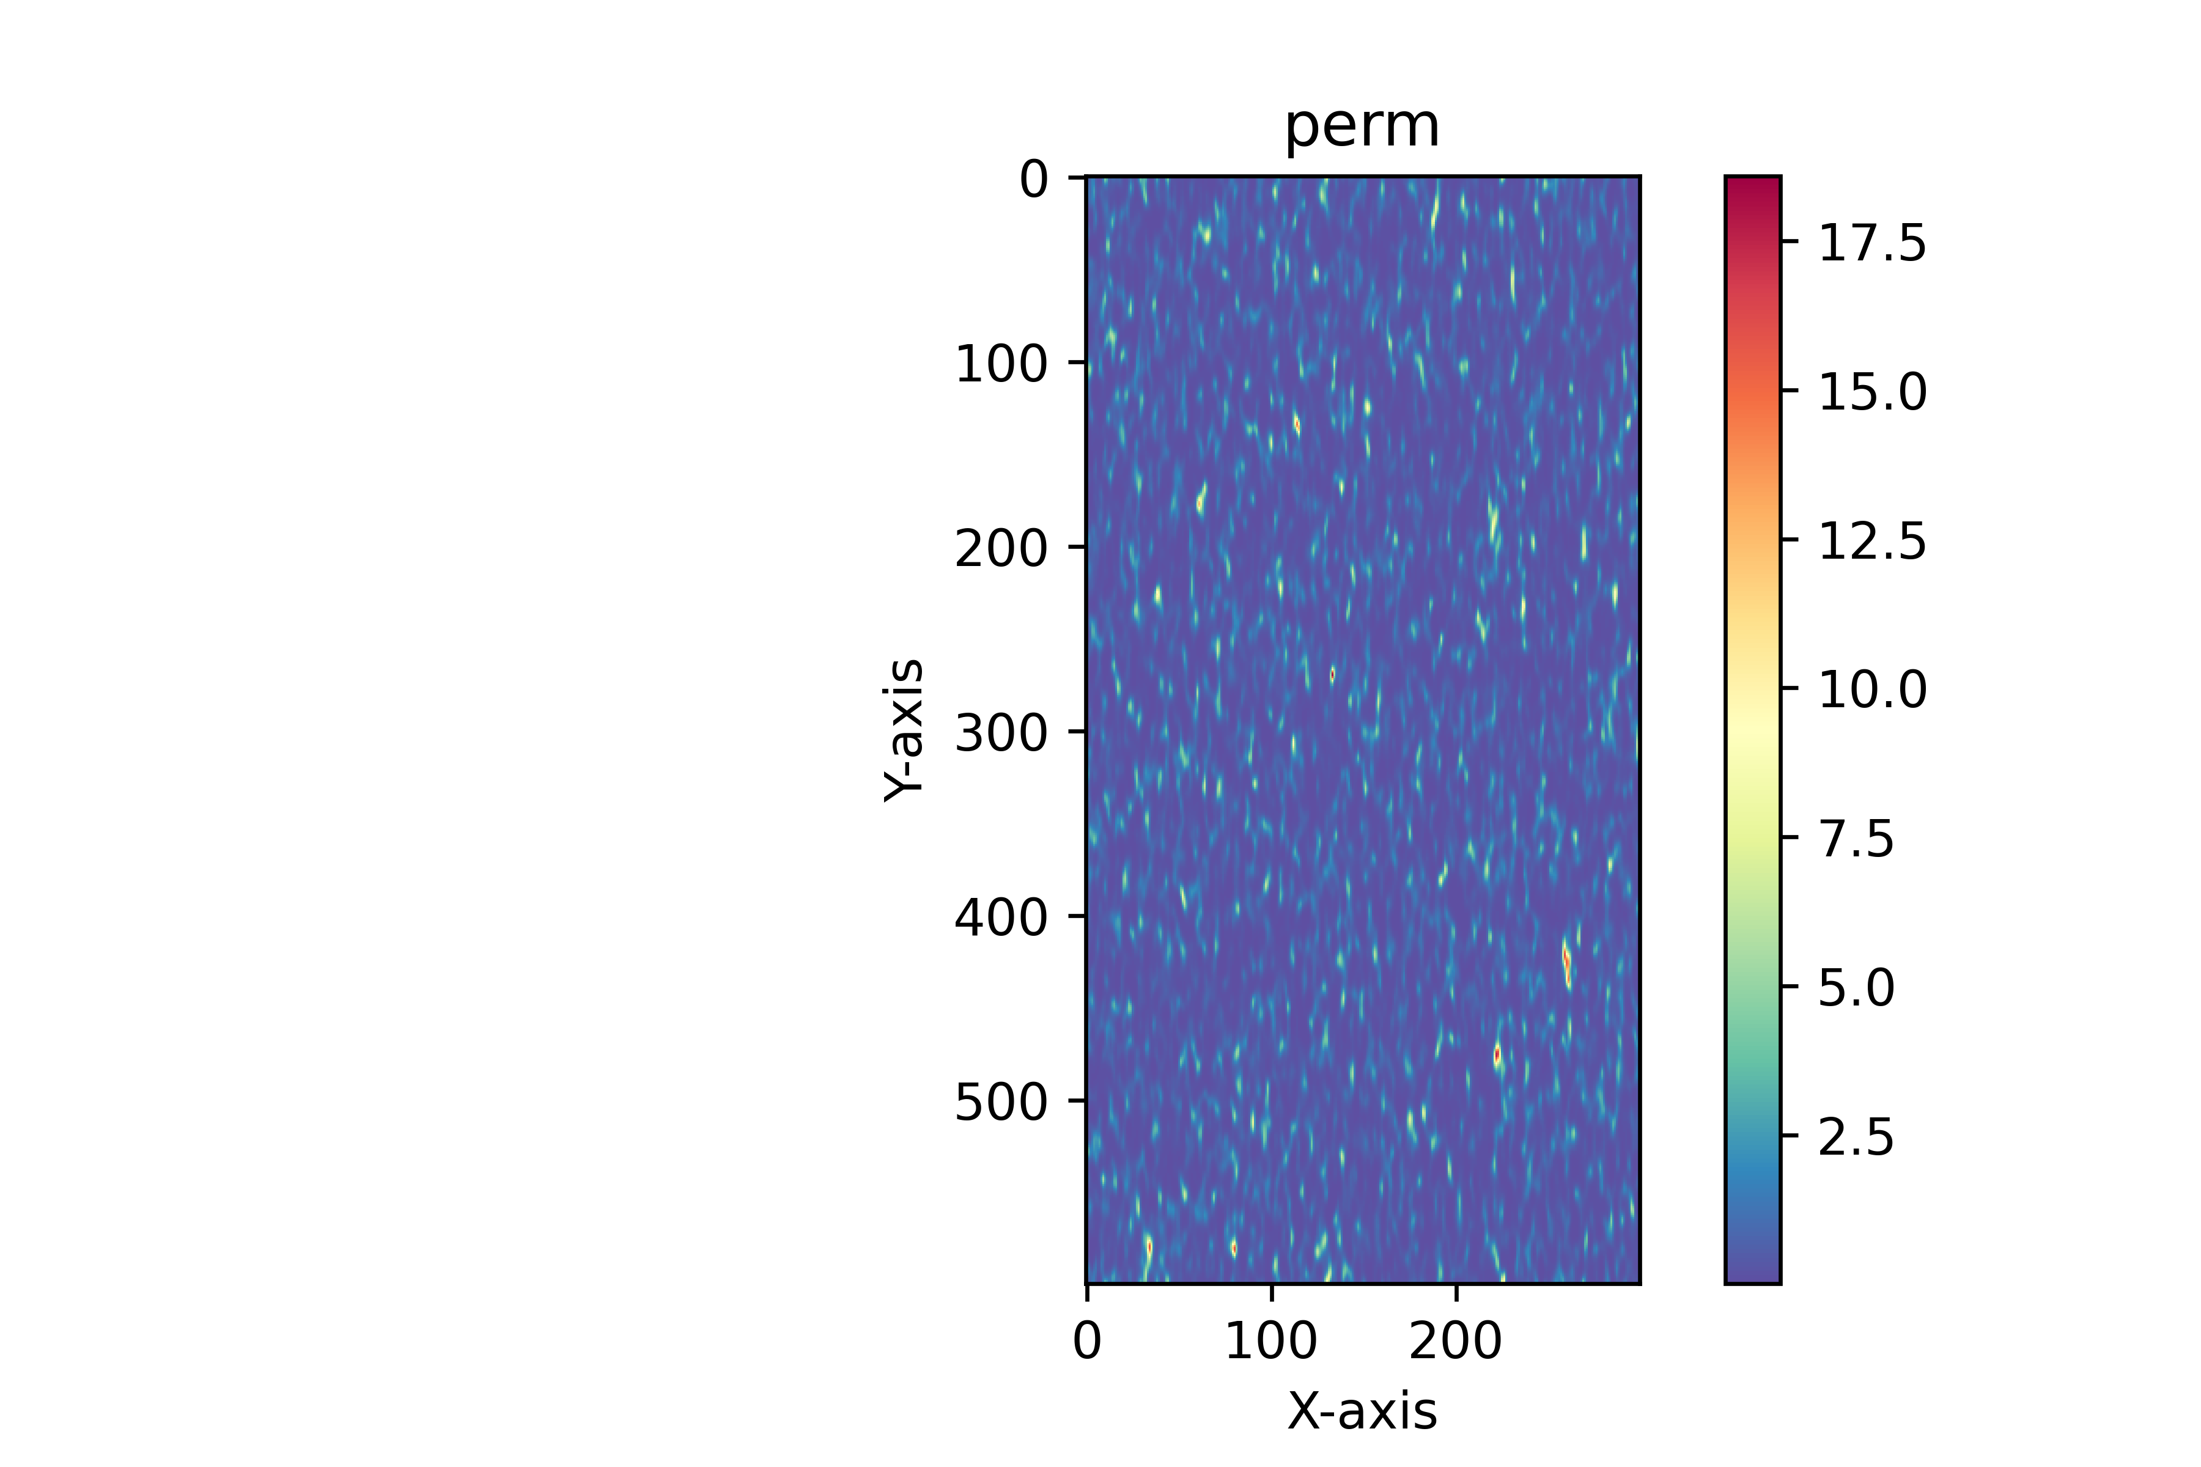
1. Introduction 2.Methodology 3. Model Setup 4. Results and Discussion 5. Conclusions 6. Future work
1. Objective
To investigate the impact of soil heterogeneity and preferential flow formation on unsaturated flow and solute transport.
Soil heterogeneity
Preferential Flow
Cremer, C. J., Schuetz, C., Neuweiler, I., Lehmann, P., & Lehmann, E. H. (2017). Unstable infiltration experiments in dry porous media. Vadose Zone Journal, 16(7), 1-13.
2. Applicability
Protecting water resources
Environmental remediation
Predicting contaminant transport
2

Slide 3
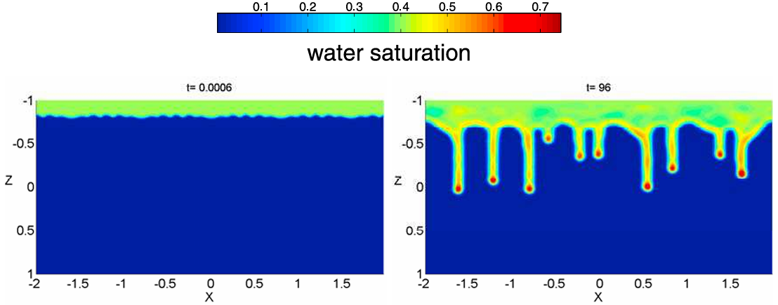
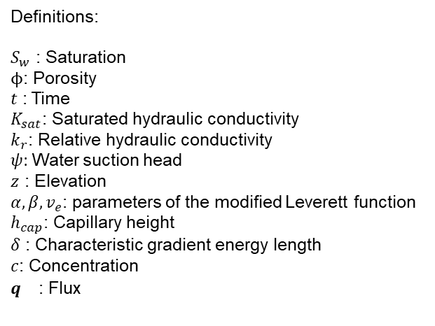



1. Introduction 2.Methodology 3. Model Setup 4. Results and Discussion 5. Conclusions 6. Future work
Flow equation
Richards’ equation
$$φ\frac{\left(∂S_{w}\right)}{\left(∂t\right)}=−∇∙\left[K_{sat}k_{r}\left(S_{w}\right)∇\left( Ψ\left(S_{w}\right) + z \right)\right]$$
Capillary forces
Gravitational forces
Extended Richards’ equation following Cueto-Felgueroso et al. (2020)
$$φ\frac{\left(∂S_{w}\right)}{\left(∂t\right)}=−∇∙\left[K_{sat}k_{r}\left(S_{w}\right)∇\left( Ψ\left(S_{w}\right) + z + \sqrt{κ(S_{w})}∇∙\left(\sqrt{κ\left(S_{w}\right)}∇S_{w}\right) \right)\right]$$
Two-dimensional simulations of fingered flow (Cueto-Felgueroso and Juanes, 2009)
Nonlocal capillary effects
$$k_{r}\left(S_{w}\right)={\left(\frac{S_{w}− S_{rw}}{1−S_{rw}}\right)}^{a}$$
Definitions:
$S_{w}$ : Saturation
$ϕ$: Porosity
$t$ : Time
$K_{sat}$: Saturated hydraulic conductivity
$k_{r}$: Relative hydraulic conductivity
$ψ$: Water suction head
$z$ : Elevation
$α,β,v_{e}$: parameters of the modified Leverett function
$h_{cap}$: Capillary height
$δ$ : Characteristic gradient energy length
$c$: Concentration
$q^{}$ : Flux
$$Ψ(S_{w})=h_{cap}S_{w}^{−1/α}\left[1−exp⁡(β\left(S_{w}−v_{e}\right))\left(1+β\frac{α}{α−1}S_{w}\right) \right]$$
$$κ\left(S_{w}\right)=h_{cap}δ^{2}\frac{α}{α−1}S_{w}^{(α−1)/α}\left[1−exp⁡(β(S_{w}−v_{e}))\right]$$
Transport equation
$$φS_{w}\frac{∂c}{∂t}=−q∙∇c+∇∙(φS_{w}D∇c)$$
3

Slide 4

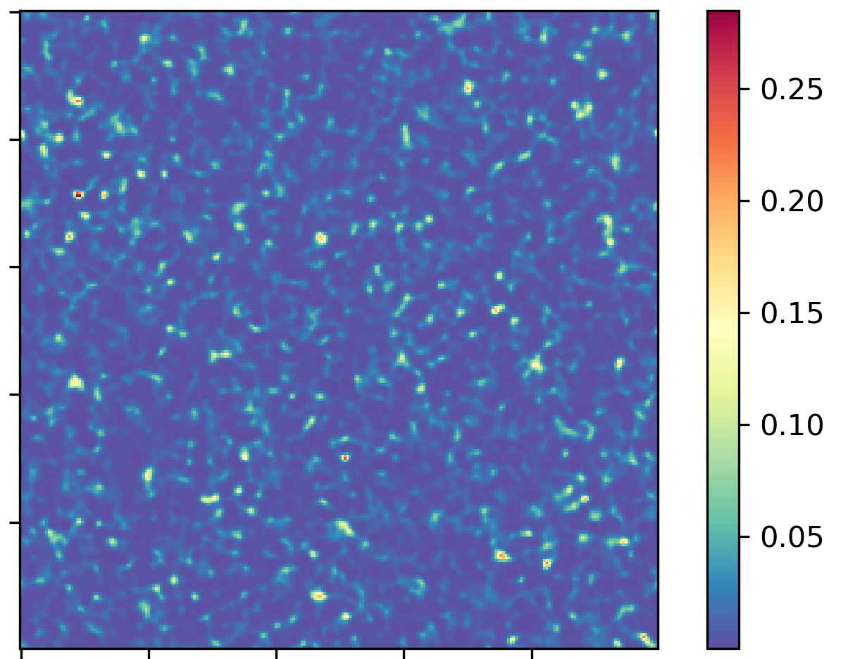
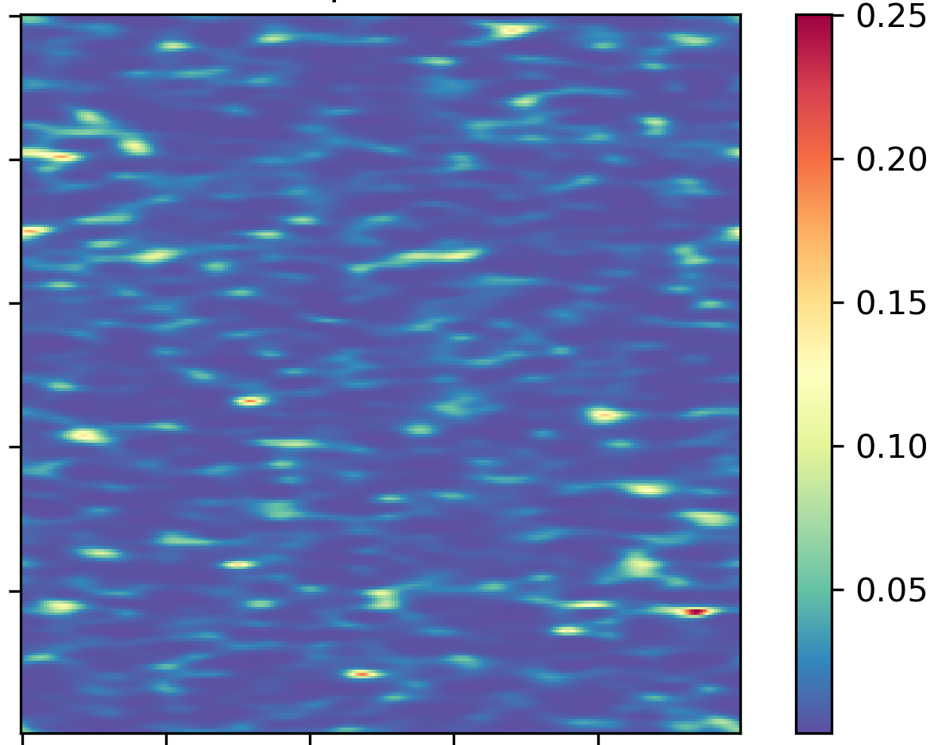









1. Introduction 2.Methodology 3. Model Setup 4. Results and Discussion 5. Conclusions 6. Future work
Geometry
Heterogeneous soils
C = 1 during the solute pulse; C = 0 otherwise
Horizontal
anisotropy
Vertical
anisotropy
Isotropic
$q_{w}$ (Infiltration)
$$K_{sat}$$
$$K_{sat}$$
$$K_{sat}$$
$${\text{S}}_{0}=0.1$$
z
Free drainage
x
Parameters
Geometric mean:
$$K_{sat,g}=6.6 x{10}^{−3}m/s$$
Flux ratio:
$$R_{s}=0.002$$
Flux:
$$q_{w}=1.32 x{10}^{−5}m/s$$
5

Slide 5
1. Introduction 2.Methodology 3. Model Setup 4. Results and Discussion 5. Conclusions 6. Future work
Cases studied
Part 1: Richards’ equation vs. extended model under homogeneous hydraulic conductivity and isotropic initial saturation perturbations.
Part 2: Extended-model simulations of unsaturated flow and solute transport in heterogeneous soils.

Slide 6
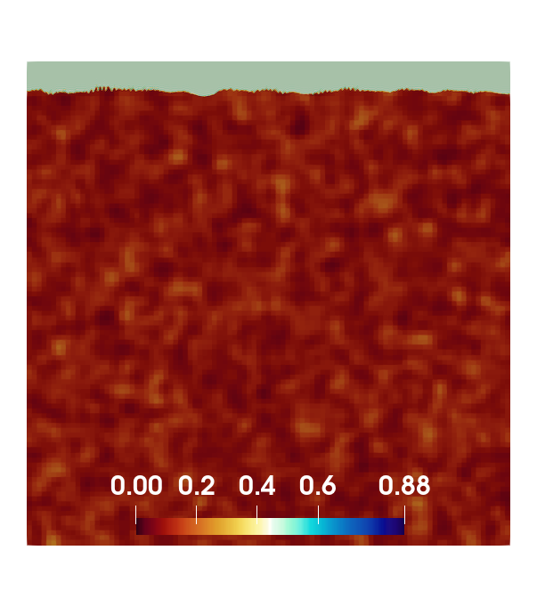
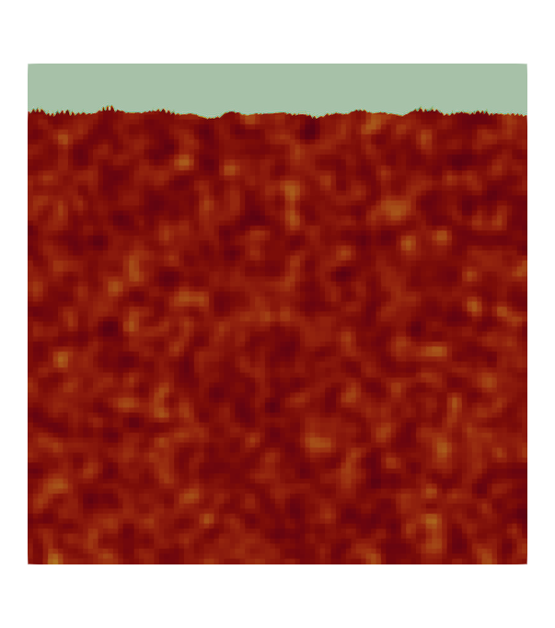
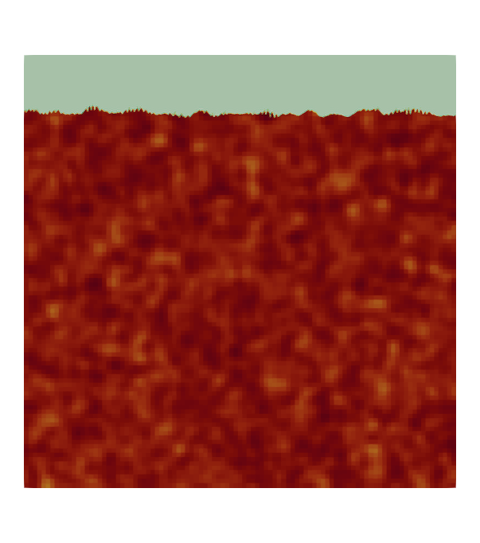
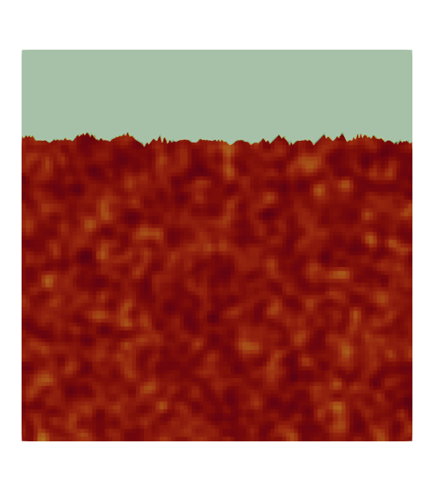
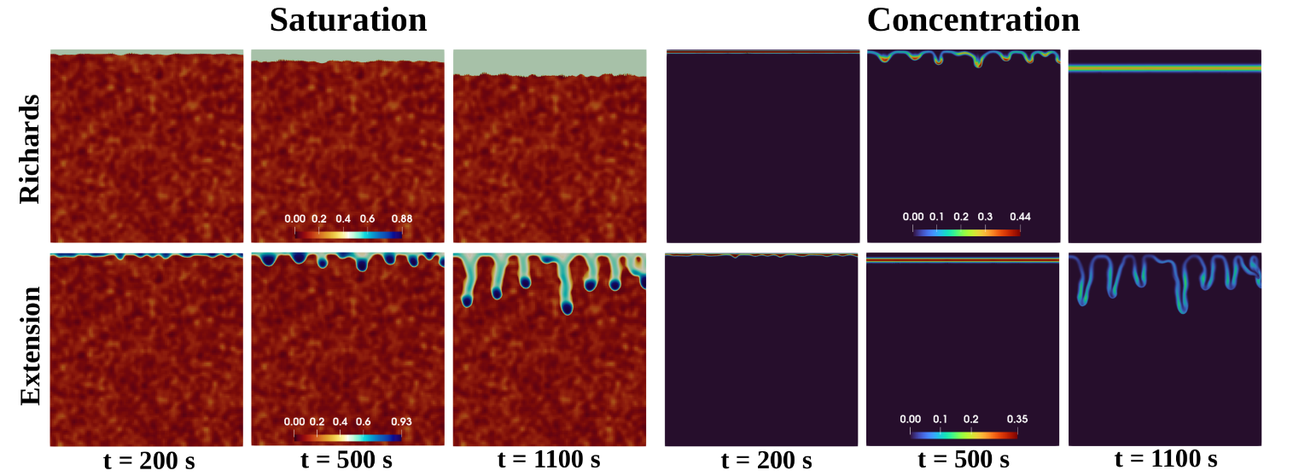
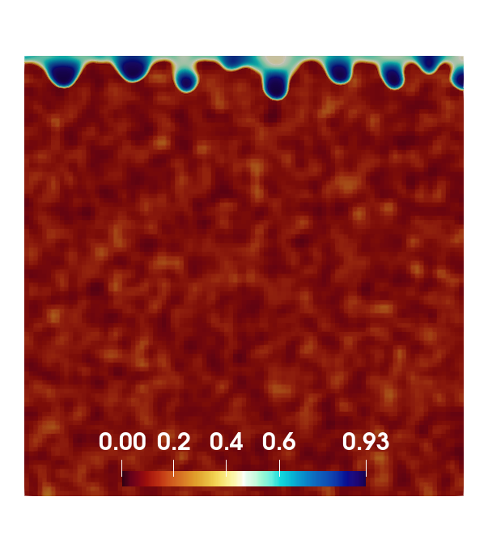
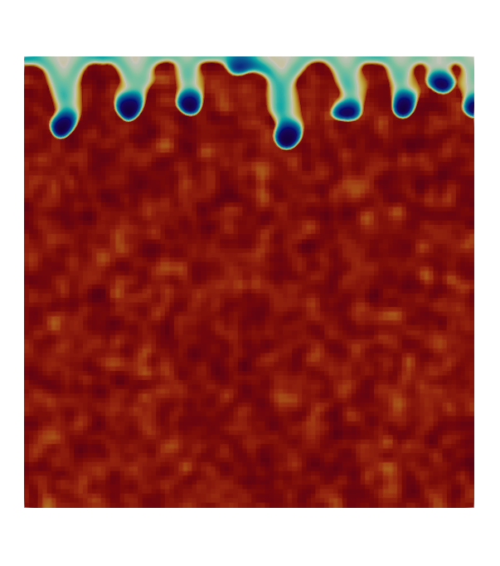
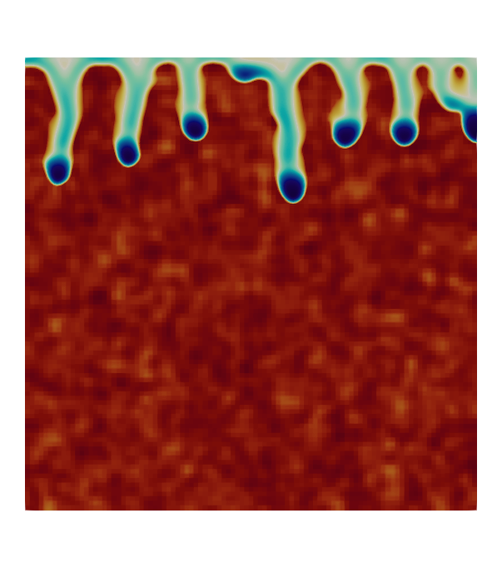
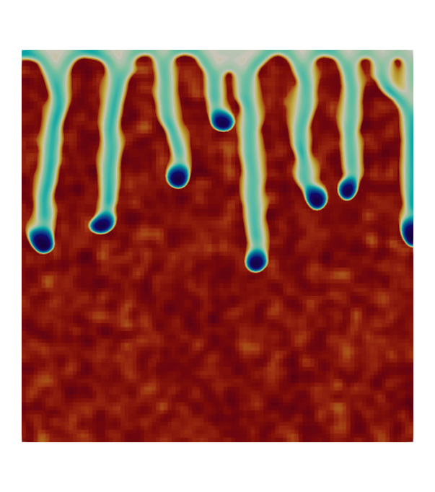
1. Introduction 2.Methodology 3. Model Setup 4. Results and Discussion 5. Conclusions 6. Future work
Saturation
Richards model
Extended model
t = 500 s
t = 800 s
t = 1100 s
t = 1900 s
6

Slide 7
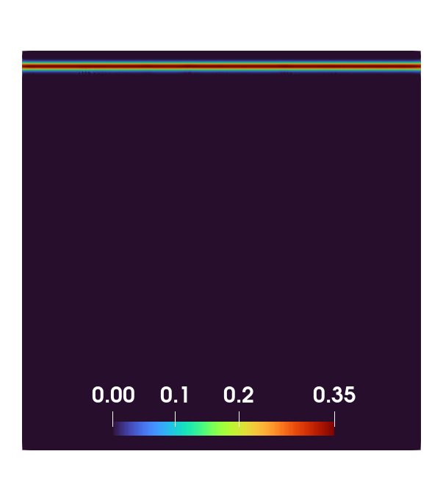



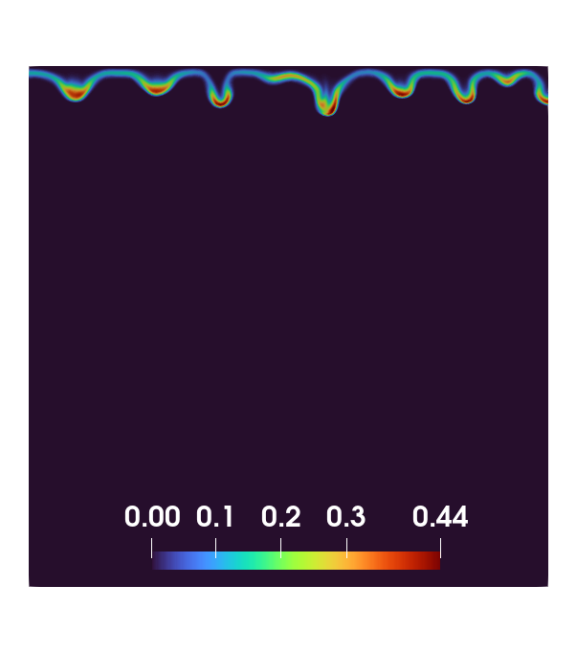

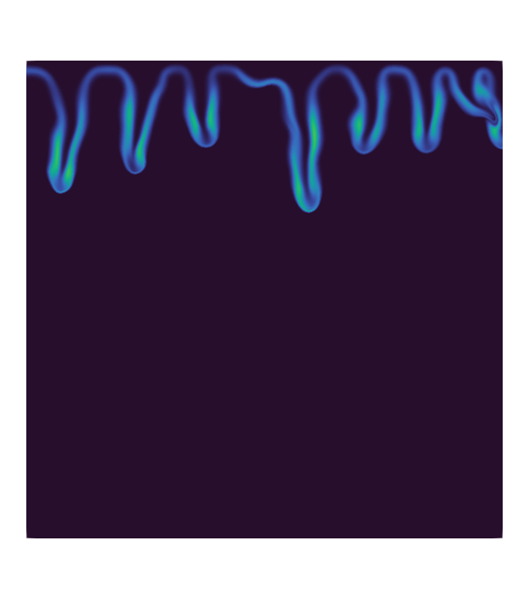
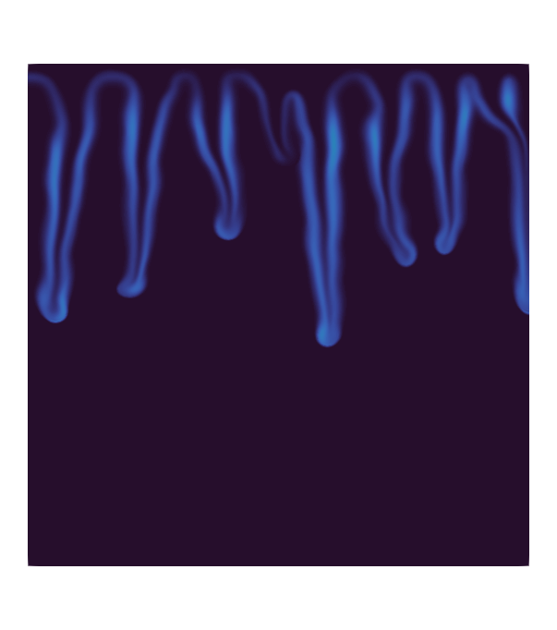
1. Introduction 2.Methodology 3. Model Setup 4. Results and Discussion 5. Conclusions 6. Future work
Solute transport
Richards model
Extended model
t = 500 s
t = 800 s
t = 1100 s
t = 1900 s
6

Slide 8
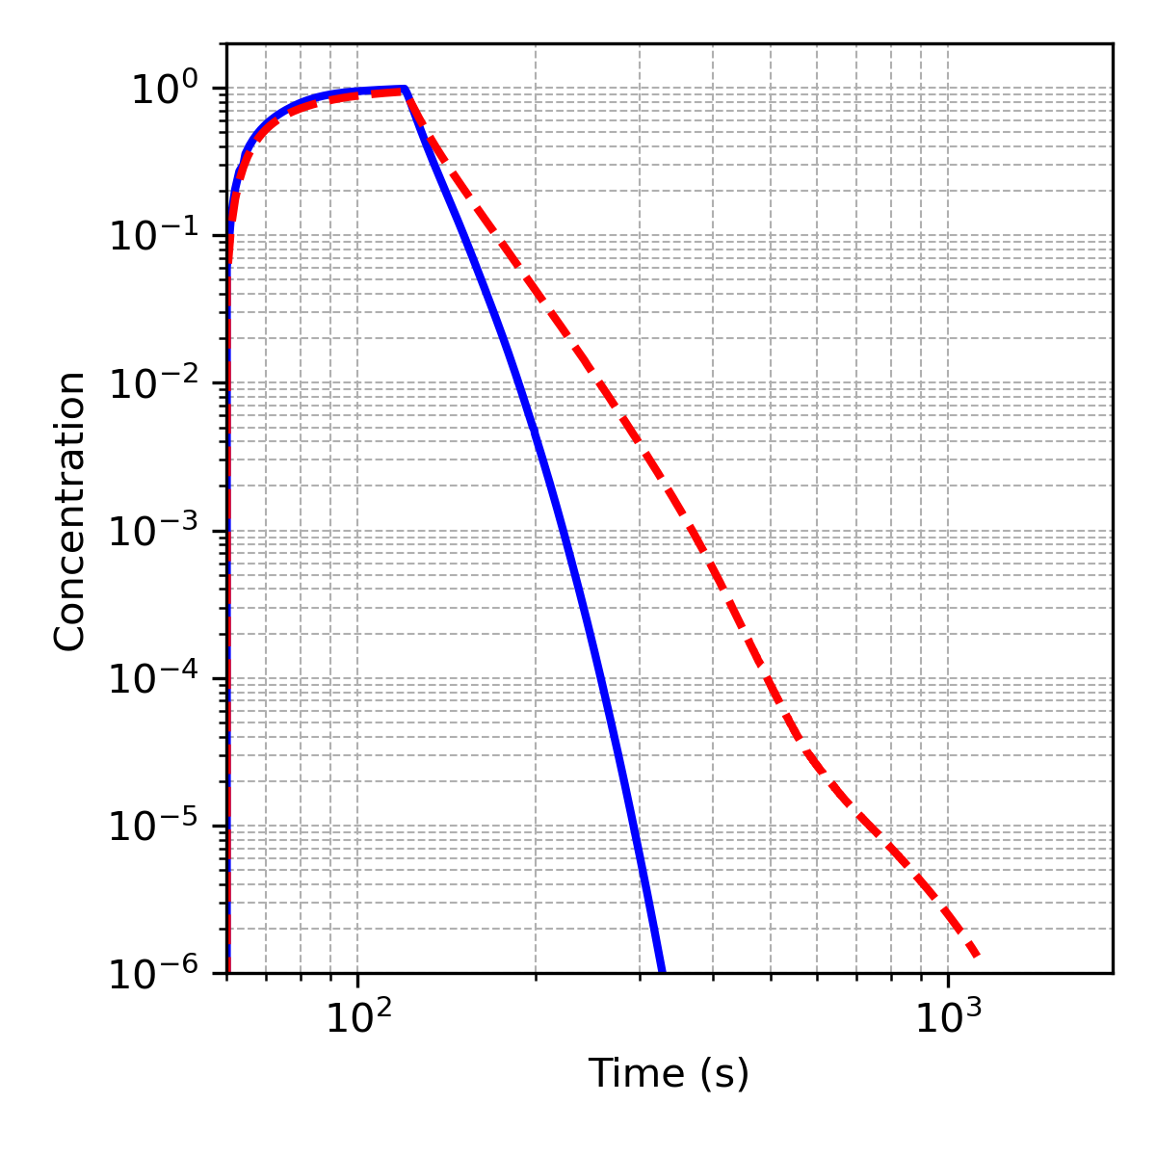
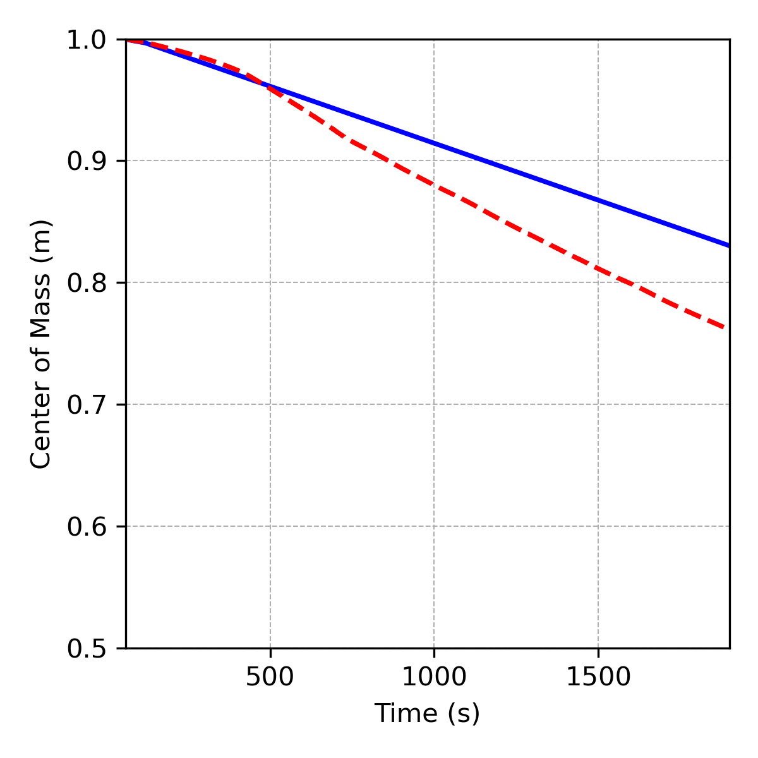
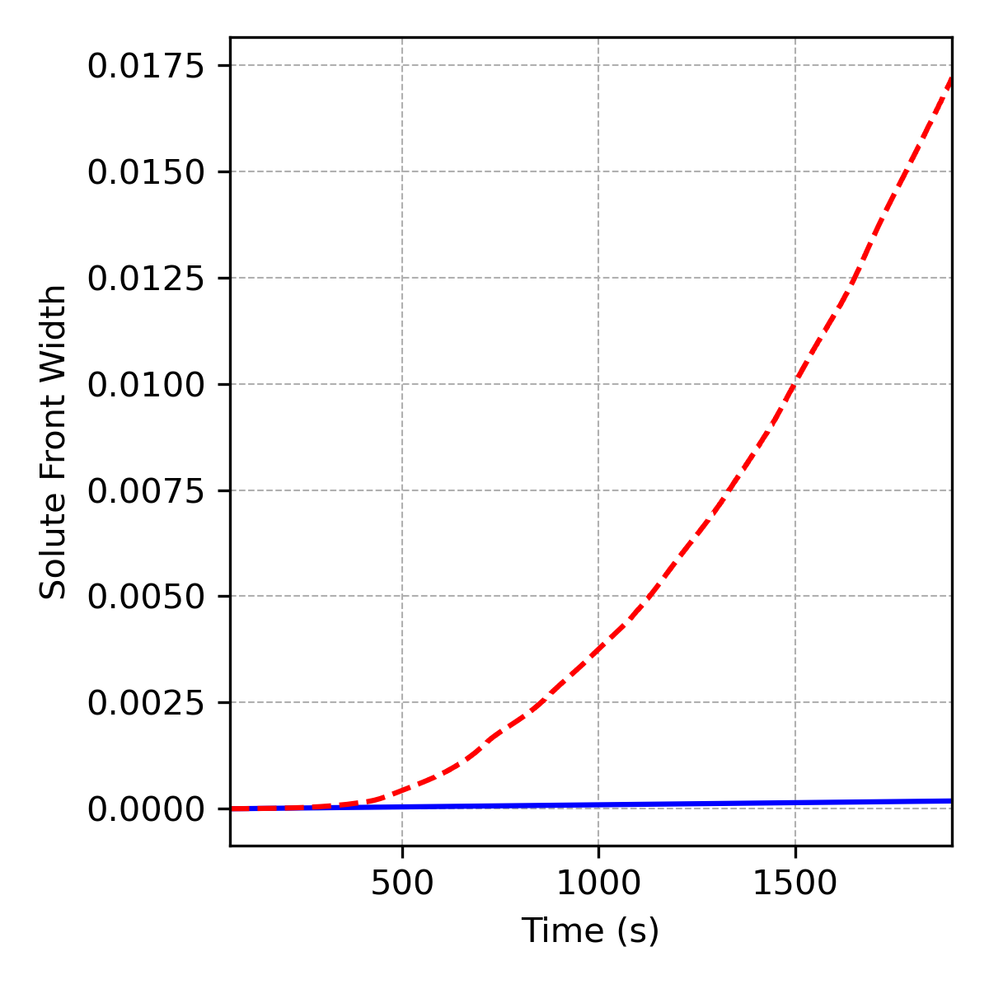
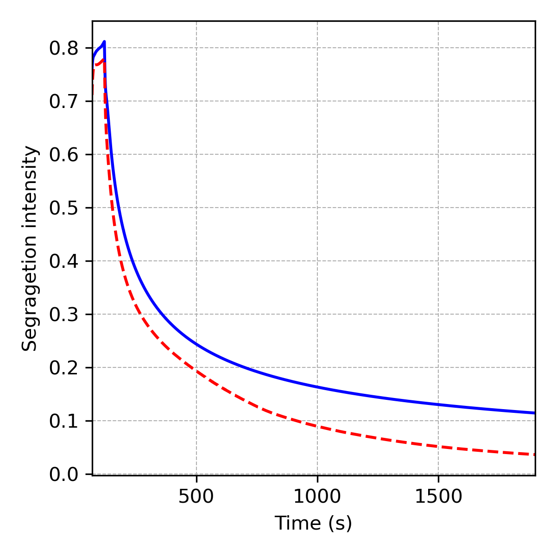
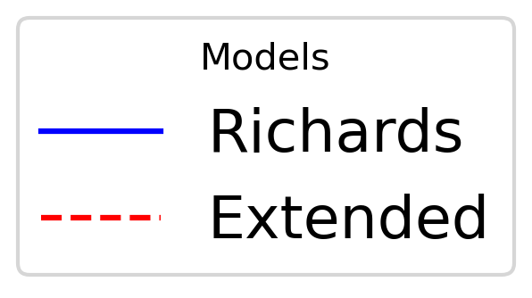



1. Introduction 2.Methodology 3. Model Setup 4. Results and Discussion 5. Conclusions 6. Future work
Breakthrough curve
Center of mass
Solute front width
Segregation intensity
$$W\left(t\right)= \frac{M_{2}(t)}{M_{0}(t)}−{\left(\frac{M_{1}(t)}{M_{0}(t)}\right)}^{2}$$
$$S=\frac{Var(θ\overline{c})}{θ\overline{c}(1−θ\overline{c})}$$
$$CM(t)= \frac{M_{1}(t)}{M_{0}(t)}$$
Center of the mass
Solute front width
8

Slide 9
1. Introduction 2.Methodology 3. Model Setup 4. Results and Discussion 5. Conclusions 6. Future work
Cases studied
Part 1: Richards’ equation vs. extended model under homogeneous hydraulic conductivity and isotropic initial saturation perturbations.
Part 2: Extended-model simulations of unsaturated flow and solute transport in heterogeneous soils.

Slide 10
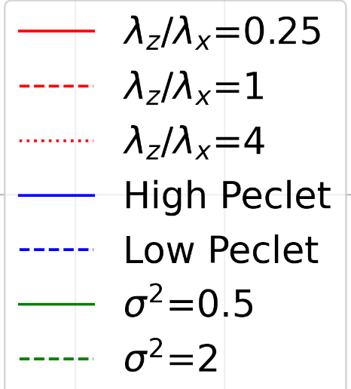
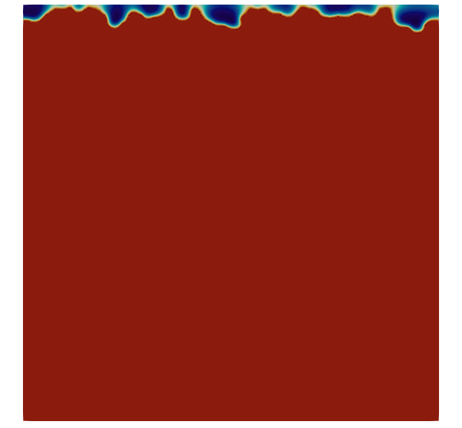
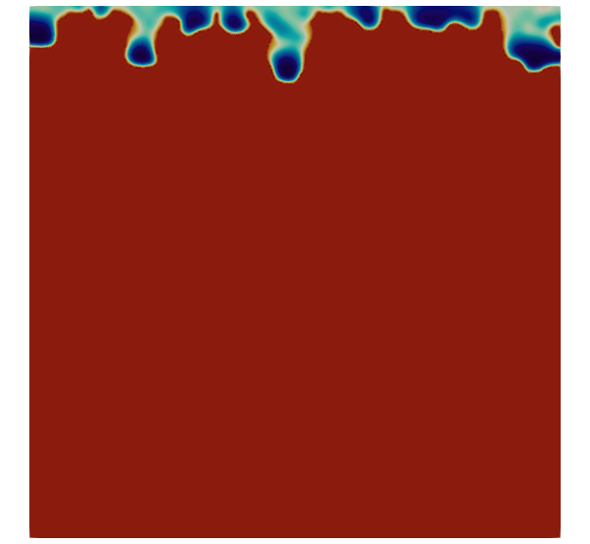
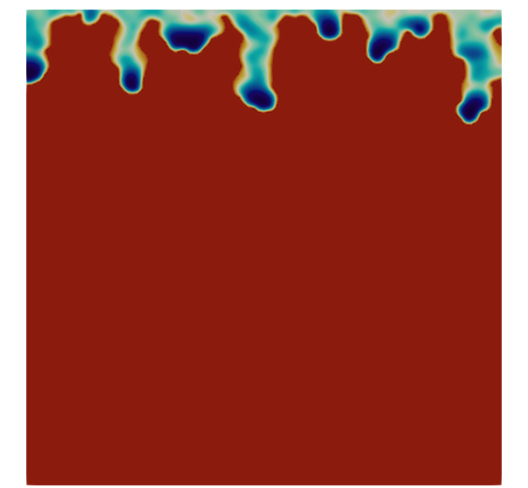
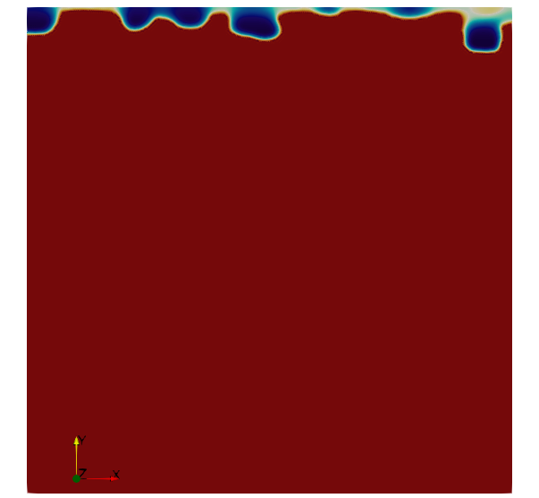
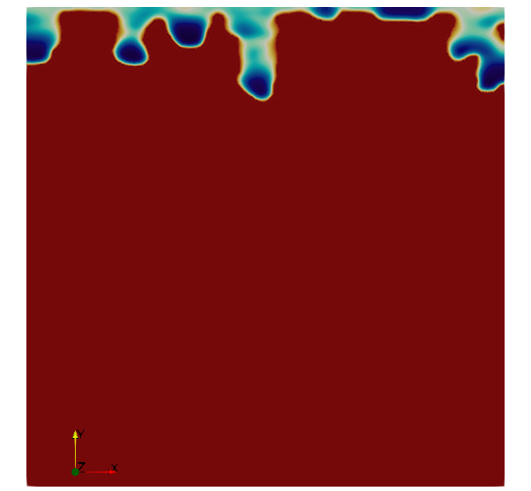
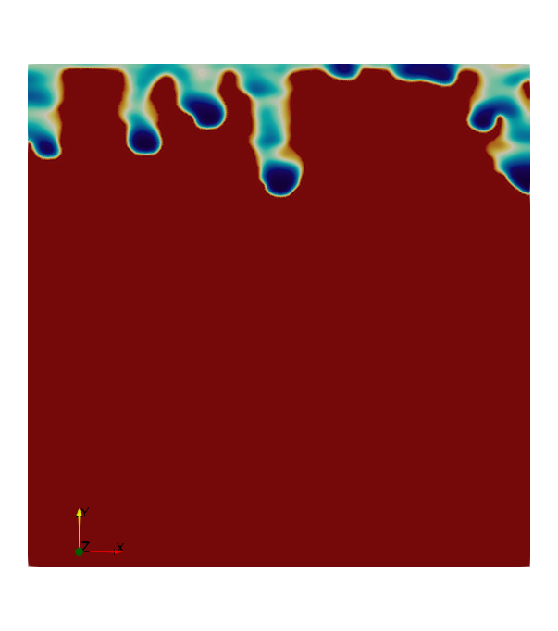
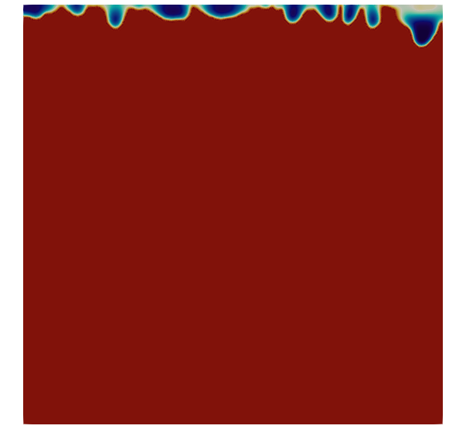
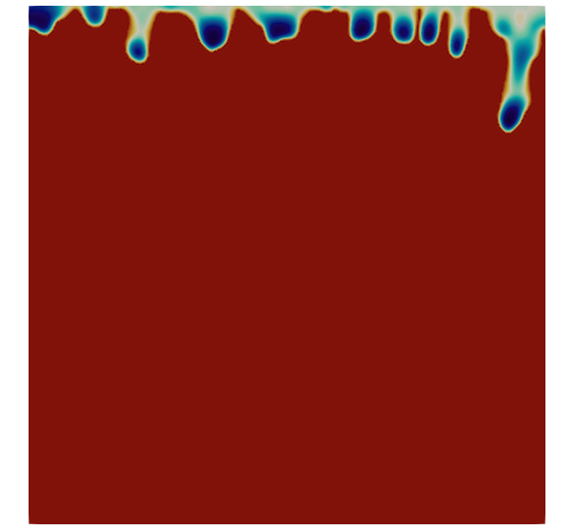
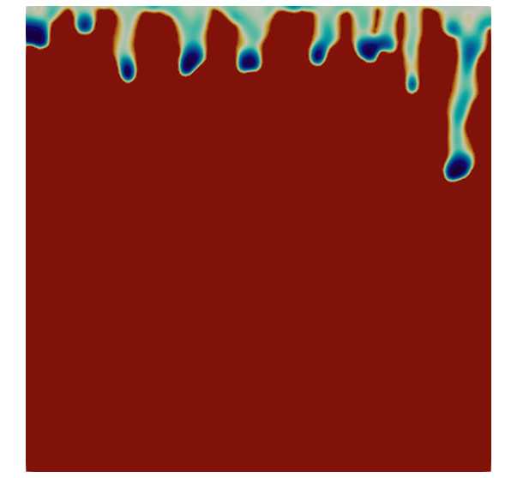
1. Introduction 2.Methodology 3. Model Setup 4. Results and Discussion 5. Conclusions 6. Future work
Hydraulic
conductivity field
Saturation
t = 200 s
t = 350 s
t = 490 s
Isotropic
Horizontal
anisotropy
Vertical
anisotropy
9

Slide 11

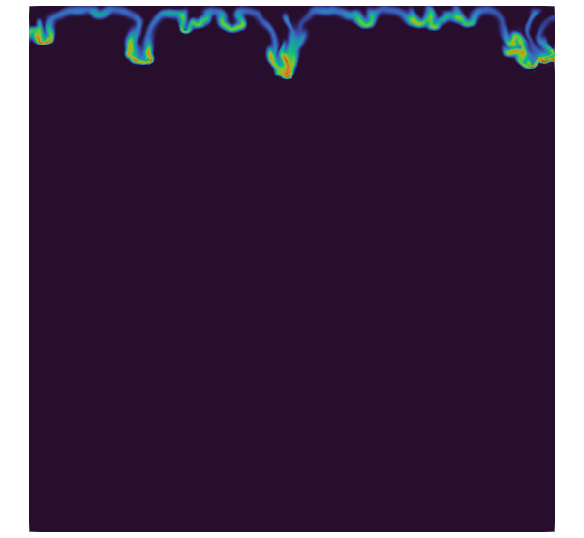

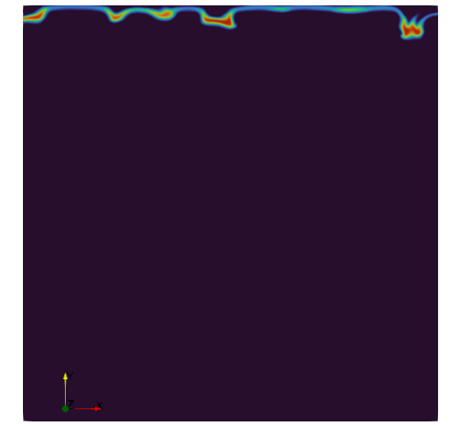
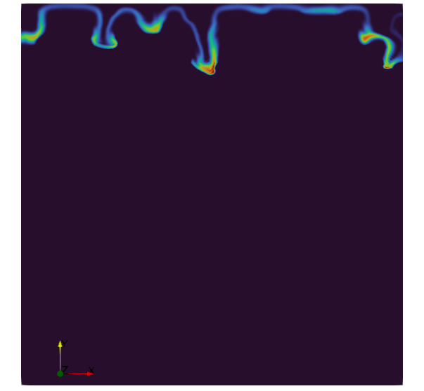
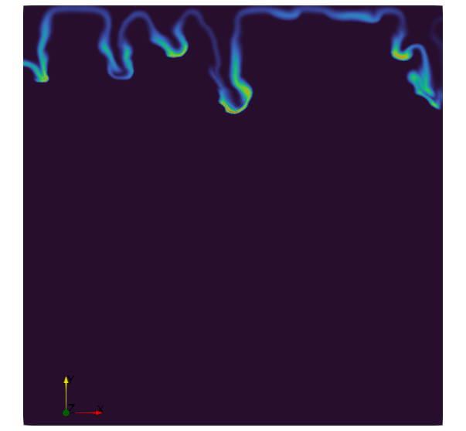



1. Introduction 2.Methodology 3. Model Setup 4. Results and Discussion 5. Conclusions 6. Future work
Hydraulic
conductivity field
Solute transport
t = 200 s
t = 350 s
t = 490 s
Isotropic
Horizontal
anisotropy
Vertical
anisotropy
10

Slide 12
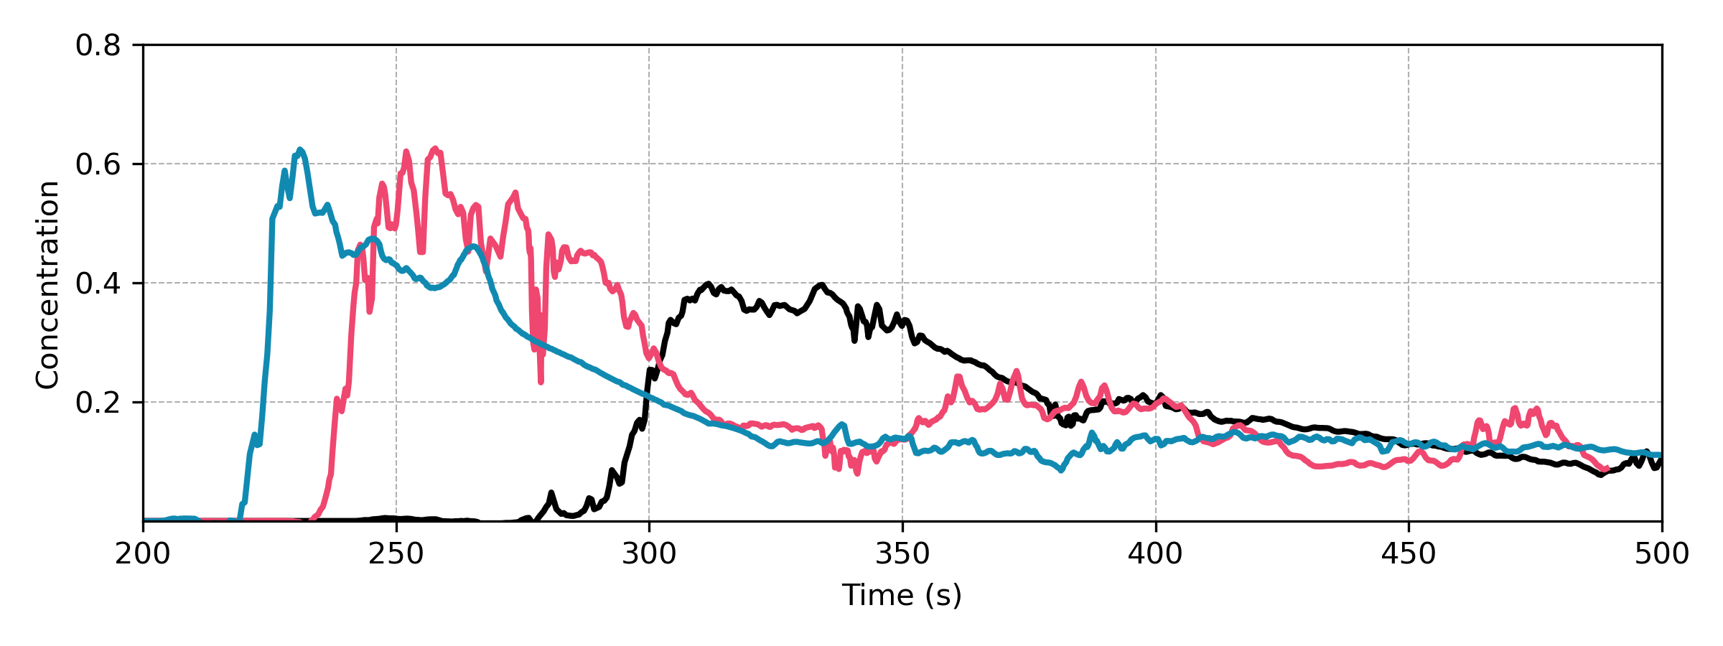
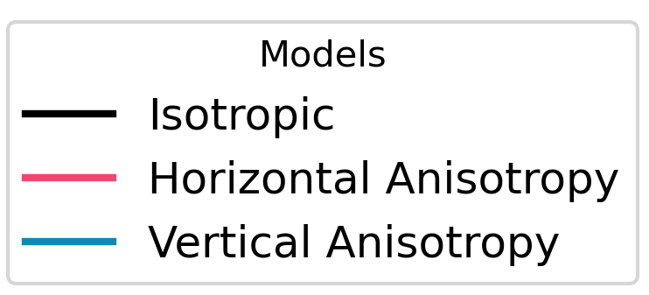
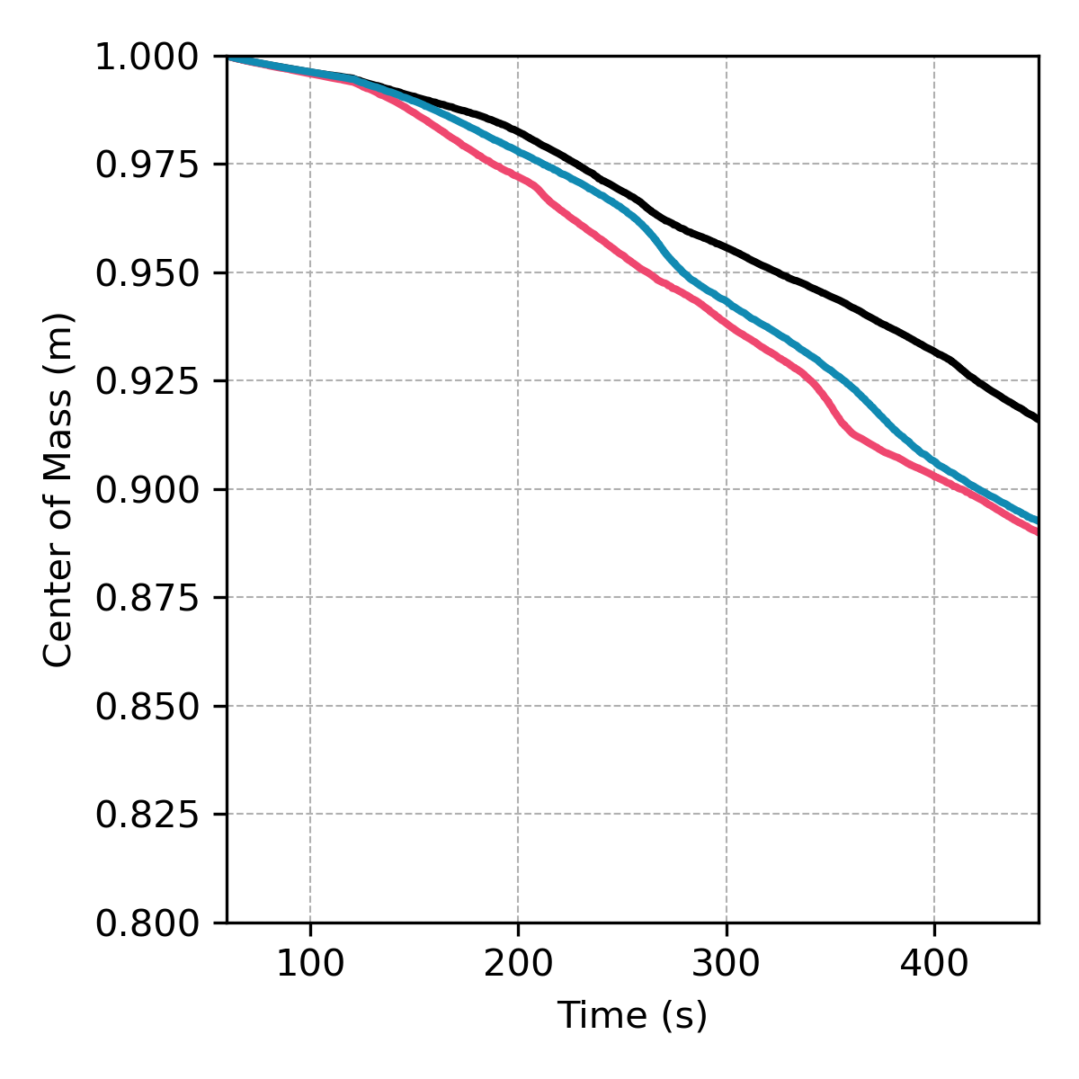
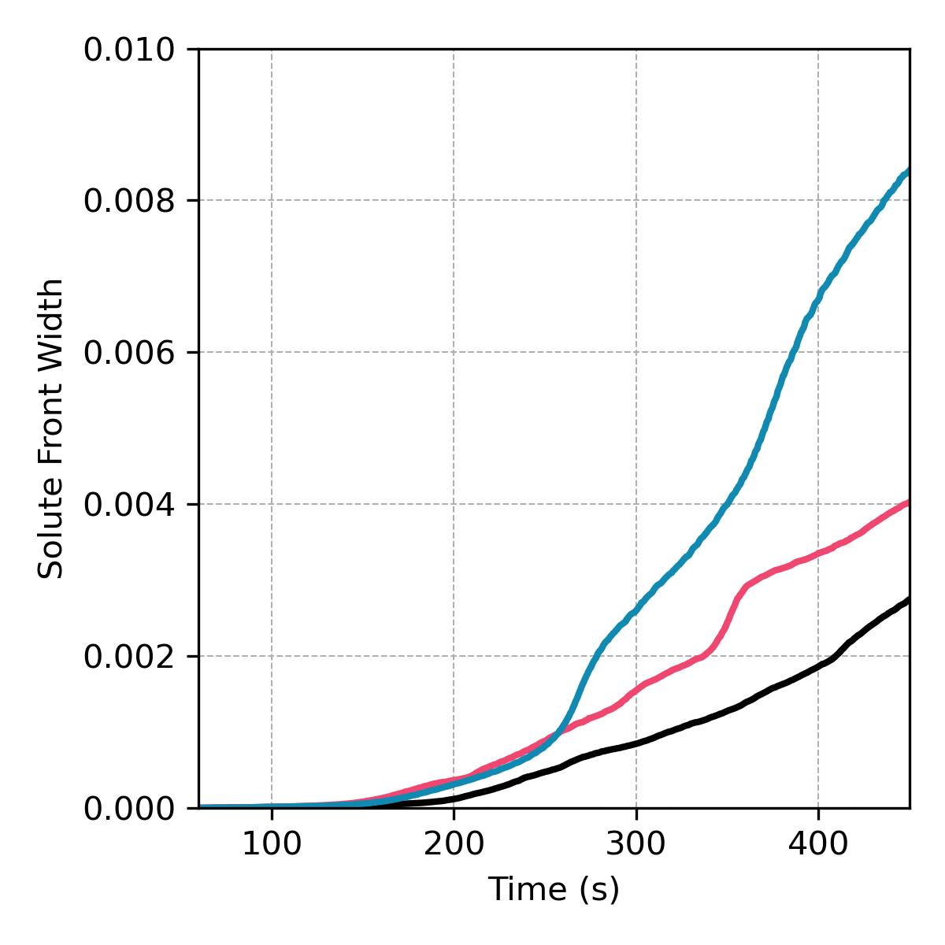
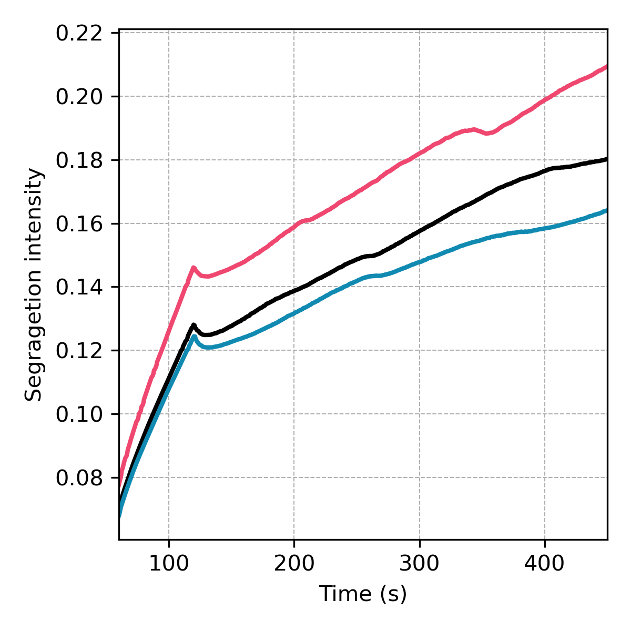
1. Introduction 2.Methodology 3. Model Setup 4. Results and Discussion 5. Conclusions 6. Future work
Breakthrough curve
Center of mass
Solute front width
Segregation intensity
11

Slide 13
1. Introduction 2.Methodology 3. Model Setup 4. Results and Discussion 5. Conclusions 6. Future work
5. Main findings
For flow:
  Richards’ equation does not reproduce preferential flow, whereas the extended model captures the formation of gravity fingers.
  Vertical anisotropy enhances preferential flow, while horizontal anisotropy tends to reduce it.
For transport:
  The extended model shows earlier solute arrival, longer breakthrough-curve tails, wider solute fronts, and enhanced mixing.
  In heterogeneous soils, vertical anisotropy produces the strongest transport effects.
12

Slide 14
1. Introduction 2.Methodology 3. Model Setup 4. Results and Discussion 5. Conclusions 6. Future work
Future work
Validate the model with experimental data.
Study the transport of a conservative solute under infiltration and evaporation cycles.
Consider reactive transport.
Acknowledgements
The authors acknowledge the support from Spanish research agency (10.13039/501100011033) and Spanish Ministry of Science and Innovation through the project HydroPore II. (PID2022-137652NB-C41).
Thank you for your attention

