Slide 1

Pore-scale level-set simulation of drainage and imbibition of trapped gas in the presence of oil and water during reservoir pressure cycling
Johan Olav Helland
Espen Jettestuen, Olav Aursjø
NORCE Norwegian Research Centre

Slide 2
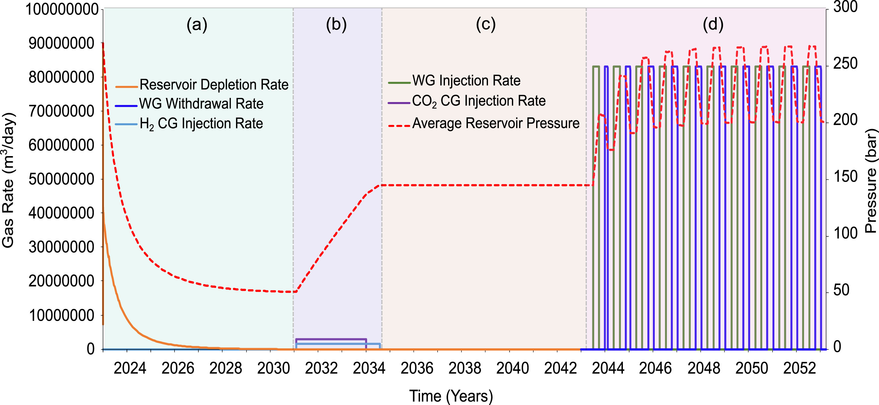
Motivation & Objectives
Subsurface storage technologies (UNGS, UHS, CCS) involve reservoir pressure changes during seasonal schedules of gas injection and production.
Depressurization for hydrocarbon production in HPHT reservoirs (e.g., 800-1000 bar)
This leads to drainage and imbibition processes in the reservoir which is typically studied at the pore scale by multiphase flow at constant reservoir conditions (compressibility effects ignored).
Objective: Simulate expansion & compression of trapped gas in the presence of oil and water during reservoir pressure cycles
Approach: Combine level set method for 3-phase capillary displacement with mass conservation and equation of state (EOS)
Explore hysteresis behaviour during depressurization and re-pressurization in sandstone.
~70 bar
Williams et al. (2025), International Journal of Hydrogen Energy, 102,
1116-1129. https://doi.org/10.1016/j.ijhydene.2024.12.371.
2

Slide 3


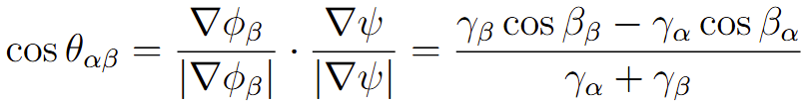
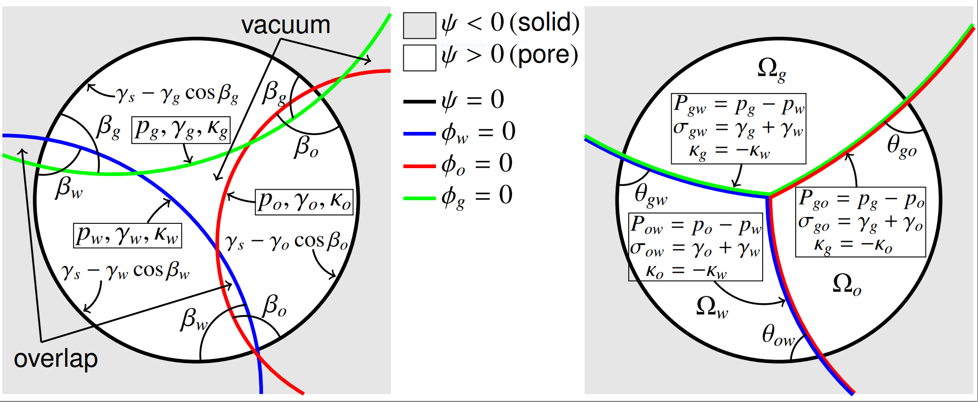
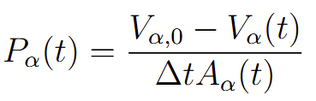
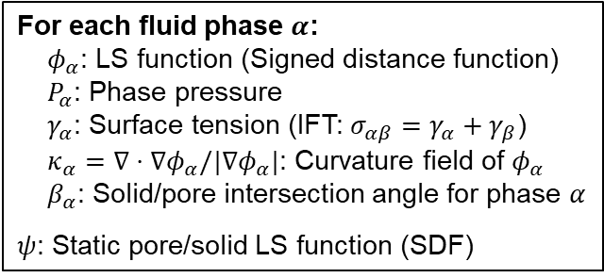

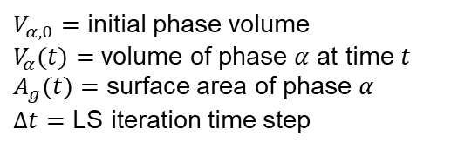
Level set (LS) method for 3-phase capillary displacement
One LS evolution equation per fluid phase (Helland et al. 2019):
A projection step makes fluid/fluid interfaces unique ($φ_{α}=φ_{β}=0$).
At equilibrium:
For conservation of total volume of phase $α$, update the phase pressure $P_{α}$:
Capillary displacement (pore space)
Contact angle formation (pore walls/solid)
For each fluid phase $α$:
$φ_{α}$: LS function (Signed distance function)
$P_{α}$: Phase pressure
$γ_{α}$: Surface tension (IFT: $σ_{αβ}=γ_{α}+γ_{β}$)
$κ_{α}=∇⋅∇φ_{α}/|∇φ_{α}|$: Curvature field of $φ_{α}$
$β_{α}$: Solid/pore intersection angle for phase $α$
$ψ$: Static pore/solid LS function (SDF)
(Young-Laplace’s eq.)
(Young’s eq.)
$V_{α,0}=$ initial phase volume
$V_{α}(t)=$ volume of phase $α$ at time $t$
$A_{g}(t)=$ surface area of phase $α$
$Δt=$ LS iteration time step
Projection step
3

Slide 4
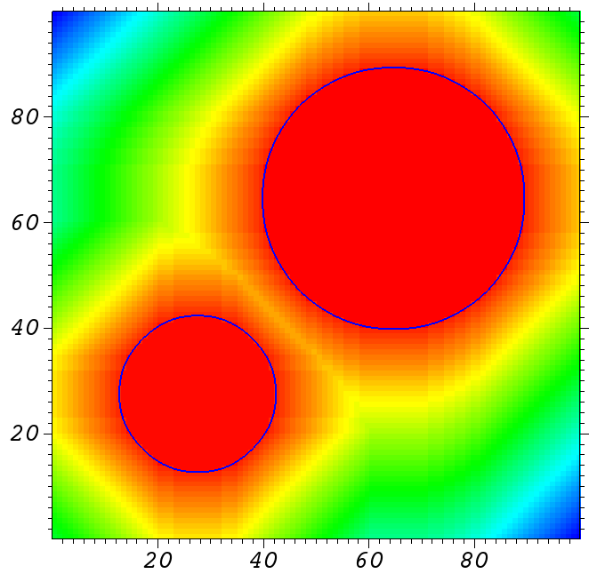
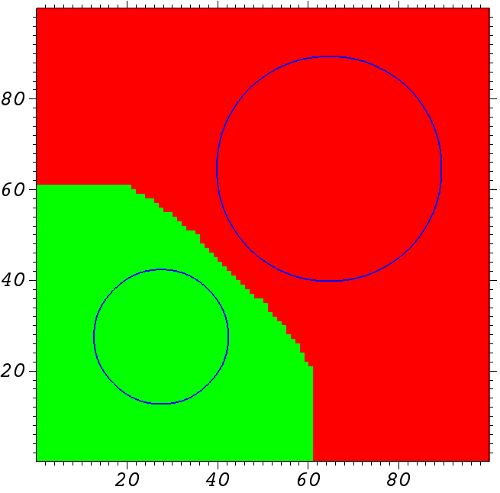
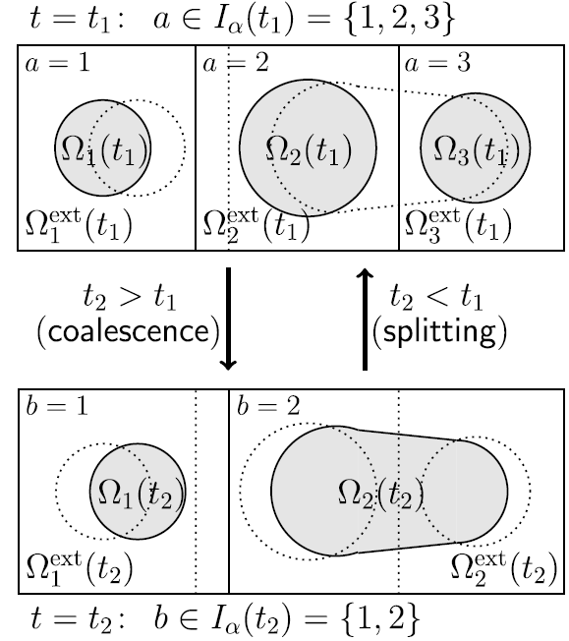
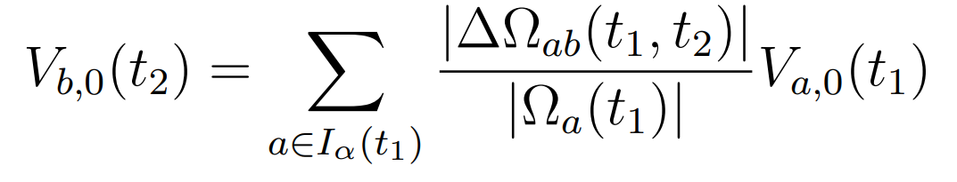

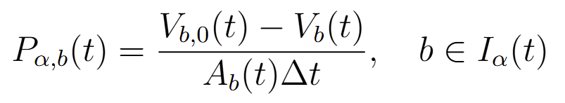


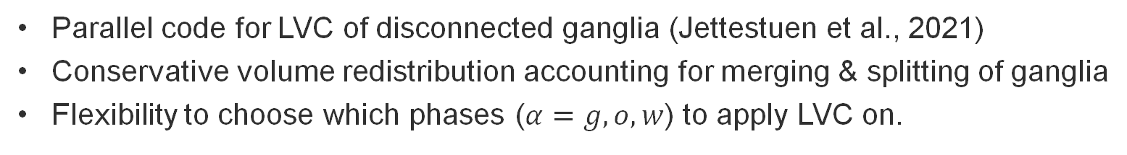


Local volume conservation (LVC)
Parallel code for LVC of disconnected ganglia (Jettestuen et al., 2021)
Conservative volume redistribution accounting for merging & splitting of ganglia
Flexibility to choose which phases ($α=g,o,w$) to apply LVC on.
$$Ω_{2}$$
$$Ω_{2}^{ext}$$
$$Ω_{1}$$
$$Ω_{1}^{ext}$$
Map with domains (grassfire algorithm) and distance
Extended domains
Domain volumes:
where
Domain phase pressures:
4

Slide 5
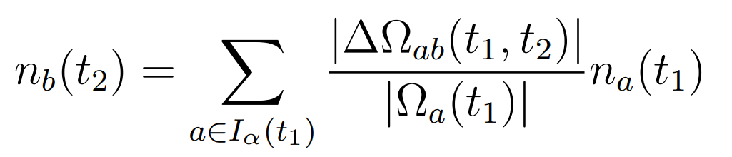
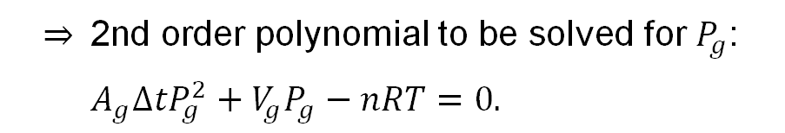
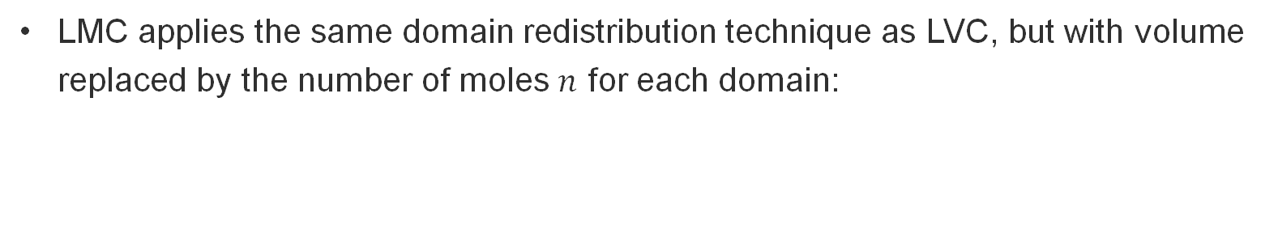



Local mass conservation (LMC)
LMC applies the same domain redistribution technique as LVC, but with volume replaced by the number of moles $n$ for each domain:
Domain gas pressures are calculated by solving the pressure expression and EOS together for $P_{g}$ and $V_{g,0}$, with $V_{g}(t)$, $A_{g}(t)$, $Δt$ and $n$ as known parameters [skip LMC notation from now].
Example with ideal gas:
$P_{g}V_{g,0}=nRT$,
$V_{g,0}=P_{g}A_{g}Δt+V_{g}$
$⇒$ 2nd order polynomial to be solved for $P_{g}$:
$A_{g}ΔtP_{g}^{2}+V_{g}P_{g}−nRT=0.$
5

Slide 6
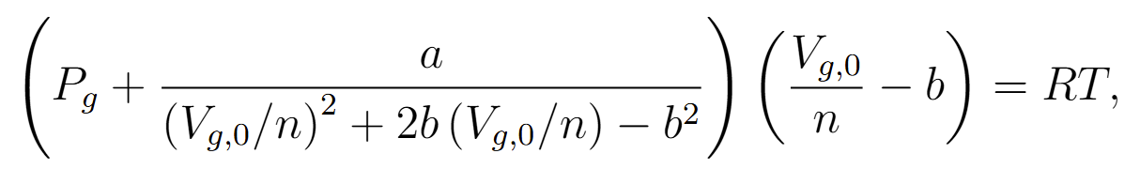



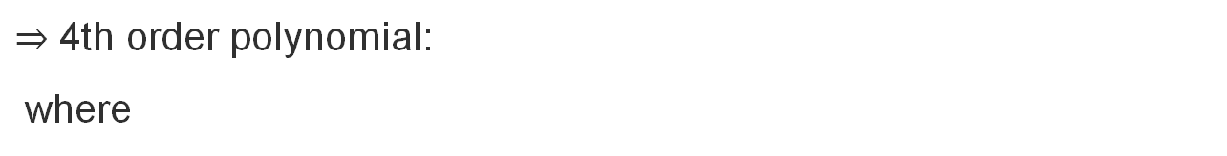
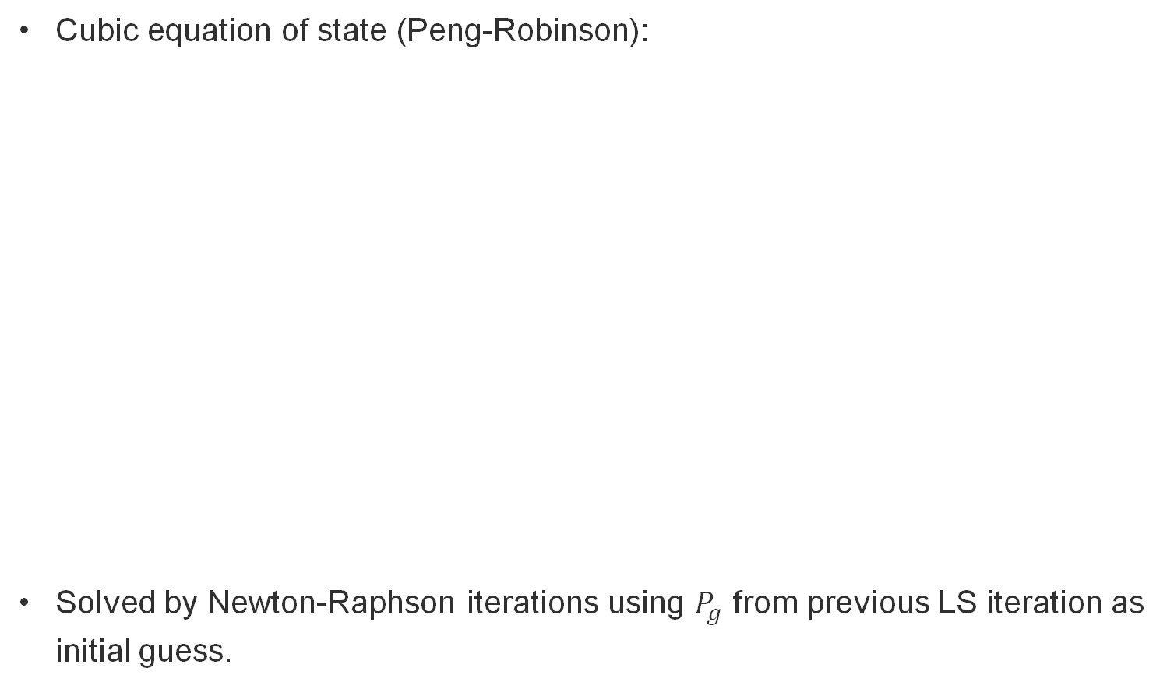
Phase-pressure calculation of gas ganglia
Cubic equation of state (Peng-Robinson):
Solved by Newton-Raphson iterations using $P_{g}$ from previous LS iteration as initial guess.
$⇒$ 4th order polynomial:
where
6

Slide 7
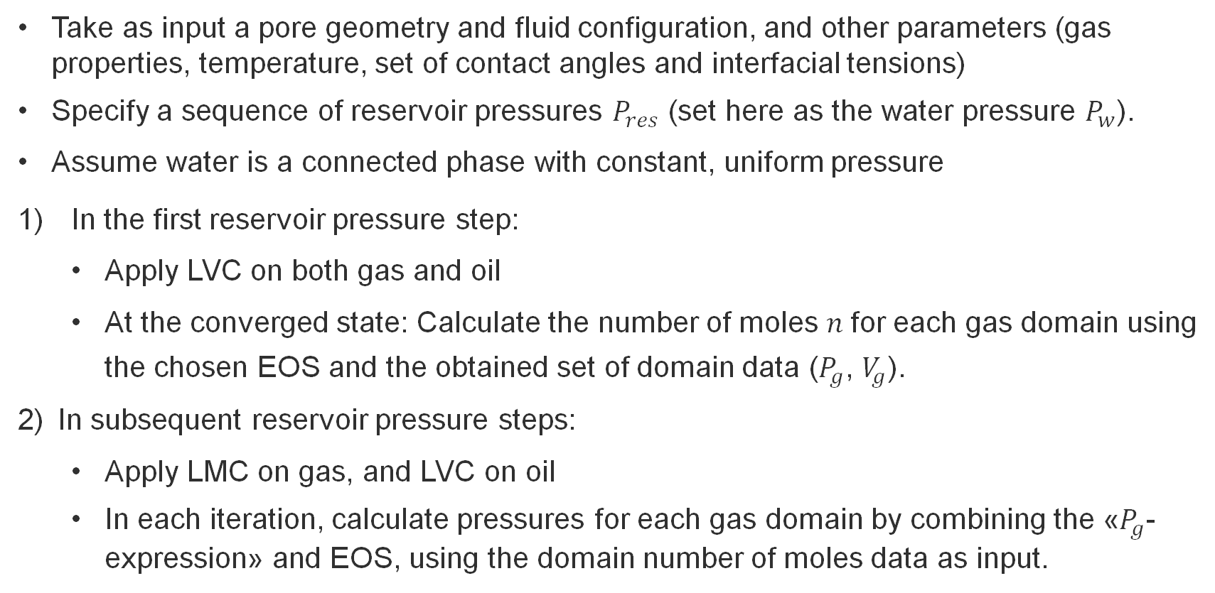
Overall algorithm for simulations
Take as input a pore geometry and fluid configuration, and other parameters (gas properties, temperature, set of contact angles and interfacial tensions)
Specify a sequence of reservoir pressures $P_{res}$ (set here as the water pressure $P_{w}$).
Assume water is a connected phase with constant, uniform pressure
In the first reservoir pressure step:
Apply LVC on both gas and oil
At the converged state: Calculate the number of moles $n$for each gas domain using the chosen EOS and the obtained set of domain data ($P_{g}$, $V_{g}$).
In subsequent reservoir pressure steps:
Apply LMC on gas, and LVC on oil
In each iteration, calculate pressures for each gas domain by combining the «$P_{g}$-expression» and EOS, using the domain number of moles data as input.
C++ implementation using the software framework SAMRAI (LLNL) for parallelism and adaptive mesh refinement.
7

Slide 8
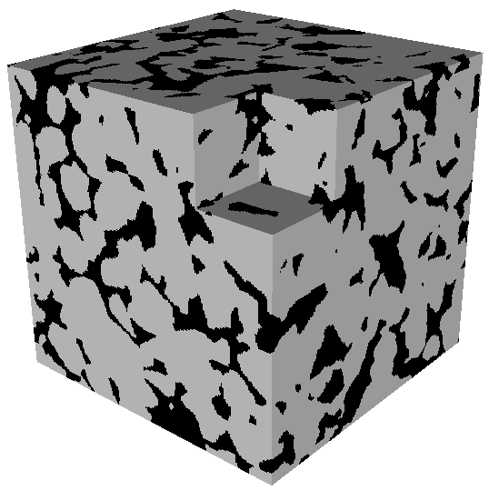
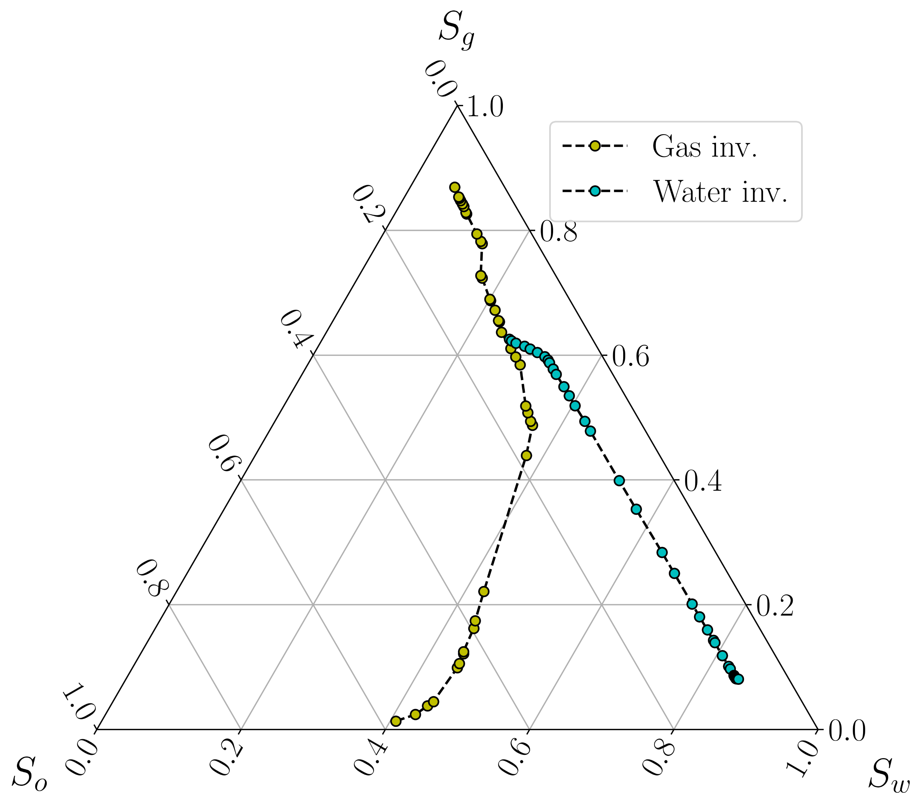
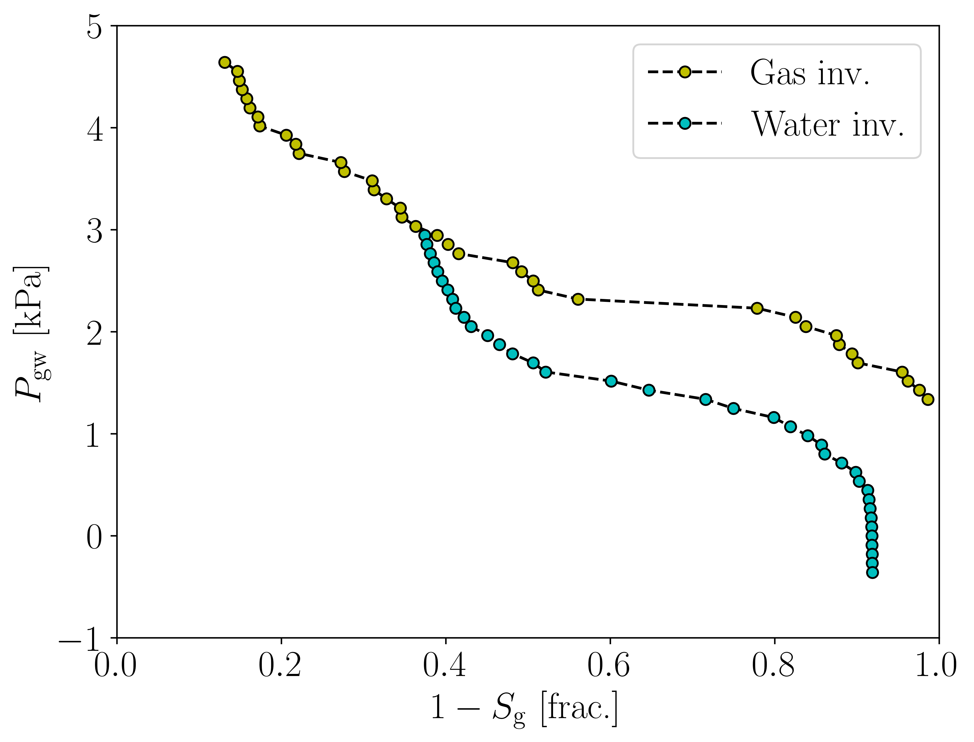
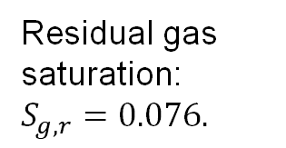
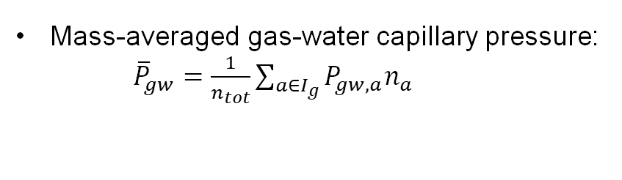

Simulation cases
Castlegate sandstone:
Sample size: ${200}^{3}$ voxels
Porosity $22.7 \%$.
CO₂-oil-water fluid system:
IFT: $σ_{ow}=0.020$, $σ_{go}=0.011$, $σ_{gw}=0.030$ N/m
Contact angles: $θ_{ow}={20}^{∘},θ_{go}={24.2}^{∘},θ_{gw}={16.1}^{∘}$
Saturation history:
Primary drainage → Imbibition → Gas invasion → Water invasion.
Reservoir conditions:
$T_{res}=333.15$ K
$P_{res}$ changes between $10.7$ and $20.5$ MPa (depressurization & re-pressurization).
Saturation history:
Quasi-static, pressure-controlled simulation of gas & water invasions with LVC applied to oil and gas ganglia.
Gas/water capillary pressure:
Residual gas saturation:
$$S_{g,r}=0.076.$$
We explore hysteresis behaviour wrt. saturation:
Mass-averaged gas-water capillary pressure:
${\overline{P}}_{gw}=\frac{1}{n_{tot}}\sum_{a∈I_{g}}{P_{gw,a}n_{a}}$
Normalized Euler characteristic: $χ_{n,α}=χ_{α}/V_{B}$.
8

Slide 9
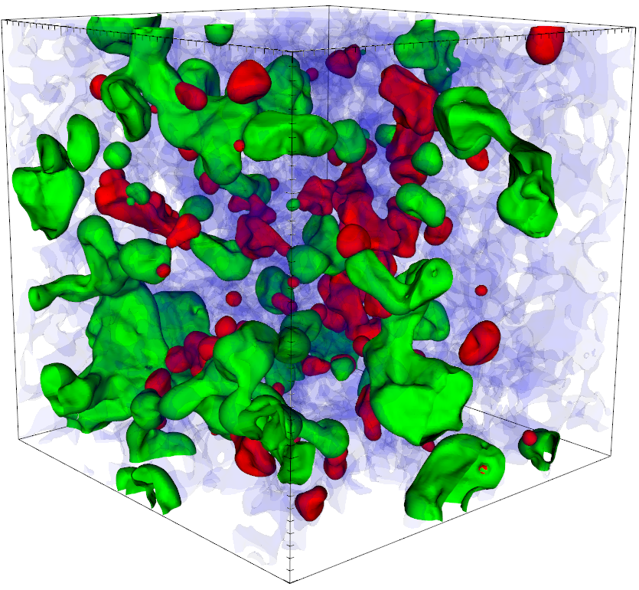
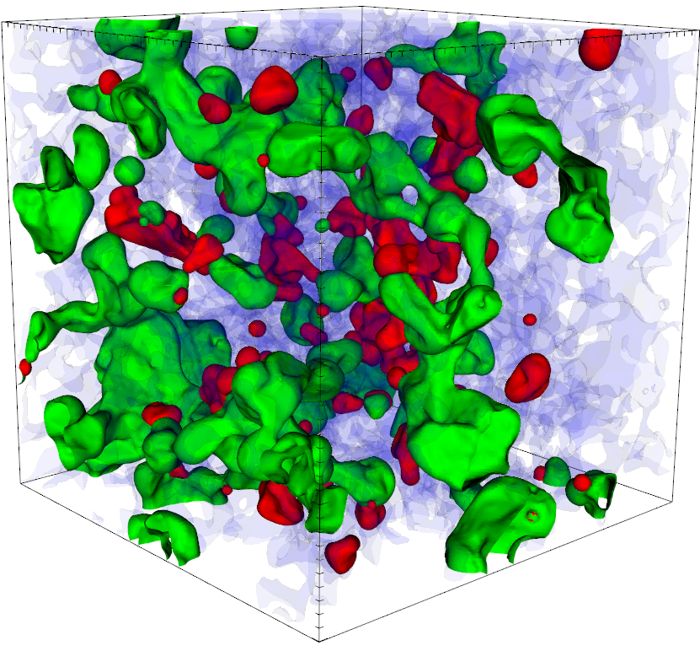
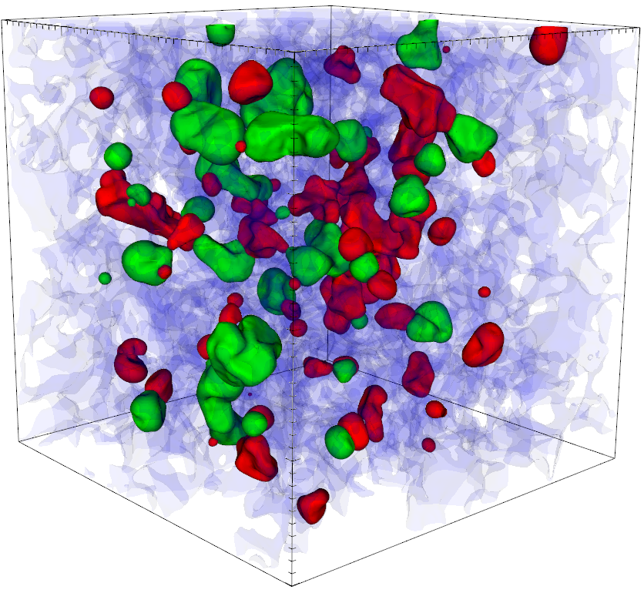
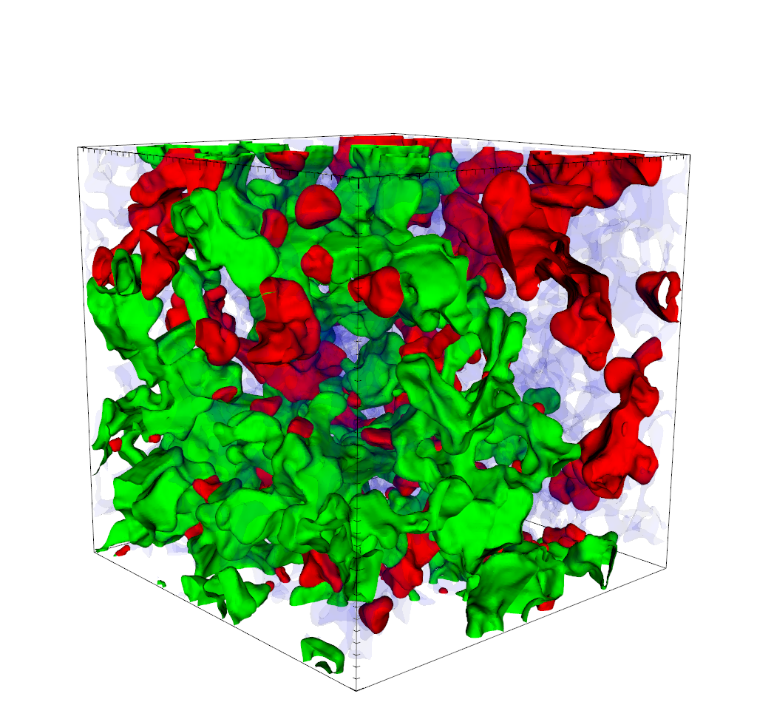


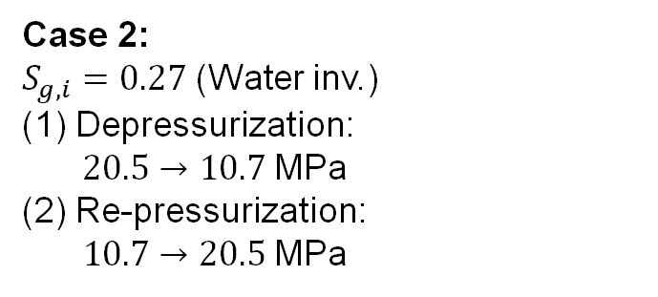
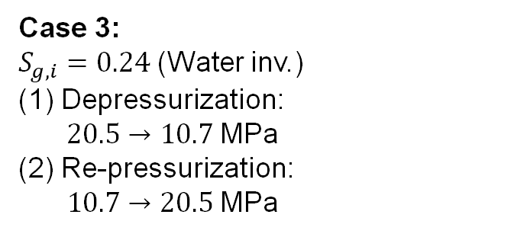
Simulation cases
Case 3:
Case 3:
$S_{g,i}=0.24$ (Water inv.)
Depressurization:
$20.5→10.7$MPa
(2) Re-pressurization:
$10.7→20.5$MPa
All cases: CO₂ (LMC), oil (LVC), water (continuous)
Case 2:
$S_{g,i}=0.27$ (Water inv.)
Depressurization:
$20.5→10.7$MPa
(2) Re-pressurization:
$10.7→20.5$MPa
Case 4:
$S_{g,i}=S_{g,r}=0.076$ (Water inv.)
Depressurization:
$20.5→10.7$MPa
(2) Re-pressurization:
$10.7→20.5$MPa
Gas
Oil
Case 1:
$S_{g,i}=0.45$ (Gas inv.)
Pressurization: $10.7→20.5$MPa
Depressurization: $20.5→10.7$MPa
Water
9

Slide 10
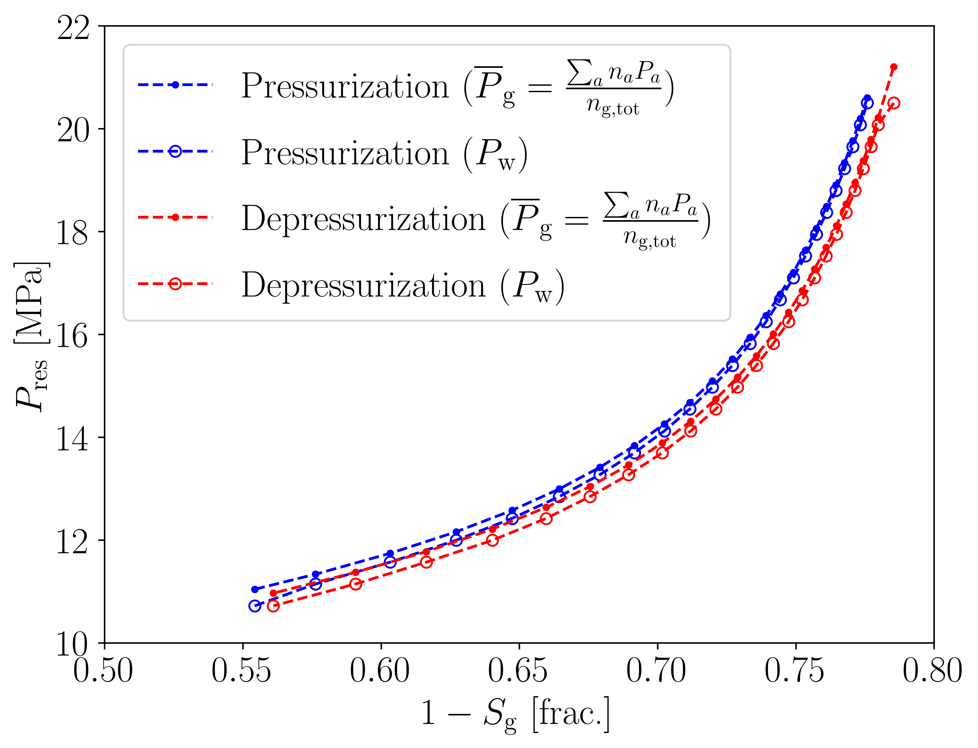
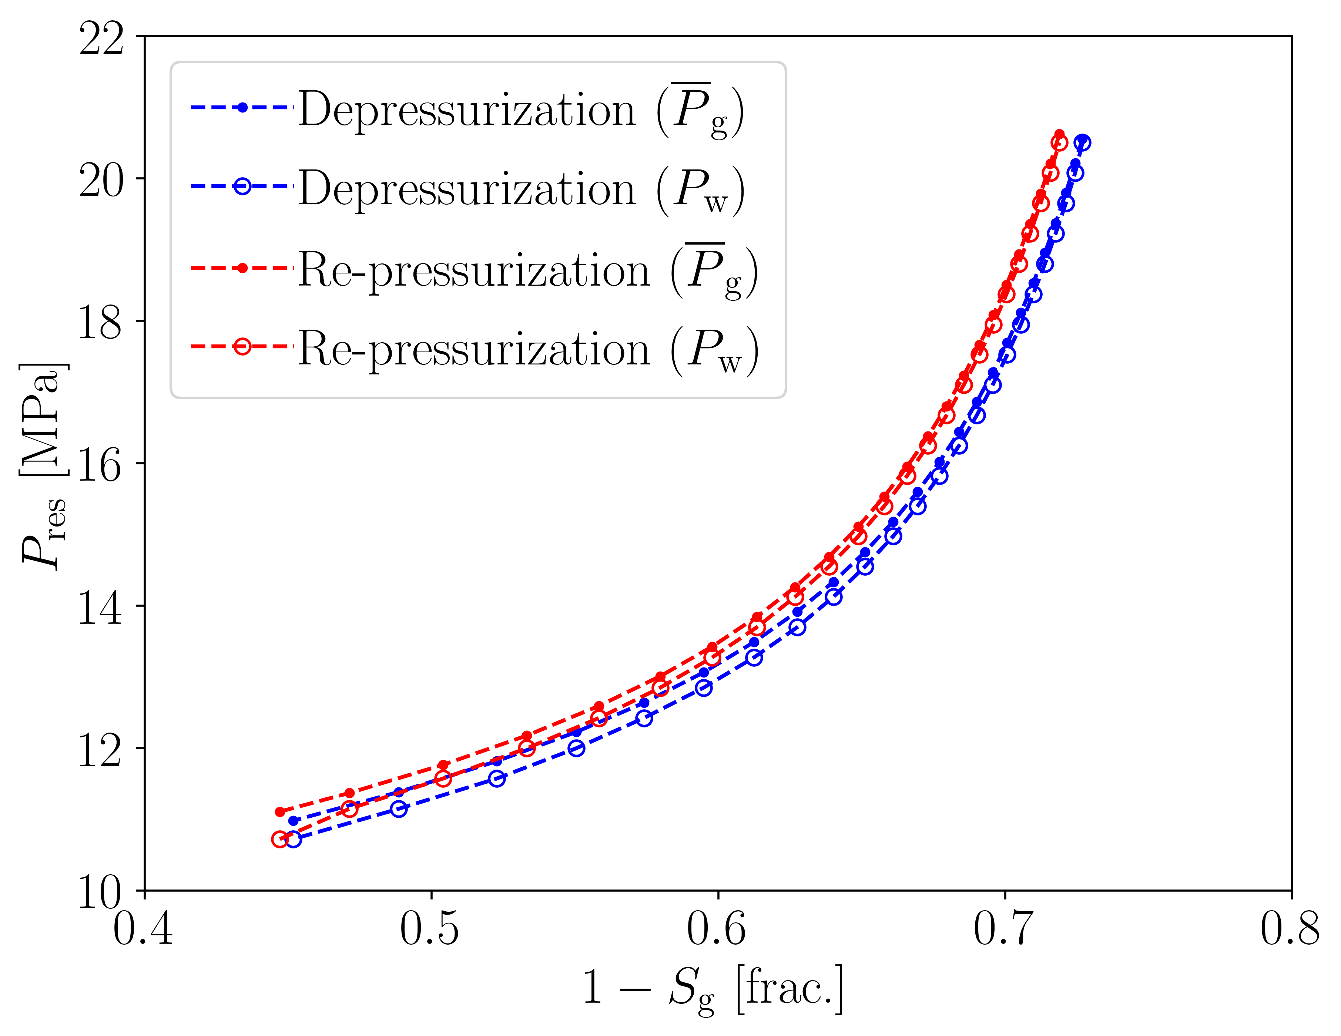
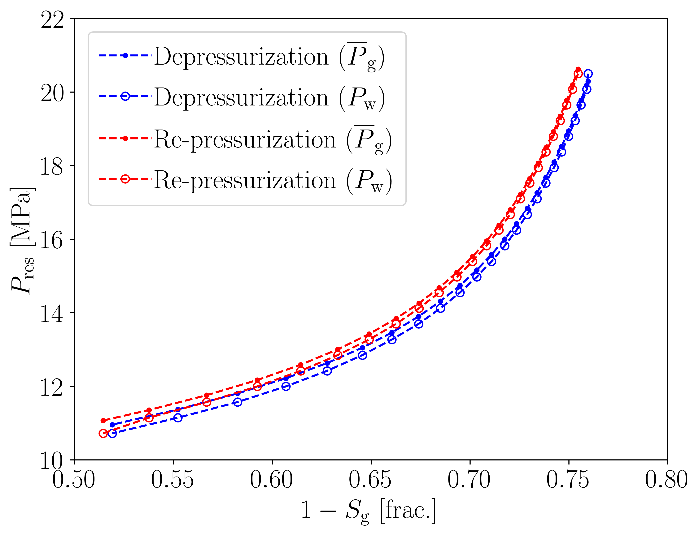
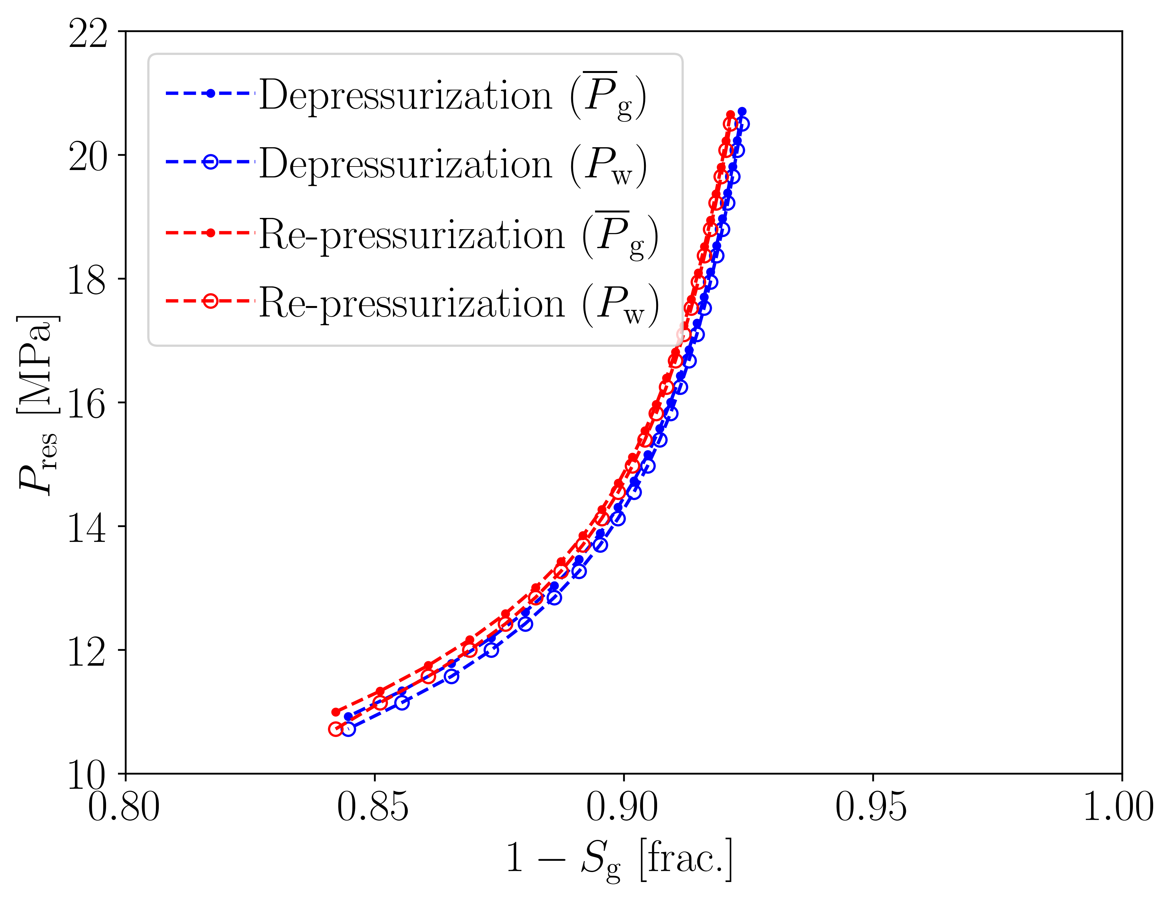

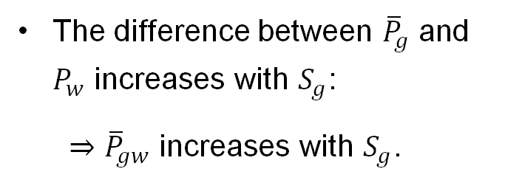



Reservoir pressure
The difference between ${\overline{P}}_{g}$ and $P_{w}$ increases with $S_{g}$:
$⇒{\overline{P}}_{gw}$ increases with $S_{g}$.
(2)
(2)
(1)
(1)
Case 1:
$$S_{g,i}=0.45$$
Case 2:
$$S_{g,i}=0.27$$
(2)
(1)
(2)
Case 3:
$$S_{g,i}=0.24$$
Case 4:
$$S_{g,i}=S_{g,r}$$
$$=0.076$$
(1)
10

Slide 11
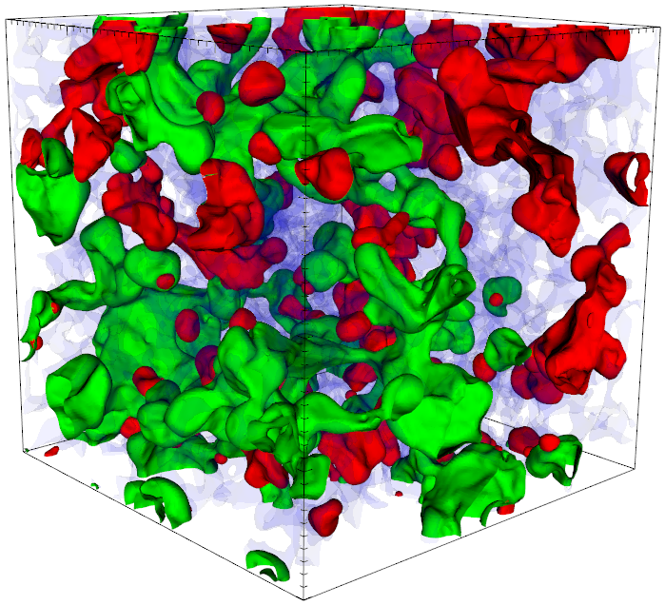
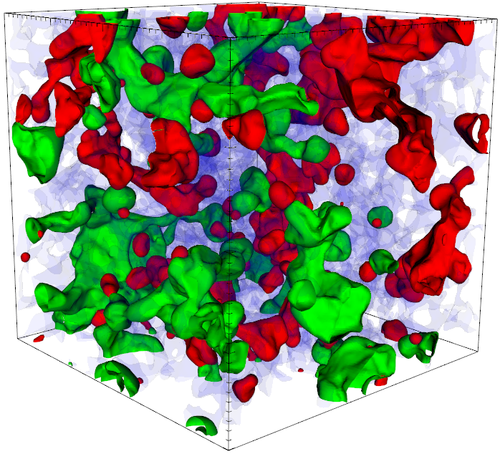
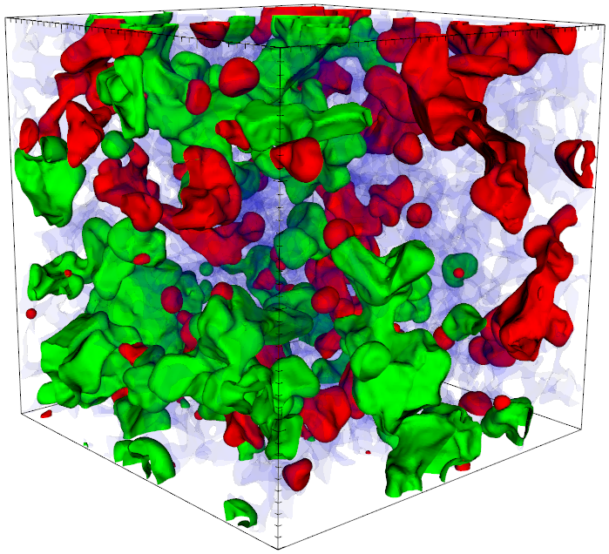
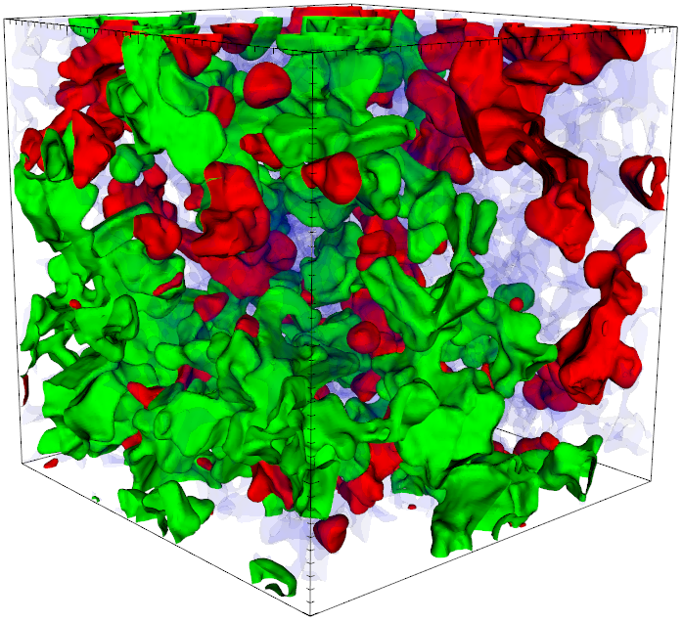
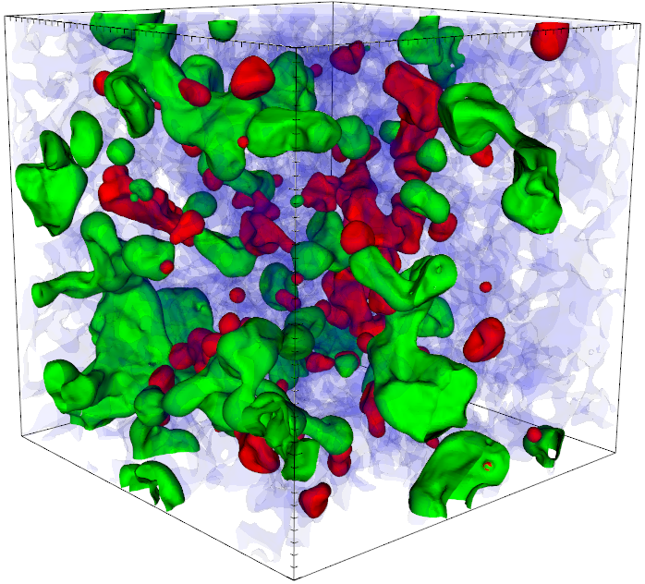
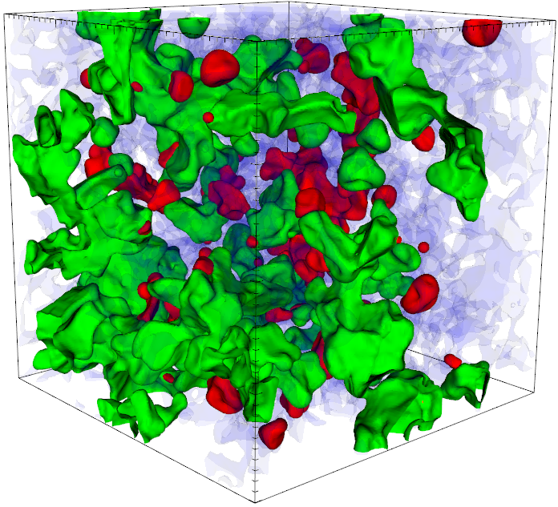

















Fluid configurations
Increasing $P_{res}$
Decreasing $P_{res}$
Case 1:
$$S_{g,i}=0.45$$
$P_{res}=10.7$ MPa
$P_{res}=16.3$ MPa
$P_{res}=20.5$ MPa
$P_{res}=13.3$ MPa
$P_{res}=10.7$ MPa
Decreasing $P_{res}$
Increasing $P_{res}$
Case 3:
$$S_{g,i}=0.24$$
$P_{res}=20.5$ MPa
$P_{res}=12.4$ MPa
$P_{res}=10.7$ MPa
$P_{res}=14.6$ MPa
$P_{res}=20.5$ MPa
Increasing $P_{res}$: Snap-off → disconnected gas ganglia. W→O→G double displacements.
Decreasing $P_{res}$: Coalescence → increased gas connectivity. G→O→W double displacements.
11

Slide 12



Gas/water capillary pressure:
Mass-average vs. individual ganglia
The majority of gas ganglia have higher $P_{gw}$ in depressurization than in re-pressurization
For most gas ganglia, $P_{gw}$ increases with gas saturation.
Case 3: $S_{g,i}=0.24$
(1)
(1)
(2)
(2)
12

Slide 13






Gas/water capillary pressure:
Reservoir pressure cycles vs. gas & water invasions
Case 1:
$$S_{g,i}=0.45$$
Case 2:
$$S_{g,i}=0.27$$
The ${\overline{P}}_{gw}\left(S_{g}\right)$-curves for reservoir pressure cycles are aligned with and bounded by the $P_{gw}\left(S_{g}\right)$-curves for the gas and water invasions.
Differences might occur when the gas phase only consists of small disconnected ganglia (cf. Case 4).
(2)
(1)
(2)
(1)
Case 3:
$$S_{g,i}=0.24$$
Case 4:
$$S_{g,i}=S_{g,r}=0.076$$
(1)
(1)
(2)
(2)
13

Slide 14








Gas connectivity (Euler char. $χ_{gas}$)
(1)
Significant hysteresis of gas connectivity.
Connected gas pathways break at low $S_{g}$ during pressurization. Recovery of these pathways occurs at higher $S_{g}$ during depressurization.
(2)
(1)
(2)
Case 1:
$$S_{g,i}=0.45$$
Case 2:
$$S_{g,i}=0.27$$
(1)
(1)
(2)
(2)
Case 4:
$$S_{g,i}=S_{g,r}$$
$$=0.076$$
Case 3:
$$S_{g,i}=0.24$$
14

Slide 15

















Critical gas saturation & spanning gas clusters
$S_{g,c}$: Critical gas saturation at which a gas cluster first spans the sample during depressurization.
$S_{g,disc}$: Gas saturation at which the last spanning gas cluster disconnects during pressurization.
Case 2:
Depressurization
Case 3:
Case 3
Case 2
Case 3
$$S_{g,i}=0.27$$
$$S_{g,c}=0.41$$
$$S_{g,i}=0.24$$
$$S_{g,c}=0.48$$
Case 2
Case 1
Case 2:
Pressurization
Case 3:
Disconnected gas
$$S_{g,i}=0.55$$
$$S_{g,disc}=0.28$$
$$S_{g,i}=0.49$$
$$S_{g,disc}=0.32$$
Spanning gas cluster
15

Slide 16








Oil connectivity (Euler char. $χ_{oil}$)
Case 1:
$$S_{g,i}=0.45$$
Case 2:
$$S_{g,i}=0.27$$
(1)
Limited extent of fragmentation and coalescence of oil ganglia.
Most oil ganglia change their shape and location by double displacements (G→O→W and W→O→G).
(1)
(2)
(2)
Case 3:
$$S_{g,i}=0.24$$
Case 4:
$$S_{g,i}=S_{g,r}$$
$$=0.076$$
(1)
(1)
(2)
(2)
16

Slide 17








Oil displacement
Depressurization:
Initial oil ganglia
Final oil ganglia
Case 1
Case 2
Case 3
Case 4
Pressurization:
Case 1
Case 2
Case 3
Case 4
17

Slide 18









Mass conservation errors in the simulations are small
Case 1:
$$S_{g,i}=0.45$$
Case 2:
$$S_{g,i}=0.27$$
(1)
(2)
(2)
(1)
$n_{a,PR}$: Number of moles calculated with EOS
based on $P_{g,a}$ and $V_{g,a}$ from simulation
$n_{a,0}$: Number of moles calculated initially
$N_{g}:$ Number of gas ganglia
RMSE$<0.02 \%$ in all cases.
Case 3:
$$S_{g,i}=0.24$$
Case 4:
$$S_{g,i}=S_{g,r}$$
$$=0.076$$
(2)
(2)
(1)
(1)
18

Slide 19

Conclusions
Coupling of level set method with local mass conservation and EOS to study gas expansion & compression during reservoir pressure cycles in 3-phase systems at the pore scale.
${\overline{P}}_{gw}\left(S_{g}\right)$ and $χ_{g}\left(S_{g}\right)$ exhibit hysteresis loops during reservoir pressure cycles in sandstone.
The ${\overline{P}}_{gw}\left(S_{g}\right)$-curves form nested hysteresis loops bounded by the $P_{gw}\left(S_{g}\right)$-curves from standard gas and water invasions at constant reservoir pressure.
The saturation range and hysteresis extent depend on the reservoir conditions and gas properties.
Hysteresis behaviour of connectivity (snap-off & coalescence) has implications for determination of critical gas saturation.
Double displacements change the location of oil ganglia.
Next step: To include gas dissolution & exsolution (with nucleation) in the liquids, and to couple this approach with models for Ostwald ripening (Singh et al., 2022-2024).
19

