Slide 1

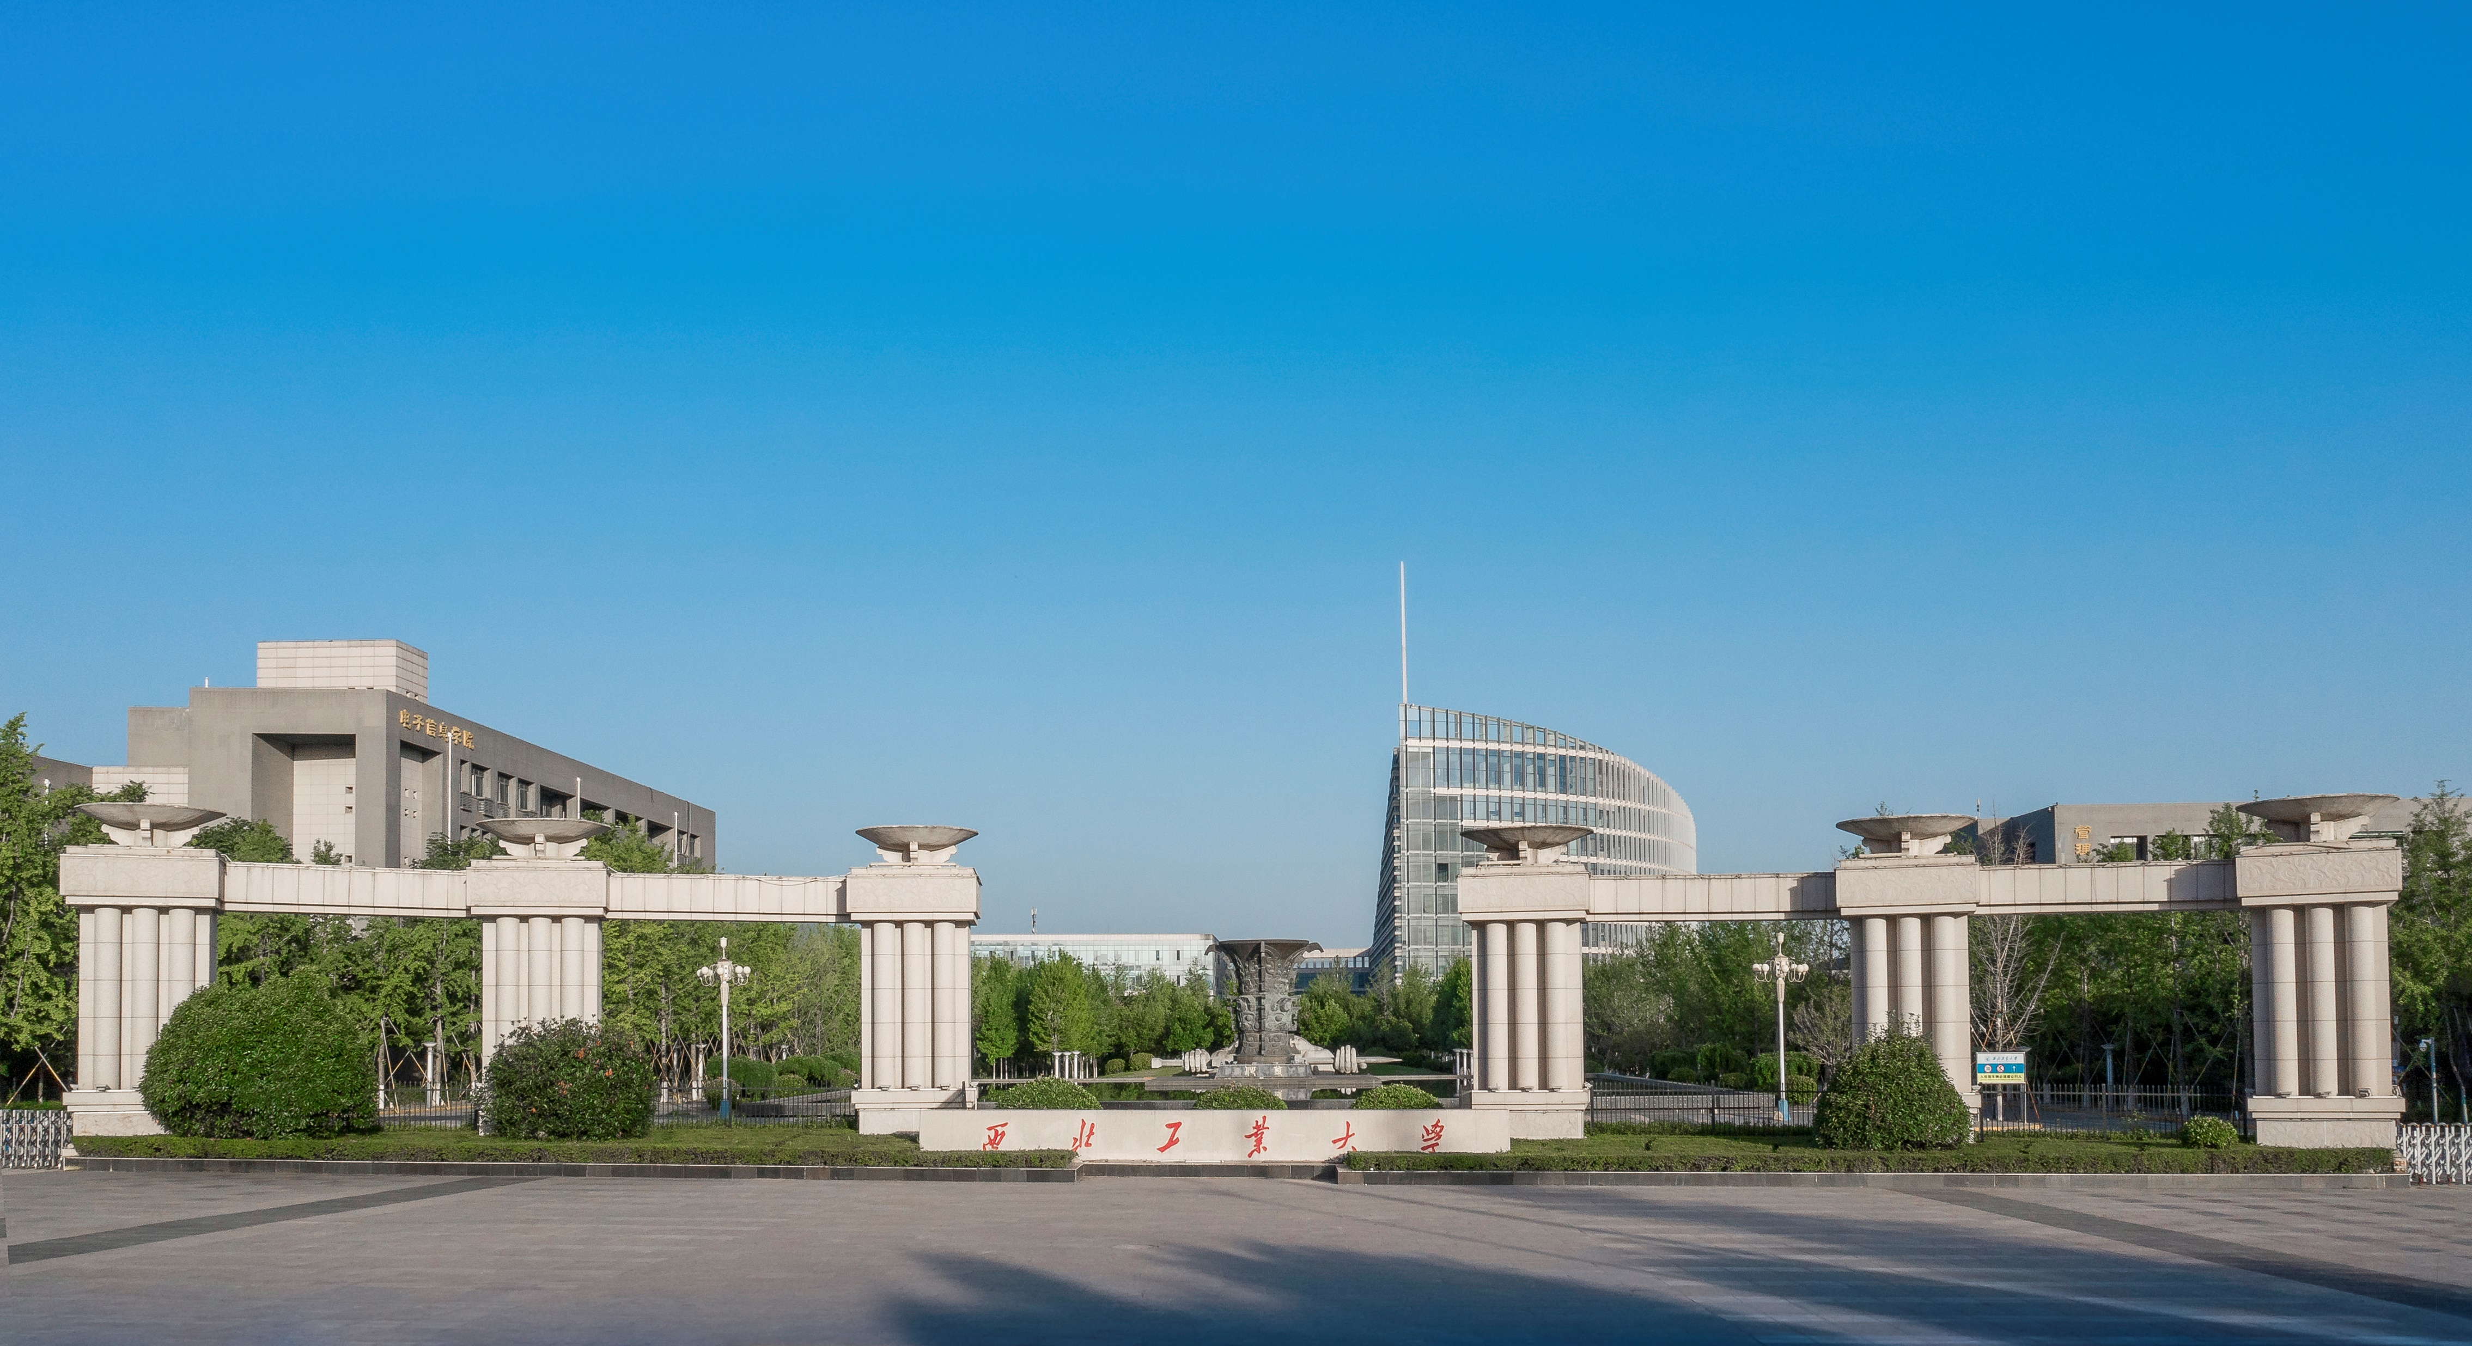
Pore-scale modeling of multiphase flow and phase change in porous media by lattice Boltzmann method
${Feifei Qin}^{1}$, ${\text{Linlin} \text{Fei}}^{3}$, ${\text{Jianlin} \text{Zhao}}^{4}, {\text{Qinjun} \text{Kang}}^{5}$, ${\text{Sauro} \text{Succi}}^{6,7}$, ${\text{Dominique} \text{Derome}}^{8}$, ${\text{Jan} \text{Carmeliet}}^{2}$
1 Institute of Extreme Mechanics, Northwestern Polytechnical University, Xi’an, 710072, Shannxi, China.
2 Chair of Building Physics, Department of Mechanical and Process Engineering, ETH Zurich (Swiss Federal Institute of Technology in Zurich), Zurich 8092, Switzerland
3 Key Laboratory of Thermo-fluid Science and Engineering, Ministry of Education, School of Energy and Power Engineering, Xi’an Jiaotong University, Xi’an, Shaanxi 710049, China
4 College of Petroleum Engineering, China University of Petroleum in Beijing, PR China
5 Earth and Environment Sciences Division (EES-16), Los Alamos National Laboratory (LANL), Los Alamos, NM 87545, USA
6 Center for Life Nano Science at La Sapienza, Fondazione Istituto Italiano di Tecnologia, Viale Regina Margherita 295, 00161, Roma, Italy
7 Physics Department and Institute for Applied Computational Science, John A. Paulson School of Applied Science and Engineering, Harvard University, Oxford Street 29, Cambridge, MA 02138, USA.
8 Dep. of Civil and Building Engineering, Universite de Sherbrooke, Sherbrooke Qc J1K 2R1, Canada

Slide 2
Contents
01
Background
02
Numerical model
03
Results and discussions
04
Conclusion and outlook

Slide 3
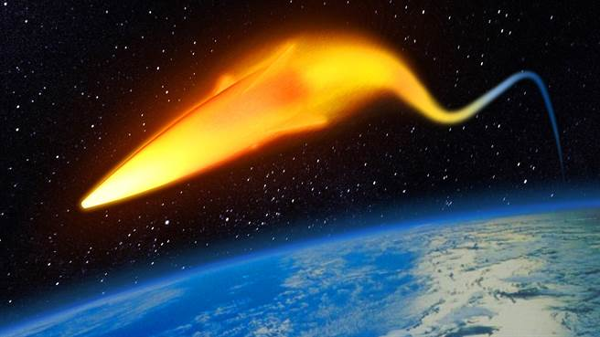
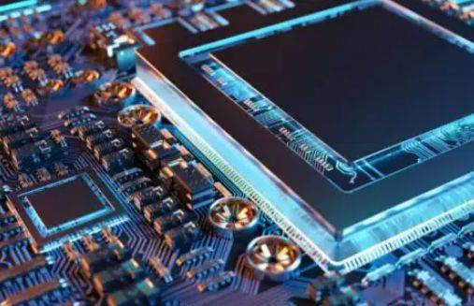
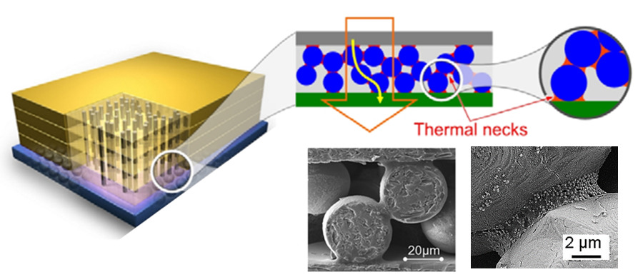
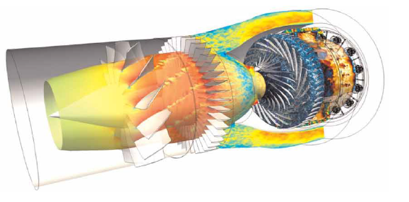
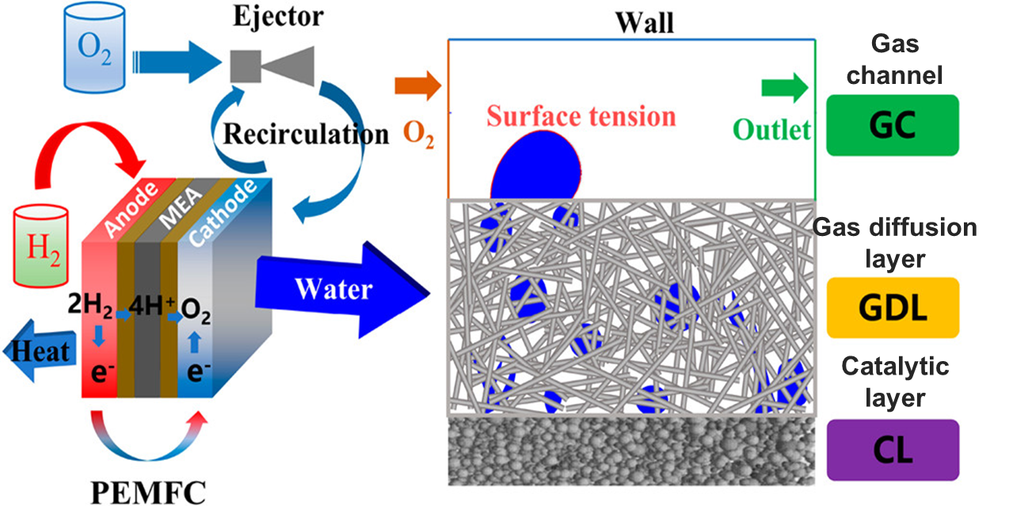
Multiphase flows and phase change in porous media
Enhanced cooling of 3D chip stacks (evaporation)
Thermal protection of high-speed aircrafts
(boiling + evaporation)
Combustion in aircraft engines (boiling + evaporation)
Water flooding in Proton Exchange Membrane Fuel Cell (condensation)

Slide 4
Contents
01
Background
02
Numerical model
03
Results and discussions
04
Conclusion and outlook

Slide 5
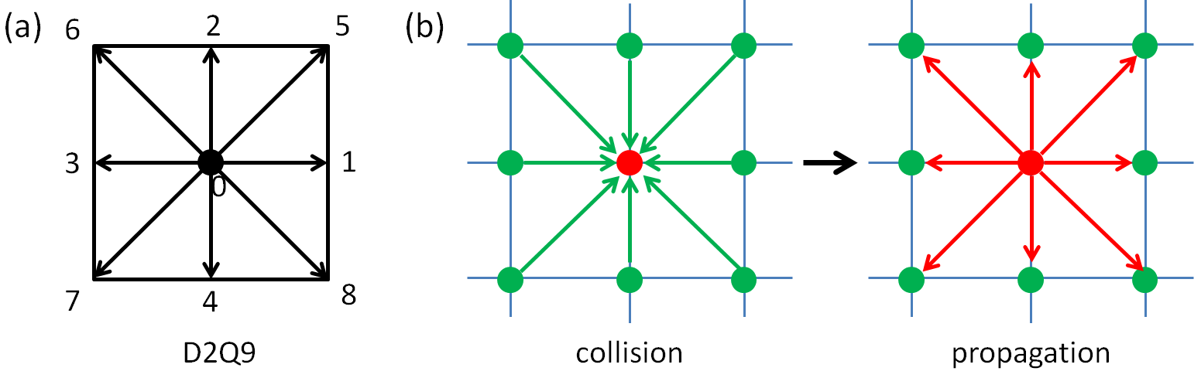
Numerical model and validation
1. Single-component multi-phase model
Iso-entropy lines
D2Q9
collision
propagation
Kinematic part
Shear part
Higher order part
Minimum entropy.
Kinematic viscosity
To realize a large range of kinematic viscosity!
Karlin et al, (2014). Physical review E, 90 (3).

Slide 6
Numerical model and validation
1. Single-component multi-phase model
External force for two-phase modeling
Our approach to consider the external force:
EDM force scheme to make it compatible with the KBC collision operator;
2. Introducing Wang’s method of two-phase force to EDM scheme to adjust the surface tension;
3. Considering the influence of the error term brought by the EDM force scheme.
Qin et al. Journal of Fluid Mechanics, (2026) 1028:A20.

Slide 7
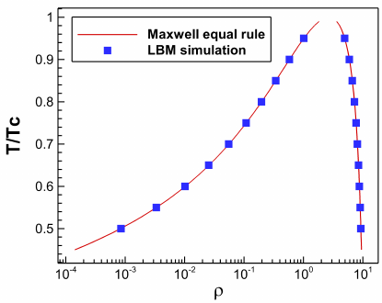
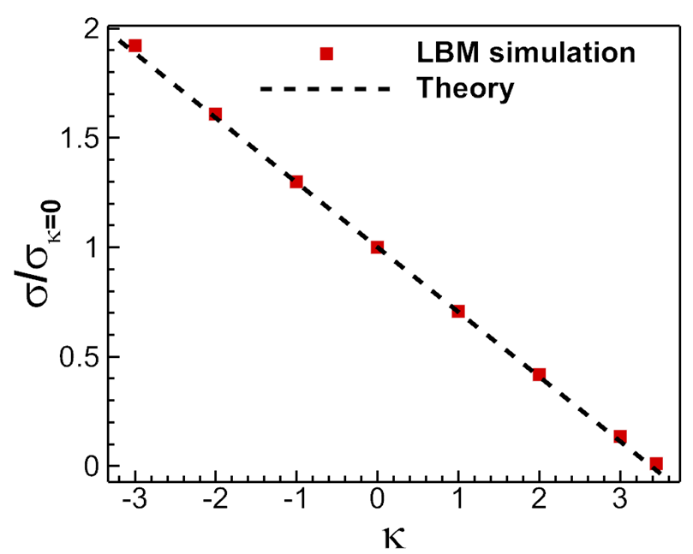
Numerical model and validation
1. Single-component multi-phase model
Different liquid-vapor density ratios with tunable surface tension
Different density ratios agree well with Maxwell equal area rule
Theoretical equation:
Tunable range of over 200 times.
Qin et al. Journal of Fluid Mechanics, (2026) 1028:A20.

Slide 8
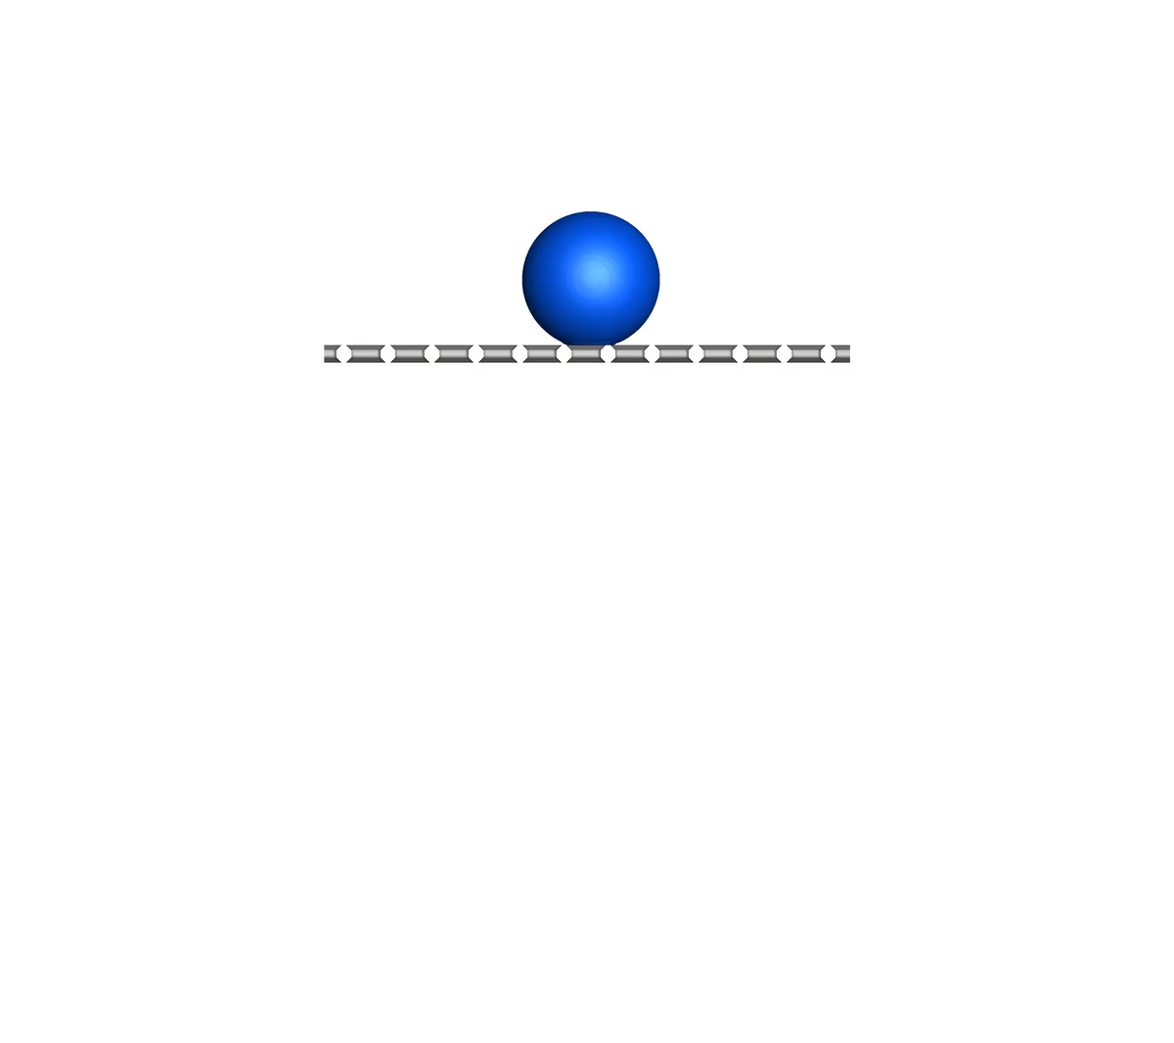
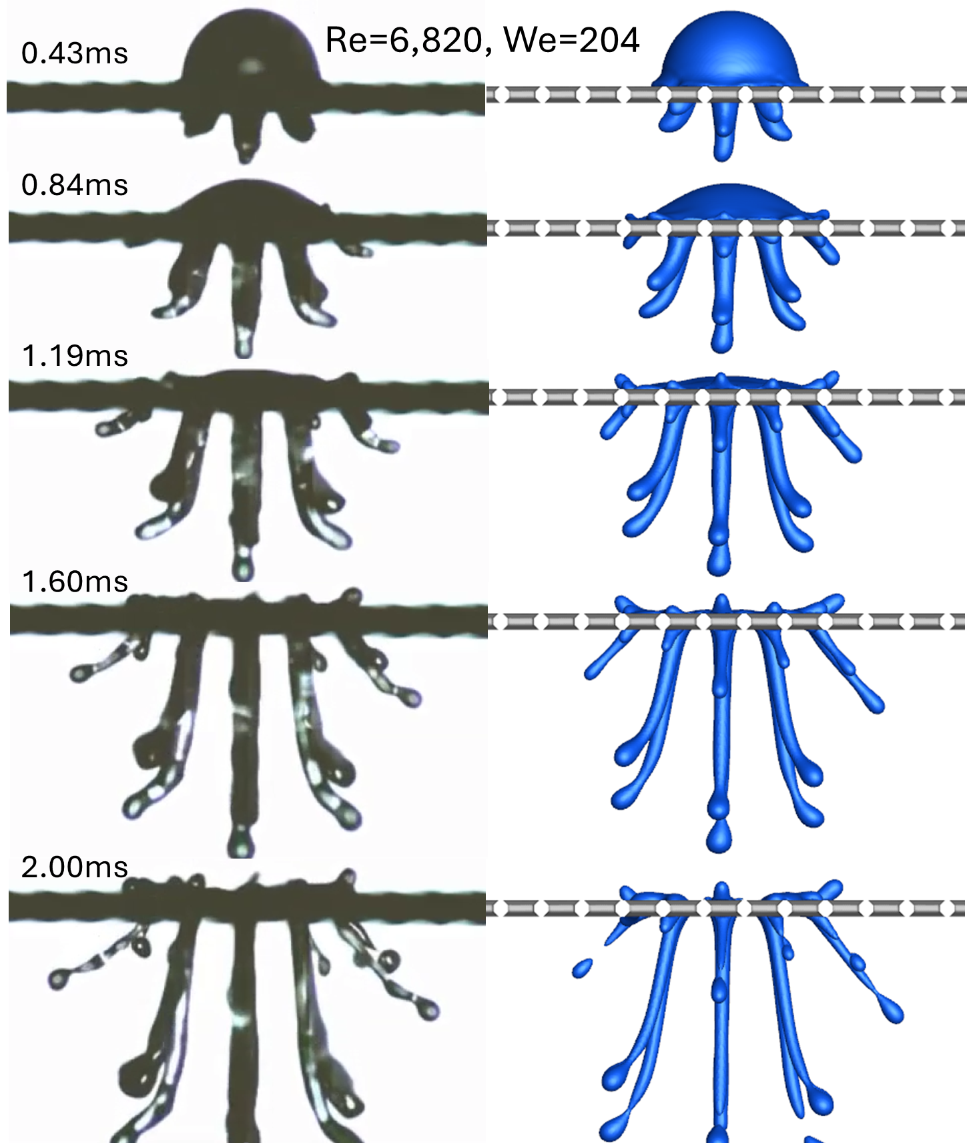
Numerical model and validation
1. Single-component multi-phase model
Droplet impact, penetration and splashing on hydrophobic mesh structures
Qin et al. Journal of Fluid Mechanics, (2026) 1028:A20.

Slide 9
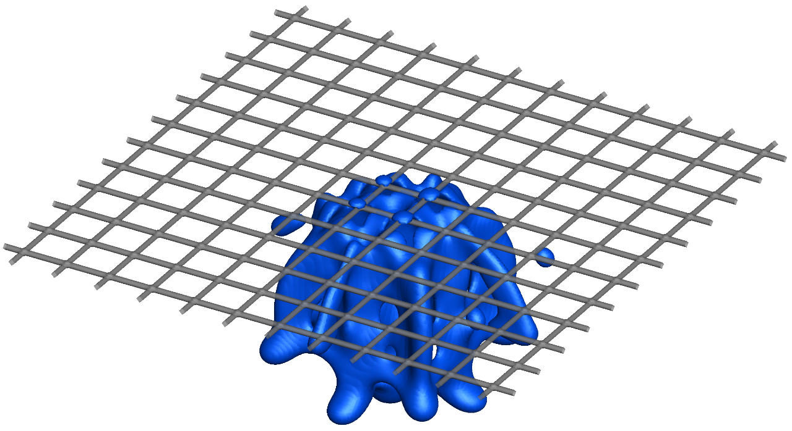
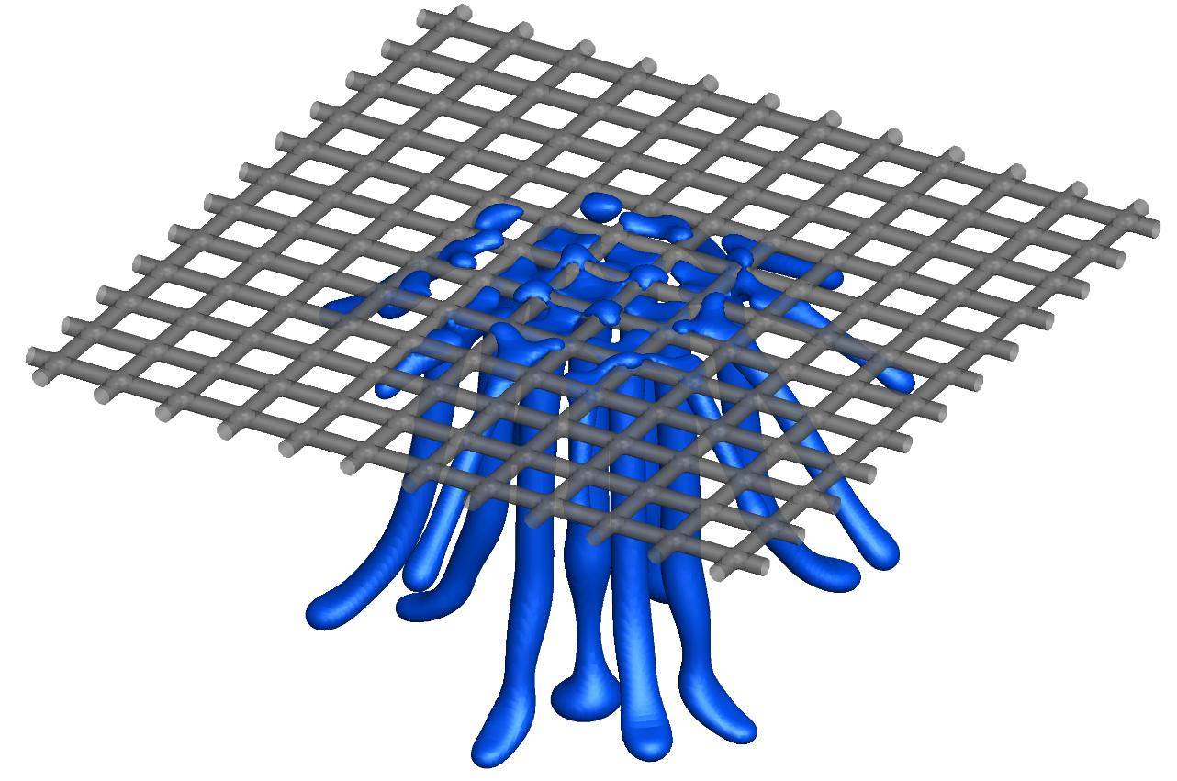
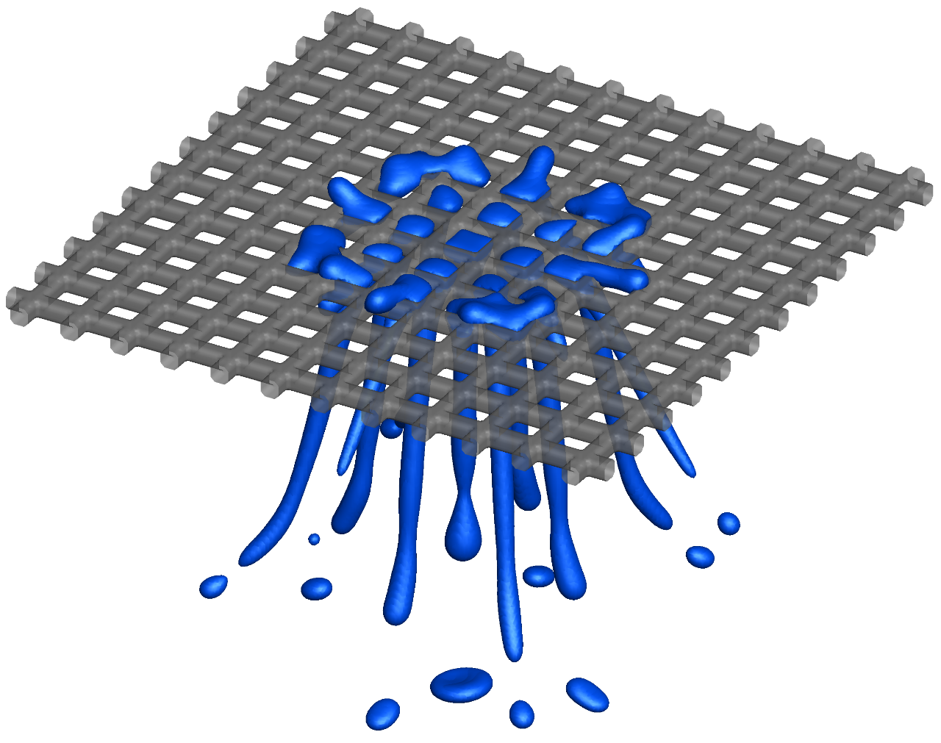
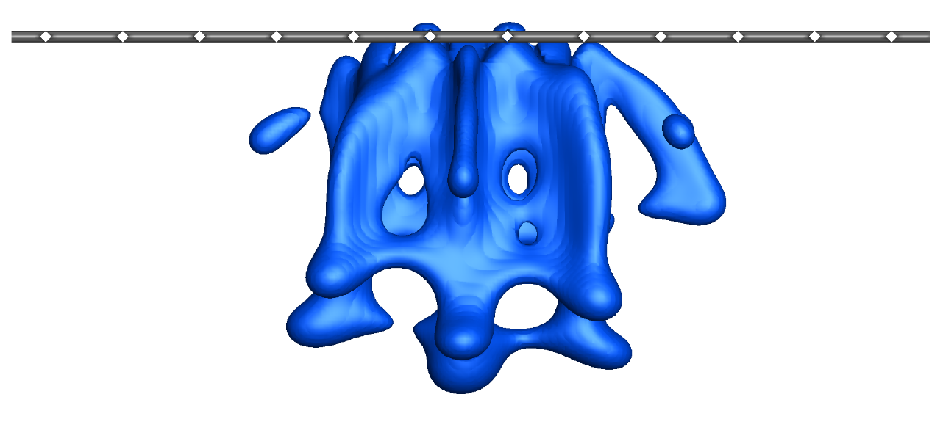
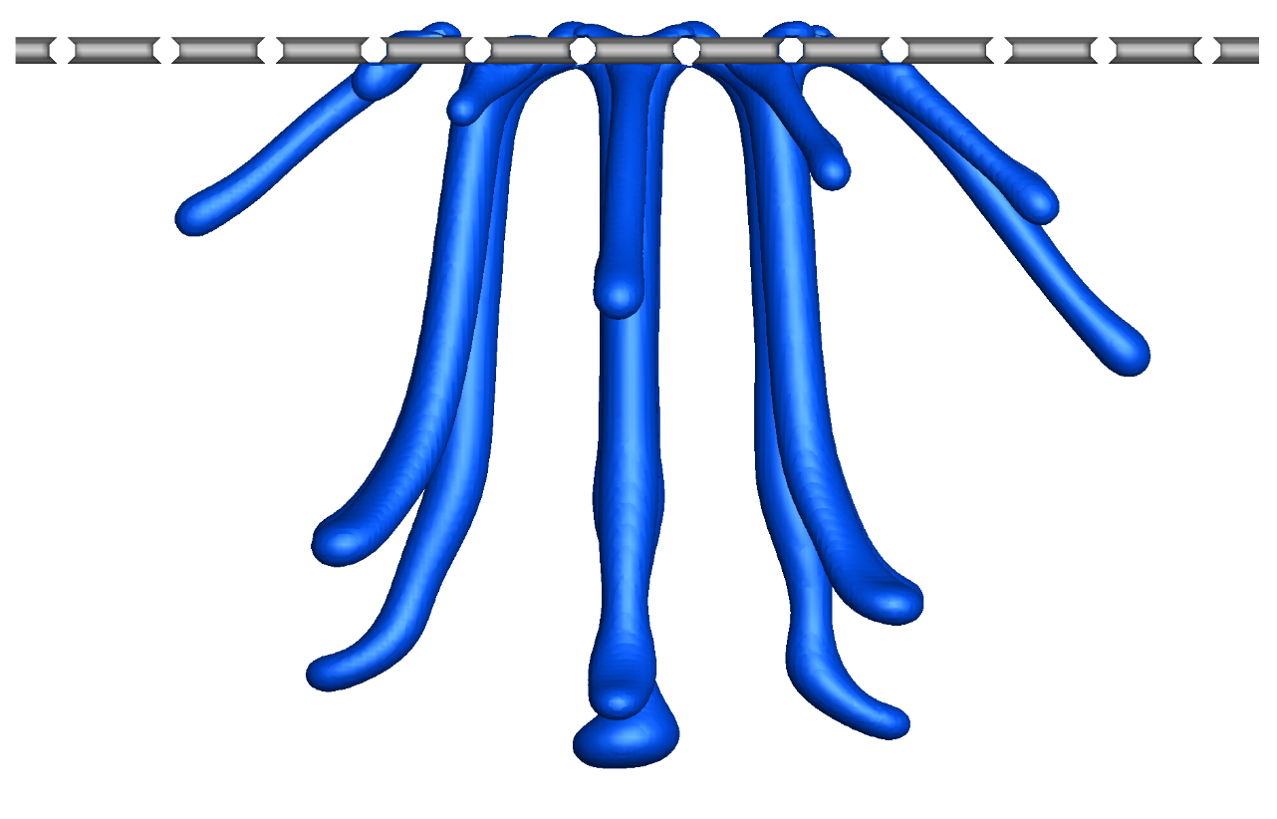
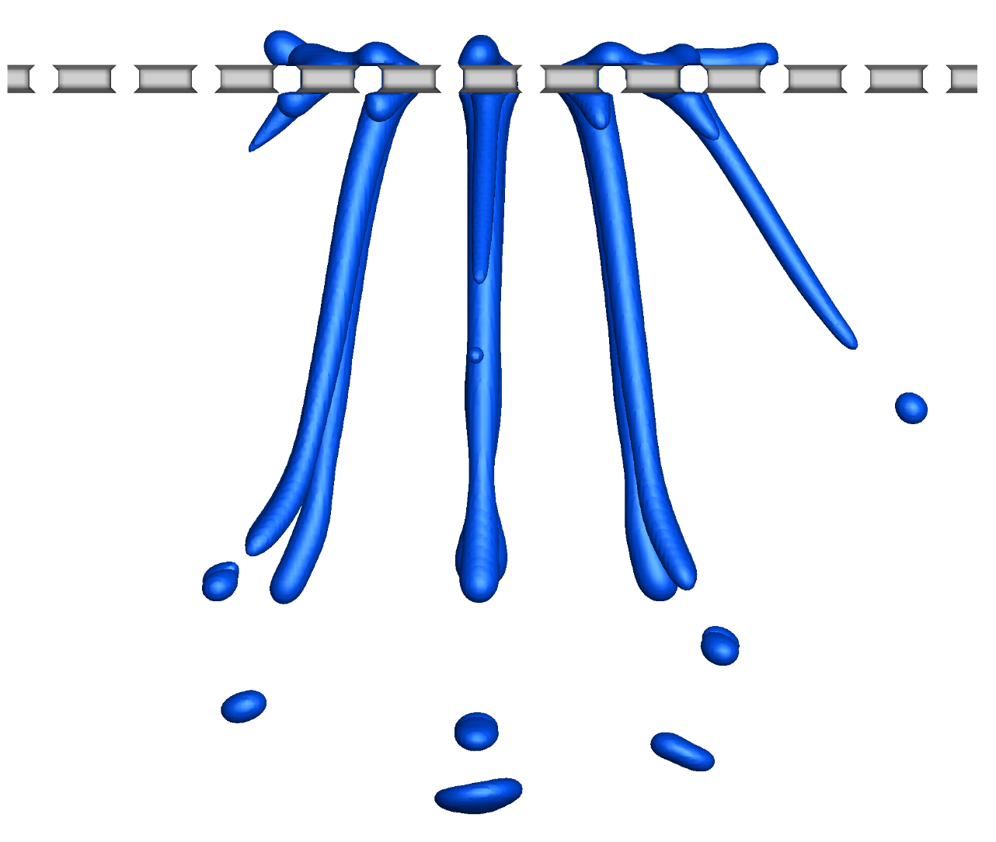
Numerical model and validation
1. Single-component multi-phase model
The influence of pore size on liquid penetration, spreading and splashing at Re=15200,We=1020
(a)
2r/d=0.12
(b)
2r/d=0.25
(c)
2r/d=0.38
0.896ms
0.896
1.12
Qin et al. Journal of Fluid Mechanics, (2026) 1028:A20.

Slide 10
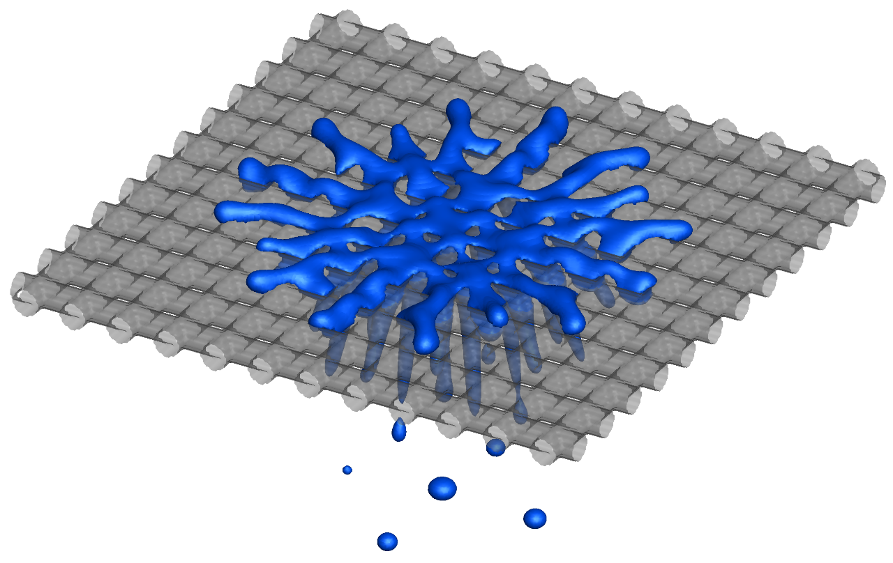
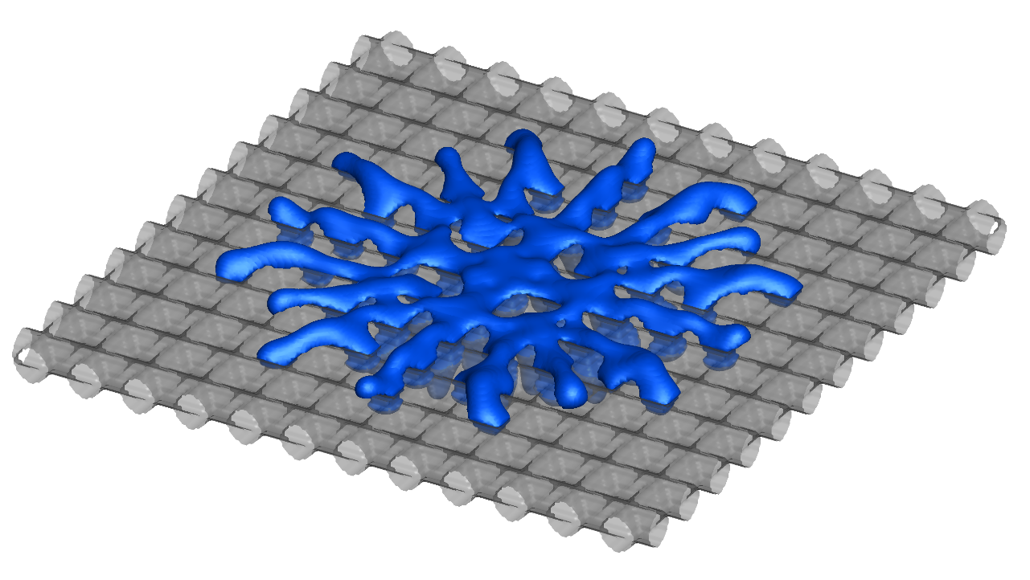
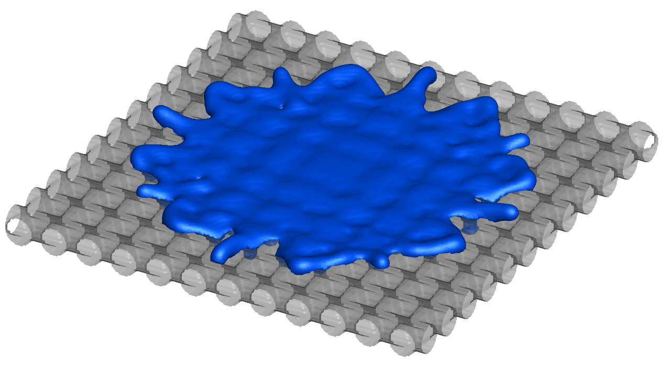
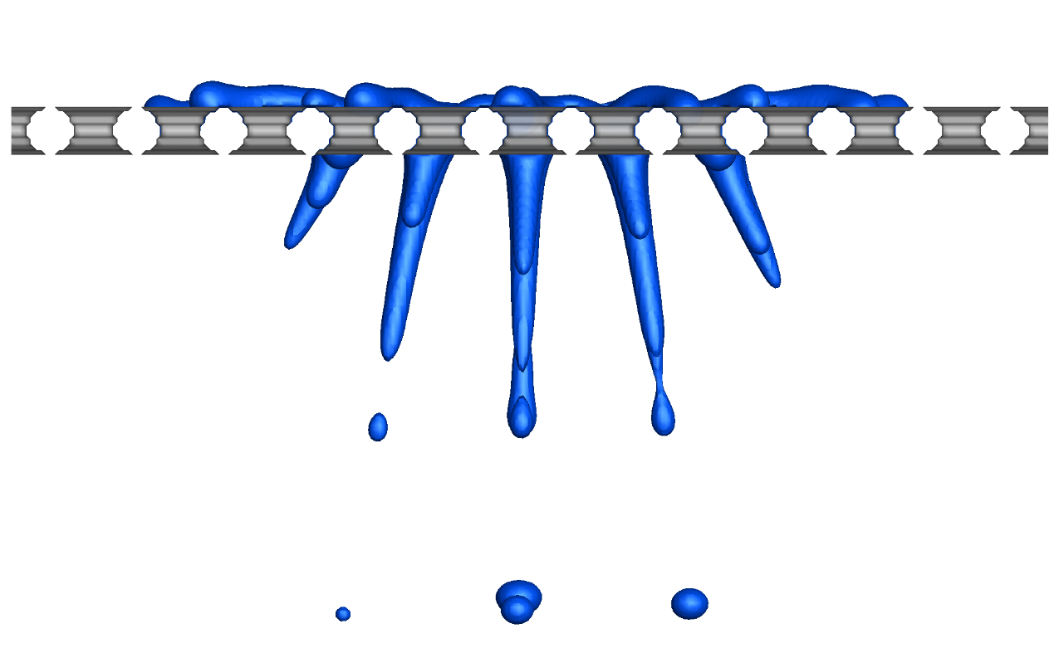
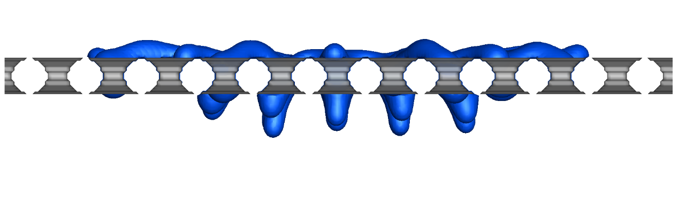
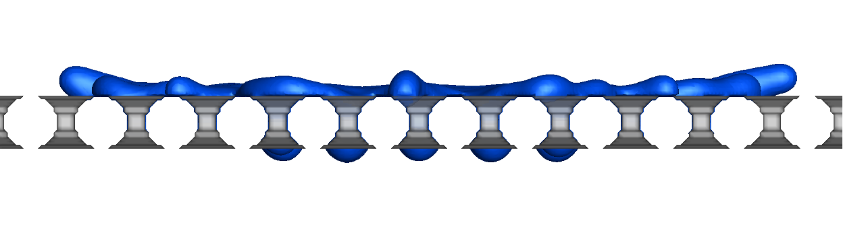
Numerical model and validation
1. Single-component multi-phase model
The influence of pore size on liquid penetration, spreading and splashing at Re=15200,We=1020
(d)
2r/d=0.52
(e)
2r/d=0.63
(f)
2r/d=0.75
1.12
1.34
1.34
Qin et al. Journal of Fluid Mechanics, (2026) 1028:A20.

Slide 11
Numerical model and validation
2. Temperature model for non-isothermal phase change
Two-way coupling by equation of state (EoS)
EMRT LBM
Temperature equation
EoS
convection
diffusion
latent heat
Finite difference method
(2nd/4th order Runge-Kutta scheme)
Li et al. (2015), INT J HEAT MASS TRANSF, 85, 787-796

Slide 12
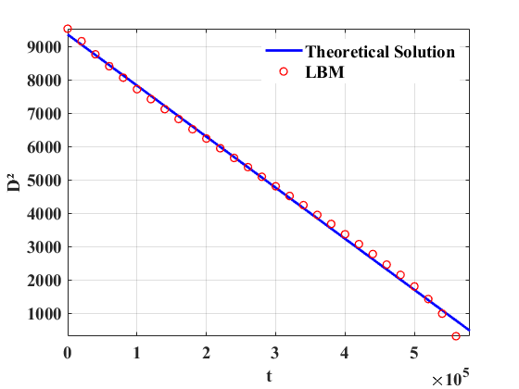
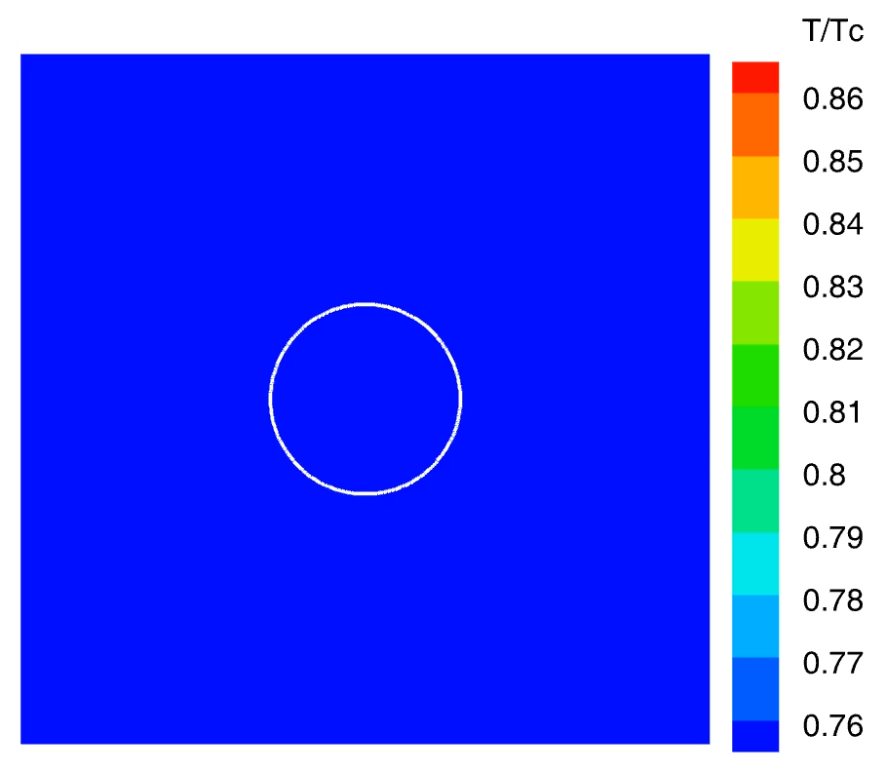
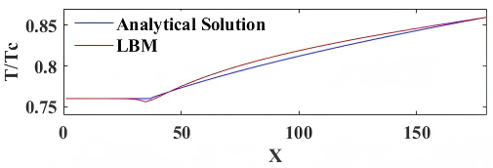
Numerical model and validation
2. Temperature model for non-isothermal phase change
1) Single droplet evaporation
Heating at four sides
Constant pressure
Fei, Qin, et al. Physical Review E 105.2 (2022): 025101.

Slide 13
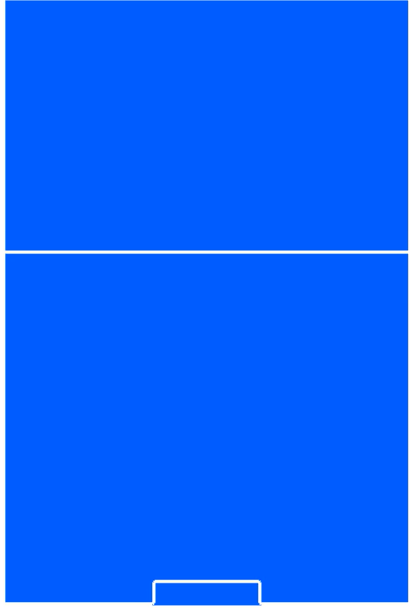


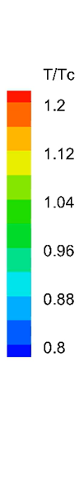
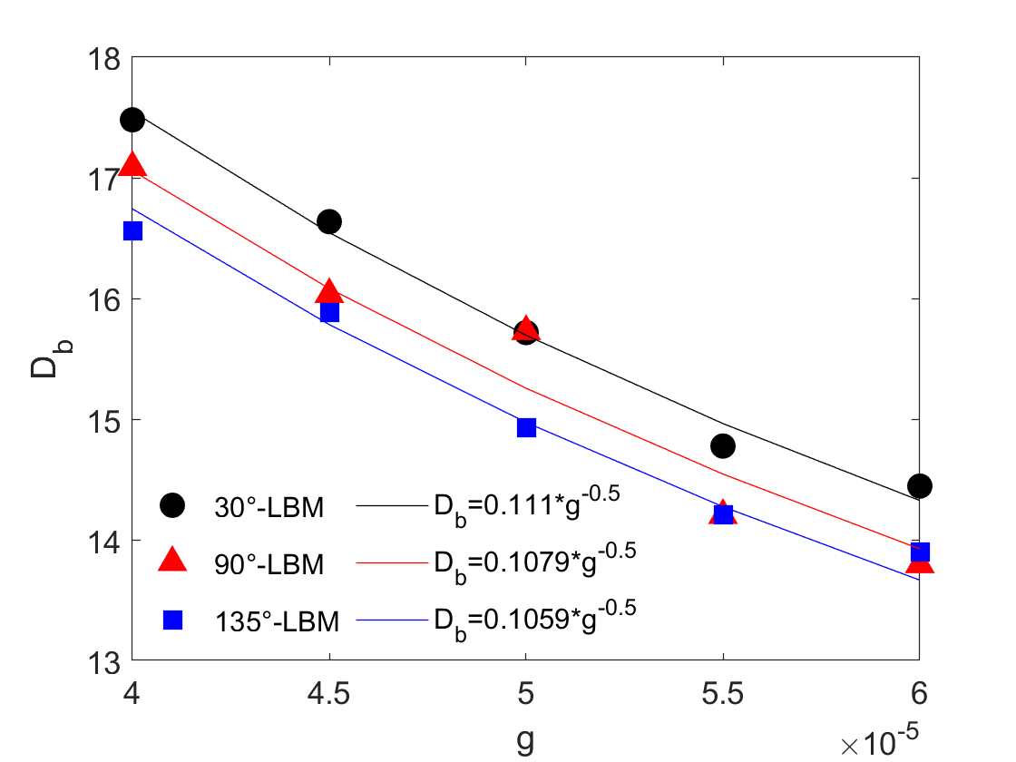


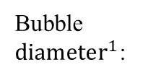

Numerical model and validation
2. Temperature model for non-isothermal phase change
2) Single bubble nucleation and departure
Bubble ${diameter}^{1}$:
Bubble departure diameter agrees with the theoretical relation.
θ=30$°$, $g=2.5×{10}^{−5}$
θ=90$°$, $g=2.5×{10}^{−5}$
θ=135$°$, $g=2.5×{10}^{−5}$
1. Friz, (1935). Physic. Zeitschz, 36, 379-354.

Slide 14
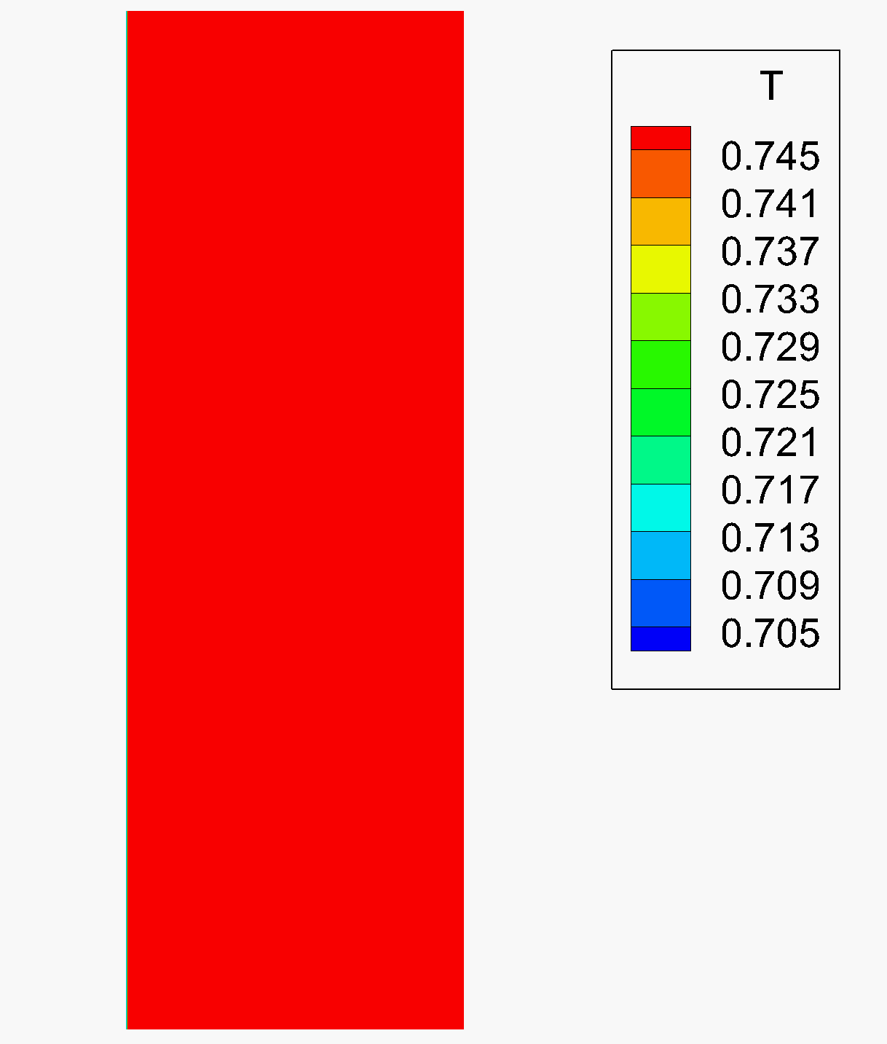
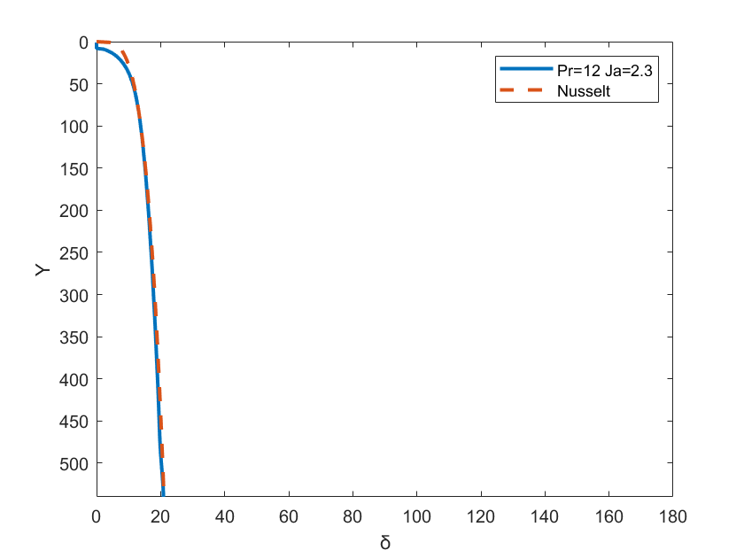
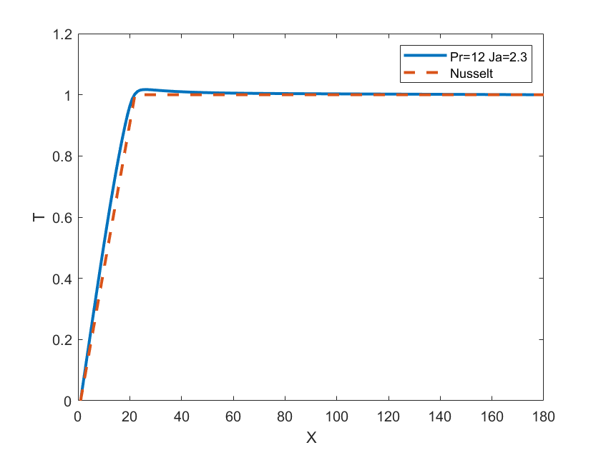

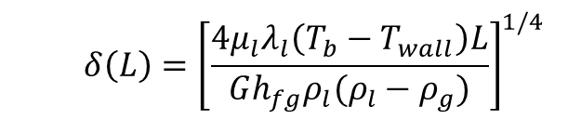

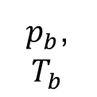


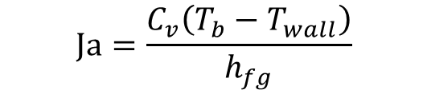
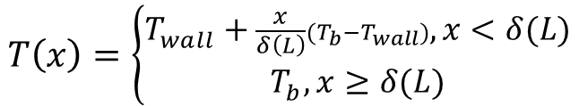
Numerical model and validation
2. Temperature model for non-isothermal phase change
$$Ja=\frac{C_{v}\left(T_{b}−T_{wall}\right)}{h_{fg}}$$
$$Pr=\frac{νC_{v}ρ_{l}}{λ_{l}}$$
3) Vapor condensation on a cold vertical flat plate
x
y
$p_{b}$,
$$T_{b}$$
$$δ\left(L\right)={\left[\frac{4μ_{l}λ_{l}\left(T_{b}−T_{wall}\right)L}{Gh_{fg}ρ_{l}(ρ_{l}−ρ_{g})}\right]}^{1/4}$$
$$T\left(x\right)=\left\{\begin{aligned}T_{wall}+\frac{x}{δ\left(L\right)}(T_{b}−T_{wall}),x<δ(L) \\ T_{b},x≥δ(L)\end{aligned}\right.$$
Cold
Wall
$$θ=40°$$
$$T_{wall}$$
$$G$$
Pr=12
Ja=2.3
$$\dot{q}=0$$
Both the film thickness and temperature profile agree well with Nusselt’s theory.
Nusselt, Zetrschr. Ver. Deutch. Ing. 60 (1916) 541–546.

Slide 15
Numerical model and validation
3. Particle transport and deposition model for evaporation of colloid suspension
T-EMRT LBM
Particle transport
Particle deposition
1. Local concentration/drying completion
Flow velocity
2. Adjacent node is wall or particle deposition
3. No particle penetration at wall
Fluid-particle interaction
Wall boundary--
One-way or two-way coupling
Qin et al., 2019. Physical Review E, 99(5), p.053306.
Qin et al., 2023. Journal of Fluid Mechanics, 963, A26.

Slide 16
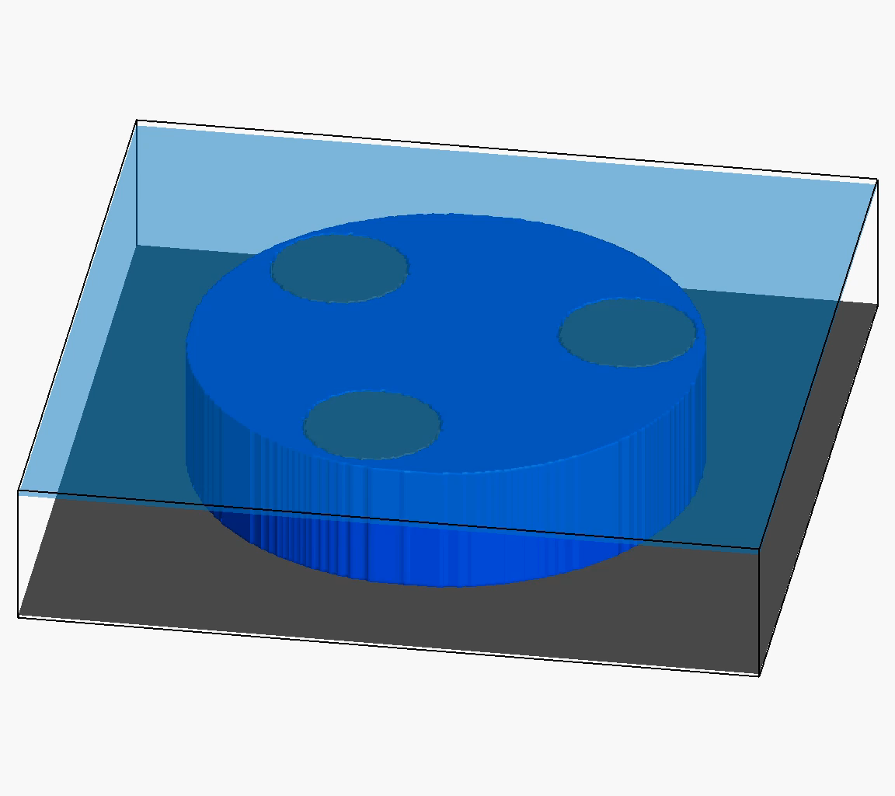
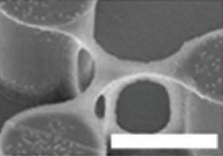
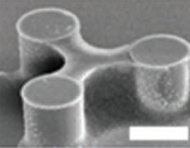
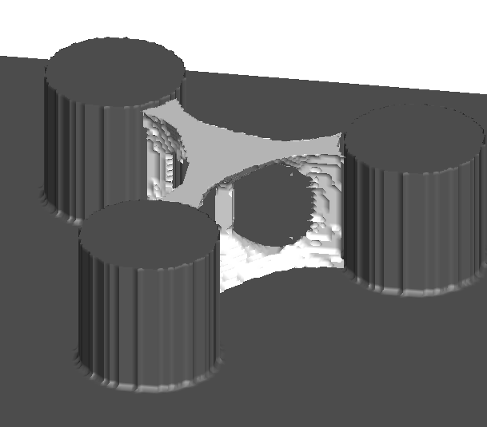
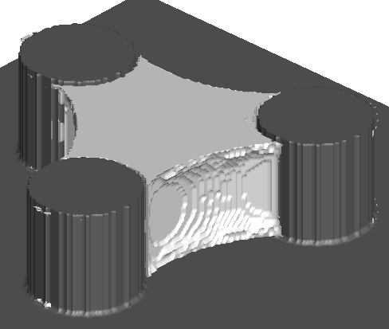
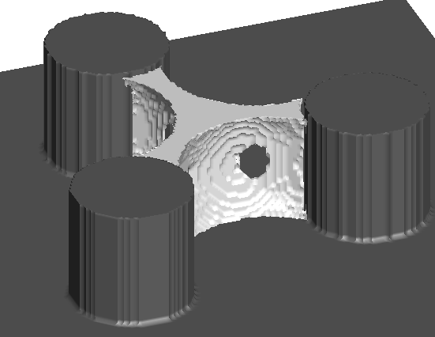
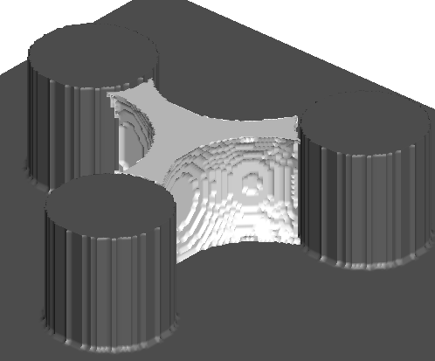


Numerical model and validation
3. Particle transport and deposition model for evaporation of colloid suspension
Deposition pattern under different particle volume fraction
Experiment
Top cover
$$10μm$$
Su et al., 2018
Simulation
d=40
240
48
240 lattices
Bottom substrate
Polystyrene nanoparticle (PSNP) suspension
Liquid contact angle: 30$°$
Qin et al., 2020. INT J HEAT MASS TRANSF, 158, 120000.

Slide 17
Contents
01
Background
02
Numerical model
03
Results and discussions
04
Conclusion and outlook

Slide 18
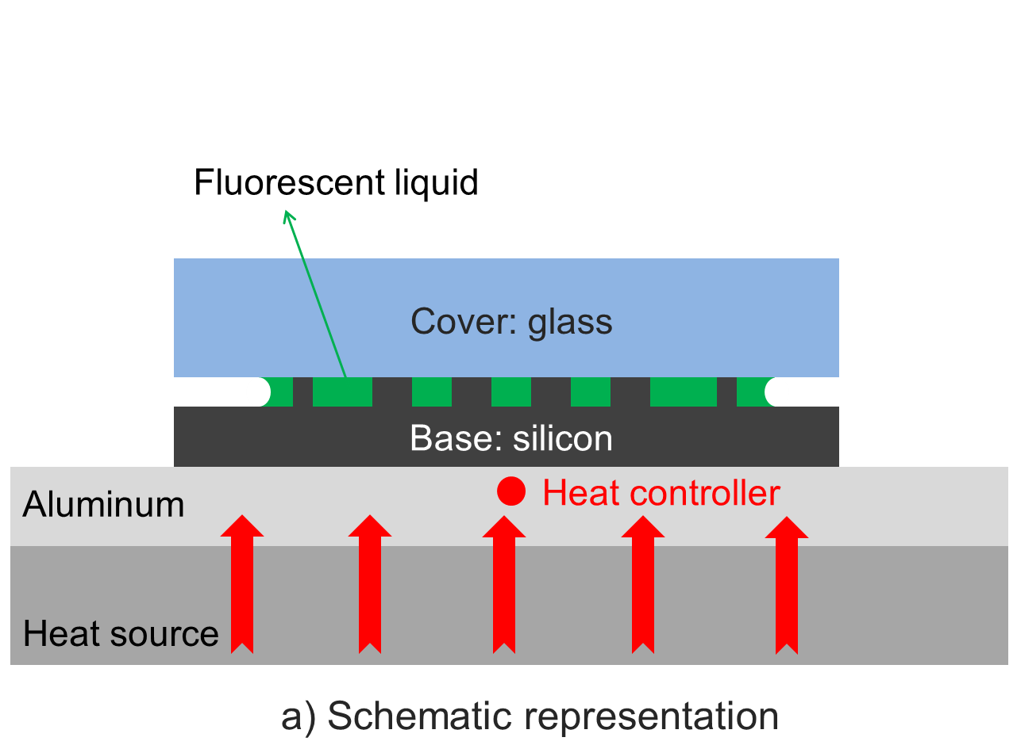
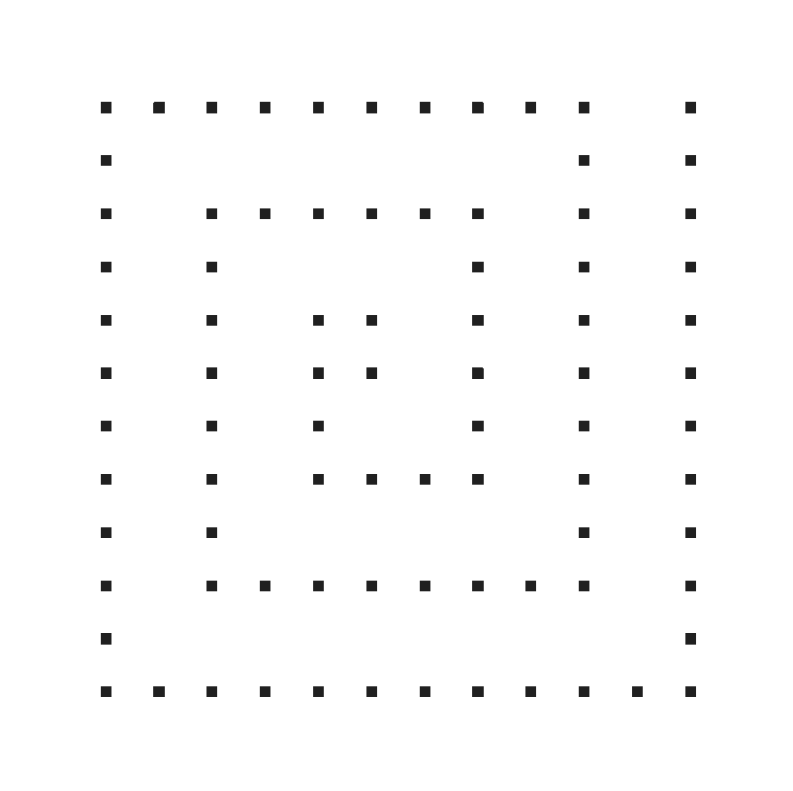
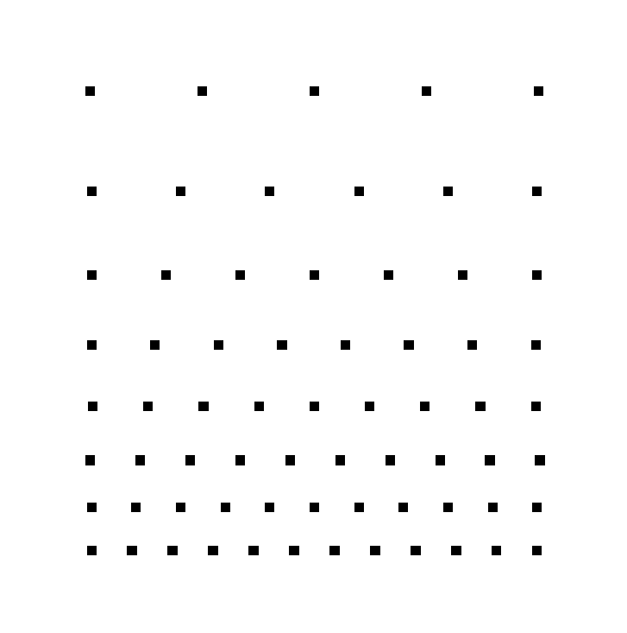




Results and discussions: evaporation
1. Non-isothermal liquid drying in micropore structures
Pillar height of 60$μm.$
D
180μm
20x20${\text{μ}\text{m}}^{2}$
80
20x20${\text{μ}\text{m}}^{2}$
230μm
200
L0
L0
180
165
147
135
123
50$℃$
115
L
D
105
100
91
85
80
75
71
L=7L0
Side view
Rectangular-spiral shape
Gradient shape
Liquid contact angle: 30$°$(plasma treatment of geometry)

Slide 19
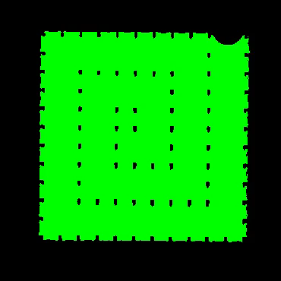










Results and discussions: evaporation
Surface tension
1. Non-isothermal liquid drying in micropore structures
Laplace pressure:
Evaporation Exp.
LBM modeling of
liquid configuration
LBM modeling of temperature
Liquid internal flow
Liquid pressure
实验 模拟
Qin et al., 2019. Journal of Fluid Mechanics, 866, pp.33-60.

Slide 20


Results and discussions: evaporation
2. Evaporation-induced particle transport and deposition
Contact angle of $θ=30°$, initial nanoparticle concentration $φ_{0}=$ 5.0%, particle contact angle $θ_{p}=$ 4$5°$, diffusion coefficient $D_{p}=$ 0.03
Qin et al., 2023. Journal of Fluid Mechanics, 963, A26.

Slide 21





Results and discussions: evaporation
2. Evaporation-induced particle transport and deposition
Evolution of liquid mass $m_{N}$ and normalized particle deposition volume $V_{d}$/ $V_{pm}$under different conditions
An empirical relation between the evaporation rate and the influential factors is established.
Qin et al., 2023. Journal of Fluid Mechanics, 963, A26.

Slide 22


Results and discussions: boiling
1. Boiling in simple porous media (PM) compared with pool boiling (at θ=90°)
Nucleate boiling
a
d
Contact line is pinned
Contact line keeps moving
Ja=0.1660（Tw=0.90Tc）
Ja= 0.1992（Tw=0.92Tc）
Qin et al., 2026, under review

Slide 23


Results and discussions: boiling
1. Boiling in simple porous media (PM) compared with pool boiling (at θ=90°)
Transition boiling
b
e
Ja= 0.2324（Tw=0.94Tc）
Ja=0.2656（Tw=0.96Tc）
Qin et al., 2026, under review
Notes:
The behaviors are similar, but the bubble nucleation and coalescence are very intensive.

Slide 24


Results and discussions: boiling
1. Boiling in simple porous media (PM) compared with pool boiling (at θ=90°)
Film boiling
f
c
Film is higher than bottom solid
Film is relatively lower
Ja= 0.8301 （Tw=1.3Tc）
Ja=0.3321（Tw=1.0Tc）
Qin et al., 2026, under review

Slide 25




Results and discussions: boiling
2. Comparison of heat transfer performance——boiling curves
h
Ja=0.2324 (point b)
Ja=0.4981 (point g)
Ja=0.6641 (point h)
The starting Ja of nucleate boiling is smaller in PM (point a compared with d)
The effective heat transfer range is 5 times higher in PM (0.6641 compared with 0.1329)
The maximum heat flux is increased by 32% in PM (8.88e-6 than 6.74e-6)
Qin et al., 2026, under review

Slide 26



Results and discussions: boiling
2. Comparison of heat transfer performance——boiling curves
The qualitative trend is the same for different contact angles of $θ=60°, 90°$ and $120°$
The highest difference of effective boiling range is at $θ=120°$ (6.4 times by 0.5313/0.083)
The highest difference of maximum heat flux is at $θ=90°$ (8.88e-6 than 6.74e-6)
Qin et al., 2026, under review

Slide 27





Results and discussions: condensation
1. Vapor condensation in a 2D cross-section of 3D fiber structures (analogous to PEMFC)
periodic
$$T_{in}=0.8T_{c}$$
$$p_{in}=const$$
$$\frac{∂u}{∂x}=0$$
$$\frac{∂T}{∂x}=0$$
periodic
Contact angle: $θ=68°$; porosity: $φ=83.47\%$
Kinematic viscosity： $ν_{v}=\frac{1}{4}; ν_{l}=\frac{1}{16}$
Thermal diffusion coefficient： $α_{v}=\frac{1}{4}; α_{l}=\frac{1}{32}$
Zhang, Qin*, et al., 2026, under review

Slide 28





















Results and discussions: condensation
1. Vapor condensation in a 2D cross-section of 3D fiber structures (analogous to PEMFC)
Liquid mass increase rate:
Initial period
Stable period
Density
$$t_{0}$$
$$t_{e}$$
$$t_{a}$$
$$t_{b}$$
$$t_{c}$$
Temperature
$$t_{a}$$
The condensation is divided to an initial fluctuation period, followed by a stable period
Zhang, Qin*, et al., 2026, under review

Slide 29




Results and discussions: condensation
1. Vapor condensation in a 2D cross-section of 3D fiber structures (analogous to PEMFC)
Vapor income rate
Condensation rate
Vapor income rate
Condensation rate
Vapor accumulation at interface-> lower vapor pressure gradient-> less vapor income
Vapor reduction at interface-> higher vapor pressure gradient-> more vapor income
The initial fluctuation period is induced by the competition between vapor income and condensation
Zhang, Qin*, et al., 2026, under review

Slide 30








Results and discussions: condensation
1. Vapor condensation in a 2D cross-section of 3D fiber structures (analogous to PEMFC)
$$t_{a}=3×{10}^{4}δ_{t}$$
$$t_{b}=8×{10}^{4}δ_{t}$$
$$t_{c}={10}^{5}δ_{t}$$
$$Y=164$$
$$Y=164$$
In the time period of $t_{a}$ -$t_{b}$ -$t_{c}$, both the temperature and velocity profiles show condensation is approaching a stable state
The stable period is due to the balance of condensation and liquid transport at left liquid-vapor interface (yellow)
Zhang, Qin*, et al., 2026, under review

Slide 31















Results and discussions: condensation
2. The influence of different parameters on the condensation mechanisms—contact angle
Isolated vapor
$$θ_{1}=120°$$
$$X=120$$
$$θ_{1}=120°$$
A
$$θ_{2}=90°$$
$$θ_{2}=90°$$
$$θ_{3}=68°$$
$$θ_{3}=68°$$
Liquid mass evolution with time
$$X=120$$
Small contact angle is favorable for vapor condensation due to high capillary pressure
High contact angle may lead to isolated vapor which prevents the condensation
Zhang, Qin*, et al., 2026, under review

Slide 32










Results and discussions: condensation
2. The influence of different parameters on the condensation mechanisms—porosity
$$φ_{1}=83.47\%$$
$$t_{1}=2×{10}^{4}δ_{t}$$
$$Φ_{3}=77.57\%$$
$$φ_{2}=81.14\%$$
$$t_{2}=4.5×{10}^{4}δ_{t}$$
$$Φ_{3}=77.57\%$$
$$φ_{3}=79.93\%$$
From $t_{1}$ to $t_{2}$, the condensation is faster
at ${\text{φ}}_{3}$ than at ${\text{φ}}_{2}$
Liquid mass evolution with time
High porosity promotes condensation due to less viscous dissipation, while heterogeneous pore structures may lead to variation of condensation rate in a certain period of time

Slide 33






Results and discussions: condensation
2. The influence of different parameters on the condensation mechanisms—Ja number
$${Ja}_{1}=0.91$$
$$∆T_{1}=0.04T_{c}$$
High Ja leads to strong vapor accumulation at left liquid-vapor interface, even inducing evaporation
$${Ja}_{2}=1.08$$
$$∆T_{2}=0.05T_{c}$$
$${Ja}_{3}=1.16$$
$$∆T_{3}=0.06T_{c}$$
Liquid mass evolution with time
At high Ja (low T of porous medium), the temperature/pressure gradient is high, leading to high vapor income rate, and thus more intensive condensation

Slide 34
Contents
01
Background
02
Numerical model
03
Results and discussions
04
Conclusion and outlook

Slide 35

Conclusions and outlook
Conclusions
Isothermal two-phase flow
Evaporation
Condensation
Boiling
Outlook
The influence of interfacial flow on evaporation-induced particle transport and deposition
The consideration of air in evaporation and boiling
Microfluid experiment for engineering applications

Slide 36


Thank you for your attention

