Slide 1
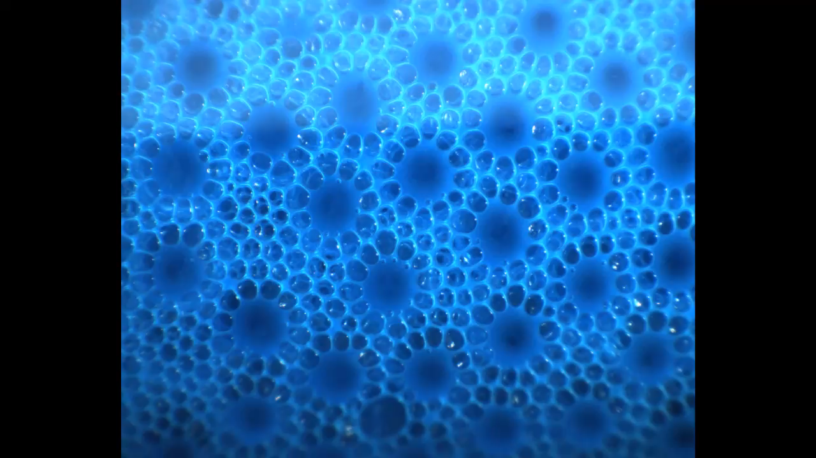


Foam confined in granular media: liquid distribution & consequences
A. Salamé, V. Langlois, O. Pitois

Slide 2
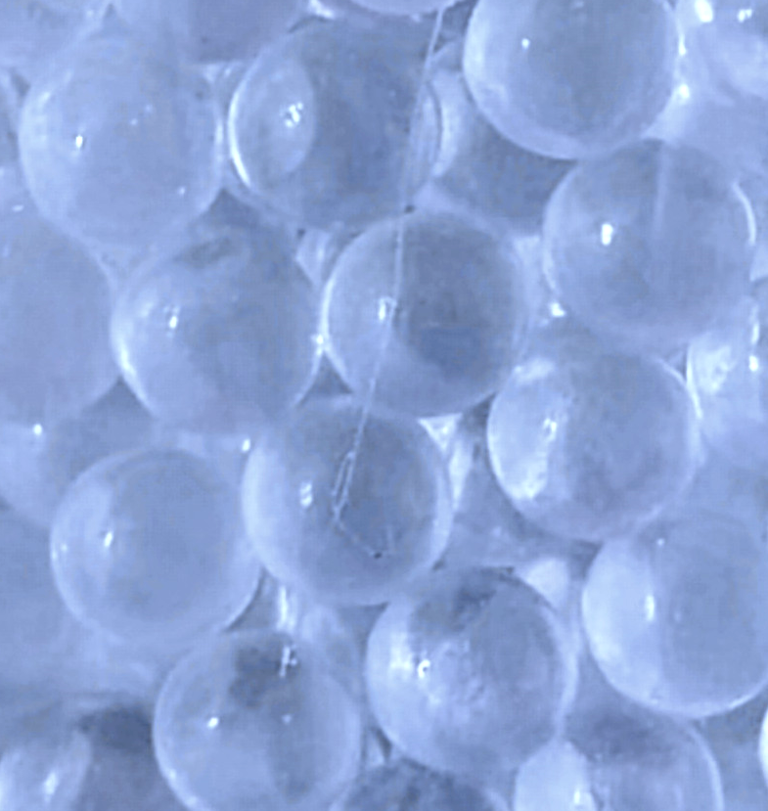
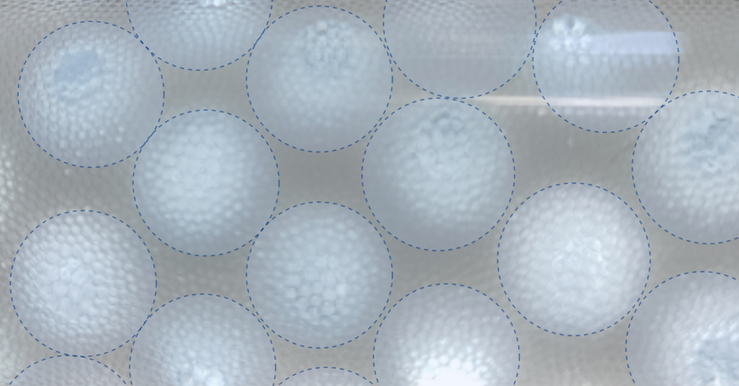
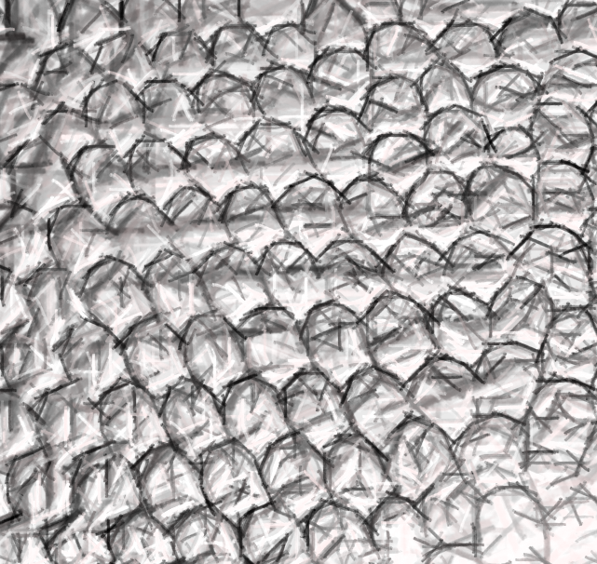
Introduction
Foam in porous media – Applications
Applications for 50 years: Petroleum Operations (drilling fluid, sand cleanout fluid,…)
New applications:
“In situ” soil remediation (hydrocarbur, heavy metals,…)
Soil reinforcement (microbiologically induced calcite precipitation,…)
Potential use of foam as binder of granular media (especially waste granular materials)
Foam + binders:
cement slurries,
geopolymer solutions,
calcined clay suspensions
Granular media

Slide 3
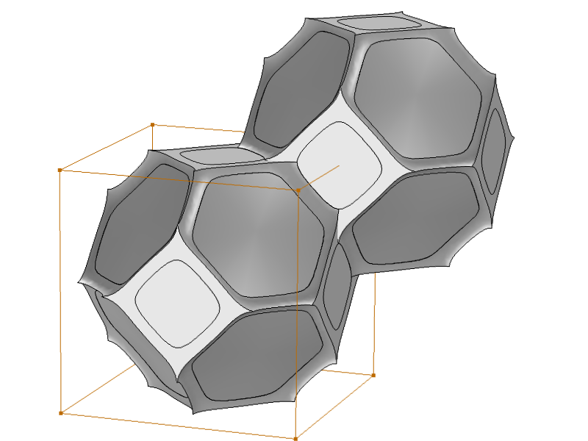
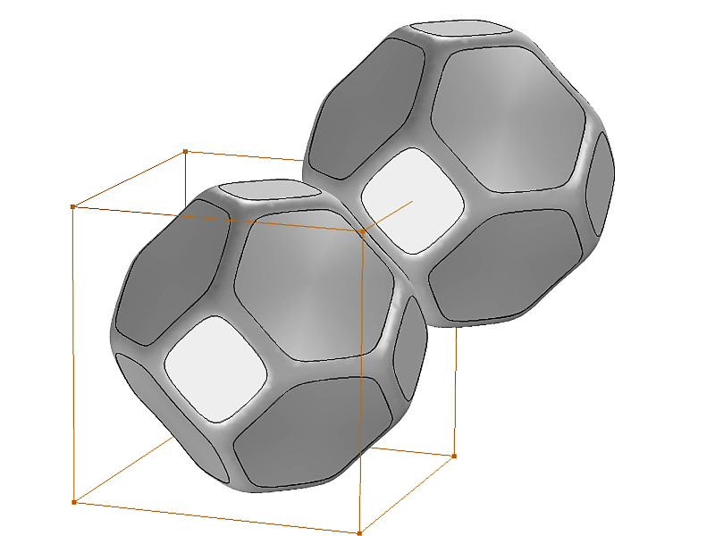
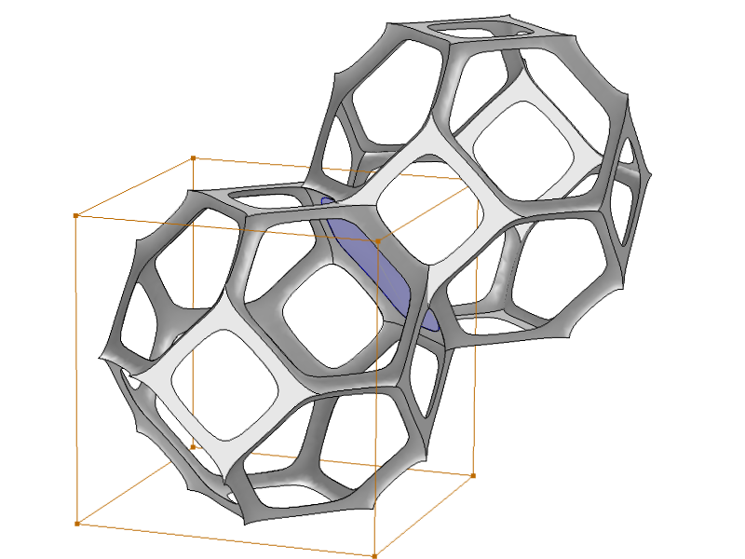



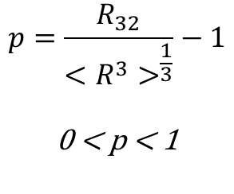
Introduction
Foam: Dispersion of a large amount of gas in a liquid phase.
Characteristic parameters:
Liquid fraction $φ_{l}$
Bubble sizes $R_{b}$ ($\left\langle R_{b}\right\rangle$, polydispersity degree $p$,…)
For foam confined in granular media: Grain sizes $R_{g}$ ($\left\langle R_{g}\right\rangle$, polydispersity,…), $r=\frac{\left\langle R_{b}\right\rangle }{\left\langle R_{g}\right\rangle }$
Questions raised for confined foams:
1. What’s the microstructure of a confined foam? How does the liquid distribute itself inside the pore space?
2. How are the properties of the foam affected by confinement?
Microstructure of bulk foam
Bulk foam
Network of Plateau borders
polydispersity:
$${2R}_{b}$$
Continuous liquid phase
Gas bubbles
$$p=\frac{R_{32}}{{<R^{3}>}^{\frac{1}{3}}}−1$$
$$\text{0} \text{<} \text{p}\text{ < 1}$$
Confined foam
$$R_{g}$$

Slide 4
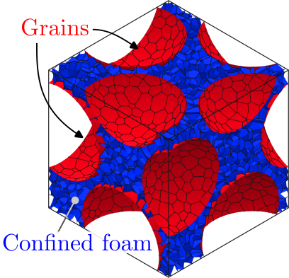
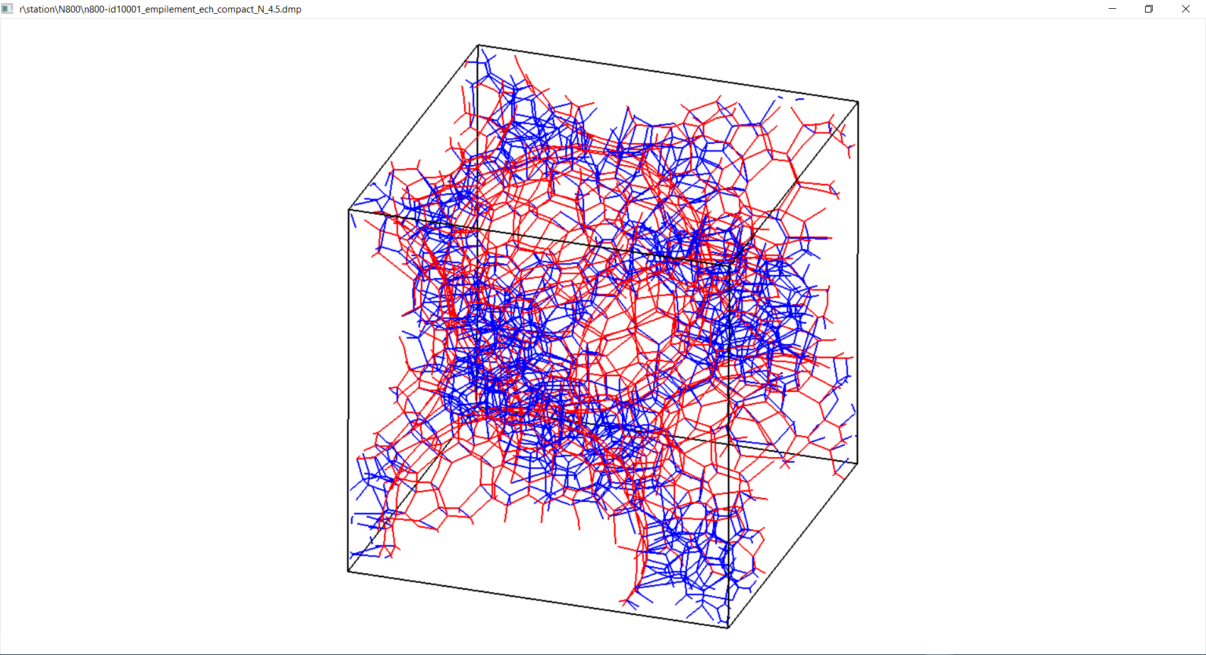
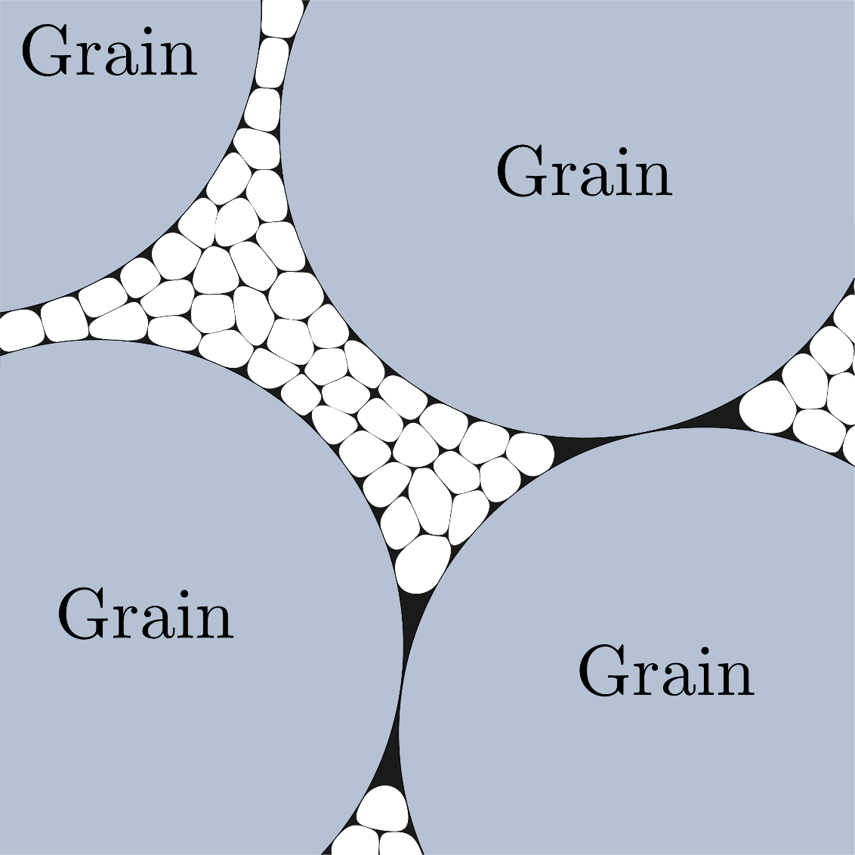
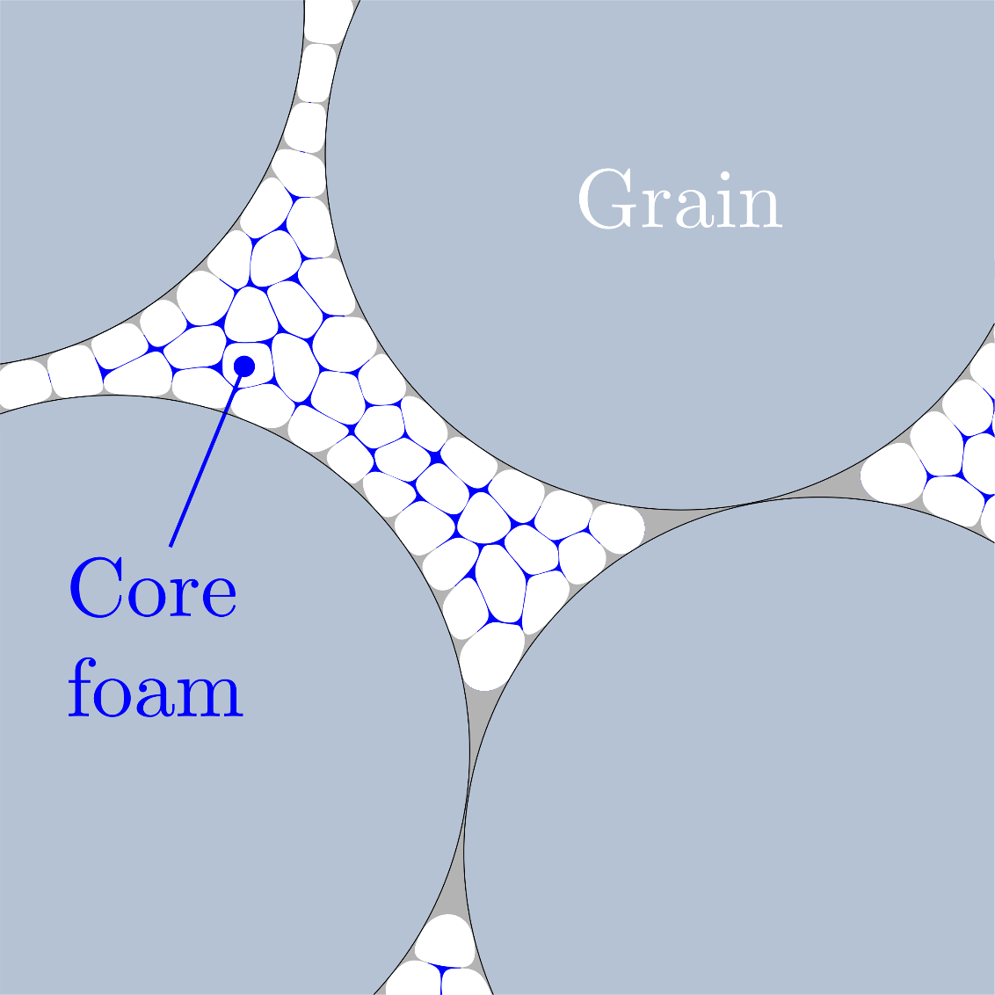
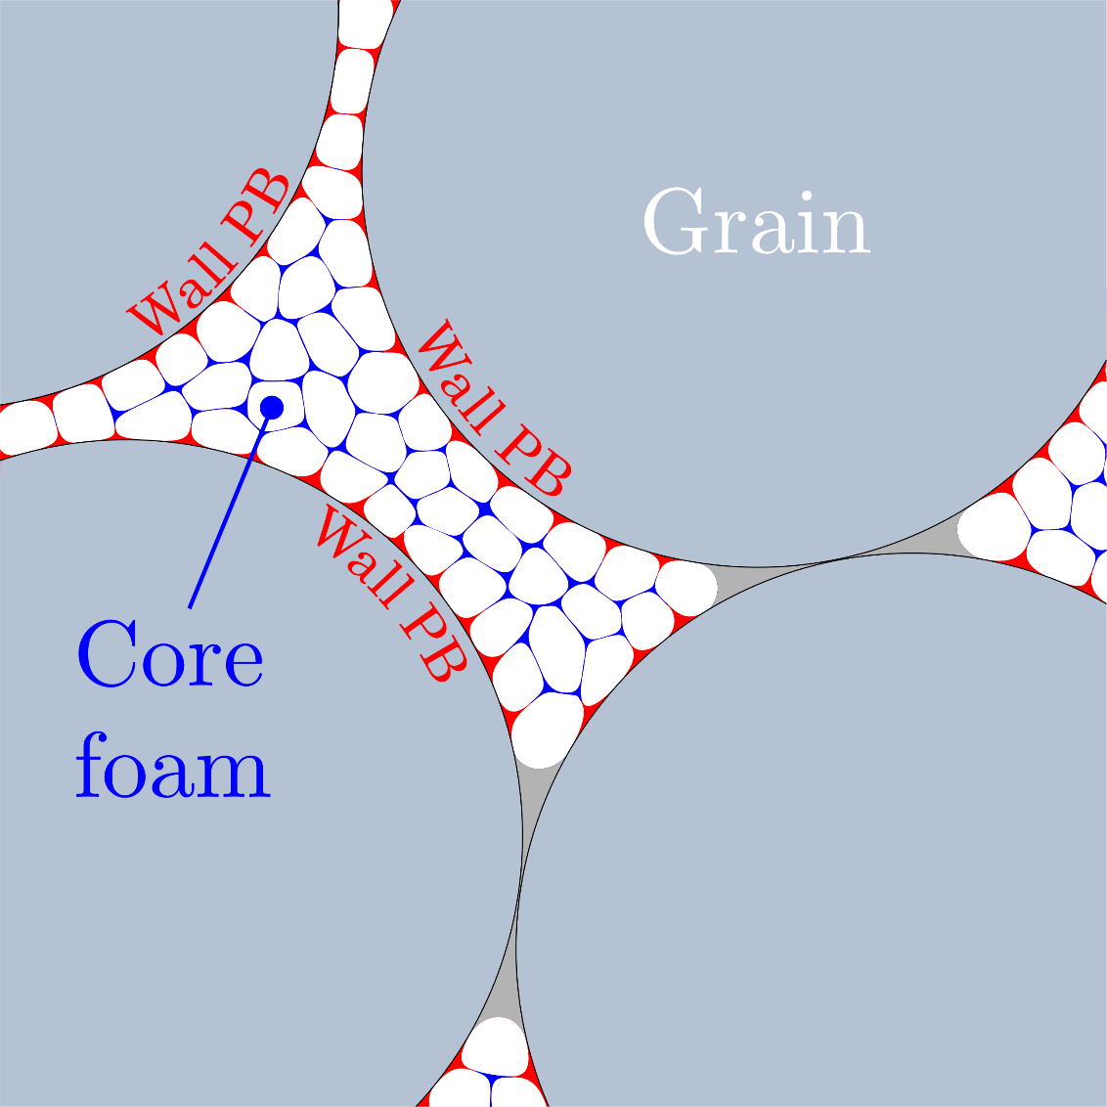
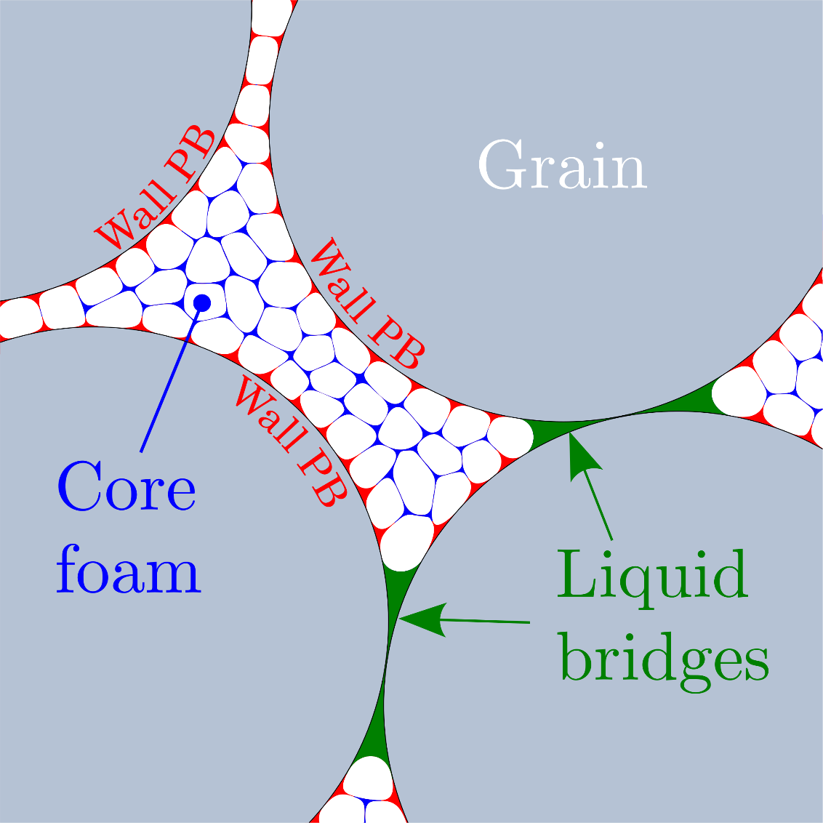
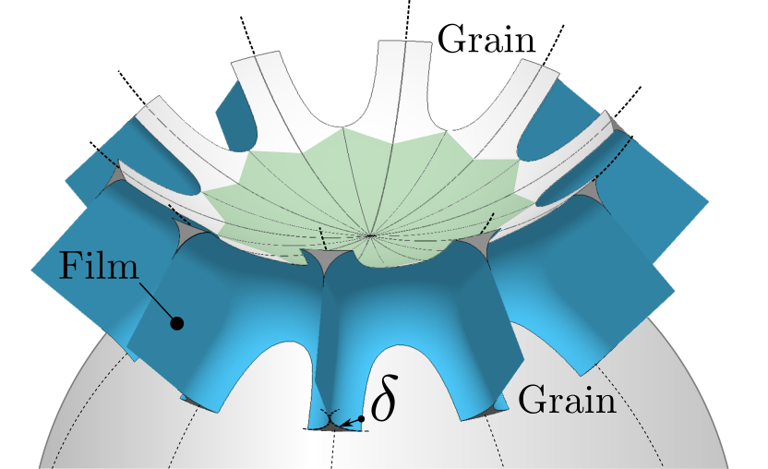
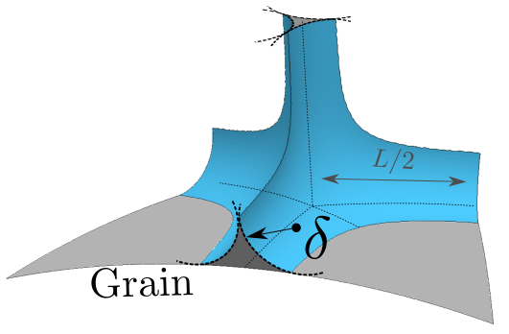
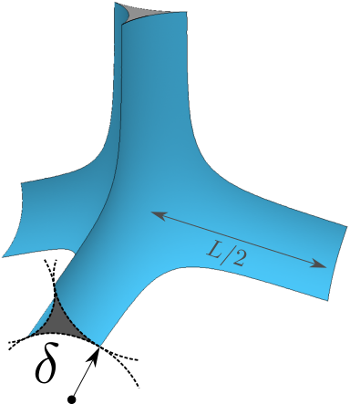
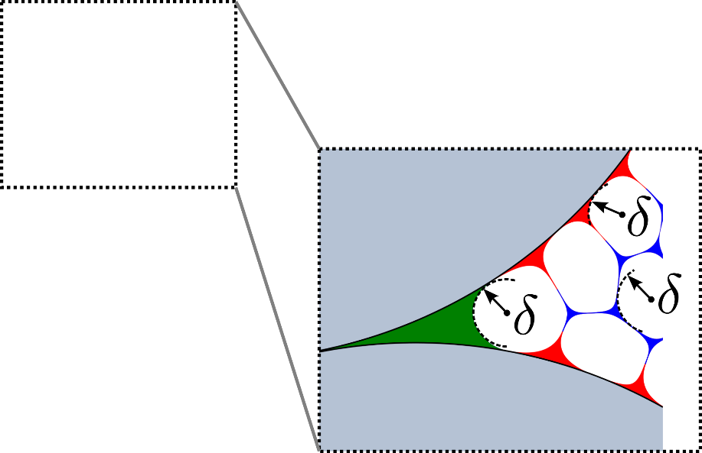
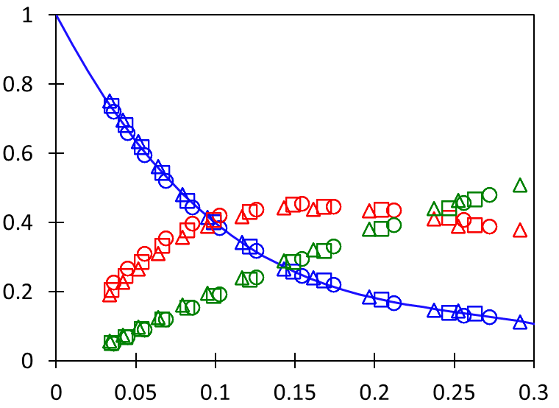







1. Confined foam microstructure & liquid distribution
Model for the liquid distribution in porous space
Numerical simulations (Surface Evolver)
Assumptions:
Monodisperse spherical grains
Monodisperse bubbles
Perfect wetting
Foam at equilibrium with uniform capillary pressure $γ/δ$ (with $γ$ surface tension)
Liquid bridges
Wall Plateau Borders
Core Plateau Borders
$$φ_{l}$$
5%
$$φ_{l}^{eff}/φ_{l}$$
10%
15%
$$φ_{l}^{wall}/φ_{l}$$
$$φ_{l}^{bridge}/φ_{l}$$
$$φ_{l}≈φ_{l}^{bridge}+φ_{l}^{wall}+φ_{l}^{eff}$$
Liquid fraction of the foam introduced in the granular medium
Effective liquid fraction of the foam filling the core of the pore space
Daisy shaped liquid bridges in foam-filled granular packings, Pitois O., Salamé A. et al., JCIS, 2023
$$r=R_{b}/R_{g}$$
Permeability of foam-filled granular packings: numerical modeling, Langlois V., Salamé A. et al., PRF , 2025

Slide 5


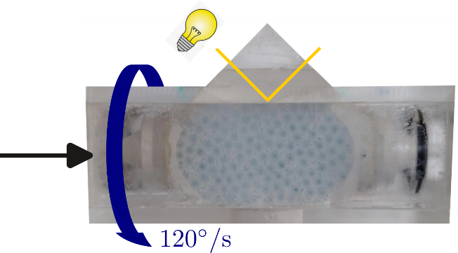
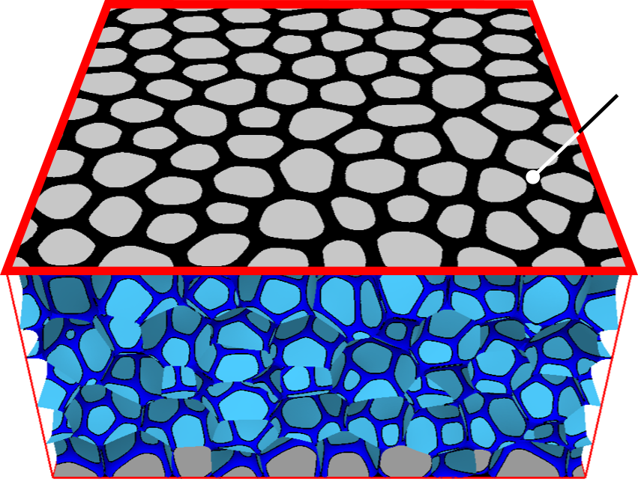
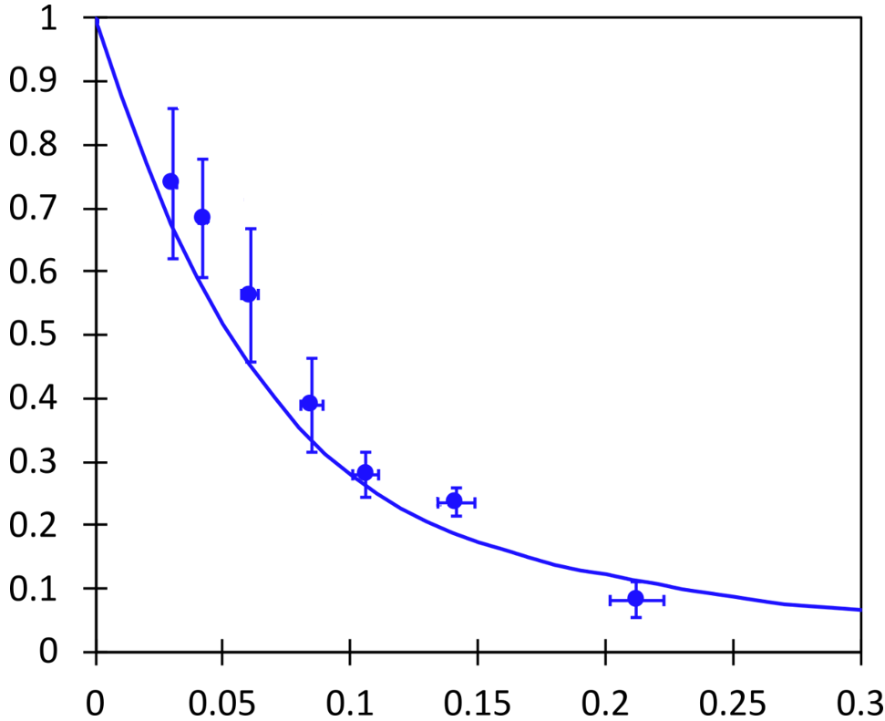
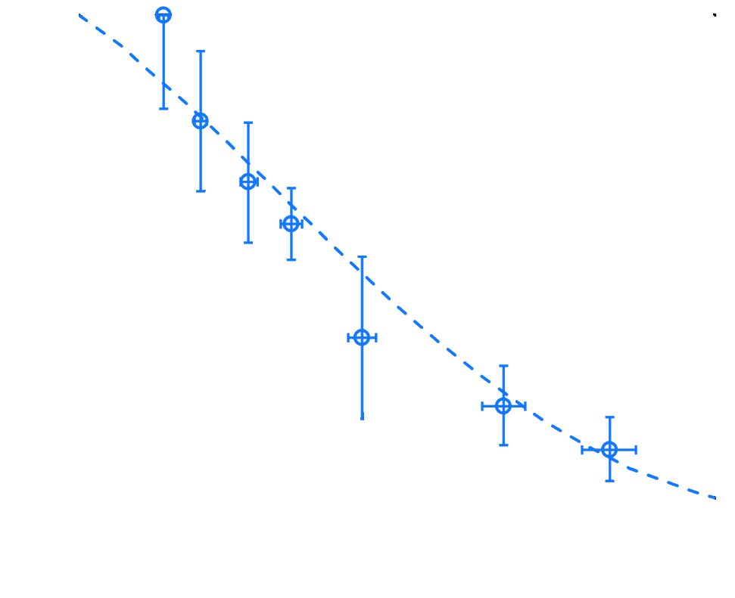
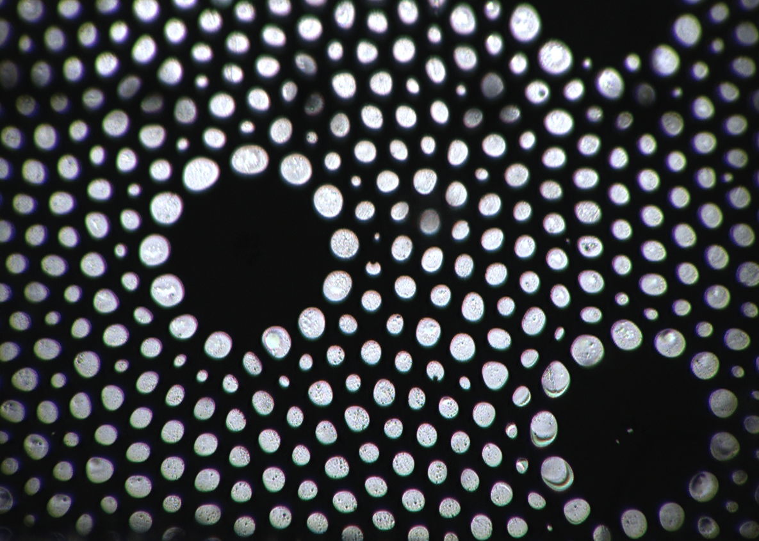
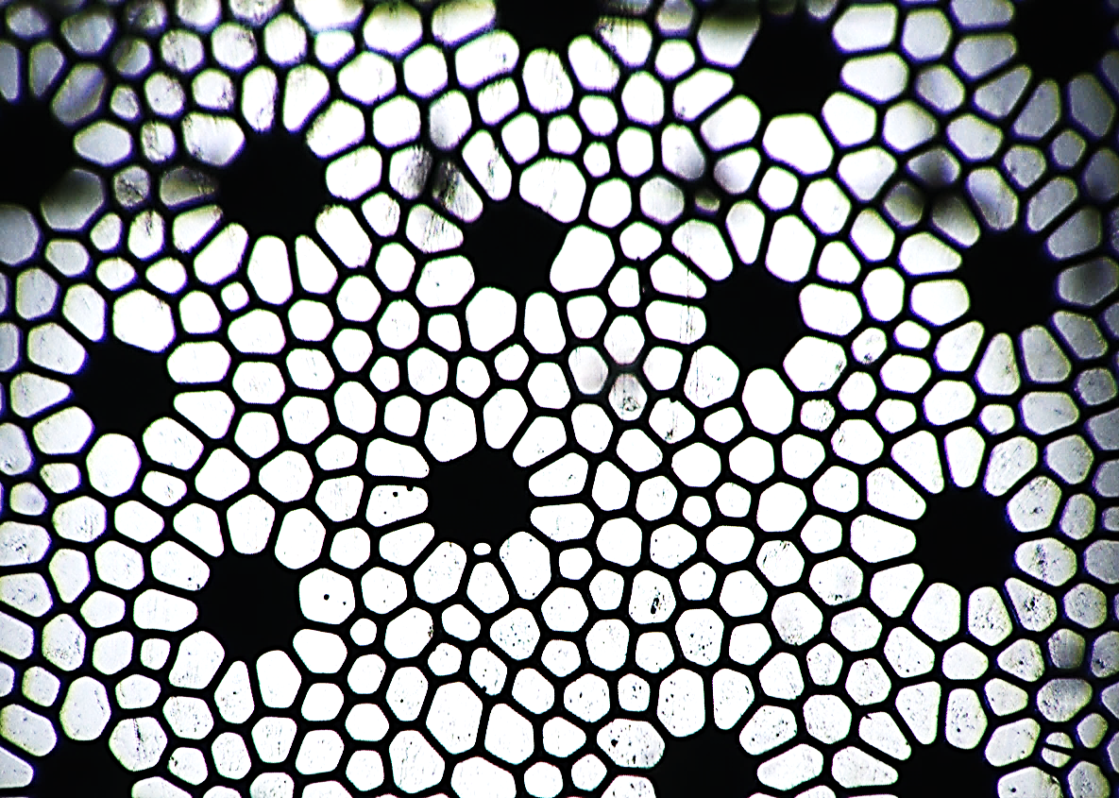


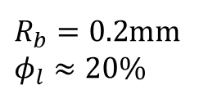





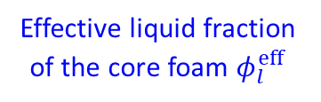


1. Confined foam microstructure & liquid distribution
Experiments: Measure the effective liquid fraction of the core foam
Camera
Column wall
Surface liquid fraction of the core foam at the column wall.
liquid
Column wall
Höhler R. et al., Soft Matter, 2021
Bulk foam $\left(R_{b},φ_{l}\right)$
G$rains$ $R_{g}$
Effective liquid fraction of the core foam $φ_{l}^{eff}$
core foam
(to prevent gravity drainage)
Example:
$R_{g}=1.0$mm
$R_{g}=2.5$mm
Polydisperse foam
$R_{b}=0.2$mm $φ_{l}≈20\%$
$$\frac{φ_{l}^{eff}}{φ_{l}}$$
$$r↗$$
Monodisperse
$$φ_{l}^{eff}≈8\%$$
$$φ_{l}^{eff}≈2\%$$
$$r=\left\langle R_{b}\right\rangle /R_{g}$$

Slide 6
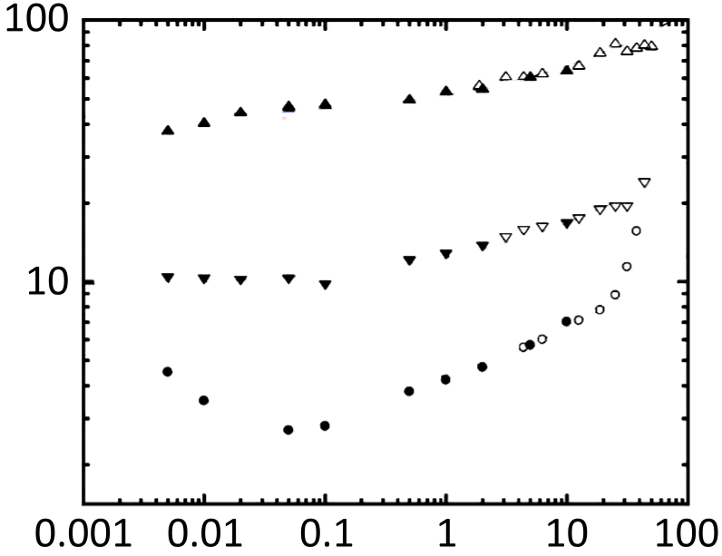
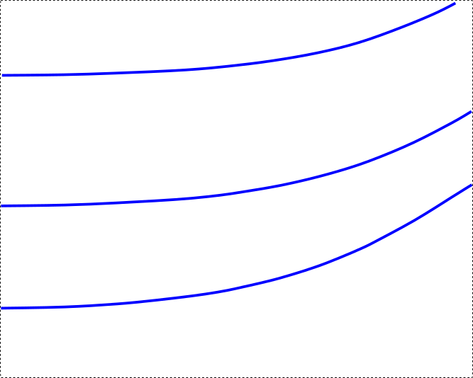
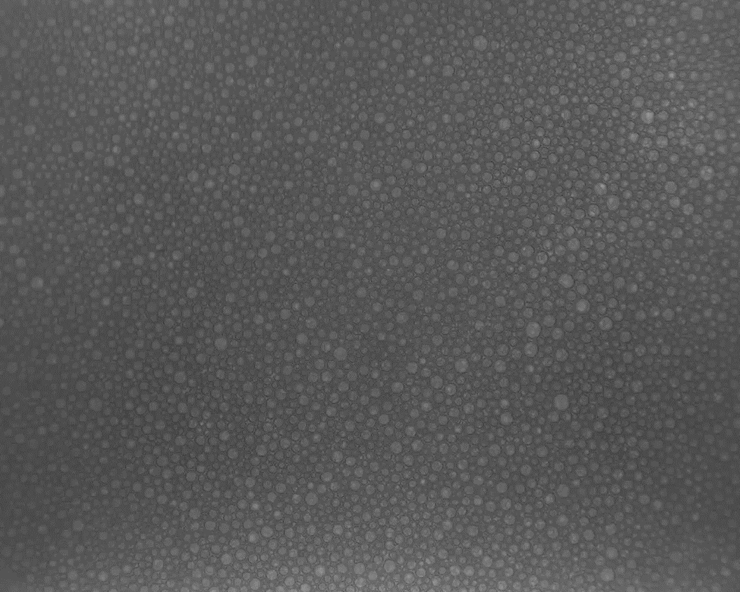
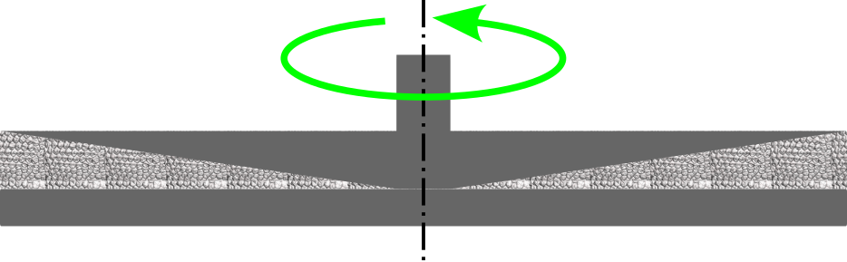








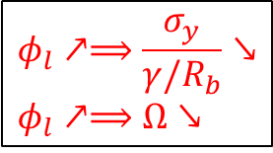
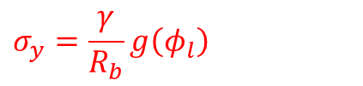


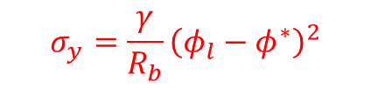
2. Consequences on confined foam properties
Bulk foam
Foam properties
Aging: Coarsening
Rheology: Yield stress
$$φ_{l}=15\%$$
Real time: 2h
Rheometer
$$φ_{l}=5\%$$
Foam
Shear stress
$σ$ (Pa)
$$φ_{l}=15\%$$
$$φ_{l}=20\%$$
Pasquet M. et al.,
JCIS, 2023
Marze et al.,
J. Rheol. 2008
1 mm
Experiment performed in the International Space Station
Shear rate $\dot{ε}$
For bulk foam, bubble growth in the stationary regime:
Herschel Bulkley (HB) model:
${\left\langle R_{b}\left(t\right)\right\rangle }^{2}−{\left\langle R_{b}\left(t_{0}\right)\right\rangle }^{2}=$ $Ω×\left(t−t_{0}\right)$
$$σ=σ_{y}+k{\dot{ε}}^{n}$$
Bulk foam:
Coarsening rate, $Ω=\frac{d}{dt}{\left\langle R_{b}\left(t\right)\right\rangle }^{2}$
Yield stress, $σ_{y}$
$$φ_{l}↗⟹\frac{σ_{y}}{γ/R_{b}}↘$$
$$φ_{l}↗⟹Ω↘$$
$$Ω\left(φ_{l}\right)=Ω_{0}f(φ_{l})$$
$$σ_{y}=\frac{γ}{R_{b}}g\left(φ_{l}\right)$$
$$σ_{y}=\frac{γ}{R_{b}}{\left(φ_{l}−φ^{∗}\right)}^{2}$$

Slide 7
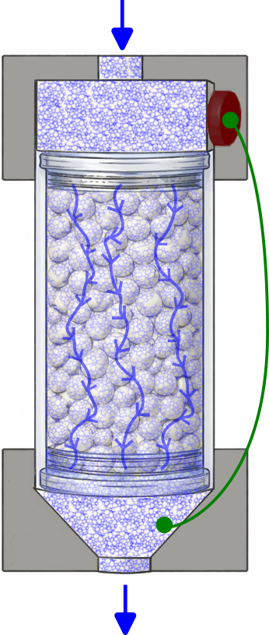
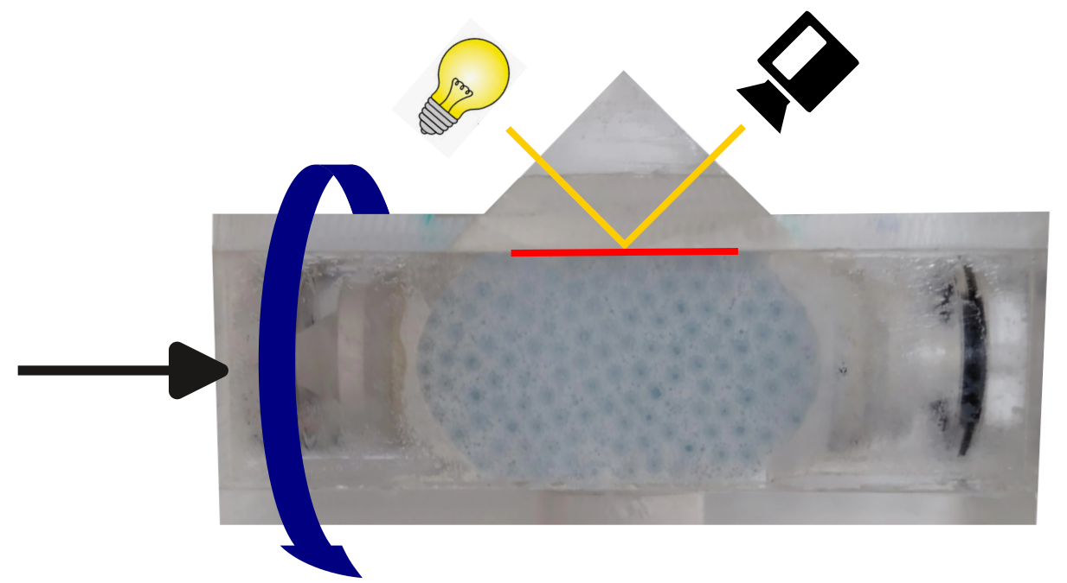

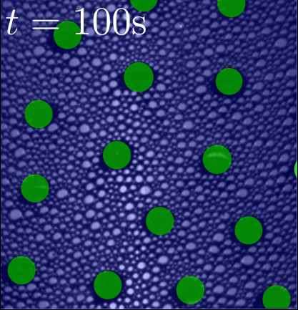
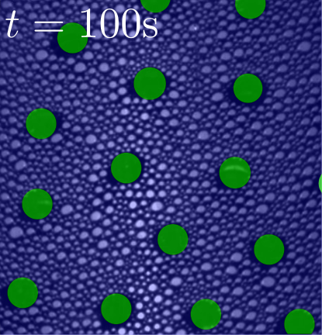
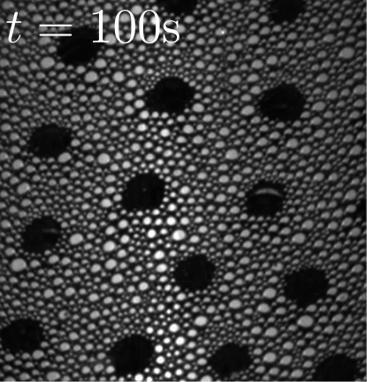






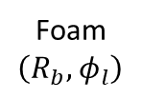





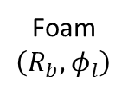

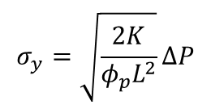
2. Consequences on confined foam properties
Confined foam
Foam properties
Aging: Coarsening
Rheology: Yield stress
Camera
Pressure drop
$$ΔP$$
Time
Foam $\left(R_{b},φ_{l}\right)$
Grains $R_{g}$
Foam $\left(R_{b},φ_{l}\right)$
Foam flow rate $Q$
Grains $R_{g}$
Omirbekov S. et al.,
Adv. in Water Resour. (2020)
$r_{p}=\sqrt{8K/φ_{p}}:$Pore’s radius
$⇒$ Apparent viscosity $μ_{eff}$
$$σ_{y}=\sqrt{\frac{2K}{φ_{p}L^{2}}}ΔP$$
Darcy’s law:
$$v=\frac{Q}{S}=\frac{K}{μ_{eff}}\frac{∆P}{L}$$
$K$: intrinsic permeability
$L$: sample length
$S$: cross-section area
$φ_{p}$: Porosity
$r_{p}$: Pore size
Equivalent
shear rate:
$$\dot{ε}=\frac{4v}{φ_{p}r_{p}}$$
$R_{b}\left(t\right)⇒$ Coarsening rate $Ω\left(t\right)=\frac{d}{dt}{\left\langle R_{b}\left(t\right)\right\rangle }^{2}$
$⇒$ Apparent yield stress $σ_{y}\left(φ_{l},R_{b},R_{g}\right)$

Slide 8
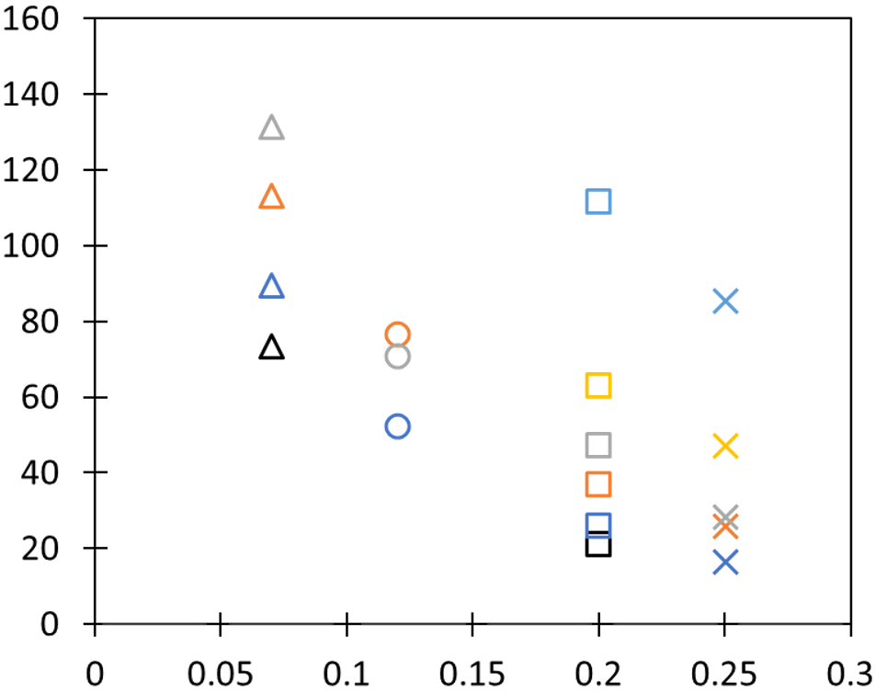











2. Consequences on confined foam properties
Confined foam
Foam properties
Aging: Coarsening
Rheology: Yield stress
At $t_{0}=100$s
$$R_{g}(µm)$$
$$R_{b}(µm)$$
$$R_{g}(µm)$$
2500
750
1500
550
1000
400
$$Ω_{t_{0}}$$
$$(µm^{2}/s)$$
$$\frac{σ_{y}}{γ/{R_{b}}}$$
$$φ_{l}$$
Total liquid fraction
$$φ_{l}$$

Slide 9






2. Consequences on confined foam properties
Confined foam
Foam properties
Aging: Coarsening
Rheology: Yield stress
At $t_{0}=100$s
$$R_{g}(µm)$$
$$R_{b}(µm)$$
$$R_{g}(µm)$$
2500
750
1500
550
1000
400
$$Ω_{t_{0}}$$
$$(µm^{2}/s)$$
Bulk foam
$$\frac{σ_{y}}{γ/{R_{b}}}$$
Bulk foam
$$φ_{l}^{eff}$$
Effective liquid fraction of the core foam
$$φ_{l}^{eff}$$
Determined independently under static conditions
We assume that the liquid distribution does not significantly differ under dynamic conditions

Slide 10
Conclusion & perspectives
Conclusion
When liquid foam is injected in a granular medium, the liquid redistributes from the core foam towards the surface of the grains and the contacts between the grains. The core foam is therefore drier than the injected foam.
We have determined the liquid fraction of the core foam at equilibrium and shown that its effective liquid fraction can be used to interpret several properties of confined foam involving non-equilibrium phenomena, such as coarsening and flow of foam through granular media.
At first order, the coarsening rate and the apparent yield stress for confined foam can be evaluated from the values obtained for bulk foam, using the effective liquid fraction of the core foam instead of the total liquid fraction.
Perspectives
Validation of our microstructure model with 3D imaging (Ultra-Fast X-ray tomography).
To study the dynamics of the liquid redistribution during the foam coarsening or the foam flow.
Publications
Pitois O. et al., “Daisy shaped liquid bridges in foam-filled granular packings”, JCIS, 2023
Langlois V. et al., “Permeability of foam-filled granular packings: numerical modeling”, PRF , 2025
Salamé A., et al., “Rheology of liquid foam flowing through porous media”, Physics of Fluids, 2025
Salamé A., et al., “Enhanced coarsening induced by pore confinement”, PRE, 2025
Salamé A., et al., “Foam coarsening in granular packings”, PRE, 2026

Slide 12








Foam production (coarsening)
Polydispersity index:
$$p_{t_{0}}≈0.13$$
$$p=R_{32}/{<R^{3}>}^{1/3}−1$$
$$\text{0} \text{<} \text{p}\text{ < 1}$$
$$7\%≲φ_{l}≲25\%$$
$$φ_{l}≈7\%$$
Foaming solution:
Non-ionic surfactant
AlkylPolyGlucosides (Glucopon® 225DK)
at 20 g/L in water
Salamé A., et al., “Enhanced coarsening induced by pore confinement”, PRE, 2025
Salamé A., et al., “Foam coarsening in granular packings”, PRE, 2026

Slide 13







Foam production (foam flow)
Control of the distribution of the bubble sizes
Control of the liquid fraction
Cationic surfactant TTAB at 10 g/L in water.
$$p≈0.13$$
$$N_{2}$$
+
$$C_{6}F_{14}$$
Reduced length to limit compressibility effects
Perfluorohexane
Grains
$$R_{g}$$
Decreases strongly the coarsening rate
$$R_{b}/\left\langle R_{b}\right\rangle$$
Salamé A., et al., “Rheology of liquid foam flowing through porous media”, Physics of Fluids, 2025

Slide 14











1. Confined foam microstructure & liquid distribution
Model for the liquid distribution in porous space
$$φ_{l}≈φ_{l}^{bridge}+φ_{l}^{wall}+φ_{l}^{eff}$$
Assumptions:
Monodisperse spherical grains
Monodisperse bubbles
Perfect wetting
Foam at equilibrium with uniform capillary pressure $γ/δ$ (with $γ$ surface tension)
$$∝\frac{1}{D_{g}^{3}}∗N_{b}∗\frac{δ^{4}}{D_{g}}$$
$$∝\frac{1}{D_{g}^{3}}∗\frac{D_{g}^{2}}{D_{b}^{2}}∗D_{b}δ^{2}$$
$$∝\frac{1}{D_{g}^{3}}∗\frac{D_{g}^{3}}{D_{b}^{3}}∗D_{b}δ^{2}$$
$$=N_{b}r^{4}\frac{δ^{4}}{D_{b}^{4}}$$
$$=r\frac{δ^{2}}{D_{b}^{2}}$$
$$=\frac{δ^{2}}{D_{b}^{2}}$$
$$\frac{δ}{D_{b}}$$
Daisy shaped liquid bridges in foam-filled granular packings, Pitois O., Salamé A. et al., JCIS, 2023
$$r$$
Permeability of foam-filled granular packings: numerical modeling, Langlois V., Salamé A. et al., PRF , 2025

