Slide 1
Study on non-isothermal drying of porous media with hybrid lattice Boltzmann method: Drying rate prediction
- InterPore 2026
Nantes, France, 18-22 May 2026
Timan Lei, Dominique Derome, Linlin Fei, Kai H. Luo, Jan Carmeliet
Postdoctoral Researcher @ ETH Zürich

Slide 2
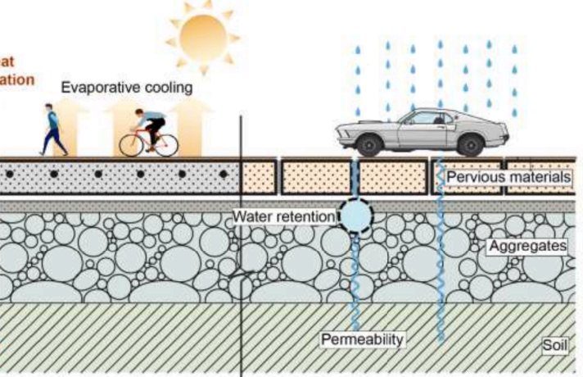
Background – Drying of porous media
Drying of porous media – Passive and energy-efficient cooling method
Plays an important role in evaporative cooling applications
Well-designed porous structure + Convective air flow
→ Capillary-driven liquid supply + Moisture removal
→ Continuous evaporation & continuous cooling
The challenge in simulations
(Water Research 221 (2022) 118755)
Strongly coupled Multiphysics at the pore scale
( multiphase flow, multicomponent transport, conjugate heat transfer, phase change … )
Sensitivity of drying rate and cooling performance to operating conditions
Pore-scale study on non-isothermal drying of porous media

Slide 3

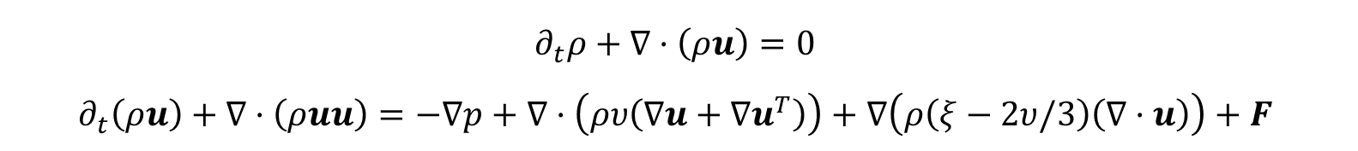
Mathematical Model
Conservation equations
1. Multiphase flow (air-water):
$$∂_{t}ρ+∇·\left(ρu\right)=0$$
$$∂_{t}\left(ρu\right)+∇·\left(ρuu\right)=−∇p+∇·\left(ρυ\left(∇u+{∇u}^{T}\right)\right)+∇\left(ρ\left(ξ−2υ/3\right)\left(∇·u\right)\right)+F$$
2. Water vapor transport:
$$∂_{t}Y+u·∇Y=∇\left(D∇Y\right)$$
3. Energy balance for heat transfer (Physical Review E 103, 043308 (2021)):
$$∂_{t}T=−u·∇T+\frac{∇\left(λ∇Y\right)}{ρc_{v}}−\frac{ρ}{c_{v}}\left(\frac{h_{fg}−p_{sat}\left(v_{v}−v_{l}\right)}{ρ_{l}−ρ_{v}}+\frac{p}{ρ^{2}}\right)∇·u$$
Linear latent heat model:
  To improve the numerical stability
  To decouple the latent heat of vaporization from EOS

Slide 4


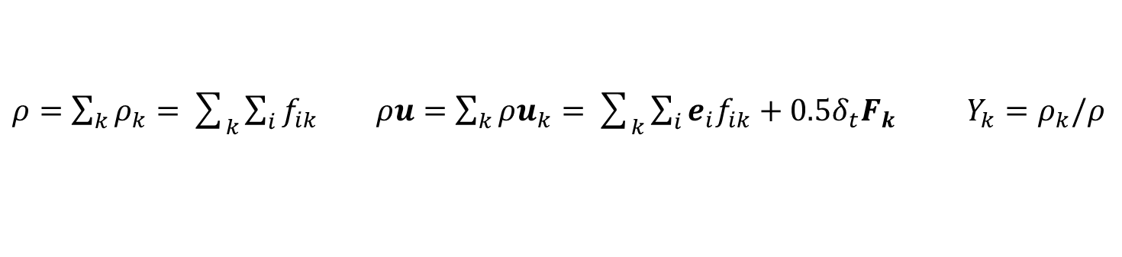
LBM-FDM
LBM for two-phase two-component flow
$$f_{i,k}\left(x+e_{i}δ_{t},t+δ_{t}\right)=f_{i,k}\left(x,t\right)−{\left(M^{−1}SM\right)}_{ij}\left(f_{j,k}\left(x,t\right)−f_{j,k}^{eq}\left(x,t\right)\right)+{δ_{t}\left(M^{−1}\left(I−0.5S\right)M\right)}_{ij}F_{j,k}$$
Water / water vapor (A): phase change, intra-component interaction between liquid water and vapor
Dry air (B): ideal gas, miscible with water vapor but insoluble in liquid water
Inter-component interaction between A and B
Interaction forces:
Macroscopic parameters:
$ρ=\sum_{k}{ρ_{k}}=\sum_{k}{\sum_{i}{f_{ik}}}$ $ρu=\sum_{k}{{ρu}_{k}}=\sum_{k}{\sum_{i}{{e_{i}f}_{ik}}+0.5δ_{t}F_{k}}$ $Y_{k}=ρ_{k}/ρ$

Slide 5
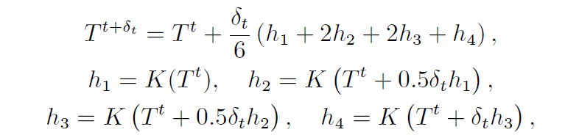
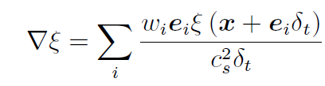


LBM-FDM
FDM for heat transfer
$$∂_{t}T=−u·∇T+\frac{∇\left(λ∇Y\right)}{ρc_{v}}−\frac{ρ}{c_{v}}\left(\frac{h_{fg}−p_{sat}\left(v_{v}−v_{l}\right)}{ρ_{l}−ρ_{v}}+\frac{p}{ρ^{2}}\right)∇·u$$
$$K\left(T\right)$$
The four-order Runge–Kutta:
The convection term: lattice-based finite difference scheme,
The conduction term: finite volume method (Applied Thermal Engineering 159 (2019) 113788)

Slide 6
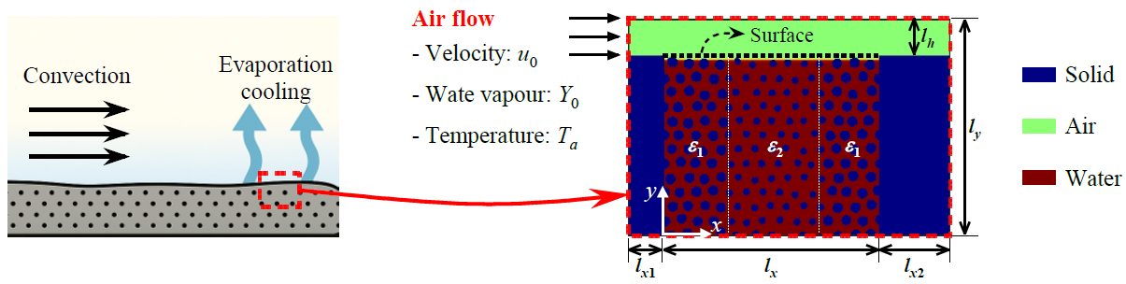
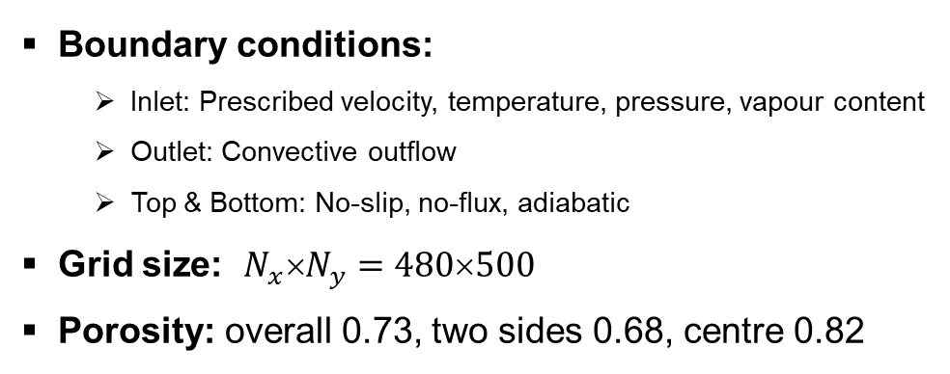
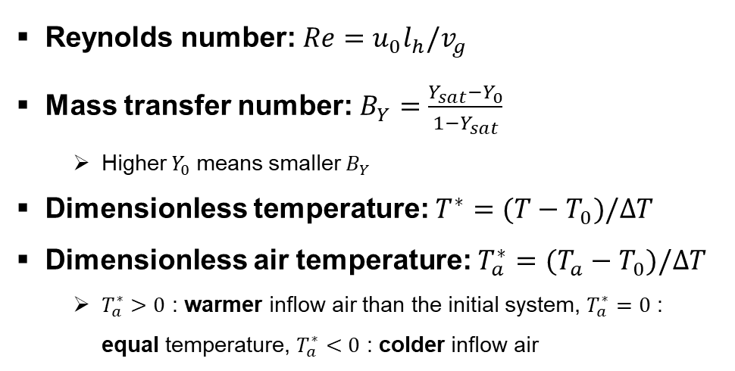
Problem Description – Non-isothermal drying of porous media
Computational domain & boundary conditions
Boundary conditions:
  Inlet: Prescribed velocity, temperature, pressure, vapour content
  Outlet: Convective outflow
  Top & Bottom: No-slip, no-flux, adiabatic
Grid size: $N_{x}\text{×}N_{y}=480\text{×}500$
Porosity: overall 0.73, two sides 0.68, centre 0.82
Reynolds number: $Re=u_{0}l_{h}/v_{g}$
Mass transfer number: $B_{Y}=\frac{Y_{sat}−Y_{0}}{1−Y_{sat}}$
  Higher $Y_{0}$ means smaller $B_{Y}$
Dimensionless temperature: $T^{∗}=(T−T_{0})/∆T$
Dimensionless air temperature: $T_{a}^{∗}=(T_{a}−T_{0})/∆T$
  $T_{a}^{∗}>0$ : warmer inflow air than the initial system, $T_{a}^{∗}=0$ : equal temperature, $T_{a}^{∗}<0$ : colder inflow air

Slide 7
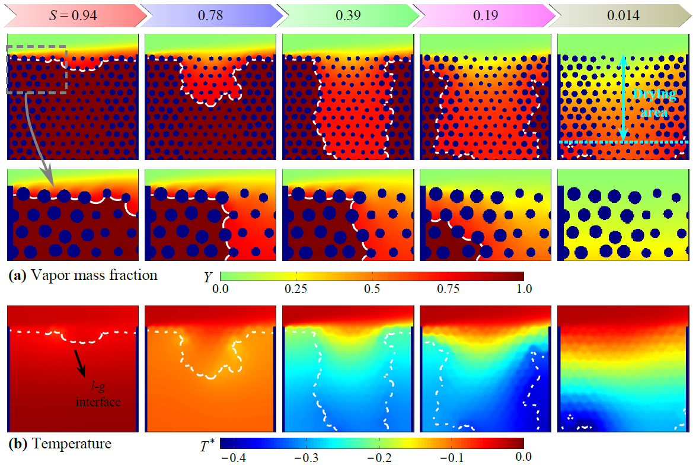
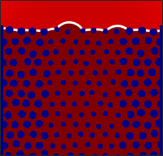
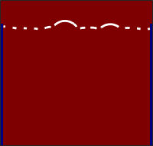
Non-isothermal drying of porous media
Vapor mass fraction Y and temperature $T^{∗}$ during drying @ $Re=40$, $T_{a}^{∗}=0$, $B_{Y}=5.44$
Vapor mass
Temperature
The evaporation front recedes first from the middle with larger pores
In large pores, capillary pressure is small and liquid pressure is large
Captured the evaporative cooing during drying

Slide 8
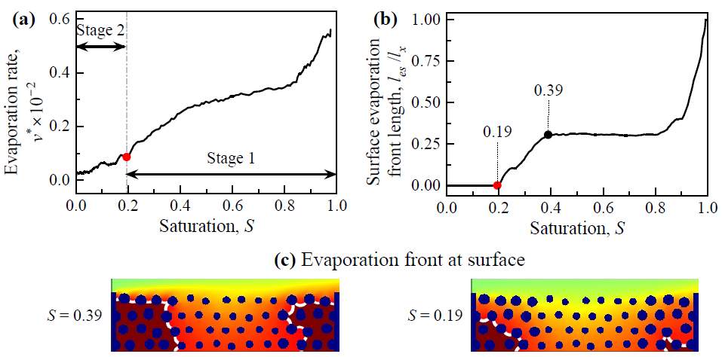
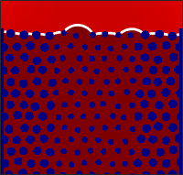
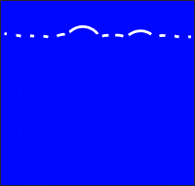
Non-isothermal drying of porous media
Drying rate: $v^{∗}=−dS/dt^{∗}$
Vapor mass
A classical transition from the high-rate Stage 1 to the falling-rate Stage 2
Stage 1: capillary-driven liquid from large to small pores
Stage 2: no evaporation front at surface
Temperature

Slide 9
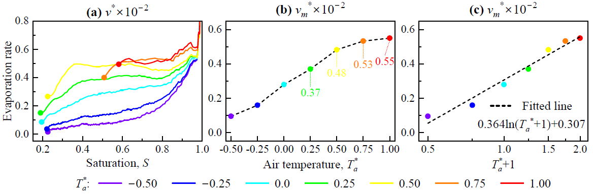
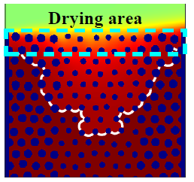


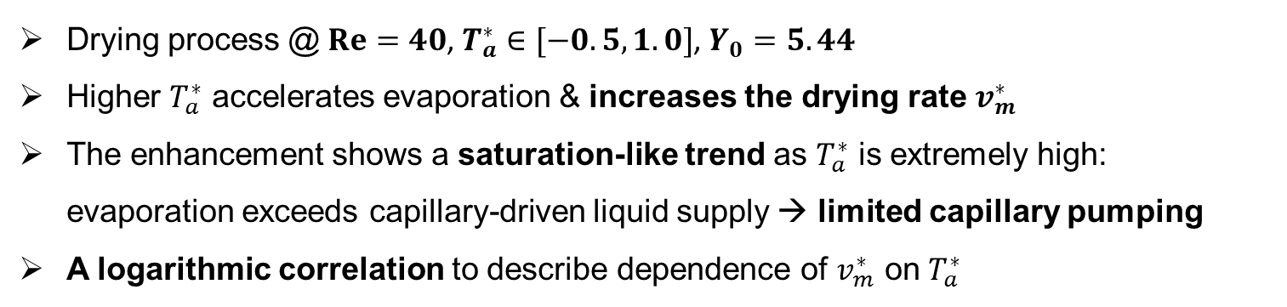
Effects of inflow air temperature
Drying process @ $Re=40$, $T_{a}^{∗}∈[−0.5,1.0]$, $Y_{0}=5.44$
Higher $T_{a}^{∗}$ accelerates evaporation & increases the drying rate $v_{m}^{∗}$
The enhancement shows a saturation-like trend as $T_{a}^{∗}$ is extremely high: evaporation exceeds capillary-driven liquid supply → limited capillary pumping
A logarithmic correlation to describe dependence of $v_{m}^{∗}$ on $T_{a}^{∗}$
$$T_{a}^{∗}=1.0$$

Slide 10
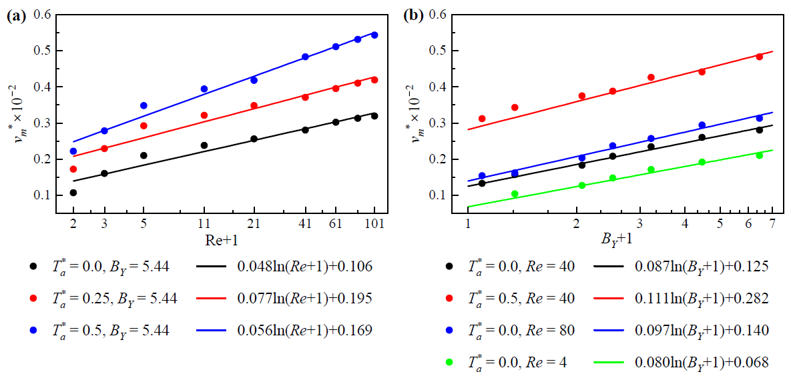
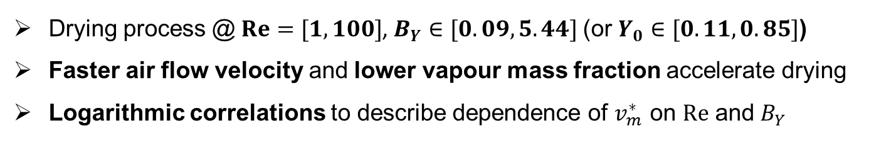
Effects of inflow airflow velocity and vapour mass fraction
Drying process @ $Re=[1, 100]$, $B_{Y}∈[0.09,5.44]$ (or $Y_{0}∈[0.11,0.85]$)
Faster air flow velocity and lower vapour mass fraction accelerate drying
Logarithmic correlations to describe dependence of $v_{m}^{∗}$ on $Re$ and $B_{Y}$

Slide 11
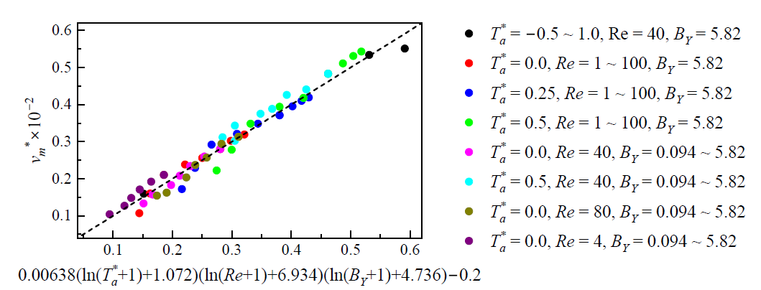
Effects of operating conditions
Drying process @ $Re=[1, 100]$, $T_{a}^{∗}∈[−0.5,1.0]$, $B_{Y}∈[0.09,5.44]$ (or $Y_{0}∈[0.11,0.85]$)
A universal scaling correlation is established to describe the effect of $T_{a}^{∗}$, $Re$, and $B_{Y}$ on drying rate

Slide 12
Summary
A hybrid LBM-FDM model is used to study the non-isothermal drying of porous media
By conducting pore-scale simulations, the transition from the fast-rate Stage 1 to the falling rate Stage 2 is captured, consistent with experiments
The drying rate is investigated for various inflow air temperature, airflow velocity, and vapour mass fraction
A universal scaling relation is proposed to describe the dependence of drying rate on operating conditions.
Thank you!

