Slide 1

Employing NMR To Quantify Porosity Changes and Surface Relaxivity due to Mineral Alteration for CCUS Carbon Mineralization Applications
Presented by Derrick Green

Slide 2

Co-Authors
Dragan Veselinovic (Green Imaging)
Jake Tielke (Columbia Lamont-Doherty Earth Observatory)
James Howard (DigiM Solution LLC)
Michael Dick (Green Imaging)
Olivia Terry (Department of Earth and Environmental Engineering, Columbia University)
Shaina Kelly (Department of Earth and Environmental Engineering, Columbia University)
Tianxiao Shen (Department of Earth and Environmental Engineering, Columbia University)
Zuhao Kou (Department of Earth and Environmental Engineering, Columbia University)
Rosalie Krasnoff and Kelsey Lauren Yao from Columbia are present at Interpore
Mark MacKenzie from GreenImaging is present at Interpore

Slide 3
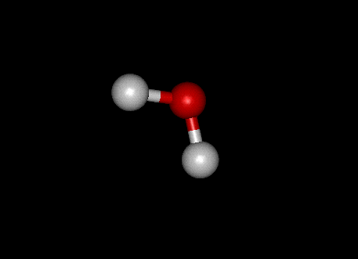
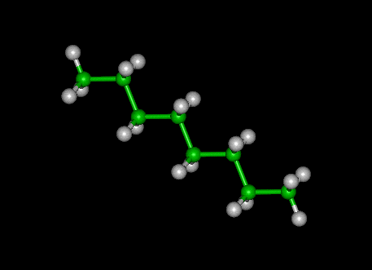
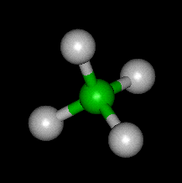
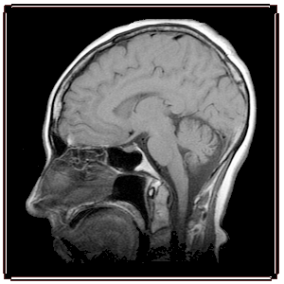
What is NMR?
H₂O
C₈H₁₈
NMR can directly determine the amount of hydrogen
MRI alters the magnetic field to localize the signal (1D, 2D, or 3D images) using gradients
CH₄
Signal lifetimes (T₁, T₂, T₂*) depend on environment of hydrogen (i.e. pore space)
Notes:
3
MRI has been used for years in the medical field to get nice images of humans like this. For rocks we do not necessary need all this detail.
MRI spatial resolves the hydrogen signal to form images. Here is a 2D image of a human head. We can also calapse one dimension and get a simple profile. This is what is done for rocks.
Why is NMR or MRI so good? How can we tell the difference between different tissues or fluids?
Signal intensity depends directly on the amount of hydrogen.
Signal intensity will vary in a predictable way, and re-align with the main magnetic field in predictable ways. There are two main relaxation times – T1, and T2. There is also T2*, but that is a modification of T2. These times are characteristic for different substances. For eg. in humans, fat has a short T1 and a short T2. Water has a long T1 and a long T2.
Also the lifetime of the signals depend on the environment of the hydrogens - i.e. small versus large pore in the T2 distributions.

Slide 4
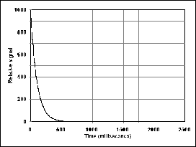
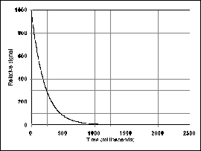
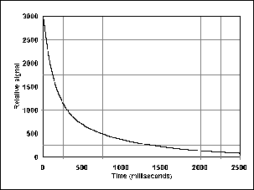
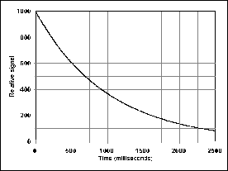
NMR Rock Measurements
NMR signal from a real core is a mixture of signals from all pore sizes
Notes:
Signal from large pores will decay slowly and signals from small pores will decay quickly.

Slide 5
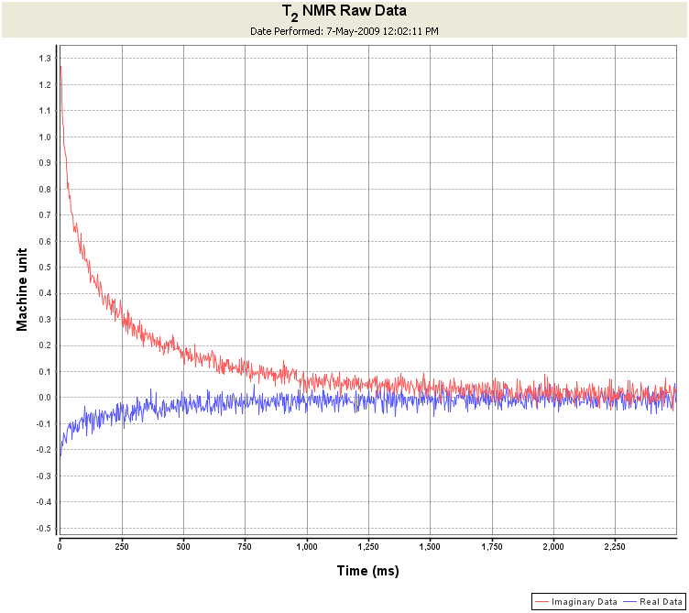
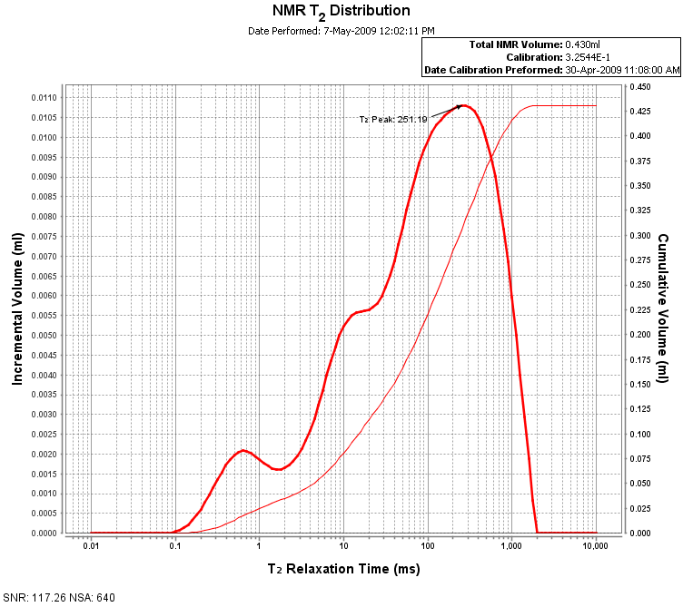
T₂ Decay to Pore Size Distribution
Math (Inversion)
Butler et al, SIAM Journal on Numerical Analysis, Vol. 18, No. 3. (Jun., 1981), pp. 381-397.
Notes:
So how to move from the acquired signal to what we want which is a pore size distribution. We use the NMR signal equation and solve the following math…. The trick is the alpha term as the equation without it has many solutions. BRD developed a algorithm which is accepted as a way….

Slide 6
NMR T₂ Distributions
Pore Size
Relaxivity
Relaxivity is related to the interaction of the pore wall with the fluid in the pore
K.J. Dunn et all, SPE 28367
Notes:
Here is an example of a “standard” NMR T2 distribution that your might get from a typical laboratory rock core. On the left axis is incremental volume, and on the right is cumulative volume. Incremental volume is indicated by the heavy line, cumulative by the lighter yellow line. The relationship between t2 and s/v is given here and if T2 bulk is large and TE is short then we have a direct relationship.
What we try to do is apply a cut-off which divides bound and free fluid.
Total pore volume = area under the dark blue curve (fully saturated T2 distribution).
Bound volume index = area under the dark red curve (fully desaturated T2 distribution).
Free fluid index = Total – BVI
Clay bound water = area up to 2.5ms
6

Slide 7

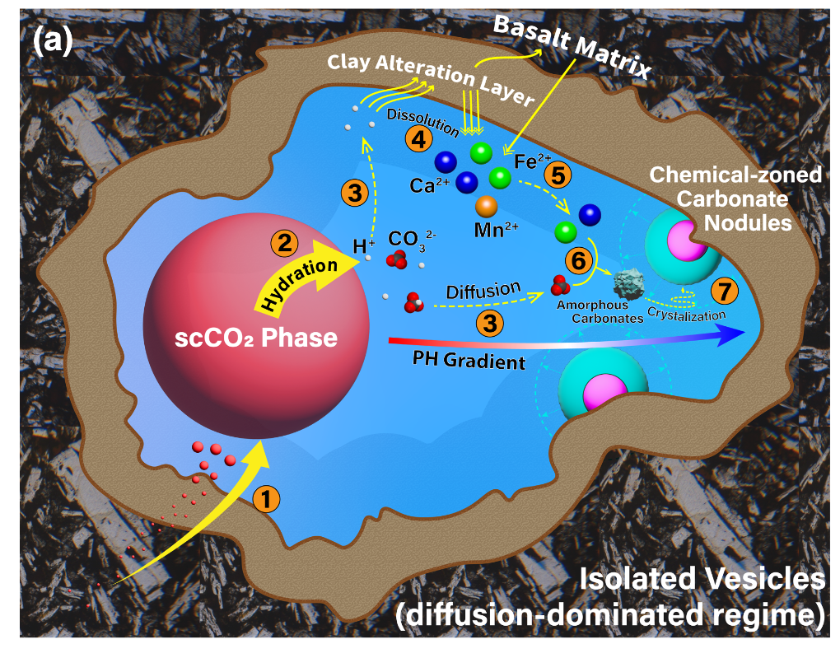
How Does Carbon Mineralization Work
Injection period:
(1) scCO₂ enters isolated vesicles under injection pressure
Post-injection period:
(2) Dissolution of CO₂ at scCO2/water interface
(3) Diffusion and chemical equilibrium of carbonate species
(4) Minerals releasing major cations (Mn, Ca, Fe)
(5) Diffusion of cations
(6) And (7) Crystallization of carbonates
Mineralization is favored in rocks rich in magnesium, calcium and iron (such as mafic and ultramafic).
Mineralization can be enhanced in regions where rocks have undergone hydrothermal alteration.
Quantifying the extent of hydrothermal alteration in basalt is crucial for various geological and environmental studies, including carbon sequestration, critical mineral resource exploration and geothermal energy development.
Shen et al. 2025 ES&T paper (in review).
Notes:
So how does carbon mineralization work. This figure is from an upcoming paper our partners at Columbia are publishing in collaboration with the Pacific Northwest National Lab. In it they present a hypothesis on how injection of supercritical CO2 can lead to carbon mineralization. I am not presenting this figure to get too much into the fine details of the hypothesis but instead to emphasize a couple of points about the mineralization process that will become important in our current investigation.
Briefly, CO2 is first injected into the pore network. Next CO2 dissolves into the existing water in the pores. The dissolution process forms carbonate species. These species then migrate to the pore walls where they interact with cations such as Mn, Ca and Fe. The carbonates then bond with these cations which eventually lead to carbon mineralization.
A couple things to note here that will become important when I talk about our results are firstly mineralization will lead to a reduction in the pore volume. The newly formed carbonate minerals will eat up pore space.
Secondly, it is clear now why mineralization is favored in rocks rich in magnesium, calcium and iron. This explains why our study as focused on mafic and ultramafic rocks. In addition, mineralization can be enhanced in regions where rocks have undergone hydrothermal alteration.
So for this reason quantifying the extent of hydrothermal alteration in basalt is crucial for various geological and environmental studies, including carbon sequestration, critical mineral resource exploration and geothermal energy development. As you will see this has been a big focus of this study and something NMR has proven to be good at.

Slide 8
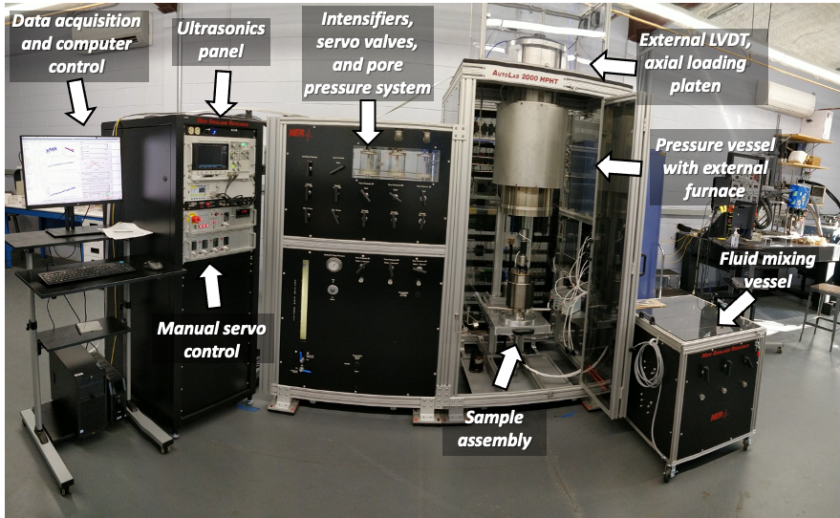
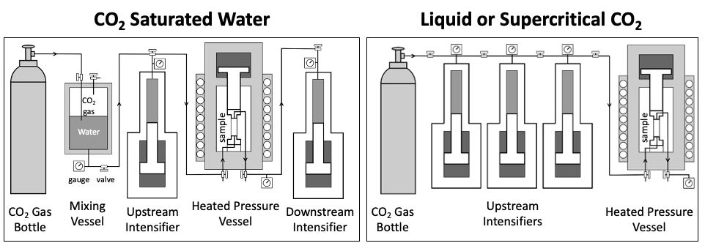
NMR/Carbon Mineralization Experiment # 1
Injection # | Injected Fluid | Pore Pressure (MPa) | Temperature (°C) | Duration (hours) | K_{initial} (microD) | K_{final} (microD) | Change
1 | sc-CO₂ | 8.9 | 150 | 5.6 | 113 | 28 | -75%
2 | sc-CO₂ | 15 | 21 | 19.9 | 28 | 11 | -60%
The samples underwent super-critical-CO₂ (sc-CO₂) injection at differing pore pressures, temperatures and durations.
The permeability was observed to decrease likely due to the formation of hydrous
Experiment 1 was a set of two samples. One with no injection of CO₂ and one with injections describe above.
What can a T₂ measurement tell us?
Notes:
Following thermal fracturing, Sample 2 underwent two experiments where super-critical-CO2 (sc-CO2) was injected into the sample at differing pore pressures, temperatures and durations. This was done in the lab at Columbia using the experimental setup shown here.
After each experiment, the permeability of the sample was verified and was observed to decrease first from 113 microD to 28 microD and then from 28 microD to 11 microD. This decrease was likely due to the formation of hydrous magnesium carbonate near region of sc-CO2 injection as is shown in this image.
So the question became, could a T2 measurement yield any more information about this sample beyond just the reduction in permeability following the injection of sc-CO2? What if a T2 measurement was also completed on Sample 1 which didn’t undergo scCO2 injection? What would a comparison of Sample 1 vs 2 look like? So Columbia sent these two samples to us at Green Imaging and we initiated an NMR investigation into.

Slide 9
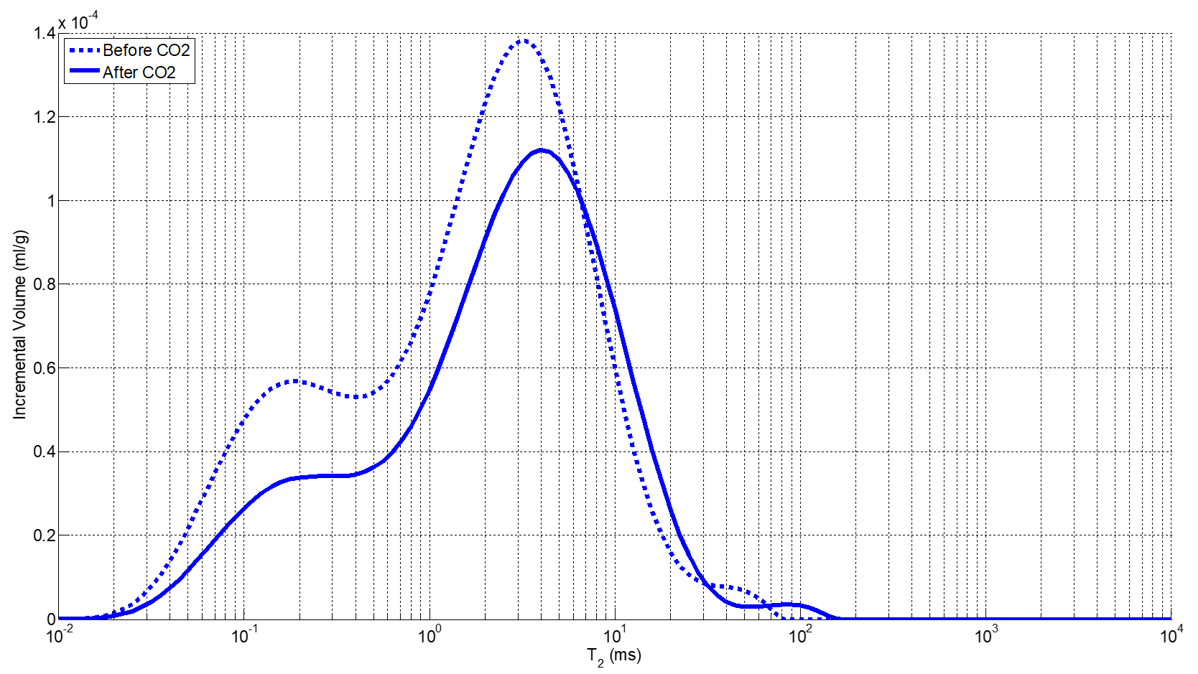
Experiment #1: T₂ measurements
Sample 1
Sample 2
Fully saturated measurements'
Sample # | Injected Fluid | Pore Volume (ml) | Mass(g) | Pore Volume /g
1 | None | 0.553 | 140.05 | 3.95x10⁻³ ml/g
2 | sc-CO₂ | 0.504 | 160.95 | 3.13x10⁻³ ml/g
The pore volume dropped by over 20%
Both the small pores and larger pores are affected
This information could not be ascertained from permeability measurement alone.
Notes:
Once each sample was received in our lab, they were vacuum saturated with deionized water.
The samples were then placed inside a pressure vessel where 10,000 PSI of overburden pressure was applied to further saturate the samples. Employing an increased pressure ensures that all the pores are fully saturated within the samples.
Next T2 distributions of these 100% saturated samples were recorded. As you can see the pore volume of the sample 2, which underwent injection of CO2, decreased. Specifically, the pore volume per gram of sample has dropped by over 20% after being carbonated.
The distributions also show that both the small pores and larger pores have had their pore volume reduced due to carbonate mineralization. The shape of the T2 distribution did not change much following mineralization. All this information is unique to the NMR measurement and could not be ascertained from permeability measurement alone.

Slide 10
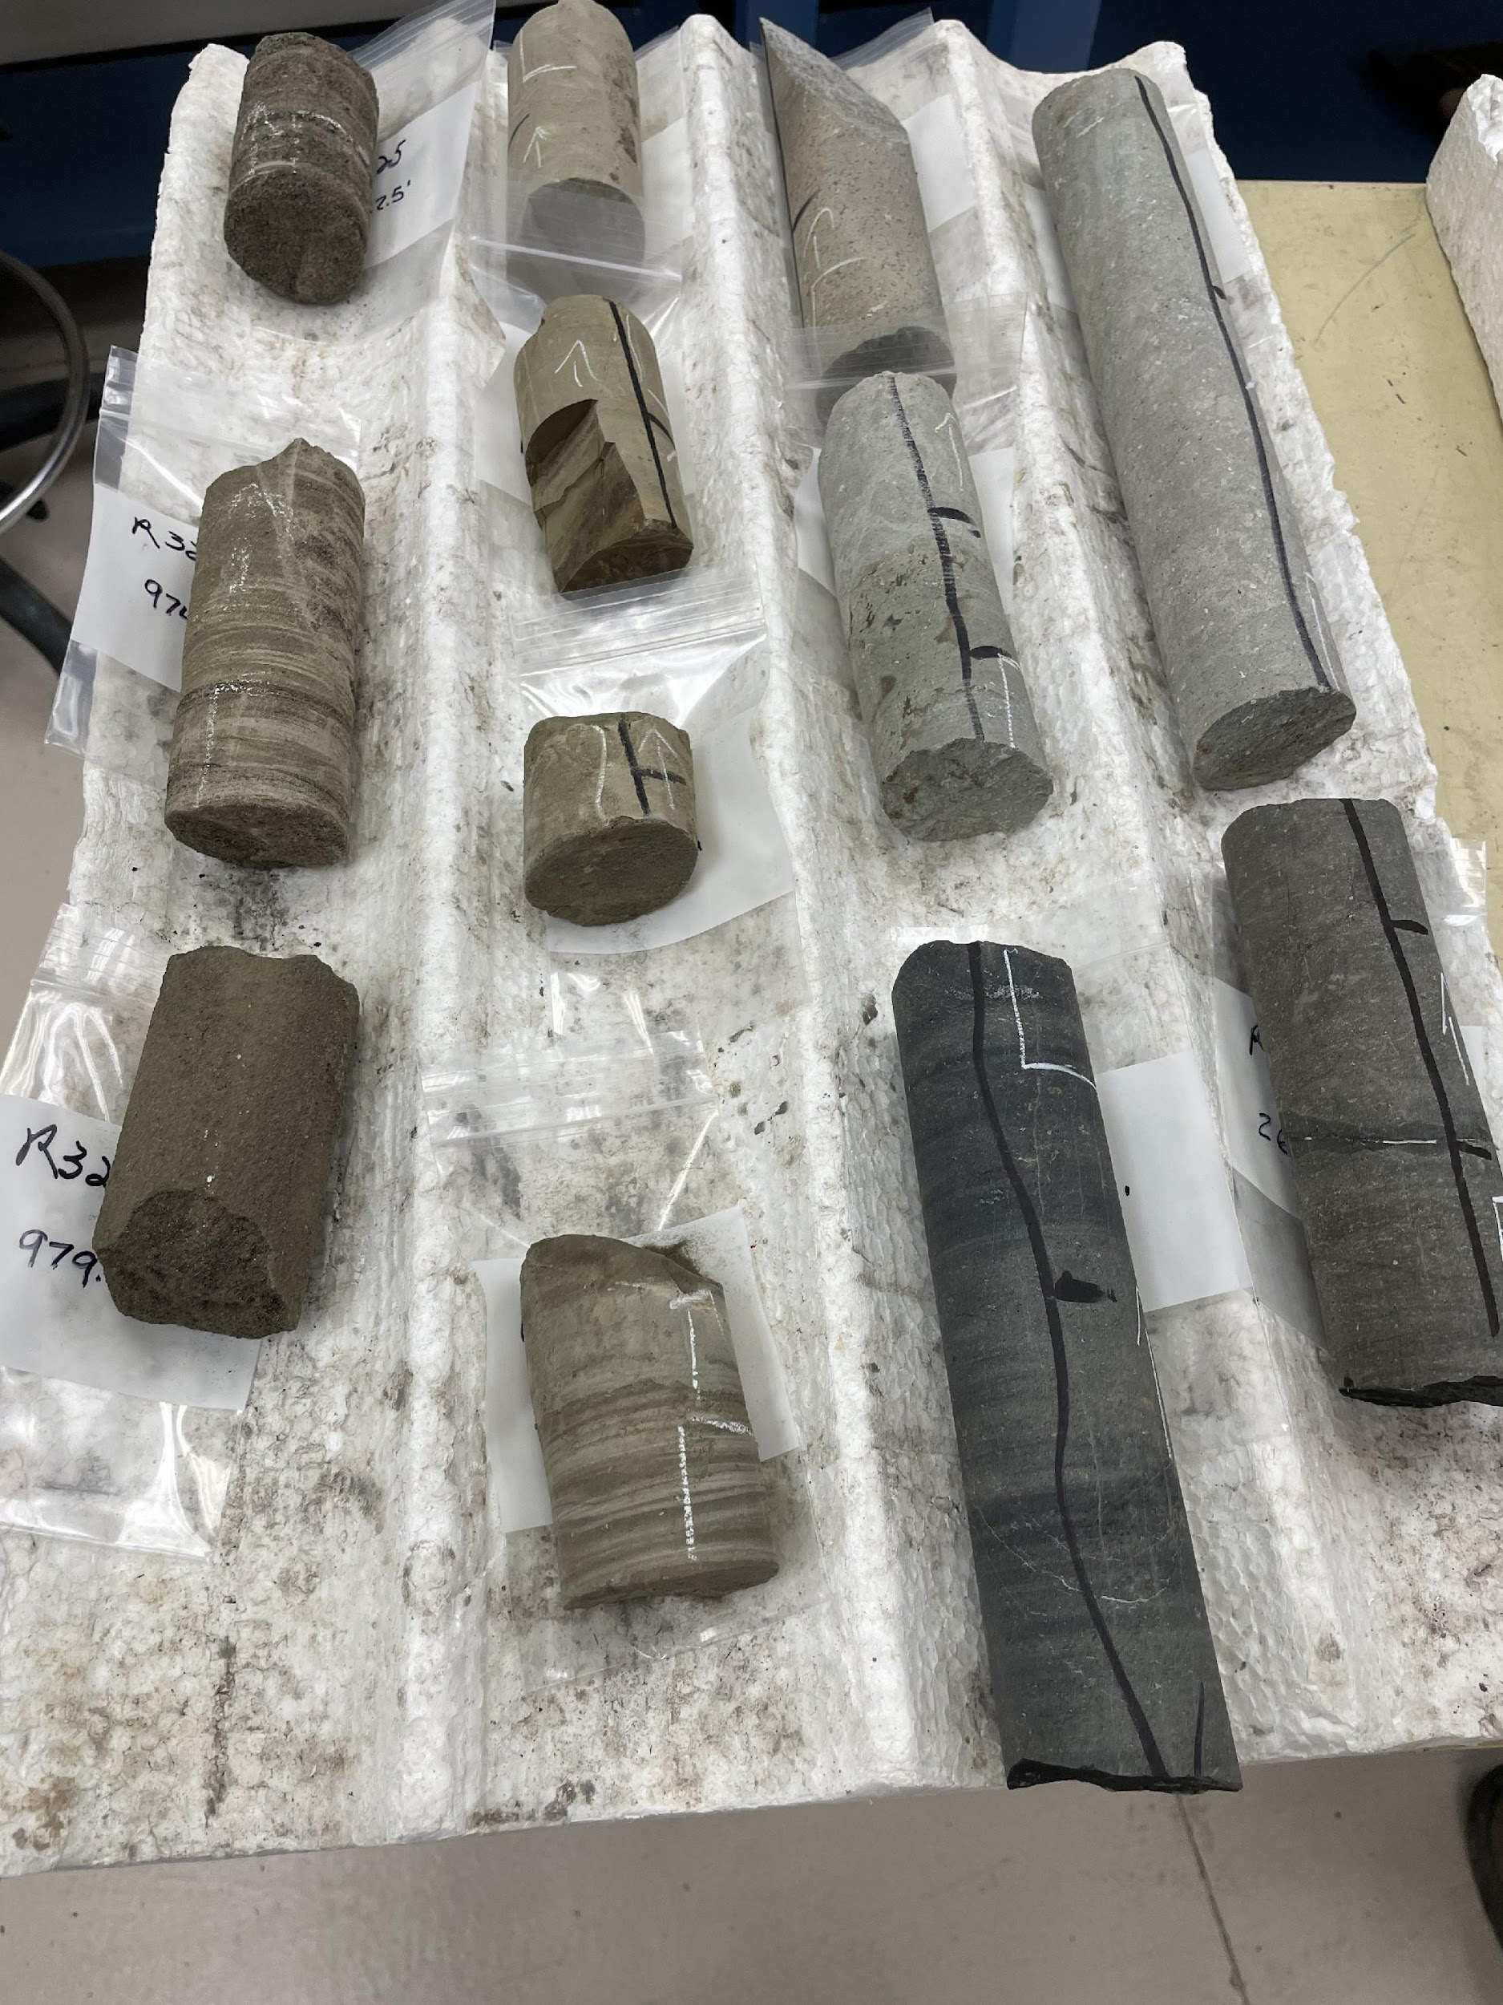
Experiment #2: Newberry Volcano Samples
Sample | Depth (m) | Porosity | Mineralogy
J | 792.8 | 23.2% | Andesite-Basalt Lava Flow
L | 809.1 | 1.74% | Flow Interior Basalt
Q | 852.8 | 27.53% | Flow Top Basalt
R | 910 | 23% | Flow Top Basalt
S | 929 | 1.74% | Flow Interior Basalt
T | 930.7 | 29.3% | Flow Top Basalt
The sample selection was based on depth, lithology, and alteration extent, as indicated by bulk mineralogy
Notes:
A total of 6 core samples were selected for study from the well. The sample selection was based on depth, lithology, and alteration extent, as indicated by bulk mineralogy.
Of particular interest was the region between 757m and 932m where interbedded andesite and basalt lava flows occurred which are characterized by interior flows and brecciated flow tops.
These two flows should provide interesting case studies on the degree of hydrothermal alteration. Interior flows have few vesicles and less connected fractures, preventing hydrothermal fluid invasion and resulting in less secondary mineral precipitation. In other words, they have lower porosity and less pore connectivity and as a result less hydrothermal alteration is expected.
On the other hand, flow tops have a higher porosity and a more interconnected pore system, ranging from nano- to macro-pores as well as fracture systems. All these factors will promote a range of hydrothermal fluid invasion mineral precipitation scenarios.

Slide 11
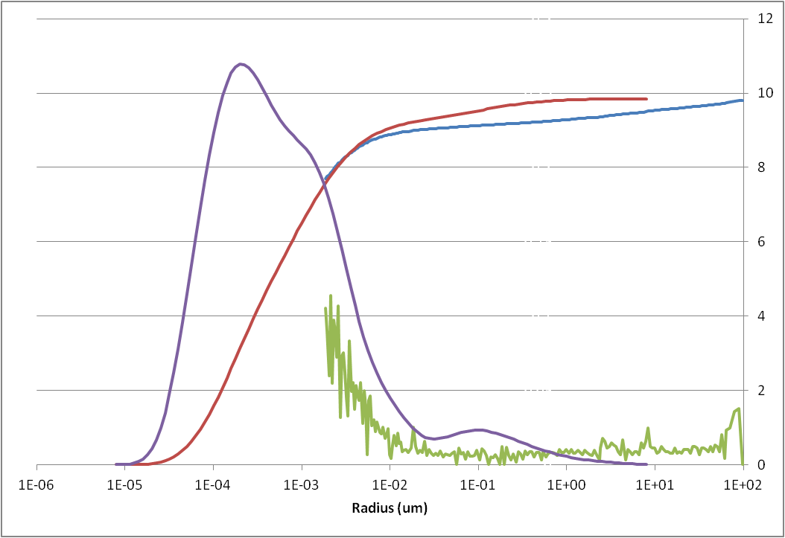
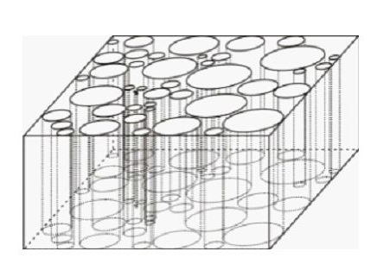
NMR Relaxivity Determination
Relaxivity relates T₂ to pore size
Use MICP “aligned” with NMR

Slide 12
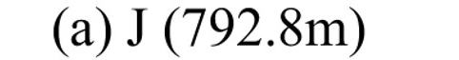
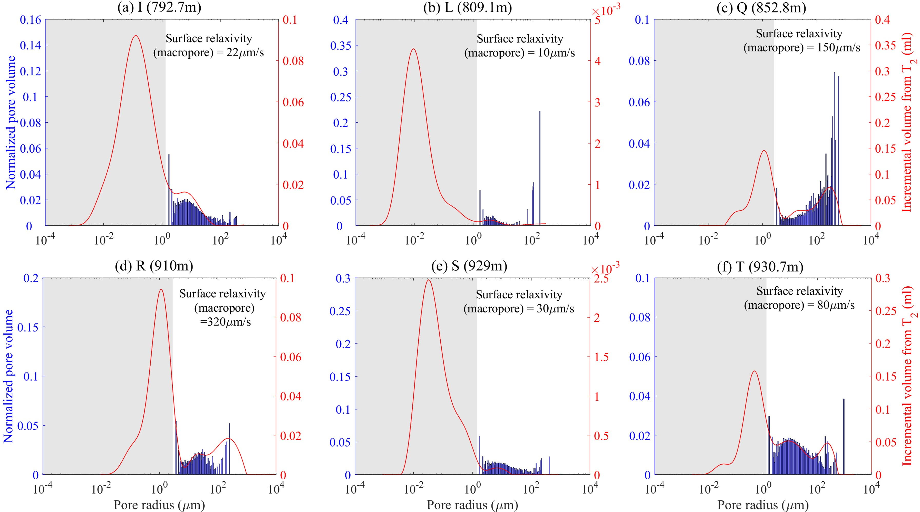
Experiment #2: Nano-Scale Surface Relaxivity
The surface relaxivity of the micro/macro pores vary significantly.
The interior flow basalts (Samples L and S) have lower surface relaxivity values, not surprising as less micro/macro porosity available for hydrothermal alteration.
The surface relaxivity of the flow top basalts (Samples J, Q, R and T) generally increases with depth, not surprising as direction of hydrothermal flow will be from bottom up.
Notes:
This slide shows the pore size distribution derived from the gas adsorption data overlayed with the T2 pore size distributions. It should be noted that the pore size distribution obtained from gas adsorption is not perfectly smooth due to the adsorption model and inversion method used to convert the gas adsorption data to pore size.
As you can see all, the nanopore surface relaxivity values are around 10 μm/s, which indicates that minerals surrounding or adjacent to the nanopores are primarily diamagnetic minerals. They lack the ions or unpaired electrons which lead to higher surface relaxation values.
Also, the uniformity of the surface relaxivity values for all samples indicates that surface alteration is not predominant in the nano-pores.

Slide 13
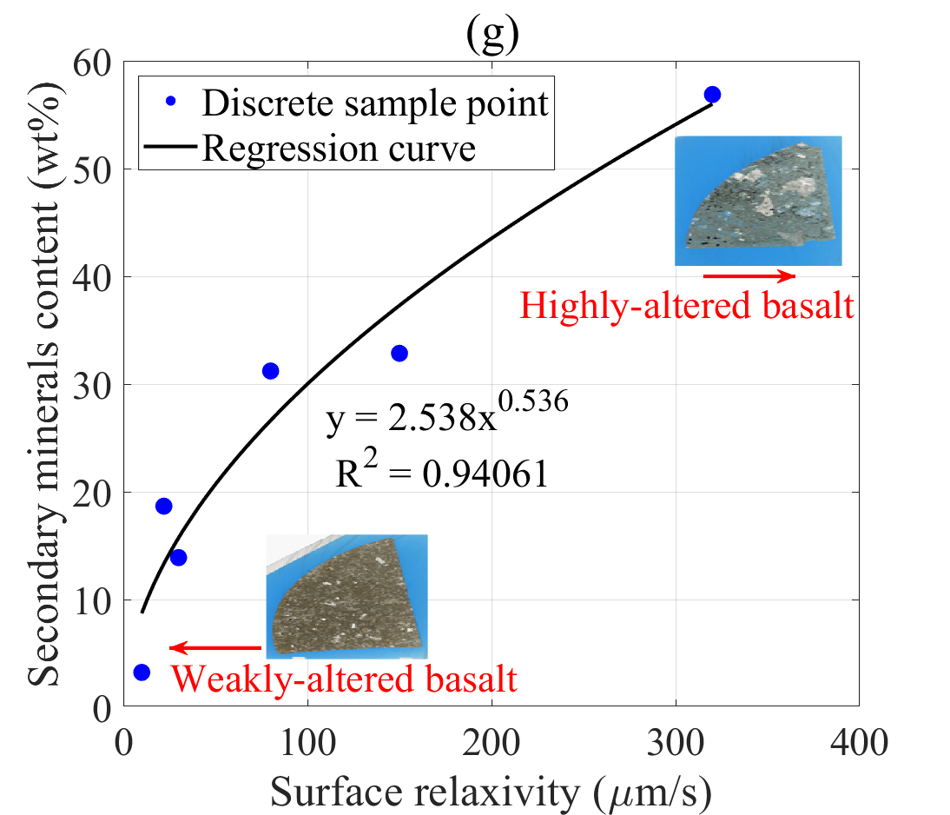
Experiment #2: Micro/Macropore Relaxivity
R
Sample | Depth (m) | Porosity | Mineralogy
J | 792.8 | 23.2% | Andesite-Basalt Lava Flow
L | 809.1 | 1.74% | Flow Interior Basalt
Q | 852.8 | 27.53% | Flow Top Basalt
R | 910 | 23% | Flow Top Basalt
S | 929 | 1.74% | Flow Interior Basalt
T | 930.7 | 29.3% | Flow Top Basalt
T
Q
J
S
L
Notes:
So we have shown that the NMR data can be coupled with other measurements to derive the surface relaxivity for core samples. We have also shown that the surface relaxivity of the micro and macro pores changes with sample. We hypothesized that this was a result of more hydrothermal surface alteration in some samples as compared to others.
The question became could we corelate these different surface relaxivities for the micro and macro pores to some other parameter such as secondary mineral content. The answer was yes. This figure illustrates the relationships between micro/macropore relaxivity and weight percent of potentially paramagnetic or weakly ferromagnetic (Fe/Mn)-bearing hydrothermal mineral content (chlorite, calcite, pyrite, and hematite) for the six Newberry basalt samples. There is clearly a trend in the data. In fact the trend can be fit to a power-law relationship
∑〖𝑤_𝑖=𝑎〖(𝜌)〗^𝑏 〗
here wi is the weight percent of SR-enhancing hydrothermal mineral I, ρ is the surface relaxivity and a and b are the power law coefficient and exponent.
This is an interesting result and opens up the possibility that secondary mineral content could be employed to determine the surface relaxivity of different samples.

Slide 14
Conclusions/Future Work
NMR core analysis can be an important tool for assessing samples of for Carbon Capture Utilization and Storage (CCUS) and it is especially effective for assessing carbon mineralization.
NMR measures the change in porosity due to carbon mineralization
Surface relaxivity of can be correlated with zones that will produce better mineralization through detection of higher icon concentrations.
We want to continue to assess and explore how NMR core analysis can be employed for CCUS applications.
Notes:
So that brings me to the conclusion of my talk. I will close by just summarizing a few conclusions and discussing future work we are hoping to accomplish.
We have shown that NMR core analysis can be an important tool for assessing samples of for Carbon Capture Utilization and Storage (CCUS) and it is especially effective for assessing carbon mineralization. We have shown that in this study through two experiments. Firstly, T2 pore size distributions were shown to measure the change in porosity due to carbon mineralization. Secondly, by coupling T2 pore size distributions with gas adsorption and SEM measurements, the surface relaxivity of various basalt samples have been determined. Pores with higher degrees of hydrothermal alteration have shown higher surface relaxivity values.
This effort showed that surface relaxivity of micro/macro pores in basalt samples can be quantitatively correlated with potentially paramagnetic or weakly ferromagnetic (Fe/Mn)-bearing hydrothermal mineral content (chlorite, calcite, pyrite, and hematite).
Overall our work on surface relaxivity has three implications:
1) A uniform surface relaxivity cannot be employed for basalt rocks.
2) A positive relationship exists between surface relaxivity and the degree of hydrothermal alteration.
3) The identified link between enhanced pore SR and mineral alteration in basalts may be used for in situ assessment of spatial and temporal changes within vesicle pores and microfractures.
In the future, we want to continue to assess and explore how NMR core analysis can be employed for CCUS applications.

Slide 15
  Green Imaging Technologies, Inc.
  214 Brookside Drive, Suite B
  Fredericton, NB
  Canada, E3A 8V2
  Ph: +1 (506) 458-9992
  Fax: +1 (506) 458-9615
  www.greenimaging.com

