Slide 1


Interpore 2026
Deep-learning reconstruction of digital rocks of shale matrix and numerical predictions of apparent permeability
Presenter: Zhiwei Wang
Author: Zhiwei Wang，Jianqi Rong， Bowen Shi，Dongchen Liu，Yingfang Zhou，Chaozhong Qin
22th May, 2026
Nantes, France
Notes:
Good afternoon everyone. My name is Zhiwei Wang. I am a PhD student from Chongqing University, and I am currently a joint PhD visiting student at the University of Aberdeen. it is my pleasure to present our work on “Deep-learning reconstruction of digital rocks of shale matrix and numerical predictions of apparent permeability.”

Slide 2
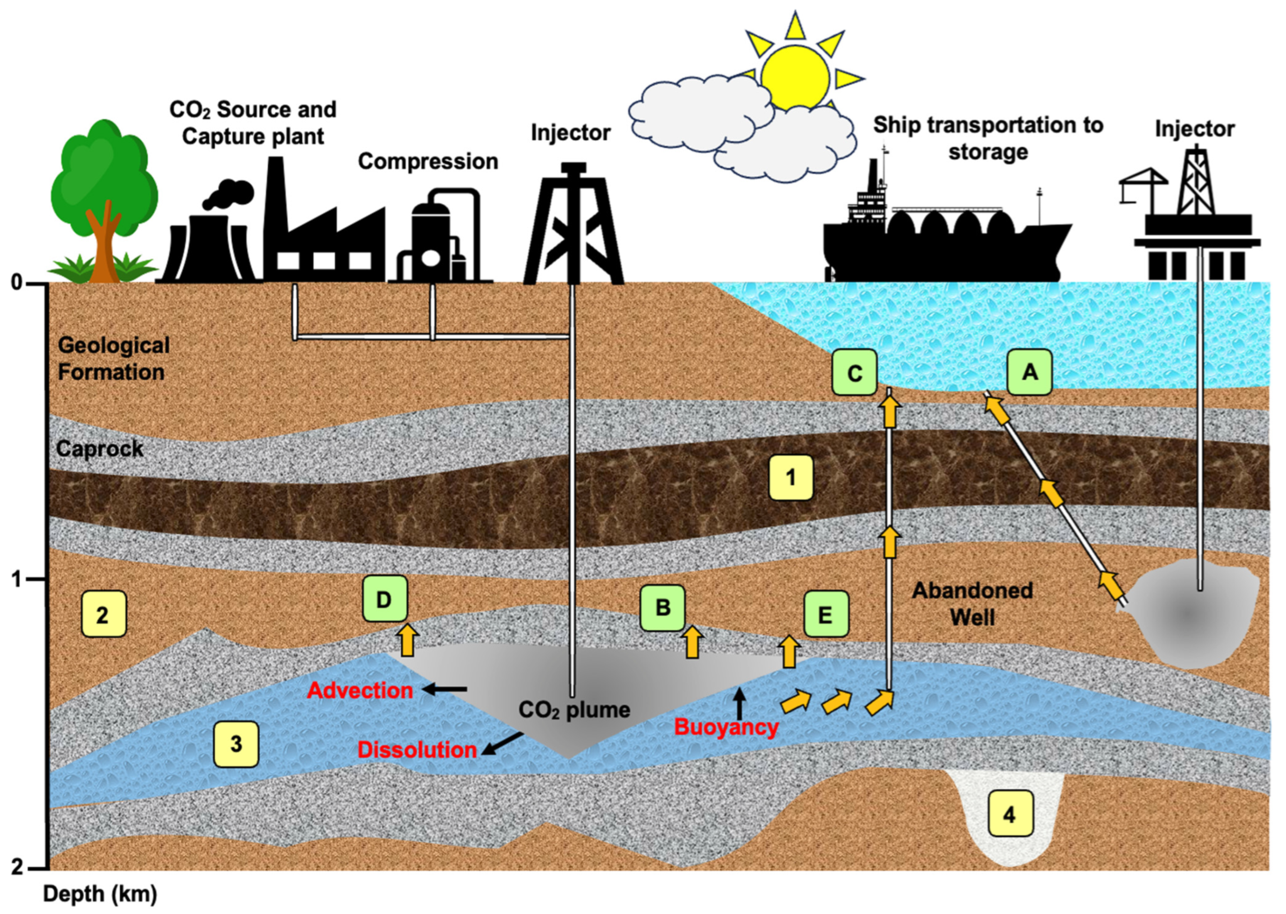




Research background
Shale is a critical subsurface resource, permeability is a key parameter, because it controls gas transport, production efficiency, injection capacity, and storage efficiency.
Shale Gas production
Primary energy source through methane extraction. Essential for bridging the gap during the transition to renewables.
Underground Hydrogen Storage
Potential large-scale sites for the Future Hydrogen Economy. Providing essential stability for intermittent green energy.
CO₂ Storage
Secure carbon locking sites for CCUS initiatives. Vital for achieving Net-Zero targets through permanent geological storage.
Multiscale pathways for CO2 sequestration and geological storage options （Rigby, et al., 2023）.
Notes:
Shale is an important subsurface resource for shale gas production, and underground hydrogen storage. , and CO₂ storage
For all these applications, permeability is a key parameter, because it controls gas transport, production efficiency, injection capacity, and storage efficiency.
To predict permeability reliably, we first need to understand the three-dimensional pore connectivity inside the shale matrix.However, this is very challenging because shale has highly heterogeneous and multiscale pore structure.

Slide 3
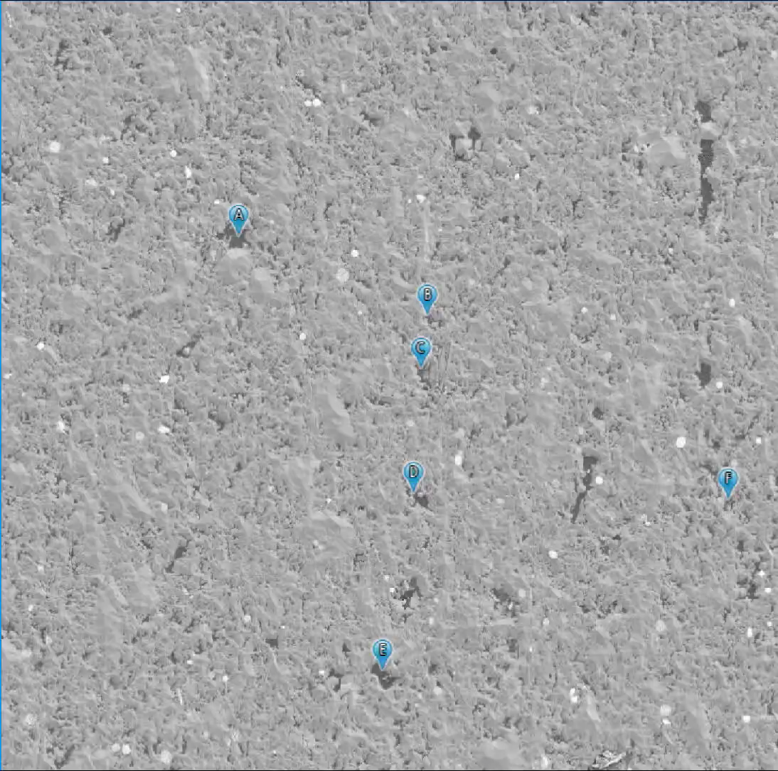
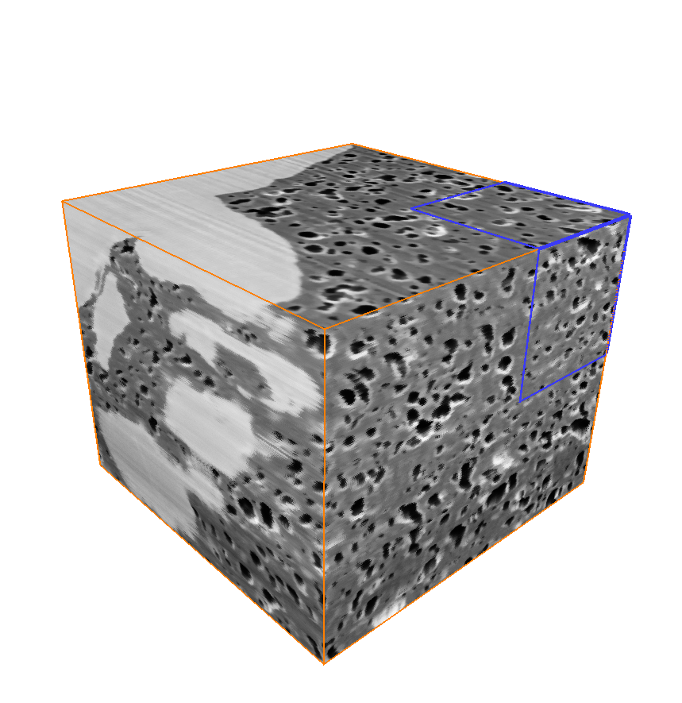
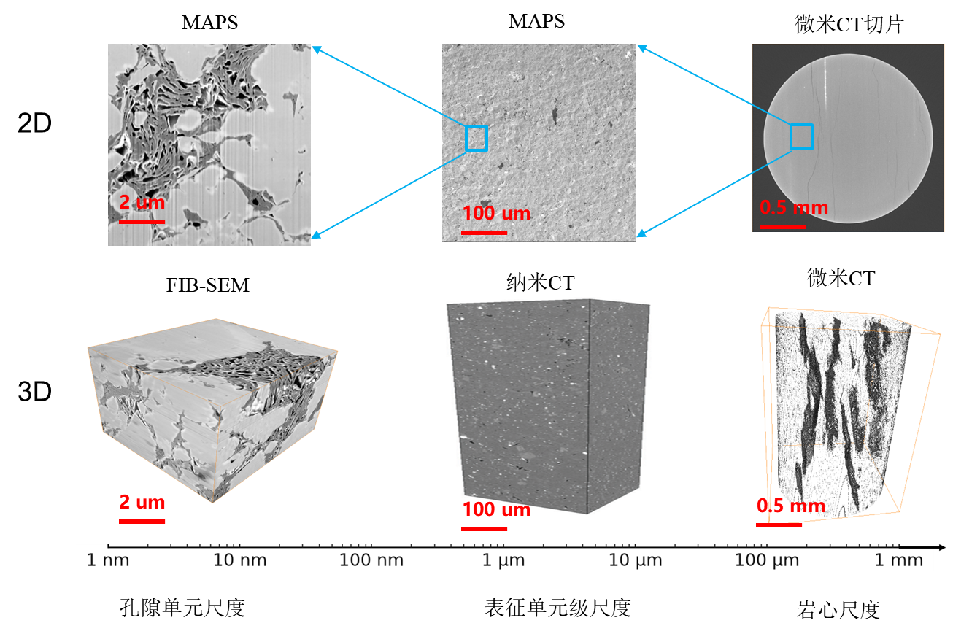



Key Challenge
3D image High resolution captures nanoscale pores, but only within a small volume; large field of view captures representative structures, but loses nanoscale details.
1 μm
MAPS (2D)
FIB-SEM (3D)
Micro(Nono)-CT (3D)
Adapted from Ma et al. (2021)
Large & Clear
Clear
Representative
Limitation: Strictly 2D Surface Only
Limitation: Too Local
Limitation: intra-mineral pores Loss
MAPS provides a large and clear two-dimensional field of view, which is useful for capturing capture nanoscale intra-mineral pores. However, it cannot directly provide 3D pore connectivity. FIB-SEM can resolve nanoscale 3D pore structures, but its imaging volume is too small and too local. In contrast, micro-CT or nano-CT can cover a larger volume, but their resolution is not sufficient to capture nanoscale intra-mineral pores.
Notes:
Common imaging methods include MAPS, FIB-SEM, and micro- or nano-CT. MAPS means large-area SEM imaging. These methods are useful, but each has its own limitation.
MAPS provides a large and clear two-dimensional field of view, which is useful for capturing capture nanoscale intra-mineral pores. However, it cannot directly provide 3D pore connectivity. FIB-SEM can resolve nanoscale 3D pore structures, but its imaging volume is too small and too local. In contrast, micro-CT or nano-CT can cover a larger volume, but their resolution is not sufficient to capture nanoscale intra-mineral pores.
Therefore, the key challenge is the trade-off between imaging resolution and field of view. This makes 3D digital rock reconstruction difficult, and also makes permeability prediction difficult.

Slide 4
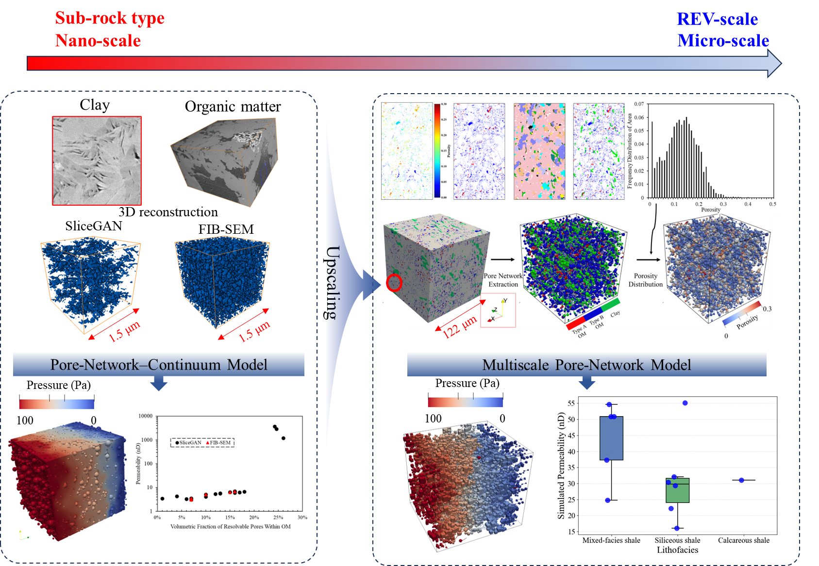



Proposed Multiscale Workflow
Upscaling sub-rock type information to the REV scale
Sub-rock Type (Nano-scale)
Reconstruct 3D units via SliceGAN & FIB-SEM. Calculate intrinsic permeability using a hybrid PNM-Continuum model.
Coarse-graining
Categorize units to bridge the scale gap while strictly preserving critical connectivity information.
REV-scale (Micro-scale)
Assemble the 122 μm digital core. Predict macroscopic permeability across lithofacies using Multiscale PNM.
Notes:
To solve this problem, we propose a multiscale workflow. The goal is to bring nanoscale pore-structure information into a large REV-scale 3D digital rock for permeability prediction.
nextI will discuss the workflow at two scales:: the sub-rock-type scale and the REV scale.
First, at the sub-rock-type scale, We use SliceGAN and FIB-SEM data to build representative 3D sub-units, and then calculate their intrinsic permeability.
Second, at the REV scale, we combine MAPS images and QEMSCAN mineral maps to obtain the spatial distribution of OM and clay. During coarsening, we keep the important pore-structure information from the high-resolution images.
Finally, we construct the 3D digital rock, assign pore and permeability information to each element, and predict the apparent permeability with a multiscale pore-network model.
In this way, we link nanoscale pore information to REV-scale permeability prediction.

Slide 5


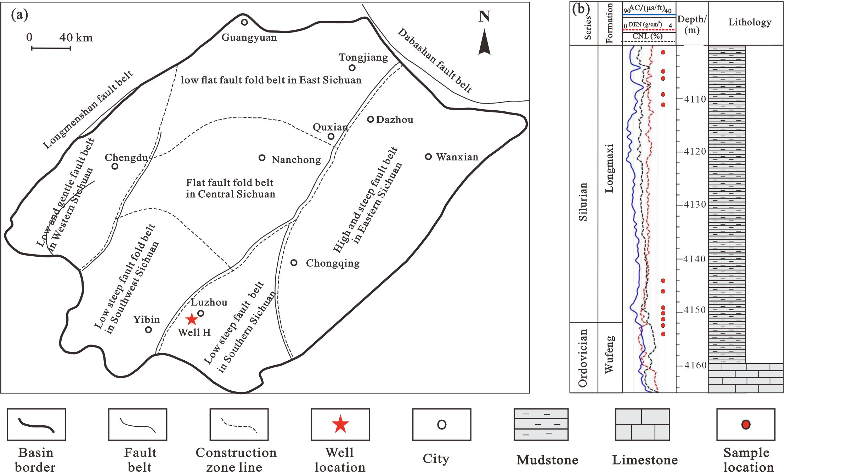

Geological Setting and Multiscale Dataset
Experimental and imaging constraints for reconstruction and validation.
Study Area & Sampling
Multiscale Experimental Suite
12 shale samples collected from various depths of Well H in the Wufeng–Longmaxi Formation, Luzhou Block, Sichuan Basin, China.
Crushed-shale Poro-Perm
MAPS (2D Large FOV)
QEMSCAN (Mineralogy)
FIB-SEM (3D Sub-rock Type -scale)
Lithofacies Classification
Samples cover three distinct facies:
•
Mixed-facies shale
•
Siliceous shale
•
Calcareous shale
Notes:
Before jumping into the reconstruction work flow, let me briefly introduce our dataset.
We collected twelve shale samples from Wufeng–Longmaxi Formation in the Sichuan Basin.
To accurately analysis these samples across different scales, we employed experiment including MAPS, QEMSCAN, and FIB-SEM, alongside crushed-shale permeability tests.
based on the mineralogical evaluation shown in this ternary diagram, our twelve samples naturally fall into three distinct categories: mixed-facies, siliceous, and calcareous shales.

Slide 6


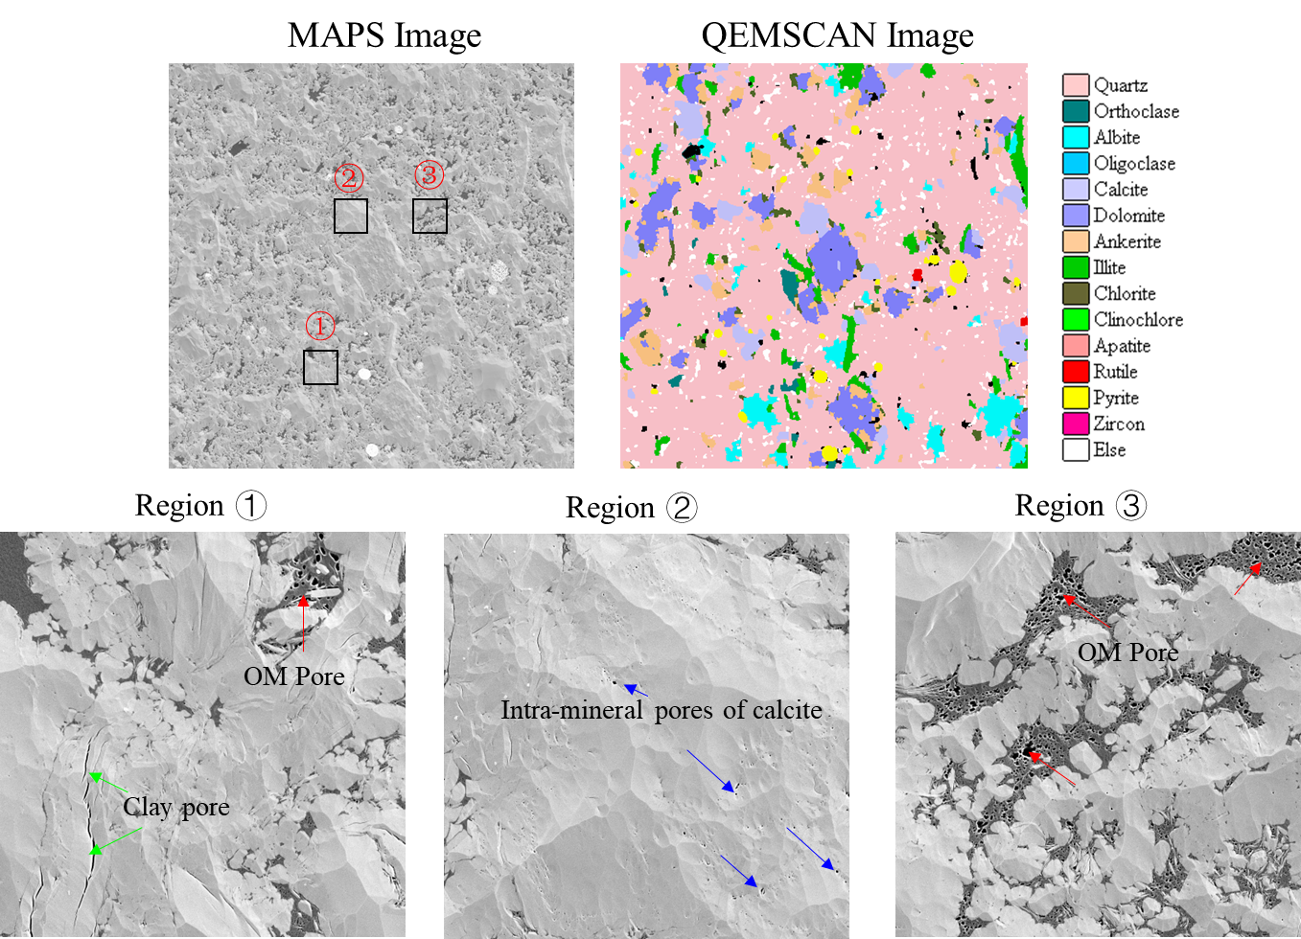

Sub-rock type scale: Pore-bearing Components
Resolved pores are mainly hosted in organic matter and clay minerals.
Mineral & Pore Distribution (MAPS + QEMSCAN)
Statistical Correlation
1. The resolvable pores are predominantly hosted within Organic Matter (OM) and Clay minerals.
2. Dissolution pores in calcite/dolomite are isolated and do not contribute to the global connected pore system(Ma et al., 2021).
Notes:
After introducing the dataset, we first examine which components mainly host the resolvable pores in the shale matrix.
By combining MAPS images and QEMSCAN mineral maps, we can link pore development with mineral composition. Previous studies have suggested that dissolution pores in carbonate minerals, such as calcite or dolomite, are often relatively isolated and may not significantly contribute to the globally connected pore system. Therefore, in this study, we focus on OM and clay as the main pore-bearing components for digital rock construction.
The statistical plot on the right also supports this choice. The particle porosity generally increases with the combined area fraction of clay and OM

Slide 7




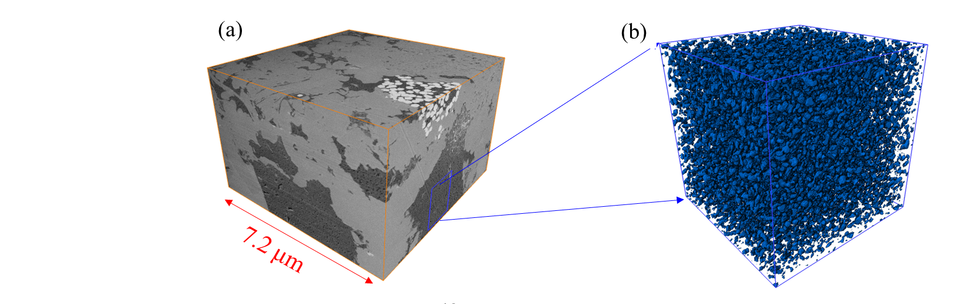
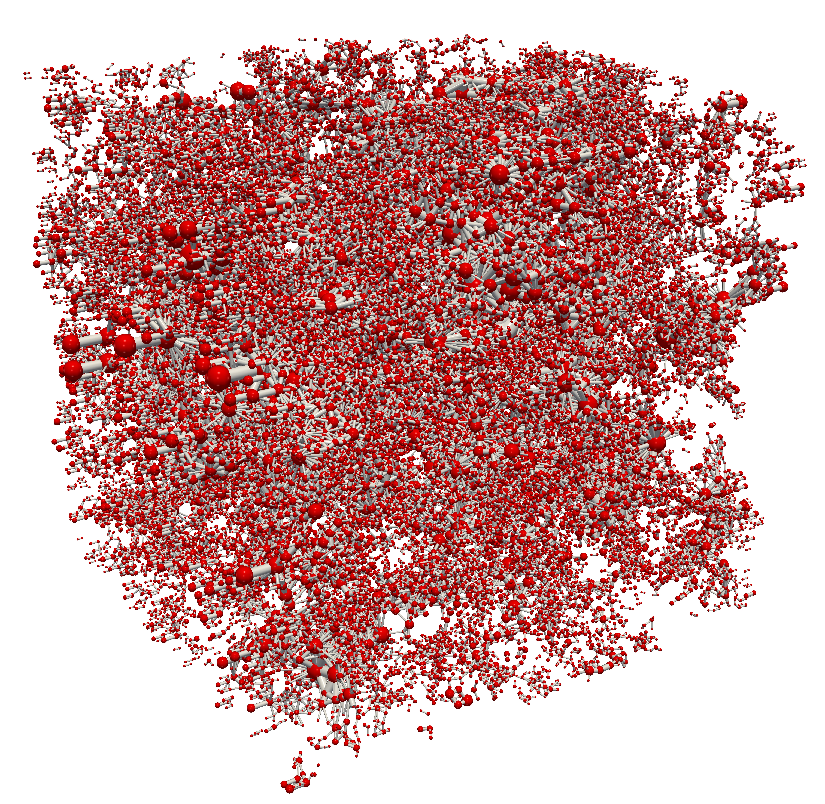
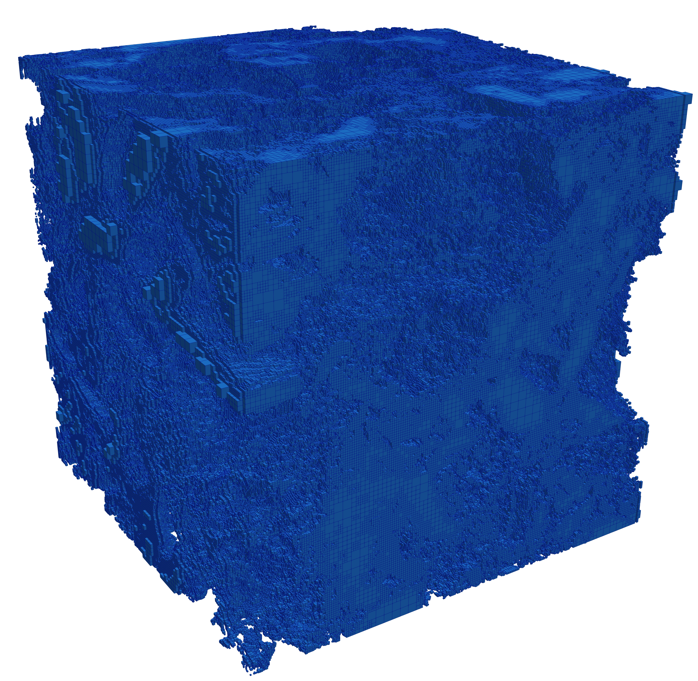
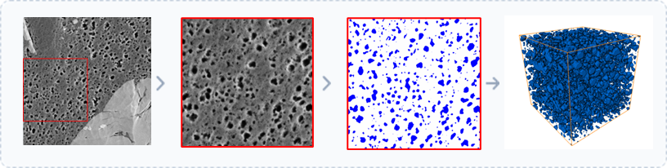

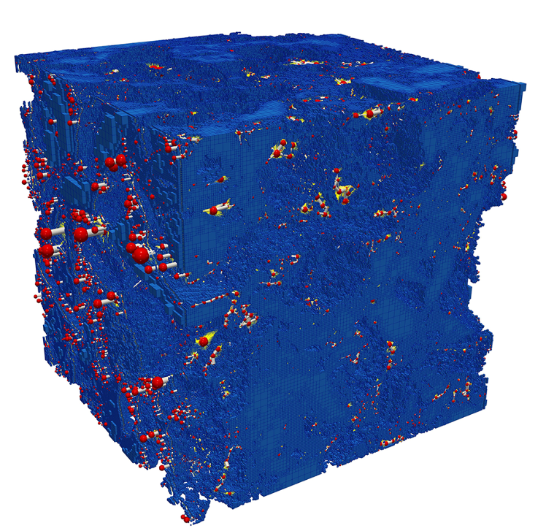
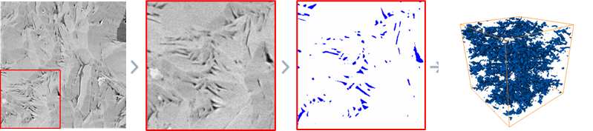
Sub-rock type scale: Sub-unit Simulation
Acquiring intrinsic porosity–permeability parameters for OM and Clay element classes.
1. 3D Structure Generation
2. Hybrid Flow Simulation
Validation Benchmark
Experimental 3D volume extracted to verify the SliceGAN porosity & geometry accuracy (Error < 10%).
Method based on SliceGAN: Kench et al. (2021)
Coupling
Pore-Network-Continuum Model
Notes:
Since OM and clay are the dominant pore-bearing components, we first need to determine their intrinsic permeability. FIB-SEM provides real high-resolution 3D pore structures, so it is used here as an experimental benchmark. However, FIB-SEM is expensive and limited in volume and sample number, so it cannot cover all OM and clay sub-units.
Therefore, we use SliceGAN, an excellent open-source 2D-to-3D reconstruction method, to generate additional 3D structures from high-resolution 2D images. The FIB-SEM data are used to validate the SliceGAN reconstruction result.
Then, we apply a pore-network–continuum model. Resolved pores are described by a pore network, while sub-resolution pores are treated as a continuum matrix. The output of this step is the intrinsic permeability of OM and clay sub-units, which will be used for REV-scale permeability prediction.

Slide 8


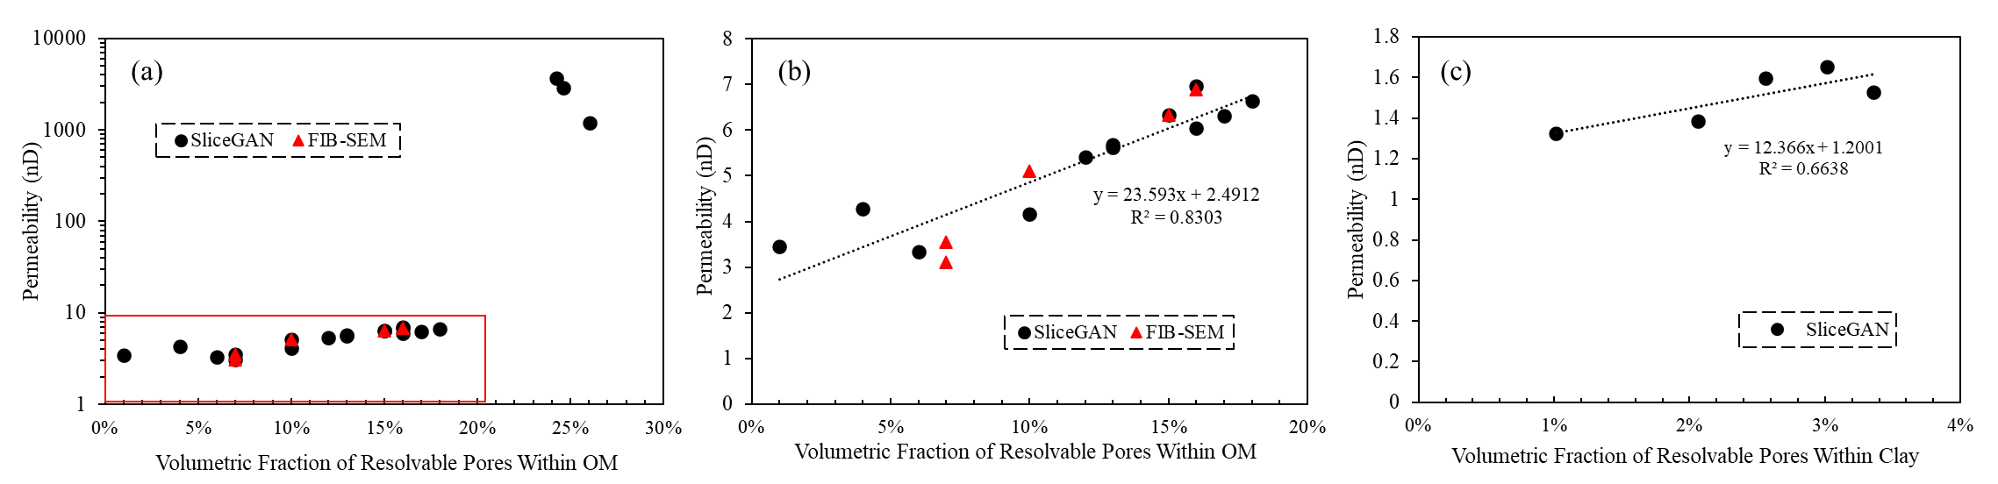
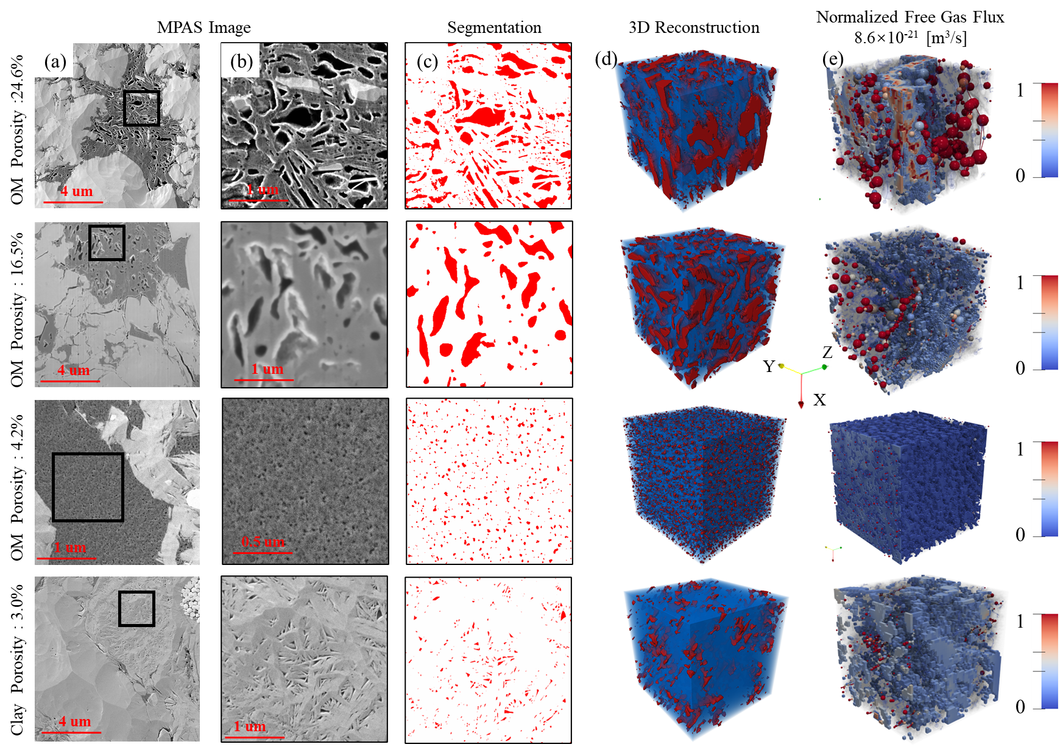
Sub-rock-type scale: Transport-based Typing
Quantifying intrinsic permeability of OM and clay sub-elements.
30 sub-units simulated:
20 SliceGAN OM + 5 SliceGAN clay + 5 FIB-SEM OM
Simulated Permeability
Defined Sub-rock Types
Surface porosity > 20%. Highly connected resolvable pores. Permeability is 2 orders of magnitude higher.
Surface porosity < 20%. permeability shows a linear relationship with porosity.
Surface porosity consistently < 5%. Treated as a single uniform unit driven by sub-resolution pathways.
Notes:
After the sub-unit reconstruction and simulation, we further analyzed the relationship between resolved pore porosity and intrinsic permeability. To make this relationship robust, we simulated 30 sub-units in total: 20 SliceGAN-reconstructed OM units, 5 SliceGAN-reconstructed clay units, and 5 FIB-SEM OM units used as experimental benchmarks.
For organic matter, the permeability is very sensitive to resolved pore porosity. When the porosity is below about 20 percent, the resolved pores are mostly isolated and the permeability remains low. Once the porosity exceeds this threshold, the resolved pores become highly connected, and the permeability increases sharply, by around two orders of magnitude.
Based on this transition, we classify organic matter into two types: OM-A, with surface porosity higher than 20 percent and highly connected resolved pores; and OM-B, with surface porosity lower than 20 percent and predominantly isolated resolved pores.
For clay minerals, the resolved pore porosity is generally lower than 5 percent, and the permeability variation is much smaller. Therefore, clay is treated as one relatively uniform sub-rock type.

Slide 9
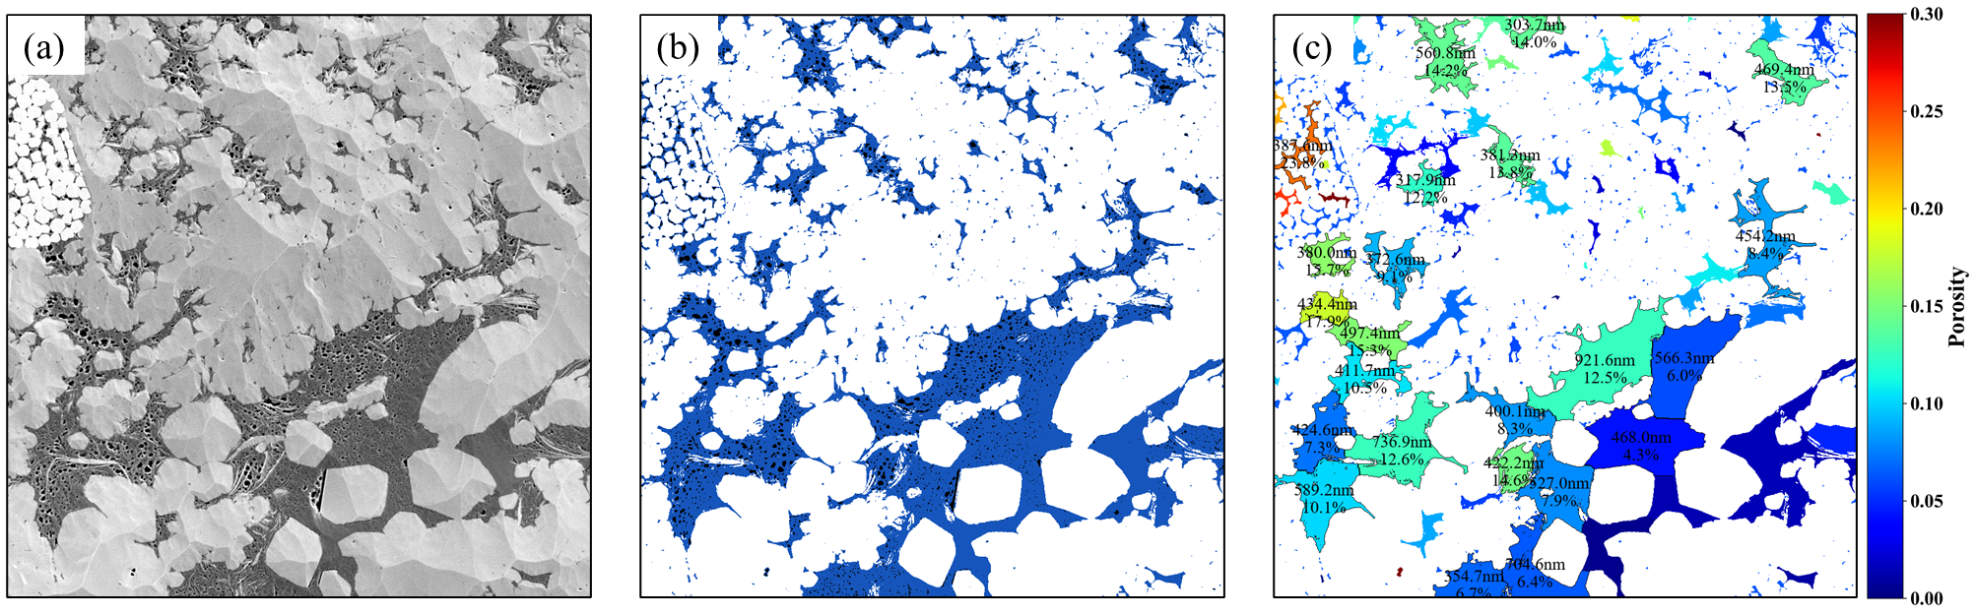



Sub-rock type scale: Feature Extraction
Automated segmentation and watershed analysis for element-level pore feature extraction.
1. Raw Data Input
2. Deep Learning
3. Feature Extraction
High-resolution MAPS mosaic (16 nm) captures mineralogical heterogeneity and complex organic matter (OM) distribution.
Trainable Weka Segmentation used to isolate OM, organic pores, and inorganic pores from solid minerals.
Watershed subdivision enables the automated calculation of surface porosity and pore diameter for every individual OM element.
Notes:
After defining the 20 percent threshold from the permeability simulations, we need to apply this criterion to the real MAPS images.
Here, the raw MAPS image is first segmented using trainable Weka segmentation. This allows us to identify organic matter, organic pores, inorganic pores, and solid minerals.
Then, we use watershed analysis to divide the organic matter phase into individual OM elements. For each OM element, we calculate the surface porosity and pore size information automatically.
In this way, each OM element is no longer treated as the same material. Instead, it is described by its own pore features. These features provide the basis for identifying connectivity-related sub-rock types in the following reconstruction.

Slide 10


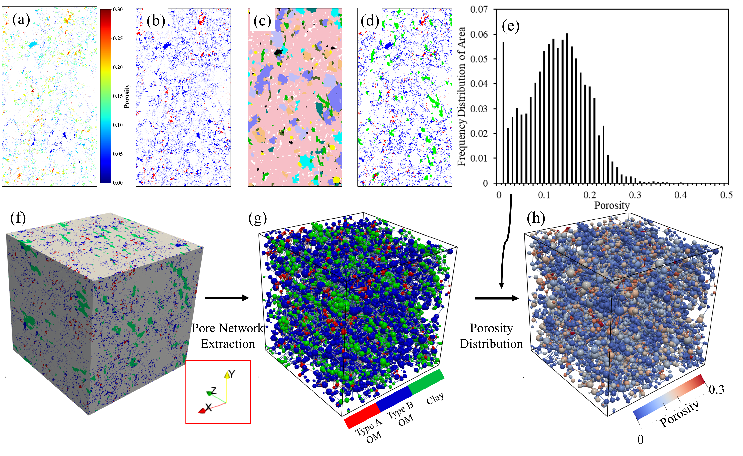

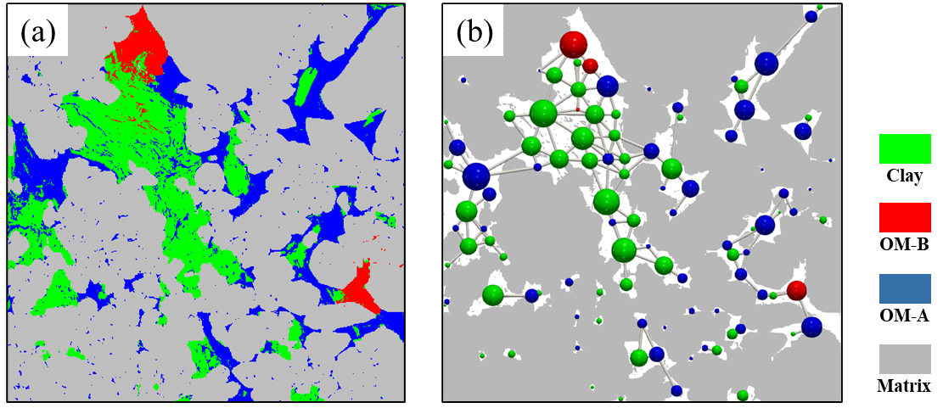

REV scale: Digital Rock Construction
Integrating sub-rock features into a representative 3D digital rock
Governing Transport Physics
Multiscale Assembly Pipeline
$$k_{a,om}=\frac{1}{ρ^{g}}μ^{g}D_{s}n_{ad}^{max}\frac{K}{{\left(1+Kp^{g}\right)}^{2}}+\left(1+α_{om}Kn\right)\left(1+\frac{4Kn}{1+Kn}\right)K_{OM}$$
$k_{a,clay}=\left(1+α_{clay}Kn\right)\left(1+\frac{4Kn}{1+Kn}\right)K_{clay}$
Organic Matter: Coupled slippage, Knudsen, and Adsorption-Desorption physics.
Clay: Slippage and Knudsen diffusion (Adsorption negligible).
Local Network Extraction Schematic
•
(a) Mapping spatial distribution of OM and Clay.
Output: Permeability Field
•
(b) Topological extraction of multiscale pore networks for OM-A, OM-B, and Clay elements.
The multiscale Pore Network Model preserves high-resolution features across a 122 μm representative volume.
Notes:
After feature extraction, we move to the REV scale. Here, the goal is to integrate local pore-structure information into a representative 3D digital rock.
We first define the transport physics for different components. For organic matter, apparent permeability includes slip flow, Knudsen diffusion, and adsorption–desorption. For clay, gas adsorption is neglected because natural shale is usually water-bearing, so we mainly consider slip flow and Knudsen diffusion.
Then, the coarsened MAPS image and QEMSCAN mineral map are combined to obtain the spatial distribution of OM and clay. SliceGAN is used to construct the REV-scale 3D digital rock, and a multiscale pore network is extracted, including OM-A, OM-B, and clay elements.
Finally, porosity and permeability information are assigned to the network elements, and the apparent permeability is predicted using the multiscale pore-network model. This allows us to evaluate both 3D connectivity and permeability at the REV scale.

Slide 11

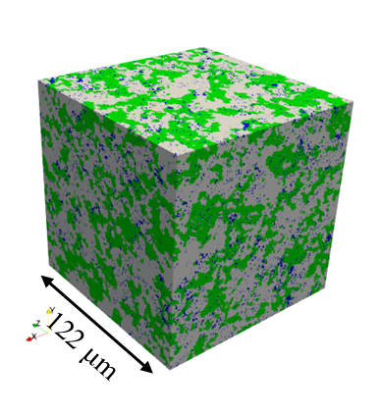
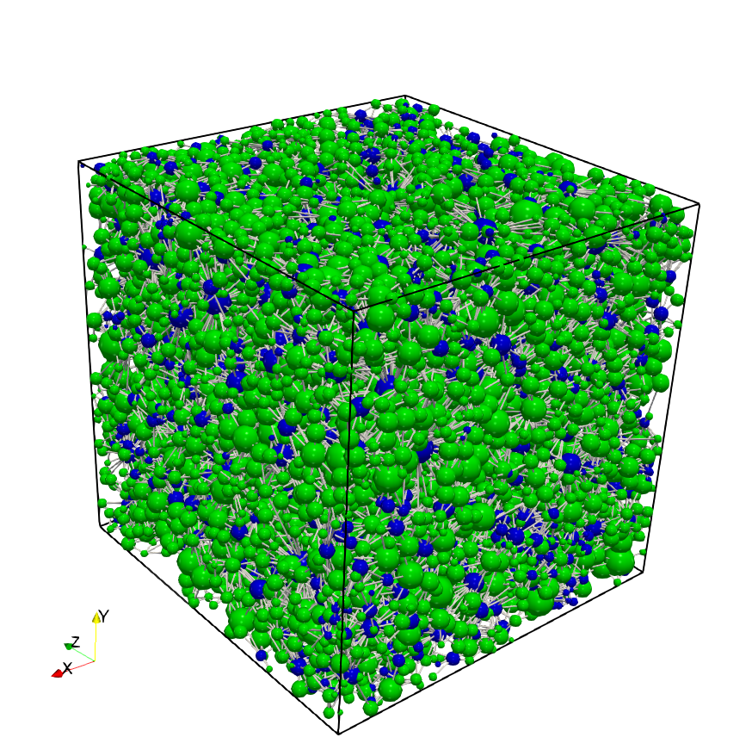




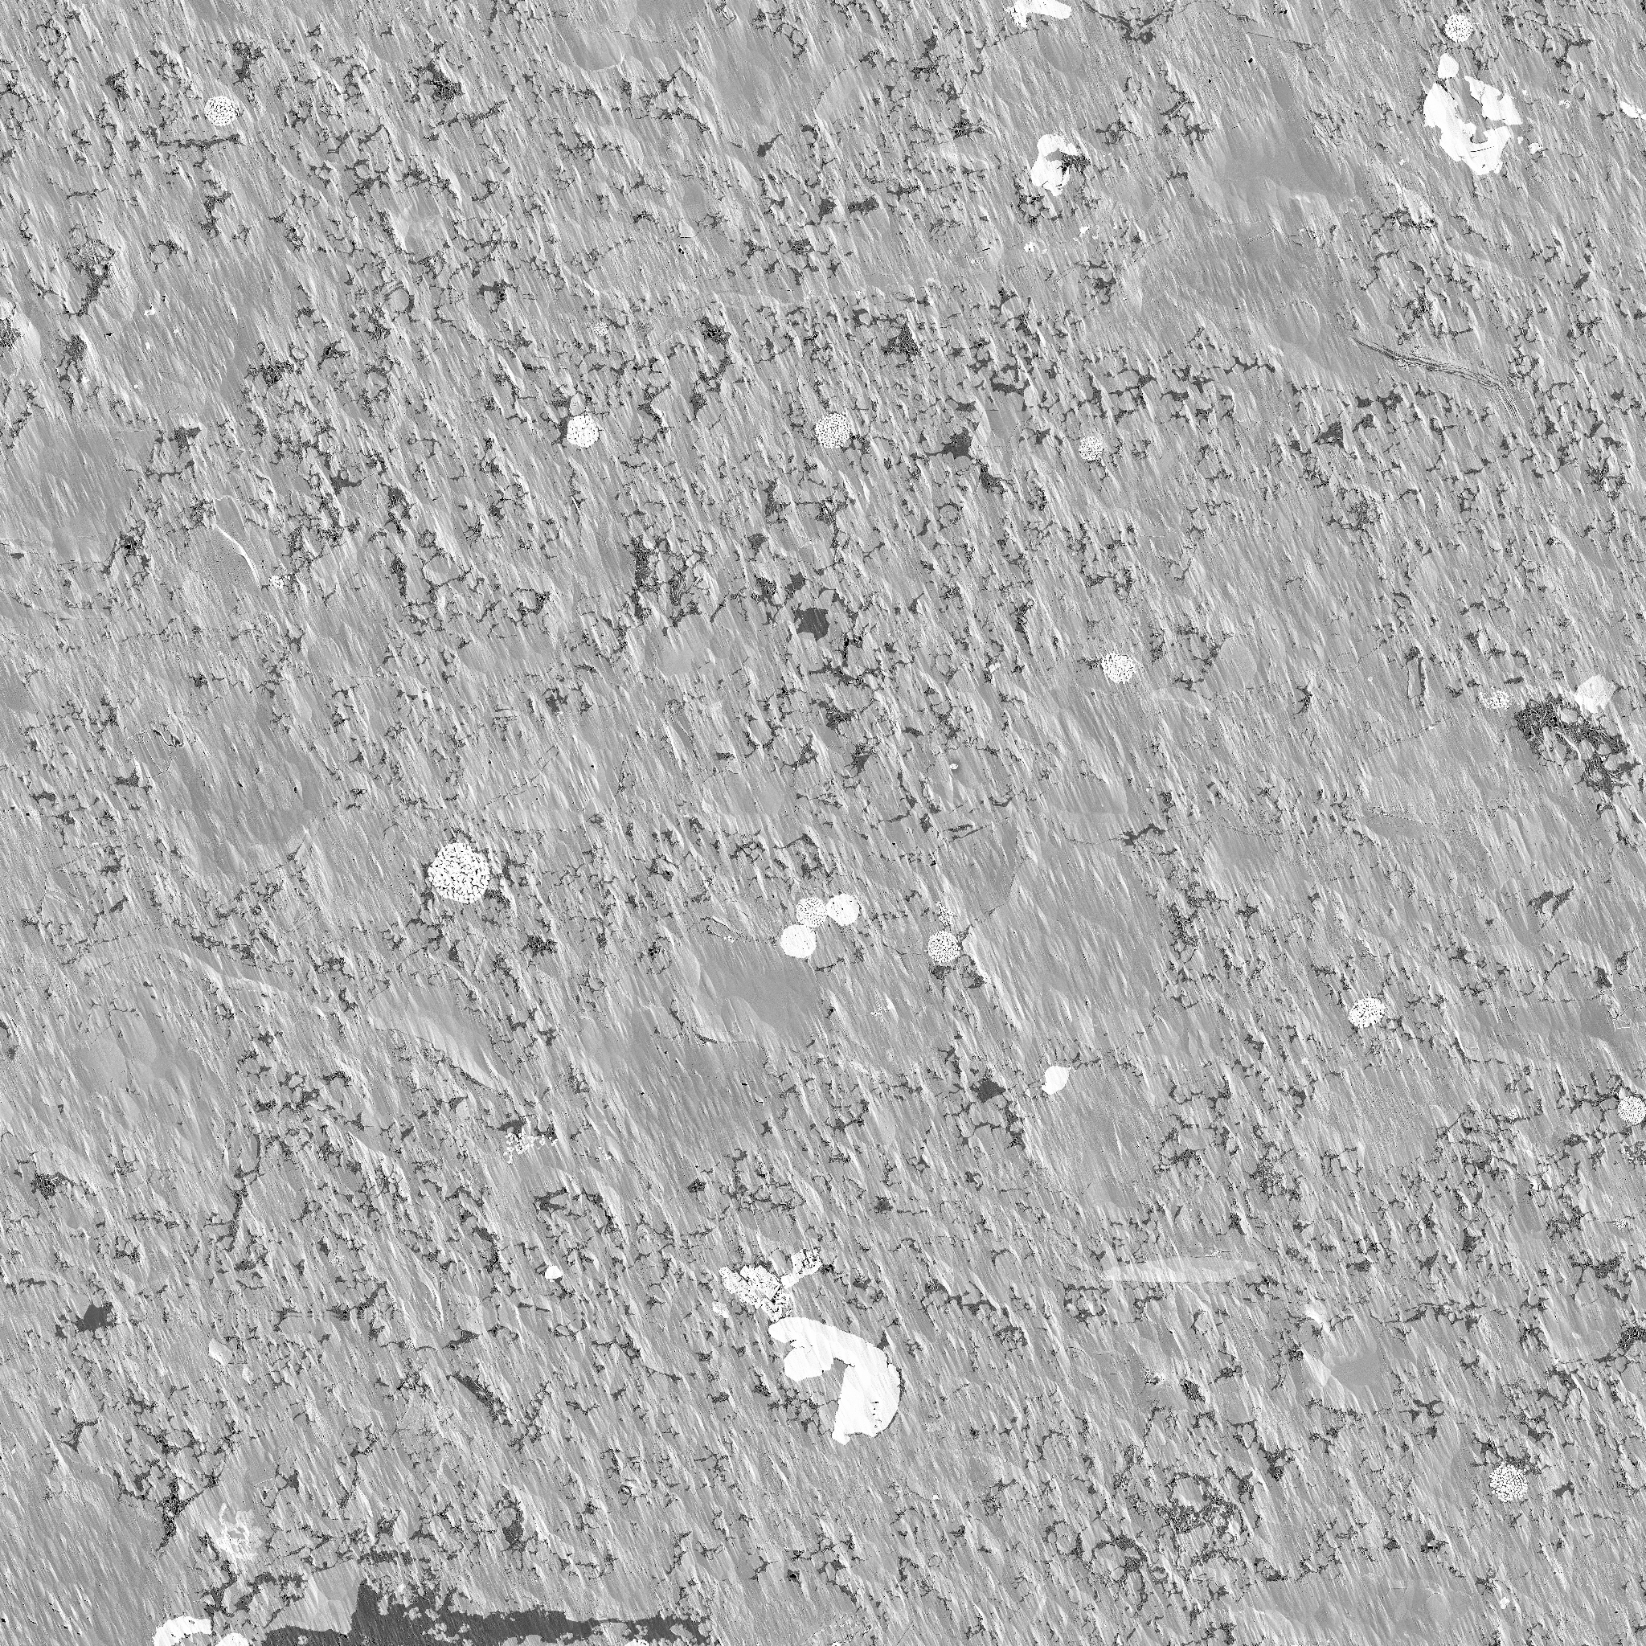
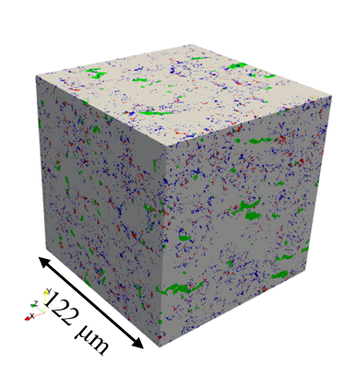
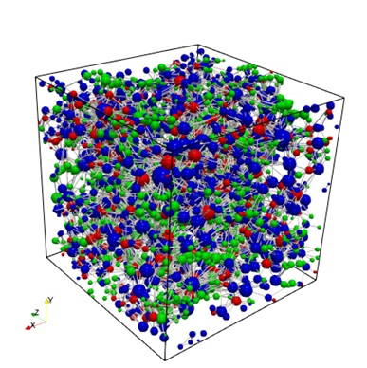

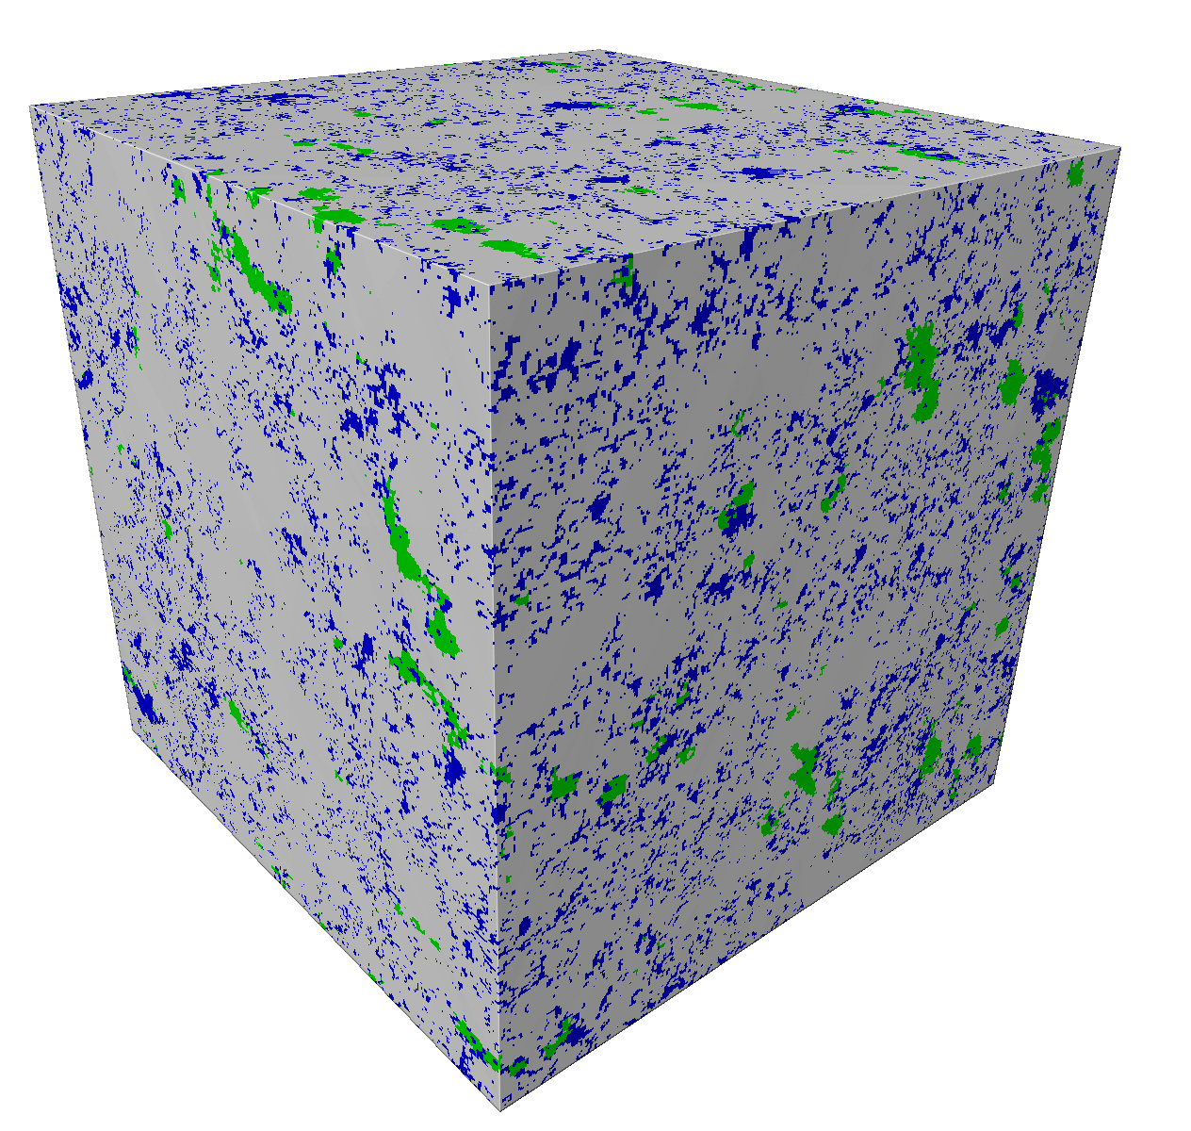
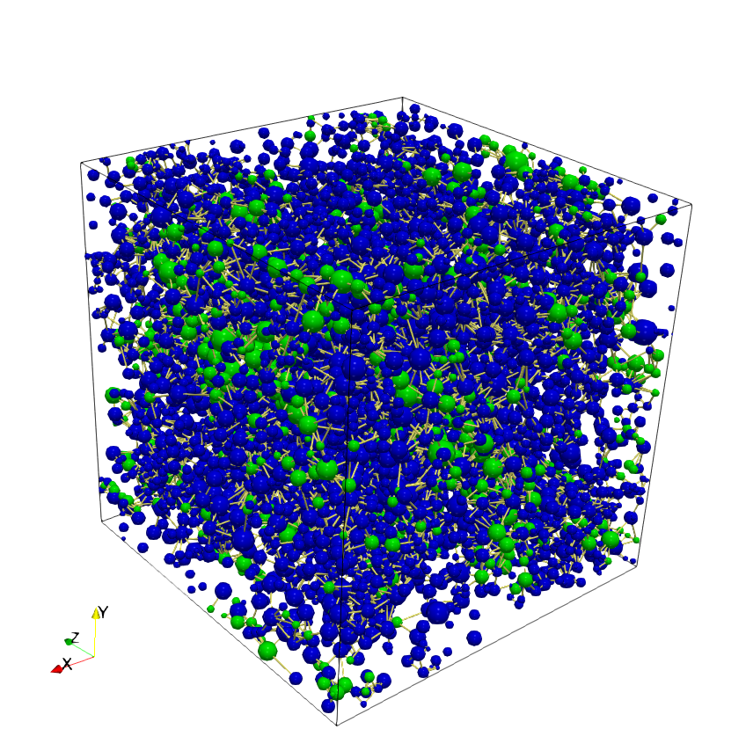

REV scale: 3D Connectivity
Mixed-facies shale exhibits a high Coordination Number. Its high clay content forms an independent, connected network. In siliceous and calcareous shales, connectivity is depends on OM-Clay contacts.
Sample H4
Avg. Coordination No. [H4 average CN=11.88]
Mixed-Facies
Clay-dominated mode. high connectivity; OM acts merely as tributaries.
MAPS
QEMSCAN
SUB-ROCK MAP
3D VOLUME
PORE NETWORK
Sample H8
Avg. Coordination No. [H8 average CN=7.05]
Siliceous
Interdependent mode. pathways relying on OM-Clay bridges.
MAPS
QEMSCAN
SUB-ROCK MAP
3D VOLUME
PORE NETWORK
Sample H11
Avg. Coordination No. [H11 average CN=8.02]
Calcareous
Interdependent mode. pathways relying on OM-Clay bridges.
MAPS
QEMSCAN
SUB-ROCK MAP
3D VOLUME
PORE NETWORK
Notes:
After constructing the REV-scale digital rocks, we extract the multiscale pore networks and compare their 3D connectivity in three representative samples.
For H4, the mixed-facies shale, the high clay content forms a relatively continuous connectivity scaffold. This gives a clay-dominated connectivity mode.
For H8 and H11, the connectivity is more dependent on the spatial contacts between OM and clay elements. So these samples show a more interdependent connectivity mode.
The key point here is that REV-scale connectivity is not controlled only by mineral content. It also depends on the spatial distribution and contact relationships among pore-bearing elements.

Slide 12


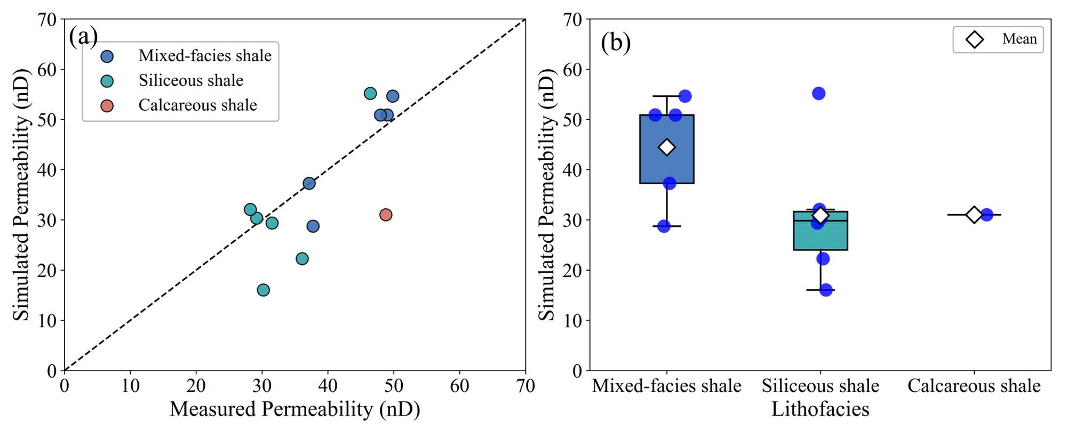

REV scale: Permeability Validation
Validating flow capacity against experimental measurements.
1. Simulation Accuracy
2. Lithofacies Comparison
experiment and simulation were conducted under the same mean gas pressure of 0.7 MPa. the proposed multiscale framework accurately predicts the apparent permeability, showing good agreement with laboratory measured data across all tested samples.
In our samples, the average simulated permeability follows this order，Mixed-facies ＞Calcareous＞Siliceous
Notes:
After analyzing the REV-scale connectivity, we validate the apparent permeability prediction. The left figure compares the simulated permeability with laboratory measurements from crushed shale samples ，experiment and simulation were conducted under the same mean gas pressure of 0.7 MPa. the proposed multiscale framework accurately predicts the apparent permeability, showing good agreement with laboratory measured data.
. that the multiscale framework can reasonably predict shale matrix permeability.
Then, we compare different lithofacies. The mixed-facies shale shows the highest average simulated permeability, followed by calcareous shale and siliceous shale.

Slide 13




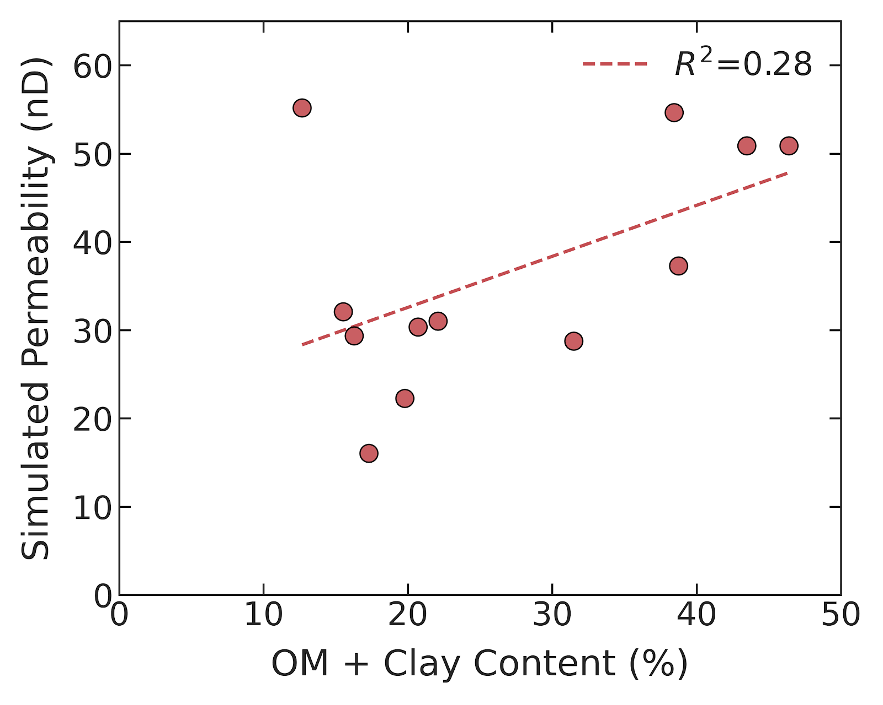
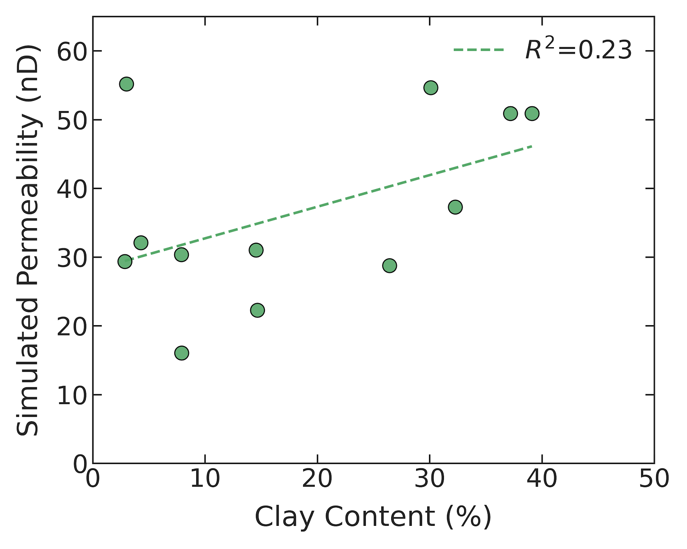


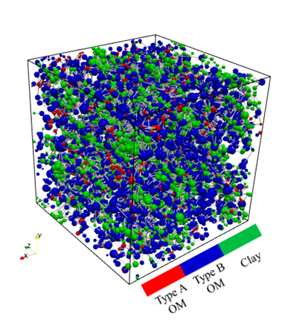


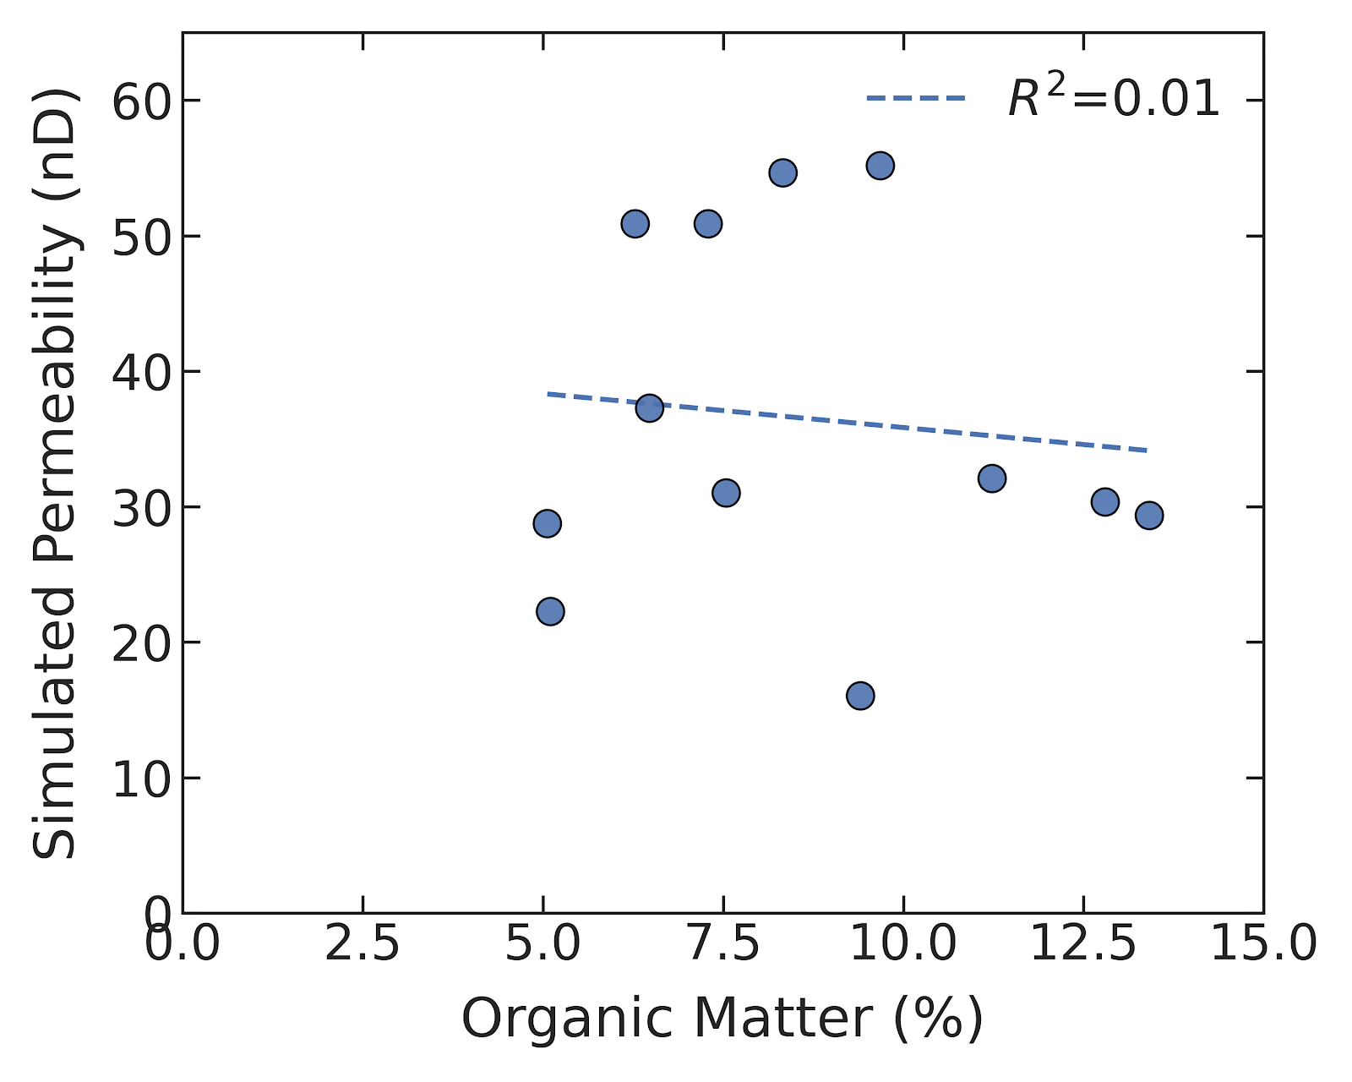
REV scale: Permeability Controls
Apparent permeability is jointly controlled by mineral composition, spatial connectivity, and OM-type heterogeneity.
1. Impact of OM-Type Heterogeneity
2. Impact of Pore-Bearing Mineral Content
Comparing two samples with similar total mineral volumes but drastically different permeabilities.
Global statistical trends confirming that single mineral volume is an insufficient predictor.
Sample H8
Sample H9
Statistical Insight
Parameter | Sample H8 | Sample H9
Total Clay + OM (%) | 12.7 | 15.5
OM-A Proportion (%) | 2.5% | 1.3%
OM-B Proportion (%) | 7.1% | 9.9%
Avg. Coordination No. | 7.05 | 5.78
Simulated Perm. (nD) | 55.18 | 32.08
The low R² values (e.g., 0.01 for total OM) demonstrate that simply measuring macroscopic mineral volume cannot reliably predict gas transport capacity in shale.
Notes:
The comparison between H8 and H9 is important. They have similar total clay and OM contents, but the permerbility is DIFFERENT. H8 has more OM-A and higher permeability, while H9 contains more OM-B and lower permeability. This shows that OM-type heterogeneity matters.
The correlation plots on the right also show that mineral content alone cannot explain permeability very well. The R² values are relatively low, especially for total OM content.
So, the key message is that apparent permeability is jointly controlled by mineral composition, spatial connectivity, and OM-type heterogeneity.

Slide 14



Conclusions and Future Outlook
A novel multiscale 3D reconstruction and flow simulation framework for highly heterogeneous shale.
Main Conclusions
Sub-rock-type behavior
REV-scale connectivity
Multi-factor Control
Different lithofacies show distinct connectivity modes.
Mixed-facies shale is mainly clay-dominated, while siliceous and calcareous shales rely more on OM–clay contacts
Simulated apparent permeability agrees with experiments.
Permeability is jointly controlled by mineral composition, spatial connectivity, and OM-type heterogeneity
OM with resolved pore porosity > 20% forms connected pathways.
Local flow contribution follows: OM-A > OM-B > clay.
•
•
Current Limitations
Future Outlook
Multiphase transport: incorporate water saturation and water–gas interactions in OM and clay pores.
Cross-scale coupling: integrate matrix-scale pore networks with microfracture.
Model transferability: extend the workflow to other tight reservoirs, such as tight sandstones and carbonates..
Assumes single-phase gas transport; does not account for water saturation in our model.
Model is bounded by the REV scale; lacks integration of macro-scale microfractures which significantly affect reservoir deliverability.
Notes:
To summarize, this study develops a multiscale reconstruction and flow simulation framework for shale matrix permeability prediction.
First, at the sub-rock-type scale, OM shows a clear permeability transition at about 20 percent resolved-pore porosity, and the local flow contribution follows the order: OM-A, OM-B, and clay.
Second, at the REV scale, different lithofacies show different connectivity modes. Mixed-facies shale is mainly clay-dominated, while siliceous and calcareous shales rely more on OM–clay contacts.
Third, the simulated apparent permeability agrees reasonably well with experimental measurements. The results indicate that permeability is jointly controlled by mineral composition, spatial connectivity, and OM-type heterogeneity.
Future work will consider water saturation, matrix–fracture coupling, and applications to other tight reservoirs.

Slide 15
Interpore 2026
Thanks for your attention!

Slide 16
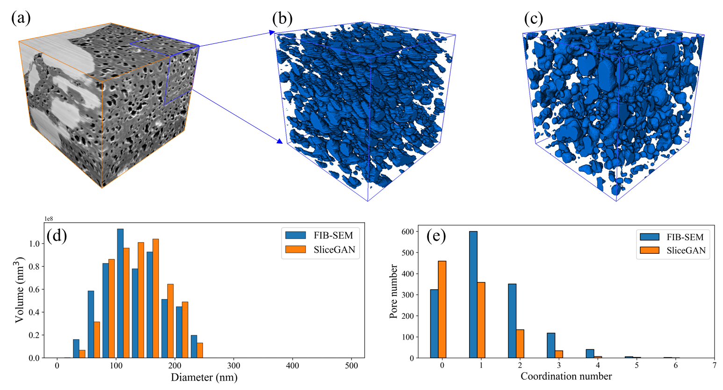

Slide 17
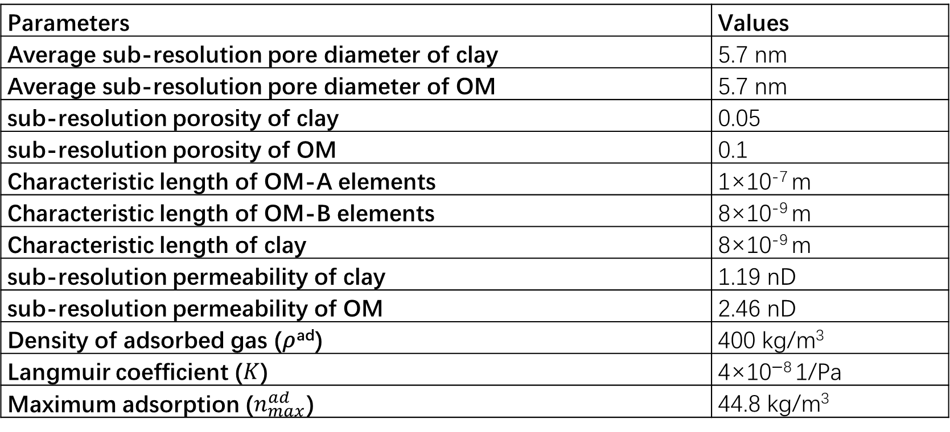
Geometric and physical parameters used in our numerical simulations
Parameters | Values
Average sub-resolution pore diameter of clay | 5.7 nm
Average sub-resolution pore diameter of OM | 5.7 nm
sub-resolution porosity of clay | 0.05
sub-resolution porosity of OM | 0.1
Characteristic length of OM-A elements | 1×10⁻⁷ m
Characteristic length of OM-B elements | 8×10⁻⁹ m
Characteristic length of clay | 8×10⁻⁹ m
sub-resolution permeability of clay | 1.19 nD
sub-resolution permeability of OM | 2.46 nD
Density of adsorbed gas (𝜌^{ad}) | 400 kg/m³
Langmuir coefficient ($K$) | 4×10⁻⁸ 1/Pa
Maximum adsorption ($n_{max}^{ad}$) | 44.8 kg/m³

