Slide 1


Configurational entropy in immiscible, steady-state, two-phase flow in porous media
Porelab.no
Anders Daltveit Melveª, Amalie Hermundstad^{b}, Santanu Sinhaª and Alex Hansenª
ªPoreLab, Department of Physics, Norwegian University of Science and University, Trondheim, Norway
^{b}Department of Mathematics, University of Oslo, Norway

Slide 2
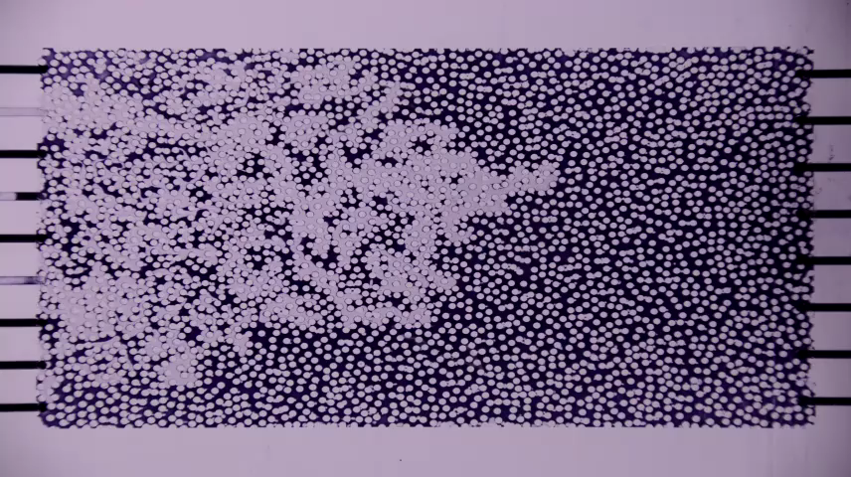
Thermodynamics-like formalism I
1 / 8
Systems at pore scale – Darcy scale
Steady state: relevant
quantities fluctuating around
well-defined averages
Steady state flow
Marcel Moura, University of Oslo
Notes:
The system we have in mind is not given. Explain the relevant sizes, qt.s etc. Many different fields represented at Interpore.
Specifically talking about pore scale -> darcy scale.

Slide 3
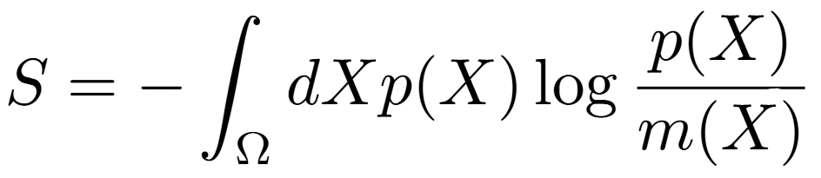
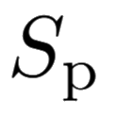


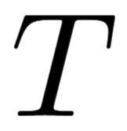
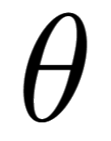
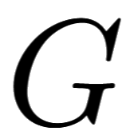
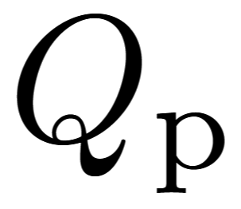
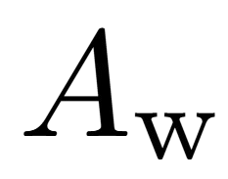
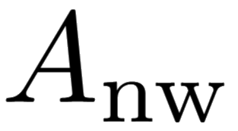
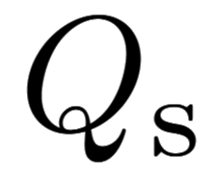
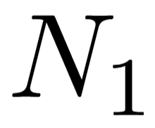
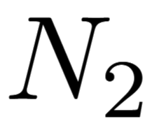
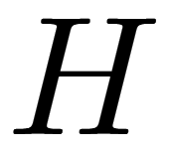
Thermodynamics-like formalism I
2 / 8
  Thermodynamics, binary mixes This formalism
Configurational entropy
Entropy
Temperature
Agiture
Gibbs free energy
Volumetric flow rate
Other quantities:
, , …
, , …
Details: Hansen & Sinha, Entropy, 27, 121 (2025)
Notes:
Quickly address the issue of the invariant (reference) measure

Slide 4
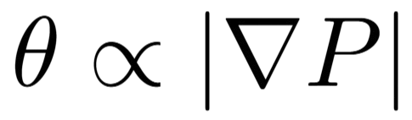
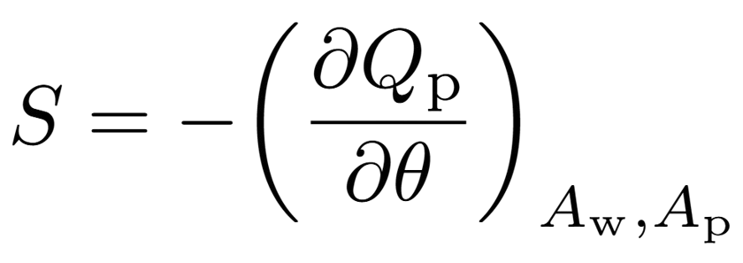
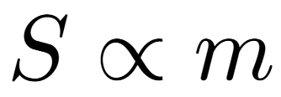
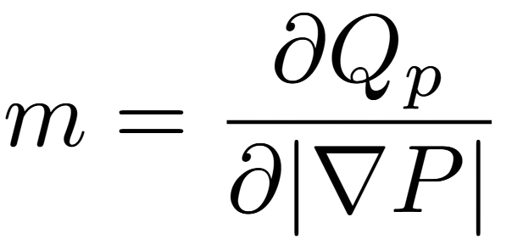

Thermodynamics-like formalism III
3 / 8
Hansen & Sinha, Entropy, 27, 121 (2025):
  Differential conductivity:
?

Slide 5

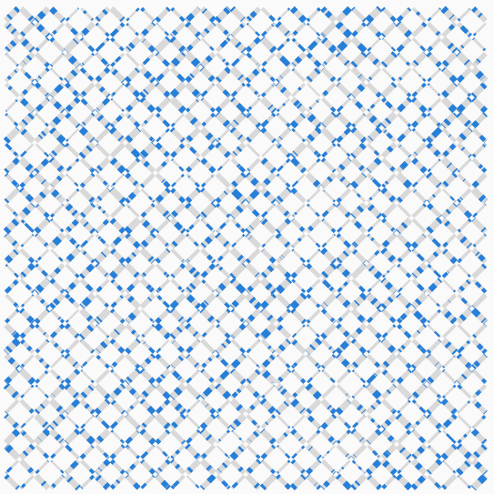
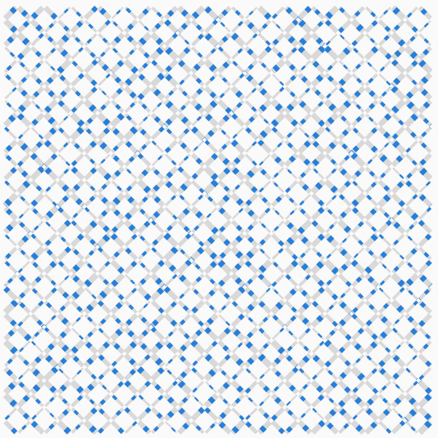
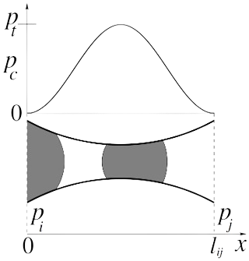


Pore network model
4 / 8
Link flow rate
$$q_{ij}$$
$$q_{ij}\left(t\right)=−\frac{g_{ij}}{l_{ij}μ_{ij}}\left(∆p_{ij}−\sum_{k}{p_{k}^{c}}\right)$$
Notes:
Add a line and an explanation that a row becomes our REA
Just form a bit of intuition
Mention that we have the pore network model at our hands, so we used this to test. There are many ways of testing of course, experimental etc., but we use the PN model and might move on to other methods later.

Slide 6
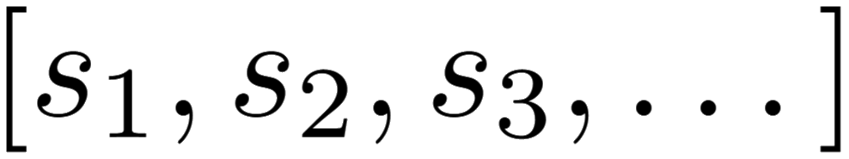

Wavelet transformation
5 / 8
Multiscale decomposition
Approximately decorrelates data
Orthogonal transformation
  Preserves information
Fine details Coarse data
Notes:
Orthonormal basis, invertible transformation
Information is preserved, particularly this means information on spatial correlations

Slide 7
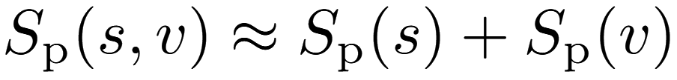
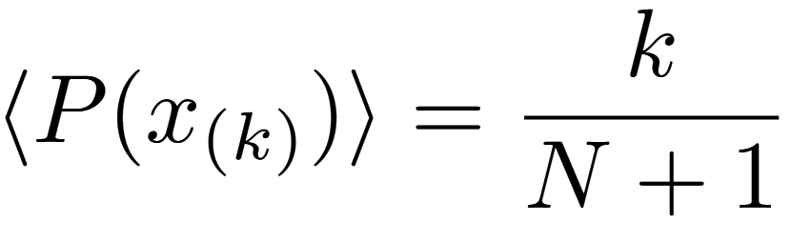
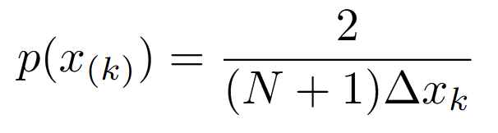


Order statistics entropy estimation
6 / 8
Sort variables order statistics
Central differences:
Integrate per-scale, add up contributions from ,

Slide 8
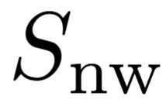
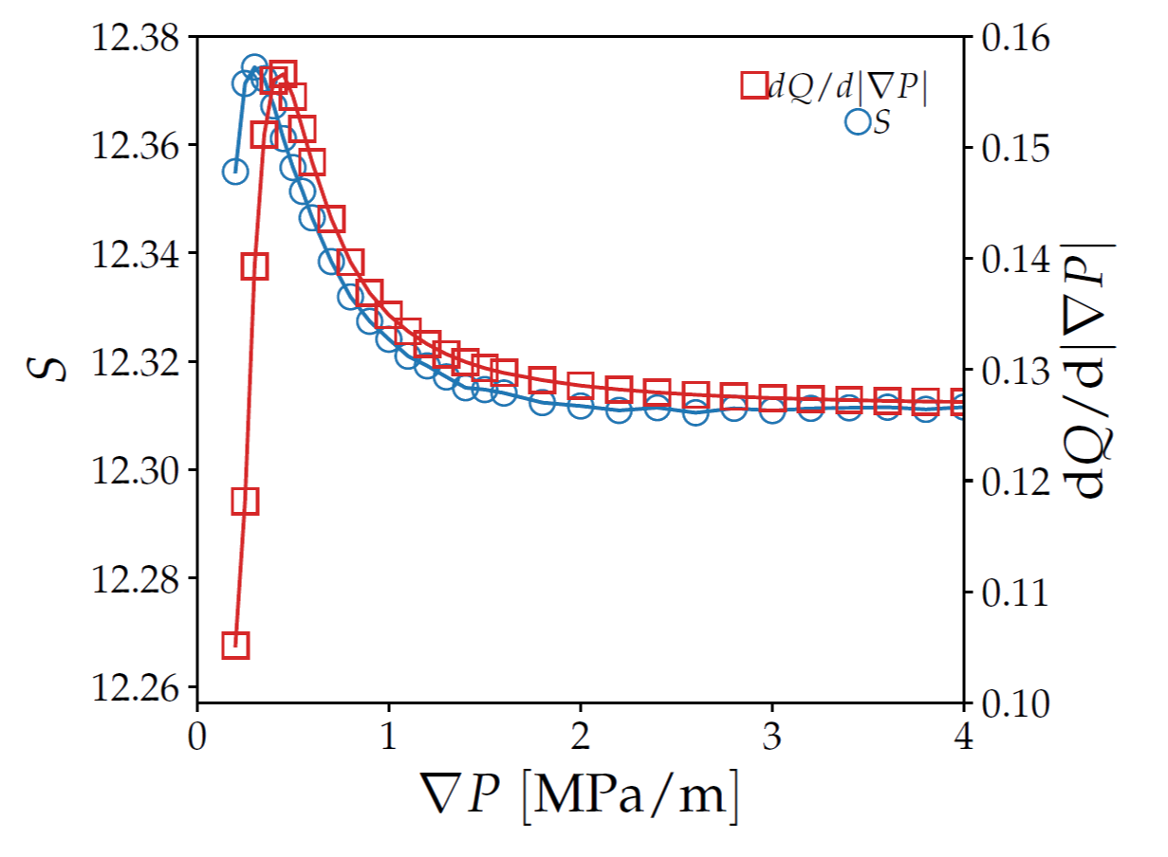
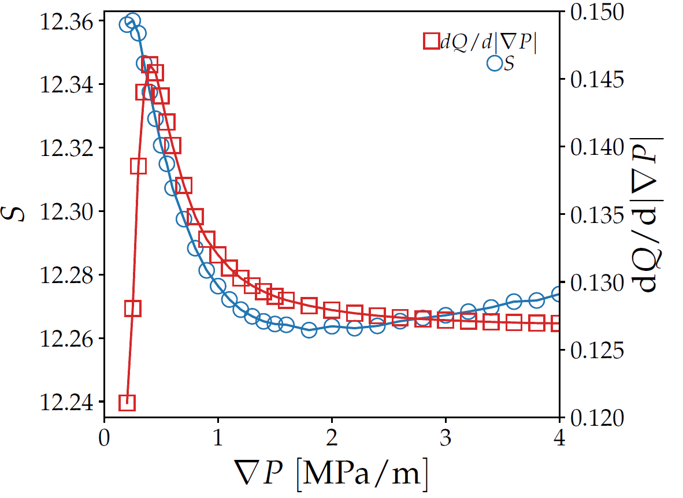
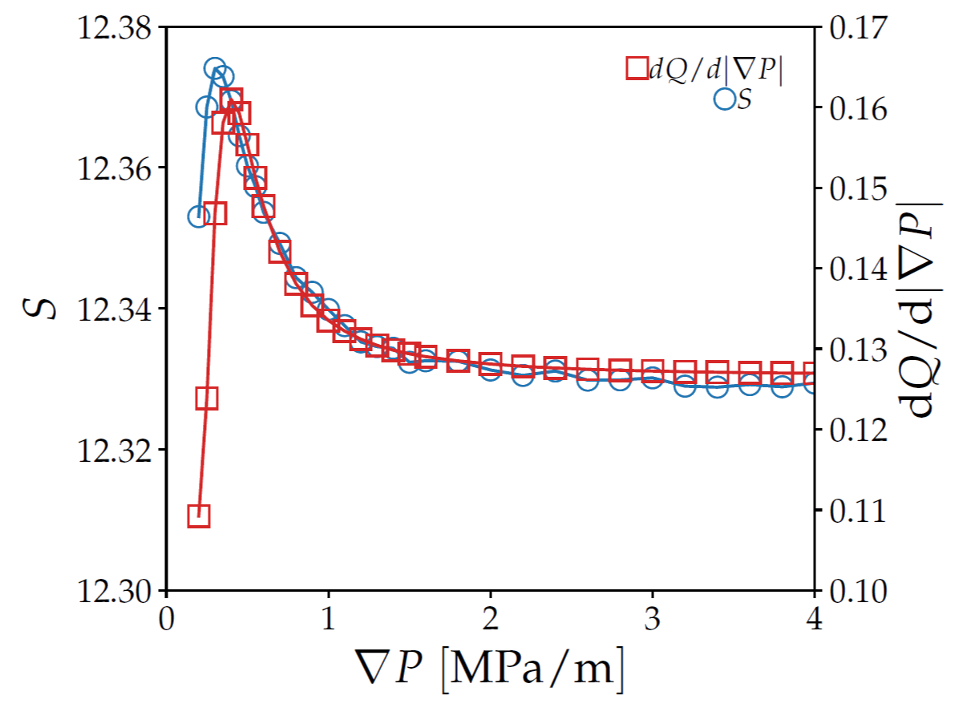
Results
7 / 8
= 0.3
= 0.7
= 0.5
?
Notes:
Have equations on slide and POINT
This is where we’re bringing it home
Also highlight remaining challenges and further work
Estimators: balance of detail captured and accuracy
Jaynes’ correction to differential entropy → choice of invariant measure

Slide 9
THANK YOU!
8 / 8

