Slide 1


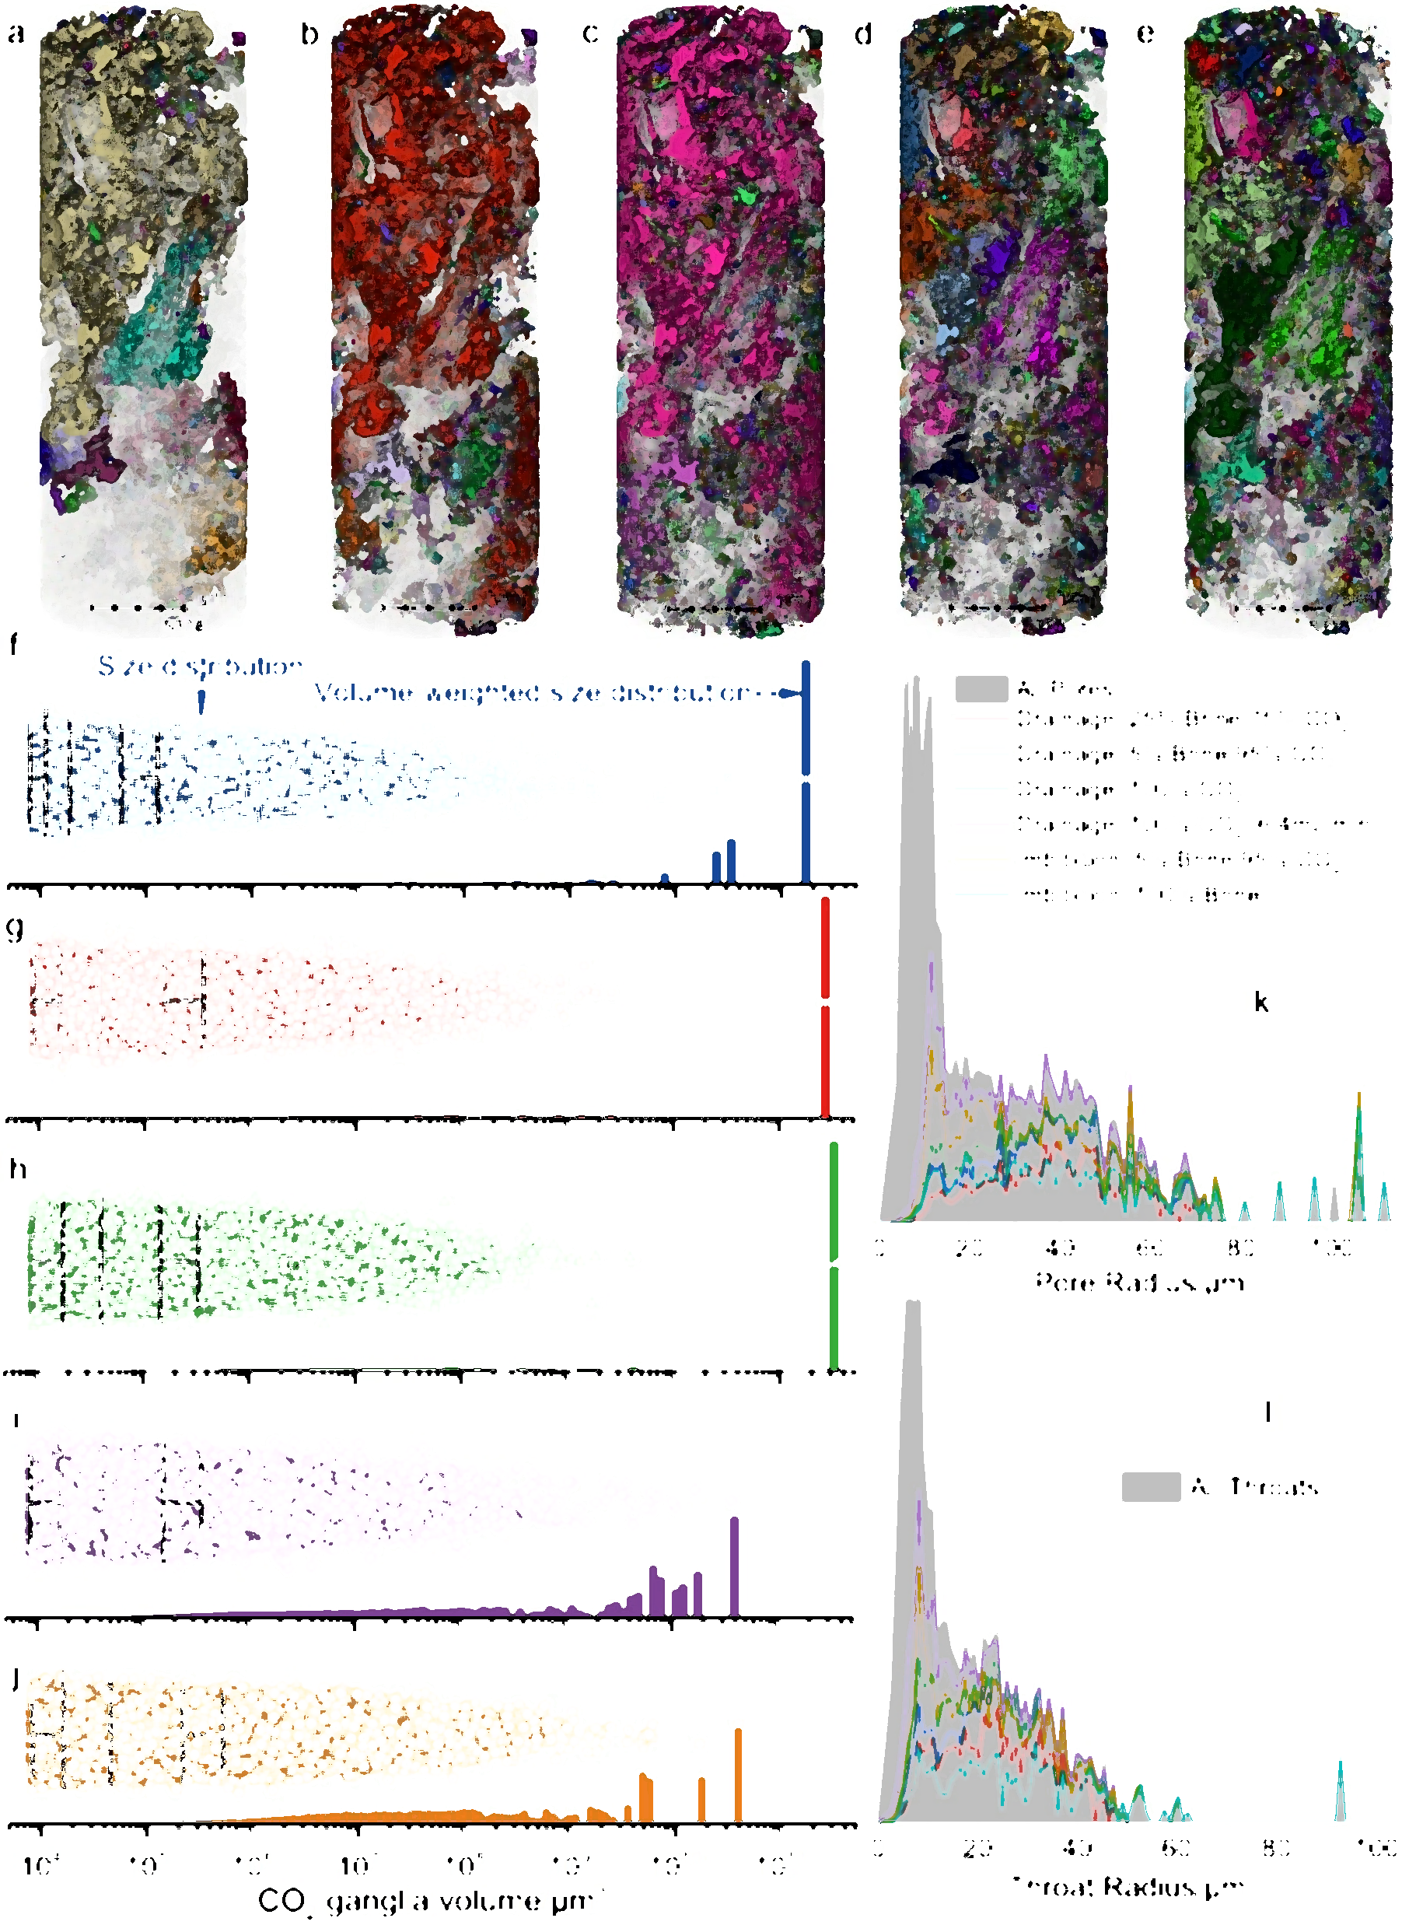
Pore-scale Imaging and Modeling of CO₂-Brine Relative Permeability and Hysteresis in a Reservoir Carbonate
Rukuan Chai, Sajjad Foroughi, Branko Bijeljic, Martin J. Blunt
Imperial College London
22nd May 2026

Slide 2
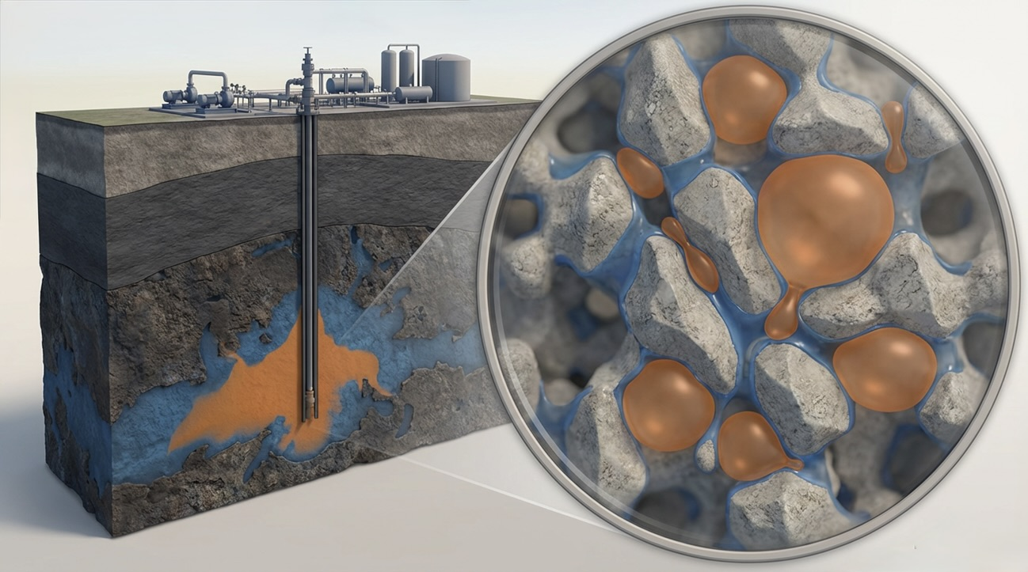
Why Carbonates Matter for CO₂ Storage — and What We Don't Yet Know
Context: Carbonates host ~60% of the world's hydrocarbon reserves and are prime targets for CCS.
Problem: Their extreme pore heterogeneity makes injectivity and trapping hard to predict.
Gap: In situ, pore-scale multiphase flow under reservoir conditions are scarce.
We combine steady-state relative permeability measurements, in situ micro-CT imaging, and pore-network modeling to unravel the pore-scale controls of flow hysteresis and residual trapping.
2

Slide 3
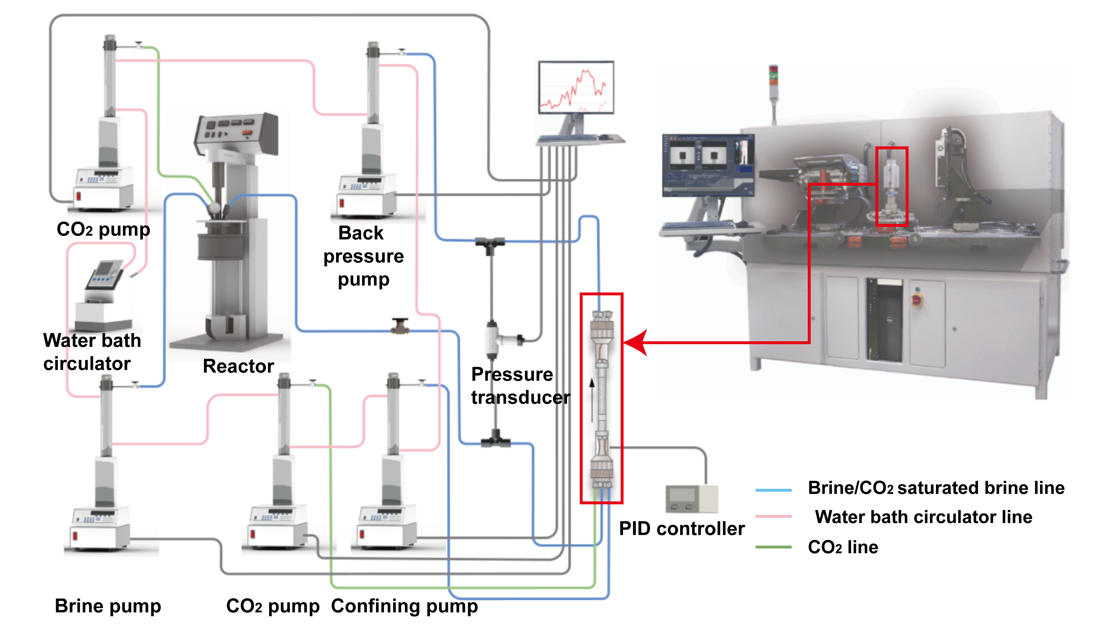
Experimental Workflow: From Reservoir Conditions to Pore-Scale Imaging
Drainage
100%, 50%, 25%, 10%, 5%, 0%Brine
Bump Flow
0%Brine (3.2 and 6.4mL/min)
Imbibition
0%, 10%, 25%, 50%, 100%Brine
50℃ & 8.0MPa & Ca=5.89×10⁻⁸

Slide 4
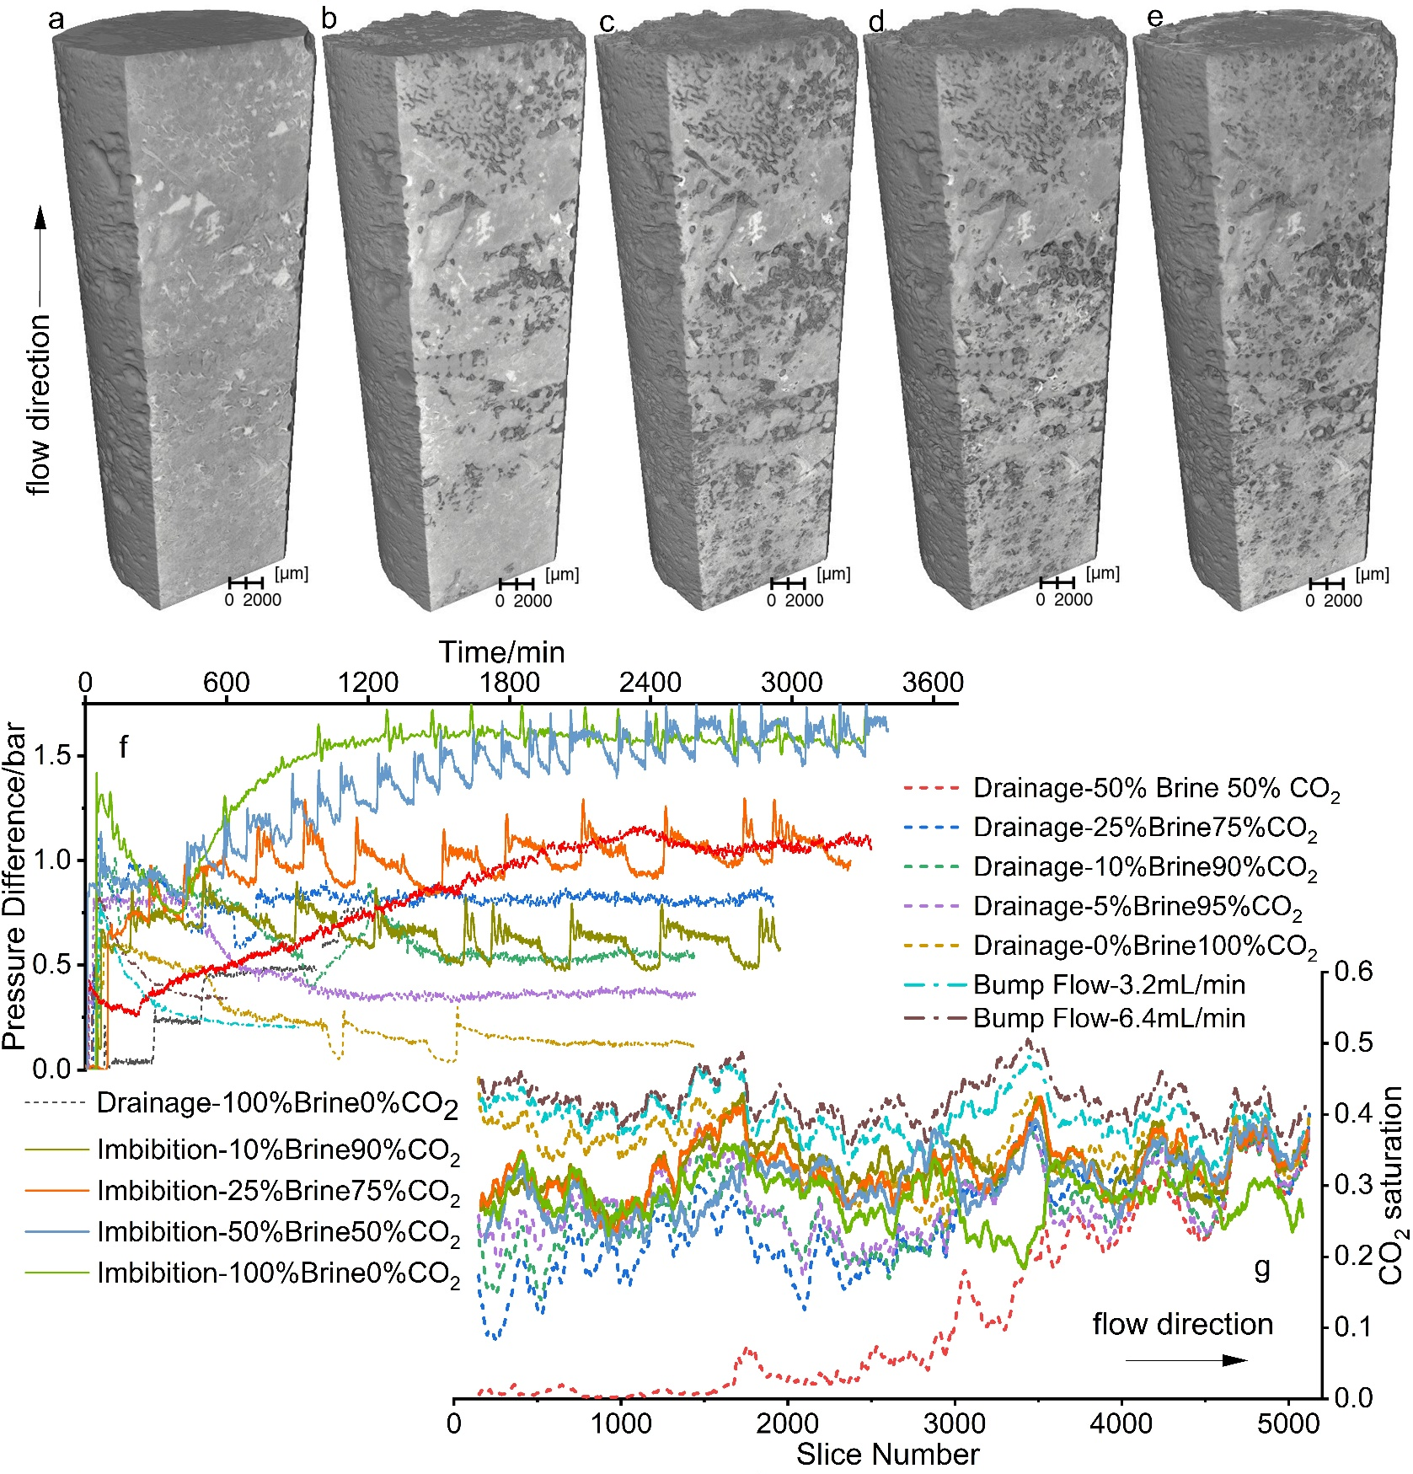
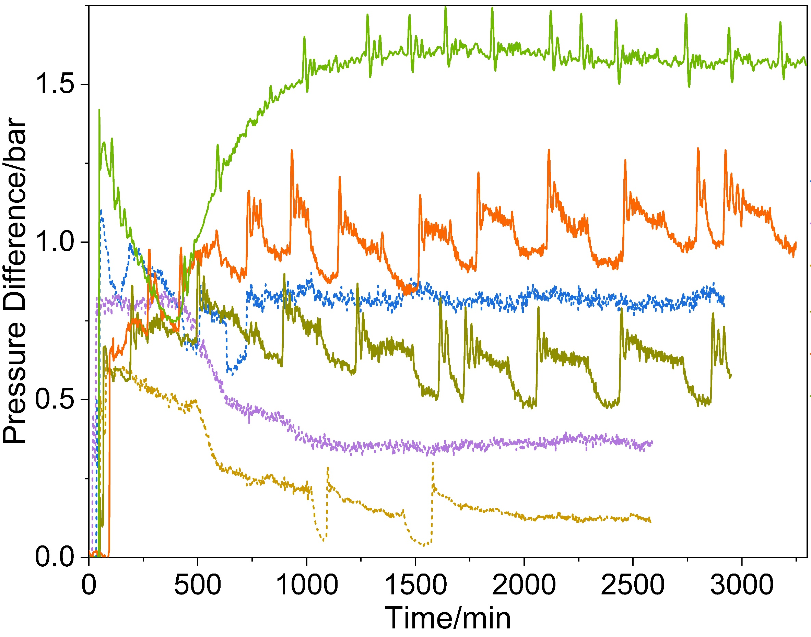
Drainage vs. Imbibition: Two Distinct Pressure Signatures
Drainage: High initial hump; Minimal ΔP fluctuations
Imbibition: No initial hump; Pronounced ΔP fluctuations-Rearrangement events

Slide 5
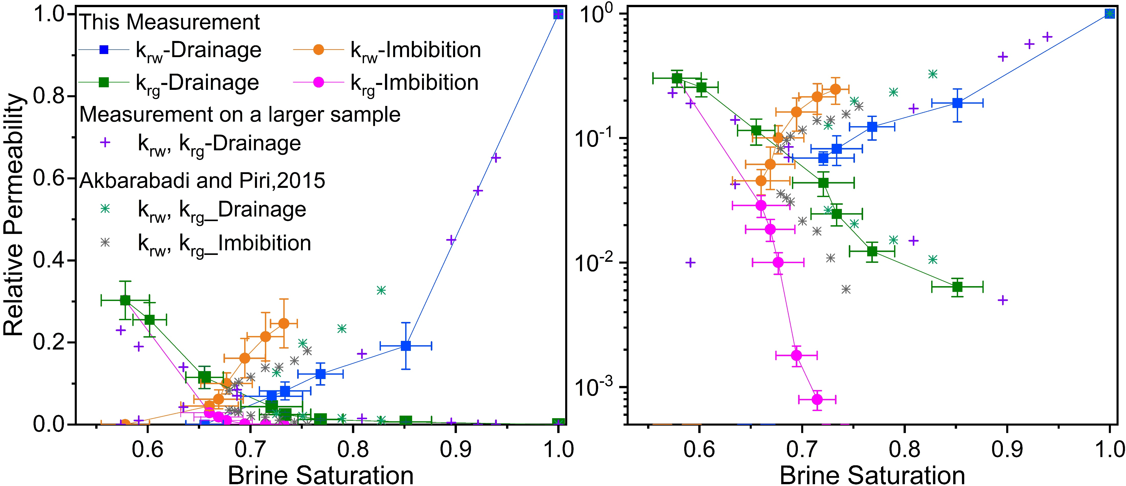
Low CO₂ Mobility and Strong Hysteresis
Low CO₂ Mobility: Low CO₂ relative permeability, despite high saturation
Strong Hysteresis: Pronounced drainage-imbibition cycle disparity
High Residual Trapping: 63% of initial saturation

Slide 6
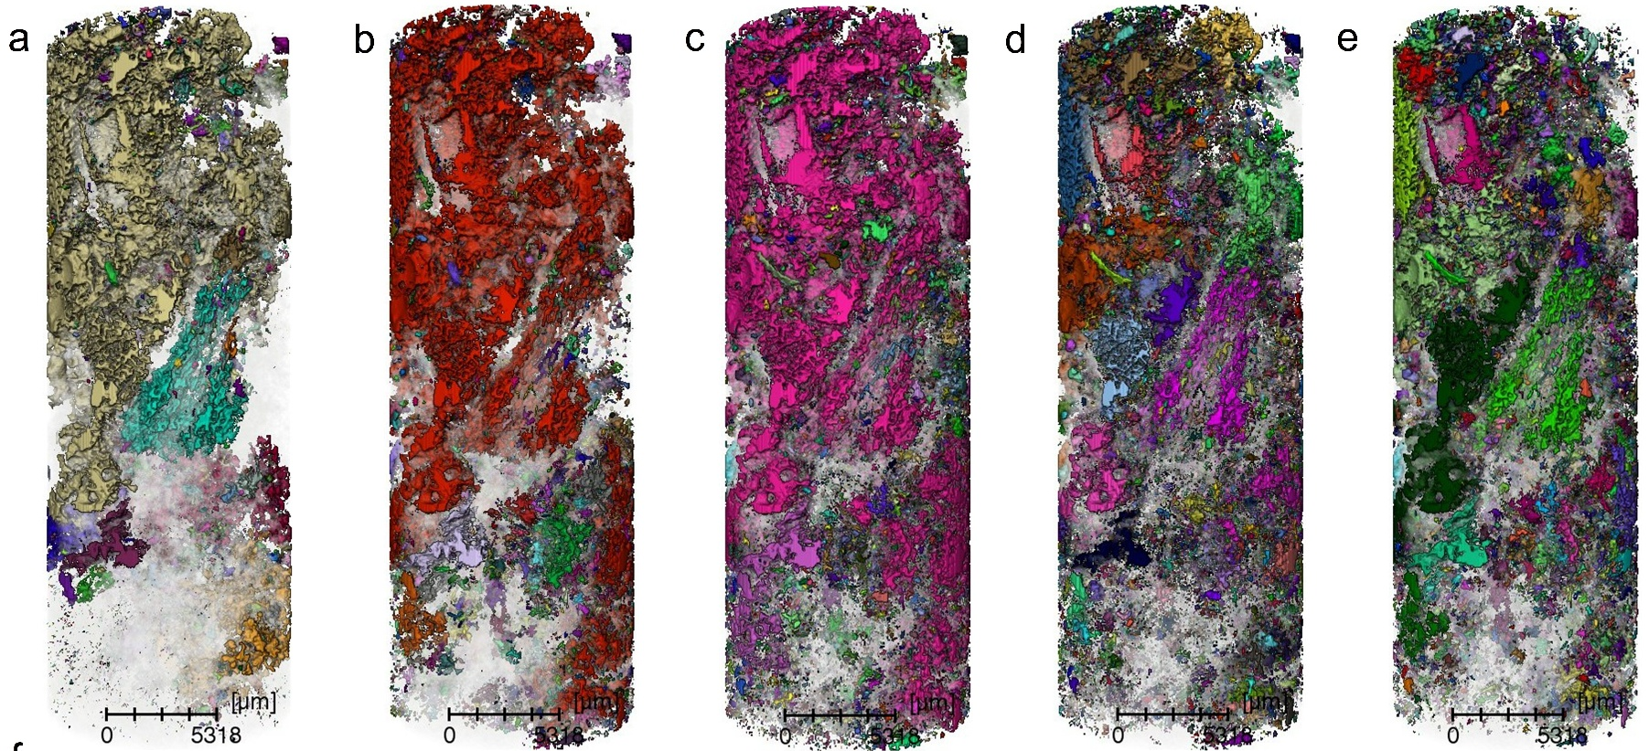
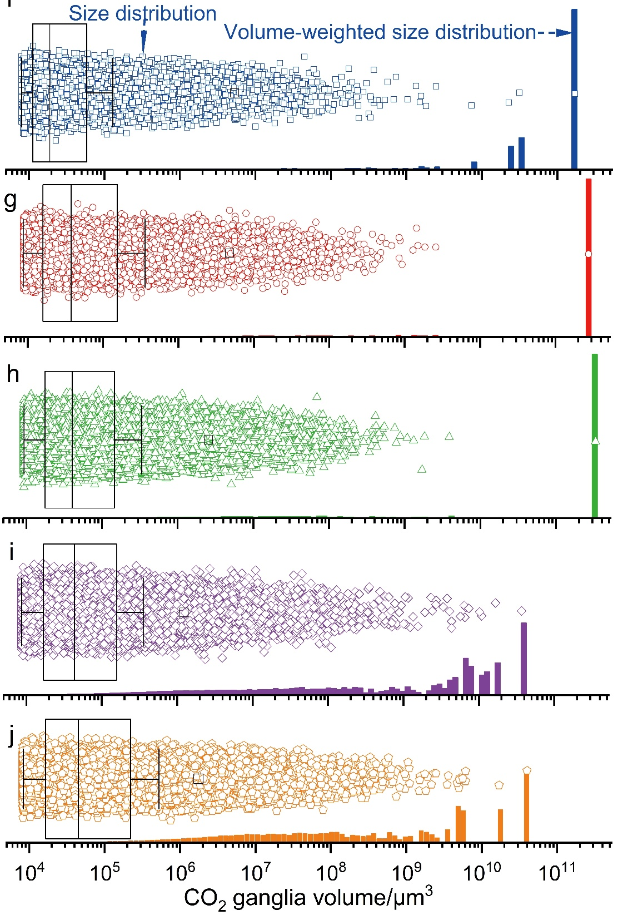
Drainage Builds a Spanning Cluster; Imbibition Breaks It Apart
drainage
(25%brine/75%CO₂)
drainage
(0%brine/100%CO₂)
drainage
(25%brine/75%CO₂)
drainage
(0%brine/100%CO₂)
drainage
(0%brine/100%CO₂)
6.4mL/min
drainage
(0%brine/100%CO₂), 6.4mL/min
imbibition
(5%brine/95%CO₂)
imbibition
(100%brine/0%CO₂)
imbibition
(5%brine/95%CO₂)
Drainage-Coalescence into a spanning cluster; Normalized Euler characteristic χ drops from 5 (early) to -16 mm⁻³ (end)
Imbibition-Fragmentation into dispersed, isolated ganglia; Normalized χ rises to 19 mm⁻³
Topological changes, not just saturation change, governs hysteresis.
imbibition
(100%brine/0%CO₂)

Slide 7
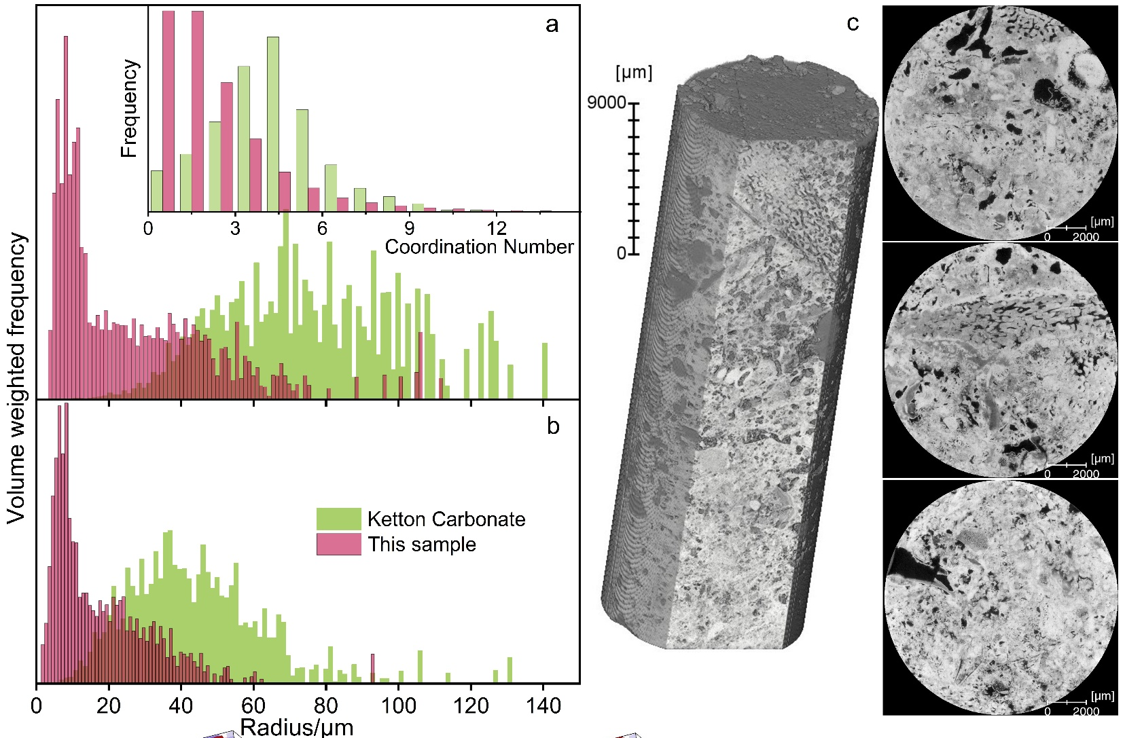

Structure Wins Over Wettability: What Really Controls the Flow
Wettability
In situ strong water-wet
Contact angle hysteresis is minor
Drainage_100%CO₂
Drainage_100%CO_{2_}
6.4mL/min
Imbibition_100%Brine
Structural Heterogeneity
Skewed, multimodal pore-throat distributions
Low coordination number
Limits flow pathways and promotes multiphases rearrangement

Slide 8
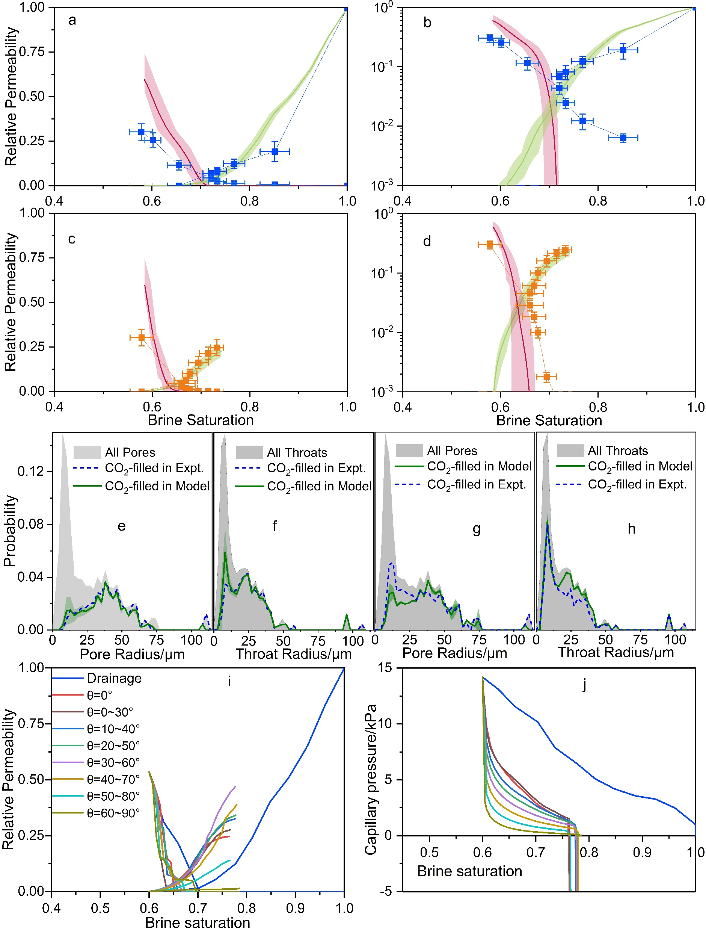
Pore-Network Model Reproduces the Data and Pinpoints the Mechanism
Mechanism: Snap-off dominates the throat-filling events during imbibition.
Sensitivity: Varying contact angles showed modest impact on relative permeability.
Relative permeability shape is set by geometry, not by wettability.
Validation: PNM reproduces experimental relative permeability and hysteresis.
https://github.com/ImperialCollegeLondon/pnflow

Slide 9
Conclusions and Future Work
Low CO₂ relative permeability— caused by poorly-connected ganglia in heterogeneous pore space.
Strong hysteresis — driven by changes in topology (coalescence ↔ fragmentation), with snap-off as the dominant imbibition mechanism.
High residual trapping — favorable for long-term CO₂ security in carbonates.
Rukuan Chai, Sajjad Foroughi, Qianqian Ma, Foo Yoong Yow, Branko Bijeljic, and Martin J. Blunt
Pore-Network Topology Dominates CO₂ Flow Hysteresis and Trapping for Secure Geological Carbon Storage in Reservoir Carbonates
FUEL
Under Review
Future work: “Design” CO₂ Storage
Tailored pore structure + engineered wettability → optimzed trapping & injectivity

Slide 10

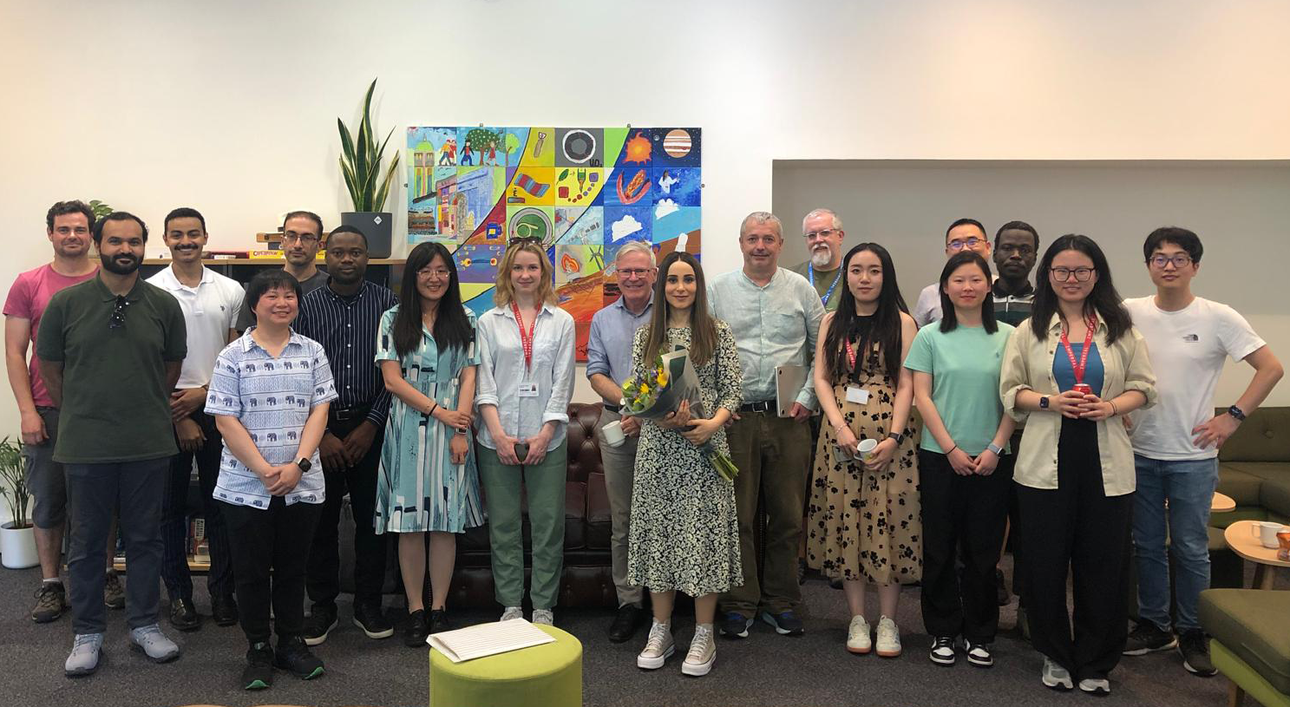
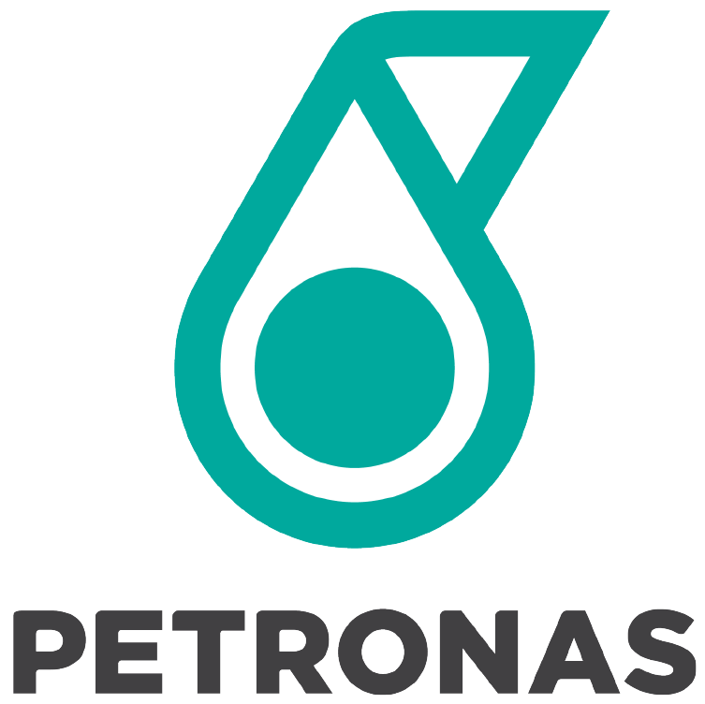
Rukuan Chai
Research Associate
Imperial College London
r.chai@imperial.ac.uk
Thanks to Martin Blunt, Branko Bijeljic,
and all Pore-Scale Modelling and Imaging group members.

