Slide 1
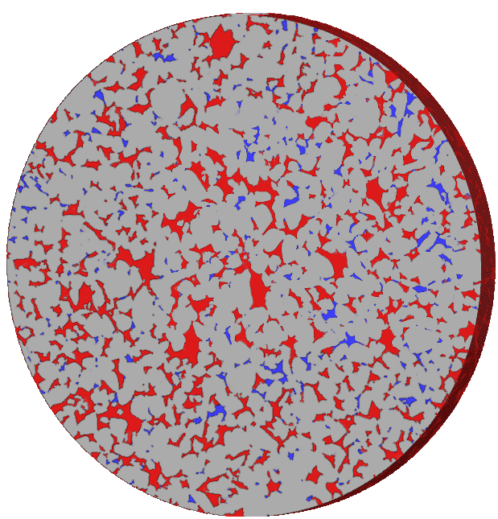


A study of Hysteresis in Geometric, Topological and Macroscopic measurements of micro-CT images of fast, dynamic multiphase flow in porous media
Eric Sonny Mathew¹, Michael Camilleri², Quan Zheng³, Yufu Niu⁴, Bianca Brandstätter⁵, Kunning Tang³, Mohammad Ebadi¹, Peyman Mostaghimi¹, Ryan T. Armstrong¹, Samuel Jackson²
¹School of Civil and Environmental Engineering, University of New South Wales, Sydney, Australia
²CSIRO Energy, Clayton South, Australia
³School of Minerals and Energy Resources Engineering, University of New South Wales, Sydney, Australia
⁴CSIRO Mineral Resources, Lucas Heights, Australia
⁵Department Geoenergy, University of Leoben, Leoben, Austria
Notes:
Good afternoon, as introduced by the chair, my name is Eric and I am a final year PhD student at University of New south wales, Sydney Australia under the supervision of Ryan Armstrong and Samuel Jackson who is from CSIRO. Today I am going to talk about my research project titled ____. I would also like to mention the other collaborators in this work – Michael, Quan, Yufu, Bianca, Kunning, Mohammad and Peyman.

Slide 2
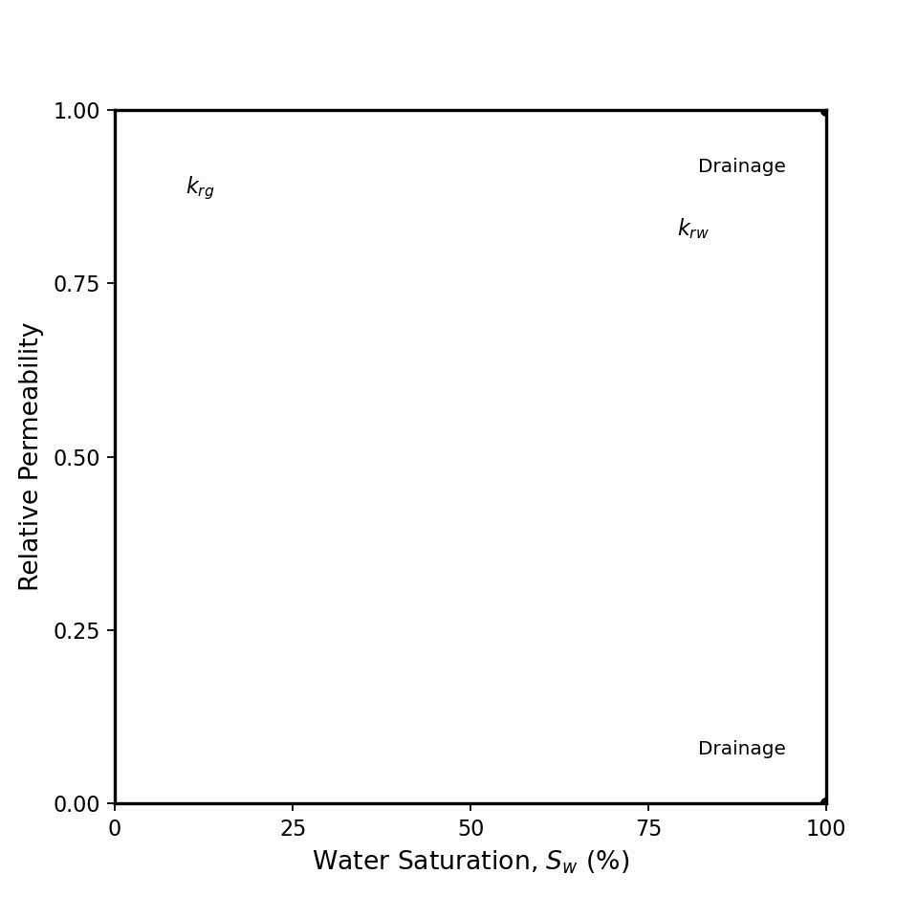
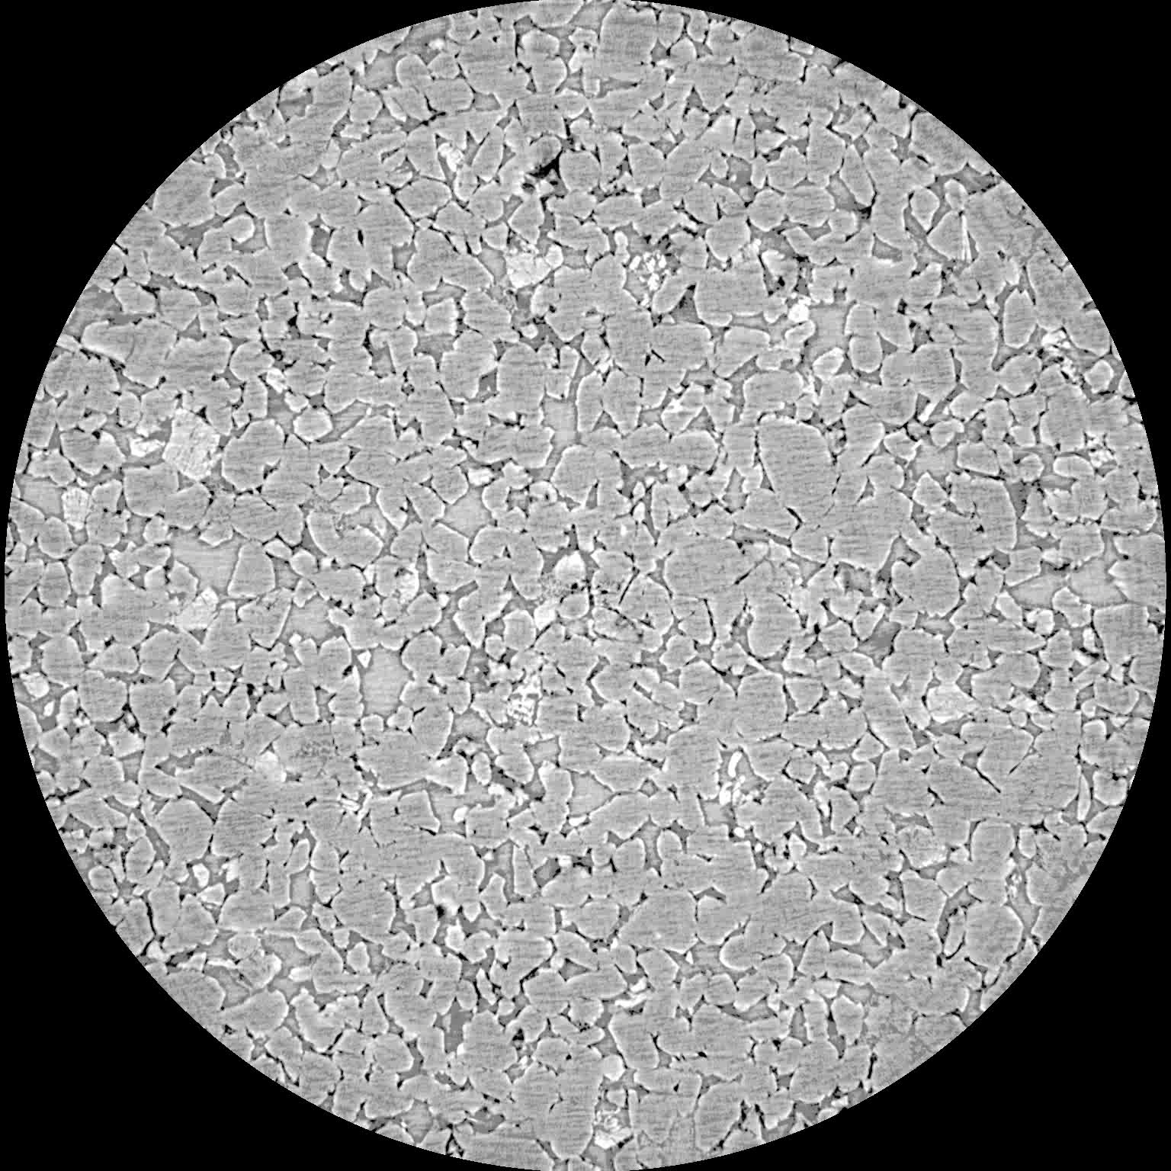
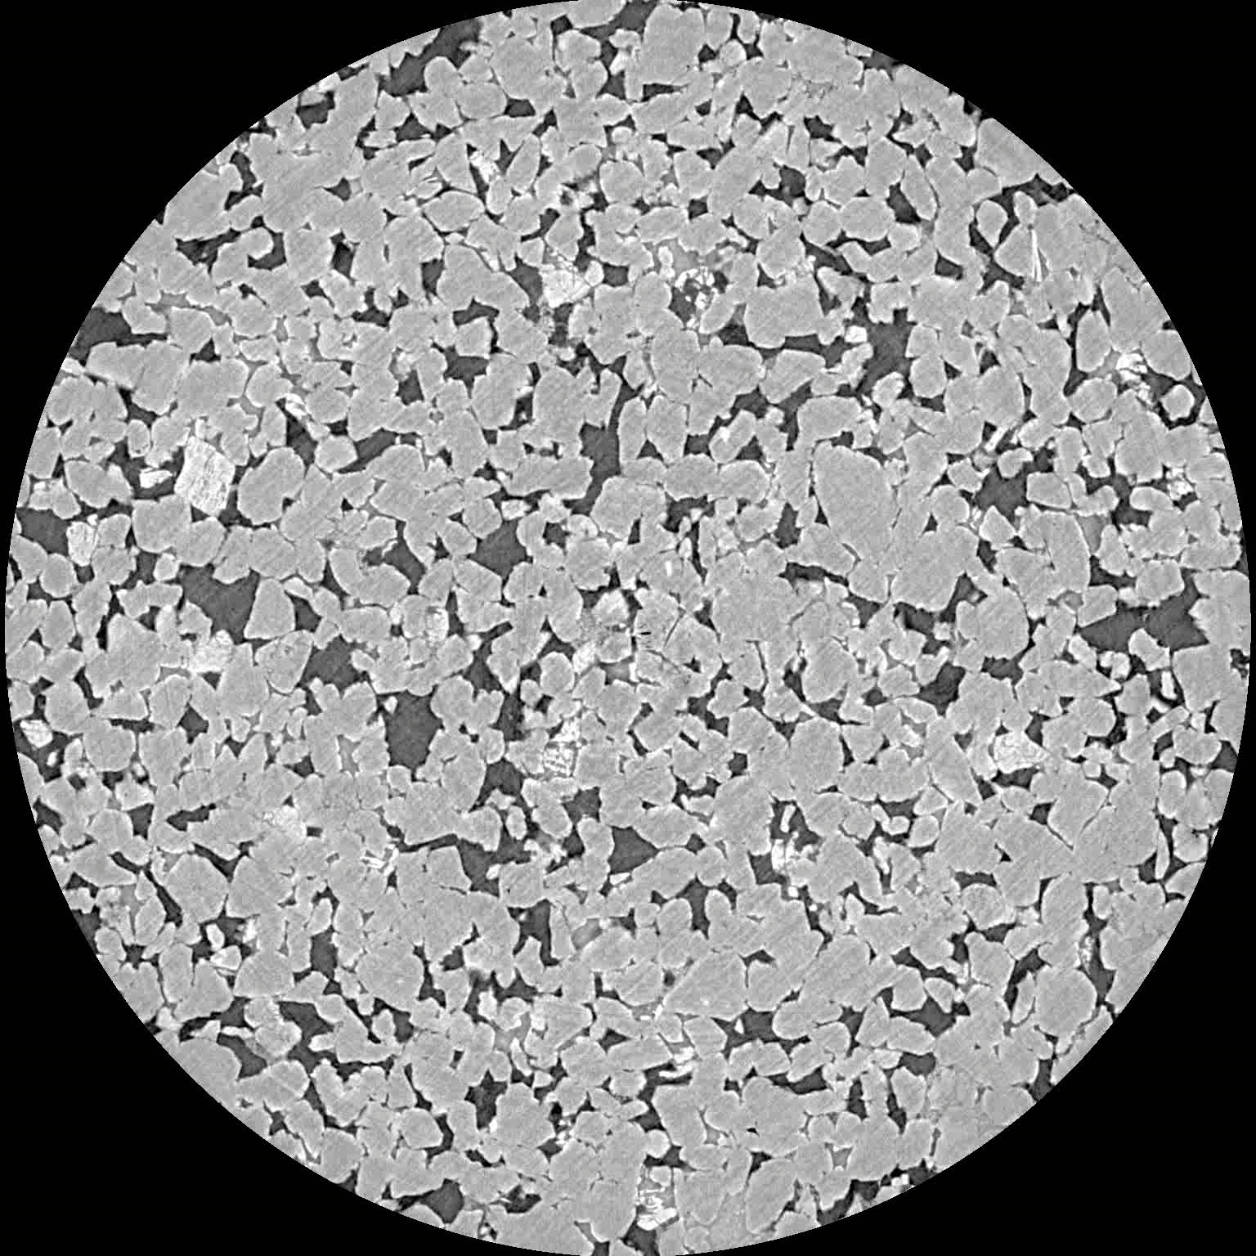
Hysteresis governs subsurface gas storage
Fluid configuration depends on saturation history.
Hysteresis governs trapping, mobility and recovery efficiency.
After Drainage –
connected gas pathways
After Imbibition –
disconnected ganglia
Relative Permeability Hysteresis
Notes:
Subsurface gas storage processes are fundamentally hysteretic.
What we observe at the continuum scale — such as hysteresis in relative permeability — originates from irreversible pore-scale fluid rearrangements during drainage and imbibition cycles.
On the left is a relative permeability hysteresis loop, showing how flow behavior changes depending on the saturation path.
On the right are synchrotron micro-CT images of the central slice shown as a timelapse. After drainage, the non-wetting phase remains relatively connected, whereas after imbibition, the same phase becomes disconnected and trapped within the pore space.
These different pore-scale configurations at similar saturations are what govern residual trapping, phase mobility, and ultimately storage security and recovery efficiency.”

Slide 3
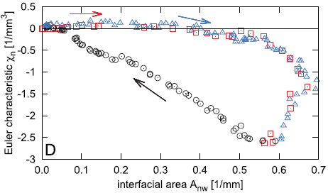

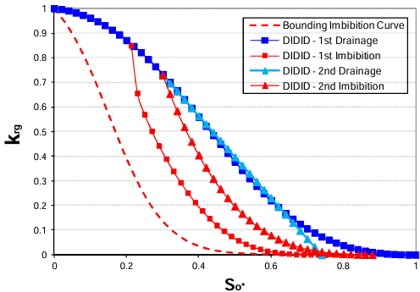
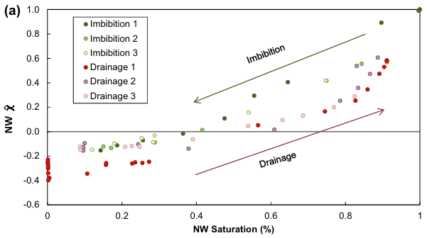
Hysteresis commonly characterized across full saturation range
Most studies characterise hysteresis across complete drainage-imbibition saturation pathways.
Practical flow reversals often occur within intermediate saturation ranges.
Euler characteristic and Interfacial area hysteresis relation (Schlüter et al., 2016)
Normalized Euler as a function of NW saturation over multiple drainage-imbibition cycles (Herring et al., 2013)
Gas relative permeability hysteresis (Fatemi and Sohrabi, 2018)
Notes:
“Several pore-scale studies have characterised hysteresis using metrics such as Euler characteristic, interfacial area, relative permeability, and capillary pressure.”
“And, these behaviours are typically analysed across complete drainage–imbibition saturation pathways.”
“However, In practical subsurface storage systems, many flow reversals occur within intermediate saturation ranges.”

Slide 4



Hysteresis at intermediate saturations - uncharacterized
$K_{r}$ , $χ_{n}$ , $A_{nw}$ - full range
literature
Uncharacterized saturation range
Flow reversals + gas trapping
reservoir
= $S_{wi}$
= $S_{gr}$
|
|
|
|
|
0
0.25
0.50
0.75
1.0
Water Saturation $S_{w}$
Gas trapping due to snap-off.
Saturation history dependent pore scale processes.
Fluid rearrangement in pore spaces.
Notes:
So what does this mean,
“Most pore-scale hysteresis studies characterise drainage–imbibition behaviour across the full saturation pathway…”
“…from fully saturated to endpoint conditions.”
(point to literature range)
“However, practical subsurface storage systems rarely experience complete saturation cycling.”
(move to highlighted intermediate range)
“During repeated injection and withdrawal, flow reversals typically occur within intermediate saturation regimes…”
“…where local trapping, remobilisation, and pore-scale rearrangement dominate the displacement behaviour.”
(pause briefly)
“Despite this, hysteresis evolution within these intermediate saturation ranges remains relatively uncharacterised.”
And so this is the region that we wanted to probe into
Connect to the physics (30 seconds) This matters because snap-off, Haines jumps, and pore-scale fluid redistribution — the events that control trapping — are not uniformly distributed across saturation. They are concentrated in this intermediate regime, where connected ganglia are breaking up or reconnecting. The Euler characteristic and interfacial area changes you saw on the previous slide are most dynamic precisely here. So the hysteresis in kr, topology, and fluid-fluid interfaces is most consequential in the window that nobody has actually studied in isolation.
Land the gap (10 seconds) So we have a situation where the most trapping-relevant part of the saturation space has been passed through in full-range experiments but never deliberately characterised. That is the gap this work addresses.
The through-line for the audience is: the literature gives you the full picture but the reservoir only cares about the middle — and the middle is where all the interesting physics happens.

Slide 5
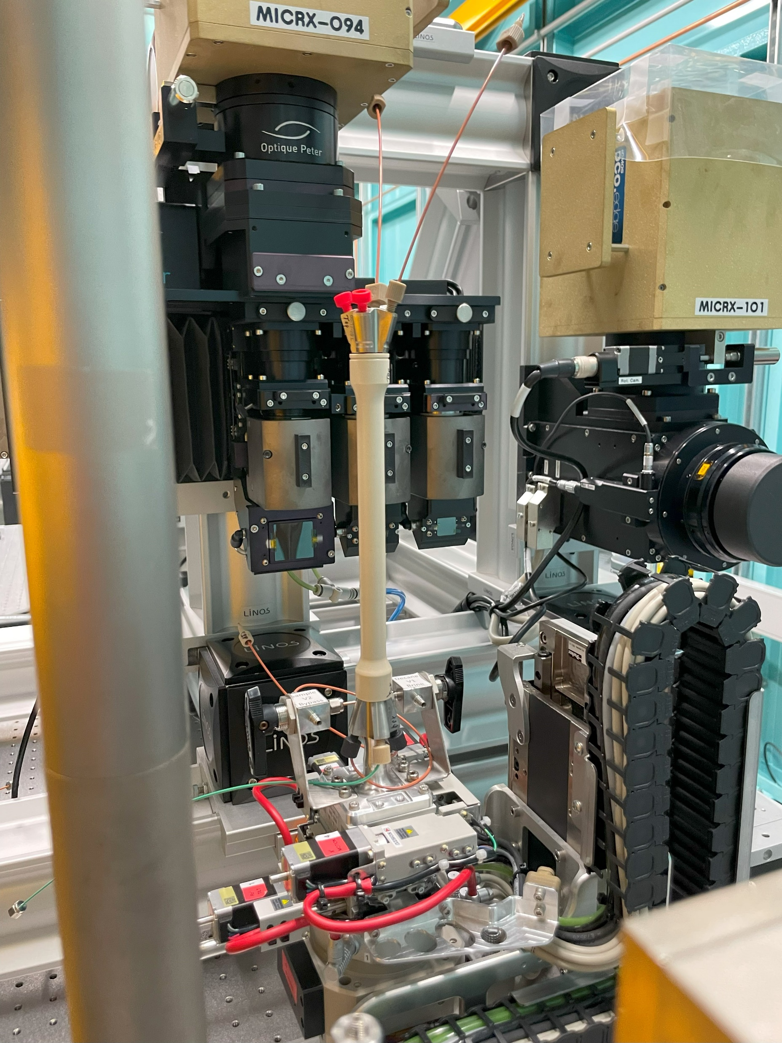
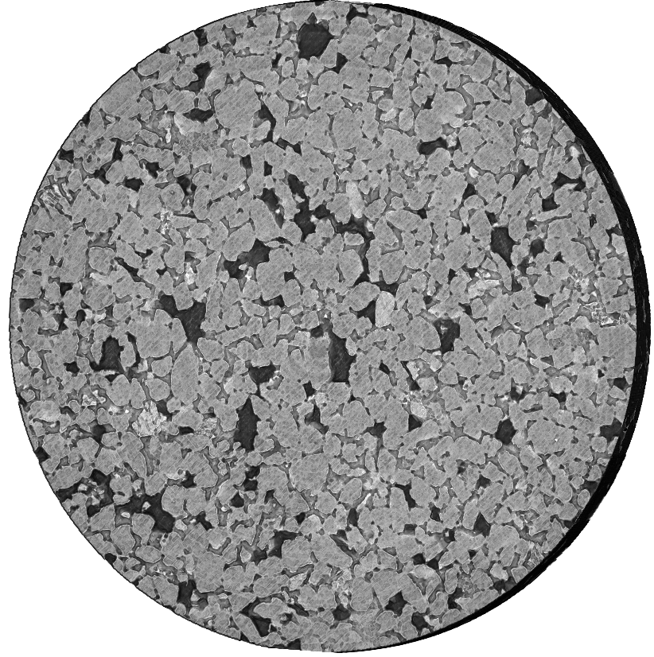
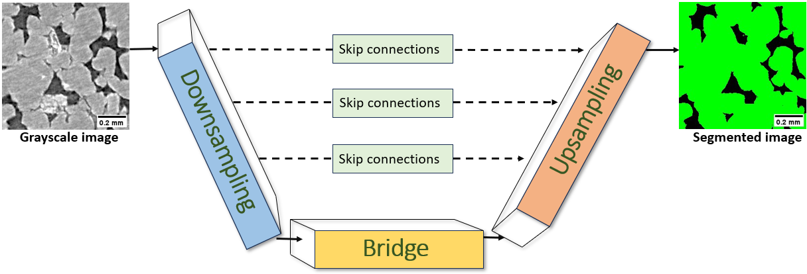
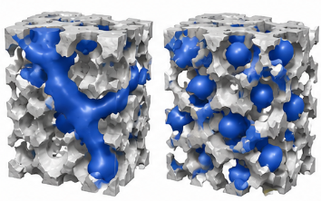
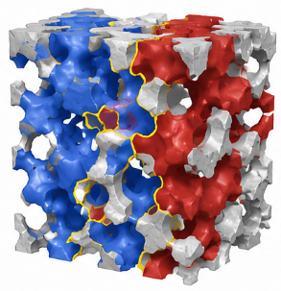
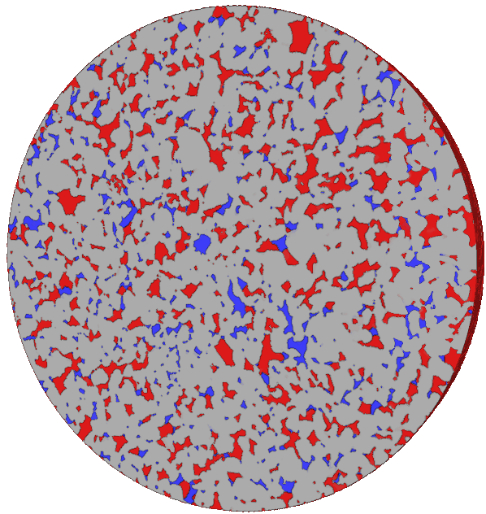
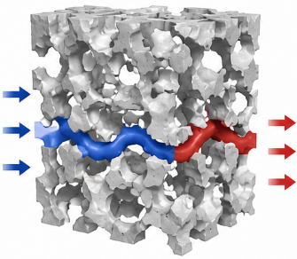



Workflow for pore-scale hysteresis characterization
Image Acquisition
Image Preprocessing
Training and Testing U-ResNet Model
Quantification
U-ResNet Segmentation
$χ_{n}$
$$A_{nw}$$
$K_{r}$
4
Notes:
So how did we go about this
“The workflow begins with image acquisition – multiple drainage imbibition fast scans were conducted on a water wet and a mixed wet Bentheimer sandstone samples at the Australian Synchrotron facility in Melbourne”
“Followed by preprocessing steps to prepare the data…”
“We then train a 2D U-ResNet model for segmentation…”
“Which generates segmentation results for the full dataset…and also verified to ensure accuracy”
“And finally,
“The segmented time-resolved datasets were used to quantify connectivity through Euler characteristic, fluid-fluid interfacial area, and relative permeability behaviour.”

Slide 6
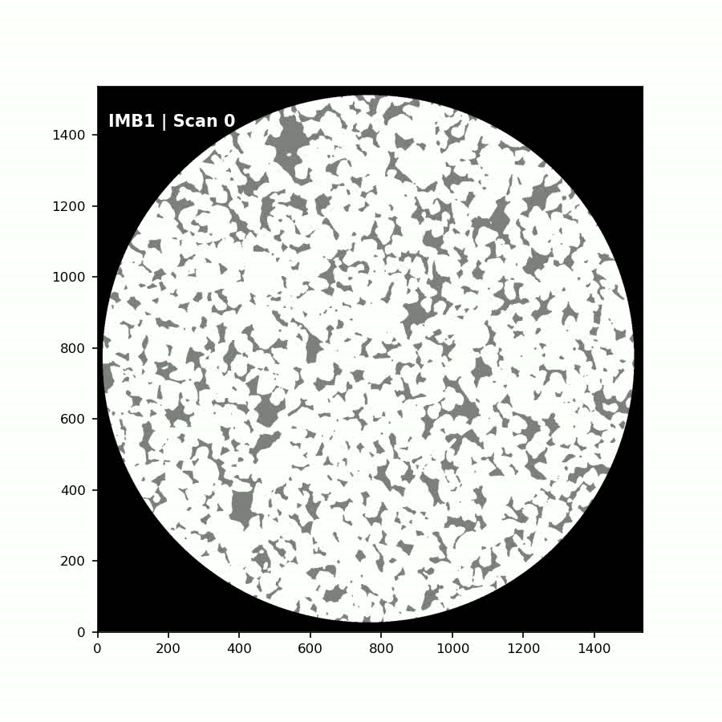
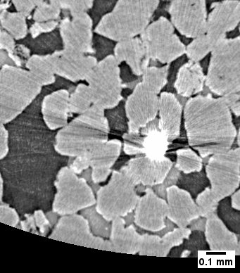
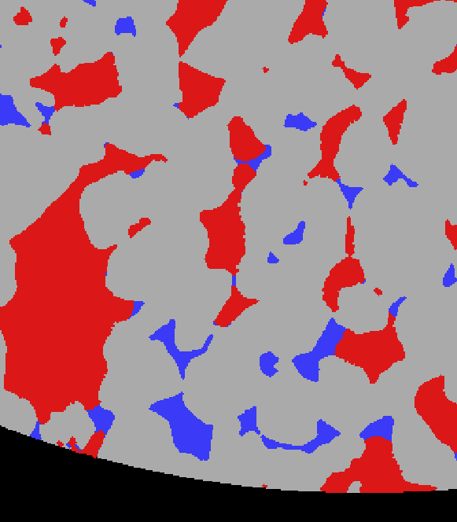

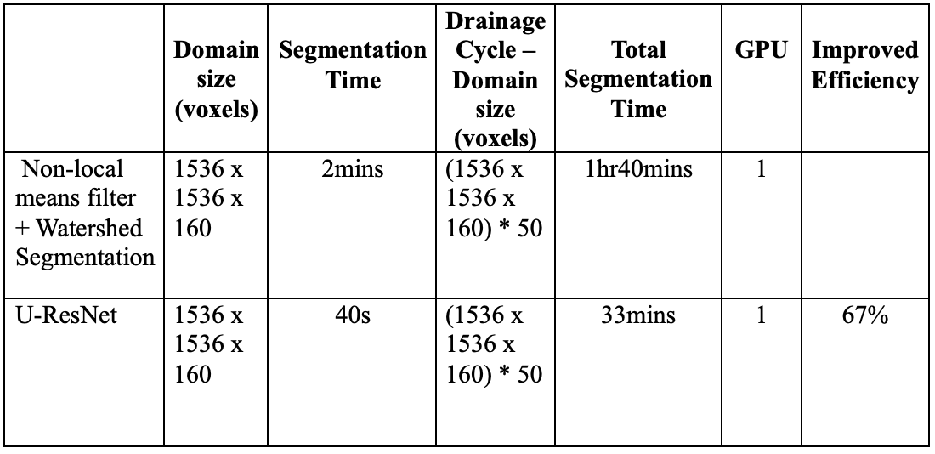
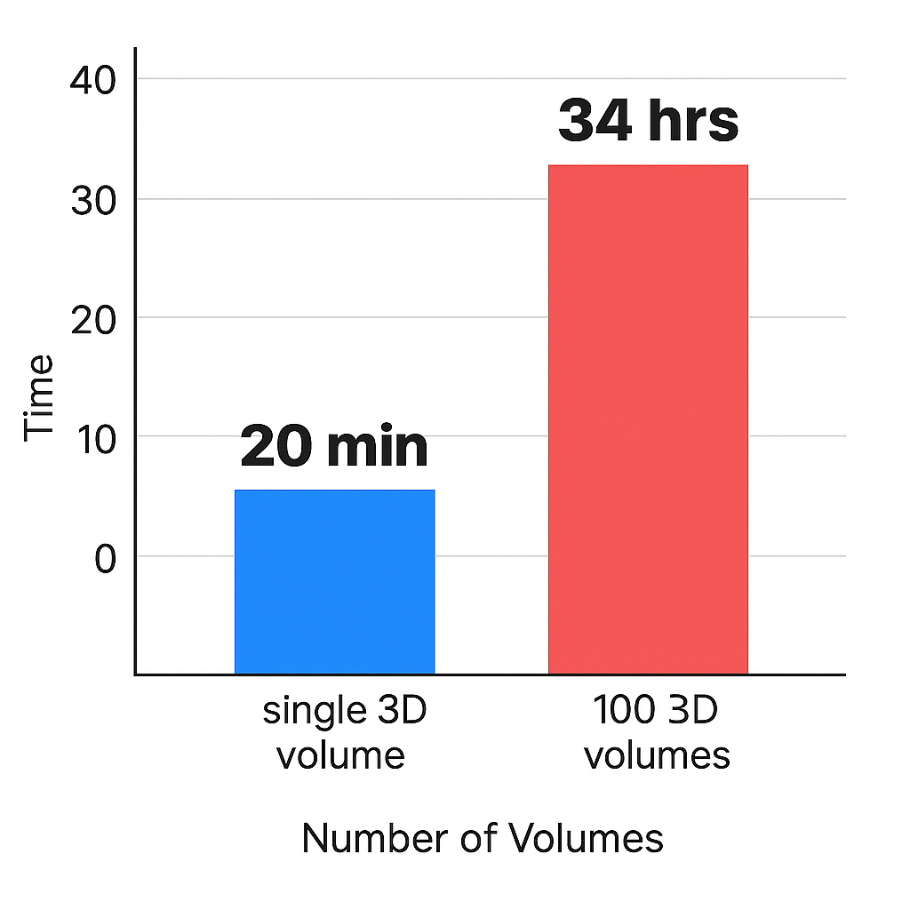
Automated segmentation for time-resolved hysteresis analysis
50 fast scans per experiment
U-ResNet Segmentation
~7 TBs of data to process
Streak artifacts and beam hardening
1536x1536x160 voxels
Time cost with Conventional workflow
Multiplies if the image has artifacts
~7 TBs of Data = months of computational time
Comparison of segmentation time
Notes:
Now, why did we include a deep learning network to segment our datasets
“So Time-resolved synchrotron imaging during drainage–imbibition cycling generates very large dynamic datasets.”
“These datasets contain substantial image artifacts and require segmentation across many sequential timesteps.”
“Using conventional segmentation workflows, processing the full experimental dataset becomes computationally expensive and difficult to scale.”
“To address this, we implemented an automated U-ResNet segmentation workflow capable of robust artifact mitigation across the dynamic image sequences.”
But more importantly,
“The workflow significantly reduced segmentation time while maintaining consistent segmentation quality across the drainage–imbibition cycles.”
So while watershed segmentation for a 3D dataset of say 1000x1000x100 voxels takes 2mins, our model needed only 40s. This meant for a fast batch of say 50scans, while watershed requires an 1hr and a half, we required only 33mins. And this was just on a system with a single GPU. This scales beautifully, infact nearly linearly when run on a system in parallel with multiple GPUs
“This enabled large-scale pore-scale quantification of connectivity, interfacial structure, and flow hysteresis.”
“Fast synchrotron imaging generates large dynamic datasets with substantial artifact contamination and significant processing requirements.”
(point to bar graph)
“Conventional workflows become increasingly impractical at the scale of full drainage–imbibition experiments.”
2. Solution (~10–15 sec)
(point right)
“The U-ResNet workflow provided robust segmentation despite streak artifacts while significantly reducing segmentation time.”
(point to timing table)
“This enabled scalable and consistent quantification of pore-scale hysteresis metrics across the full dataset.”
Then immediately:
“Using these segmented datasets, we first analysed hysteresis in topology and interfacial structure.”

Slide 7
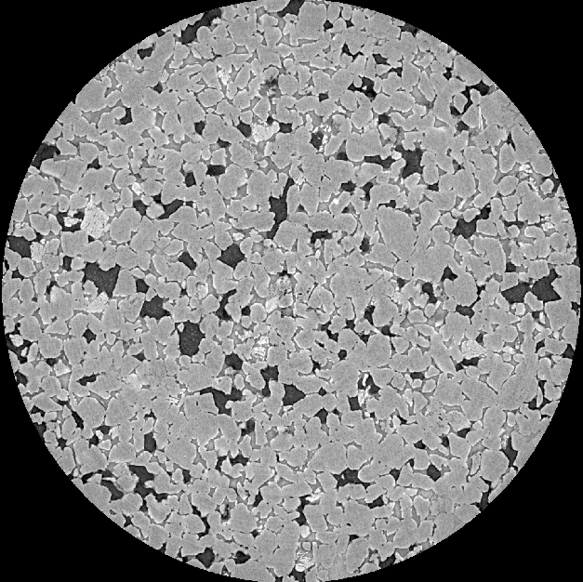
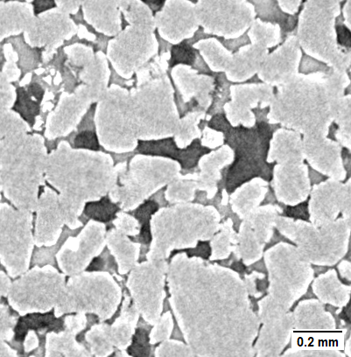
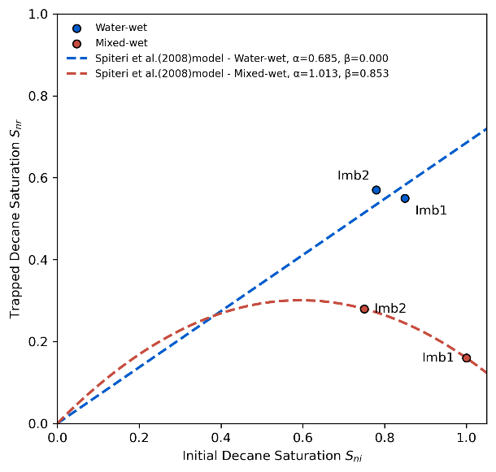
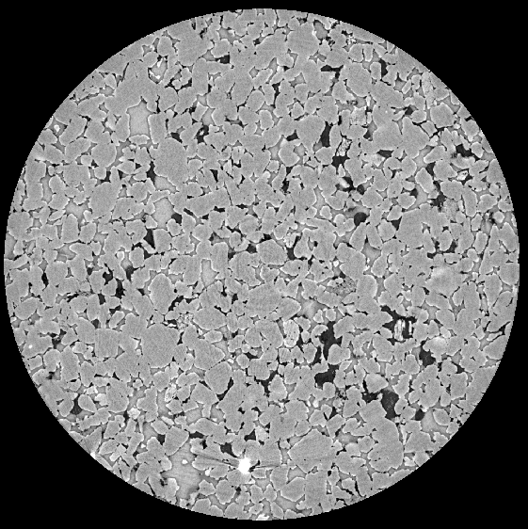
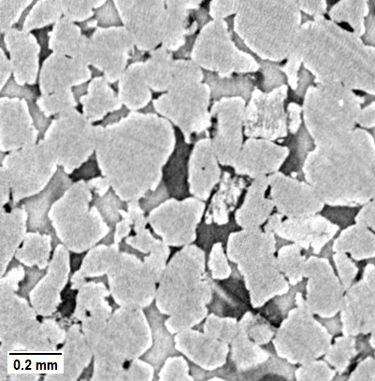


Sample characterization – wettability & trapping behaviour
$θ_{c}$ < ${90}^{°}$
Water-wet sample
$θ_{c}$ > ${90}^{°}$
Relation between trapped and initial decane saturation after imbibition1 and imbibition2
Mixed-wet sample
6
Notes:
Before examining the hysteresis evolution, we first qualitatively characterised the displacement behaviour of the two samples.”
“The mixed-wet sample shows altered fluid occupancy behaviour, consistent with wettability modification following ageing.”
For the points available, the Spiteri model indicates a near linear trend for the water-wet sample and a parabolic behaviour for the mixed-wet sample.
“These wettability differences are also reflected in the expected trapping behaviour, where water-wet systems generally exhibit stronger residual trapping of the non-wetting phase.”
“We then investigated how these wettability-dependent displacement behaviours influence pore-scale hysteresis evolution.”
Notably, we did not measure the contact angles explicitly in our dataset as these are fast scans which meant there could be unresolved interfaces that could lead to unreliable measurements. While visual inspection suggests the difference in wettability between the two samples, the extend of decane trapping at the end of the injection cycles were further used to verify this characterization.
Snap-off is the dominant mechanism of nonwetting phase displacement in water-wet rocks and this leads to increased trapping and relative permeability hysteresis

Slide 8
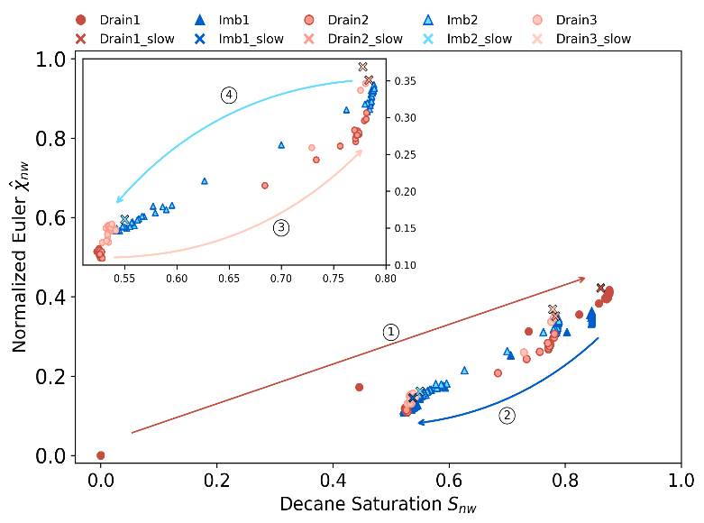
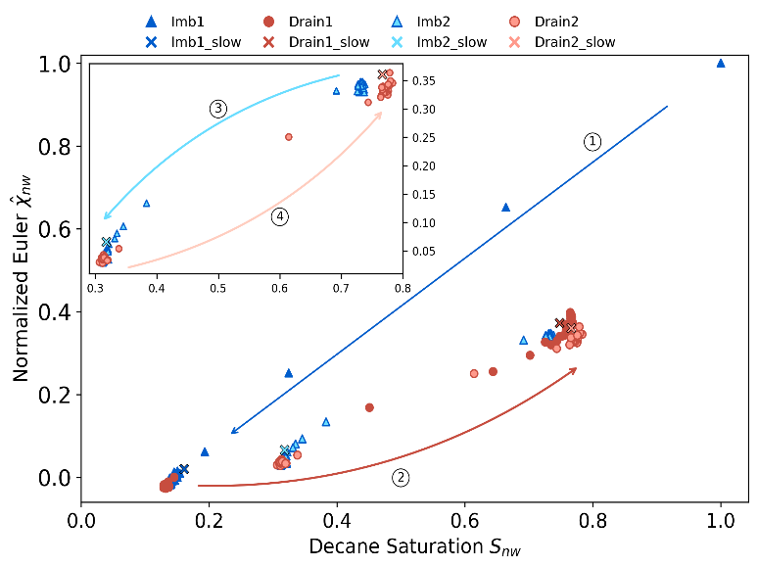
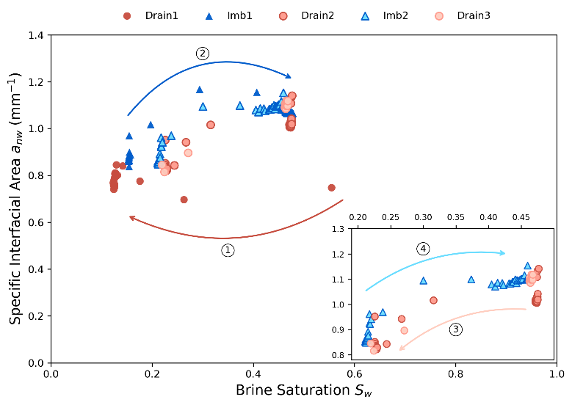
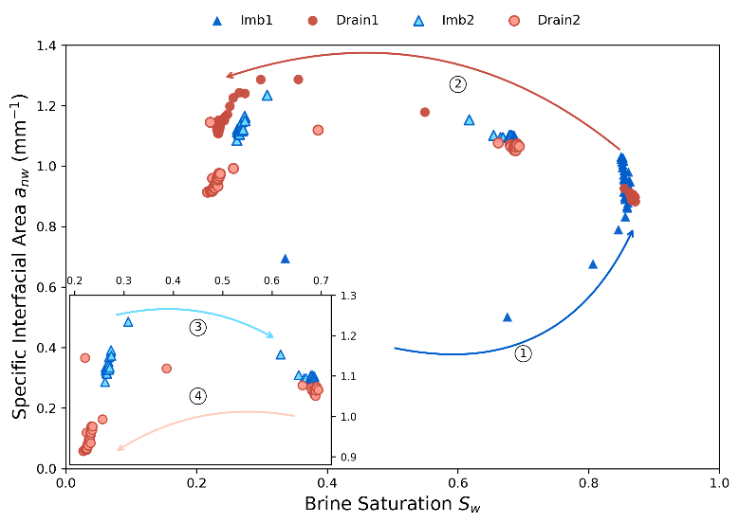
Pore-scale hysteresis in connectivity and interfacial structure
Pore connectivity vs decane saturation for Water-wet
Pore connectivity vs decane saturation for Mixed-wet
Fluid-fluid interfacial area vs brine saturation for Water-wet
Fluid-fluid interfacial area vs brine saturation for Mixed-wet
7
Notes:
So for our datasets, by using morphological descriptors we quantify hysteresis occurring at the pore scale.
“First we look at The Euler characteristic which reflects the connectivity of the fluid phases.”
“We observe different flow paths during drainage and imbibition…”
“…indicating that the connectivity of the fluid structure depends on flow history.”
Similarly, interfacial area also shows distinct flow paths.”
“For the same saturation, the interfacial area differs between drainage and imbibition.”
Both samples exhibit clear hysteresis during the first drainage–imbibition cycle, indicating irreversible rearrangement of the non-wetting phase
Interestingly, subsequent cycles show increasing reversibility, suggesting stabilization of the pore-scale flow configuration.
“This behaviour is consistent across both samples.”

Slide 9
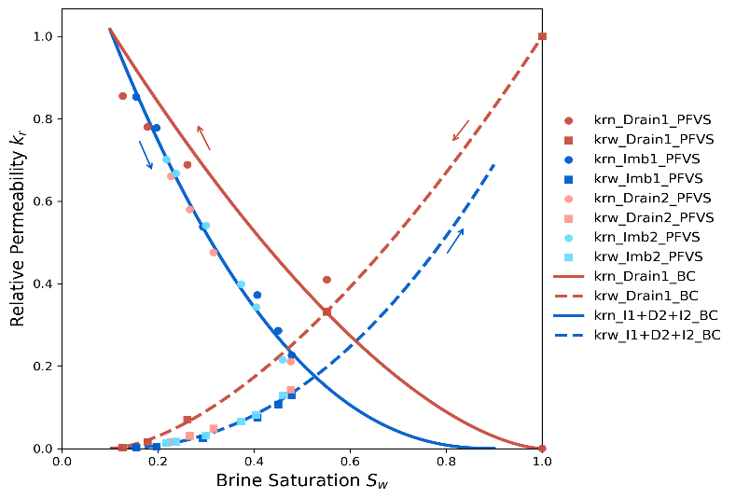
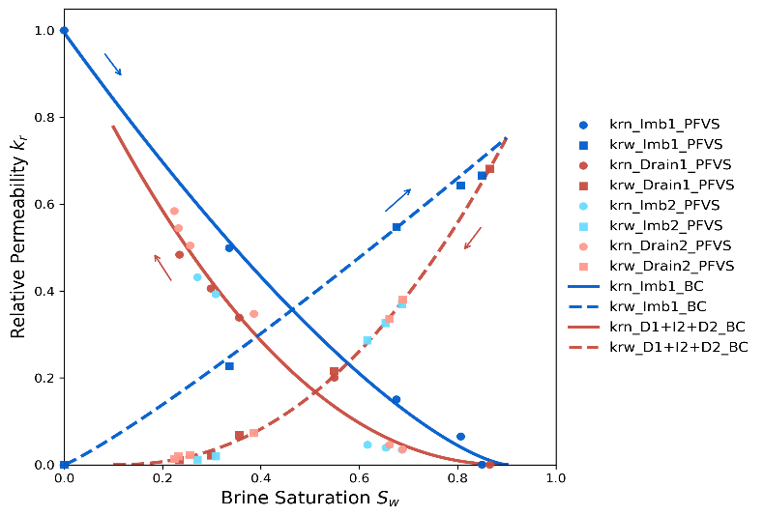
Implications of pore-scale hysteresis on Fluid Flow
Relative permeability vs brine saturation for Water-wet
Relative permeability vs brine saturation for Mixed-wet
1st drainage-imbibition cycle shows strong hysteresis
2nd drainage-imbibition cycle shows full reversibility
Greater fluid trapping observed in water-wet sample
8
Notes:
Lets see how this pore-scale hysteresis translates to macroscopic flow behaviour through relative permeability.”
This was calculated using PFVS (pore finite volume solver)
“We observe distinct differences between drainage and imbibition curves like that seen in both Euler and IFA and exactly similar trends as well.
So Across all these results, the common observations are
Hysteresis is most prominent in the first drainage–imbibition cycle.”
In subsequent cycles, the curves become more reversible…”
“…indicating that the fluid configurations are stable and similar.”
“And as expected water wet sample shows increased fluid trapping…”
“…which influences flow behaviour and residual saturation.”
These results highlight how pore-scale processes directly impact macroscopic flow behaviour.
Our results show that trapping is most established in the first cycle, subsequent cycles show little additional trapping and are governed by stable configuration.
This is complimentary to gas storage studies which focus on conditions where trapping continues across cycles and they observe irreversible flow. In their conditions pore scale configuration keeps changing
because of large saturation range, ,
Snap off is the dominant mechanism of decane displacement in water-wet rocks thereby leading to increased trapping and relative permeability hysteresis.
These differences in connectivity and interfacial structure influence how fluids flow through the pore space. “As a result, relative permeability differs between drainage and imbibition, even at the same saturation.”
The relative permeability behaviour reflects the pore-scale hysteresis observed in connectivity and interfacial structure.”
(point first cycle)
“Strong hysteresis is observed during the first drainage–imbibition cycle, indicating irreversible redistribution of the non-wetting phase.”
(point later cycles)
“However, subsequent cycles exhibit increasing reversibility, suggesting stabilization of the flow pathways.”
(point WW sample)
“The water-wet sample also exhibits greater non-wetting phase trapping, consistent with the stronger hysteresis observed in the EC and IFA measurements.”
That last line is VERY important because it connects all your results together.

Slide 10
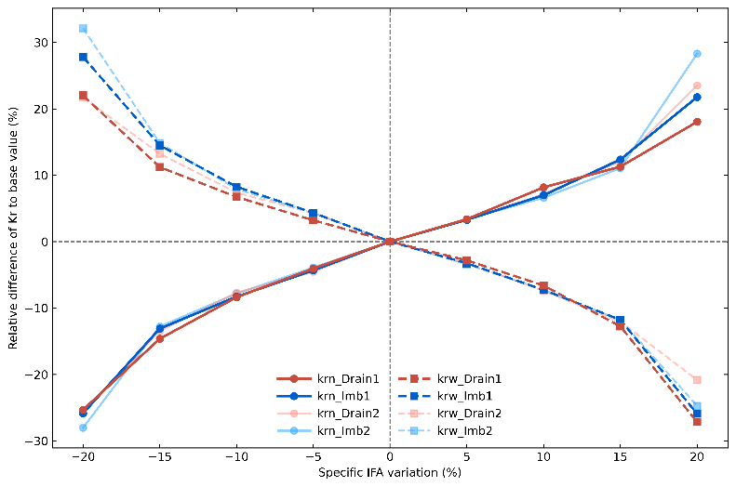
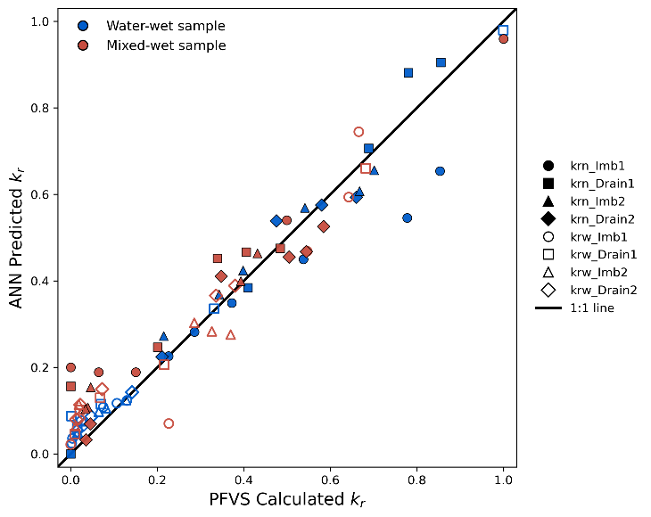
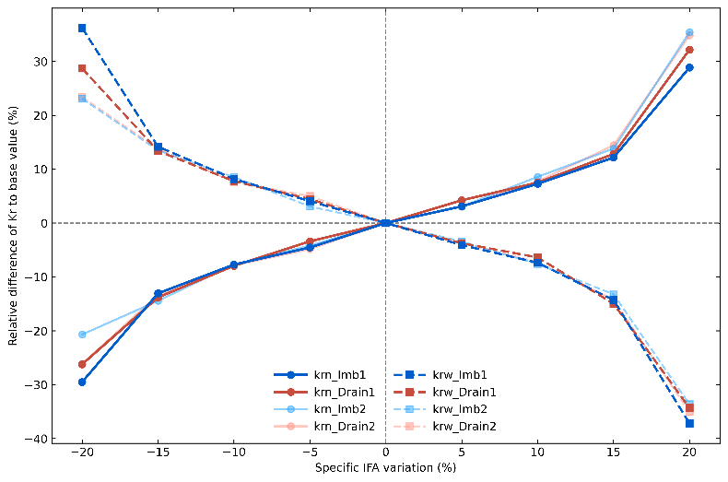
Influence of interfacial area on flow behaviour
Percentage relative difference of K_{r} vs Percentage specific IFA for Water-wet
Percentage relative difference of K_{r} vs Percentage specific IFA for Mixed-wet
Cross plot between ANN predicted relative permeability and PFVS estimates for relative permeability
9
Notes:
“Additionally, we also explored ANN-based estimation of relative permeability.”
“The ANN predictions which was based on phase saturation and specific interfacial area, show good agreement with the PFVS-derived relative permeability behaviour.”
“This provided an efficient framework for further investigating the relationship between pore-scale morphology and flow response.”
“Using this approach, we observed that changes in interfacial area are strongly correlated with changes in relative permeability.”
(point to slope/1:1 trend)
“Interestingly, approximately a 5% change in interfacial area corresponded to a similar change in relative permeability, suggesting a near-linear relationship.”
And after 15% we see that it deviates from the 1:1 trend. These 2 plots estimate the expected differences between drainage and imbibition rel perm curves based on variations observed in IFA variations
This again offers insight into the role of geometric hysteresis in multiphase flow
This linear trend is evident till about 15% variation in $a_{x}$ beyond which it deviates from the 1:1 trend and exhibits a nonlinear increase. These plots estimate the expected differences between drainage and imbibition $k_{r}$ curves based on observed variations in $a_{x}$, offering insight into the role of geometric hysteresis in multiphase flow. Overall, relative permeability hysteresis is expected to be minimal for a 5% variation in $a_{x}$ between drainage and imbibition. Moreover, an increase in $a_{x}$ leads to a reduction in $k_{r}$for phase $x$, as the additional surface area contributes to increased frictional drag.

Slide 11
Key Conclusions
Hysteresis was strongest in the 1st drainage-imbibition cycle.
Subsequent cycles exhibit increasing reversibility .
1:1 linear trend between interfacial area and relative permeability behaviour.
2x more trapping of decane observed in the water-wet sample in comparison to the mixed-wet sample.
Notes:
“This work investigated pore-scale hysteresis specifically within intermediate saturation regimes relevant to subsurface gas storage.”
“The results showed strong hysteresis during the first drainage–imbibition cycle, followed by increasing reversibility during subsequent cycling.”
We saw a strong relation between geometric hysteresis and macroscopic flow behaviours
“Water-wet conditions exhibited greater trapping behaviour, consistent across topology, interfacial structure, and flow measurements.”
Overall, our results suggest that while hysteresis strongly influences the initial displacement cycle, subsequent cyclic flow behaviour may become increasingly stable and predictable within intermediate saturation regimes., thereby governing pore-scale flow and trapping behaviour.”

Slide 12


THANK YOU
Connect on LinkedIn
Notes:
And that’s the end of my presentation. Thank you all for listening. And I have also included a QR code here if you would like to connect with me on Linkedin for further discussions or collaborations.

Slide 13
References
CARLSON, F. M. 1980. Simulation of relative permeability hystersis to the nonwetting phase. Journal Name: Soc. Pet. Eng. AIME, Pap.; (United States). United States: Amoco Prod Co.
FATEMI, S. M. & SOHRABI, M. 2018. Relative permeabilities hysteresis for oil/water, gas/water and gas/oil systems in mixed-wet rocks. Journal of Petroleum Science and Engineering, 161, 559-581.
HERRING, A. L., HARPER, E. J., ANDERSSON, L., SHEPPARD, A., BAY, B. K. & WILDENSCHILD, D. 2013. Effect of fluid topology on residual nonwetting phase trapping: Implications for geologic CO2 sequestration. Advances in Water Resources, 62, 47-58.
KILLOUGH, J. E. 1976. Reservoir Simulation With History-Dependent Saturation Functions. Society of Petroleum Engineers Journal, 16, 37-48.
SCHLÜTER, S., BERG, S., RÜCKER, M., ARMSTRONG, R. T., VOGEL, H.-J., HILFER, R. & WILDENSCHILD, D. 2016. Pore-scale displacement mechanisms as a source of hysteresis for two-phase flow in porous media. Water Resources Research, 52, 2194-2205.
SPITERI, E. J., JUANES, R., BLUNT, M. J. & ORR, F. M. 2008. A New Model of Trapping and Relative Permeability Hysteresis for All Wettability Characteristics. SPE Journal, 13, 277-288.
12
Notes:
These are the references I used for putting together my slides

Slide 14
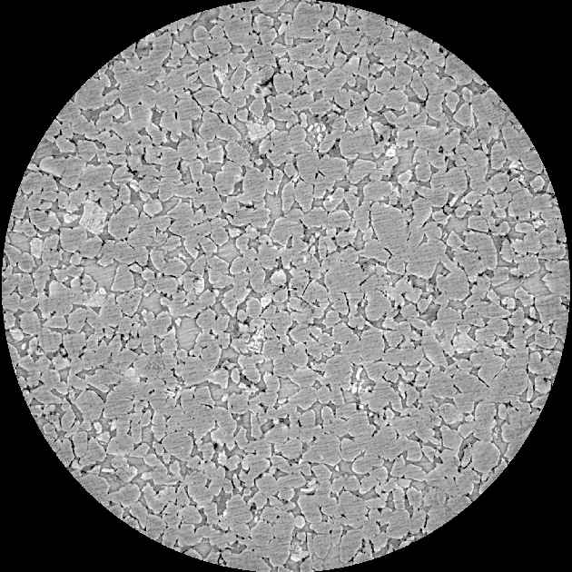
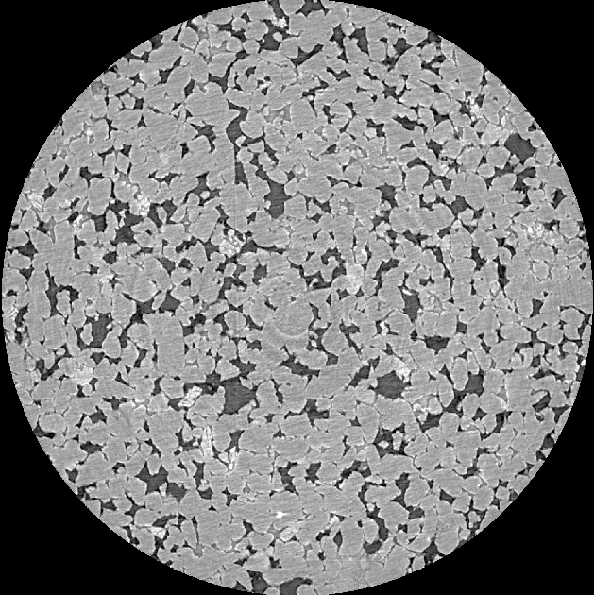
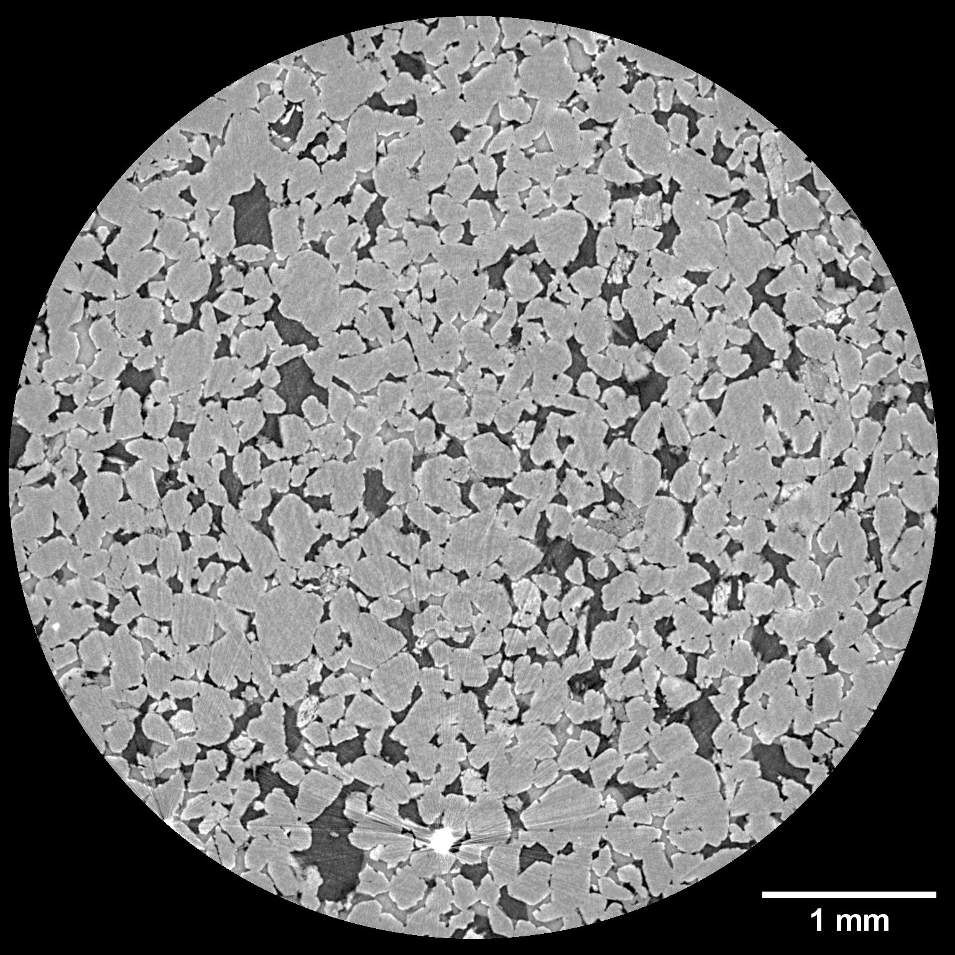
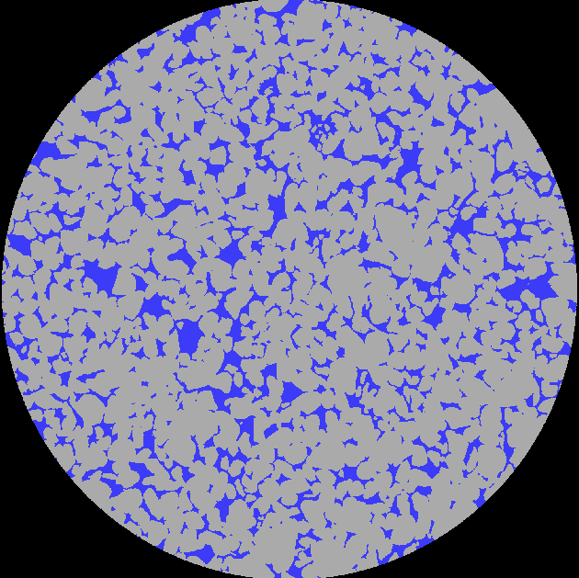
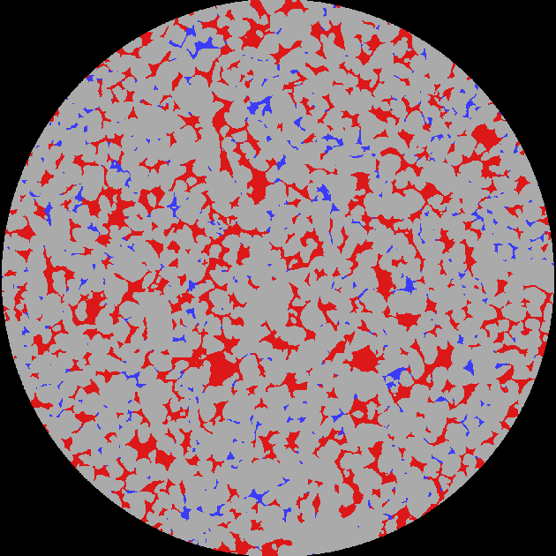
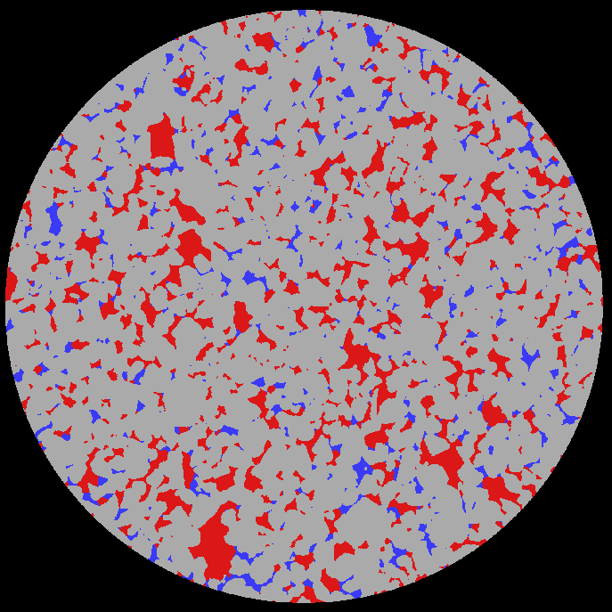
Automated Segmentation Results
Fast batch scan 13 – Water-wet
Fast batch scan 49 – Water-wet
Fast batch scan 44 – Mixed-wet
13
Notes:
“Here are examples of segmentation results generated by the model.”
“The model is able to capture fluid distribution and pore structure consistently across the datasets.”
“The results show clear and physically meaningful segmentation of the pore space.”
Here I’ve illustrated a few representative slices from the inference output of the trained and tested UResNet model.
On the left, we see a slice from a water-wet sample, still fully saturated—decane hasn’t yet broken through, so the pore space is dominated by water.
In the middle, we have a slice from another fast batch scan of the water wet sample, where decane has displaced most of the water and now occupies the majority of the pore space.
And on the right, a slice from a mixed-wet sample, showing co-occupancy of both water and decane
Visually, the UResNet model has performed well in labeling the fluid phases with clarity and consistency.
Notably, it has also mitigated the impact of streak artifacts in this region, preserving segmentation accuracy. In the next slide we shall take a closer look at artifact filled regions
Now lets move on and take a look at some of the results from the 2nd objective which uses the U-ResNet model.
On the left hand side of the slide, I have showed a slice each from both the mixed-wet sample and the water-wet sample after segmentation using the trained and tested U-ResNet model. Visually in comparison to the gray scale images our U-ResNet model has done a good classification of the nonwetting phase which is decane. This is also substantiated by the phase accuracy calculations in the form of confusion matrices in which we can see high scores of 93% and 95% accuracy for the decane phase.
Apart from pixel wise accuracy, we also calculated mean intersection over union which basically measures how well the predicted image overlaps the ground truth image. This metric too gave high scores which averaged between 93 and 96% for both samples.
I must add at this point that the ground truth images used for training the model as well as for segmentation accuracy calculations were 2d Slices that were segmented using WEKA segmentation which is a plugin available in ImageJ software that helps in manually segmenting images using random forest classifier or algorithm.
Now we shall look at the results from the U-ResNet model. Here I have showed U-ResNet segmented images from both the mixed wet sample on the left and the water-wet sample on the right. Ofcourse in the mixed wet sample a bright region or a minor streak artifact is visible and that is minimized by the U-ResNet model on segmentation. We shall take a closer look at streak artifacts mitigation in the coming slides. On the other half of the slide, I have showed examples of segmentation accuracy measurements done in the form of phase accuracy calculations visualized as confusion matrices. For these calculations, I chose a few 2D slices that were WEKA segmented and not used for training the model and so they acted as ground truth slices. In both examples shown here, one each from either sample, we can see that the accuracy is 93% in the water-wet sample and 95% in the mixed-wet sample. On an average for some of the other slices calculated also, the value ranged from 93 to 95%.
Here I have showed 2 reconstructed images of fast scans conducted at ANSTO synchrotron in Melbourne in December 2023. The resolution of these scans was 3.6 microns and we were able to capture fast scans at 20seconds which includes 16seconds for the rotating stage to come back to the initial position between each fast scan. The yellow arrows in the figures show the interface between the nonwetting phase (decane) and wetting phase (brine) in the pore spaces. On the left is a water wet sample and on the right is a mixed wet sample.
(we had exposure set to 0.001s, 1001 projects and flyer speed mode set to 1000 Hz. We used effective 23.5 keV with a magnification of 1.806 to get a 3.6um resolution. We did 50 flats/darks at the start of each batch scan, and then set a new set of stacked scans off, with a traverse of 0 to do repeated scans at the same location. These stacked scans didn’t have any pre/post darks/flats, to maximise scanning times. So basically we had 1 sec scans.
In mixed wet sample, in some pores we can see that oil is at the corners and in crevices showing that those pores are oil wet. Mixed wet means the same sample has some pores that are water wet and some that are oil wet. If its oil wet the contact angle between water and the rock surface is obtuse and greater than 90 degrees and is 90 to 180 degrees. In the water wet sample, contact angle between water and rock surface is acute angle is 0 to 90 degrees. The liquid tends to spread out on the surface. If the contact angle is 90 degrees then it is intermediate wet.)

Slide 15
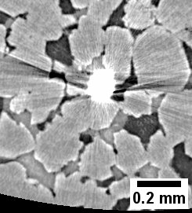
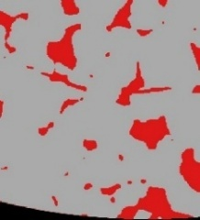
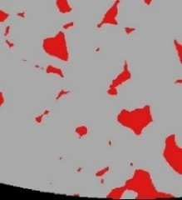
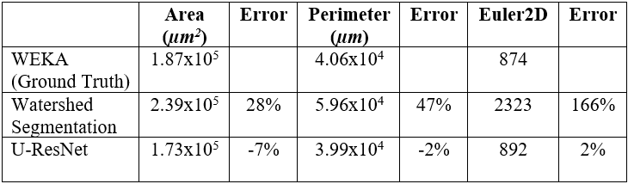
Comparison with Watershed Segmentation
Watershed
U-ResNet
2D Minkowski functionals
Comparison of segmentation time
14
Notes:
Now lets see how our model compares with traditional methods.
The U-ResNet model captures pore structures more accurately compared to watershed segmentation.
This is also reflected quantitatively. “We observe lower errors in area, perimeter, and Euler characteristic.
Importantly, there is a significant difference in computation time.”
“watershed-based segmentation takes 2 mins for a 3D volume of this size”
“…whereas the deep learning model performs segmentation in a fraction of that time.”
This demonstrates that the model is not only more accurate—but also significantly quicker. Moreover, this time is when the model is run on a single GPU, so lets see how this scales up when run in parallel on multiple GPUs
Deep learning outperforms traditional segmentation methods
To further validate our U-ResNet model’s performance, we compared it with traditional methods like watershed-based segmentation.
Segmentation accuracy was also validated by visualizing phase wise mean Intersection over Union and it was seen that our U-ResNet model outperforms watershed in classifying the decane phase at 96% in comparison to 90%.
But the biggest advantage of our U-ResNet model apart from accuracy was in terms of speed.
I would like to draw your attention to the fact that this segmentation time of 33mins is using 1 GPU, this can be scaled by using multiple GPUs.
For the watershed segmentation, even though the non local means filter uses GPU, the watershed segmentation itself runs on CPU, so when scaled to multiple GPUs, much improvement will not be observed.
So lets take a closer look at how scaling helps in reducing segmentation time for a U-ResNet model.

Slide 16
Scalability Potential
GPU 1
GPU 2
Image
Segmentation
GPU 3
GPU 4
Data | No. of scans | Resolution µm | Imaging Time mins | U-ResNet Segmentation Time mins | GPU
Fast batch scans | 50 | 3.6 | 13 approx. | 33 | 1
 |  |  |  | 5 mins approx. (7 x speedup) | 4
Image Processing Time < Image Acquisition Time
15
Notes:
This slide demonstrates the scalability of the U-ResNet model when deployed on multi-GPU systems.
On the left, we see a performance benchmark from the Gadi supercomputer in Australia.
As we increase the number of GPUs from 1 to 4, we observe a near-linear speedup—reaching ~7× faster with 4 GPUs
So while imaging time for a fast batch of 50 scans takes typically 13mins, processing time would be approx. 5 mins then
This means image processing is now actually faster than acquisition time enabling real-time analysis.
This makes it feasible to analyse time-resolved datasets at scale

Slide 17
Missing states
t0
t0
?
t1
t1
t2
t2
Without Deep Learning
With Deep Learning
16
Notes:
“Here, lets take a closer look at the limitation of discrete imaging.”
“We observe the system at time t0 and t2…”
“…but the intermediate state at t1 is missing.”
“But by Using deep learning, we can reconstruct this intermediate state…”
“Thereby, providing a continuous representation of fluid evolution.”

Slide 18
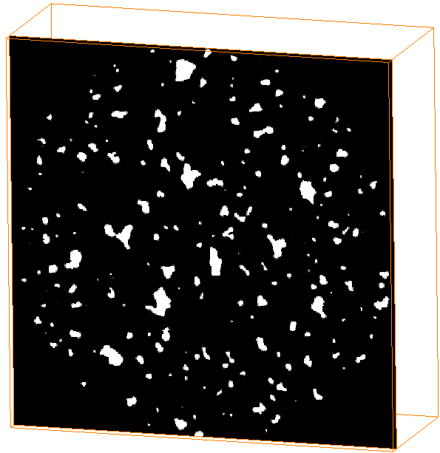
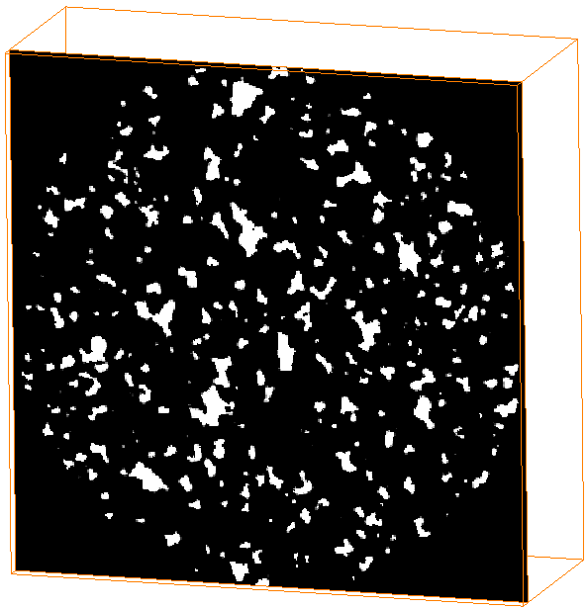
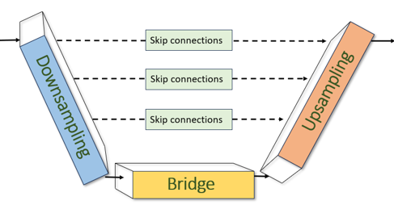
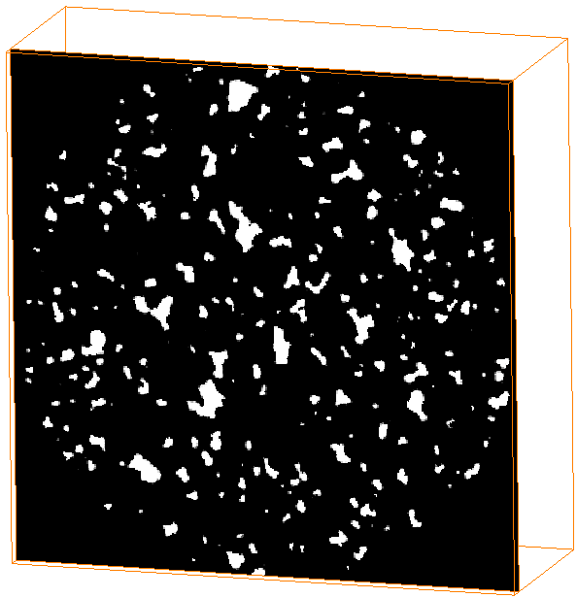
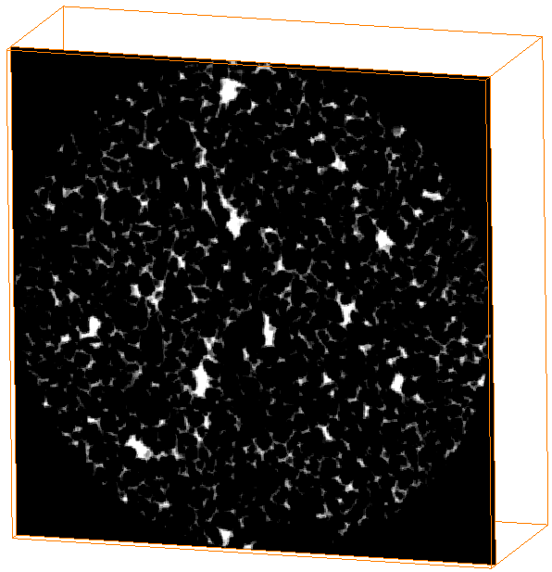
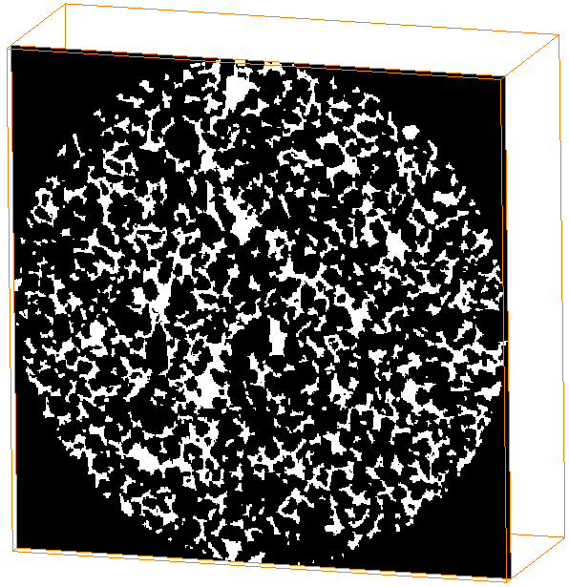
Time-series interpolation framework
+
t0_decane
t2_decane
+
t1_decane
+
Euclidean distance transform map
Pore mask
A simple 3D U-ResNet schematic
Model targets the moving phase - decane
17
Notes:
“So how do we go about this, to reconstruct the missing states, we develop a time-series interpolation framework.”
“The model takes known states at two time steps—for example, t0 and t2…”
“It then learns the spatial and temporal relationships between these states…”
“And predicts the intermediate state at t1.”

Slide 19
Impact of the Time-series framework
Enables continuous reconstruction of fluid evolution
Improves effective temporal resolution
Captures dynamic pore-scale transitions
18
Notes:
“This framework enables reconstruction of missing states between scans…”
“Providing a more continuous representation of fluid evolution…”
“This allows us to better capture rapid pore-scale events…”
“And ultimately, it improves our ability to analyse and understand flow behaviour in porous media.”
This is currently work in progress and so

