Slide 1
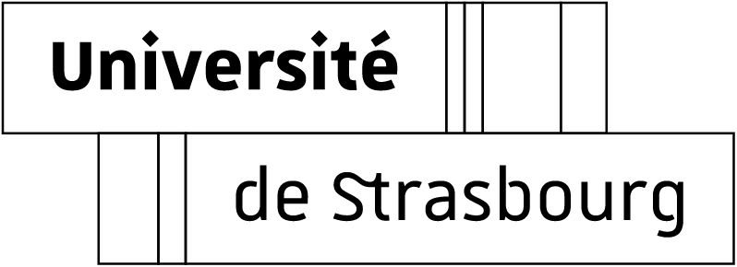
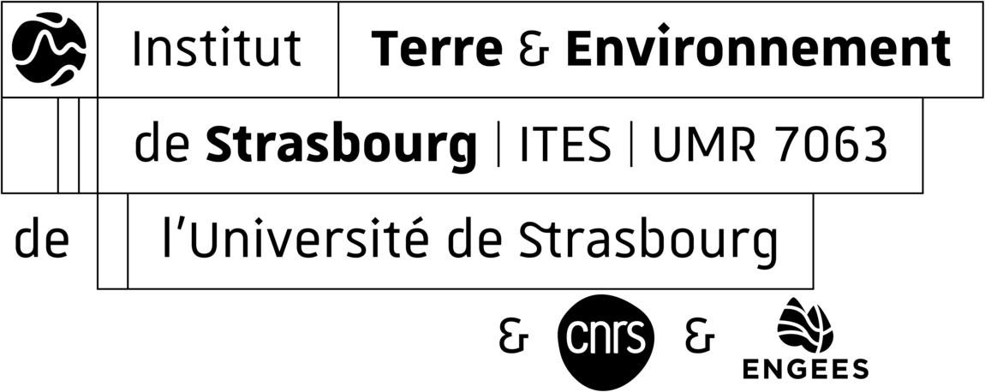
Influence of wettability on water-air relative permeability curves in unconsolidated porous media: from water-wet to oil-wet
Kevin HERNANDEZ-PEREZ PhD supervisors:
PhD candidate Gerhard SCHÄFER
Third-year Renaud TOUSSAINT
*This PhD is part of the international CONTINUUM project, in collaboration with the “Center of Innovation for Flow through Porous Media” at the University of Wyoming.

Slide 2

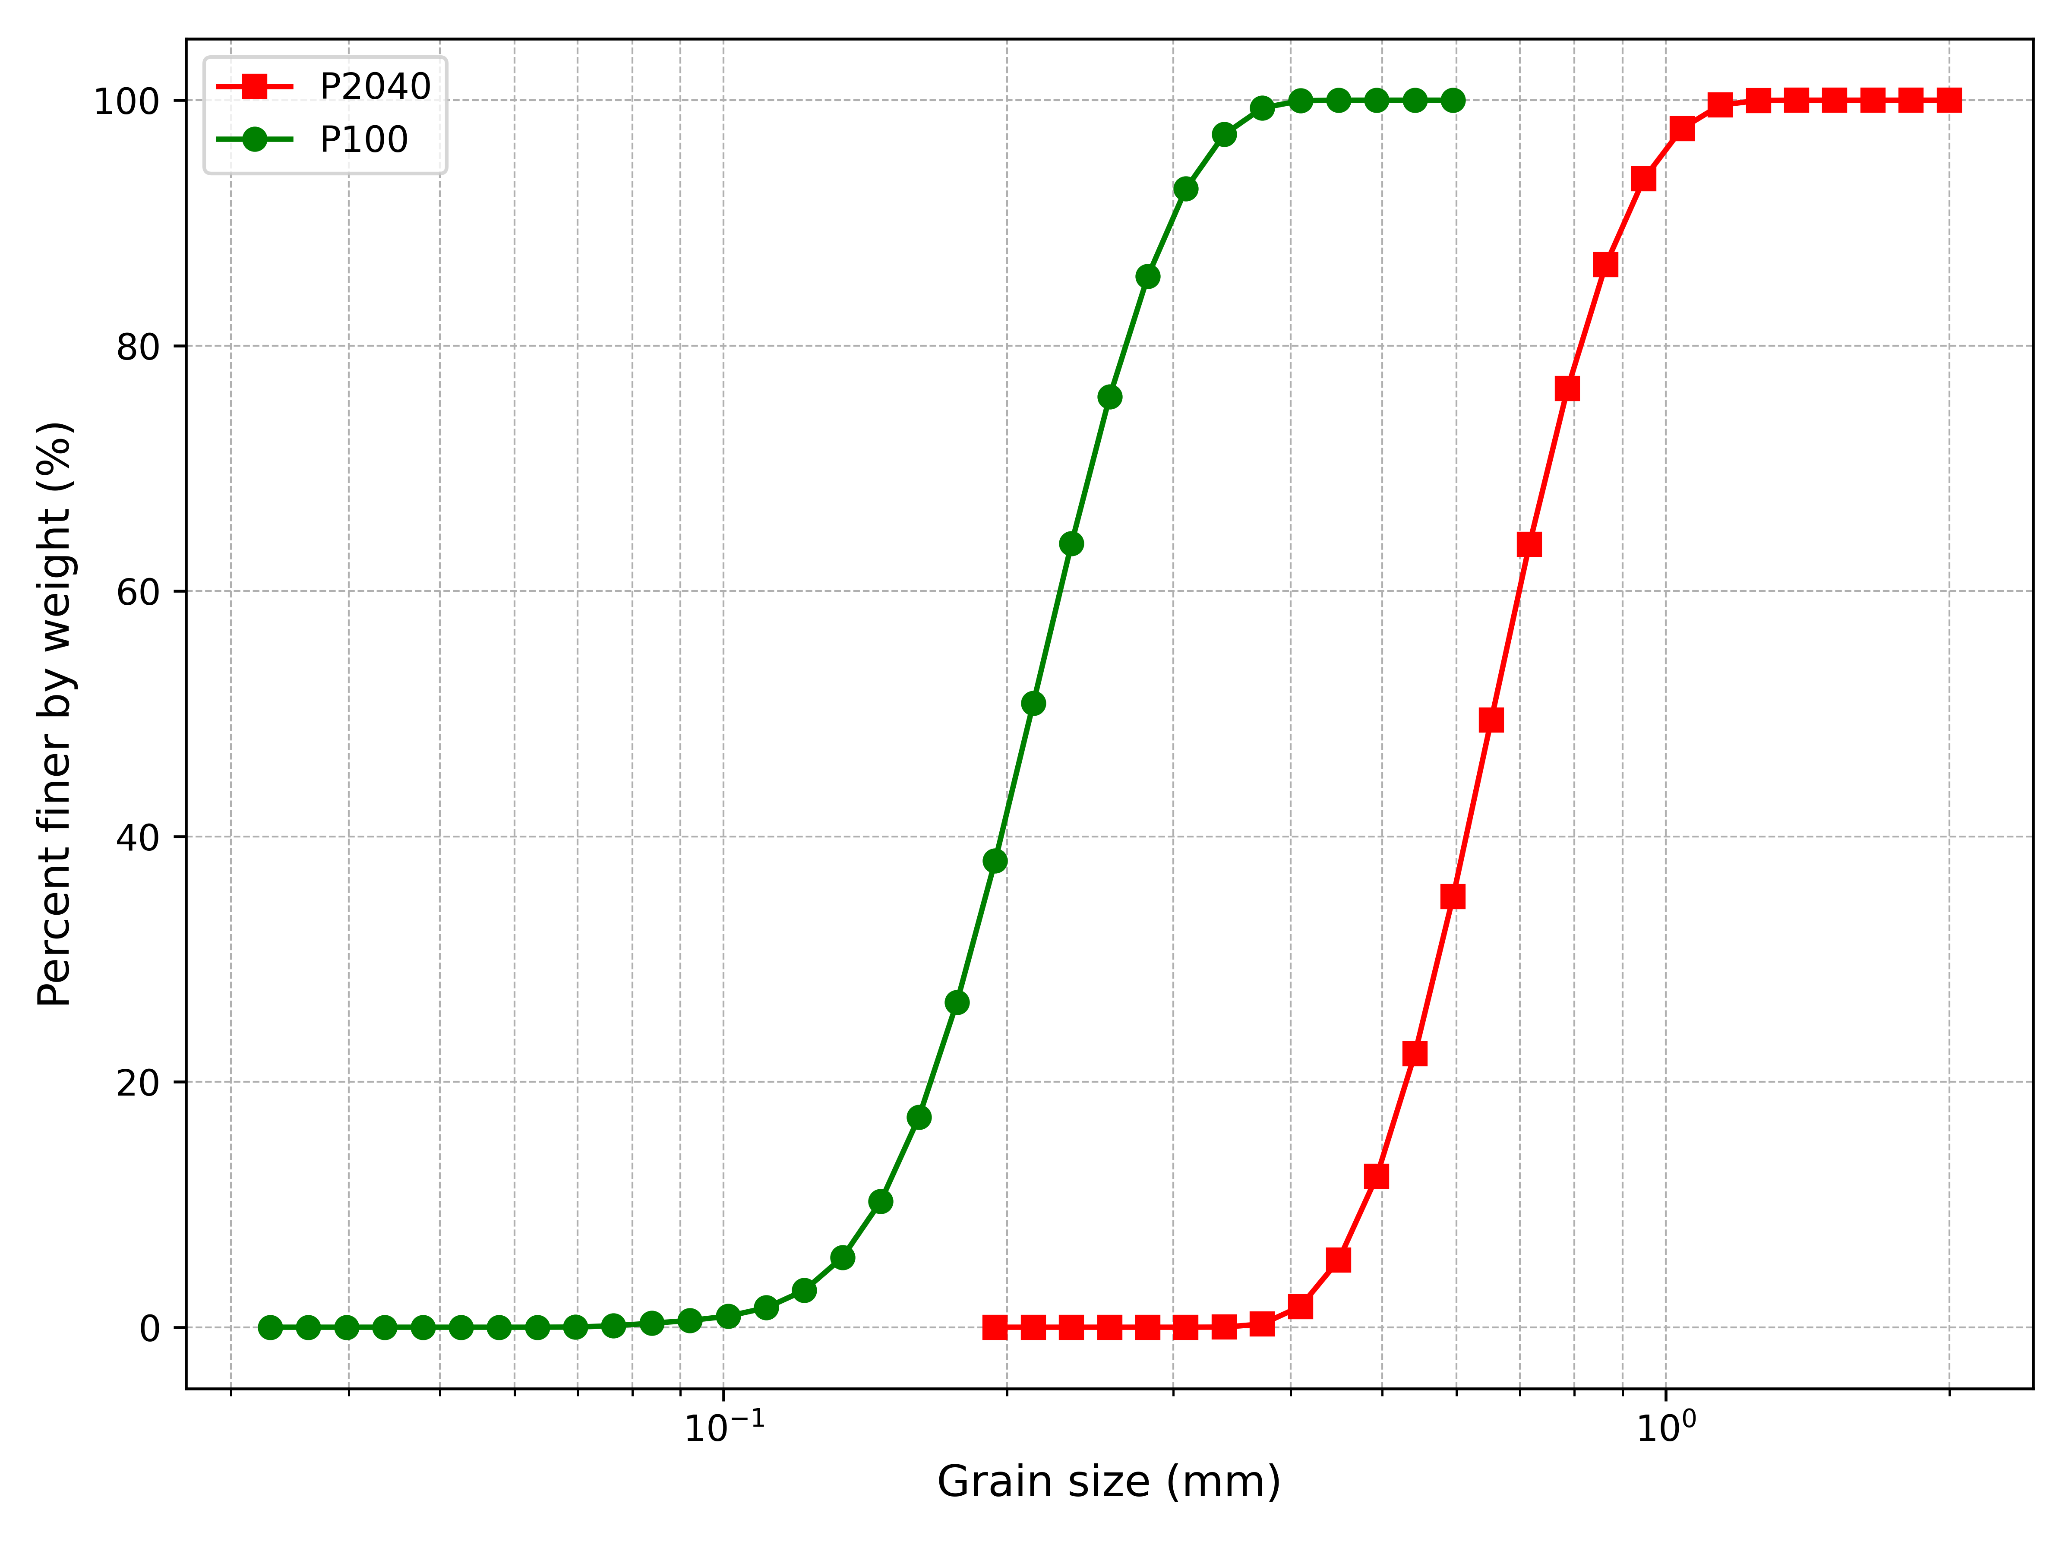
Materials and methods: the porous media
Two types of quartz sands, P100 and P2040, were used.
P100 is classified as a fine sand, whereas P2040 is classified as a medium sand.
Gerhard Schäfer, Kevin Hernandez Perez, Panav Hulsurkar, Magda Ibrahim Youssif, François Lehmann, Mohammad Piri,
Influence of wettability on water retention curves in unconsolidated porous media,
Journal of Contaminant Hydrology, Volume 269, 2025.
 | P2040 | P2040ag | P100 | P100ag
oil-water θ_{ow} (°) | 39.0±8.8 | 98.5±12.9 | 35.8±5.2 | 93.3±9.4
gas-oil θ_{go} (°) | 47.0±6.0 | 26.4±4.2 | 45.3±6.2 | 27.5±4.7
gas-water θ_{gw} (°) | 24.1±5.7 | 46.7±6.4 | 28.2±6.2 | 48.8±5.5
Table 1. In situ static contact angles quantified for the four aged and unaged sands (ag=aged)
Fig. 1 Cumulative particle size distribution of the experimental porous medium (Schäfer et al., 2025).

Slide 3
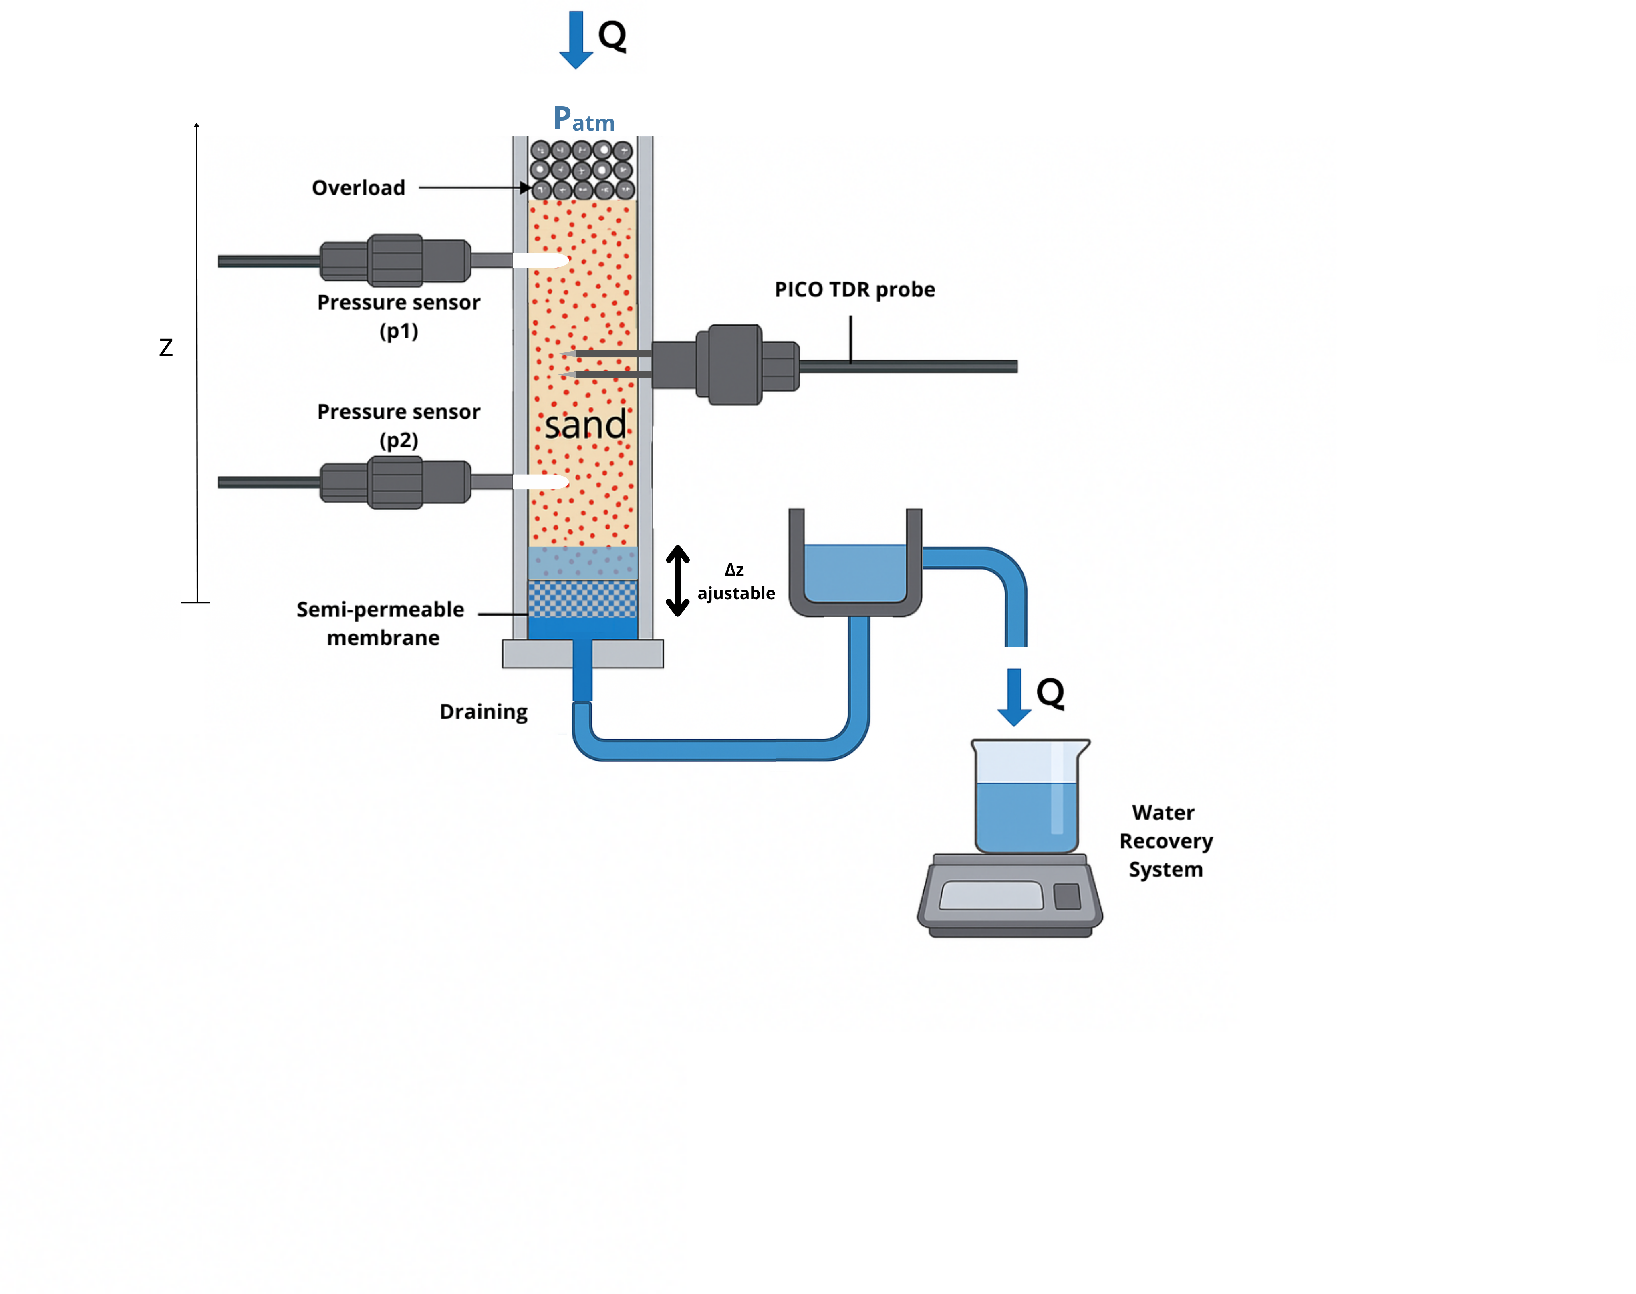
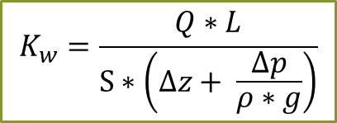
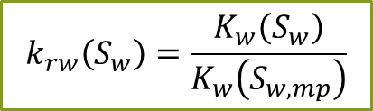
Materials and methods: Experimental setup for the measurement of hydraulic conductivity (K_{w}–S)
$$K_{w}=\frac{Q∗L}{S∗\left(∆z+ \frac{∆p}{ρ∗g}\right)}$$
$$k_{rw}\left(S_{w}\right)=\frac{K_{w}\left(S_{w}\right)}{K_{w}\left(S_{w,mp}\right)}$$
Fig. 2 Design of the experimental setup to measure water conductivity as function of water saturation.

Slide 4
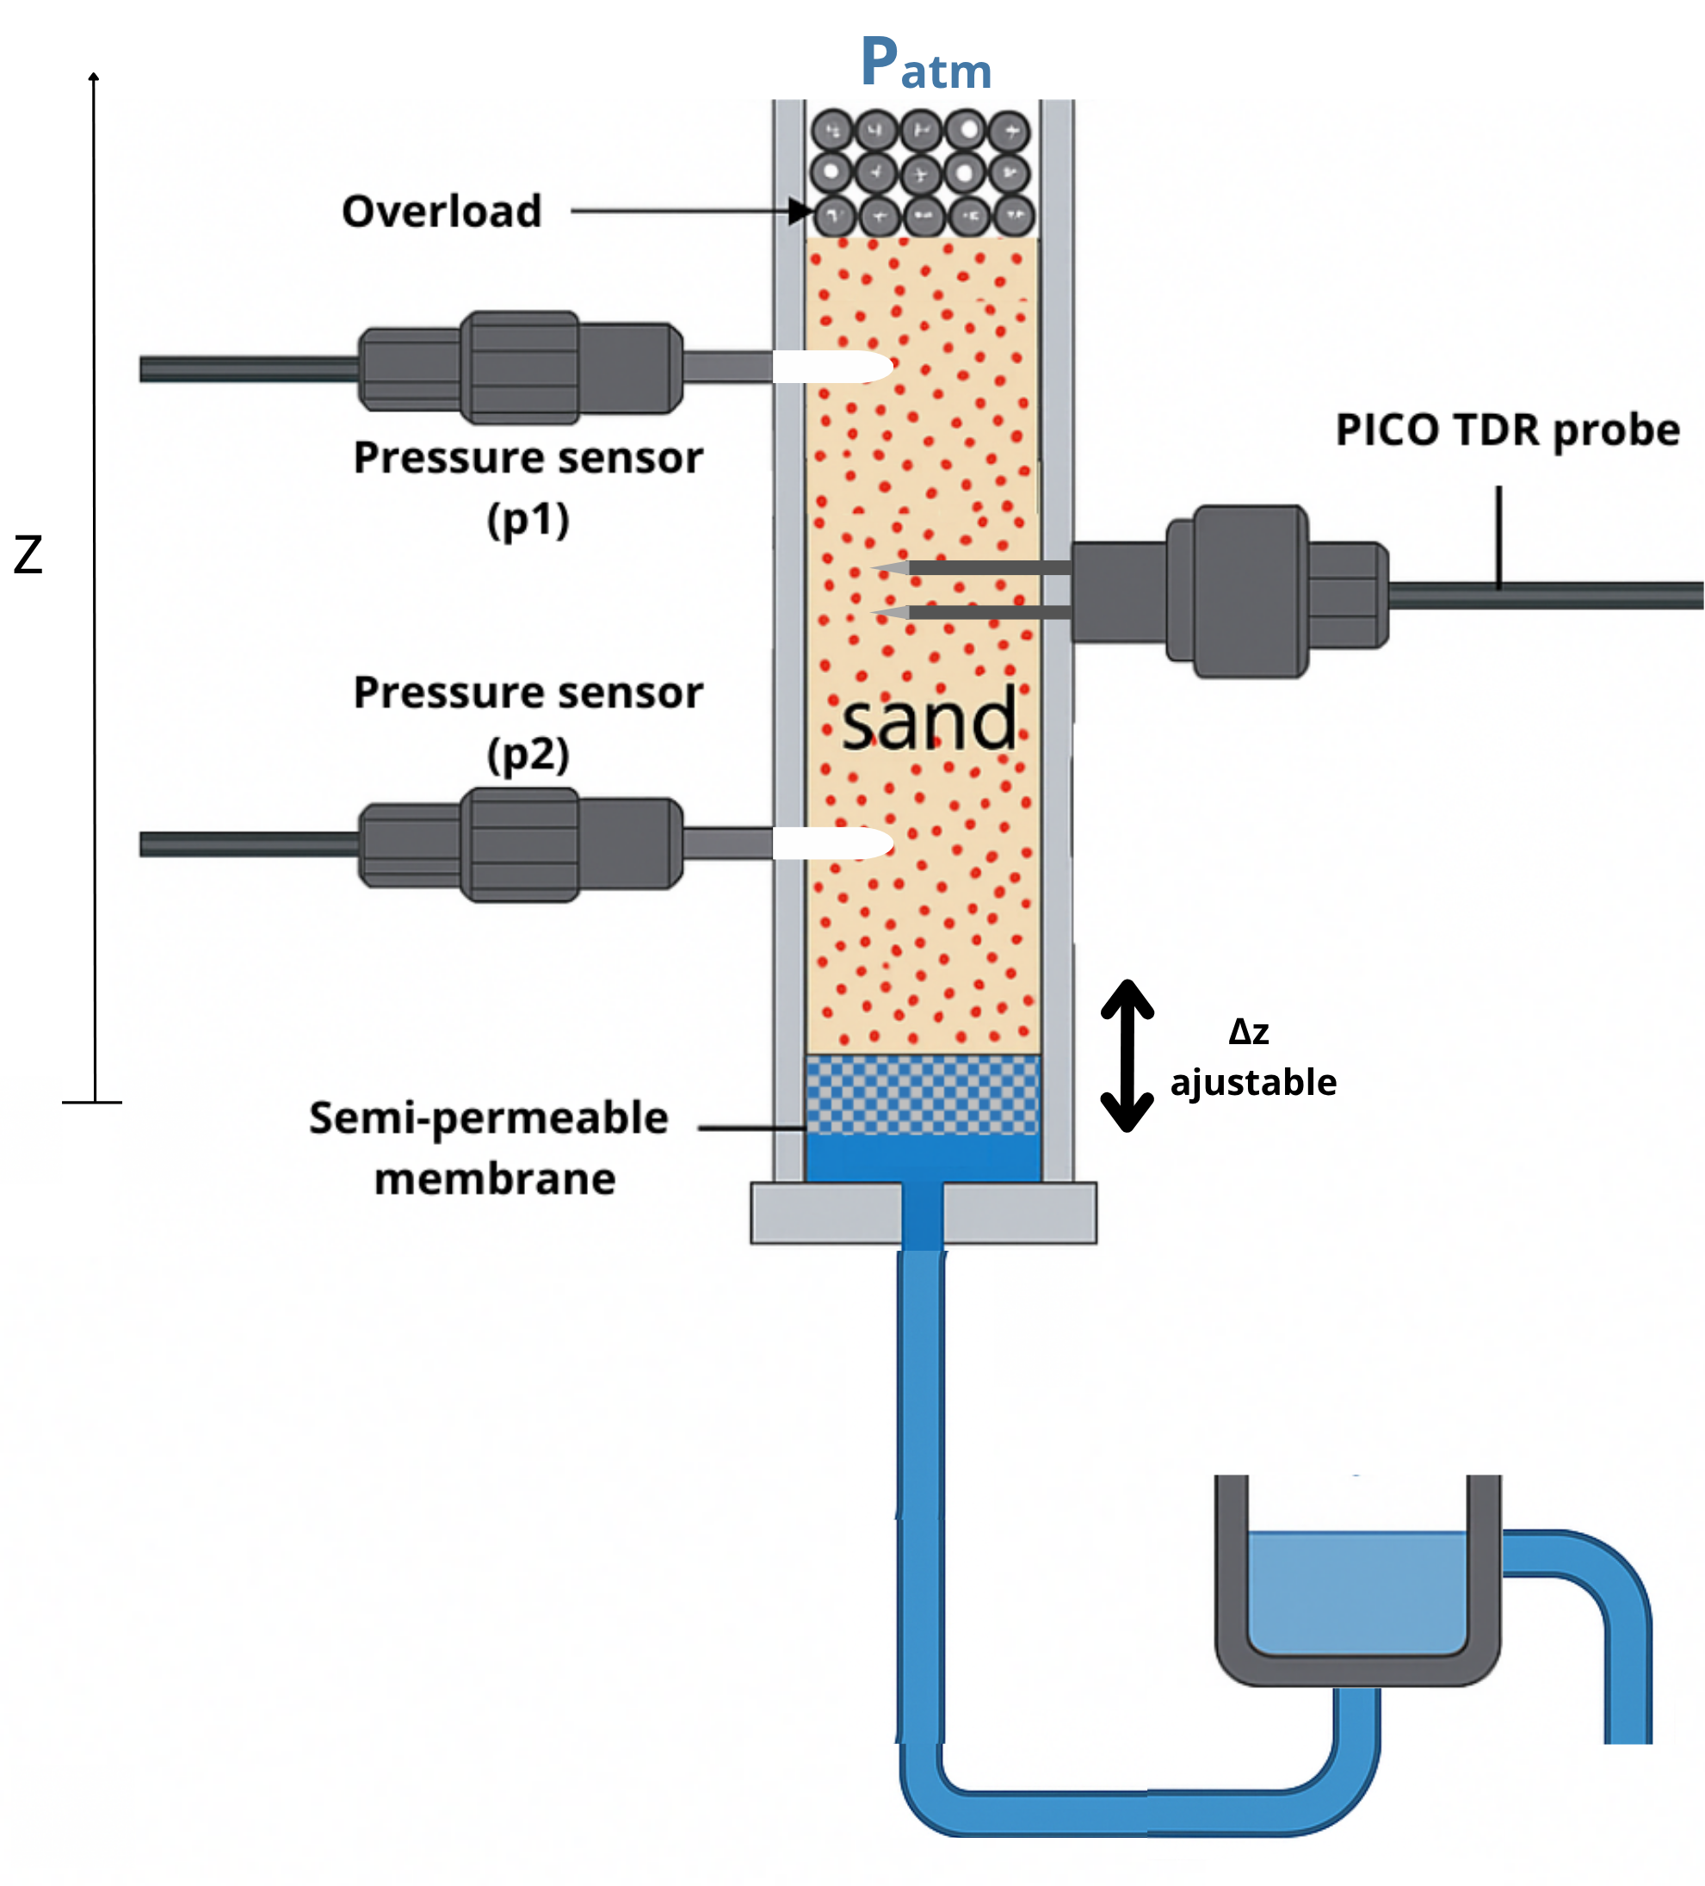

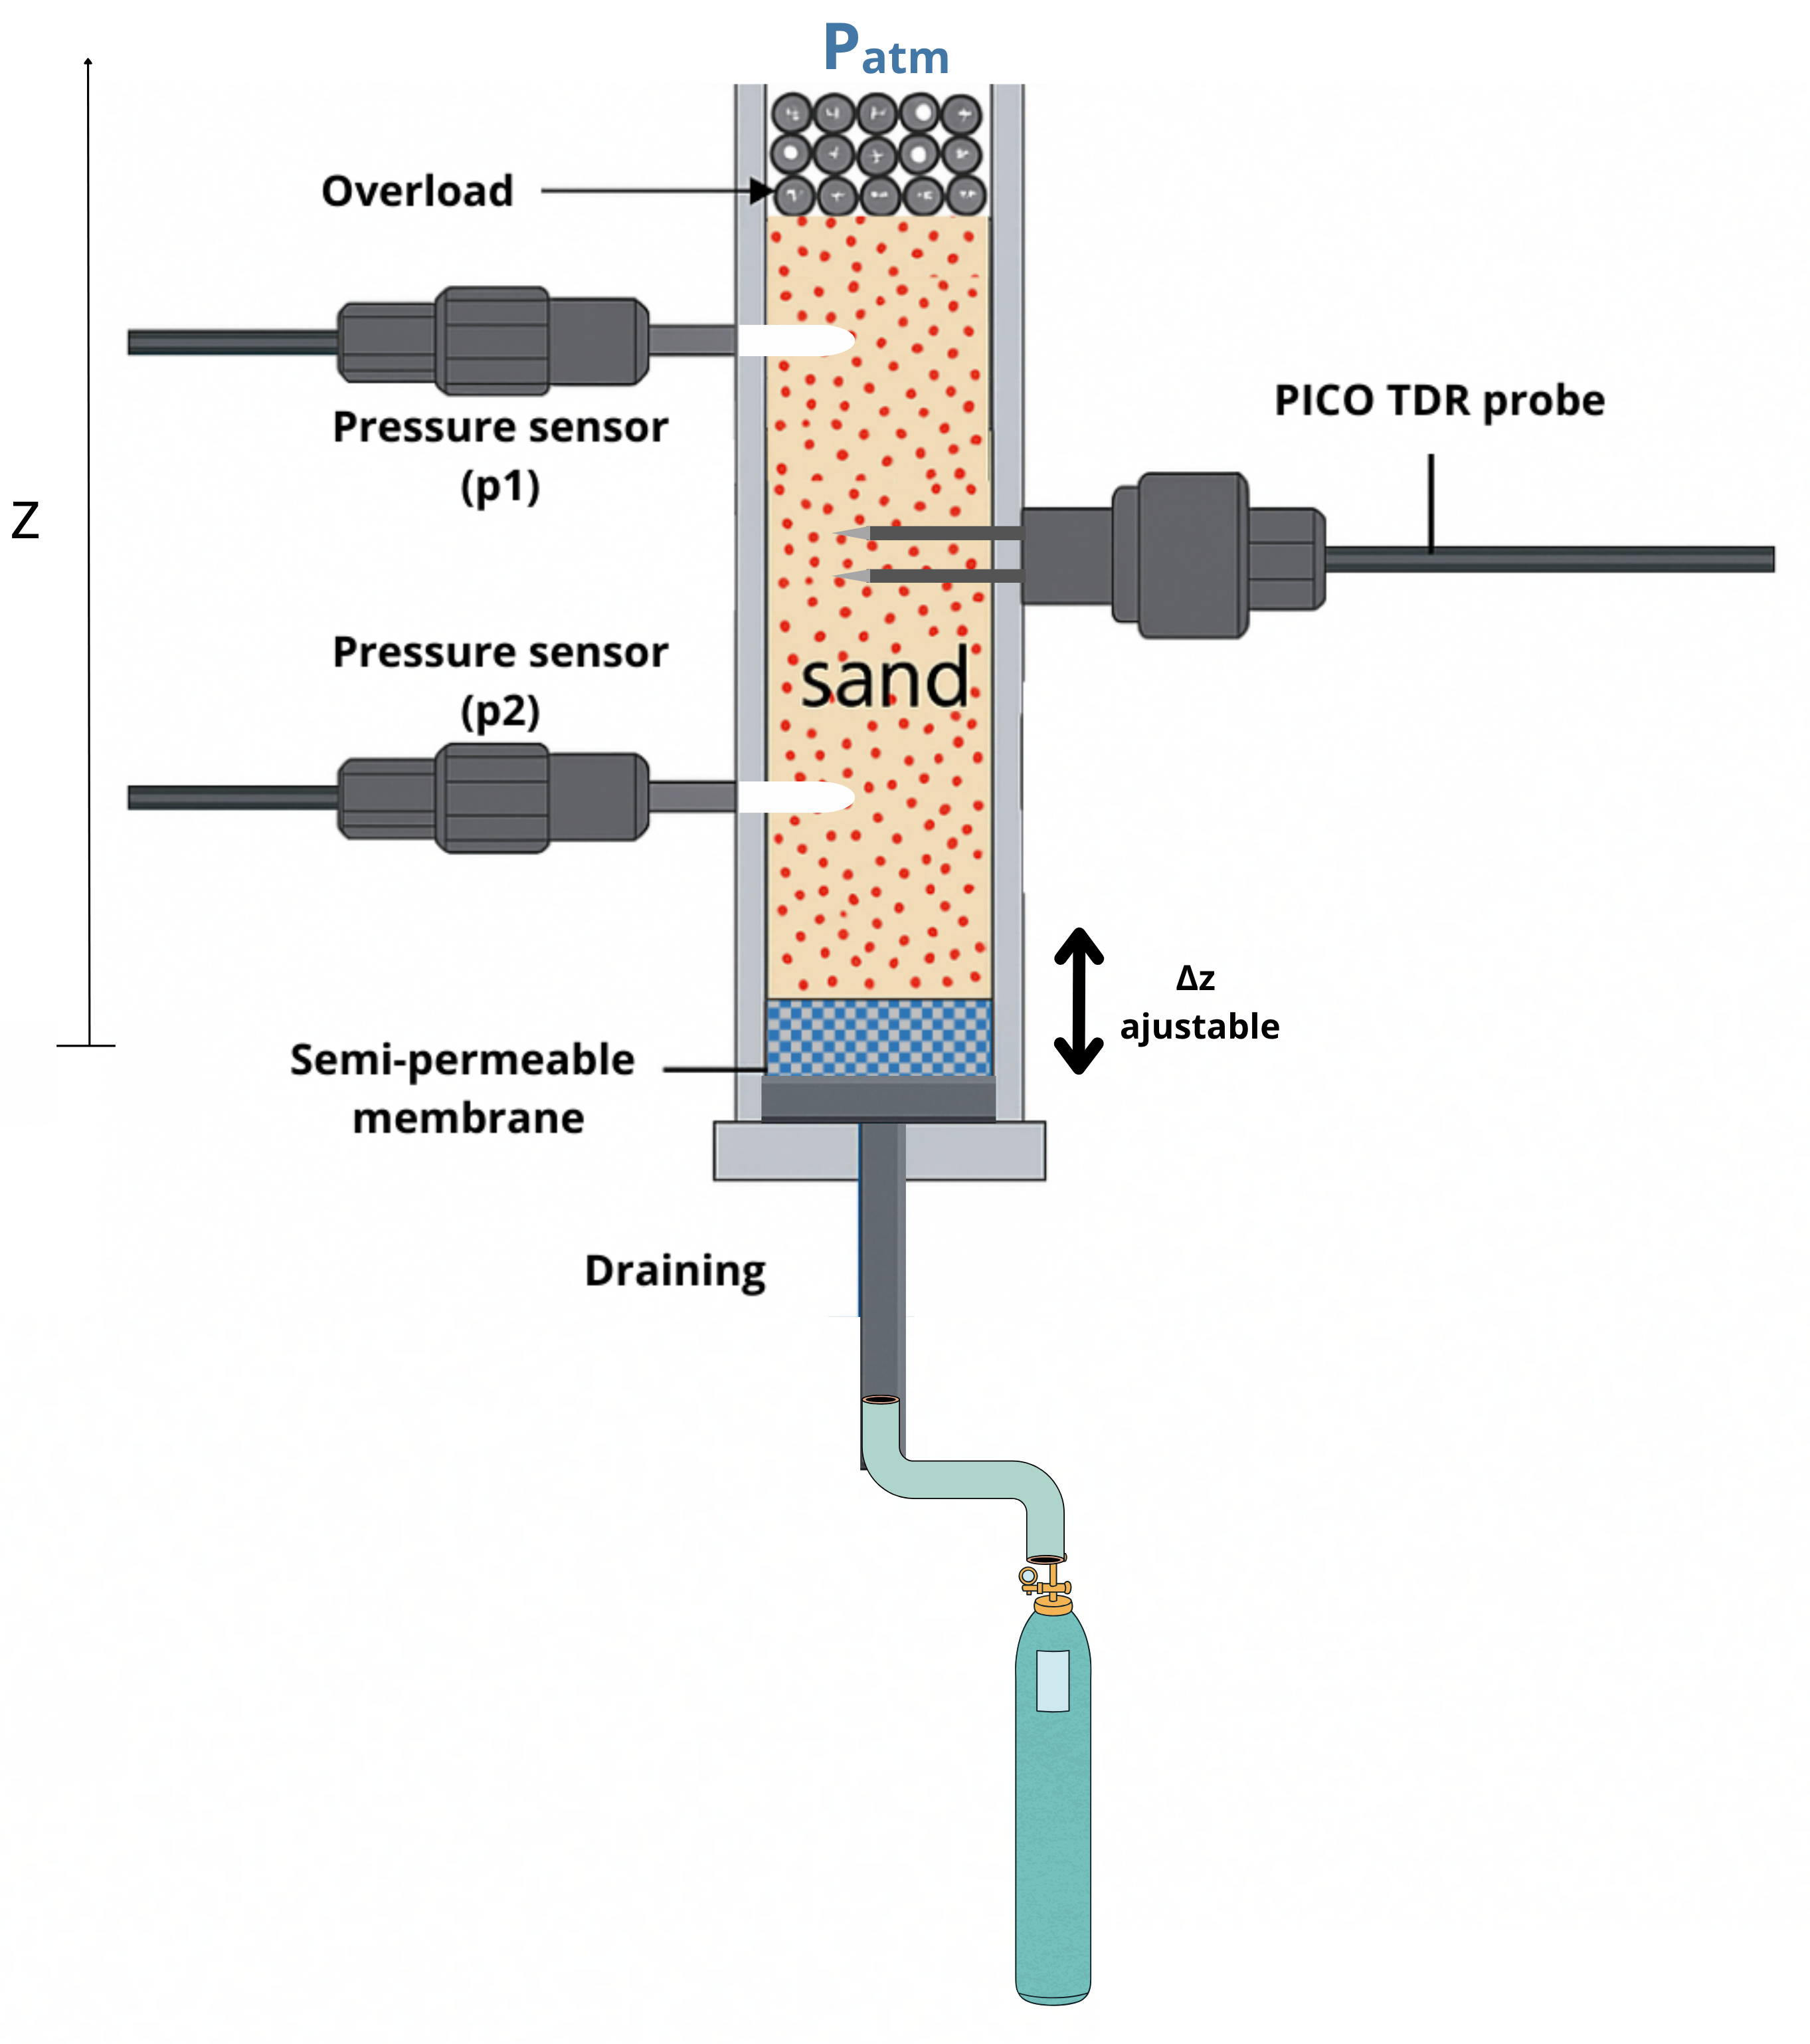
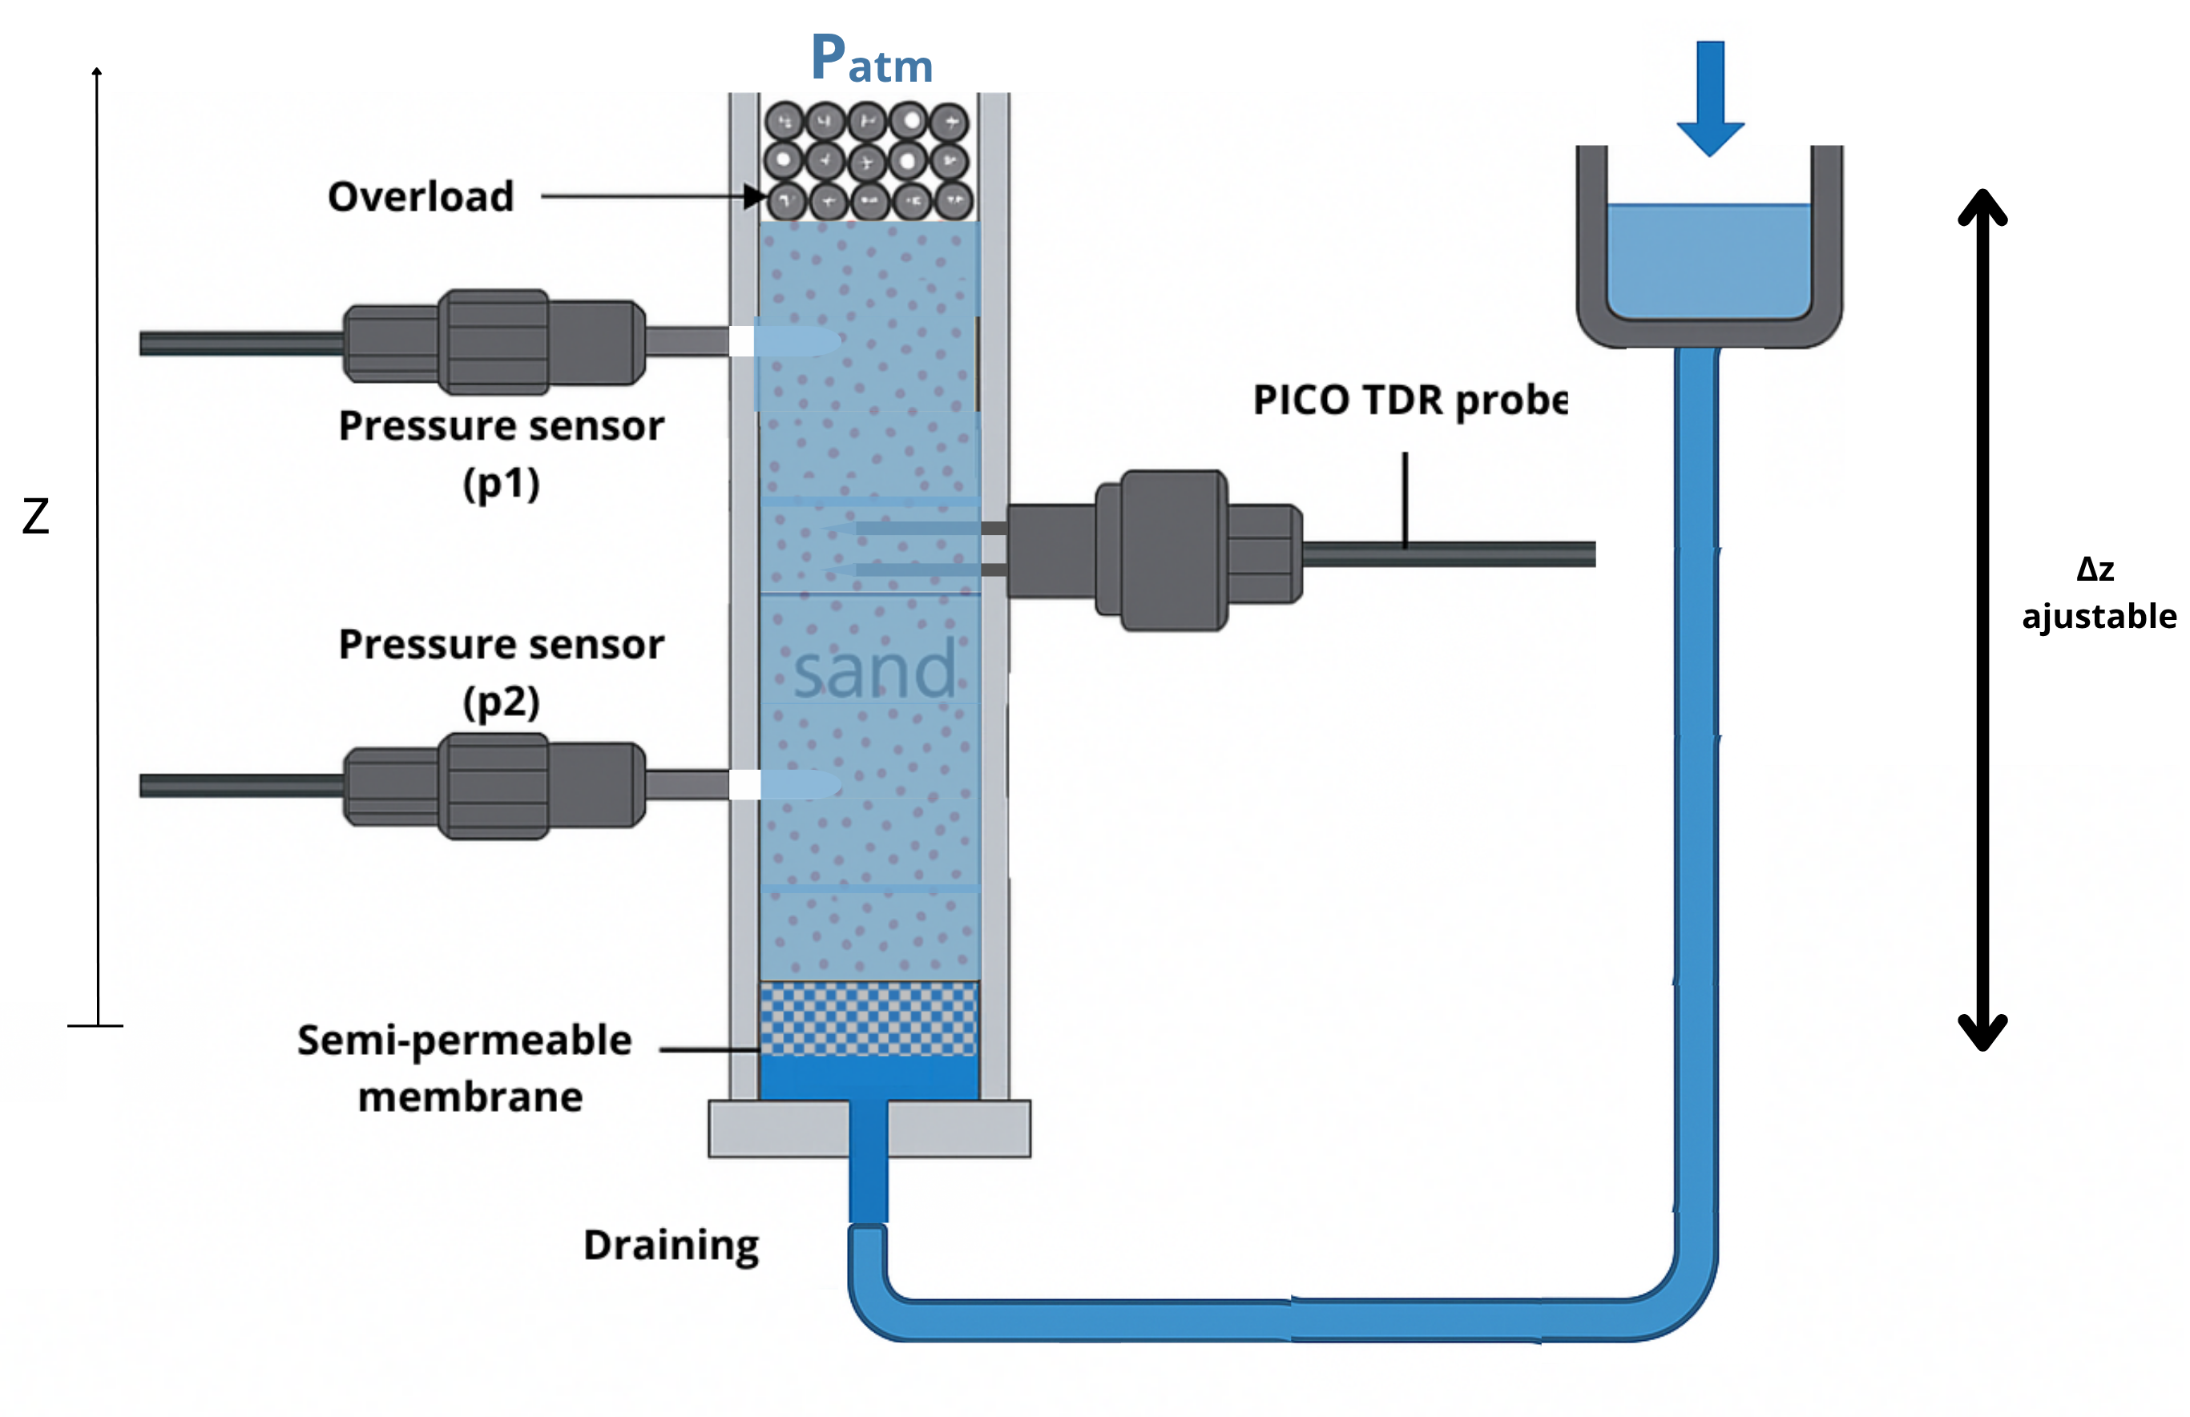
Experimental protocol for the measurement of K_{w}–S
4,5,…
3
1
1
2
Kevin Hernandez-Perez; Gerhard Schäfer; François Lehmann; Mohammad Piri; Renaud Toussaint.
An innovative experimental device to quantify the water relative permeability and in situ water retention curves of unconsolidated porous media.
Comptes Rendus. Géoscience, Volume 357 (2025)
Protocol:
Sand preparation
Nitrogen injection
Primary cycle (PICO calibration)
Main cycle (Kw measurement)
Third cycle (retention curves)
0
1
2
3
4
5
6

Slide 5
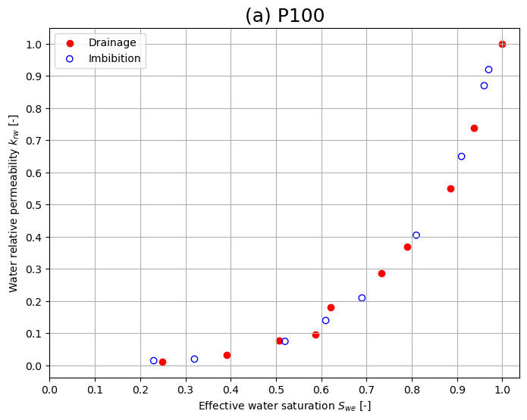
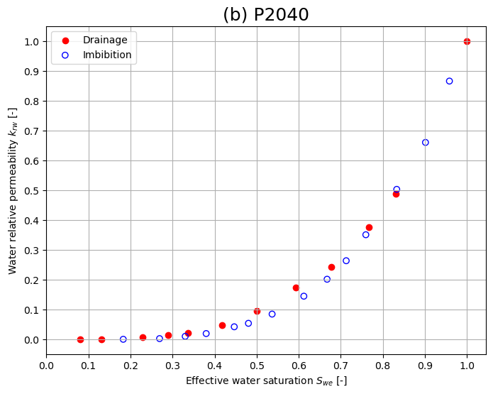

Relative permeability results (kr)
k_{rw} (water-wet sands)
Minimal hysteresis
Quasi-unique k_{rw}-S function
Fig. 3 Experimental water relative permeability (krw) curves as a function of effective water saturation (Swe) for (a) P100 and (b) P2040 sands.
$$S_{we}=\frac{S_{w}−S_{wi}}{S_{w,max}−S_{wi}}$$

Slide 6
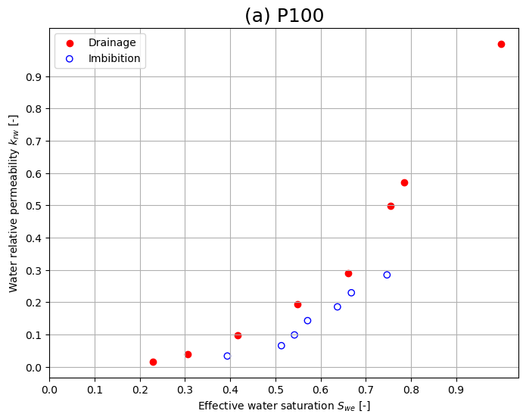
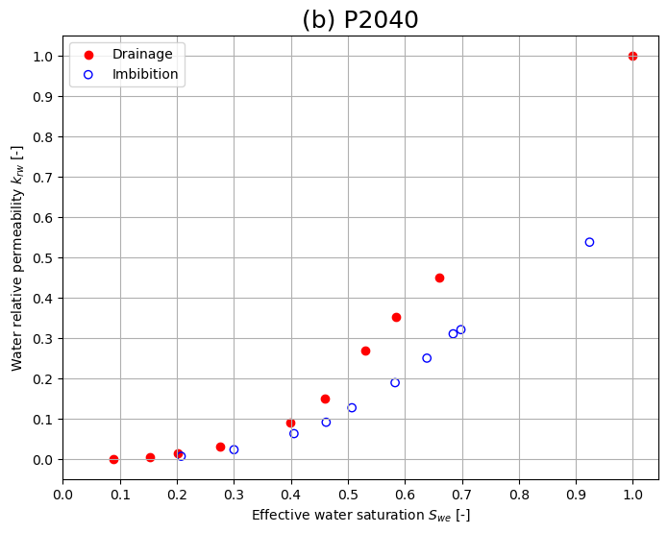
b) k_{rw} (oil-wet sands)
Hysteresis presence
aged
aged
Fig. 4 Experimental water relative permeability (krw) curves as a function of effective water saturation (Swe) for the (a)P100 and (b)P2040 sands under oil-wet conditions.

Slide 7
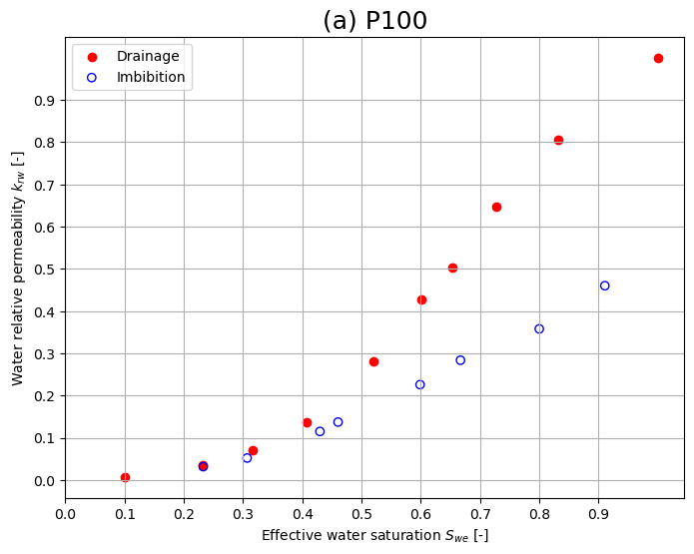
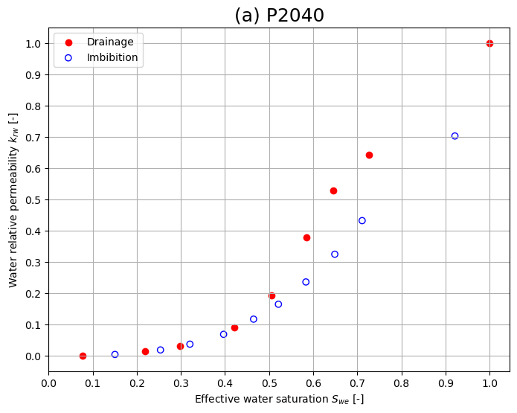
c) k_{rw} (fractional wetting) (50% water-wet, 50% oil-wet)
Fig. 5 Water relative permeability (krw) curves as a function of effective water saturation (Swe) for a 50/50 mixture of water-wet and oil-wet sands.

Slide 8
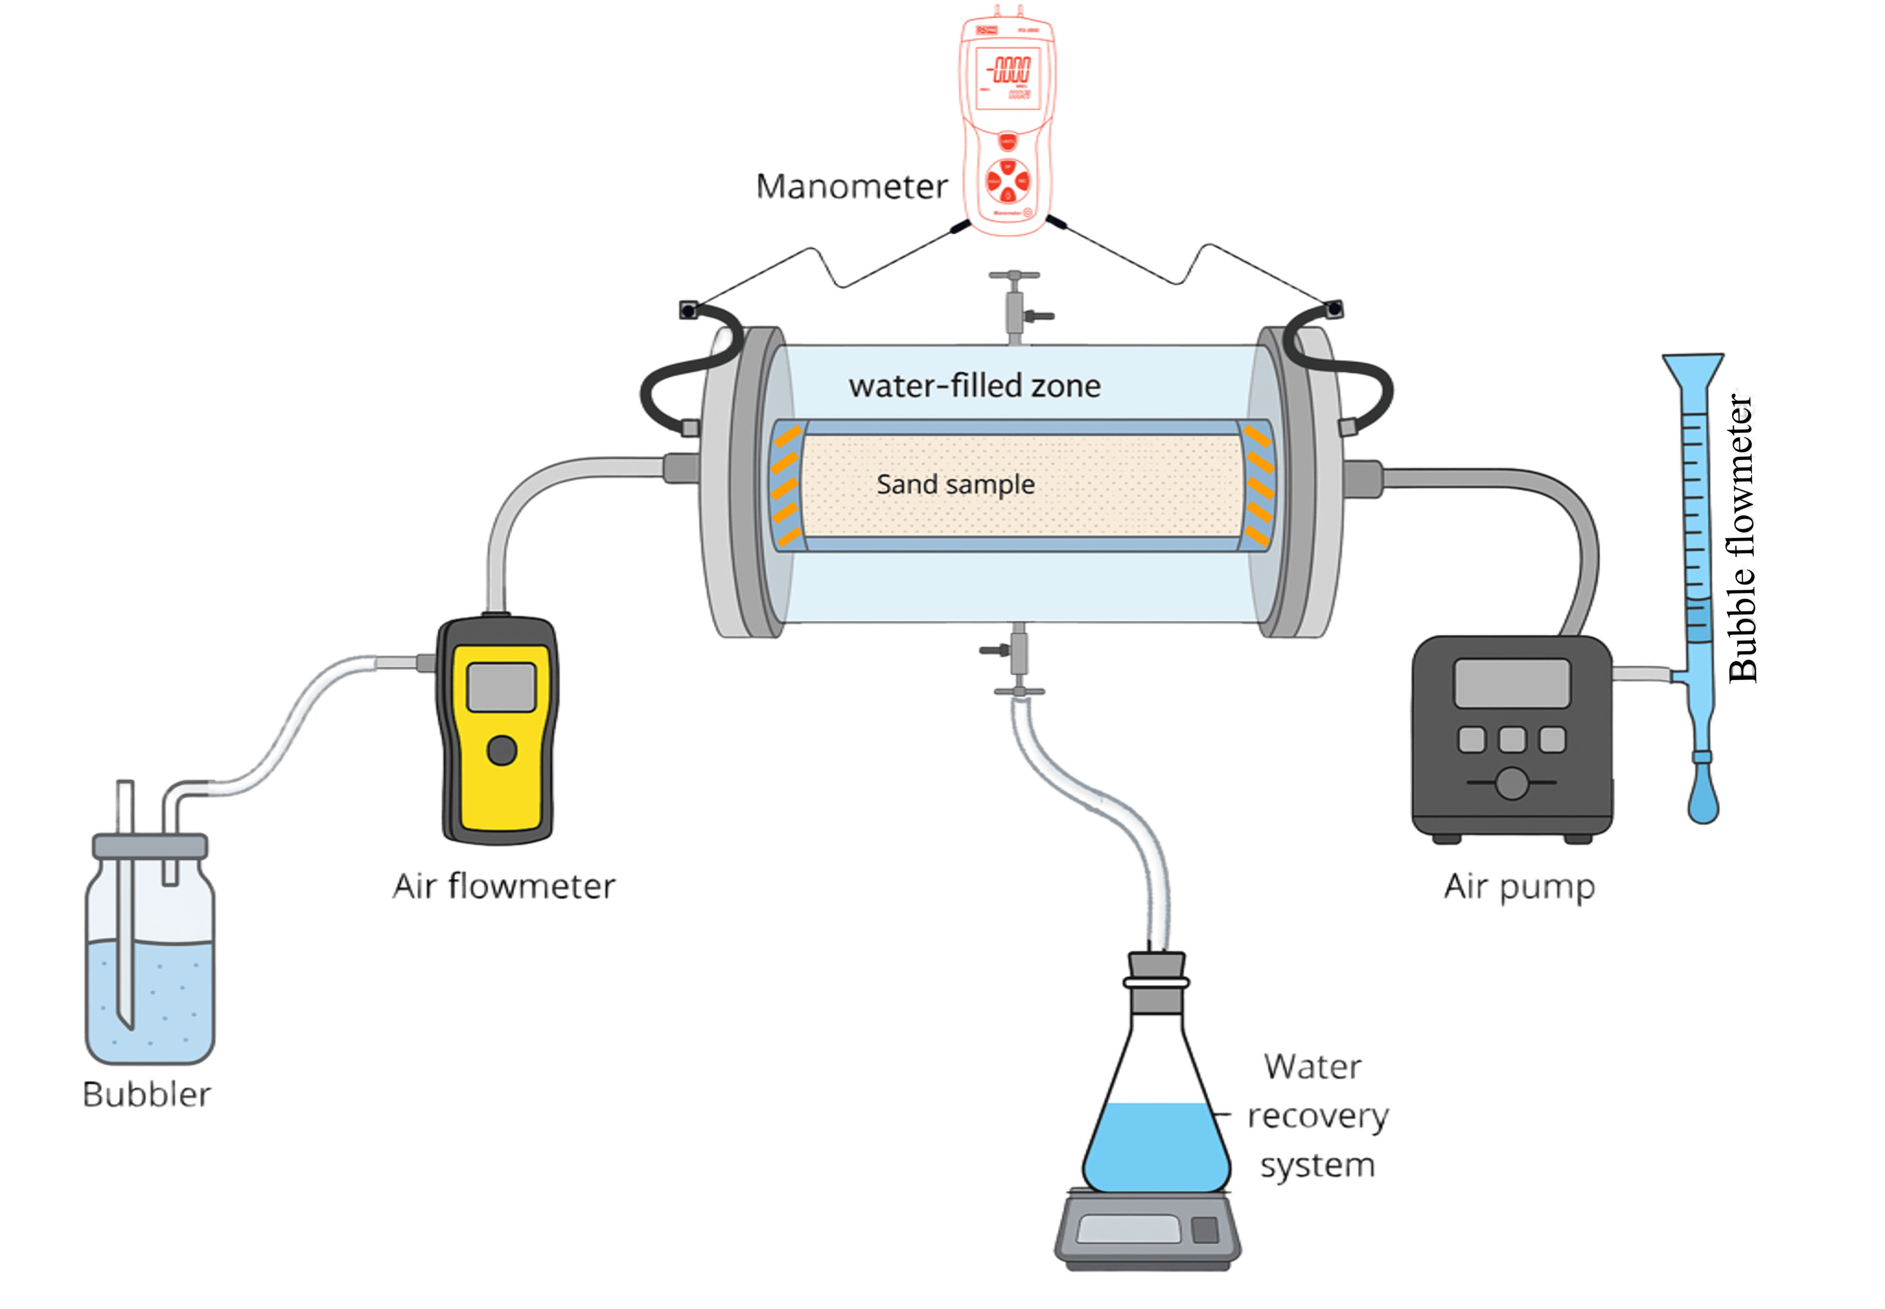
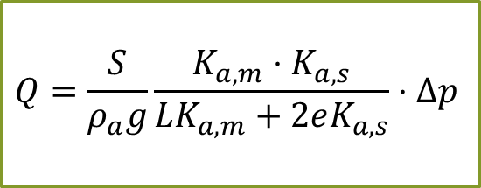
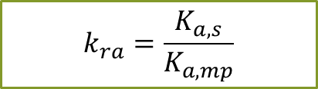
Materials and methods: Experimental setup for the measurement of K_{a}–S
$$Q=\frac{S}{ρ_{a}g}\frac{K_{a,m}⋅K_{a,s}}{LK_{a,m}+2eK_{a,s}}⋅Δp$$
Δz
$$k_{ra}=\frac{K_{a,s}}{K_{a,mp}}$$
Fig. 6 Design of the experimental setup to measure air conductivity as function of water saturation.

Slide 9
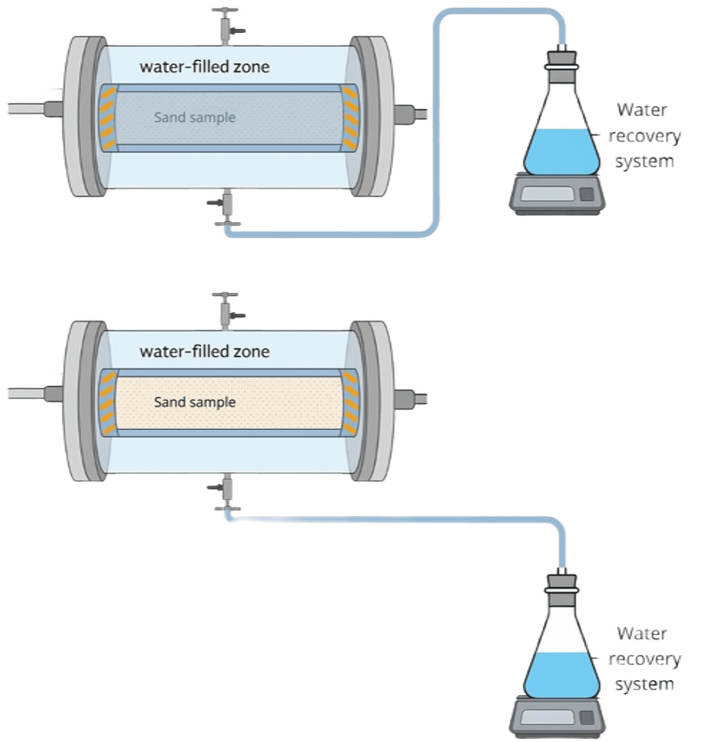

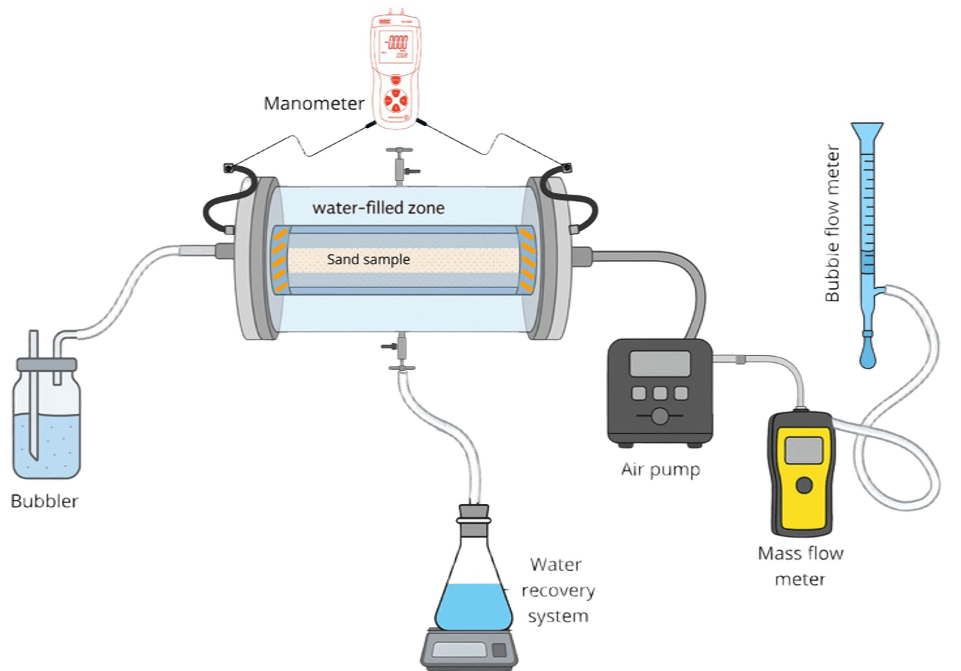
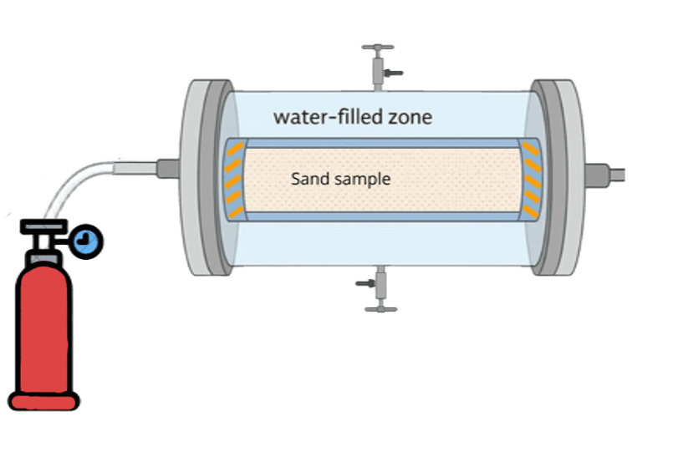
Experimental protocol for the measurement of K_{a}–S
3, 4
1
Kevin HERNANDEZ-PEREZ, Gerhard SCHÄFER, Amir H. Alizadeh et al. Design of a hydraulically confined column device for simultaneous measurement of air relative permeability and water retention in unconsolidated porous media, 28 April 2026, PREPRINT (Version 1)
Protocol:
Sand preparation
Nitrogen injection
Primary cycle
Main cycle (Ka measurement - water retention curves)
2
0
1
Δz
2
3
4

Slide 10
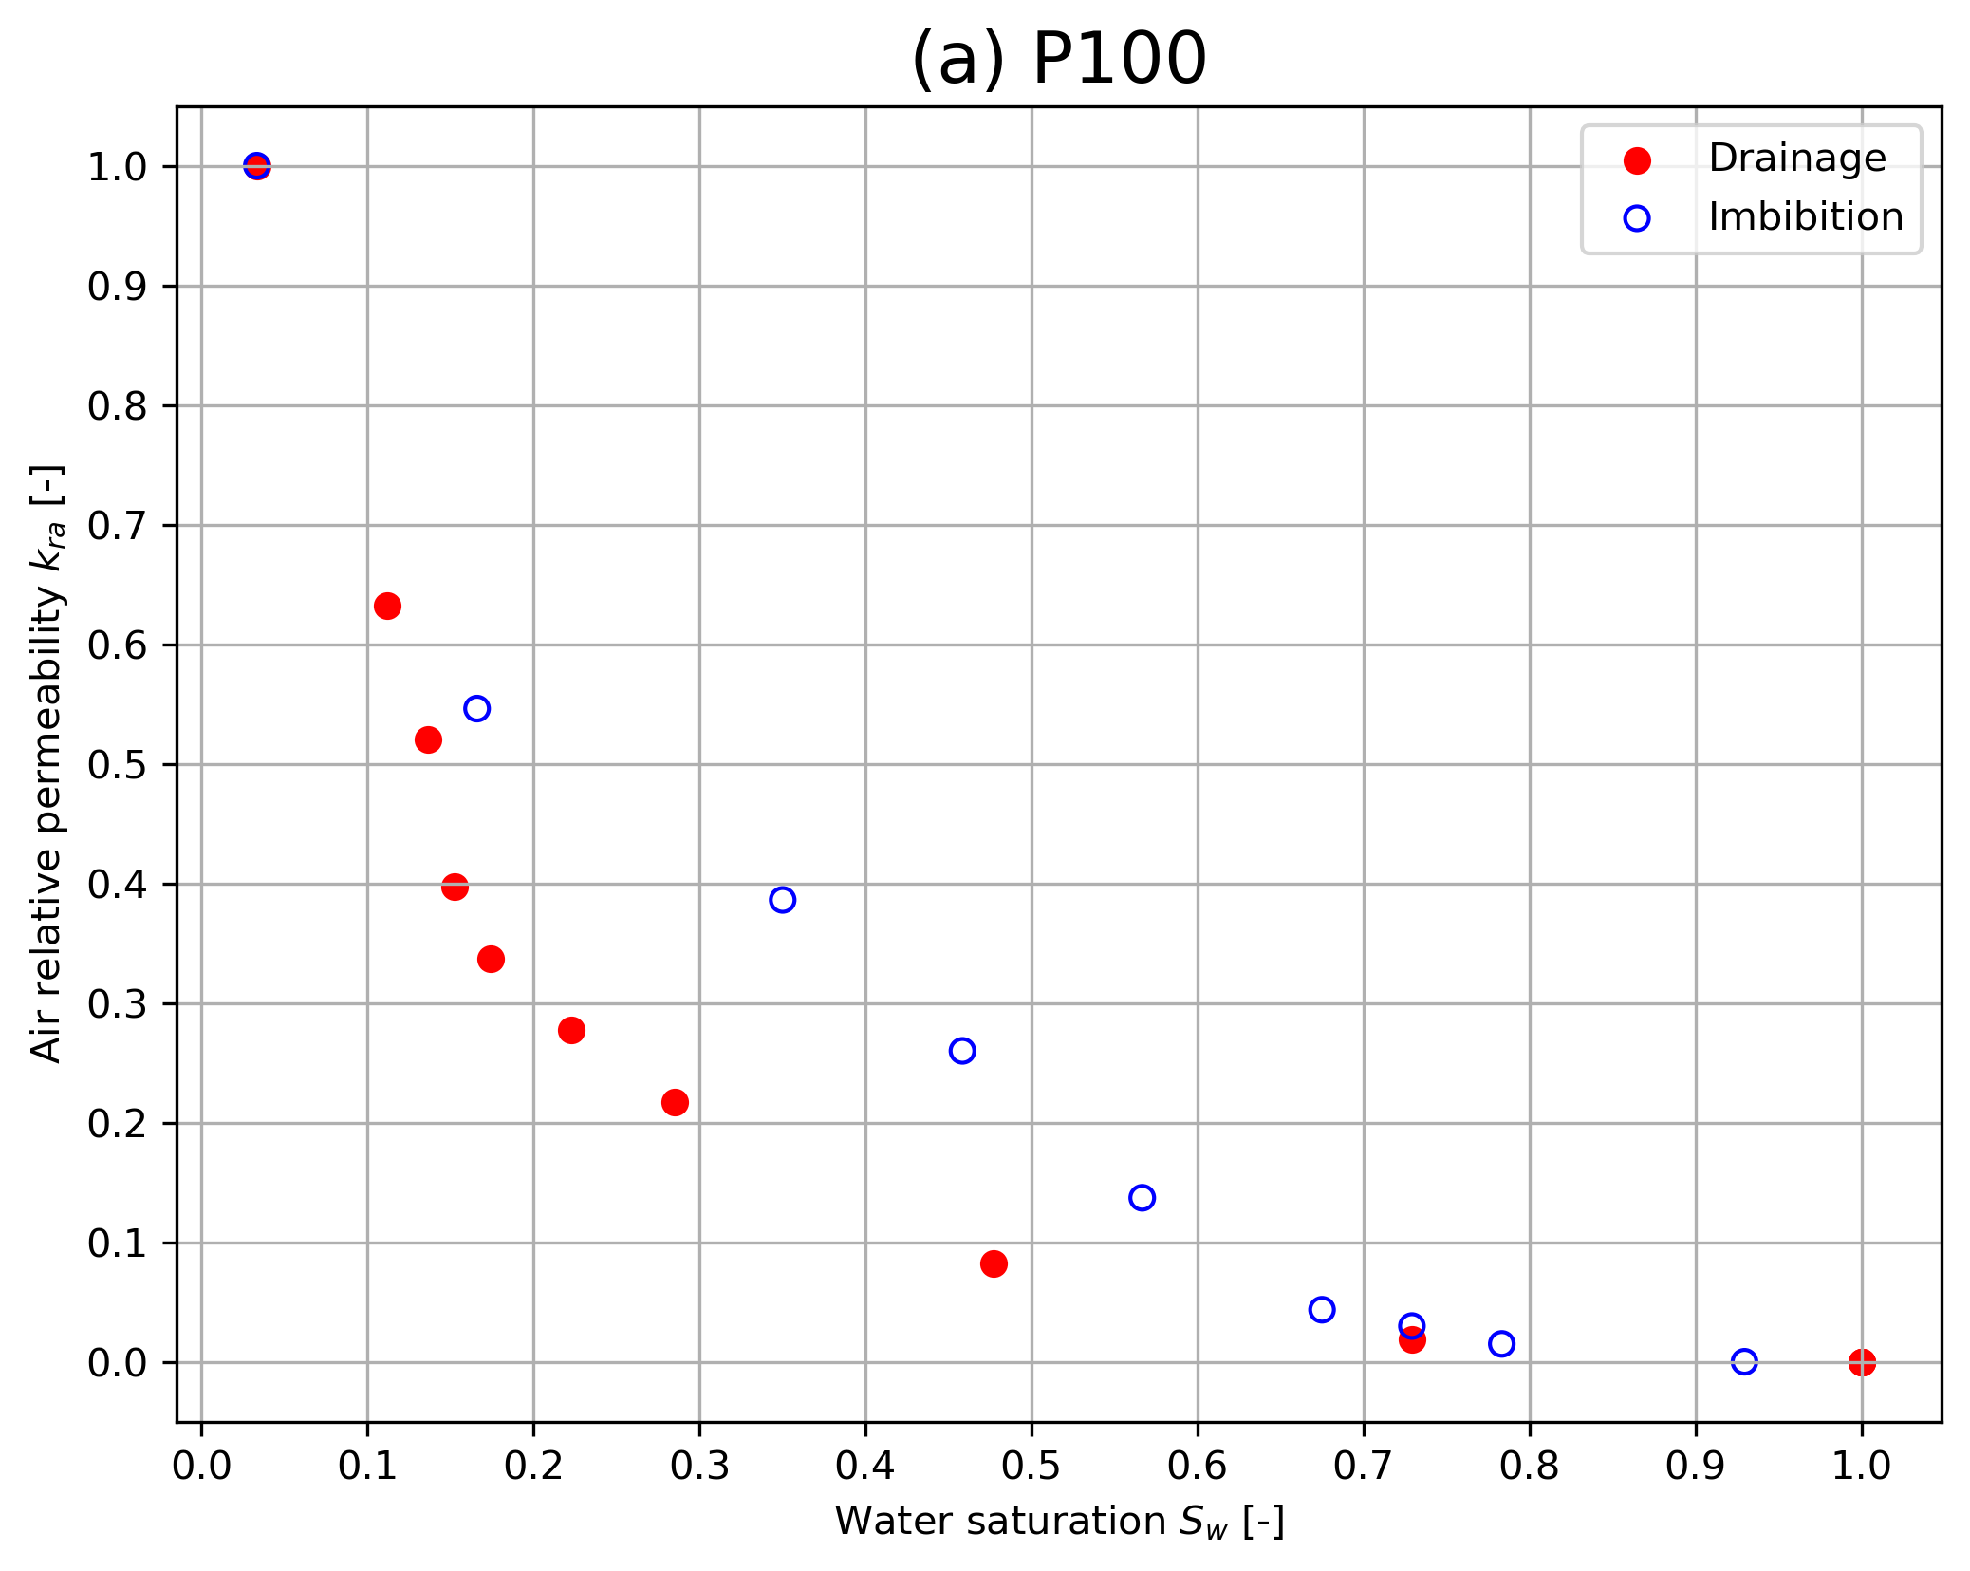
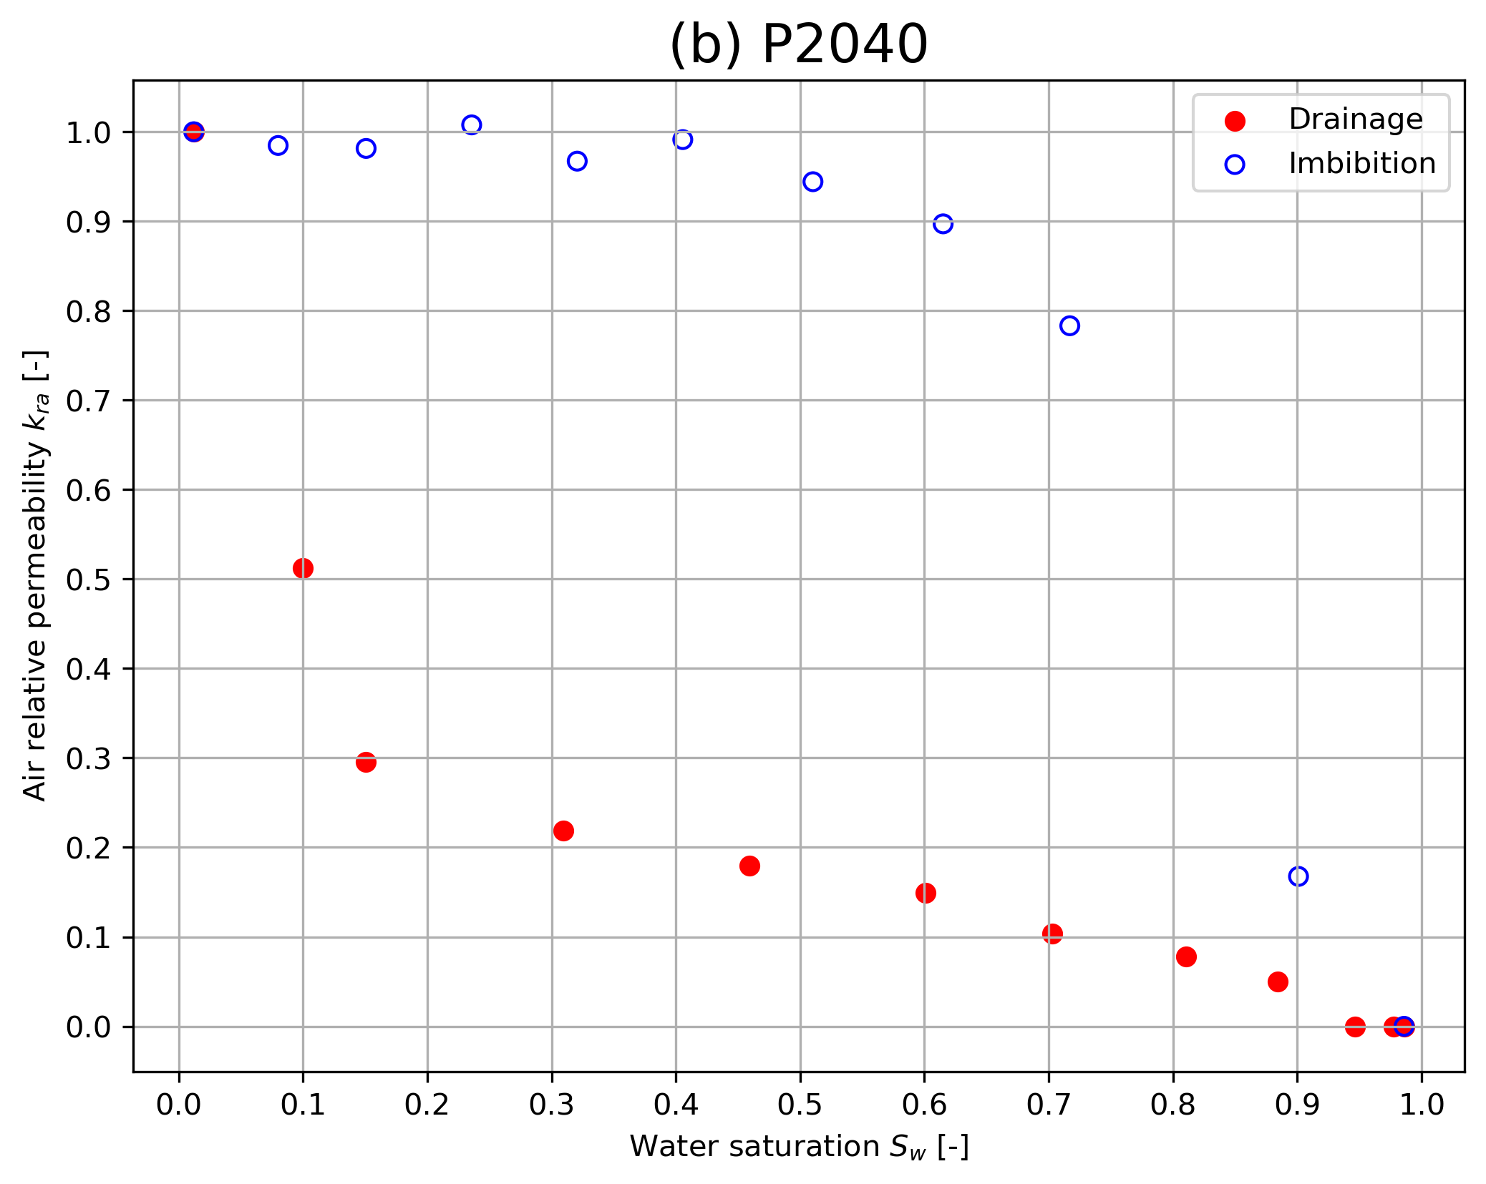
Results-kr
k_{ra} (water-wet sands)
Hysteresis presence
$$q_{a}=−\frac{kk_{ra}}{μ_{a}}∇P_{a} ⇒ q_{a}=−\frac{k}{μ_{a}}(k_{aa}∇P_{a}+k_{aw}∇P_{w})$$
Fig. 7 Experimental air relative permeability (kra) curves as a function of water saturation (Sw) for (a) P100 and (b) P2040 sands.

Slide 11
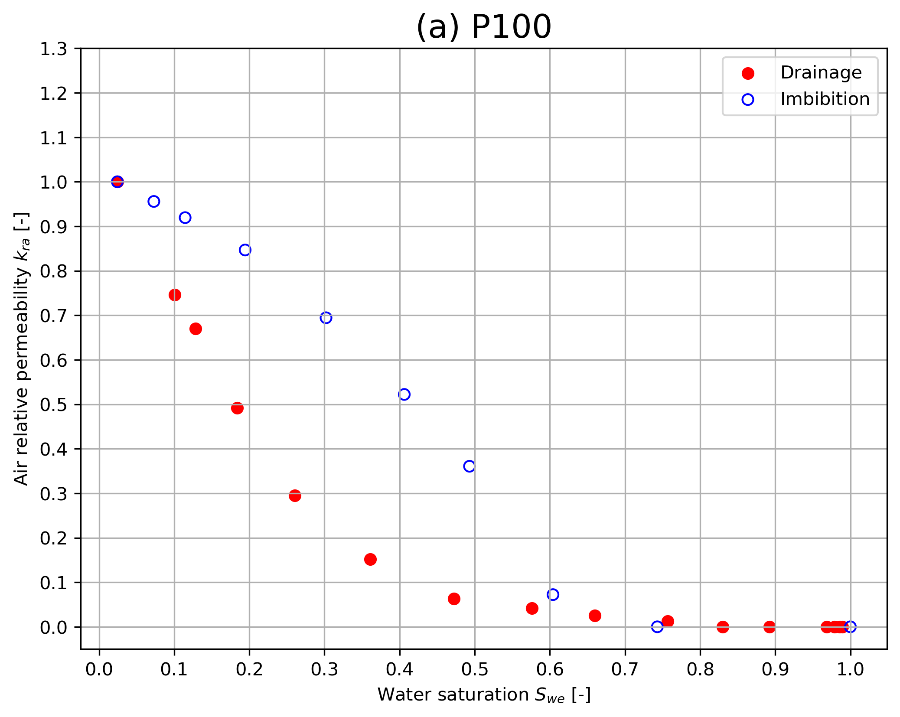
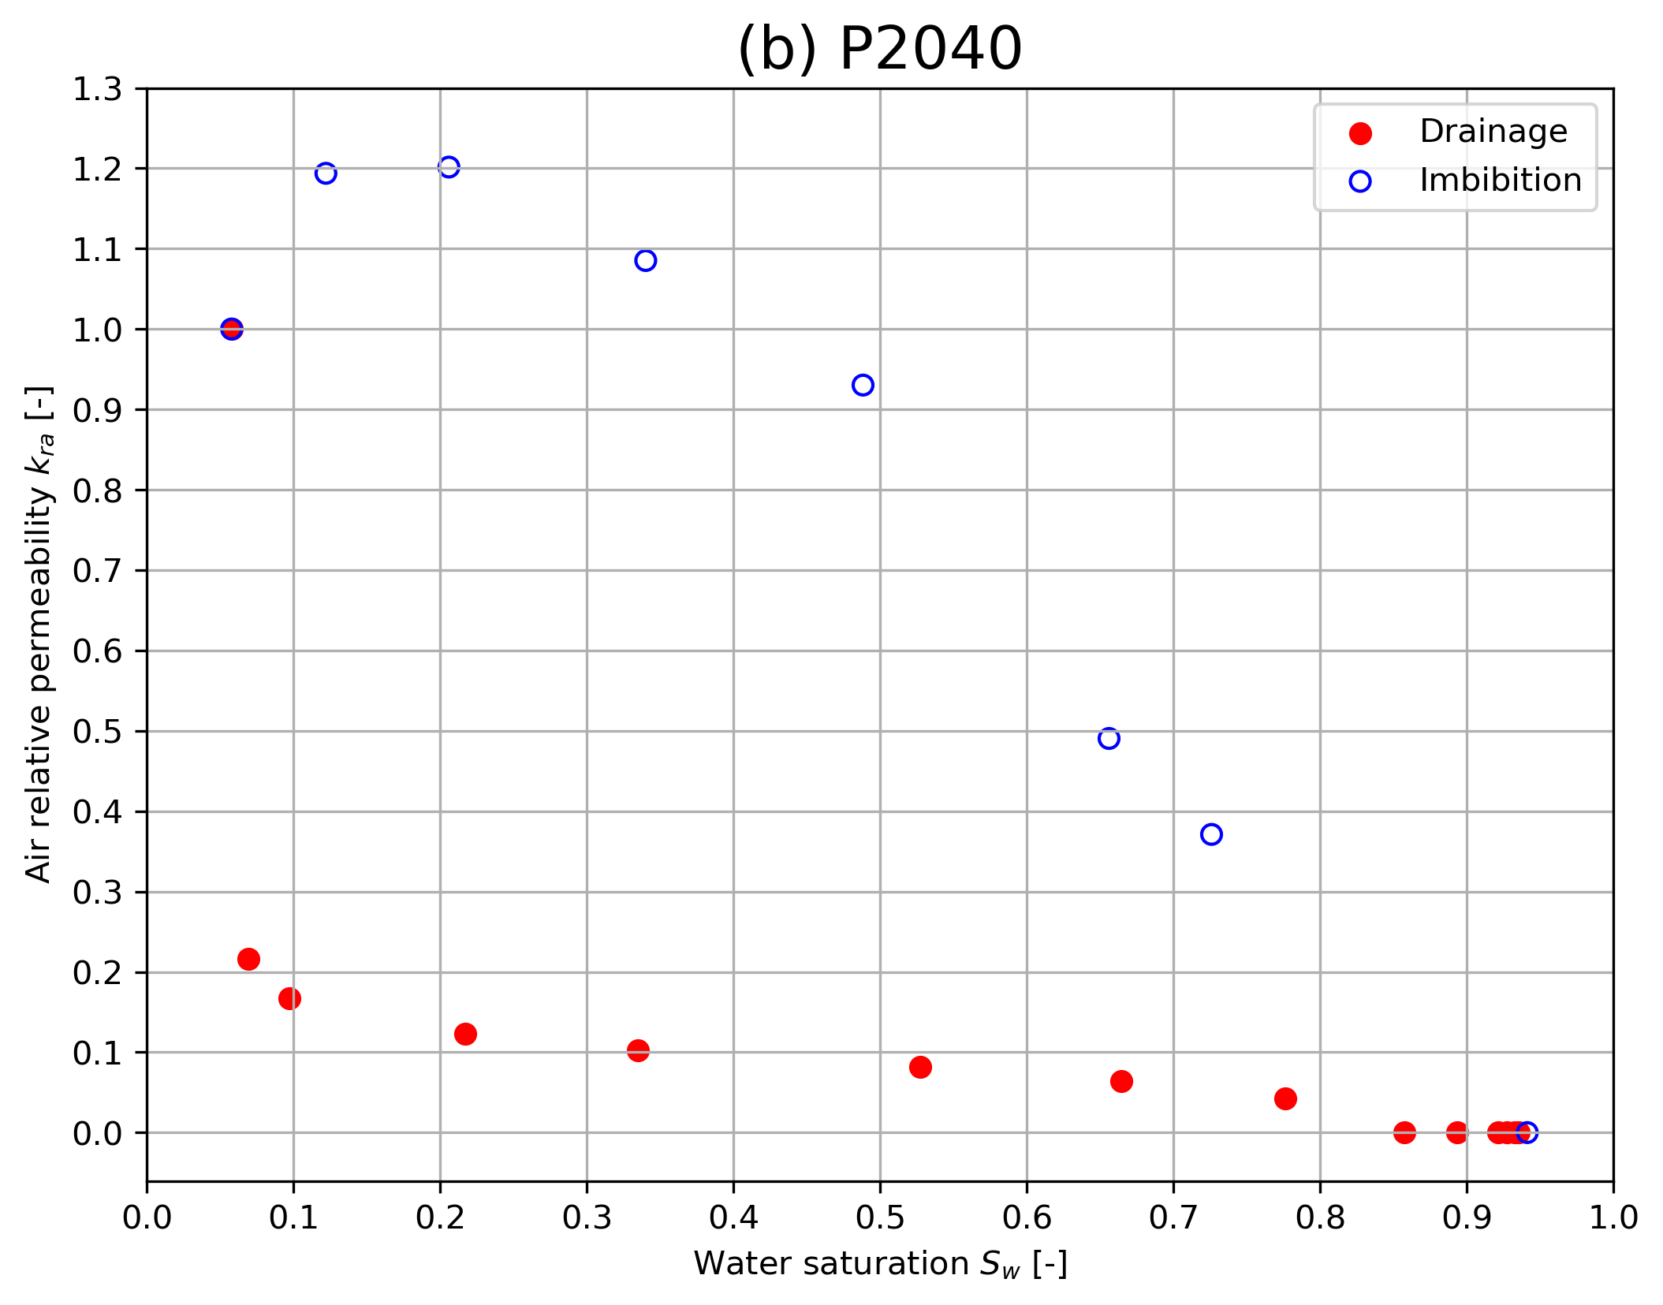
b) k_{rw} (oil-wet sands)
Hysteresis presence
Fig. 8 Experimental air relative permeability (kra) curves as a function of water saturation (Sw) for the (a)P100 and (b)P2040 sands under oil-wet conditions.

Slide 12
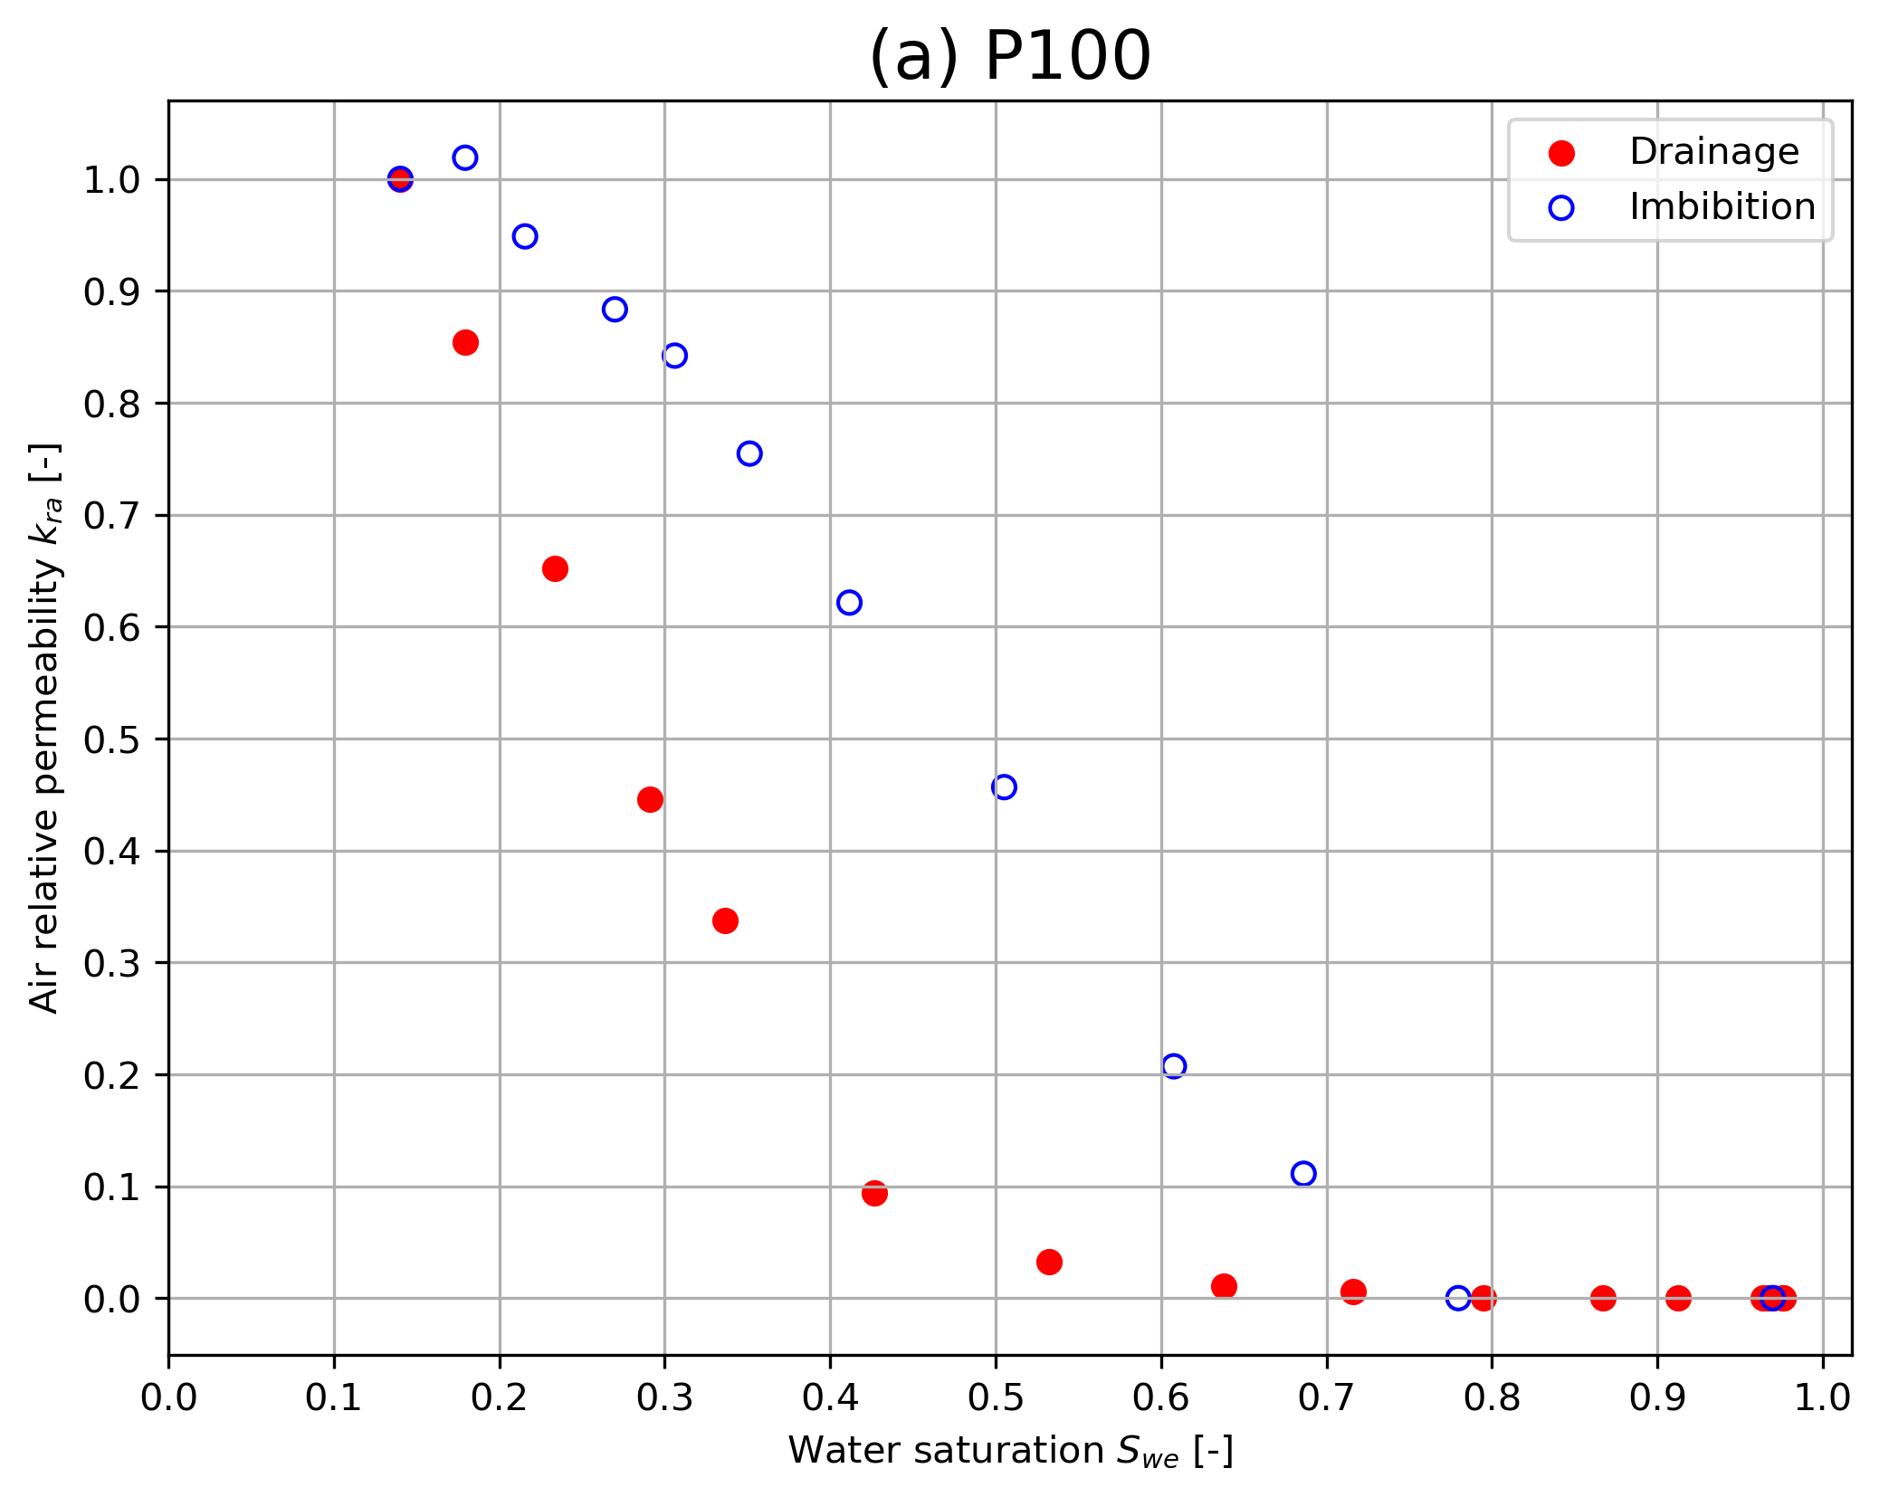
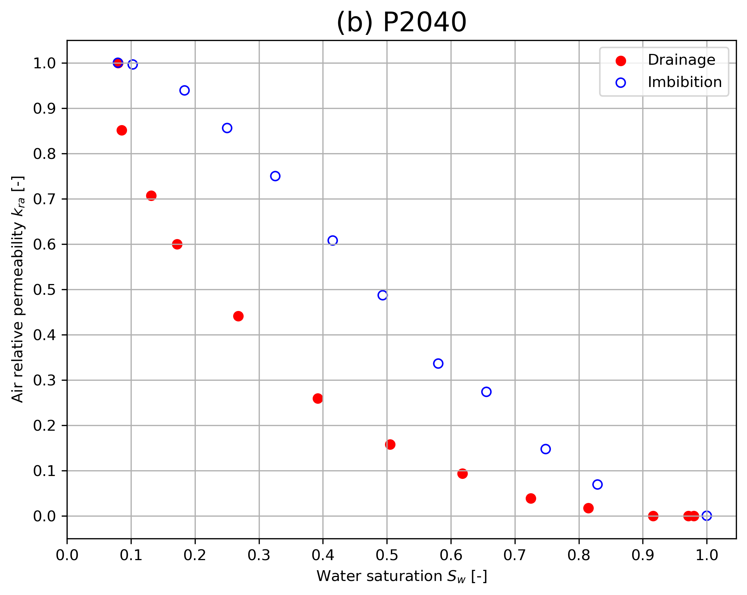
c) k_{ra} (fractional wetting) (50% water-wet, 50% oil-wet)
Fig. 9 Experimental air relative permeability (kra) curves as function of water saturation (Sw) for a 50/50 mixture of water-wet and oil-wet sands.

Slide 13
Capillary pressure results (Pc - unaged sands)
Fig. 10 Experimental water retention curves (Pc) as a function of water saturation (Sw) for the (a) P100 and (b)P2040 sands under water-wet conditions.

Slide 14
Results-Pc (aged sand)
Fig. 11 Experimental water retention curves (Pc) as a function of water saturation (Sw) for the (a) P100 and (b)P2040 sands under oil-wet conditions.

Slide 15
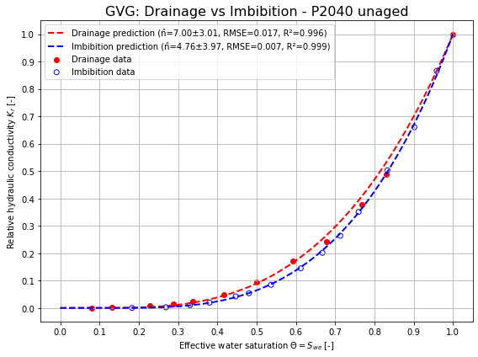
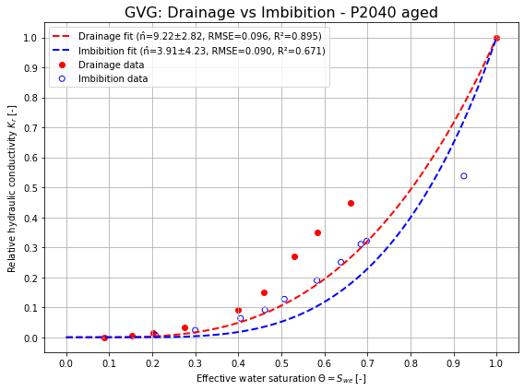
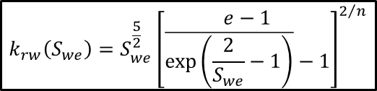

Predictive modelling using General van Genuchten (GVG) parameters from water retention curves
(Ghorbani, A., Sadeghi, M., Tuller, M., Durner, W., & Jones, S. B. (2024). A generalized van Genuchten model for unsaturated soil hydraulic conductivity. Vadose Zone Journal, 23(5), e20369. https://doi.org/10.1002/vzj2.20369)
$$k_{rw}\left(S_{we}\right)=S_{we}^{\frac{5}{2}}{\left[\begin{matrix}ⅇ−1 \\ \overline{\exp\left(\frac{2}{S_{we}}−1\right)}−1\end{matrix}\right]}^{2/n}$$
$$S_{we}={\left\{1+\ln\left[1+{\left(αp_{c}\right)}^{n}\right]\right\}}^{−m}$$
$$m=1−\frac{1}{n}$$
Fig. 12 Water relative permeability (krw) as function of effective water saturation (Swe) for sand P2040. Experimental data are shown for drainage (red filled circles) and imbibition (blue unfilled circles). Solid lines represent the predicted krw curves obtained from the General van Genuchten model using the fitted capillary pressure parameters obtained in Figures 3 and 4.

Slide 16
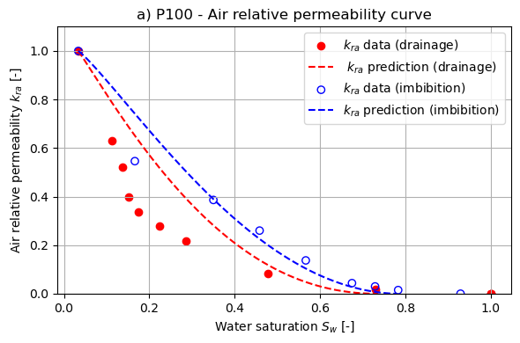
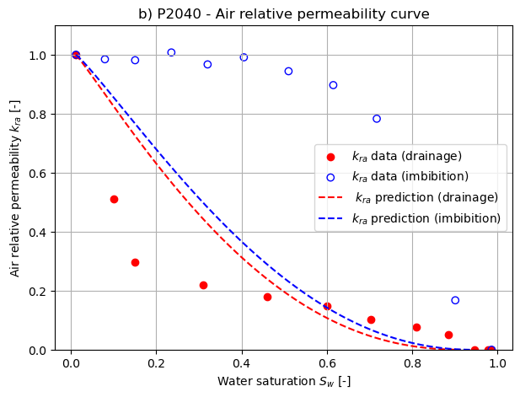

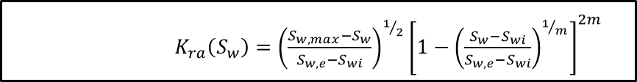
Predictive modelling using van Genuchten (VG) parameters from water retention curves
$$S_{w}={\left\{1+{\left(αp_{c}\right)}^{n}\right\}}^{−m}$$
$K_{ra}\left(S_{w}\right)={\left(\frac{S_{w,max}−S_{w}}{S_{w,e}−S_{wi}}\right)}^{1/2}{\left[1−{\left(\frac{S_{w}−S_{wi}}{S_{w,e}−S_{wi}}\right)}^{1/m}\right]}^{2m}$
$$m=1−\frac{1}{n}$$
Fig. 13 Air relative permeability (kra) as function of water saturation (Sw) for sands P100 and P2040. Experimental data are shown for drainage (red filled circles) and imbibition (blue unfilled circles). Solid lines represent the predicted kra curves obtained from the van Genuchten model.

Slide 17
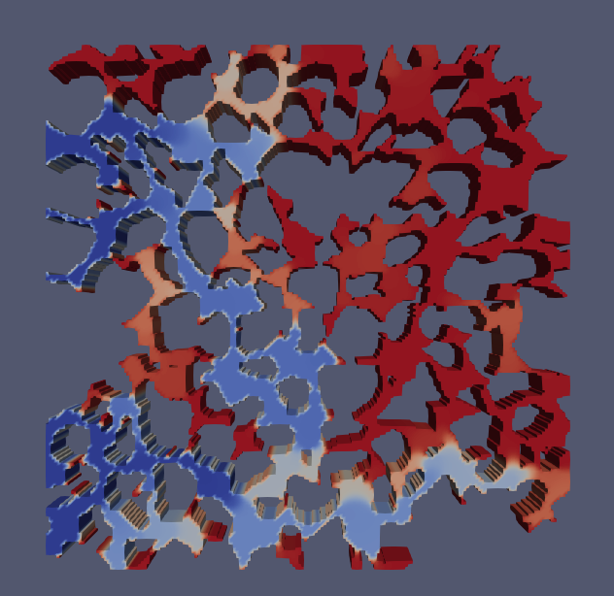
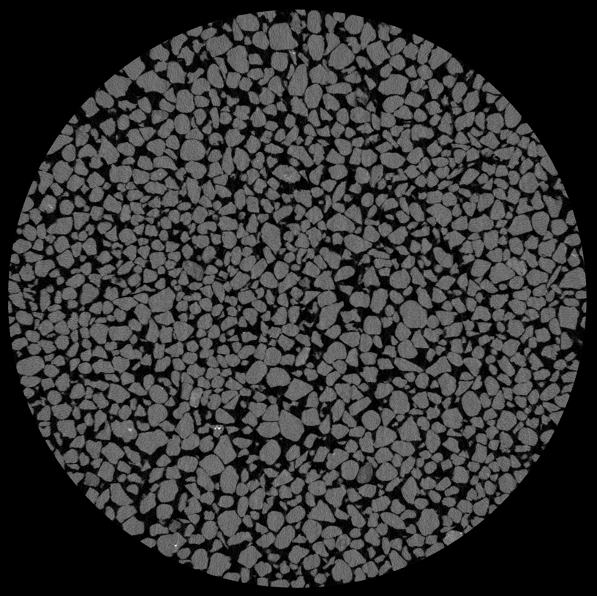
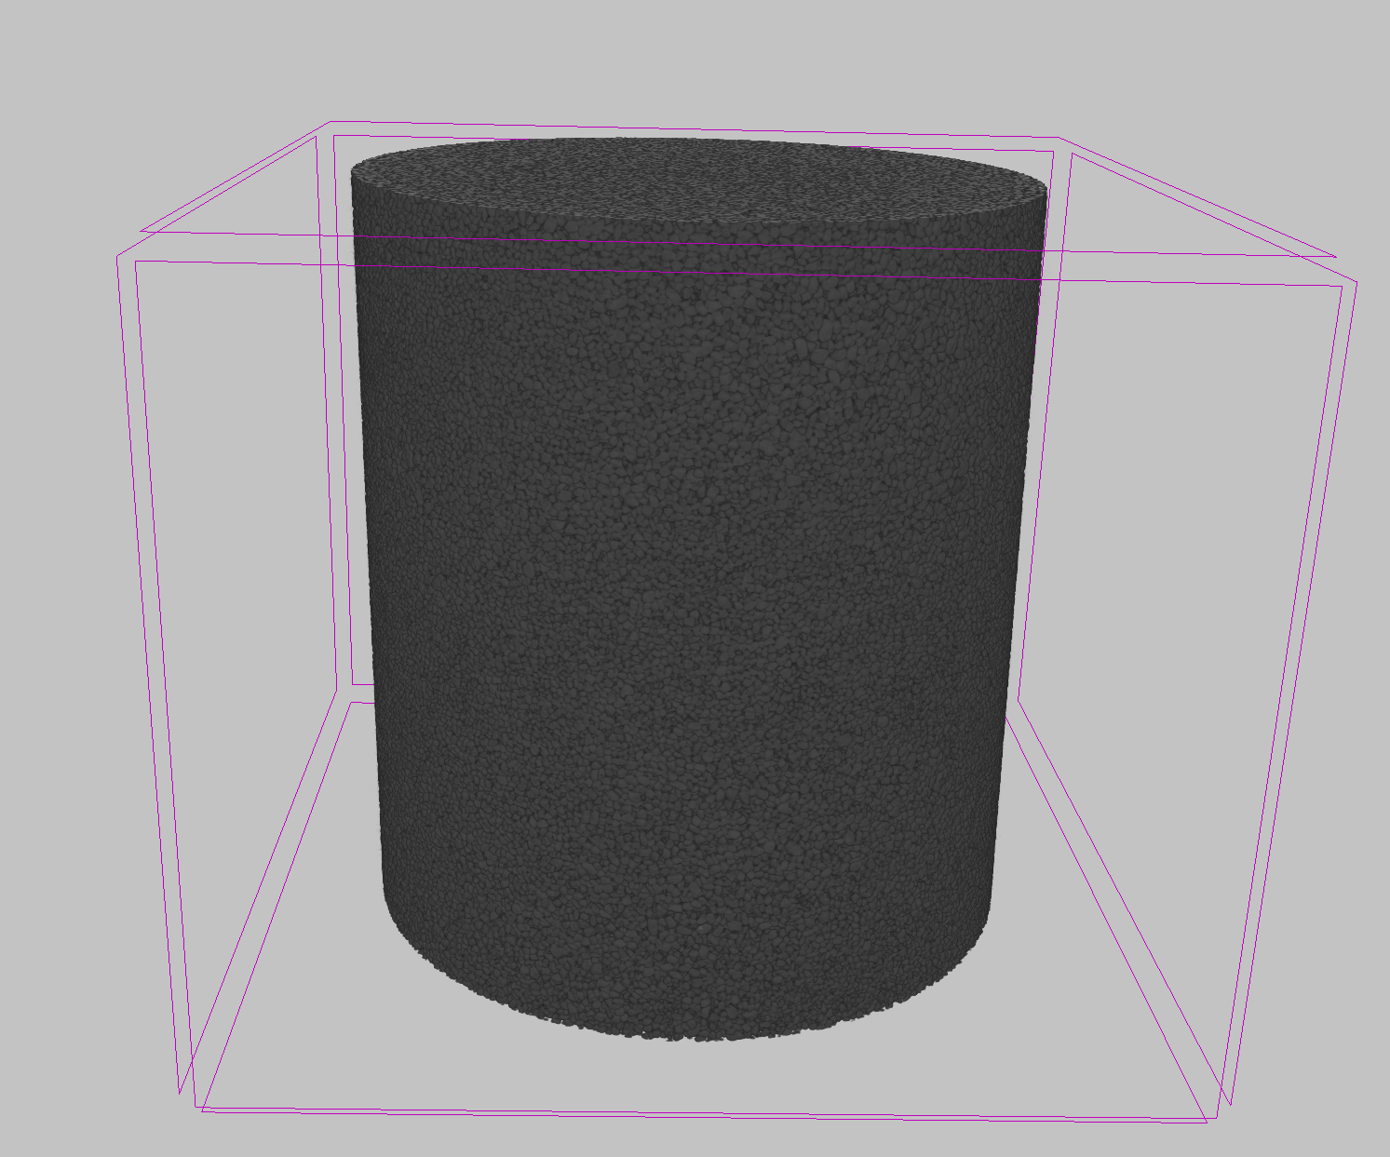
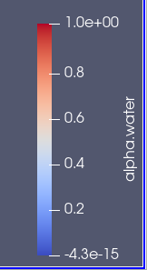
Ongoing work: OpenFOAM simulations
Pore-scale numerical modelling based on X-ray microtomography images is currently being conducted using OpenFOAM to investigate the microscopic displacement mechanisms observed experimentally.
Fig. 14 X-ray tomography images and reconstruction for the coarse sand P2040.
Fig. 15 Simulation of the drainage process during air injection.

Slide 18
Take-home messages
Wettability controls the shape and hysteresis of relative permeability curves.
Air relative permeability is strongly path-dependent and cannot be explained only by saturation.
Retention-based predictive models capture general trends but miss important pore-scale mechanisms.

Slide 19
Thank you!

