Slide 1


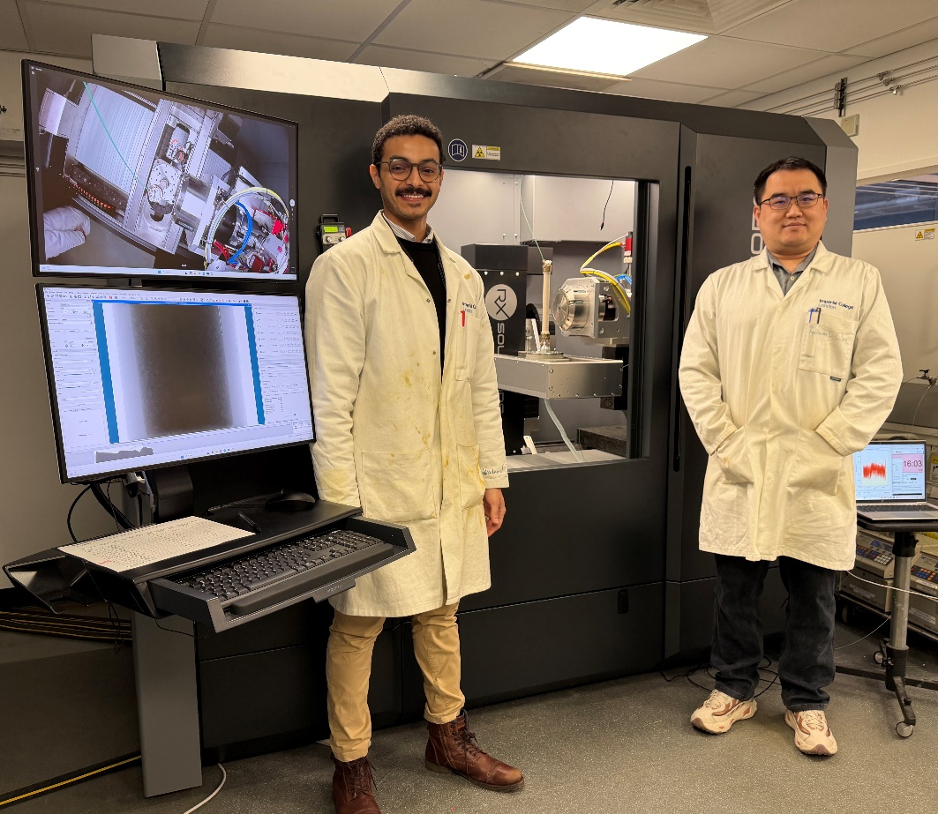

Using pore-scale imaging and modelling for the design of porous materials
Martin Blunt, Branko Bijeljic, Linqi Zhu,Yihuai Zhang, Sajjad Foroughi, Rukuan Chai
Zhejiang University: Yingshi Zhang, Jin-Ping Yang, Ming-Liang Qu, Jie Luo, Qingyang (Lewis) Lin

Slide 2
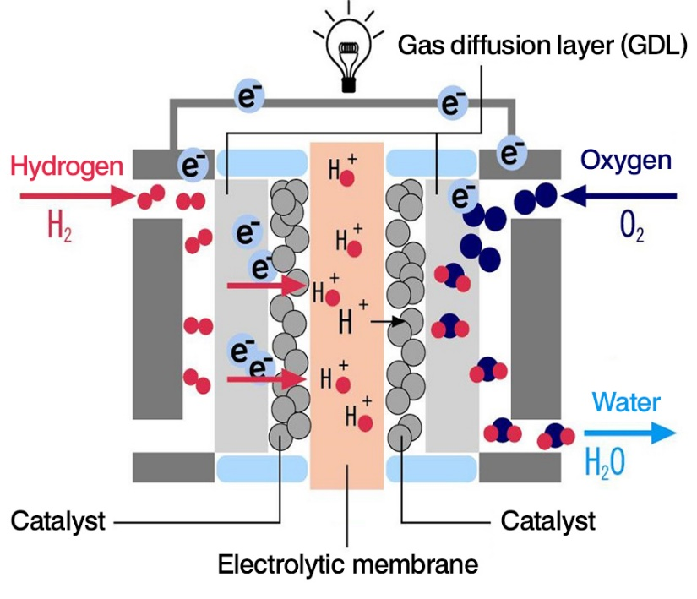
Many of the societal challenges for the 21st century involve flow in porous media
CO₂ storage underground
Groundwater use and protection
Geothermal energy
Hydrogen storage
Electrochemical devices
Packed bed reactors
Oil & gas production (still >50% world energy production)
Hodges et al. Nature Communications (2022)
Hematpur et al. Advances in Geo-Energy Research (2023)

Slide 3
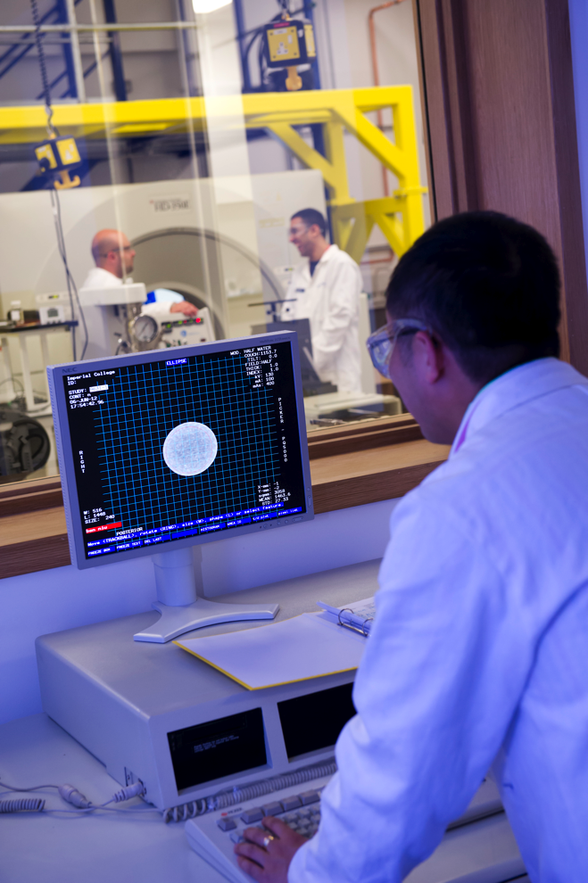
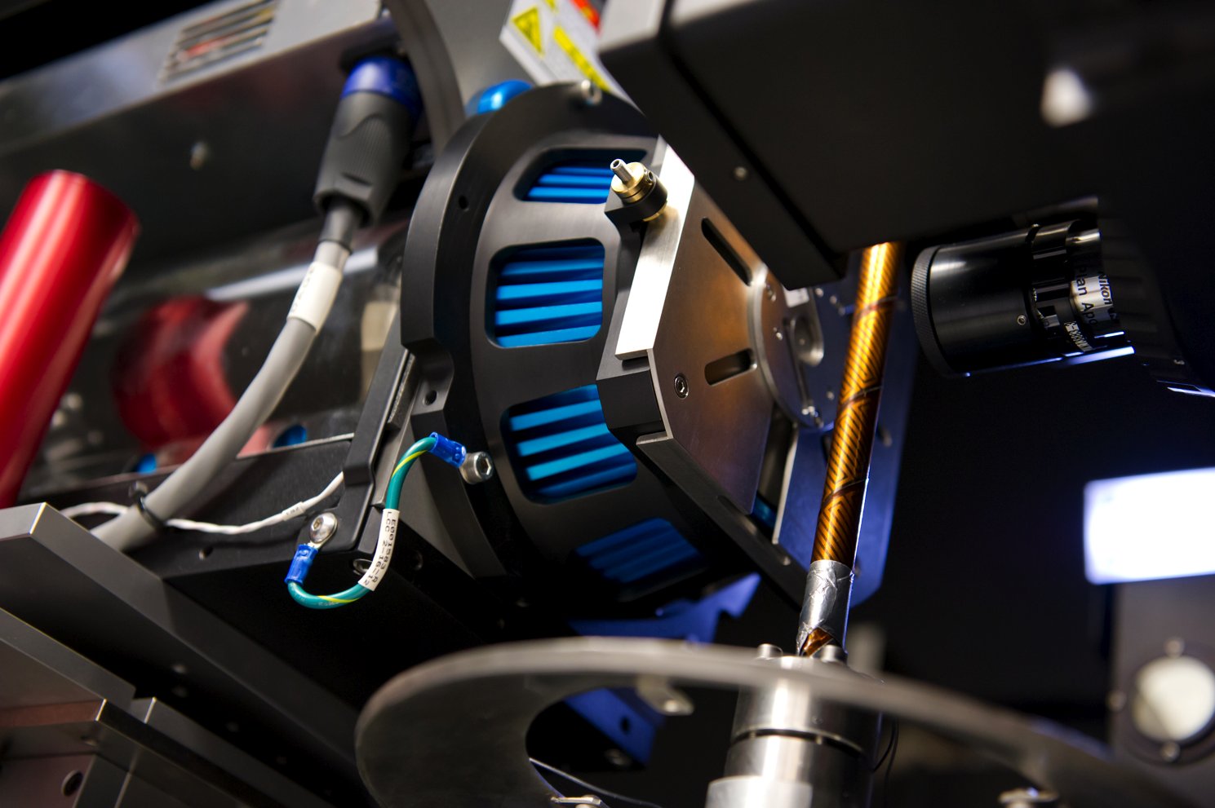
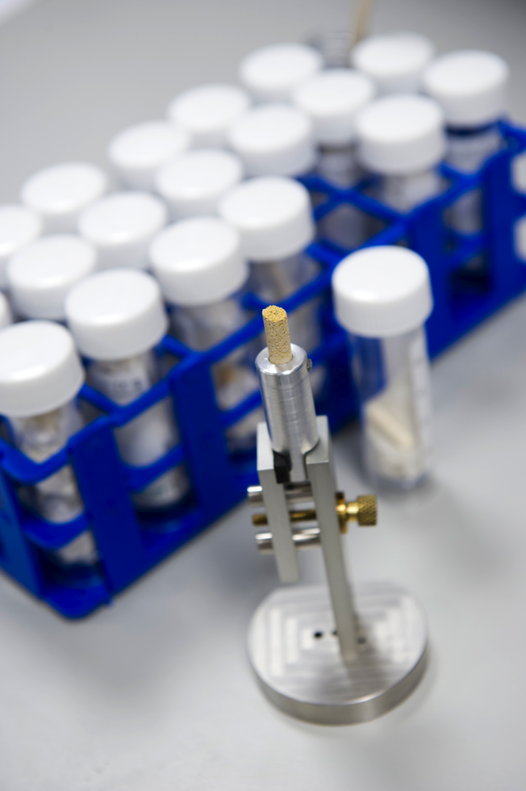
Big data from rock images
High-resolution three-dimensional imaging of porous materials – SEM and X-rays – from nanometre to metre scales. Coupled with multiscale modelling and design.

Slide 4
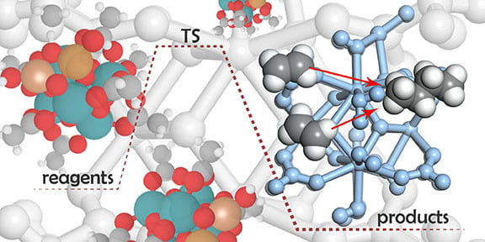
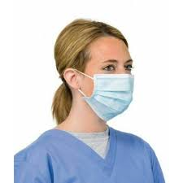
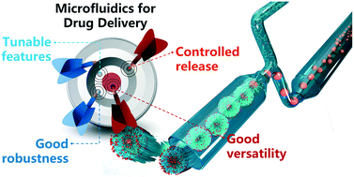
Trapping and flow
There are two things we need to design:
Trapping. One phase is surrounded by the other in the wider pore spaces and cannot flow. CO₂ storage, surgical masks.
Flow. Both phases can flow over a wide saturation range with little trapping or retention of either phase. Fuel cells, oil recovery, gas storage, hydrogen storage, packed bed reactors, catalysis, electrodes.
Controlled by pore structure and wettability – the local distribution of contact angle. Multi-physics experiments and modelling.

Slide 5
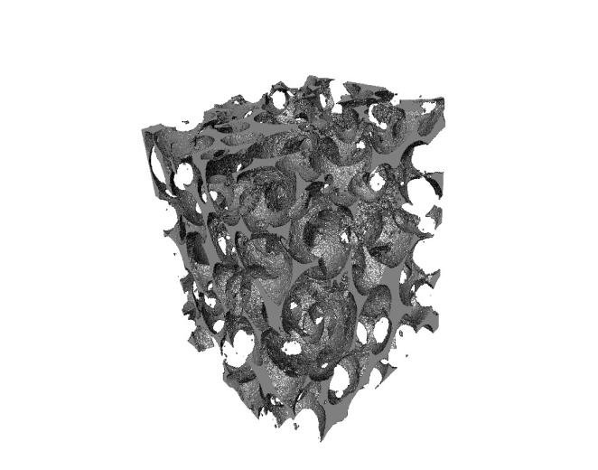
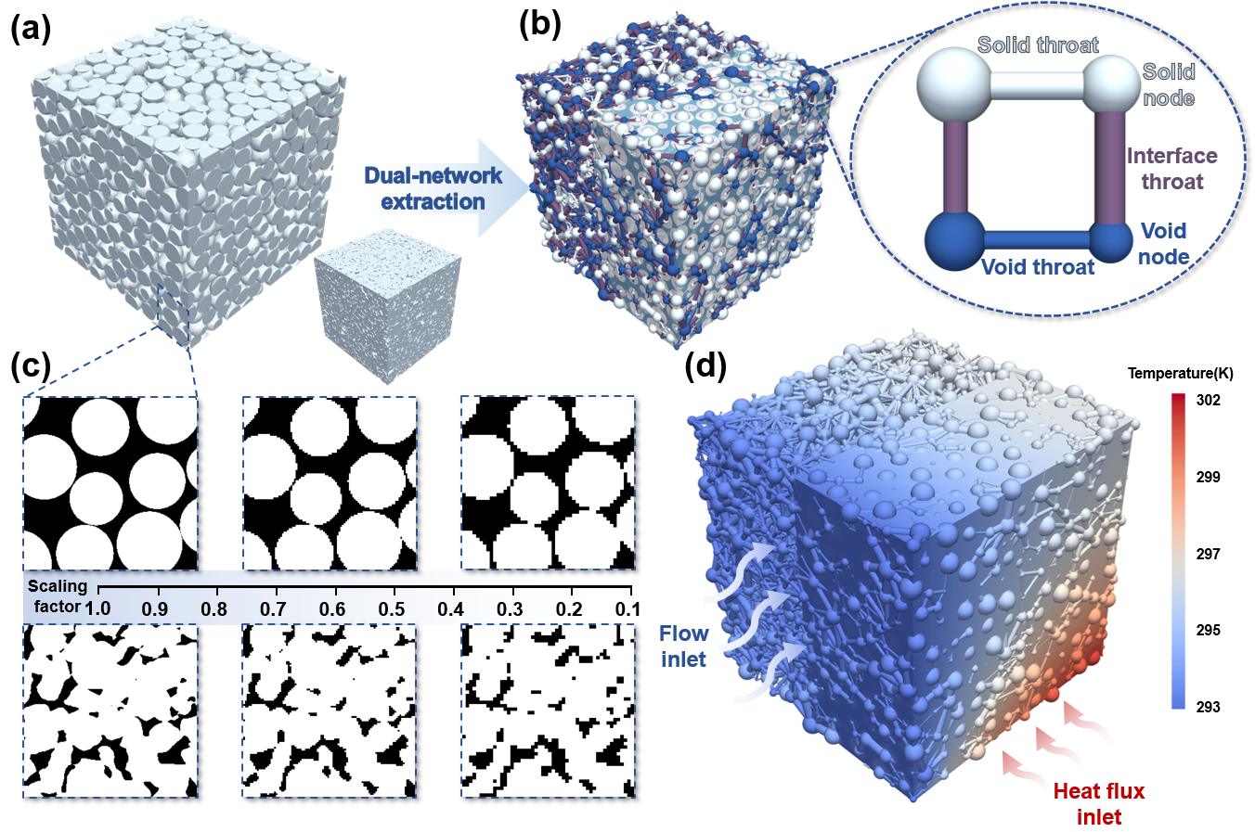
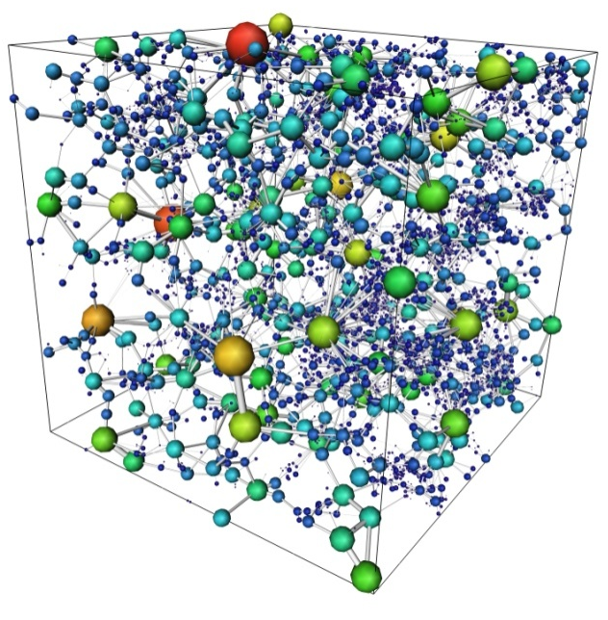
Pore network modelling
Represent the pore space topologically as a disordered lattice of pores – wide regions – connected by throats – constrictions. Combine with the solid network. Compute the relevant physics and chemistry semi-analytically through the network.

Slide 6
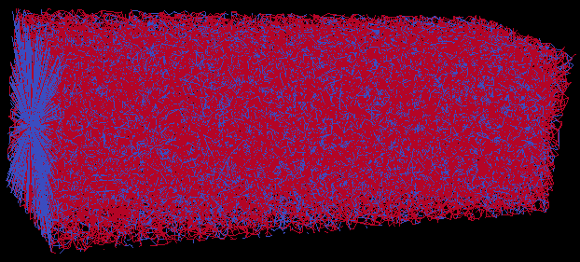
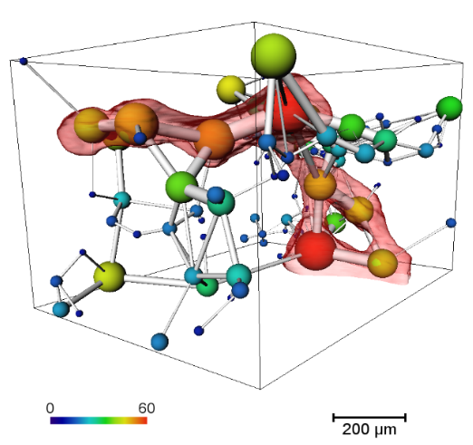
Pore network modelling approach
From 10-billion voxel three-dimensional images an equivalent pore network is extracted through which multiphase fluid flow/ heat transport/ reaction/ electrochemical behaviour is simulated (left).
The predicted fluid configurations at the micron scale are compared to experiment (middle) or direct numerical simulation (Yang et al., 2026). Parameters are tuned to match pore-scale phenomena. Then predictions of properties – such as relative permeability as a function of saturation – can be made (right).
Experiment
Simulation
Foroughi et al. Transport in Porous Media (2021); Physical Review E (2020)

Slide 7
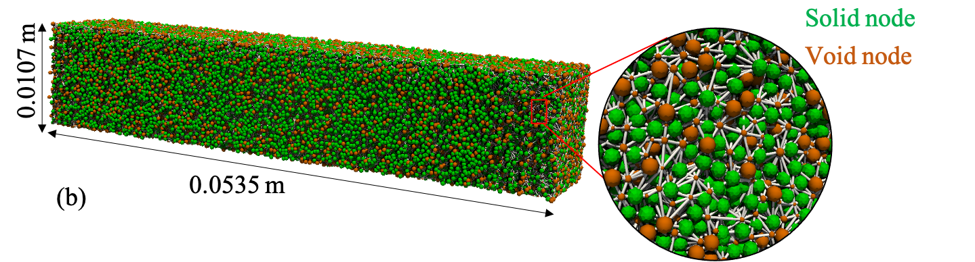
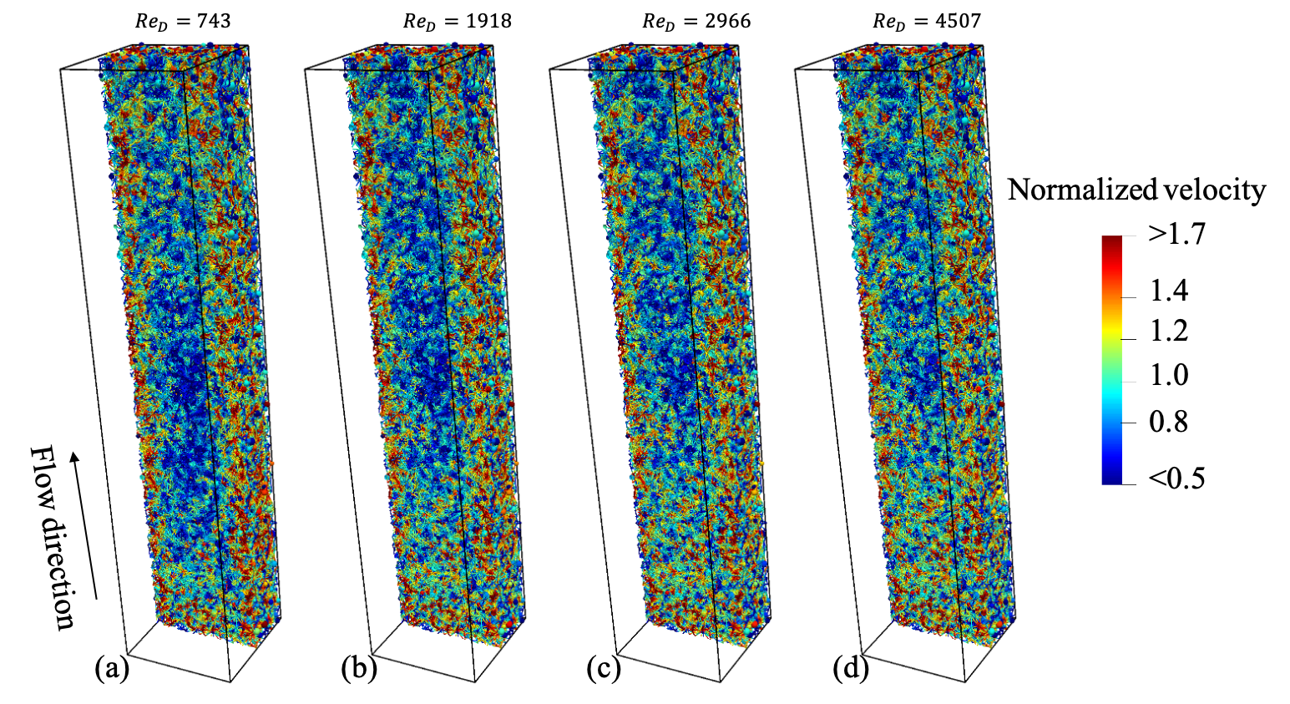
Modelling heat and mass transfer for design
Interaction between temperature (hotter at the walls), viscosity (lower where hotter) and flow (fastest where the viscosity is low). Can be used to design packings with optimal properties: place smaller beads at the heated surface.
Qu et al. AIChE Journal (2023;), Luo et al. AIChE Journal (2025)

Slide 8
Including reaction kinetics
The framework is demonstrated for sorption-enhanced CO₂ hydrogenation to
methanol. We identify optimal catalyst-sorbent configurations that maximize apparent activity and reactor-scale performance.
Qu et al. Advanced Science (2026)

Slide 9
Wettability-informed design
Design the optimal wettability state in gas/liquid flow – namely the mixture of binder (PTFE) and active material – for the catalyst layer used in CO₂ electroreduction in flow cells. Optimal state confirmed by experiment.
Qu et al. in prep (2026)

Slide 10
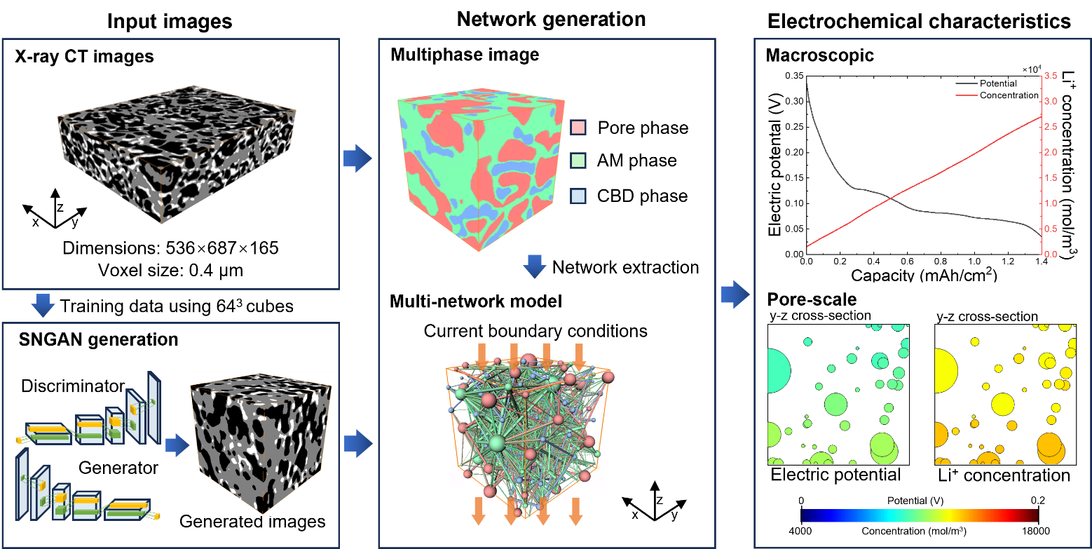
Design of graphite electrodes
Use nano-CT to image a three-phase graphite electrode. Then solve for electrical potential and Lithium ion concentration. Validate against direct simulation and upscale to large networks.
Zhang et al. in prep (2026)

Slide 11
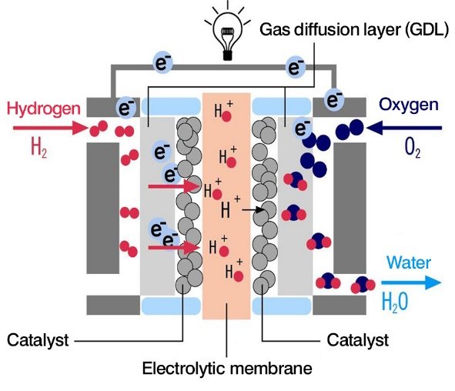
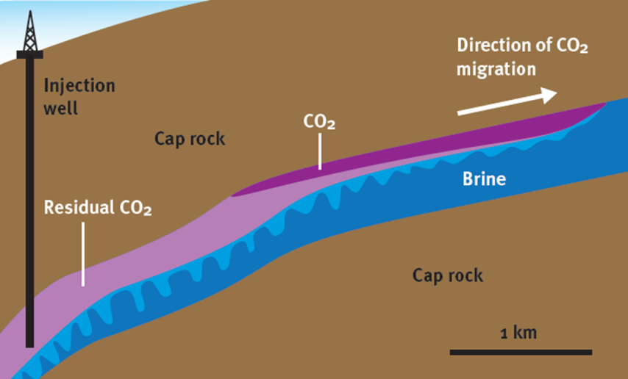
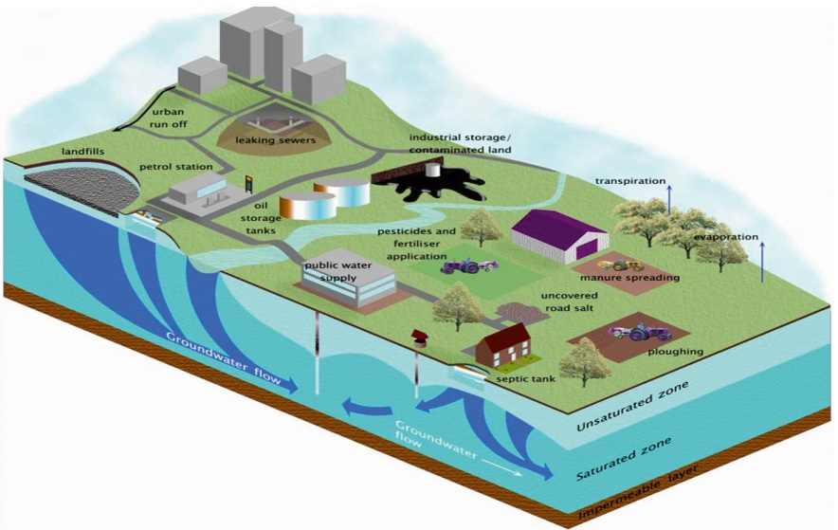
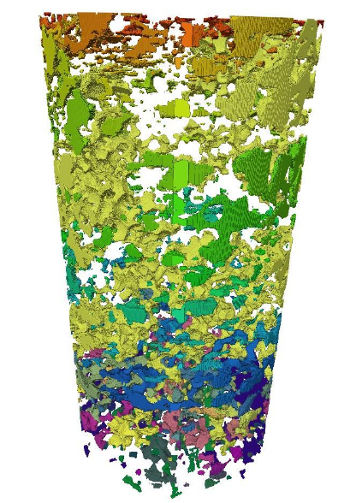
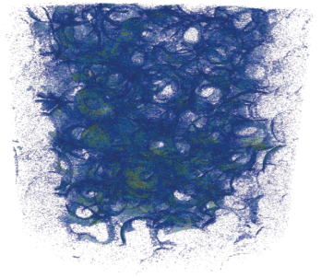
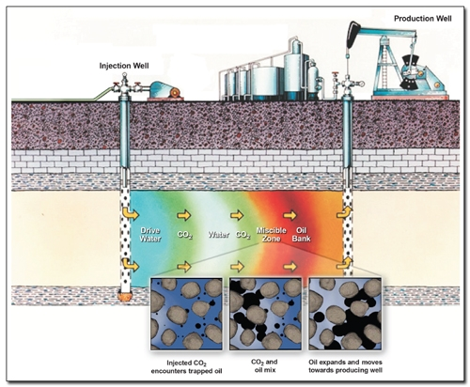
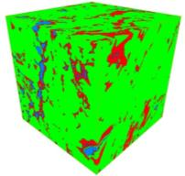
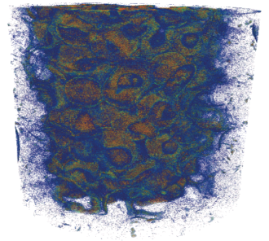
Does it matter?
Electrochemical devices
Natural gas storage
Carbon and Hydrogen Storage
http://www.euwfd.com/html/groundwater.html
Contaminant
Transport
http://energy.gov/
3D X-ray Micro-CT imaging of a porous sample
Shale oil and gas
Enhanced Oil Recovery
Reactors
Notes:
Industrial waste remedy
Biodegradation of landfills
Tracer studies
Miscible displacement
Capillary trapping – multi-phase flow
Development of miscibility - transport
Fluid-solid interaction - reaction

Slide 12

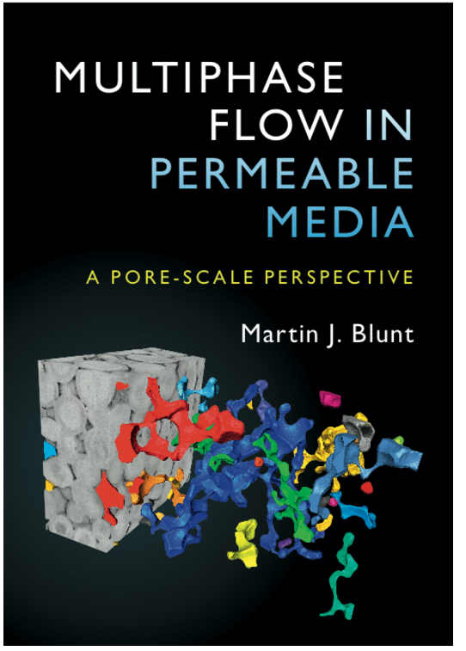



Acknowledgements
YouTube site
Github for codes

