Slide 1

Interplay between Pore and Solid Tortuosities of Synthetic Rocks
Alexandre Sac-Morane
Navier, CNRS, UGE, ENPC
In collaboration with:
Maria Olarte-Garzon, Jean-Michel Pereira, Philipp Braun
https://alexsacmorane.github.io/
alexandre.sac-morane@enpc.fr
Notes:
10 minutes + 5 min Q&A

Slide 2
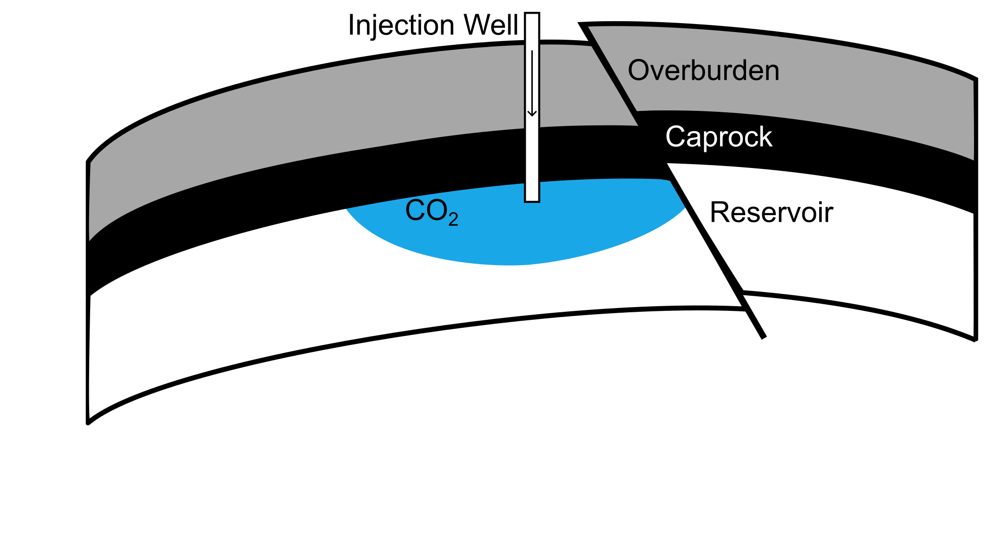

Challenges for energy and geomechanics
Introduction Digital twin Synthetic rock
Distance ~ 2.5 km
Temperature ~ 70-90 °C
Pressure ~ 65 MPa
What are the properties (hydraulical/mechanical/thermal) of the reservoir rock ?
What are the properties (hydraulical/mechanical/thermal) of the reservoir rock
with a limited access to it ?

Slide 3


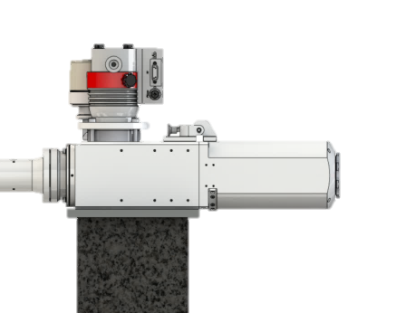
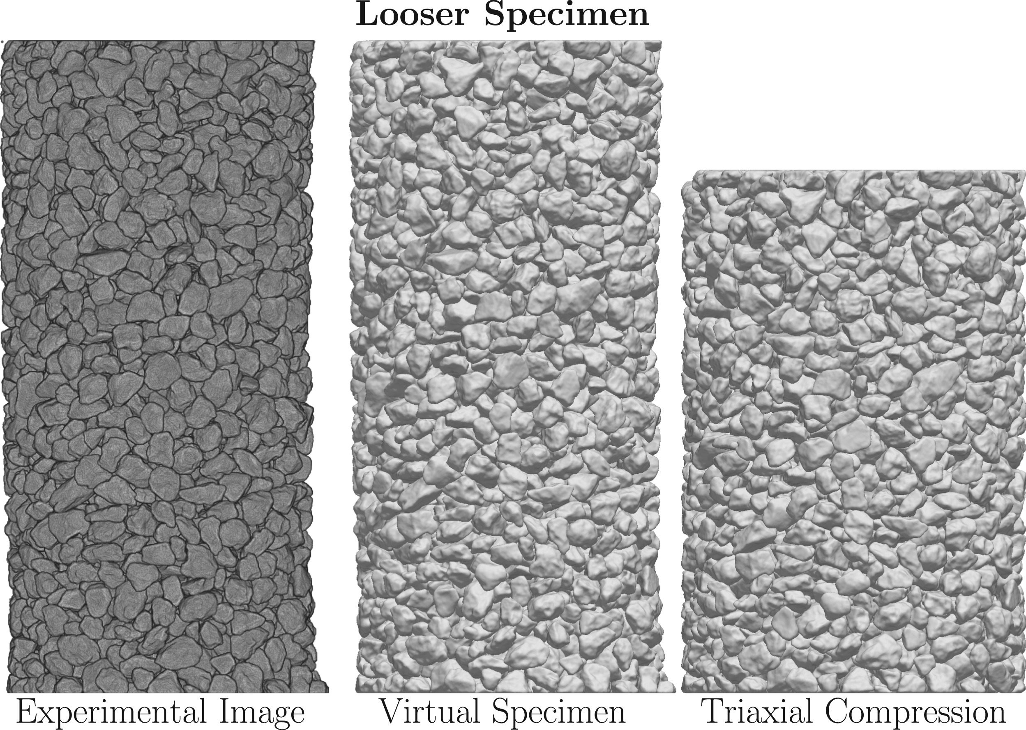

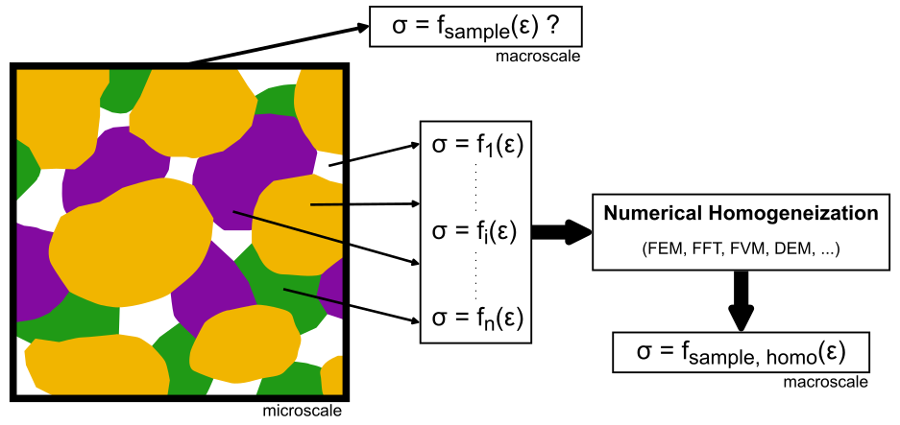
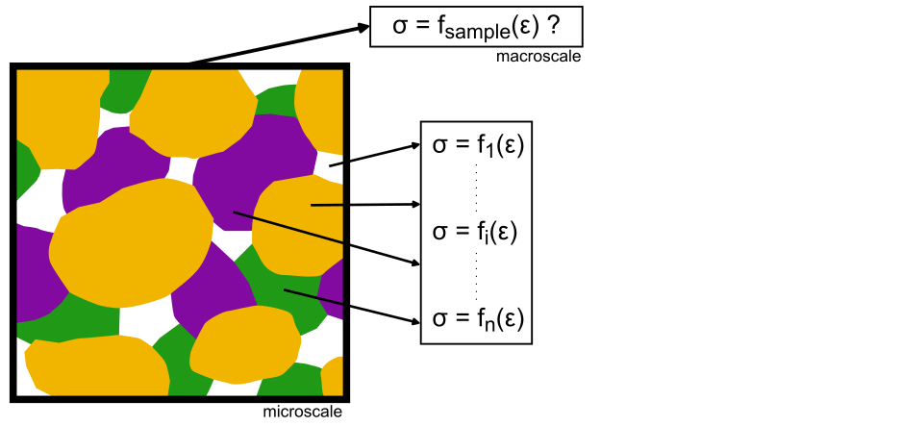
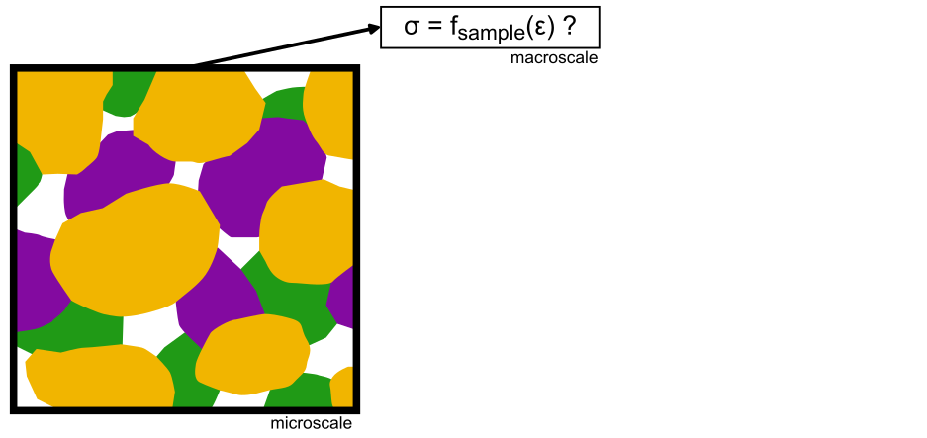
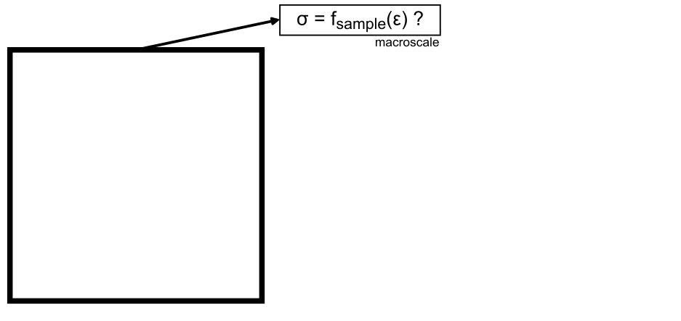
Introduction Digital twin Synthetic rock
Digital twin / Rock Digital Physics
Real World
Digital World
Digital Twin
Example of digital twin for a granular sample (Kawamoto, 2016)

Slide 4
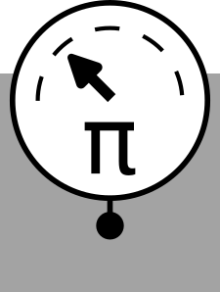



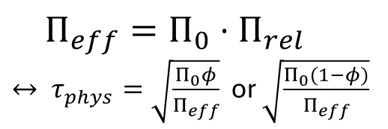




Introduction Digital twin Synthetic rock
Tortuosities
$$M$$
$$Π$$
$$Π_{eff}=Π_{0}⋅Π_{rel}$$
$↔ τ_{phys}=\sqrt{\frac{Π_{0}φ}{Π_{eff}}}$ or $\sqrt{\frac{Π_{0}(1−φ)}{Π_{eff}}}$
Morphometer
at the microscale
Parameter
at the macroscale
Based on physics
$$L_{0}$$
$$L$$
$$τ_{geom}=L/L_{0}$$
Based on geometry
Sample properties are dictated by the tortuosity of the microstructure (Slotte, 2019)
Notes:
lien entre digital twin et tortuosity
Pas de ct-scan ou pas mesh fine nenough
Exemple of real life

Slide 5
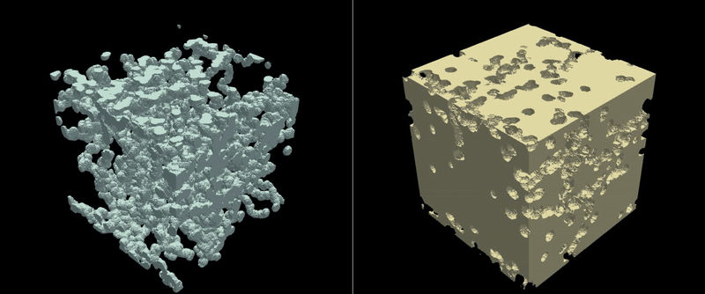
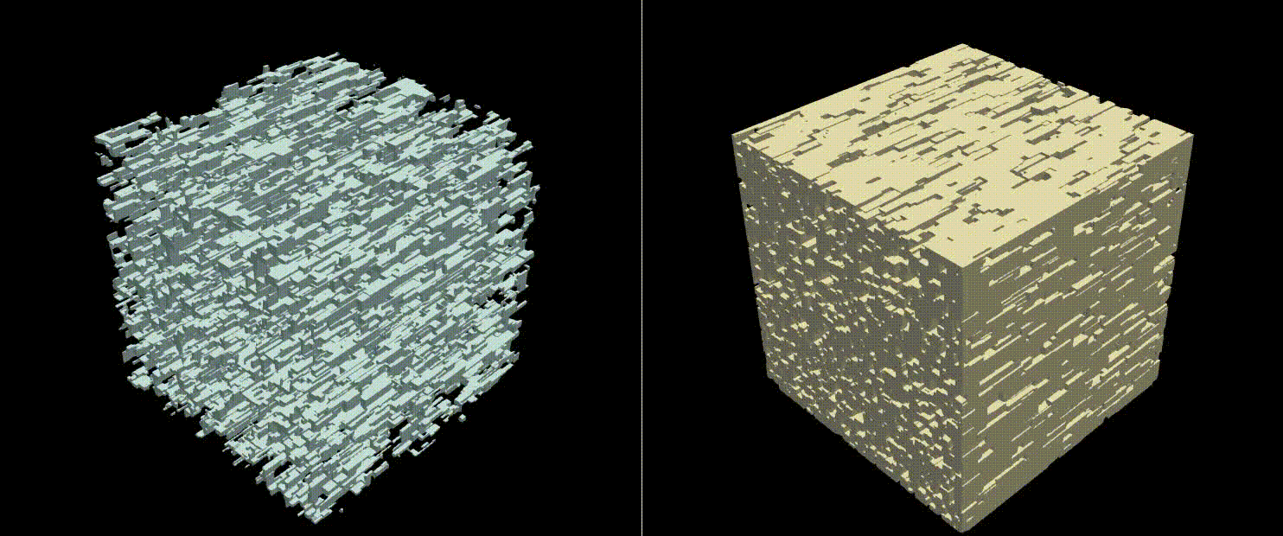
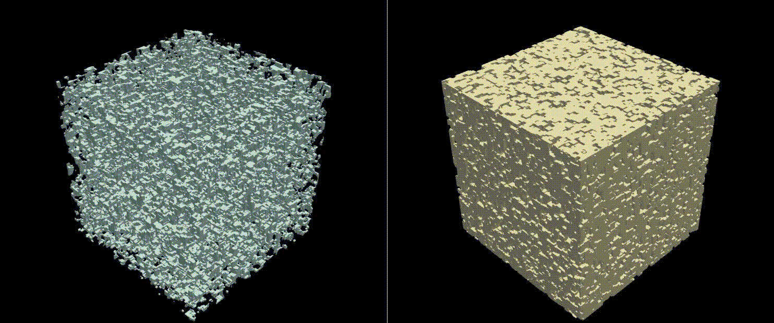
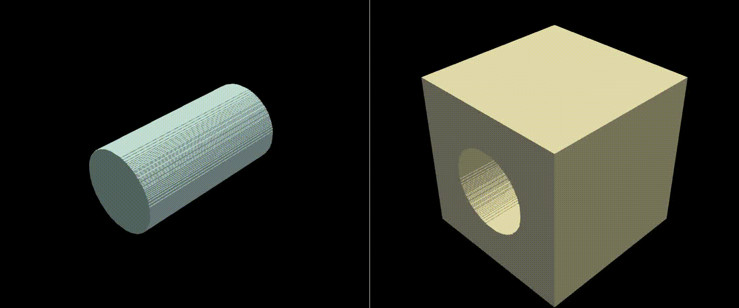
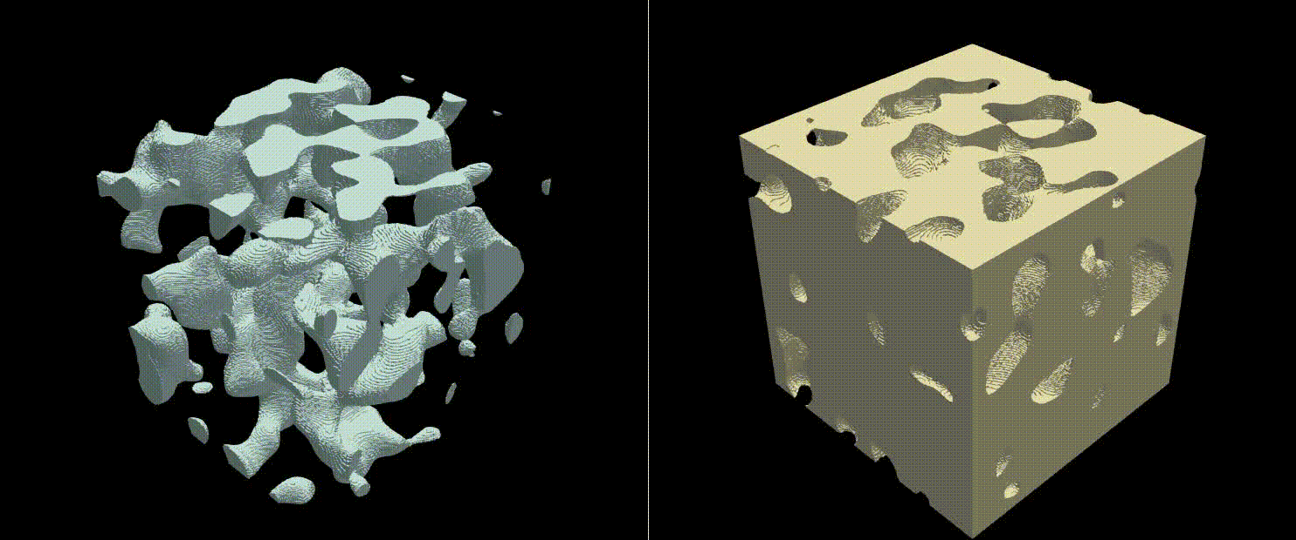
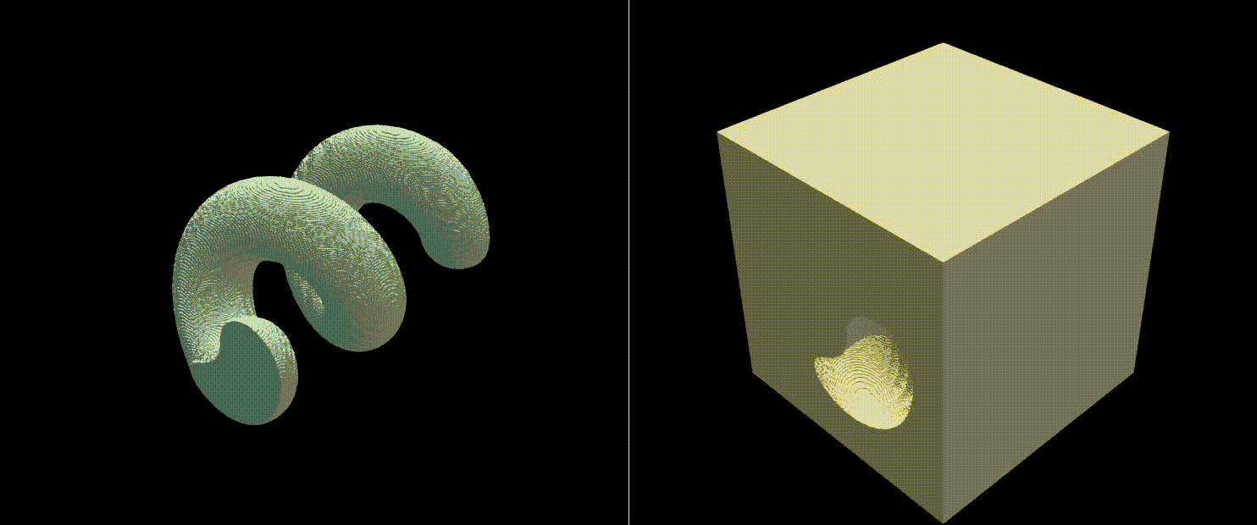
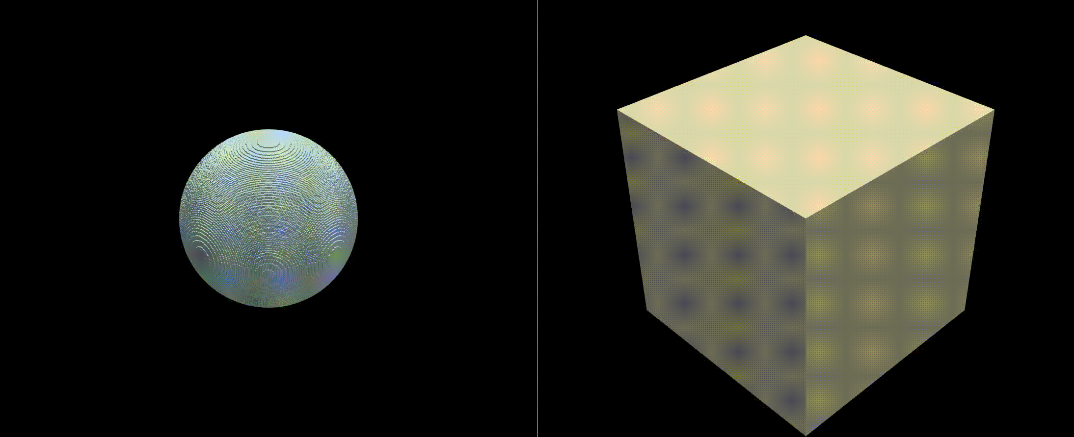
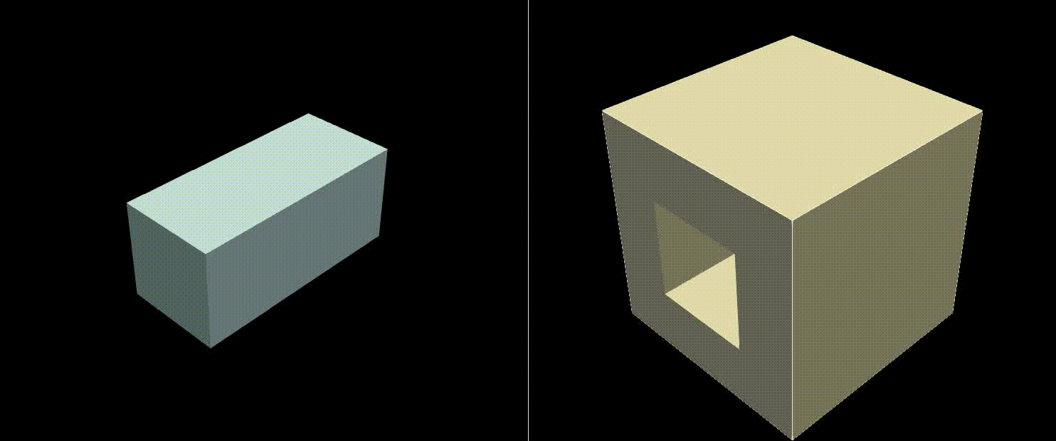
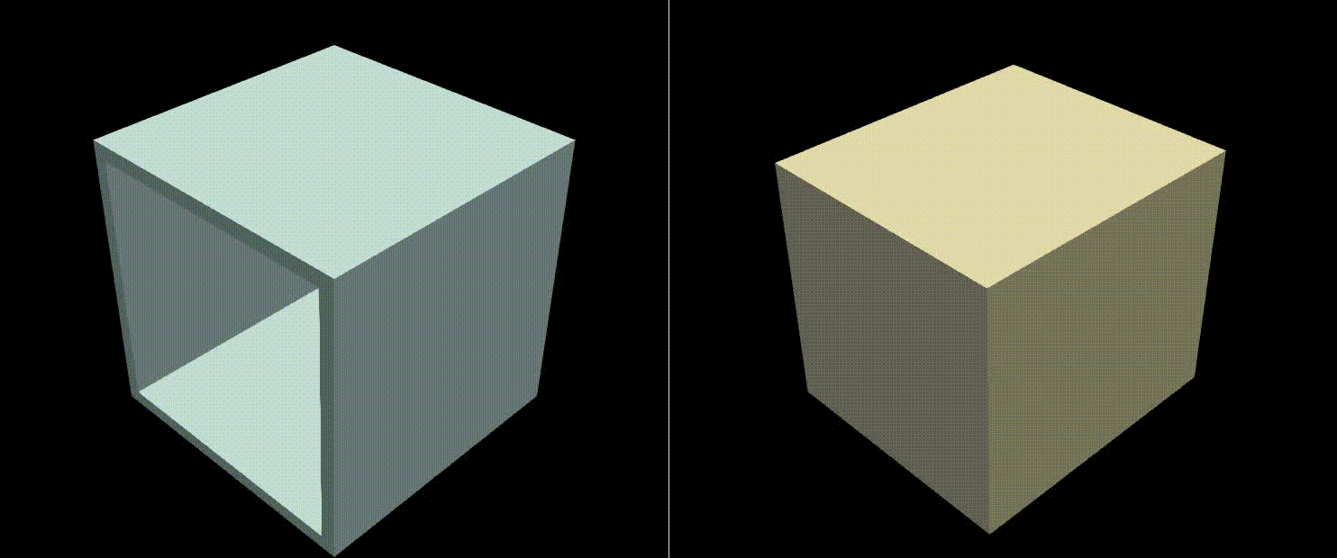
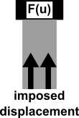
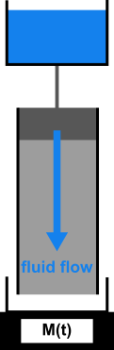
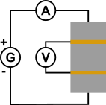
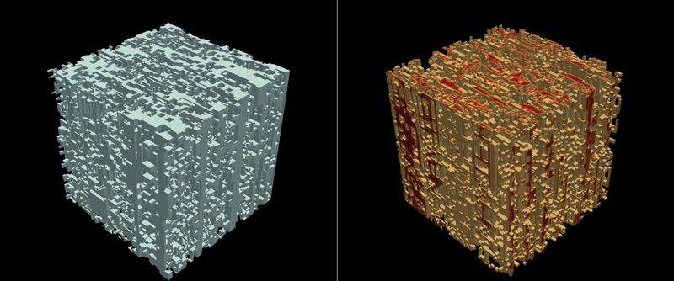
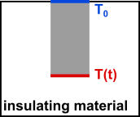
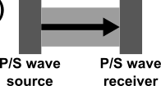
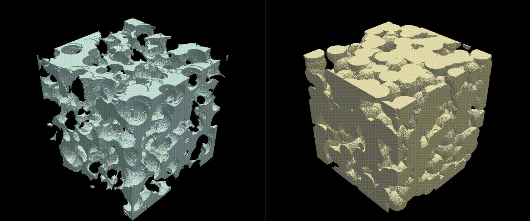







Introduction Digital twin Synthetic rock
Tortuosities
Hydraulic
permeability
Mechanical
isotropic
oedometric
Numerical workflow
Thermal
conductivity
$$3 τ_{phys}^{H}$$
Hydro-Mechanical
confined pressurization
$$4 τ_{phys}^{M}$$
$$1 τ_{phys}^{HM}$$
Thermo-Mechanical
confined thermal expansion
$$3 τ_{phys}^{T}$$
$$1 τ_{phys}^{TM}$$
Fast Fourier Transform
Physical tortuosities
Pore
Solid
$$4 τ_{geom}^{pore}$$
$$4 τ_{geom}^{solid}$$
Fast Marching Method
Geometric tortuosities
Experimental validation
Sample generation

Slide 6
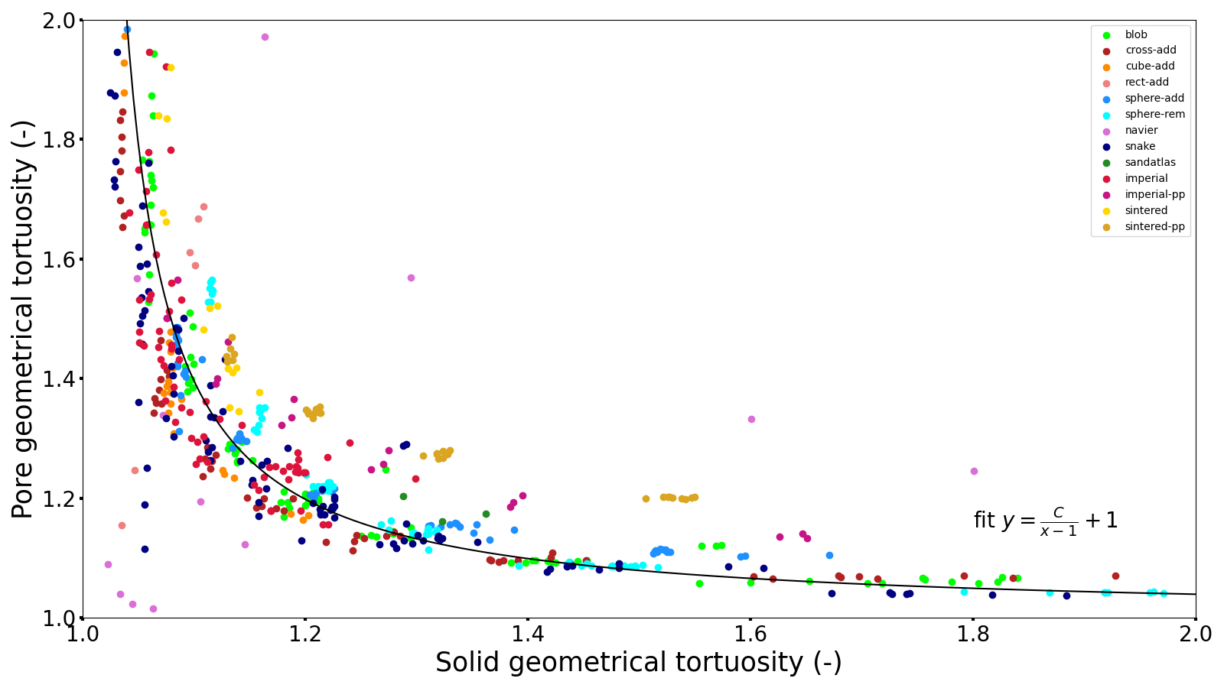
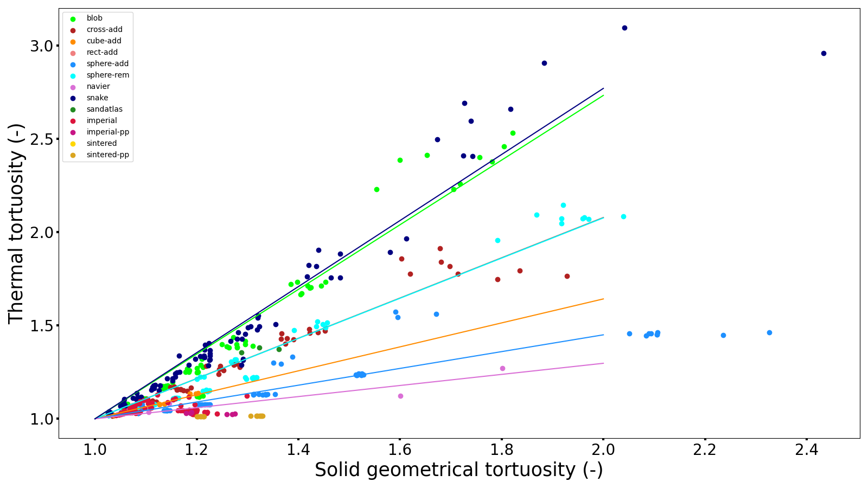
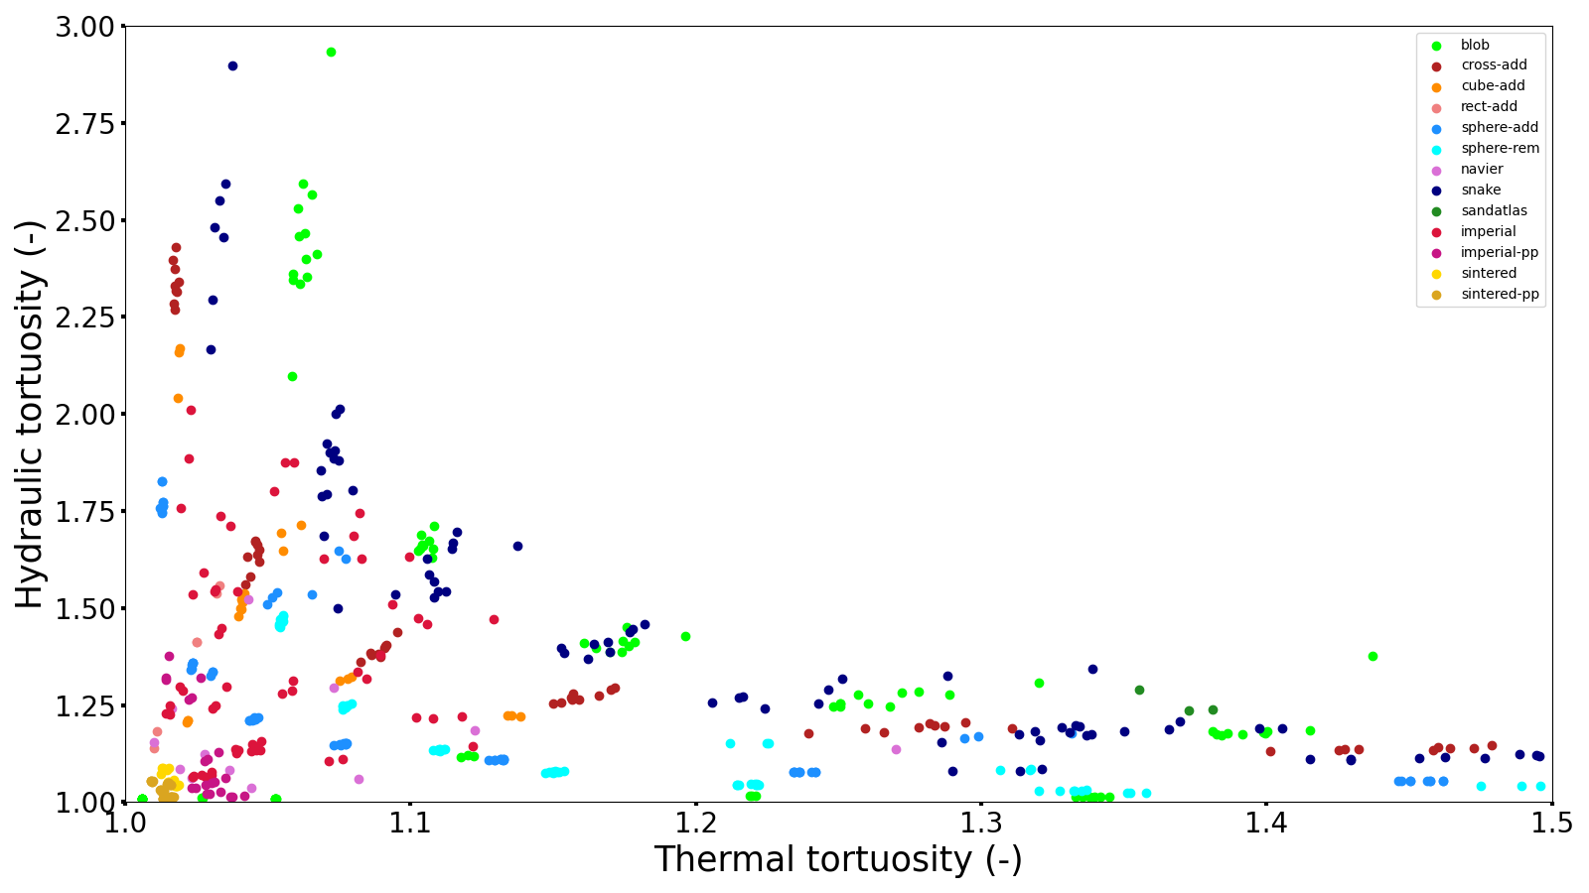
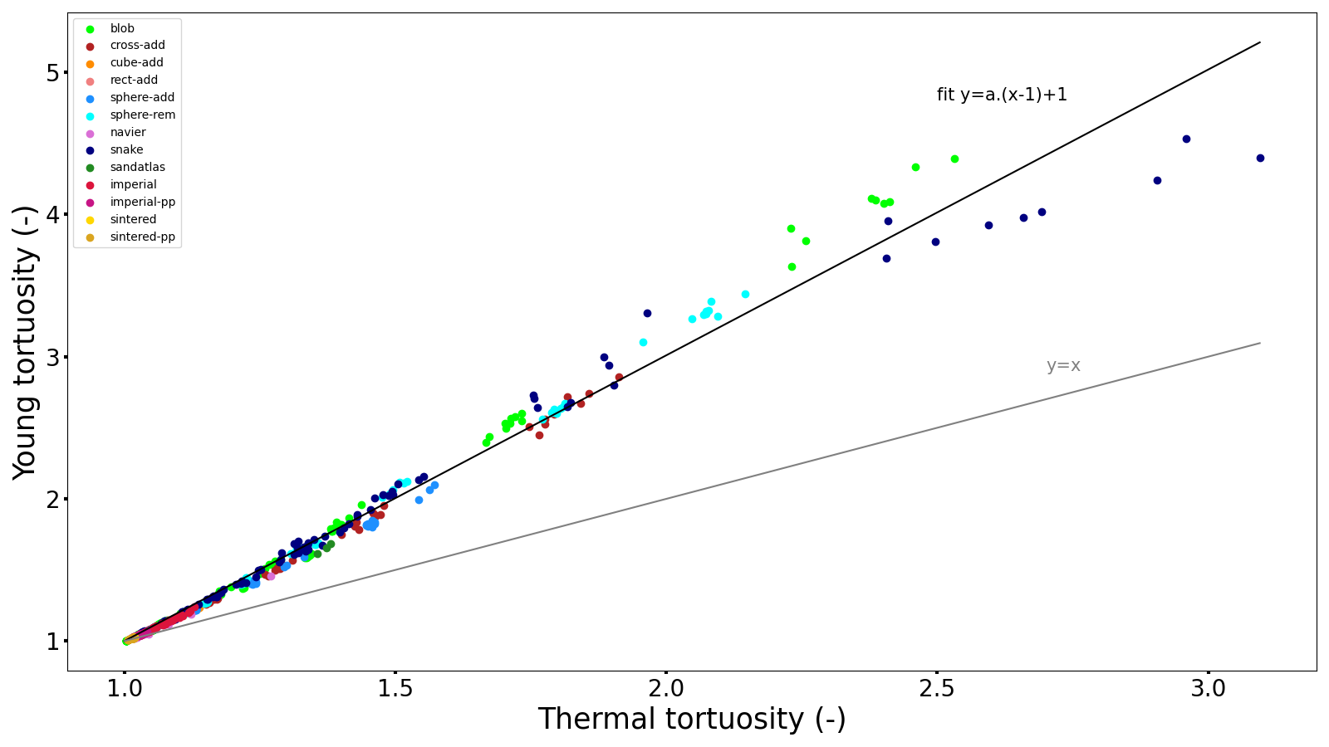
Introduction Digital twin Synthetic rock
Digital twin / Rock Digital Physics
The geometrical tortuosities are related
The geometrical and physical tortuosities are related
The thermal and hydraulic performances are not related
The thermal and mechanical performances are related

Slide 7
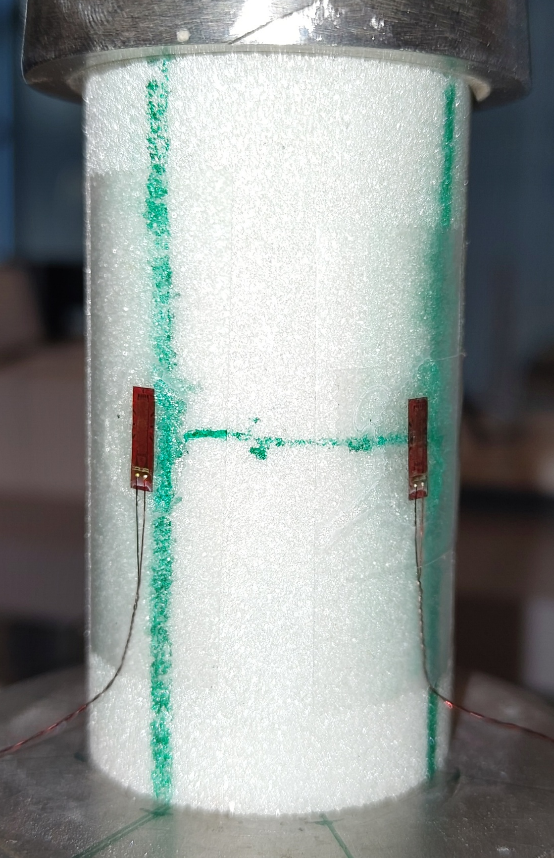
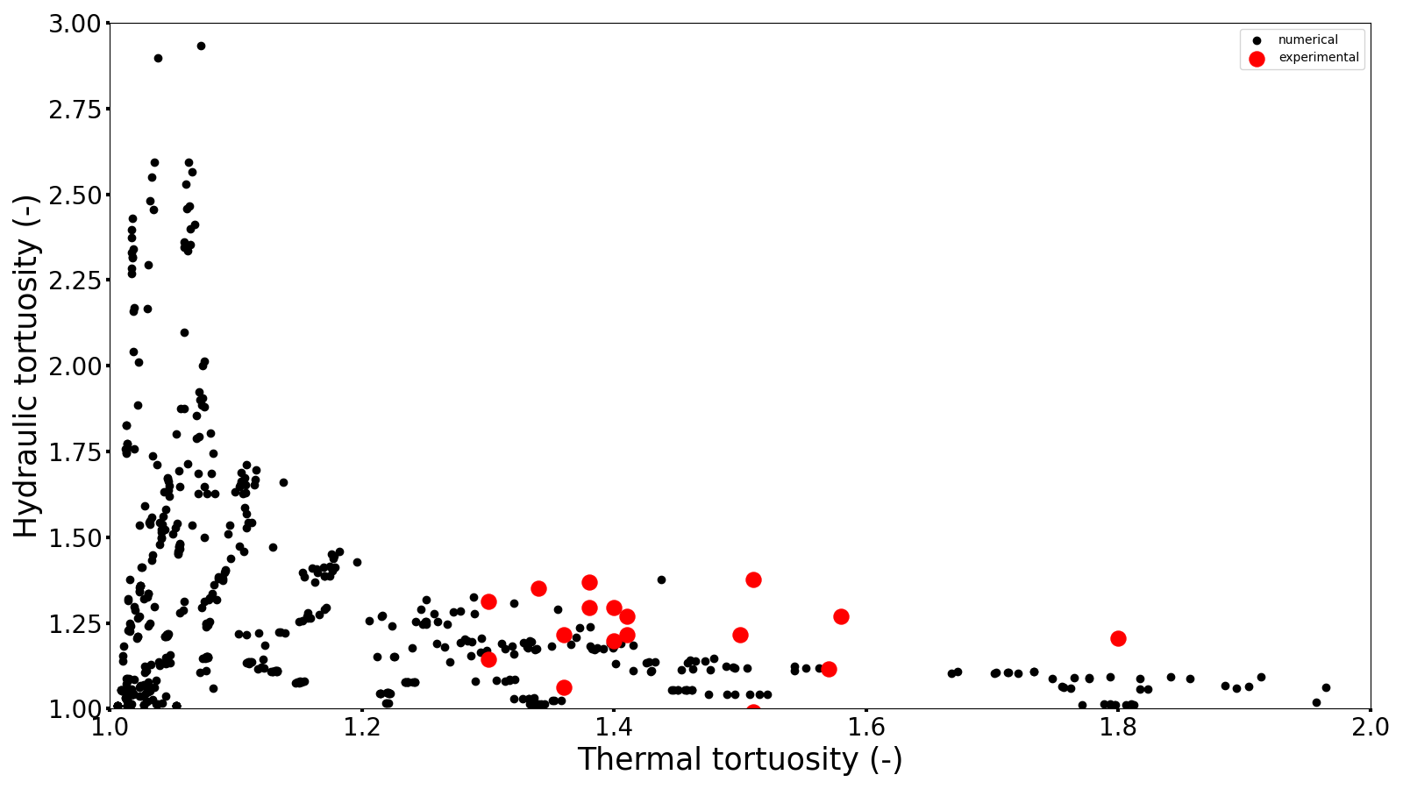
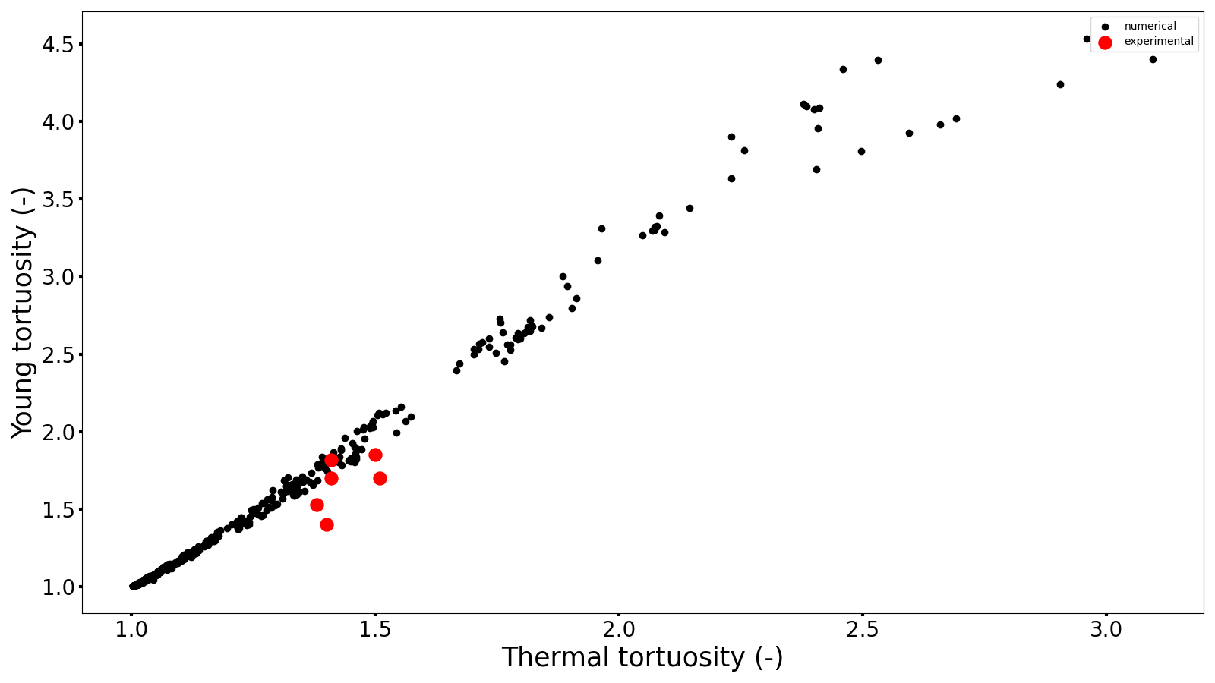
Introduction Digital twin Synthetic rock
Experimental validation with synthetic rocks
Preparation of
synthetic rocks
Hydraulic permeability test
Thermal conductivity test
Mechanical uniaxial compression test

Slide 8

Acknowledgements to :
M. Olarte-Garzon, J.M. Pereira, P. Braun
Conclusion
characterization of a reservoir rock with a limited access to it
Correlations (or not) between the physical and geometrical tortuosities
Use of virtual and real synthetic rocks
https://alexsacmorane.github.io/
alexandre.sac-morane@enpc.fr

Slide 9
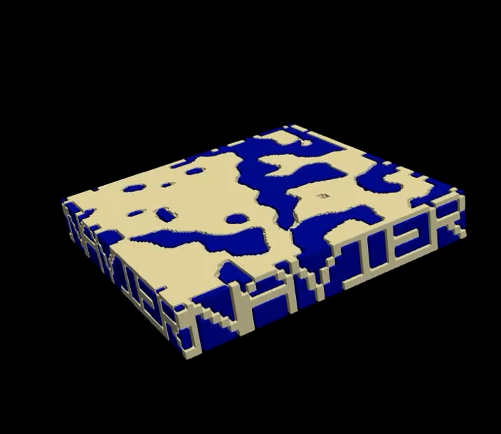
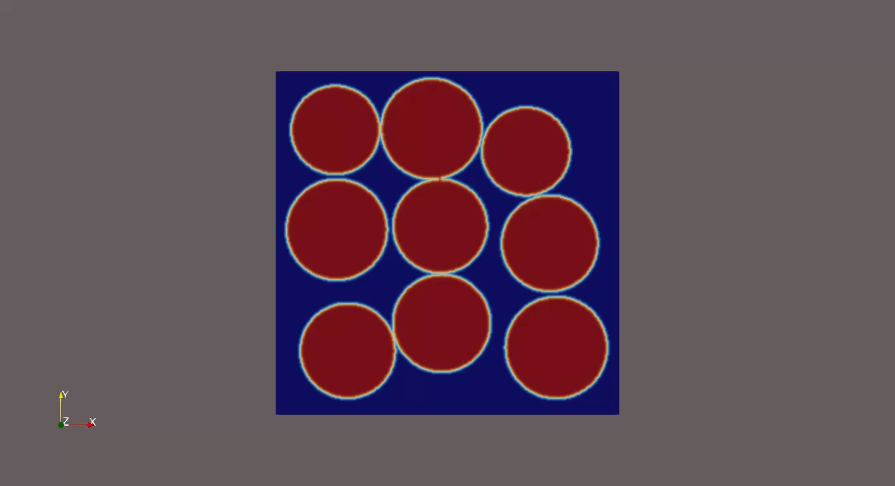
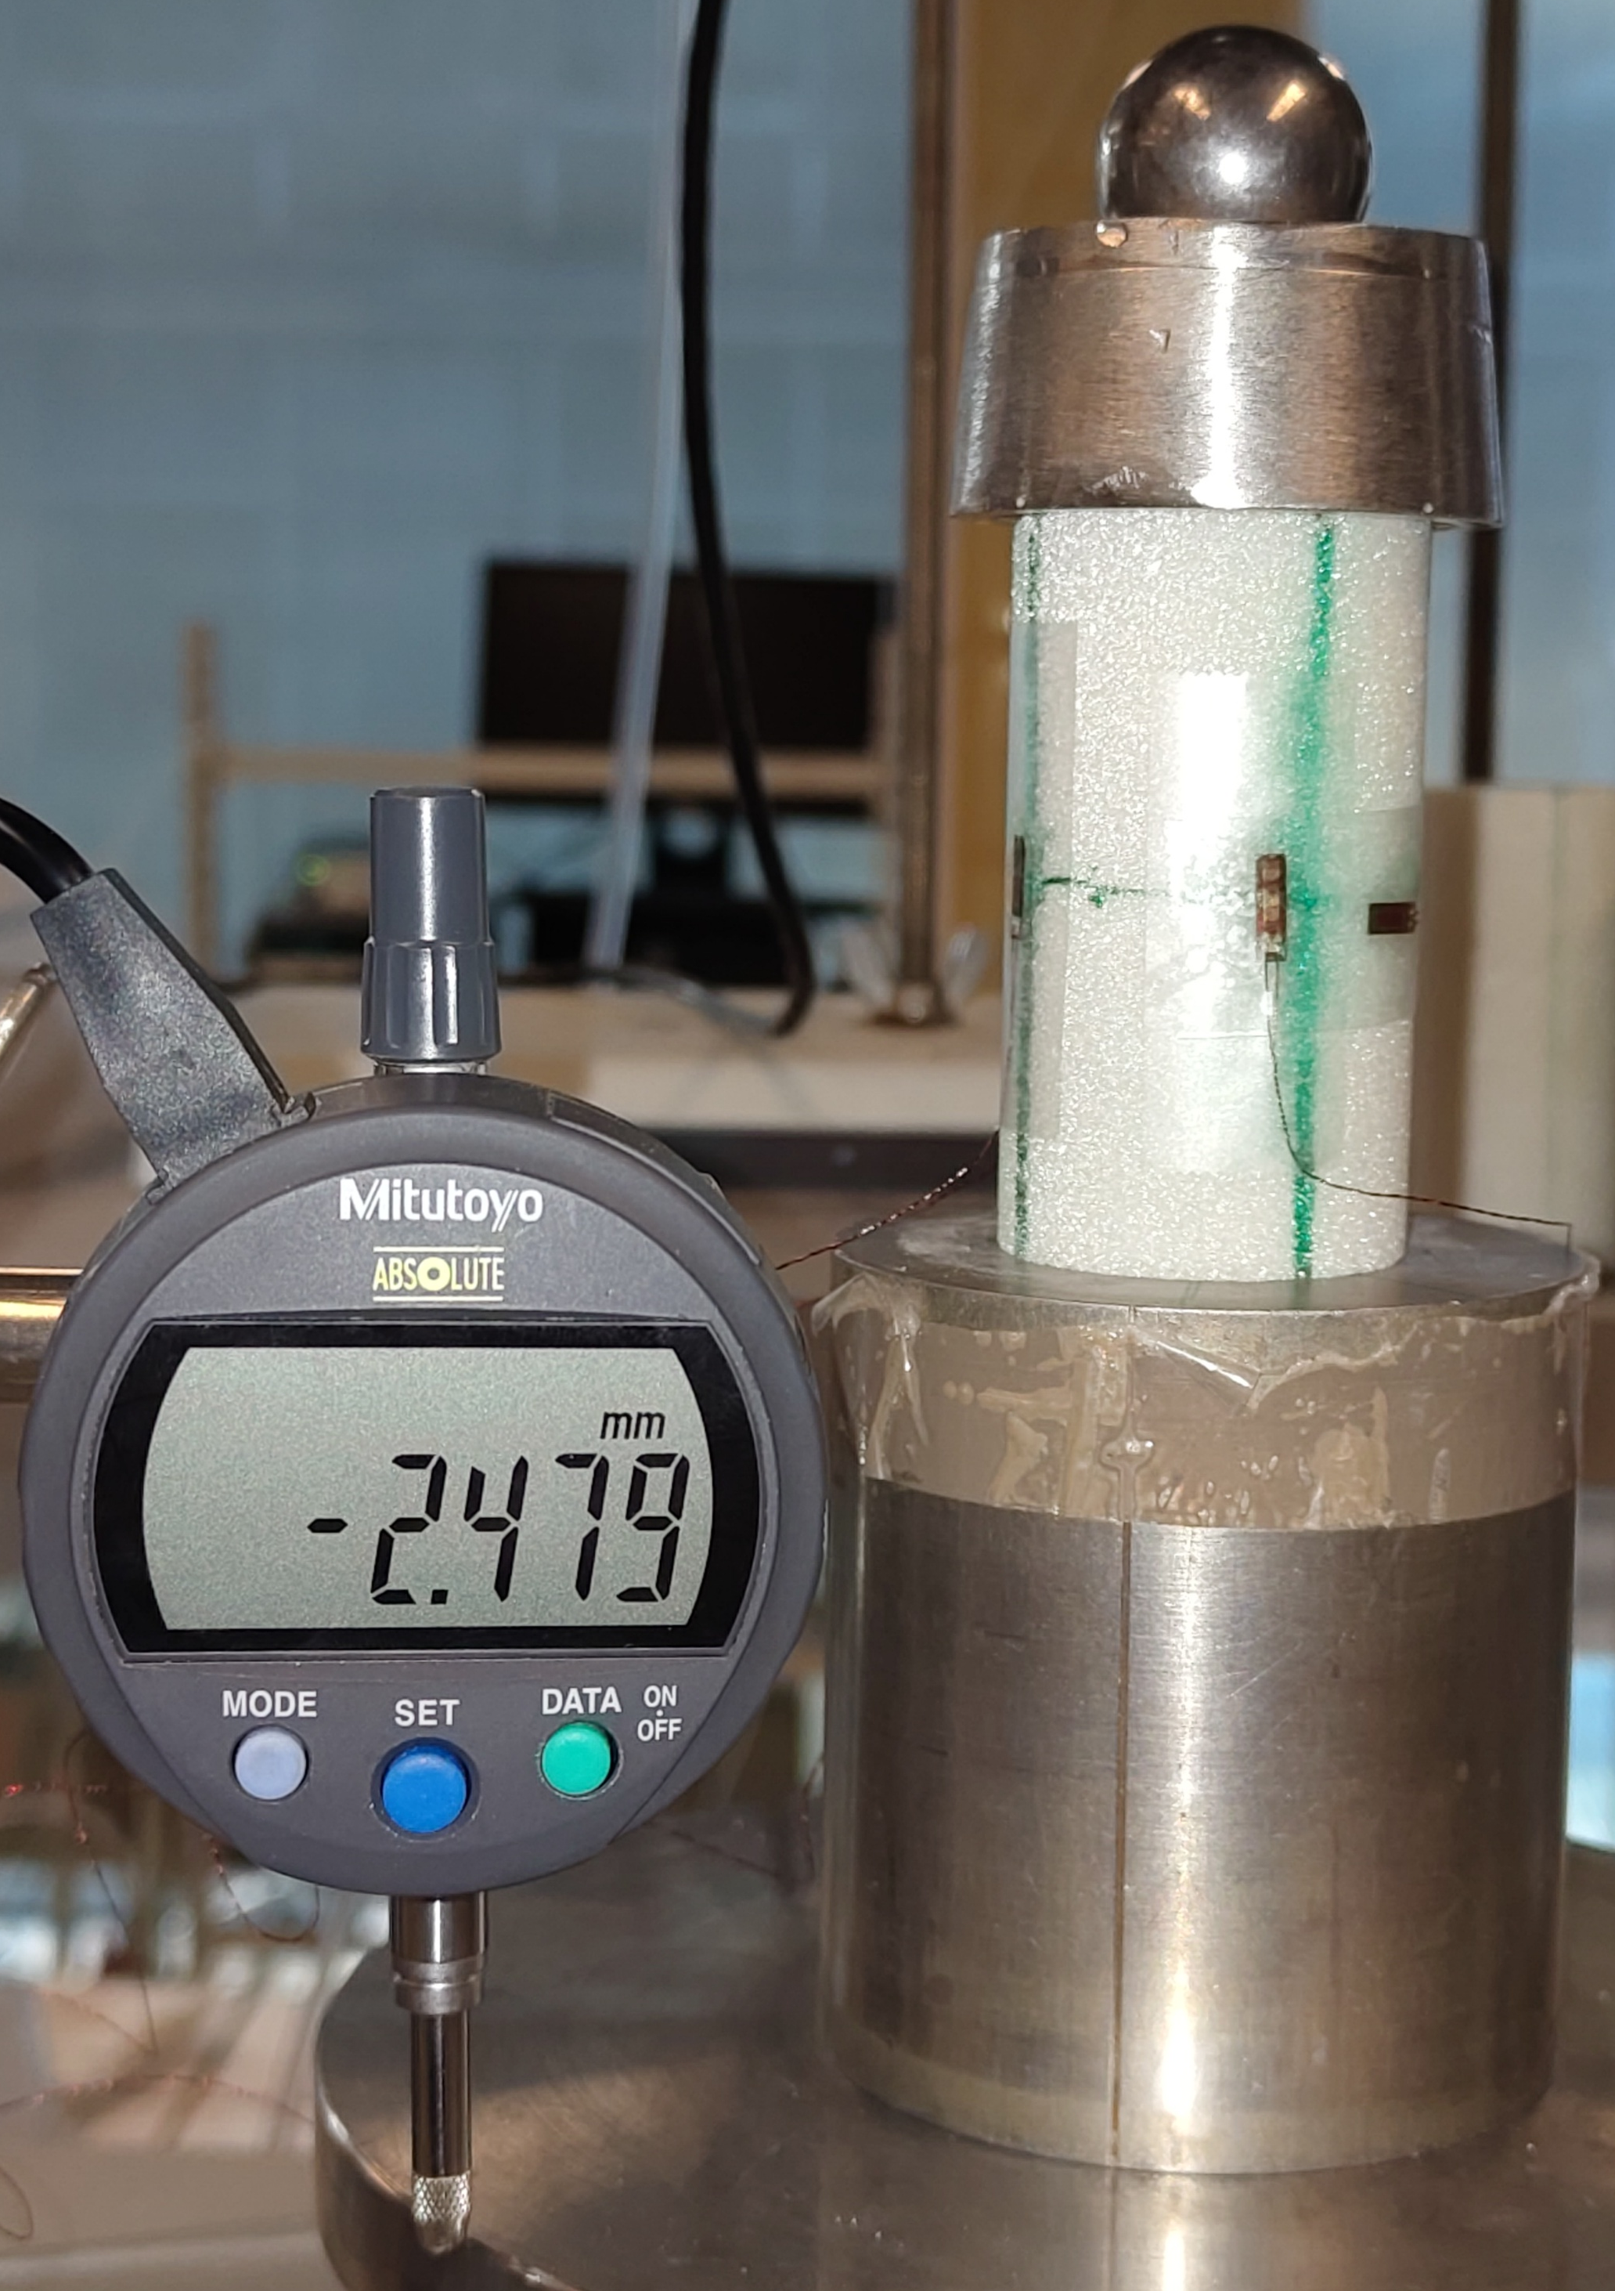
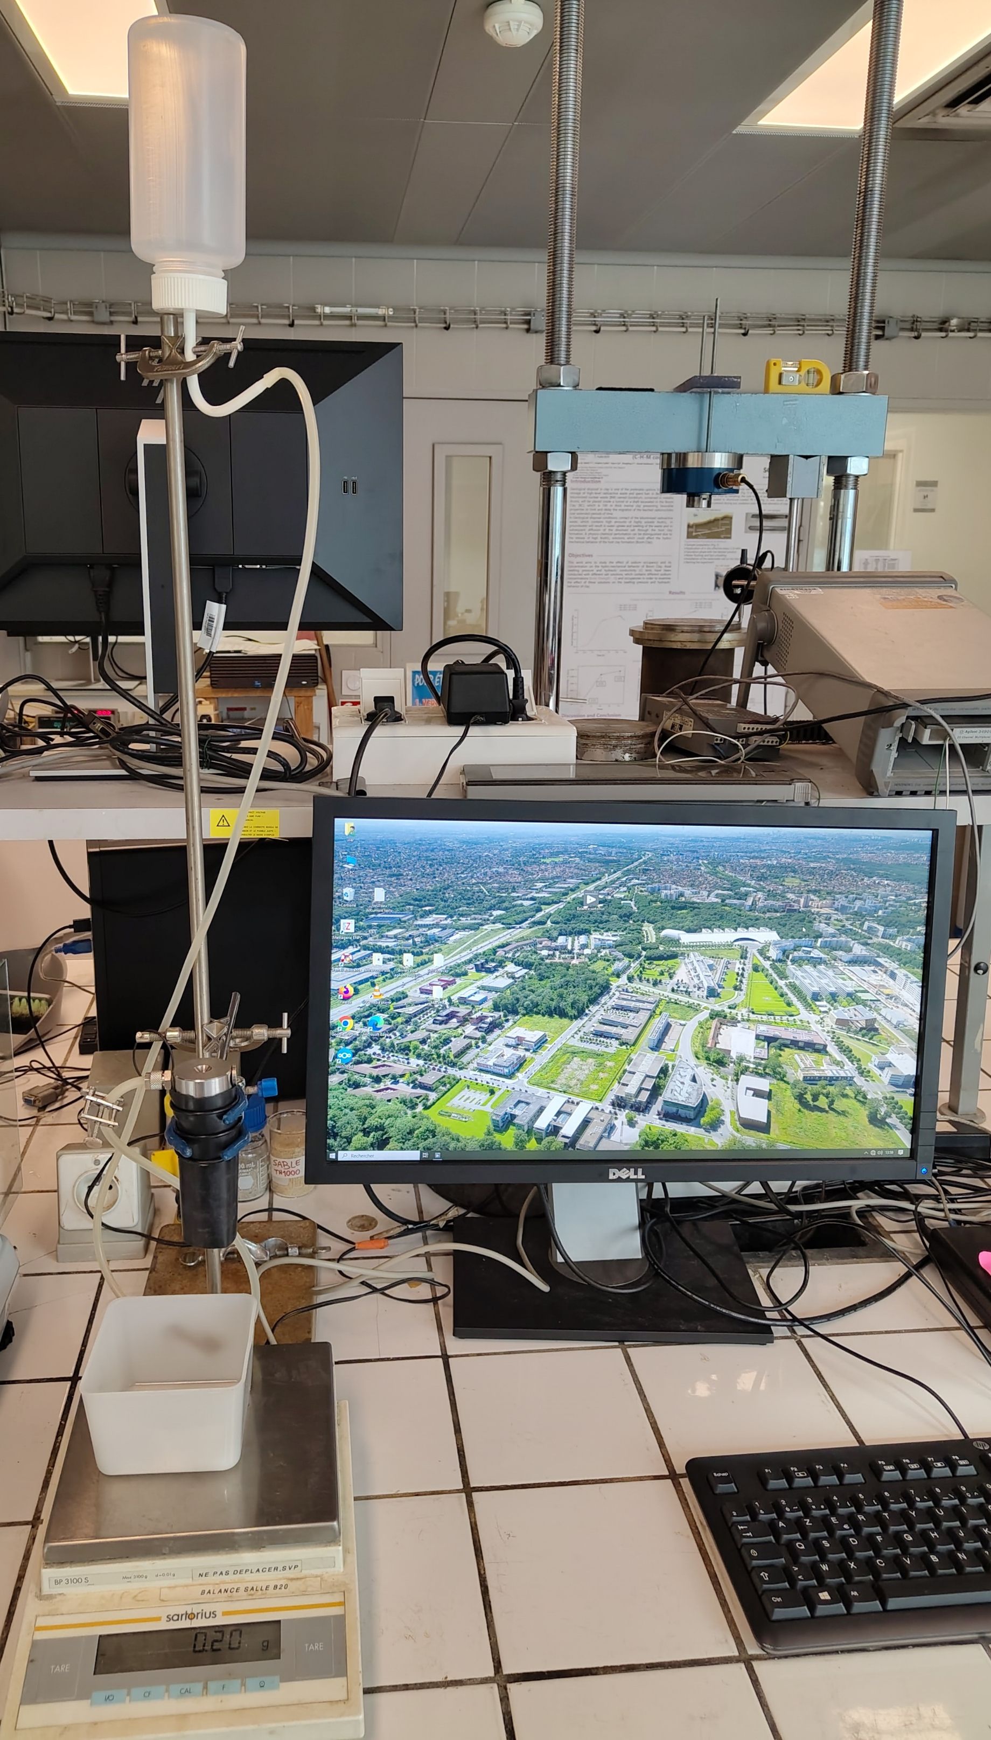
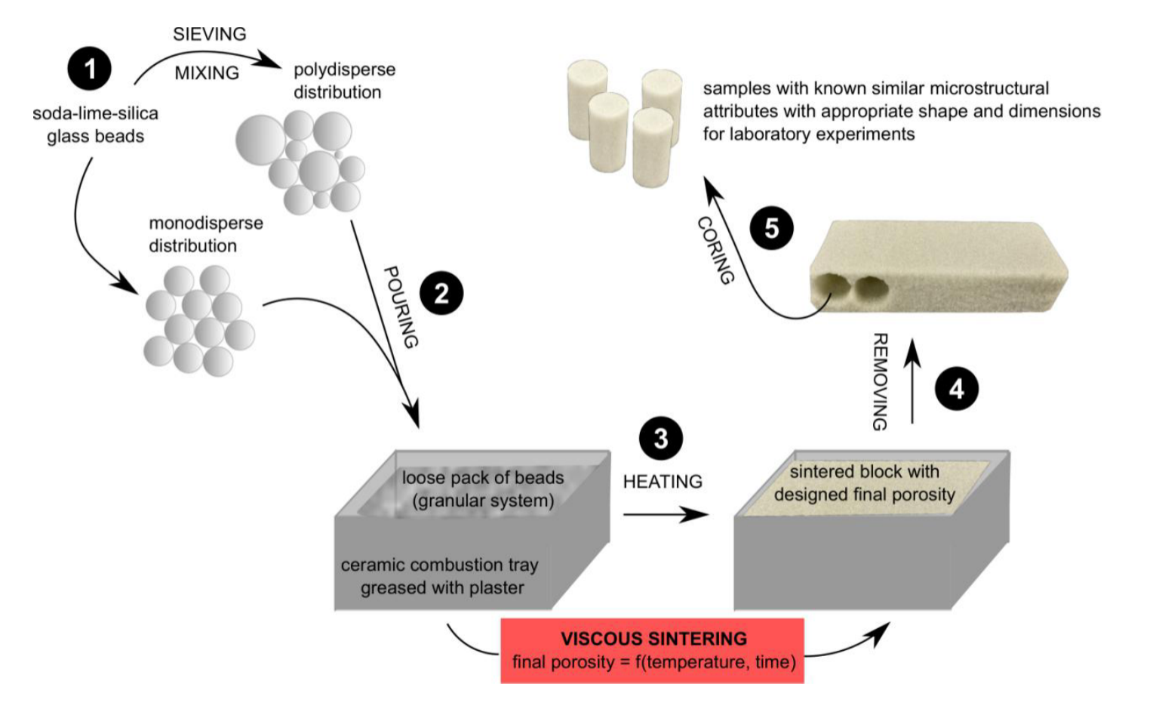
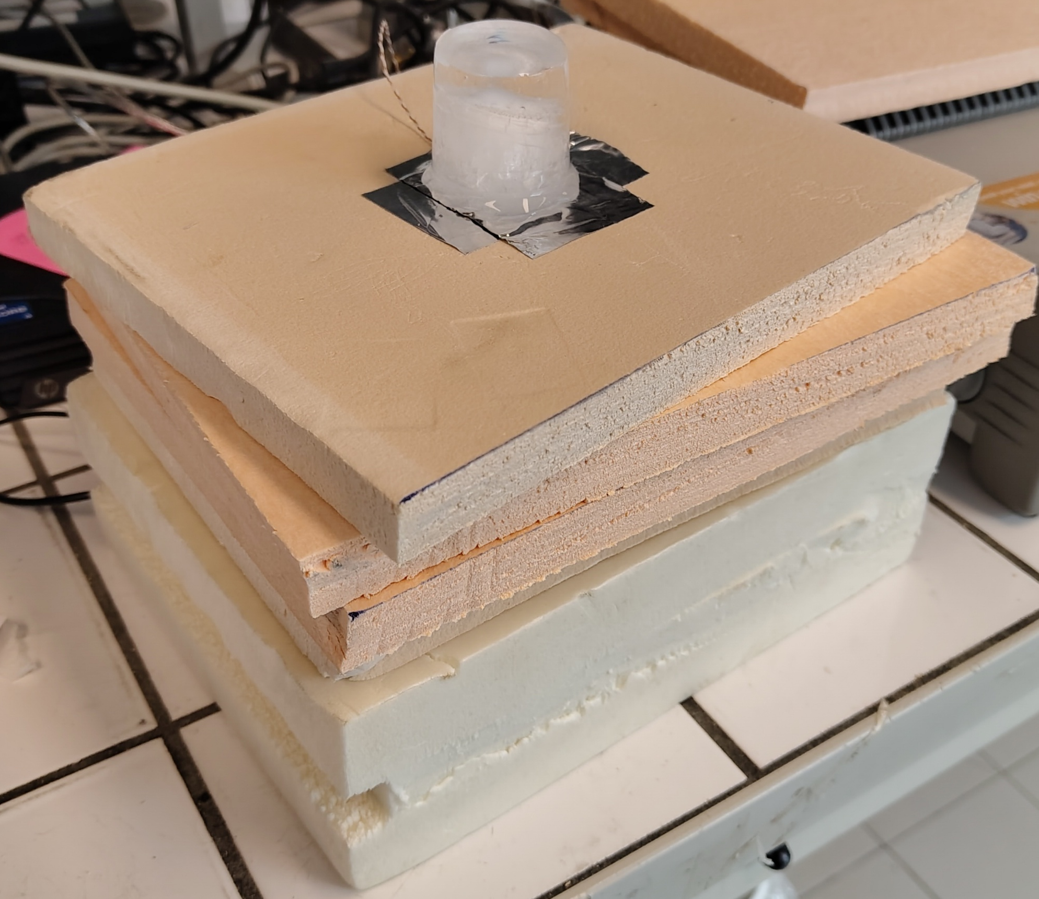
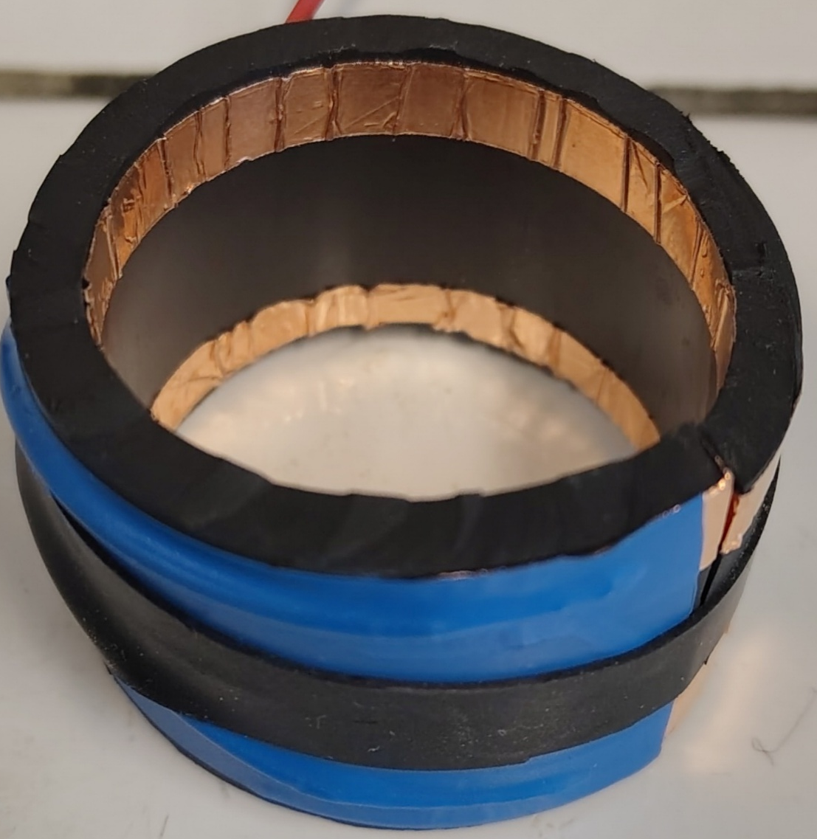
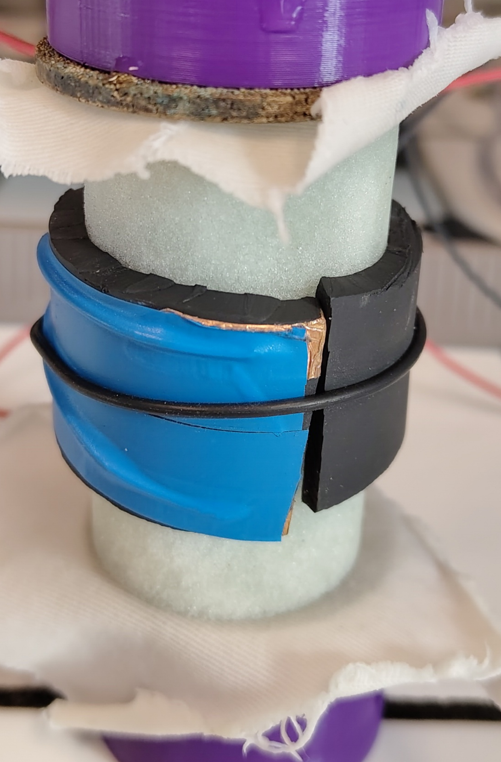
Introduction Digital twin Synthetic rock 1/5
From synthetic rocks to synthetic rocks
Not all microstructures are representative
Simulation of thermal sintering
Uniaxial compression test
Permeability test to determine the hydraulic conductivity
Configuration to determine the thermal coefficient
Configuration to determine the electrical resistance
Preparation of synthetics rocks from fritted glass samples (Carbillet, 2022)
Solid phase
Pore phase

Slide 10

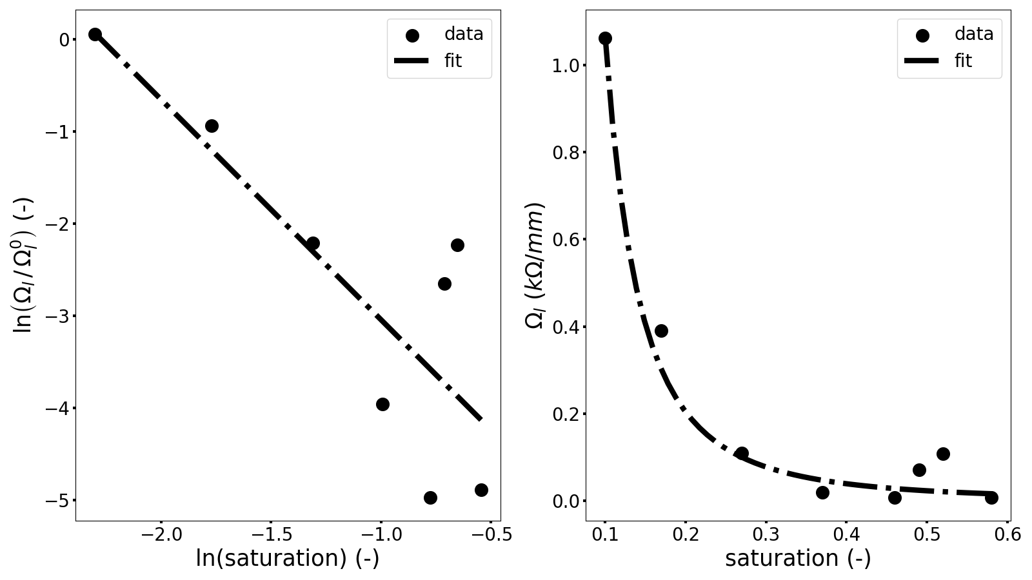
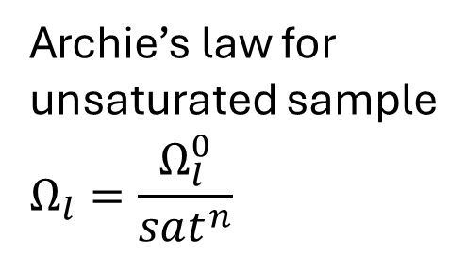
Introduction Digital twin Synthetic rock 5/5
Synthetic rocks
Archie’s law for
unsaturated sample
$$Ω_{l}=\frac{Ω_{l}^{0}}{sat^{n}}$$
Determination of the parameters of the Archie’s law for unsaturated sample

Slide 11
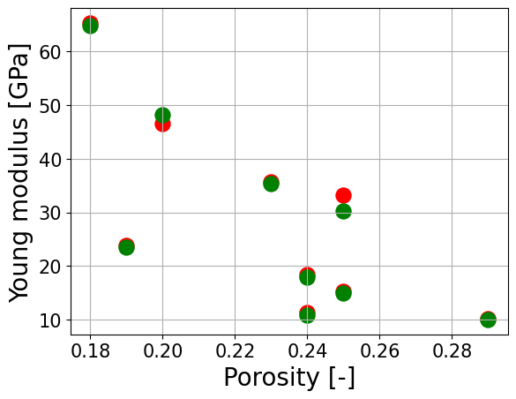
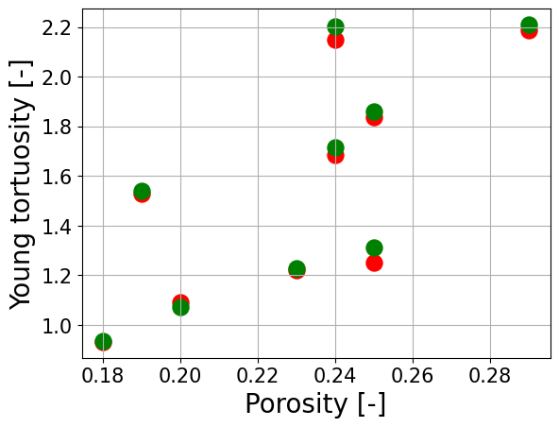
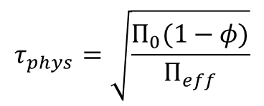
Introduction Digital twin Synthetic rock 2/5
Synthetic rocks
$$τ_{phys}=\sqrt{\frac{Π_{0}(1−φ)}{Π_{eff}}}$$

Slide 12
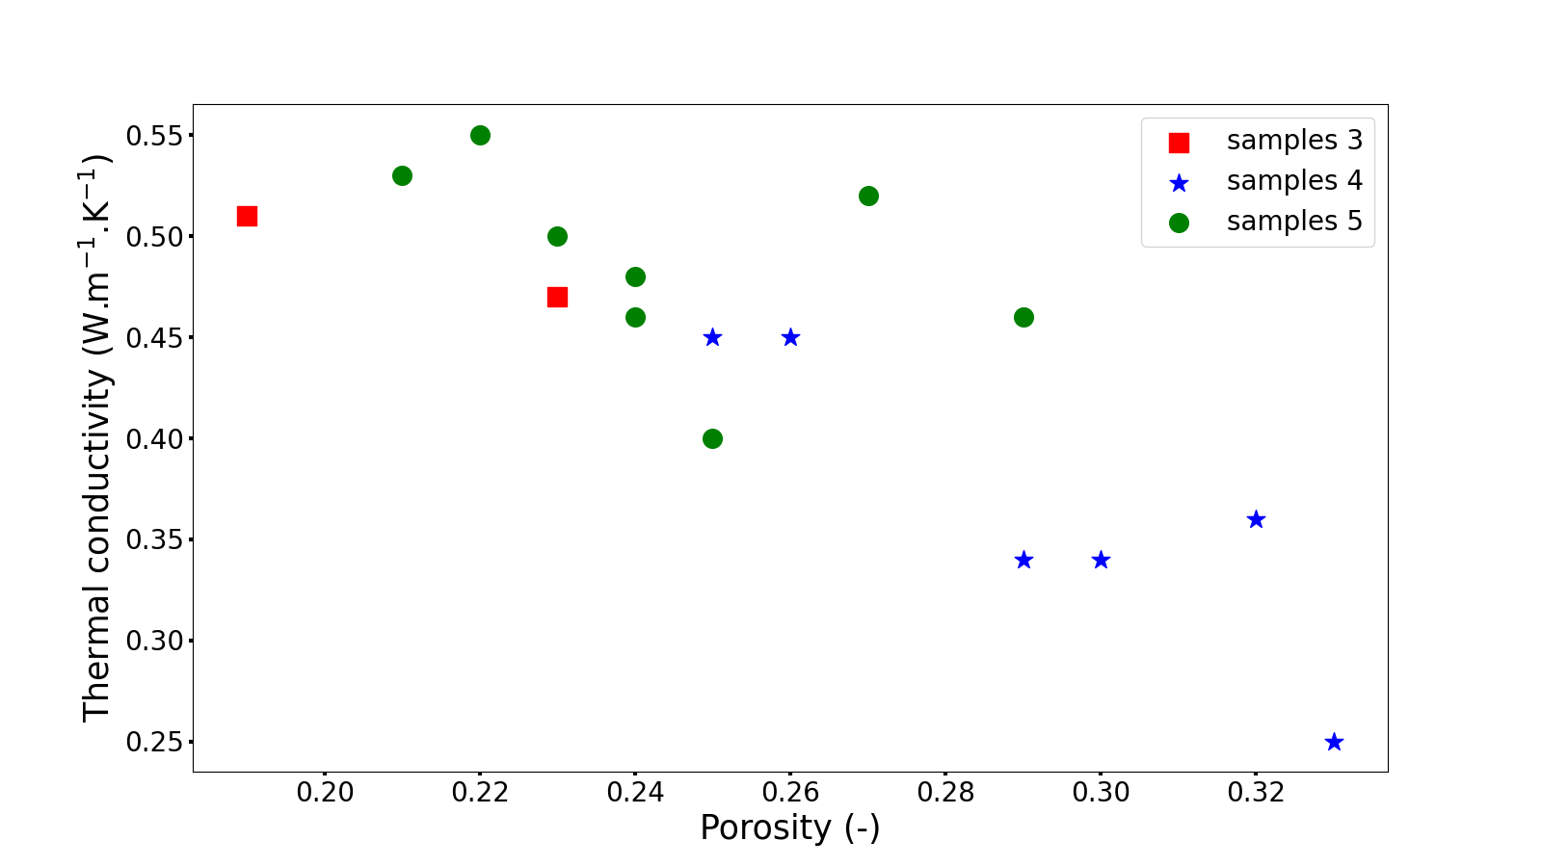
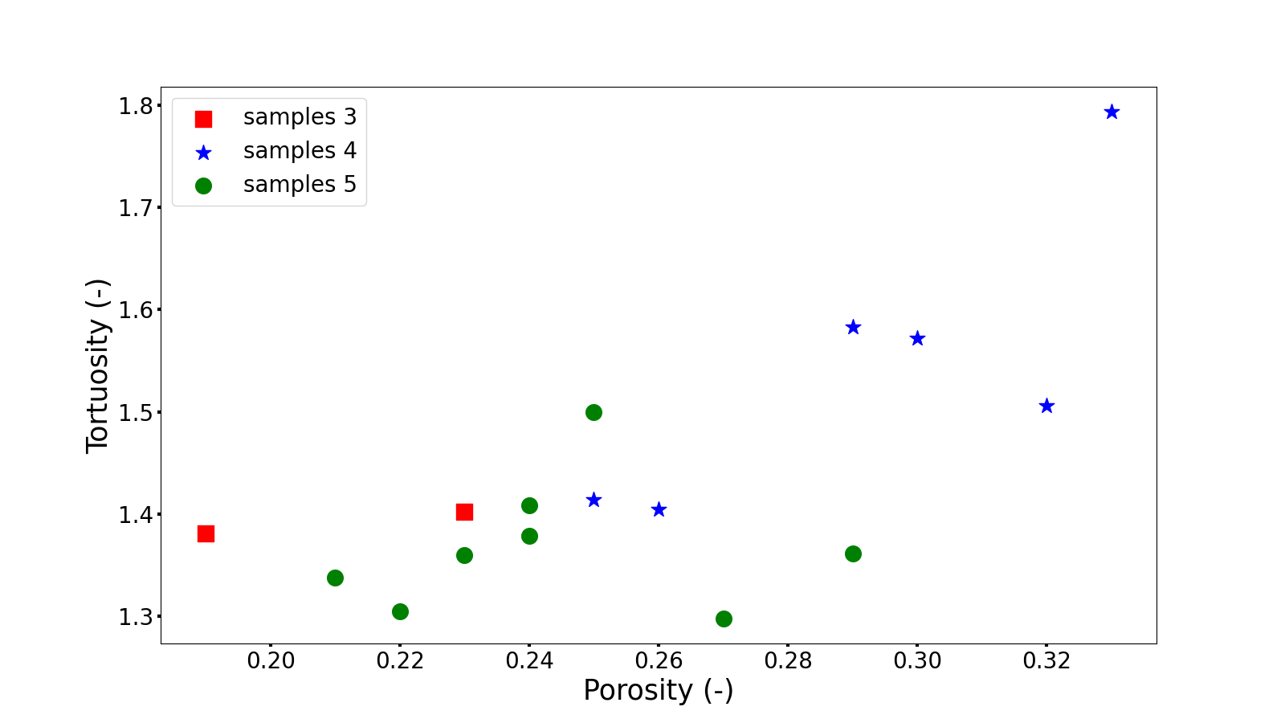
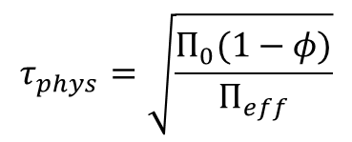
Introduction Digital twin Synthetic rock 3/5
Synthetic rocks
$$τ_{phys}=\sqrt{\frac{Π_{0}(1−φ)}{Π_{eff}}}$$

Slide 13
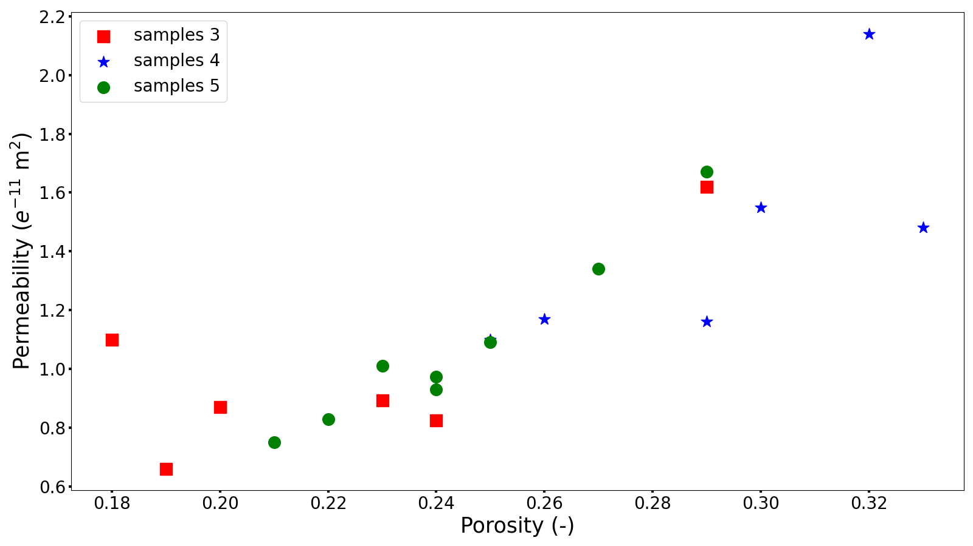



Introduction Digital twin Synthetic rock 4/5
Synthetic rocks
$$τ_{phys}=\sqrt{\frac{Π_{0} φ}{Π_{eff}}}$$

Slide 14



Thermal and Mechanical mechanisms

