Slide 1



Interfacial instability in non-Newtonian multiphase porous media flow
Sourav Mondal¹ and Pooja Singh^{1,2}
¹ Indian Institute of Technology Kharagpur, email: smondal@che.iitkgp.ac.in
² Norwegian university of Science and Technology (NTNU)

Slide 2
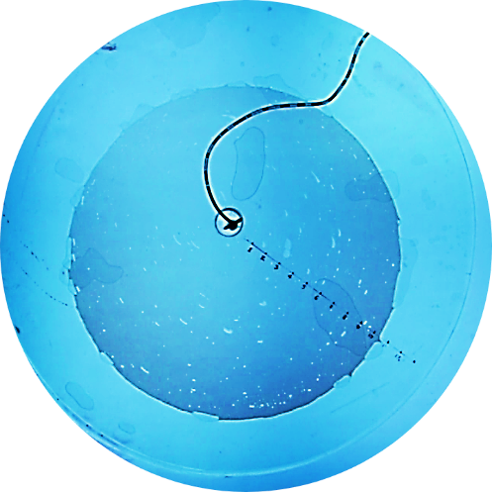
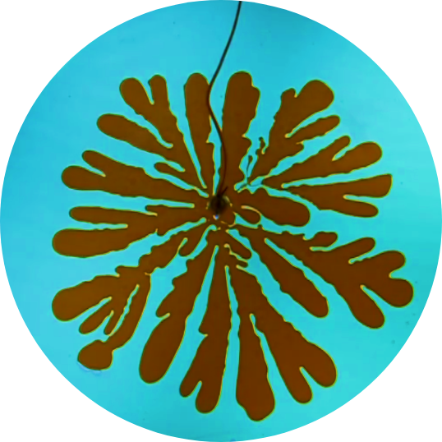
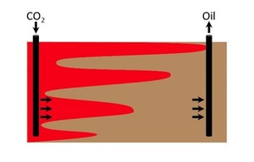
Interfacial instability – viscous fingering
When a more viscous fluid is displaced by a less viscous fluid in a porous media or in Hele-Shaw cell, the boundary of the two fluids (fluid-fluid interface) becomes unstable and forms a finger-like pattern.
Why viscous fingering is important and relevant, for engineering applications ?
Oil recovery challenges!
High Pressure Steam
Oil is displacing water: Stable interface
Water is displacing oil: Viscous fingering
P.G. Saffman, J. Fluid Mech. 173 (1986) 73-94.

Slide 3
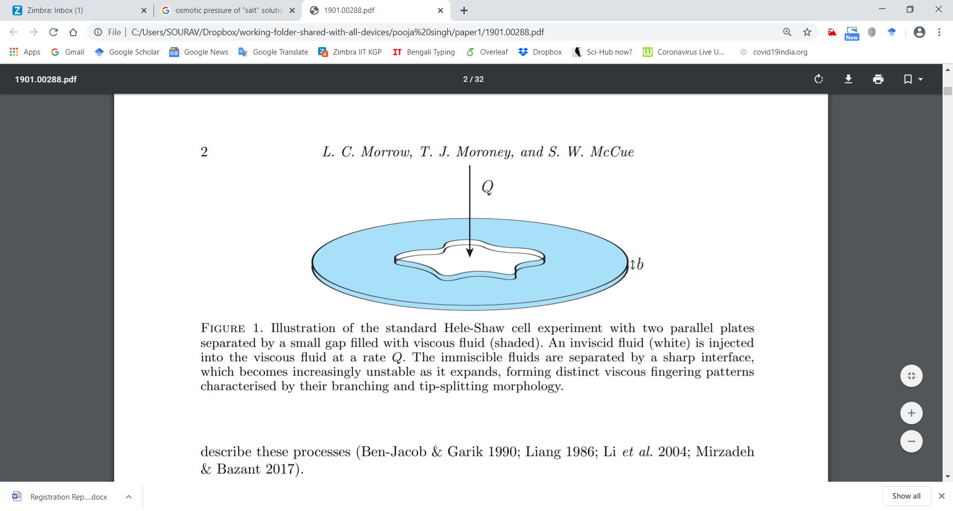


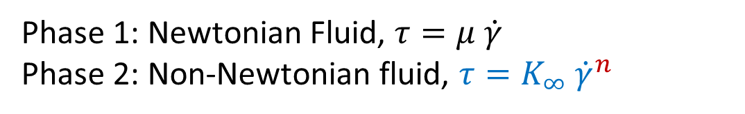
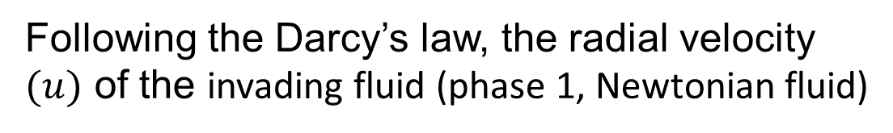
Radial Hele-Shaw cell:: non-Newtonian Fluid
Phase 1: Newtonian Fluid, $τ=μ \dot{γ}$
Phase 2: Non-Newtonian fluid, $τ=K_{∞} {\dot{γ}}^{n}$
R
Phase 2
r
r_{p}
Phase 1
Following the Darcy’s law, the radial velocity $(u)$ of the invading fluid (phase 1, Newtonian fluid)
The displaced fluid (phase 2) in a Hele–Shaw cell
P. Singh, S. Mondal, Physics of Fluids 34 (2022) 114117, [Featured article – Editors’ pick of 2022]

Slide 4
Radial Hele-Shaw cell:: non-Newtonian Fluid
Phase 1: Newtonian Fluid, $τ=μ \dot{γ}$
Phase 2: Non-Newtonian fluid, $τ=K_{∞} {\dot{γ}}^{n}$
R
Phase 2
r
r_{p}
Phase 1
Following the Darcy’s law, the radial velocity $(u)$ of the invading fluid (phase 1, Newtonian fluid)
The displaced fluid (phase 2) in a Hele–Shaw cell
P. Singh, S. Mondal, Physics of Fluids 34 (2022) 114117, [Featured article – Editors’ pick of 2022]

Slide 5
Radial Hele-Shaw cell:: non-Newtonian Fluid
Phase 1: Newtonian Fluid, $τ=μ \dot{γ}$
Phase 2: Non-Newtonian fluid, $τ=K_{∞} {\dot{γ}}^{n}$
R
Phase 2
r
r_{p}
Phase 1
Following the Darcy’s law, the radial velocity $(u)$ of the invading fluid (phase 1, Newtonian fluid)
The displaced fluid (phase 2) in a Hele–Shaw cell
P. Singh, S. Mondal, Physics of Fluids 34 (2022) 114117, [Featured article – Editors’ pick of 2022]

Slide 6
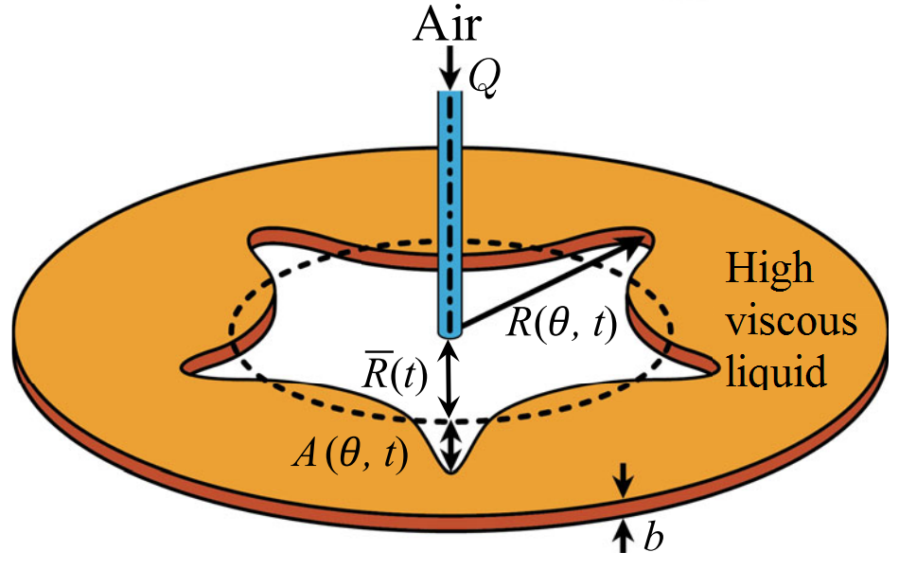



Non-Newtonian Hele Shaw flow
At the fluid–fluid (deformed) interface, the normal and tangential components of the stresses are balanced,
where $κ$ is the curvature of the interface.
The viscosity of the invading fluid ${(μ}_{1})$ is negligible compared to the viscosity of the displaced fluid $(μ_{2}=K_{∞} {\dot{γ}}^{n−1})$ ::: $\frac{μ_{1}}{μ_{2}}≪1$.
Considering expansion of $φ=φ^{0}+εφ^{1},$the (zeroth order) solution of the velocity potential $φ$
where $V=∂φ/∂r$ is the interface radial velocity and R is the radial ordinate of the (undeformed) interface.

Slide 7
Non-Newtonian Hele Shaw flow
At the fluid–fluid (deformed) interface, the normal and tangential components of the stresses are balanced,
where $κ$ is the curvature of the interface.
The viscosity of the invading fluid ${(μ}_{1})$ is negligible compared to the viscosity of the displaced fluid $(μ_{2}=K_{∞} {\dot{γ}}^{n−1})$ ::: $\frac{μ_{1}}{μ_{2}}≪1$.
Considering expansion of $φ=φ^{0}+εφ^{1},$the (zeroth order) solution of the velocity potential $φ$
where $V=∂φ/∂r$ is the interface radial velocity and R is the radial ordinate of the (undeformed) interface.

Slide 8



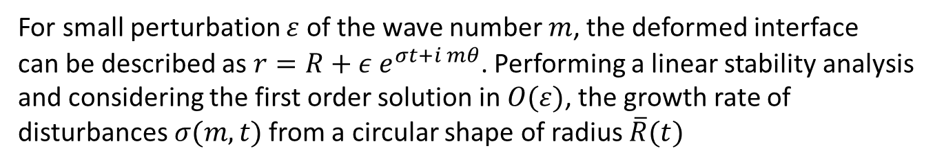
Linear Stability analysis
For small perturbation $ε$ of the wave number $m$, the deformed interface can be described as $r=R+ε e^{σt+i mθ}$. Performing a linear stability analysis and considering the first order solution in$O(ε)$, the growth rate of disturbances$σ(m,t)$ from a circular shape of radius $\overline{R}(t)$
where $\overline{R}(t)$ is obtained from mass conservation,
The dimensionless (control) parameter
Also, $J$ is related to the capillary number $(Ca=μ_{2}V/Γ)$ as $J=2 Ca {\left[\frac{\overline{R}\left(t\right)}{b}\right]}^{2} {\left(\frac{4n\text{+2}}{n}\right)}^{n}$

Slide 9
Linear Stability analysis
For small perturbation $ε$ of the wave number $m$, the deformed interface can be described as $r=R+ε e^{σt+i mθ}$. Performing a linear stability analysis and considering the first order solution in$O(ε)$, the growth rate of disturbances$σ(m,t)$ from a circular shape of radius $\overline{R}(t)$
where $\overline{R}(t)$ is obtained from mass conservation,
The dimensionless (control) parameter
$J$ can also be related to the capillary number $(Ca=μ_{2}V/Γ)$ as $J=2 Ca {\left[\frac{\overline{R}\left(t\right)}{b}\right]}^{2} {\left(\frac{4n\text{+2}}{n}\right)}^{n}$

Slide 10

Viscous fingering – how to control?
For the maximum growth mode, ${\left.\frac{∂σ\left(m,t\right)}{∂m}\right|}_{m=m_{m}}=0$, in this case
$J=3m_{max}^{2}−2m_{max}\left(1−n\right)−1$
where $J=\frac{2K_{∞}{\overline{R}\left(t\right)}^{2−n}Q{\left(t\right)}^{n}}{Γb^{1+2n}\left(1−n\right)}{\left(\frac{2n+1}{πn}\right)}^{n}$

Slide 11

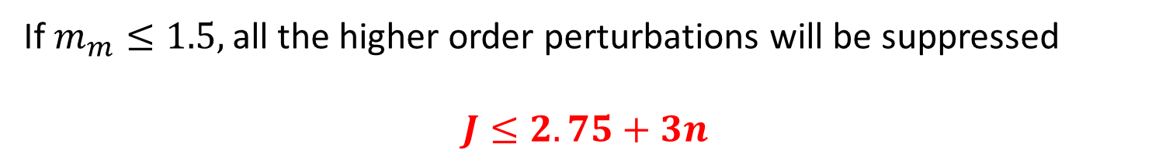

Suppressing viscous fingering
$J=3m_{max}^{2}−2m_{max}\left(1−n\right)−1$
If $m_{m}≤1.5,$all the higher order perturbations will be suppressed
$$J≤2.75+3n$$
$J$has to be time invariant, $Q\left(t\right)=Q_{0}t^{−\frac{2−n}{2+n}}$
P. Singh, S. Mondal, Physics of Fluids 34 (2022) 114117, [Featured article – Editors’ pick of 2022]

Slide 12
Suppressing viscous fingering
$J=3m_{max}^{2}−2m_{max}\left(1−n\right)−1$
If $m_{m}≤1.5,$all the higher order perturbations will be suppressed
$$J≤2.75+3n$$
$J$has to be time invariant, $Q\left(t\right)=Q_{0}t^{−\frac{2−n}{2+n}}$
P. Singh, S. Mondal, Physics of Fluids 34 (2022) 114117, [Featured article – Editors’ pick of 2022]

Slide 13

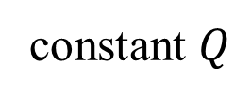


Numerical results
Constant $J$ $\left(Q \sim t^{−\frac{2−n}{2+n}}\right)$, Critical $J≤2.75+3 n$ for stability
Choosing $n$ $\sim$ 0.5 (equivalent for 0.1% w/v Carbopol solution)
constant $Q$
$$J=400$$
$$J=200$$
$$J=3$$

Slide 14
Numerical results
Constant $J$ $\left(Q \sim t^{−\frac{2−n}{2+n}}\right)$, Critical $J≤2.75+3 n$ for stability
Choosing $n$ $\sim$ 0.5 (equivalent for 0.1% w/v Carbopol solution)
constant $Q$
$$J=400$$
$$J=200$$
$$J=3$$

Slide 15
Numerical results
Constant $J$ $\left(Q \sim t^{−\frac{2−n}{2+n}}\right)$, Critical $J≤2.75+3 n$ for stability
Choosing $n$ $\sim$ 0.5 (equivalent for 0.1% w/v Carbopol solution)
constant $Q$
$$J=400$$
$$J=200$$
$$J=3$$

Slide 16
Numerical results
Constant $J$ $\left(Q \sim t^{−\frac{2−n}{2+n}}\right)$, Critical $J≤2.75+3 n$ for stability
Choosing $n$ $\sim$ 0.5 (equivalent for 0.1% w/v Carbopol solution)
constant $Q$
$$J=400$$
$$J=200$$
$$J=3$$

Slide 17
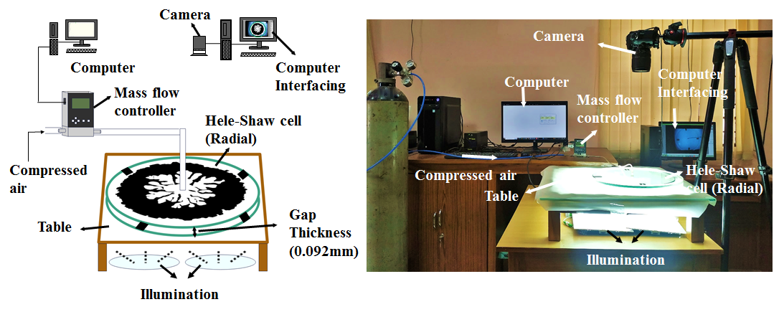
Hele – Shaw cell experimental setup
Actual picture of the experimental setup.
Schematic of the radial Hele-Shaw cell design.

Slide 18
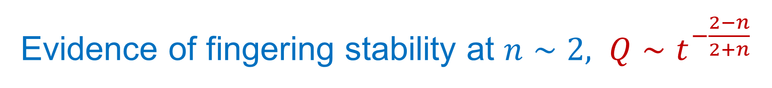
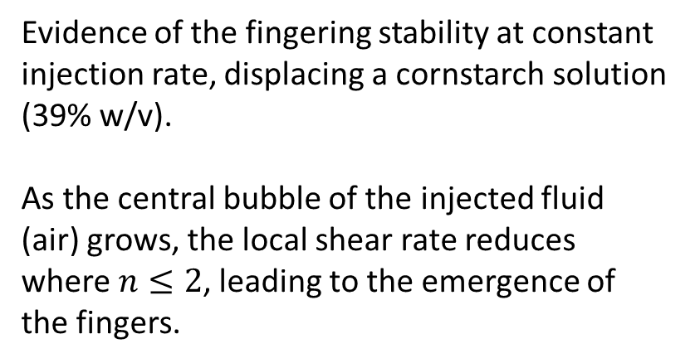
Evidence of fingering stability at $n∼2, {Q∼t}^{−\frac{2−n}{2+n}}$
Evidence of the fingering stability at constant injection rate, displacing a cornstarch solution (39% w/v).
As the central bubble of the injected fluid (air) grows, the local shear rate reduces where $n≤2$, leading to the emergence of the fingers.
Singh, P., & Mondal, S. (2022). Physics of Fluids, 34(11), 114117. (Selected as the editors’ pick of 2022)
Singh, P., & Mondal, S. (2023). Physics of Fluids, 35(6).

Slide 19
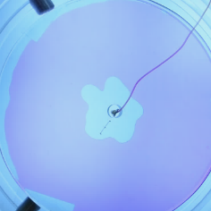
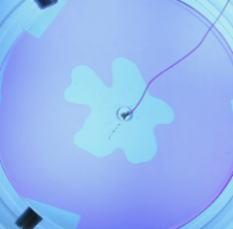
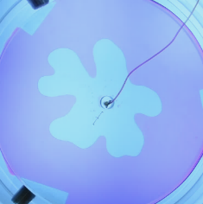
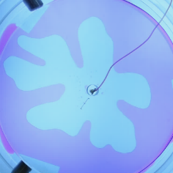
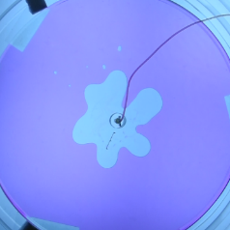
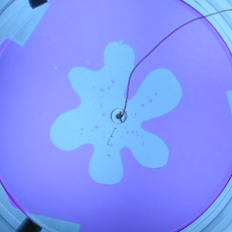
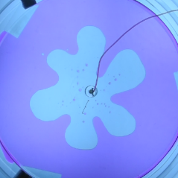
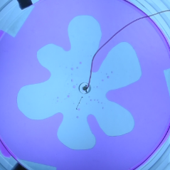
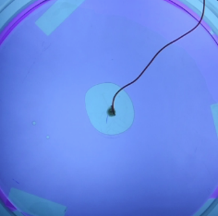
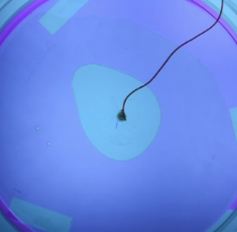
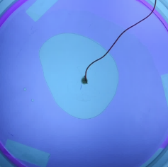
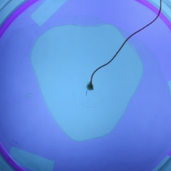
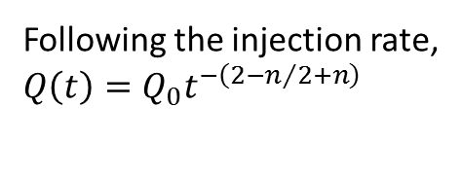
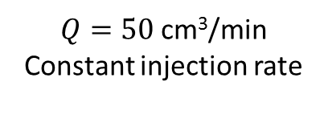


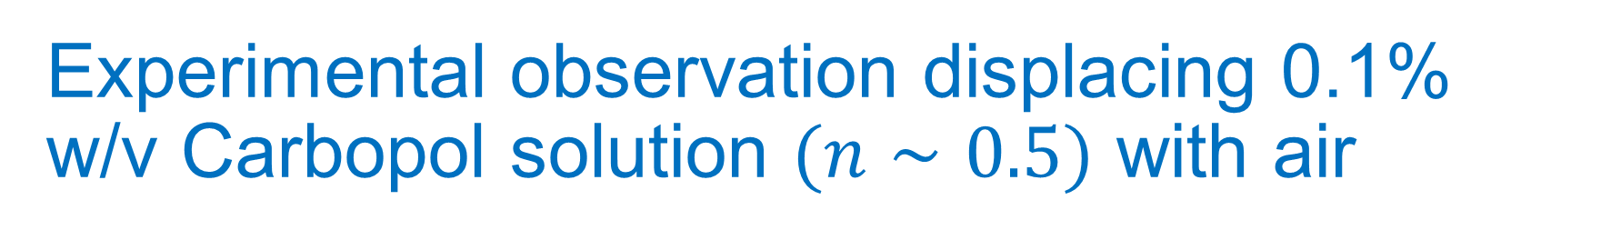
Experimental observation displacing 0.1% w/v Carbopol solution $(n∼0.5)$ with air
$Q=50$cm³/min
Constant injection rate
Following the injection rate,
$$Q\left(t\right)=Q_{0}t^{−{\left(2−n\right.}/{\left.2+n\right)}}$$
$$J=400( J>J_{cr})$$
$$J=4( J<J_{cr})$$

Slide 20

Experimental observation displacing 0.1% w/v Carbopol solution $(n∼0.5)$ with air
$Q=50$cm³/min
Constant injection rate
Following the injection rate,
$$Q\left(t\right)=Q_{0}t^{−{\left(2−n\right.}/{\left.2+n\right)}}$$
$$J=400( J>J_{cr})$$
$$J=4( J<J_{cr})$$

Slide 21
Experimental observation displacing 0.1% w/v Carbopol solution $(n∼0.5)$ with air
$Q=50$cm³/min
Constant injection rate
Following the injection rate,
$$Q\left(t\right)=Q_{0}t^{−{\left(2−n\right.}/{\left.2+n\right)}}$$
$$J=400( J>J_{cr})$$
$$J=4( J<J_{cr})$$

Slide 22
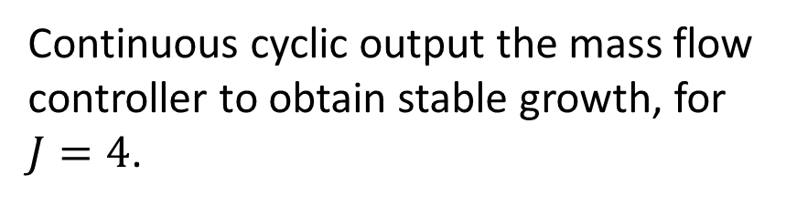
Continuous long term operation in fingering suppression
Continuous cyclic output the mass flow controller to obtain stable growth, for $J=4$.
P. Singh, S. Mondal, Physics of Fluids 34 (2022) 114117, [Featured article – Editors’ pick of 2022]

Slide 23
Concluding thoughts
The rheology of the displaced fluid is important.
It is possible to control and manipulate the fingering behaviour, and thus the consequent fingering pattern, affecting fluid displacement efficiency.
Multi-modal interactions is prominent is important at large scale fingering structures evolution.
[work in progress] Long term miscible fingering displacement prediction can be achieved by diffusive porous transport theory or AI inspired fractal pattern evolution.
[work in progress] Reaction at the interface can change the displacement (or instability pattern) – can have stabilising or de-stabilizing effect.

Slide 24
Concluding thoughts
The rheology of the displaced fluid is important.
It is possible to control and manipulate the fingering behaviour, and thus the consequent fingering pattern, affecting fluid displacement efficiency.
Multi-modal interactions is prominent is important at large scale fingering structures evolution.
[work in progress] Long term miscible fingering displacement prediction can be achieved by diffusive porous transport theory or AI inspired fractal pattern evolution.
[work in progress] Reaction at the interface can change the displacement (or instability pattern) – can have stabilising or de-stabilizing effect.

Slide 25
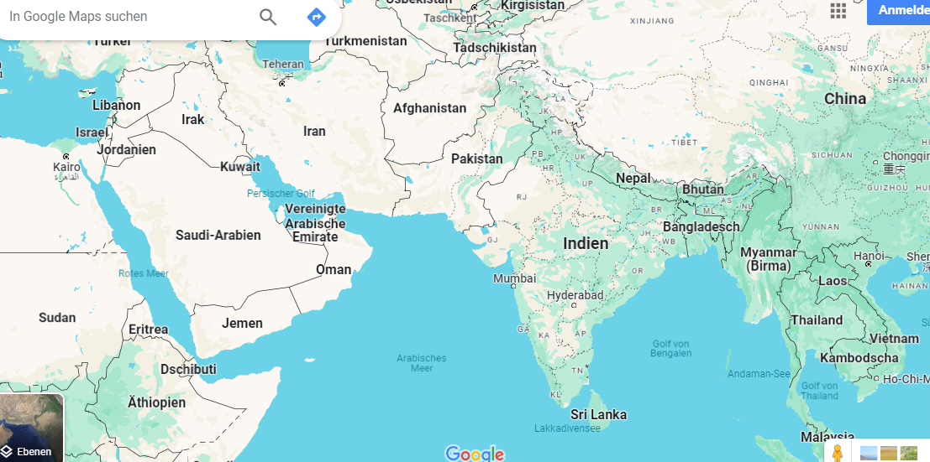
Indian Institute of Technology Kharagpur
THANK YOU

