Slide 1



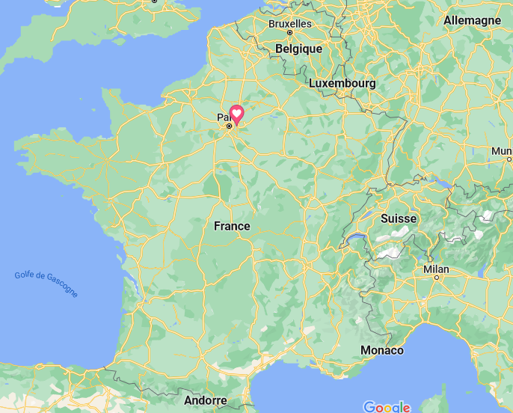


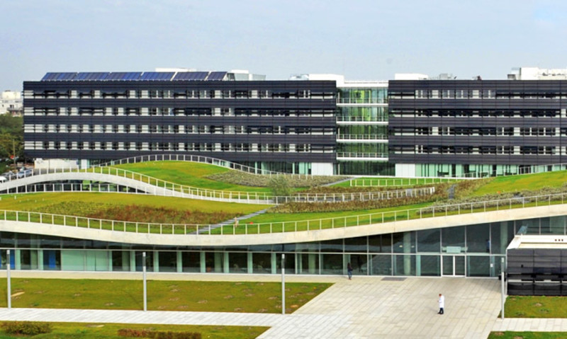
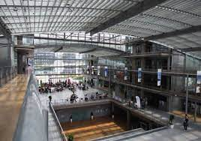
Interpore 2026, Nantes. MS05 (Physics of multiphase flow in diverse porous media)
22 may 2026
Fluid transfers through versatile dynamic NMR relaxometry
Benjamin Maillet (oral presenter), Philippe Coussot, Rahima Sidi-Boulenouar (Navier laboratory)
Rheology and Porous Media team building
Ecole des Ponts Paris Tech
Champs-sur-Marne
France
Main topic of Navier laboratory : Material for construction by plenty of approaches.

Slide 2
Why understand the interaction between water and solid matrix ?
Plenty of approaches but often …
→ not temporally and/or spacially resolved (only 1 image or a set of global information)
→ not « multiscale »
→ not quantitative
→ not so versatile (only specific material)
→ needs to hydric equlibrium (in contrary to the « real life »).
Using colloidal deposition to mobilize immiscible fluids from porous media
Joanna Schneider, Rodney D. Priestley, and Sujit S. Datta
Phys. Rev. Fluids, 2021
Lehoux et al, Physical Review E, 2016
→ The « Dynamic NMR relaxometry » is an innovative and general approach to answer to all these limitations for porous media and complex fluids

Slide 3
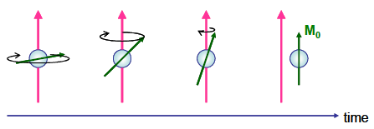
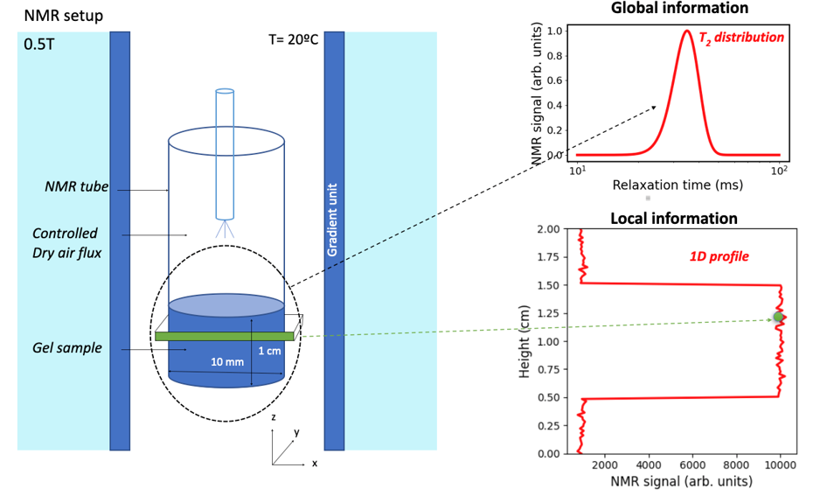

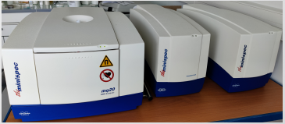
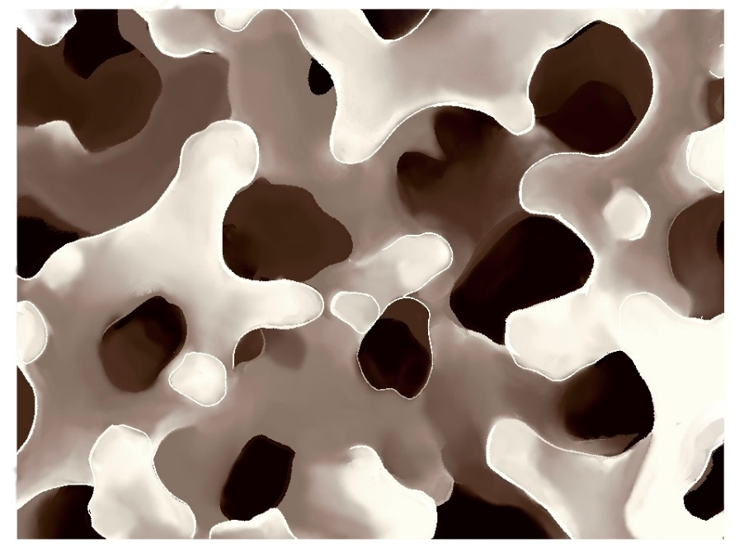
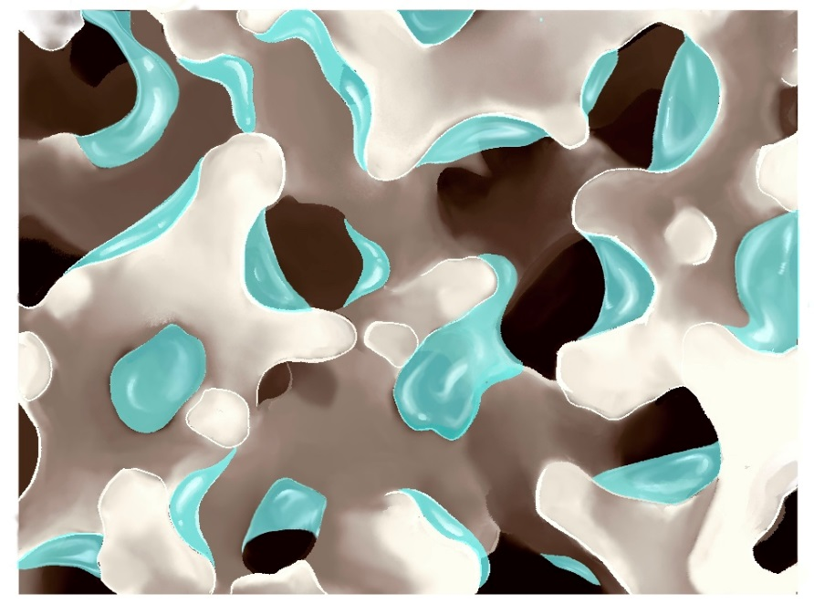
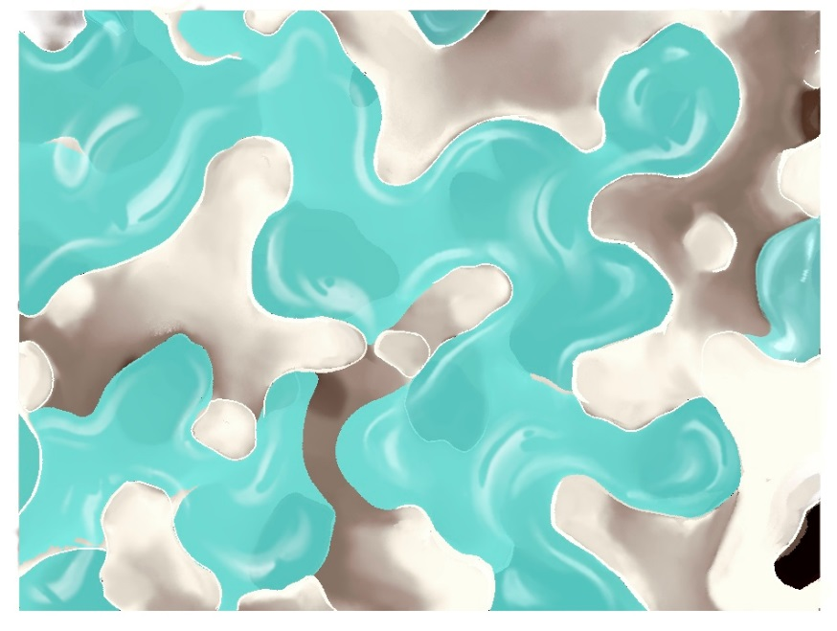
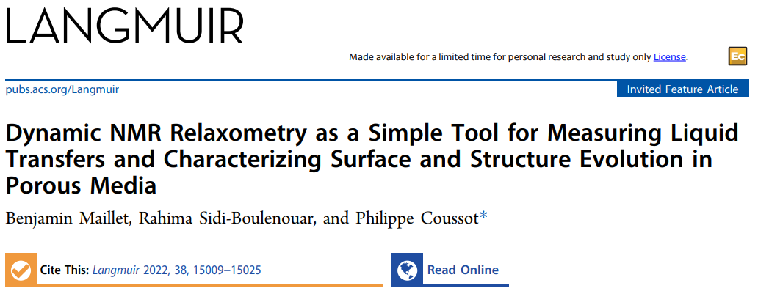
The most standard NMR setup at Navier laboratory…
T2 : characteristic time of magnetization (transverse part) to come back at equilibrium
CPMG sequence
Global information
→ T2 probability
density function
∫ A.exp(-t/T2) d( ln(T2) )
B₀
G_{z}
B₁
Minispec Brüker 0,5 teslas
Loop process
Spin Echo sequence
Local information
(optional)
V(sample) ≈ 1 cm³ >> pore, particle,… size
Duration(exp) ≈ 10 min << drying duration
↗ dry air flux + ↘ distance [air tube – sample]
→ « more agressive » drying by the top surface
→ NMR of liquid proton (water at 20 °C by default)
→ Direct access to NMR observable evolution

Slide 4
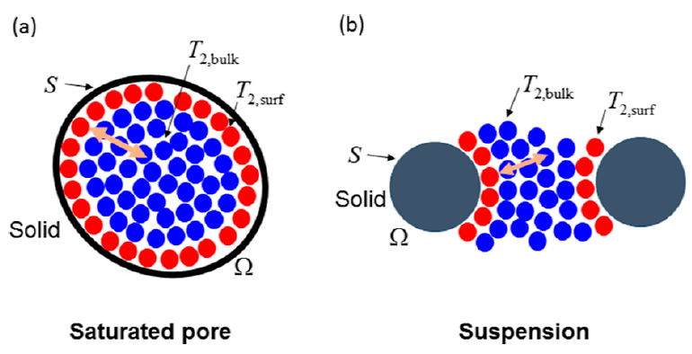
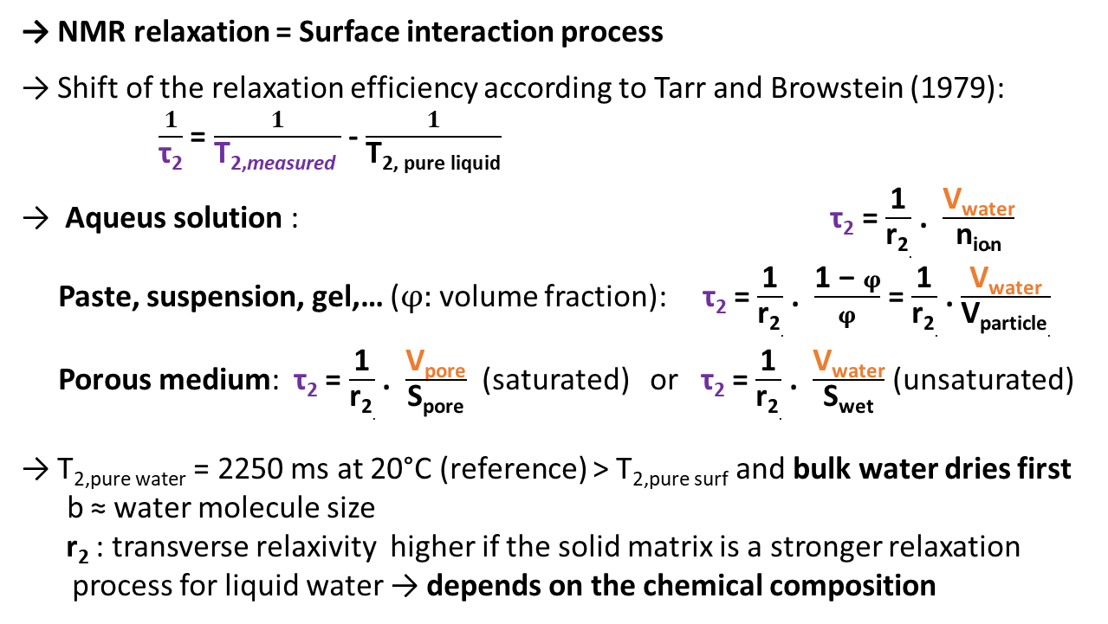
The fast exchange theory as a key concept…
ANR Thermo NMR, Sidi-Boulenouar (> 2026)
→ NMR relaxation = Surface interaction process
→ Shift of the relaxation efficiency according to Tarr and Browstein (1979):
$\frac{1}{\text{τ}\text{2}}$ = $\frac{1}{\text{T}\text{2,}\text{measured} }$ - $\frac{1}{\text{T}\text{2, }\text{pure} \text{liquid}}$
→ Aqueus solution : τ₂ = $\frac{\text{1}}{\text{r}\text{2}.}$ . $\frac{\text{V}\text{water}}{\text{n}\text{ion}}$
Paste, suspension, gel,… ($φ:$volume fraction): τ₂ = $\frac{\text{1}}{\text{r}\text{2}.}$ . $\frac{\text{1 − }φ}{φ}$ = $\frac{\text{1}}{\text{r}\text{2}.}$ . $\frac{\text{V}\text{water}}{\text{V}\text{particle}.}$
Porous medium: τ₂ = $\frac{\text{1}}{\text{r}\text{2}.}$ . $\frac{\text{V}\text{pore}}{\text{S}\text{pore}}$ (saturated) or τ₂ = $\frac{\text{1}}{\text{r}\text{2}.}$ . $\frac{\text{V}\text{water}}{\text{S}\text{wet}}$ (unsaturated)
→ T_{2,pure water} = 2250 ms at 20°C (reference) > T_{2,pure surf} and bulk water dries first
$\text{b}$≈ water molecule size
r₂ : transverse relaxivity higher if the solid matrix is a stronger relaxation process for liquid water → depends on the chemical composition
NMR signal
S_{NMR} α V(water)
Log(T2)
T_{2,},_{measured}
Julien, Maillet, Tocquer, Aime, Coussot
Langmuir, 2024
Fast exchange bulk – surface available if :
→ 1 molecule can explore surface and bulk several times during T2 duration
→ Surface residence time << Diffusion time inside the pore
Dynamic relaxometry easier to interpret if :
→ T_{2,ads.} or r₂ constant during the drying if stable roughness, chemical composition,…
→ No gradient of water content, isotropic swelling or shrinkage,…
→ No dewetting of the solid matrix
4

Slide 5
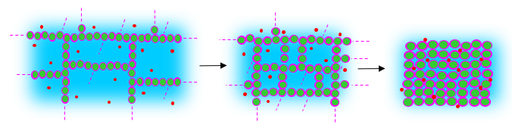
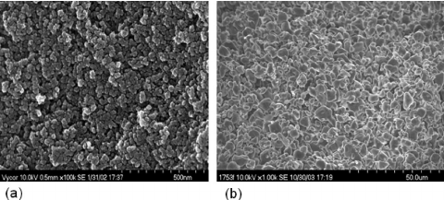
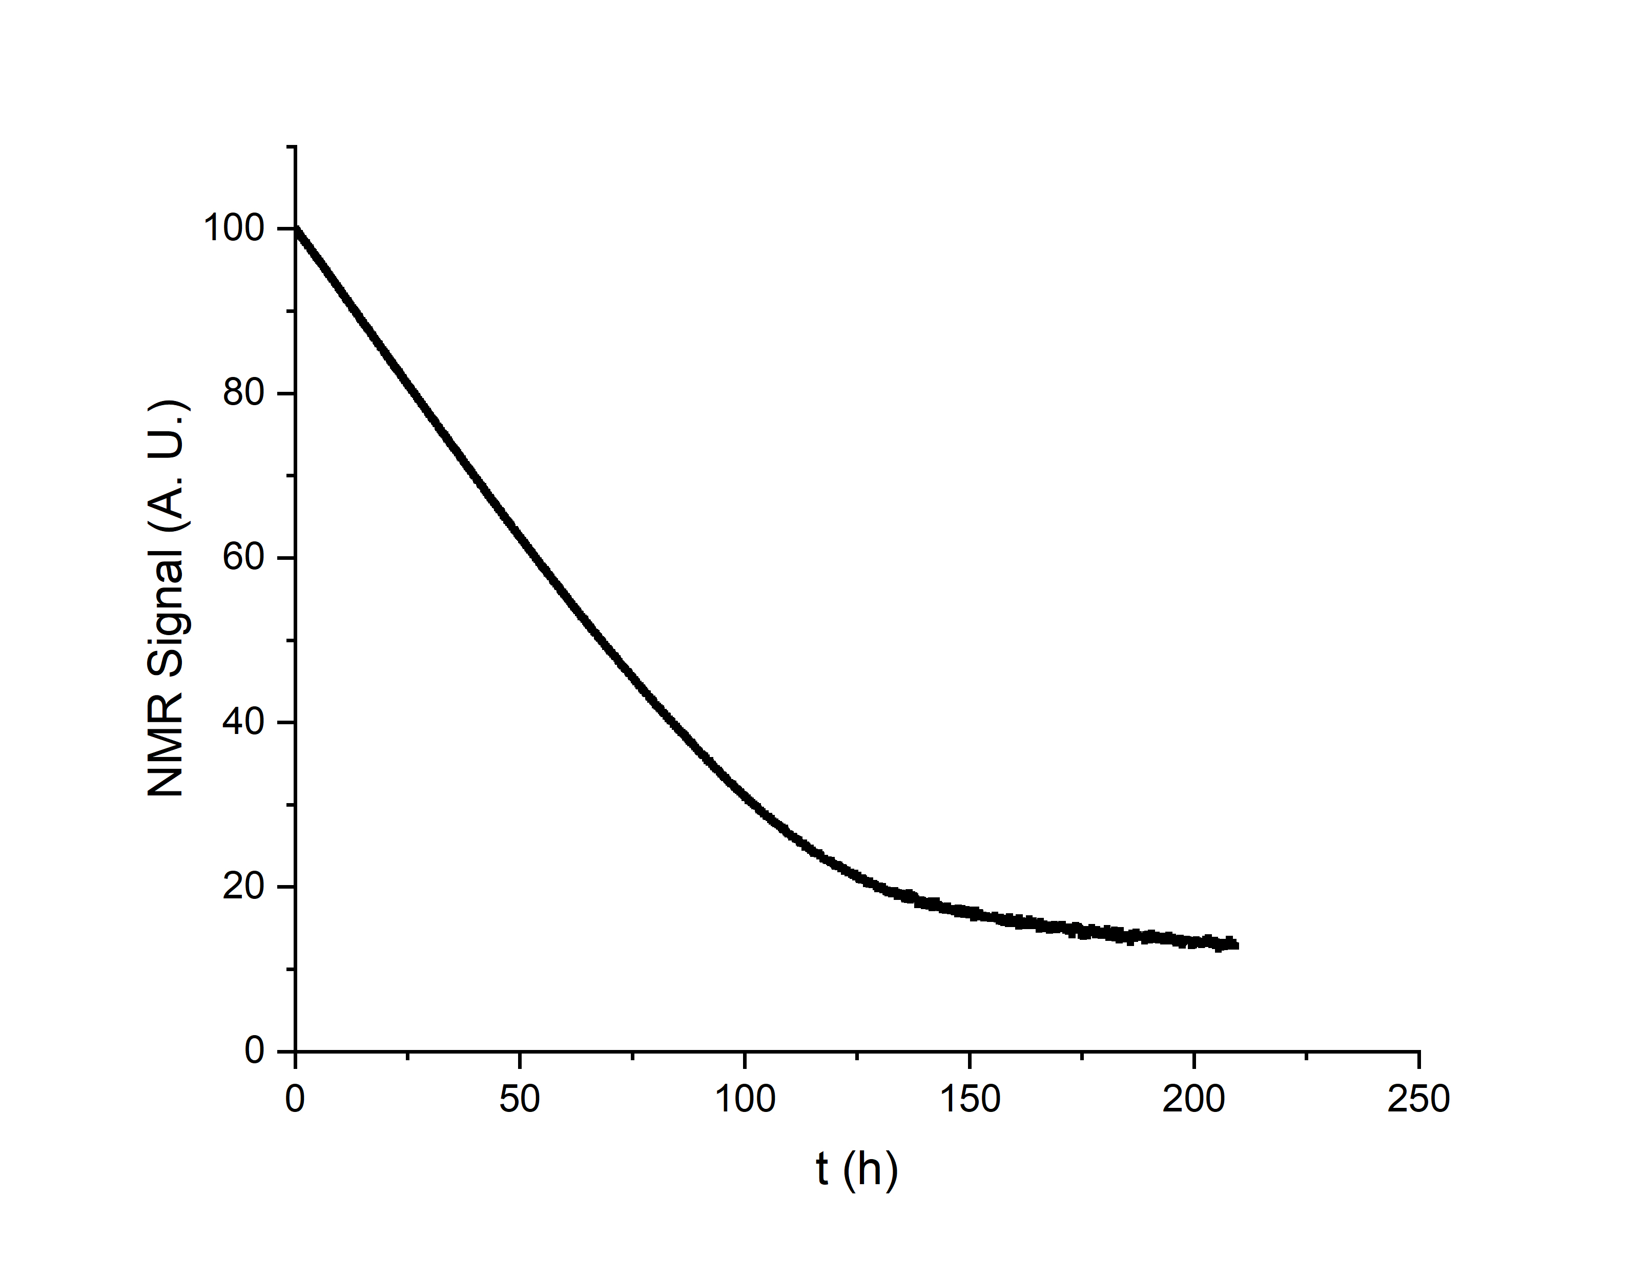
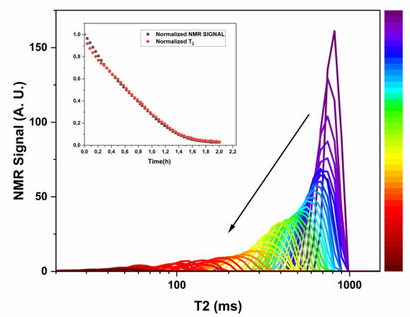
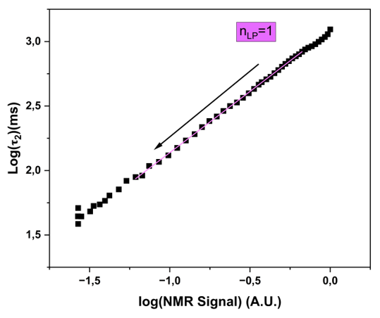
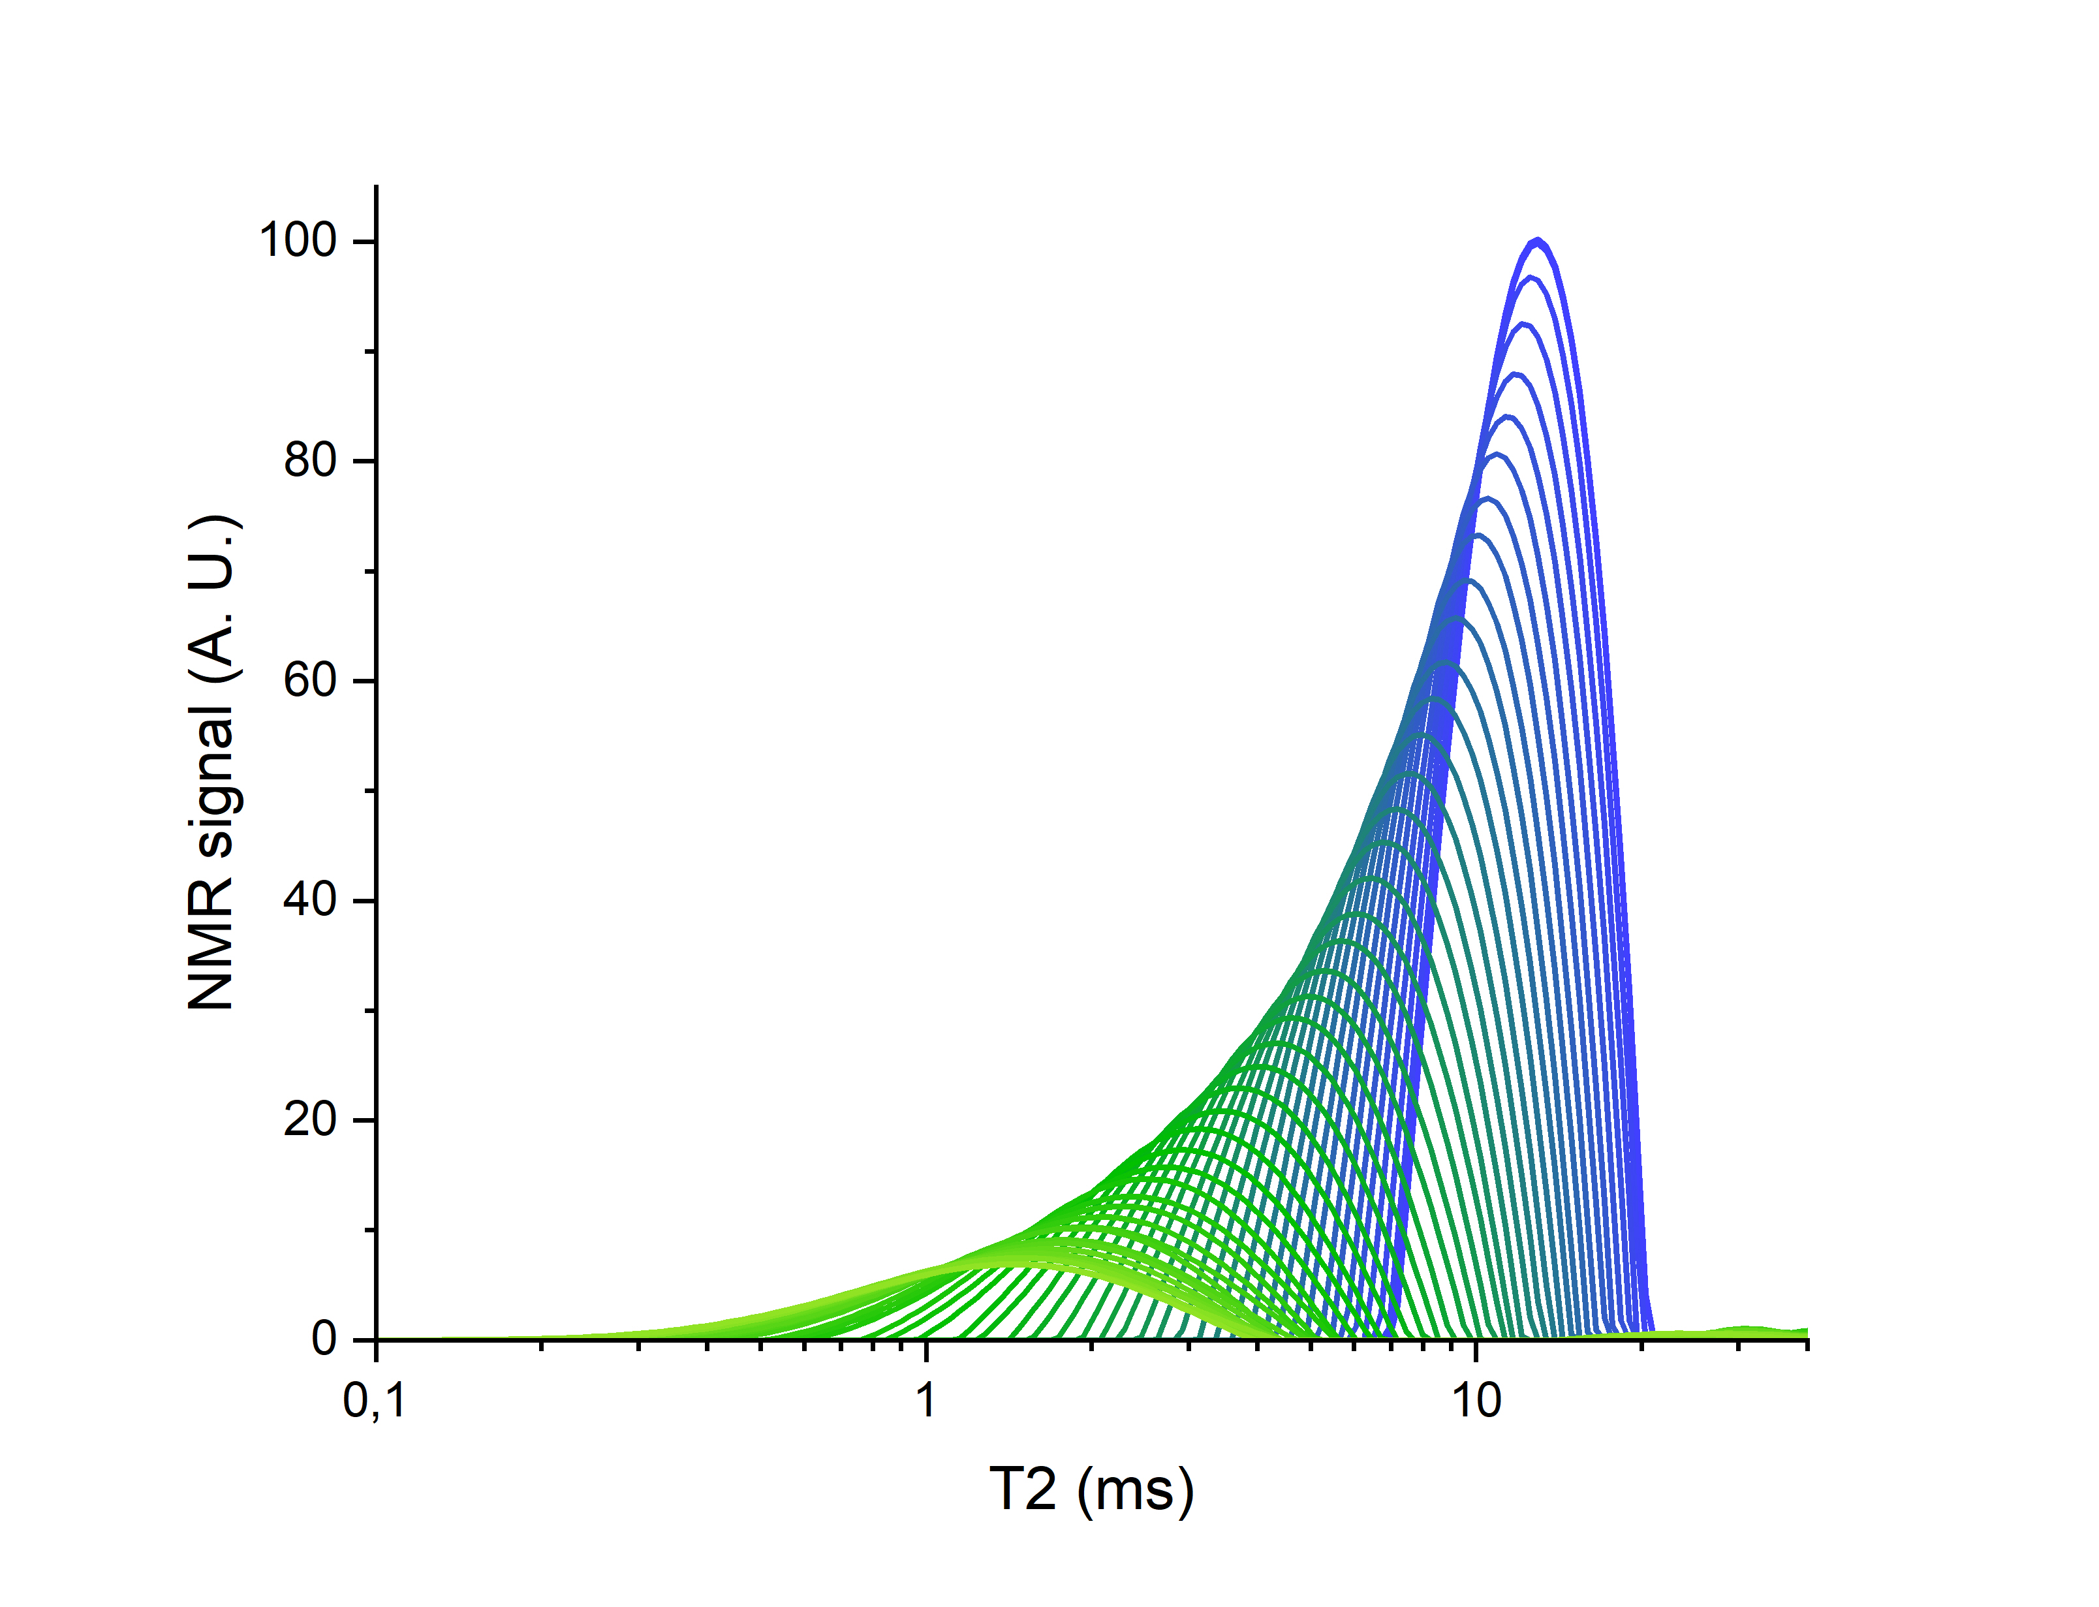
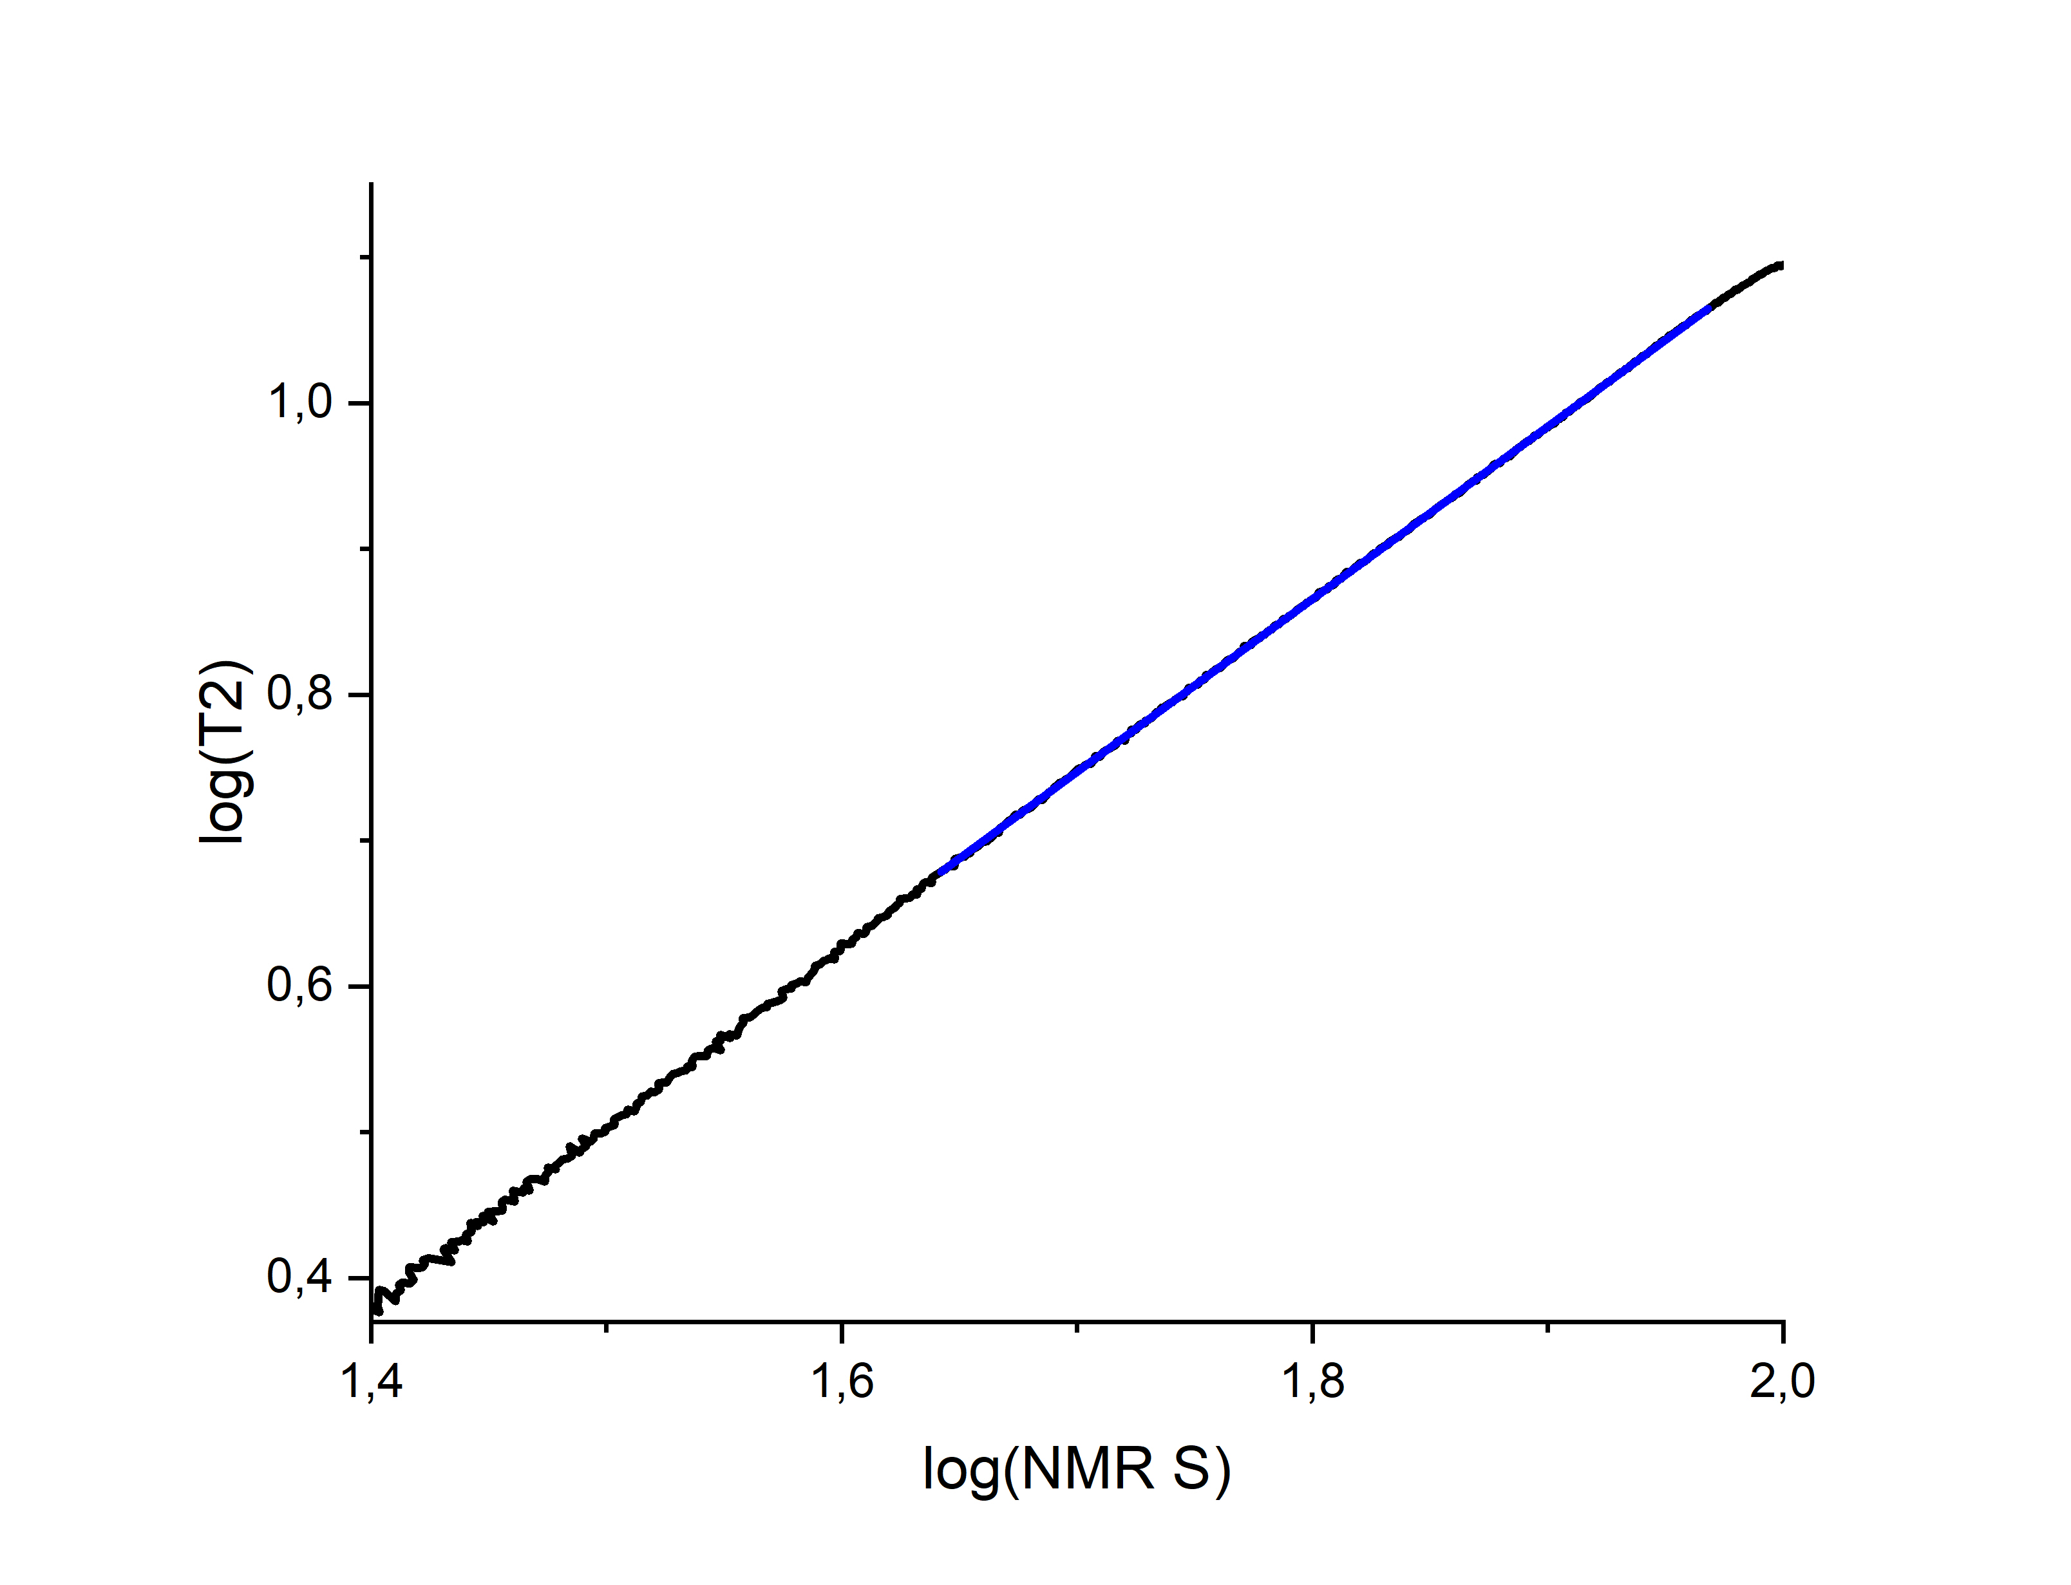
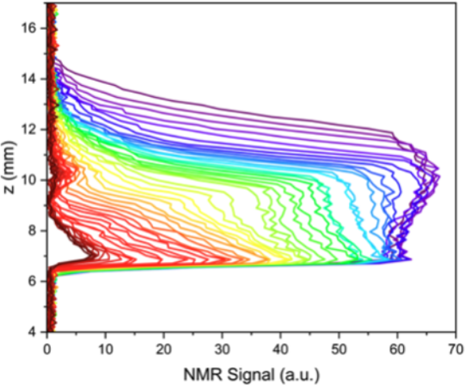
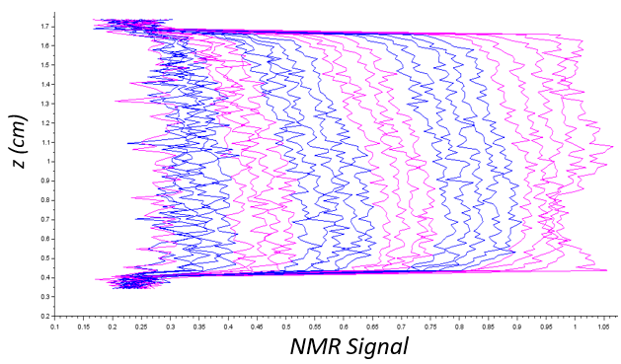
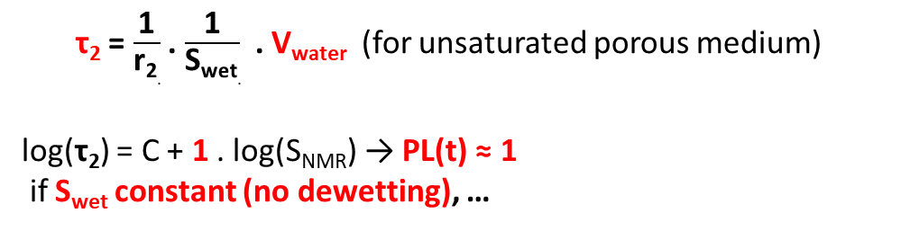
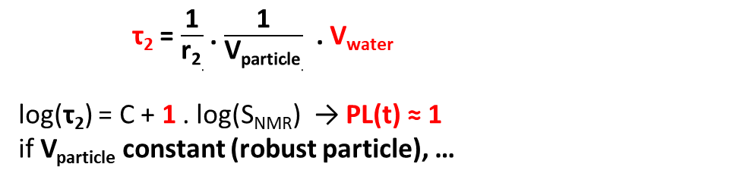
The reference power law… PL(t) = 1 ! Slow drying of a stable material
Dry air
Slow drying of Ludox suspension 0,5 M
Slow drying of saturated Vycor
= pure fused silica glass by 3D network of interconnected tortuous isotropic monodisperse pores (size ≈ 4,6 nm).
Constant drying rate
Adsorbed + non adsorbed water
Falling drying rate
≈ 1
Adsorbed water
T_{2,ads. water} = 2 ms
T_{2,sat. pore} = 12 ms
Sidi-Boulenouar, Maillet, Carouge, Ayturk, Poulesquen, Langmuir, 2026
Maillet, Sidi-Boulenouar, Coussot. Langmuir, 2022
τ₂ = $\frac{\text{1}}{\text{r}\text{2}.}$ . $\frac{\text{1}}{\text{V}\text{particle}.}$ . V_{water}
log(τ₂) = C + 1 . log(S_{NMR}) → PL(t) ≈ 1
if V_{particle} constant (robust particle), …
τ₂ = $\frac{\text{1}}{\text{r}\text{2}.}$ . $\frac{\text{1}}{\text{S}\text{wet}.}$ . V_{water} (for unsaturated porous medium)
log(τ₂) = C + 1 . log(S_{NMR}) → PL(t) ≈ 1
if S_{wet} constant (no dewetting), …
… , r₂ constant (chemical stability), fast exchange available, homogenous hydric content during the most of the drying.

Slide 6
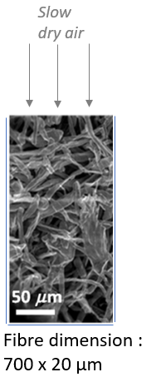
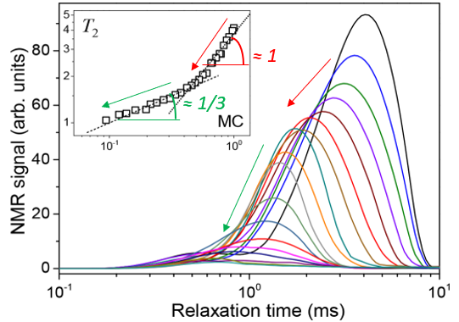

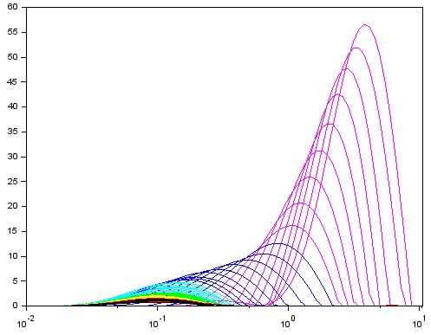
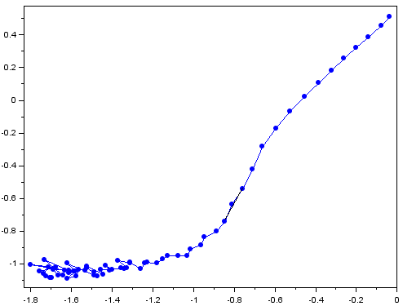
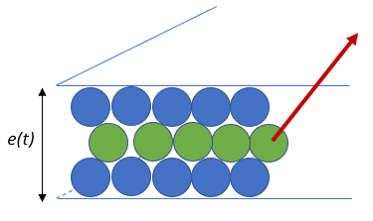
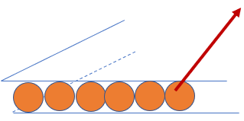
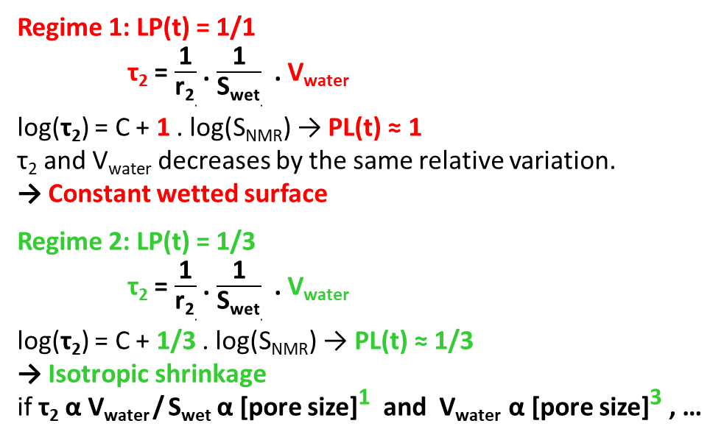
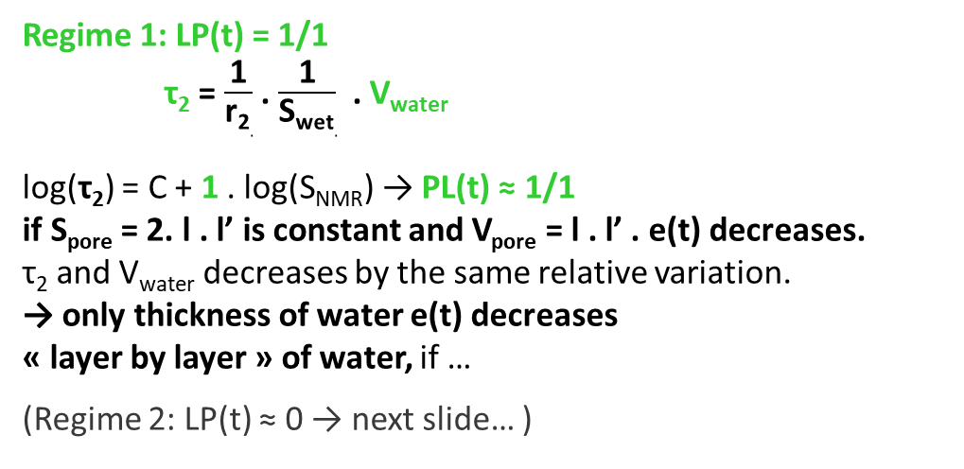
Deviation of the power law PL(t) n° 1. Shrinkage with no desaturatrion (PL < or = 1).
Slow drying of
Humid cellulose
First part of slow drying of
montmorillonite paste (shrinkage)
T2 pdf (ms)
Log(T2)(log(S))
Régime 1
≈ 1
Régime 2
Regime 1: LP(t) = 1/1
τ₂ = $\frac{\text{1}}{\text{r}\text{2}.}$ . $\frac{\text{1}}{\text{S}\text{wet}.}$ . V_{water}
log(τ₂) = C + 1 . log(S_{NMR}) → PL(t) ≈ 1
τ₂ and V_{water} decreases by the same relative variation.
→ Constant wetted surface
Regime 2: LP(t) = 1/3
τ₂ = $\frac{\text{1}}{\text{r}\text{2}.}$ . $\frac{\text{1}}{\text{S}\text{wet}.}$ . V_{water}
log(τ₂) = C + 1/3 . log(S_{NMR}) → PL(t) ≈ 1/3
→ Isotropic shrinkage
if τ₂ α V_{water} / S_{wet} α [pore size]¹ and V_{water} α [pore size]³ , …
Maillet
Sidi-Boulenouar
Coussot. Langmuir
2022
Regime 1: LP(t) = 1/1
τ₂ = $\frac{\text{1}}{\text{r}\text{2}.}$ . $\frac{\text{1}}{\text{S}\text{wet}.}$ . V_{water}
log(τ₂) = C + 1 . log(S_{NMR}) → PL(t) ≈ 1/1
if S_{pore} = 2. l . l’ is constant and V_{pore} = l . l’ . e(t) decreases.
τ₂ and V_{water} decreases by the same relative variation.
→ only thickness of water e(t) decreases
« layer by layer » of water, if …
(Regime 2: LP(t) ≈ 0 → next slide… )
Maillet
Sidi-Boulenouar
Keita
2026
… , r₂ constant (chemical stability), fast exchange available, homogenous hydric content during the most of the drying.

Slide 7
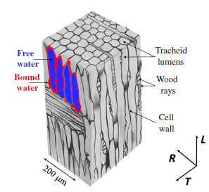

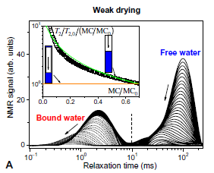
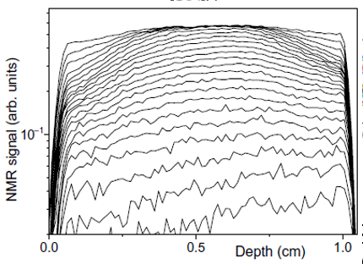
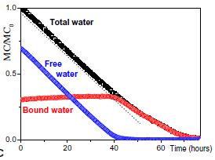
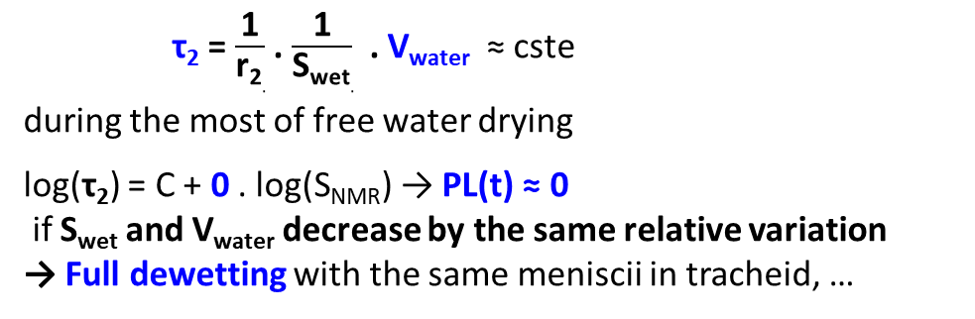
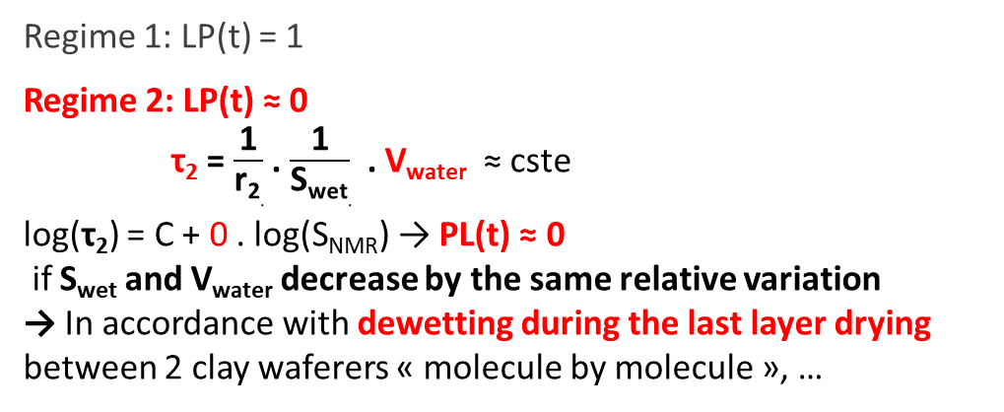
Deviation of the power law PL(t) n° 2. Desaturation with perfect dewetting (PL = 0).
Slow drying of green poplar (free water)
First part of slow drying of
montmorillonite paste (shrinkage)
T2 pdf (ms)
Log(T2)(log(S))
Régime 1
≈ 1
Régime 2
Regime 1: LP(t) = 1
Regime 2: LP(t) ≈ 0
τ₂ = $\frac{\text{1}}{\text{r}\text{2}.}$ . $\frac{\text{1}}{\text{S}\text{wet}.}$ . V_{water} ≈ cste
log(τ₂) = C + 0 . log(S_{NMR}) → PL(t) ≈ 0
if S_{wet} and V_{water} decrease by the same relative variation
→ In accordance with dewetting during the last layer drying between 2 clay waferers « molecule by molecule », …
Maillet
Sidi-Boulenouar
Keita
2026
τ₂ = $\frac{\text{1}}{\text{r}\text{2}.}$ . $\frac{\text{1}}{\text{S}\text{wet}.}$ . V_{water} ≈ cste
during the most of free water drying
log(τ₂) = C + 0 . log(S_{NMR}) → PL(t) ≈ 0
if S_{wet} and V_{water} decrease by the same relative variation
→ Full dewetting with the same meniscii in tracheid, …
… , r₂ constant (chemical stability), fast exchange available, homogenous hydric content during the most of the drying.

Slide 8


Generalization of the power law if stable chemistry and homogen water content:
Shrinkage or swelling of a saturated porous medium :
Saturation or desaturation of non deformable porous medium ;
Power law | Dimentionality of the deformation
1 / 1 | N = 1 Ex : Lamellar shape (only thickness changes)
1 / 2 | N = 2 Ex :Thin cylindric shape (only diameter changes)
1 / 3 | N = 3 Ex : Spherical pore (only diamter changes)
1 / ∞ | Thin cylindric shape (only height changes)
1 / N | N : Dimenssionality of the deformation
Power law | Wetability
1 | Pore wall remains totaly wet d(S(wet)/S(wet)) = 0
]0 ; 1[ | 0 < d(S(wet)/S(wet)) < d(V(water)/V(water))
0 | Stable meniscus : d(V(water)/V(water)) = d(S(wet)/S(wet))
e
d
Glass sphere
d
Bridge water
h
Glass sphere

Slide 9
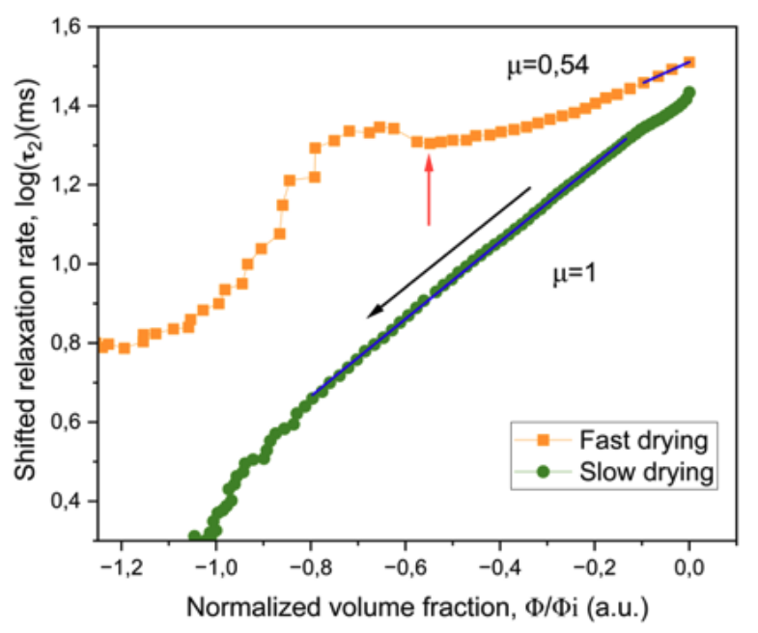
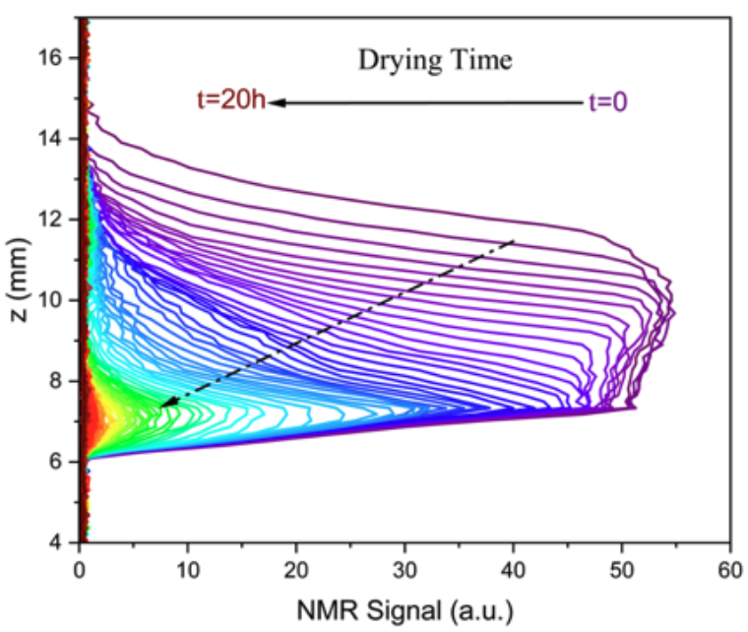
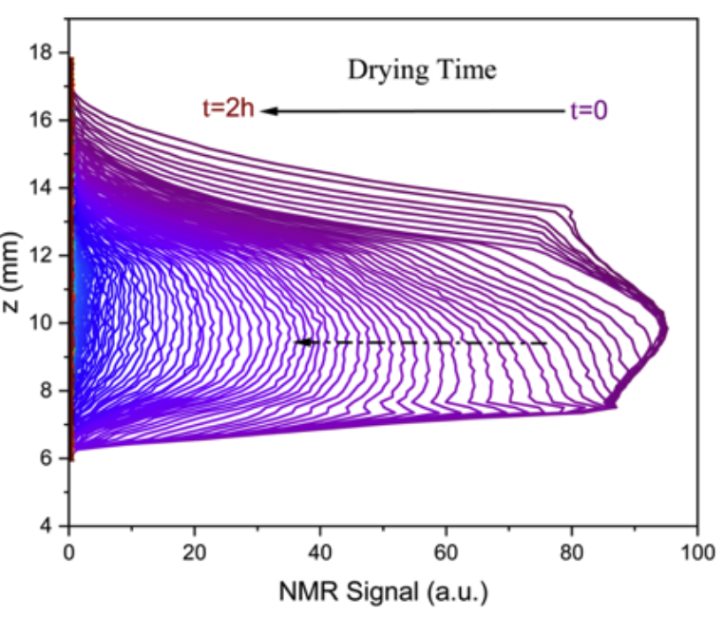
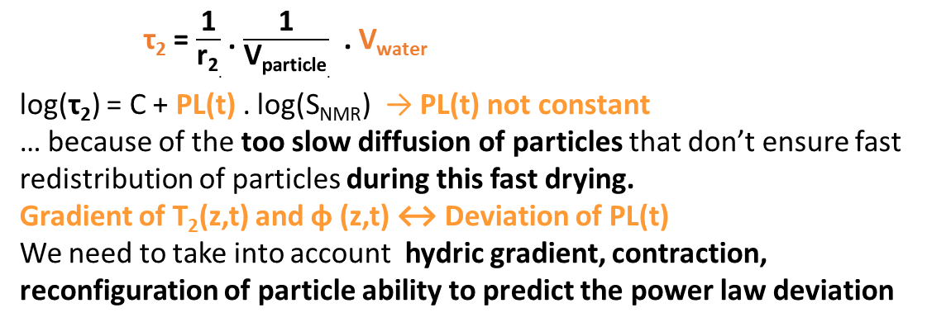
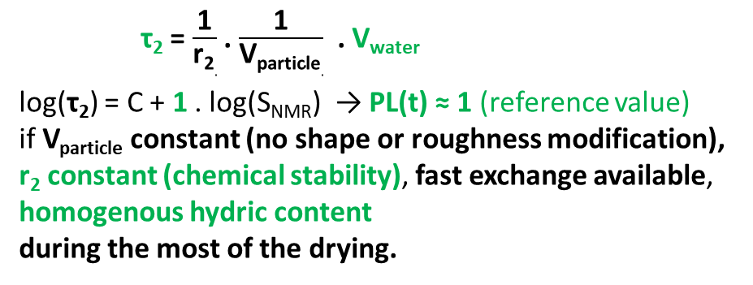
Deviation of the power law PL(t) n° 3. Hydric inhomogneity development.
Drying of aluminosilicate gel
Sidi-Boulenouar, Maillet, Carouge, Ayturk, Poulesquen.
Langmuir, 2026
Submitted
≠ 1
Hydric vertical profiles of the AlSi gel during fast drying
Hydric vertical profiles of the AlSi gel during slow drying
≈ 1
log(Normalized NMR signal)
τ₂ = $\frac{\text{1}}{\text{r}\text{2}.}$ . $\frac{\text{1}}{\text{V}\text{particle}.}$ . V_{water}
log(τ₂) = C + PL(t) . log(S_{NMR}) → PL(t) not constant
… because of the too slow diffusion of particles that don’t ensure fast redistribution of particles during this fast drying.
Gradient of T₂(z,t) and φ (z,t) ↔ Deviation of PL(t)
We need to take into account hydric gradient, contraction, reconfiguration of particle ability to predict the power law deviation
τ₂ = $\frac{\text{1}}{\text{r}\text{2}.}$ . $\frac{\text{1}}{\text{V}\text{particle}.}$ . V_{water}
log(τ₂) = C + 1 . log(S_{NMR}) → PL(t) ≈ 1 (reference value)
if V_{particle} constant (no shape or roughness modification), r₂ constant (chemical stability), fast exchange available, homogenous hydric content
during the most of the drying.
→ See Rahima Sidi-Boulenouar’s poster for more details based on simulatuion of profiles to predict PL(t) fully !

Slide 10
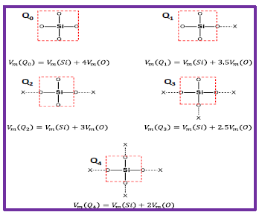
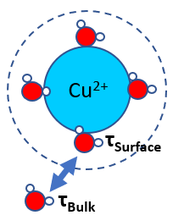
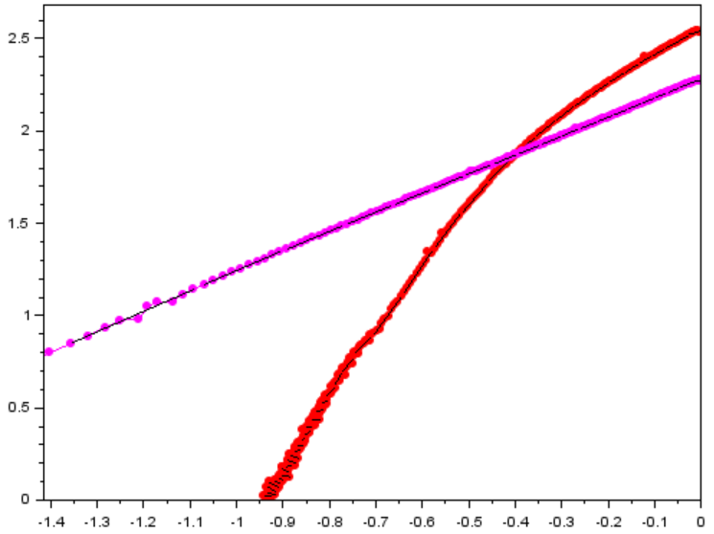
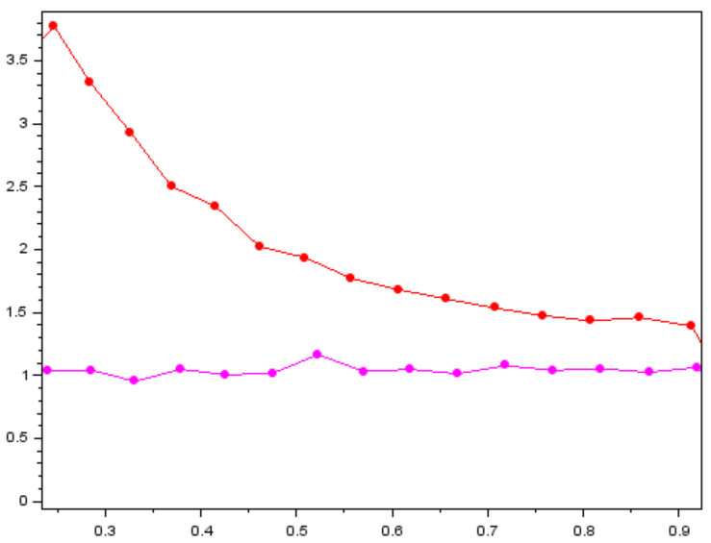
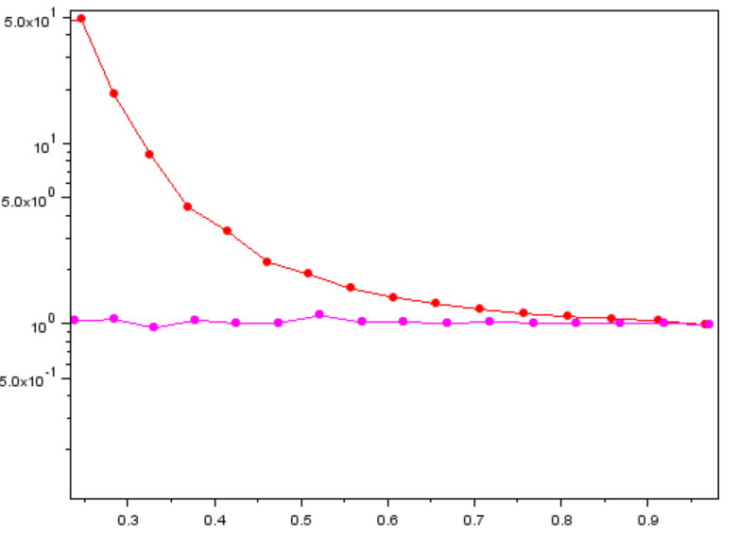
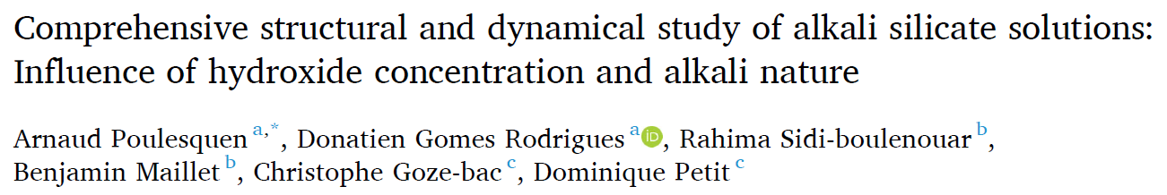
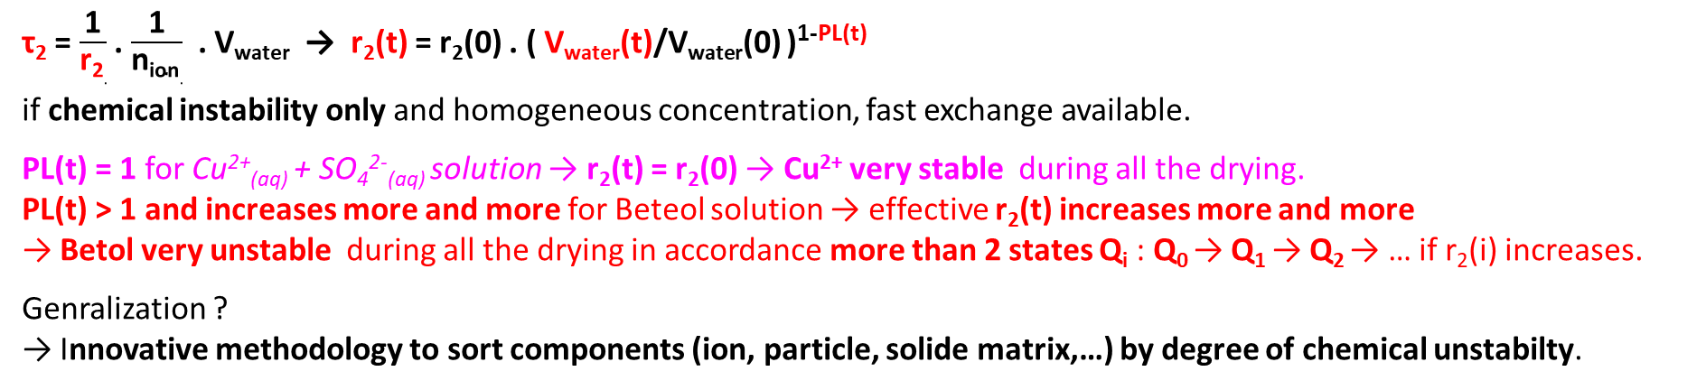
M’Homa
Chabane
Maillet
Sidi-Boulenouar
Poulesquen
2026 (in progress)
Deviation of the power law PL(t) n° 4. Chemical instability
Slow drying (concentrations increase) of
Cu²⁺_{(aq)} + SO₄²⁻_{(aq)} solution (very stable)
… vs … Betol solution (gel AlSi precursor : Si_{n}0_{m}H_{p(aq)} , Na⁺_{(aq)} , HO⁻_{(aq)} )
Betol_{(aq)}
Betol_{(aq)}
i.e. PL(t)
Cu²⁺_{(aq)} + SO₄²⁻_{(aq)}
Cu²⁺_{(aq)} + SO₄²⁻_{(aq)}
log(τ2) (in ms)
Cu²⁺_{(aq)} + SO₄²⁻_{(aq)}
→ Chemical « avalanche »
Q₀ → Q₁ → Q₂ →…
r2(t) / r2(0)
≈ 1
PL(t) > 1
Slope of the cureve log(τ2) vs log(Normalized NMR signal)
Betol_{(aq)}
→ Chemical stability
log(Normalized NMR signal)
Normalized NMR signal
Normalized NMR signal
τ₂ = $\frac{\text{1}}{\text{r}\text{2}.}$ . $\frac{\text{1}}{\text{n}\text{ion}.}$ . V_{water} → r₂(t) = r₂(0) . ( V_{water}(t)/V_{water}(0) )^{1-PL(t)}
if chemical instability only and homogeneous concentration, fast exchange available.
PL(t) = 1 for Cu²⁺_{(aq)} + SO₄²⁻_{(aq)} solution → r₂(t) = r₂(0) → Cu²⁺ very stable during all the drying.
PL(t) > 1 and increases more and more for Beteol solution → effective r₂(t) increases more and more
→ Betol very unstable during all the drying in accordance more than 2 states Q_{i} : Q₀ → Q₁ → Q₂ → … if r₂(i) increases.
Genralization ?
→ Innovative methodology to sort components (ion, particle, solide matrix,…) by degree of chemical unstabilty.

Slide 11
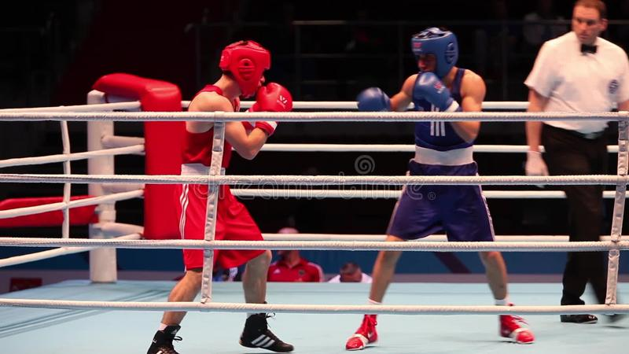


Conclusion and perspective.
Shift of the relaxation efficinecy : $\frac{1}{\text{τ}\text{2}}$ = $\frac{1}{\text{T}\text{2,}\text{measured} }$ - $\frac{1}{\text{T}\text{2, }\text{pure} \text{liquid}}$ = r₂ . $\frac{α}{\text{V}\text{wat}\text{er}}$ = « Chemical term x Physical term »
… always based on the fast exchange theory (surface and bulk water by diffusion and other…)
log( τ₂ ) vs log( NMR S ) → power law evolution PL(t) during drying = innovative, very generalisable representation to catch all physical and chemical instabilites by a multiscale, temprally and non invasive approach:
dewetting of the solid matrix, inhomogneity of local water content, chemical instability, … and more ?
The Dynamic NMR relaxometry can scope all water state progressively and is available for hydric drying of plenty of material as porous medium, paste, suspension, gel, solution, granular media, … and also foam, emulsion, … ?
Generalizations should be possible for all water transfer (ex: imbibition) or other volatil protonic liquids,…
… or a chemicaly and physicaly unstable material (ex: setting of a fresh cement paste) ?
Do you want to see more NMR or MRI
from Navier laboratory ?
→ 4 other presentations
(P. Coussot, F. Gerony, E. Keita, O. Hbaieb)
→ 2 posters
(R. Sidi-Boulenouar, A. Samba)

Slide 13

Sum up of the main expected aspects of the T2 pdf

