Slide 1
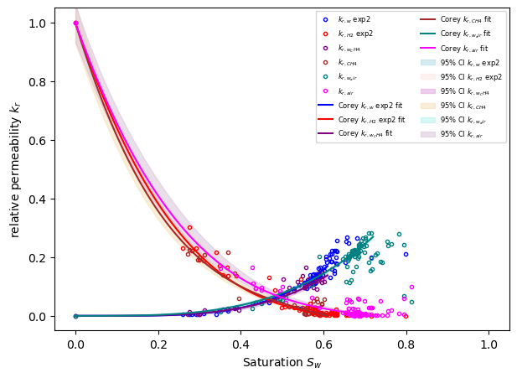
A Novel Method for Determining Hydrogen Relative Permeability
InterPore 2026, Nantes, 19-22 May 2026
Session 2.1. MS05 – 20.05.2026 – 09:20-09:35
Paper #8
Elenora Parente^{a,b}, Ying Gaoª, Karin de Borstª, Vishal Ahuja, Shashank Tiwari, Evren Unsalª, Steffen Berg^{a,c}
ªShell Global Solutions International B.V., Amsterdam, The Netherlands
^{b}Shell India Markets Private Limited, Bangalore, India
^{c}PoreLab, Norwegian University of Science and Technology (NTNU), Trondheim, Norway

Slide 2
Cautionary note
The companies in which Shell plc directly and indirectly owns investments are separate legal entities. In this content “Shell”, “Shell Group” and “Group” are sometimes used for convenience to reference Shell plc and its subsidiaries in general. Likewise, the words “we”, “us” and “our” are also used to refer to Shell plc and its subsidiaries in general or to those who work for them. These terms are also used where no useful purpose is served by identifying the particular entity or entities. ‘‘Subsidiaries’’, “Shell subsidiaries” and “Shell companies” as used in this content refer to entities over which Shell plc either directly or indirectly has control. The terms “joint venture”, “joint operations”, “joint arrangements”, and “associates” may also be used to refer to a commercial arrangement in which Shell has a direct or indirect ownership interest with one or more parties. The term “Shell interest” is used for convenience to indicate the direct and/or indirect ownership interest held by Shell in an entity or unincorporated joint arrangement, after exclusion of all third-party interest.
Forward-Looking statements
This content contains forward-looking statements (within the meaning of the U.S. Private Securities Litigation Reform Act of 1995) concerning the financial condition, results of operations and businesses of Shell. All statements other than statements of historical fact are, or may be deemed to be, forward-looking statements. Forward-looking statements are statements of future expectations that are based on management’s current expectations and assumptions and involve known and unknown risks and uncertainties that could cause actual results, performance or events to differ materially from those expressed or implied in these statements. Forward-looking statements include, among other things, statements concerning the potential exposure of Shell to market risks and statements expressing management’s expectations, beliefs, estimates, forecasts, projections and assumptions. These forward-looking statements are identified by their use of terms and phrases such as “aim”; “ambition”; ‘‘anticipate’’; “aspire”, “aspiration”, ‘‘believe’’; “commit”; “commitment”; ‘‘could’’; “desire”; ‘‘estimate’’; ‘‘expect’’; ‘‘goals’’; ‘‘intend’’; ‘‘may’’; “milestones”; ‘‘objectives’’; ‘‘outlook’’; ‘‘plan’’; ‘‘probably’’; ‘‘project’’; ‘‘risks’’; “schedule”; ‘‘seek’’; ‘‘should’’; ‘‘target’’; “vision”; ‘‘will’’; “would” and similar terms and phrases. There are a number of factors that could affect the future operations of Shell and could cause those results to differ materially from those expressed in the forward-looking statements included in this content, including (without limitation): (a) price fluctuations in crude oil and natural gas; (b) changes in demand for Shell’s products; (c) currency fluctuations; (d) drilling and production results; (e) reserves estimates; (f) loss of market share and industry competition; (g) environmental and physical risks, including climate change; (h) risks associated with the identification of suitable potential acquisition properties and targets, and successful negotiation and completion of such transactions; (i) the risk of doing business in developing countries and countries subject to international sanctions; (j) legislative, judicial, fiscal and regulatory developments including tariffs and regulatory measures addressing climate change; (k) economic and financial market conditions in various countries and regions; (l) political risks, including the risks of expropriation and renegotiation of the terms of contracts with governmental entities, delays or advancements in the approval of projects and delays in the reimbursement for shared costs; (m) risks associated with the impact of pandemics, regional conflicts, such as the Russia-Ukraine war and the conflict in the Middle East, and a significant cyber security, data privacy or IT incident; (n) the pace of the energy transition; and (o) changes in trading conditions. No assurance is provided that future dividend payments will match or exceed previous dividend payments. All forward-looking statements contained in this content are expressly qualified in their entirety by the cautionary statements contained or referred to in this section. Readers should not place undue reliance on forward-looking statements. Additional risk factors that may affect future results are contained in Shell plc’s Form 20-F for the year ended December 31, 2024 (available at www.shell.com/investors/news-and-filings/sec-filings.html and www.sec.gov). These risk factors also expressly qualify all forward-looking statements contained in this content and should be considered by the reader. Each forward-looking statement speaks only as of the date of this content 20 May 2026. Neither Shell plc nor any of its subsidiaries undertake any obligation to publicly update or revise any forward-looking statement as a result of new information, future events or other information. In light of these risks, results could differ materially from those stated, implied or inferred from the forward-looking statements contained in this content.
Shell’s net carbon intensity
Also, in this content we may refer to Shell’s “net carbon intensity” (NCI), which includes Shell’s carbon emissions from the production of our energy products, our suppliers’ carbon emissions in supplying energy for that production and our customers’ carbon emissions associated with their use of the energy products we sell. Shell’s NCI also includes the emissions associated with the production and use of energy products produced by others which Shell purchases for resale. Shell only controls its own emissions. The use of the terms Shell’s “net carbon intensity” or NCI is for convenience only and not intended to suggest these emissions are those of Shell plc or its subsidiaries.
Shell’s net-zero emissions target
Shell’s operating plan and outlook are forecasted for a three-year period and ten-year period, respectively, and are updated every year. They reflect the current economic environment and what we can reasonably expect to see over the next three and ten years. Accordingly, the outlook reflects our Scope 1, Scope 2 and NCI targets over the next ten years. However, Shell’s operating plan and outlook cannot reflect our 2050 net-zero emissions target, as this target is outside our planning period. Such future operating plans and outlooks could include changes to our portfolio, efficiency improvements and the use of carbon capture and storage and carbon credits. In the future, as society moves towards net-zero emissions, we expect Shell’s operating plans and outlooks to reflect this movement. However, if society is not net zero in 2050, as of today, there would be significant risk that Shell may not meet this target.
Forward-Looking non-GAAP measures
This content may contain certain forward-looking non-GAAP measures such as adjusted earnings and divestments. We are unable to provide a reconciliation of these forward-looking non-GAAP measures to the most comparable GAAP financial measures because certain information needed to reconcile those non-GAAP measures to the most comparable GAAP financial measures is dependent on future events some of which are outside the control of Shell, such as oil and gas prices, interest rates and exchange rates. Moreover, estimating such GAAP measures with the required precision necessary to provide a meaningful reconciliation is extremely difficult and could not be accomplished without unreasonable effort. Non-GAAP measures in respect of future periods which cannot be reconciled to the most comparable GAAP financial measure are calculated in a manner which is consistent with the accounting policies applied in Shell plc’s consolidated financial statements.
The contents of websites referred to in this content do not form part of this content.
We may have used certain terms, such as resources, in this content that the United States Securities and Exchange Commission (SEC) strictly prohibits us from including in our filings with the SEC. Investors are urged to consider closely the disclosure in our Form 20-F, File No 1-32575, available on the SEC website www.sec.gov
.

Slide 3
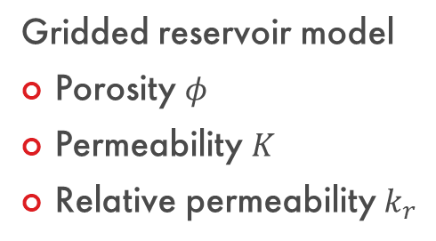
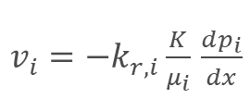
Underground Storage of Hydrogen
Gridded reservoir model
Porosity $φ$
Permeability $K$
Relative permeability $k_{r}$
$v_{i}=−k_{r,i}\frac{K}{μ_{i}}$ $\frac{dp_{i}}{dx}$
Copyright of Shell Global Solutions International B.V.
International Journal of Hydrogen Energy 229, 154730, 2026.

Slide 4
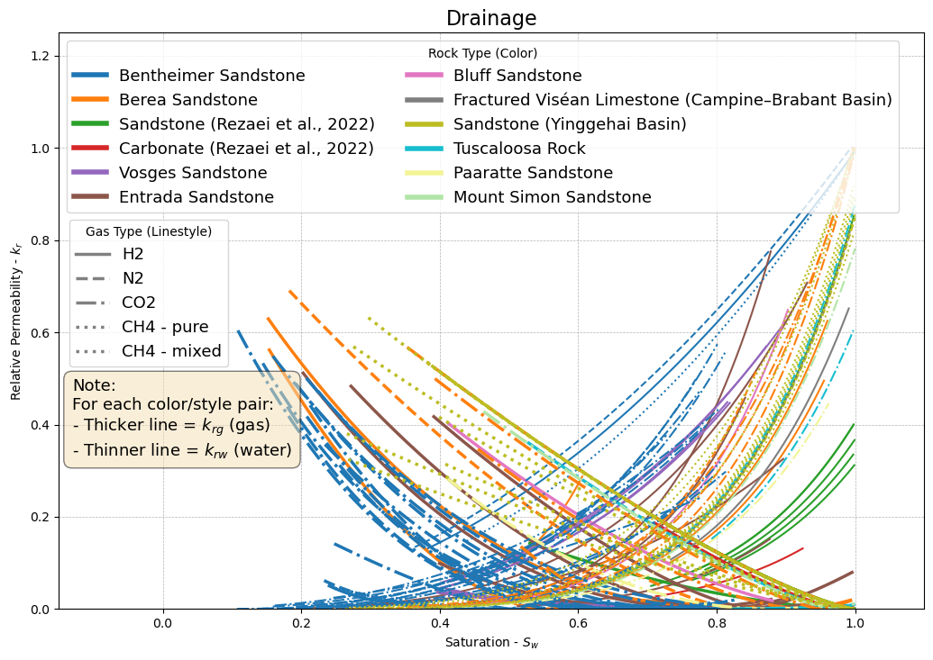
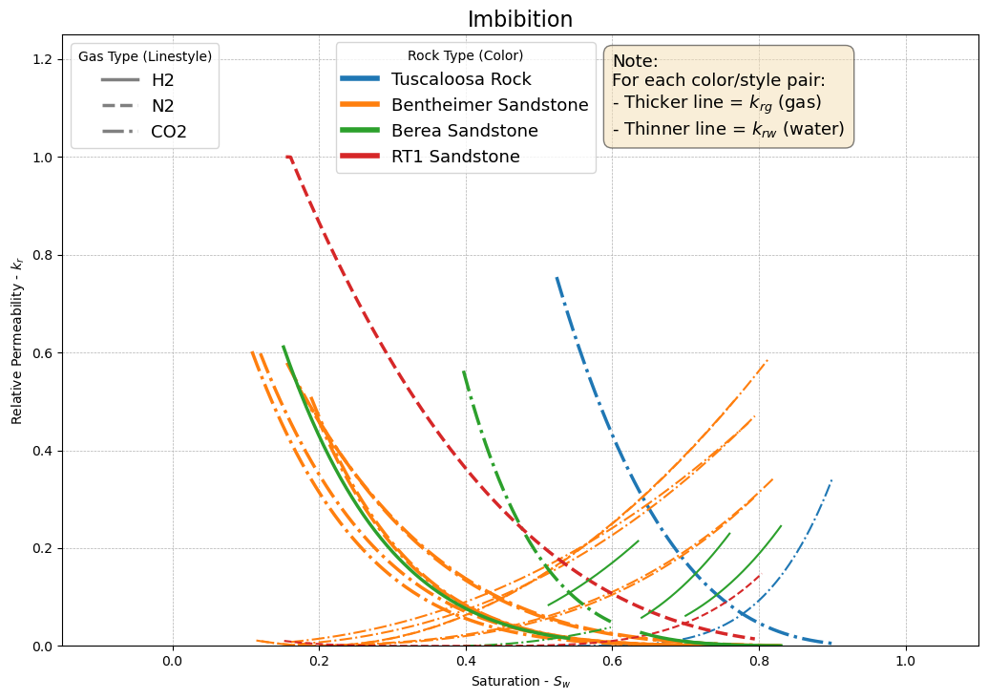



Relative Permeability Data in the Literature
Relative permeability $k_{r}$
Saturation $S_{w}$
Saturation $S_{w}$
Inconsistency in protocols
Limited mobile saturation range

Slide 5
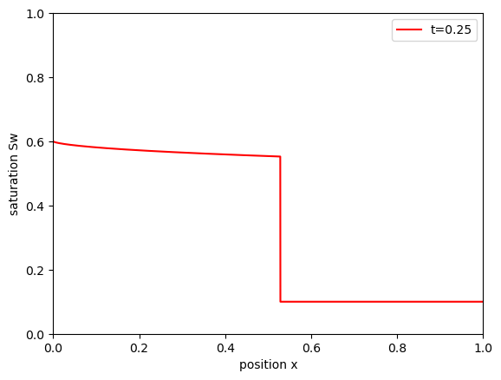
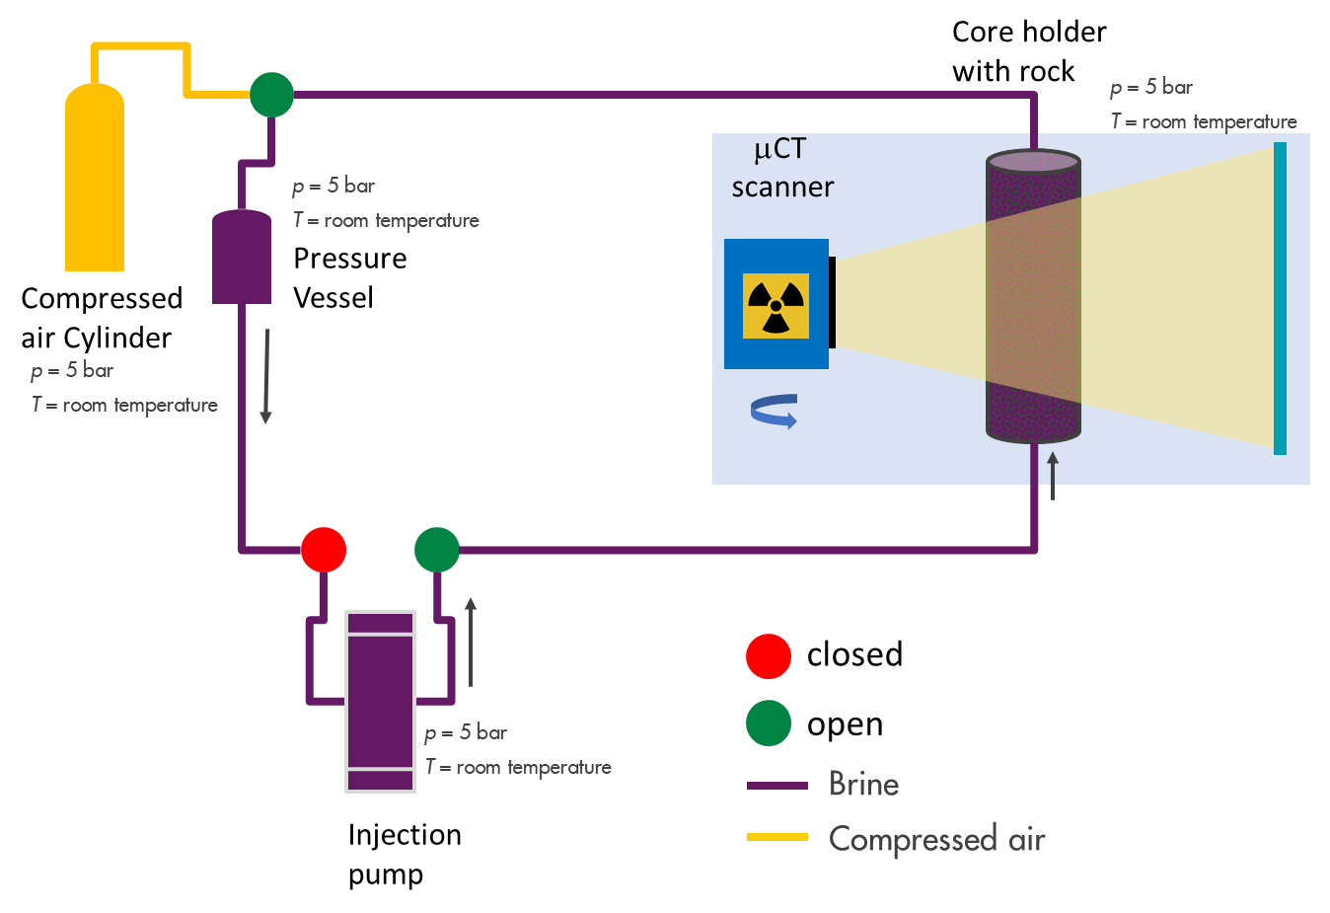
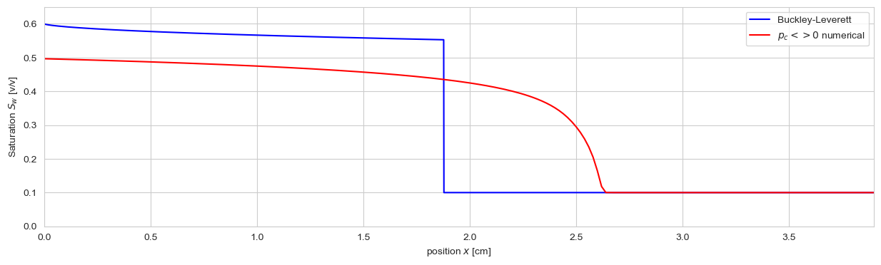




Classical Unsteady-State vs. Micro-CT Flow Experiment
Unsteady-state (USS) Method
Δp
Limited mobile saturation range
$S_{w}$ range
water
core
Capillary dispersion zone
μCT sample length
$$p_{c}=0$$
$$p_{c}≠0$$
time
$$S_{w,i}$$
Shock front
Conventional USS-SCAL sample length

Slide 6
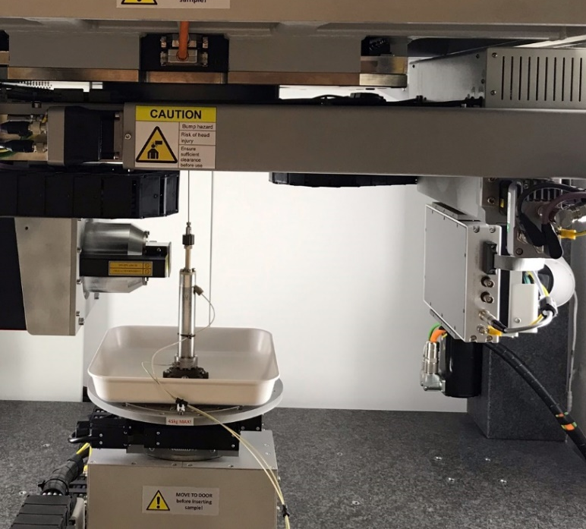
Classical Unsteady-State vs. Micro-CT Flow Experiment
Unsteady-state (USS) Method
Δp
Limited mobile saturation range
$S_{w}$ range
water
core
Production line
X-ray
2cm
Capillary dispersion zone
Injection line
μCT sample length
$$p_{c}=0$$
$$p_{c}≠0$$
Detector
Core holder
time
$$S_{w,i}$$
Shock front
Flow lines
Conventional USS-SCAL sample length

Slide 7


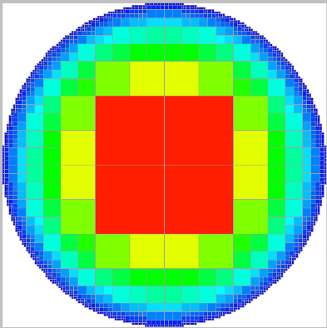


Relative Permeability from Stokes Flow Simulations on Imaging Data
Gas-liquid flow experiment in rock with in-situ 3D imaging
Pore scale
Gas-liquid
distribution
Pore scale
Stokes Flow Simulation
on each phase
Relative permeability
μCT
scanner
1
Rock sample
w
g
gas
Relative permeability $k_{r}$
water
0
H₂,CH₄ N₂
0
Water saturation $S_{w}$
1
LIR solver
GeoDict
brine
International Journal of Hydrogen Energy 229, 154730, 2026.

Slide 8
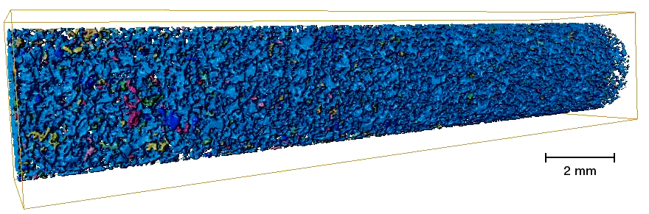
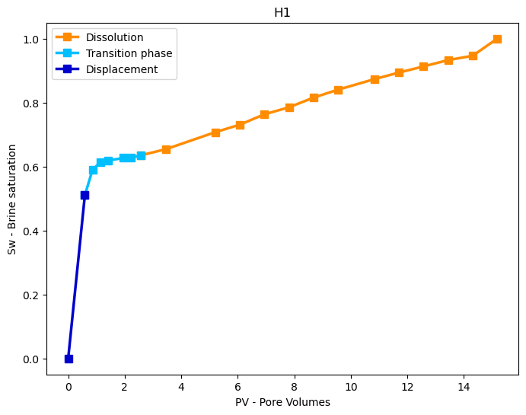
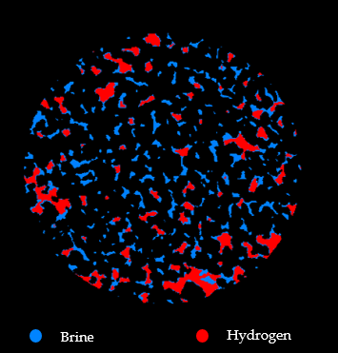
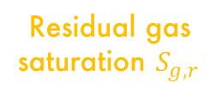
Micro-CT Flow Experiments
Displacement-
dominated
Dissolution-dominated (caused by ripening)
Residual gas saturation $S_{g,r}$
Bentheimer sandstone, 4 mm x 20 mm
4 experiments:
Compressed air (mainly N2)
Methane
Hydrogen-1, 2 (repeat)
Typical production data without dissolution
Brine
Hydrogen
Gao et al. Petrophysics 64 (03), 368–383, 2023.

Slide 9
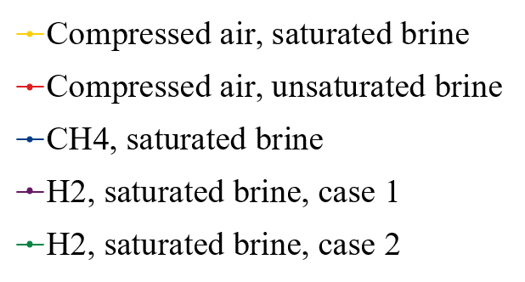
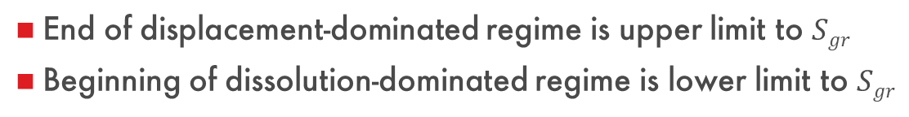
Determining Residual Gas Saturation $S_{g,r}$ from Minkowski Functionals
H₂ saturation levels different Differences in preparation ?
Displacement
dominated
Dissolution
dominated
Euler Characteristic χ =
Objects – Loops (+ Inclusions)
End of displacement-dominated regime is upper limit to $Sgr$
Beginning of dissolution-dominated regime is lower limit to $Sgr$
Clear trend of dissolution dominated regime with saturation level of brine
Gao et al. Society of Core Analysts Annual Conference 2025, SCA2025-1028

Slide 10
Determining Residual Gas Saturation $S_{g,r}$ from Minkowski Functionals
International Journal of Hydrogen Energy 229, 154730, 2026.

Slide 11
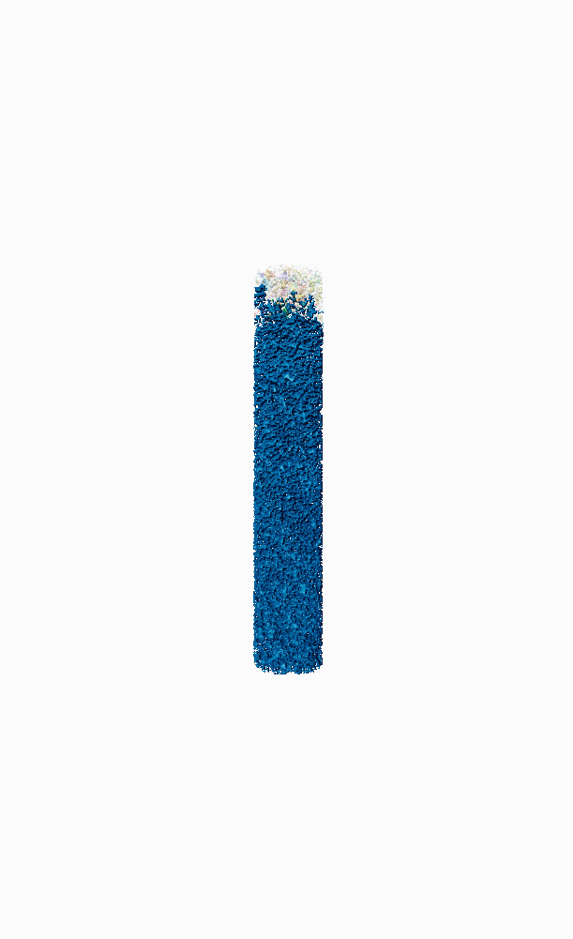





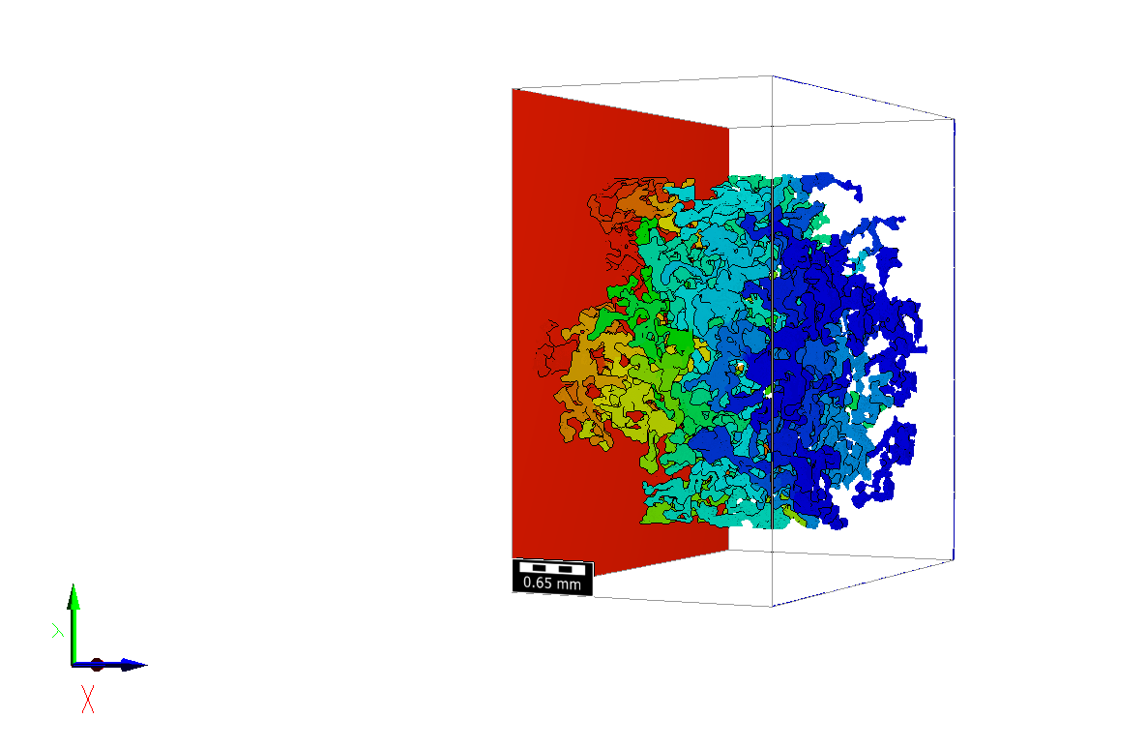
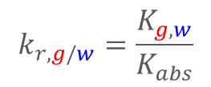

Relative Permeability from Stokes Flow Simulations on Imaging Data
Stokes Flow Sim.
$$−\vec{∇}p+μ∇^{2}\vec{u}=0$$
Section 6
Section 9
Section 8
Section 10
Section 2
Section 7
Section 1
Geodict
LIR solver
Adaptive
meshing
Section 4
Section 11
Section 5
Section 12
Section 3
$$k_{r,g/w}=\frac{K_{g,w}}{K_{abs}}$$
0.3
0.6
0.9
1.1
1.4
1.7
1.84
PV - Pore volumes
Relative permeability
International Journal of Hydrogen Energy 229, 154730, 2026.

Slide 12
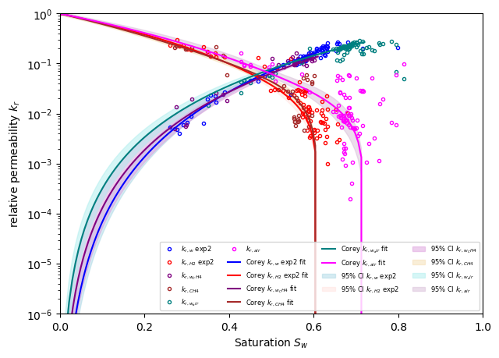
Comparison of 3 Gasses: Relative Permeability
Differences between gases NOT significant, only difference is $S_{gr}$ for N₂
Dissolution
regime
H₂ Exp 2
H₂ CH₄
N₂
Dissolution
regime
International Journal of Hydrogen Energy 229, 154730, 2026.

Slide 13

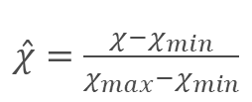
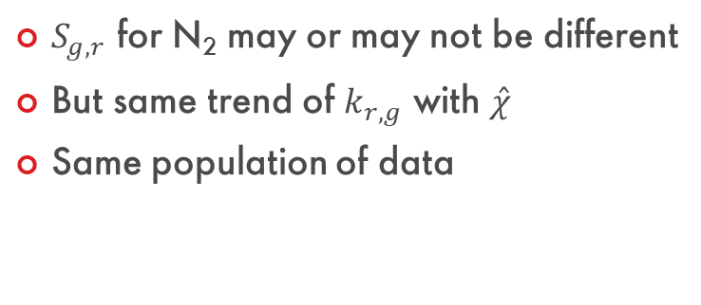

Comparison of 3 Gasses: Relative Permeability – Same population
$S_{g,r}$ for N₂ may or may not be different
But same trend of $k_{r,g}$ with $\hat{χ}$
Same population of data
Relative permeability $k_{r,g}$
Scaled Euler characteristic
$\hat{χ}=\frac{χ−χ_{min}}{χ_{max}−χ_{min}}$
International Journal of Hydrogen Energy 229, 154730, 2026.

Slide 14
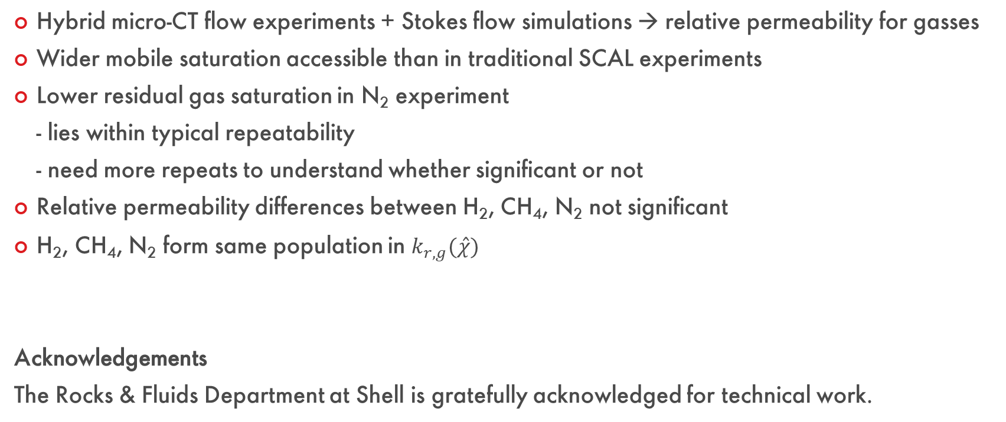
Summary & Conclusions
Hybrid micro-CT flow experiments + Stokes flow simulations → relative permeability for gasses
Wider mobile saturation accessible than in traditional SCAL experiments
Lower residual gas saturation in N₂ experiment - lies within typical repeatability - need more repeats to understand whether significant or not
Relative permeability differences between H₂, CH₄, N₂ not significant
H₂, CH₄, N₂ form same population in $k_{r,g}(\hat{χ})$
Acknowledgements
The Rocks & Fluids Department at Shell is gratefully acknowledged for technical work.
International Journal of Hydrogen Energy 229, 154730, 2026.

Slide 15
Q&A

Slide 16
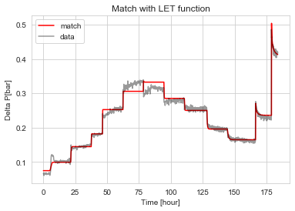
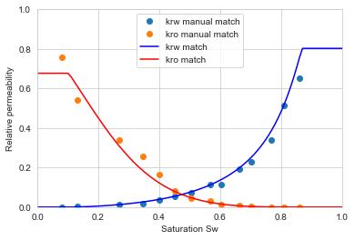
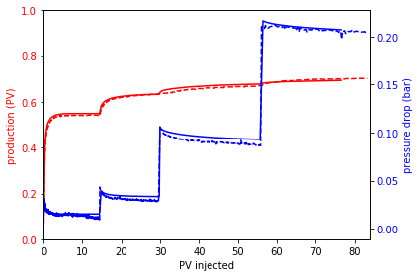
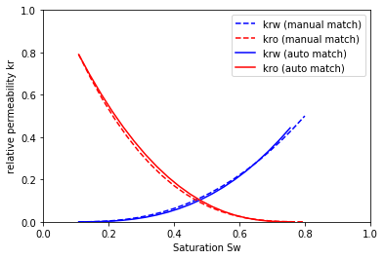
Accepted Standard Experimental Methods
Steady-state (SS)
Δp
water
core
gas
Unsteady-state (USS)
Δp
water
core
https://github.com/sede-open/Core2Relperm

Slide 17
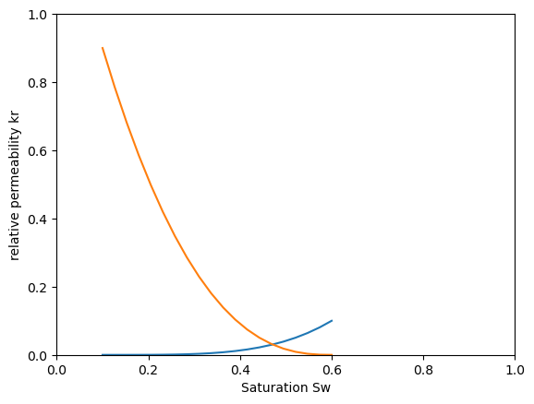
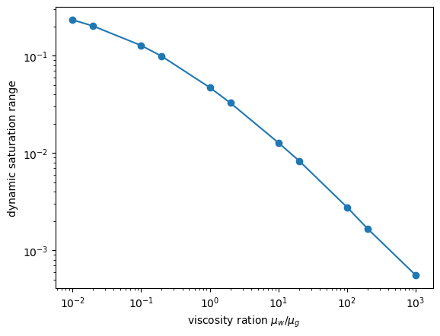
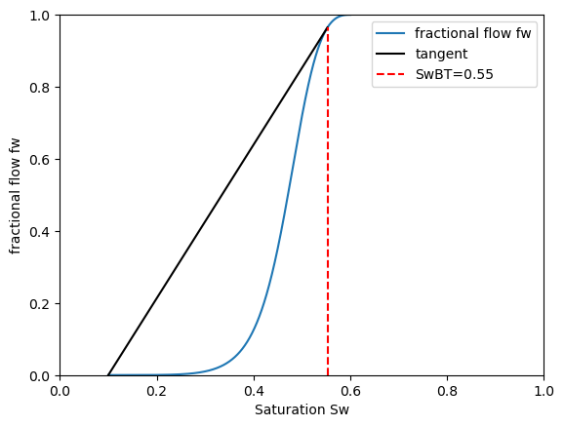


Standard Experimental Methods: Limited Saturation Range
Relative permeability
viscosity ratio = 1
Viscosity ratio dependency
$S_{w}$ range
range for gases
$$S_{g,r}$$
Fractional Flow Solution
Unsteady-state (USS) Method
Breakthrough saturation
Δp
water
core
Copyright of Shell Global Solutions International B.V.

Slide 18



Smaller Sample + Capillary Dispersion
Capillary dispersion zone
μCT sample length
$$p_{c}=0$$
$$p_{c}≠0$$
time
$$S_{w,i}$$
Shock front
Conventional USS-SCAL sample length

Slide 19
Micro-CT Flow Experiments
Production line
X-ray
2cm
Injection line
Detector
Core holder
Flow lines
Gao et al. Petrophysics 64 (03), 368–383, 2023.

Slide 20
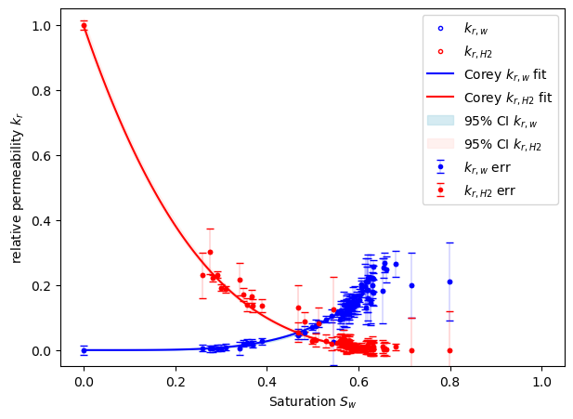



Relative Permeability from Stokes Flow Simulations on Imaging Data
LIR solver
GeoDict
Stokes flow
$$−\vec{∇}p+μ∇^{2}\vec{u}=0$$
$K_{abs}$ $K_{w}$ $K_{g}$
$$k_{r,w/g}=\frac{K_{w,g}}{K_{abs}}$$
In dissolution regime
International Journal of Hydrogen Eenergy 229, 154730, 2026.

Slide 21
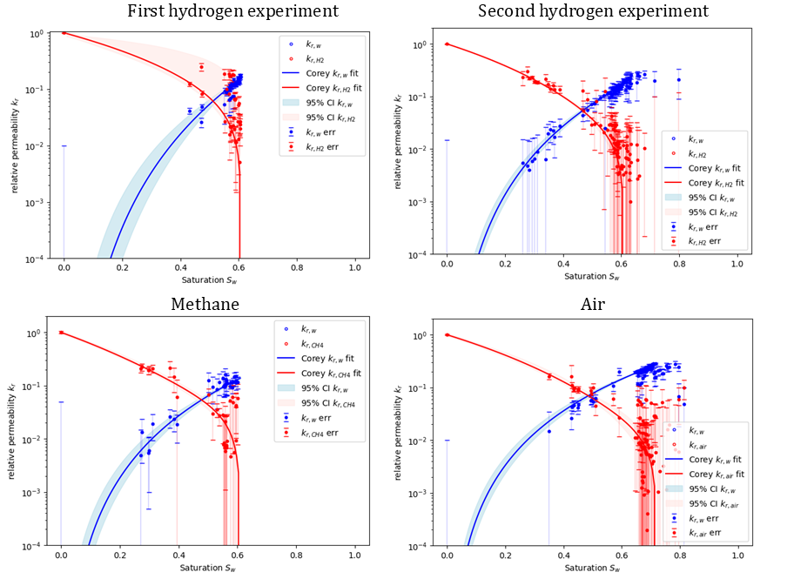
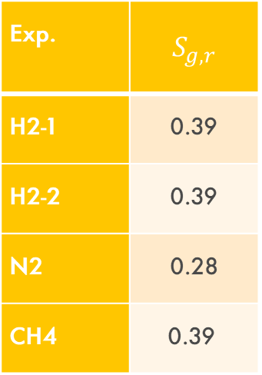
Relative Permeability from Stokes Flow Simulations on Imaging Data
Exp. | $$S_{g,r}$$
H2-1 | 0.39
H2-2 | 0.39
N2 | 0.28
CH4 | 0.39
Copyright of Shell Global Solutions International B.V.

Slide 22
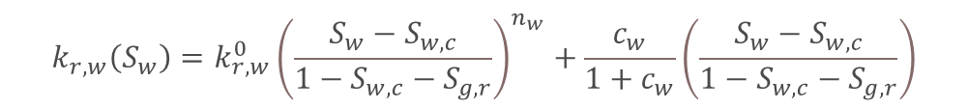
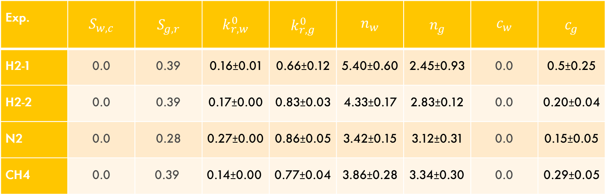

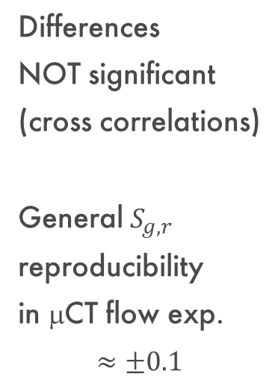
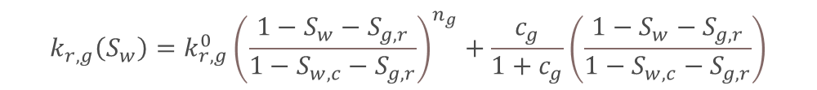
Relative Permeability from Stokes Flow Simulations on Imaging Data
Extended Corey Model
$$k_{r,w}\left(S_{w}\right)=k_{r,w}^{0}{\left(\frac{S_{w}−S_{w,c}}{1−S_{w,c}−S_{g,r}}\right)}^{n_{w}}+\frac{c_{w}}{1+c_{w}}\left(\frac{S_{w}−S_{w,c}}{1−S_{w,c}−S_{g,r}}\right)$$
$$k_{r,g}\left(S_{w}\right)=k_{r,g}^{0}{\left(\frac{1−S_{w}−S_{g,r}}{1−S_{w,c}−S_{g,r}}\right)}^{n_{g}}+\frac{c_{g}}{1+c_{g}}\left(\frac{{1−S}_{w}−S_{g,r}}{1−S_{w,c}−S_{g,r}}\right)$$
fixed
$n_{w}>n_{g}$ → water-wet
Exp. | $$S_{w,c}$$ | $$S_{g,r}$$ | $$k_{r,w}^{0}$$ | $$k_{r,g}^{0}$$ | $$n_{w}$$ | $$n_{g}$$ | $$c_{w}$$ | $$c_{g}$$
H2-1 | 0.0 | 0.39 | 0.16±0.01 | 0.66±0.12 | 5.40±0.60 | 2.45±0.93 | 0.0 | 0.5±0.25
H2-2 | 0.0 | 0.39 | 0.17±0.00 | 0.83±0.03 | 4.33±0.17 | 2.83±0.12 | 0.0 | 0.20±0.04
N2 | 0.0 | 0.28 | 0.27±0.00 | 0.86±0.05 | 3.42±0.15 | 3.12±0.31 | 0.0 | 0.15±0.05
CH4 | 0.0 | 0.39 | 0.14±0.00 | 0.77±0.04 | 3.86±0.28 | 3.34±0.30 | 0.0 | 0.29±0.05
Differences
NOT significant
(cross correlations)
General $S_{g,r}$ reproducibility
in μCT flow exp. $$≈±0.1$$
No significant difference in wettability

Slide 23
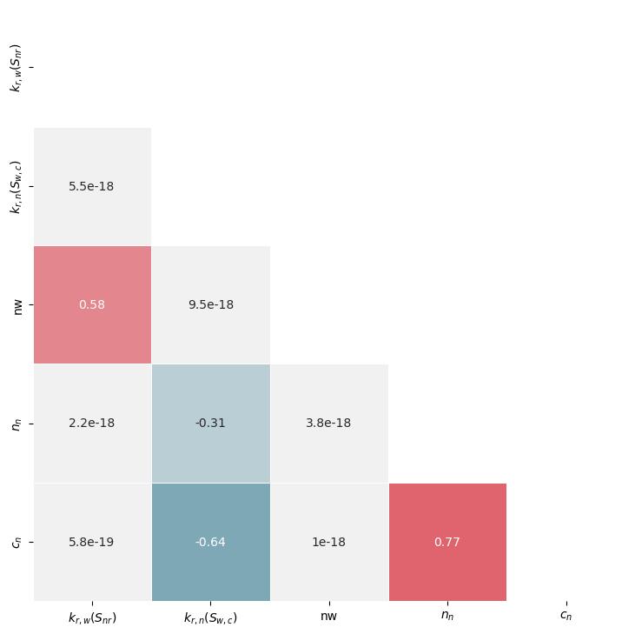
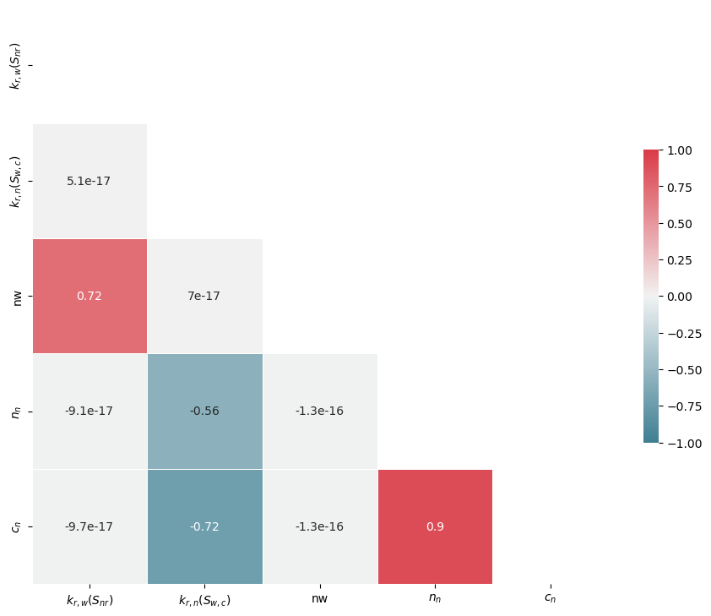
Relative Permeability from Stokes Flow Simulations on Imaging Data
Individual errors impacted by cross correlations between fit parameters
CH₄
N₄
E. Parente, MSc Thesis, Politecnico die Milano, 2025.

