Slide 1
Drying and Storage of Sporosarcina pasteurii for Subsequent Use in Microbially Induced Carbonate Precipitation
Department of Engineering and Management
Patrick Hanisch
21.05.2026

Slide 2
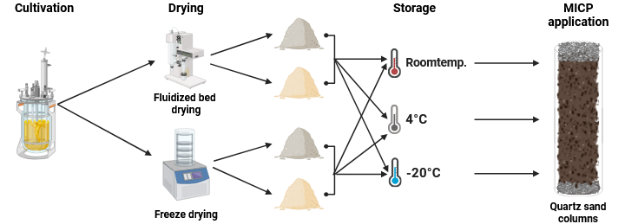
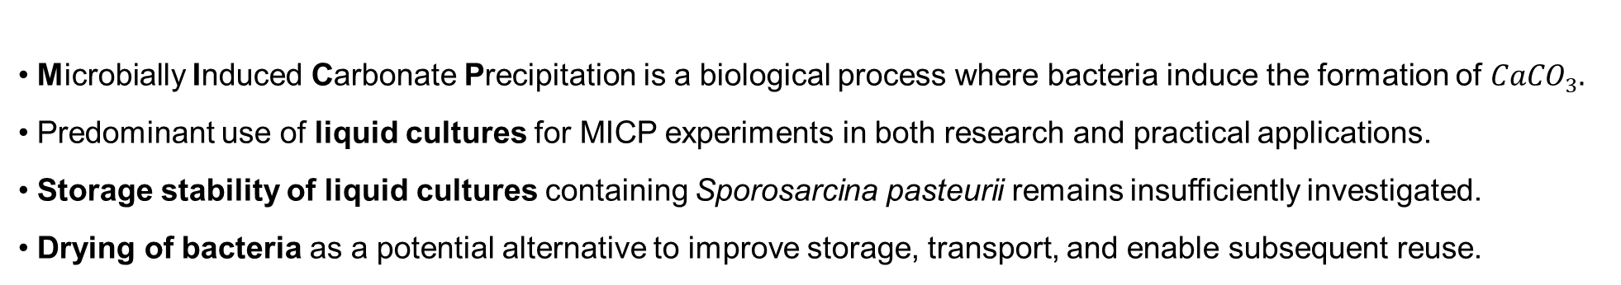
Introduction
Microbially Induced Carbonate Precipitation is a biological process where bacteria induce the formation of ${CaCO}_{3}.$
Predominant use of liquid cultures for MICP experiments in both research and practical applications.
Storage stability of liquid cultures containing Sporosarcina pasteurii remains insufficiently investigated.
Drying of bacteria as a potential alternative to improve storage, transport, and enable subsequent reuse.
Drying with or without the
cryoprotectant maltodextrin
→ How does bacterial drying affect the viability and MICP performance of Sporosarcina pasteurii compared to conventional liquid cultures?

Slide 3
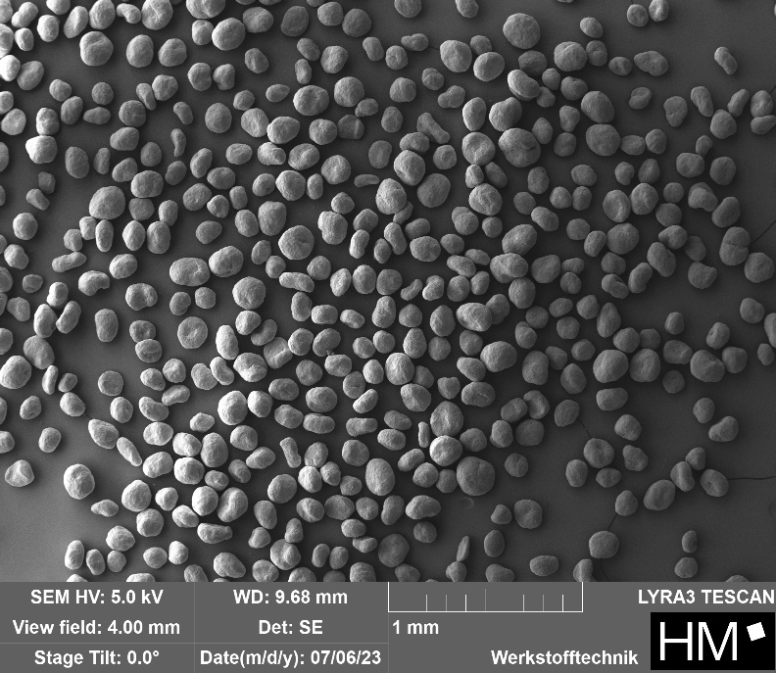
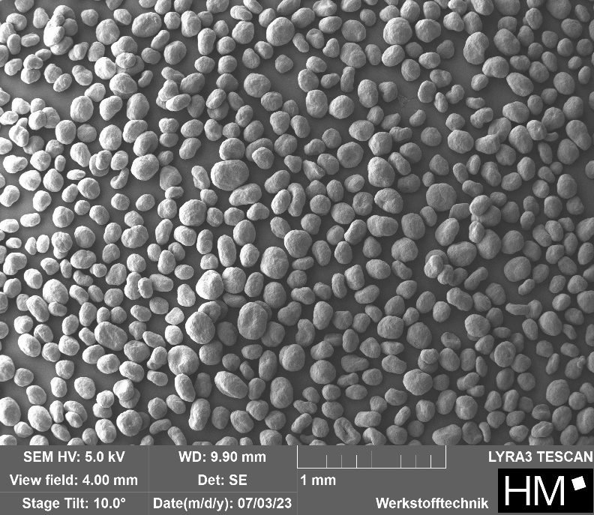
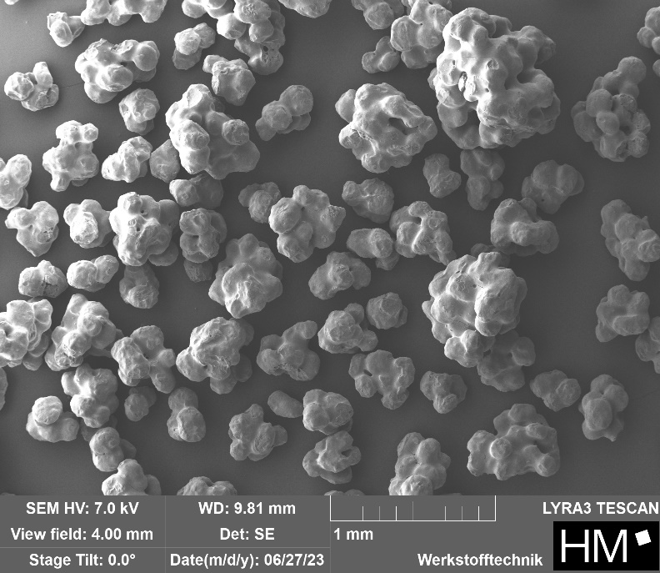
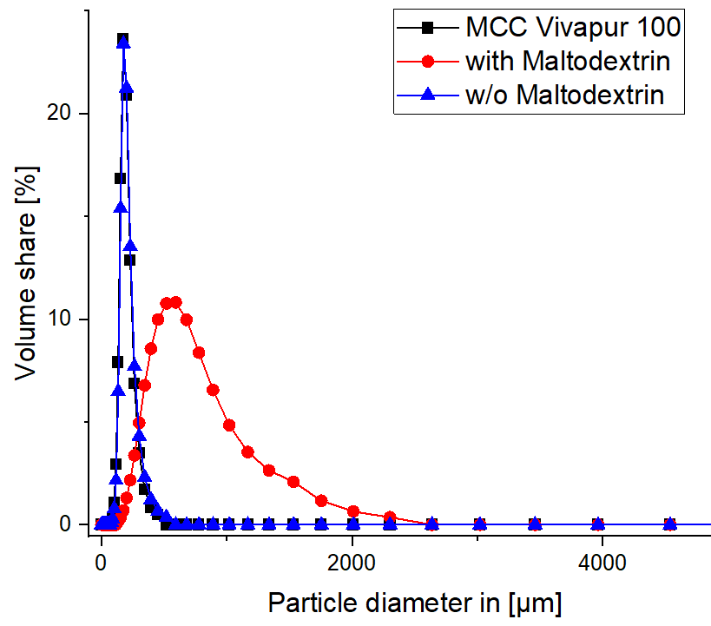
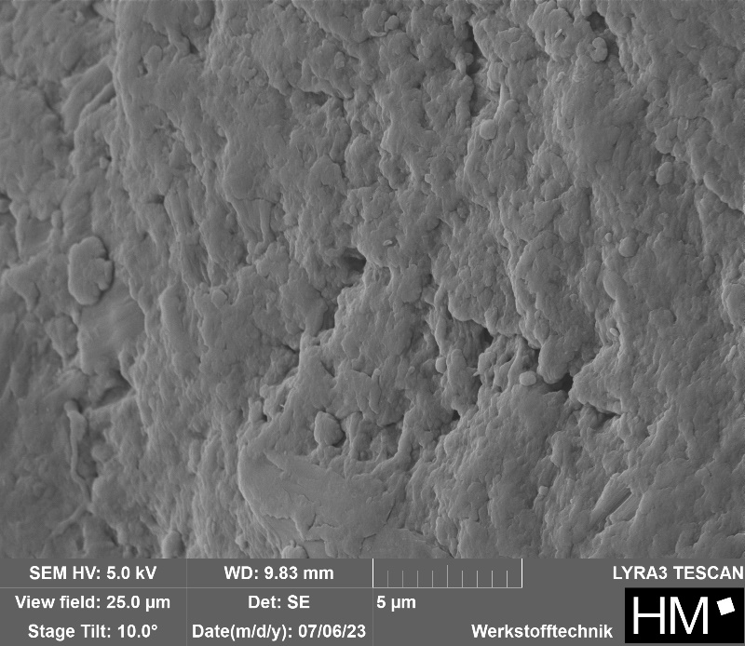
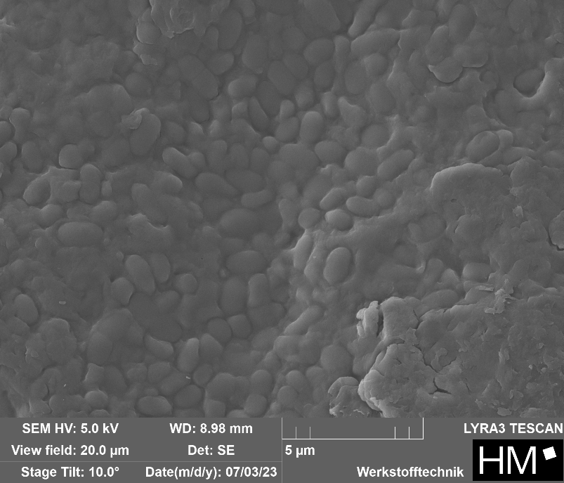
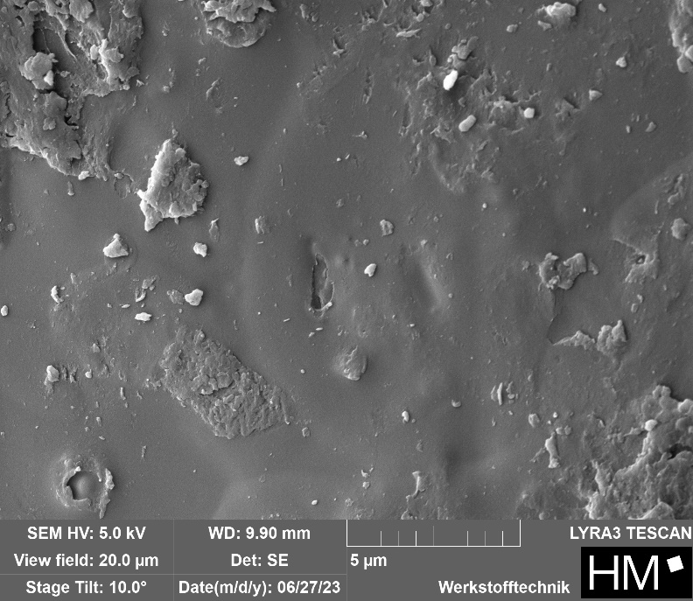
SEM images after drying – Fluidized bed drying
MCC before
Without Maltodextrin
With Maltodextrin
Cell viability after drying: < 1 %

Slide 4
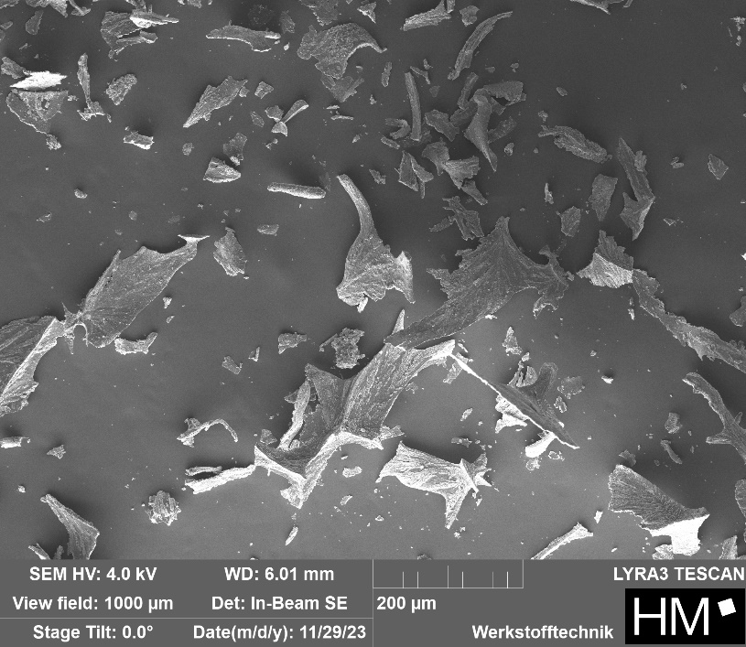
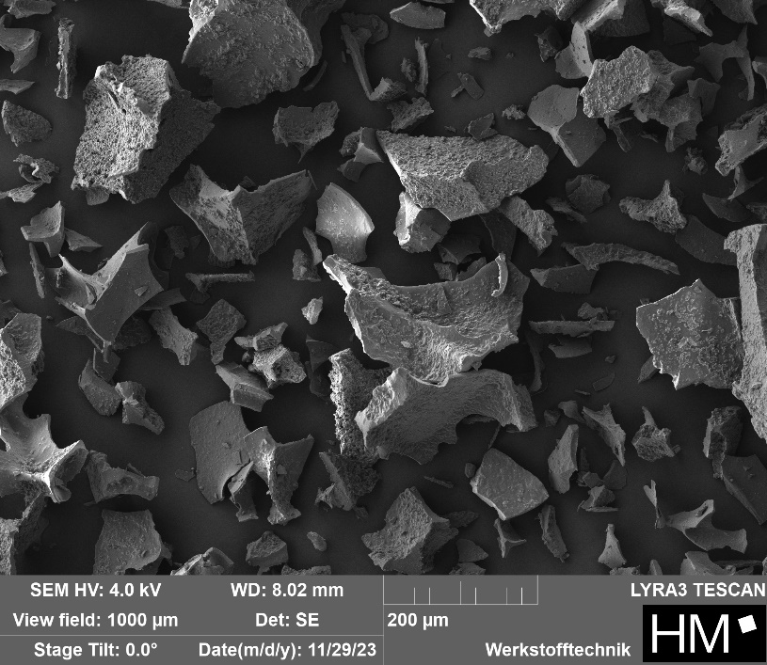
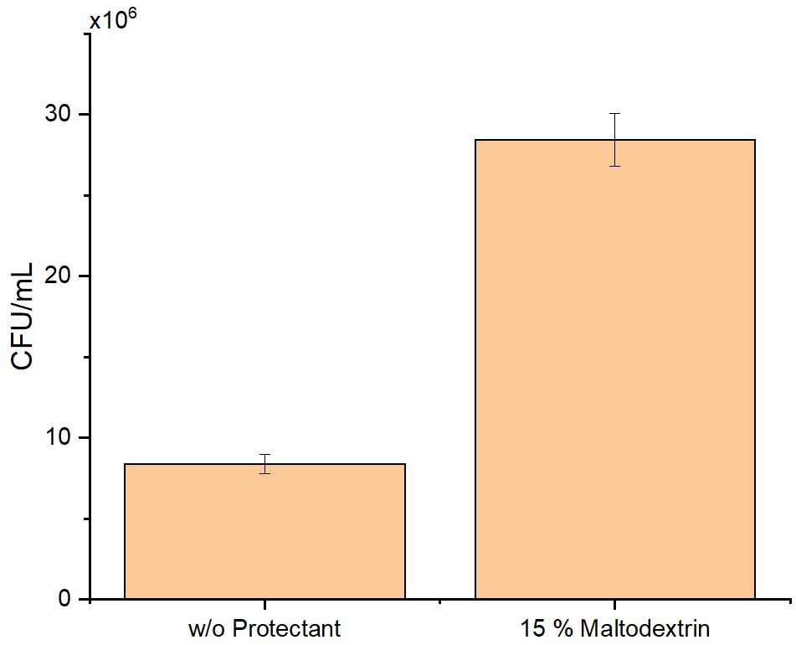
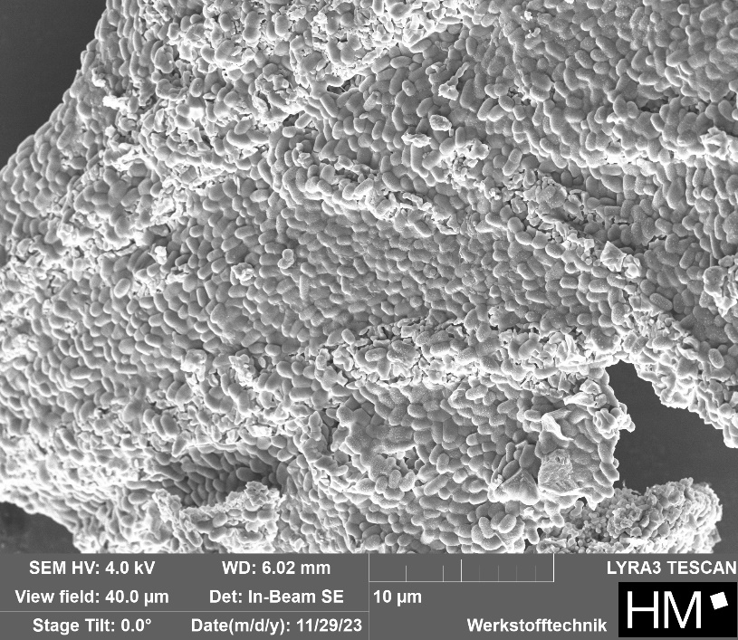
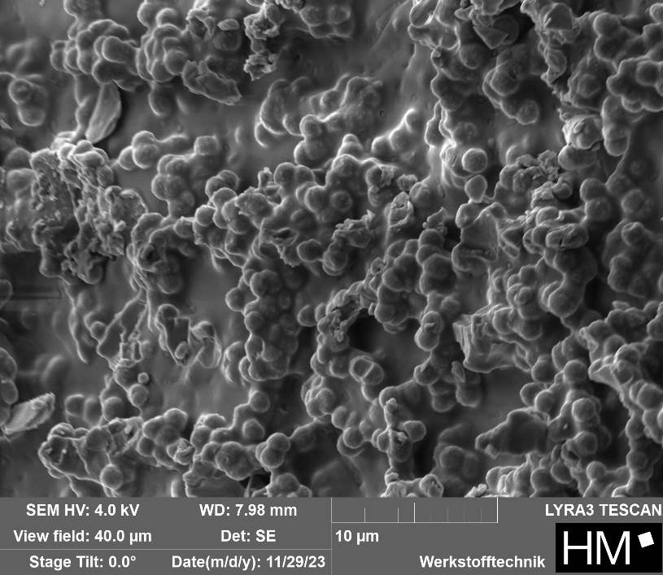
SEM images after drying – Freeze drying
Cell viability after drying:
Without Maltodextrin
With Maltodextrin
~ 20 %
~ 6 %

Slide 5
Storage – Fluidized bed drying
Without Maltodextrin
With Maltodextrin

Slide 6
Storage – Freeze drying
Without Maltodextrin
With Maltodextrin

Slide 7
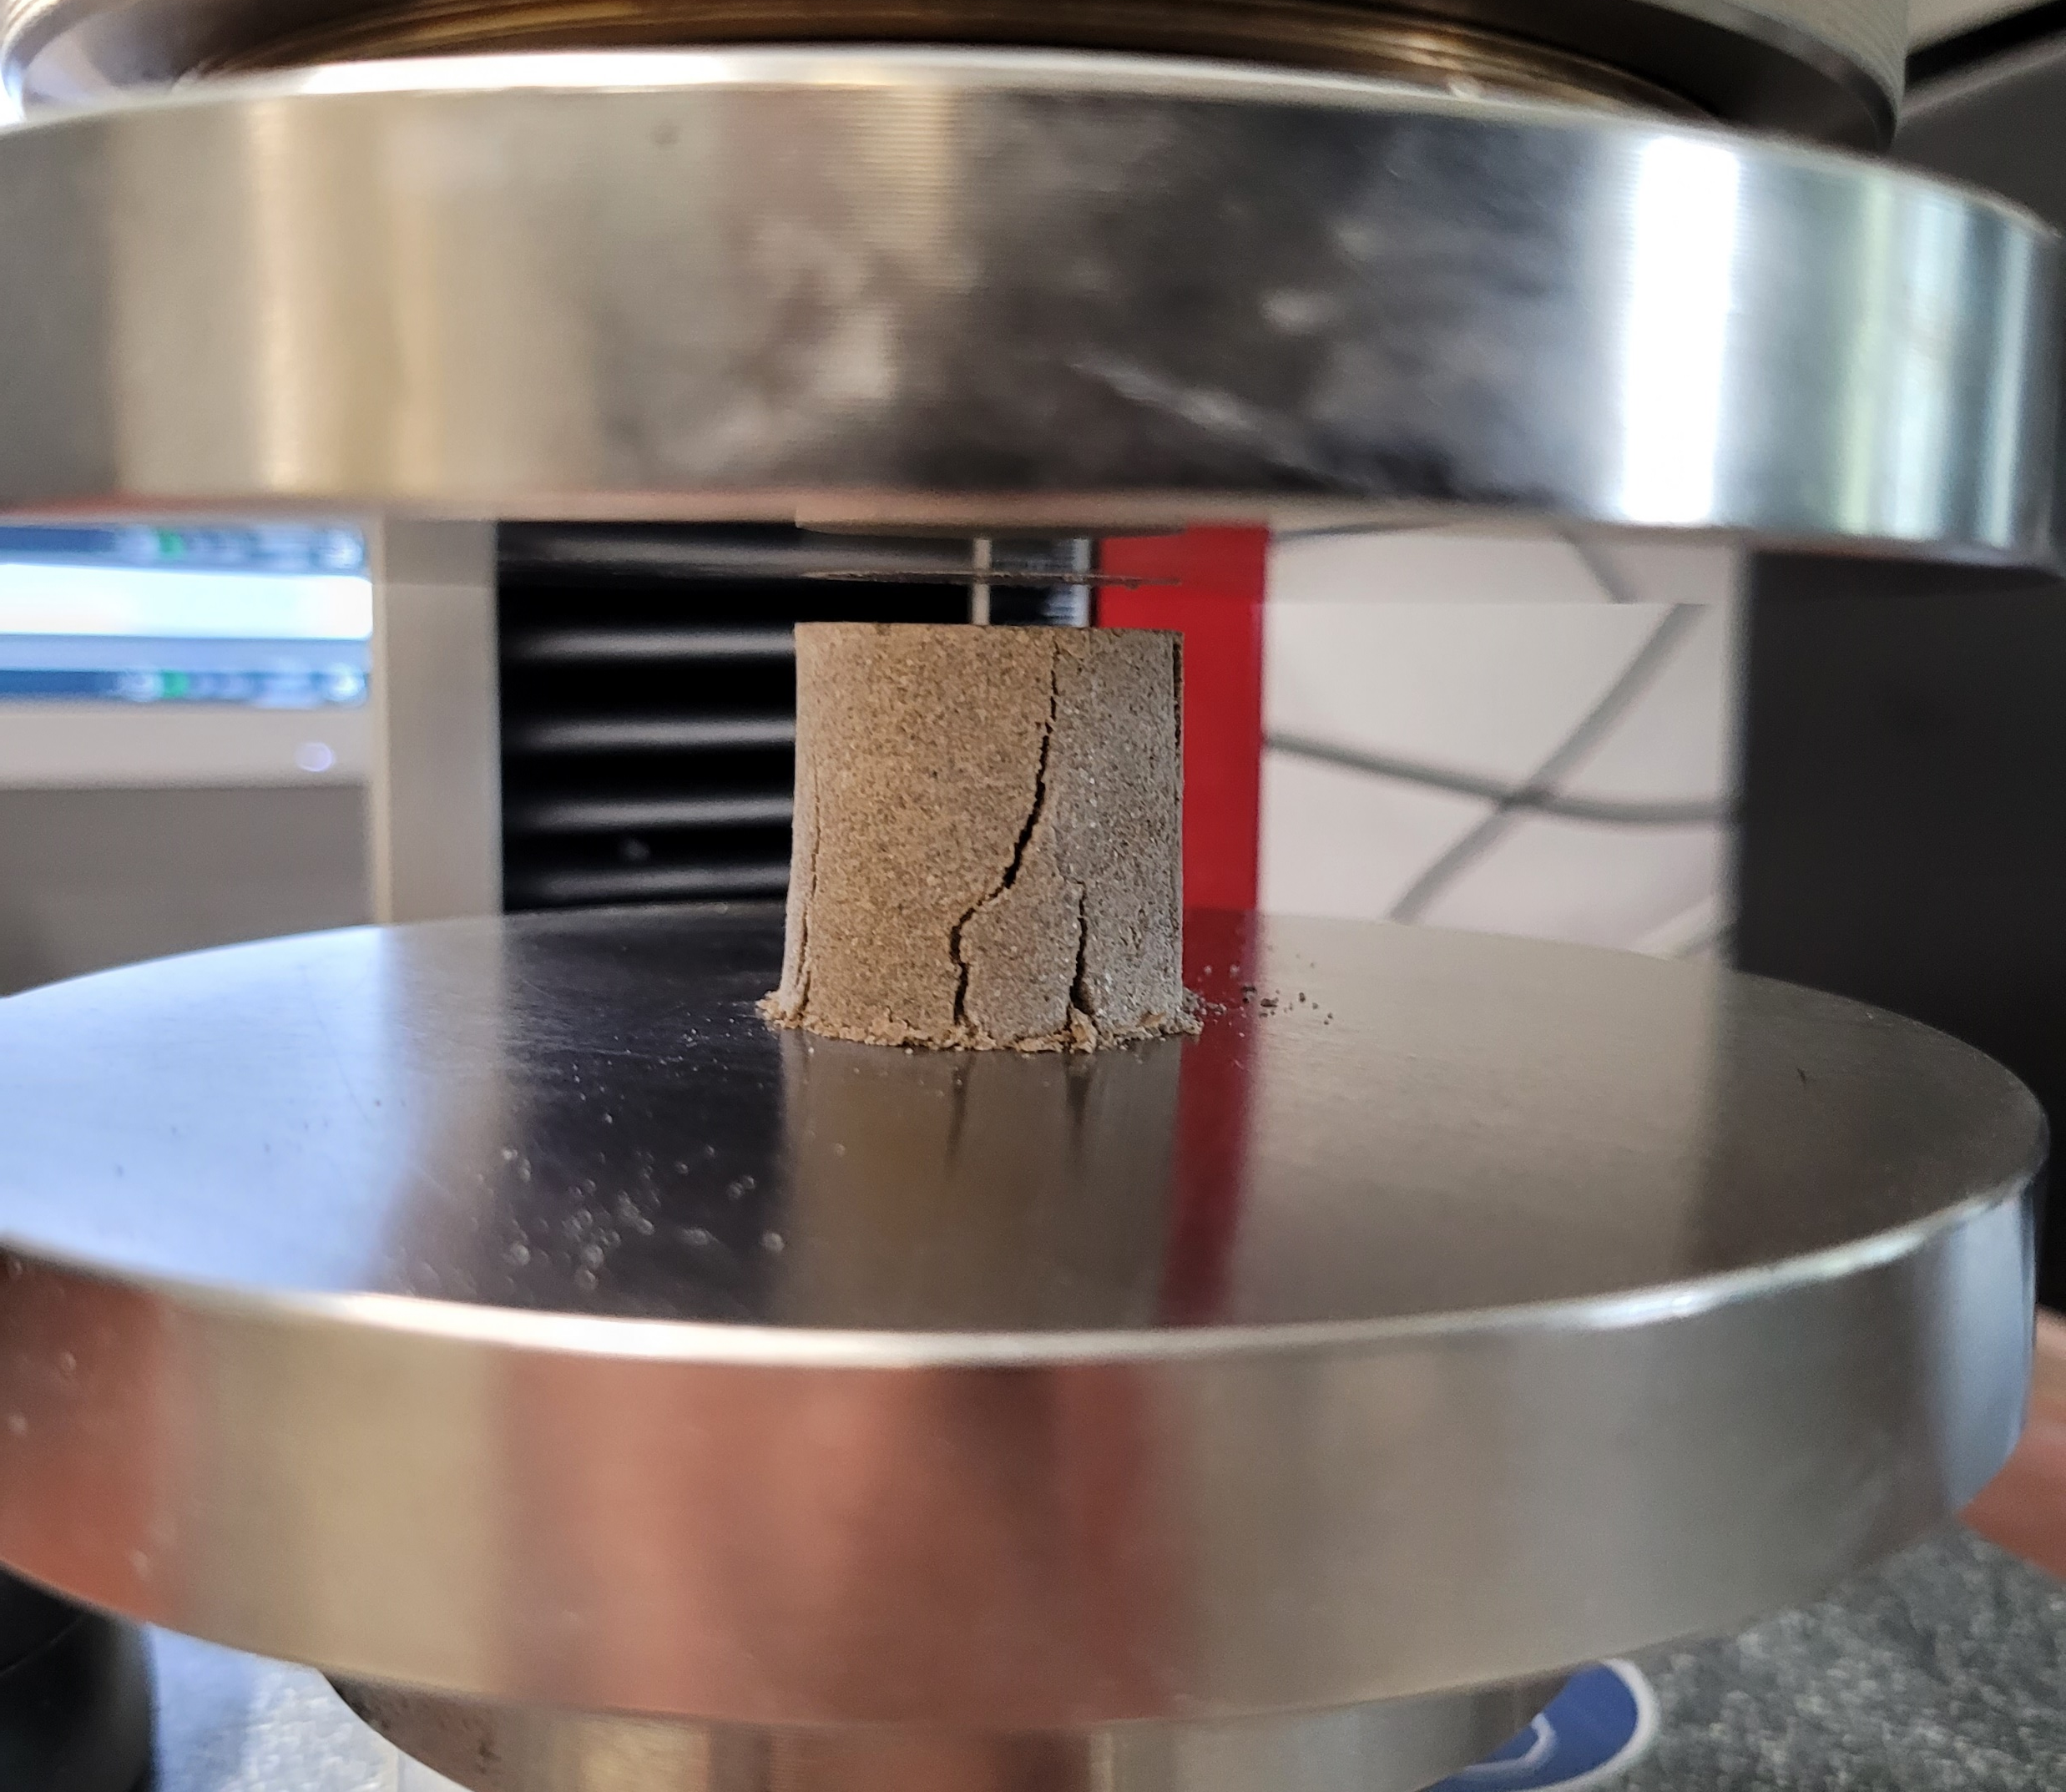
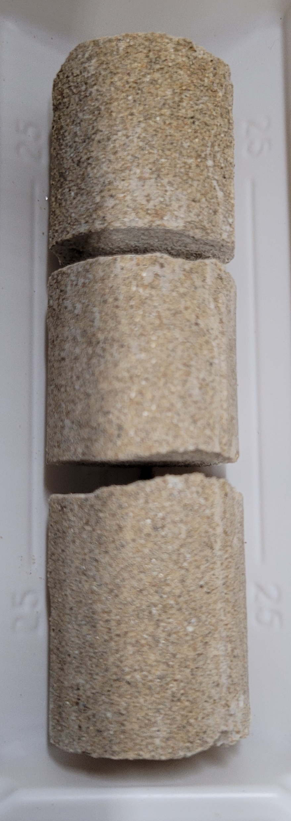
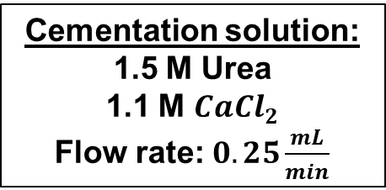
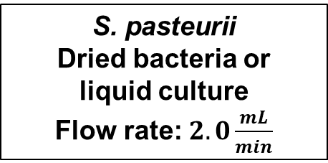
MICP application – Quartz sand columns
S. pasteurii
Dried bacteria or
liquid culture
Flow rate: $2.0\frac{mL}{min}$
Cementation solution:
1.5 M Urea
1.1 M ${CaCl}_{2}$
Flow rate: $0.25\frac{mL}{min}$
6 × [100 min pump ON /
100 min pump OFF]
14 days at 40 °C

Slide 8
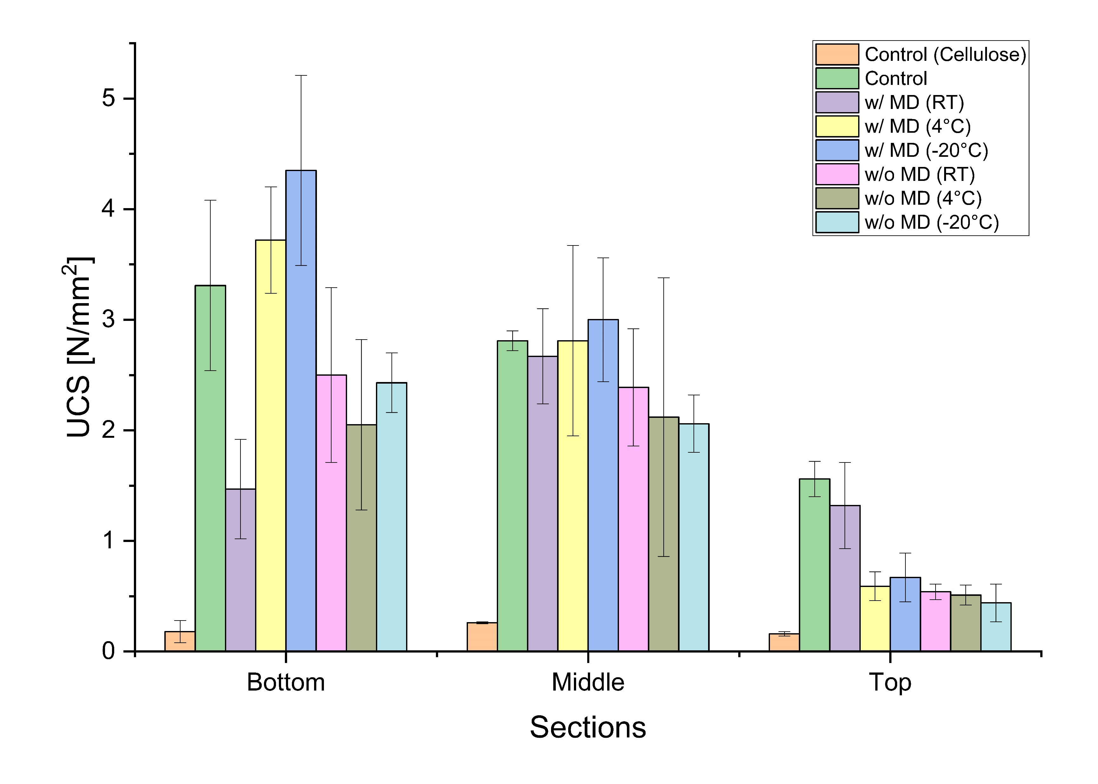
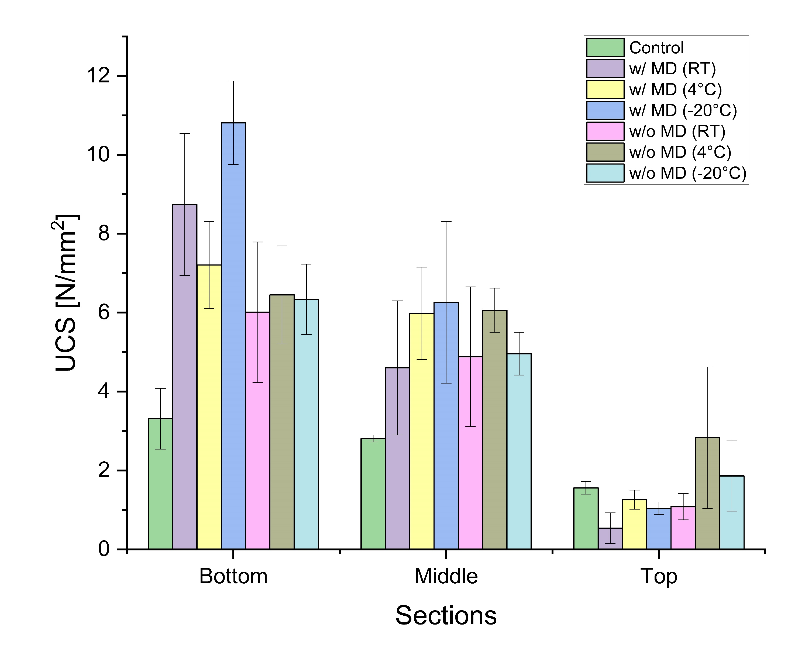
MICP application – Quartz sand columns
Fluidized bed dried
Freeze dried

Slide 9
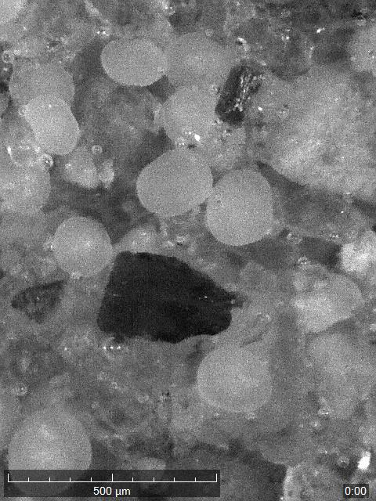
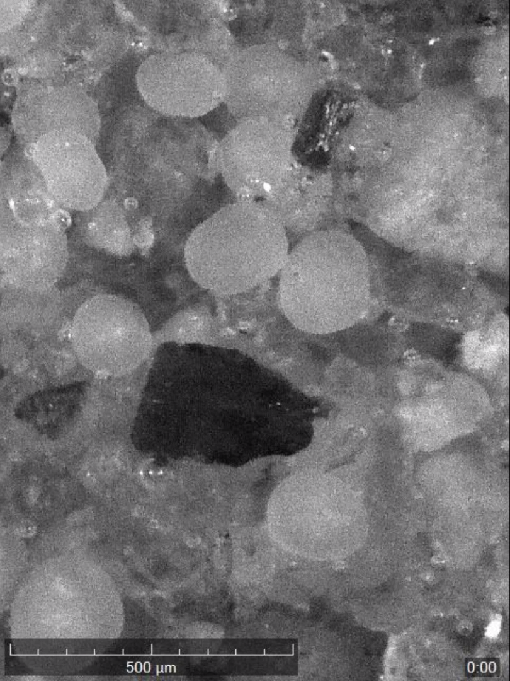
Storage – Fluidized bed drying
Before
After
Coated MCC particles

Slide 10
Key findings
Maltodextrin acts as an effective protective agent, improving cell viability and urease stability, especially in freeze-drying.
Freeze-drying resulted in significantly higher bacterial survival compared to fluidized bed drying.
Urease activity was preserved across all powders and decreased depending on storage temperature and time.
Dried bacterial powders enabled effective MICP-based soil strengthening, achieving higher compressive strength than liquid culture.
MCC appears to negatively affect UCS, while dried bacteria applied on MCC were still able to achieve high compressive strengths through MICP.
Notes:
Dried Sporosarcina pasteurii cells, particularly when protected with maltodextrin and freeze-dried, maintain functional urease activity and enable effective MICP-based soil strengthening, making them a promising and more practical alternative to conventional liquid cultures despite reduced cell viability.

Slide 11

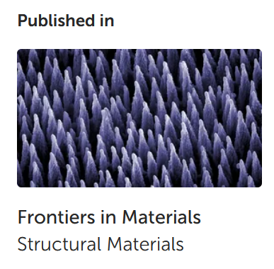
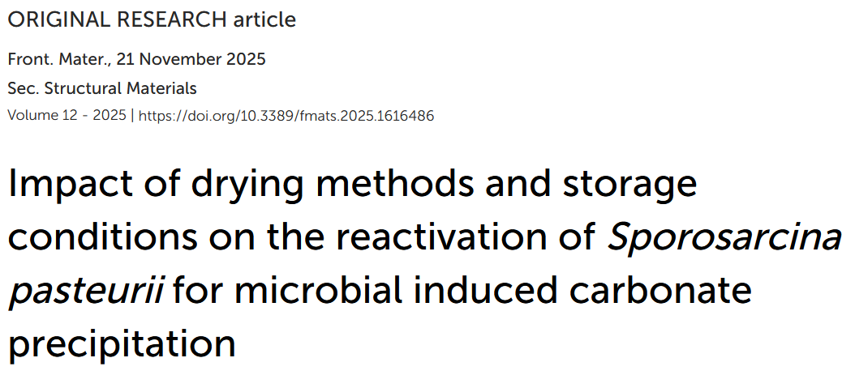




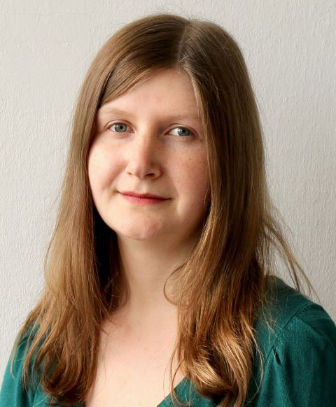
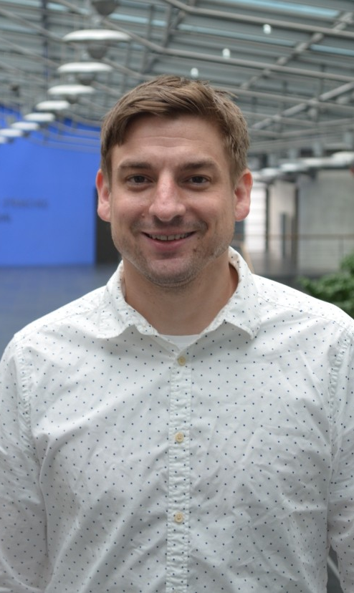

Funded by:
Thank you!
University of Applied Sciences Munich HM, Germany
Department of Engineering and Management
Department of Civil Engineering
Prof. Robert Huber
Prof. Andrea Kustermann
Contact: Patrick Hanisch, patrick.hanisch@hm.edu

