Slide 1






Model based assessment of pore-size dependent biofilm growth kinetics with application to productive biofilm-reactors
Maike Werdin¹, Loisa Borde^{1,2}, Nicole Vorhauer-Huget¹
¹ Chair of Thermal Process Engineering, Otto von Guericke University, Magdeburg, Germany
² Process Synthesis and Process Dynamics, Max Planck Institute for Dynamics of Complex Technical Systems, Magdeburg, Germany
tvt.ovgu.de/tpm
InterPore 2026
18th annual meeting & conference courses
19th – 22nd May 2026, Nantes, France

Slide 2
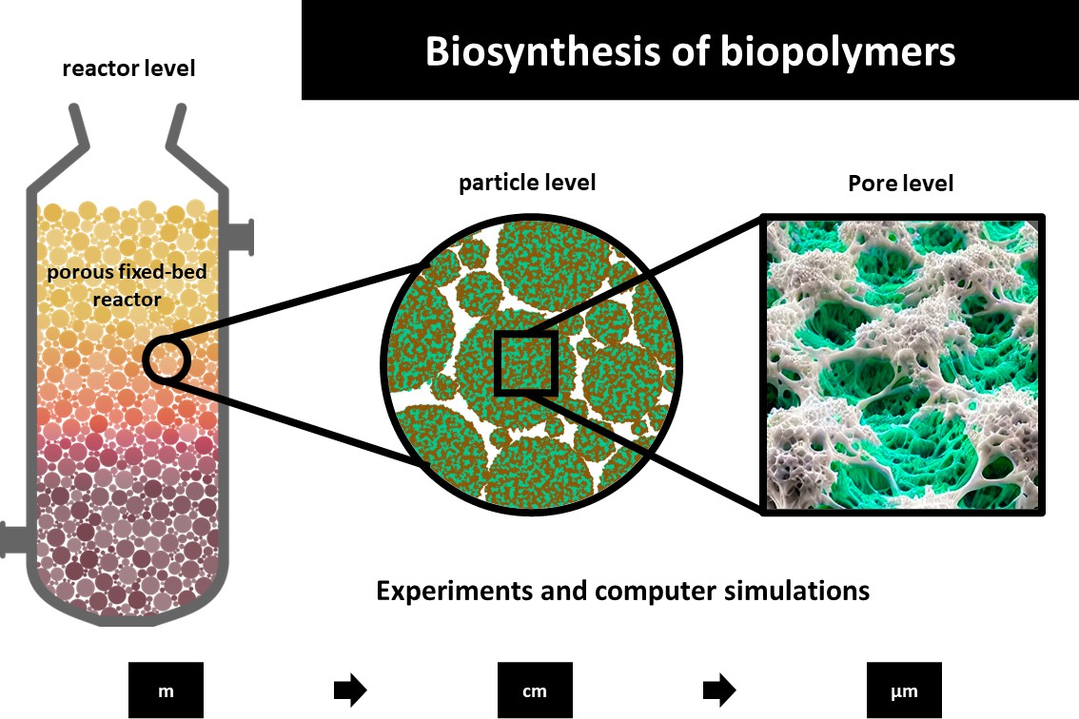

Motivation and GOALS Biofilms in porous structures
Sustainable production based on microorganisms
Natural growth formation: biofilms
Enhancement: porous structures in bioreactor
Investigation of influence of pore geometry on biofilm growth
Extra polymeric substances (EPS)
Microorganisms
Surface

Slide 3
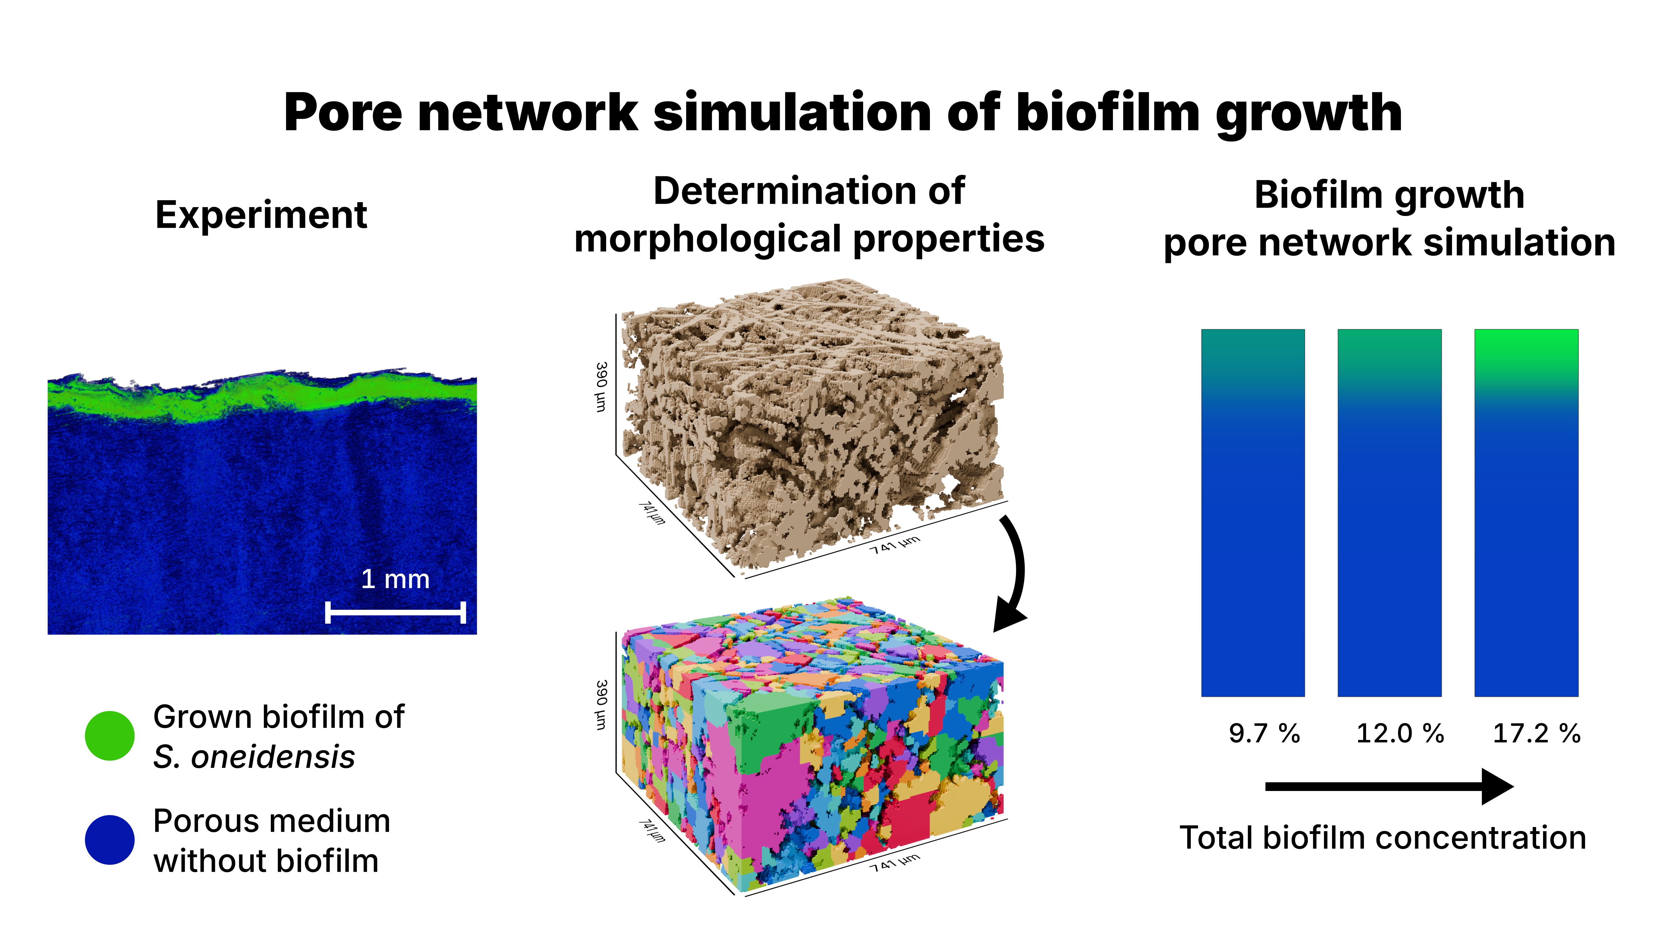
Reconstruction of porous structures
Biomass
Visualization of scanned X-ray tomography
Reconstructed Pore Network
Total Biomass Concentration
Deepen understanding on single pore scale
Pore Network Model for Study of Biofilm Growth Limitations in Porous Substrata, Aamer et al, 2025, Transport in porous Media

Slide 4
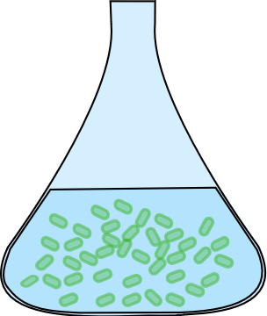
Model – Calculation Sequence in each time step
Substrate Concentration
Biomass Concentration
Single pore in detail:
Current concentration of metabolites and microorganisms
Microorganisms consume substrates to produce biomass

Slide 5
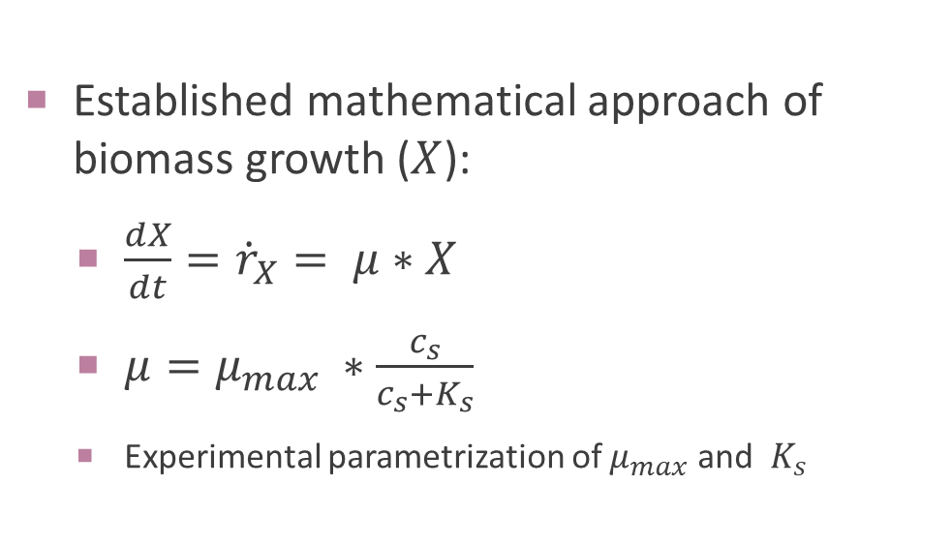
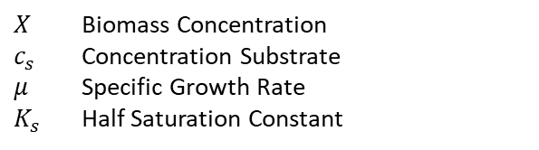
Model – Calculation Sequence in each time step
Substrate Concentration
Biomass Concentration
Established mathematical approach of biomass growth ($X$):
$\frac{dX}{dt}={\dot{r}}_{X}= μ∗X$
$μ=μ_{max} ∗\frac{c_{s}}{c_{s}+K_{s}}$
Experimental parametrization of $μ_{max}$ and $K_{s}$
Biomass Growth
$X$ Biomass Concentration
$c_{s}$ Concentration Substrate
$μ$ Specific Growth Rate
$K_{s}$ Half Saturation Constant

Slide 6
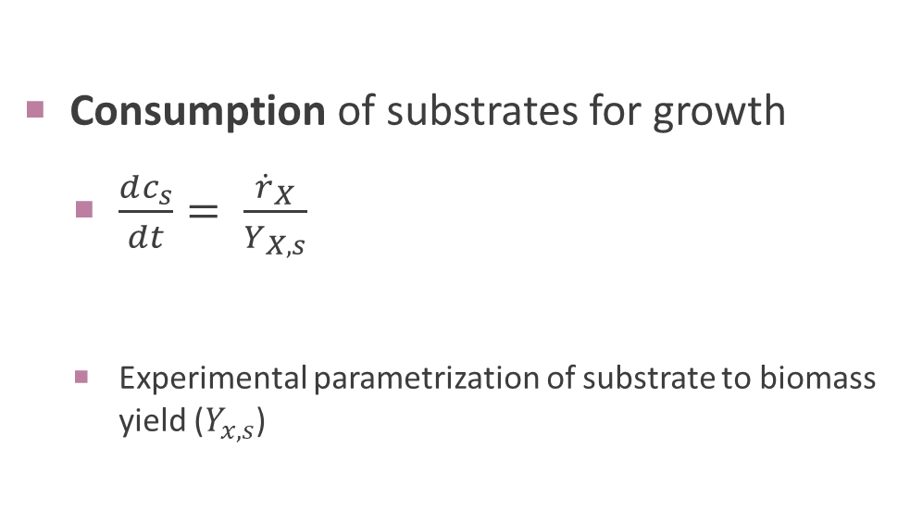
Model – Calculation Sequence in each time step
Substrate Concentration
Biomass Concentration
Biomass Growth
Consumption of substrates for growth
$\frac{dc_{s}}{dt}= \frac{{\dot{r}}_{X}}{Y_{X,s}}$
Experimental parametrization of substrate to biomass yield ($Y_{x,s}$)
Substrate Consumption

Slide 7


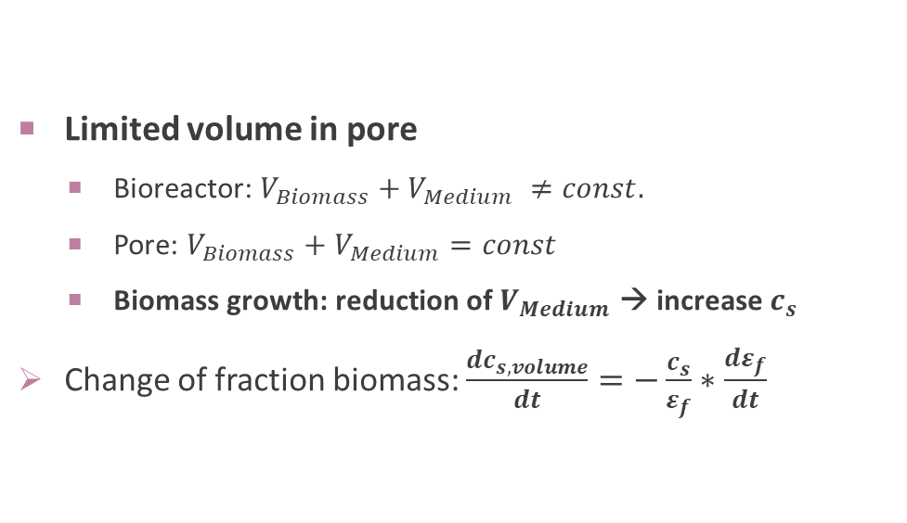

Model – Calculation Sequence in each time step
Substrate Concentration
Biomass Concentration
Biomass ($ε_{bm}=\frac{c_{bm}}{c_{max}}$)
Fluid (Medium, $ε_{f}$)
Biomass Growth
Limited volume in pore
Bioreactor: $V_{Biomass}+V_{Medium} ≠const.$
Pore: $V_{Biomass}+V_{Medium}=const$
Biomass growth: reduction of $V_{Medium}$ → increase $c_{s}$
Change of fraction biomass: $\frac{dc_{s,volume}}{dt}=−\frac{c_{s}}{ε_{f}}∗\frac{dε_{f}}{dt}$
Substrate Consumption
Limited Volume

Slide 8
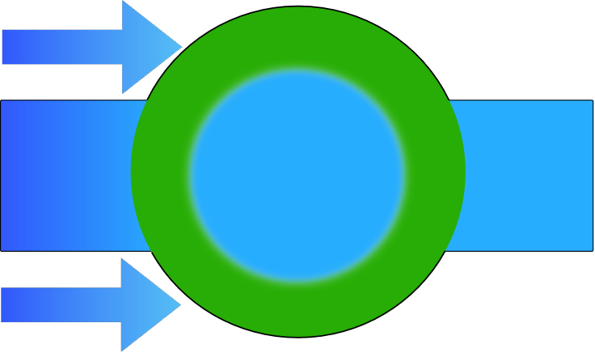
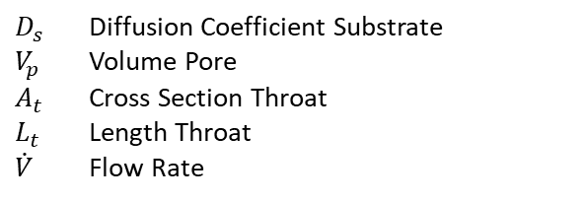

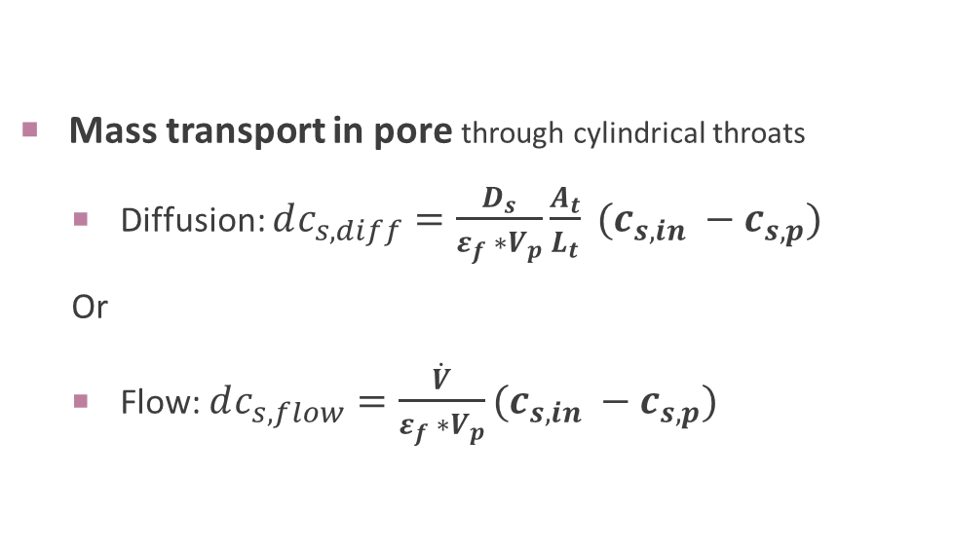


Model – Calculation Sequence in each time step
Substrate Concentration
Biomass Concentration
Diffusion
$$L_{t}$$
$$r_{t}$$
$$r_{p}$$
Flow
Biomass Growth
Mass transport in pore through cylindrical throats
Diffusion: $dc_{s,diff}=\frac{D_{s}}{ε_{f} ∗V_{p}}\frac{A_{t}}{L_{t}} (c_{s,in} −c_{s,p})$
Or
Flow: $dc_{s,flow}=\frac{\dot{V}}{ε_{f} ∗V_{p}}(c_{s,in} −c_{s,p})$
Substrate Consumption
Volume Effect
Mass Transport
$D_{s}$ Diffusion Coefficient Substrate
$V_{p}$ Volume Pore
$A_{t}$ Cross Section Throat
$L_{t}$ Length Throat
$\dot{V}$ Flow Rate

Slide 9
Model – Calculation Sequence in each time step
Substrate Concentration
Biomass Concentration
Total substrate concentration change in pore
Substrate = Consumption + Volume Change + Mass Transfer
Biomass Growth
Substrate Consumption
Volume Effect
Mass Transfer
Substrate Concentration Change

Slide 10
Model – Calculation Sequence in each time step
Substrate Concentration
Biomass Concentration
Update substrate and biomass concentration
Biomass Growth
Substrate Consumption
Volume Effect
Mass Transfer
Substrate Concentration Change

Slide 11

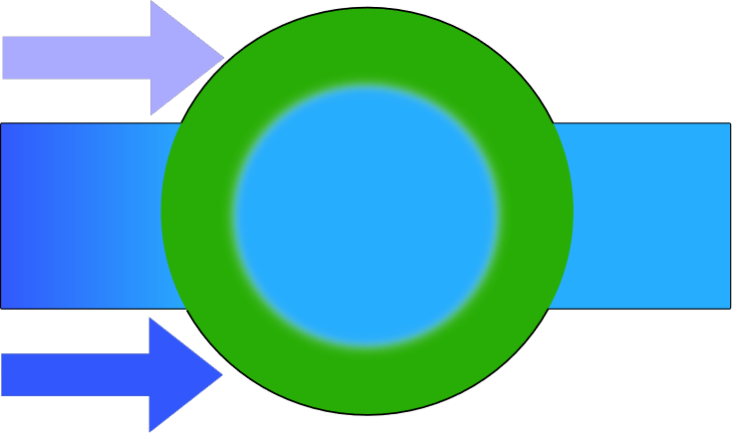
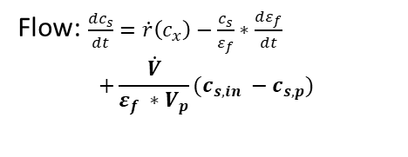
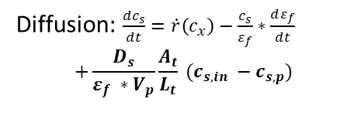



Results - Influence of process conditions
Batch: $\frac{dc_{s}}{dt}=\dot{r}\left(c_{x}\right)$
Flow
Flow
Diffusion
Pore: $\frac{dc_{s}}{dt}=\dot{r}\left(c_{x}\right)−\frac{c_{s}}{ε_{f}}∗\frac{dε_{f}}{dt}$
Batch;
Pore
Diffusion: $\frac{dc_{s}}{dt}=\dot{r}\left(c_{x}\right)−\frac{c_{s}}{ε_{f}}∗\frac{dε_{f}}{dt}$
$$+\frac{D_{s}}{ε_{f} ∗V_{p}}\frac{A_{t}}{L_{t}} (c_{s,in} −c_{s,p})$$
Diffusion
Batch; Pore
Flow: $\frac{dc_{s}}{dt}=\dot{r}\left(c_{x}\right)−\frac{c_{s}}{ε_{f}}∗\frac{dε_{f}}{dt}$
$$+\frac{\dot{V}}{ε_{f} ∗V_{p}}(c_{s,in} −c_{s,p})$$
Higher substrate concentrations under mass transport conditions
Increased biomass growth
Batch-Model: Weiler et al.. „Strain and Model Development for Auto- and Heterotrophic 2,3-Butanediol Production Using Cupriavidus Necator H16“. Biotechnology for Biofuels and Bioproducts 17, Nr. 1 (2024): 108. https://doi.org/10.1186/s13068-024-02549-7.
Initial conditions: $c_{s}=20mM;c_{bm}=0.1 g/L$

Slide 12
Conclusion & Outlook
Growth highly dependent on substrate supply:
Influenced by pore and throat geometry
Increased substrate supply → increased biomass growth
Outlook:
Biofilm:
Determination of kinetic parameters by experimental biofilm data
Characterization
Recommendation: MS04, part 3: 88. Design of a microfluidic setup to assess scale-dependent metabolic kinetics in Azotobacter vinelandii biofilms producing polysaccharides - Loisa Borde
Identify process conditions in reconstructed porous structures
Interactions of biofilm and porous structures: clogging of pores
→ Application of characterized biofilm growth on reconstructed Pore Network Models

Slide 13
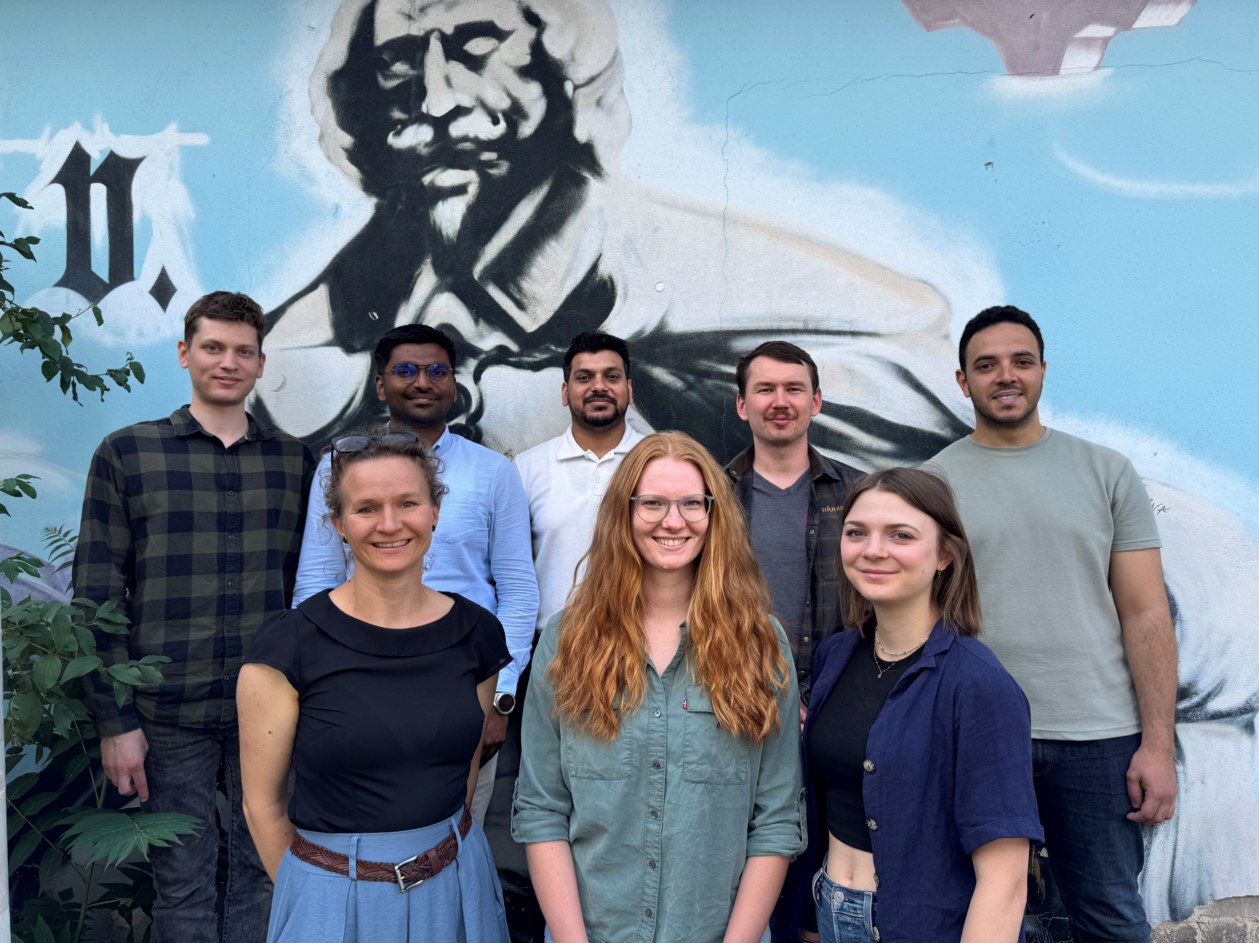
Thank you for your attention!
Thanks to
Dr. Nicole Vorhauer-Huget
Loisa Borde
Research Group Transport in Porous Media
Transport in porous media research group
Acknowledgement: The authors gratefully acknowledge the funding from the Deutsche Forschungsgemeinschaft (DFG priority program SPP2494, project no. 559381551 (Assessing terpene productivity of Methanosarcina acetivorans biofilms in porous substrata using a mathematical physiological approach)

Slide 14
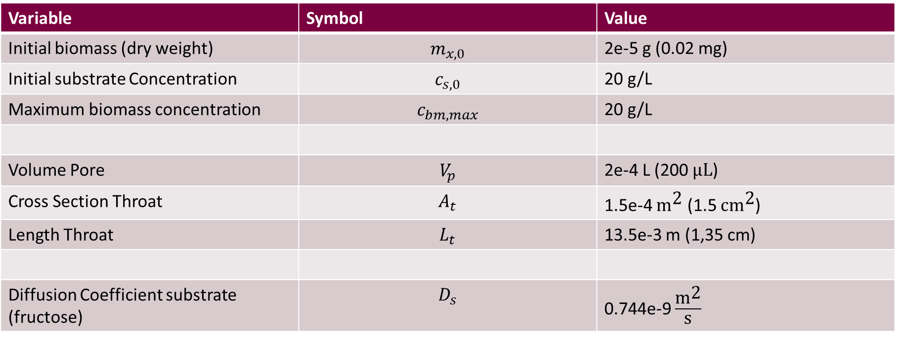
Initial and boundary conditions
Variable | Symbol | Value
Initial biomass (dry weight) | $$m_{x,0}$$ | 2e-5 g (0.02 mg)
Initial substrate Concentration | $$c_{s,0}$$ | 20 g/L
Maximum biomass concentration | $$c_{bm,max}$$ | 20 g/L
Volume Pore | $$V_{p}$$ | 2e-4 L (200 $\text{μL}$)
Cross Section Throat | $$A_{t}$$ | 1.5e-4 ${\text{m}}^{\text{2}}$ (1.5 $\text{c}{\text{m}}^{\text{2}}$)
Length Throat | $$L_{t}$$ | 13.5e-3 m (1,35 cm)
Diffusion Coefficient substrate (fructose) | $$D_{s}$$ | 0.744e-9 $\frac{{\text{m}}^{\text{2}}}{\text{s}}$

Slide 15
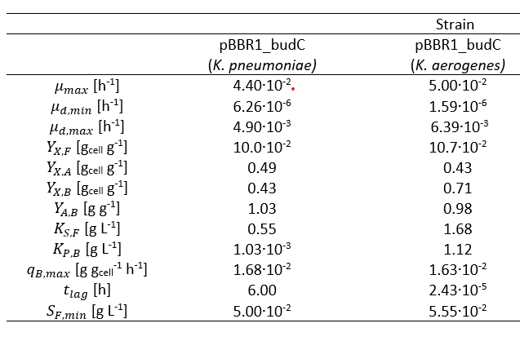
Kinetic parameters
Batch-Model: Weiler et al.. „Strain and Model Development for Auto- and Heterotrophic 2,3-Butanediol Production Using Cupriavidus Necator H16“. Biotechnology for Biofuels and Bioproducts 17, Nr. 1 (2024): 108. https://doi.org/10.1186/s13068-024-02549-7.

Slide 16
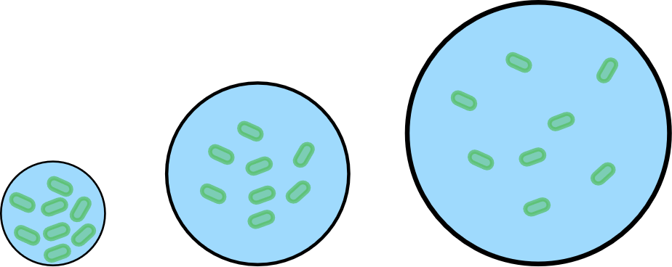
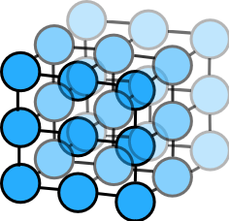
Influence initial biomass concentration
Same mass in different volumes → different concentrations
→ Initial biomass concentration determines kinetics

Slide 17
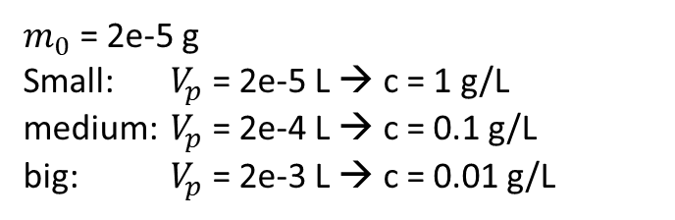
Influence initial biomass concentration
$m_{0}$ = 2e-5 g
Small: $V_{p}$ = 2e-5 L → c = 1 g/L
medium: $V_{p}$ = 2e-4 L → c = 0.1 g/L
big: $V_{p}$ = 2e-3 L → c = 0.01 g/L

Slide 18
Diffusion
 | Diffusion | R_{p} [mm] | V_{p} [m3] | R_{t} [mm] | A_{t} [m2] | L_{t} [mm]
A | Low | 4 | 2e-7 | 1.7 | 9.1e-6 | 54
B | Medium | 4 | 2e-7 | 3.4 | 3.6e-5 | 27
C | high | 4 | 2e-7 | 6.8 | 1.5e-4 | 13.5

Slide 19
Flow rates
Low flow = 4ul/min
Medium Flow = 40 ul/min
High = 400 ul/min

