Slide 1






Design of a microfluidic setup to assess scale-dependent metabolic kinetics in Azotobacter vinelandii biofilms producing polysaccharides
Loisa Borde^{1,2}, Maike Werdin¹, Stefanie Duvigneau³, Nicole Vorhauer-Huget¹
¹ Chair of Thermal Process Engineering, Otto von Guericke University, Magdeburg, Germany
² Process Synthesis and Process Dynamics, Max Planck Institute for Dynamics of Complex Technical Systems, Magdeburg, Germany
³ Technical University of Munich, Germany
InterPore 2026
18th annual meeting & conference courses
19th – 22nd May 2026, Nantes, France
loisa.borde@ovgu.de

Slide 2
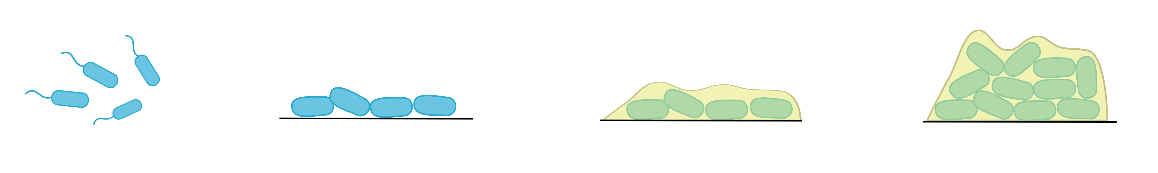
Productive Biofilms For biopolymer Production
loisa.borde@ovgu.de
Biofilms: microbial communities embedded in extracellular polysaccharides (EPS) that adhere to surfaces
A. vinelandii produces biofilms consisting of alginate (biopolymer used in food industry and medicine)
Media with high surface-to-volume ratio → increased biofilm formation → increased alginate production
Schematic overview of biofilm formation

Slide 3
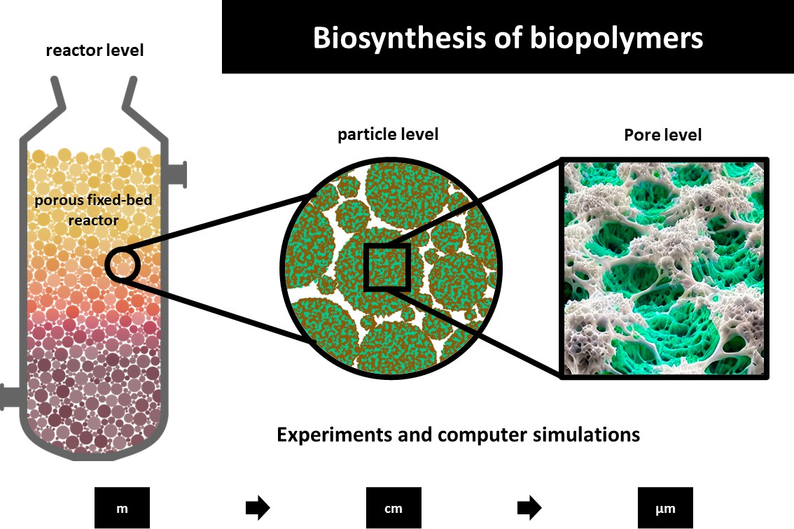
Pore Network Model (PNM)
loisa.borde@ovgu.de
Pore Network Model: biofilm formation in porous structures
Experimental data for model parametrization and validation
  Boundary and initial conditions
  Transport parameters (permeability, diffusion)
  Maximum biofilm thickness
  Attachment and detachment of biofilm

Slide 4
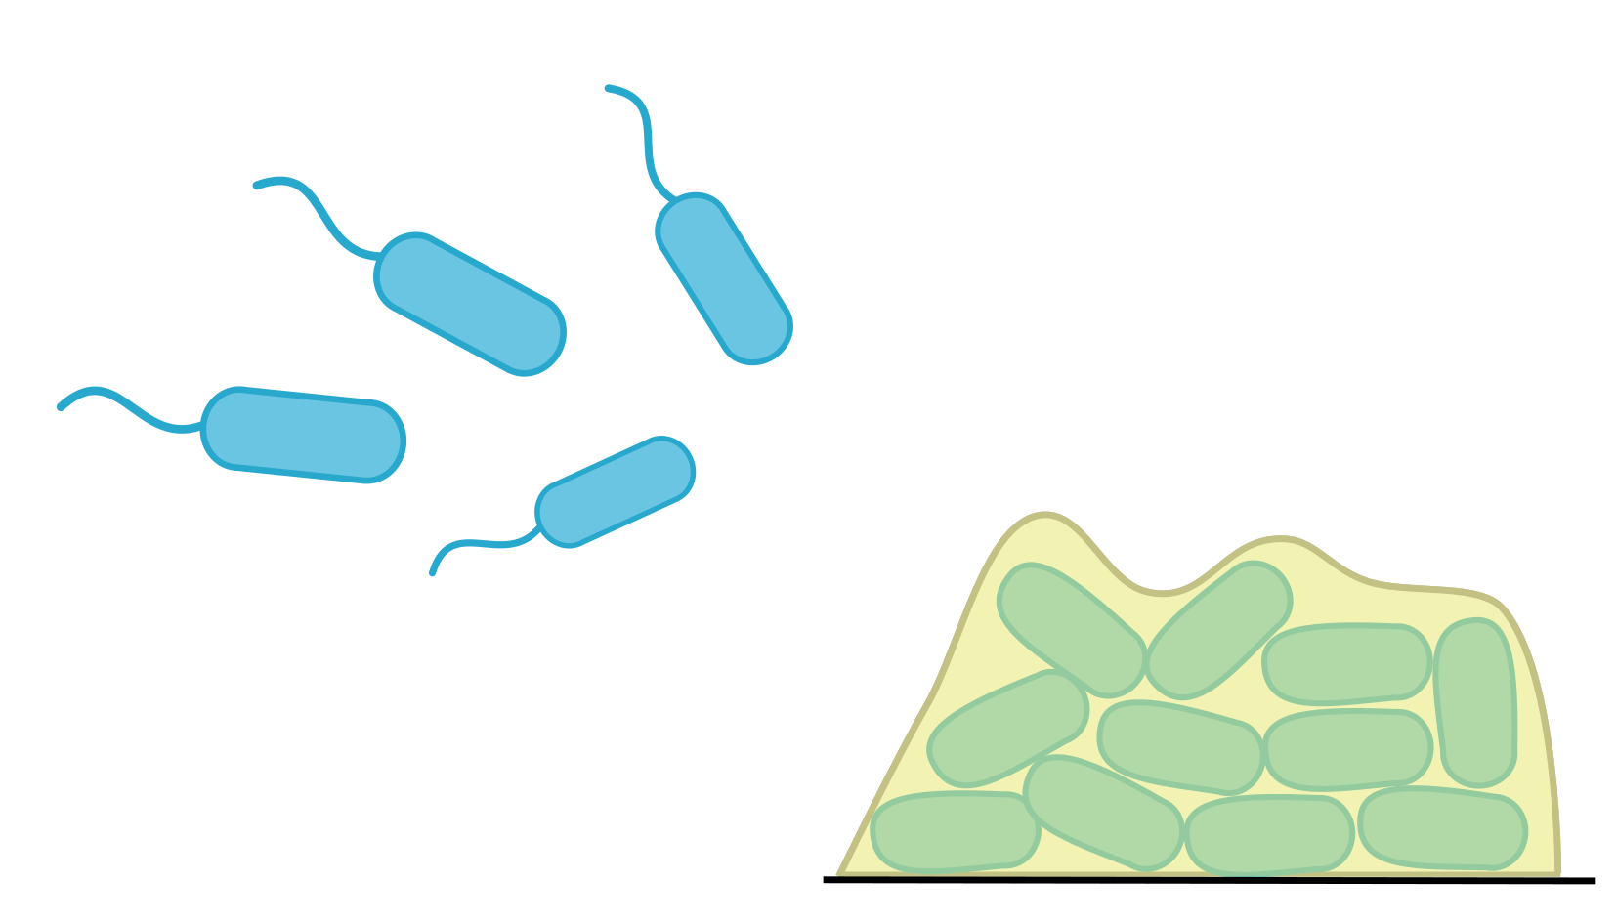
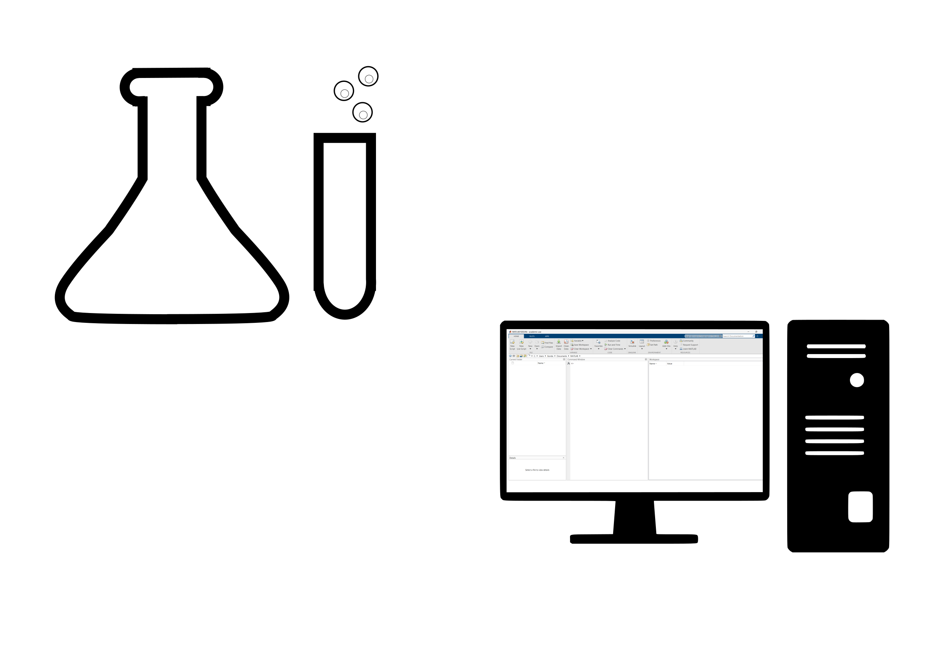
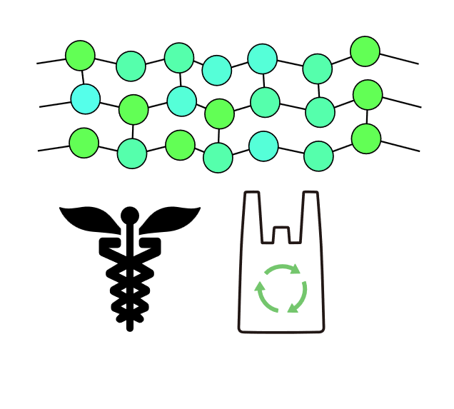
Motivation and Goals
loisa.borde@ovgu.de
Production of biopolymers using bacteria
Biofilm formation in porous substrates
Experimental data for modeling
Polymer production for food industry and medical applications
Objective: investigate biofilm formation and measure kinetic parameters

Slide 5
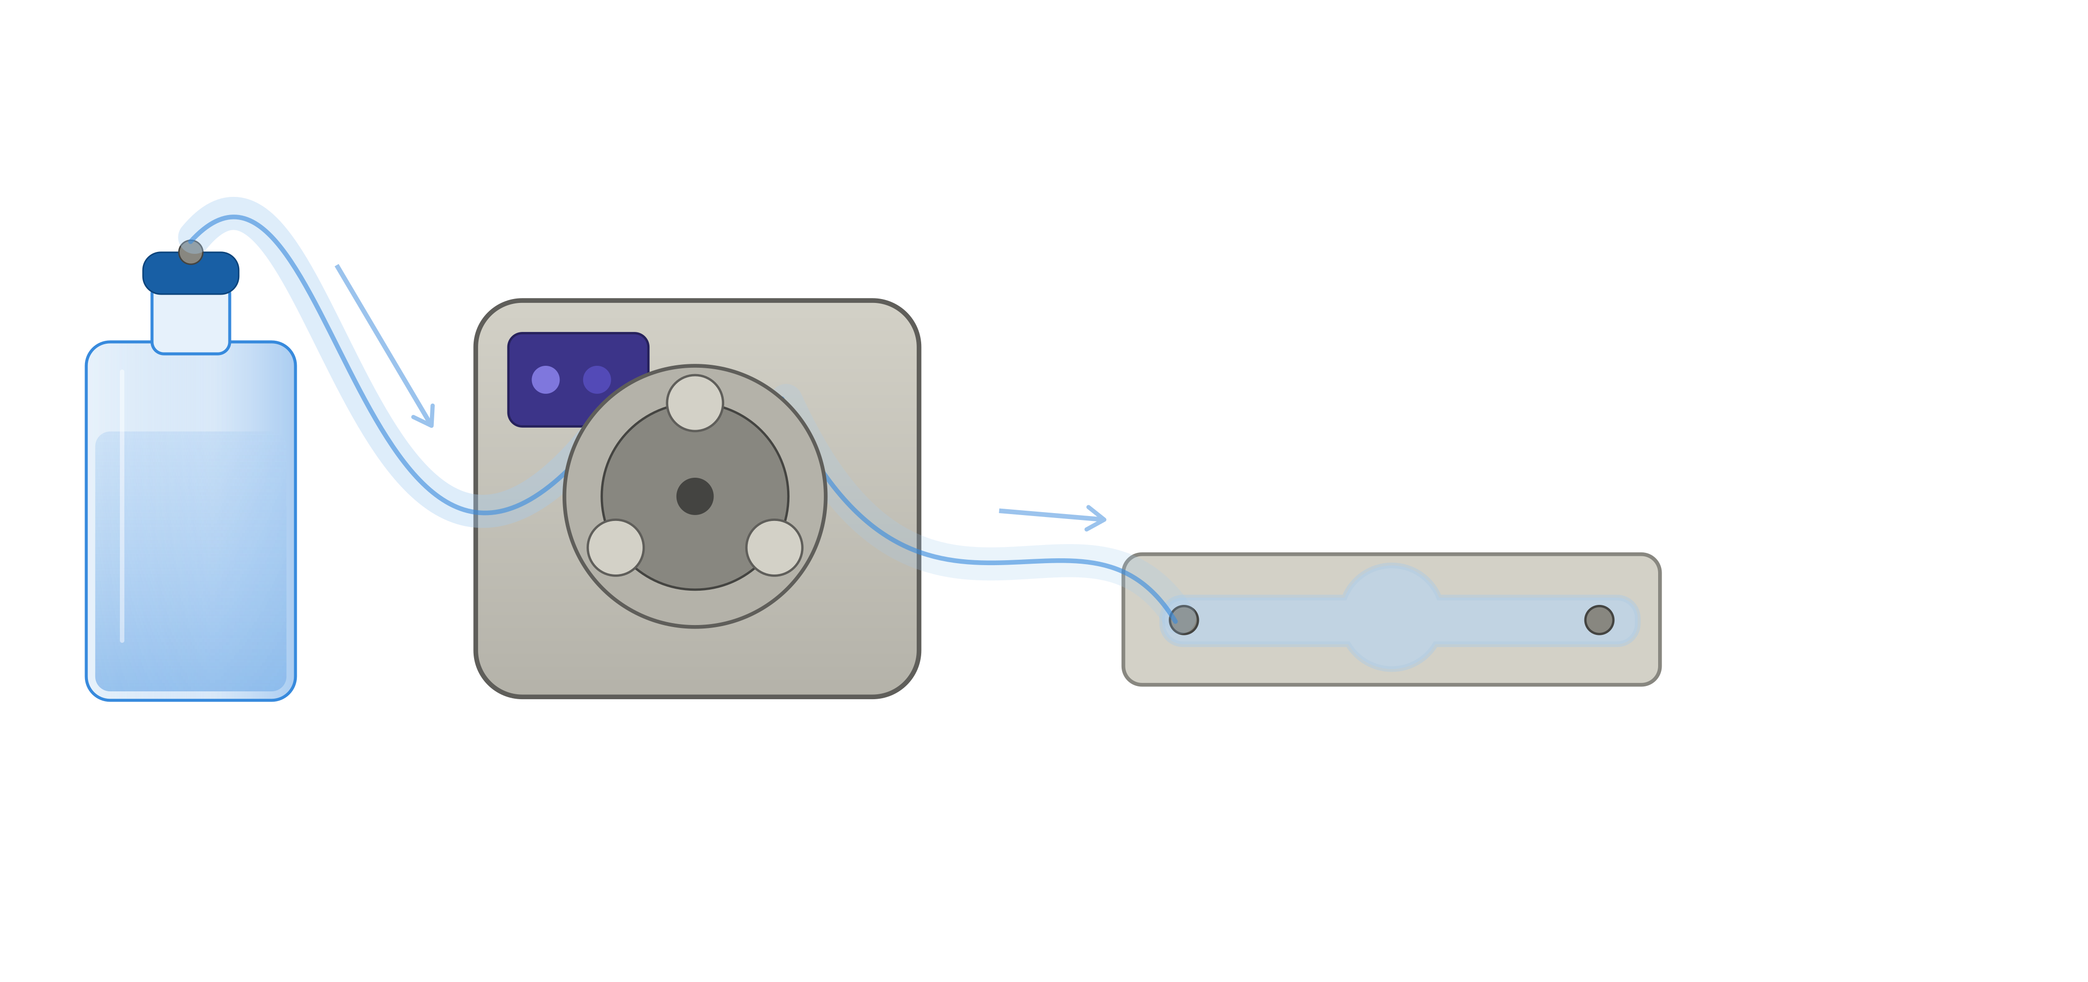
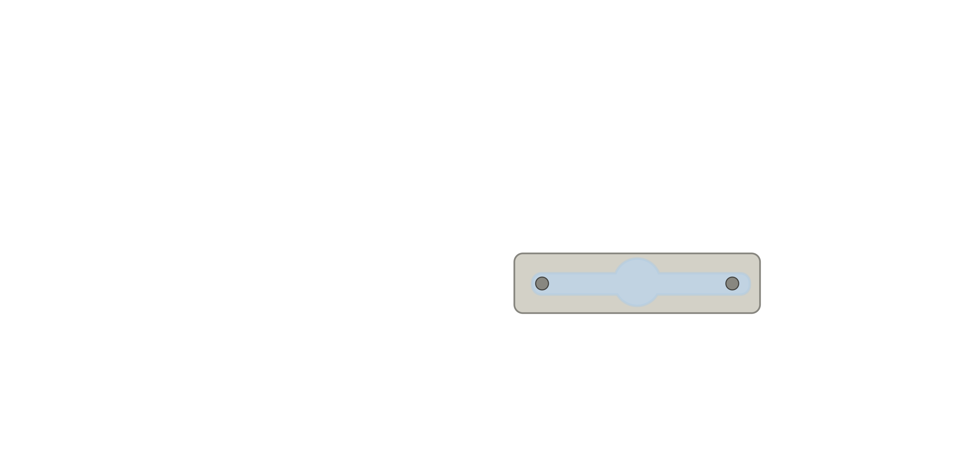
Development of Experimental SetUP For Biofilm formation
loisa.borde@ovgu.de
Devices fabricated from polydimethylsiloxane (PDMS)
Channel geometry designed to imitate a single pore enabeling geometry-dependent biofilm formation (V = 400 µl)
10 g/l Sucrose
10 g/l Succinate
Salt solution
Phosphate buffer
Inoculation with cultures pre-grown in shaking flasks
Continuous medium flow: 40 µl/min for 9 days
8 mm
30 mm
Medium
Peristaltic pump
PDMS Device
Experimental setup for biofilm cultivation

Slide 6
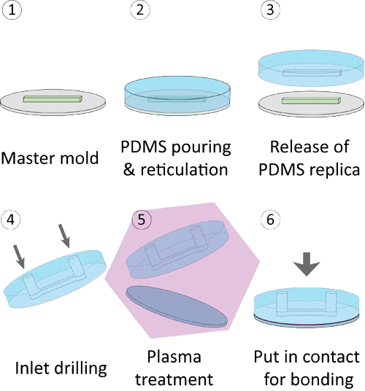
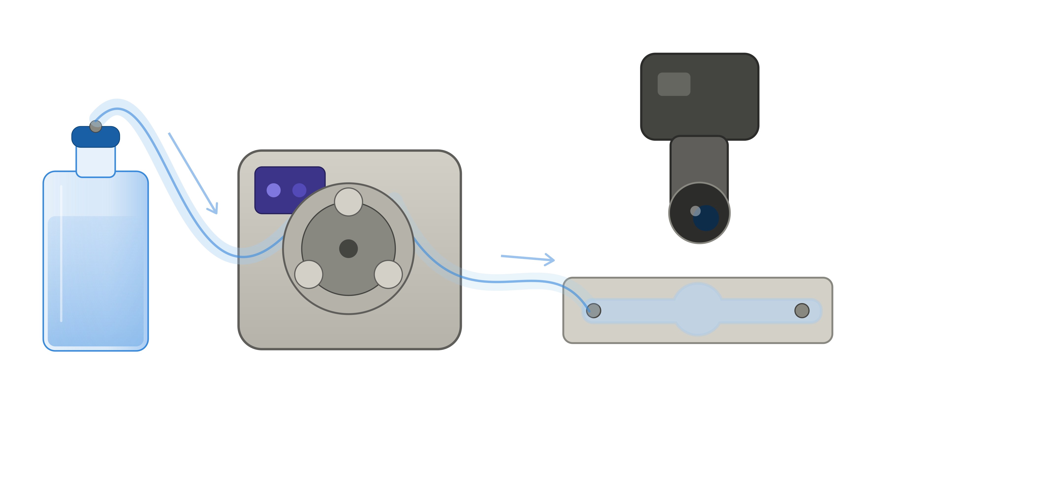
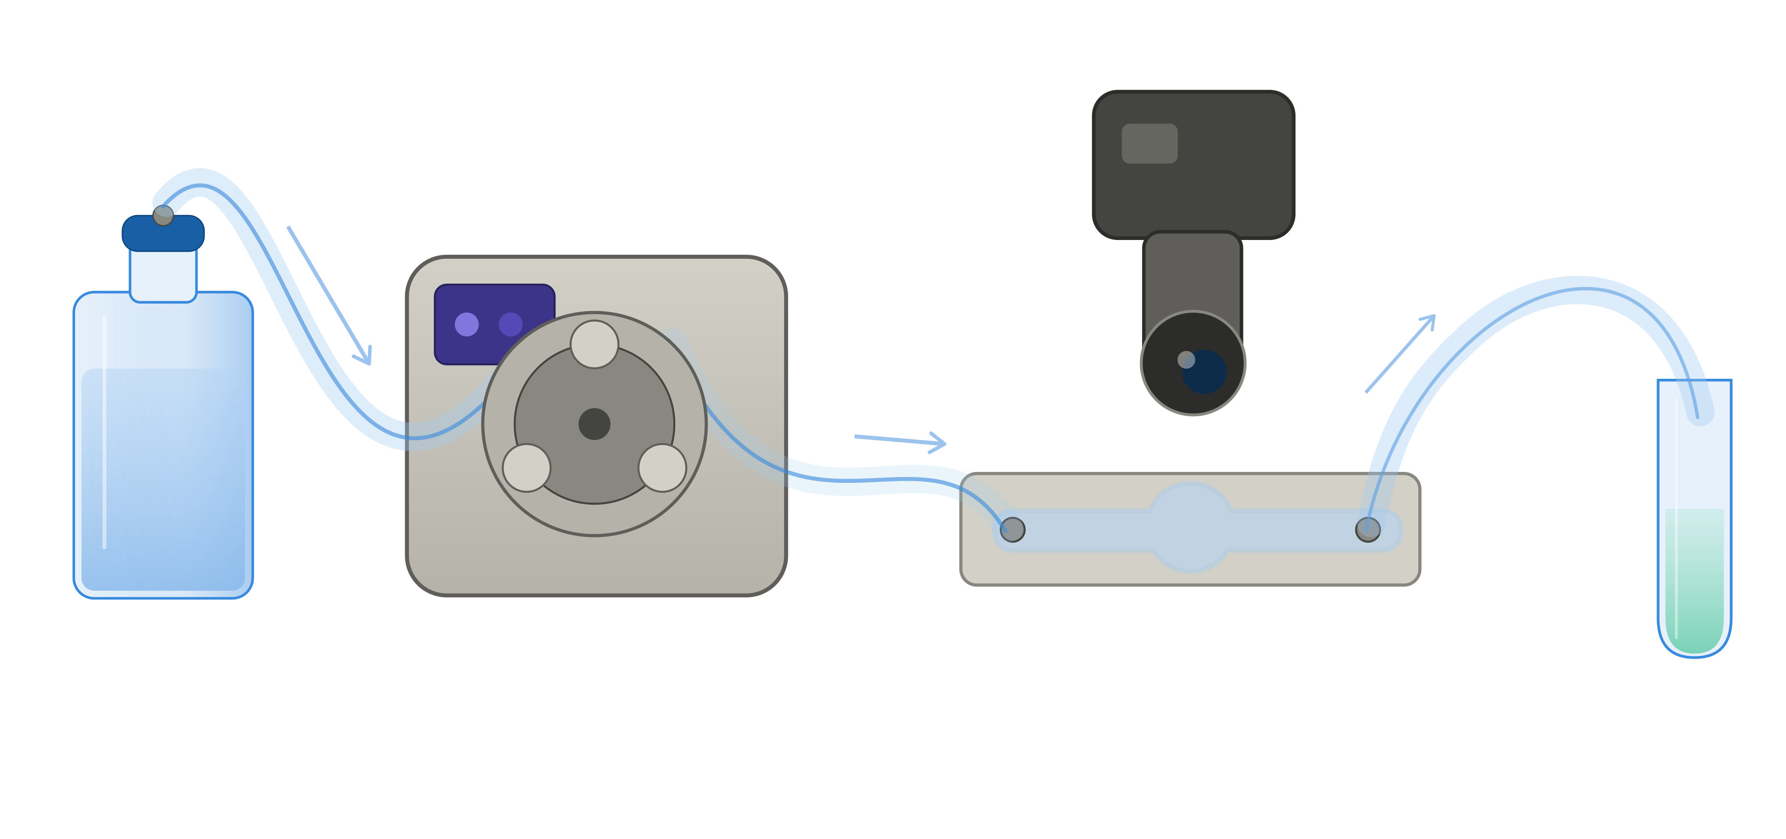
Development of Experimental SetUP For Biofilm formation
loisa.borde@ovgu.de
Camera
Image Analysis:
Growth Curve
HPLC:
Succinate and Sucrose Concentration (Carbon Sources)
10 g/l Sucrose
10 g/l Succinate
Salt solution
Phosphate buffer
Medium
Peristaltic pump
PDMS Device
Collection Tube
Rinse after Cultivation
Carbazole Assay: Alginate Quantification
Dried Biomass: Biomass Concentration

Slide 7
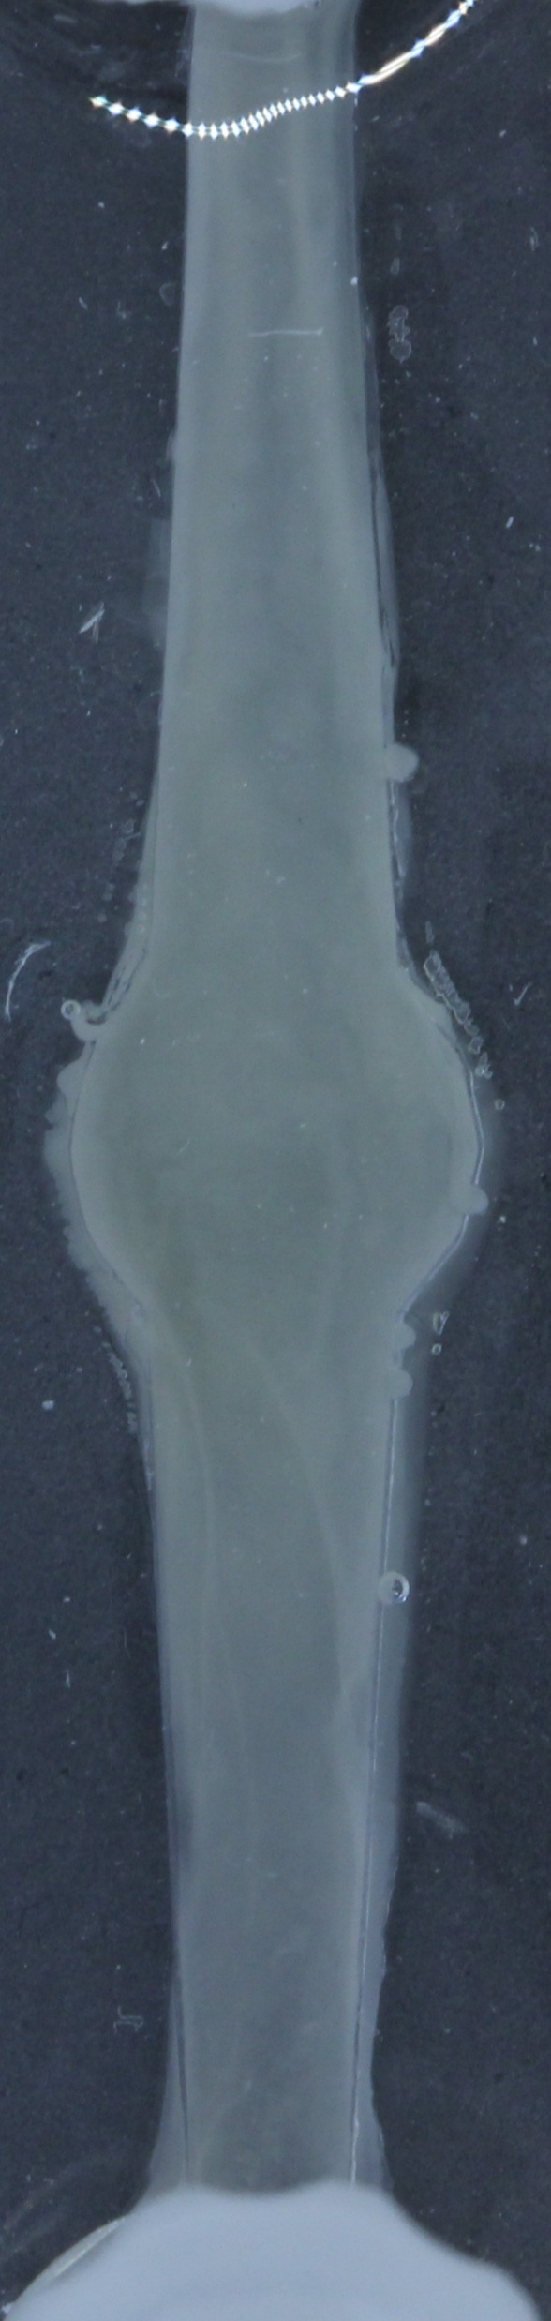
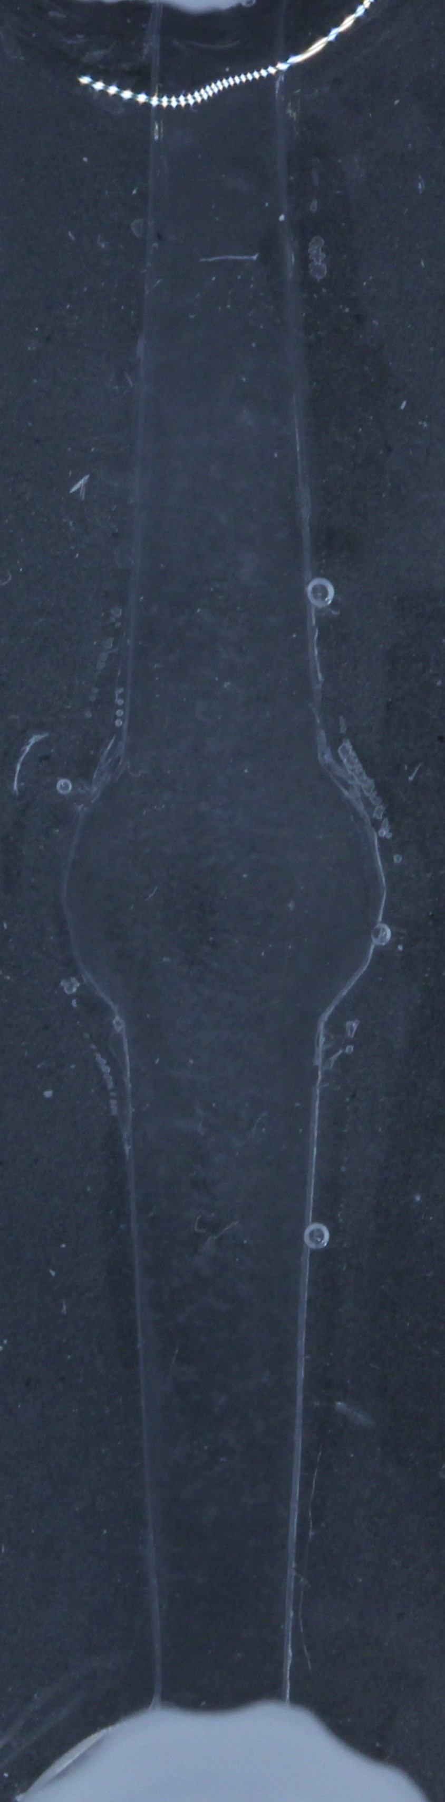
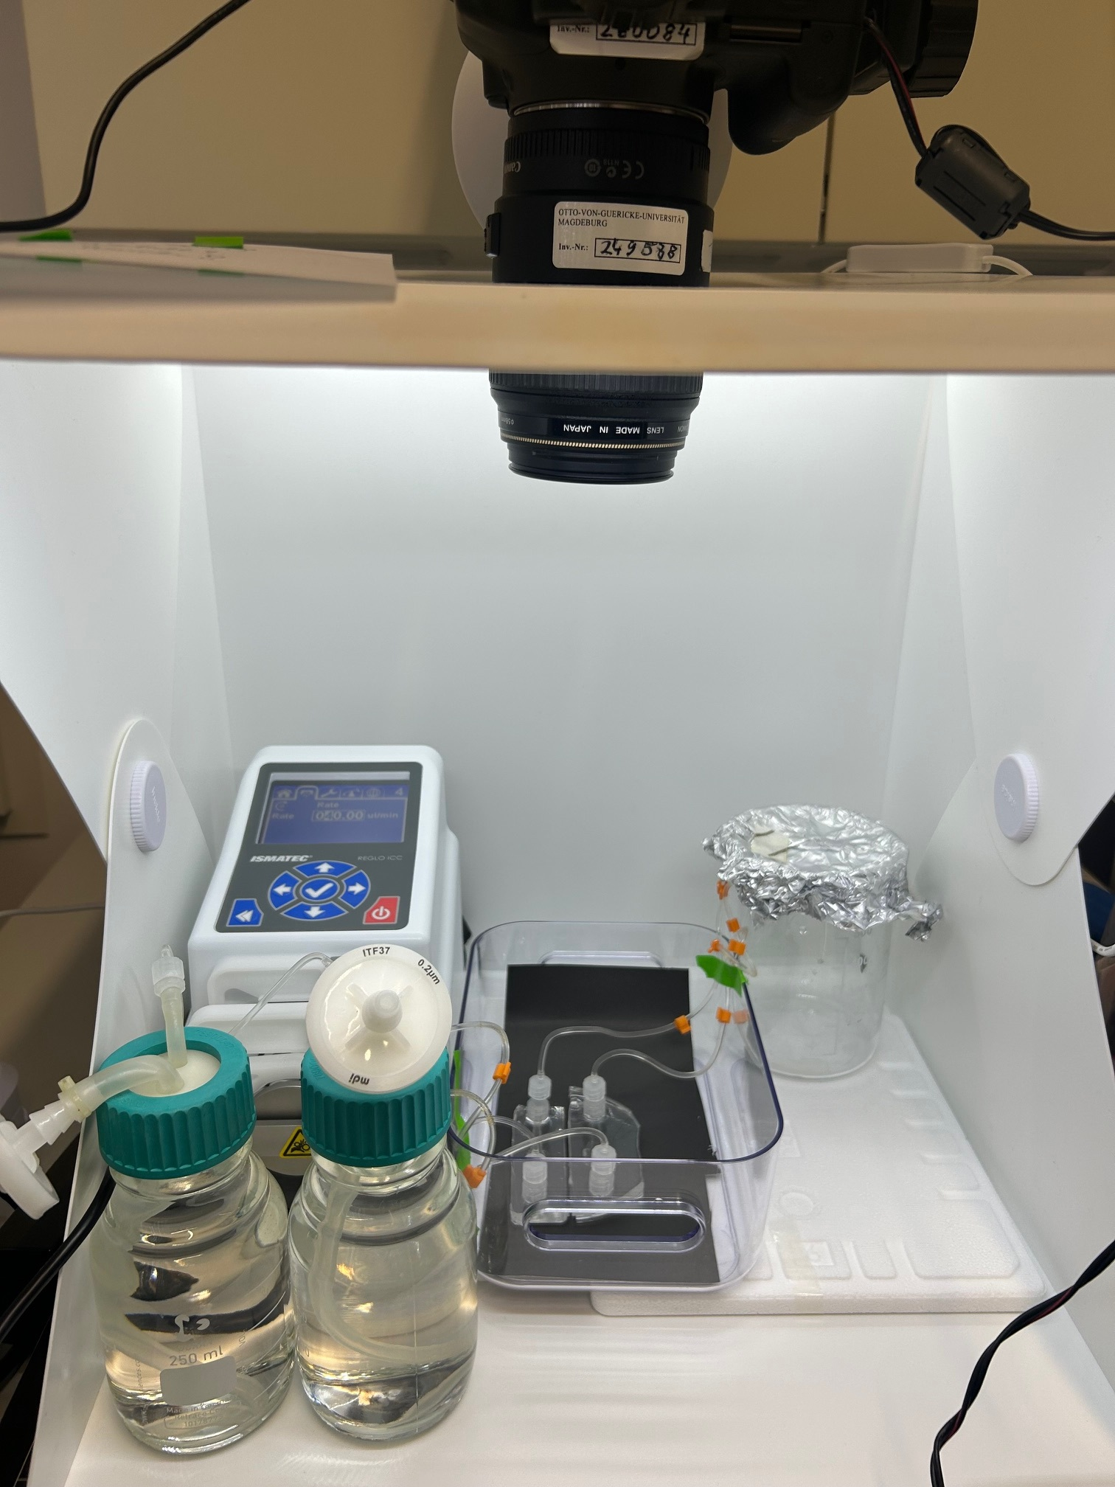
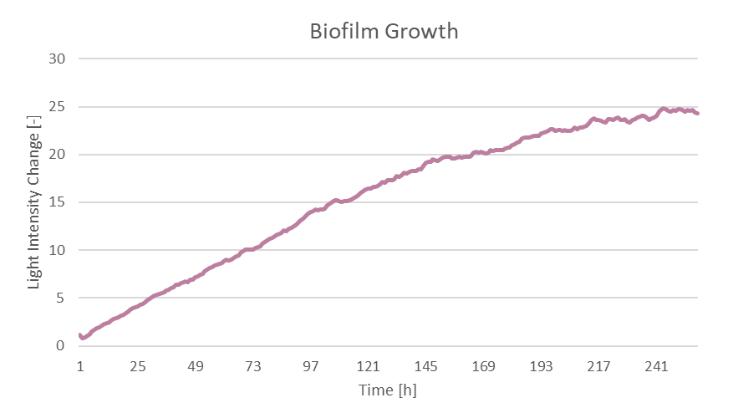
Image Analysis To Observe Biofilm Growth
loisa.borde@ovgu.de
Capture image every hour under constant lighting conditions
Calculate mean grey values of seven sectors for each image
Substraction of zero value
Light intensity change in relation to the zero value

Slide 8
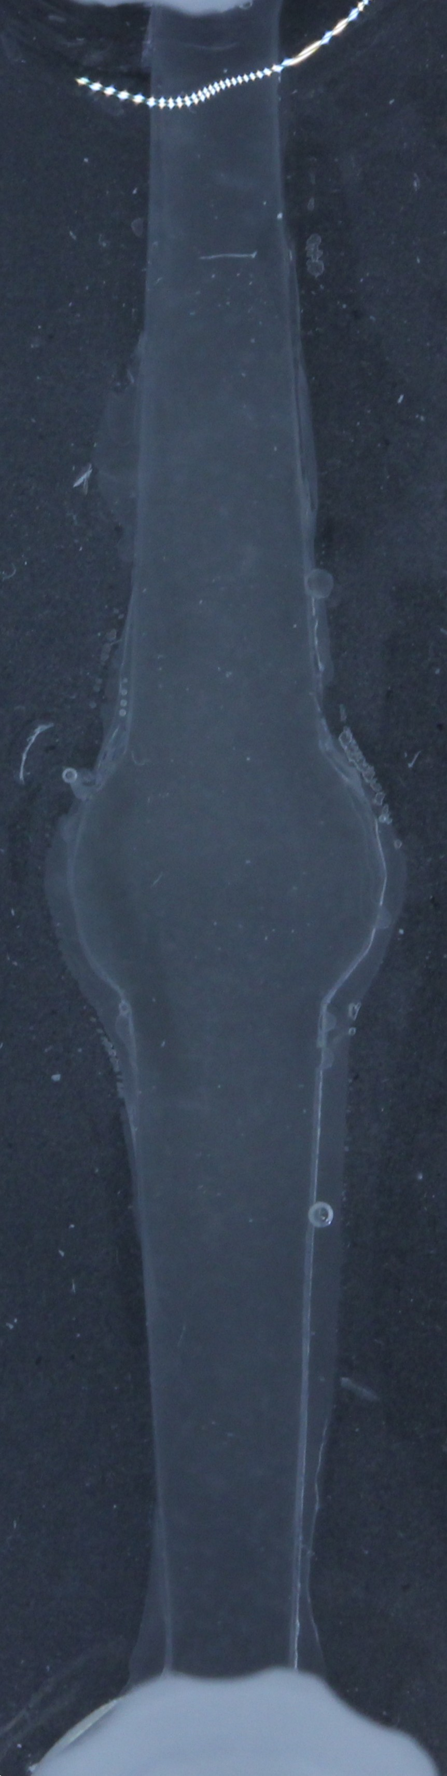
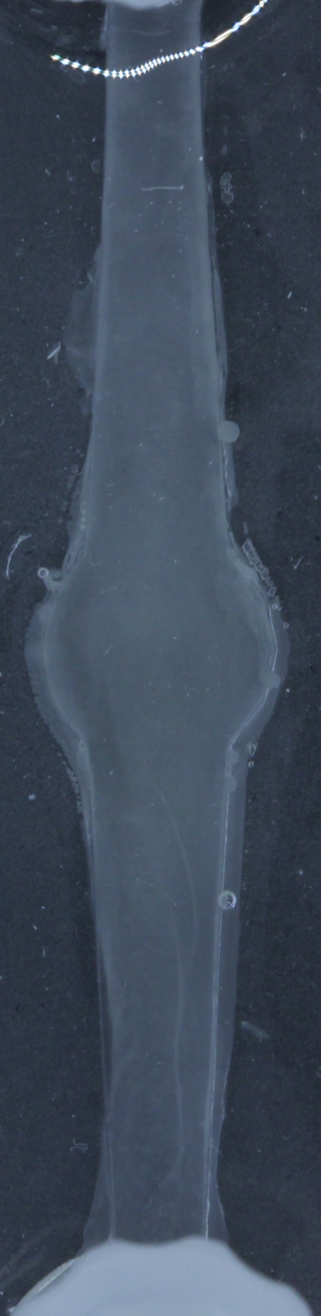
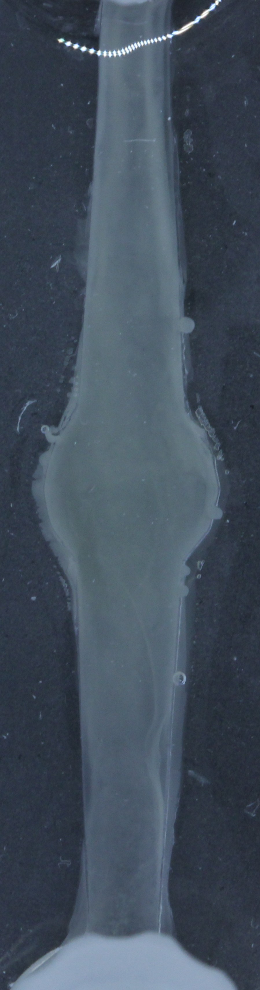
Biofilm Growth Observed in Microfluidic Devices
loisa.borde@ovgu.de
1 h
48 h
96 h
144 h
192 h
Continuous growth for 160 h, followed by slower growth
Stationary phase reached after 200 h

Slide 9
BioFilm Growth Depending on PDMS Thickness
loisa.borde@ovgu.de
PDMS: oxygen permeable
thinner PDMS-layer → higher oxygen availability → faster biofilm formation
→ Biofilm growth depends on oxygen availability

Slide 10
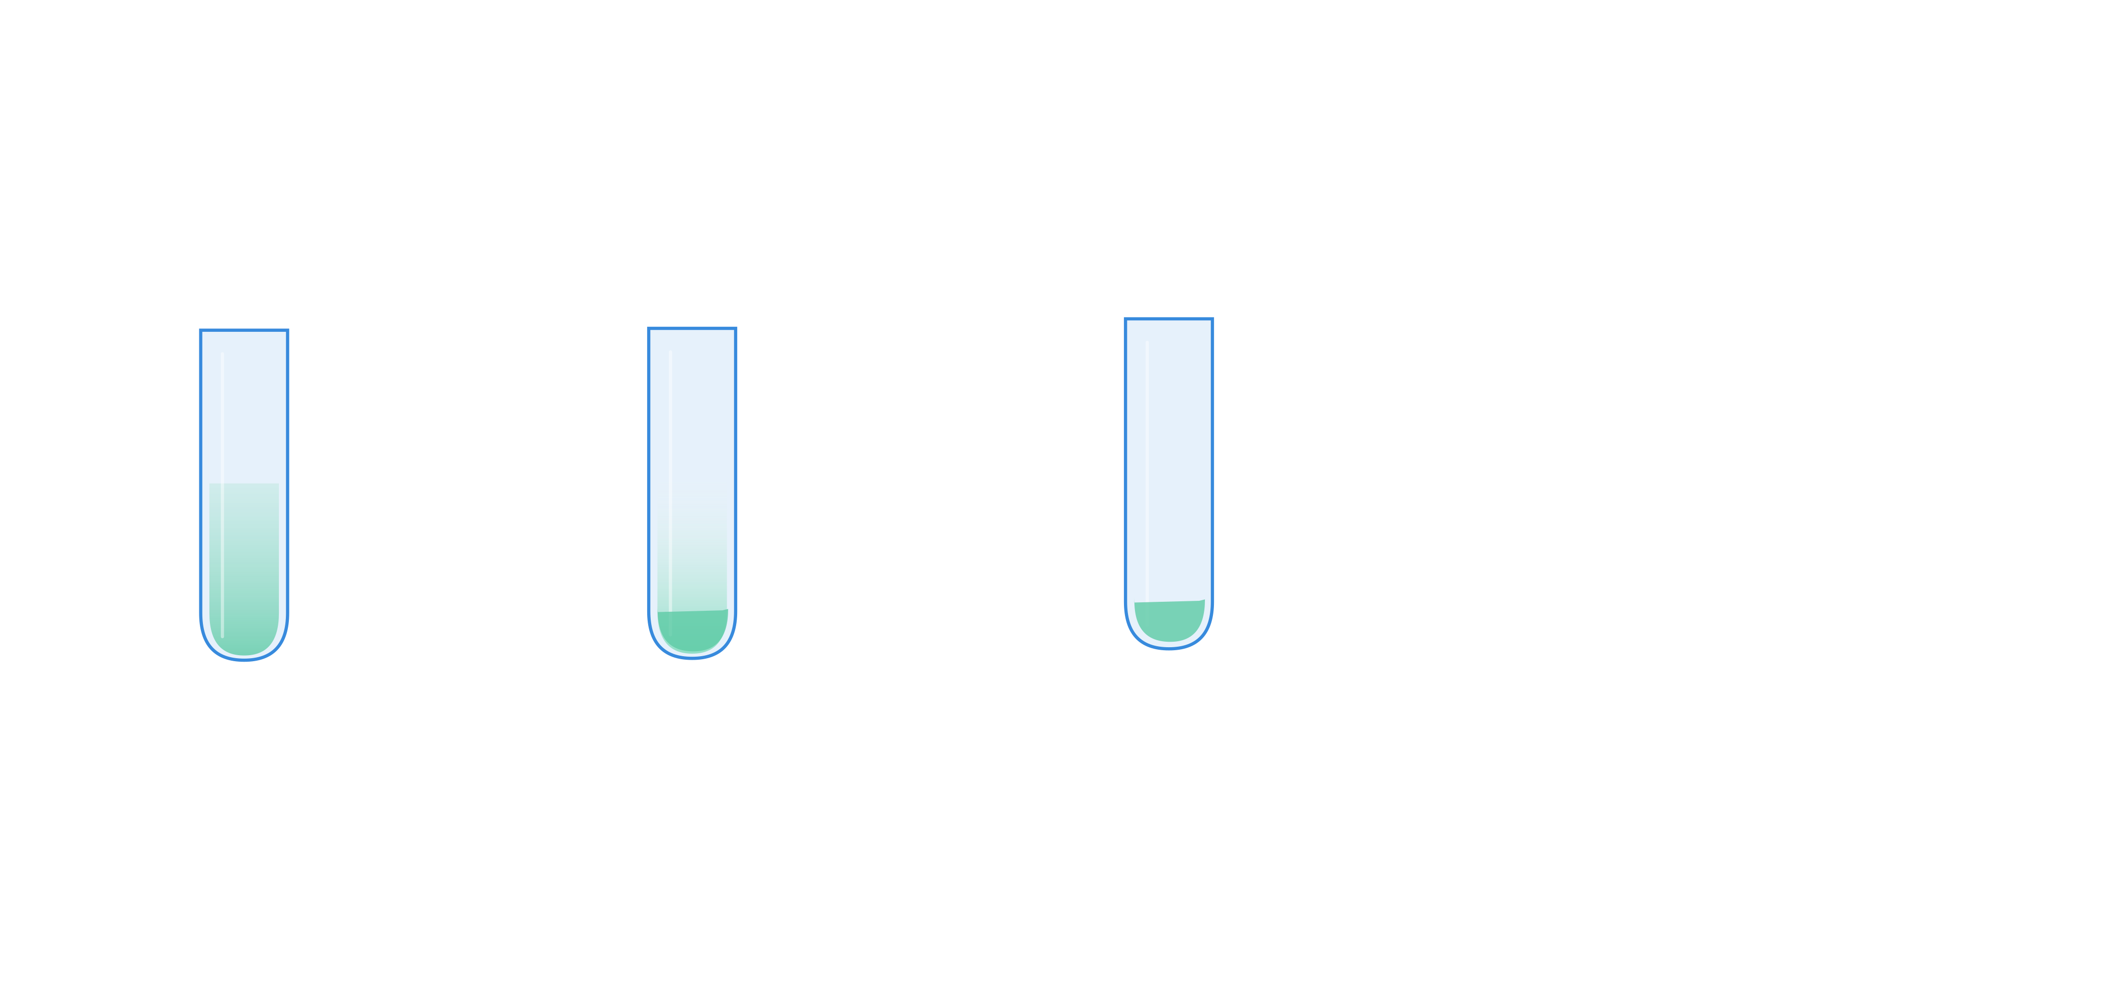
Experimental procedure to measure the biomass concentration
loisa.borde@ovgu.de
Biomass concentration (up to 17 g/l)
Workflow for biomass measurement
Rinse out biofilm at different time points → Calibration curve for biomass concentration depending on light intensity change
10.000 x g
10 min
wash pellet
80 °C
24 h
Biofilm Growth
250 h
Rinse after cultivation
Weigh dried biomass

Slide 11
Outlook
loisa.borde@ovgu.de
Improvement of currently used methods (measurement of substrates and alginate, calibration curve for calculation of biomass concentration)
Expansion of kinetic parameter measurement (oxygen content, pH-values, attachment and detachment of biofilms)
Model parametrization and validation based on experimentally derived kinetic parameters
Deeper understanding of biofilm formation depending on pore geometry and enhanced biopolymer production in biofilms growing in porous substrates

Slide 12
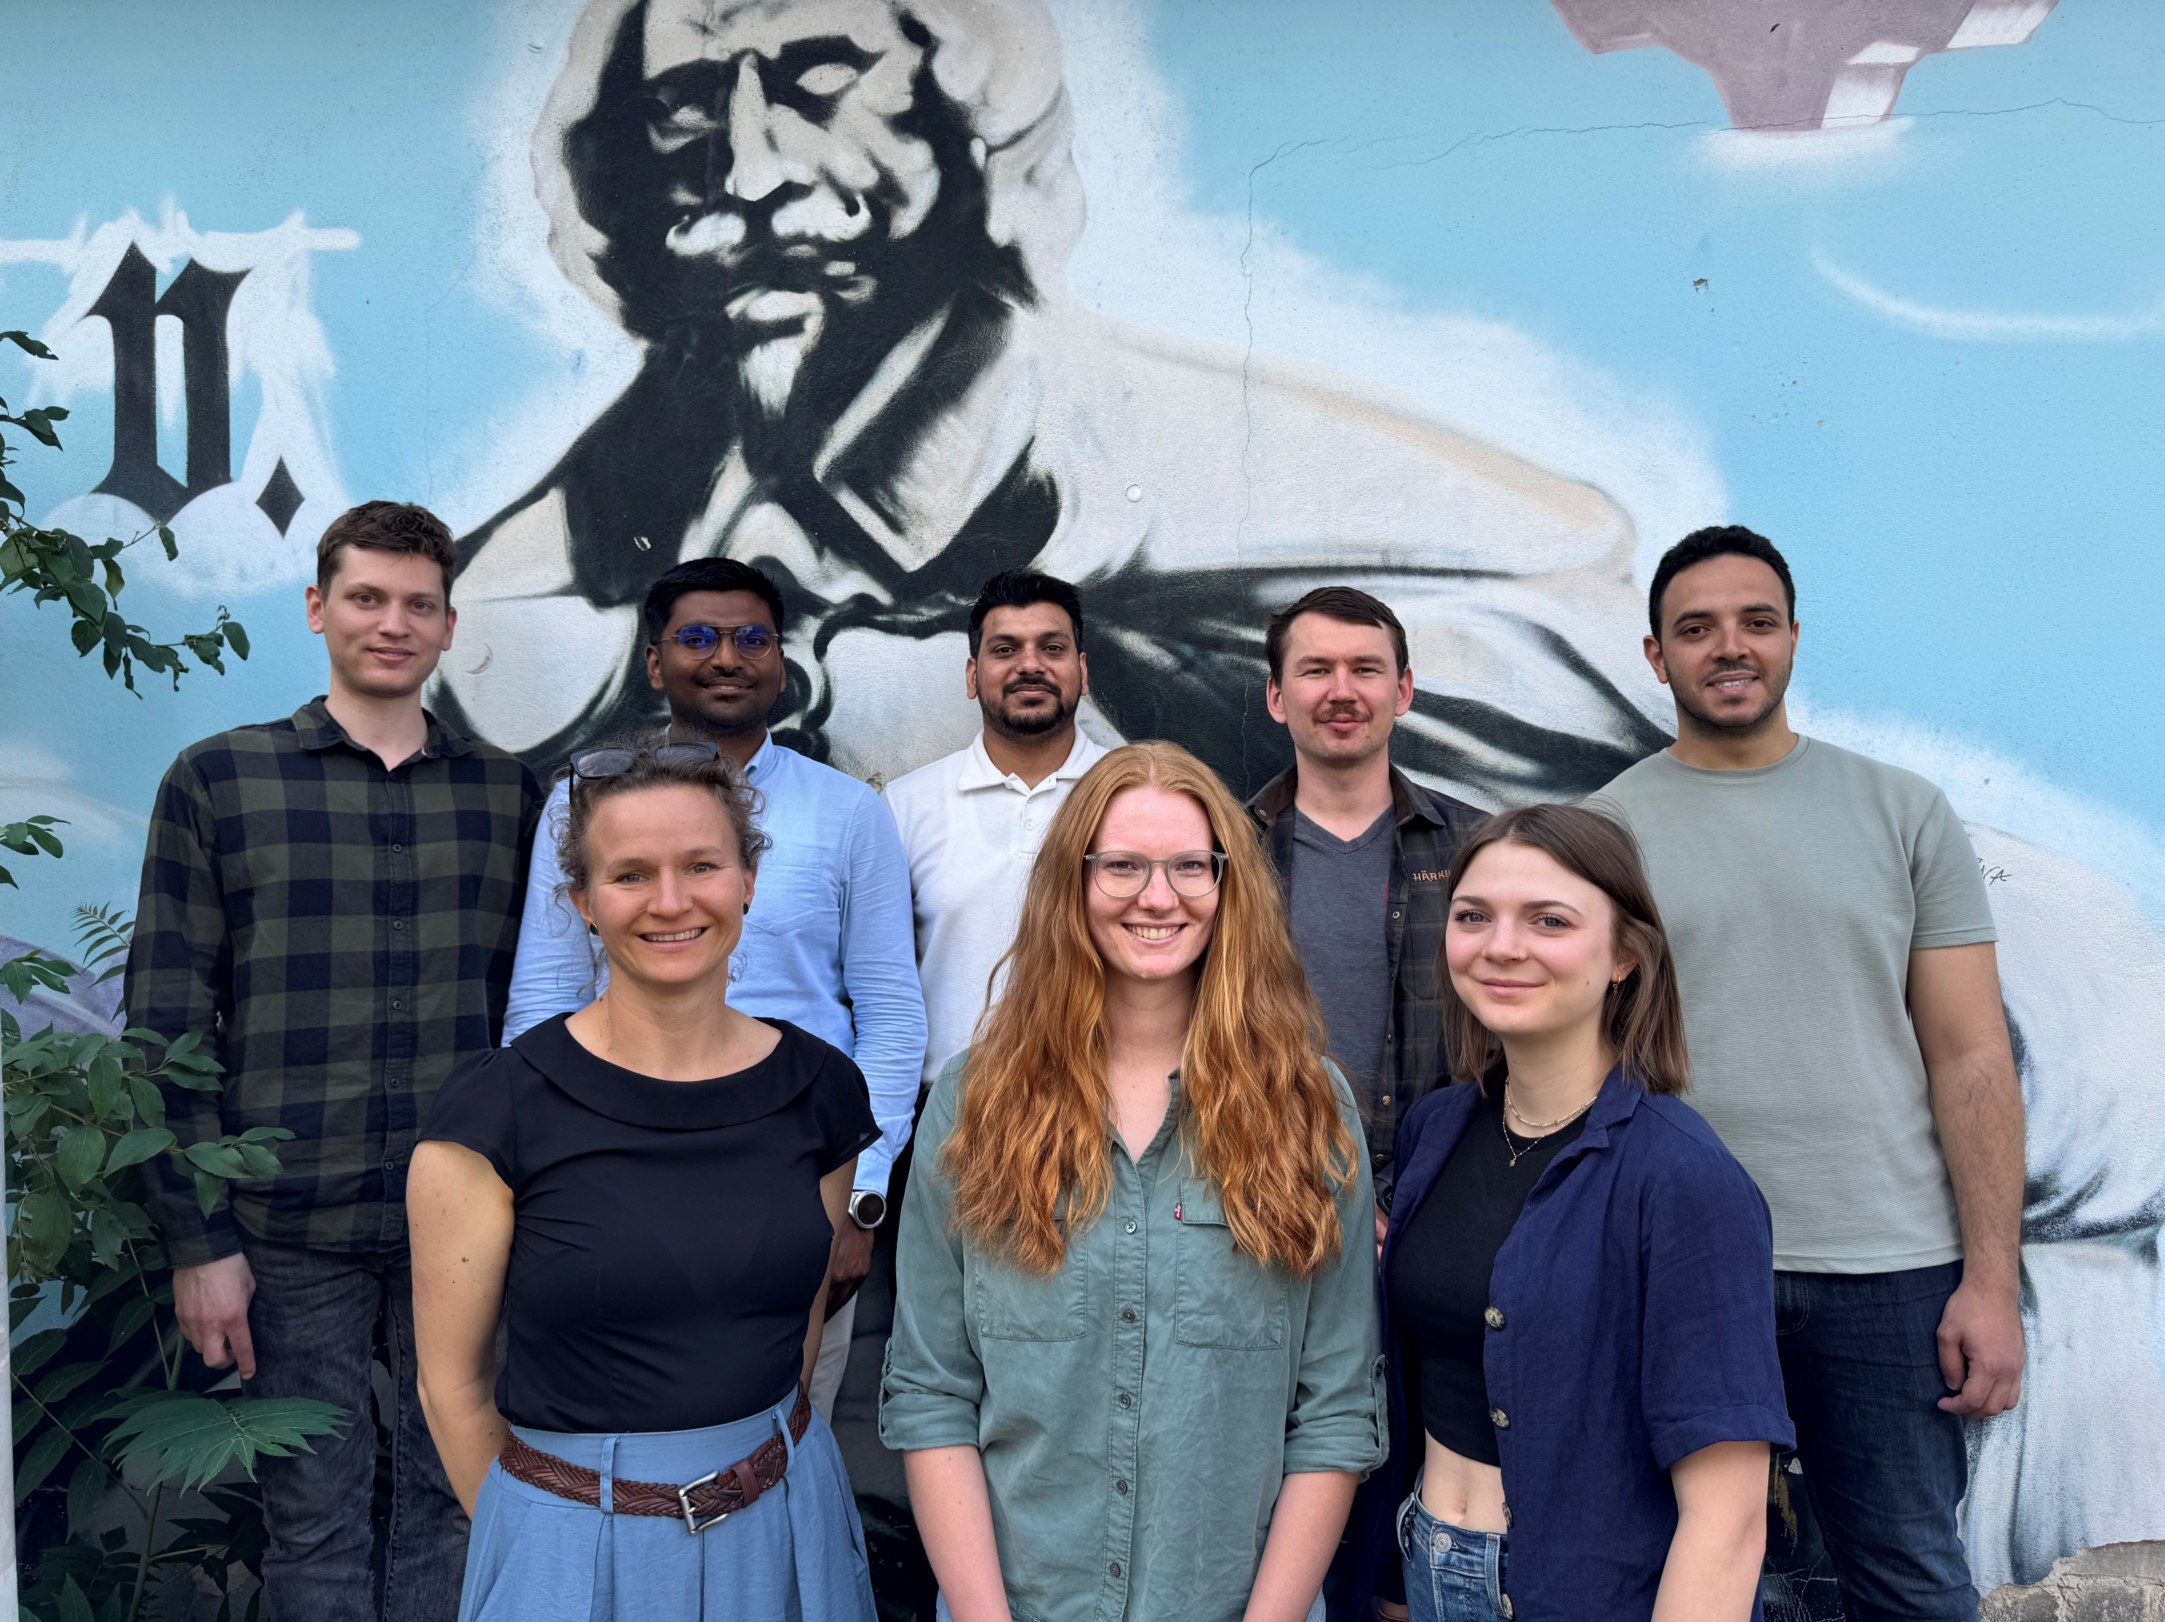
Thank you for your attention!
M. Sc. Loisa Borde
Institute of Process Engineering
Otto-von-Guericke University Magdeburg
Universitätsplatz 2
39106 Magdeburg
loisa.borde@ovgu.de
+49 (0) 391 67 50246
Many thanks to:
Dr. Nicole Vorhauer-Huget
Prof. Dr. Stefanie Duvigneau
Maike Werdin
Transport in porous media research group
Acknowledgement: The authors gratefully acknowledge the funding by the European Regional Development Fund (ERDF) within the programme Research and Innovation - Grant Number ZS/2023/12/182075.

Slide 13
References
Iain D. Hay, Zahid Ur Rehman, M. Fata Moradali, Yajie Wang, and Bernd H. A. Rehm. Microbial alginate production, modification and its applications. Microbial Biotechnology, 6(6):637–650, 2013. DOI: 10.1111/1751-7915.12076;
George E. Kapellos, Terpsichori S. Alexiou, and Stavros Pavlou. Chapter 8 - fluid-biofilm interactions in porous media. In Sid M. Becker and Andrey V. Kuznetsov, editors, Heat Transfer and Fluid Flow in Biological Processes, pages 207–238. Academic Press, Boston, 2015. ISBN 978-0-12-408077-5. DOI: 10.1016/B978-0-12-408077-5.00008-0;
Aamer, E., Faber, F., Bhaskaran, S. et al. Pore Network Model for Study of Biofilm Growth Limitations in Porous Substrata. Transp Porous Med 153, 12 (2026). DOI: 10.1007/s11242-025-02261-6

