Slide 1

Model Calibration and Prediction of Biogeochemical Processes in Porous Hydrogen Storage Birger Hagemann Clausthal University of Technology Nantes, May 20, 2026
Presented at:

Slide 2
Content
Introduction
Reactive transport model
Model calibration by experimental studies
Model validation
Conclusions & learnings

Slide 3
Introduction – Underground Hydrogen Storage
Underground hydrogen storage enables large-scale balancing of renewable energy
(Laminar) flow through the porous rock
Horizontal dimension much larger than vertical dimension
Flow predominantly in horizonal direction
Mobile water might be present
Two-phase flow
Schematic structure of a pore storage
(Source: Adapted from Katz & Lee (1990))

Slide 4
Introduction – Relevant transport and reactive processes
H₂
During and after injection
Advective flow and mechanical dispersion in high permeable layers
Molecular diffusion in lower permeable (water-saturated) layers
Microbial reactions:
e.g. methanogenesis:
and sulfate reduction:
CH₄
caprock
CH₄
H₂
H₂
H₂
storage rock
H₂
H₂
H₂
CH₄
CH₄
underlying rock
During and after withdrawal
H₂
caprock
H₂
H₂
H₂
CH₄
CH₄
storage rock
CH₄
CH₄
H₂
H₂
H₂
underlying rock
Molecular diffusion
Mechanical dispersion
Microbial reaction
Adapted and extended from Arekhov et al. (2023)

Slide 5
Reactive transport model – Assumptions and scales
Various physical, chemical and biological processes on different time and length scales
Upscaling to Darcy scale by using a representative elementary volume:
Further assumptions:
Kinetic consideration of bio-reactions
Thermodynamic equilibrium for dissolution/vaporization
Continuum scale for lab and field scale simulation

Slide 6
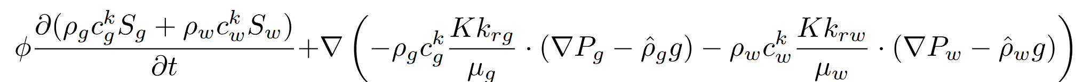
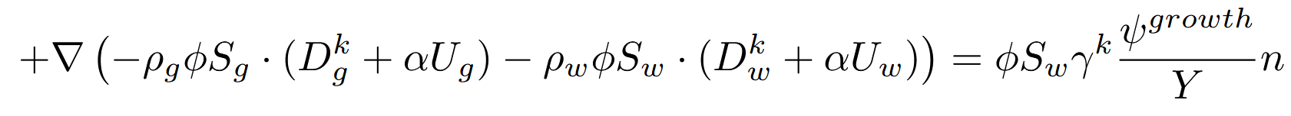
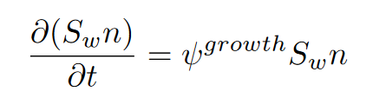
Reactive transport model – Equations
Multicomponent two-phase (gas – water) reactive transport model based on Darcy’s law:
Population dynamics for microbial species:
Numerically implemented in DuMu^{x}
Advective flow/transport
Diffusive and dispersive transport
Bio-reactions
Microbial growth

Slide 7
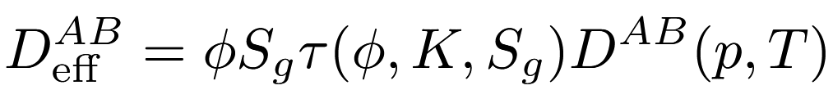
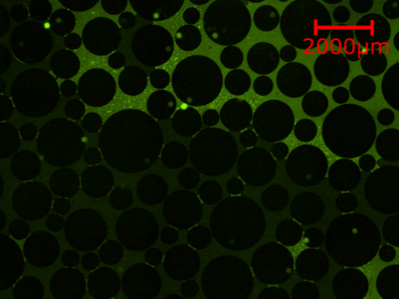
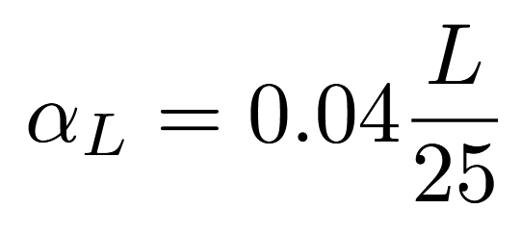
Model calibration by experimental studies
Effective molecular diffusion coefficients
Measurements on over 50 real rock samples under reservoir conditions
Development of a correlation for simulation models:
Mechanical dispersivity
~20 measurements using a 25 m slim tube coil filled with porous material under reservoir conditions
Development of a correlation for simulation models:
Microbial growth and reaction kinetics
Observations of microbial behavior using a microfluidic setup with methanogenic archaea and an H₂/CO₂ gas mixture
Development of a new model for growth and reaction kinetics
Range of effective diffusion coefficients
Microscopic image of the gas-water saturated pore space partially populated with microbes

Slide 8


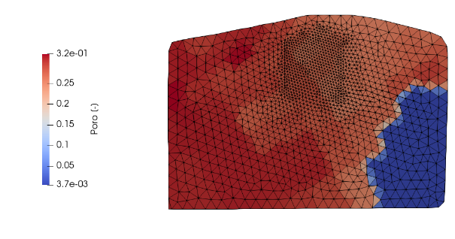
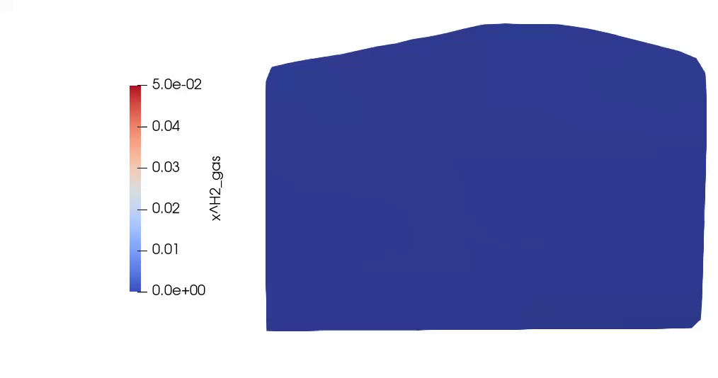

Model validation by field test data
H₂
Near-wellbore region around the operational well
Investigation of layered model realizations
Main calibration parameters
Mechanical dispersivity ($αL$)
Reaction kinetic parameters
No flow BC (Neumann)
Open BC (Dirichlet)
No flow BC (Neumann)
CO₂
Open BC (Dirichlet)
Single-layered
Multi-layered
Reservoir
K=K, φ=φ, S_{w}=0.15
Reservoir
K=0.4 ∙ K, φ=φ, S_{w}=0.5
H₂S
K=1.6 ∙ K, φ=φ, S_{w}=0.15

Slide 9
Conclusions & Learnings
A mathematical model for the bio-reactive two-phase flow in UHS was developed and numerically implemented
Different laboratory measurements are applied for calibrating and improving the model
Gas mixing effects: Effective diffusion coefficients and mechanical dispersivities
Microbial growth and reaction kinetic function and empirical coefficients
Multi-layer reservoir characteristics are important during initial filling and early H₂ cycling
In high-permeability rocks, mechanical dispersion can dominate over molecular diffusion even at low flow velocities
In low-permeability, water-saturated rocks, molecular diffusion is the dominant transport mechanism
Model validation through history matching with field data is ongoing
Numerical diffusion/dispersion should be minimized but is challenging to be reduced below physical levels
Measurement uncertainties (lab and field) must be considered
Model calibration should not exceed data accuracy limits

Slide 10


Thank you for your attention!

Slide 11
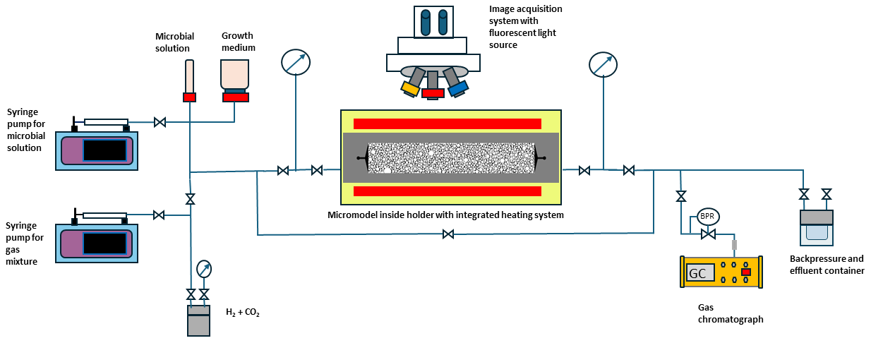
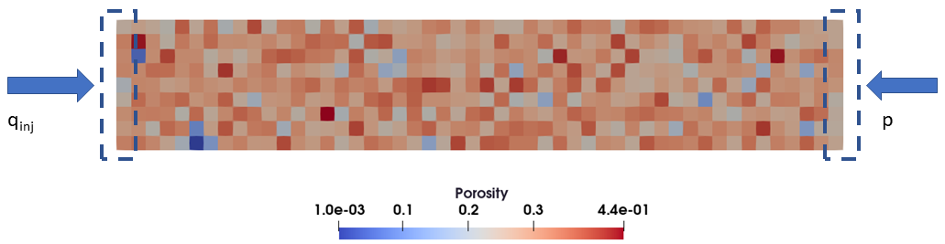
Experimental setup and procedure
Dynamic experiments using methanogenic archaea and a H₂-CO₂ gas mixture
Preparation of a 5 ml nutrient-microbial mixture
Attain a liquid-phase saturation inside the micromodel
Inject 5 bar pressurized H₂-CO₂ into the micromodel
Divert gas flow to the gas chromatograph
Maintain constant injection rate of 2.8 µl/min
Repeated gas composition measurement and image acquisition of microbial count
50 mm
9 mm

Slide 12

Microbial growth and metabolic reactions
Double Monod model extended by population limit function to describe microbial growth
Population limit function
Metabolic reaction rate

