Slide 1


x10
x50
x100

Slide 2
Experimental Micromodel Approaches for Capturing Biogeochemical Interactions in UHS Systems
Frank E. Viveros
Na Liu, Martin Fernø

Slide 3
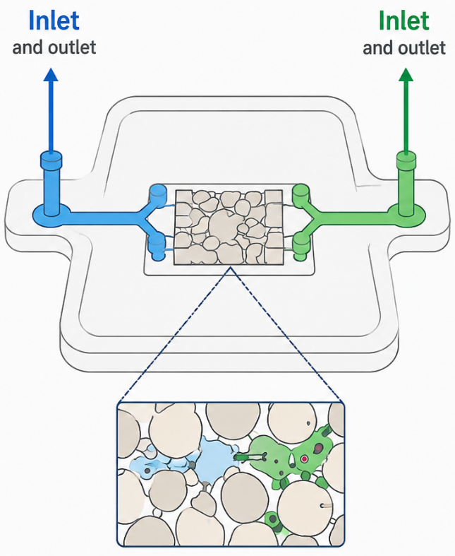
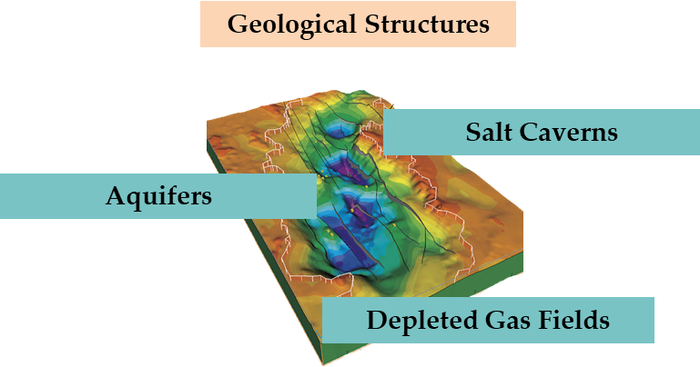
Choosing the Right Window into the Subsurface
H₂ Value Chain
A small window into a big subsurface problem
Storage
Precise control of fluids
Visualization of microscale process
monitor chemistry and flow in real time
Key question: how do we study what happens underground?

Slide 4
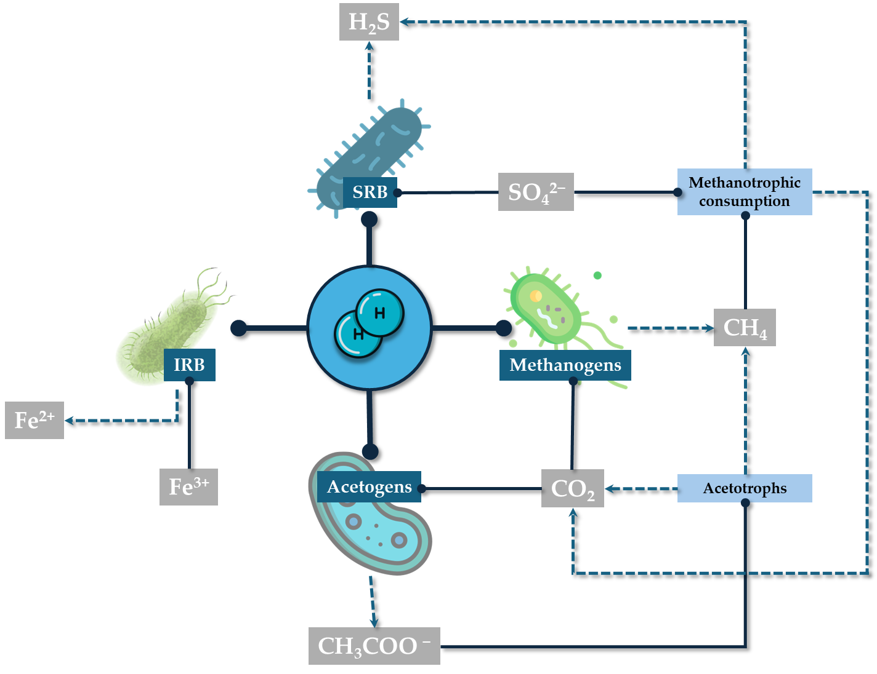
Electron flow from H₂: Microbial networks in UHS
e-
B
e-
e-
Reduced
compound
A
e-
Reduced compound
B
Oxidized compound
A
Oxidized
compound
Bacteria consume H₂ (A) as electron donor and reduce sulfate (B) as electron acceptor via
redox metabolism.
Microbial interactions in porous media using H₂ for their metabolic pathways.

Slide 5



Beyond Microbes: Minerals team up to boost H₂ Consumption
BioGeoChemical interactions
Sulfide minerals
Hydrogen
Microorganism
Where the raw material come from?
$${SO}_{4}^{2−}+4H_{2}+{2H}^{+}\text{⇌} H_{2}S+4H_{2}O$$
Electron acceptor
Electron donor
Effects on the medium
Sulfate reduction coupled to H₂ oxidation leads to microbial H₂ consumption and H₂S generation.
$$\text{Change} \text{petrophysical}$$
$$\text{properties}$$
$$Clogging and corrosion$$
$$Gas loss$$
$$Gas composition changes$$
Can subsurface H₂ storage remain secure in the presence of this interactions?

Slide 6
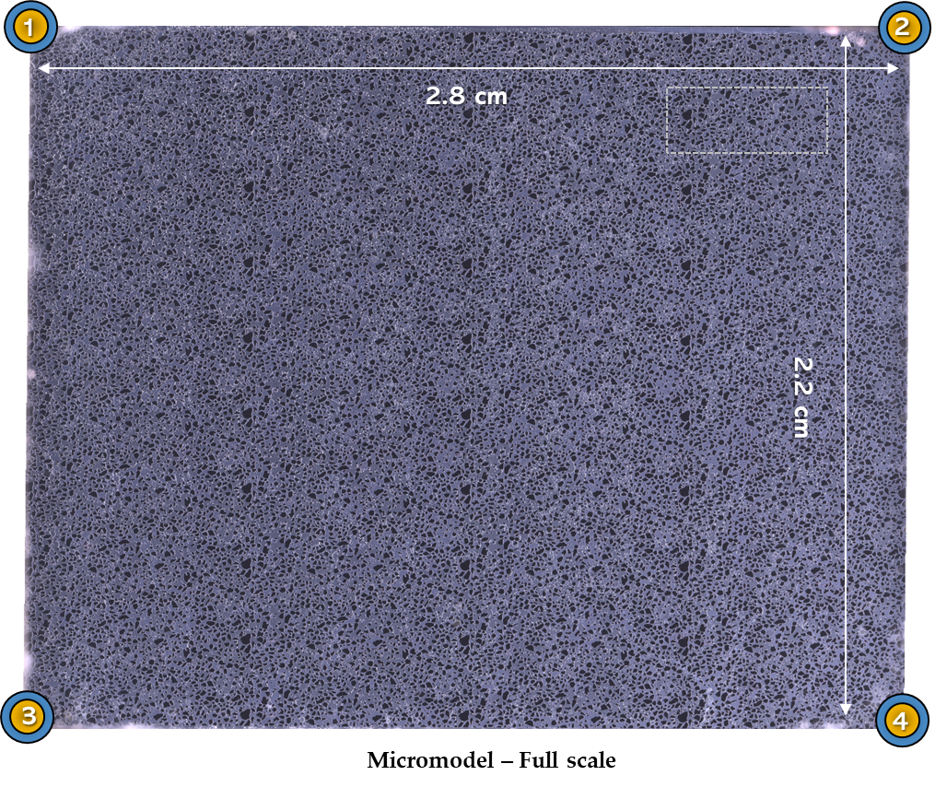
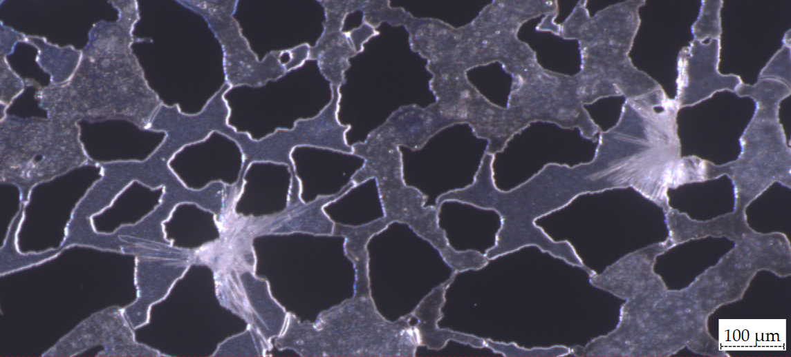
Pore-scale experimental setup (Microfluidic system)
CaSO₄ + SRB + H₂
Mineral (Gypsum_CaSO₄)
Microbial solution (SRB_Oleidesulfovibrio alaskensis G20)
Gas phase (H₂)
H₂
MS
Sulfate
Petrophysical properties
Porosity (%) | ~60
Permeability (mD) | 2.9
Av. Grain size (um) | 99.3
Operational conditions: 10.7 bar and 37 ºC
Grains
Multiphase system
Gas | Liquid | Rock | Mineral
GLRM
MS: Microbial Solution

Slide 7
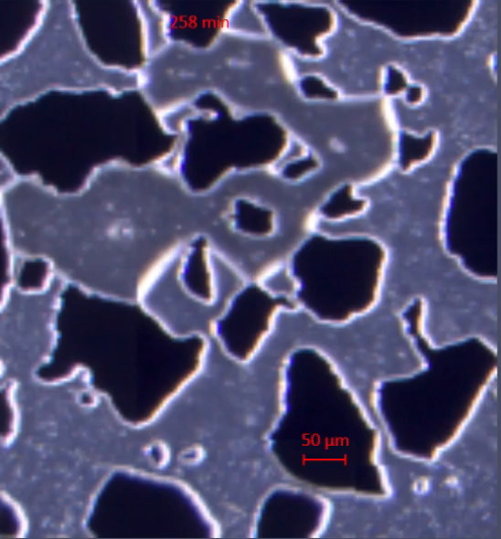
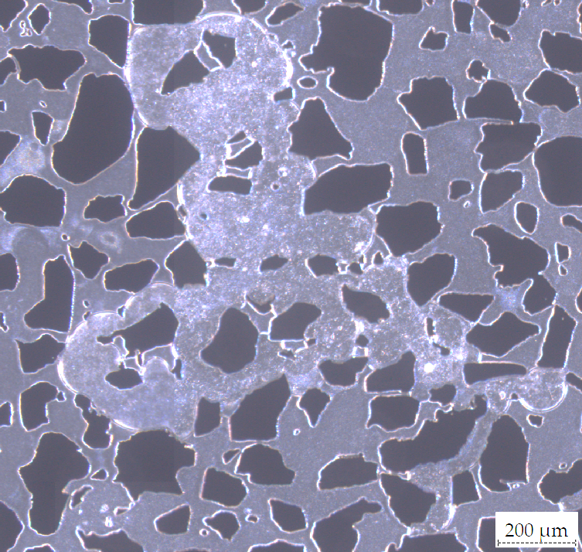
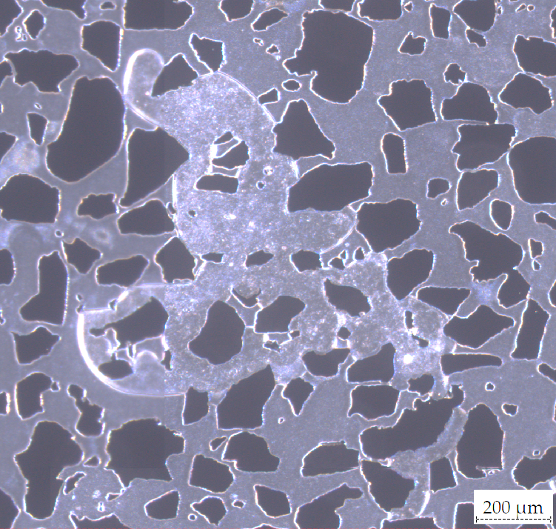
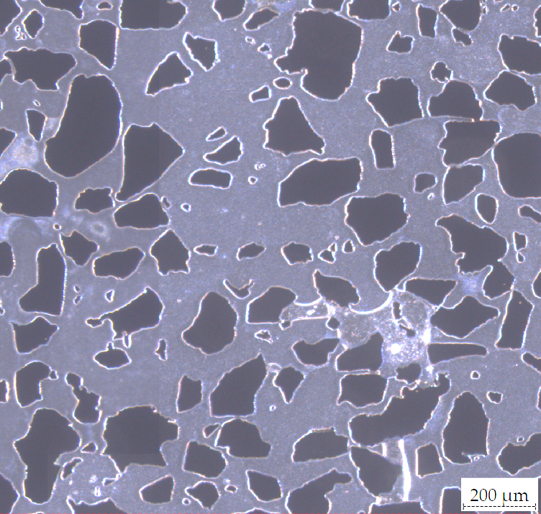
Gas consumption
H₂
MS
t_0h_Initial stage
t_10h_Gas consumption
t_26h_Final stage
The images show progressive gas depletion, with isolated pockets disappearing more readily than pockets connected to the main gas network.
t_0h - 9h _Gas Consumption
MS: Microbial Solution

Slide 8
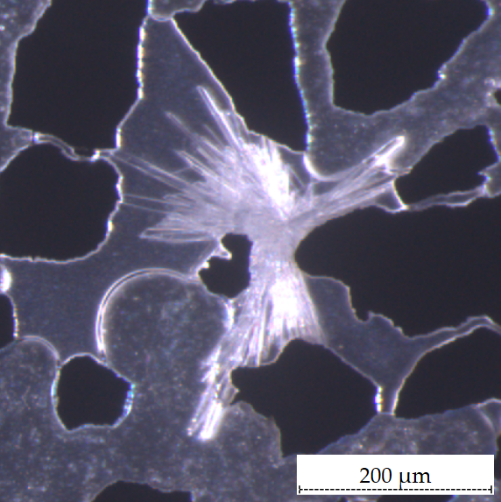
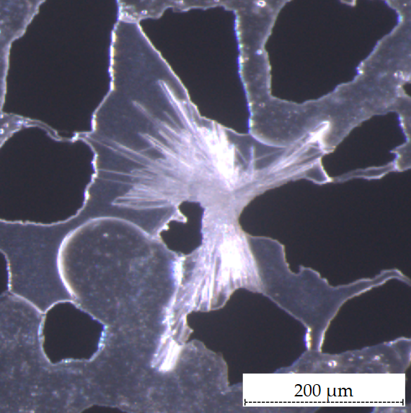
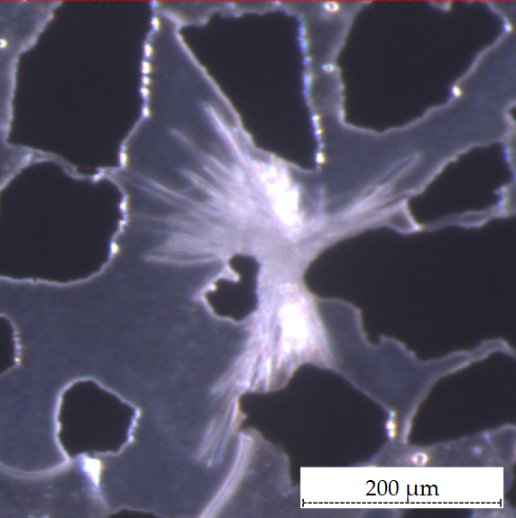
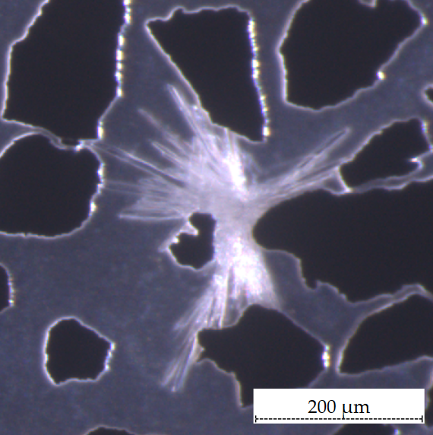
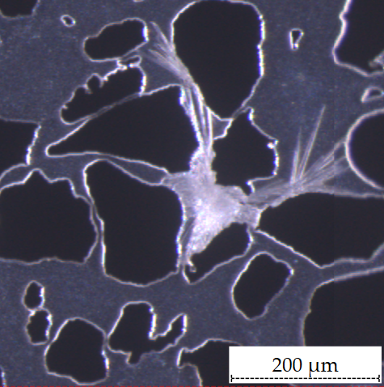
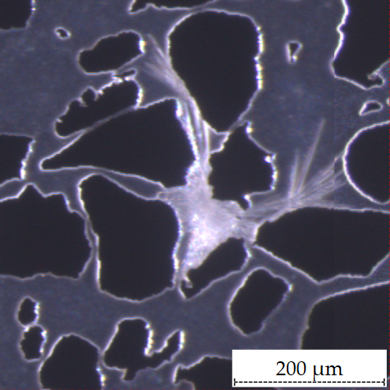
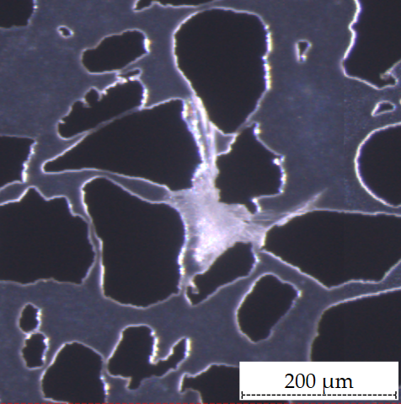
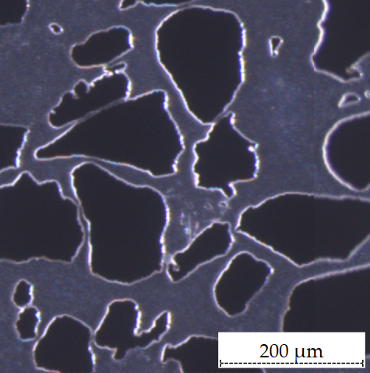
Mineral dissolution
Mineral with gas around
The disolution start once the gas had been consume. After 59 hour, the rate consuption is lower than mineral consumption at the beginning of the experiment in a mineral expose.
t_0h_Initial stage
t_33h_Initial stage
t_59h_Initial stage
t_149h_Initial stage
Mineral with no gas around
The disolution start after 6h and have a hight disolution rate after 15h. This can be comparable with the nucleation point.
t_0h_Initial stage
t_6h_Start of disolution
t_15h_Start of disolution
t_25h_Final disolution stage

Slide 9
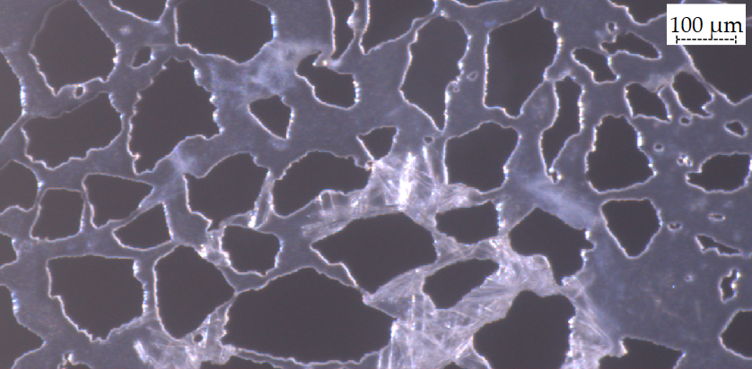
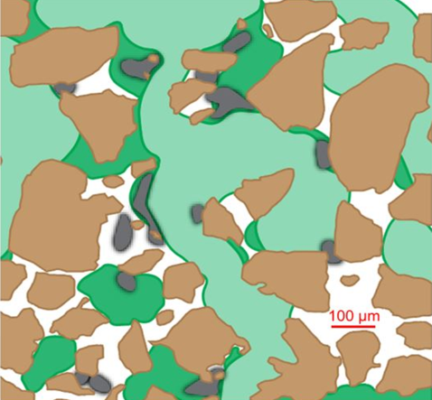
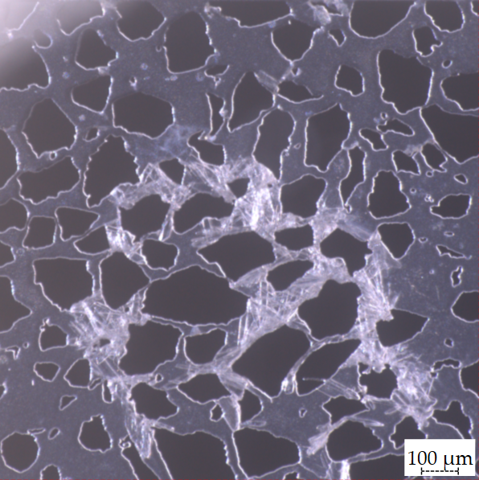
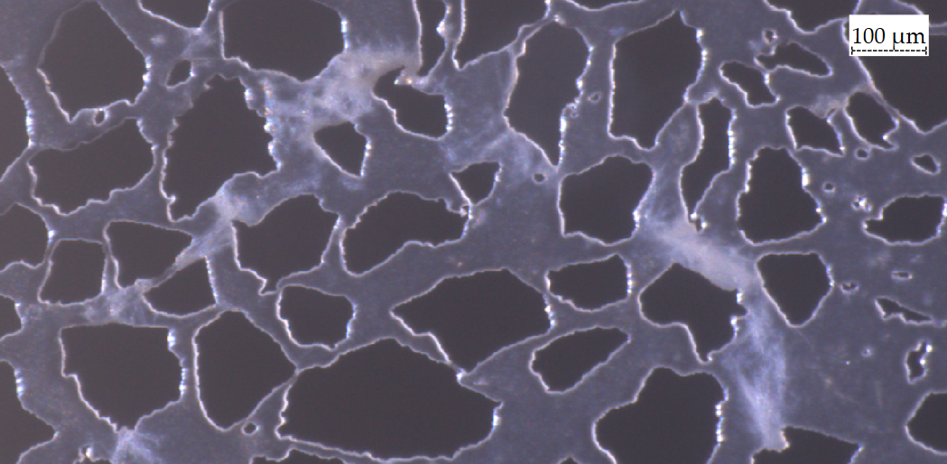
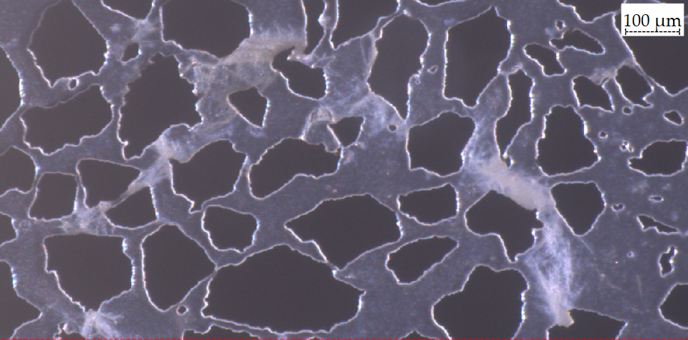
Biofilm formation
t_39h_Mineral dissolution and biofilm formation
t_33h_Mineral consumption and biofilm formation
t_59h_Biofilm formation
[7] Na Liu et al. 2025
The presence of biofilms caused by bacterial attachment to minerals changes the initial flow injection patterns.
Dark green: initial H₂ injection without biofilms
Light green: H₂ injection with biofilm presence.
t_59h_Biofilm formation and maturation

Slide 10

Take home-message
Minerals are key players in UHS. They shape microbial behavior which produce chemical reactions that altered how much H₂ is lost and safe storage can remain.
H₂ loss depends on flow paths and microbial environment.
Mineral can modify SRB activities.
Gypsum influences the formation of biofilms.
In short:
Hydrogen is a fuel, microbes decides its "fate" and mineral set the stage.

Slide 11




Acknowledgments
The project is supported by the Clean Hydrogen Partnership and its members. Co-funded by the European Union under Grant Agreement
No. 101192337 — HyDRA.

Slide 12
References
[1] Alanazi, A., Ye, J., Afifi, A., & Hoteit, H. (2024, February). Underground hydrogen storage in Saudi Arabia: opportunities and challenges. In International Petroleum Technology Conference (p. D031S097R003). IPTC.
[2] Liu, N., Kovscek, A. R., Fernø, M. A., & Dopffel, N. (2023). Pore-scale study of microbial hydrogen consumption and wettability alteration during underground hydrogen storage. Frontiers in energy research, 11, 1124621.
[3] Hellerschmied, C., Schritter, J., Waldmann, N., Zaduryan, A. B., Rachbauer, L., Scherr, K. E., ... & Loibner, A. P. (2024). Hydrogen storage and geo-methanation in a depleted underground hydrocarbon reservoir. Nature Energy, 9(3), 333-344.
[4] Dopffel, N., Mayers, K., Kedir, A., Alagic, E., An-Stepec, B. A., Djurhuus, K., ... & Hoth, S. (2023). Microbial hydrogen consumption leads to a significant pH increase under high-saline-conditions: implications for hydrogen storage in salt caverns. Scientific Reports, 13(1), 10564.
[5] Boon, M., Buntic, I., Ahmed, K., Dopffel, N., Peters, C., & Hajibeygi, H. (2024). Microbial induced wettability alteration with implications for Underground Hydrogen Storage. Scientific reports, 14(1), 8248.
[6] Liu, N., & Fernø, M. A. (2025). Calcite-functionalized microfluidic chip for pore scale investigation of biogeochemical interactions in porous media. Lab on a Chip, 25(10), 2320-2324.
[7] Liu, N., Ostertag-Henning, C., Fernø, M. A., & Dopffel, N. (2025). Growth on hydrogen by the sulfate-reducing Oleidesulfovibrio alaskensis induces biofilm dispersion and detachment─ implications for underground hydrogen storage. Environmental Science & Technology, 59(14), 7095-7105.

Slide 13
uib.no

Slide 14





Impact of microbial reactions on UHS in porous media
Determine microbial kinetics across European geochemical characteristics.

Slide 15
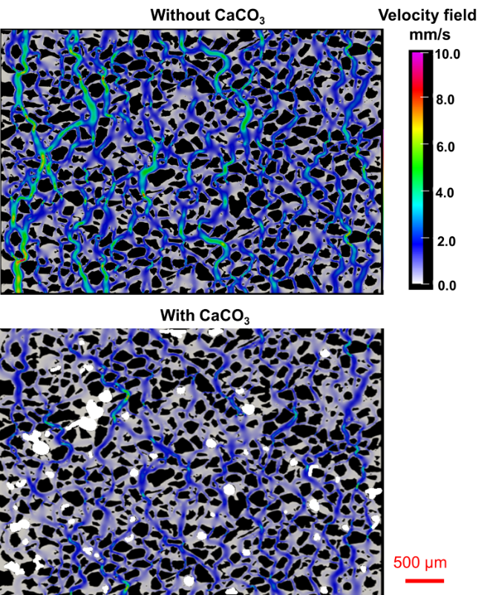
Effect of minerals on flow velocity
(Microfluidic system)
[6] Na Liu et al. 2025
No minerals
With minerals

Slide 16
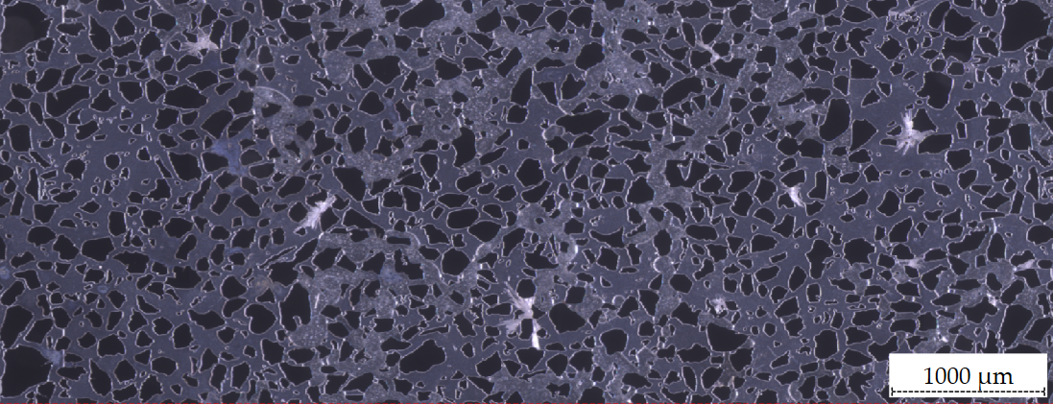
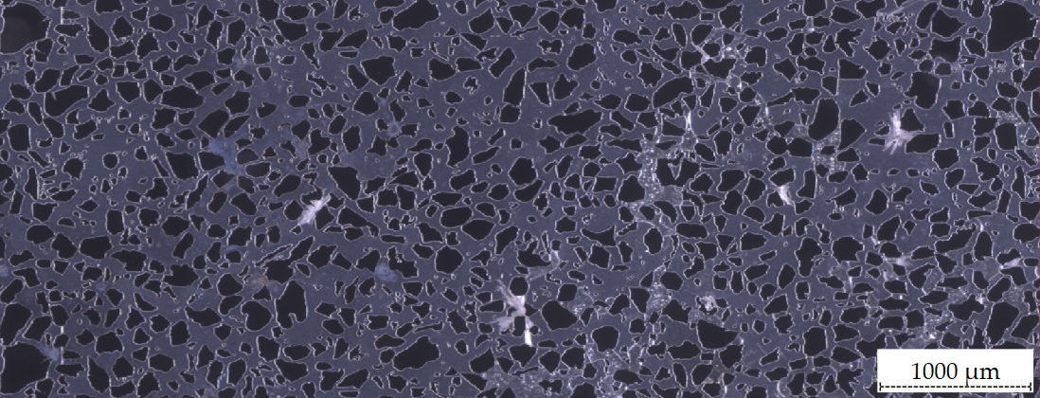
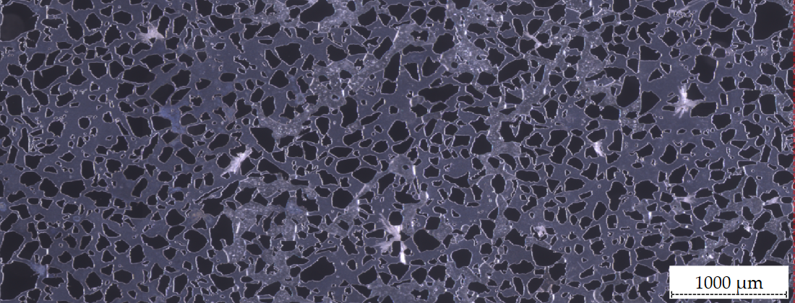
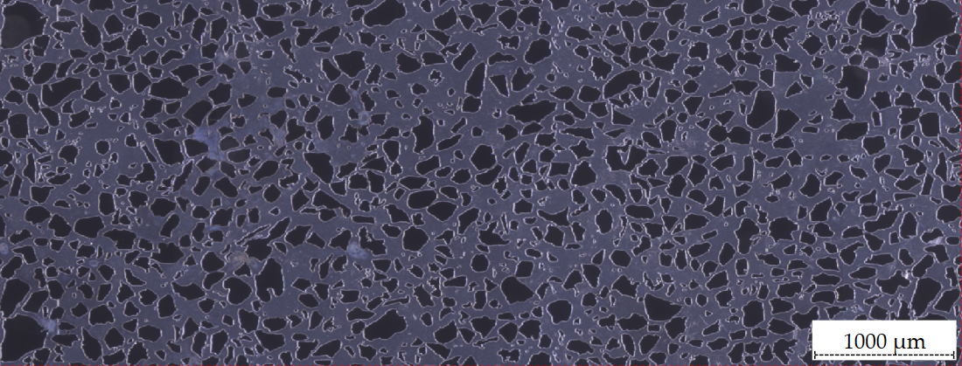
Gas consumption
Is there a pattern?
3. Both at the same time?
1. Gas consumption → Mineral dissolution?
2. Mineral dissolution → Gas consumption?
I
III
Gas consumption preceded mineral dissolution in regions where gas and minerals coexisted. In contrast, mineral-only zones showed a different response.
Bacterial activity was higher at locations where both phases were present than in single-phase regions.
t_0h_Initial stage
t_16h_Gas consumption and mineral disolution
II
IV
t_10h_Gas consumption_No mineral disolution
t_33h_Completely Gas consumption and mineral disolution

