Slide 1

Microfluidic platforms for anaerobic hydrogen–mineral–microbial reactions
Na Liu | University of Bergen
Edgard Frank Viveros Acosta, Chaojie Cheng, Christian Ostertag-Henning
InterPore Conference, Nantes, France 2026

Slide 2



The micromodel for biogeochemical study duirng UHS
Micromodel = microfluidic representation of porous media
Flow & transport:
Hydrogen distribution, phase trapping, accessibility, and mass transfer at the pore scale
Microbial processes
Biofilm growth, hydrogen consumption, sulfate reduction, and bioclogging
Mineral reactions:
Dissolution, precipitation, and microbe–mineral interactions under reactive flow conditions
Micromodels provide direct visualization of these coupled pore-scale processes that are difficult to observe in conventional core-scale experiments.
Naga Siva Kumar Gunda, et al. Lab on a Chip 2011. 22: p. 7.

Slide 3
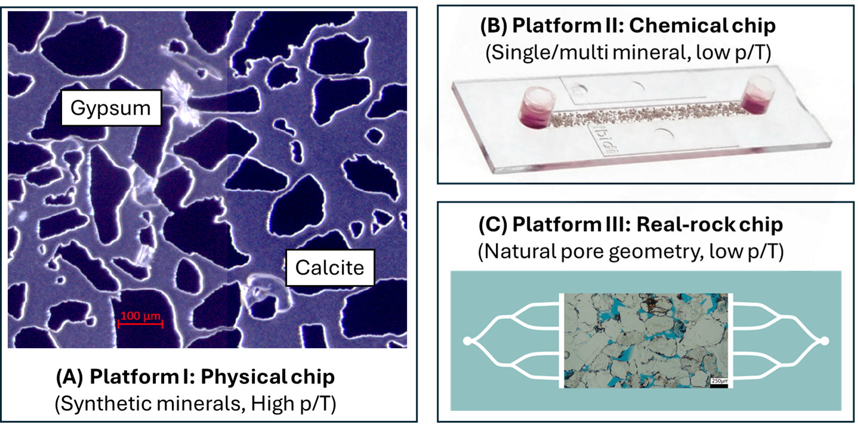
A three-platform strategy: pressure control → chemistry → geological realism
Platform I — Silicon–glass chip
High P–T, gas-tight, quantitative flow and biofilm analysis.
Synthetic minerals (calcite, gypsum)
Platform II — Polymer ibidi chip
Real mineral grains, excellent Raman/confocal compatibility.
Ambient pressure condition
Platform III — Real-rock chip
Platform comparison: which research questions can each chip answer reliably?
Real pore texture, roughness and mineral heterogeneity.
Limited control, ambient pressure condition

Slide 4
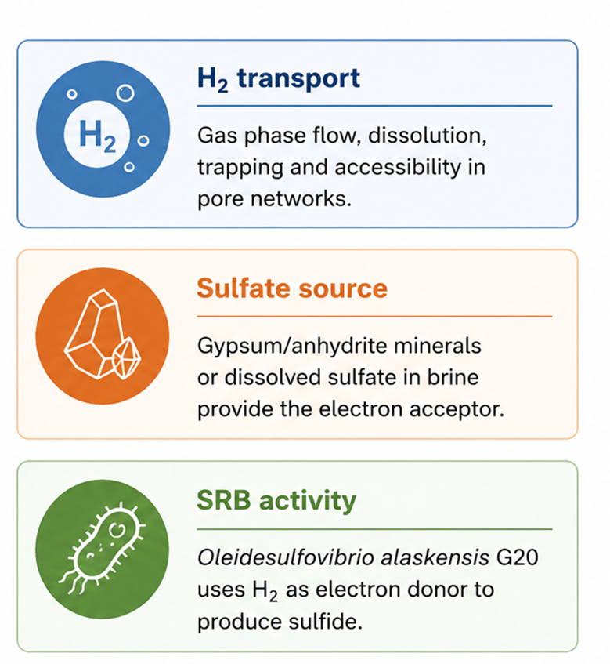
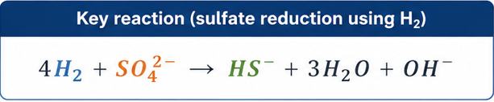
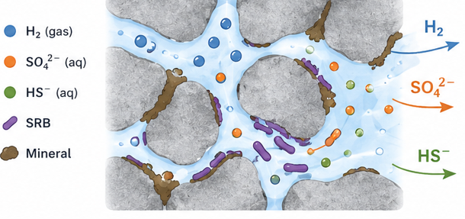

Representative case
Hydrogen-driven sulfate reduction in porous media
Biofilm
Research question: Which microfluidic platform can directly observe H₂ transport, microbial activity, and mineral reactions under relevant experimental conditions?

Slide 5
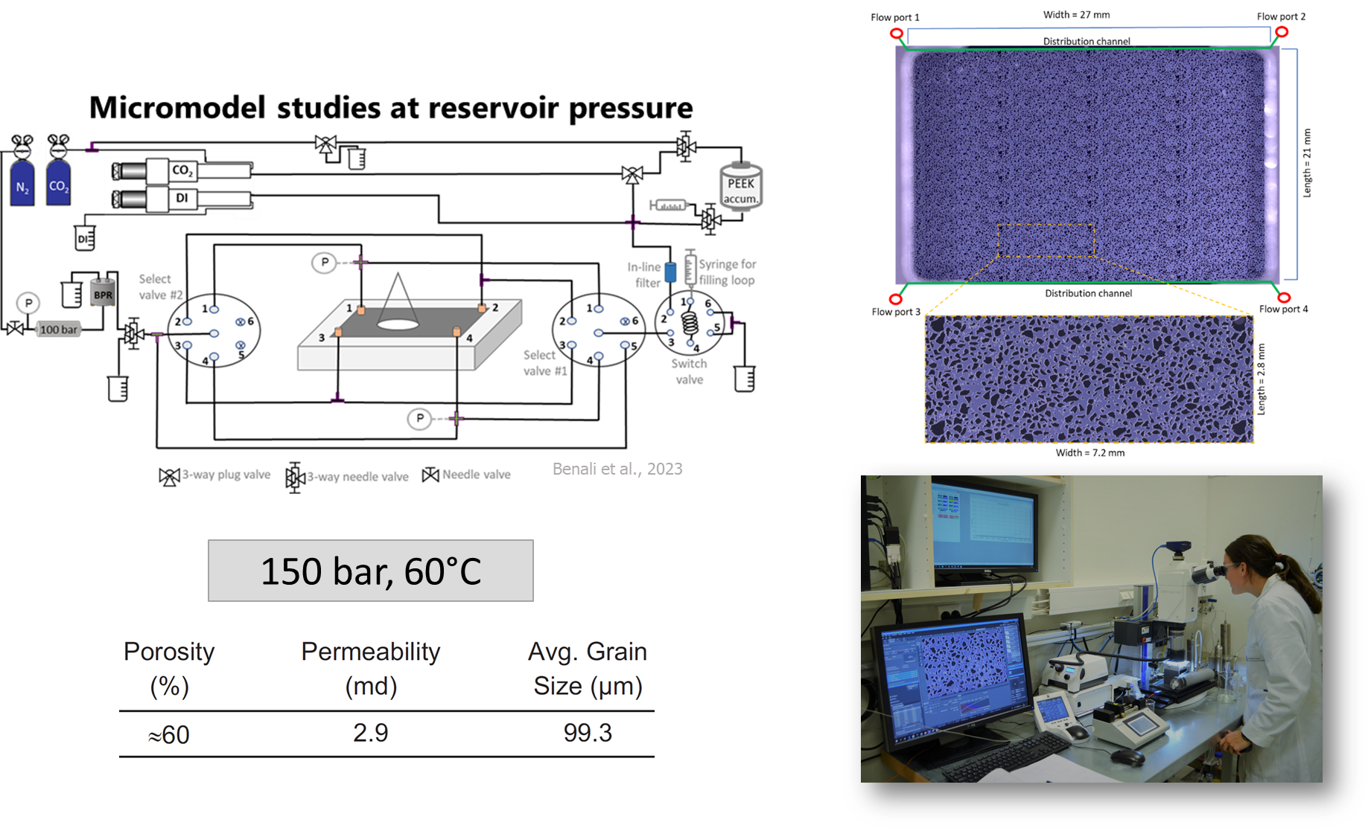
Platform I — silicon–glass high-pressure micromodel
Experimental capability
Reservoir-relevant pressure and temperature
stable anaerobic condtions
quantitative pore-scale flow visualization
What we can measure
H₂ consumption,
biofilm-induced bioclogging,
wettability changes,
flow redistribution.
Main limitation
Idealized geometry/surfaces
Limited Raman access through thick glass.

Slide 6
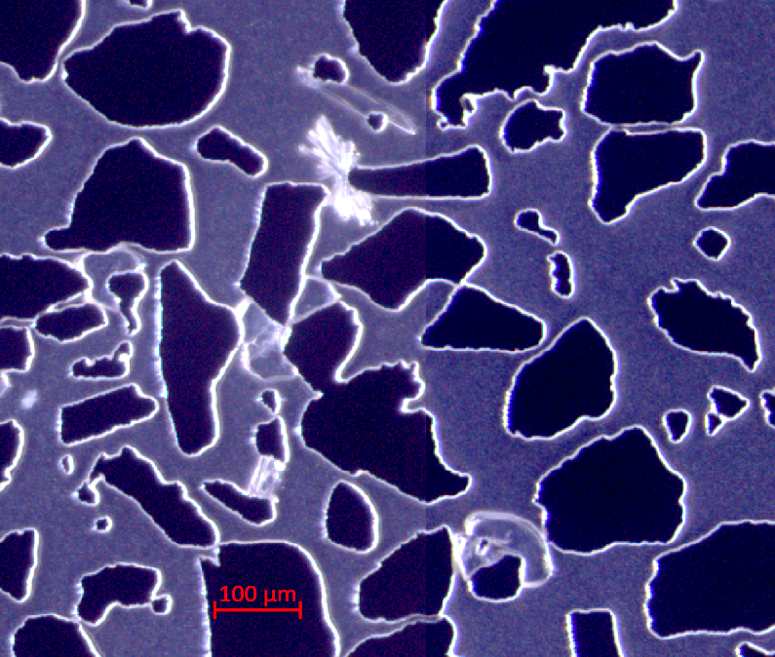
Multimineral reactive micromodel
Base geometry: silicon micromodel
Mineral phases introduced:
  Calcite&Gypsum (sulfate source)
Controlled pore structure
Gypsum
Silicon pillar
Calcite
Vaterite
Enables direct observation of H₂ transport, microbial activity and mineral reactions under reservoir conditions.

Slide 7
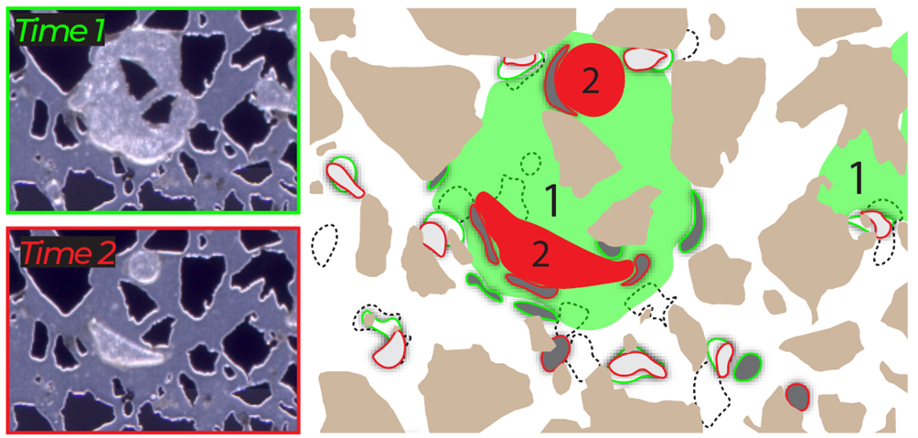
Example from platform I: biofilm growth changes flow
Liu et al. 2025, https://doi.org/10.1021/acs.est.4c13893
This platform is strongest for dynamic flow–biofilm coupling.

Slide 8
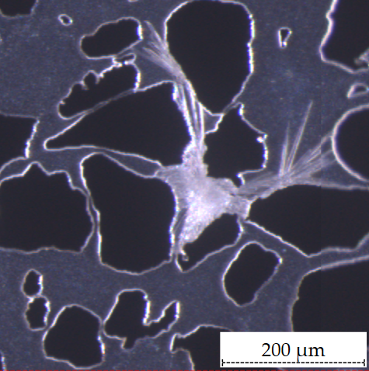
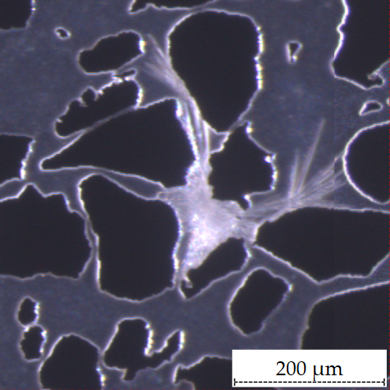
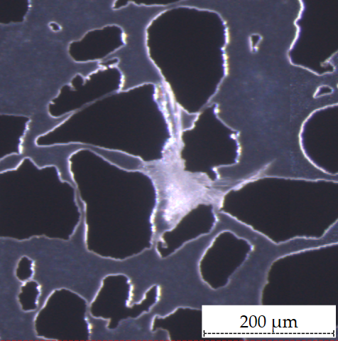
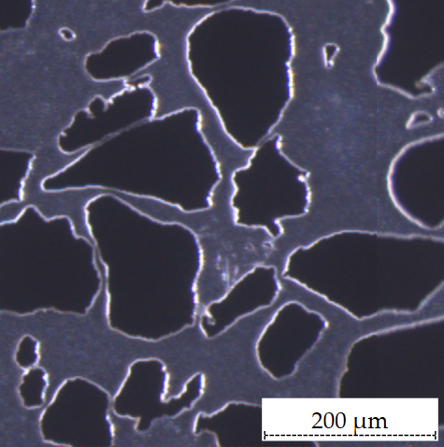
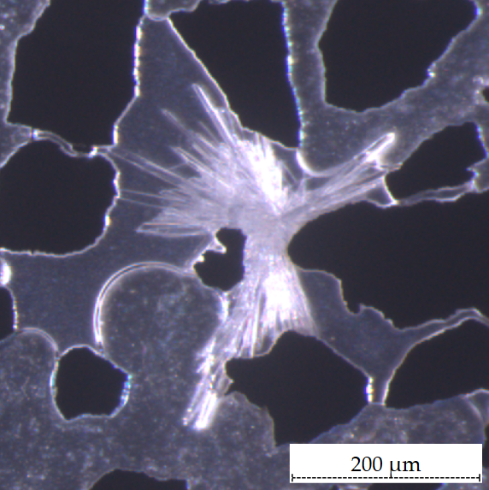
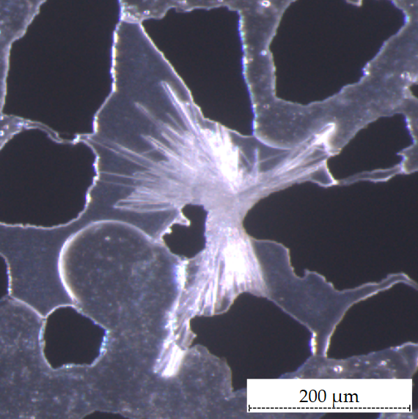
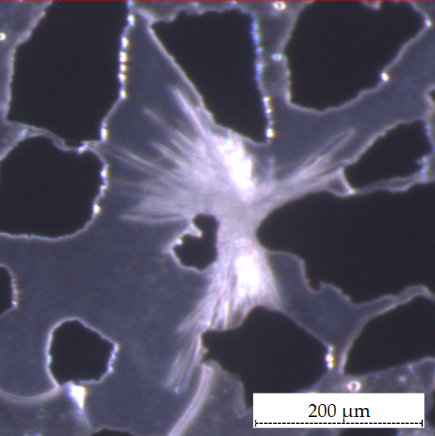
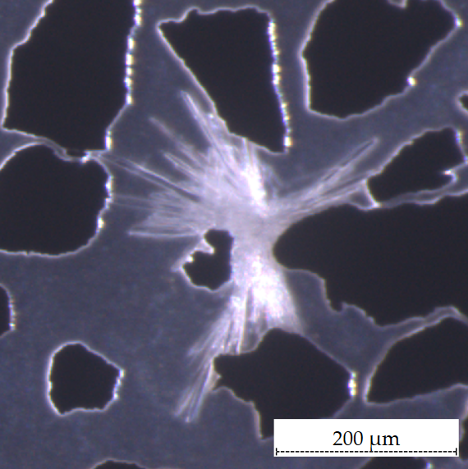
Example from platform I: gypsum dissolution
0h
6h
15h
25h
Dissolution is delayed and reduced when gas surrounds the mineral.
0h
33h
59h
149h
The reaction rate is controlled by local mass transfer, not mineral chemistry alone.

Slide 9
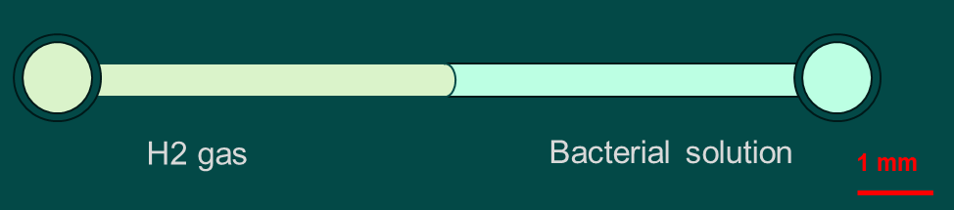
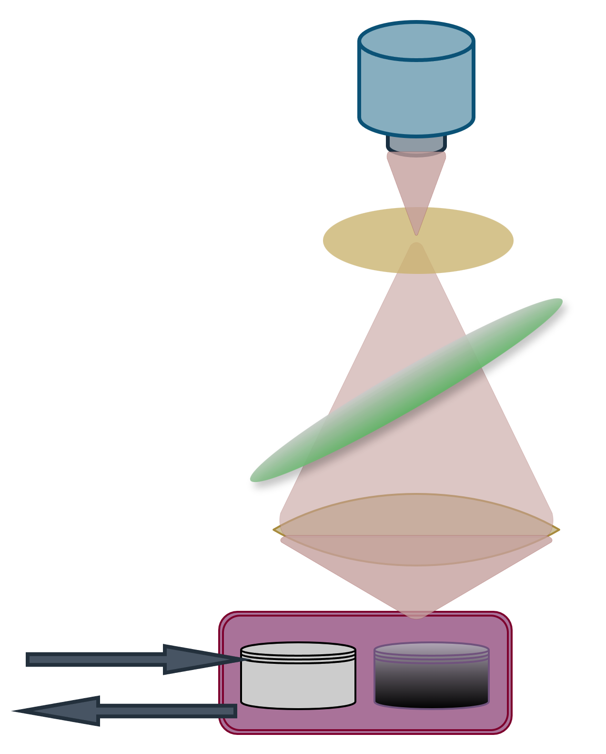
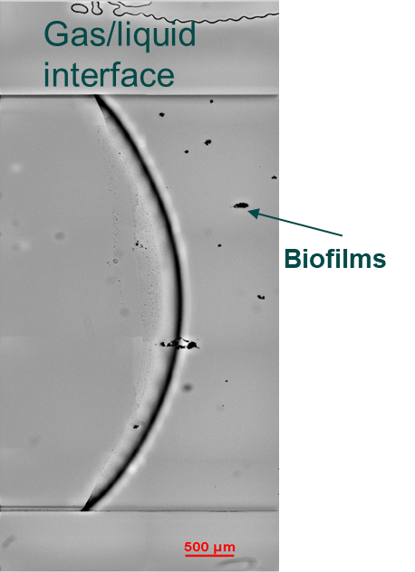
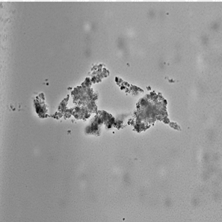
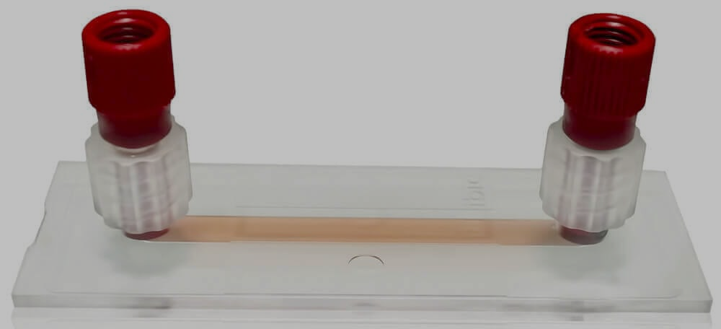
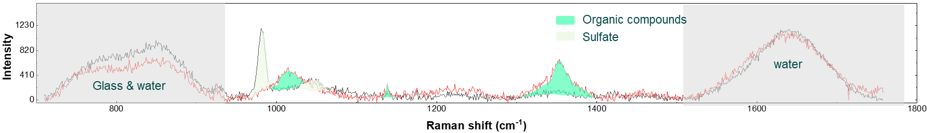
Platform II — ibidi chip coupled with Raman/confocal microscopy
In situ Raman spectroscopy for chemical mapping in a reactive microfluidic system.
Ibidi microfluidic channel
In situ Raman measurement
This setup enables non-destructive, in situ chemical mapping of biofilms and minerals at the pore-scale.
Raman objective
Laser
Optical images
Biofilms
N₂ gas
Scattered Raman light
Work from Dr. Christian Ostertag-Henning, BGR
Representative Raman spectra
Work done in BGR

Slide 10
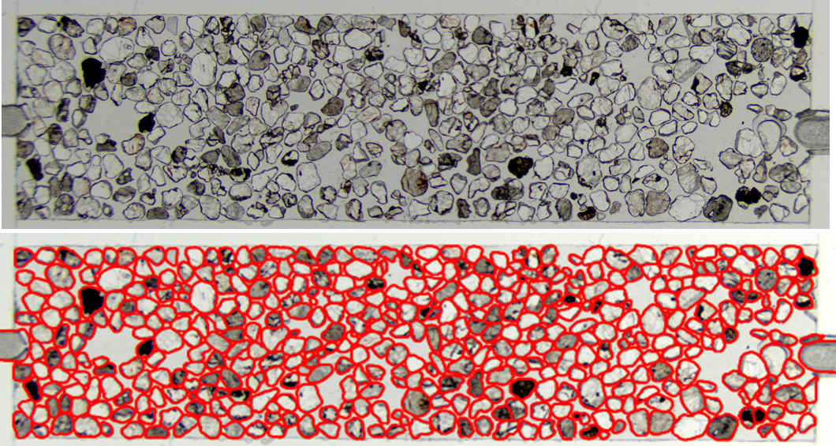
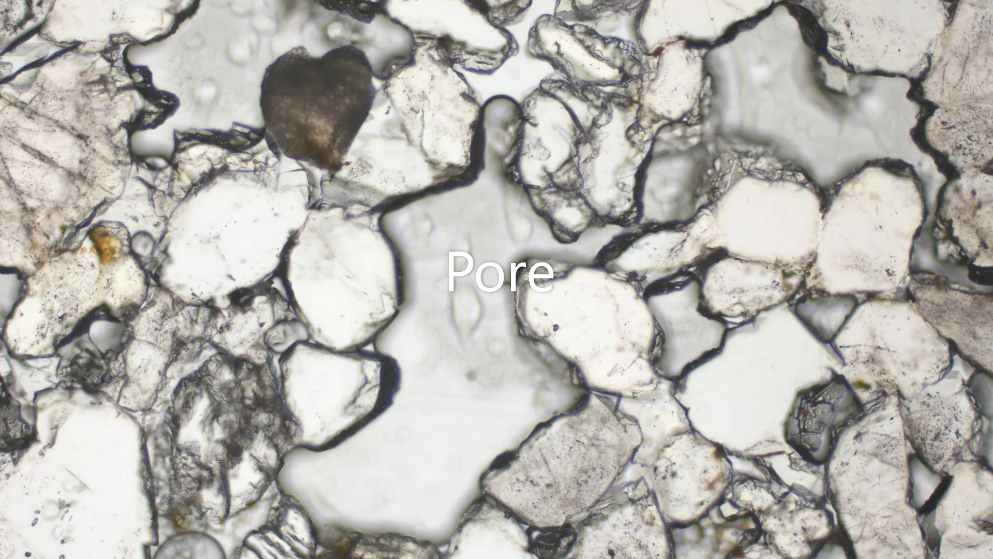
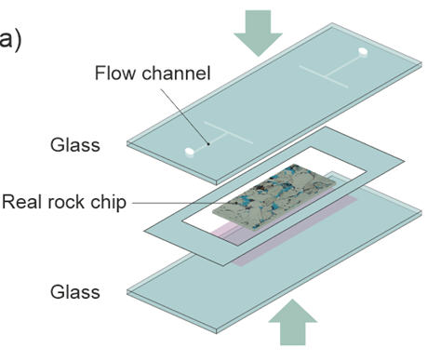
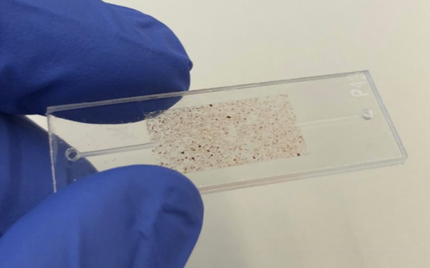
Platform III — Real rock chip
Real rock chip thin section
Real-rock micromodel containing sulfates and carbonates for bio-geochemical reactions.
  Natural rock texture and heterogeneity
  Contains sulfates & carbonates
  (e.g., limestone, calcite, dolomite, anhydrite)
Micromodel assemply
Real rock chip
A realistic platform for studying coupled transport, biofilm activity, and mineral reactions in porous rocks.
Work from Dr. Chaojie Cheng, KIT

Slide 11
Platform comparison: complementary, not competing
Physical chip (UiB)
Silicon-glass chip
Chemical chip (BGR)
Polymer(ibidi) chip
Real-rock chip (KIT)
Thin section chip
Strengths:
High P–T (up to 150 bar)
Gas-tight → stable anaerobic conditions
Quantitative flow & biofilm analysis
Limitations:
Idealized geometry
Limited Raman access
Strengths:
Natural mineralogy & roughness
Real pore structure
High geological realism
Limitations:
H₂ leakage risk
Experimental constraints
Strengths:
Raman + confocal compatible
Good for chemical mapping
Controlled anaerobic conditions
Limitations:
Atmospheric pressure
Simpler flow conditions
Dynamics
Chemistry
Mineral heterogeneity
No single platform is sufficient, mechanistic understanding requires integration.

Slide 12
Conclusion
Micromodels resolve coupled H₂–microbe–mineral processes at the pore scale
…but no single platform captures all relevant subsurface conditions.
Platform | Research questions
Silicon–glass HP chip | Dynamic H₂ transport, pressure effects, quantitative biofilm–flow feedback
Ibidi polymer chip | Interfacial chemistry, spatial sulfate depletion, biofilm localization, In situ Raman/confocal imaging and interfacial chemistry
Real-rock micromodel | Mineral heterogeneity, natural pore structure, and realistic rock surfaces influence microbial colonization, H₂ accessibility, and mineral reactions
Outlook
Integrating complementary micromodels provides a stronger framework for studying biogeochemical processes relevant to underground hydrogen storage.

Slide 13
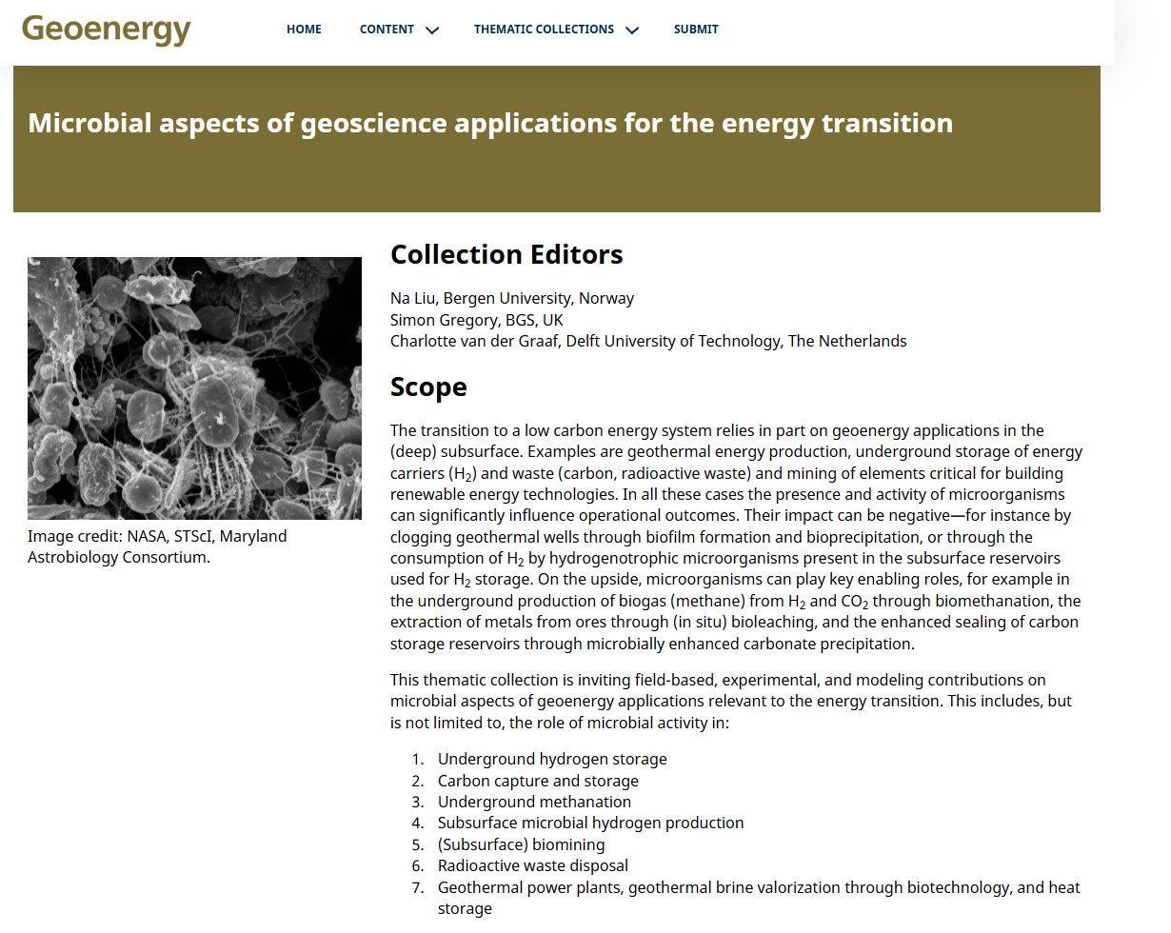

Slide 14
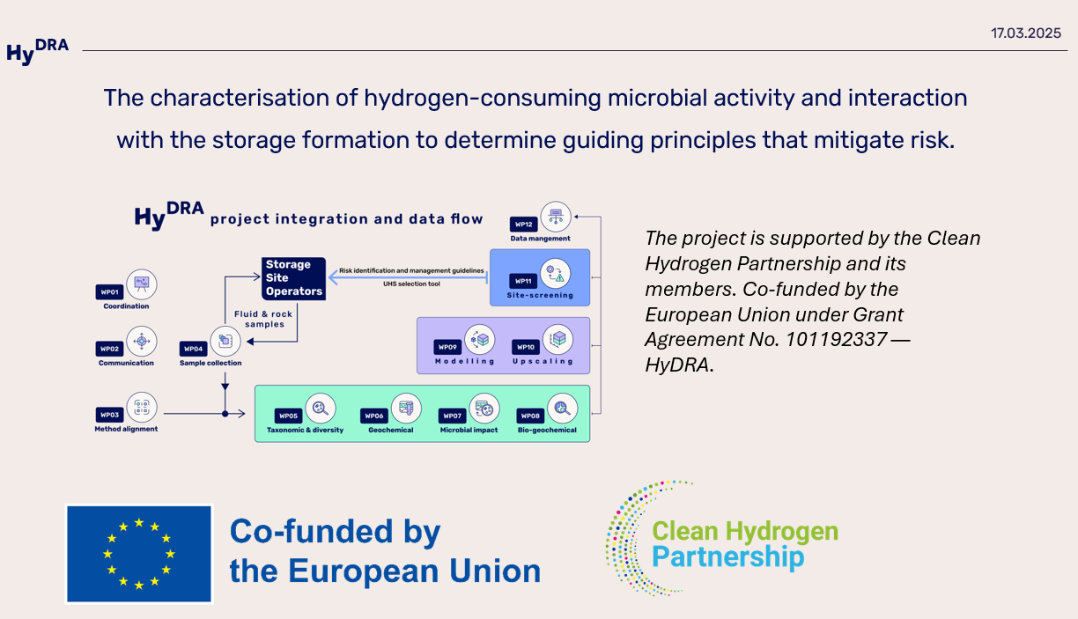
https://hydrahydrogen.eu

Slide 15
