Slide 1






Spatio-temporal characteristics of a proliferating S.cerevisiae clog
1/10
Mathieu Ghenni mathieu.ghenni@imft.fr
Supervisors:
Olivier Liot
Morgan Delarue

Slide 2
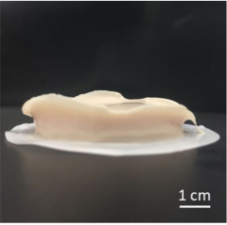
Context
Bioclogging
2/10
2/20
Bioclogging = obstruction of a porous surface by the accumulation of biological particles
Generation of a porous media
Characteristics related to living entities:
  Deformability
  Capacity of growth and division
  Nutrient consumption
Most studies at the macro-scale
Proliferation is absent in all bioclogging studies
Clog
Filter
Yeast cake filtration
From Katagiri et al. (2021)

Slide 3
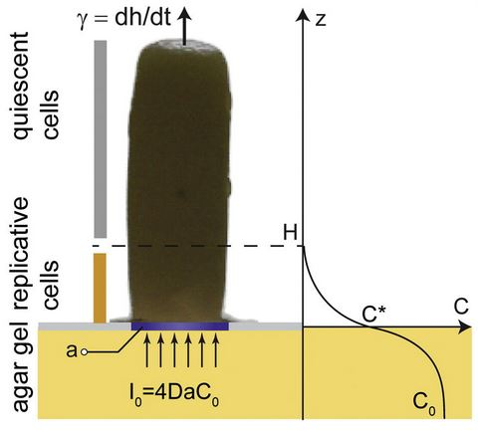





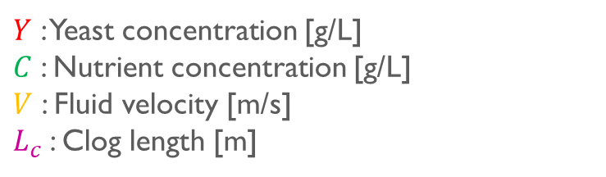
Context
Bioclogging
3/10
3/20
Proliferation affects flow and clog structure:
  Growth of the clog => lower flow-rate
  Appearance of nutrients gradients => behavior modification
  Proliferation => change of porous structure
Studies on the impact of the nutrient availability in proliferation
  Nutrient transport by diffusion only
  Two zones with different proliferation characteristics
Concentration $C(x,t)$
$$Y(x,t)$$
2
$$\frac{dL_{c}}{dt}$$
Flow $V(t)$
$$L_{c}(t)$$
Nutrient diffusion
$Y$ : Yeast concentration [g/L]
$C$ : Nutrient concentration [g/L]
$V$ : Fluid velocity [m/s]
$L_{c}$: Clog length [m]
Diagram of a yeast colony on agar. Growth rate (γ) depends on glucose access, with a gradient from base to top.
From Vulin et al. (2014)

Slide 4
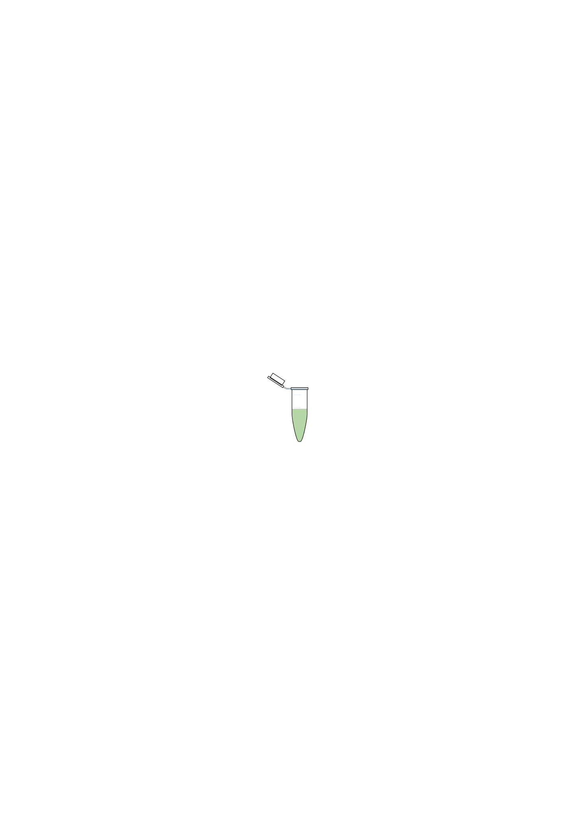
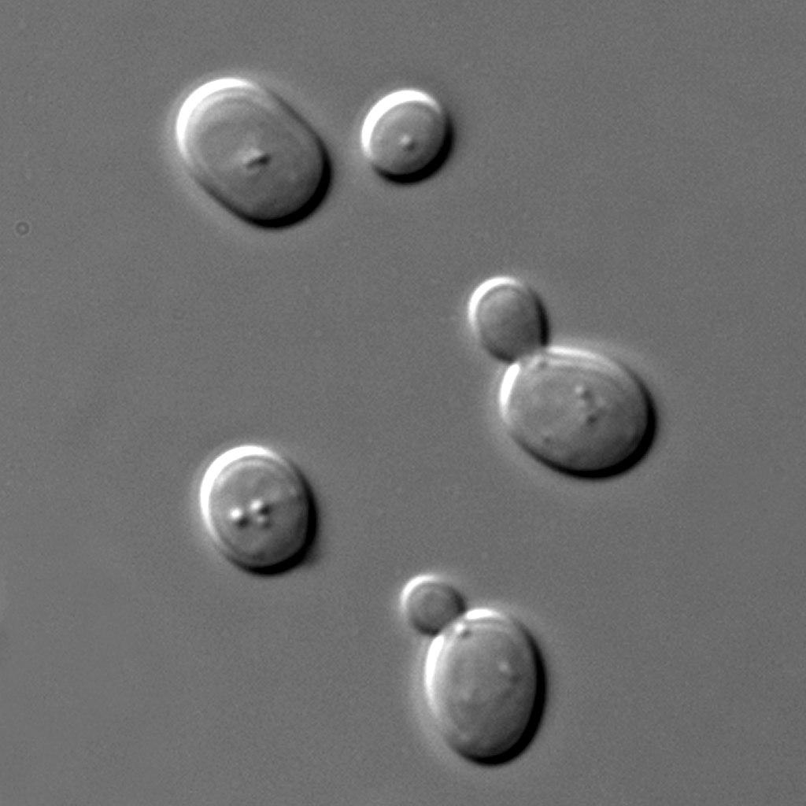
Context
Material
4/10
4/20
Culture solution
Culture solution
with yeasts
Microscale => Microfluidic silicon chip
Constriction(s) to trap yeasts
Constant applied pressure
Dimensions:
  Channel width: W = 140 µm
  Pore width: w = 3 µm
  Depth: h = 6,5 µm
Use of Saccharomyces cerevisiae yeasts
  Typical diameter 4,5µm
  Division by budding
w_{p}
W
P₀+ΔP₁
P₀+ΔP₂
Inlets
Flow
P₀

Slide 5
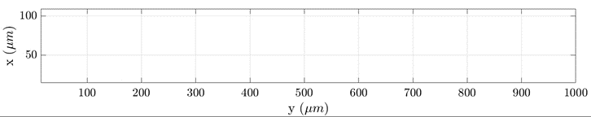
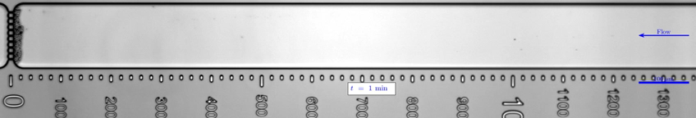
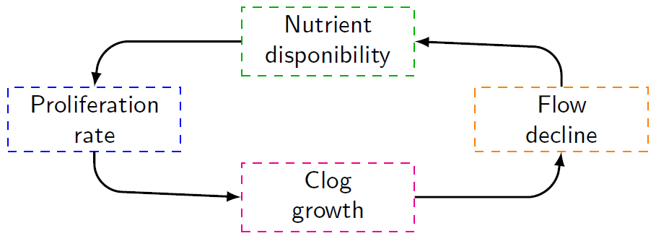
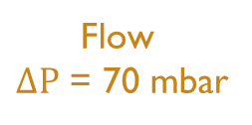
Results
Experiments
5/10
5/20
No displacement zone
Displacement zone
Flow
$ΔP$ = 70 mbar
Why are there two zones ?

Slide 6
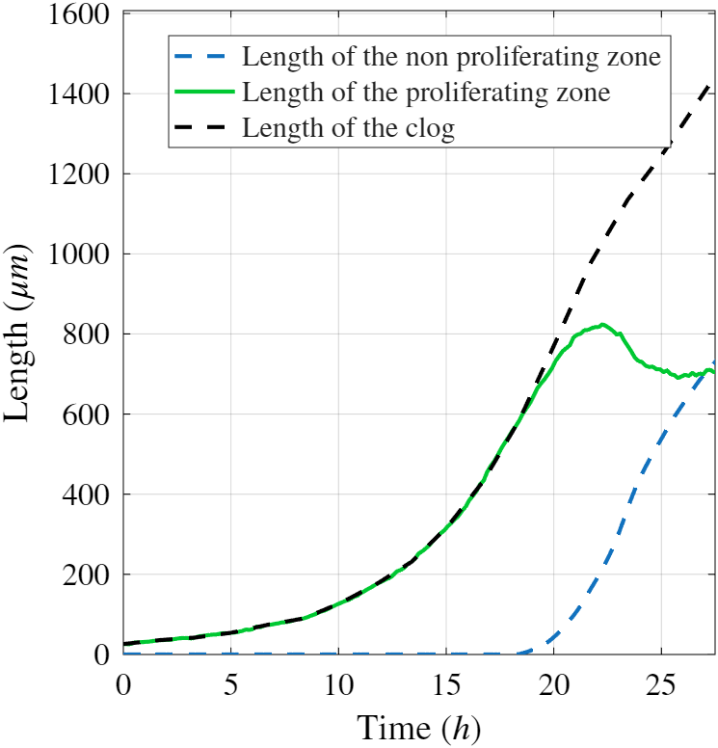
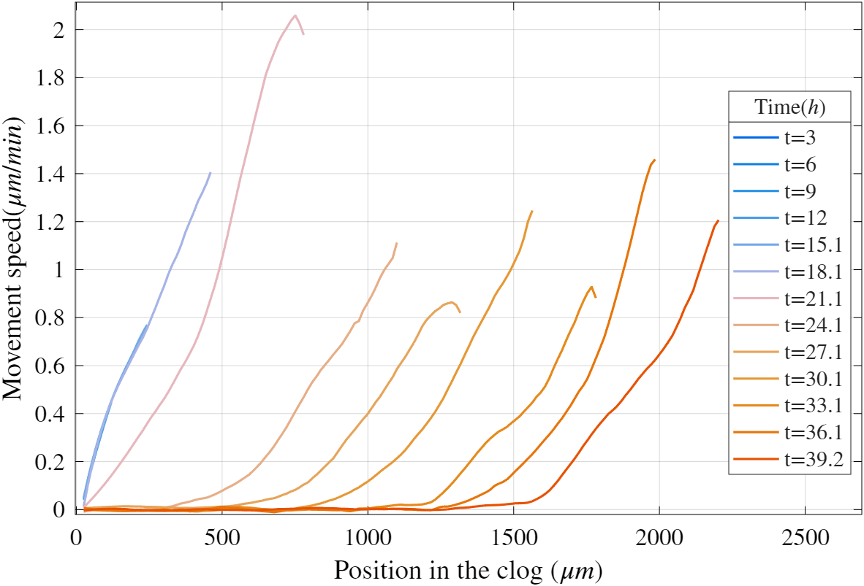
Results
Displacement profiles
6/10
6/20
Succession of two regimes:
  Fully proliferating
  Partially proliferating
Fully proliferating
clog
Displacement zone
Partially proliferating clog
No displacement zone

Slide 7

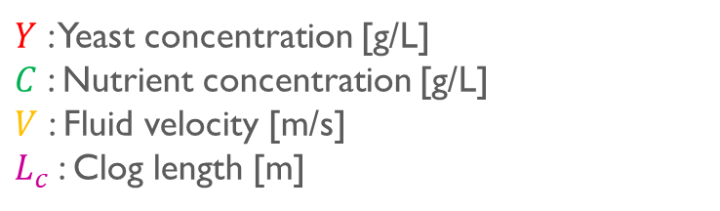
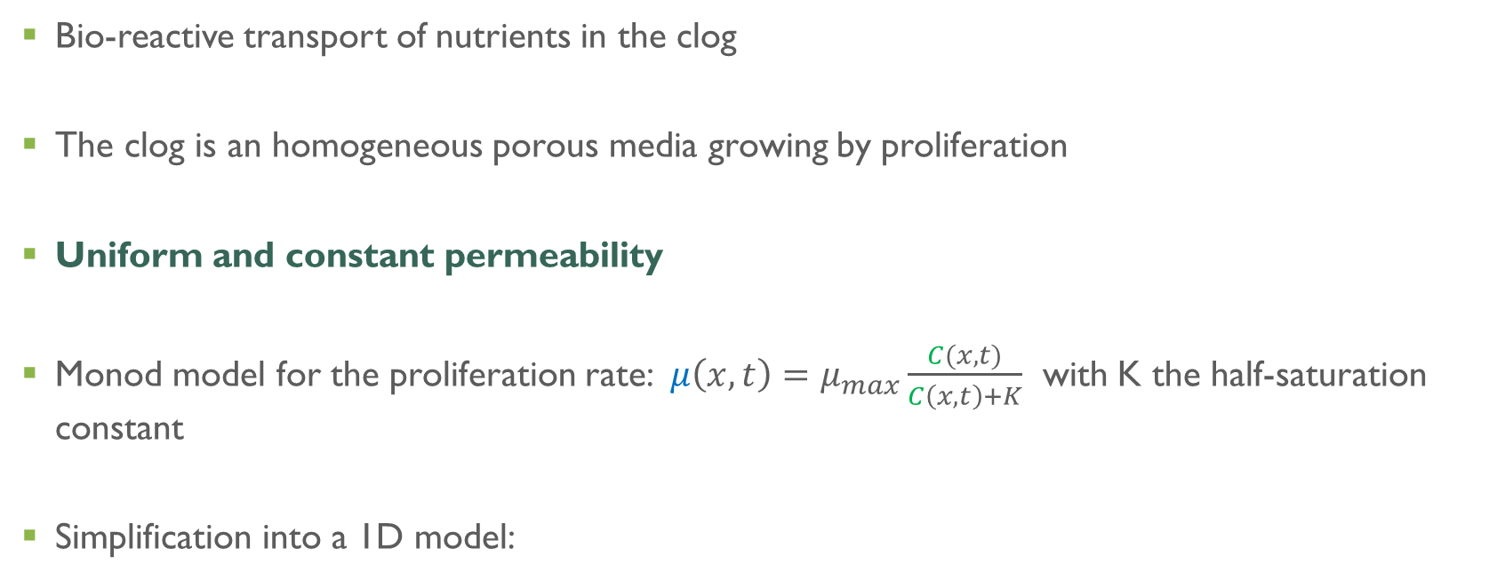

Model
Hypothesis
7/10
9/20
Bio-reactive transport of nutrients in the clog
The clog is an homogeneous porous media growing by proliferation
Uniform and constant permeability
Monod model for the proliferation rate: $μ\left(x,t\right)=μ_{max}\frac{C(x,t)}{C\left(x,t\right)+K}$ with K the half-saturation constant
Simplification into a 1D model:
Concentration $C(x,t)$
$$Y(x,t)$$
$Y$ : Yeast concentration [g/L]
$C$ : Nutrient concentration [g/L]
$V$ : Fluid velocity [m/s]
$L_{c}$: Clog length [m]
$$\frac{dL_{c}}{dt}$$
$$x$$
Flow $V(t)$
$$L_{c}(t)$$

Slide 8
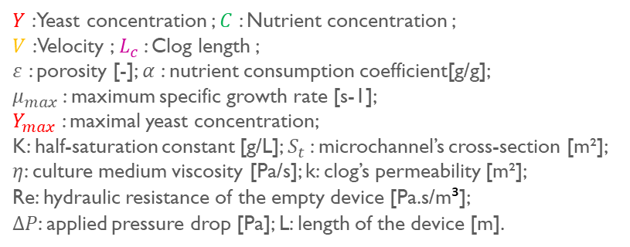
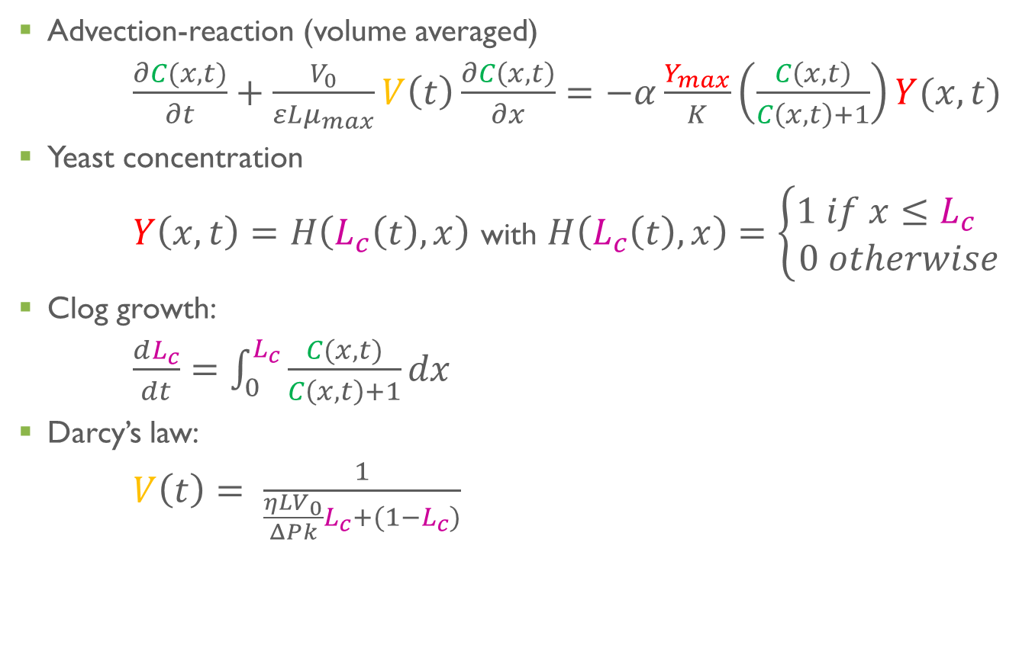
Model
Dimensionless equations
8/10
Advection-reaction (volume averaged)
$\frac{∂C(x,t)}{∂t}+\frac{V_{0}}{εLμ_{max}}V\left(t\right)\frac{∂C\left(x,t\right)}{∂x}=−α\frac{Y_{max}}{K}\left(\frac{C\left(x,t\right)}{C\left(x,t\right)+1}\right)Y(x,t)$
Yeast concentration
$Y\left(x,t\right)=H\left(L_{c}\left(t\right),x\right)$ with $H\left(L_{c}\left(t\right),x\right)=\left\{\begin{aligned}1 if x≤L_{c} \\ 0 otherwise\end{aligned}\right.$
Clog growth:
$\frac{dL_{c}}{dt}=\int_{0}^{L_{c}}{\frac{C(x,t)}{C\left(x,t\right)+1}dx}$
Darcy’s law:
$V\left(t\right)= \frac{1}{\frac{ηLV_{0}}{ΔPk}L_{c}+(1−L_{c})}$
$Y$ : Yeast concentration ; $C$ : Nutrient concentration ;
$V$ : Velocity ; $L_{c}$: Clog length ;
$ε$ : porosity [-]; $α$ : nutrient consumption coefficient[g/g];
$μ_{max}$: maximum specific growth rate [s-1];
$Y_{max}$ : maximal yeast concentration;
K: half-saturation constant [g/L]; $S_{t}$: microchannel’s cross-section [m²];
$η$: culture medium viscosity [Pa/s]; k: clog’s permeability [m²];
Re: hydraulic resistance of the empty device [Pa.s/m³];
$ΔP$: applied pressure drop [Pa]; L: length of the device [m].

Slide 9
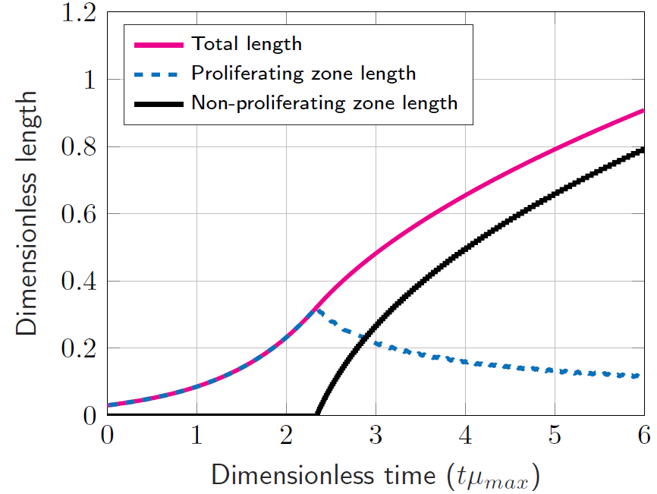
Model
Resolution of the model
9/10
Fully proliferating
clog
Partially proliferating clog
Same trend as in the experiments
Validity of permeability hypothesis?

Slide 10
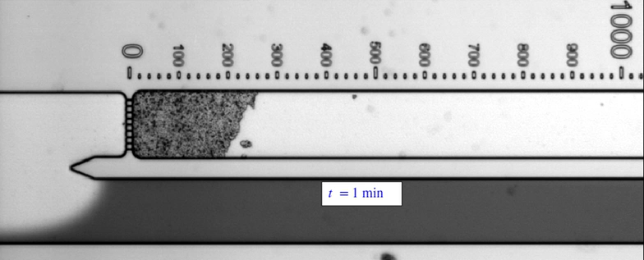
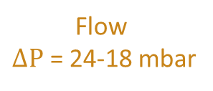
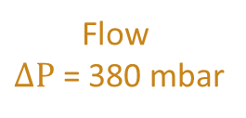
Conclusions and perspectives
10/10
Two proliferation regimes appear depending on the nutrient availability
Simple bio-reactive model captures the clog growth dynamics
What is the permeability of the clog? Is it uniform/ constant?
Flow
$ΔP$ = 380 mbar
Flow
$ΔP$ = 24-18 mbar

Slide 11
Thank you

Slide 12
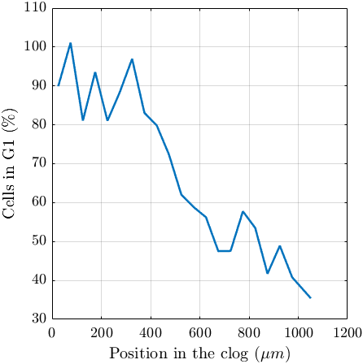
Results
Origin of the zones
Labeling of whi-5:
  G1 phase cells have fluorescent nuclei
  Cells that don’t proliferate are locked in the G1 phase
Difference of density of cells in G1 in the clog
No displacements = non-proliferating cells
Flow
0
100
200
300
400
500
600
700
800
900
1000
Scale in µm

Slide 13
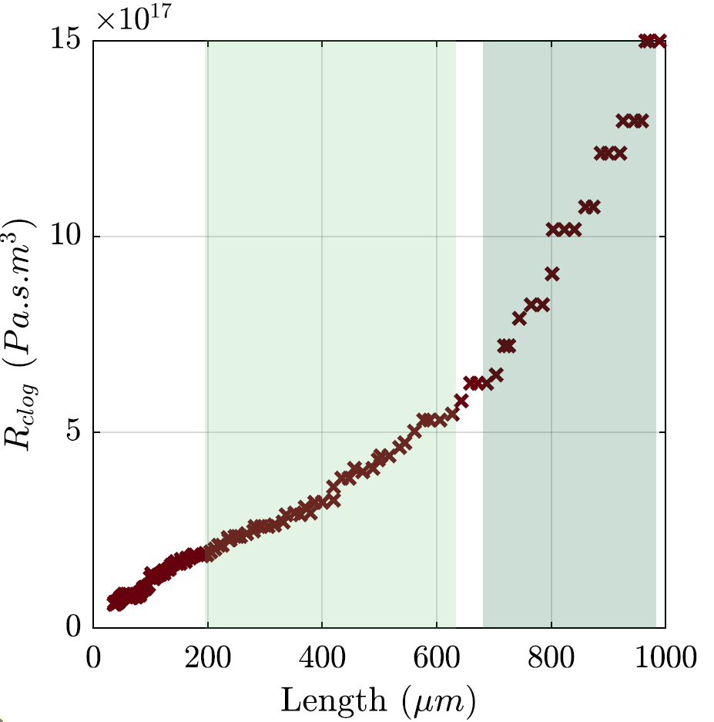
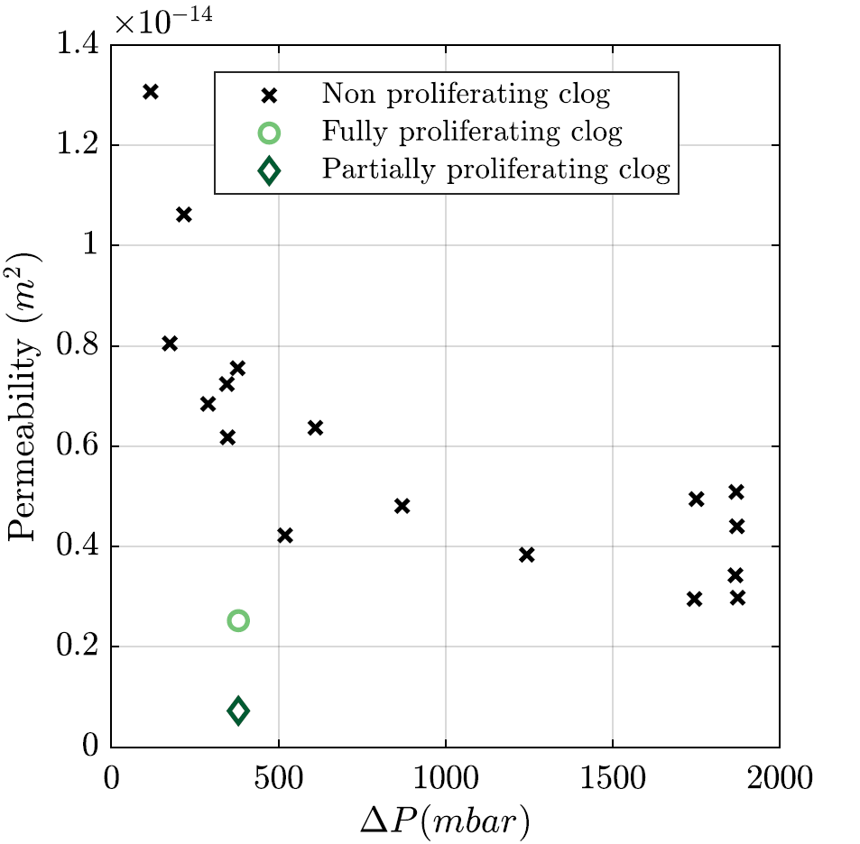
Results
Hydrodynamic resistance and permeability
Non proliferating clog
Proliferating clog: 200-620 µm
Proliferating clog: 680-990µm
Lower and lowering permeability of proliferating clogs

