Slide 1

Optimization and experimental validation of graph-based model of complex transport processes in fractured porous media
Christopher Zahasky
Associate Professor, Department of Geoscience
University of Wisconsin-Madison
Email: czahasky@wisc.edu
Website: Zahasky.geoscience.wisc.edu
Collin Sutton
NSF-EAR Postdoctoral Fellow
Colorado School of Mines
Email: Collin.Sutton@Mines.edu
InterPore 2026– May 22, 2026

Slide 2
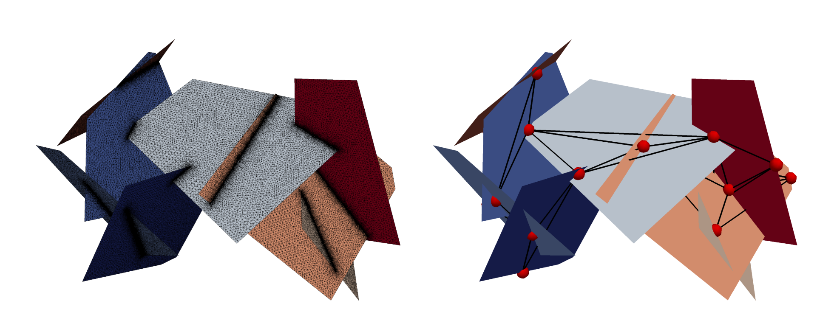
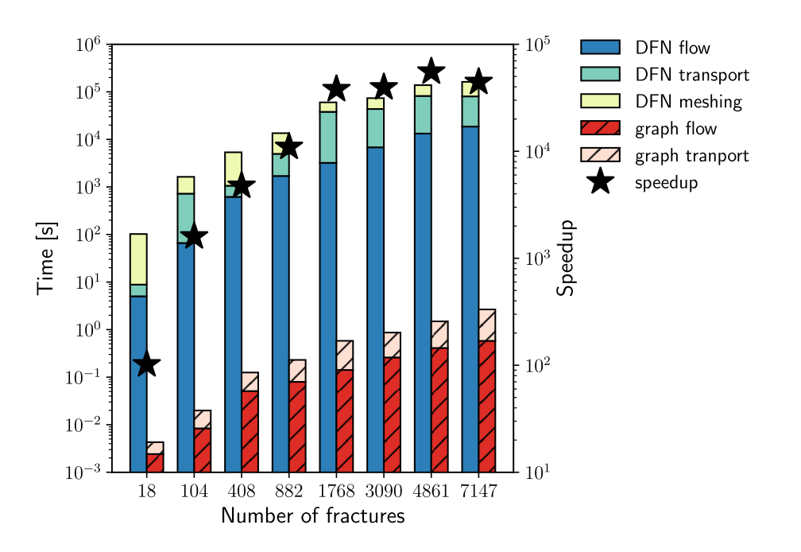
Modeling transport on graphs lead to 4-5 orders of magnitude speed up
DFN model
Graph model
[Karra et al, 2017]
Notes:
Graph based models are a way to represent fractures with a small number of nodes and edges rather than a fully meshed discrete fracture network. This reduced-physics representation has been shown to enable 4-5 orders of magnitude speed up in computational time.

Slide 3
Despite the promise of graph models, validations against observational data is lacking
Current Objectives
Validate first-order reactions and fracture/matrix processes on graph-based flow and transport models in fractured rock cores
Determine if models can capture more complex, meso-scale fracture flow and transport behavior
Design flexible optimization framework for robustly fitting graph-based models to observational data across scales

Slide 4
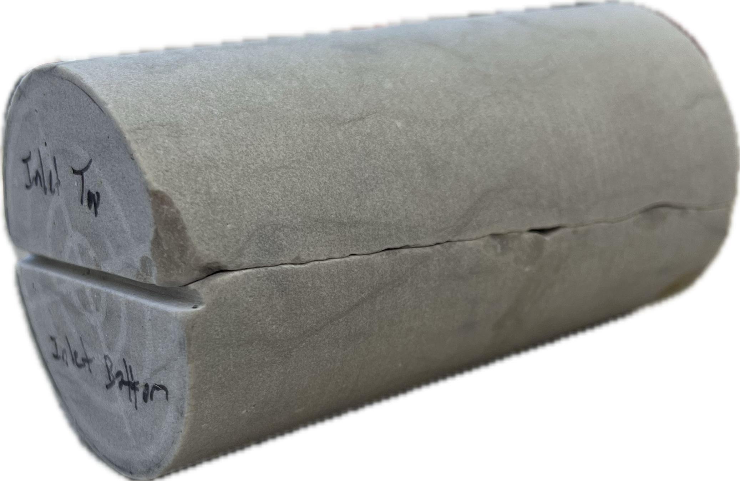
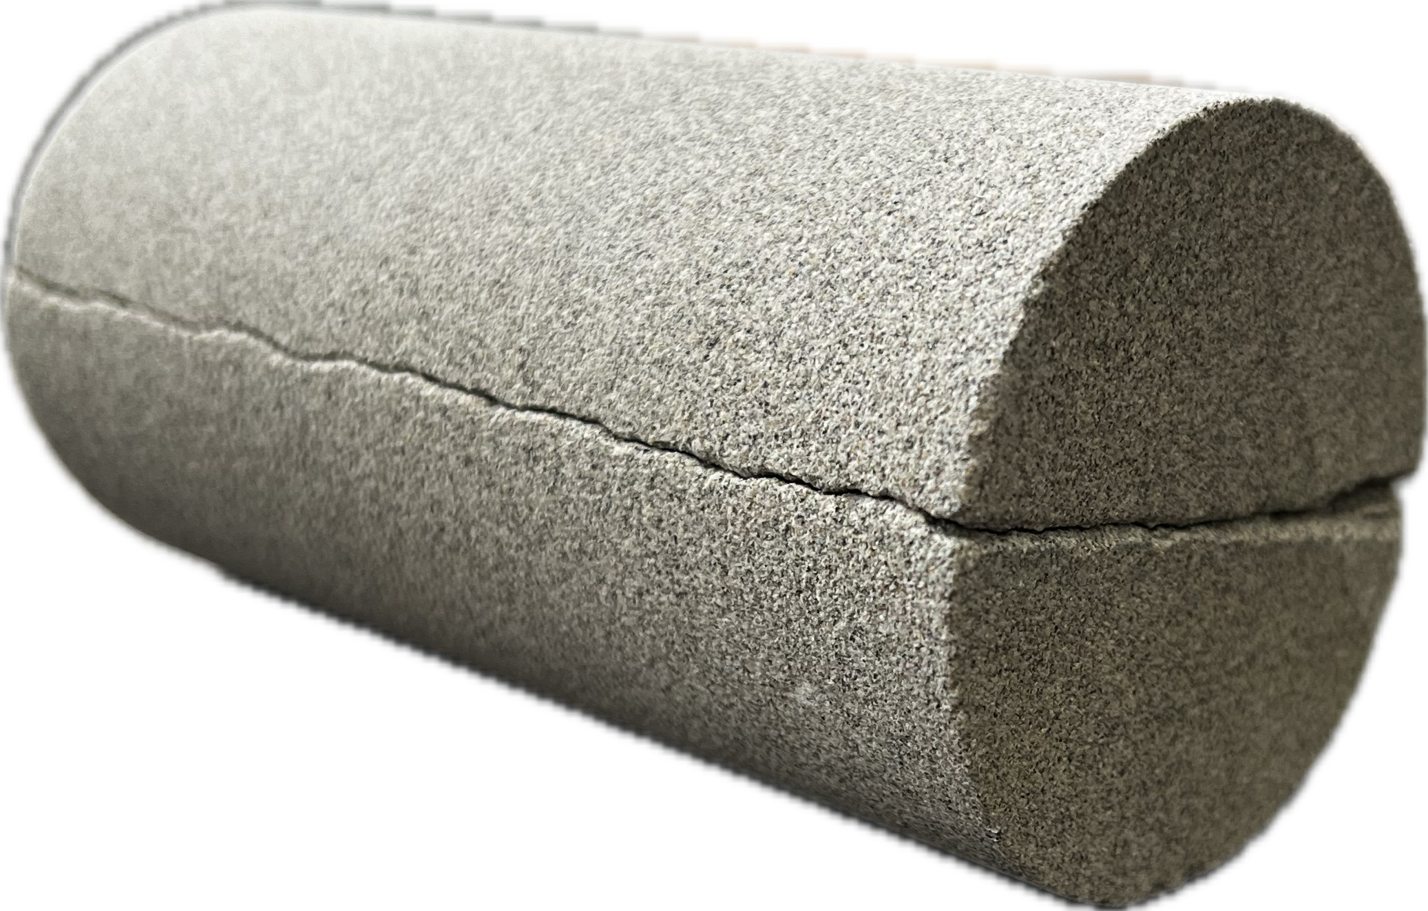
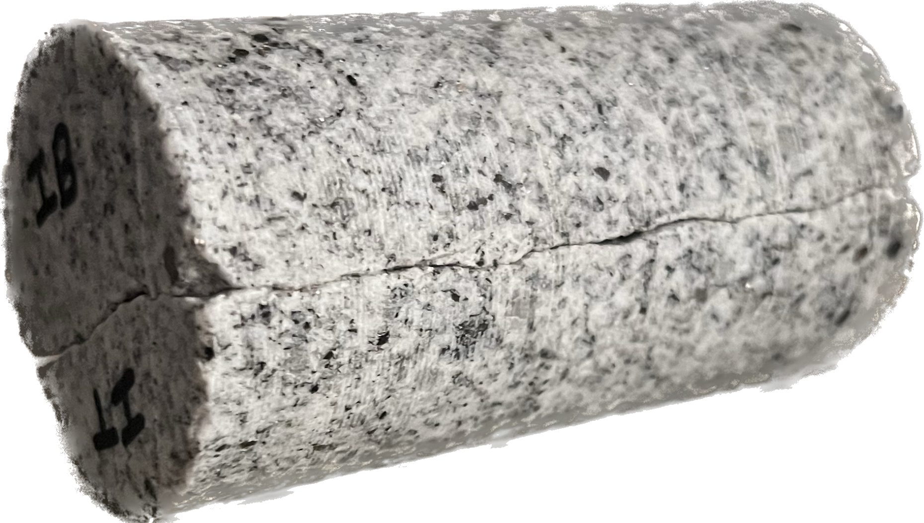
Core-scale Experiments
Niagaran Dolomite
Berea Sandstone
5.08 cm
Confining fluid
End caps
Core/fracture
10 cm
Sierra Granite
Flow direction
Inlet port
Outer coreholder
Shrink wrap and neoprene

Slide 5
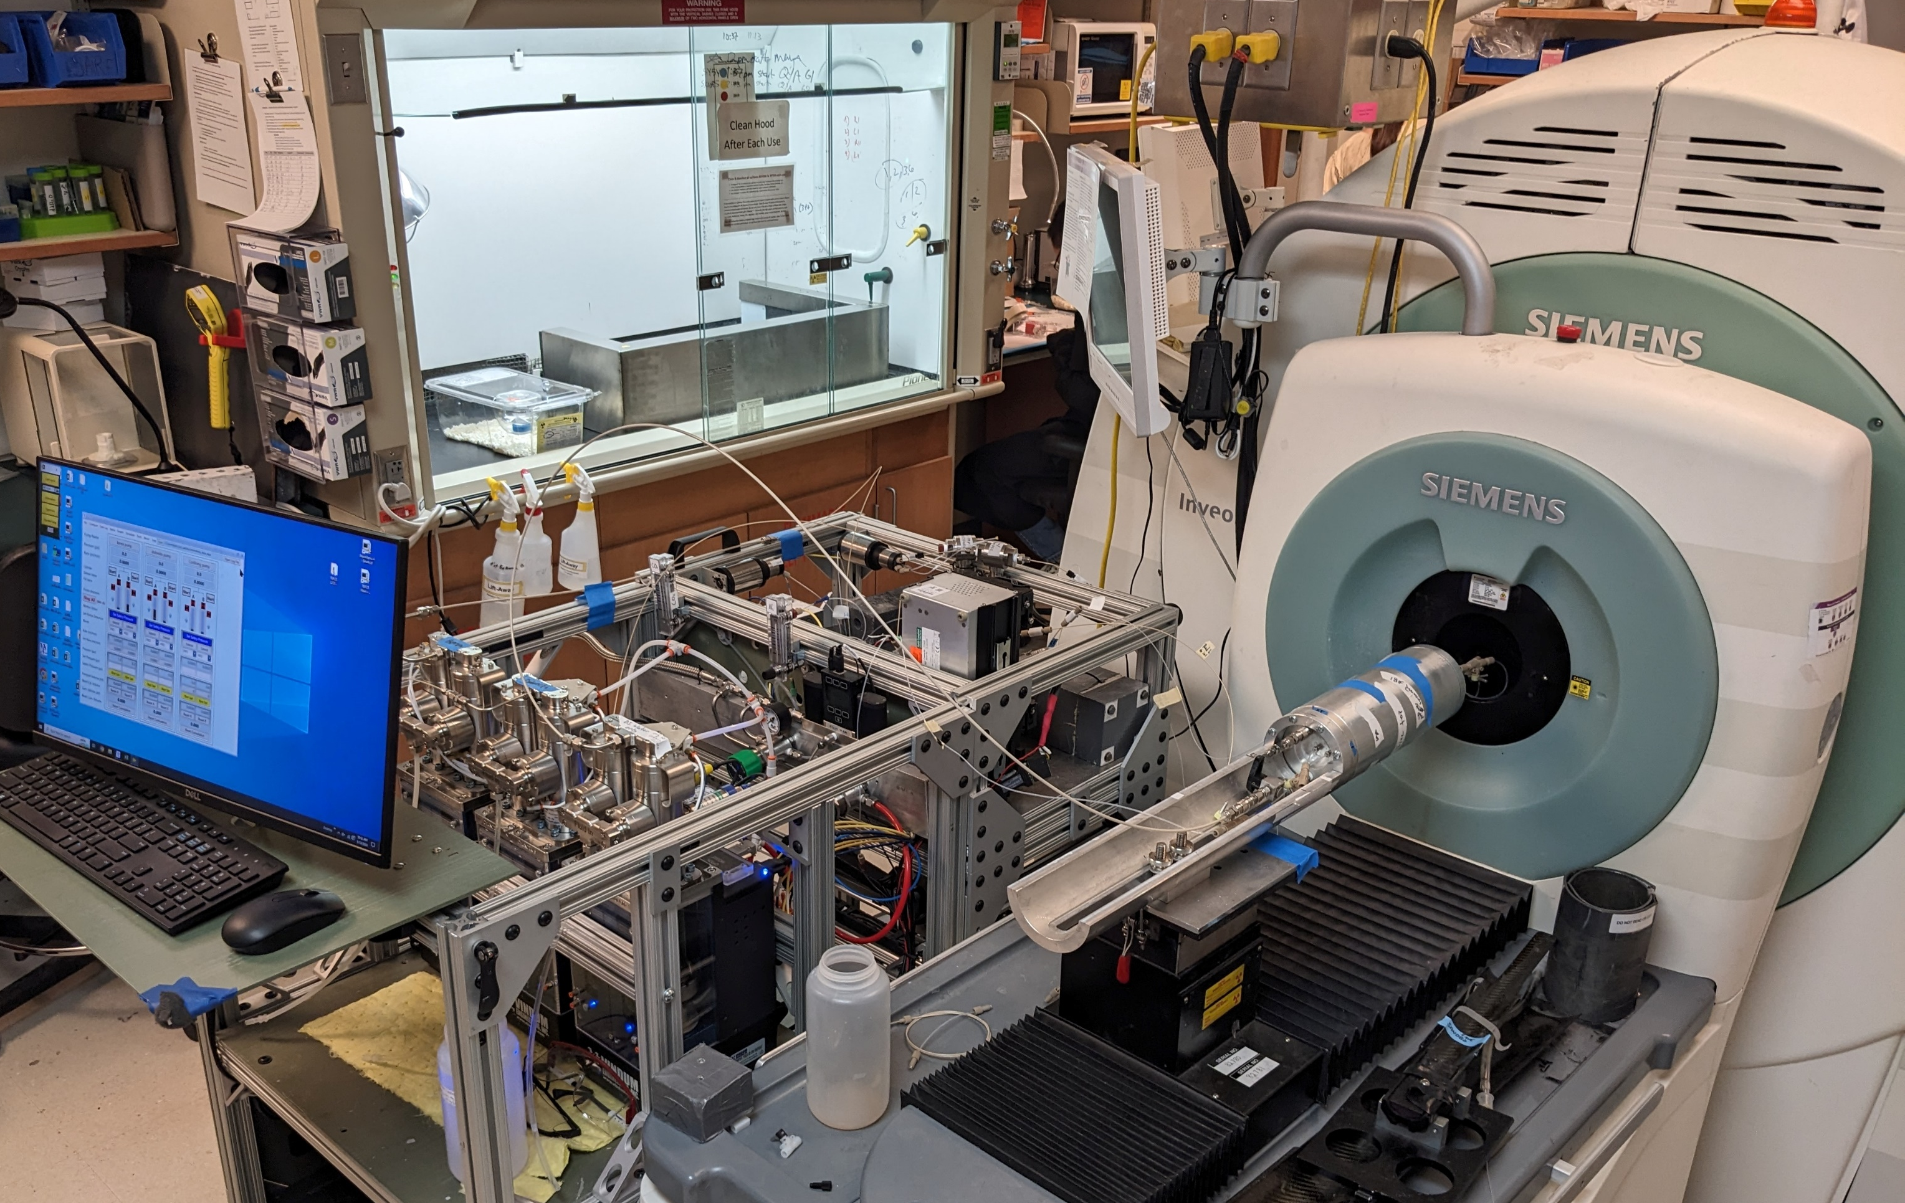
Core-scale Experiments Imaged with Positron Emission Tomography (PET)
PET scanner
Radiotracer sensors measure inlet and outlet radioconcentration
Confining fluid
End caps
Core/fracture
Flow direction
Scanner parameters:
30-60 second timesteps
Voxel dimension = 0.77 x 0.77 x 0.8 mm
[Zahasky et al, 2019]
Inlet port
Outer coreholder
Shrink wrap and neoprene

Slide 6
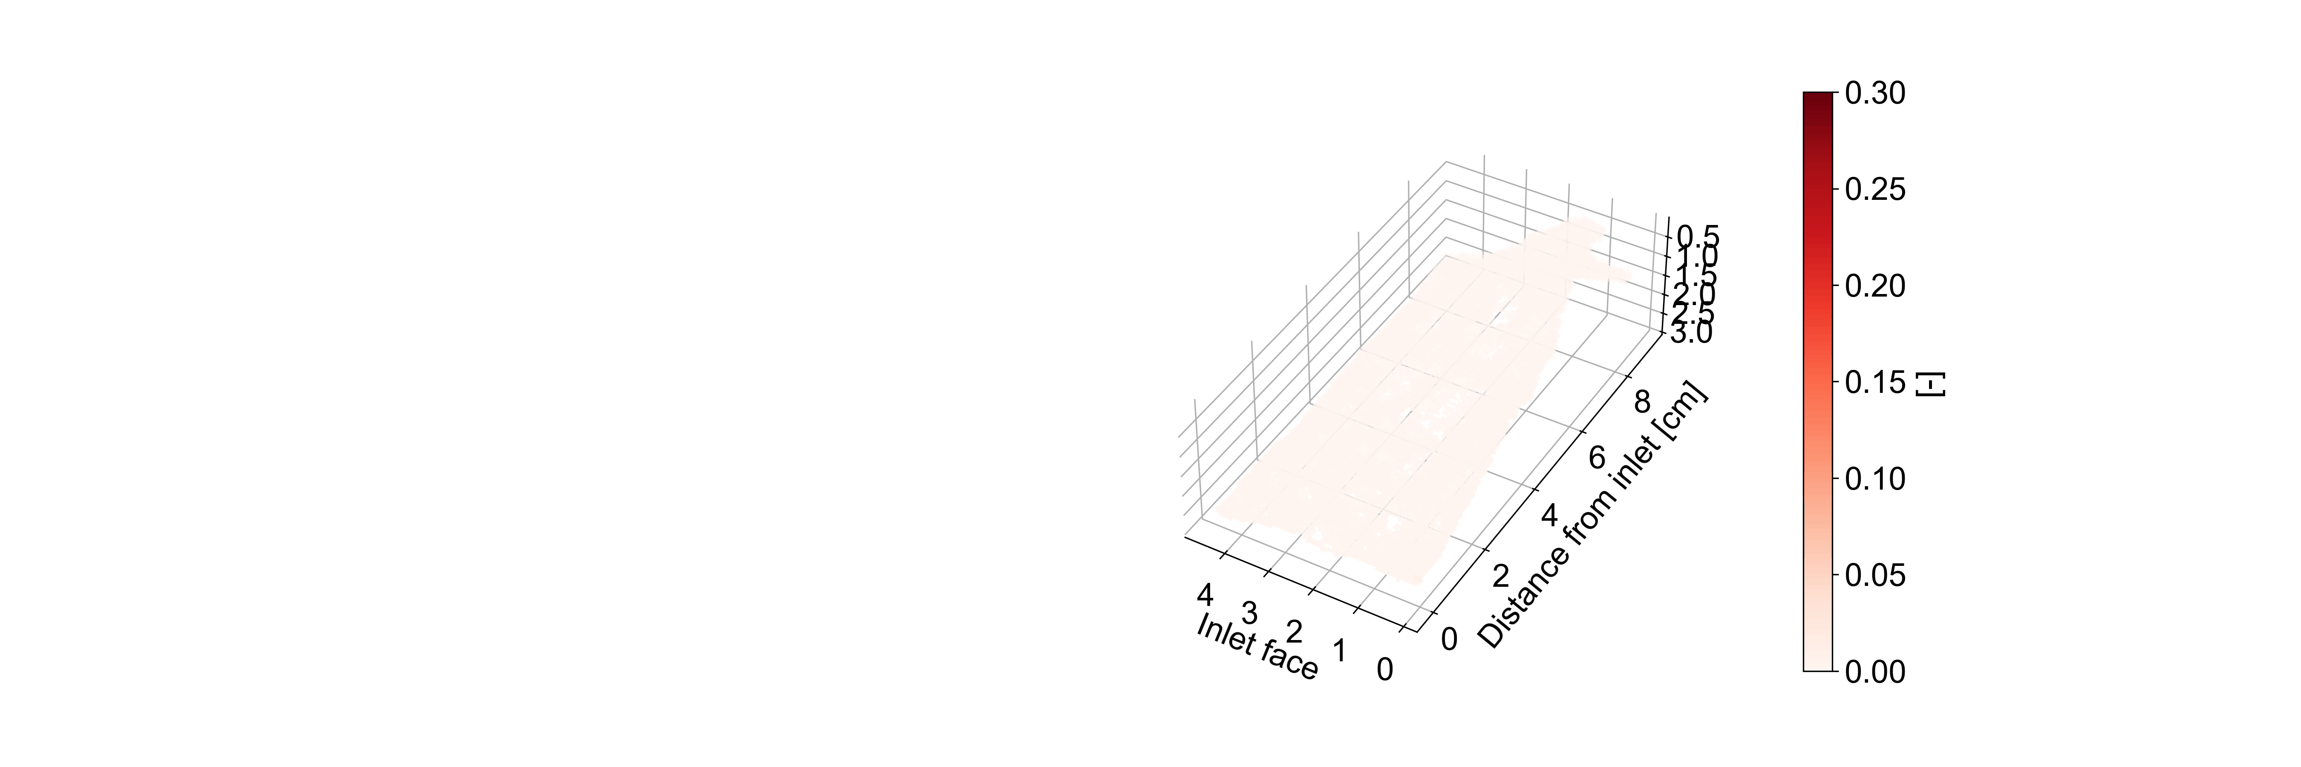
Core-scale Tracer Experiments Imaged with PET
PET scanner
Radiotracer sensors measure inlet and outlet radioconcentration
Direction of flow
Distance from inlet [cm]
Scanner parameters:
60 second timesteps
Voxel dimension = 0.77 x 0.77 x 0.8 mm
Experiment parameters:
0.5 mL/min flow rate
1mL injection of ¹⁸F-FDG tracer

Slide 7
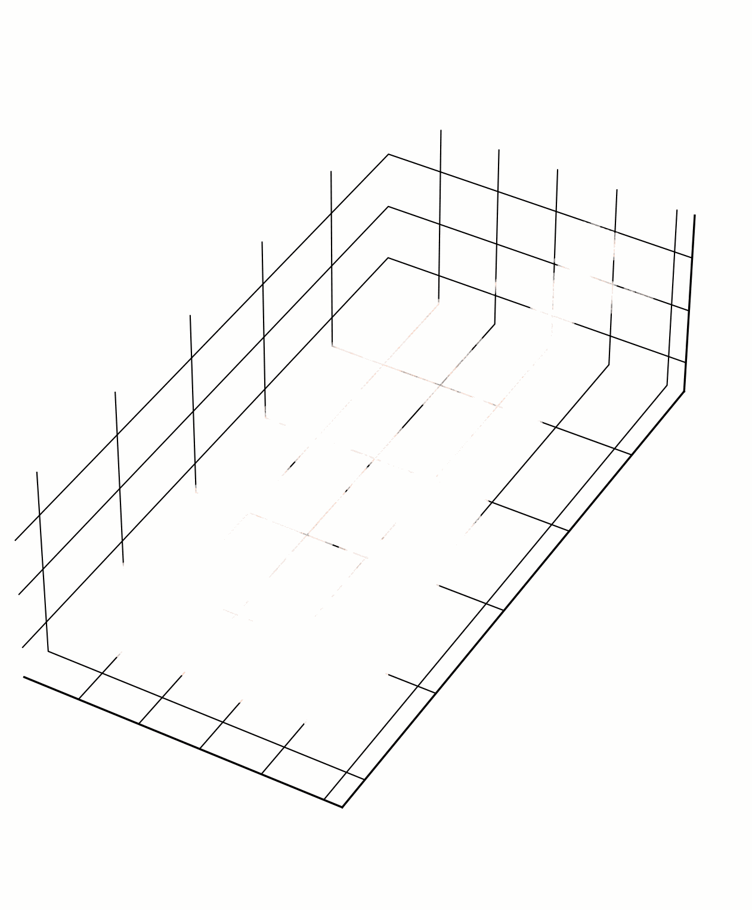
Core-scale Colloid Experiments Imaged with PET
PET scanner
Radiotracer sensors measure inlet and outlet radioconcentration
Direction of flow
Scanner parameters:
60 second timesteps
Voxel dimension = 0.77 x 0.77 x 0.8 mm
Experiment parameters:
0.5 mL/min flow rate
1mL injection of ⁶⁴Cu-labeled kaolinite

Slide 8
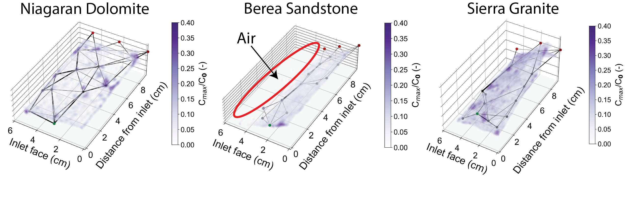
Graph network from PET images
Peak PET voxel concentrations used to make graphs from transport data
Heirarchical-based clustering approach for nodes [Ester et al., 1996]
K-nearest neighbors for edge connection

Slide 9
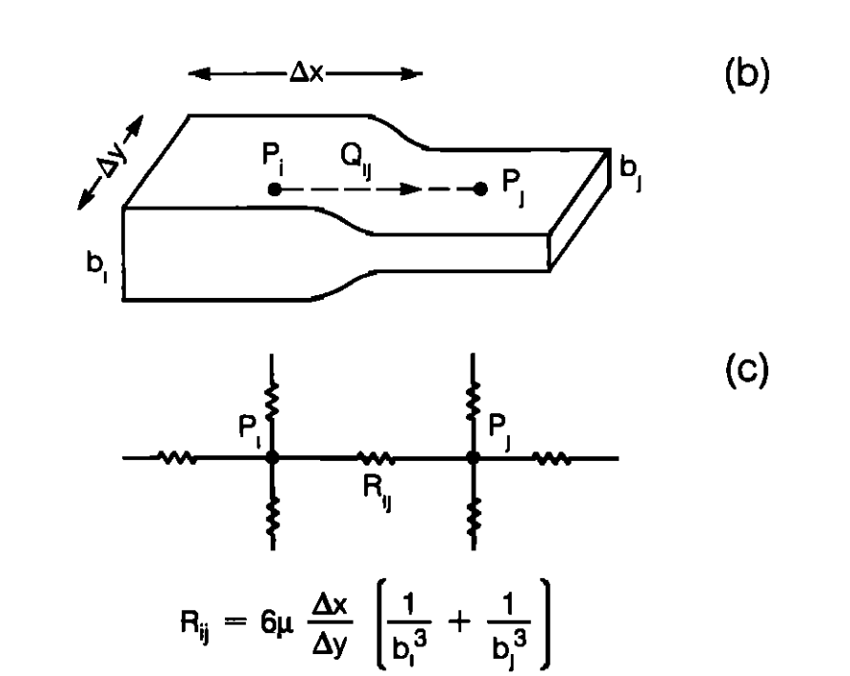
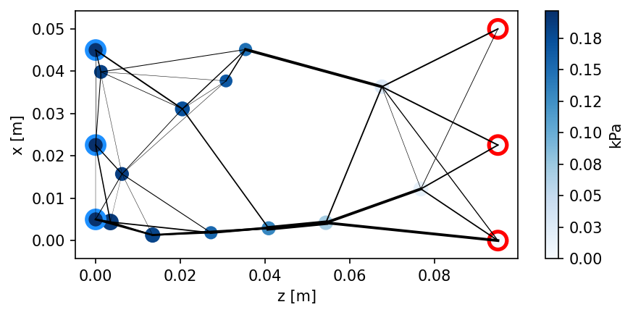
Solve flow equations
Finite volume resistance network formulation
Constant flow nodes
Constant pressure nodes
[Moreno et al, 1988]

Slide 10

Solve for transport with Time Domain Random Walk Model
Empirically corrected lognormal PDF used when edge Pe > 10
Lookup table at Pe <10, draw a random uniform number from (0,1) and lookup to determine travel time.
Matrix diffusion
First order reactions if deposition/reaction time is less than travel time
[Bodin et al, 2023]
[Yosri et al, 2020; Liu et al, 2022]
[Liu et al, 2022]
Notes:
To match laboratory experiments where breakthrough is measured at a detector connected to the
fracture outlet by tubing of length Lt and inner radius rt, particle arrival times are convolved with
a Taylor–Aris response

Slide 11
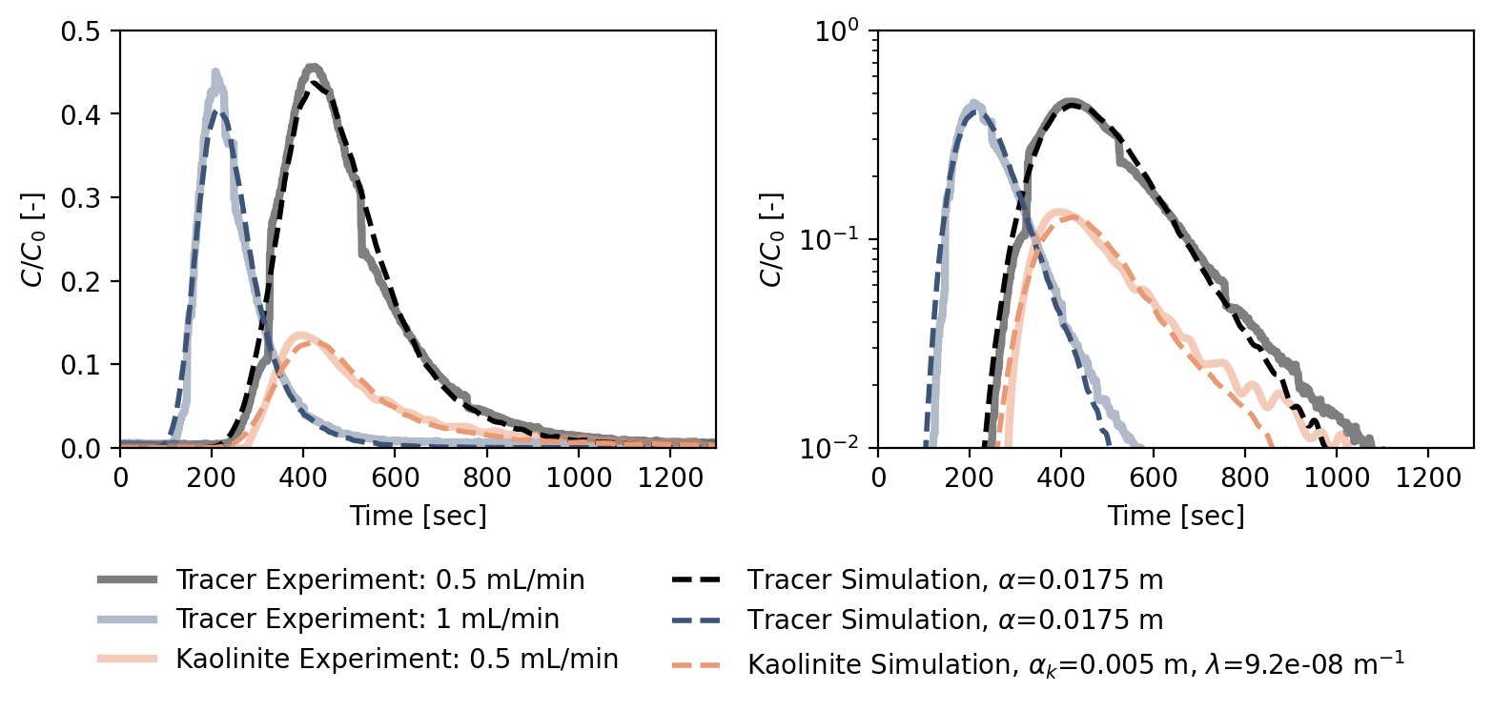
Fractured Sierra granite with subtle matrix diffusion and colloid transport
First-order attachment term and dispersivity are the only colloid transport tuning parameters relative to tracer fit

Slide 12
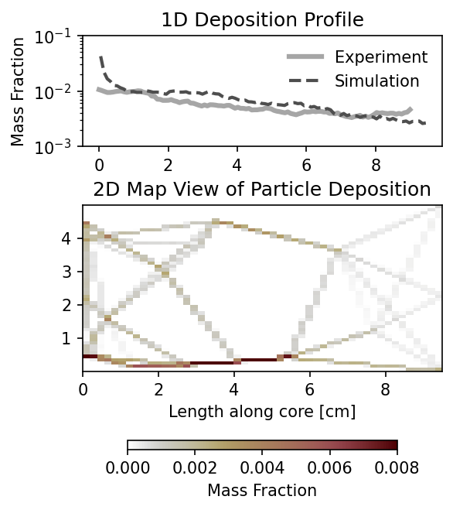
In addition to breakthrough curves, we can also compare deposition profiles
Flow solution

Slide 13
In addition to breakthrough curves, we can also compare deposition profiles
Flow solution

Slide 14
… but what about more complex fracture networks and boundary conditions?
Notes:
these graph-based models can describe flow, transport, matrix diffusion, and first-order reactions at the core scale

Slide 15
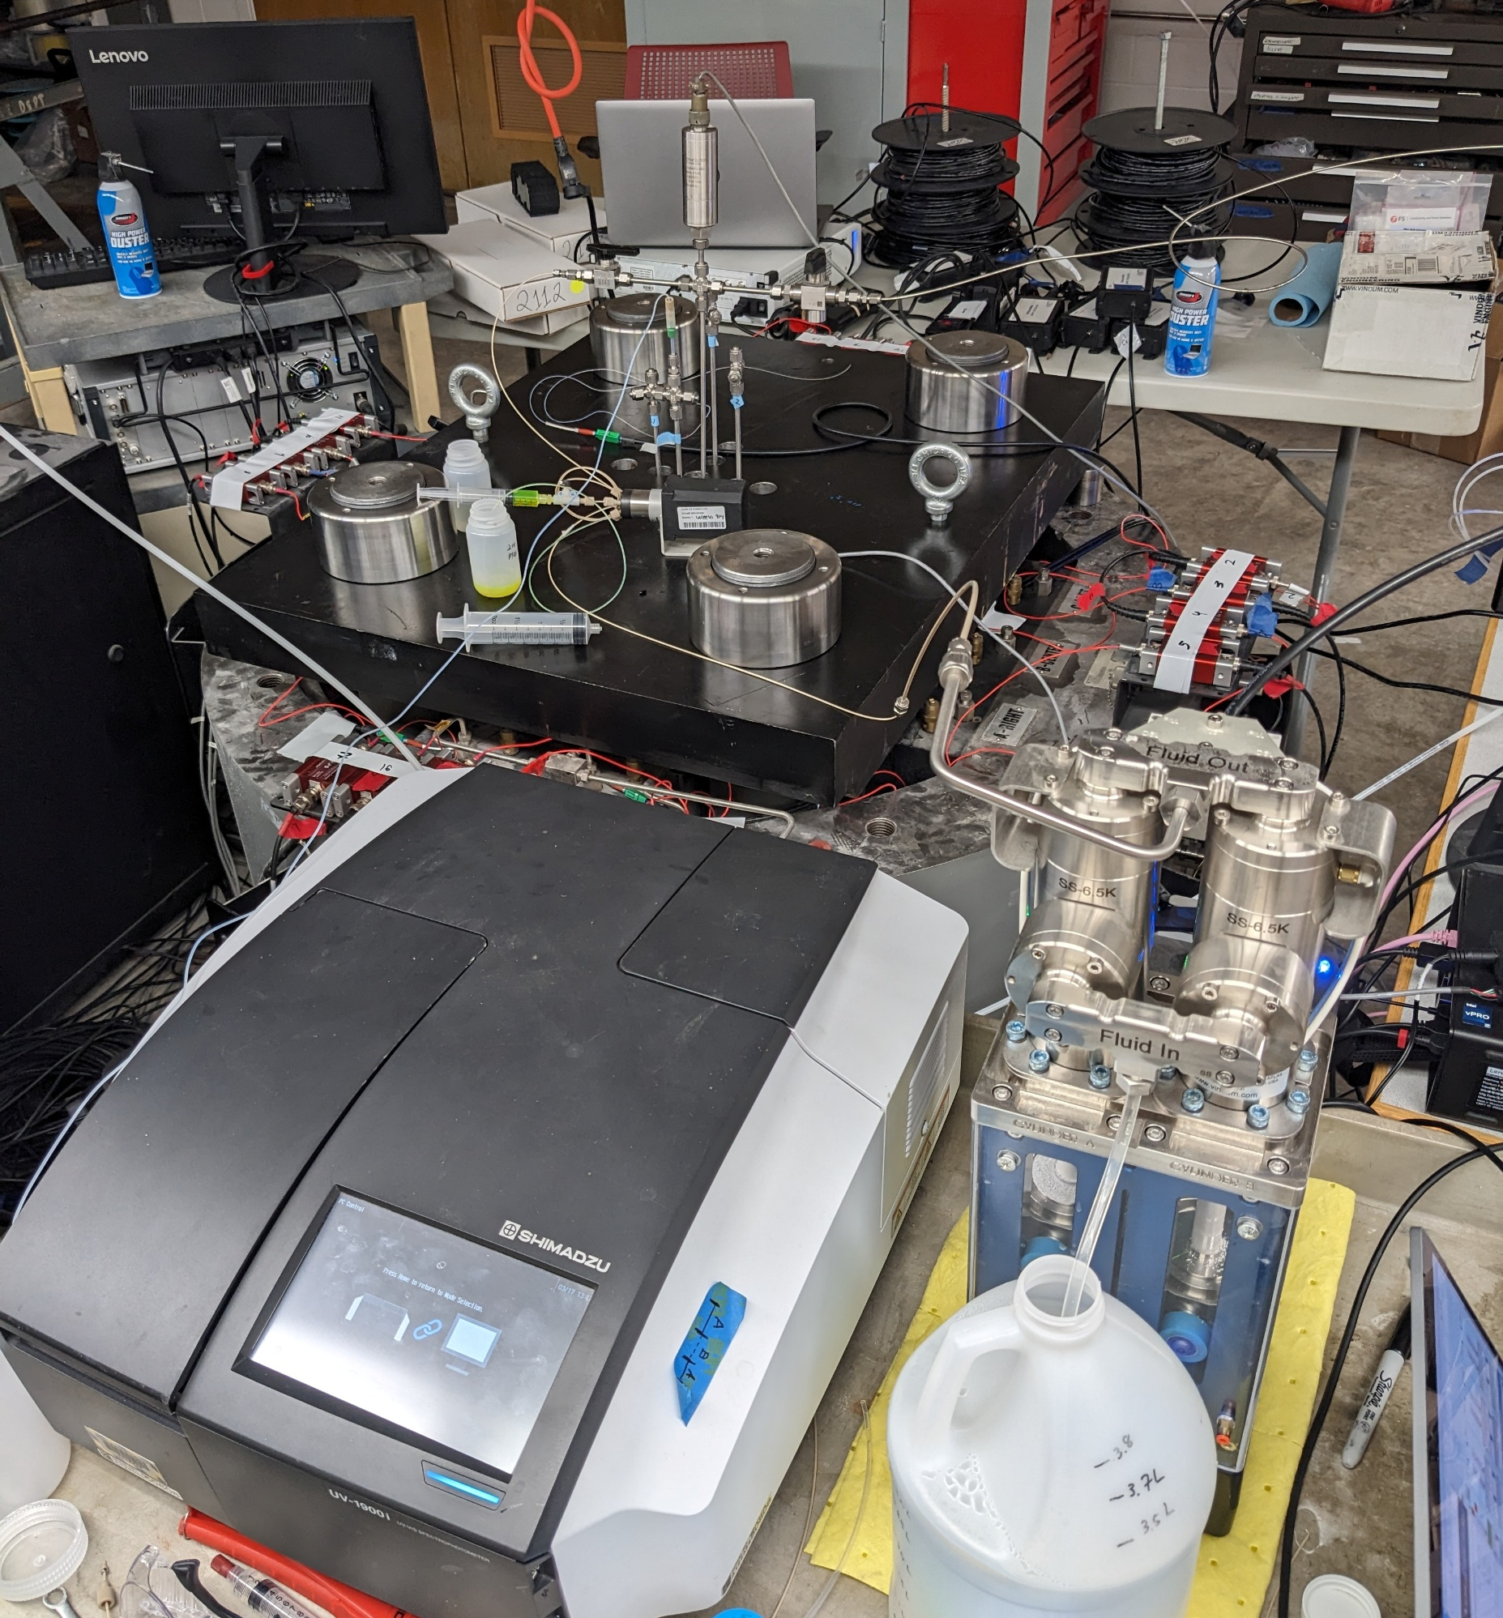
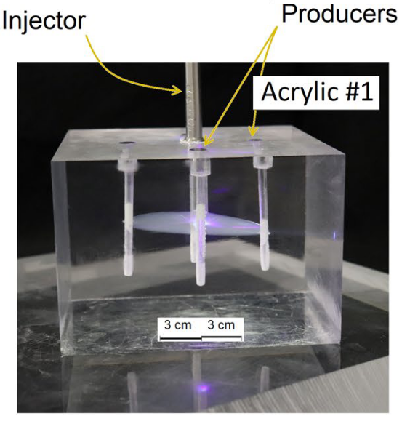

Use multiwell fracture caging to generate hydraulic fractures in laboratory
Same well arrangement but in granite block
(45 x 30 x 30 cm) under triaxial stress conditions
$σ_{1}=σ_{2}=$ 31MPa
$σ_{3}=$ 5.9MPa
[Frash et al, 2021]

Slide 16
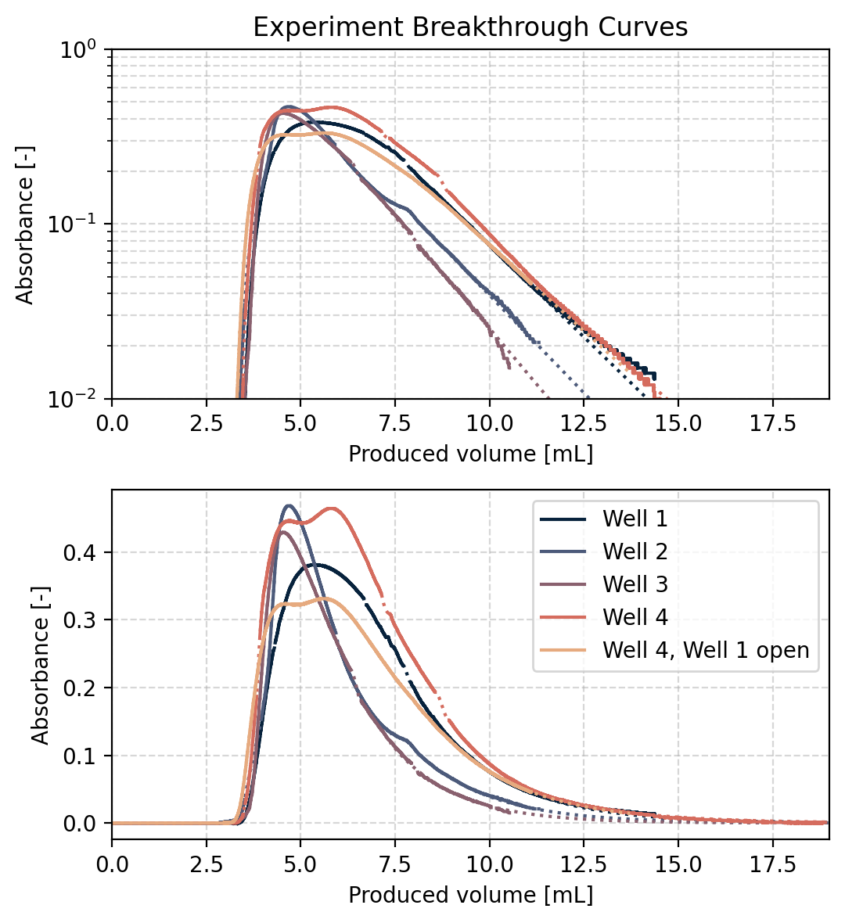

Multiwell tracer tests
Fluorescene tracer injected into center well
$σ_{1}=σ_{2}=$ 31MPa
$σ_{3}=$ 5.9MPa
BTC at open wells measured with custom flow-through cuvette in UV-Vis spectrophotometer

Slide 17
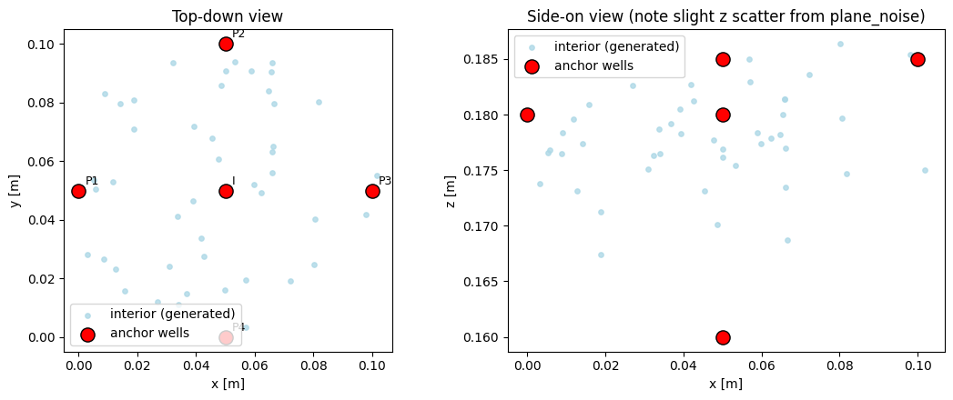
Initial graph parameterization uses known wells at nodes and random interior nodes
Top view
Side view
5 cm

Slide 18
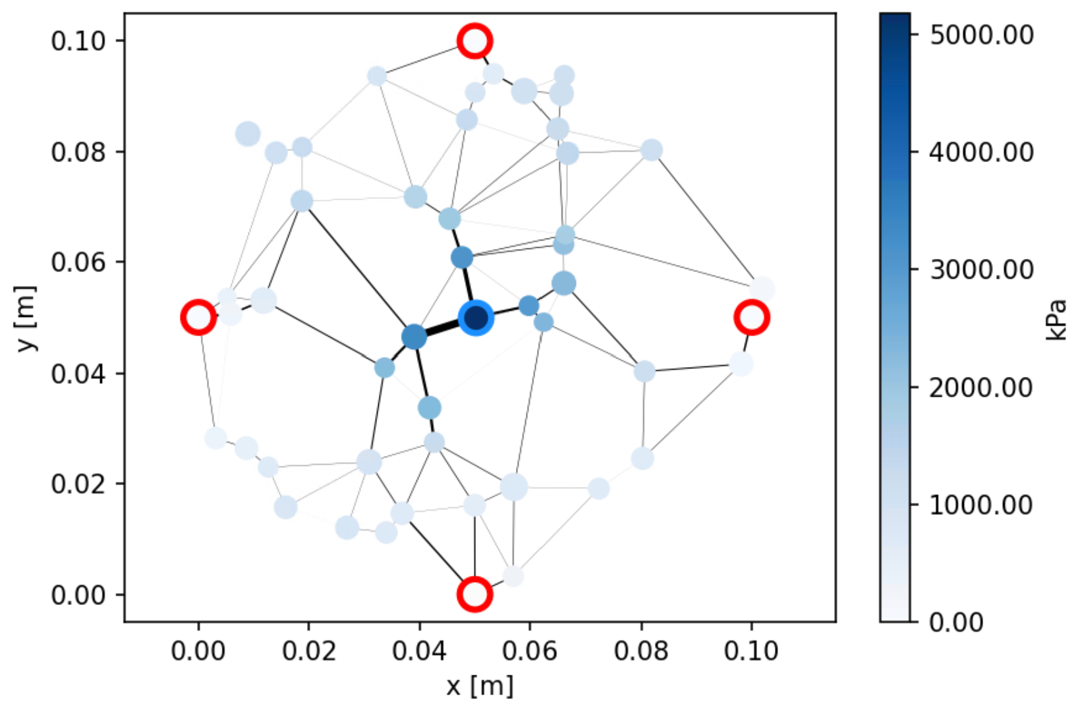
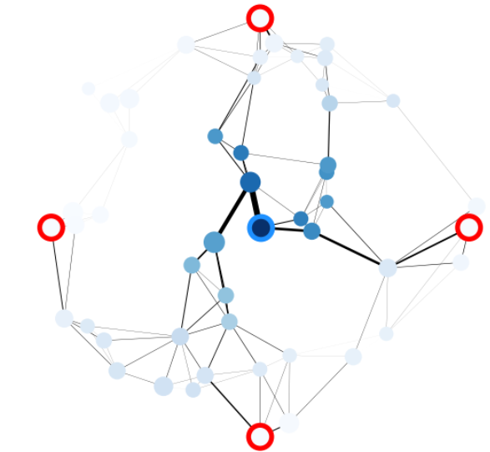
Initial graph parameterization uses known wells at nodes and random interior nodes
Constant flow node
Constant pressure nodes

Slide 19
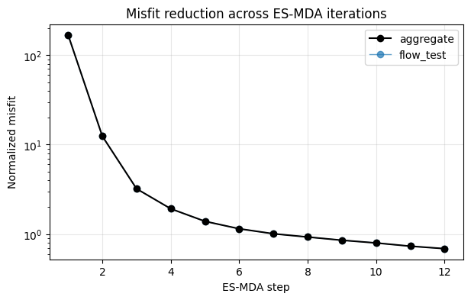
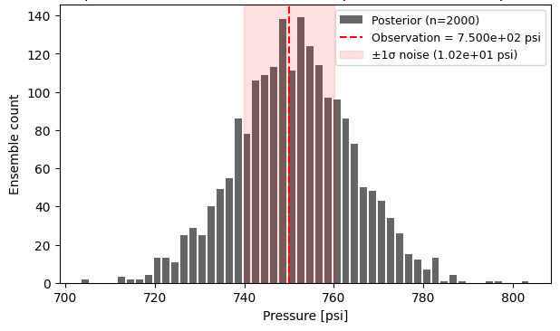
Given a fixed network geometry, we can apply classic inversion methods to fit node apertures and global transport parameters to pressure, flow, and BTC observations.
Ensemble Smoother Multiple Data Assimilation (ES-MDA) with 2000 models runs each flow iteration in 20 seconds on 8 processors.
Misfit reduction across 12 ES-MDA iterations

Slide 20
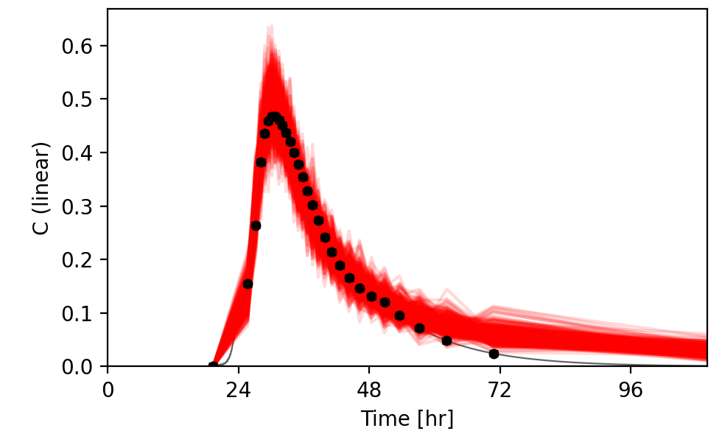
Given a fixed network geometry, we can apply classic inversion methods to fit node apertures and global transport parameters to pressure, flow, and BTC observations.
Ensemble Smoother Multiple Data Assimilation (ES-MDA) with 2000 models runs each flow iteration in 20 seconds on 8 processors.
Well 2 Experiment
Misfit reduction across 12 ES-MDA iterations
Posterior models
Notes:
15 min per TDRW iteration on downsampled ensemble of 400 models

Slide 21
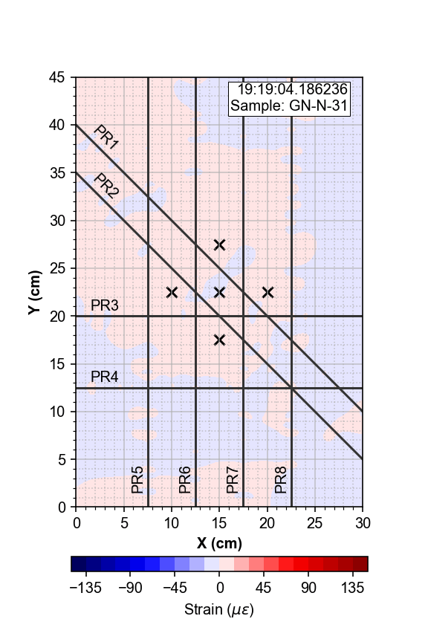
The next step is to assimilate acoustic emission and strain data to constrain graph parameters
Fiber optic strain measurements
Time-resolved granite block deformation measured with DSS
[Opperman MS, 2026]
Notes:
Distributed Strain Sensing - Fiber sensing is interferometry
Rayleigh Optical Frequency Domain Reflectometry
Frequency Sweep
Differences in beat frequency encode strain and temperature changes
Hydromechanical coupling was documented with DSS data
Flow controls fracture extent and velocity
Caged geothermal systems were successfully created and described in lab-scale granite samples.

Slide 22
Summary
At the core scale, graph-based models can effectively describe flow, transport, matrix diffusion, first-order reactions, and colloid transport.
Models fit to one set of conditions can be used to forecast to other system physics or boundary conditions.

Slide 23
Summary
At the core scale, graph-based models can effectively describe flow, transport, matrix diffusion, first-order reactions, and colloid transport.
Models fit to one set of conditions can be used to forecast to other system physics or boundary conditions.
The computational efficiency of graph-based models enables ensemble-based inversion methods
Ongoing work is focused on assimilating multiple datastreams, geometry optimization, and increasing TDRW model speed.
KNN - 4

Slide 24



Questions? Interested in this work? I’m looking for PhD students and postdocs!
C/C₀
Email: czahasky@wisc.edu
References:
Zahasky et al, (2019) Positron emission tomography in water resources and subsurface energy resources engineering research. AWR
Sutton and Zahasky (2024) In Situ Quantification of Colloidal Kaolinite Transport and Attachment in Porous Media Using Positron Emission Tomography. TiPM
Sutton and Zahasky (2025) A laboratory‐validated, graph‐based flow and transport model for naturally fractured media. GRL
Frash, L., et al (2021) Fracture Caging to Limit Induced Seismicity. GRL
Liu, L., et al. (2022) A new analytical solution of contaminant transport along a single fracture connected with porous matrix. J. Hydrology
Grant No. 2002412,
2437912
Grant No. 66040-DNI9
InterPore 2026– May 22, 2026

Slide 26
Extra slides

Slide 27
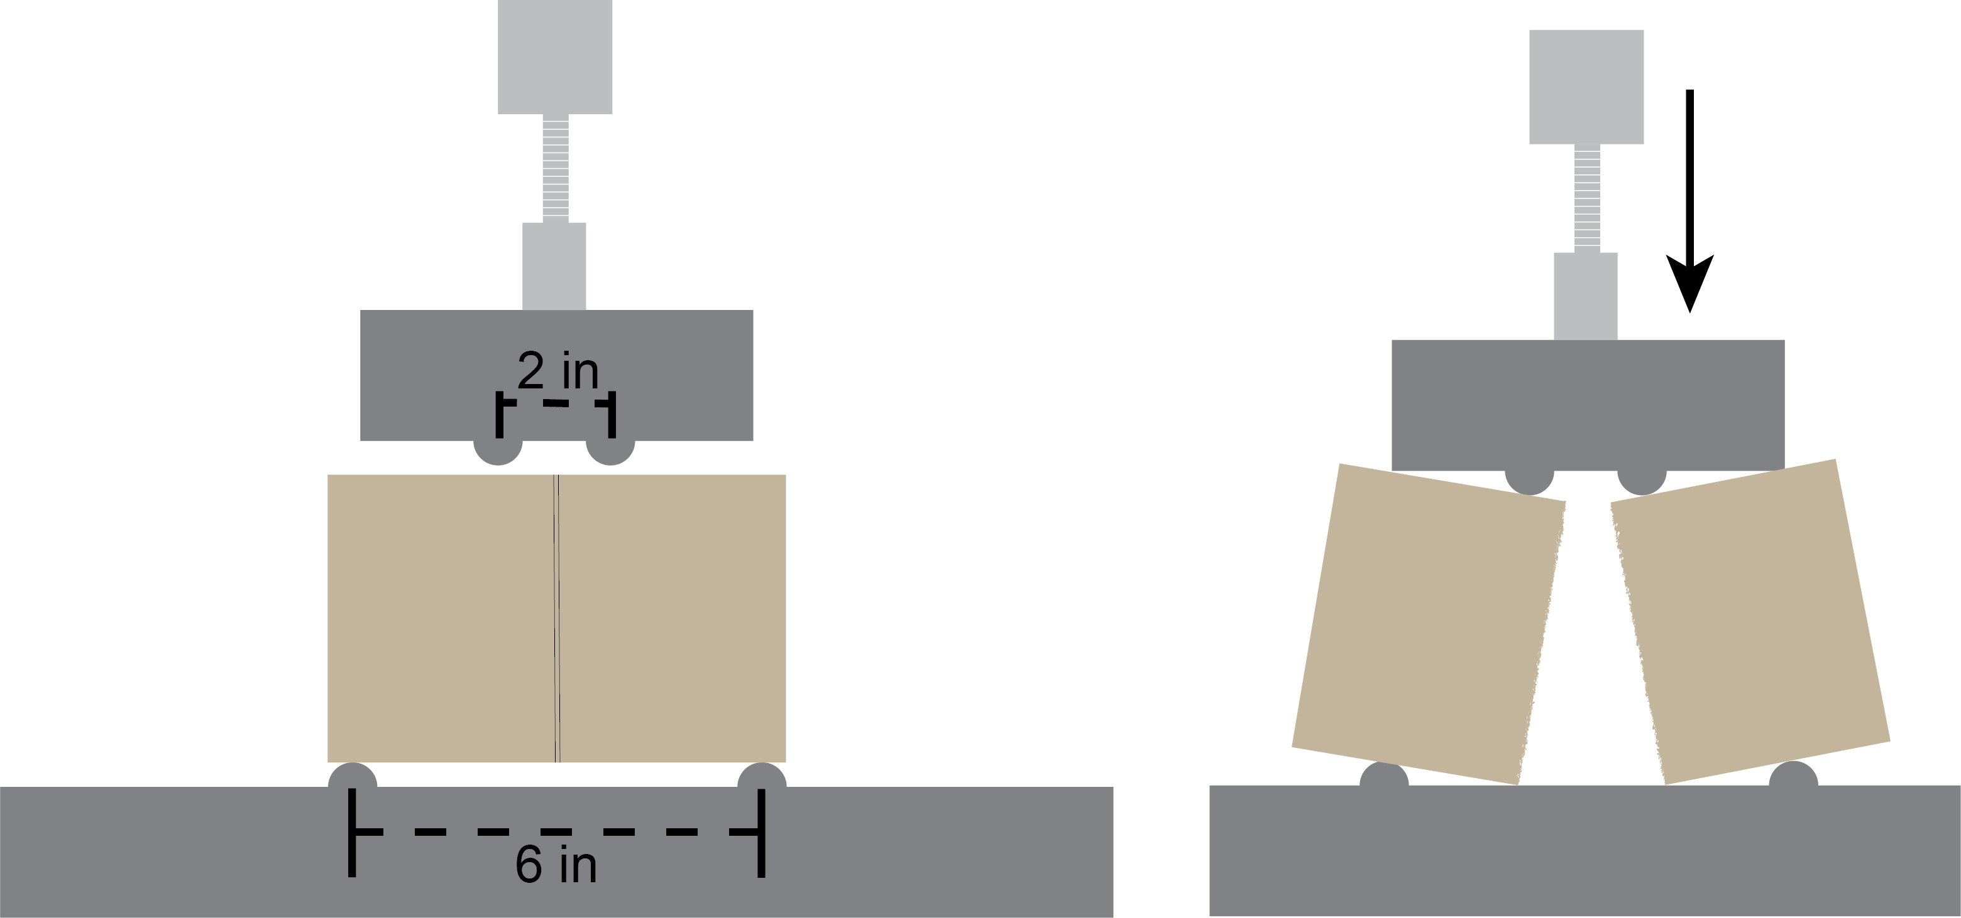
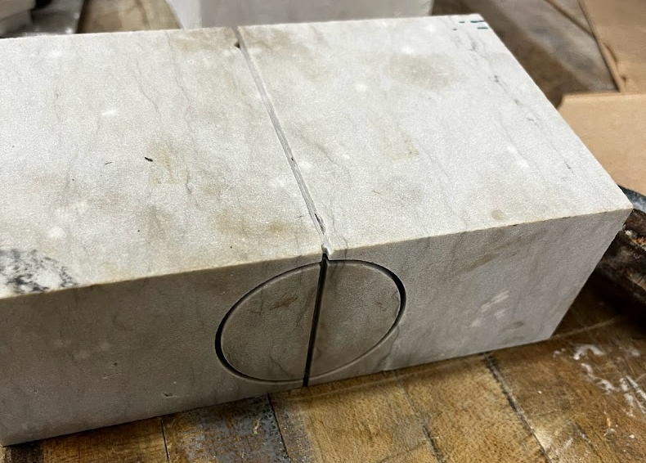
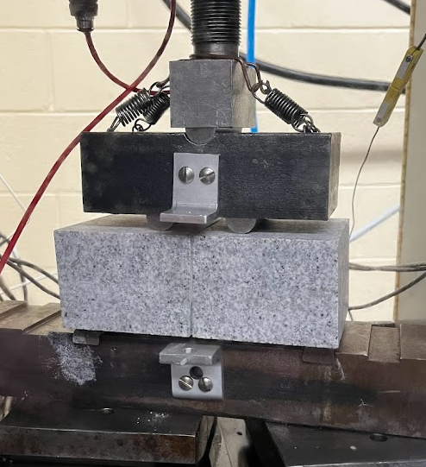
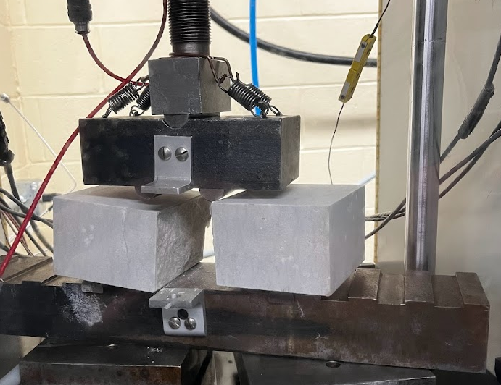
Creating Axial-Parallel Fractured Cores

Slide 28
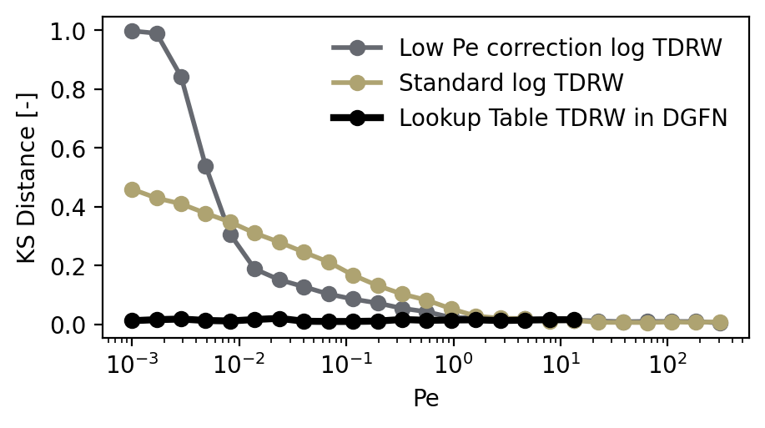
Solve for transport with Time Domain Random Walk Model
Empirically corrected lognormal PDF used when edge Pe > 10
Lookup table at Pe <10, draw a random uniform number from (0,1) and lookup to determine travel time.
[Bodin et al, 2023]
KS distance between CDF of TDRW methods and analytical solution
Notes:
To match laboratory experiments where breakthrough is measured at a detector connected to the
fracture outlet by tubing of length Lt and inner radius rt, particle arrival times are convolved with
a Taylor–Aris response

Slide 29
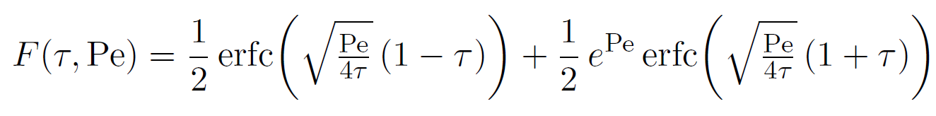
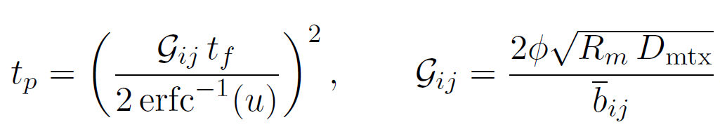
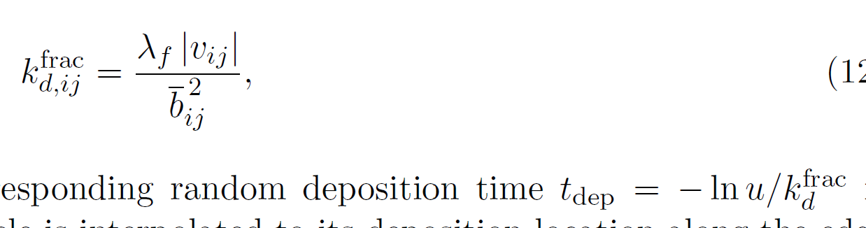
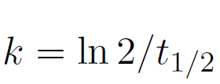
Solve for transport with Time Domain Random Walk Model
Empirically corrected lognormal PDF used when edge Pe > 10
Lookup table at Pe <10, draw a random uniform number from (0,1) and lookup to determine travel time.
Matrix diffusion
First order reactions if deposition/reaction time is less than travel time
[Bodin et al, 2023]
[Yosri et al, 2020; Liu et al, 2022]
[Liu et al, 2022]
Notes:
To match laboratory experiments where breakthrough is measured at a detector connected to the
fracture outlet by tubing of length Lt and inner radius rt, particle arrival times are convolved with
a Taylor–Aris response

Slide 30


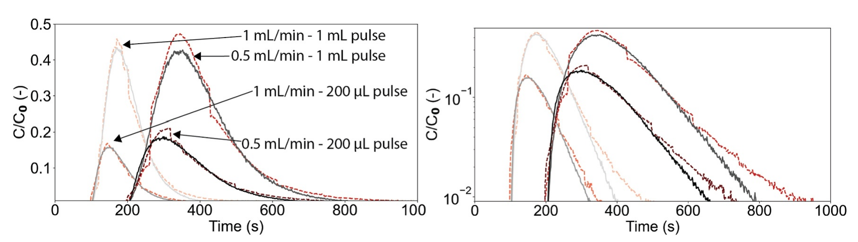
Graph model with no matrix diffusion or reactions was compared with core-scale experimental data in our paper last year
Model fit to one experiment showed generalizability across experiments with different boundary conditions without tuning

Slide 31
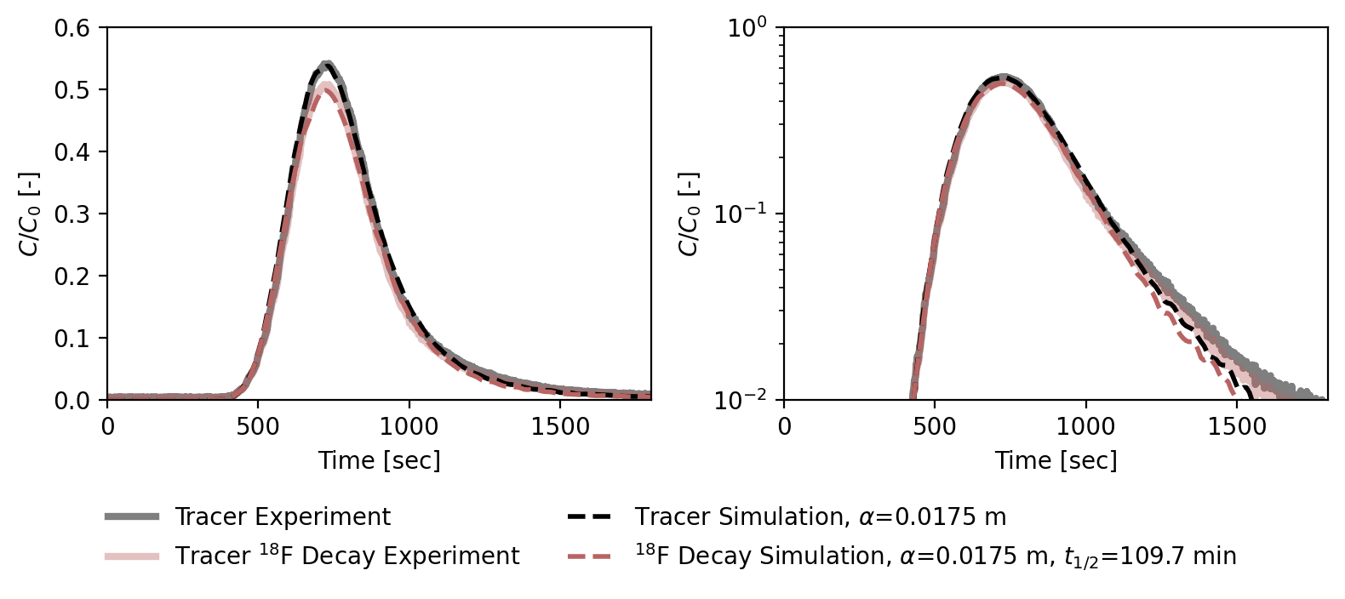
Fractured dolomite with subtle matrix diffusion and first-order decay
First-order reaction uses exact ¹⁸F half-life and model uses measured porosity.

Slide 32
Exploring different connectivity algorithms (K-nearest neighbors vs Gabriel graph)
Gabriel graph
KNN - 4
Constant flow node
Notes:
Knn and Gabriel graph with 50 total nodes
Two nodes are Gabriel neighbors if the smallest circle/sphere through both of them is "empty" of other points.
Gabriel graph is a subgraph of the Delaunay triangulation. Every Gabriel edge is a Delaunay edge. This makes sense because both are "empty region" graphs — Delaunay requires some empty circle through the two points, while Gabriel requires the specific diametral circle to be empty, a stricter condition.

Slide 33
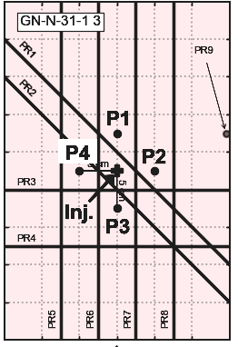
System is also instrumented with distributed strain sensing and acoustic emission sensors
Same well arrangement but in granite block under triaxial stress conditions
$σ_{1}=σ_{2}=$ 31MPa
$σ_{3}=$ 5.9MPa
Fiber optic strain measurements

