Slide 1



What controls mixing in Discrete Fracture Networks?
Stefano Ascione (1,2) Joris Heyman (1) Tanguy Le Borgne(1) Daniel R. Lester(2) Benoit Pinier(1,3)
1 Université de Rennes / CNRS , - 2 RMIT University, - 3 Fractory / ITASCA
This project has received funding from the European Union's Horizon 2020 research and innovation programme under the Marie Skłodowska-Curie grant agreement No 101034328 , Region Bretagne, Rennes Ville Metropole and College Doctoral Bretagne. This publication reflects only the author's view and the Research Executive Agency is not responsible for any use that may be made of the information it contains.
Ascione et al, J. Fluid Mech. (2026)
1 / 17
Notes:
Slide 1. Editable PowerPoint recreation of the Beamer draft, using paper figures as raster assets and text as editable PPTX objects.

Slide 2
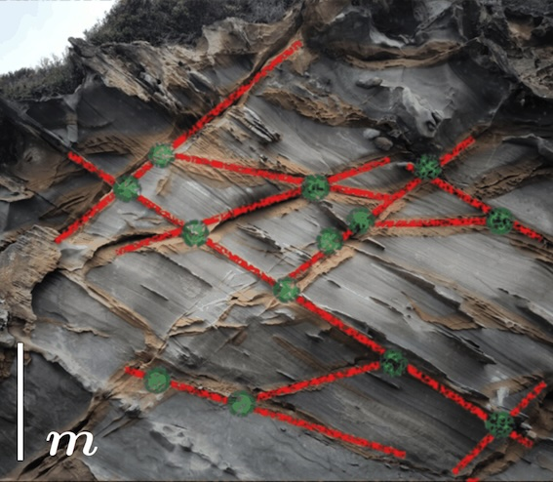
Fractured Media
High-permeability fractures in low-permeability rock.
Thin apertures: ℓ≪L .
Fractures are connected by intersections.
Cape oatway , VIC, AU
Ascione et al, J. Fluid Mech. (2026)
2 / 17
Notes:
Slide 2. Editable PowerPoint recreation of the Beamer draft, using paper figures as raster assets and text as editable PPTX objects.

Slide 3
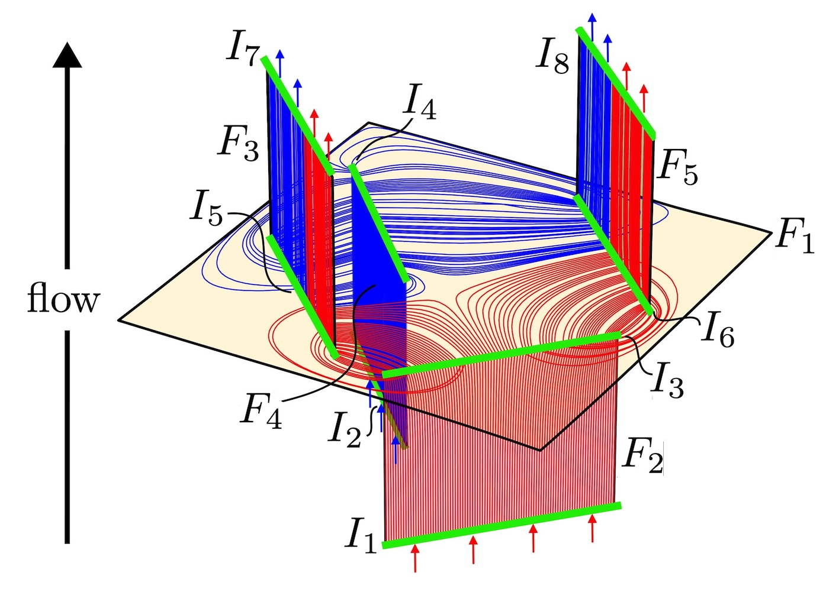
Flow in Fractured Media
Transport is controlled by streamline routing through fractures and intersections.
Flow is concentrated in the high-permeability fractures.
Mixing affects dilution, chemical reactions, and biological activity.
Central problem
What is the mechanism that govern mixing in Fracture Networks?
Ascione et al, J. Fluid Mech. (2026)
3 / 17
Notes:
Slide 2. Editable PowerPoint recreation of the Beamer draft, using paper figures as raster assets and text as editable PPTX objects.

Slide 4
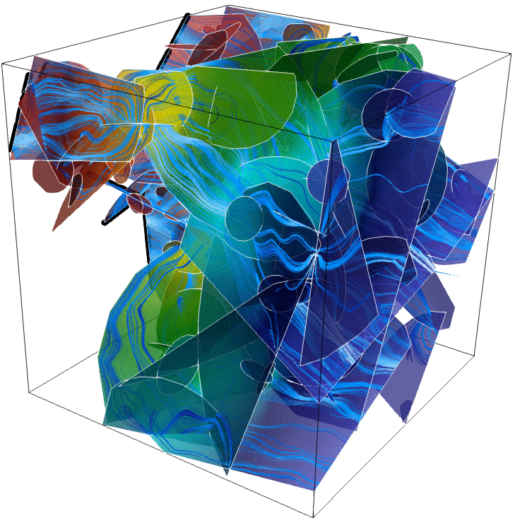
Why standard DFN transport is not enough
A DFN reduces fractured rock to 2D fracture planes connected by 1D intersections.
This is efficient for flow and dispersion, but it hides aperture-scale structure.
Random flux weighted rules at intersections break deterministic advective reversibility.
DFN.lab, ITASCA & University of Rennes
Missing ingredient
A deterministic description of how streamlines parcels are cut, routed, recombined and locally deformed.
Ascione et al, J. Fluid Mech. (2026)
4 / 17
Notes:
Slide 3. Editable PowerPoint recreation of the Beamer draft, using paper figures as raster assets and text as editable PPTX objects.

Slide 5
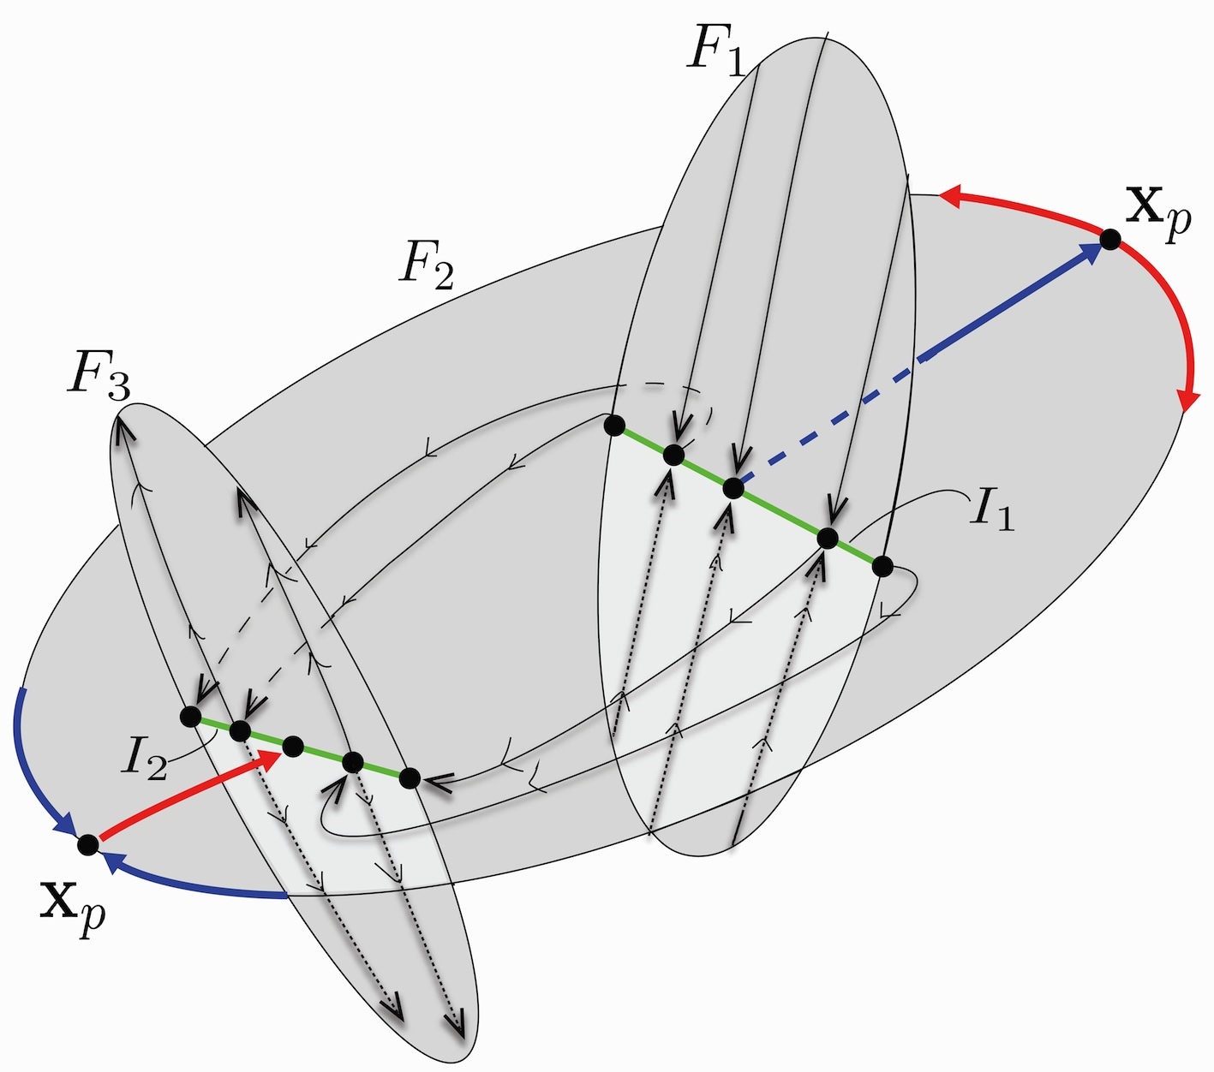
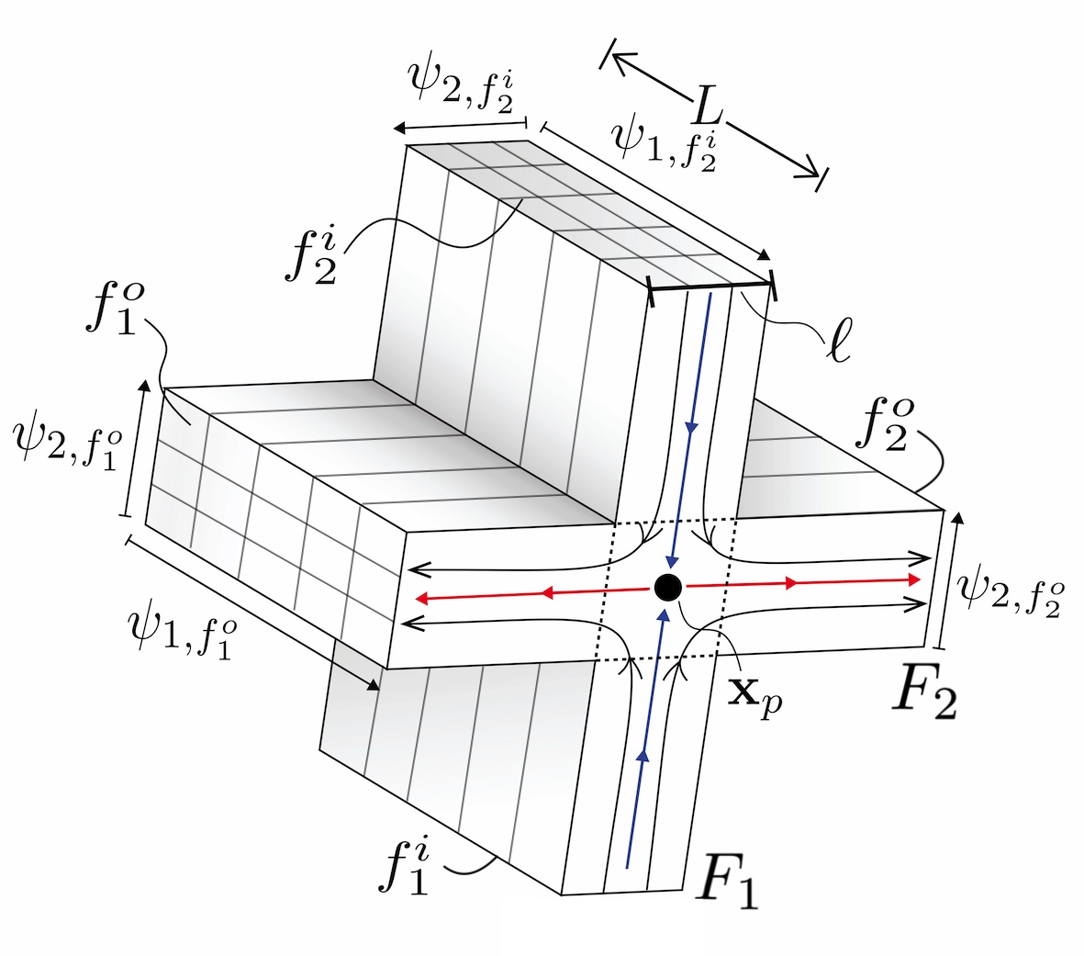
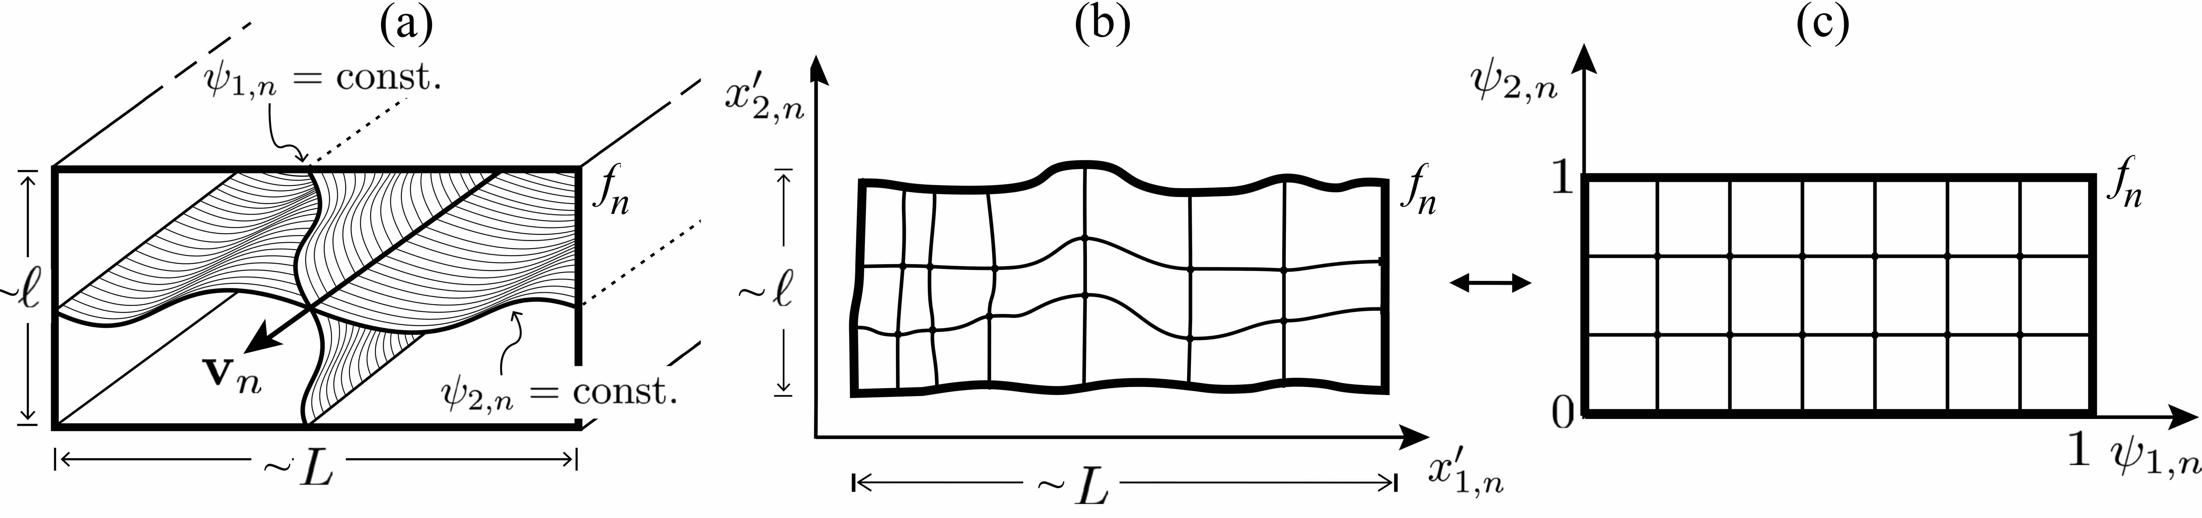


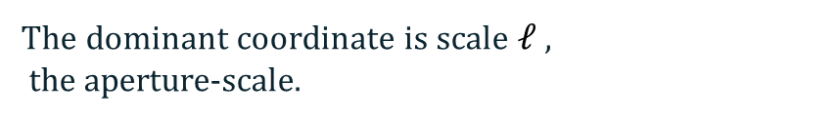


Fracture-scale $L$ and Intersection-scale $ℓ$ routing
$$L$$
$$L$$
Separating streamlines partition a fracture into coherent parcels routed from an upstream face to a downstream face.
This produces large-scale rearrangement at scale L
$$≫$$
Intersections route streamlines through separatrices and stagnation structures.
$$ℓ$$
The dominant coordinate is scale $ℓ$ ,
the aperture-scale.
Ascione et al, J. Fluid Mech. (2026)
5/ 17
Notes:
Slide 6. Editable PowerPoint recreation of the Beamer draft, using paper figures as raster assets and text as editable PPTX objects.

Slide 6
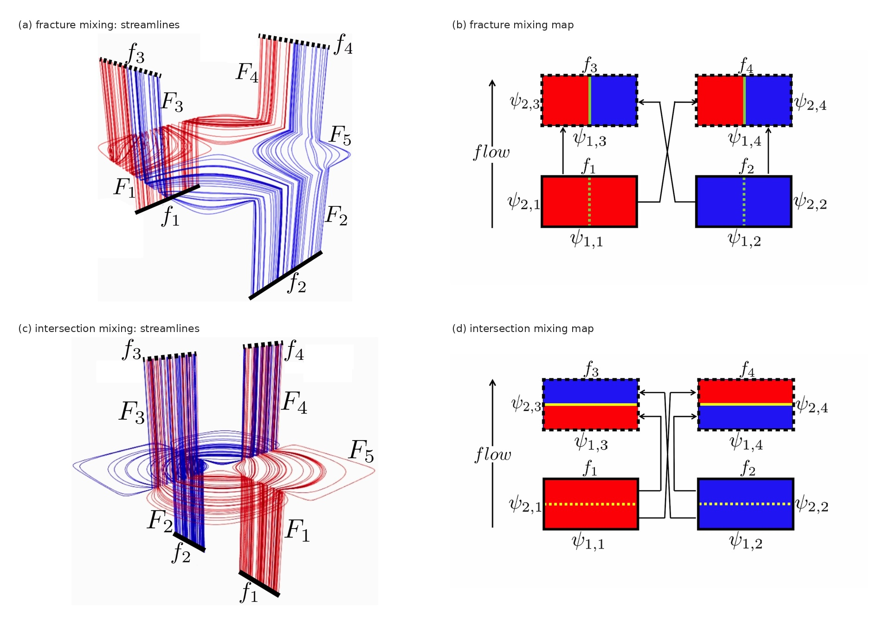
Mixing mechanisms occur at two separated scales
Fracture mixing
Streamlines split and recombine inside fractures.
This acts at the fracture-width scale L.
Intersection mixing
Streamline routing at junctions interleaves fluid elements at the aperture scale ℓ.
ℓ ≪ L makes the two mechanisms dynamically distinct.
Ascione et al, J. Fluid Mech. (2026)
6/ 17
Notes:
Slide 4. Editable PowerPoint recreation of the Beamer draft, using paper figures as raster assets and text as editable PPTX objects.

Slide 7
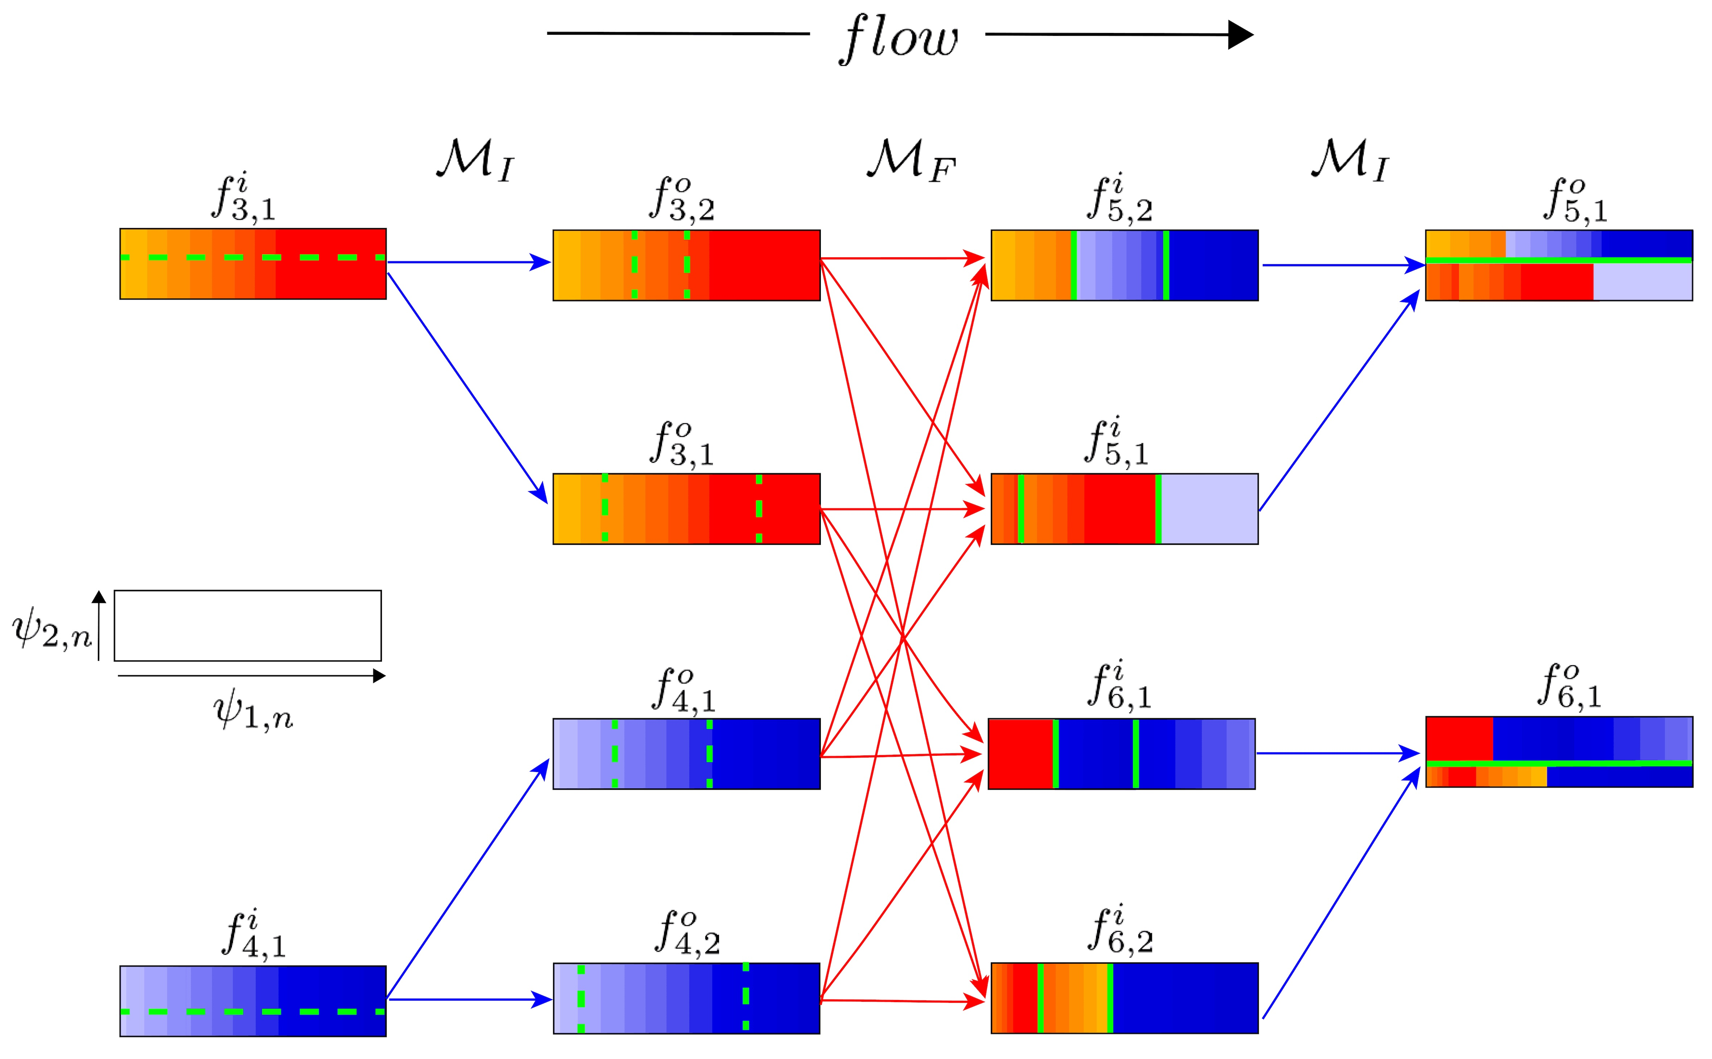

The mixing graph $G_{m}$
Each face stores a local concentration field $c_{n}$(ψ₁,n, ψ₂,n).
The outlet field is the composed action of all maps along paths in $G_{M}$
$$M=M_{F}∘M_{I}∘ …∘M_{F}∘M_{I}$$
Ascione et al, J. Fluid Mech. (2026)
7 / 17
Notes:
Slide 10. Editable PowerPoint recreation of the Beamer draft, using paper figures as raster assets and text as editable PPTX objects.

Slide 8
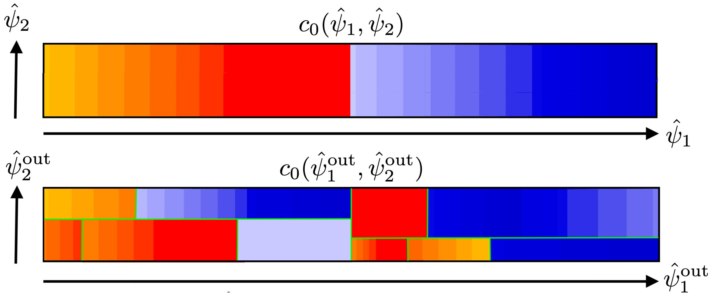
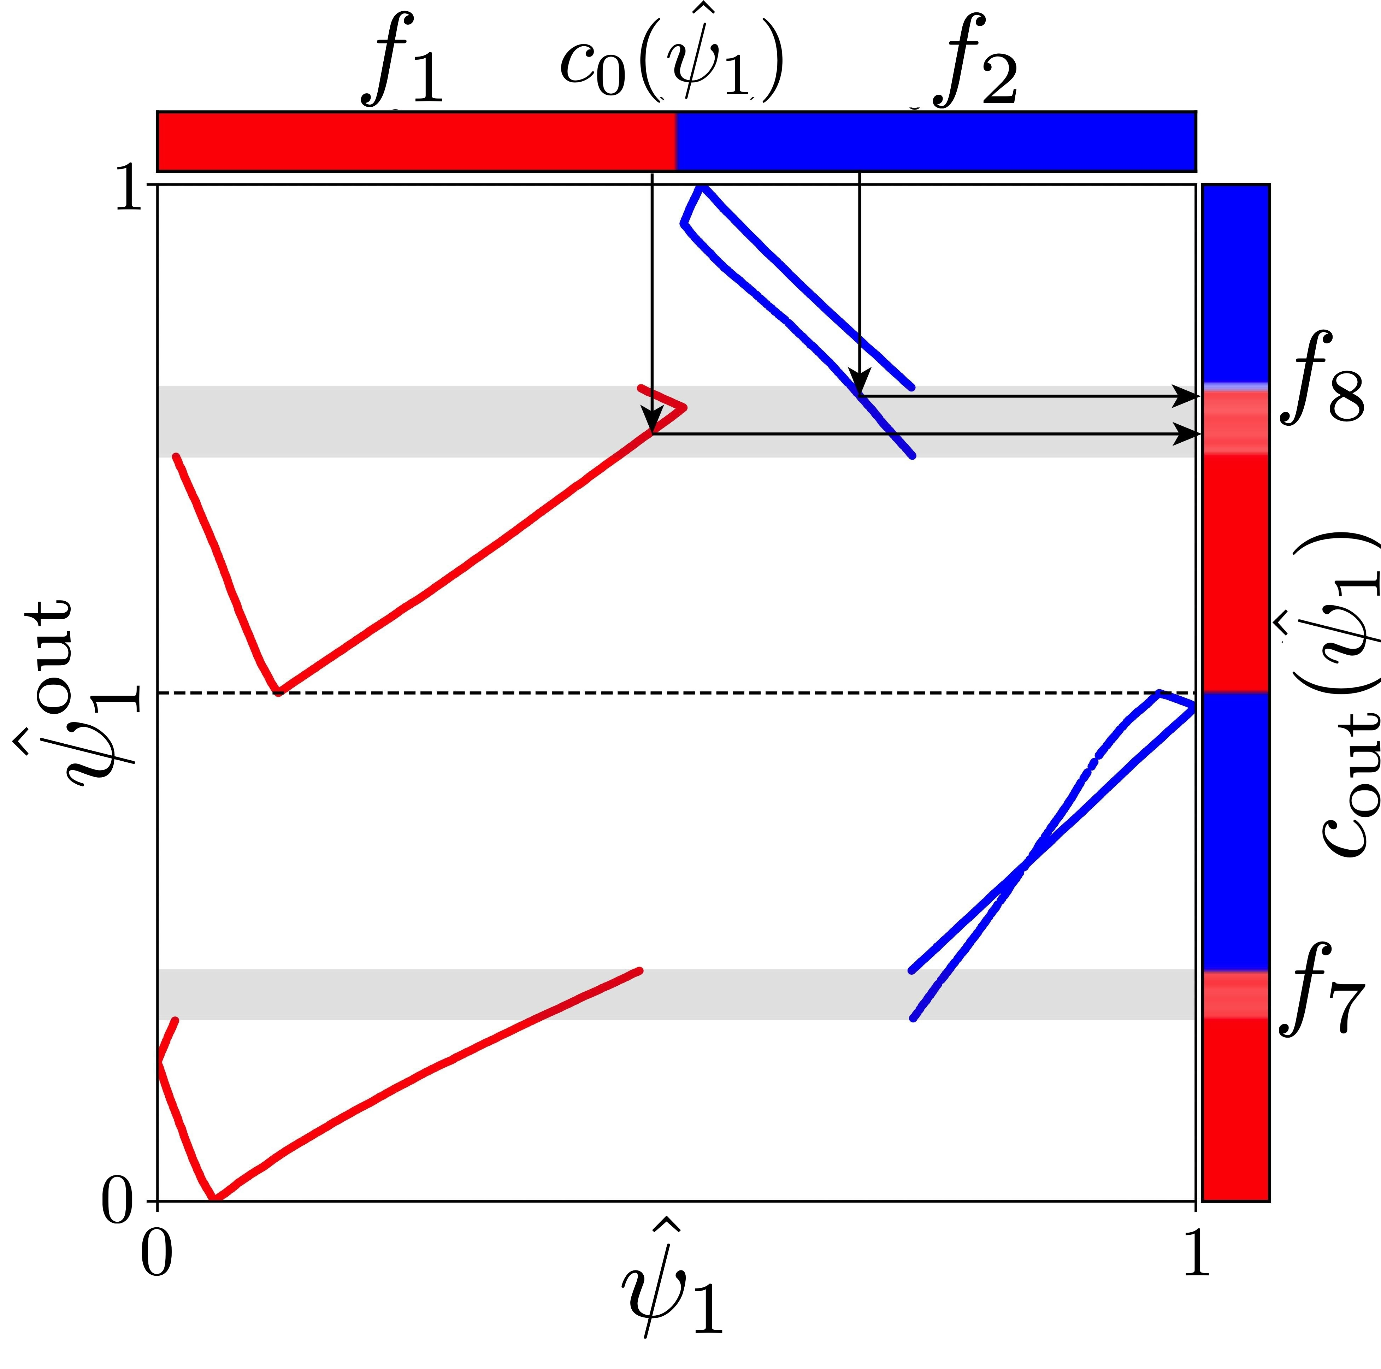






Inlet to output concentration map and Mixing metric
The inlet concentration is mapped to the outlet by streamline labels.
Fracture mixing creates macroscopic rearrangement.
$$s_{1}$$
Intersection mixing creates overlap along the aperture direction in the 2D view.
$$s_{2}$$
$$s_{3}$$
Mixing metric
We use a multiscale mix-norm, not simple concentration variance, because pure advection preserves variance.
Scale-dependent mix-norm, adapted from “A multiscale measure for mixing” Mathew, Mezić & Petzold (2005).
Ascione et al, J. Fluid Mech. (2026)
8 / 17
Notes:
Slide 11. Editable PowerPoint recreation of the Beamer draft, using paper figures as raster assets and text as editable PPTX objects.

Slide 9
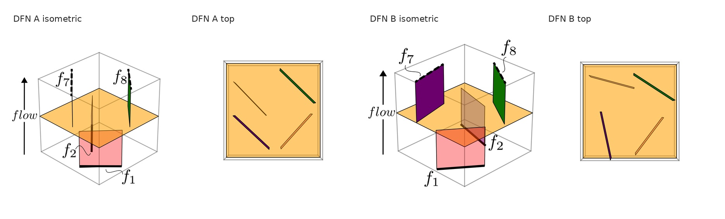
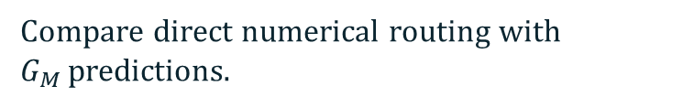

Numerical validation: two test DFNs
Flow solved with DFN.lab.
Validation target
Streamlines seeded flux-weighted at inlets.
Reproduce $c_{out }$ and multiscale mixing measures without direct particle integration.
Compare direct numerical routing with $G_{M }$predictions.
Ascione et al, J. Fluid Mech. (2026)
9 / 17
Notes:
Slide 12. Editable PowerPoint recreation of the Beamer draft, using paper figures as raster assets and text as editable PPTX objects.

Slide 10
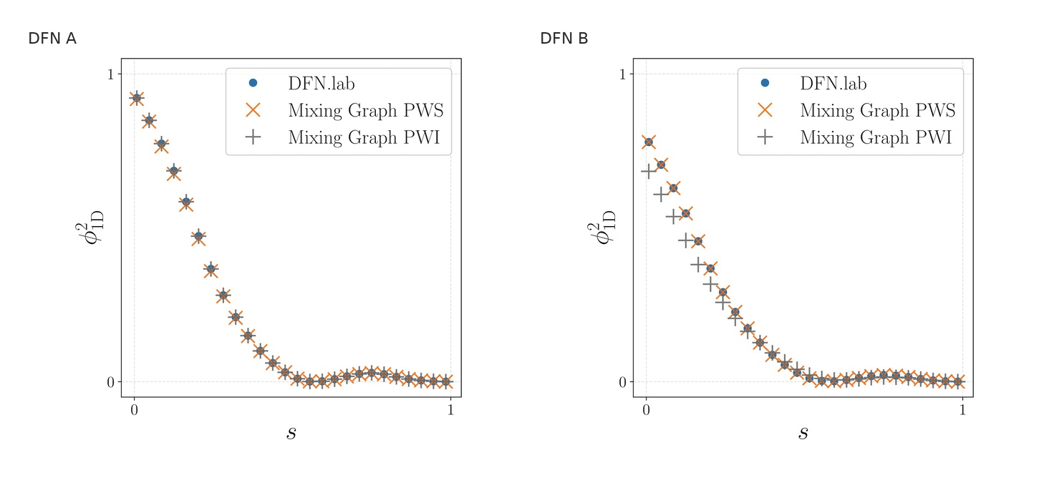
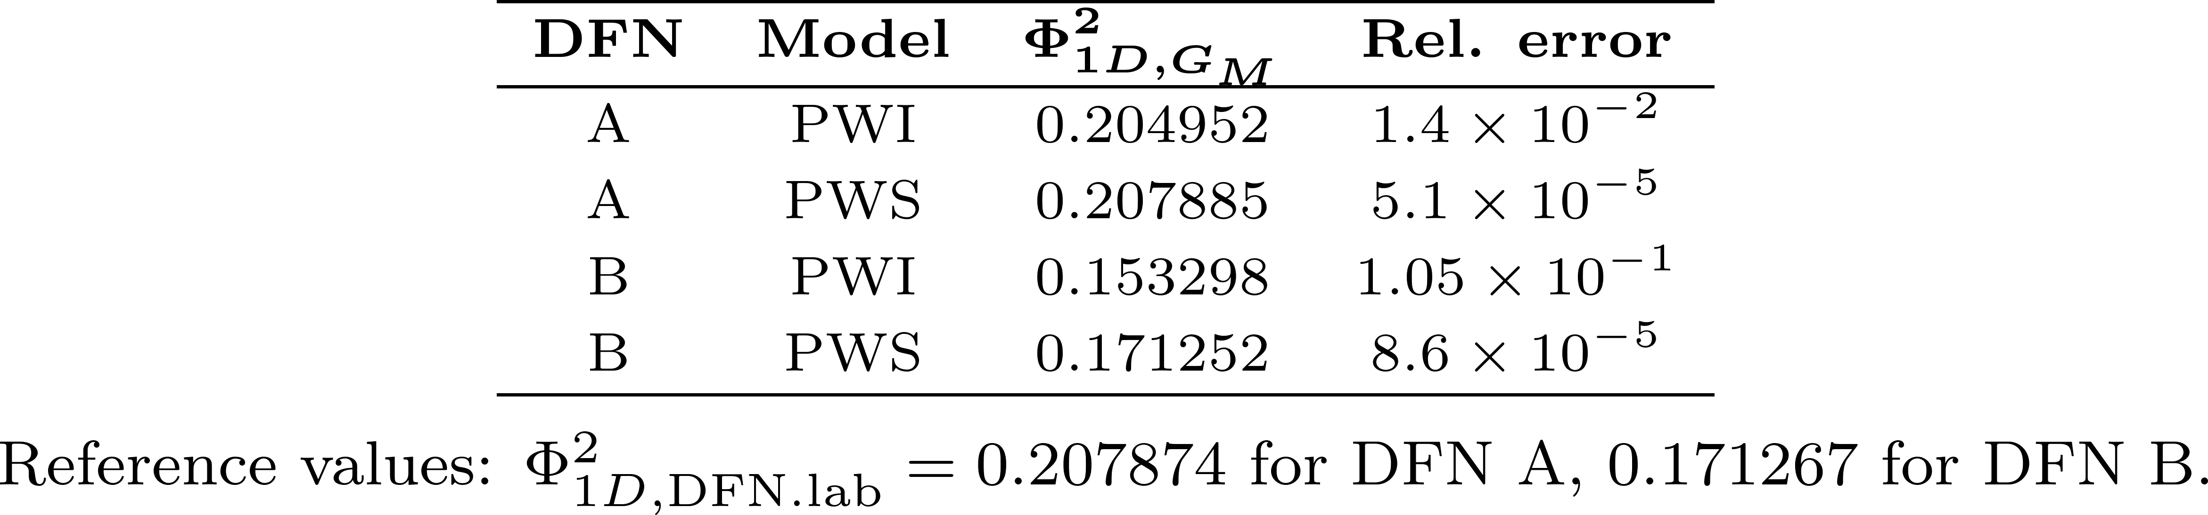
Matching direct simulations
Two models:
PWI (PieceWise Isometric map) : no local deformation.
Require only the topological information along with the fluxes
PWS (PieceWise Smooth map) : includes areal-flux deformation.
Require complete velocity profiles at the intersections
DFN A
DFN B
Ascione et al, J. Fluid Mech. (2026)
10 / 17
Notes:
Slide 13. Editable PowerPoint recreation of the Beamer draft, using paper figures as raster assets and text as editable PPTX objects.

Slide 11
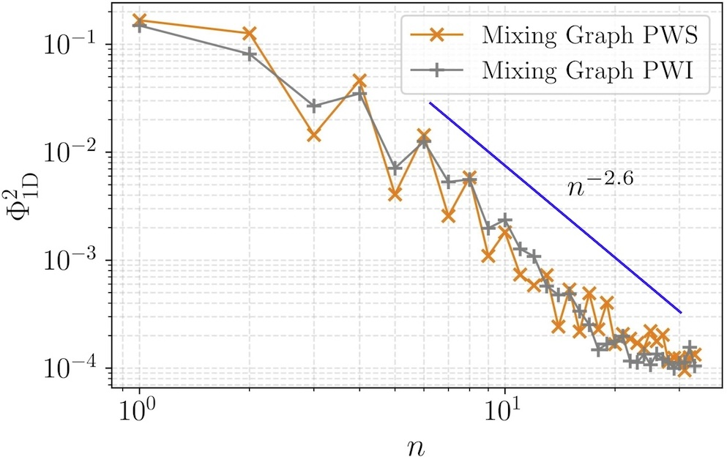
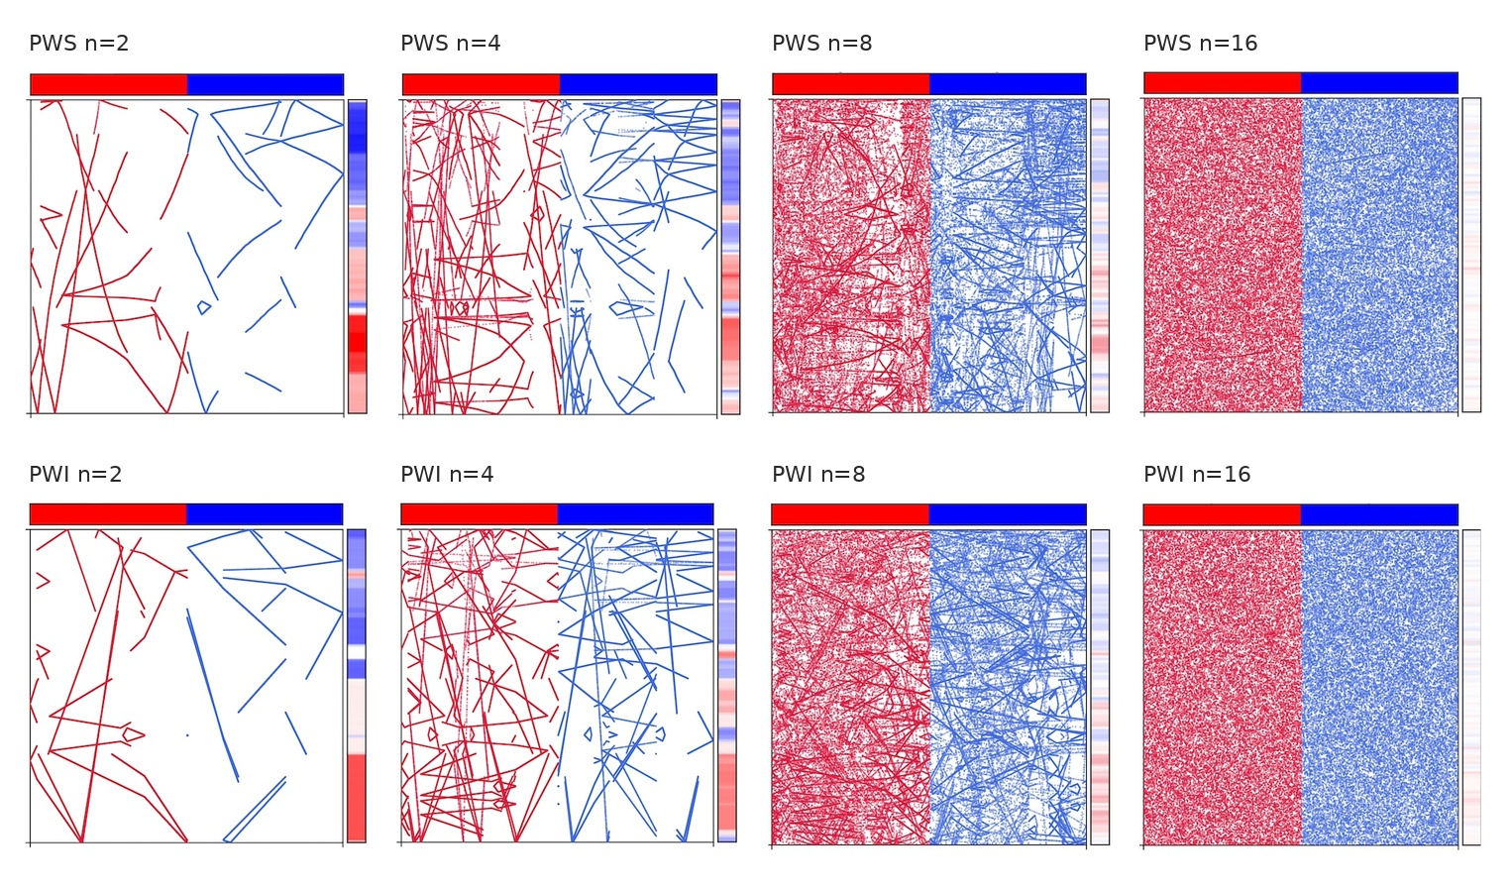
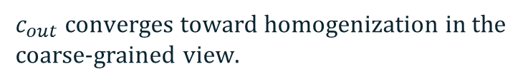
Iterated networks reveal weak mixing properties
Repeated DFN units progressively fragment the concentration field.
$c_{out}$ converges toward homogenization in the coarse-grained view.
The mix-norm decays algebraically, consistent with cutting-and-shuffling dynamics.
Ascione et al, J. Fluid Mech. (2026)
11 / 17
Notes:
Slide 14. Editable PowerPoint recreation of the Beamer draft, using paper figures as raster assets and text as editable PPTX objects.

Slide 12
Takeaways
DFNs show evidences of a cutting-and-shuffling dynamic
A DFN can be modeled as a Sequential Dynamical System where nodes are system’s faces and edges are deterministic maps.
Two main mechanisms act a different scale: Fracture mixing and Intersection mixing
Ascione et al, J. Fluid Mech. (2026)
11 / 171
Notes:
Slide 16. Editable PowerPoint recreation of the Beamer draft, using paper figures as raster assets and text as editable PPTX objects.

Slide 13
Next steps
Extend from advective mixing to finite-Pe solute mixing.
Couple cutting-and-shuffling maps to diffusion and residence-time statistics.
Build $G_{M}$models for large random DFNs.
Identify network observables predictive of mixing efficiency.
Ascione et al, J. Fluid Mech. (2026)
11 / 171
Notes:
Slide 16. Editable PowerPoint recreation of the Beamer draft, using paper figures as raster assets and text as editable PPTX objects.

Slide 14
Thank you!

Slide 15
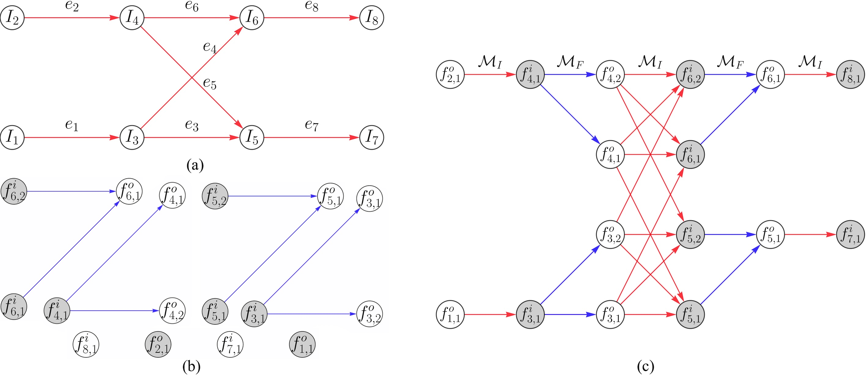





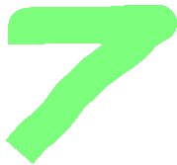


From intersection graph to mixing graph
The standard graph G_I (G_F) stores intersections (Fractures) as nodes and fractures (Intersections) as edges.
The mixing graph G_M expands each intersection into clusters composed of inlet and outlet faces.
Edges carry either M_I or M_F maps.
G_M encodes
Network topology, flow partitioning, face ordering, and streamline routing.
Ascione et al. (RMIT / Rennes)
13 / 17
Notes:
Slide 9. Editable PowerPoint recreation of the Beamer draft, using paper figures as raster assets and text as editable PPTX objects.

Slide 16
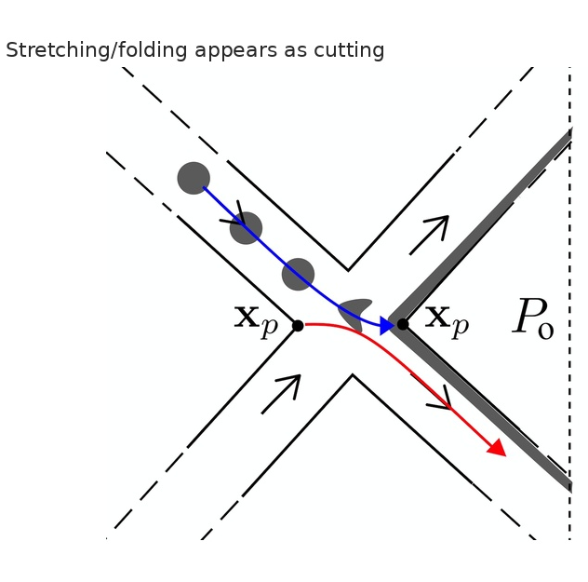
The mechanism is cutting-and-shuffling, not classical chaotic stretching
Classical porous-media chaos relies on persistent stretching and folding.
Large fracture aspect ratio constrains manifold intersections.
The projected action is discontinuous: fluid elements are cut, shuffled and recombined.
Consequence
Mixing can be efficient while remaining weakly ergodic, with algebraic rather than exponential decay of mixing measures.
Ascione et al. (RMIT / Rennes)
14 / 17
Notes:
Slide 8. Editable PowerPoint recreation of the Beamer draft, using paper figures as raster assets and text as editable PPTX objects.

Slide 17
What controls mixing in DFNs?
Primary controls
Main claim
1 Network topology.
2 Flux partitioning between fractures and intersections.
3 Face ordering around each intersection.
4 Areal-flux heterogeneity, when PWS effects matter.
Advective mixing in large-aspect-ratio DFNs is predominantly discontinuous and graph-representable.
Interpretation
Uniform flux distributions distribute cutting-and-shuffling over the network. Highly non-uniform flux distributions create short-circuiting and weak effective mixing.
Ascione et al. (RMIT / Rennes)
15 / 17
Notes:
Slide 15. Editable PowerPoint recreation of the Beamer draft, using paper figures as raster assets and text as editable PPTX objects.

Slide 18
Streamfunction coordinates make routing explicit
For steady isotropic Darcy flow, the velocity field can be represented by two streamfunctions:
v = Q ∇ψ̂₁ × ∇ψ̂₂.
Interpretation
ψ̂₁ labels streamsurfaces across fracture width L.
Mixing becomes a mapping of labels from face to face, not a brute-force trajectory problem.
ψ̂₂ labels streamsurfaces across aperture ℓ.
A streamline is identified by the pair (ψ̂₁, ψ̂₂).
Ascione et al. (RMIT / Rennes)
516/ 17
Notes:
Slide 5. Editable PowerPoint recreation of the Beamer draft, using paper figures as raster assets and text as editable PPTX objects.

Slide 19
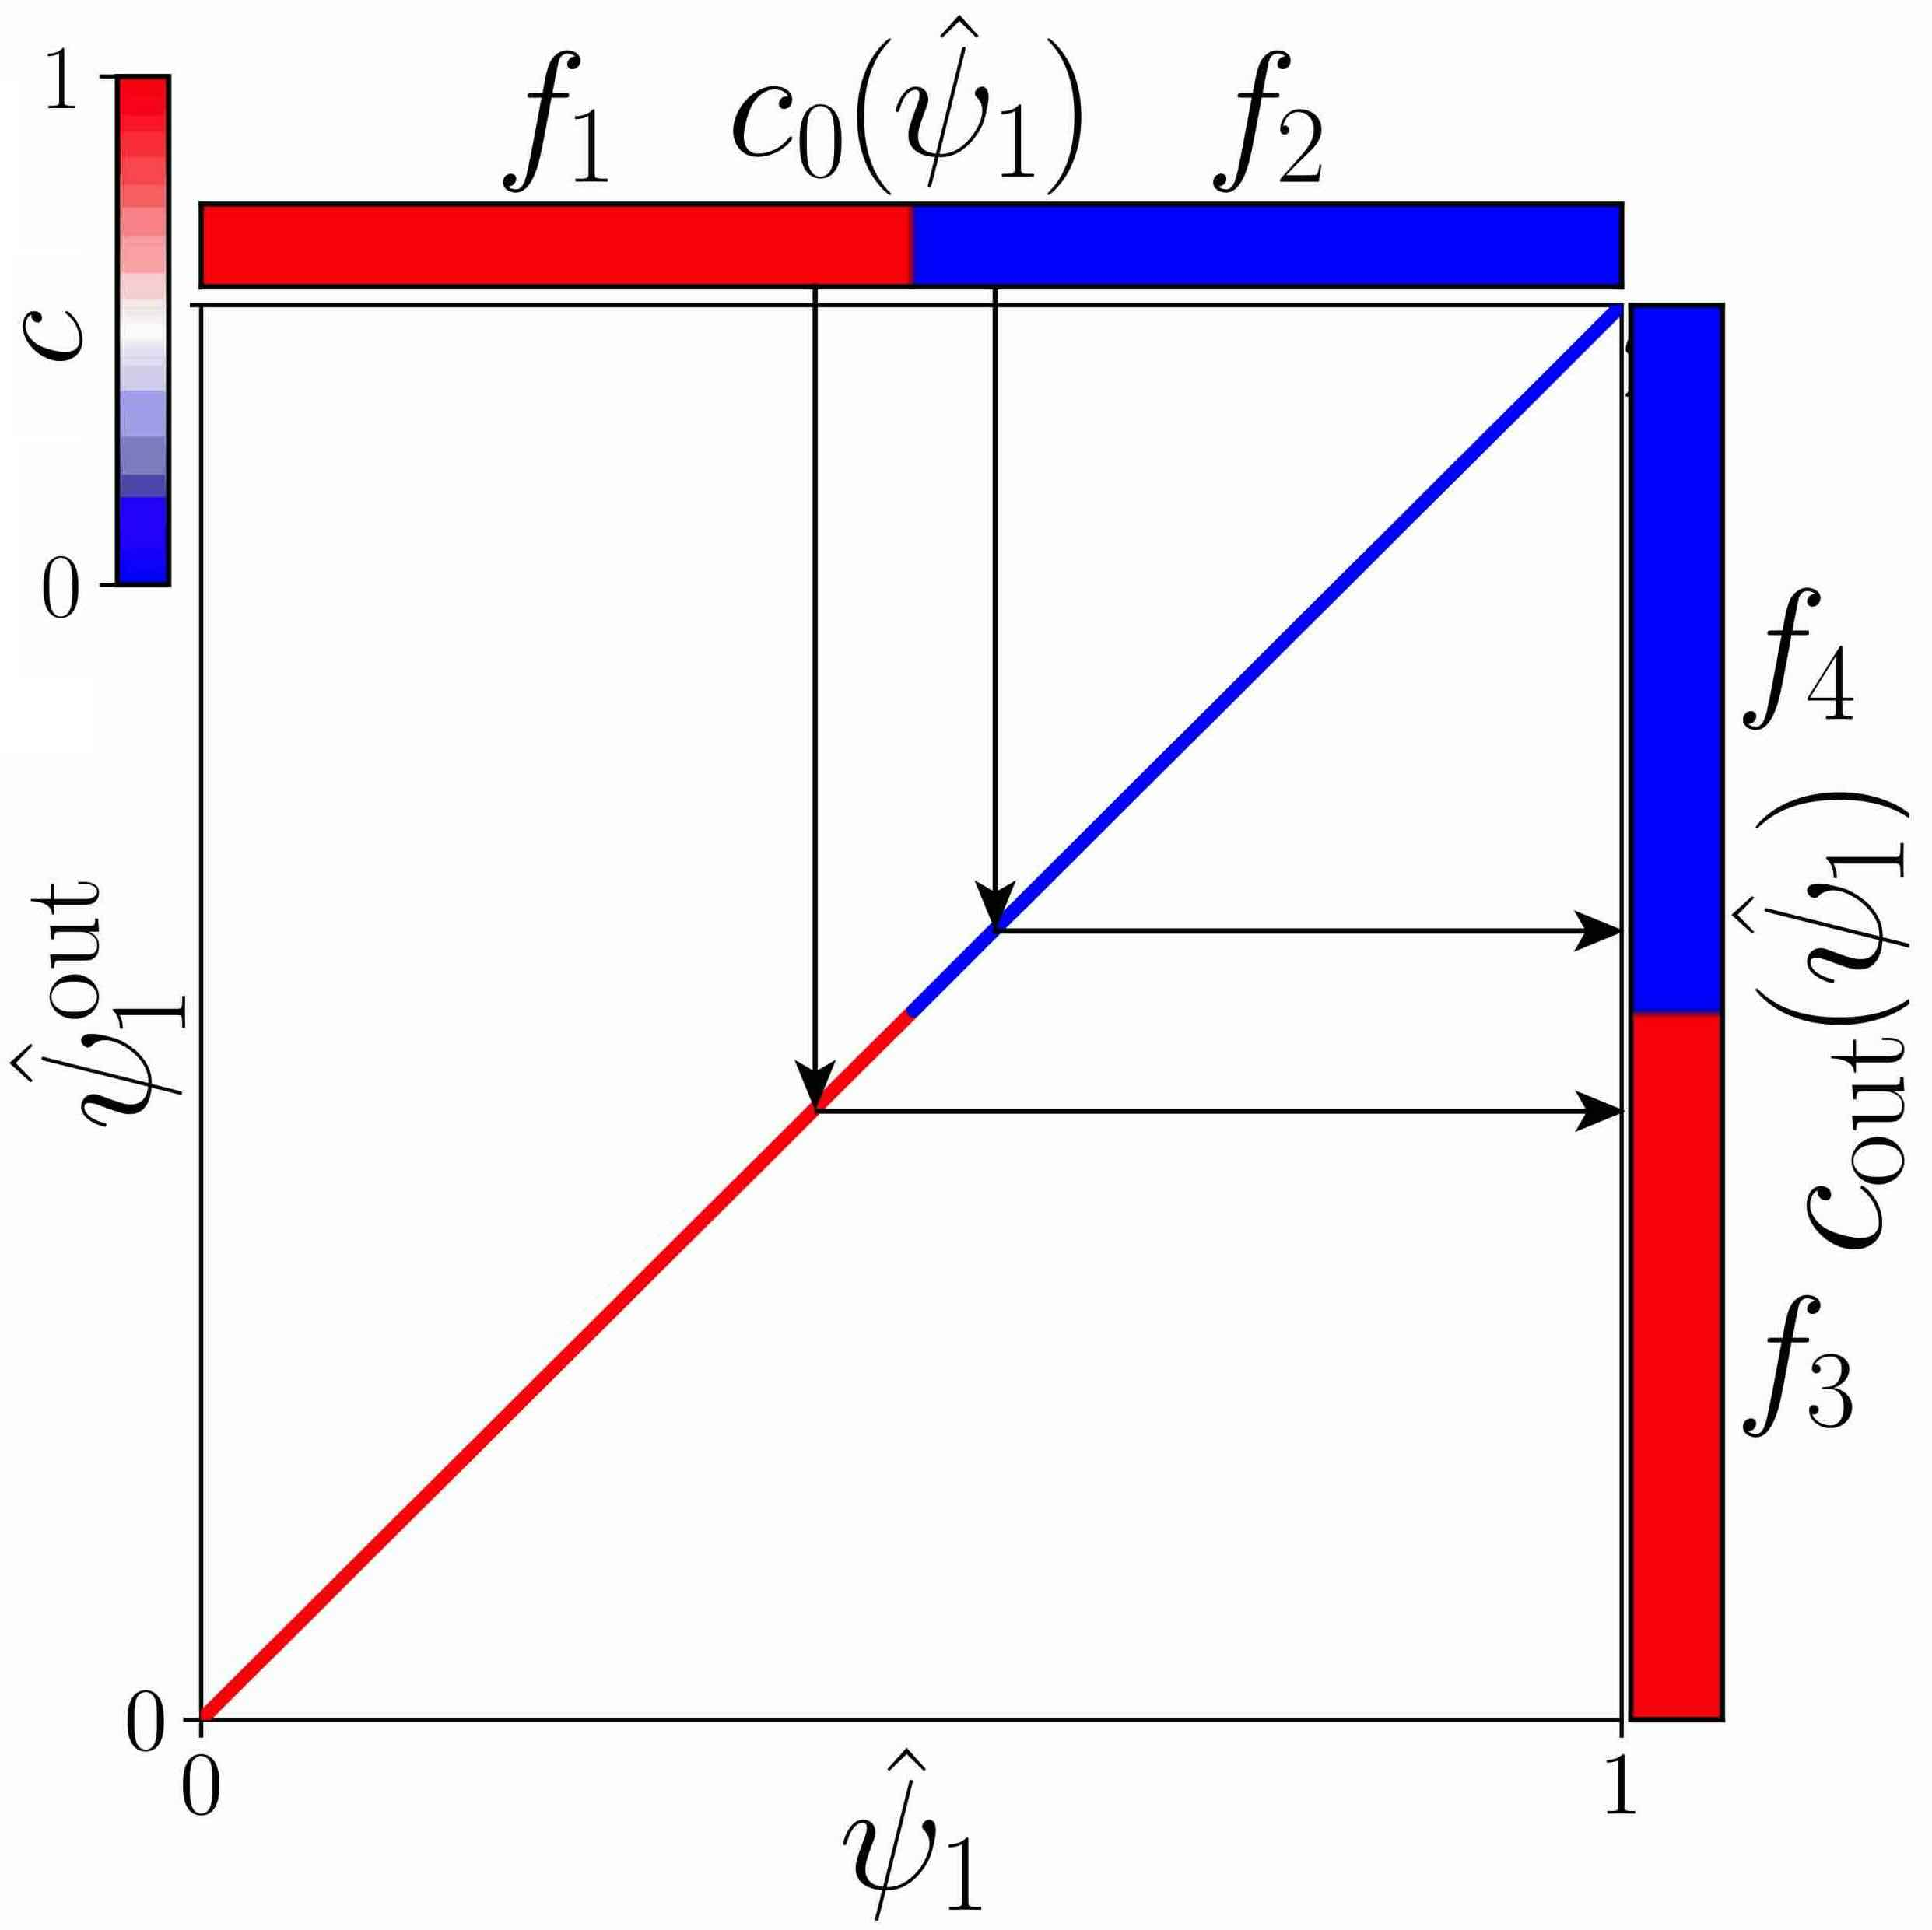
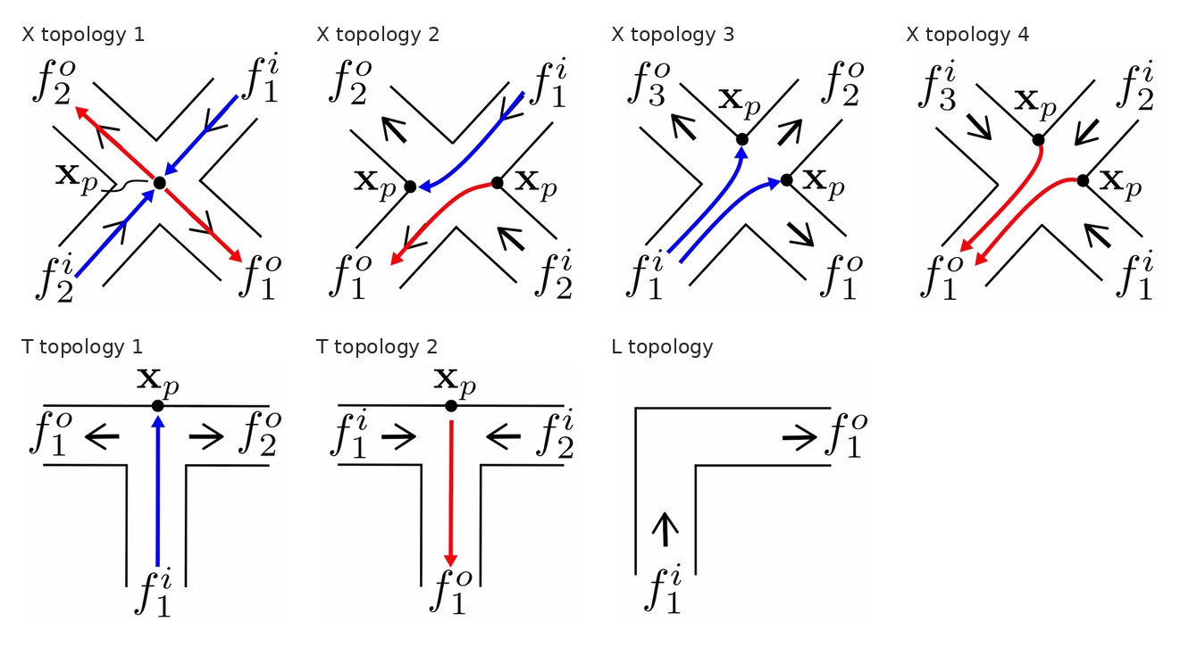
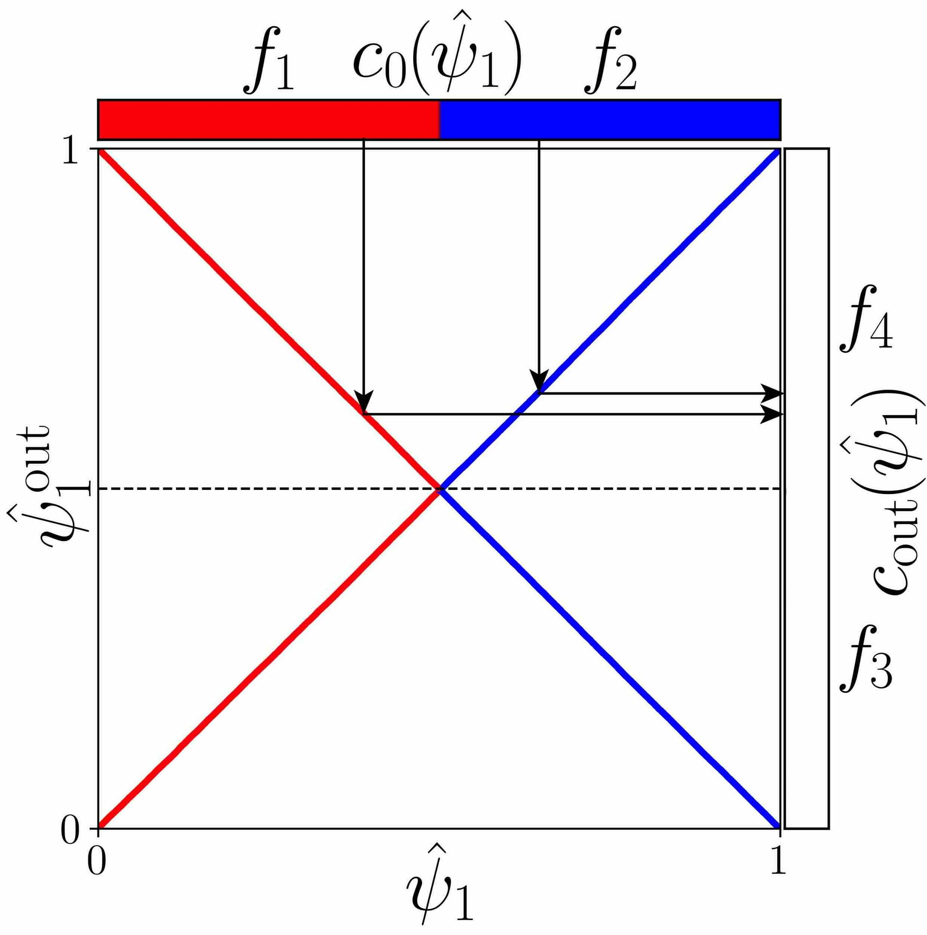
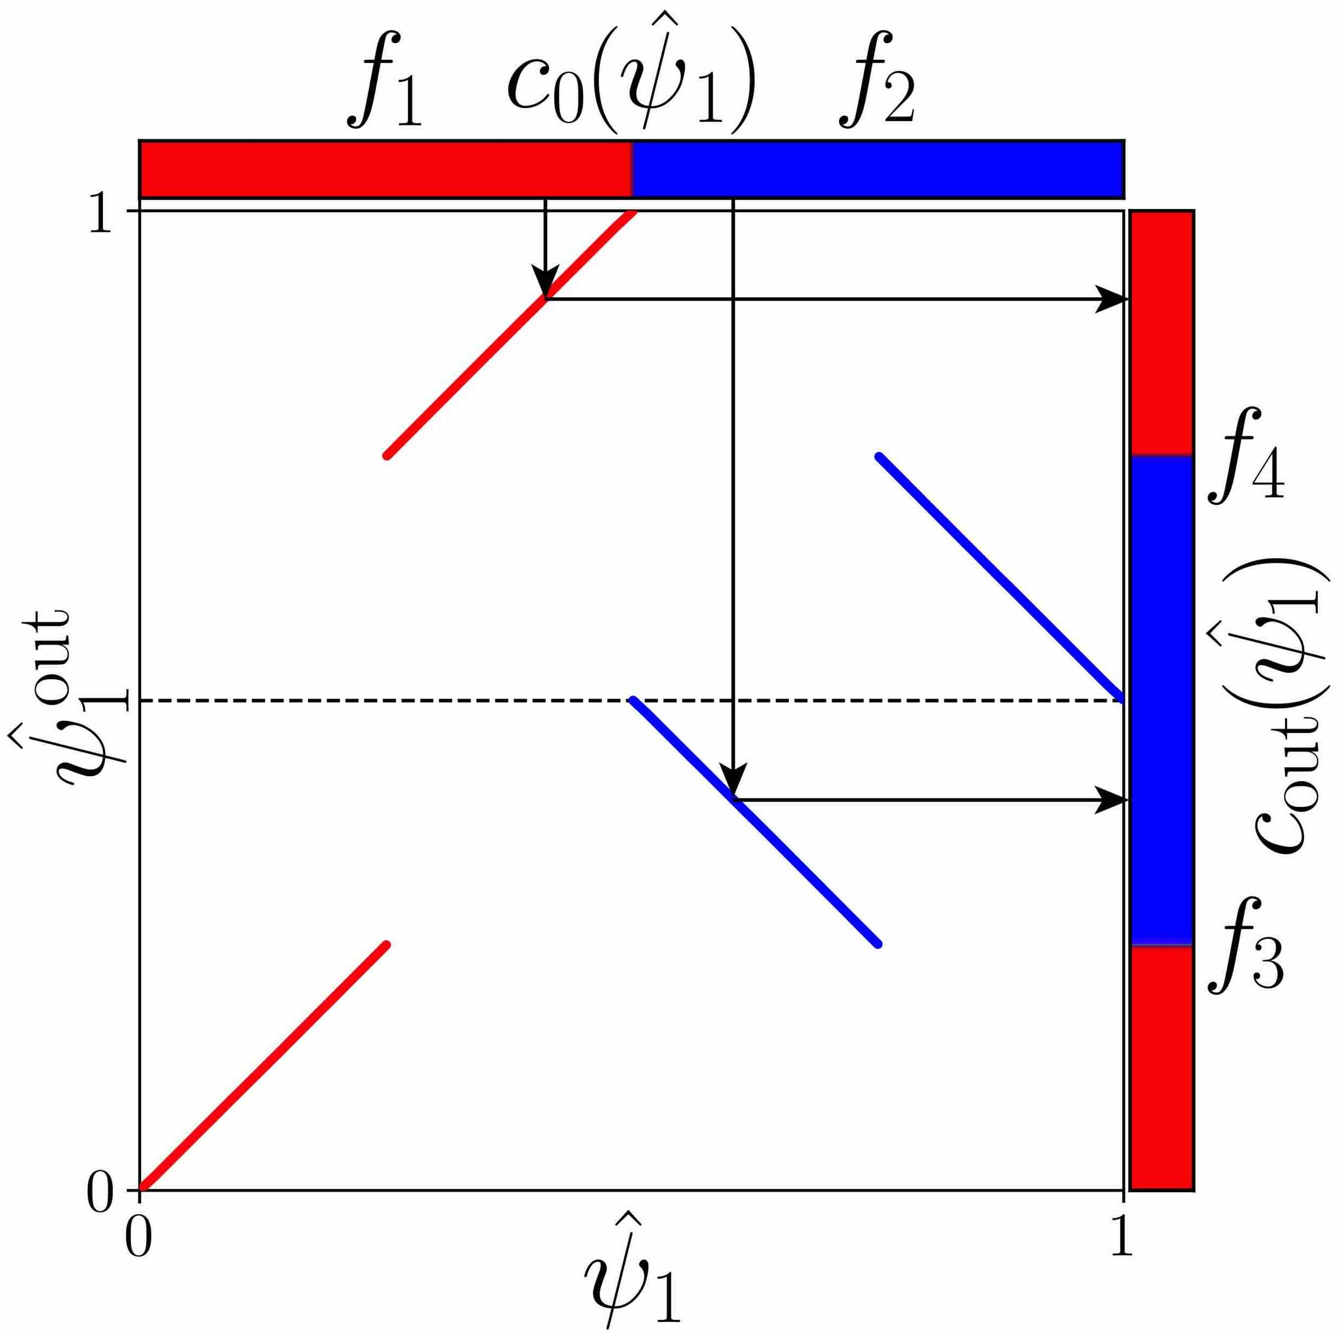
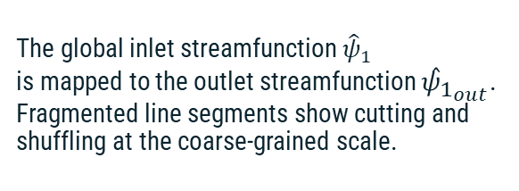
Network advective maps
Reading the plots
The global inlet streamfunction ${\hat{ψ}}_{1}$
is mapped to the outlet streamfunction ${\hat{ψ}}_{1_{out}}$. Fragmented line segments show cutting and shuffling at the coarse-grained scale.
Ascione et al. (RMIT / Rennes)
17 / 17
Notes:
Slide 17. Editable PowerPoint recreation of the Beamer draft, using paper figures as raster assets and text as editable PPTX objects.

Slide 20
Topology of Intersections
Ascione et al. (RMIT / Rennes)
17 / 17
Notes:
Slide 17. Editable PowerPoint recreation of the Beamer draft, using paper figures as raster assets and text as editable PPTX objects.

