Slide 1




4D X-ray particle tracking velocimetry of multiphase flow through rough fractures: quantifying influence of roughness on flow dynamics
department of Geology
research group PProGRess
Sojwal Manoorkar, Robert Van der Merwe, Sharon Ellman, Parsa Damanshokouh, Hossein Younesian Farid, Andreas Busch, Tom Bultreys

Slide 2

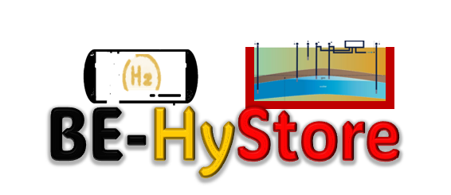
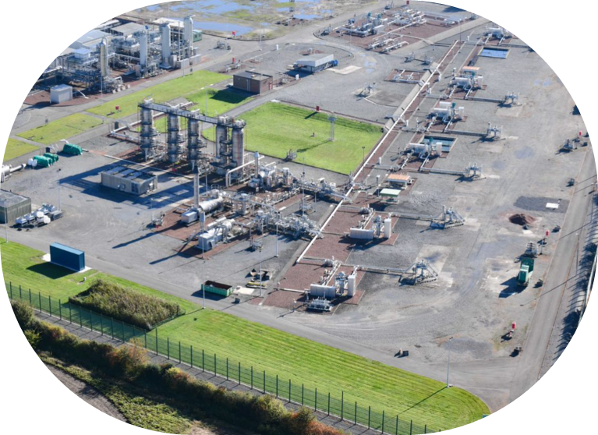
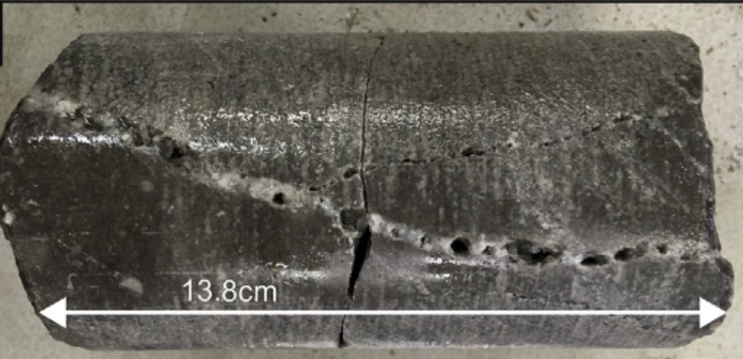
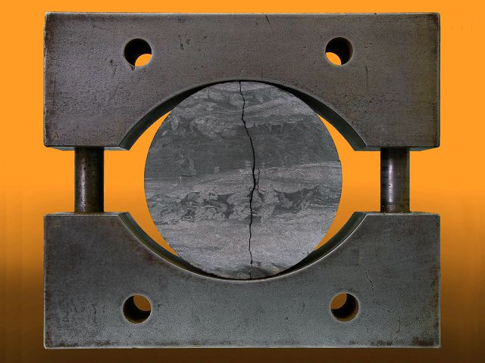
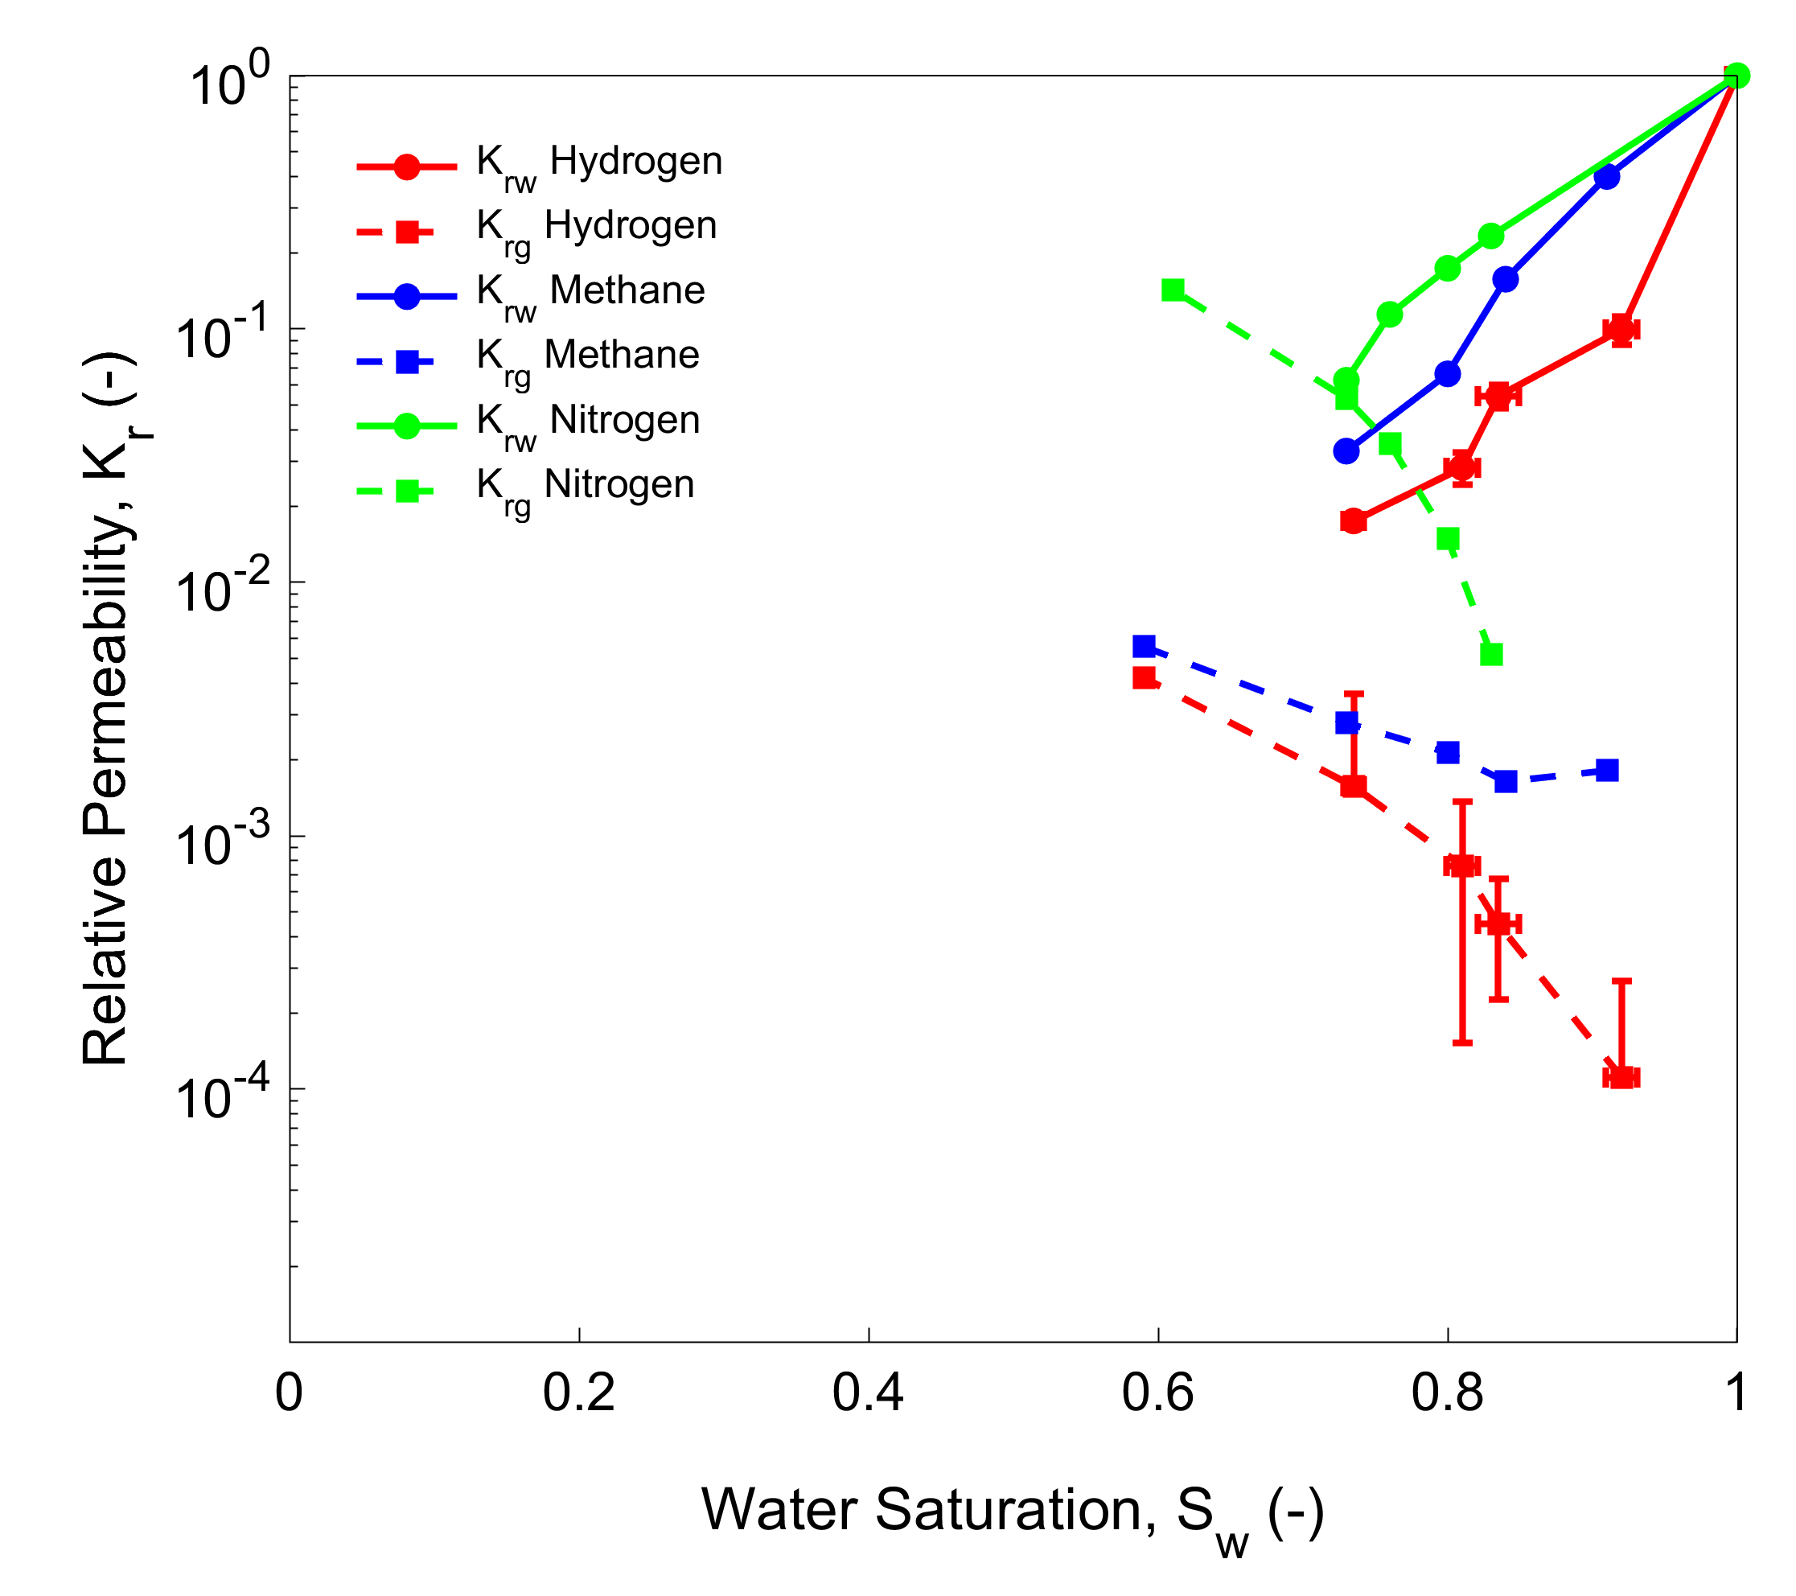
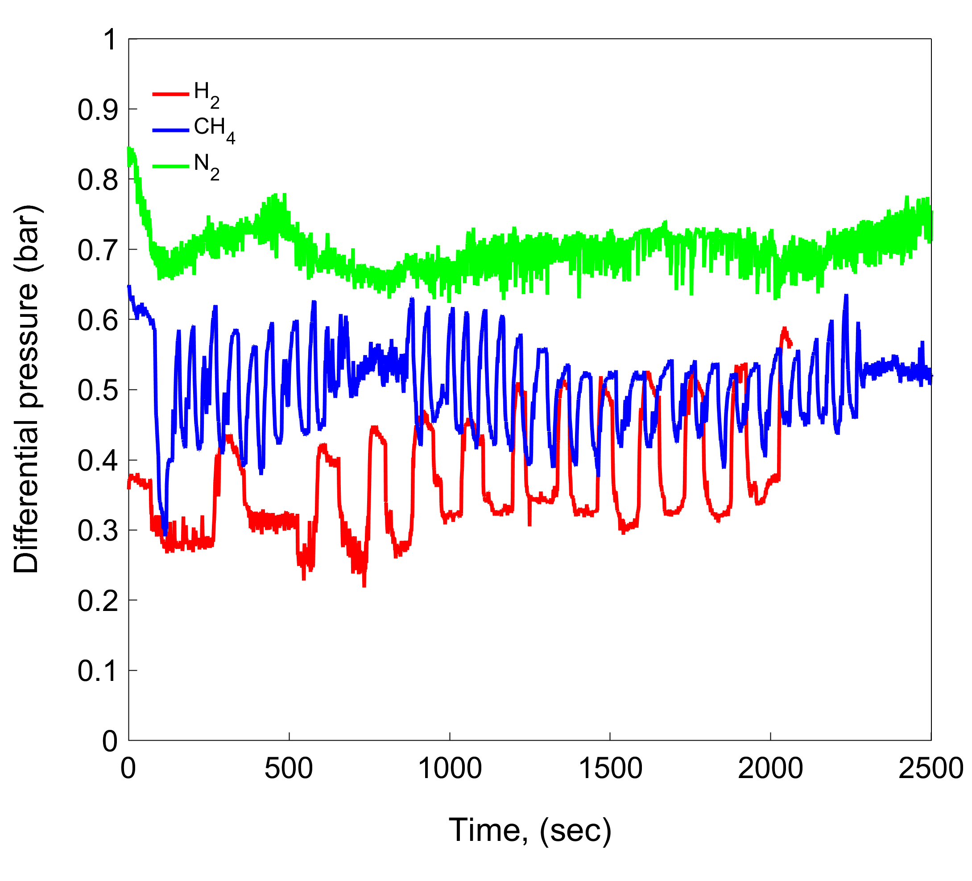
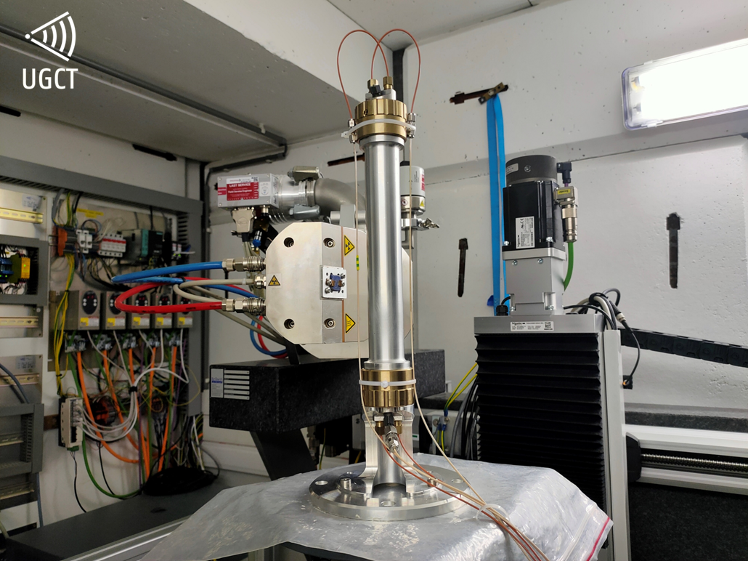
Why is flow in fractures important?
First of their kind field tests
Van der Voet et al 2020
State-of-the-art Laboratory Experiments
https://www.fluxys.com/en/hydrogen/activities/loenhout-hydrogen-underground-storage
Manoorkar et al (2026)
Notes:
Can lab-based 4D micro-CT and PTV connect rough-fracture pore-scale displacement events to measurable macroscopic flow signals?

Slide 3
Outline
Interface dynamics: multiphase co-injection
Methodology: lab-based micro-CT
4D Velocimetry: Smooth vs rough fractures

Slide 4
Outline
Interface dynamics: multiphase co-injection
Methodology: lab-based micro-CT
4D Velocimetry: Smooth vs rough fractures

Slide 5
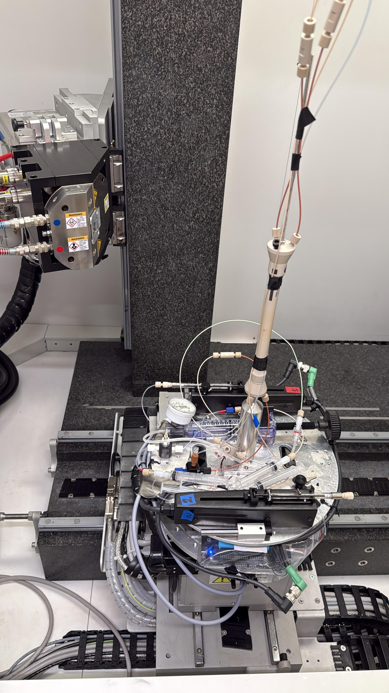
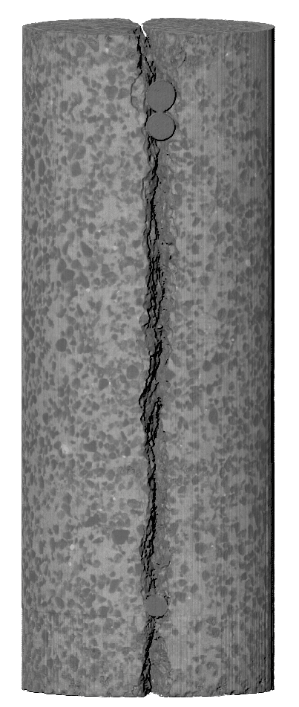
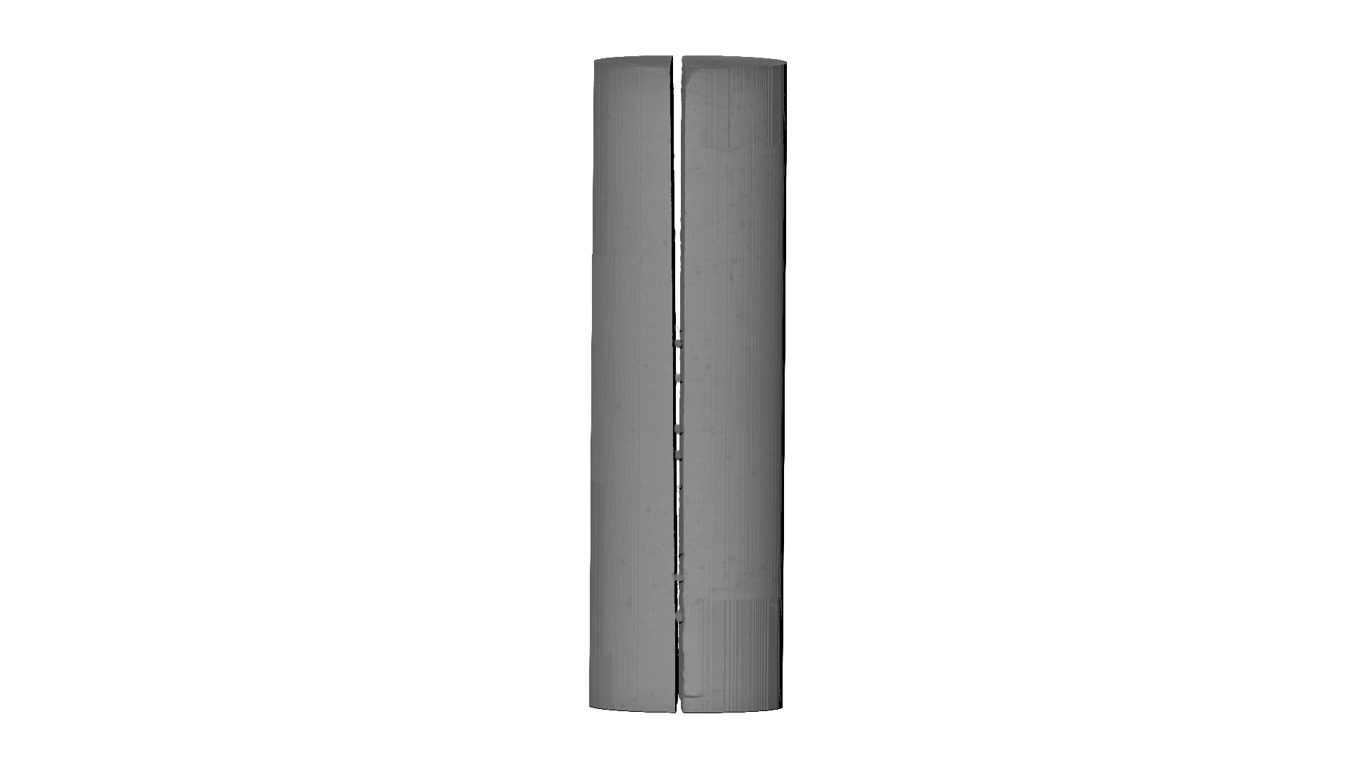
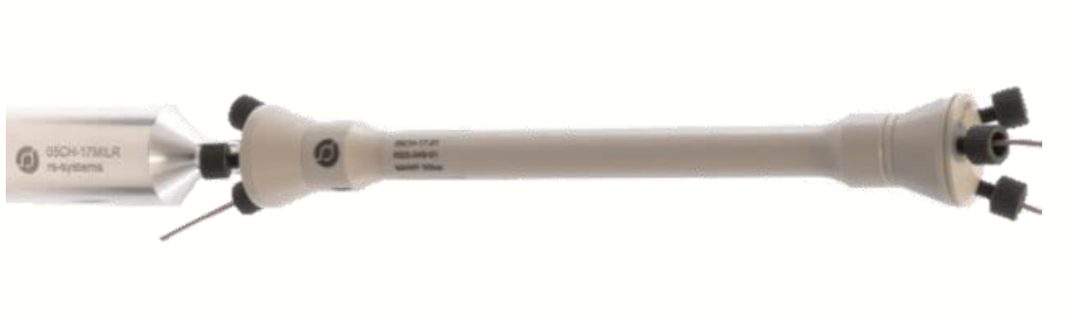
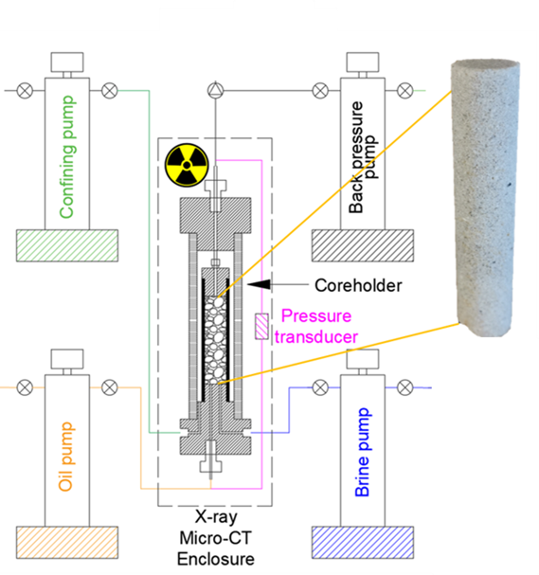
Drainage core-flooding with dynamic scanning with 30s at 12µm
Exp 1: co – injection
Goal : Dynamic interface
Exp 2: single injection
Goal : Particle - tracking velocimetry
Samples:
∆P
Carmel Sandstone
Carmel Sandstone
Belgian blue limestone
Fluids:
1. wetting phase: 96 wt% glycerol +KI
2. non-wetting phase: silicon oil
1. wetting phase: 96 wt% glycerol +KI
2. non-wetting phase: silicon oil + Ag coated hollow glass spheres as tracers
Flow Regimes:
Capillary dominated
1. Viscosity ratio (M) ~ 1
2. Capillary number (Ca) = 10⁻⁶ - 10⁻⁵
Capillary dominated
1. Viscosity ratio (M) ~ 1
2. Capillary number (Ca) = 10⁻⁶ - 10⁻⁵
Brine
Oil
Notes:
Reduction in global emissions
Green economy
Current ongoing projects
Potential sites
Goals and how much it can reduce the emissions
Blue hydrogen, green hydrogen, gray hydrogen

Slide 6
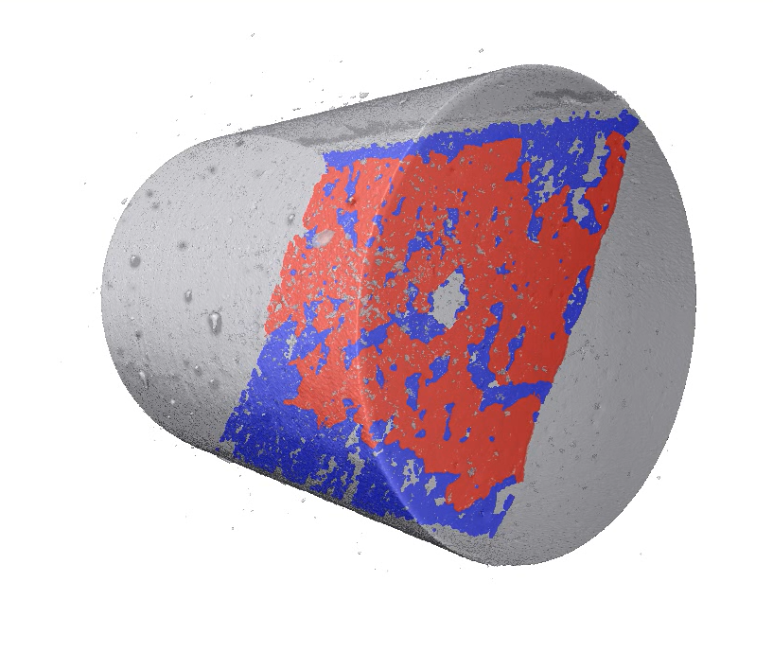
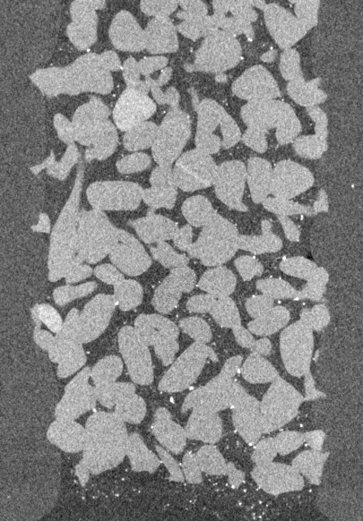
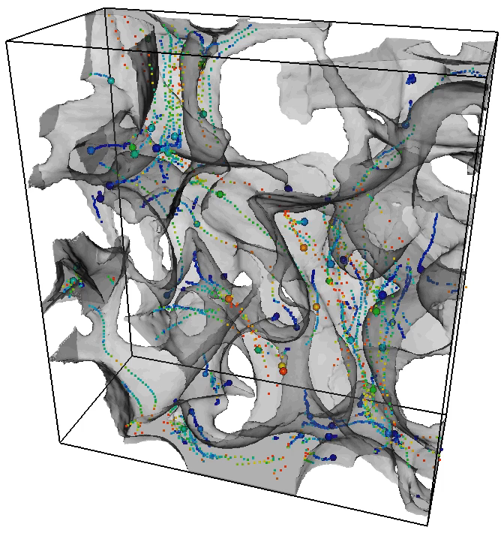
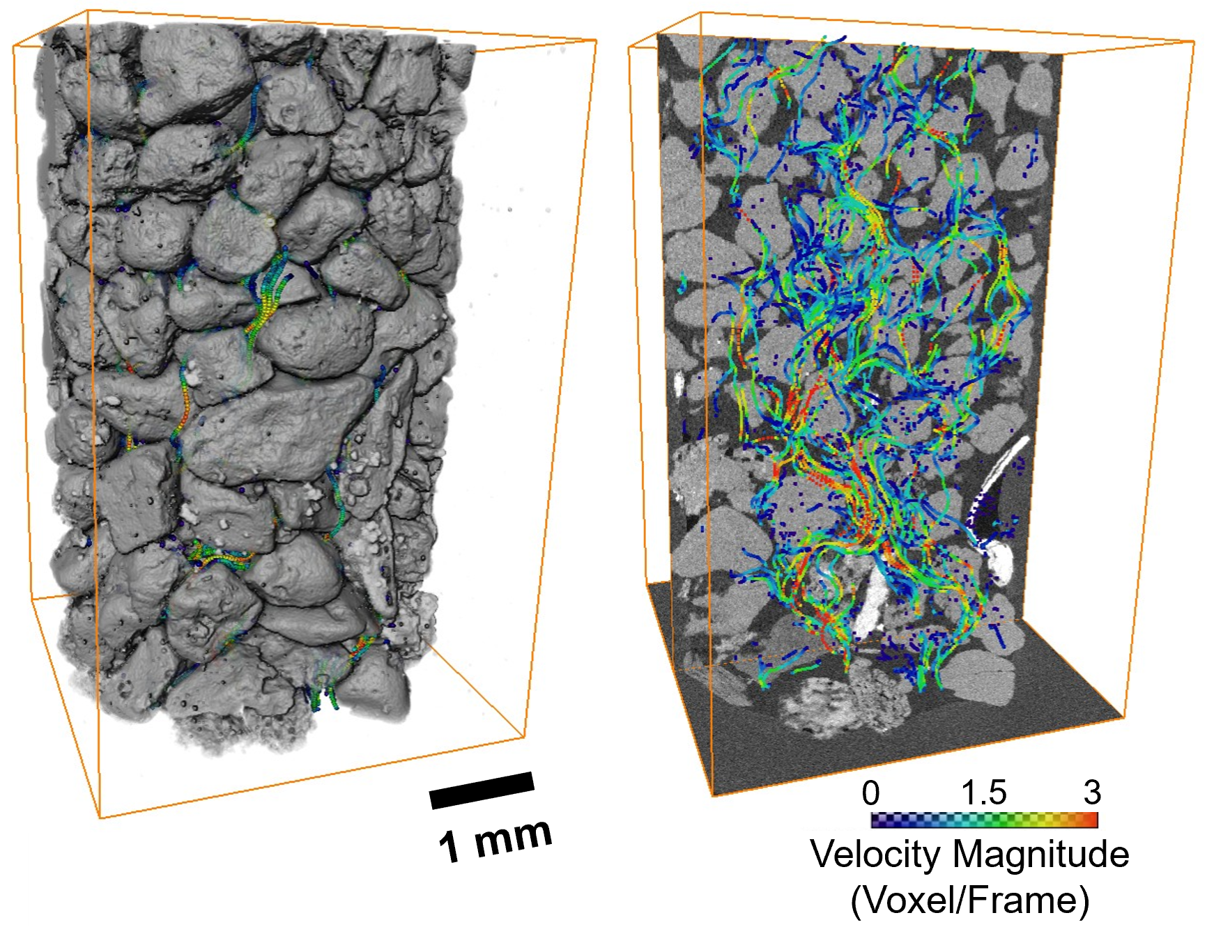
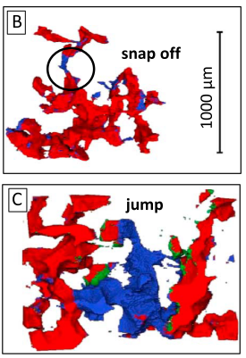
From 4D interface dynamics to Lagrangian flow pathways
Exp 1: co – injection
Goal : Dynamic interface
Exp 2: single injection
Goal : Particle - tracking velocimetry
Brine
Bultreys et al (2022)
Oil
Dynamic events
Rucker et al (2015)
Notes:
Reduction in global emissions
Green economy
Current ongoing projects
Potential sites
Goals and how much it can reduce the emissions
Blue hydrogen, green hydrogen, gray hydrogen

Slide 7
Outline
Interface dynamics: multiphase co-injection
Methodology: lab-based micro-CT
4D Velocimetry: Smooth vs rough fractures

Slide 8
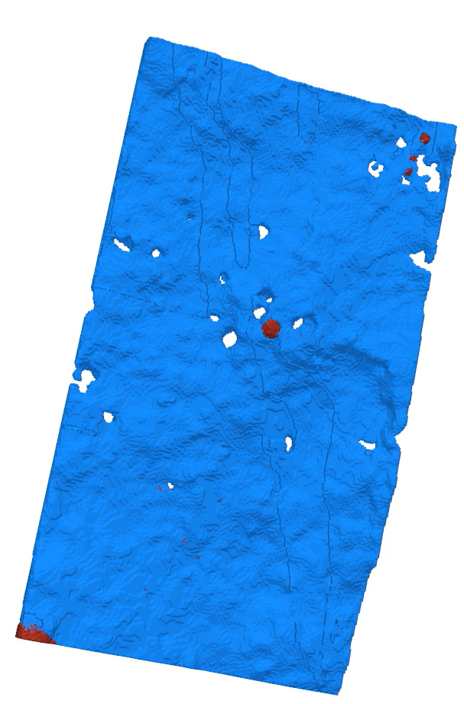
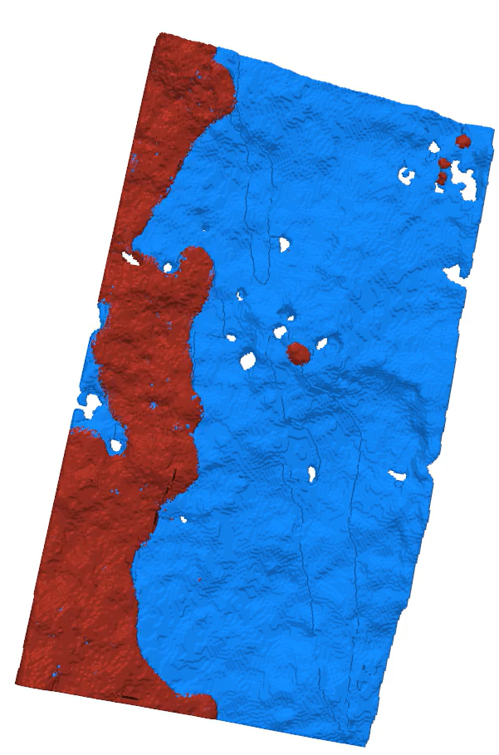
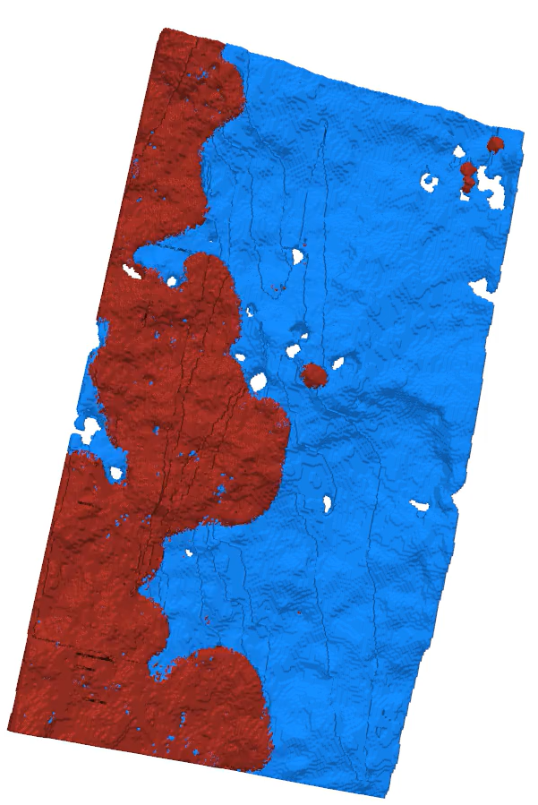
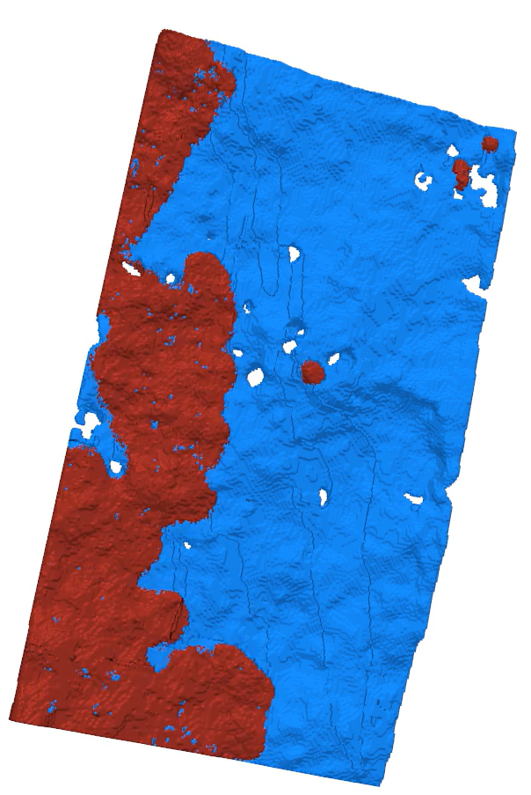
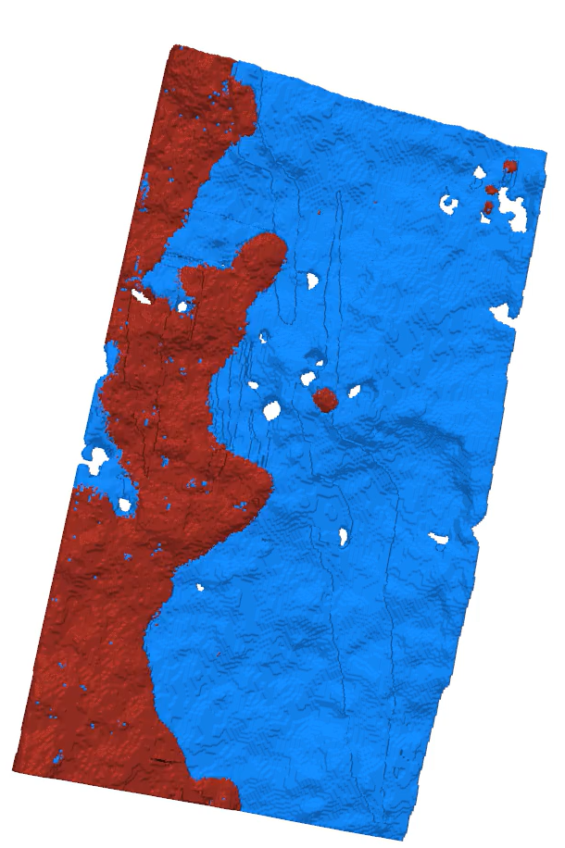

Dynamic connectivity with evolving topology
Dynamic connectivity over increasing fractional flow
F_{oil} = 0.2
F_{oil} = 0.4
F_{oil} = 0.6
F_{oil} = 0.8
Oil
Brine
Dynamic connectivity over time

Slide 9
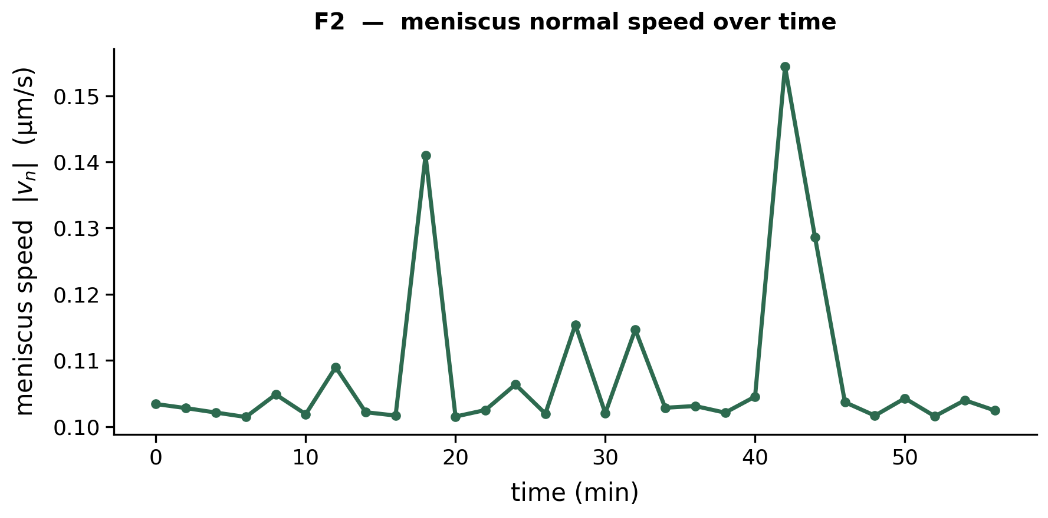
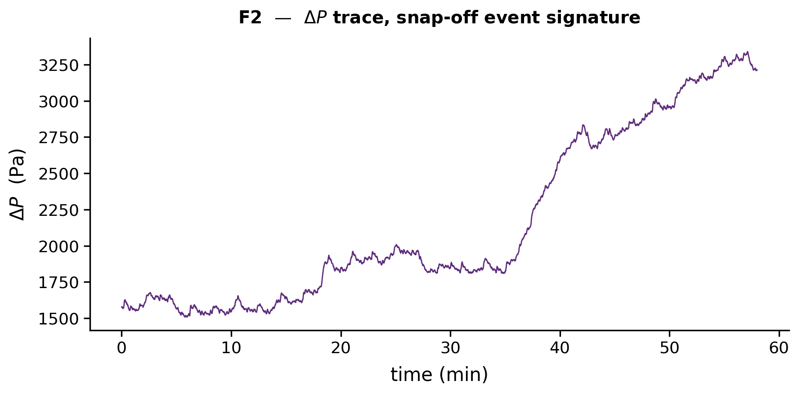
Snap-off events are captured in macroscopic pressure signals for low fractional flow
Event B
F_{oil} = 0.4
Event A
Event B
Brine
Oil
Event A

Slide 10
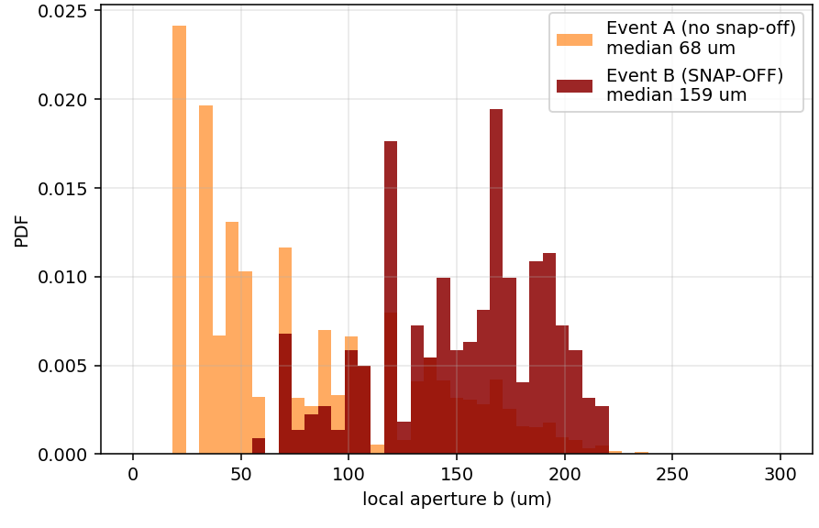
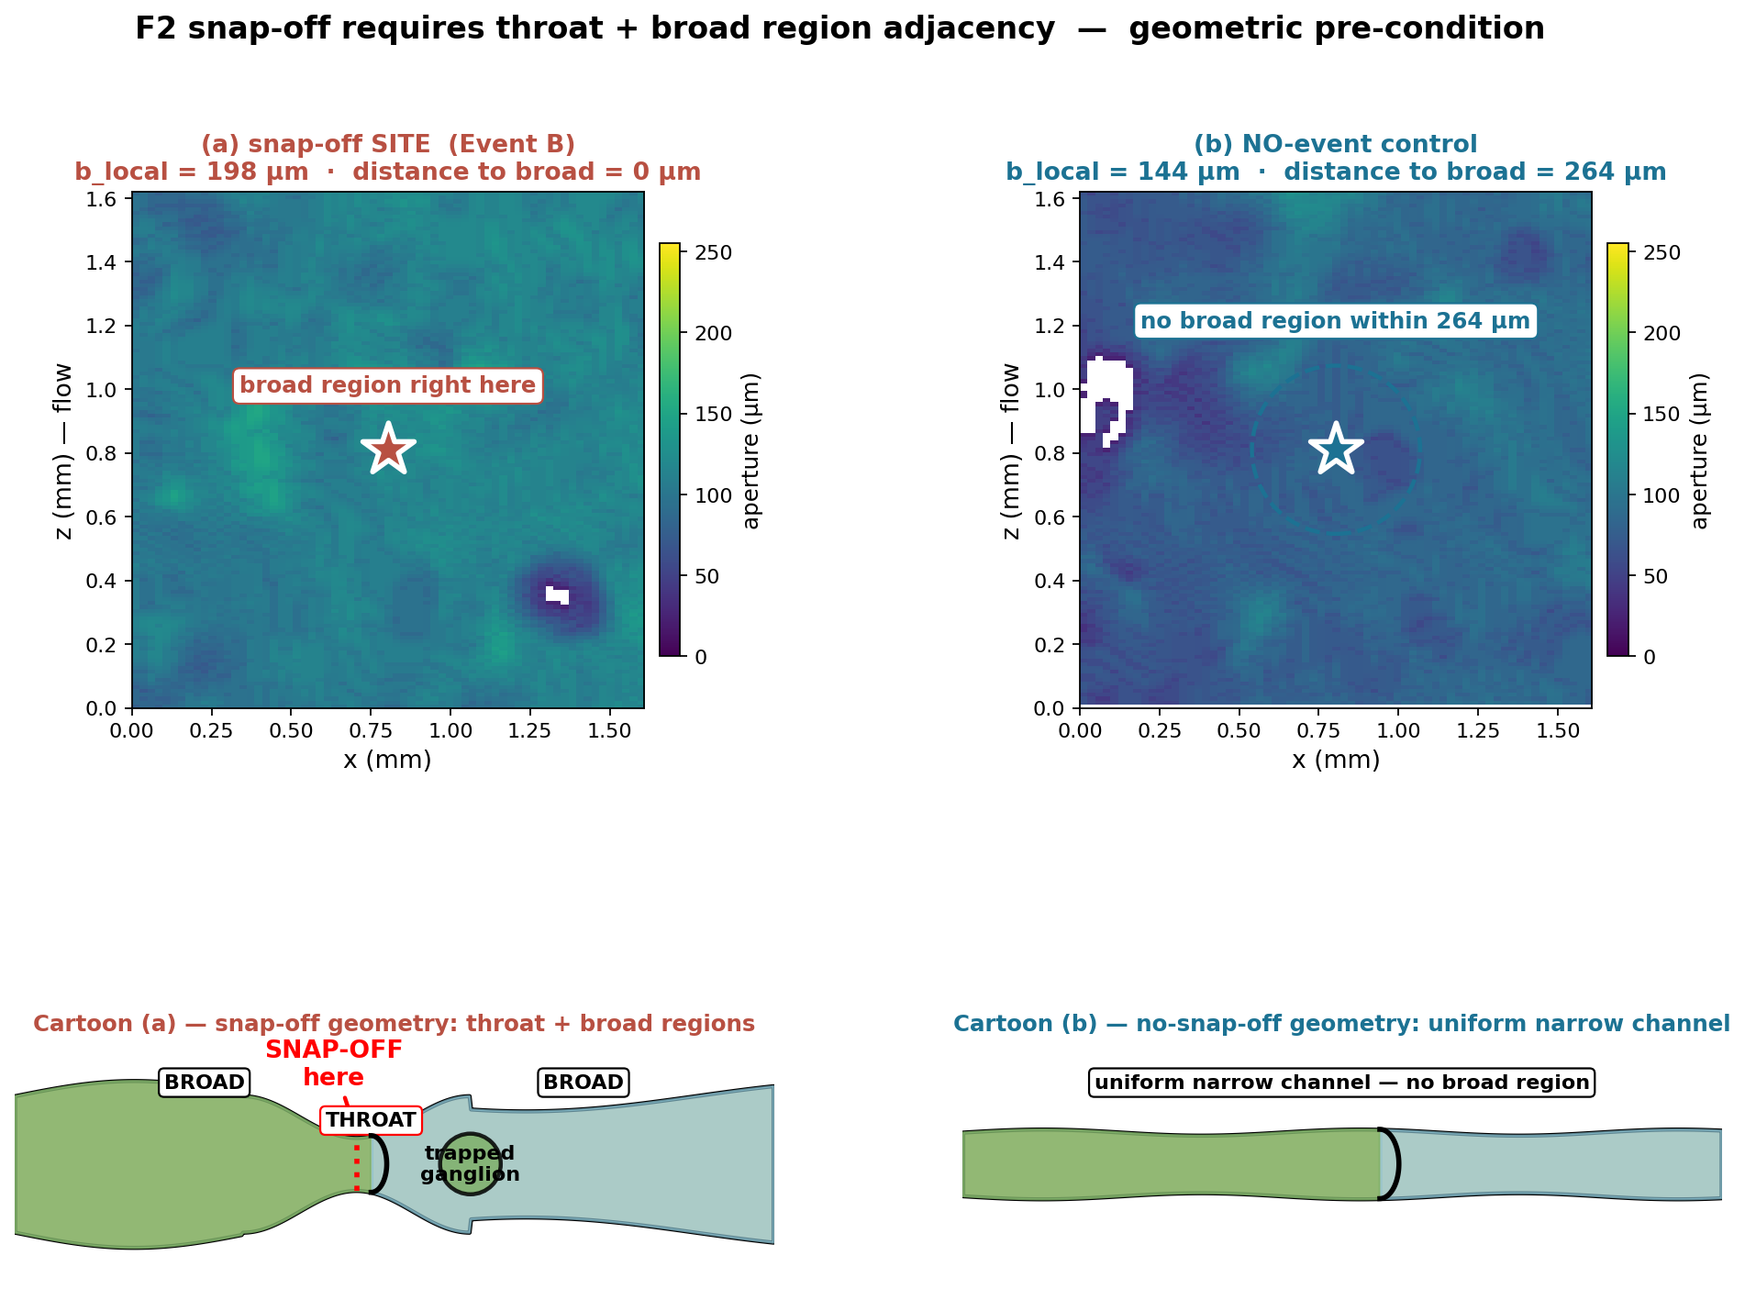
Snap-off events are sensitive to local geometry: adjacent aperture distribution

Slide 11
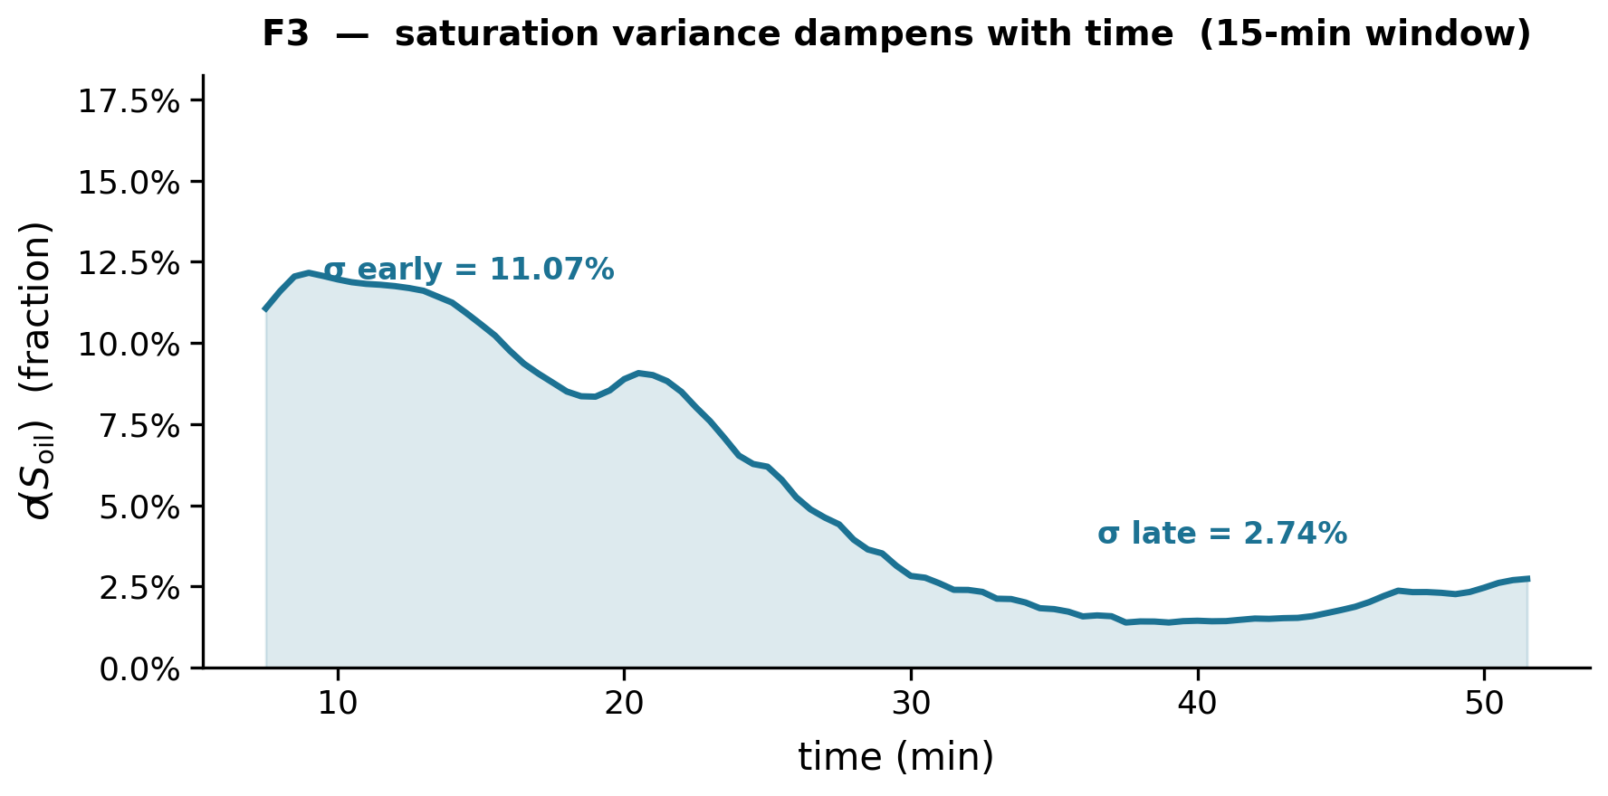
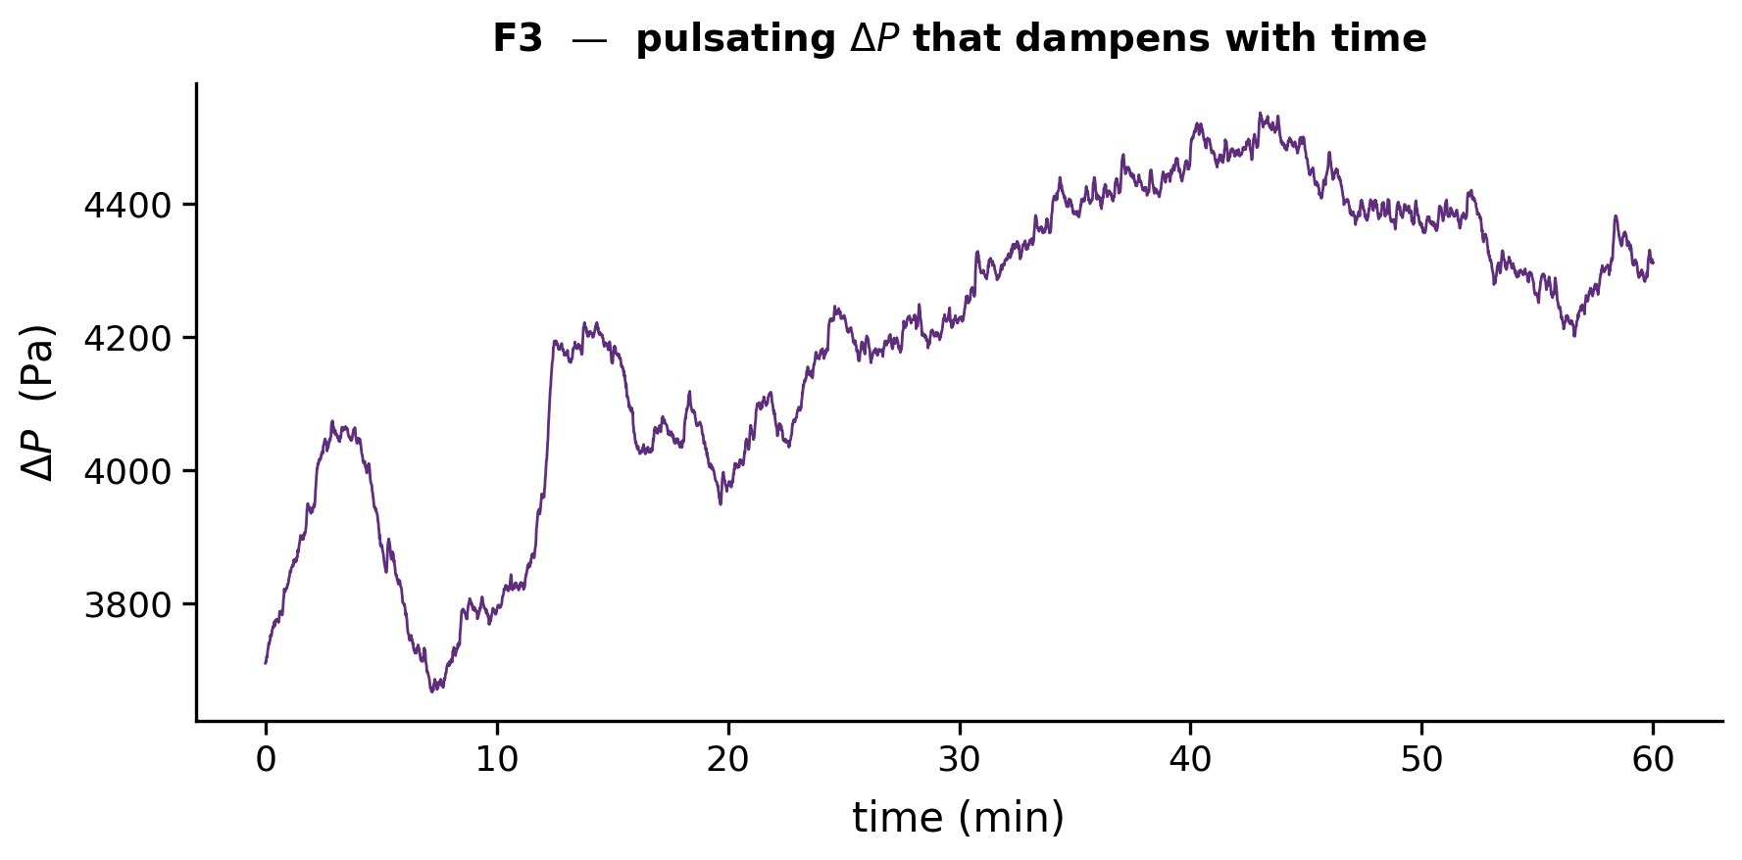
Interface and pressure fluctuations dampen on a matched ~20-min timescale at moderate fractional flow
F_{oil} = 0.6
Brine
Oil

Slide 12
Outline
Interface dynamics: multiphase co-injection
Methodology: lab-based micro-CT
4D Velocimetry: Smooth vs rough fractures

Slide 13
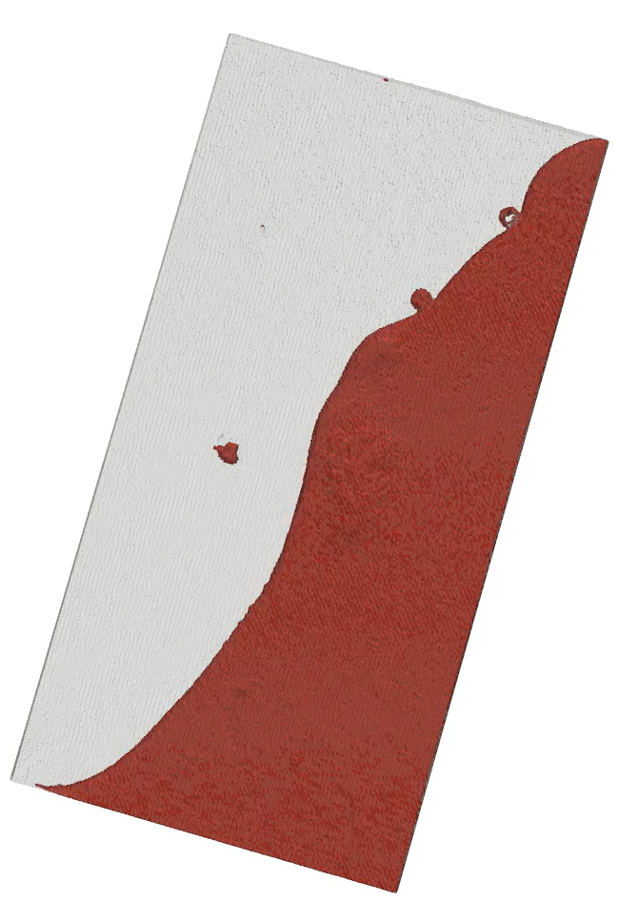
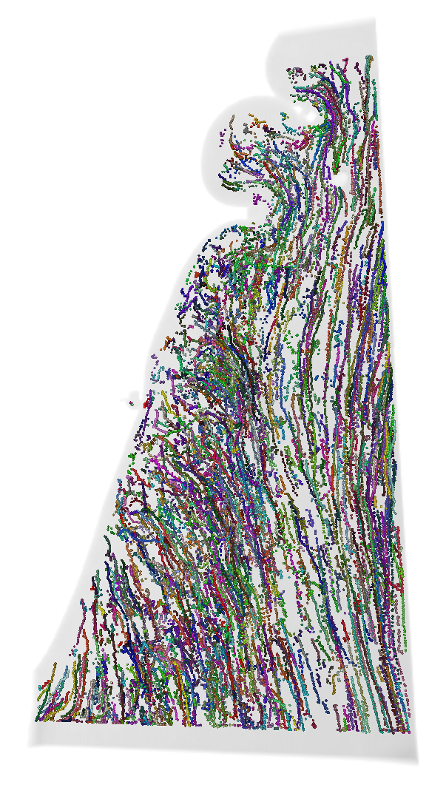
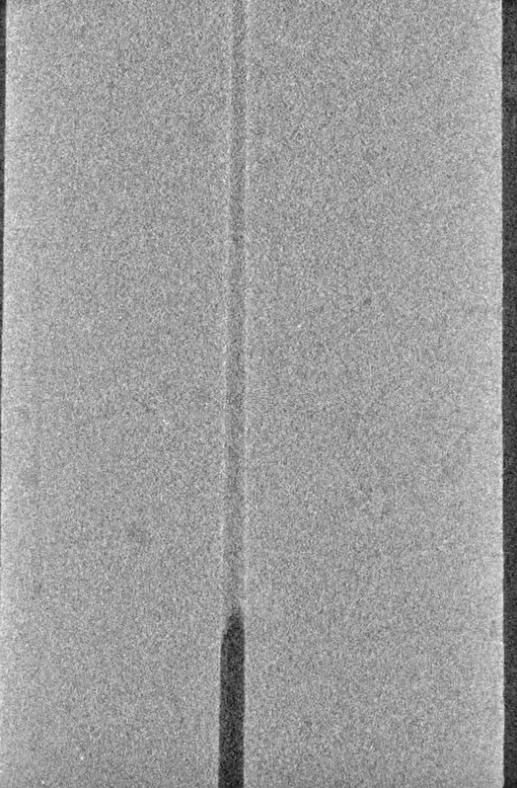
Unsteady-state drainage experiments with dynamic scanning with lab based micro-CT
Lagrangian Particle tracks
Oil segmented
Stable displacement

Slide 14
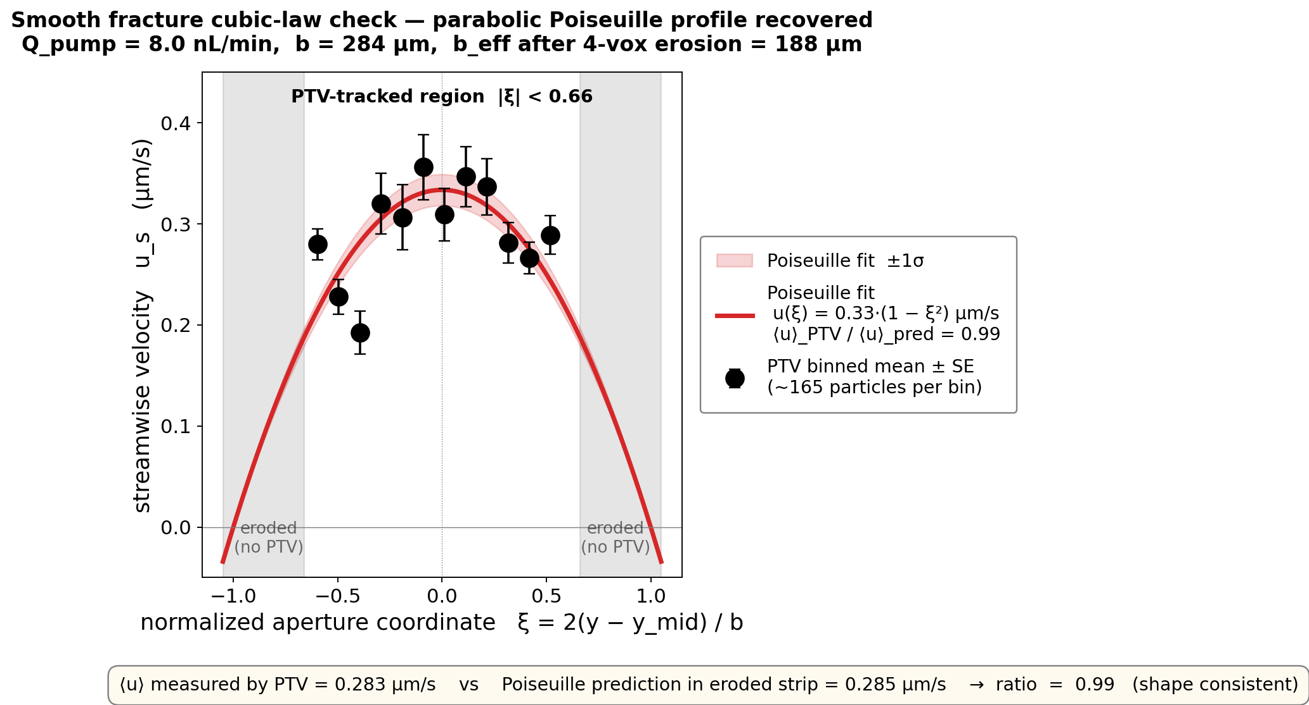
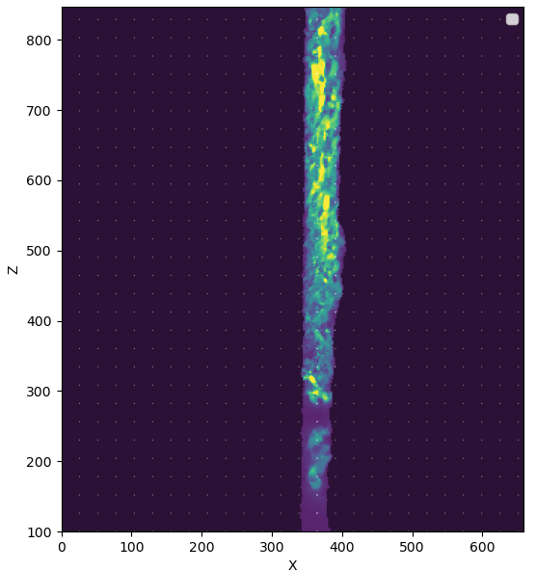
Cubic-law validation with velocity field

Slide 15
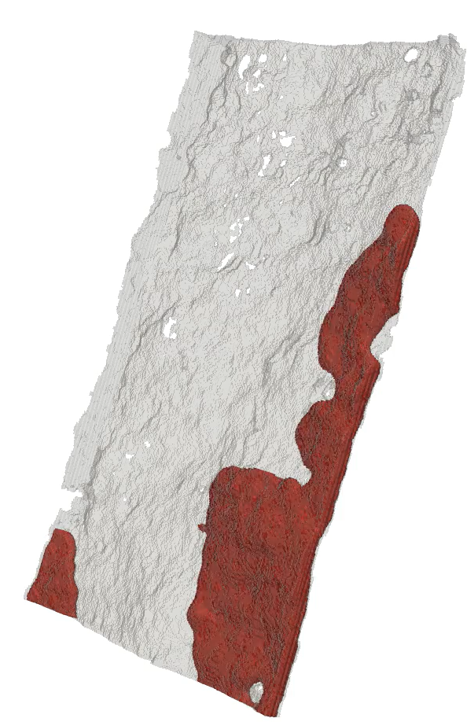
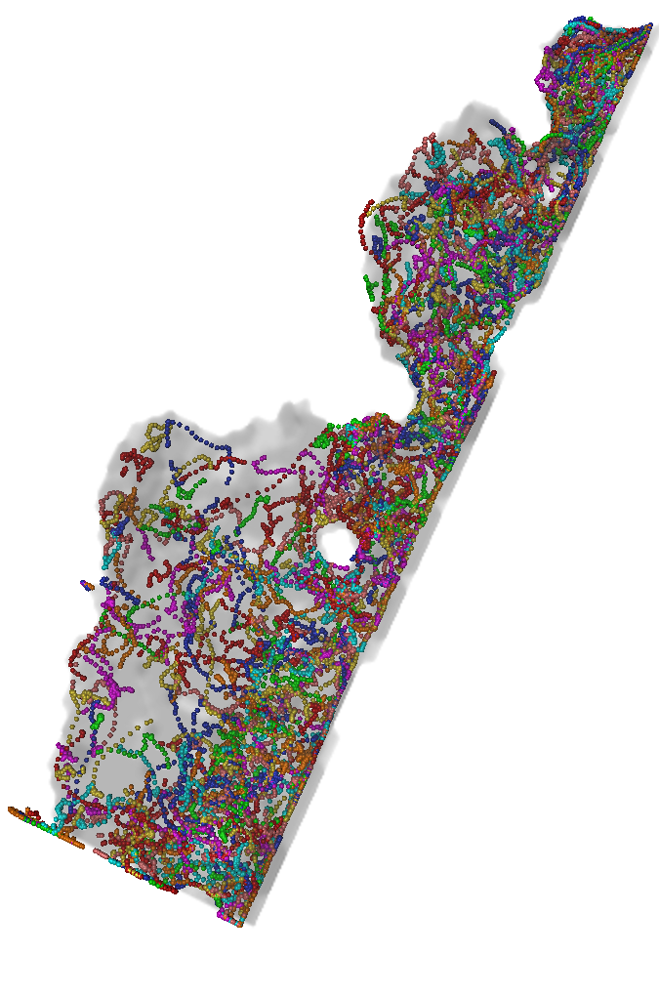
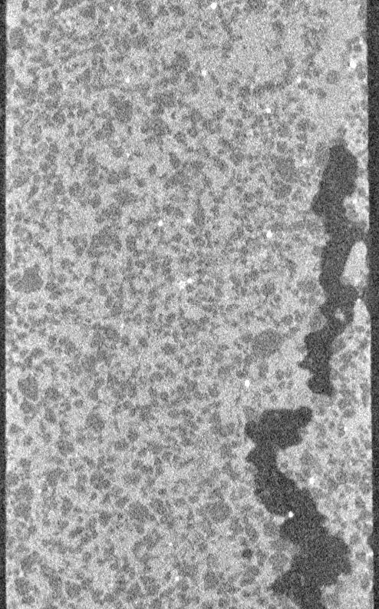
Carmel rough fracture shows complex dynamics
Lagrangian particle tracks
Oil segmented

Slide 16
Summary and Prospectives
Scientific:
Pore-scale topology events leave macroscopic pressure signatures
Moderate fractional-flow transitions are non-stationary: saturation and pressure fluctuations decay together over ~20 min
Lab-based PTV recovers cubic-law in smooth fractures and resolves complex Lagrangian dynamics in rough ones
Methodological:
Established methodology for range of M and Ca using lab-based micro-CT for multiphase flow in rough fractures
Tracking could be improved with larger and higher atomic number metal coating
Notes:
arXiv papers

Slide 17

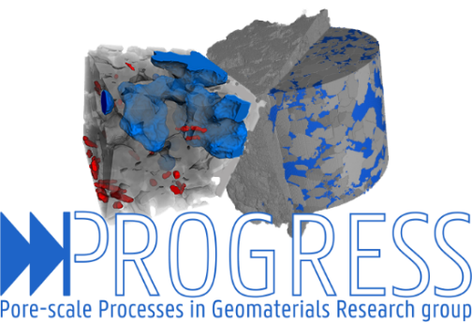
Acknowledgements

