Slide 1




Modeling Upscaled Retention Behavior of Unsaturated Fractured Rocks
Muhammad Raharsya Andiva¹, Chuanyin Jiang¹, Martin Ziegler², and Qinghua Lei¹
¹ Department of Earth Sciences, Uppsala University, Sweden
² Federal Office of Topography, Mont Terri Underground Rock Laboratory, St-Ursanne, Switzerland
Federal Office of Topography
Federal Nuclear Safety
Inspectorate ENSI

Slide 2
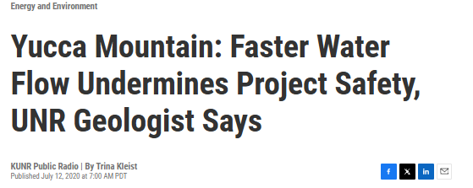
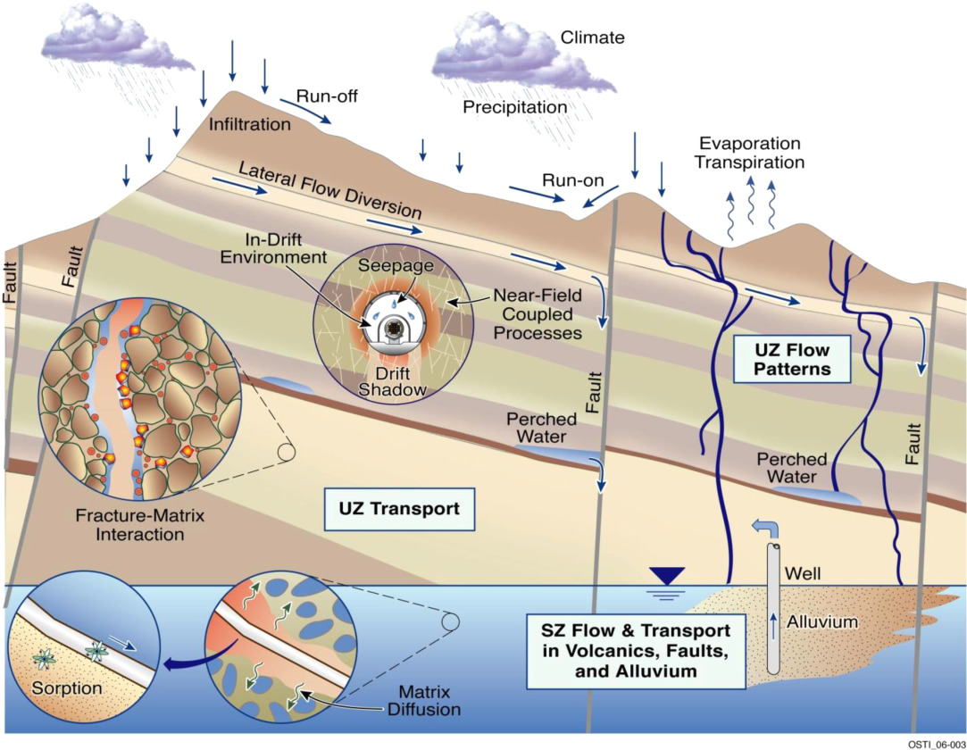
Motivation and background
Unsaturated fractured rocks control water movement in many subsurface systems.
Fractures may accelerate flow and bypass matrix storage, contradicting the classical theory perspectives.
Effective retention behavior is needed for large-scale safety and performance assessment.
Hydrological processes in the unsaturated fractured-rock system at Yucca Mountain, including seepage, fracture–matrix interaction, and transport.
(Adapted from Tsang et al. (2015))

Slide 3
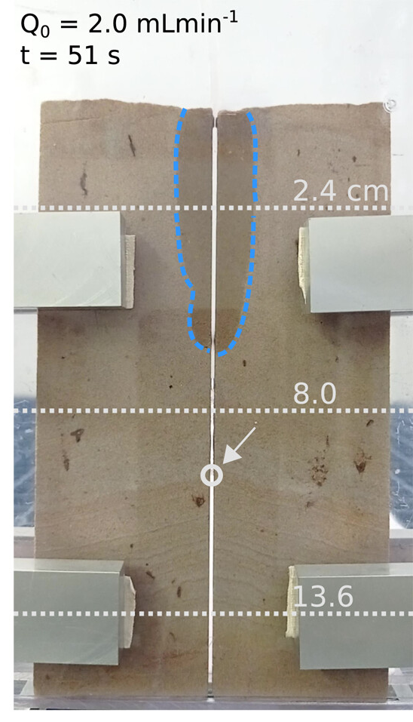
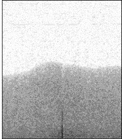
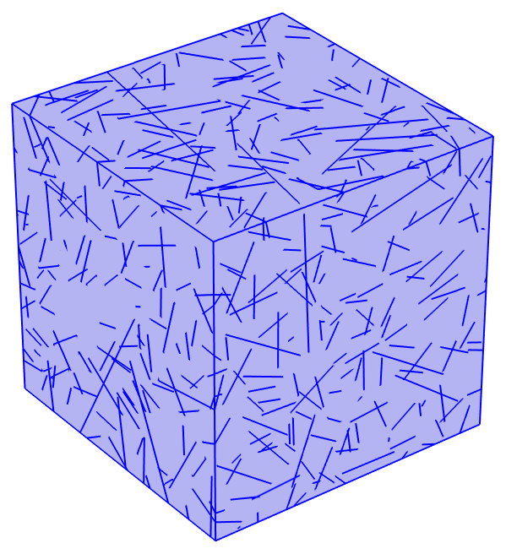
Unsaturated flow in fractured rock
Matrix dominate flow due to strong capillary forces.
Which domain controls unsaturated flow?
Fractures act as localized preferential pathways.
Can it be quantified?
Adapted from Roels et al. (2003)
Adapted from Rüdiger et al. (2024)

Slide 4
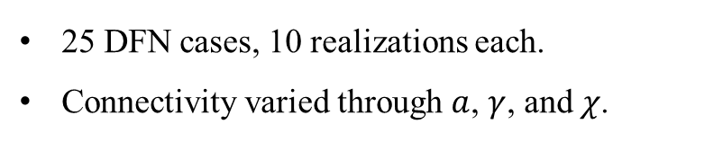
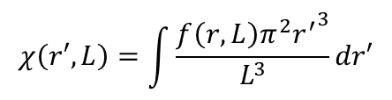
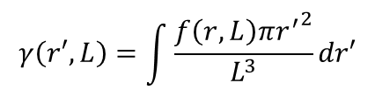
Modeling framework
Power-law distributed fracture radii
$$f\left(r,L\right)=ξr^{−a}, r_{min}≤r<r_{max}$$
Fracture intensity
$$γ\left(r′,L\right)=\int{\frac{f\left(r,L\right){πr^{′}}^{2}}{L^{3}}dr′}$$
Percolation parameter
$$χ\left(r′,L\right)=\int{\frac{f\left(r,L\right){π^{2}r^{′}}^{3}}{L^{3}}dr′}$$
25 DFN cases, 10 realizations each.
Connectivity varied through $a$, $γ$, and $χ$.

Slide 5
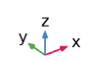
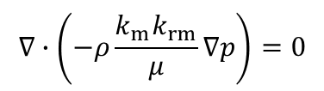



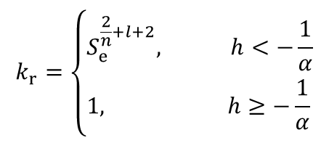
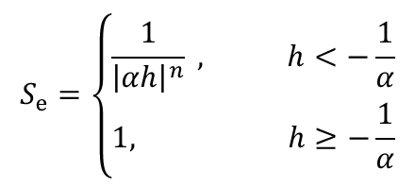

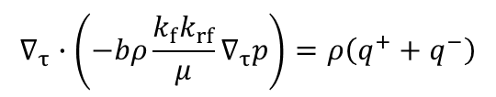
Modeling framework
Richard’s equation
A series of steady-state simulations at different saturation states.
$$∇∙\left(−ρ\frac{k_{m}k_{rm}}{μ}∇p\right)=0$$
$$∇_{τ}∙\left(−bρ\frac{k_{f}k_{rf}}{μ}∇_{τ}p\right)=ρ\left(q^{+}+q^{−}\right)$$
No flow boundary
$$h_{i}−0.001$$
Upscaled relative permeability
Brooks-Corey retention model
$$k_{r}=\frac{k_{eff}}{k_{abs}}=−\frac{Qμ}{k_{abs} L ∆P}$$
$$S_{e}=\left\{\begin{aligned}&\frac{1}{{\left|αh\right|}^{n}} , h<−\frac{1}{α} \\ &1, h≥−\frac{1}{α}\end{aligned}\right.$$
$$k_{r}=\left\{\begin{aligned}&S_{e}^{\frac{2}{n}+l+2}, h<−\frac{1}{α} \\ &1, h≥−\frac{1}{α}\end{aligned}\right.$$
$$h_{i}$$
$$p_{c}=\frac{ρg}{α}S_{e}^{−\frac{1}{n}}$$

Slide 6
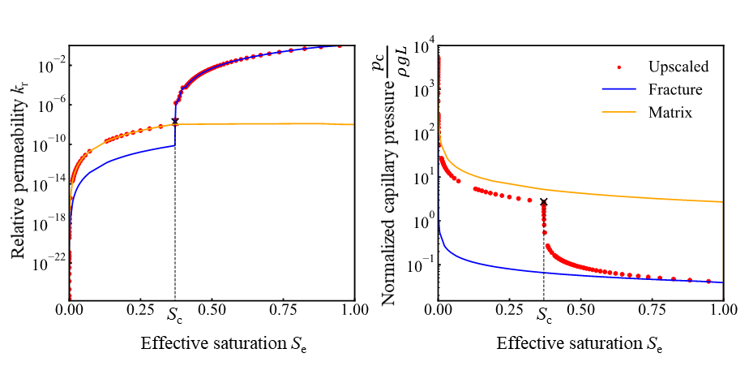
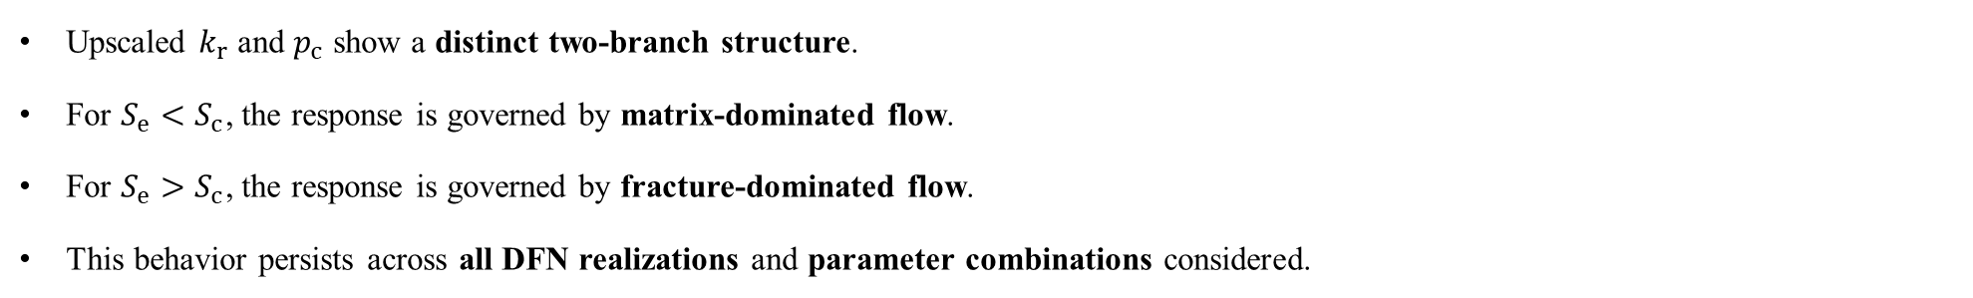
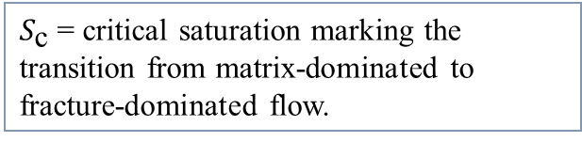
Two-branch retention behavior
Upscaled $k_{r}$​ and $p_{c}$ show a distinct two-branch structure.
For $S_{e}<S_{c}​$, the response is governed by matrix-dominated flow.
For $S_{e}>S_{c}​$, the response is governed by fracture-dominated flow.
This behavior persists across all DFN realizations and parameter combinations considered.
$S_{\text{c}}$= critical saturation marking the transition from matrix-dominated to fracture-dominated flow.

Slide 7
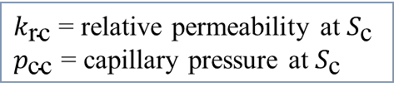


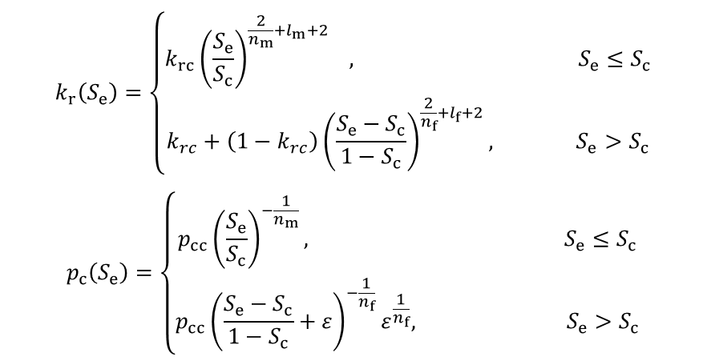
Generalized retention model
The upscaled response is represented using two continuous branches connected at $S_{c}$.
$$k_{r}\left(S_{e}\right)=\left\{\begin{aligned}k_{rc}{\left(\frac{S_{e}}{S_{c}}\right)}^{\frac{2}{n_{m}}+l_{m}+2} , S_{e}≤S_{c} \\ &{k_{rc}+\left(1−k_{rc}\right)\left(\frac{S_{e}−S_{c}}{1−S_{c}}\right)}^{\frac{2}{n_{f}}+l_{f}+2}, S_{e}>S_{c}\end{aligned}\right.$$
$$p_{c}\left(S_{e}\right)=\left\{\begin{aligned}p_{cc}{\left(\frac{S_{e}}{S_{c}}\right)}^{−\frac{1}{n_{m}}}, S_{e}≤S_{c} \\ p_{cc}{\left(\frac{S_{e}−S_{c}}{1−S_{c}}+ε\right)}^{−\frac{1}{n_{f}}}ε^{\frac{1}{n_{f}}}, S_{e}>S_{c}\end{aligned}\right.$$
$$ε=\frac{1}{{\left(\frac{α_{f}p_{cc}}{ρg}\right)}^{n_{f}}−1}$$
$k_{\text{rc}}$ = relative permeability at $S_{\text{c}}$
$p_{\text{cc}}$ = capillary pressure at $S_{\text{c}}$
Can we quantify $S_{c}$?

Slide 8
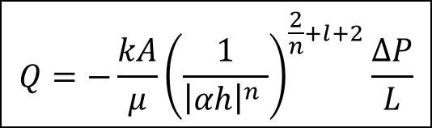
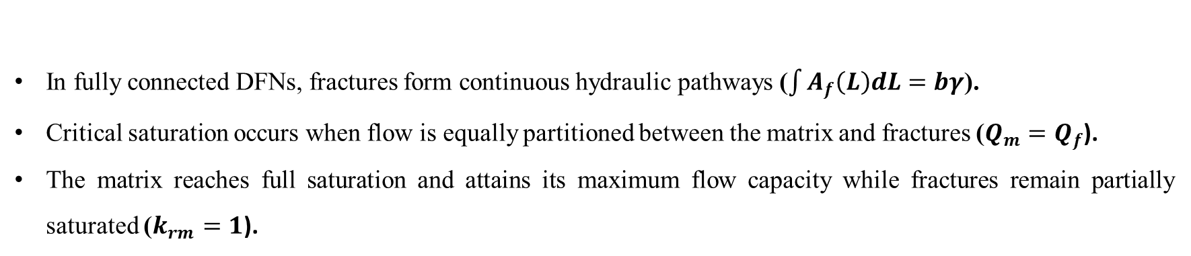

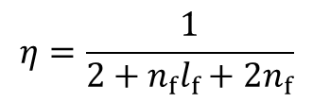
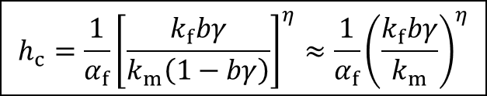
Analytical solution
In fully connected DFNs, fractures form continuous hydraulic pathways ($\int{A_{f}\left(L\right)dL}=bγ$).
Critical saturation occurs when flow is equally partitioned between the matrix and fractures ($Q_{m}=Q_{f}$).
The matrix reaches full saturation and attains its maximum flow capacity while fractures remain partially saturated ($k_{rm}=1$).
$$Q=−\frac{kA}{μ}{\left(\frac{1}{{\left|αh\right|}^{n} }\right)}^{\frac{2}{n}+l+2}\frac{∆P}{L}$$
$$h_{c}=\frac{1}{α_{f}}{\left[\frac{k_{f}bγ}{k_{m}\left(1−bγ\right)}\right]}^{η}≈\frac{1}{α_{f}}{\left(\frac{k_{f}bγ}{k_{m}}\right)}^{η}$$
Darcy´s law + BC retention model
$$η=\frac{1}{2+n_{f}l_{f}+2n_{f}}$$
$h_{\text{c}}$= critical pressure head when $S_{\text{c}}$ occurs.

Slide 9
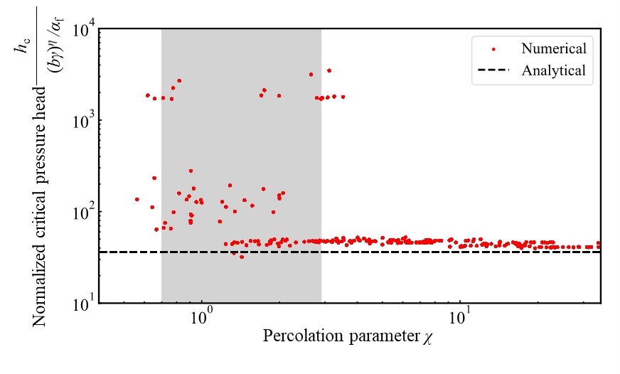
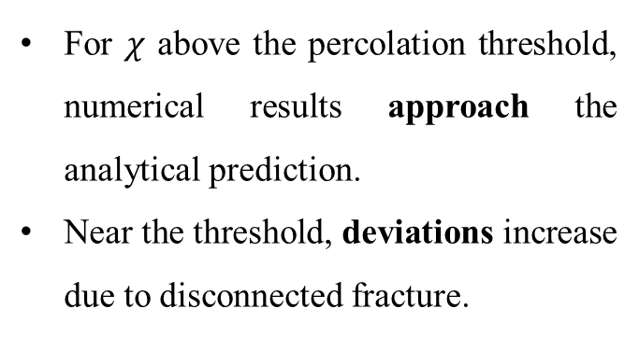
Validation
For $χ$ above the percolation threshold, numerical results approach the analytical prediction.
Near the threshold, deviations increase due to disconnected fracture.

Slide 10
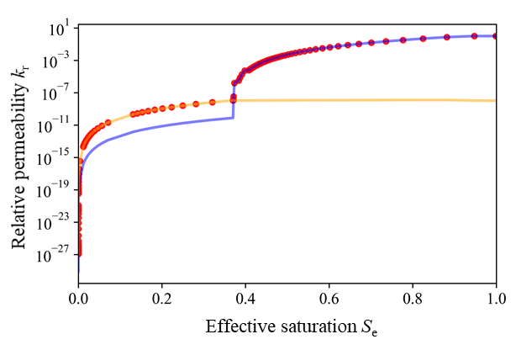
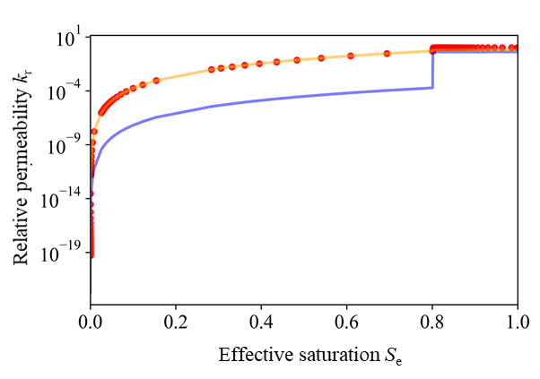
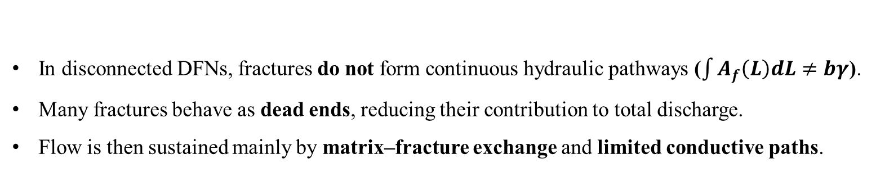
Control of fracture network connectivity
Well-connected DFN
Disconnected DFN
In disconnected DFNs, fractures do not form continuous hydraulic pathways ($\int{A_{f}\left(L\right)dL}≠bγ$).
Many fractures behave as dead ends, reducing their contribution to total discharge.
Flow is then sustained mainly by matrix–fracture exchange and limited conductive paths.

Slide 11

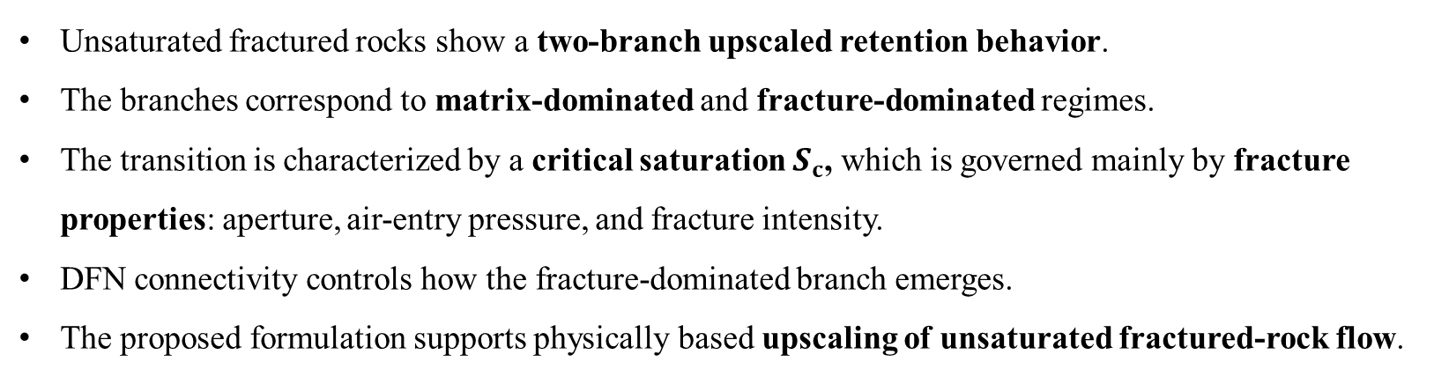
Conclusion
Unsaturated fractured rocks show a two-branch upscaled retention behavior.
The branches correspond to matrix-dominated and fracture-dominated regimes.
The transition is characterized by a critical saturation $S_{c}$​, which is governed mainly by fracture properties: aperture, air-entry pressure, and fracture intensity.
DFN connectivity controls how the fracture-dominated branch emerges.
The proposed formulation supports physically based upscaling of unsaturated fractured-rock flow.

Slide 12


CouFrac2026 – ISRM Specialized Conference
5th International Conference on Coupled Processes in Fractured Geological Media, Uppsala, Sweden, 21-23 Sep 2026
www.coufrac2026.com
12

Slide 13

Thank you
Andiva, M. R., Jiang, C., Ziegler, M., & Lei, Q. (2026). Two-branch retention behavior in unsaturated fractured rock driven by fracture-matrix flow partitioning. arXiv preprint arXiv:2603.26605.
Federal Office of Topography
Federal Nuclear Safety
Inspectorate ENSI

Slide 15
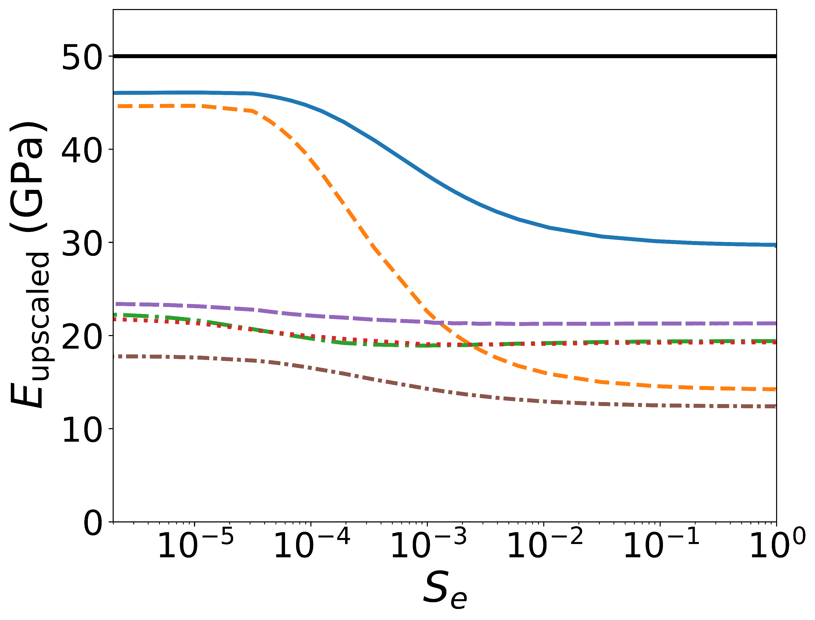
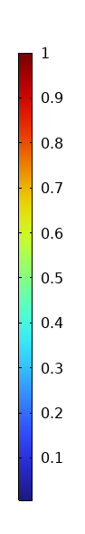
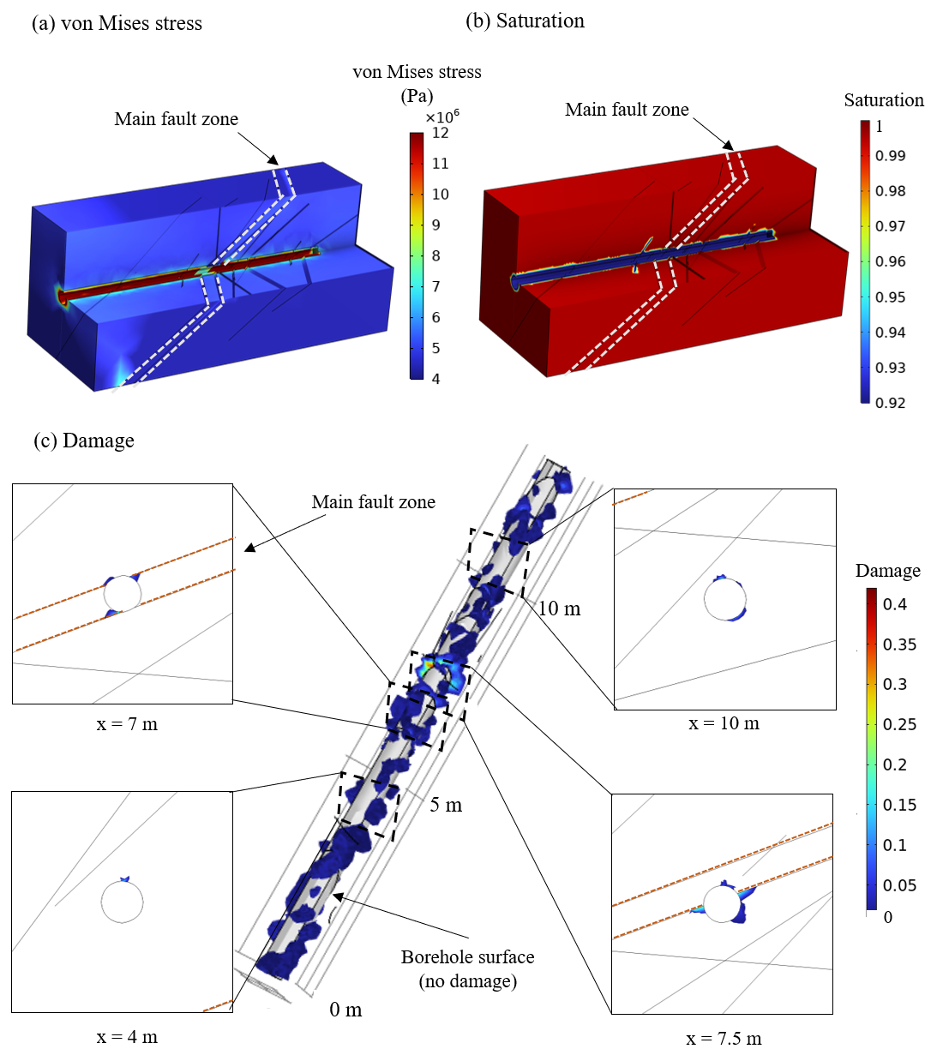
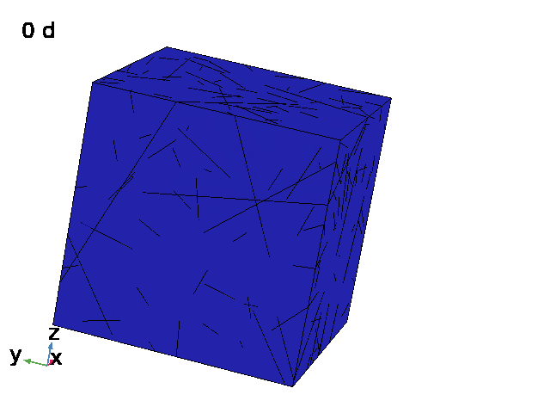
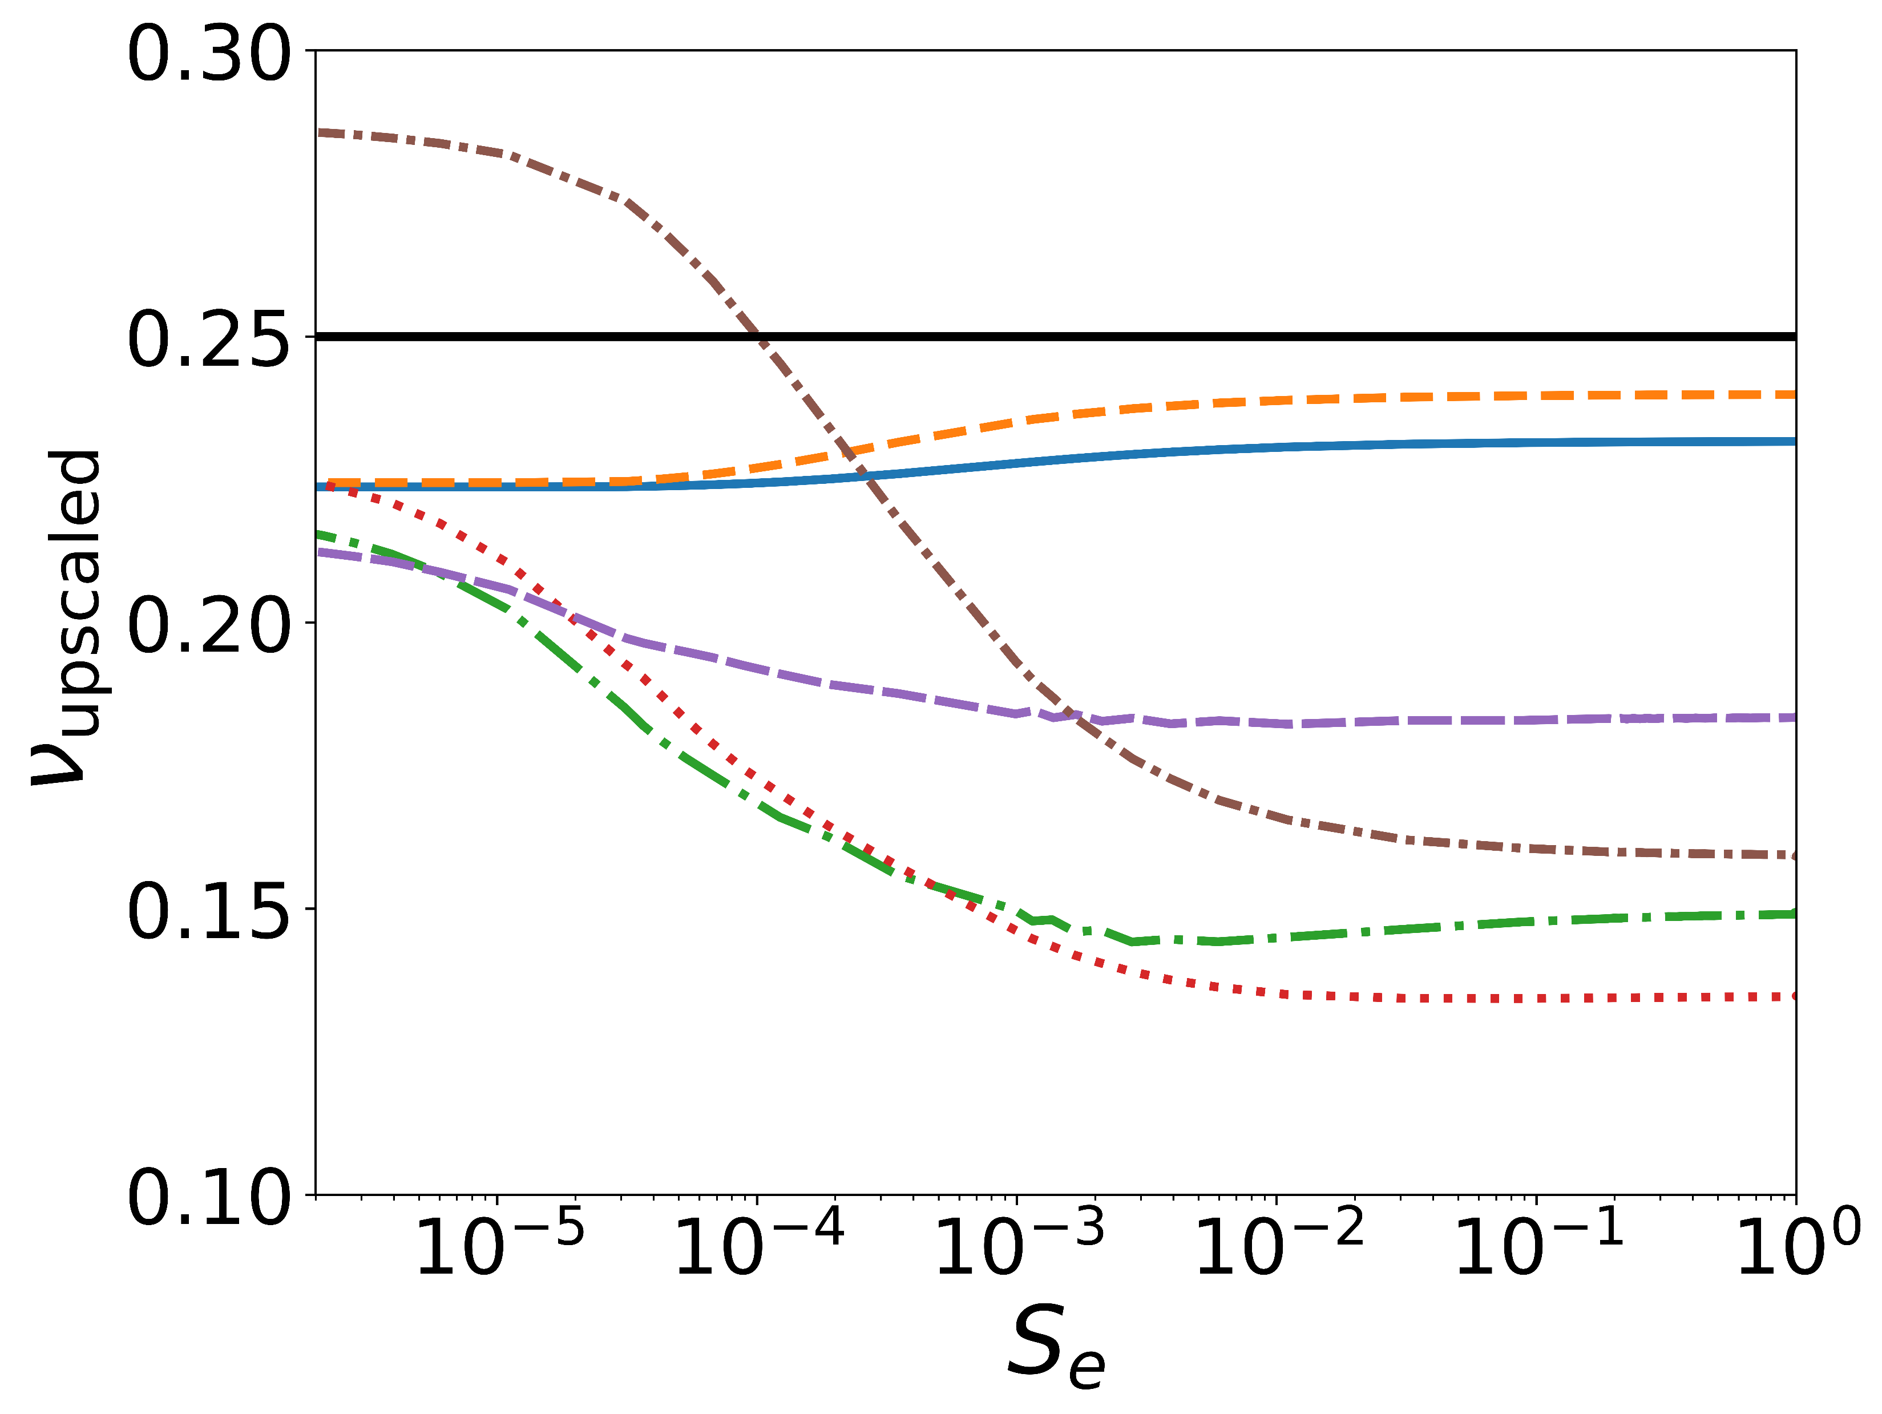
Next steps
Dynamic unsaturated flow
Hydromechanical coupling
Application to engineering problems
Matrix initial Young’s modulus
Matrix initial Poisson ratio

Slide 16
Backup slides

Slide 17
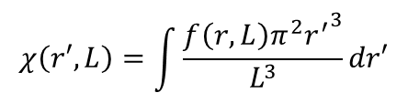
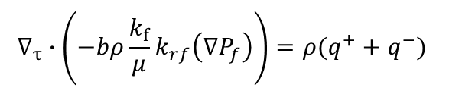
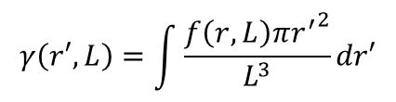
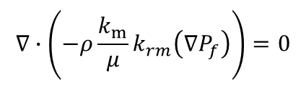
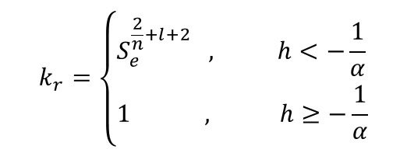
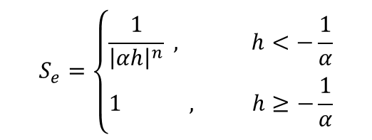

Governing equations
Richard’s equation
Fracture network parameters
$$∇∙\left(−ρ\frac{k_{m}}{μ}k_{rm}\left(∇P_{f}\right)\right)=0$$
$$f\left(r,L\right)=ξr^{−a}, r_{min}≤r<r_{max}$$
$$γ\left(r′,L\right)=\int{\frac{f\left(r,L\right){πr^{′}}^{2}}{L^{3}}dr′}$$
$$∇_{τ}∙\left(−bρ\frac{k_{f}}{μ}k_{rf}\left(∇P_{f}\right)\right)=ρ(q^{+}+q^{−})$$
$$χ\left(r′,L\right)=\int{\frac{f\left(r,L\right){π^{2}r^{′}}^{3}}{L^{3}}dr′}$$
Brooks-Corey retention model
$$S_{e}=\left\{\begin{aligned}&\frac{1}{{\left|αh\right|}^{n}} , h<−\frac{1}{α} \\ &1 , h≥−\frac{1}{α}\end{aligned}\right.$$
$$k_{r}=\left\{\begin{aligned}&S_{e}^{\frac{2}{n}+l+2} , h<−\frac{1}{α} \\ &1 , h≥−\frac{1}{α}\end{aligned}\right.$$
$$p_{c}=\frac{ρg}{α}S_{e}^{−\frac{1}{n}}$$

Slide 18
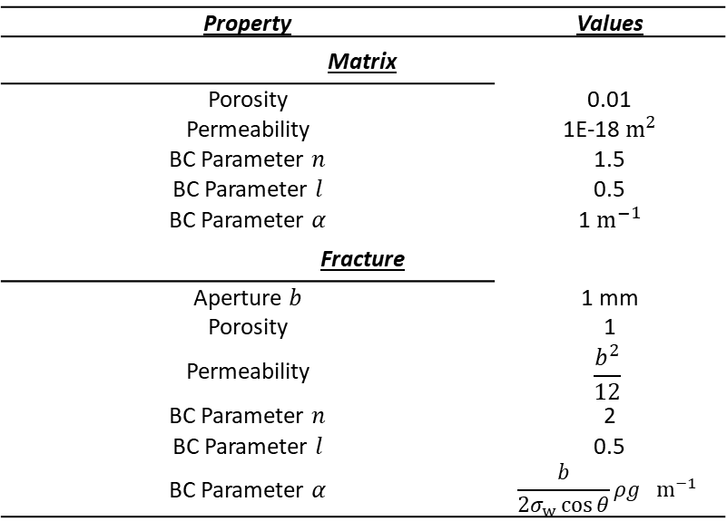
Material properties
Property | Values
Matrix
Porosity | 0.01
Permeability | 1E-18 $m^{2}$
BC Parameter $n$ | 1.5
BC Parameter $l$ | 0.5
BC Parameter $α$ | 1 $m^{−1}$
Fracture
Aperture $b$ | 1 mm
Porosity | 1
Permeability | $$\frac{b^{2}}{12}$$
BC Parameter $n$ | 2
BC Parameter $l$ | 0.5
BC Parameter $α$ | $$\frac{b}{2σ_{w}\cos{θ}}ρg { m}^{−1}$$

Slide 19
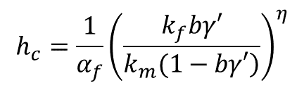
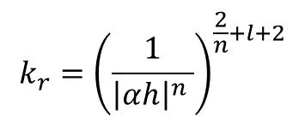
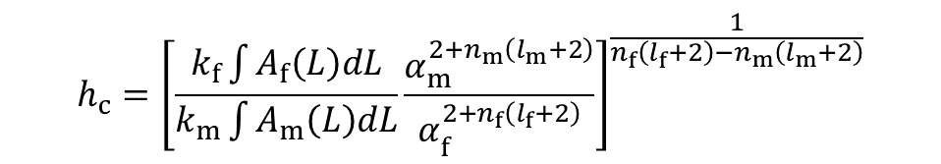
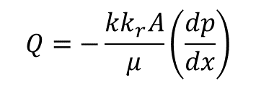


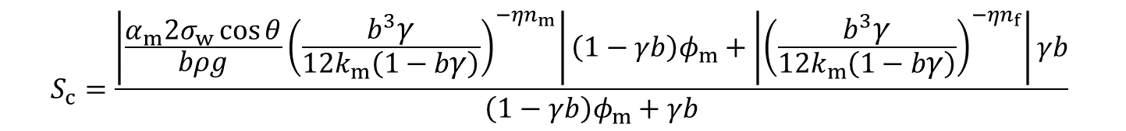
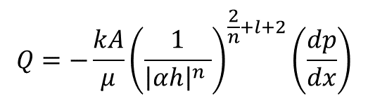
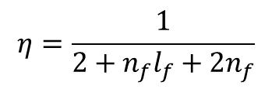
Analytical solution
$$Q=−\frac{kk_{r}A}{μ}\left(\frac{dp}{dx}\right)$$
$$Q=−\frac{kA}{μ}{\left(\frac{1}{{\left|αh\right|}^{n} }\right)}^{\frac{2}{n}+l+2}\left(\frac{dp}{dx}\right)$$
$$k_{r}={\left(\frac{1}{{\left|αh\right|}^{n} }\right)}^{\frac{2}{n}+l+2}$$
$$Q_{m}=Q_{f}$$
$$h_{c}={\left[\frac{k_{f}\int{A_{f}\left(L\right)dL}}{k_{m}\int{A_{m}\left(L\right)dL}}\frac{α_{m}^{2+n_{m}\left(l_{m}+2\right)}}{α_{f}^{2+n_{f}\left(l_{f}+2\right)}}\right]}^{\frac{1}{n_{f}\left(l_{f}+2\right)−n_{m}\left(l_{m}+2\right)}}$$
$$k_{rm}=1$$
$$h_{c}=\frac{1}{α_{f}}{\left(\frac{k_{f}bγ′}{\left.k_{m}(1−bγ′\right)}\right)}^{η}$$
$$η=\frac{1}{2+n_{f}l_{f}+2n_{f}}$$
$$S_{c}=\frac{\left|\frac{α_{m}2σ_{w}\cos{θ}}{bρg}{\left(\frac{b^{3}γ}{{12k}_{m}\left(1−bγ\right)}\right)}^{−ηn_{m}}\right|\left(1−γb\right)φ_{m}+\left|{\left(\frac{b^{3}γ}{12k_{m}\left(1−bγ\right)}\right)}^{−ηn_{f}}\right|γb}{\left(1−γb\right)φ_{m}+γb}$$

Slide 20
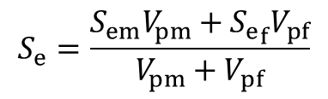
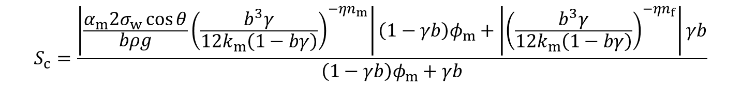
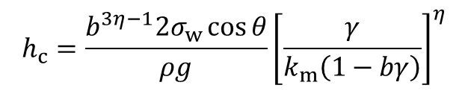



Analytical solution
$$h_{c}=\frac{b^{3η−1}2σ_{w}\cos{θ}}{ρg}{\left[\frac{γ}{k_{m}\left(1−bγ\right)}\right]}^{η}$$
$$S_{e}=\frac{S_{em}V_{pm}+{S_{e}}_{f}V_{pf}}{V_{pm}+V_{pf}}$$
$$V_{pf}=γb$$
$$S_{e}=\frac{1}{{\left|αh\right|}^{n}}$$
$$V_{pm}=\left(1−γb\right)φ_{m}$$
$$S_{c}=\frac{\left|\frac{α_{m}2σ_{w}\cos{θ}}{bρg}{\left(\frac{b^{3}γ}{{12k}_{m}\left(1−bγ\right)}\right)}^{−ηn_{m}}\right|\left(1−γb\right)φ_{m}+\left|{\left(\frac{b^{3}γ}{12k_{m}\left(1−bγ\right)}\right)}^{−ηn_{f}}\right|γb}{\left(1−γb\right)φ_{m}+γb}$$

Slide 21










Analytical estimate of the critical saturation
Inlet
Outlet
$$Q_{m}$$
$$Q_{m}<Q_{f}$$
Matrix
Fracture
$$Q_{f}$$
$$Q_{m}=Q_{f}$$
$$Q_{m}>Q_{f}$$
$$Q_{m}$$
Matrix
$$Q=−\frac{kA}{μ}{\left(\frac{1}{{\left|αh\right|}^{n} }\right)}^{\frac{2}{n}+l+2}\frac{∆P}{L}$$
$$h_{c}={\left[\frac{k_{f}\int{A_{f}\left(L\right)dL}}{k_{m}\int{A_{m}\left(L\right)dL}}\frac{α_{m}^{2+n_{m}\left(l_{m}+2\right)}}{α_{f}^{2+n_{f}\left(l_{f}+2\right)}}\right]}^{\frac{1}{n_{f}\left(l_{f}+2\right)−n_{m}\left(l_{m}+2\right)}}$$
$$Q_{m}=Q_{f}$$
Darcy´s law + BC retention model
$h_{\text{c}}$= critical pressure head when $S_{\text{c}}$ occurs.

Slide 22











Analytical estimate of the critical saturation
The matrix reaches full saturation earlier and attains its maximum flow capacity, while fractures remain partially saturated.
$$h_{c}={\left[\frac{k_{f}\int{A_{f}\left(L\right)dL}}{k_{m}\int{A_{m}\left(L\right)dL}}\frac{α_{m}^{2+n_{m}\left(l_{m}+2\right)}}{α_{f}^{2+n_{f}\left(l_{f}+2\right)}}\right]}^{\frac{1}{n_{f}\left(l_{f}+2\right)−n_{m}\left(l_{m}+2\right)}}$$
$$A_{f}=bγ$$
$$k_{rm}=1$$
$$k_{rm}=1$$
$$A_{m}=1−A_{f}$$
$$h_{c}=\frac{1}{α_{f}}{\left[\frac{k_{f}bγ}{k_{m}\left(1−bγ\right)}\right]}^{η}≈\frac{1}{α_{f}}{\left(\frac{k_{f}bγ}{k_{m}}\right)}^{η}$$
$$η=\frac{1}{2+n_{f}l_{f}+2n_{f}}$$
$$α_{f}=\frac{b}{2σ_{w}\cos{θ}}ρg$$
$bγ$ ≪ 1
$$k_{f}={b^{2}}/{12}$$
$$S_{c}=\frac{\left|\frac{α_{m}2σ_{w}\cos{θ}}{bρg}{\left(\frac{b^{3}γ}{{12k}_{m}\left(1−bγ\right)}\right)}^{−ηn_{m}}\right|\left(1−γb\right)φ_{m}+\left|{\left(\frac{b^{3}γ}{12k_{m}\left(1−bγ\right)}\right)}^{−ηn_{f}}\right|γb}{\left(1−γb\right)φ_{m}+γb}$$

Slide 23
Sensitivity analysis (single fracture)

Slide 24
Relative permeability for all DFN cases

Slide 25
Capillary pressure for all DFN cases

Slide 26
BC and VG model

Slide 27


Why Krm = 1

Slide 28






Weakly-percolated DFN
$$\frac{h_{c}α_{f}}{{\left(bγ^{′}\right)}^{η}}={\left(\frac{k_{f}}{k_{m}}\right)}^{η}$$
Weakly percolated
This discrepancy arises from the assumption that all fractures intersecting the outlet are hydraulically connected to the inlet and contribute uniformly to discharge.
Strongly percolated

Slide 29






Fractional fracture flow
$$f_{i}=\frac{\left|Q_{fi}\right|}{\sum_{i}{\left|Q_{fi}\right|}}$$
$$γ_{eff}^{′}=\frac{L_{eff}^{out}}{A_{out}}=\frac{\sum_{i}{f_{i}{ L}_{i,out}}}{A_{out}}$$
In well-connected fracture network cases, $γ_{eff}^{′}≈γ′$ and the dimensionless variable is therefore only weakly affected. In contrast, for weakly percolated networks, $γ_{eff}^{′}≪γ′$, indicating that the hydraulically active outlet intensity is significantly smaller than the geometric value (Hardebol et al., 2015; Sævik & Nixon, 2017).
$$γ^{′}=1.684 m/m^{2}$$
$$γ_{eff}^{′}=0.106 m/m^{2}$$
$$\frac{γ_{eff}^{′}}{γ^{′}}=0.063$$

Slide 30

Analytical vs Numerical (eff)

