Slide 1


Motivation
Front-aware M8 method
Evaluation and next results
Physics-informed modeling of flow instabilities during CO₂ migration in saline aquifers
A front-aware PINN-regularized surrogate
for two-dimensional CO₂–brine viscous fingering
Henglai Zhai^{[1]},
Jeff Gomes^{[1]}, Zaibin Lin^{[1]}, Francisco Oliveira^{[2]}
[1] School of Engineering, University of Aberdeen
[2] Department of Engineering and Computing , State University of Santa Cruz
Fixed-case M0–M8 ablation: localized, multiscale and conservation-sensitive CO₂ fronts
InterPore 22nd May 2026
Notes:
Good morning. Today I will talk about predicting CO₂ and brine flow with a physics-informed neural network. We call this a PINN.
Standard PINNs run into a clear problem on this kind of flow. The answer I want to defend in eleven minutes is short. The bottleneck is the fingering front, not the network size.
I will show this with our M zero to M eight ablation study, where each step adds one physically motivated component. Let me start with why fingering matters at all.

Slide 2
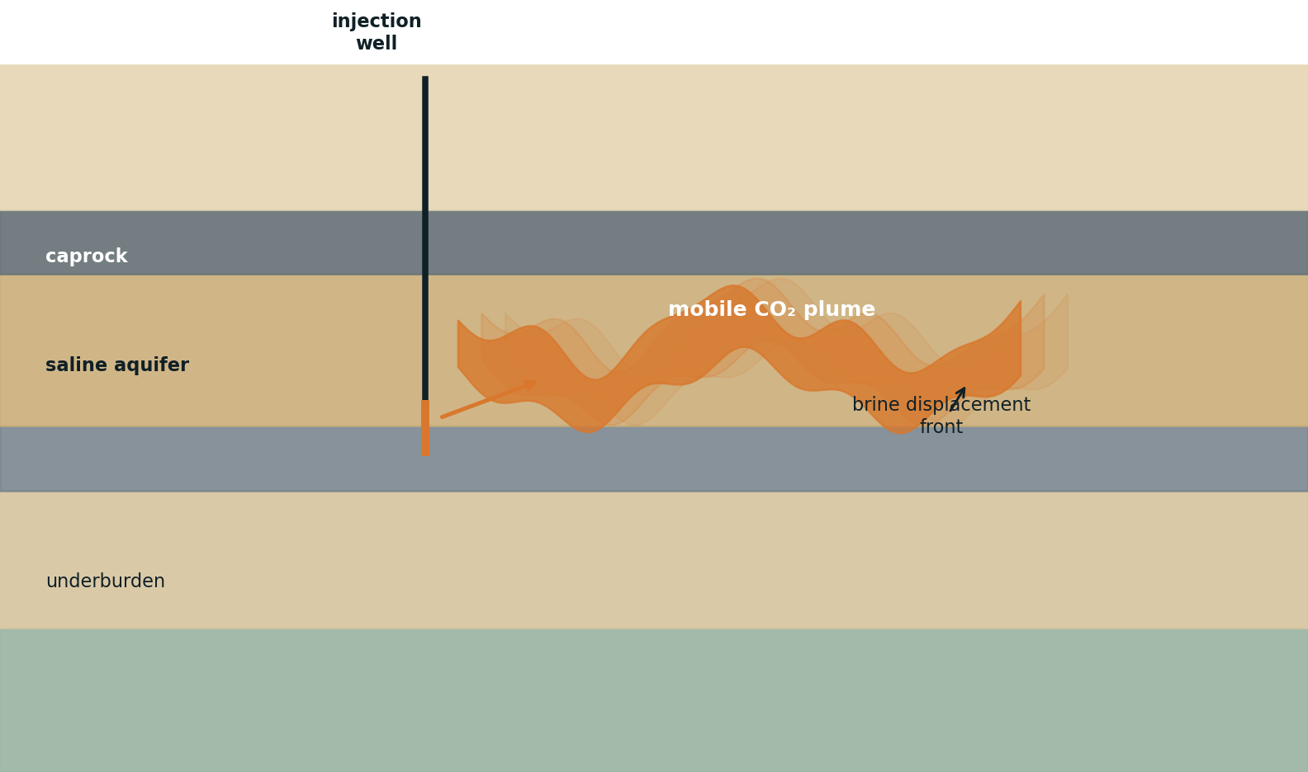
Motivation
Front-aware M8 method
Evaluation and next results
Why fingering fronts matter in geological CO₂ storage
Storage reliability depends on two coupled fields
Pressure controls injectivity, pressure buildup and monitoring response.
CO₂ saturation controls plume migration, trapping and breakthrough risk.
Viscosity contrast can destabilize the displacement front.
The target is geometric: position, sharpness, connectivity and mass balance.
WHY IT MATTERS
Storage capacity: fingers bypass most of the pore volume. Effective storage can drop well below the theoretical pore-space estimate.
Breakthrough timing: a thin finger can reach the caprock or outflow boundary years earlier than a uniform front. Smooth-front models systematically underestimate this risk.
Implication: a model that smooths the front loses the exact features that storage capacity, leakage risk and monitoring rely on. Predicting the front geometry is the central scientific target.
02
Notes:
Geological CO₂ storage depends on two coupled fields.
The first is pressure. Pressure governs injectivity, caprock loading, and how monitoring signals show up at the surface. Pressure is comparatively smooth, so a standard neural network handles it well.
The second is CO₂ saturation, which tells us where the plume actually goes and when it can break through. Saturation is the hard field, because CO₂ is much less viscous than brine. When the lower-viscosity phase pushes the heavier phase, the displacement front becomes unstable and forms fingers. So the storage problem is really a problem of predicting a moving, fingering front.

Slide 3
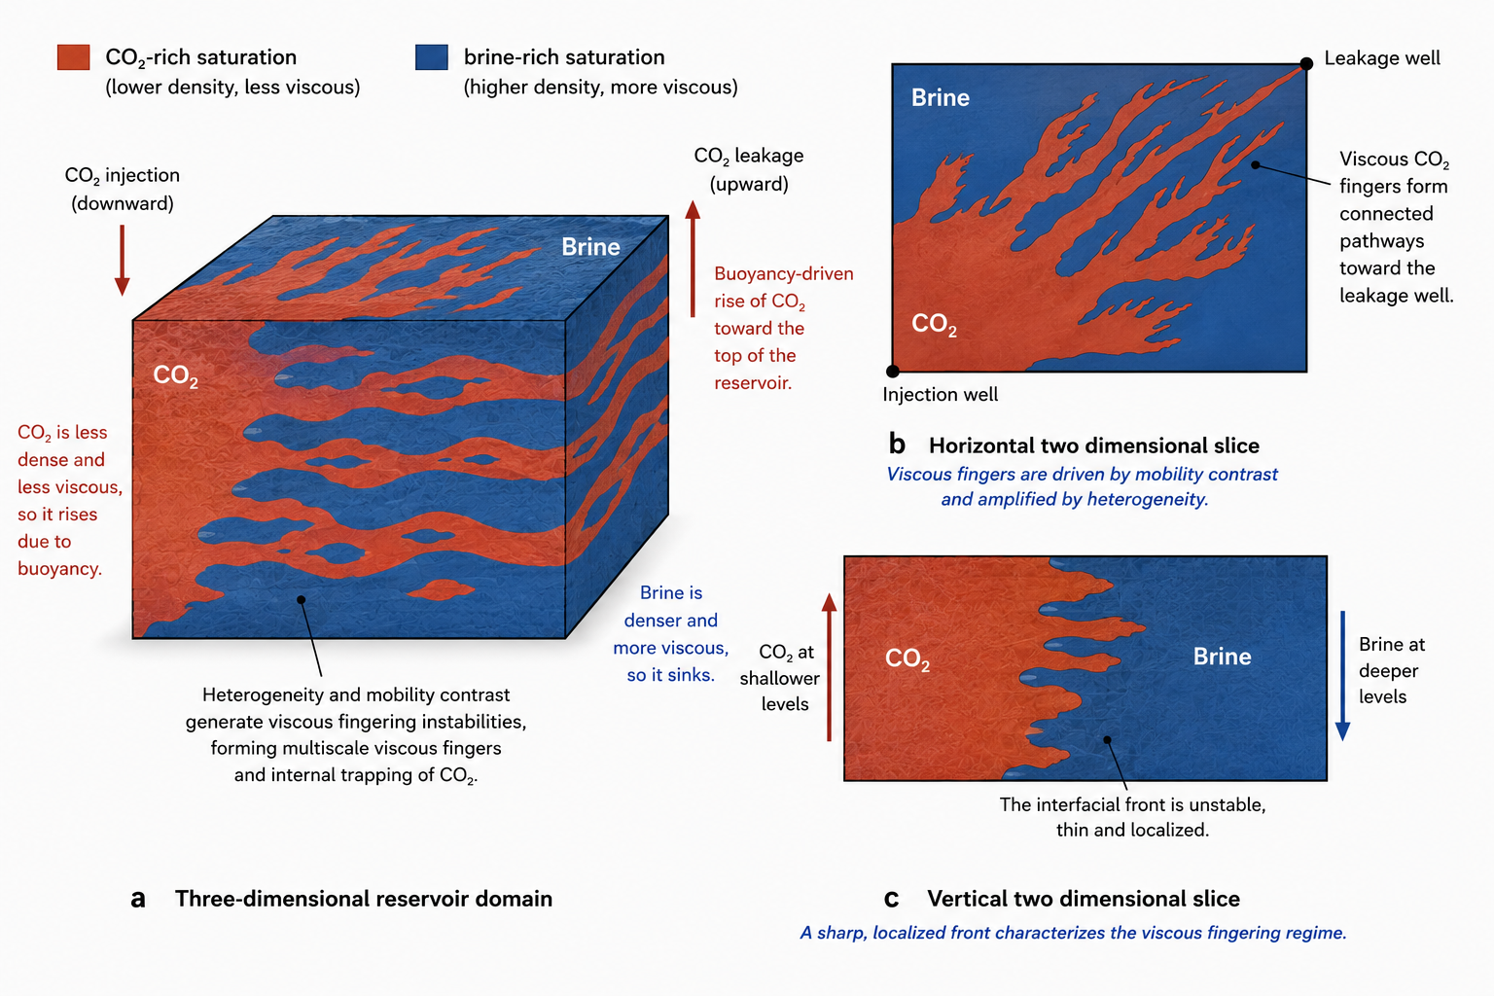
Motivation
Front-aware M8 method
Evaluation and next results
Two-phase CO₂–brine displacement: why saturation is the hard field
Mechanism
Lower-density, lower-viscosity CO₂ rises through denser brine.
Mobility contrast and heterogeneity amplify viscous fingers.
Geometry
Top view: connected pathways.
Vertical section: a thin, unstable and
localized saturation front.
CFD Simulation (ICFERST)
High-resolution mesh requirements
Intensive computational overhead
Vanilla PINNs are mismatched to saturation fields that are localized, multiscale and gradient-concentrated.
03
Notes:
This is a high-resolution simulation of the same problem. The plume develops fingers, the transition zone between CO₂ and brine is very thin, and the geometry carries the science: which channels stay connected, when CO₂ reaches the outlet, how much pore space is actually used. A single global RMSE collapses all of that information into one number and hides what matters.
So my central message is direct. A standard PINN is structurally mismatched to a saturation field that is localized, multiscale, and gradient-concentrated. The network is not too small. The training is too uniform.

Slide 4
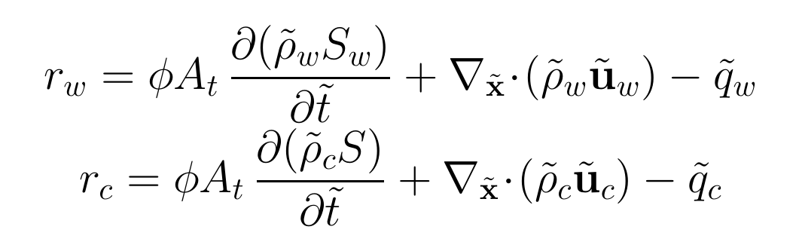
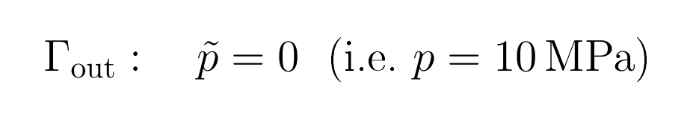
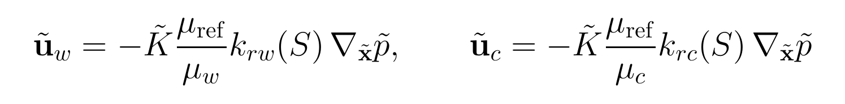
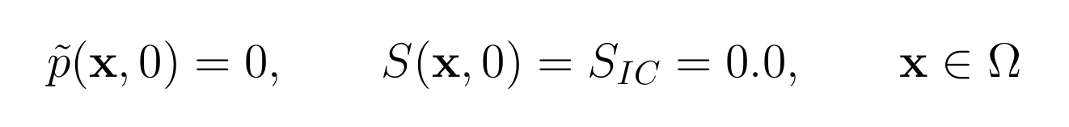
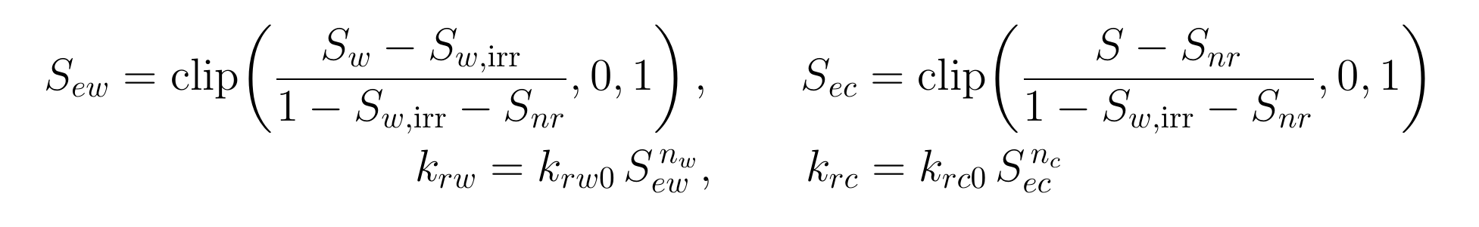
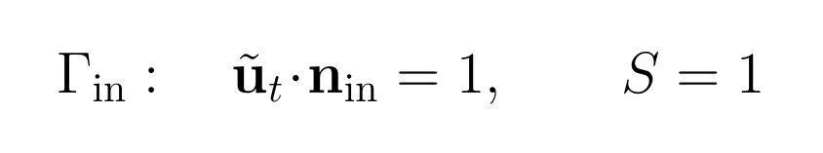
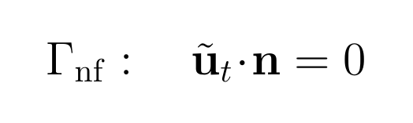
Motivation
Front-aware M8 method
Evaluation and next results
Physical model: domain constraints and two-phase residual
Physical domain, IC and boundary constraints
Dimensionless phase equation：
Square Darcy-scale domain with two quarter-well exclusions
outlet
Γ_nf
Darcy-scale square domain
Ω = (0,L)² minus well arcs
L = 5 m, R = 0.5 m
Injection, outlet and no-flow effects are imposed through Γin, Γout and Γnf losses.
Darcy fluxes
Corey mobility closure
CO₂ injection
Γ_nf
Scope of the reduced residual: capillarity, gravity, dissolution and geomechanics are not inserted into the training residual.
04
Notes:
Now the equations. We solve two-phase Darcy flow on a five-by-five-meter square domain, with two quarter-circle well exclusions. One well injects CO₂, the other lets the displaced brine leave.
For each phase we use mass conservation, Darcy's law, and a Corey-type relative permeability. CO₂ density depends on pressure, so we fit a differentiable Chebyshev surrogate that keeps the residual fully differentiable through automatic differentiation.
Initial saturation is zero point two everywhere. Outlet pressure is ten megapascals. The injection boundary prescribes both flux and saturation.
We deliberately leave out capillary pressure, gravity, and dissolution. The reduced model targets short-time viscosity-dominated displacement, not a full storage simulator.

Slide 5
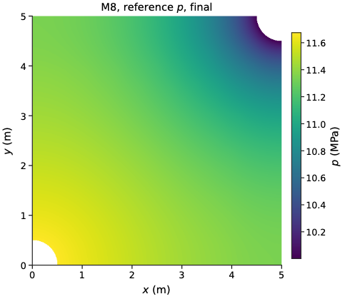
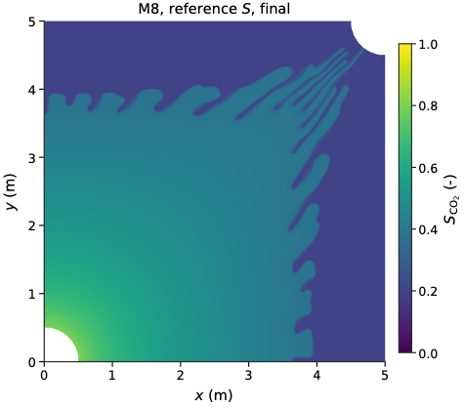
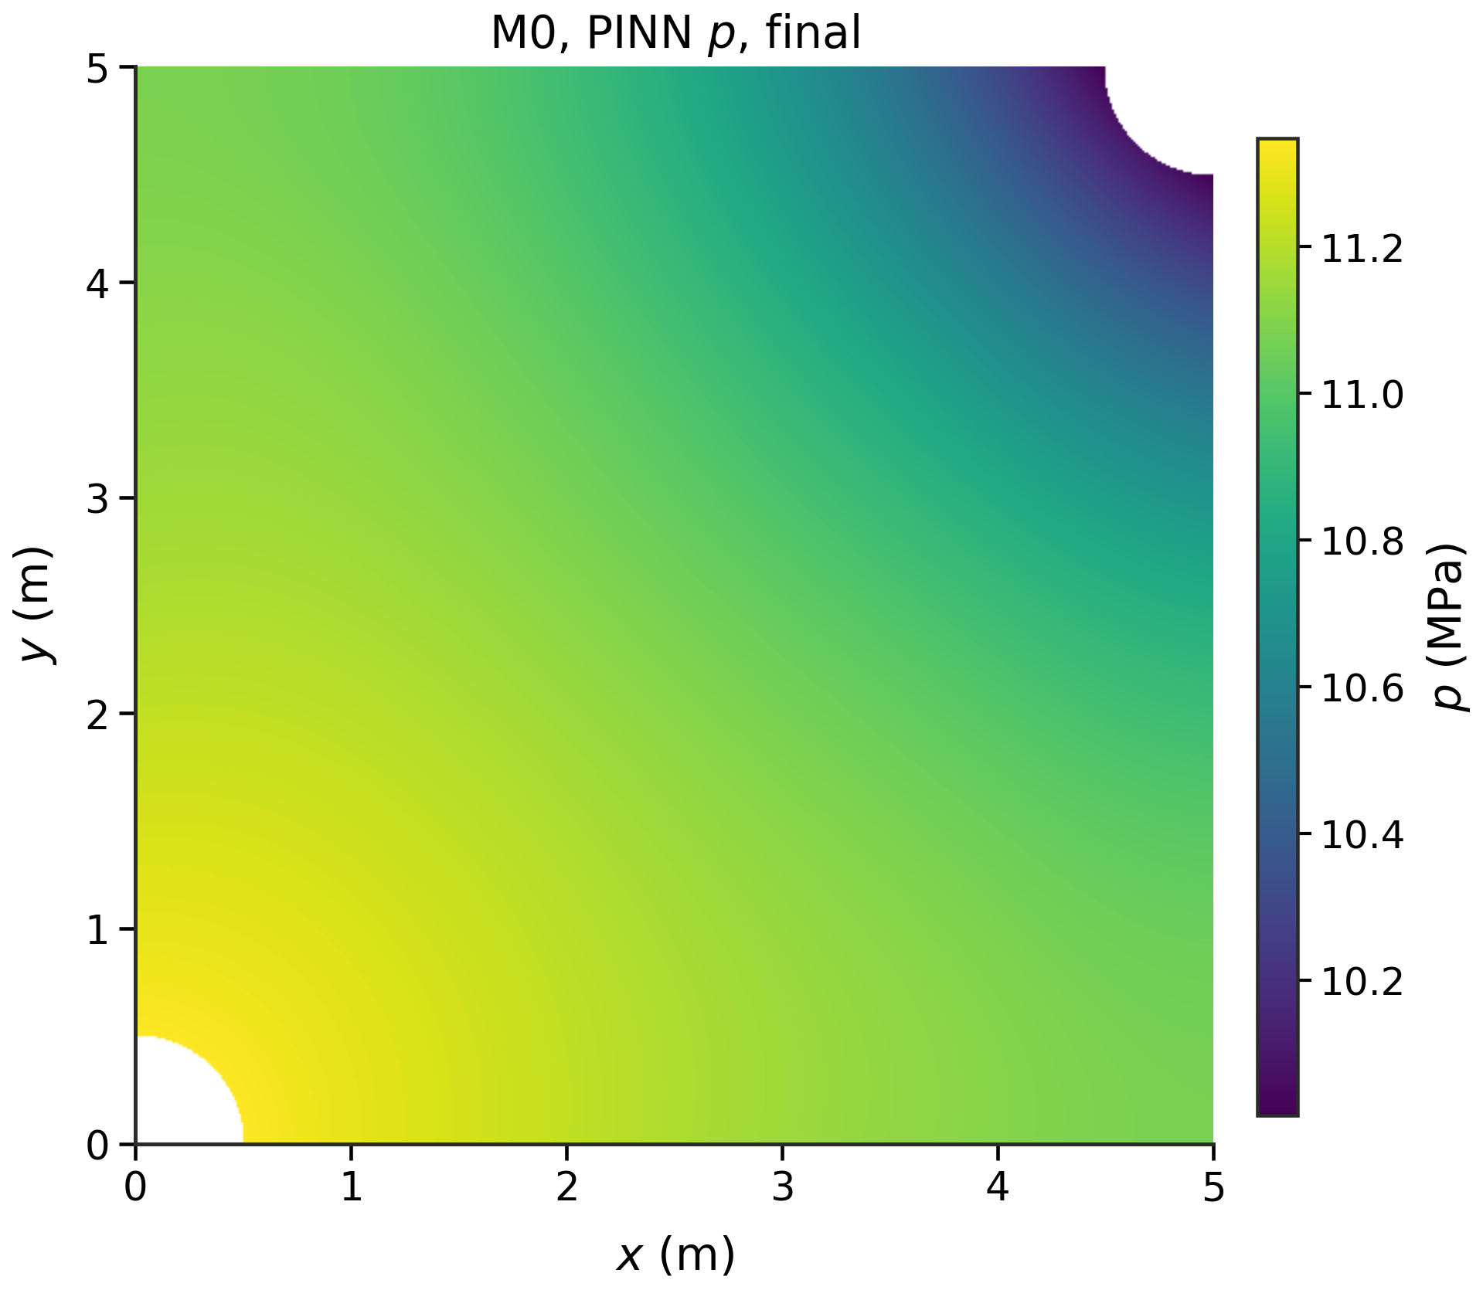
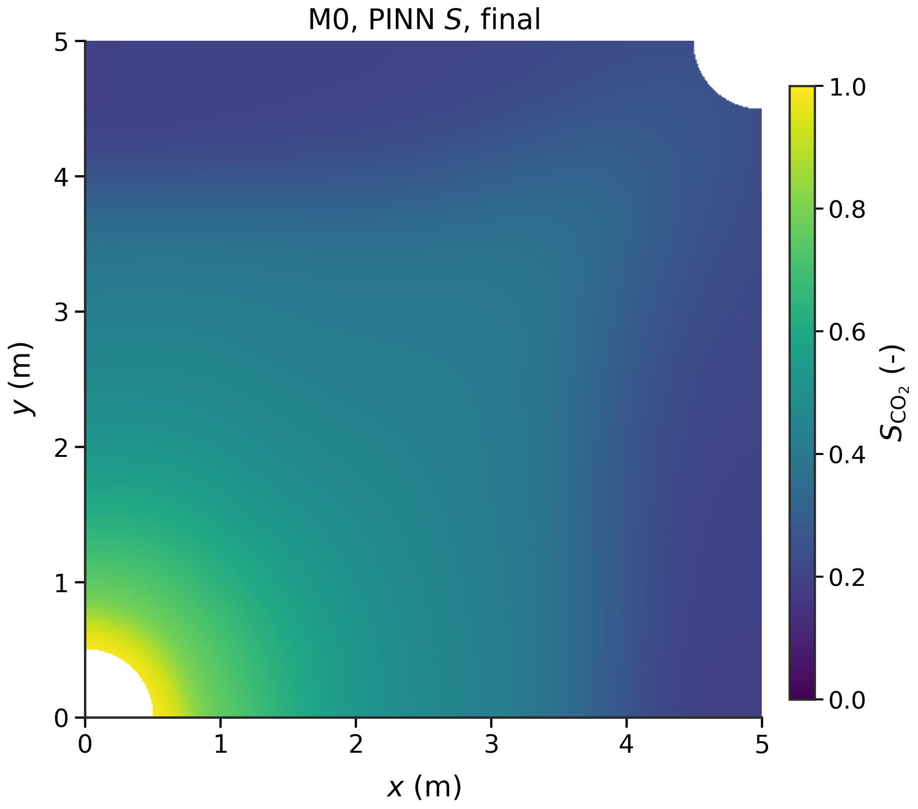
Motivation
Front-aware M8 method
Evaluation and next results
From CO₂–brine fingering to the vanilla PINN failure mode
CO₂–brine displacement creates a front problem
b
a
IC-FERST
vanilla PINN
Pressure is smooth and well predicted.
Localized
decisive errors occupy a small moving space-time band
Multiscale
a plume envelope coexists with fingers and fine edges
Viscous fingering instability can not be simulated.
Shared pressure-saturation surrogate:
smooth pressure competes with front details
Gradient-concentrated
the steep saturation transition dominates error
Pressure obeys an elliptic balance — long-range coupling, comparatively smooth fields. A generic coordinate network handles it well.
CO₂ saturation obeys hyperbolic transport — thin moving fronts, viscous fingering. The same network smooths exactly where the geometry matters.
Implication: the two fields require different representational machinery; one shared network is structurally limited.
05
Notes:
This slide makes the problem visible. On the left we have the reference field from ICFERST, the Imperial College Finite Element Reservoir Simulator, which produces sharp fingers as expected. On the right is a vanilla PINN trained on exactly the same data, with the same loss budget. The pressure field still looks fine, but the saturation geometry collapses into a smooth blob.
So the conclusion is direct. Saturation is the limiting field, and the limit is geometric, not capacity. Throwing more parameters at the same network will not bring the fingers back.

Slide 6
Motivation
Front-aware M8 method
Evaluation and next results
From CO₂–brine fingering to the vanilla PINN failure mode
b
c
Why vanilla PINNs
are structurally mismatched
Front-aware M8 response
Smooth global networks:
spectral bias against sharp fronts
Variable decoupling
separate pressure and saturation branches
Uniform collocation:
front bands receive too few points
MSFF + coarse/detail
frequency capacity only where needed
Averaged hybrid losses:
localized saturation errors are diluted
Front/plume + pair-gradient
supervise front band and local contrast
Shared pressure-saturation surrogate:
smooth pressure competes with front details
Residual RAR + local FV
spend physics effort on residual and mass balance
Therefore, representation, sampling, loss weighting and conservation checks must all become front-aware. Operator learning is complementary; here the target is fixed-case archive reconstruction.
06
Notes:
Why does the vanilla PINN fail? Four structural reasons.
First, smooth coordinate networks have a built-in spectral bias against sharp fronts.
Second, uniformly sampled collocation points undersample the narrow front band where the action is.
Third, averaging the loss over the whole domain dilutes the localized errors at the front.
Fourth, a single shared backbone forces the smooth pressure field and the sharp saturation field to compete for the same parameters.
For context, operator-learning methods such as FNO and DeepONet attack this problem from a different angle, by learning across many cases. Our work targets a single fixed case and gives a different lever: a PINN-regularized surrogate that respects the asymmetry between the two fields.

Slide 7
Motivation
Front-aware M8 method
Evaluation and next results
Final M8 architecture separates smooth pressure from multiscale saturation
Target field: localized, multiscale, gradient-concentrated CO₂ saturation fronts
a
Data and sampler pools
b
Variable-decoupled surrogate
c
Hybrid objective
Simulator archive
x, y, t, p, S, rho_c, rho_w, mu_w, mu_c
Data losses: p, S, front/plume
Pressure branch
raw normalized coordinates
MLP; depth 6
Inputs
p_nd
x_nd
PDE residuals: rw, rc
Nondimensionalization
x_nd, y_nd, t_nd; p_nd=(p−p0)/P_ref
smooth-field approximation
y_nd
Saturation branch
MS Fourier features
coarse/detail logits
BC/IC: injection, outlet, no-flow
Sampling pools
data batches; PDE/RAR;
BC/IC; FV cells
S_CO2
t_nd
M6 pairwise front-gradient loss
EOS surrogate
rho_c = f_Cheb(p)
front-resolution branch
M4 hard initial-saturation gate
Sθ = Sᵢ꜀ + g(t_nd)(Sraw − Sᵢ꜀), Sᵢ꜀=0.0
M8 delayed local FV mass loss
d
Method logic
Pressure
smooth field
Saturation
localized + multiscale
Training
front/plume M5 + pair-gradient M7
RAR M7, Conservation
delayed local FV M8
Final method M8
M0-M3 test representation; M4-M6 add hard IC and front supervision; M7 adds residual-adaptive refinement; M8 adds delayed finite-volume mass conservation.
07
Design maps smooth pressure, localized saturation, front-aware training and local conservation to distinct model components.
Notes:
This is the final M eight architecture. The design follows the pressure-versus-saturation asymmetry directly.
Pressure goes through a small depth-six MLP that takes raw normalized coordinates. A smooth field deserves a smooth network, and that is enough.
Saturation goes through a richer branch. We feed coordinates into multiscale Fourier features, then split the saturation logit into a coarse term that captures the plume envelope and a detail term, with a tanh limiter, that captures the front texture. Sigmoid bounding and a hard initial-condition gate close the saturation pipeline.
The training loss has six pieces: supervised pressure data, supervised saturation data, the PDE residuals, the boundary penalties, the front-aware data weights, and a delayed local finite-volume mass-conservation term.
Two important framings. We fit one fixed case, not a parametric operator. The optional BETA and DIFF schedules are sensitivity studies, not structural variants of the method.

Slide 8


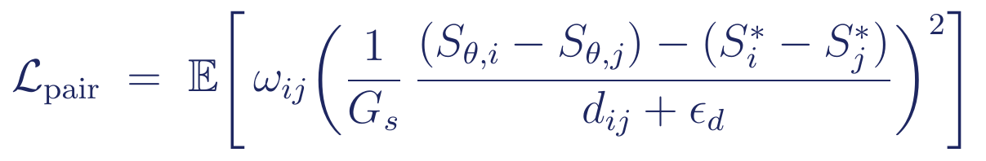
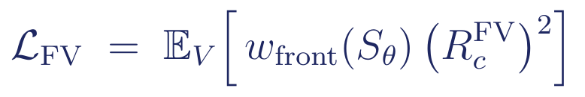
Motivation
Front-aware M8 method
Evaluation and next results
Six loss components of the M8 hybrid objective
L_p — Pressure data MSE
L_S — Saturation data MSE + front/plume
Mean-square error of pressure against the reference field over the data set D.
Global MSE plus front- and plume-anchored extra terms (M5).
L_PDE — Strong-form residual
L_BC/IC — Boundary + initial penalties
Mean square of water (r_w) and CO2 (r_c) residuals over the collocation set C.
Sum of inlet flux/saturation, outlet pressure/backflow, no-flow, initial pressure penalties.
L_pair — Supervised pairwise front-gradient
L_FV — Local CO2 finite-volume conservation
Finite-difference slope error between local point pairs near the front (M6).
Mean-square front-weighted control-volume residual; delayed and ramped (M8).
09

Slide 9
Motivation
Front-aware M8 method
Evaluation and next results
M0–M8 is an experimental argument, not a list of tricks
Structural ablation ladder
Training schedule
Single
Net
Two
Net
MSFF
Coarse/
detail
Hard
IC
Front/
plume
Pair
grad
RAR
FV
mass
data + BC/IC
M0
PDE warm-up 0-2k
PDE ramp 2k-6k
M1
RAR from 3.5k, every 100
M2
pairgrad ramp 4k-8k
FV ramp 10k-16k
M3
M4
M5
Leave-one-out attribution
M6
HARD_IC
FRONT_PLUME
M7
PAIRGRAD
RAR
M8
FV
COARSE_DETAIL
M0-M3 test representation; M4-M6 add hard IC and front supervision; M7 adds residual-adaptive refinement; M8 adds delayed finite-volume mass conservation.
08
Notes:
This is the full ablation ladder with nine variants. Each row adds one component on top of the previous row, so the experiment is read top to bottom.
M zero to M three modify the representation: SingleNet, TwoNet, multiscale Fourier features, then coarse and detail. M four to M six add front-aware supervision: hard IC, reference front and plume weights, then pairwise front-gradient learning. M seven adds adaptive sampling. M eight adds local conservation.
The training schedule on the right enforces this order. The PDE term ramps in from iteration 2000 to 6000. The pair-gradient term ramps from 4000 to 8000. The FV term ramps from 10000 to 16000.
The bottom-right card shows the leave-one-out attribution: we remove one component at a time from M eight to test whether it is still necessary in the final model.

Slide 10
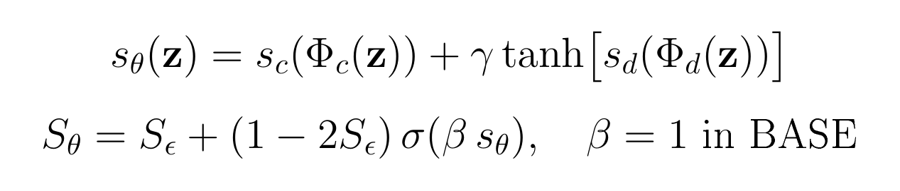
Motivation
Front-aware M8 method
Evaluation and next results
M3 | Coarse/detail saturation branch separates plume envelope from front texture
Role in the ladder: final inference architecture for M3-M8;.
coarse features
scales 1,2,4,8
MLPᶜ
depth 6
z = (x̃,ỹ,t̃)
combine logits
coarse + bounded detail
Sθ
detail features
scales 4,8,16,32
MLPᵈ
depth 6
Implementation details
• γ = 1.0, detail contribution is tanh-limited
• 24 Fourier frequencies per scale
• pressure branch remains raw-coordinate and smooth
• M3 tests whether saturation needs a multiscale split
Interpretation: the broad plume envelope and the thin fingering texture are learned by different pathways, reducing the burden on one saturation logit network.
09
Notes:
Now I walk through M three to M eight, one slide each.
M three introduces the coarse-and-detail split for saturation. We use twenty-four Fourier frequencies per scale. The coarse branch covers scales one, two, four, eight, which carry the plume envelope. The detail branch covers four, eight, sixteen, thirty-two, which carry the sharp front texture. The detail gain gamma is set to one, and the detail term is tanh-limited so it cannot dominate.
Pressure remains on raw coordinates throughout. This step is what tames the M two failure that we will see in the results.

Slide 11
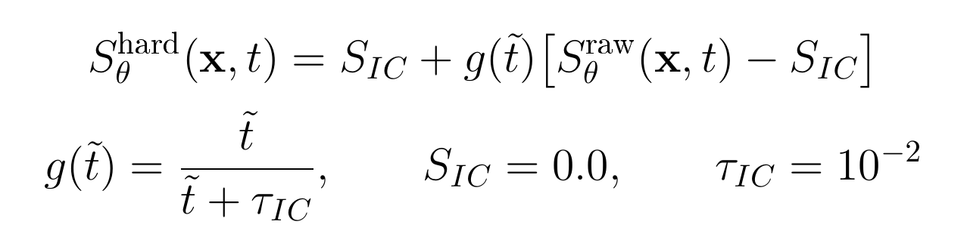
Motivation
Front-aware M8 method
Evaluation and next results
M4 | Hard initial-condition gate prevents early-time saturation drift
Purpose: enforce the simulator convention S(x,0)=0.0 exactly, rather than asking a soft IC penalty to compete with later front data.
Temporal gate
g
g→1
t̃
Code-consistent detail
When this hard gate is active, the soft saturation IC loss is set to zero; pressure still has a soft IC penalty. Injection-boundary saturation samples avoid the t=0 intersection so that S=1 at Γin does not conflict with S=0.0 at t=0.
t=0: S=S_IC=0.0
Interpretation: M4 removes an avoidable optimization conflict at the initial time, so later front errors are not caused by a drifting initial saturation floor.
10
Notes:
M four enforces the initial saturation as a hard constraint, instead of a soft loss penalty.
As the nondimensional time goes to zero, the model output is forced to zero point two zero. As time grows, the network smoothly takes over, controlled by the time constant tau-IC equal to ten to the minus two.
This eliminates early-time drift, where a soft IC loss can lose to the front-region data. When the hard gate is active, the corresponding soft saturation IC loss is set to zero.

Slide 12
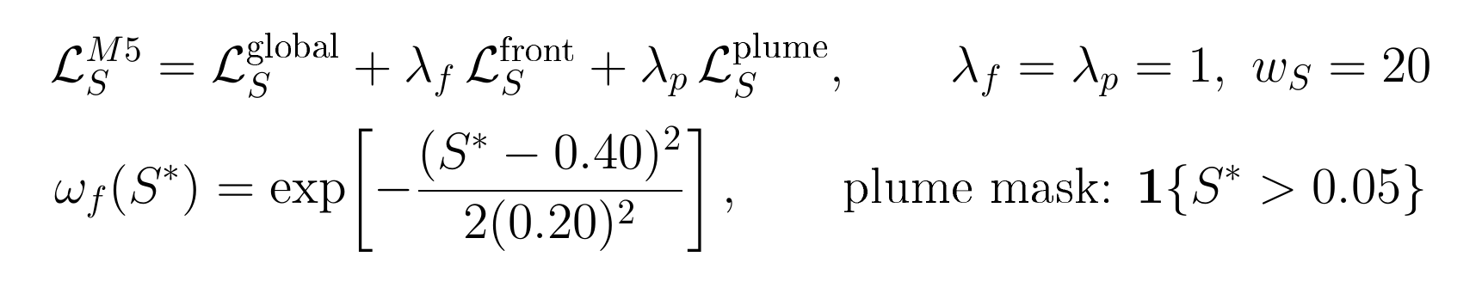
Motivation
Front-aware M8 method
Evaluation and next results
M5 | Reference front/plume supervision makes the labelled loss spatially selective
Purpose: keep global saturation MSE, But make the supervised signal louder where the plume exists and where the front is steep.
Reference-anchored weights
0.0
0.2
0.4
0.6
0.8
1.0
S* low
front band
plume
weights use reference S*,
not predicted Sθ
Interpretation: M5 changes how labelled saturation errors are weighted; it does not move collocation points. That distinction keeps M5 separate from M7.
11
Notes:
M five changes how labelled saturation errors are weighted, without moving any collocation points.
We keep the global saturation MSE and add two new terms. The first is a Gaussian weight centered at reference saturation zero point four with sigma zero point two, which concentrates loss on the front band. The second is a plume mask that activates wherever the reference saturation is above zero point zero five.
Both weights are anchored to the reference field, not to the prediction, so the front is not a moving target.
One important caveat. With λ-front and λ-plume both equal to one, the effective saturation loss is about three times the M four scale. So part of the M five gain is just a larger overall weight. We control for this with a fair-weight experiment.

Slide 13
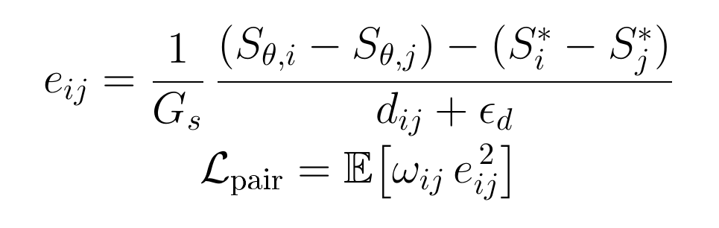
Motivation
Front-aware M8 method
Evaluation and next results
M6 | Pairwise front-gradient loss preserves local saturation contrast
Purpose: penalize wrong local front slopes, even when pointwise saturation errors look small after averaging.
Same-time local pairs
Sθᵢ
Sθ_{j}
pair distance dᵢⱼ
Code-consistent schedule
Starts at 4k Adam iterations and ramps for 4k; max relative multiplier is 0.10 inside wS·LS. Up to 2048 pairs are sampled from 8 time slices; 2×10⁻⁴ ≤ dij ≤ 1/16.
candidate band: 0.08 ≤ S* ≤ 0.90
Interpretation: M6 is supervised finite-difference front-slope learning，Absolute weight w_pair = W_S · w_pair_rel, with w_pair_rel ramped 0→1.0 between iter 4000–8000.
12
Notes:
M six adds direct supervision on the local front slope.
For each pair of close points at the same time, we compute the predicted slope between them and the reference slope between them. We normalize by a typical gradient scale, weight pairs by a front-band Gaussian, and average.
Pair distances are restricted to a band from two times ten to the minus four up to four times h-tilde, where h-tilde is the local finite-volume cell width. The term starts at iteration 4000 and ramps to a relative weight of zero point one zero by iteration 8000.

Slide 14
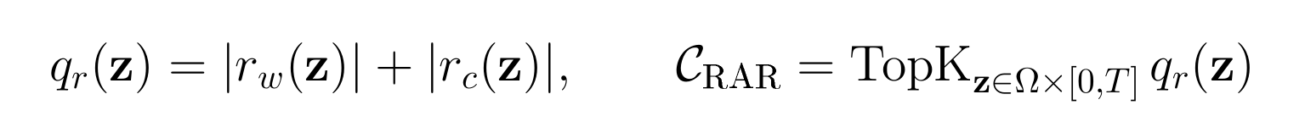
Motivation
Front-aware M8 method
Evaluation and next results
M7 | Residual-dominant RAR spends PDE effort where the residual is largest
Purpose: adapt the collocation set after warm-up, while keeping front-gradient information attributable to M6.
Sampling logic
candidate
pool
score
residuals
top-k
Code-consistent schedule
RAR begins after 3.5k Adam iterations and refreshes every 100 iterations. The selected points replace a residual-focused part of the PDE collocation batch.
Interpretation: M7 is residual-dominant adaptive refinement. It is deliberately not a gradient-band sampler, so M6 and M7 test different mechanisms.
13
Notes:
M seven is residual-dominant adaptive refinement.
We score candidate collocation points by the absolute sum of the two phase residuals, and we keep the top-scoring ones. This concentrates the PDE evaluation budget where the residual is largest, which in practice means the moving front. Refinement starts at iteration 3500 and refreshes every 100 iterations.

Slide 15
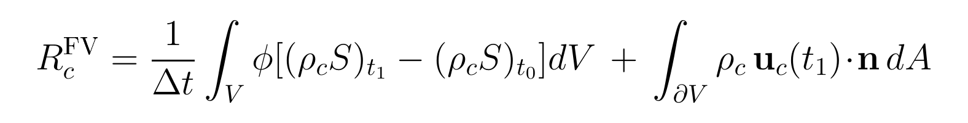
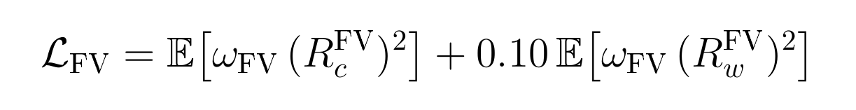
Motivation
Front-aware M8 method
Evaluation and next results
M8 | Delayed local finite-volume loss adds a conservation check near the front
Purpose: after the field is stable, penalize local CO₂ mass imbalance on small control volumes without turning the PINN into a FV simulator.
Local control volume
512 cells/it
face fluxes at t₁
Interpretation: M8 is delayed until 10k iterations and ramps for 6k to wFV=0.3, so conservation regularization sharpens a learned field rather than distorting the early front. FV front-band weight is anchored to predicted Sθ (detached), unlike M5/M6 which anchor to reference S*.
14
Notes:
M eight adds the final local conservation component. After ten thousand iterations, we sample 512 small square control volumes per training step and check the CO₂ mass balance between two consecutive timesteps on each cell. The FV weight ramps to zero point zero three over six thousand iterations.
The front weight in the FV term is anchored to the predicted saturation, but detached from the gradient graph. This prevents the model from cheating by pushing saturation out of the front band just to reduce the conservation loss.

Slide 16
Motivation
Front-aware M8 method
Evaluation and next results
M0–M8 is an experimental argument, not a list of tricks
Structural ablation ladder
Training schedule
Single
Net
Two
Net
MSFF
Coarse/
detail
Hard
IC
Front/
plume
Pair
grad
RAR
FV
mass
data + BC/IC
M0
PDE warm-up 0-2k
PDE ramp 2k-6k
M1
RAR from 3.5k, every 100
M2
pairgrad ramp 4k-8k
FV ramp 10k-16k
M3
M4
M5
Leave-one-out attribution
M6
HARD_IC
FRONT_PLUME
M7
PAIRGRAD
RAR
M8
FV
COARSE_DETAIL
M0-M3 test representation; M4-M6 add hard IC and front supervision; M7 adds residual-adaptive refinement; M8 adds delayed finite-volume mass conservation.
15
Notes:
A quick recap of the same ladder before we look at results. Nine variants, each row adds one front-aware component. M zero to M three change the representation, M four to M six change the supervision, M seven changes the sampling, and M eight adds conservation. The training schedule on the right enforces this order. The leave-one-out test on the bottom right asks the complementary question: is each piece still necessary in the final model.

Slide 17
Motivation
Front-aware M8 method
Evaluation and next results
A front-aware method needs front-aware evidence
1. Plume geometry
2. Global pressure
3. Global saturation
Visual diagnostics (support, contour, ray)
Smooth-field reconstruction
Whole-field saturation error
4. Front-band error
5. PDE residual
6. Local conservation
Reference front intervals
RAR residuals
Sampled FV residuals
Report front-band accuracy, local front-gradient fidelity, plume geometry and local mass balance.
Current quantitative claims use seed 0; multi-seed runs remain a robustness extension but is not shown here.
16
Notes:
How do we evaluate the method? We use six axes, deliberately not a single composite score.
One: global pressure accuracy. Two: global saturation accuracy. Three: front-band saturation accuracy. Four: pairwise front-gradient fidelity. Five: plume geometry. Six: local conservation.
Each axis catches a different failure mode. A model can be good on a global metric but lose the front, or sharp on the front but violate conservation. So we report all six and read them together.

Slide 18
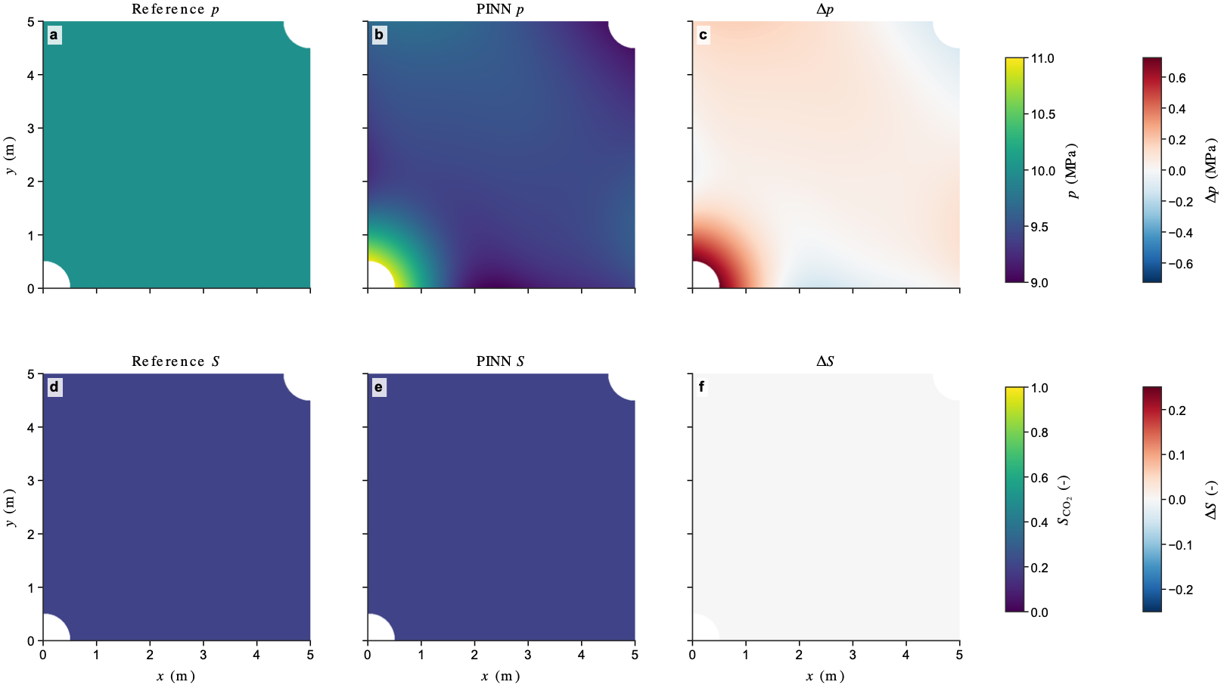
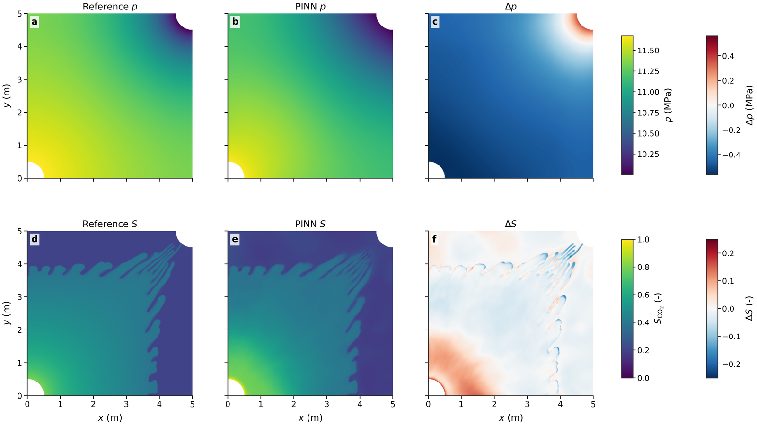
Motivation
Front-aware M8 method
Evaluation and next results
A front-aware method needs front-aware evidence
1. M8 Plume geometry
t=0
t=18698s
M8 P–S snapshots at different times
19
Notes:
This slide shows M eight across three time levels: early, middle, and late. We zoom in on the final-time diagnostic panel.
Top row reads the field directly. Reference saturation on the left, M eight prediction in the middle, signed error on the right. The two fields are visually nearly identical. The error map is mostly white, with thin red and blue stripes only along the finger tips, where the front is one or two pixels off.
Bottom row tests the geometry. The PINN front contour tracks the reference closely, but is slightly conservative at the leading edges of the longest fingers. The TP, FP, FN classification mask is almost all gray, meaning correct plume identification. The speckle mask is empty, so there are no spurious artifacts.
So M eight reproduces both the field and the geometry, with errors confined to a few-pixel band along the front. That is exactly what the front-aware design is meant to deliver.

Slide 19
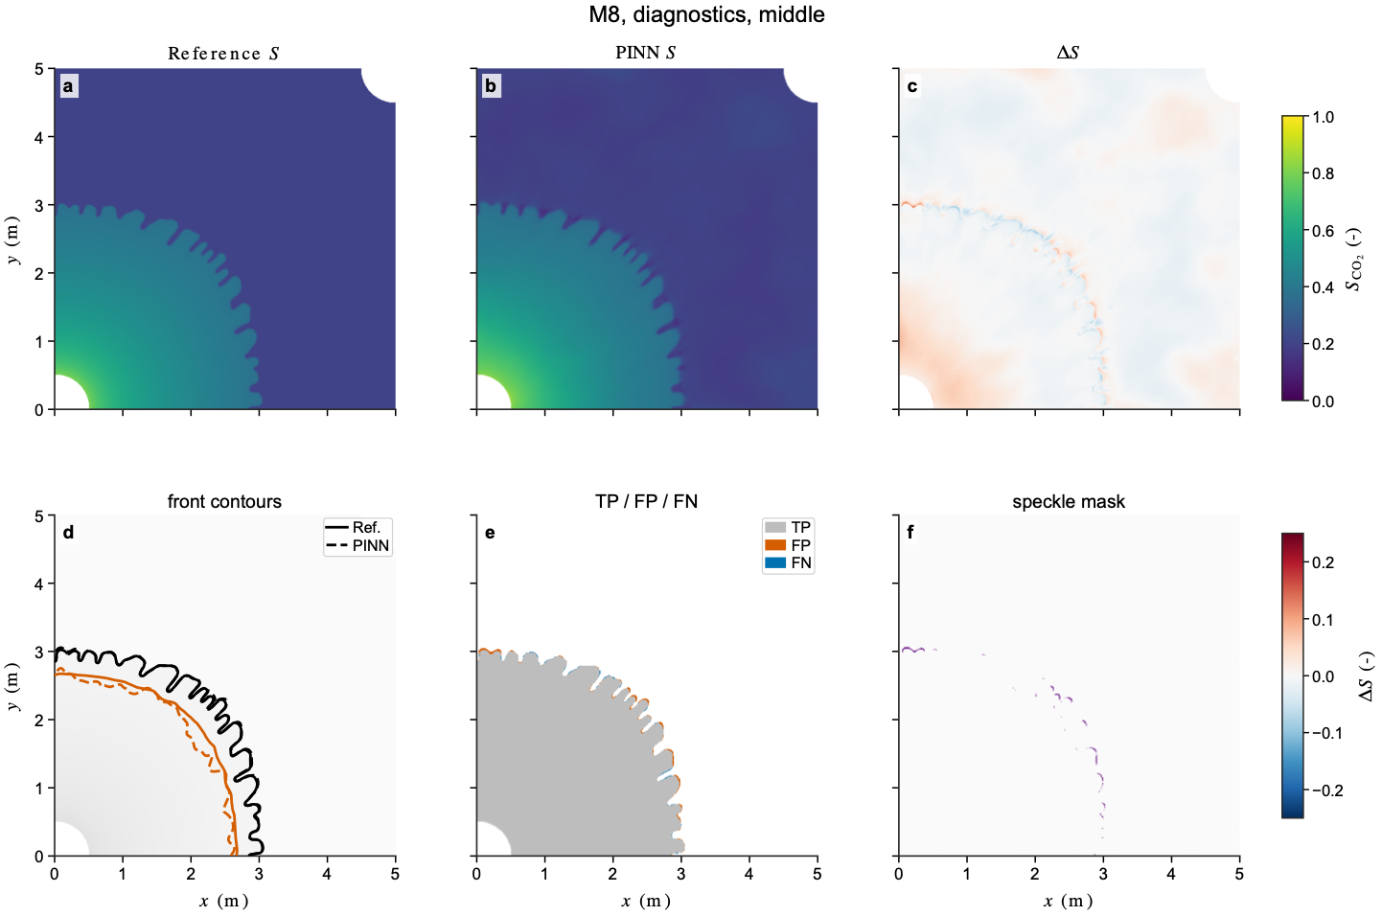
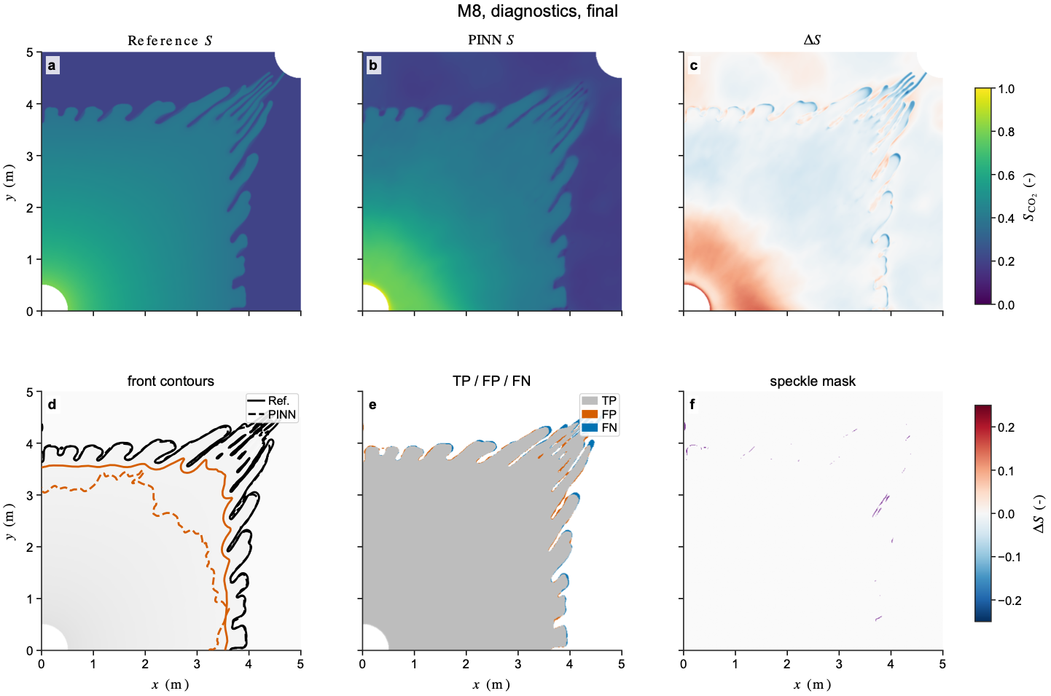
Motivation
Front-aware M8 method
Evaluation and next results
A front-aware method needs front-aware evidence
1. M8 Plume geometry
t=8971s
t=18698s
M8 P–S snapshots at different times
19
Notes:
This slide shows M eight across three time levels: early, middle, and late. We zoom in on the final-time diagnostic panel.
Top row reads the field directly. Reference saturation on the left, M eight prediction in the middle, signed error on the right. The two fields are visually nearly identical. The error map is mostly white, with thin red and blue stripes only along the finger tips, where the front is one or two pixels off.
Bottom row tests the geometry. The PINN front contour tracks the reference closely, but is slightly conservative at the leading edges of the longest fingers. The TP, FP, FN classification mask is almost all gray, meaning correct plume identification. The speckle mask is empty, so there are no spurious artifacts.
So M eight reproduces both the field and the geometry, with errors confined to a few-pixel band along the front. That is exactly what the front-aware design is meant to deliver.

Slide 20
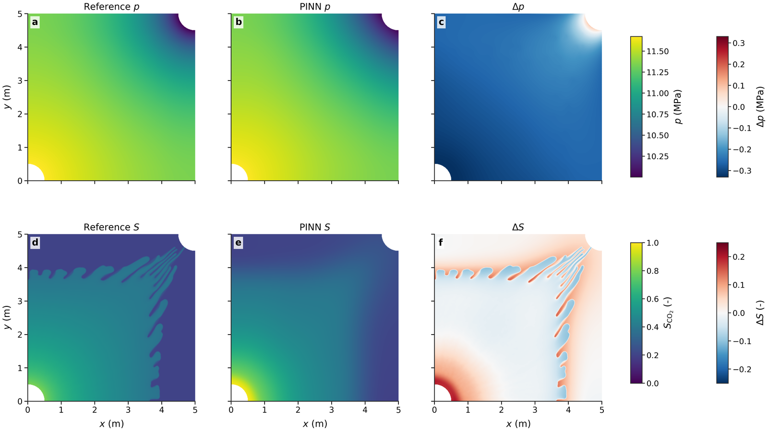
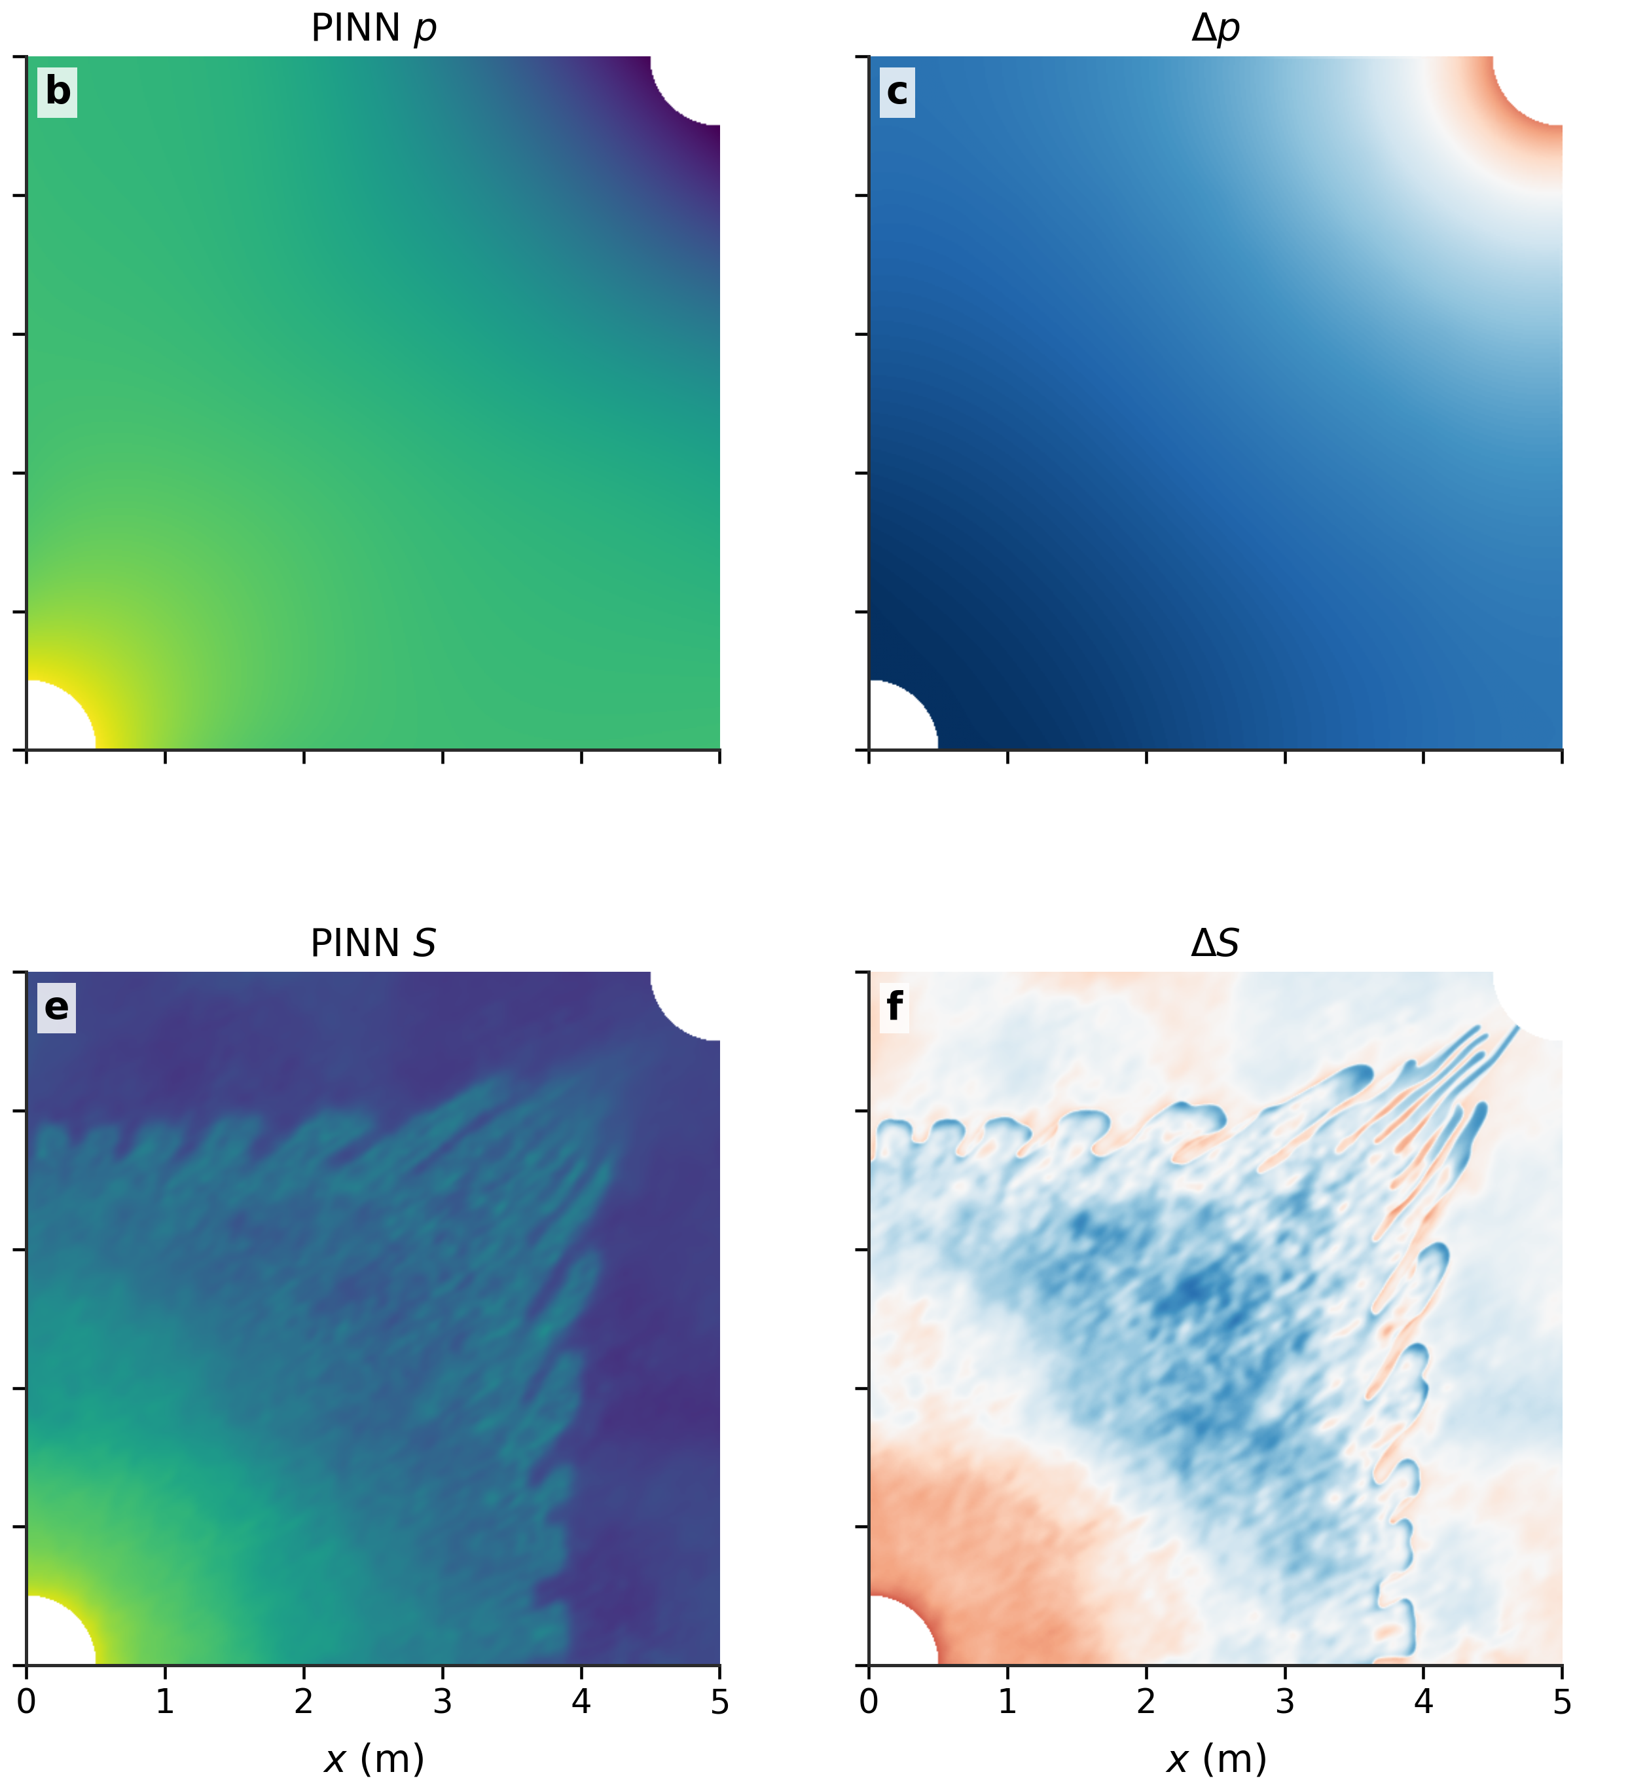
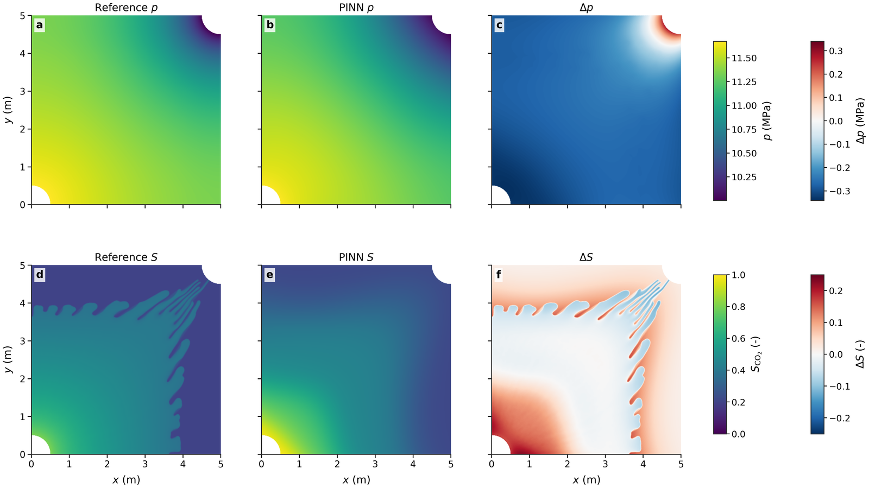
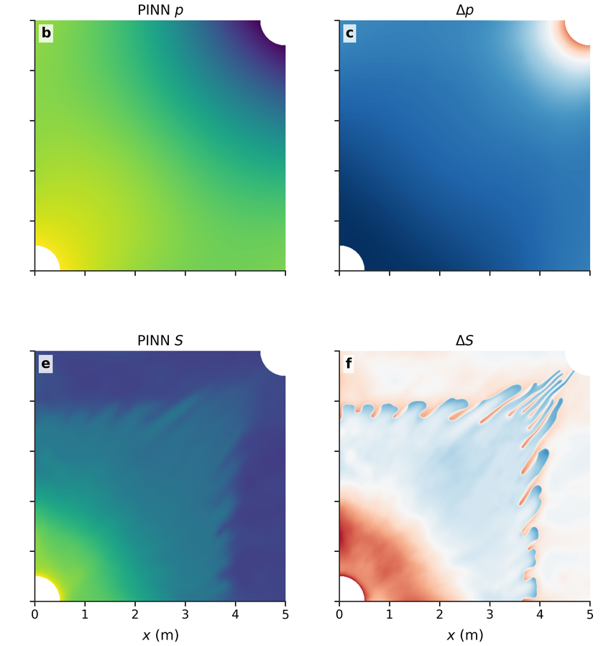
Motivation
Front-aware M8 method
Evaluation and next results
A front-aware method
needs front-aware evidence
M0–M8 final P–S snapshots (t=18698)
each cell: ref / pred / |error|,
P on top, S on bottom
M0
M2
IC-FERST
M1
M3
17
Notes:
First half of the visual proof. The grid shows M zero, M one, M two, and M three, with M zero in the top left.
Inside each cell, the top row shows pressure: reference, prediction, and absolute error. The bottom row shows saturation in the same layout.
Reading across, M zero is a blurry plume with no fingers. M one and M three look similar in shape but with progressively cleaner pressure recovery.
M two is the failure point: pressure blows up and saturation goes wild. This happens because multiscale Fourier features alone, without the coarse-and-detail split, are unstable. M three is the fix.

Slide 21
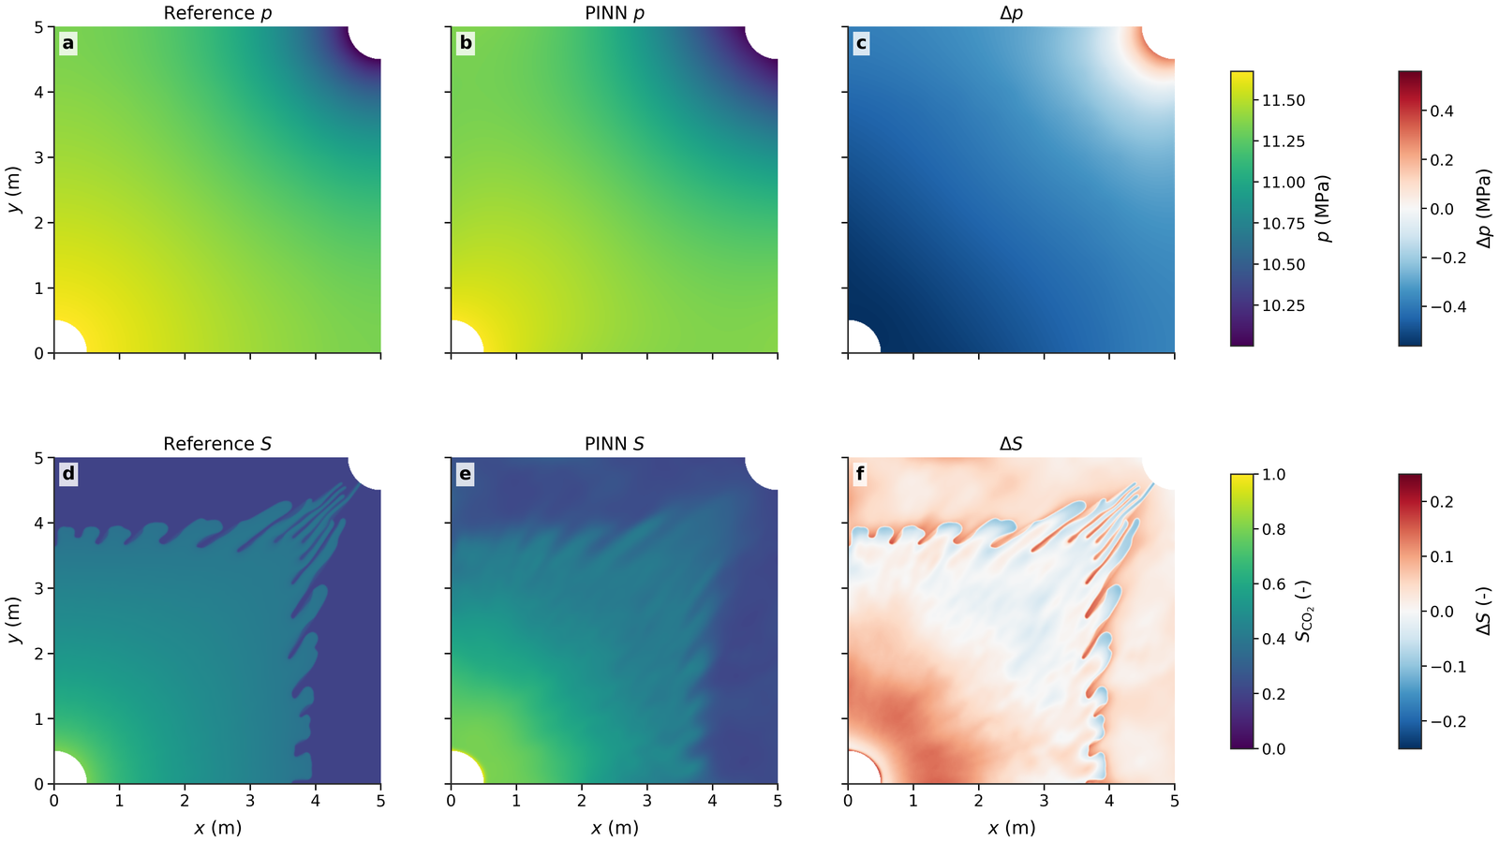
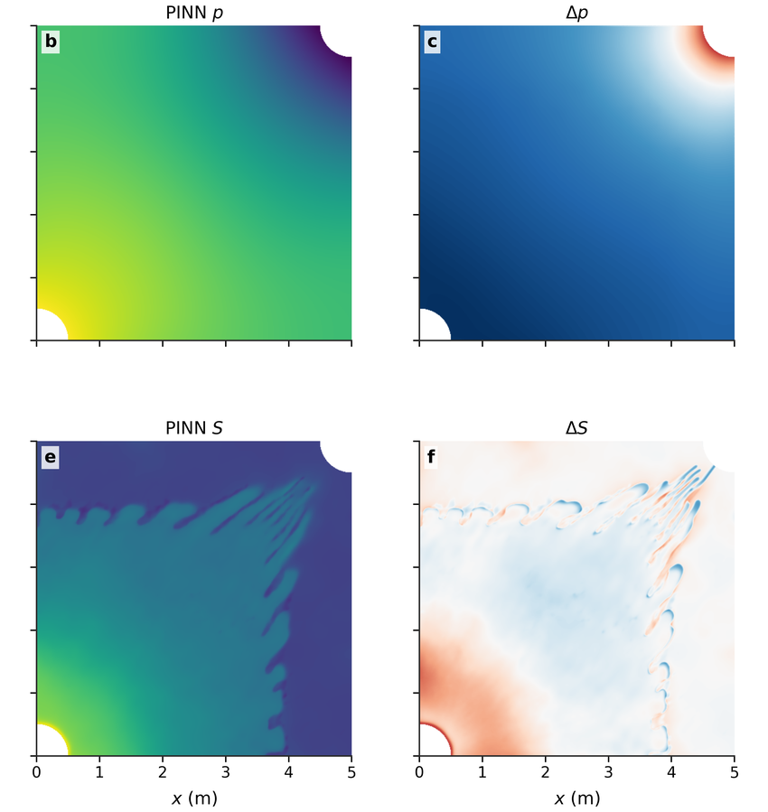


Motivation
Front-aware M8 method
Evaluation and next results
A front-aware method
needs front-aware evidence
M0–M8 final P–S snapshots (t=18698)
each cell: ref / pred / |error|,
P on top, S on bottom
M4
M6
IC-FERST
M5
M7
18
Notes:
Second half of the same grid: M four through M eight.
Compared with M zero on the previous page, the change is immediate. M four already removes the early-time saturation drift. M five and M six sharpen the front band visibly. M seven adds residual-adaptive sampling, and M eight adds local conservation. The front geometry tightens row by row.
So the visual story matches the numerical story: each component adds a different correction, and the gains stack.

Slide 22
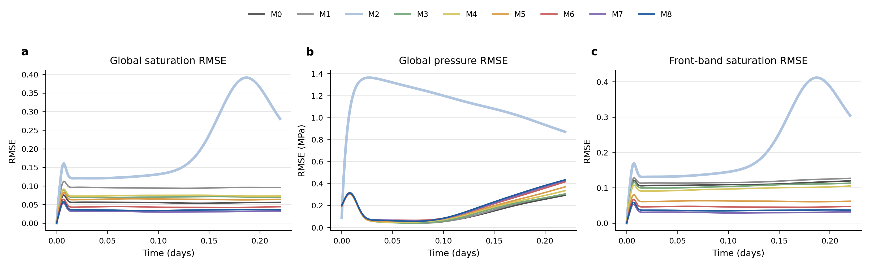
Motivation
Front-aware M8 method
Evaluation and next results
A front-aware method needs front-aware evidence
2 + 3 + 4. Global P, global S, and front-band saturation (time-resolved)
Whole-field saturation RMSE decreases from 0.054 (M0) to 0.029 (M8). Pressure RMSE is lowest for M0 (0.13 MPa) and remains moderate for M8 (0.19 MPa), so pressure and saturation are interpreted separately. M2 is unstable in this configuration.
20
Notes:
Now the quantitative results. Time-resolved curves of saturation RMSE, pressure RMSE, and the front-band saturation RMSE across M zero to M eight.
Two things to read off this figure. First, the saturation curve drops from zero point zero five four at M zero to zero point zero two nine at M eight, a roughly 46 percent reduction. Front-aware variants M five, M six, and M eight all sit well below the M zero to M three baseline.
Second, M two is a clear outlier on every curve. Saturation RMSE jumps to zero point one nine eight and pressure RMSE to one point one five megapascals. The next slide shows the same comparison in bar form for selected time levels.

Slide 23
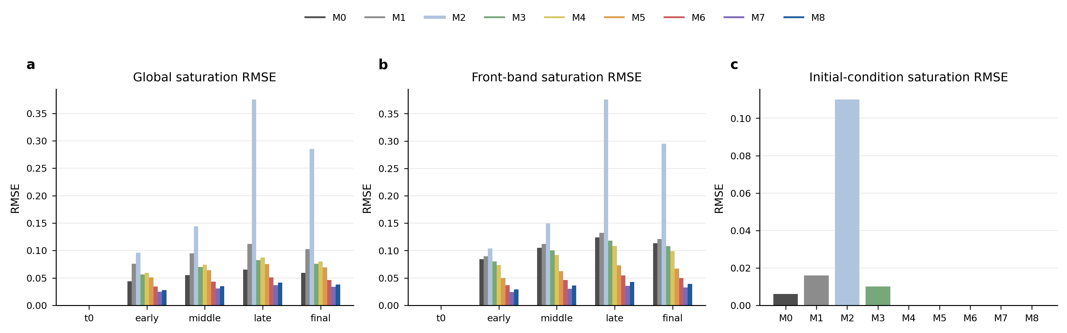
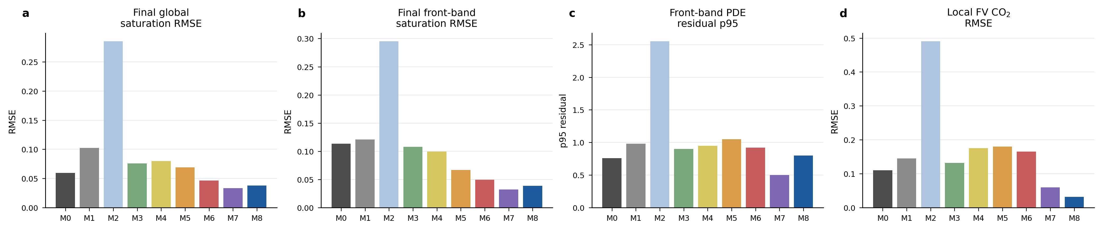
Motivation
Front-aware M8 method
Evaluation and next results
A front-aware method needs front-aware evidence
Final-time RMSE bars: global S, front-band S, and IC saturation
1. After M4 (Hard IC), the initial-condition saturation RMSE drops to essentially zero.
2. M5, M6, M7 progressively reduce the global and front-band saturation RMSE, but the gain stalls beyond M6.
21
Notes:
Same evaluation, now reduced to bar plots at selected time levels: initial, early, middle, late, and final.
Final global saturation RMSE confirms the curve story. M zero around zero point one, M two clearly worst, M six, M seven, M eight all in the low zero point zero three range. The final front-band saturation RMSE tells a sharper version of the same story: M six and M eight reach zero point zero two six.
The initial-condition saturation RMSE plot on the right is the easy axis. After M four, the hard IC gate brings this metric down to essentially zero. Before M four, M two is again the outlier with the IC residual blown up. So the IC and ablation steps line up exactly as the design predicts.

Slide 24
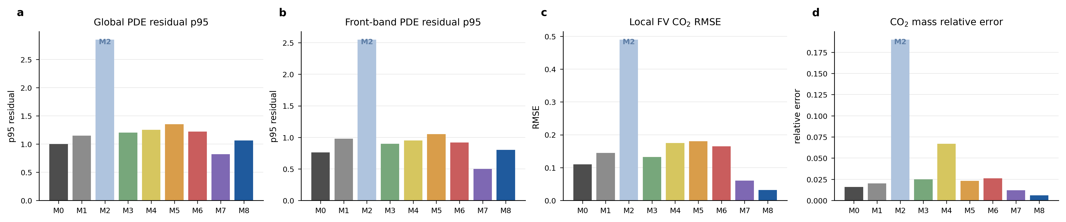
Motivation
Front-aware M8 method
Evaluation and next results
A front-aware method needs front-aware evidence
5 + 6. PDE residual quality
and local mass conservation
PDE residual at the 95th percentile shows M2 as an outlier; M7 reach the lowest residuals.
Local FV CO₂ RMSE: M0 looks low only because its near-constant prediction is trivially conservative. M2 is the worst at 0.49. M8 sits at 0.028 while giving the best reconstruction.
22
Notes:
Now the physics-axis: residual quality and local conservation. Four bar plots.
The top two show the strong-form PDE residual at the ninety-fifth percentile, globally and inside the front band. M two is again the outlier, with the residual much higher than the rest. M seven and M eight reach the lowest residuals because they explicitly drive sampling and conservation toward the front.
The bottom two show local finite-volume CO₂ RMSE and the CO₂ mass relative error. M zero has the lowest local-FV residual, but only because the M zero field is nearly constant, which is trivially conservative. The take-home is that the FV axis must be read alongside the saturation accuracy axis, not on its own.

Slide 25
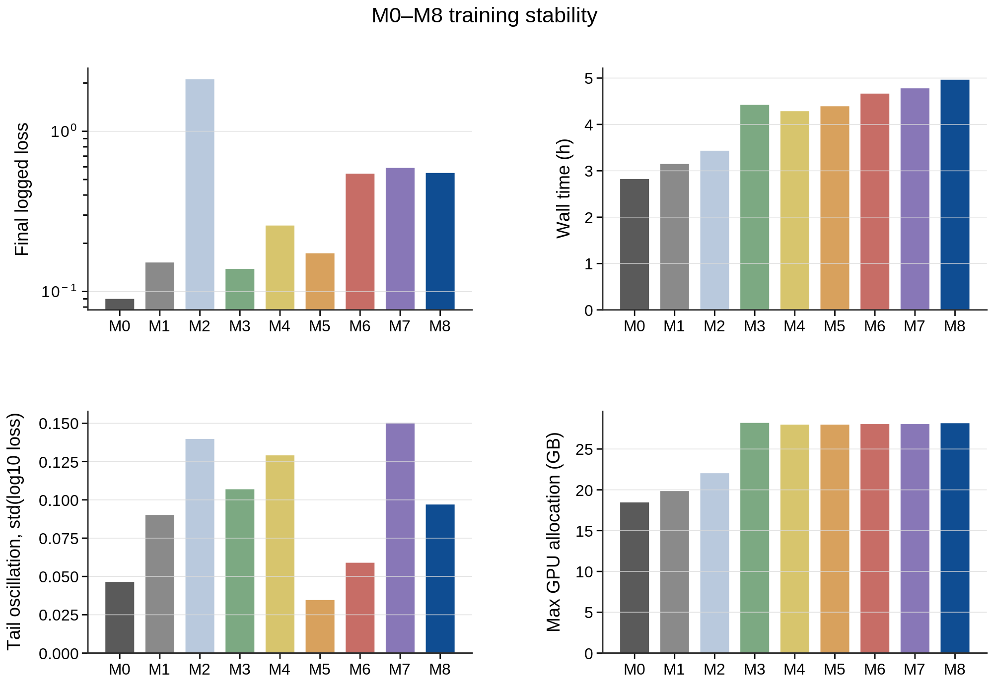
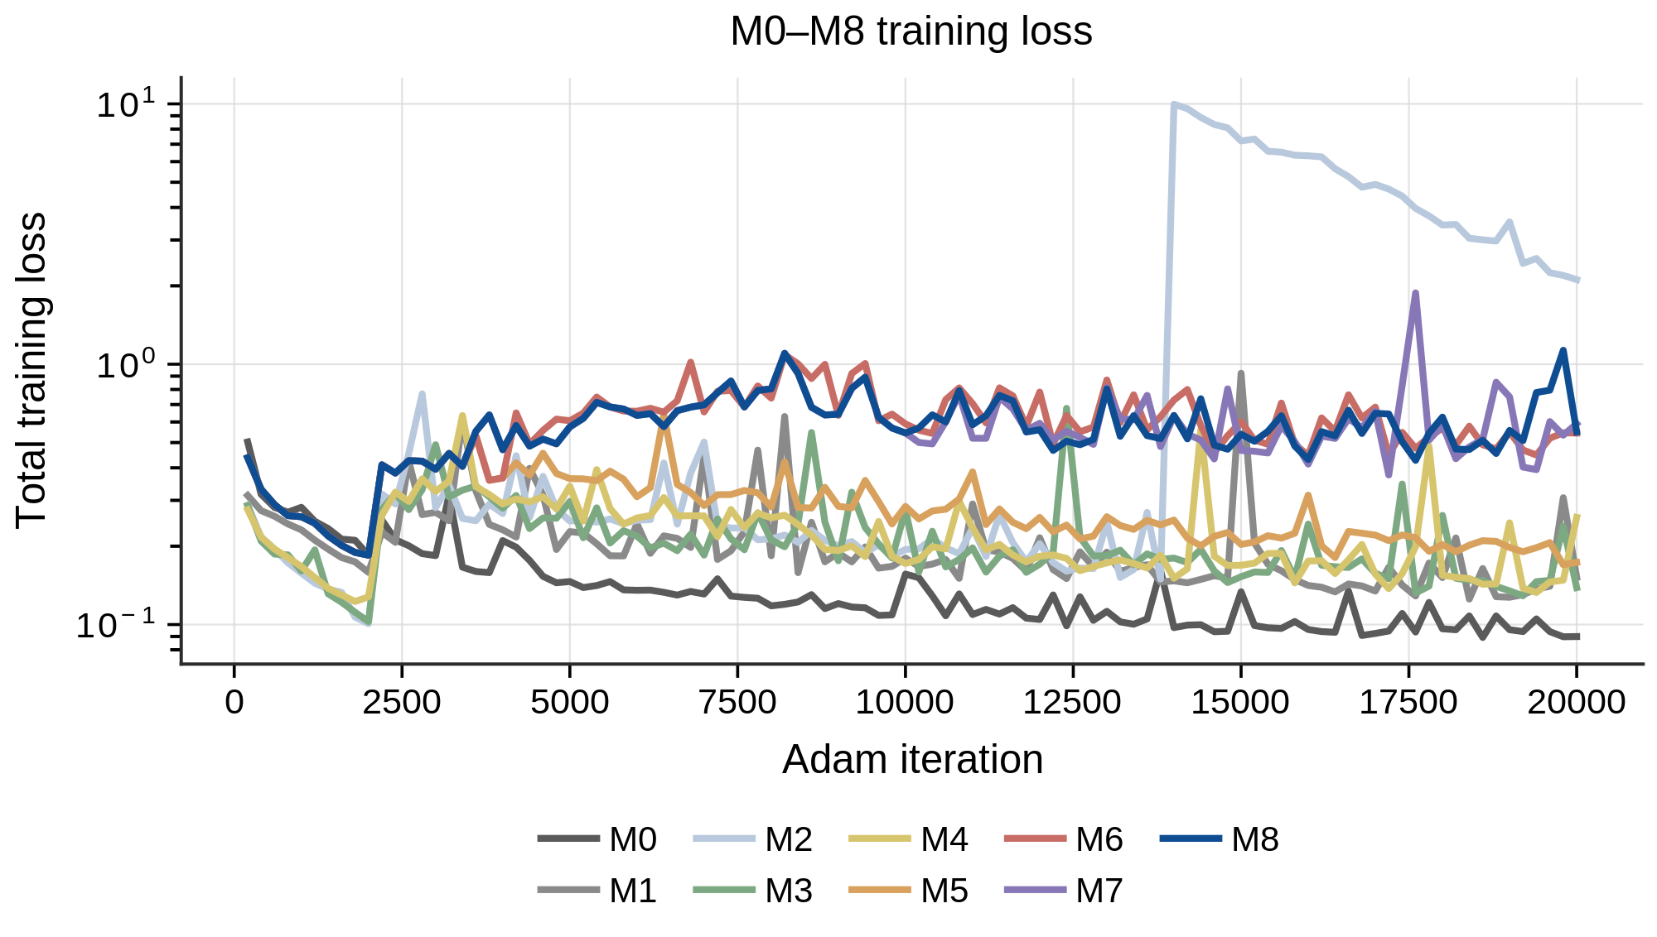
Motivation
Front-aware M8 method
Evaluation and next results
A front-aware method needs front-aware evidence
Extra: training stability
GPU v100
23
Notes:
One more diagnostic: training stability and computational cost.
The left curve shows total training loss across iterations for M zero to M eight. All variants converge smoothly, except M two, which dips early and then slowly drifts. So the M two outlier is not just an inference-time problem; it is a training instability.
The bar plots on the right show final logged loss, wall time, total iteration peak memory, and max GPU memory per variant. Front-aware variants cost moderately more compute, but the increase is bounded by the schedule of each component. This makes the front-aware additions practical, not just accurate.

Slide 26

Motivation
Front-aware M8 method
Evaluation and next results
Conclusion and future work
Vanilla PINN capacity is not the bottleneck —fingering geometry is.
Use physics to define where learning should focus.
Represent pressure and saturation according to their different mathematical character.
Evaluate geometry and conservation, not global error alone.
24
Notes:
My closing message in one line. Vanilla PINN capacity is not the bottleneck. The fingering front geometry is.
Three take-homes. First, fingering is a front problem, not a network-size problem. Second, use the physics to find where learning is hard, and target those regions specifically. Third, represent pressure and saturation differently, because they obey different mathematical structure.
One important scope note. This is one fixed case: one geology, one well plan, one geometry. Parametric generalization across cases needs multi-case training and is outside the present evidence base. That is the natural next step.

Slide 27
Motivation
Front-aware M8 method
Evaluation and next results
Thank you!
25
Notes:
Thank you. I am happy to take questions.

