Slide 1


Impact of Mineral Spatial Distribution on CO₂ Dissolution Rates in Multimineral Carbonate Rocks
InterPore 2026
Olatunbosun A. Adedipe, Yousef Al-Khulaifi, Sajjad Foroughi,
Qingyang Lin, Martin J. Blunt, Branko Bijeljic
22 May 2026

Slide 2
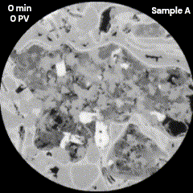
Importance of CO₂-Water Interaction
in Aquifers During CO₂ Storage
CO₂ dissolves in water to form carbonic acid (pH ≈3.1-3.5).
Carbonic acid reacts with carbonate minerals altering CO₂ transport and storage properties of the storage site.
In this work we study a multimineral system.
1 mm
Mineral dissolution by carbonic acid from Adedipe et al. 2026
CO₂ Reactive transport in Carbonates
Imperial College Pore-Scale Imaging and Modelling Group

Slide 3

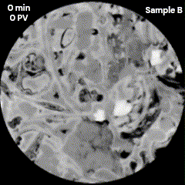
Impact of Mineral Spatial Distribution on CO₂ Dissolution Rates in Multimineral Carbonate Rocks
Olatunbosun A. Adedipe, Yousef Al-Khulaifi, Sajjad Foroughi, Qingyang Lin, Martin J. Blunt, Branko Bijeljic
Aims and Objectives
Read
Accepted
Paper
Pre-Print:
Investigate reactive dissolution of carbonate rocks under CO₂-acidified brine injection.
Analyse two samples with differing calcite-to-dolomite ratios (1:3 and 1:2) with some anhydrite, and different partial mineral distributions.
Use high-resolution micro-CT + pore-scale simulations to track porosity, permeability, flow fields, and mineral reaction rates.
Quantify how flow heterogeneity impacts dissolution patterns.
Link mineral-specific reactions to fast/slow flow regions.
Provide insights to optimize CO₂ storage in heterogeneous carbonate reservoirs.
1 mm
1 mm
Carbonic acid dissolving carbonates in this work
CO₂ Reactive transport in Carbonates
Imperial College Pore-Scale Imaging and Modelling Group

Slide 4
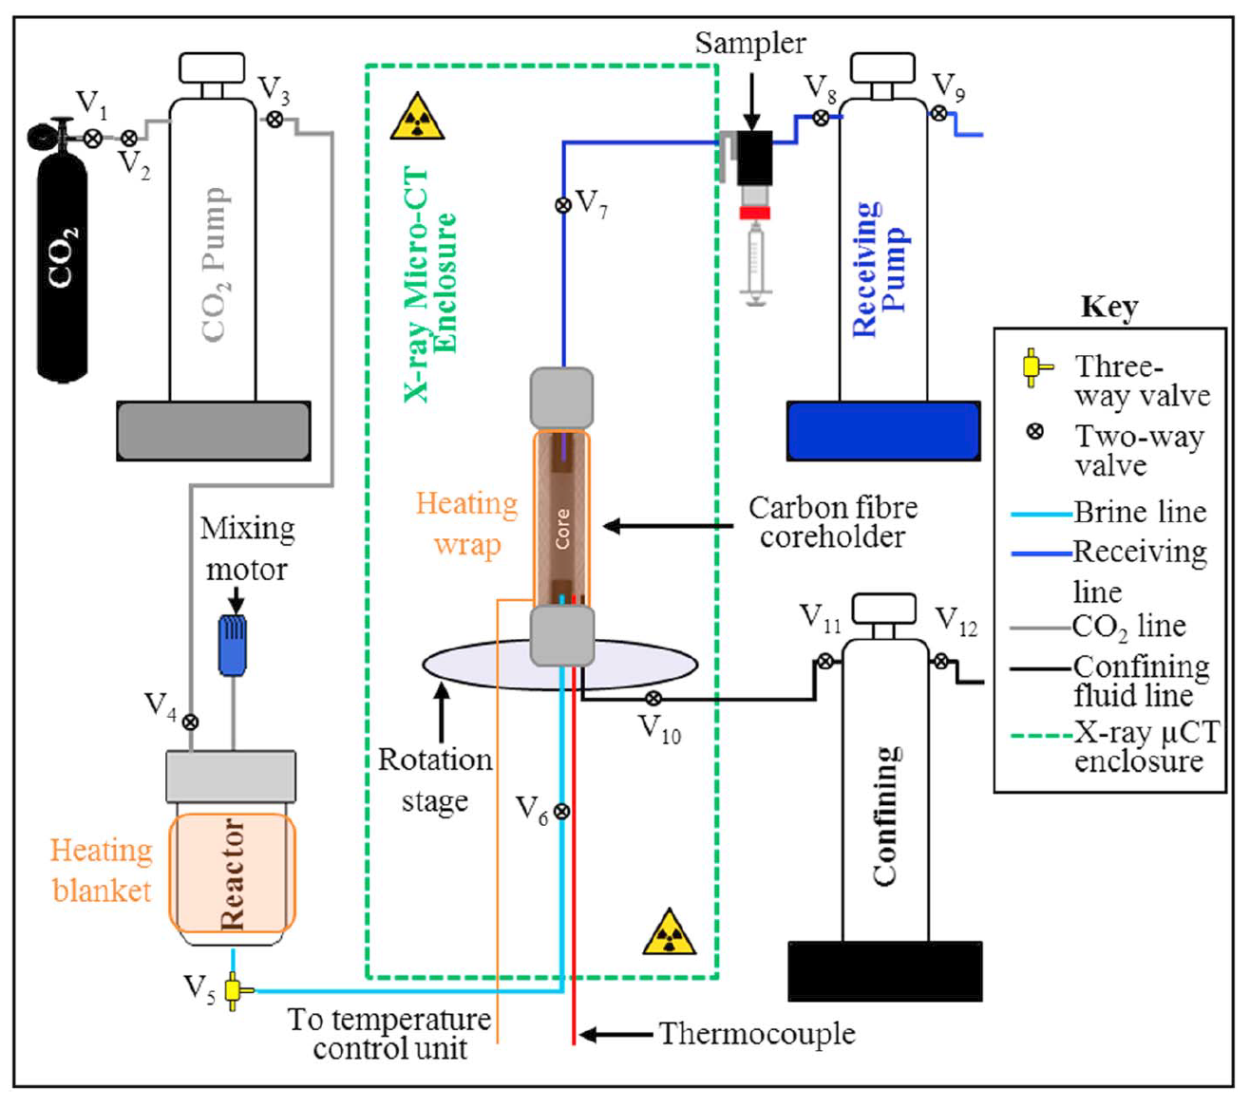
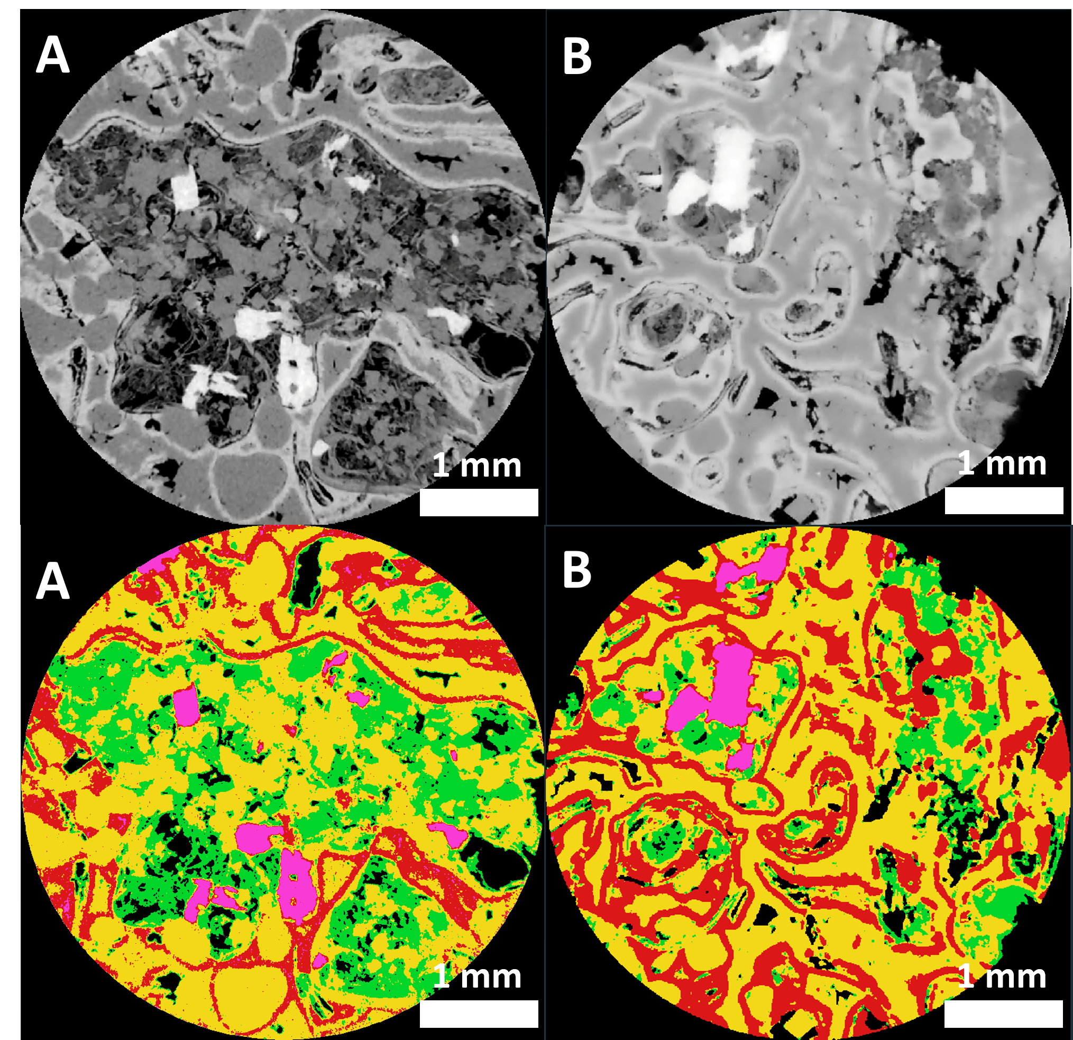
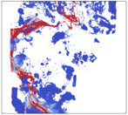
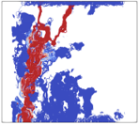

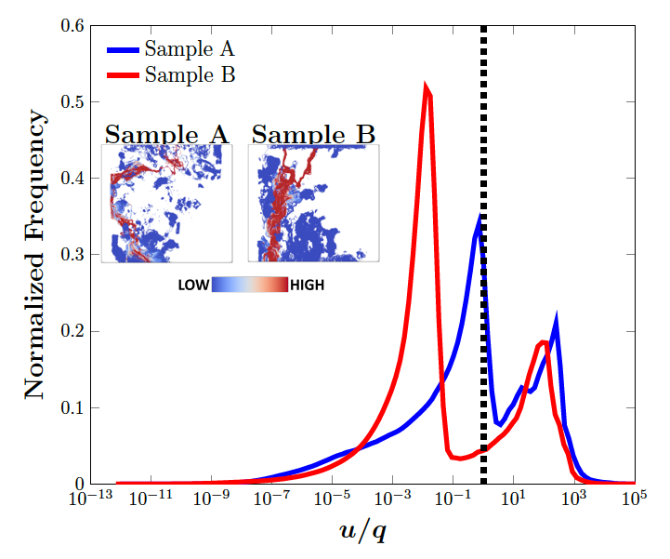
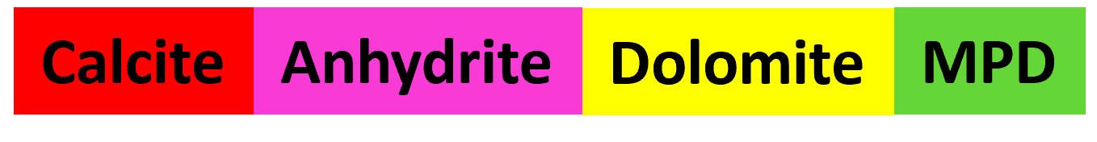
CO₂ Flooding Apparatus | Segmentation |
Flow Simulation - Velocity Distributions as Metrics for Heterogeneity
Sample A
Sample B
Injection flowrate:
0.1 ml/min
Sample dimensions:
Diameter = 5mm
Height = 5mm
Experimental conditions:
P = 10MPa
T = 50 ºC
Voxel size = 5.2 µm³
Brine Composition:
1% KCl, 5% NaCl
CO₂ saturated at: 10MPa, 50 ºC
Avizo 2023 was used to segment mineral phases based on grayscale values.
CO₂ Reactive transport in Carbonates
Imperial College Pore-Scale Imaging and Modelling Group
Notes:
Screening for Pore‐scale Imaging and Modeling (SPIM) method¹

Slide 5
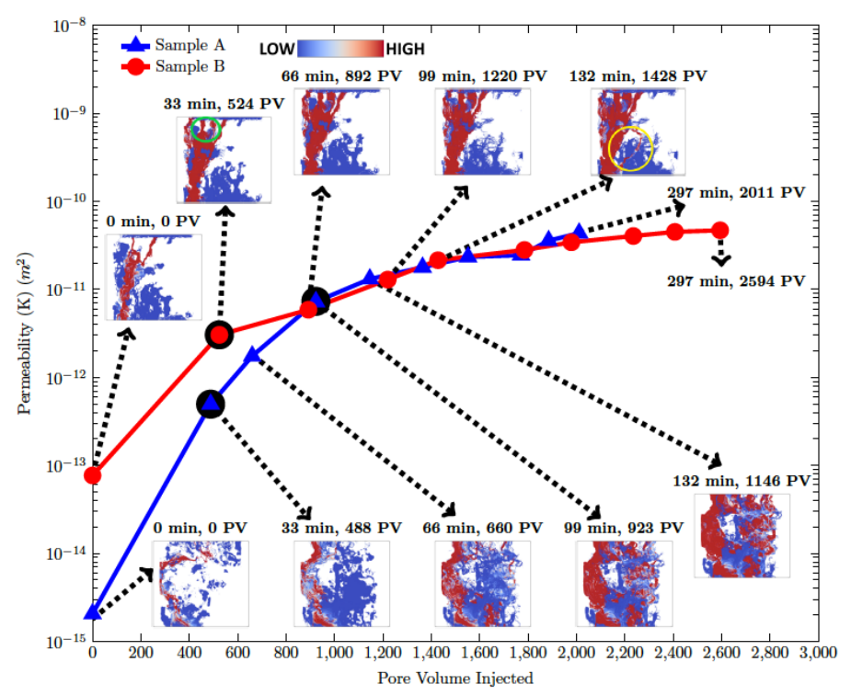
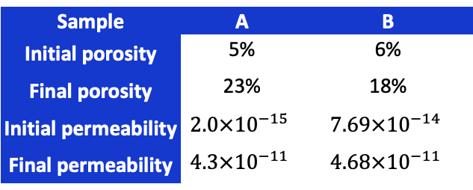
Evolution of Transport Properties
0 min: Sample B is >10x more permeable than Sample A.
33–99 min: Channel widening is present in both;
However, Sample A gains a new channel, boosting permeability by over three orders of magnitude.
Question: how can we relate development of the new fast flow channel to mineralogical spatial distribution and effective reaction rates of minerals?
In later stages of the experiment permeability of both samples follows a similar trajectory
Sample | A | B
Initial porosity | 5% | 6%
Final porosity | 23% | 18%
Initial permeability | $$2.0×{10}^{−15}$$ | $$7.69×{10}^{−14}$$
Final permeability | $$4.3×{10}^{−11}$$ | $$4.68×{10}^{−11}$$
CO₂ Reactive transport in Carbonates
Imperial College Pore-Scale Imaging and Modelling Group

Slide 6
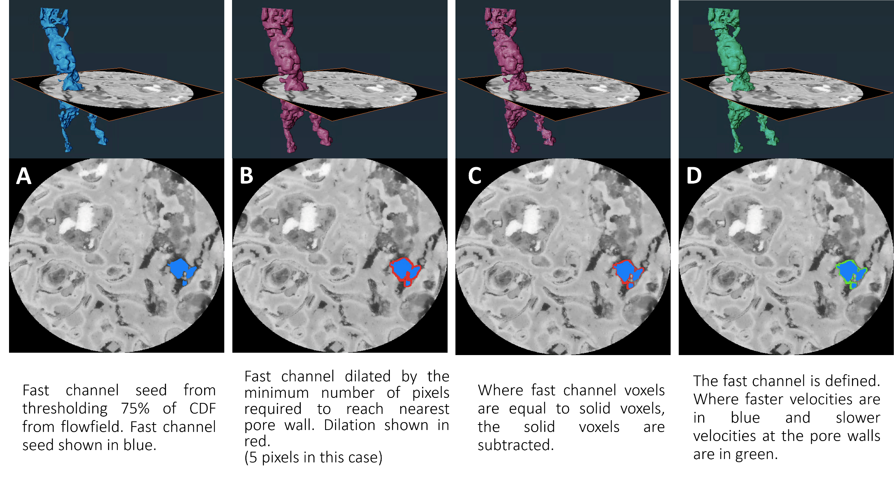
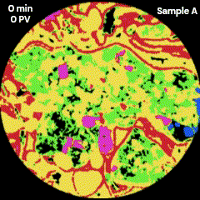
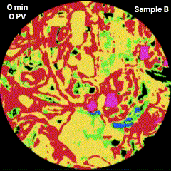
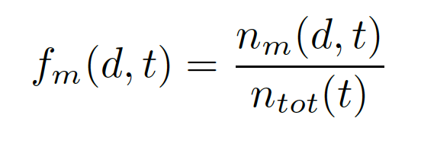


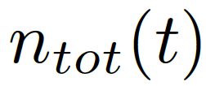
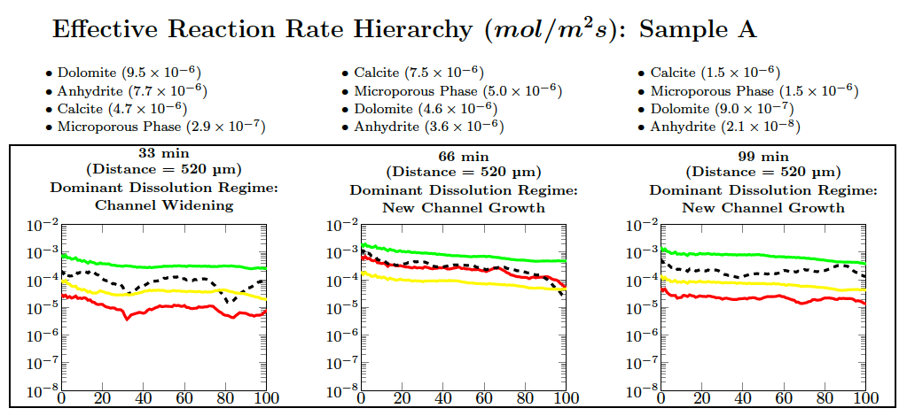


Quantifying Mineral Spatial Heterogeneity:
Defining Fast Channels and Mineral Proximity to Fast Channels
Mineral proximity fraction at a given distance (d) from a fast channel at a particular time (t).
Number of voxels a specific mineral (m) at a given distance (d) from a fast channel at a particular time (t).
Total number of solid voxels (voxels of any mineral (m) anywhere in the image.
Can we use all the information we have on flow visualisation, velocity distributions and proximity functions to synthesise these results?
CO₂ Reactive transport in Carbonates
Imperial College Pore-Scale Imaging and Modelling Group

Slide 7
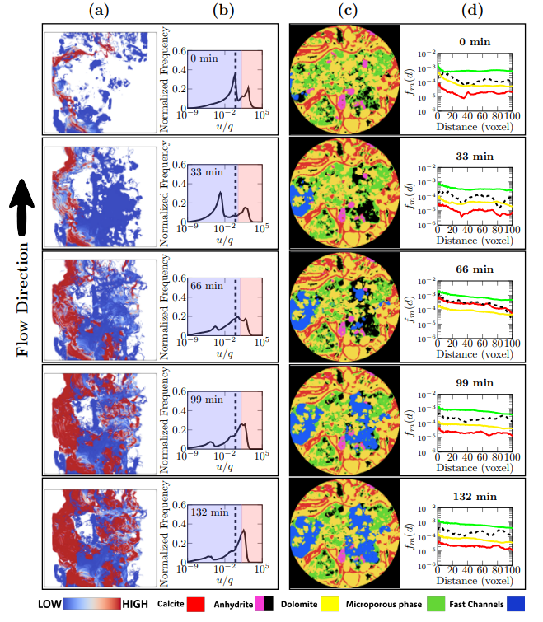
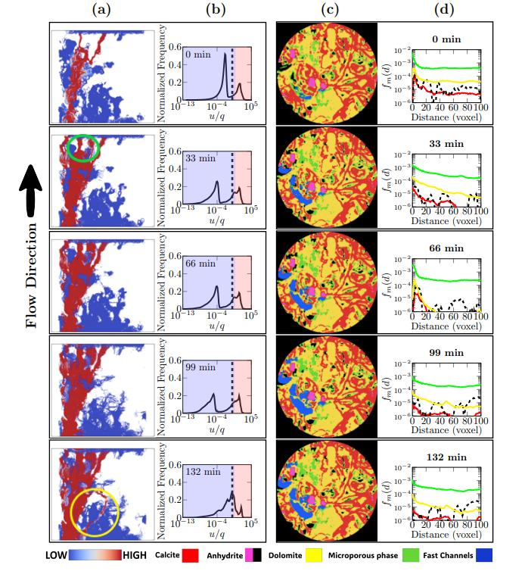
CO₂ Reactive transport in Carbonates
Imperial College Pore-Scale Imaging and Modelling Group

Slide 8
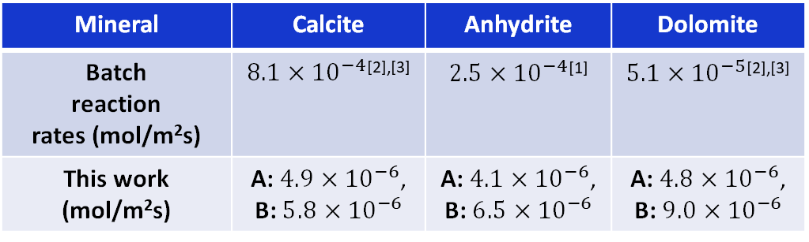
Key Points
The coupling of transport with reaction is quantified by evolving velocity distributions and mineral proximity to fast flow channels from the micro-CT images.
Minerals near fast channels dissolve faster altering reaction rate hierarchy, either forming dominant channels or widening existing channels.
Mineral reaction rates are orders of magnitude lower than the batch rates and the single-mineral system rates due to additional mass transfer limitations.
Mineral | Calcite | Anhydrite | Dolomite
Batch reaction rates (mol/m²s) | $8.1×{10}^{−4}$^{[2],[3]} | $2.5×{10}^{−4}$^{[1]} | $5.1×{10}^{−5}$^{[2],[3]}
This work (mol/m²s) | A: $4.9×{10}^{−6}$, B: $5.8×{10}^{−6}$ | A: $4.1×{10}^{−6}$, B: $6.5×{10}^{−6}$ | A: $4.8×{10}^{−6}$, B: $9.0×{10}^{−6}$
CO₂ Reactive transport in Carbonates
Imperial College Pore-Scale Imaging and Modelling Group

Slide 9
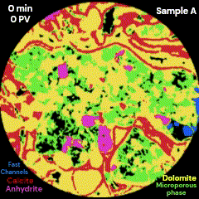
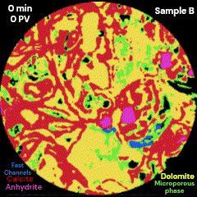
Acknowledgments
We gratefully acknowledge funding from the Qatar Carbonates and Carbon Storage Research Centre (QCCSRC), provided jointly by Qatar Petroleum, Shell, and Qatar Science and Technology Park.
We gratefully acknowledge funding from Petroleum Technology Development Fund (PTDF).
Read
Accepted Paper
Pre-Print:
Imperial College Pore-Scale Imaging and Modelling Group
CO₂ Reactive transport in Carbonates
https://www.imperial.ac.uk/earth-science/research/research-groups/pore-scale-modelling/

Slide 10
References
(1) Bildstein O, Worden RH, Brosse E. Assessment of anhydrite dissolution as the rate-limiting step during thermochemical sulfate reduction. Chem Geol. 2001 Jul 1;176(1):173–89.
(2) Peng C, U. Anabaraonye B, P. Crawshaw J, C. Maitland G, Martin Trusler JP. Kinetics of carbonate mineral dissolution in CO 2 -acidified brines at storage reservoir conditions. Faraday Discuss. 2016;192(0):545–60.
(3) Peng C, Crawshaw JP, Maitland GC, Trusler JPM. Kinetics of calcite dissolution in CO2-saturated water at temperatures between (323 and 373)K and pressures up to 13.8MPa. Chem Geol. 2015 May 18;403:74–85.
Imperial College Pore-Scale Imaging and Modelling Group

