Slide 1
Monte Carlo based approach for simulating fracture flow using fully-unstructured pEDFM
Ryan Haagenson, Mengjie Zhao, Artur Castiel, Cornelis Vuik, Hadi Hajibeygi
InterPore, 22 May 2026
Notes:
Thank you…
The title of my talk is…
Great, thank you. Good afternoon, everyone. The title of my talk is “Monte-Carlo based approach for simulating fracture flow using fully-unstructured pEDFM”; however, with recent developments that I’ll share with you all today, you’ll see that this is a misleading title. It should read something like “Monte-Carlo based and other approaches…”, but you’ll see what I mean in a minute.

Slide 2
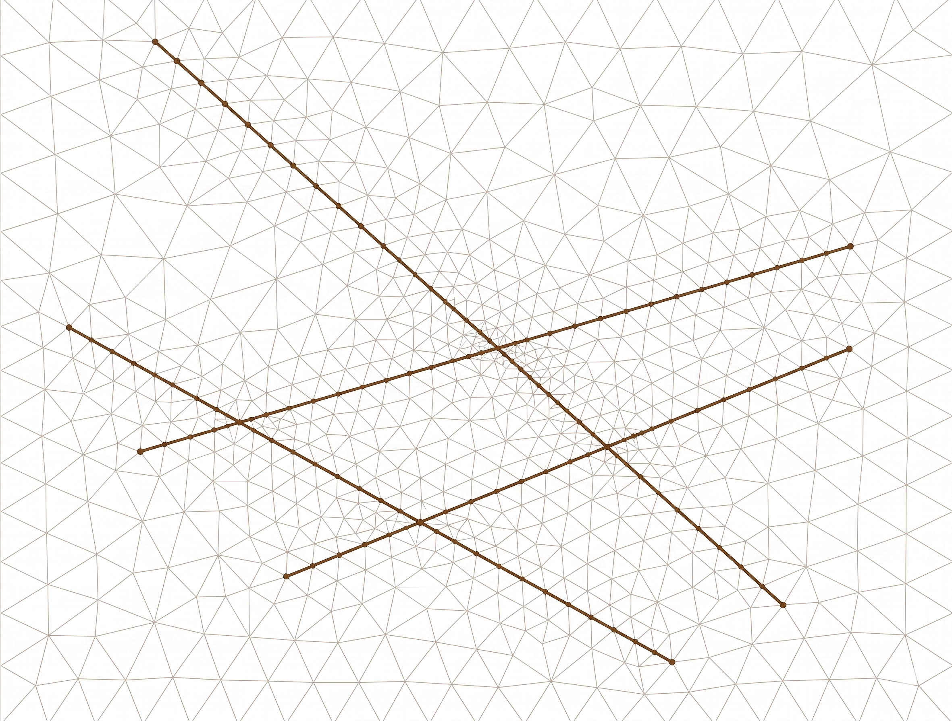
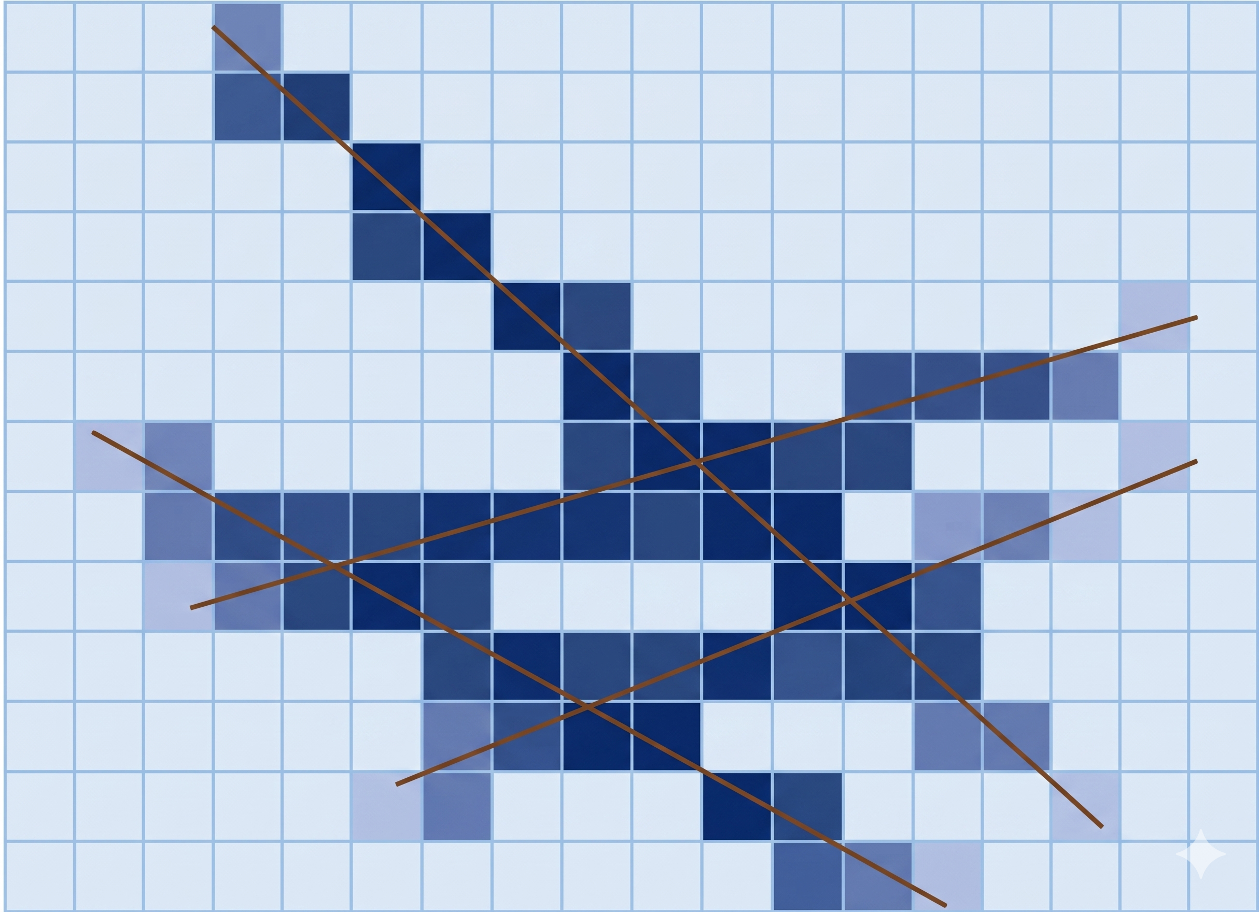
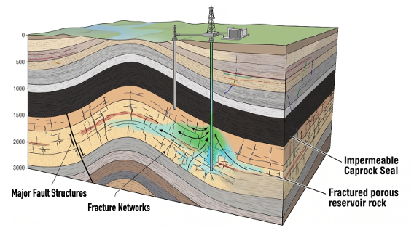
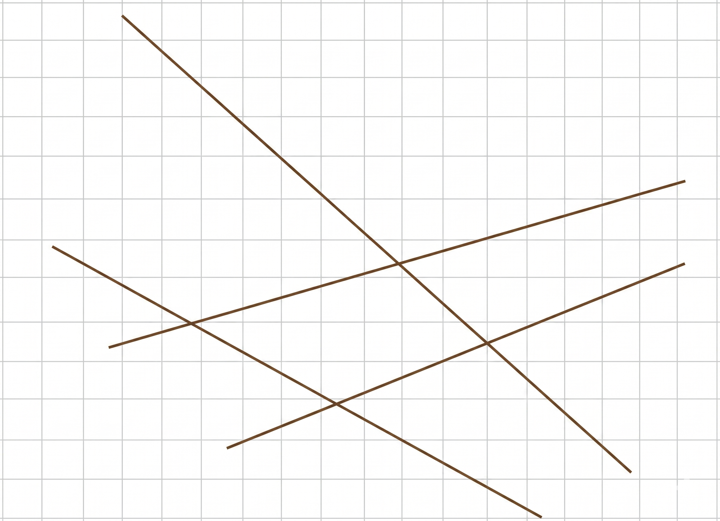
Conforming (DFM)
Upscaling (UDFM)
Embedded (EDFM)
Notes:
We all known the problem…
There are different methods…
So, we are all familiar with this problem: Real-world geological porous media includes fractures and faults on various scales and with various hydraulic properties, often contributing or even controlling the behavior of our flow system. How do we perform high-fidelity simulations in such conditions What approach should we take? There are numerous options, including so-called DFM models, which use fully conforming matrix mesh surrounding your explicitly discretized fracture network. There are upscaled techniques, where the hydraulic properties of the continuum are altered to account for the presence of the fractures implicitly. A third option is so-called embedded fractures or “EDFM”…

Slide 3
Embedded (EDFM)
Notes:
EDFM will be the focus on my talk…
Two domains are discretized separately…
Cross connections created to describe fluid flow between two domains…
… which will be the focus of my talk today. In EDFM, we mesh the rock mesh and fracture networks separately and create connections between the two domains to describe how fluid flows from one domain to the other. Much like how one matrix cell is connected to each of its neighbors with something like the two-point flux approximation, EDFM creates a set of connections between the fracture network – which has its own discrete mesh – and the rock matrix where the intersections occur. This method is well-understood for cartesian grids like the one you see here…

Slide 4
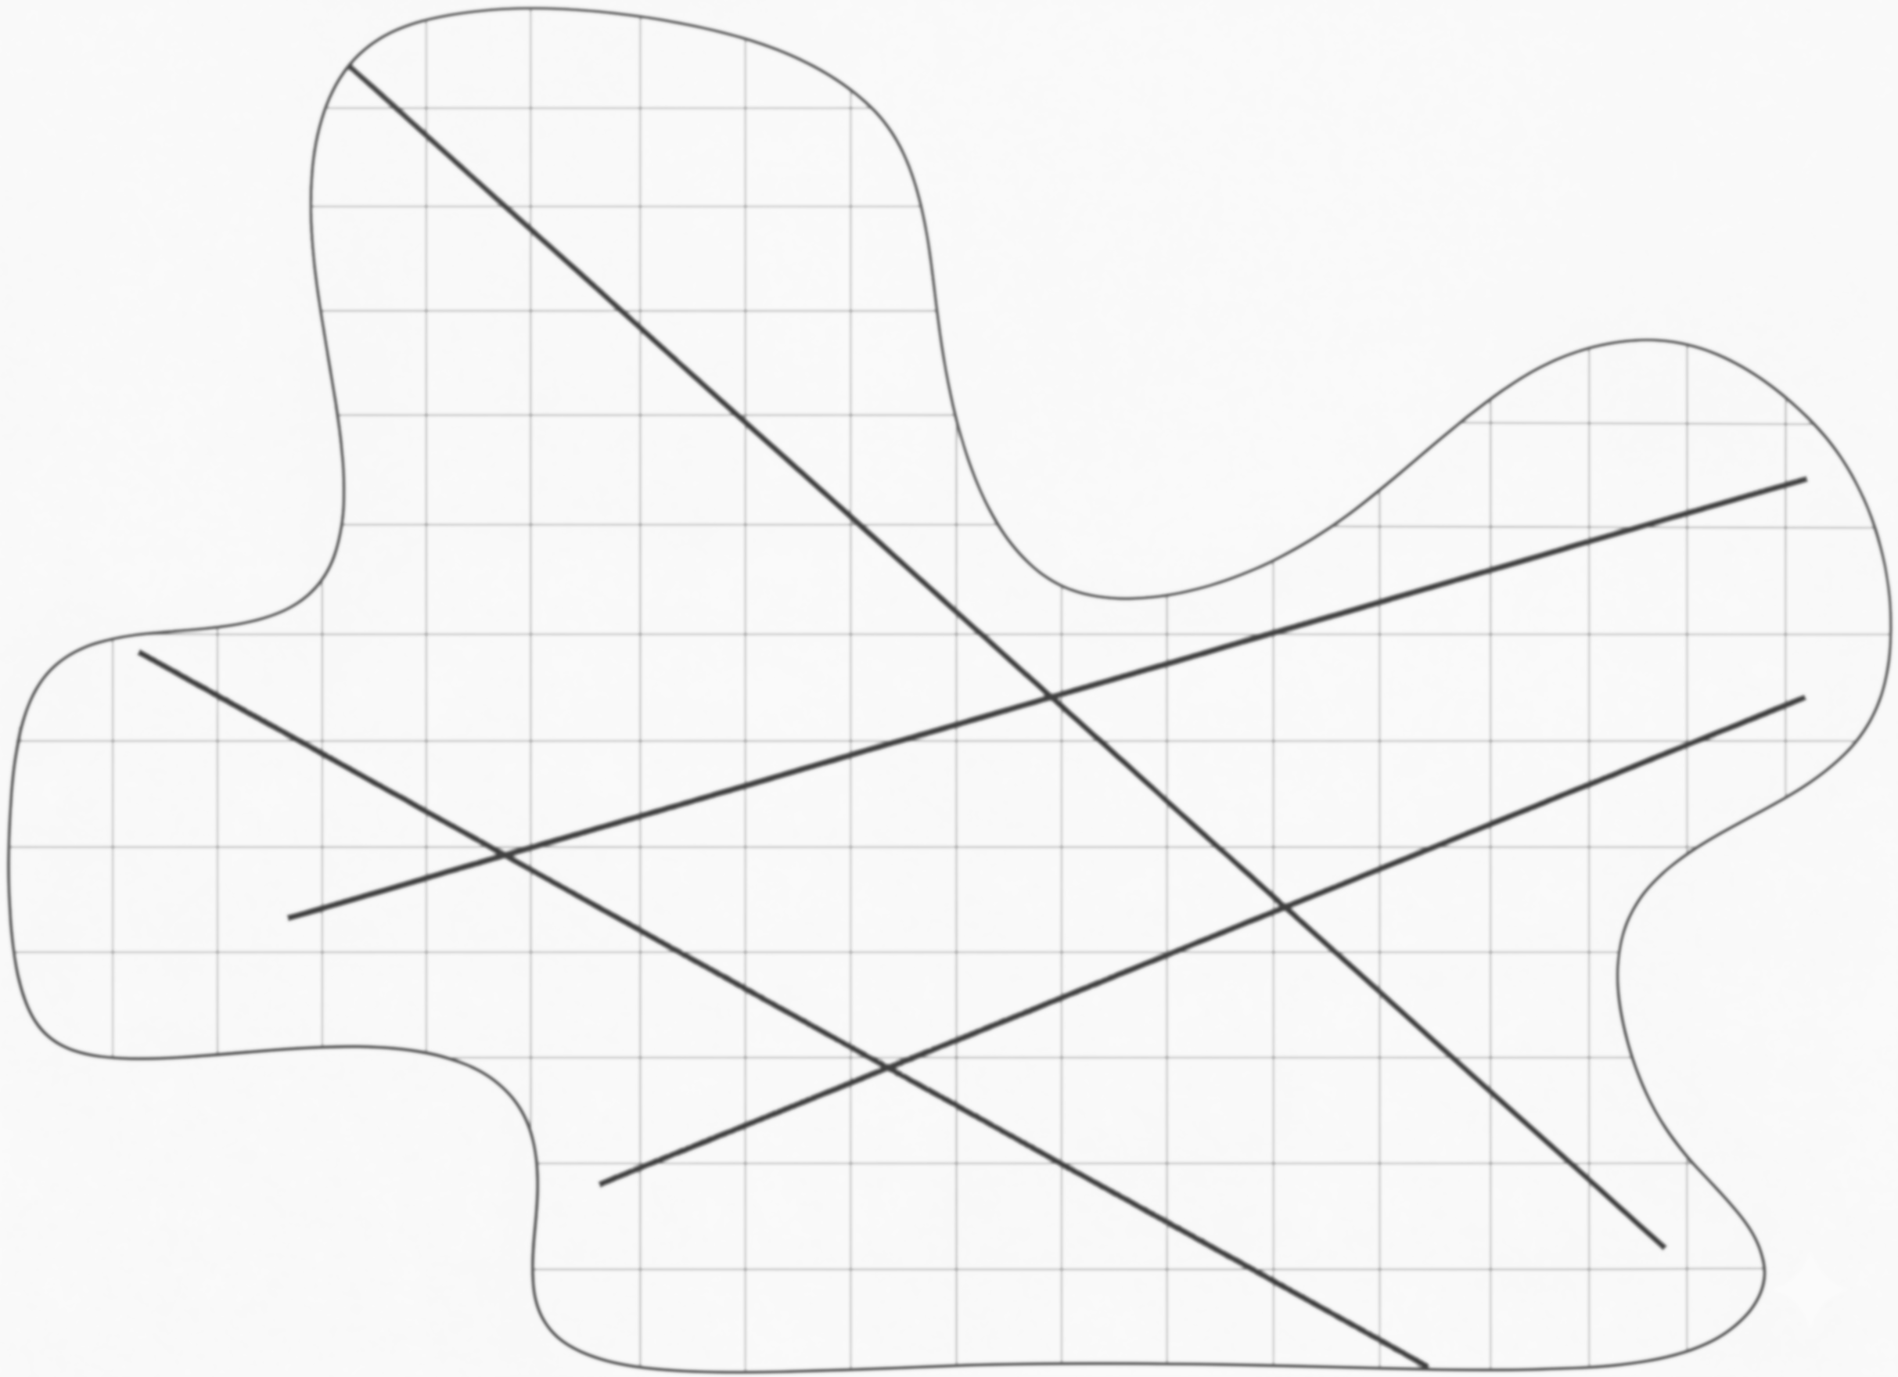
Embedded (EDFM)
Notes:
But what if we care about highly irregular domains, which can be difficult to resolve with cartesian meshes…

Slide 5
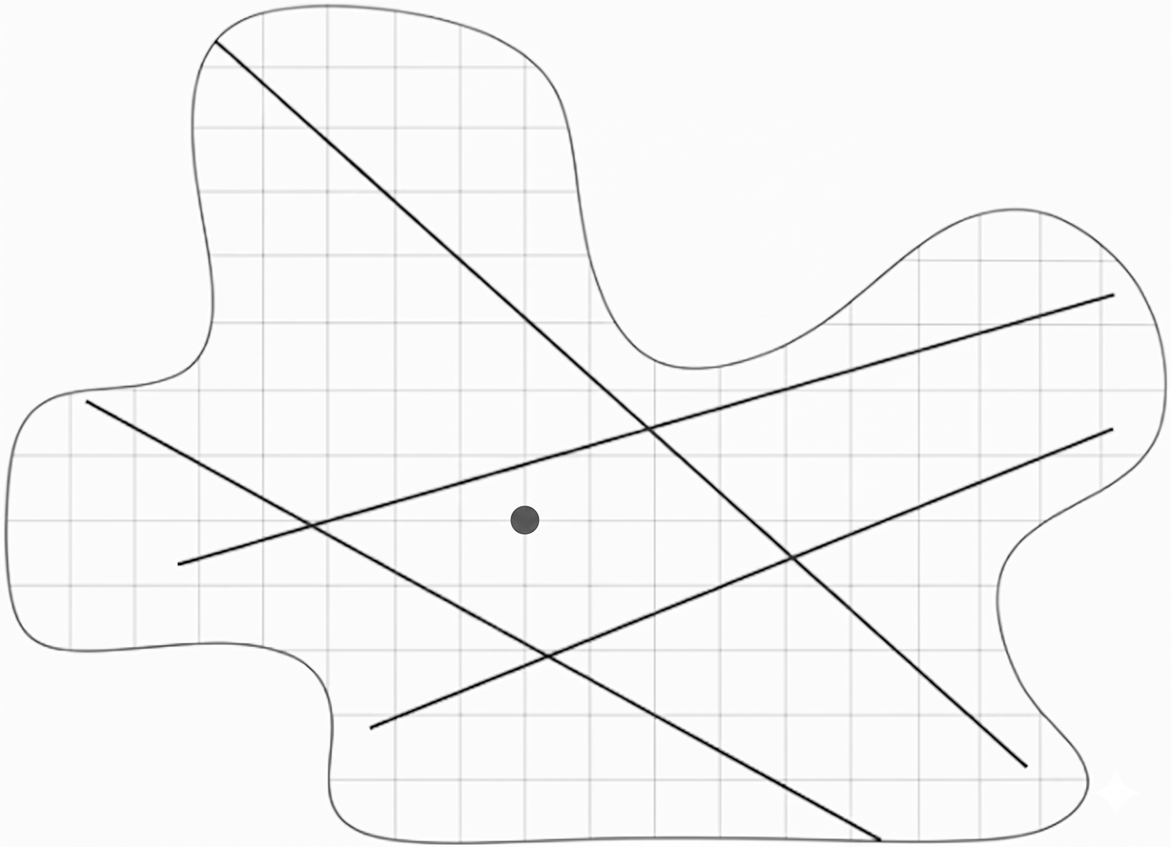
Embedded (EDFM)
Notes:
Or what if we have fluid sink or source – like a well – where we’d like to refine the mesh resolution nearby so that we can accurately capture the relatively steep pressure and saturation gradients caused by the sink or source…

Slide 6
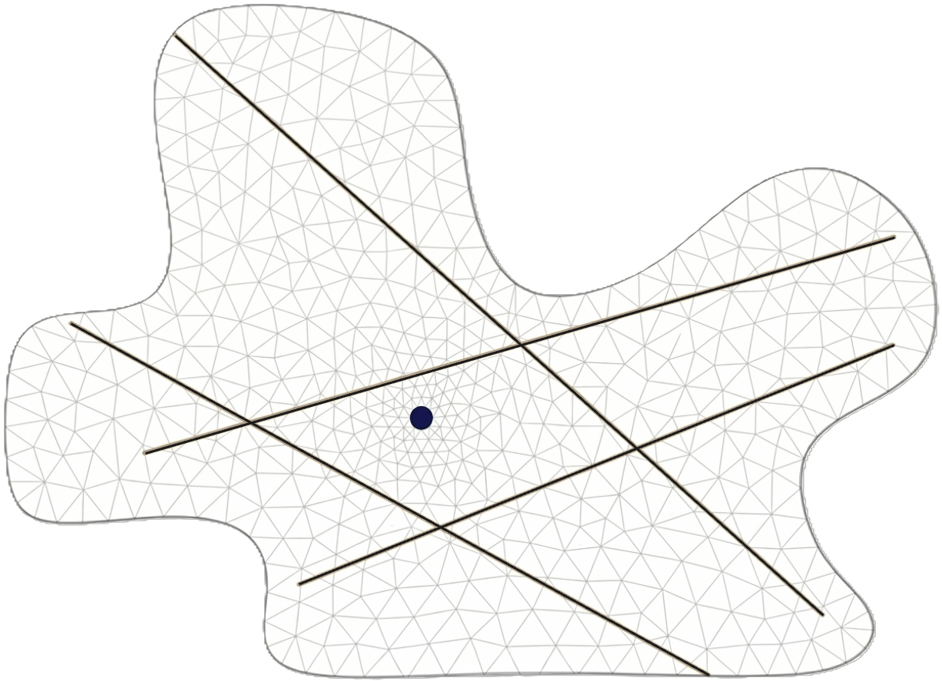
Embedded (EDFM)
Notes:
In these cases, it would often be preferable…
In these cases, it would often be preferable to use an unstructured mesh, which can adhere to the irregular boundary domain and smoothly transition from coarse to fine mesh resolution across the domain. The challenge is: Can we develop an EDFM approach for unstructured grids that is accurate, computationally efficient, and compatible with mesh elements of arbitrary order, shape, or size.

Slide 7
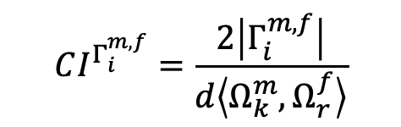
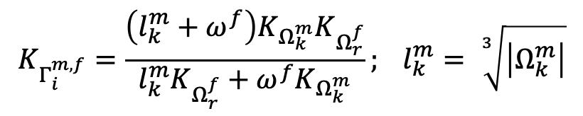
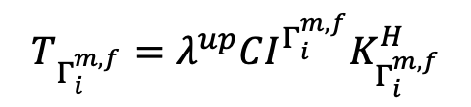


Embedded Discrete Fracture Model (EDFM)
$$Ω_{k}^{m}⟷Ω_{r}^{f}∶Γ_{i}^{m,f}$$
$$\overset{⃑}{γ}∙\overset{⃑}{N}=−T_{Γ_{i}^{m,f}}(p_{Ω_{r}^{f}}−p_{Ω_{k}^{m}})$$
$$T_{Γ_{i}^{m,f}}=λ^{up}CI^{Γ_{i}^{m,f}}K_{Γ_{i}^{m,f}}^{H}$$
$$CI^{Γ_{i}^{m,f}}=\frac{2\left|Γ_{i}^{m,f}\right|}{d\left\langle Ω_{k}^{m},Ω_{r}^{f}\right\rangle }$$
Area
Distance
$$K_{Γ_{i}^{m,f}}=\frac{\left(l_{k}^{m}+ω^{f}\right)K_{Ω_{k}^{m}}K_{Ω_{r}^{f}}}{l_{k}^{m}K_{Ω_{r}^{f}}+ω^{f}K_{Ω_{k}^{m}}}; l_{k}^{m}= \sqrt[3]{\left|Ω_{k}^{m}\right|}$$
Notes:
The crux of EDFM is creating connections between…
Connectivity Index (CI) is a geometric parameter…
So, this is what we set out to do. I won’t give too many details of the mathematics, but the crux of EDFM – as I mentioned – is the creation of connections between the rock mesh and fracture mesh, which describes fluid flow between the two separately discretized domains. The transmissibility associated with this connections depends on the so-called “connectivity index” or CI, which is a geometric parameter defined as the ratio of the area of intersection between a given fracture cell and rock cell with the average distance between the three-dimensional rock cell and the two-dimensional fracture cell. Calculating this CI parameter is the primary challenge with EDFM for unstructured grids, because we need a computationally efficient approach that is also generalized to account for polyhedron of any order, shape or size in the rock mesh. We won’t want to be limited to just tetrahedral, for example, but we’d like to handle hexahedrons, pyramids, and so on.

Slide 8
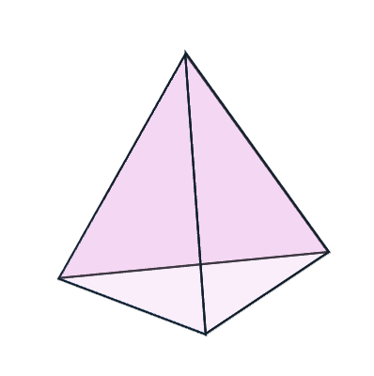
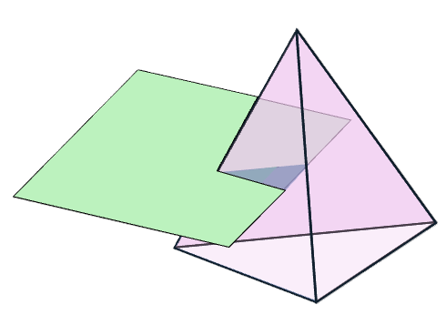
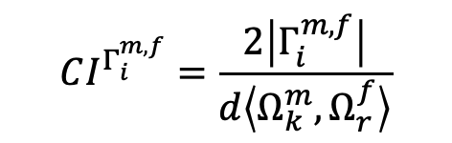
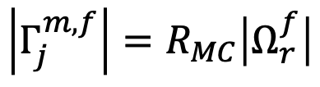
Intersection Area: Monte Carlo Method
$$CI^{Γ_{i}^{m,f}}=\frac{2\left|Γ_{i}^{m,f}\right|}{d\left\langle Ω_{k}^{m},Ω_{r}^{f}\right\rangle }$$
Area
$$\left|Γ_{j}^{m,f}\right|=R_{MC}\left|Ω_{r}^{f}\right|$$
Ratio of
# points inside to # total points
z
x
Algorithm easily vectorized…
y
Notes:
Focus on intersection area estimation…
The first method is Monte Carlo…
So, for the sake of time, I will only focus on the estimation of the intersection area. So, if we imagine some polyhedron of the rock mesh that is intersected by a two-dimensional fracture cell, we need to find the are of the shaded blue region. The first method we attempted was a Monte Carlo based approach, in which we randomly seeded the fracture cell with a large number of test points and we find which test points lie inside the polyhedron. We can then estimate the area of the intersection polygon as the product of the total area of the fracture cell multiplied by the ratio of the number of points inside the polyhedron by the total number of test points in the fracture cell. This method seemed advantageous early on, because it was clear that the algorithm could be easily vectorized to improve computational efficiency.

Slide 9
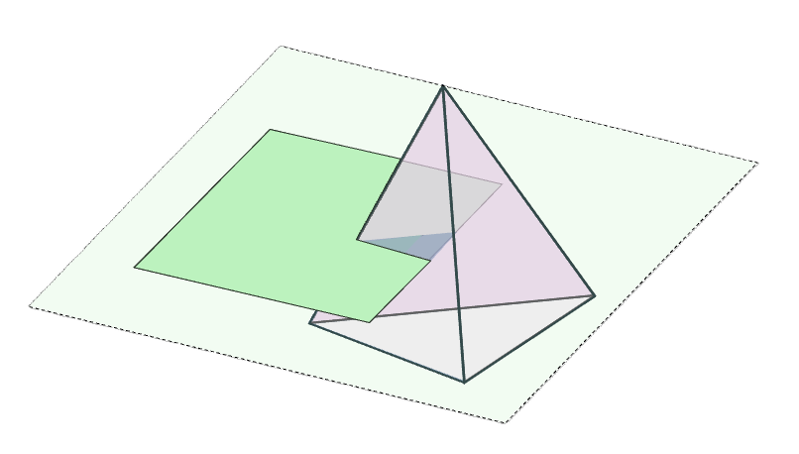
Intersection Area: Geometric Method
$$CI^{Γ_{i}^{m,f}}=\frac{2\left|Γ_{i}^{m,f}\right|}{d\left\langle Ω_{k}^{m},Ω_{r}^{f}\right\rangle }$$
Area
z
x
y
Notes:
After further development, we realized…
Still agnostic to polyhedron order….
However, after further development, we realized that there was an exact geometric method we could apply as well, while remaining agnostic to the order of the polyhedron. For this method, we first take the infinite plane that the fracture cell lies on and find the intersection points between that plane and any of the polyhedron edges. These intersection points, shown as black dots, creates a convex polygon that is coplanar with the fracture cell…

Slide 10
Intersection Area: Geometric Method
$$CI^{Γ_{i}^{m,f}}=\frac{2\left|Γ_{i}^{m,f}\right|}{d\left\langle Ω_{k}^{m},Ω_{r}^{f}\right\rangle }$$
Area
v_{f}
Simple Polygon Area Calculation
u_{f}
Notes:
We transform to local 2D coordinate system…
Computationally inexpensive
Agnostic to polyhedron order…
…meaning we can transform our coordinate system to the local, 2D coordinate system of the fracture cell and from here the calculation of the intersection area is quite straight forward and computationally inexpensive. The benefit of this approach, of course, is that it is exact and not just an approximation of the actual intersection area. What’s more is that we compared the performance of the two methods, and to our surprise it appears that the geometric method is also more computationally efficient – so it’s clear that for the time being, the geometric method is more appealing for our purposes.

Slide 11
Projection Embedded Discrete Fracture Model (pEDFM)
Matrix-Matrix Flux
EDFM: Intersected - Fracture
pEDFM: Neighbor - Fracture
Notes:
Looking back at our domain, if we zoom in…
Matrix-to-matrix
EDFM: Fracture-to-matrix
pEDFM and face selection
Looking back at our domain, if we zoom in on just two matrix cells, we have first the matrix-to-matrix flux shown in blue. If we also have a fracture intersecting one of the two cells, then we also have the EDFM connection, which describes the matrix to fracture flux. This here is enough for highly conductive fractures, but we also need to consider the possibility of low permeability – or sealing – fractures. In that case, the EDFM connection would be very weak due to the low permeability of the fracture, but the matrix-to-matrix connection would be unchanged, meaning that fluid can flow through the rock matrix as if the sealing fracture wasn’t there at all. To fix this issue, we apply projection-EDFM, also called pEDFM, where we select certain interfaces in the matrix mesh to project the fracture path onto, shown here as the pink line, and we remove the associated matrix-to-matrix connection altogether, replacing it with an additional connection between the fracture cell and the neighboring matrix cell. Now, we force fluid to flow from the matrix to the fracture back to the matrix, such that a low permeability fracture can act as a flow barrier.

Slide 12
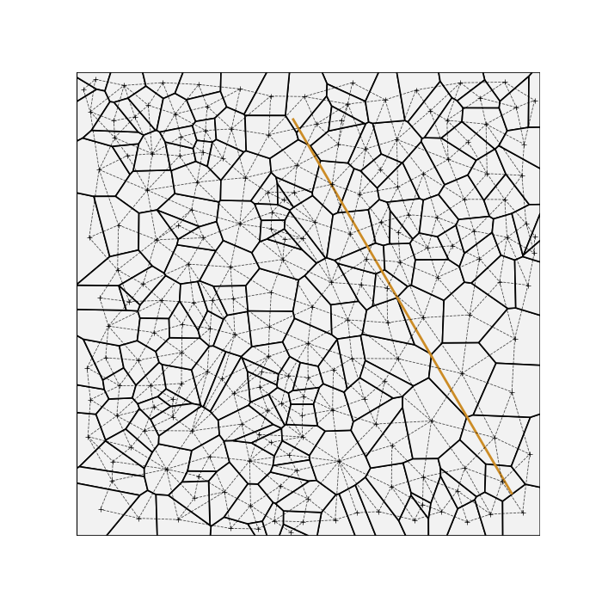
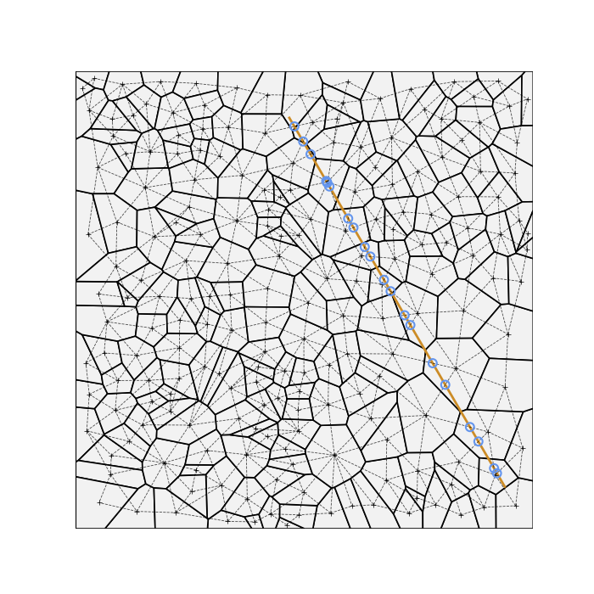
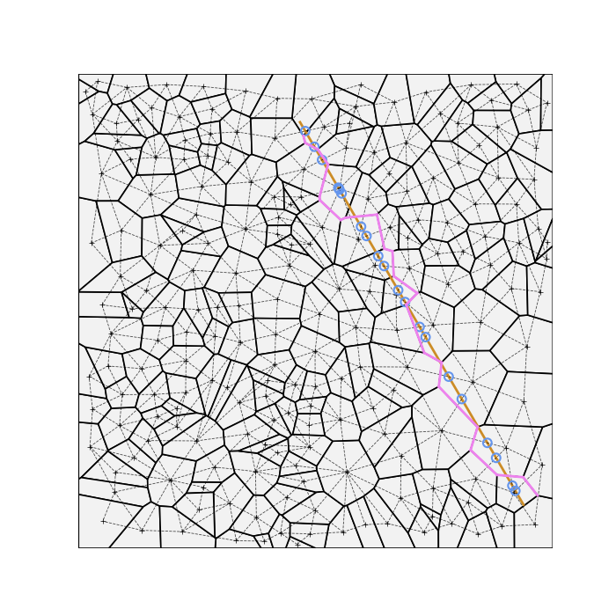
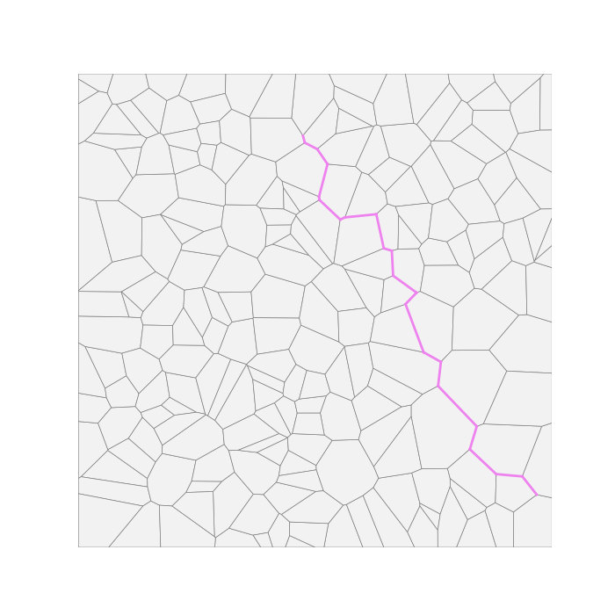
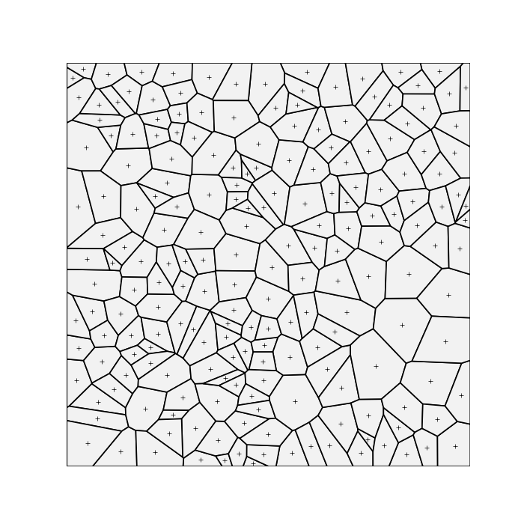
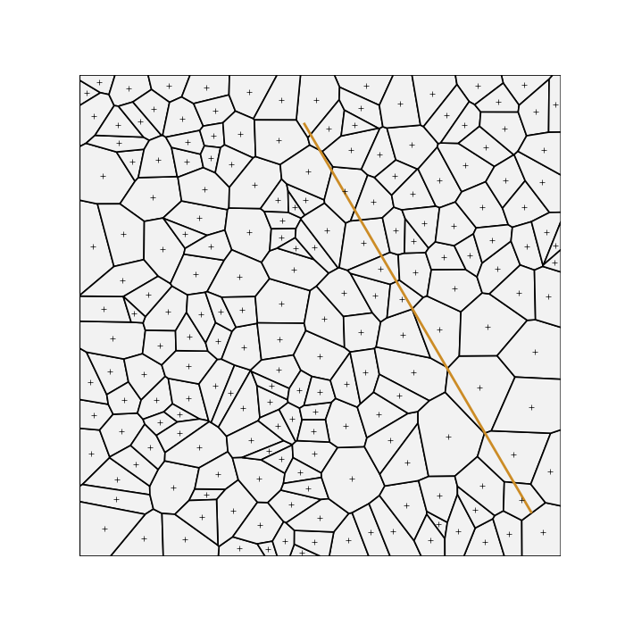
Projection Embedded Discrete Fracture Model (pEDFM)
Notes:
Which interfaces in the mesh do we select?
We start with a mesh, arbitrary polygons to show generality…
Shown in 2D, readily applies to 3D…
Which interfaces in the matrix mesh do we select to project the fracture path onto? We start with a matrix mesh – here with arbitrary polygons to highlight the generality of our method. The centroids are shown here with the markers. After overlaying our fracture onto the mesh, we draw all possible lines connecting each matrix cell centroid with the centroid of all neighboring cells. Then, for every centroid connection line intersected by the fracture, we select the associated matrix interface to be part of the projection path. And if we take away all the clutter, we see that end up with a continuous, non-branching projection path for the fracture. I’ve shown this process in 2D here, but the same idea transfers directly to 3D as well where the resulting projection is a continuous, non-branching surface composed of matrix cell interfaces.

Slide 13
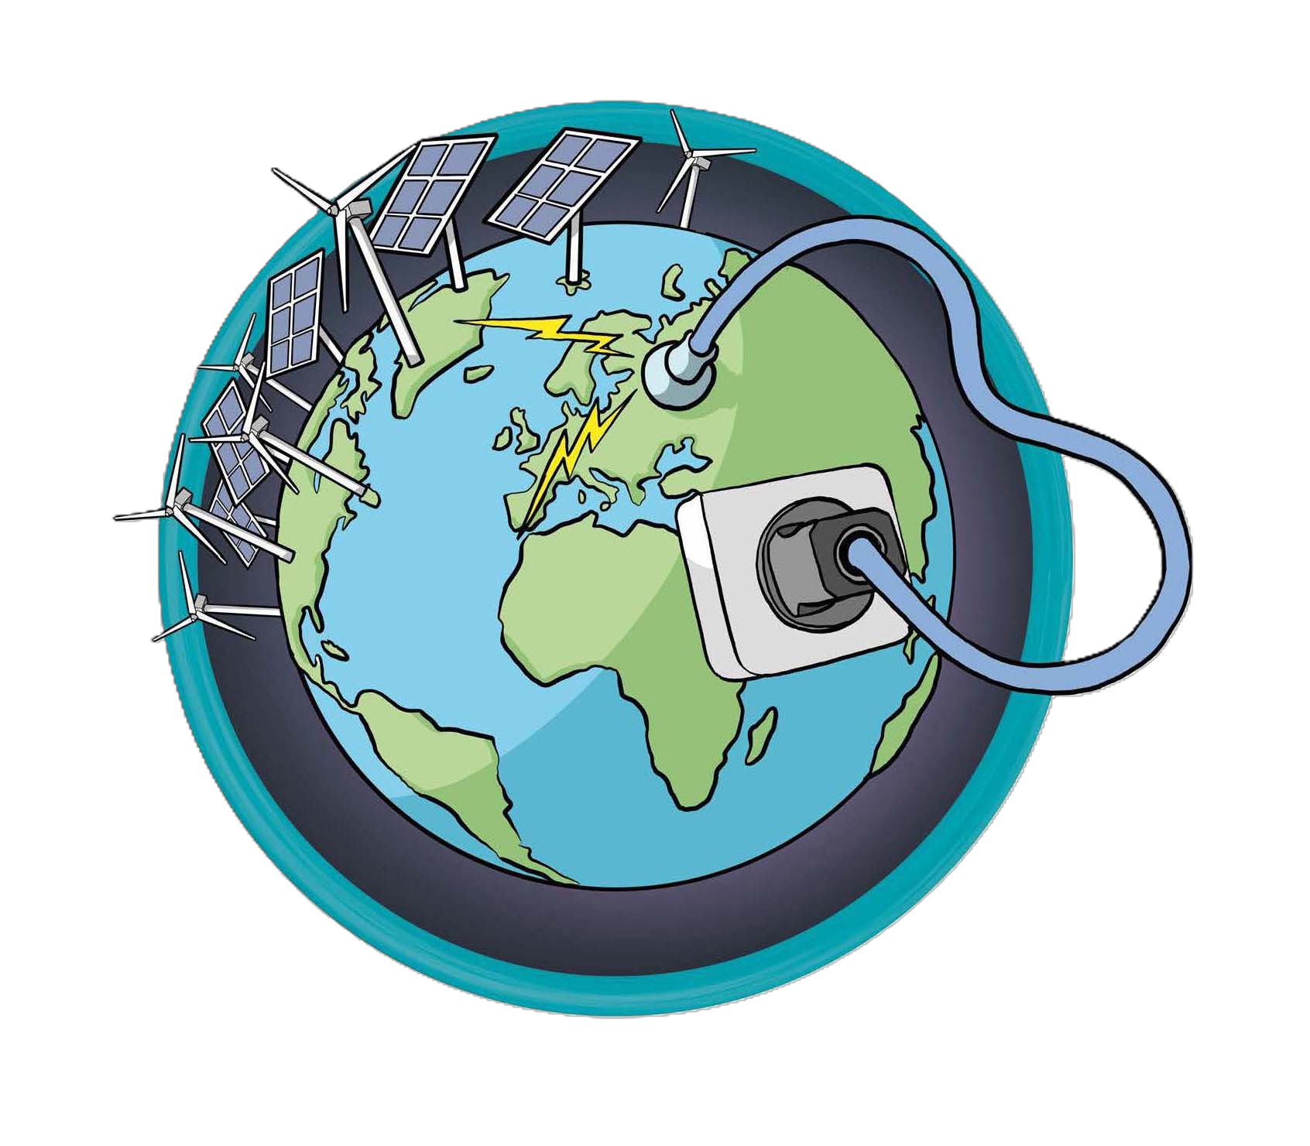
DARSim
Delft Advanced Reservoir Simulation
Notes:
We have developed this new capability in DARSim, one of our in-house reservoir simulators at TU Delft. It is an open-source software, so you are welcome to download and give this a try for yourself. We are planning a new release of DARSim in June, with several new features, so keep an eye out for that as well.

Slide 14
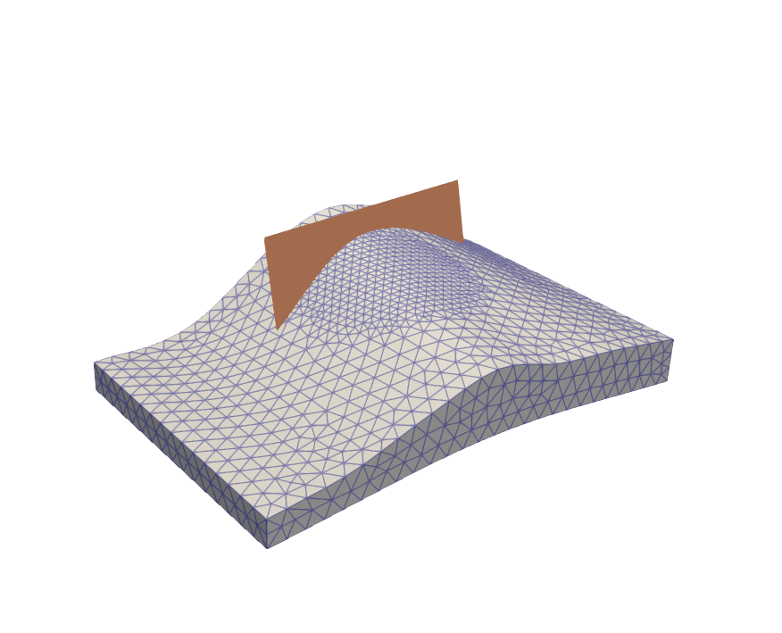

Case Study: Three-Dimensional CCS
Notes:
Finish with a demonstration…
CO2 injection
Anticline reservoir
Sealing fault on upslope side as flow barrier
Unstructured mesh captures reservoir shape and refines easily near injection well
Finally, I would like to show you an application of this method. Here we are injecting CO2 into an anticline shaped reservoir initially saturated with brine, and one one edge of the reservoir we have a sealing fault that acts as the flow barrier for the CO2 on the upslope side of the reservoir. The beauty of the EDFM method is that we can run numerous simulations with the fault in different orientations without the need to regenerate the matrix mesh. I also want to point out how the unstructured mesh is able to accurately represent the undulations in the reservoir shape and we were able to apply a local mesh refinement near the injection location, two of the main benefits of using unstructured meshes.

Slide 15
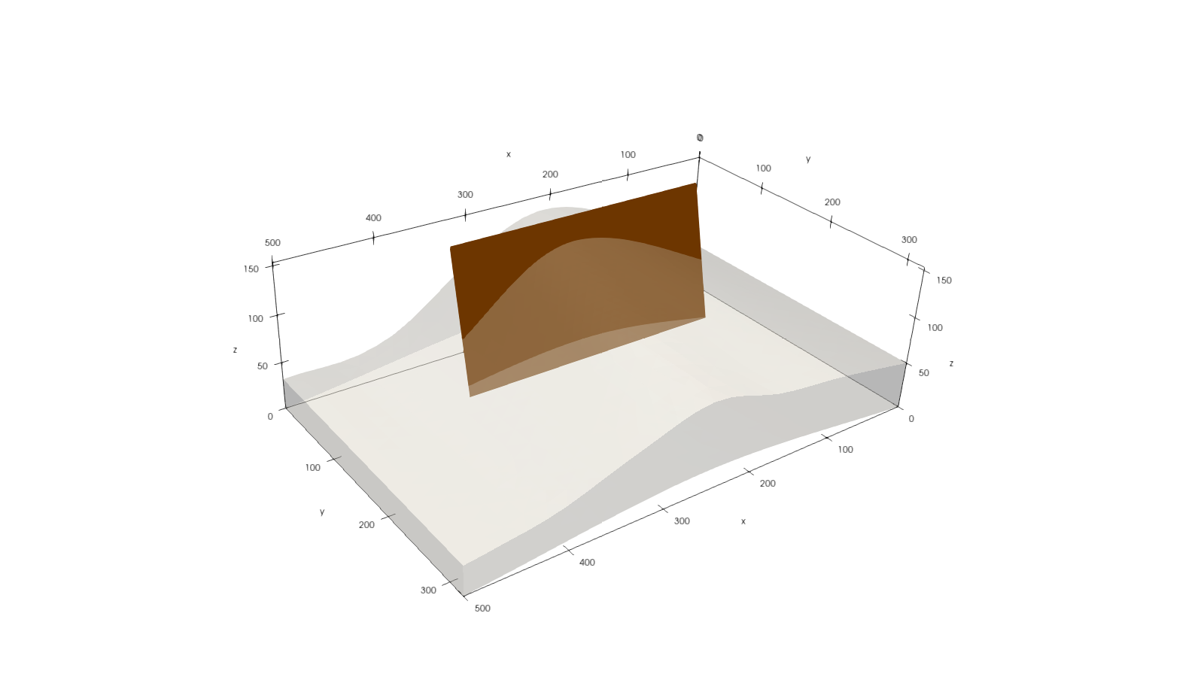
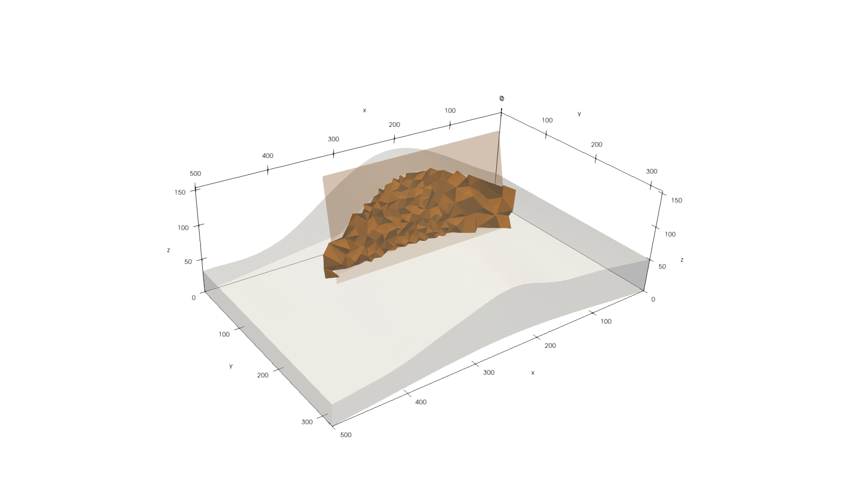
Case Study: Three-Dimensional CCS
Notes:
So, here is the fault location for the base case simulation and the injection well is shown in green. Here is the continuous projection path of the fracture within the matrix mesh…

Slide 16
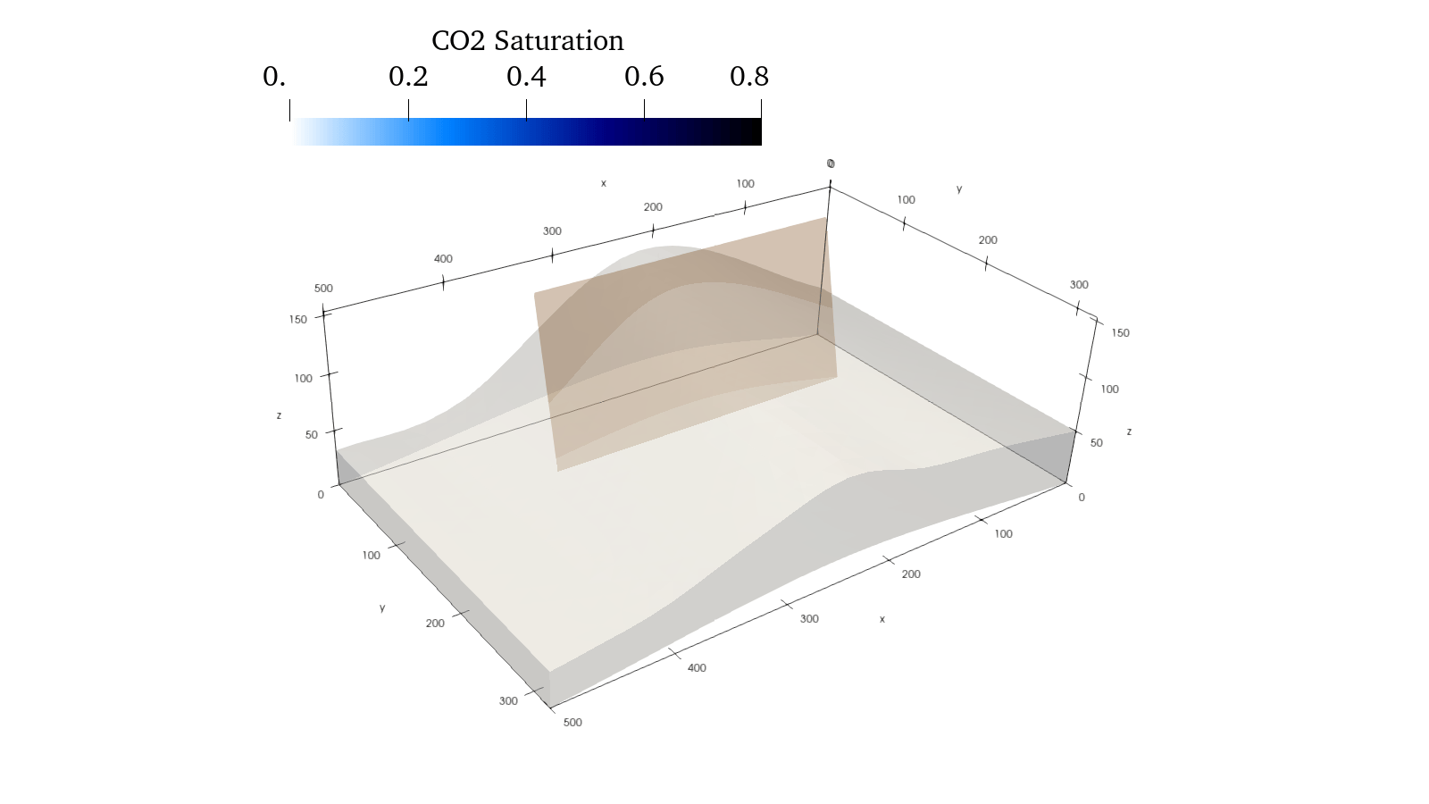
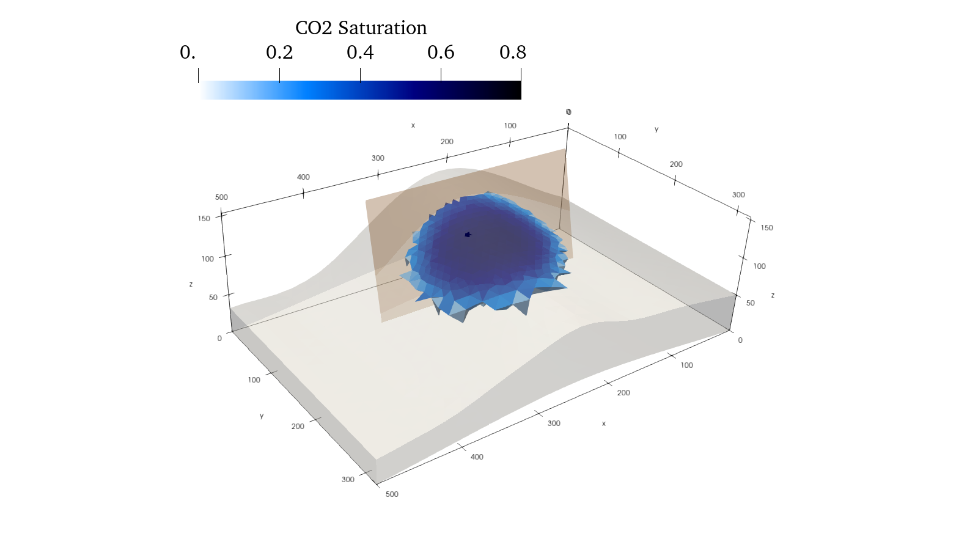
Case Study: Three-Dimensional CCS
Notes:
We we watch the CO2 injection
Plotting only over 10% saturation
Fault acts as flow barrier as expected
And here we can watch the CO2 injection. I am plotting the CO2 saturation, but only showing matrix cells with over 10% saturation for better visualization. We see the CO2 reach the upper boundary of the reservoir and initially it flows upward toward the fault, but the fault behaves as a flow barrier, causing the CO2 plume to start migrating down slope.

Slide 17
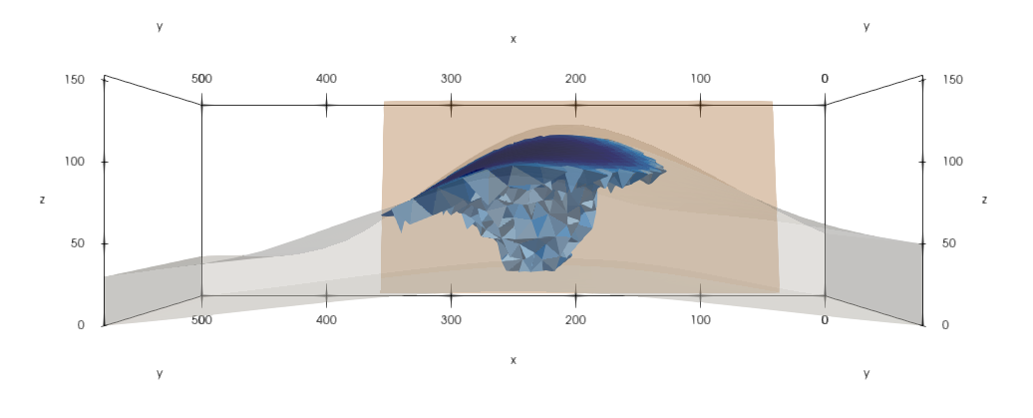
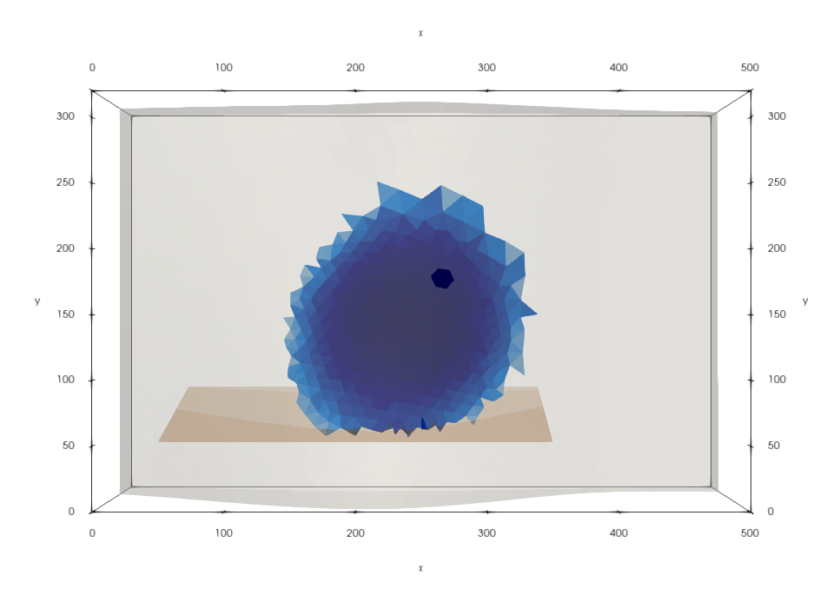
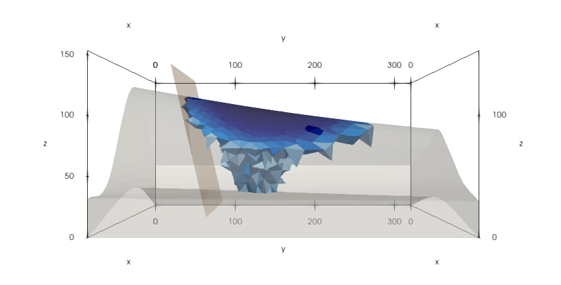
Case Study: Three-Dimensional CCS
Notes:
Which we can really see in these figures here. In the bottom right, we see how the fault is acting as a flow barrier for the CO2 plume, and in the bottom left and top right, we see how the plume has begun to flow down slope in the reservoir in response to the flow barrier.

Slide 18
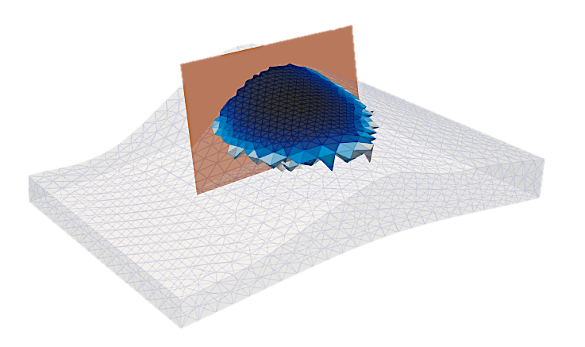
Key Points
Developed algorithms for EDFM/pEDFM in fully unstructured grids
  Geometric and Monte-Carlo based methods
Demonstrated capabilities with field scale CCS simulations
Flexibility of EDFM enhanced by flexibility of unstructured grids → opportunities!
Thank you for your kind attention
Notes:
To quickly conclude: We have developed an approach for EDFM and pEDFM in fully unstructured grids of arbitrary construction based on both geometric and Monte Carlo methods. I briefly demonstrated the types of scenarios this methodology can simulate. The main takeaway is that combining the flexibility of EDFM methods with the flexibility of unstructured meshes can lead to new and interesting opportunities for simulation. Thank you for your kind attention.

Slide 19
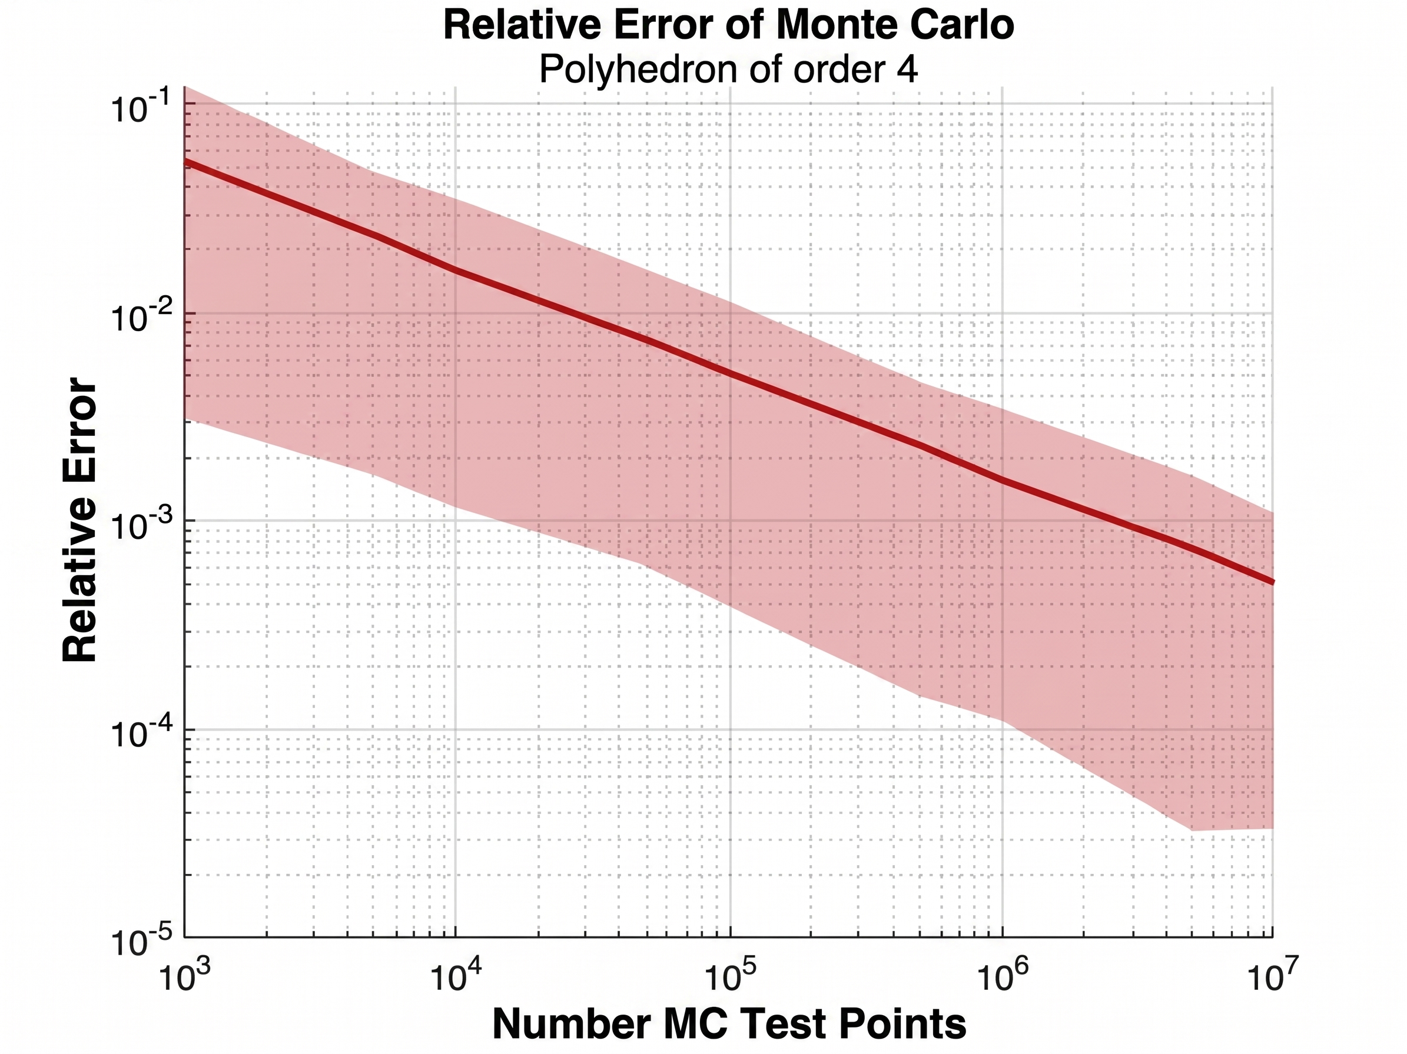
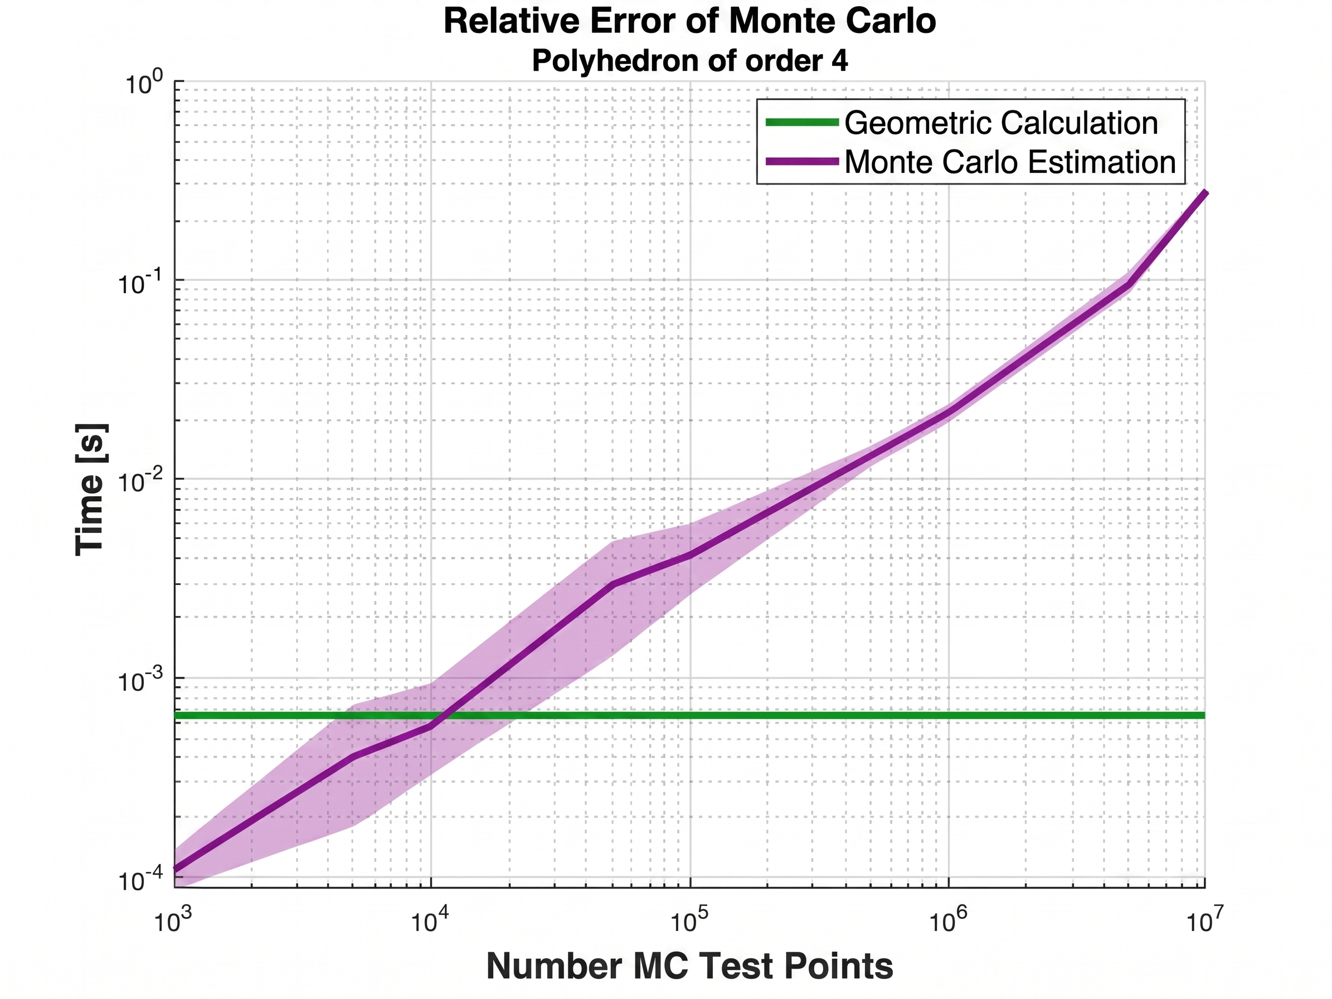
Intersection Area: Comparison
Relative Error
of Monte Carlo Approach
Computation Time
of Monte Carlo Approach
10⁰
10⁻¹
Computation Time [s]
10⁻²
10⁻³
10⁻⁴
Geometric method appears more appealing…
Notes:
So, we decided to compare the two methods to find out which was more computationally feasible. We tested the two methods one thousand different fracture-cell and matrix-cell configurations. On the left, we see the relative error of the Monte Carlo based approach, which indicates that to be consistently at or below 1% error, we need approximately ten thousand test points in our sampling per fracture cell. On the right, we are looking at a comparison of the computation time in seconds, where the purple is the Monte-Carlo method and the green is the geometric method, and for ten thousand sample points, we see that the Monte-Carlo based method was consistently slower than the geometric method, despite having a vectorizing the code wherever possible. So, it appears at this point that the geometric method is more appealing for our purposes.

Slide 20

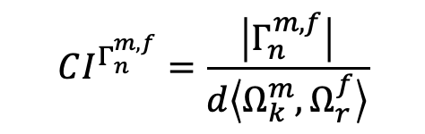
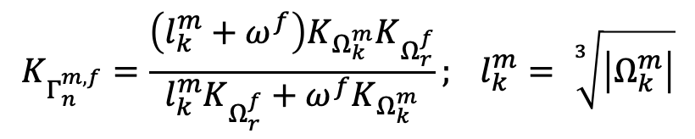
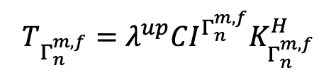

Projection Embedded Discrete Fracture Model (pEDFM)
$$Ω_{l}^{m}⟷Ω_{r}^{f}∶Γ_{n}^{m,f}$$
$$\overset{⃑}{γ}∙\overset{⃑}{N}=−T_{Γ_{n}^{m,f}}(p_{Ω_{r}^{f}}−p_{Ω_{k}^{m}})$$
$$T_{Γ_{n}^{m,f}}=λ^{up}CI^{Γ_{n}^{m,f}}K_{Γ_{n}^{m,f}}^{H}$$
$$CI^{Γ_{n}^{m,f}}=\frac{\left|Γ_{n}^{m,f}\right|}{d\left\langle Ω_{k}^{m},Ω_{r}^{f}\right\rangle }$$
$$K_{Γ_{n}^{m,f}}=\frac{\left(l_{k}^{m}+ω^{f}\right)K_{Ω_{k}^{m}}K_{Ω_{r}^{f}}}{l_{k}^{m}K_{Ω_{r}^{f}}+ω^{f}K_{Ω_{k}^{m}}}; l_{k}^{m}= \sqrt[3]{\left|Ω_{k}^{m}\right|}$$
Notes:
The formulas for creating these pEDFM connections are very similar to the EDFM connections, still using the connectivity index CI, except here we are looking at a neighboring matrix cell rather than the intersected matrix cell.

Slide 21
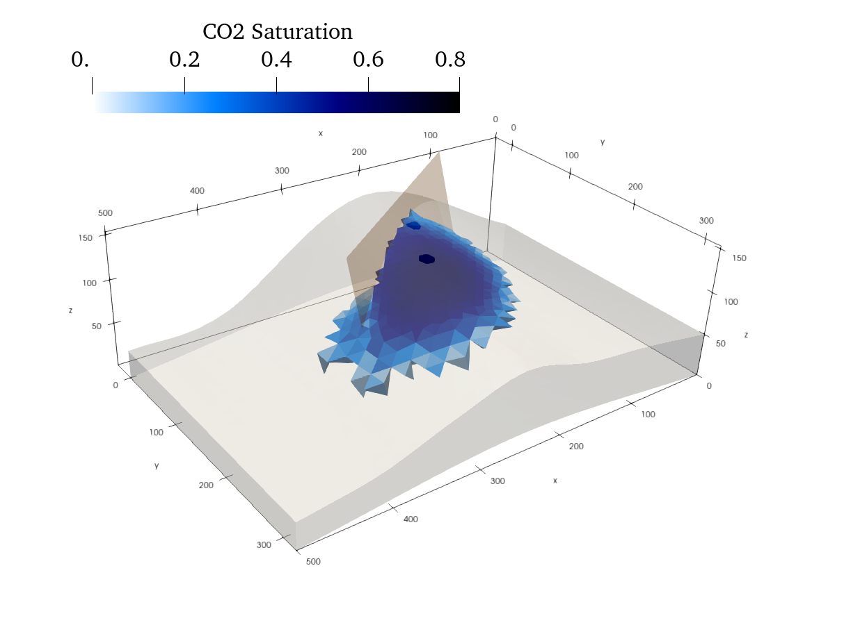
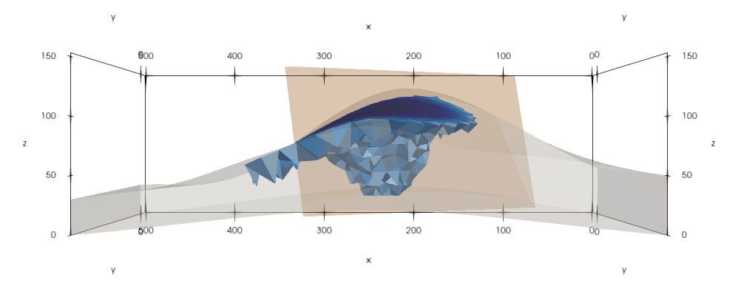
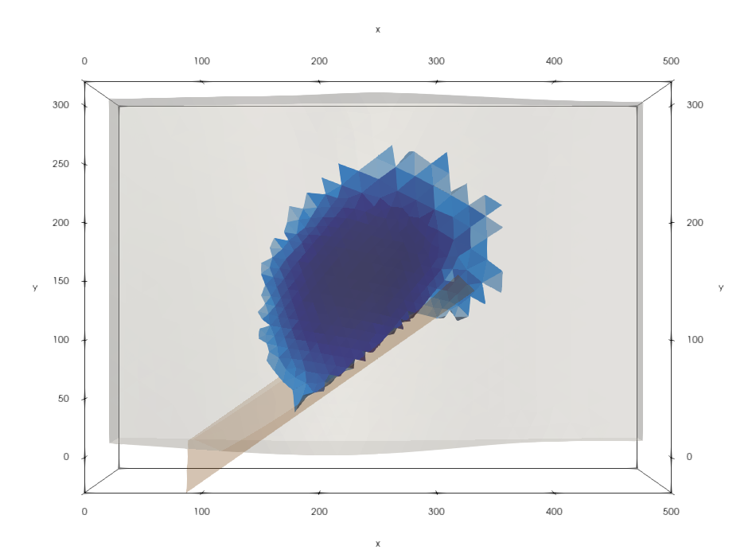
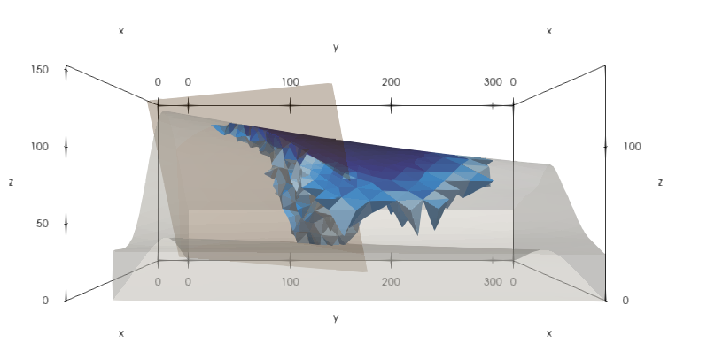
Case Study: Three-Dimensional CCS
Notes:
And here is the same scenario, expect we have rotated the fault by 35 degrees. In this case, we see that the plume circumvented the the edge of the fault and we are beginning to lose containment of the plume.

