Slide 1

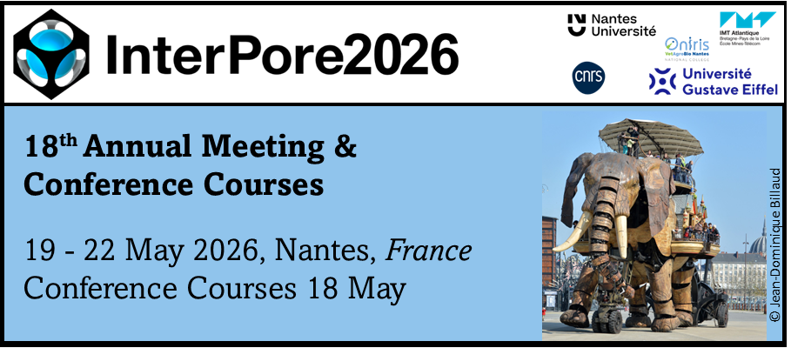
Finite Element Modeling of CO₂–Brine Flow with
Thermal Effects in Saline Aquifers
Daniel H. N. Peixoto¹*, Thiago D. dos Santos¹̛ ²
¹ CEPETRO, UNICAMP, Brazil
² FECFAU, UNICAMP, Brazil
*presenter
Notes:
Daniel -> Postdoctoral Research
Prof. Thiago Santos -> Supervisor and Co-Author

Slide 2
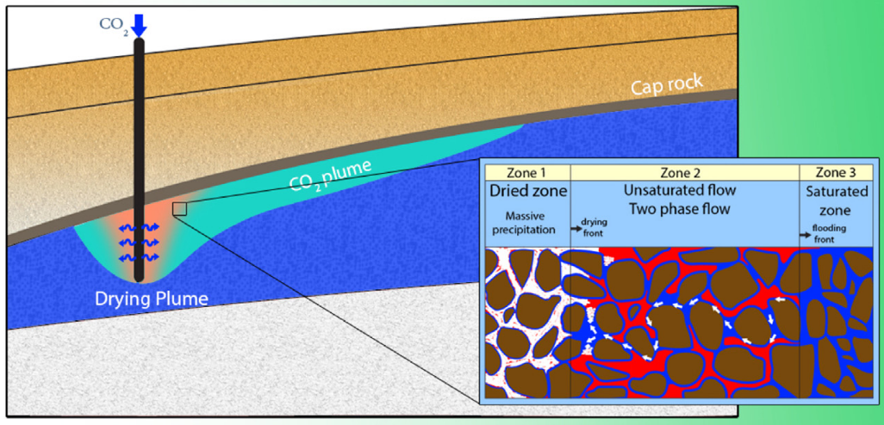
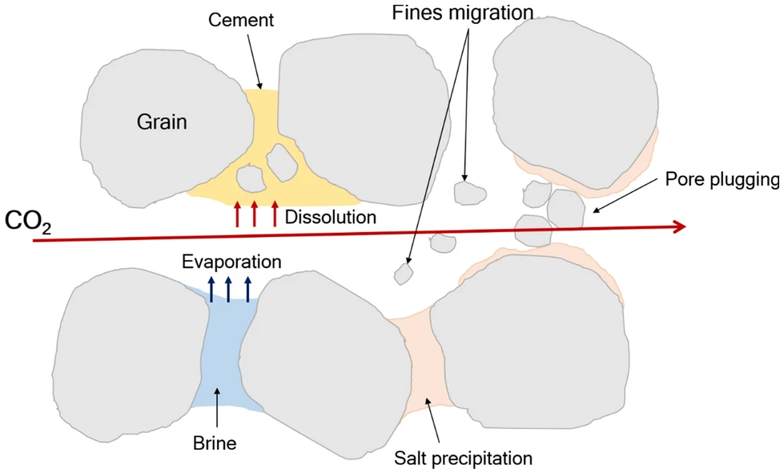

Introduction: Motivation and Project Context
1. Project Context
R&D project
UTP + CEPETRO/UNICAMP
Goal: support safer and more
efficient CO₂ geological storage.
2. Problem To Be Solved
CO₂ injection into saline aquifers
↓
Salt precipitation + fines migration
↓
Permeability reduction
↓
Injectivity loss
3. Modeling Strategy
Expandable staggered multiphysics framework:
Fluid Flow + Thermal + Geochemical
• Overall-compositional model:${CO}_{2}$–$H_{2}O$
• Energy Conservation Equation (with JT)
• Salt precipitation and fines migration
Miri & Hellevang, 2016, Int. J. Greenhouse Gas Control
Yusof et al., 2022, J. Pet. Explor. Prod. Technol.
Notes:
Context: This work is part of a R&D project -> Unicamp (Brazil) & UTP (Malásia) partnership
State the problem to be solved.
State the problem strategy -> Expandable staggered multiphysics framework: Fluid Flow solver feeds the Thermal solver; both feeds the Geochemical
Figura aslam

Slide 3


Introduction : Evolution of the Numerical Framework
1. Initial Flow Models
Validation and flow fundamentals
• Buckley–Leverett
• Black–Oil (IMPES)
Single-physics flow simulations
2. Thermal Model
Thermal transport formulation
• Energy Conservation Equation
• Joule–Thomson effect
Standalone thermal analysis
3. Flow + Thermal
Thermo-hydraulic coupling
• Pressure, Velocity, Saturation–Temperature coupling
• JT cooling
• Radial injection
Coupled multiphysics framework
→
→
→
4. Current Stage
Compositional + Thermal
• Compositional $CO_{2}$–$H_{2}O$
• Thermal coupling
• Model verification
• Modular OOP implementation
Focus of this presentation
5. Next Steps
Thermo-hydraulic coupling
• Variable properties
• Salt precipitation/fines migration
• Expandable architecture
→
→
Notes:
The goal of this slide is to show the timeline of the evolution of our numerical model, making clear our approach of making incremental improvements, of incrementally increasing the complexity of the model.
Highlight the current stage (Green Text Box): Compositional Model + Thermal + Model Verification -> presentation focus

Slide 4
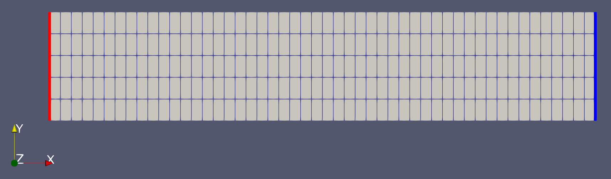
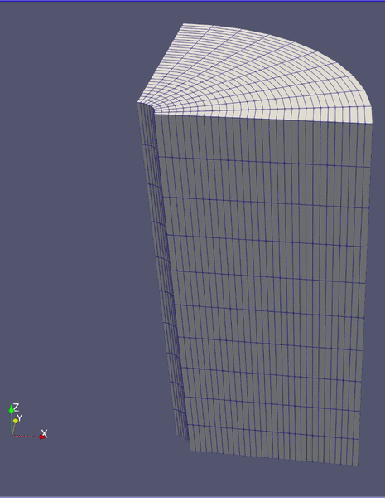


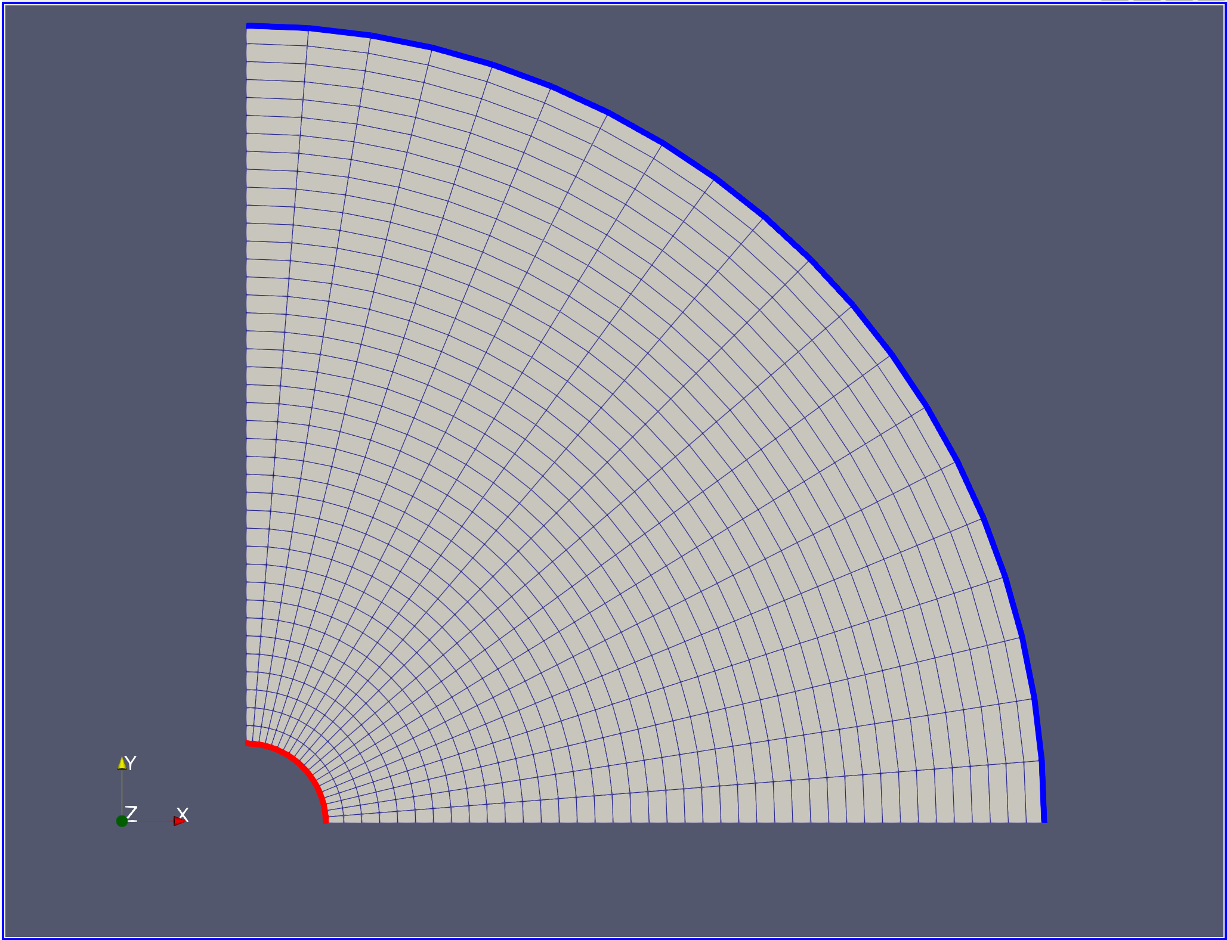


Introduction : FEM $→$ Python/Firedrake
FIREDRAKE/FEM WORKFLOW
Mesh
GEOMETRY AND BOUNDARY DEFINITIONS
Different geometries enable different physical interpretations while preserving the same FEM framework.
Function Spaces
RECTANGULAR 2D
Cartesian Flow - 1D Physics
3D QUARTER-WELLBORE
3D Geometrical Representation
Parameters
Boundary Conditions
QUARTER-WELLBORE 2D
Axisymmetric Radial Flow
{
Strong Form
Variational Forms
Weak Form
Code
Solver
Time Loop
Notes:
On the left:
Talk about the FireDrake package (we used in our numerical modeling):
- Designed for use in Python
- It's a very useful tool and greatly simplifies modeling (as can be seen in the workflow shown);
- Allows for an implementation very close to mathematical expressions, which allow us to spend more time in the physical part of the modelling.
On the right:
- Having developed a general formulation for the problem, by changing the geometry and the boundary conditions, we obtained different simulations, while maintaining the same FEM framework.
Aumentar figuras

Slide 5
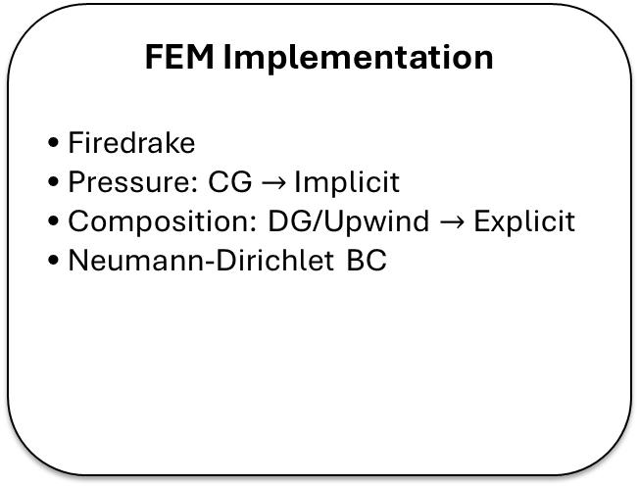


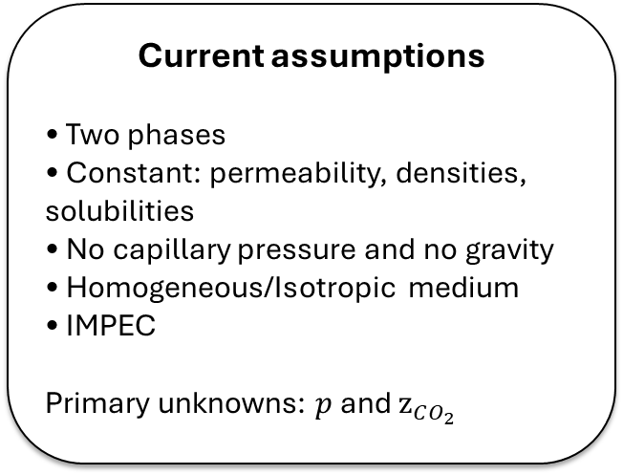
Methods: Compositional Flow Model
Current assumptions
• Two phases
• Constant: permeability, densities, solubilities
• No capillary pressure and no gravity
• Homogeneous/Isotropic medium
• IMPEC
Primary unknowns: $p$ and $z_{CO_{2}}$
FEM Implementation
• Firedrake
• Pressure: CG $→$ Implicit
• Composition: DG/Upwind $→$ Explicit
• Neumann-Dirichlet BC
IMPEC workflow
1. Solve pressure
2. Compute velocities
3. Transport components
4. Flash equilibrium
5. Recover phase-state variables
Mass Conservation: PDE Strong Form
$$CO_{2}$$
$$\frac{∂}{∂t}\left[φ\left(z_{CO_{2}}ρ_{T,mol}\right)\right]+∇⋅\left(x_{CO_{2},g}ρ_{g,mol}u_{g}+x_{CO_{2},l}ρ_{l,mol}u_{l}\right)=0$$
$$H_{2}O$$
$$\frac{∂}{∂t}\left[φ\left(z_{H_{2}O}ρ_{T,mol}\right)\right]+∇⋅\left(x_{H_{2}O,g}ρ_{g,mol}u_{g}+x_{H_{2}O,l}ρ_{l,mol}u_{l}\right)=0$$
Notes:
Left Text Box: cite the assumptions, say they are basic, but essential to build a verifiable model
Middle Text Box: Say the modelling choices: approximation spaces and BC; connect with the IMPEC name
Right Text Box: explain the flow: solve the pressure, compute the velocity using the pressure; transport the components using the velocity; perform a flash calculation; recover phase-state variables (highlight Saturation)

Slide 6
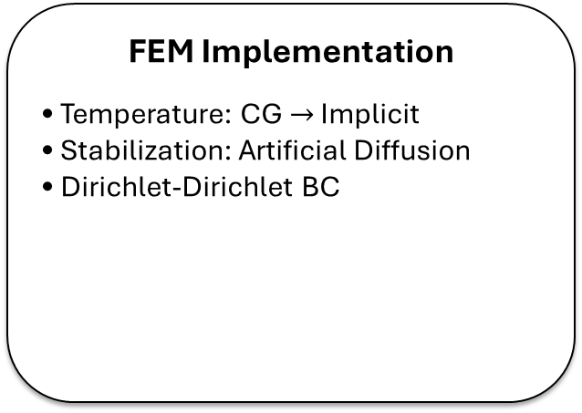
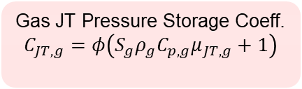
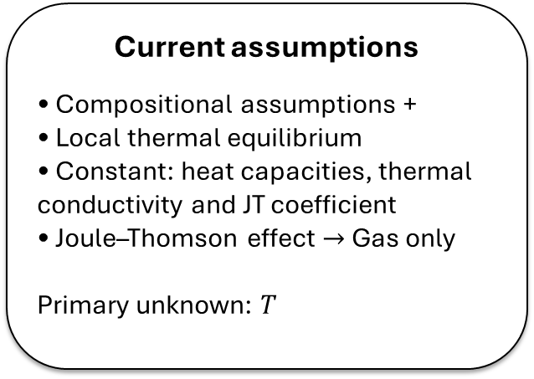
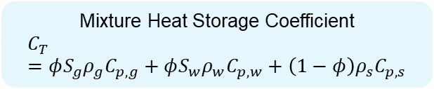
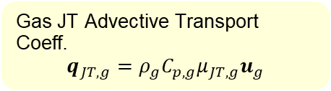
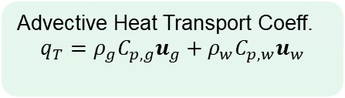
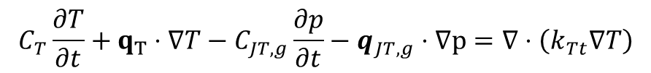
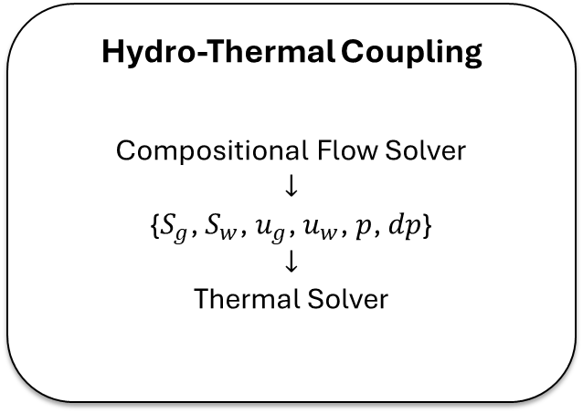
Methods: Thermal Model and JT Coupling
Current assumptions
• Compositional assumptions +
• Local thermal equilibrium
• Constant: heat capacities, thermal conductivity and JT coefficient
• Joule–Thomson effect $→$ Gas only
Primary unknown: $T$
FEM Implementation
• Temperature: CG $→$ Implicit
• Stabilization: Artificial Diffusion
• Dirichlet-Dirichlet BC
Hydro-Thermal Coupling
Compositional Flow Solver
$$↓$$
{$S_{g}$, $S_{w}$, $u_{g}$, $u_{w}$, $p$, $dp$}
$$↓$$
Thermal Solver
Energy Conservation: PDE Strong Form
$$C_{T}\frac{∂T}{∂t}+q_{T}⋅∇T−C_{JT,g}\frac{∂p}{∂t}−q_{JT,g}⋅∇p=∇⋅\left(k_{Tt}∇T\right)$$
JT Terms Modeled With the Gas JT Coefficient $μ_{JT,g}$
Mixture Heat Storage Coefficient
$$C_{T}=φS_{g}ρ_{g}C_{p,g}+φS_{w}ρ_{w}C_{p,w}+\left(1−φ\right)ρ_{s}C_{p,s}$$
Advective Heat Transport Coeff.
$$q_{T}=ρ_{g}C_{p,g}u_{g}+ρ_{w}C_{p,w}u_{w}$$
Gas JT Pressure Storage Coeff.
$$C_{JT,g}=φ\left(S_{g}ρ_{g}C_{p,g}μ_{JT,g}+1\right)$$
Gas JT Advective Transport Coeff.
$$q_{JT,g}=ρ_{g}C_{p,g}μ_{JT,g}u_{g}$$
Notes:
Left Text Box: say the same assumption of the fluid flow model + specific for the thermal are used; say the primary unknown is Temperature
Middle Text Box: Say the modelling choices: approximation spaces, stabilization method (Artificial Diffusion) and BC;
Right Text Box: explain that the compositional calculate Saturation, velocities, pressure and pressure gradient and pass to the thermal solver as “constants”, simplifying nonlinearities; obs.: because of this explanation the algorithm slide is unnecessary.

Slide 7
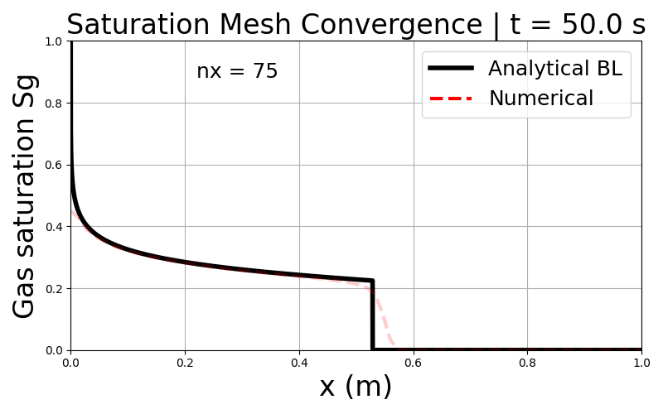
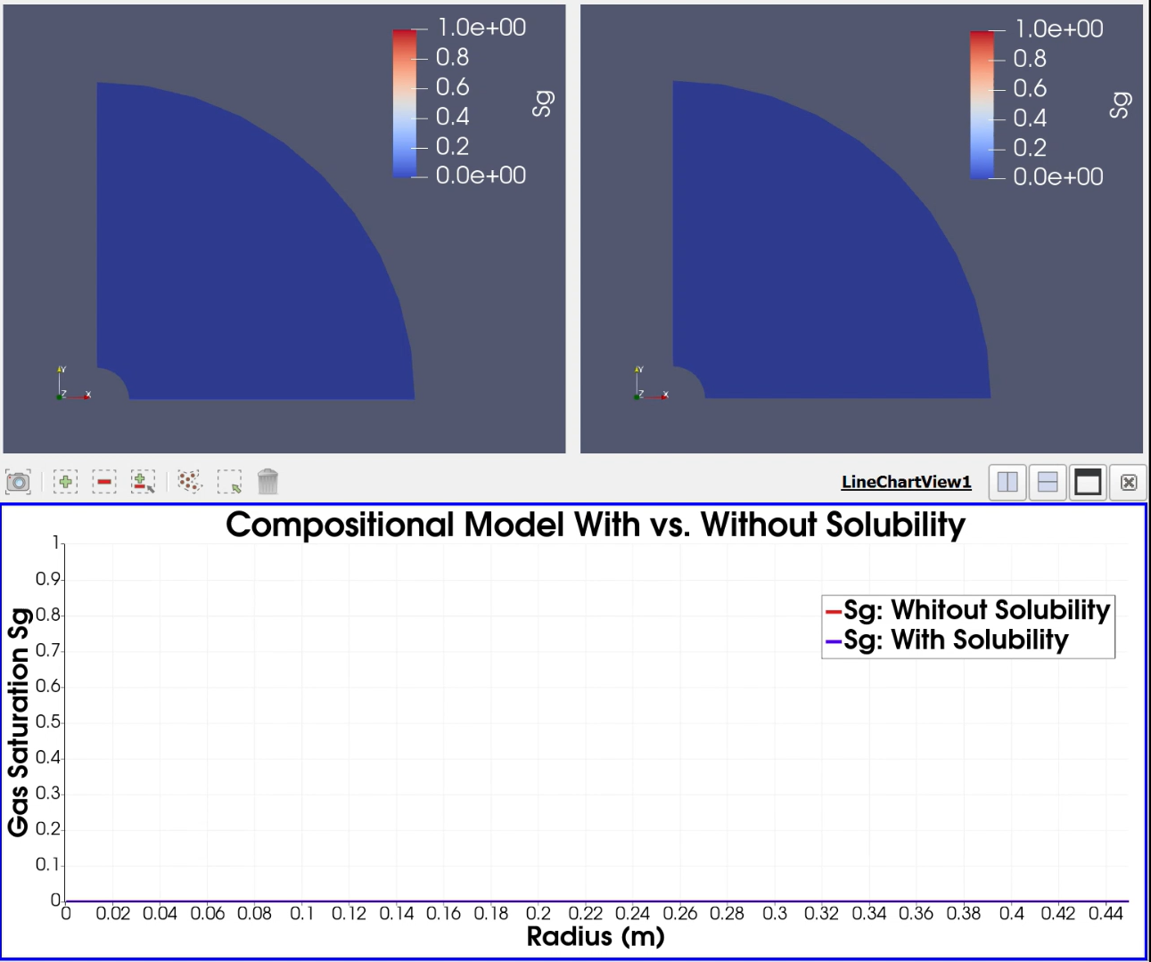
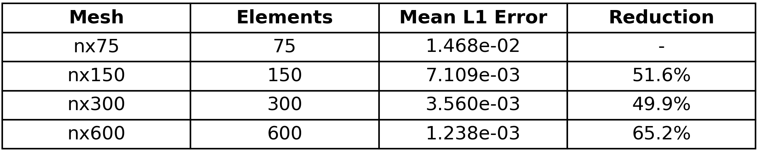
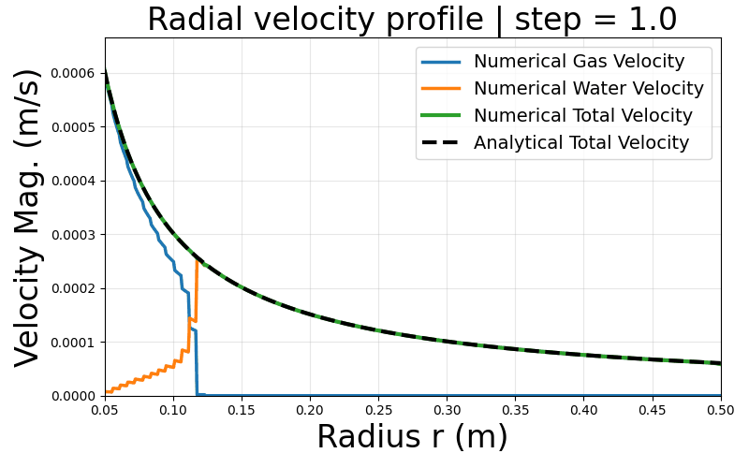
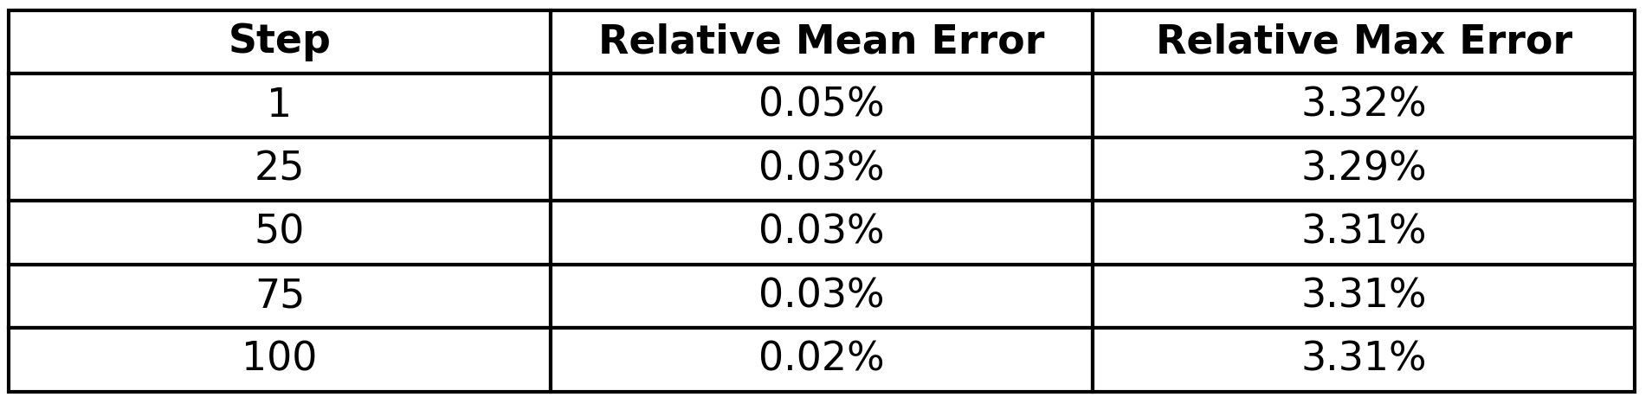
Results: Model Verification and Mesh Convergence
Notes:
On the upper left: saturation mesh convergence: by turning off the solubility, we recover the Buckley-Leverett analytical answer; as the mesh is refined, the numerical converges to the analytical;
Bottom left: numerical vs analytical comparison of the velocity, given the model assumptions, the total velocity profile on the domain is fixed and can be defined analytically. By verifying the velocity, the pressure is also verified, because the velocity is derived from the pressure;
Right: comparison between CO2 saturation profiles with and without mutual solubility between CO2 and H20. By turning the solubility on, the dry-out zone, where the salt precipitation happens, appear “naturally”.

Slide 8
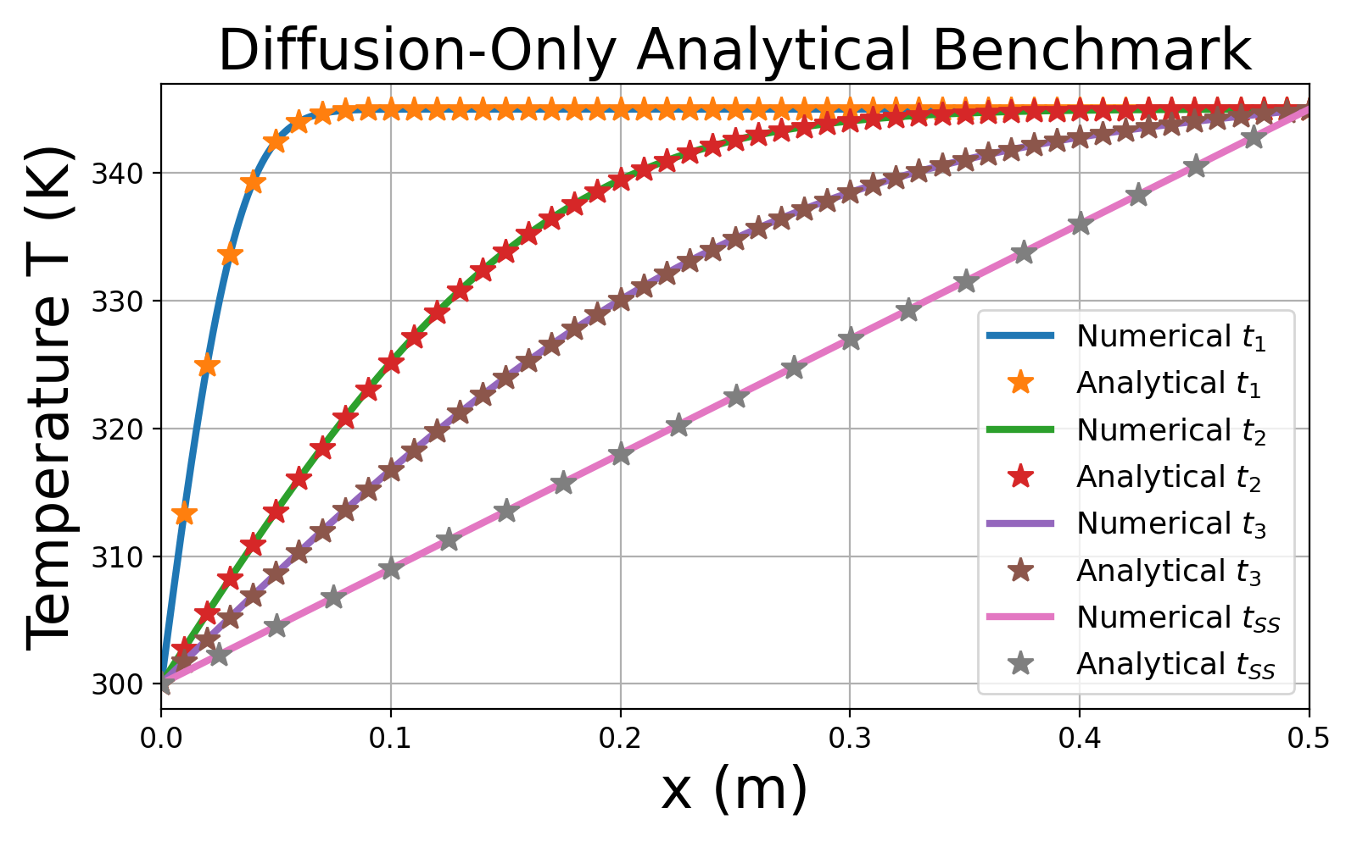
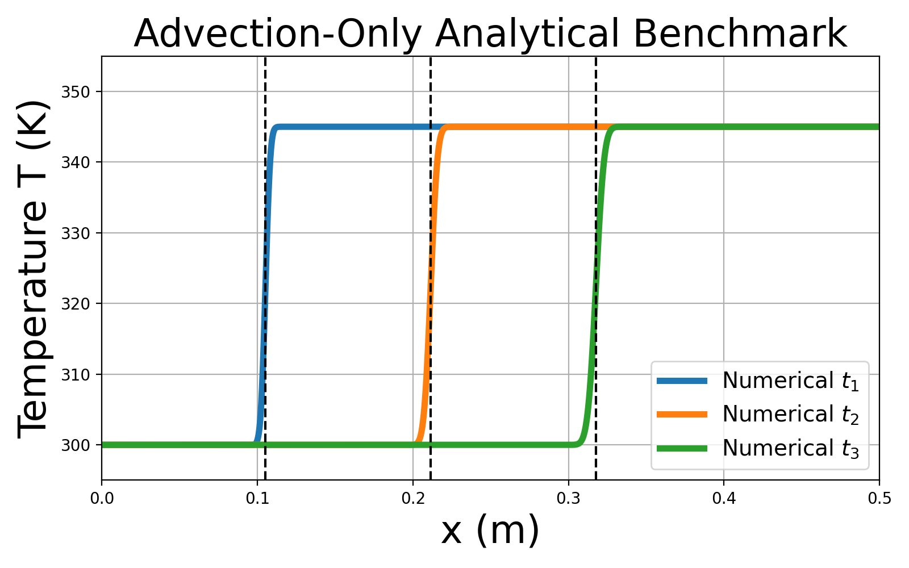
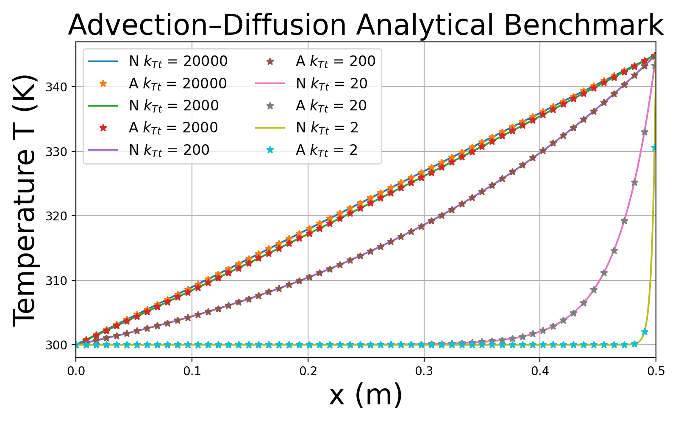
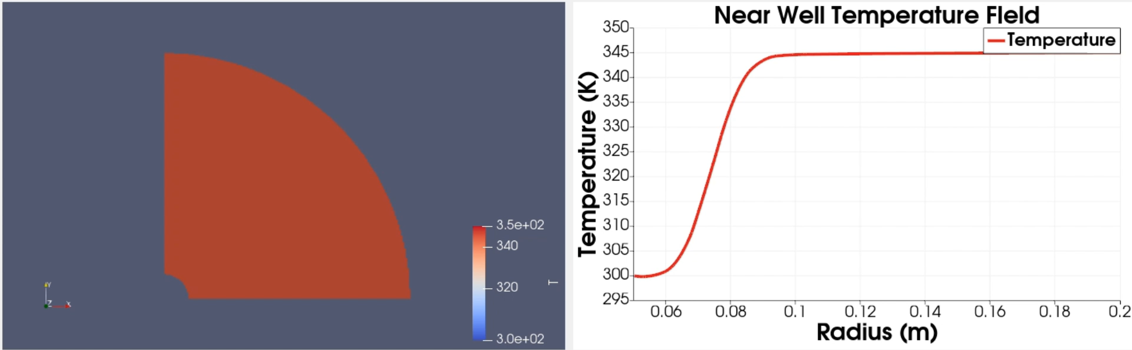
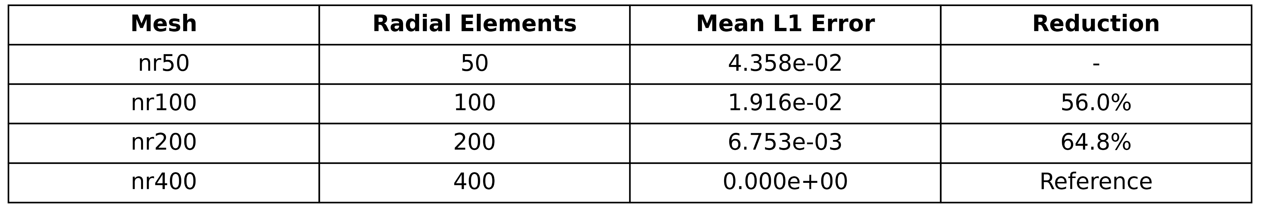
Results: Model Verification and Mesh Convergence
Notes:
The Upper Left, Upper Right and Bottom Left, are analytical vs numerical benchmarks of: diffusion Only, advection Only and advection-diffusion steady state, they all had good agreement between numerical and analytical.
The bottom right is a Mesh convergence test of the whole model, with all the terms, but since there is no analytical answer, the most refined meh was used as reference. The table shows that the model passed the convergence test.

Slide 9
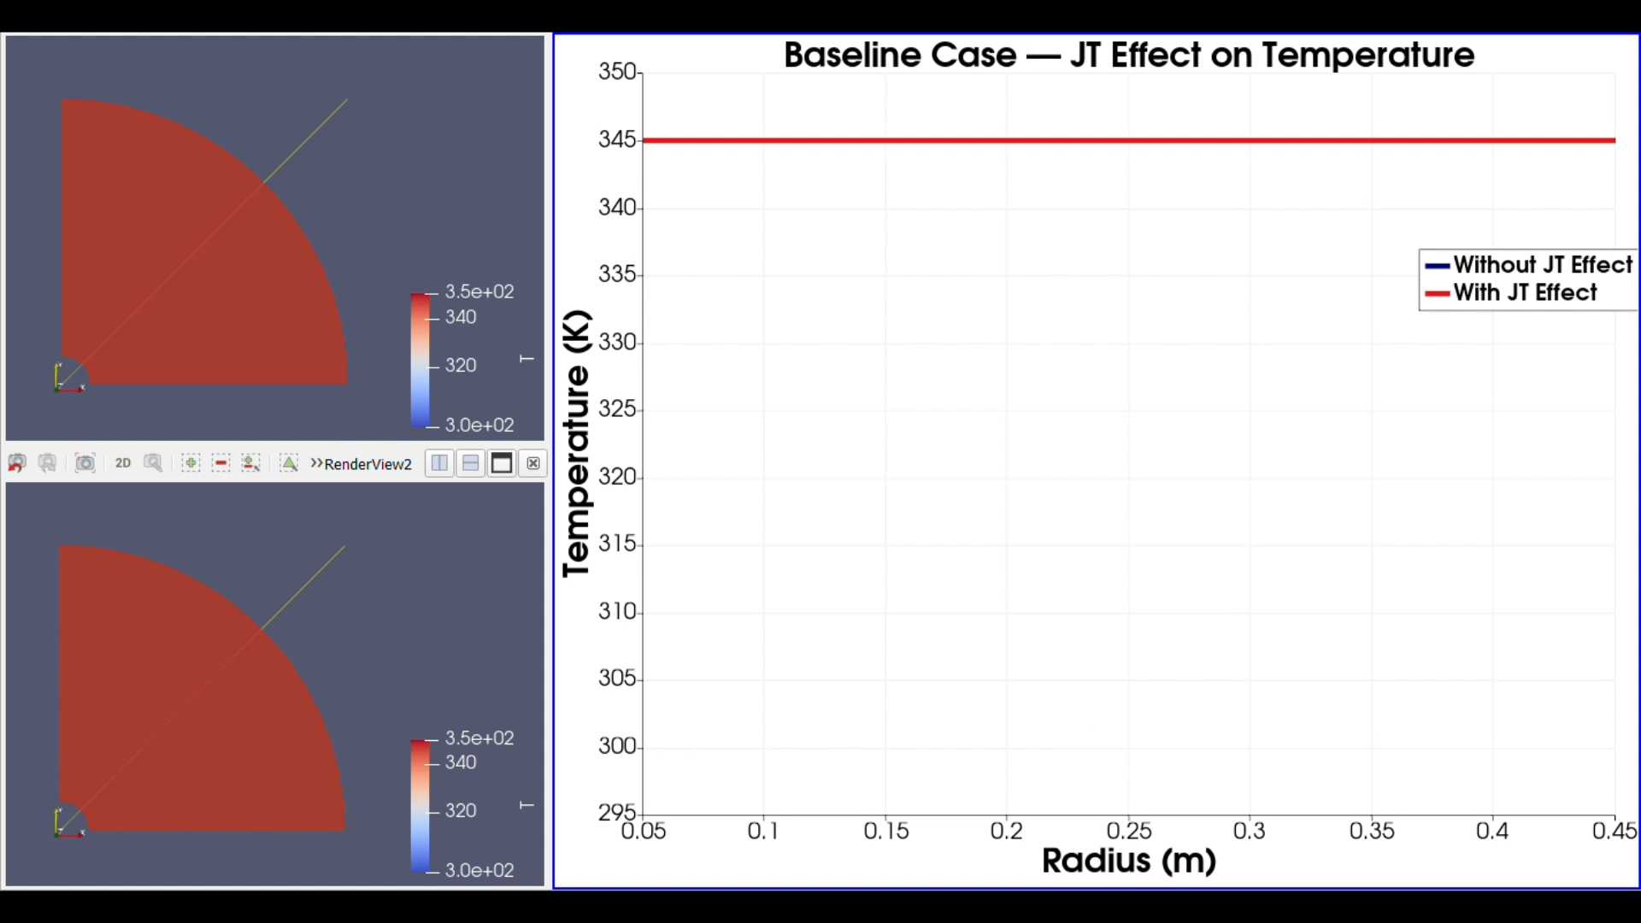
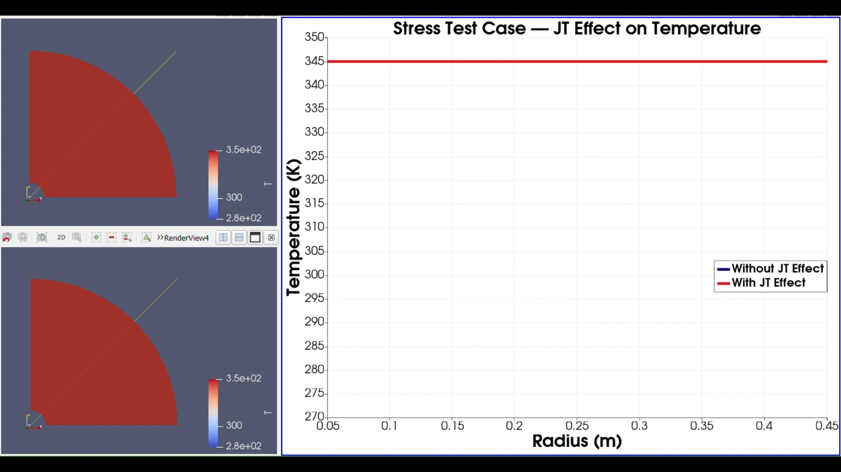
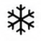
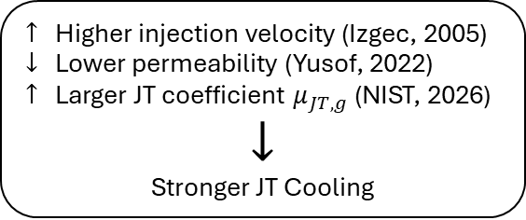
Results: Joule–Thomson Investigation
Baseline Case (Pruess, 2005)
Stress Test
Causal Chain
$↑$ Higher injection velocity (Izgec, 2005)
$↓$ Lower permeability (Yusof, 2022)
$↑$ Larger JT coefficient $μ_{JT,g}$ (NIST, 2026)
$$↓$$
Stronger JT Cooling
Notes:
This slide show the JT Effect influence in two scenarios:
- On the left, a baseline scenario, with parameter values from the work of Pruess, 2005. It shows that, when the simulation conditions do not generate strong pressure gradients, the JT Effect is only mild;
- On the right, we have a stress test: I searched the literature for the higher CO2 injection rate, the lowest permeability for sandstone and used the largest JT coefficient (which we consider constant) of the pressure and temperature intervals we are investigating: the result is that those parameters result in way larger pressure gradients, which in turn, generates way larger JT cooling.

Slide 10
Conclusions
Framework Development
  Modular compositional–thermal framework successfully implemented
  Python + Firedrake/FEM object-oriented structure
  Expandable staggered multiphysics strategy
Main Results
  Flow and thermal solvers verified
  Mesh convergence behavior investigated
  JT effect shown to depend strongly on pressure gradients
Notes:
We presented a modular compositional-thermal framework, made using python/firedrake and a staggered strategy;
The model had each module solver verified; mesh convergence tests showed good results and the JT investigation showed great dependency of the JT Effect on the pressure gradient magnitude.

Slide 11
References
[1] M. M. Amir et al., “Joule Thomson Cooling Effects on Rock Dry-Out, Salt Precipitation and Fines Migration During CO2 Storage in Depleted Oil and Gas Reservoir: Laboratory Investigation,” in SPE Asia Pacific CCUS Conference, 2025.
[2] G. K. Ekechukwu, R. de Loubens, and M. Araya-Polo, “LSTM-driven Forecast of CO2 Injection in Porous Media,” arXiv, 2022.
[3] O. Izgec et al., “Experimental and numerical investigation of carbon sequestration in saline aquifers,” in SPE/EPA/DOE Exploration and Production Environmental Conference, 2005.
[4] X. Jiang, “A review of physical modelling and numerical simulation of long-term geological storage of CO2,” Applied Energy, vol. 88, no. 11, pp. 3557–3566, 2011.
[5] R. Miri and H. Hellevang, “Salt precipitation during CO2 storage—A review,” International Journal of Greenhouse Gas Control, vol. 51, pp. 136–147, 2016.
[6] D. Nield and A. Bejan, Convection in Porous Media, 4th ed. New York, NY, USA: Springer, 2013.
[7] NIST, Thermophysical Property Database, 2026.
[8] C. M. Oldenburg, “Joule–Thomson cooling due to CO2 injection into natural gas reservoirs,” Energy Conversion and Management, vol. 48, no. 6, pp. 1808–1815, 2007.
[9] K. Pruess, “ECO2N: A TOUGH2 Fluid Property Module for Mixtures of Water, NaCl, and CO2,” Lawrence Berkeley National Laboratory, Berkeley, CA, USA, Rep. LBNL-57952, 2000.
[10] K. Pruess, “Formation dry-out from CO2 injection into saline aquifers: 2. Analytical model for salt precipitation,” Water Resources Research, vol. 45, no. 3, 2009.
[11] K. Pruess and N. Müller, “Formation dry-out from CO2 injection into saline aquifers: 1. Effects of solids precipitation and their mitigation,” Water Resources Research, vol. 45, no. 3, 2009.
[12] L. E. L. Tweed, M. J. Bickle, and J. A. Neufeld, “Transient Joule–Thomson cooling during CO2 injection in depleted reservoirs,” Journal of Fluid Mechanics, vol. 997, p. A31, 2024.
[13] D. V. Voskov and H. A. Tchelepi, “Comparison of nonlinear formulations for two-phase multi-component EoS based simulation,” Journal of Petroleum Science and Engineering, vol. 82–83, pp. 101–111, 2012.
[14] M. A. M. Yusof et al., “Experimental study of CO2 injectivity impairment in sandstone due to salt precipitation and fines migration,” Journal of Petroleum Exploration and Production Technology, vol. 12, pp. 2191–2202, 2022.
[15] M. A. M. Yusof et al., “Fines Migration During CO2 Injection: A Review of the Phenomenon and New Breakthrough,” in SPE Conference at Oman Petroleum and Energy Show (OPES), 2022.
[16] M. A. M. Yusof et al., “Influence of Brine–Rock Parameters on Rock Physical Changes During CO2 Sequestration in Saline Aquifer,” Arabian Journal for Science and Engineering, vol. 47, no. 9, pp. 11345–11359, 2022.
[17] M. Zeidouni, M. Pooladi-Darvish, and D. Keith, “Analytical solution to evaluate salt precipitation during CO2 injection in saline aquifers,” International Journal of Greenhouse Gas Control, vol. 3, no. 5, pp. 600–611, 2009.
Notes:
This is the agenda of my presentation. I am going to show the motivation and objectives of the project. Then, I will show some preliminary results.

Slide 12




Thank You!

