Slide 1



Investigating the effect of operational and petrophysical parameters on salt precipitation and injectivity loss
Vahid Niasar
Integrated Multiscale Porous Media Research (IMPRES) Group
Department of Chemical Engineering
The University of Manchester
Javad Shokri
Masoud Babaei
Rouhi Farajzadeh
www.pinch-project.co.uk
Webpage: https://www.impres.co.uk/
Email: Vahid.Niasar@manchester.ac.uk

Slide 2
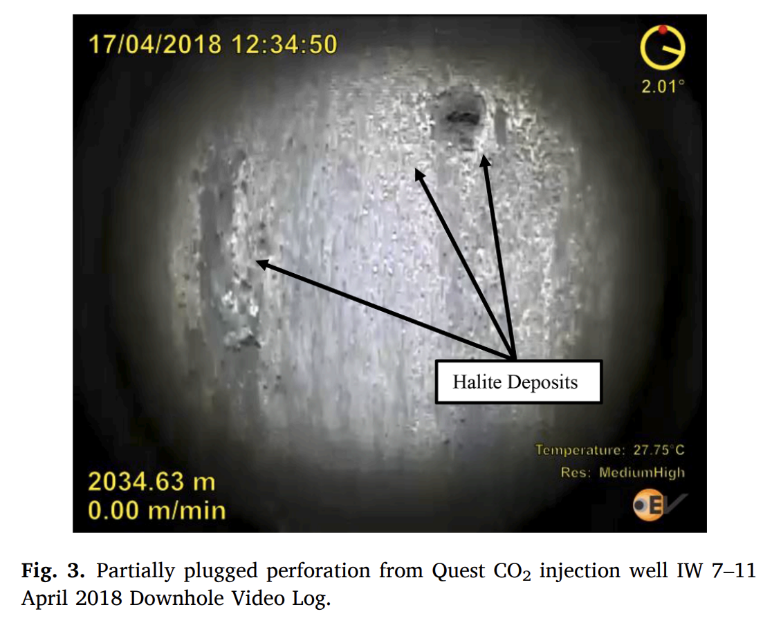
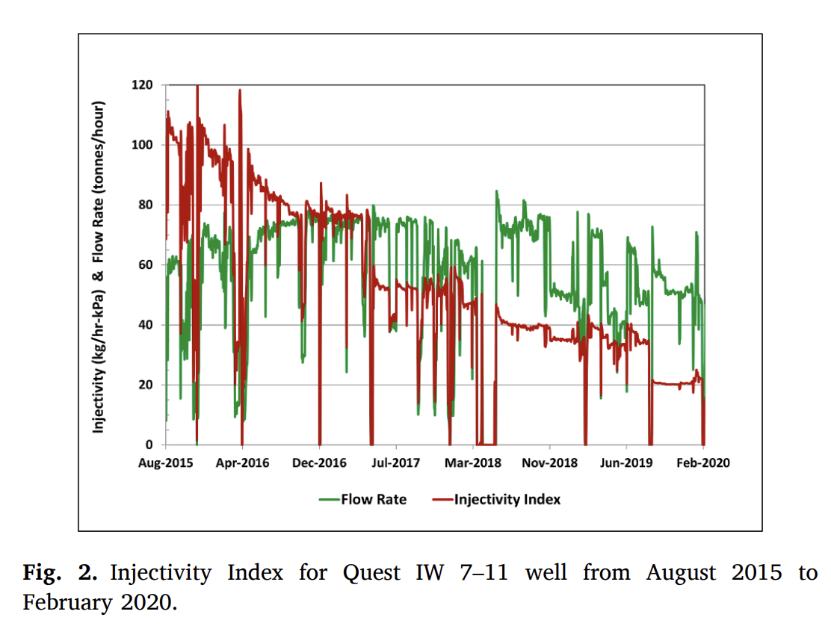
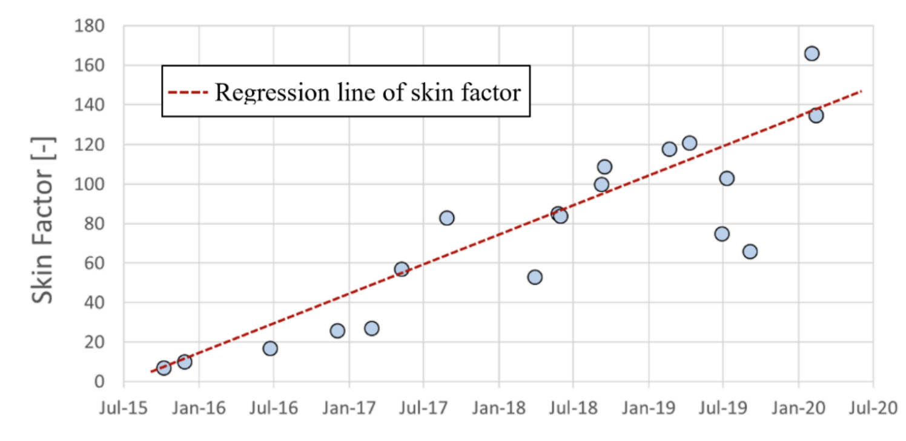
Why does salt precipitation matter in the context of CCS?
Quest CCS facility
Hypersaline aquifer (200-300kppm)
1.1Mt CO2/year injection
The formation has an average thickness of approximately 45 m with an average permeability close to 1000 md and porosity of about 17%. The initial reservoir pressure for the BCS is approximately 20 MPa.
International Journal of Greenhouse Gas Control119:103718 DOI: 10.1016/j.ijggc.2022.103718
Notes:
Very long term reduction of permeabilty

Slide 3
PINCH project in 5 areas: Pore-scale Modelling Pore-scale Experiments Darcy-scale Modelling Darcy-scale Experiments Reservoir-scale Modelling
www.pinch-project.co.uk

Slide 4

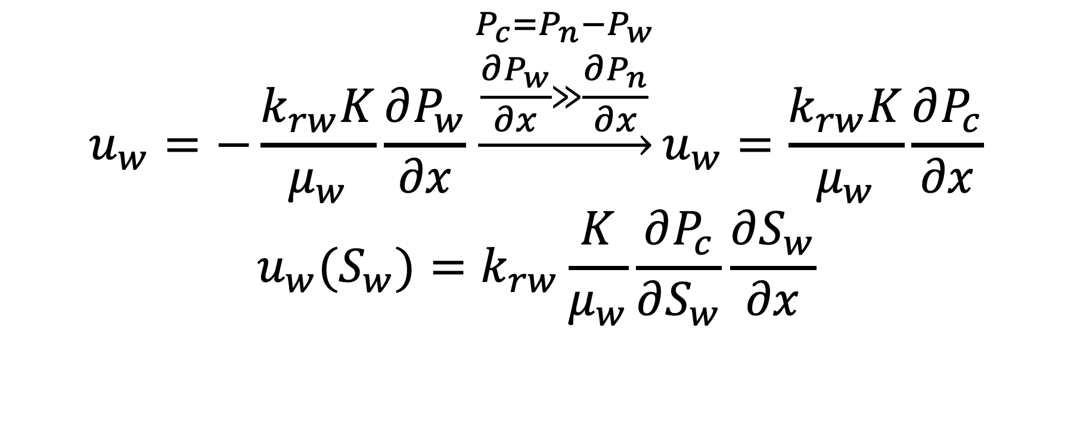


Capillary-driven backflow
$$u_{w}=−\frac{k_{rw}K}{μ_{w}}\frac{∂P_{w}}{∂x}\underset{→}{\begin{aligned}P_{c}=P_{n}−P_{w} \\ \frac{∂P_{w}}{∂x}≫\frac{∂P_{n}}{∂x}\end{aligned}}u_{w}=\frac{k_{rw}K}{μ_{w}}\frac{∂P_{c}}{∂x}$$
$$u_{w}(S_{w})=k_{rw}\frac{K}{μ_{w}}\frac{∂P_{c}}{∂S_{w}}\frac{∂S_{w}}{∂x}$$
$$→S_{wr}$$
$$→0$$
$$→−∞$$
Ott, H., de Kloe, K., Marcelis, F., Makurat, A., 2011. Injection of supercritical co2 in brine saturated sandstone: Pattern formation during salt precipitation. Energy Procedia 4, 4425–4432.

Slide 5
A simple (but not simpler) model
Radial two-phase flow simulations; Shell’s MoReS reservoir simulator
Coupled Darcy’s law (incl. capillary pressure) and evaporation/phase partitioning effects included.
Homogeneous formation, with Corey-type relative permeability,
Reservoir conditions of 108°C and 340 bar, solving EoS and thermodynamic equilibrium to assess evaporation and critical salinity to assess precipitation.
Radial system , 1600 m × 75 m was used, with injection at the wellbore and constant pressure at the outer boundary.
CO₂

Slide 6
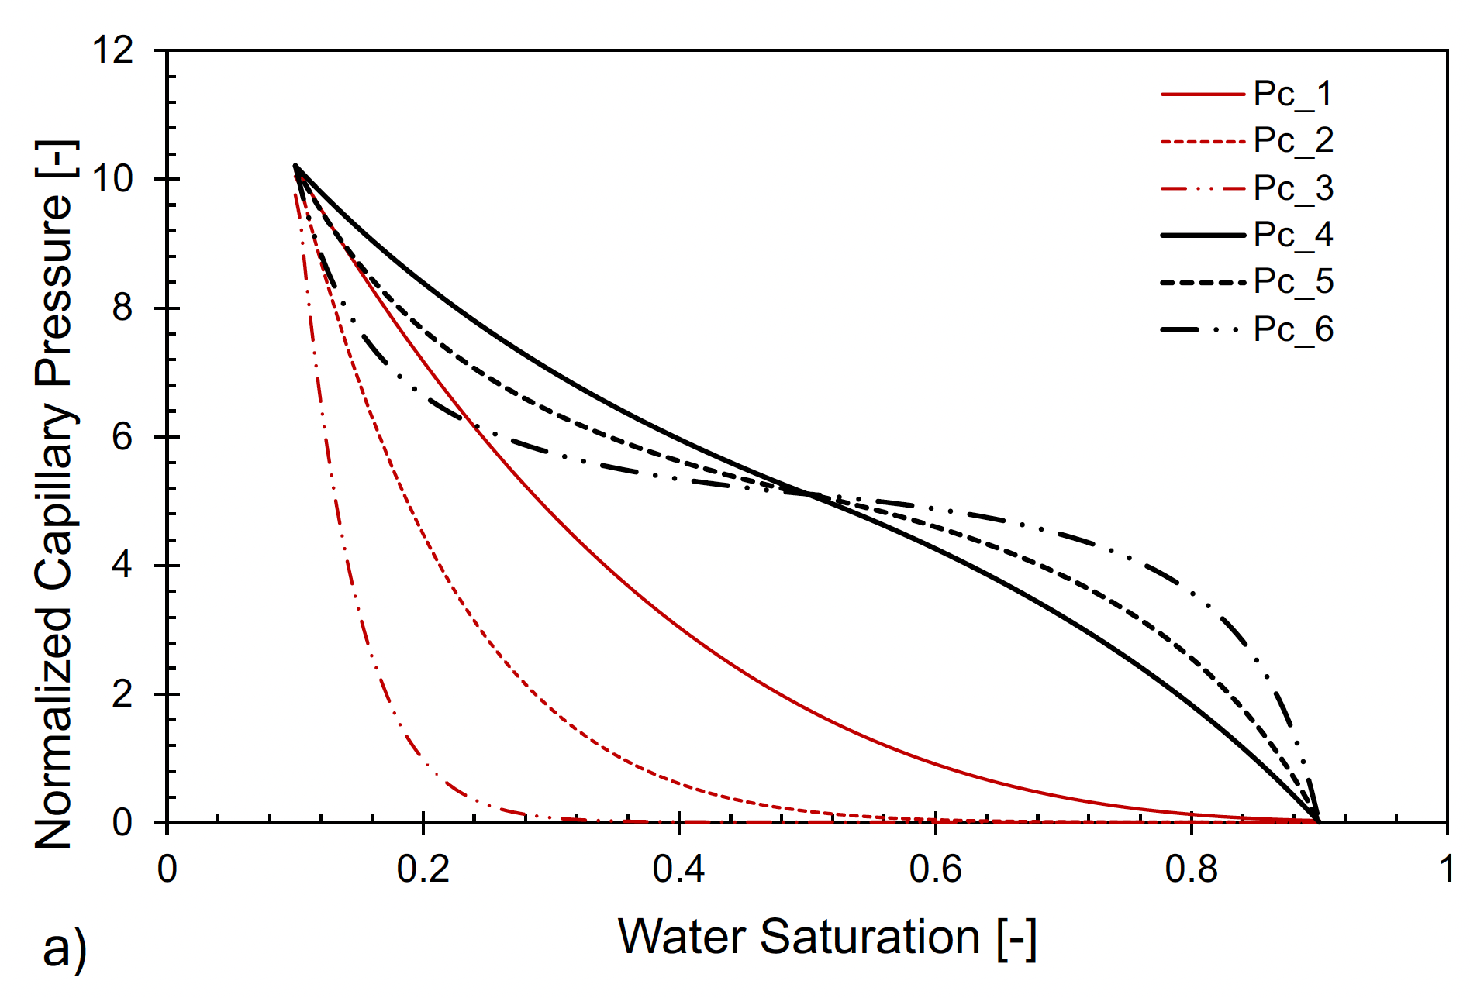
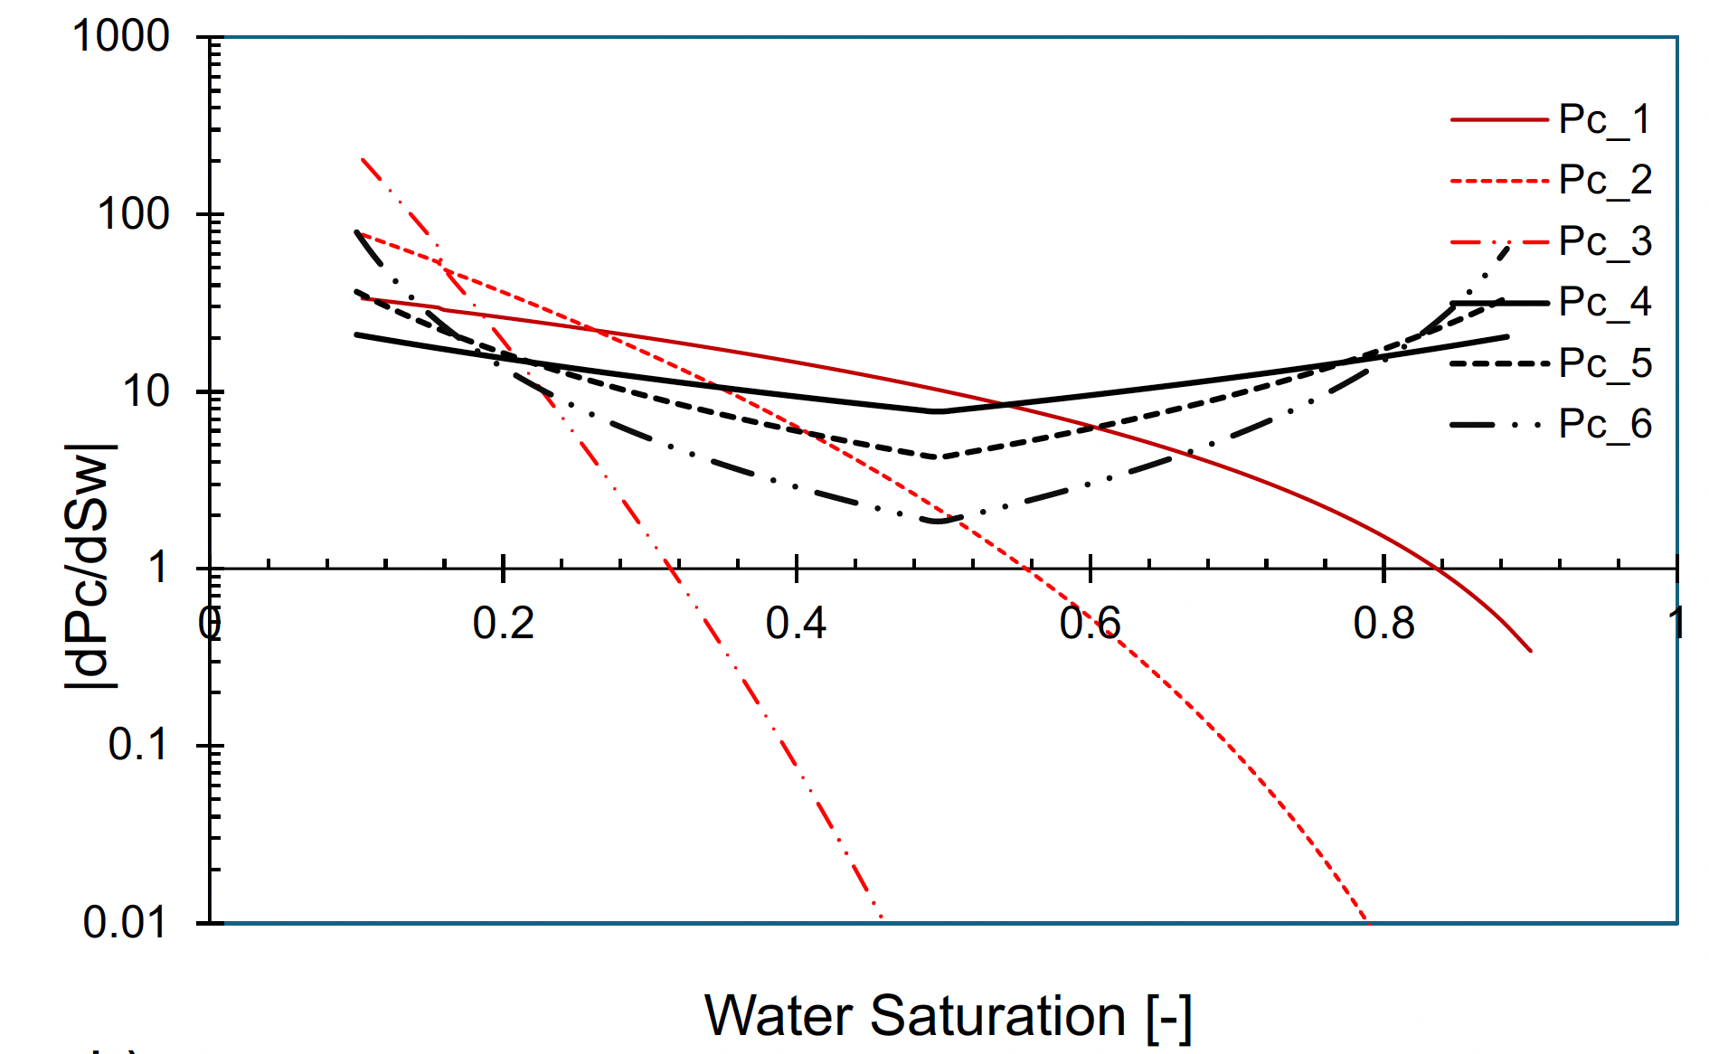
Hypothetical Pc-S curves

Slide 7
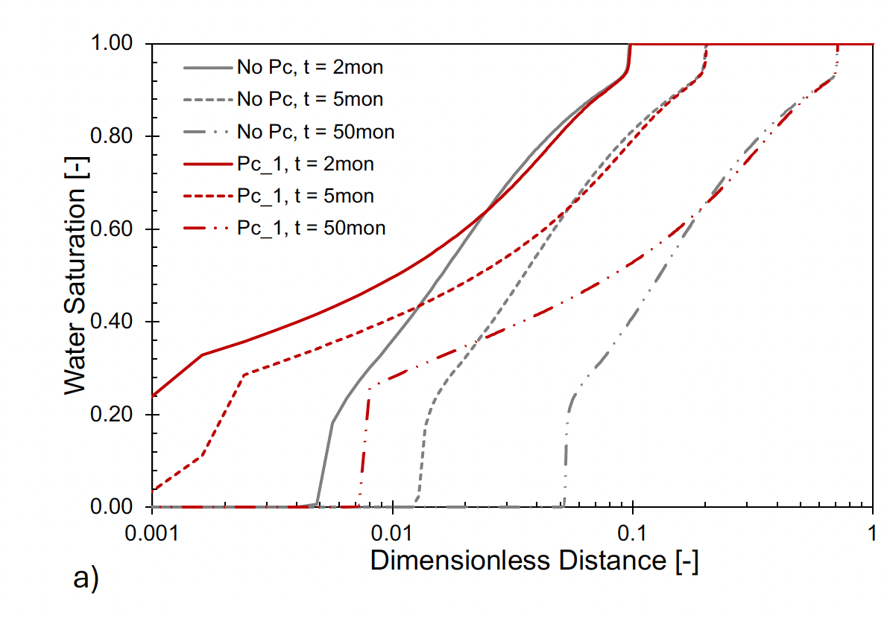
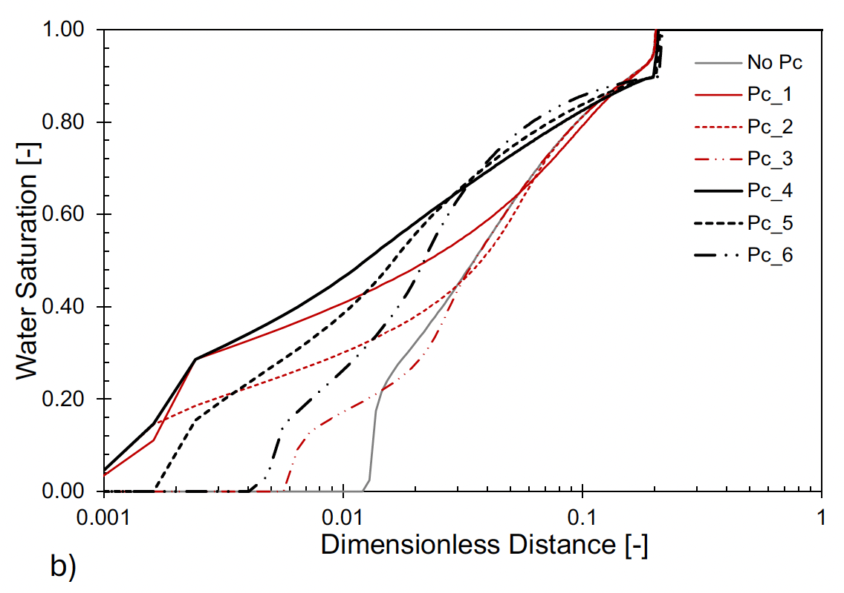
Water saturation front

Slide 8
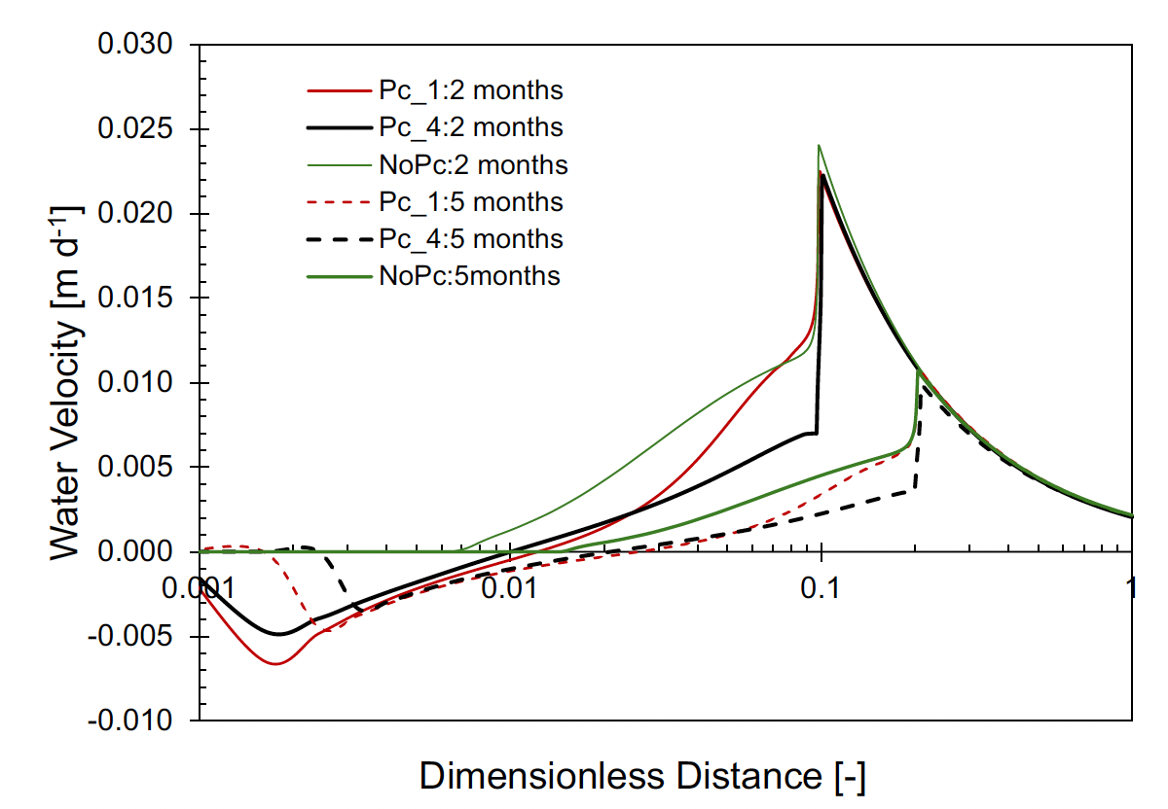
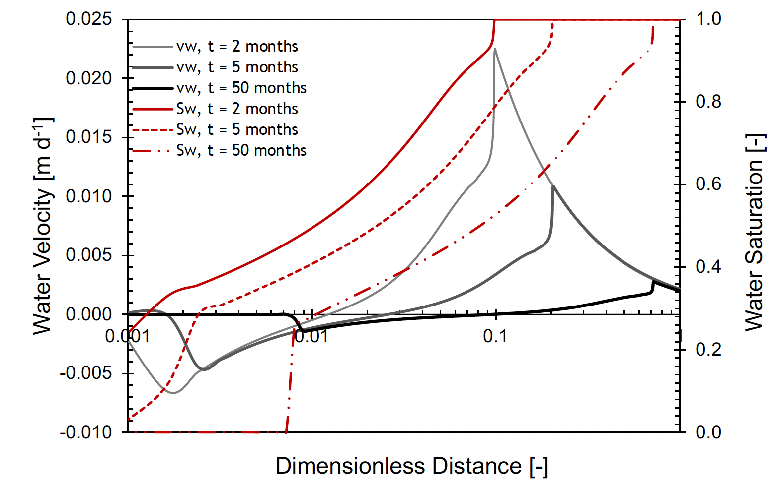
Water velocity (u_{w}<0→ capillary backflow)
Reference:
Rouhi Farajzadeh, Vahid Niasar, Chemical Engineering Journal, Volume 534, 2026, 175212, ISSN 1385-8947, https://doi.org/10.1016/j.cej.2026.175212.

Slide 9
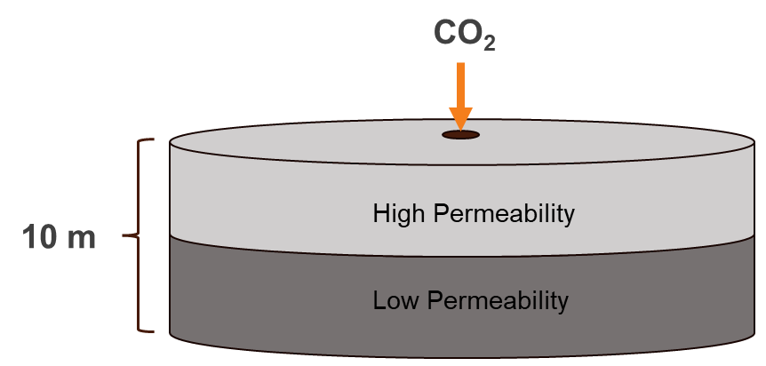
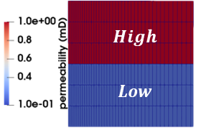
3D modelling with layered geometry
Gas injection
interface
Initial Conditions:
P: 120 bar
T: 50 °C – isothermal
Salt x: 0.15 w/w
Boundary Conditions:
Constant mass injection rate at the inlet
2D simulations in X-Z direction
Gravity is on, downward direction
Permeability changes due to the precipitation of salt
6

Slide 10
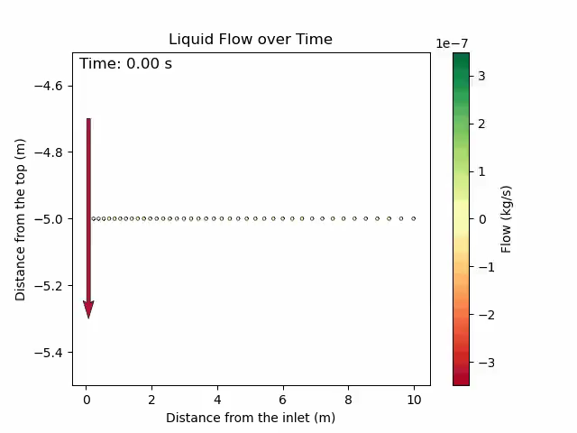
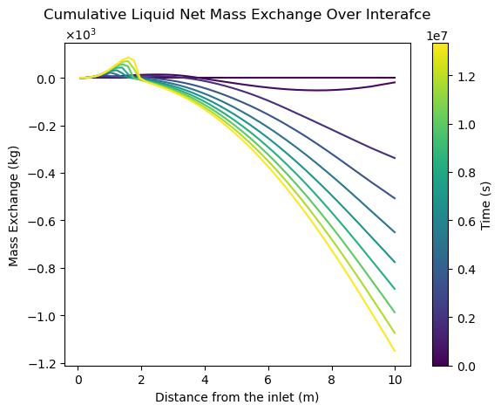
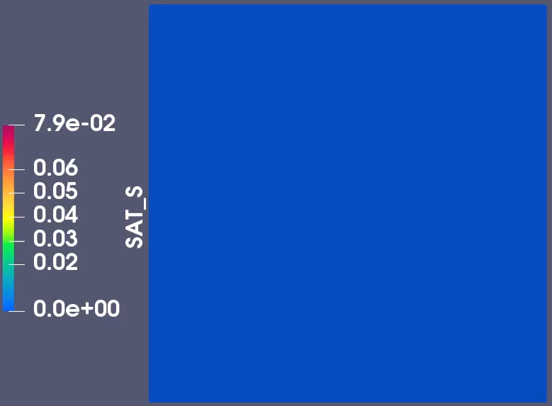
Exchange between layers
The combined effect of PC and relative permeability draws water from the lower permeability layer toward the injection point, after which it moves upward to the upper layer, where most of the evaporation occurs.
11

Slide 11
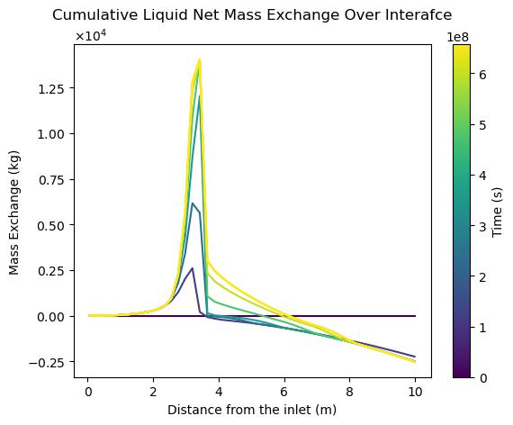
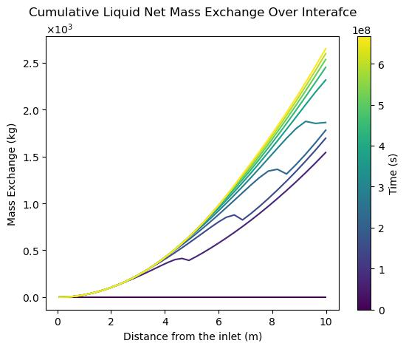
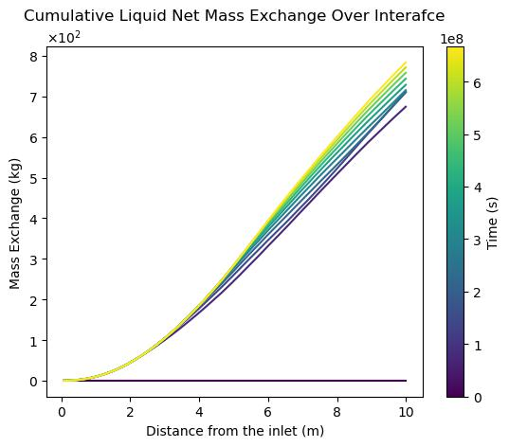
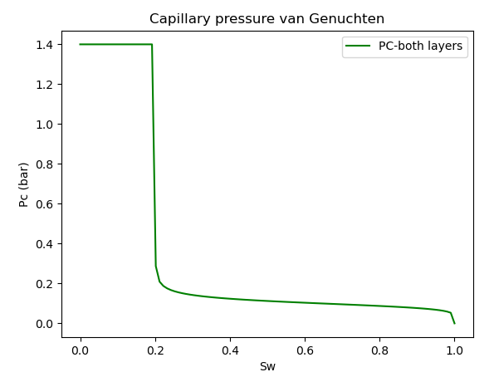
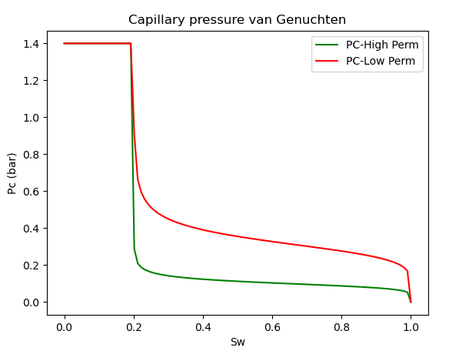

The effect of capillary pressure on mass exchange between layers
$$\text{Ca}\text{ = 4}×10\text{−7}$$
Capillary pressure is responsible for mixed mass exchange across the interfaces
12

Slide 12
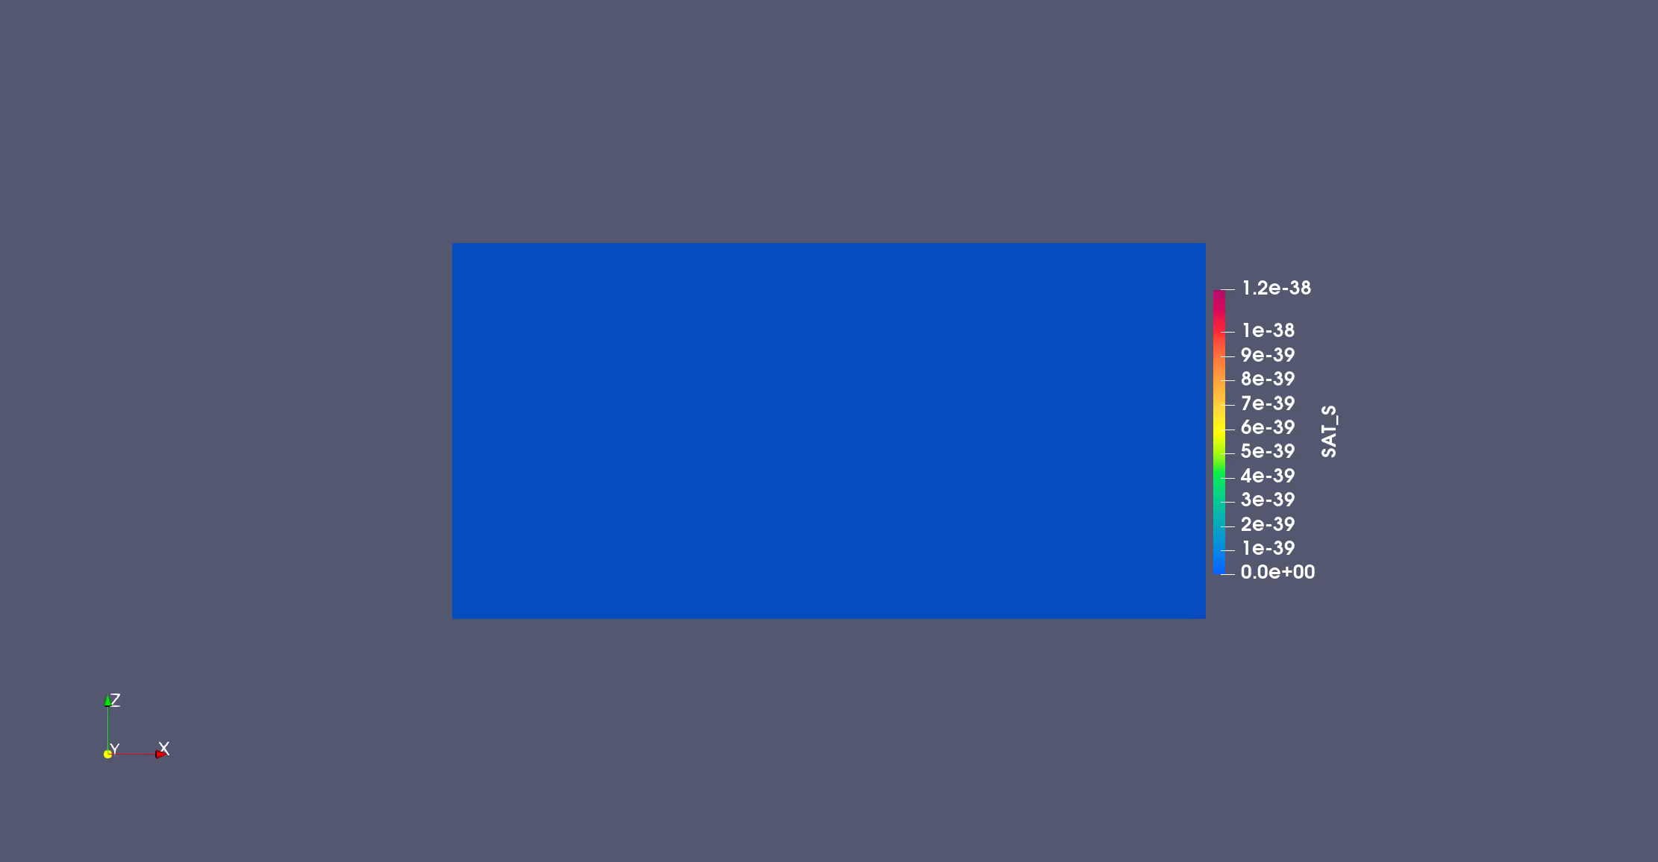
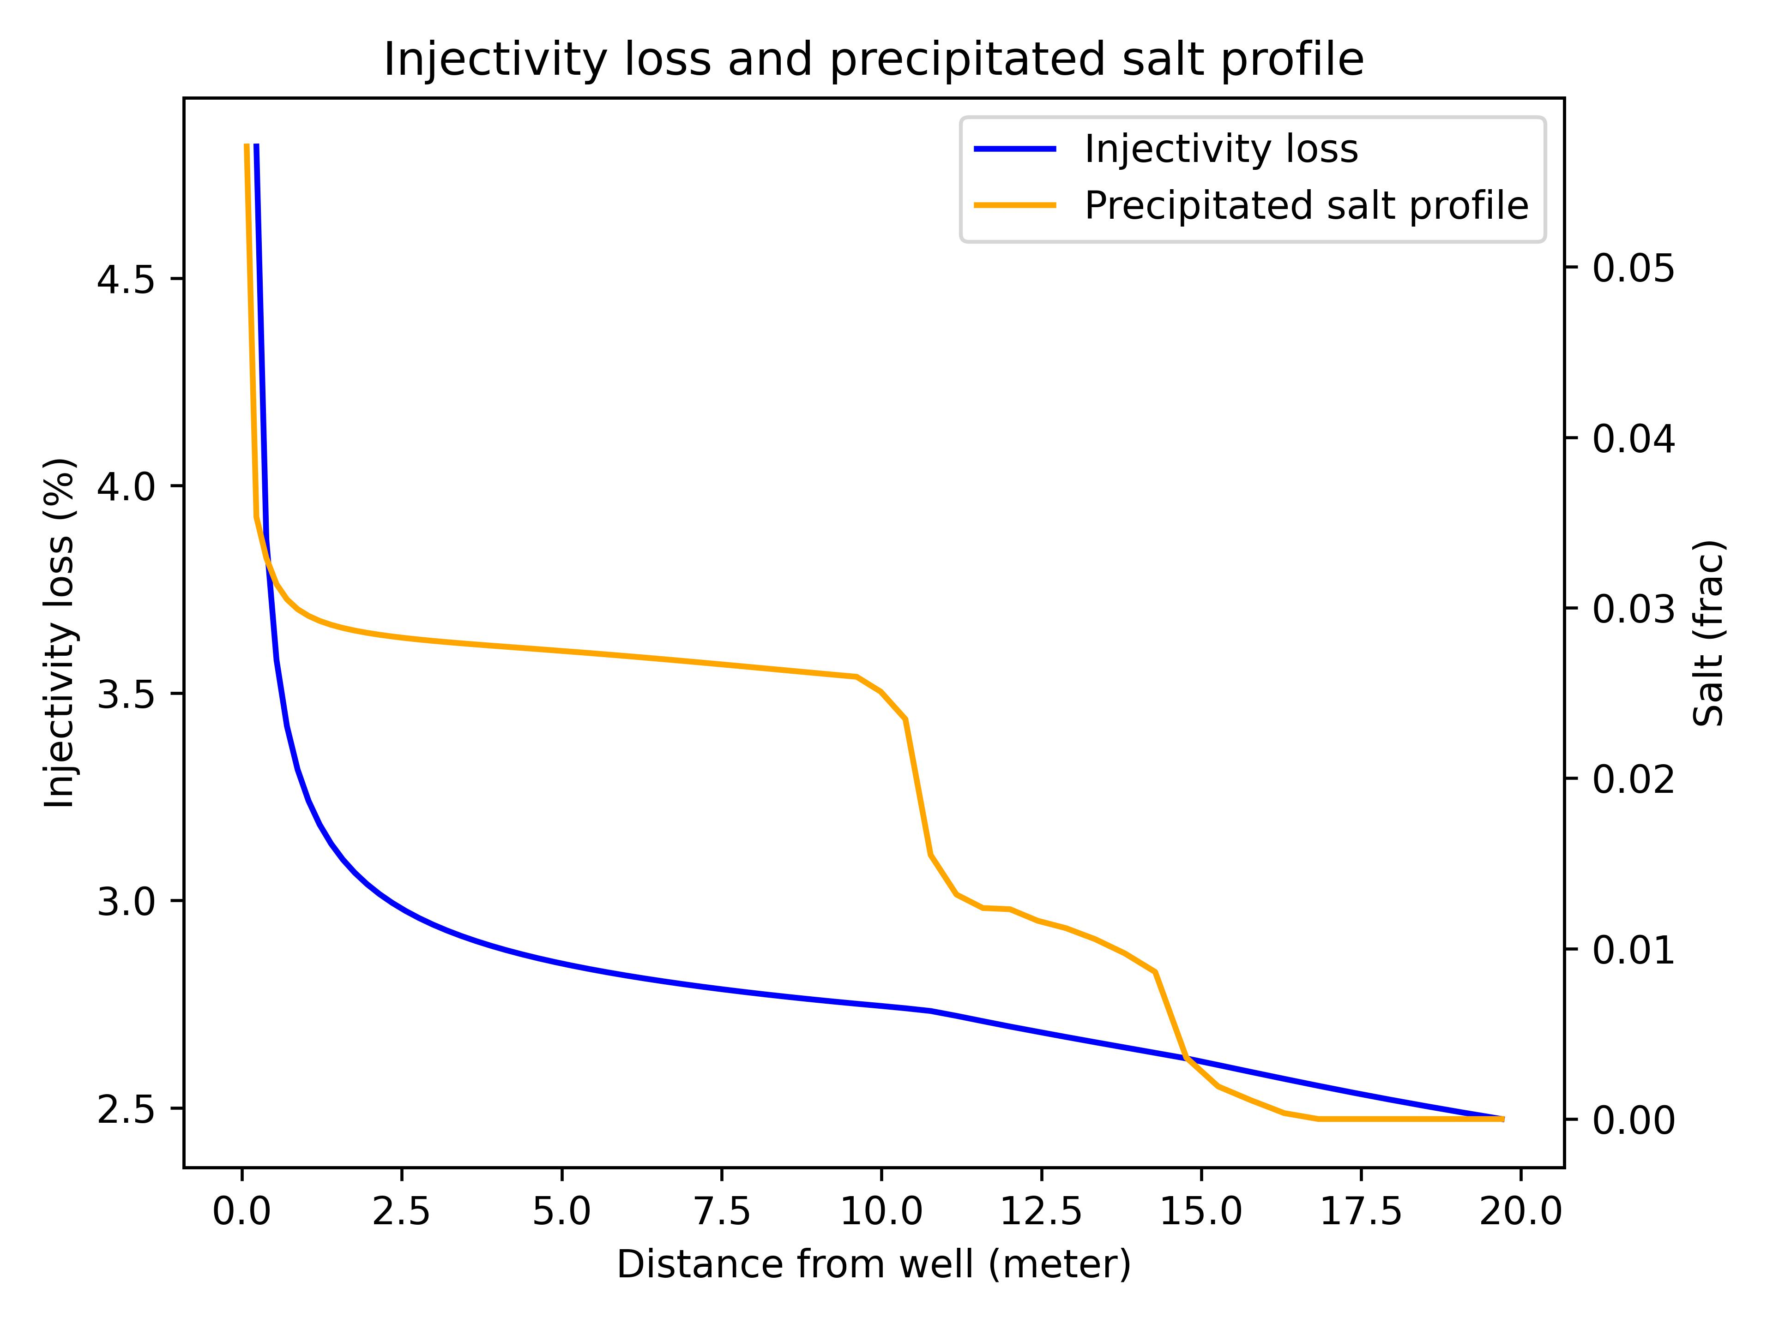
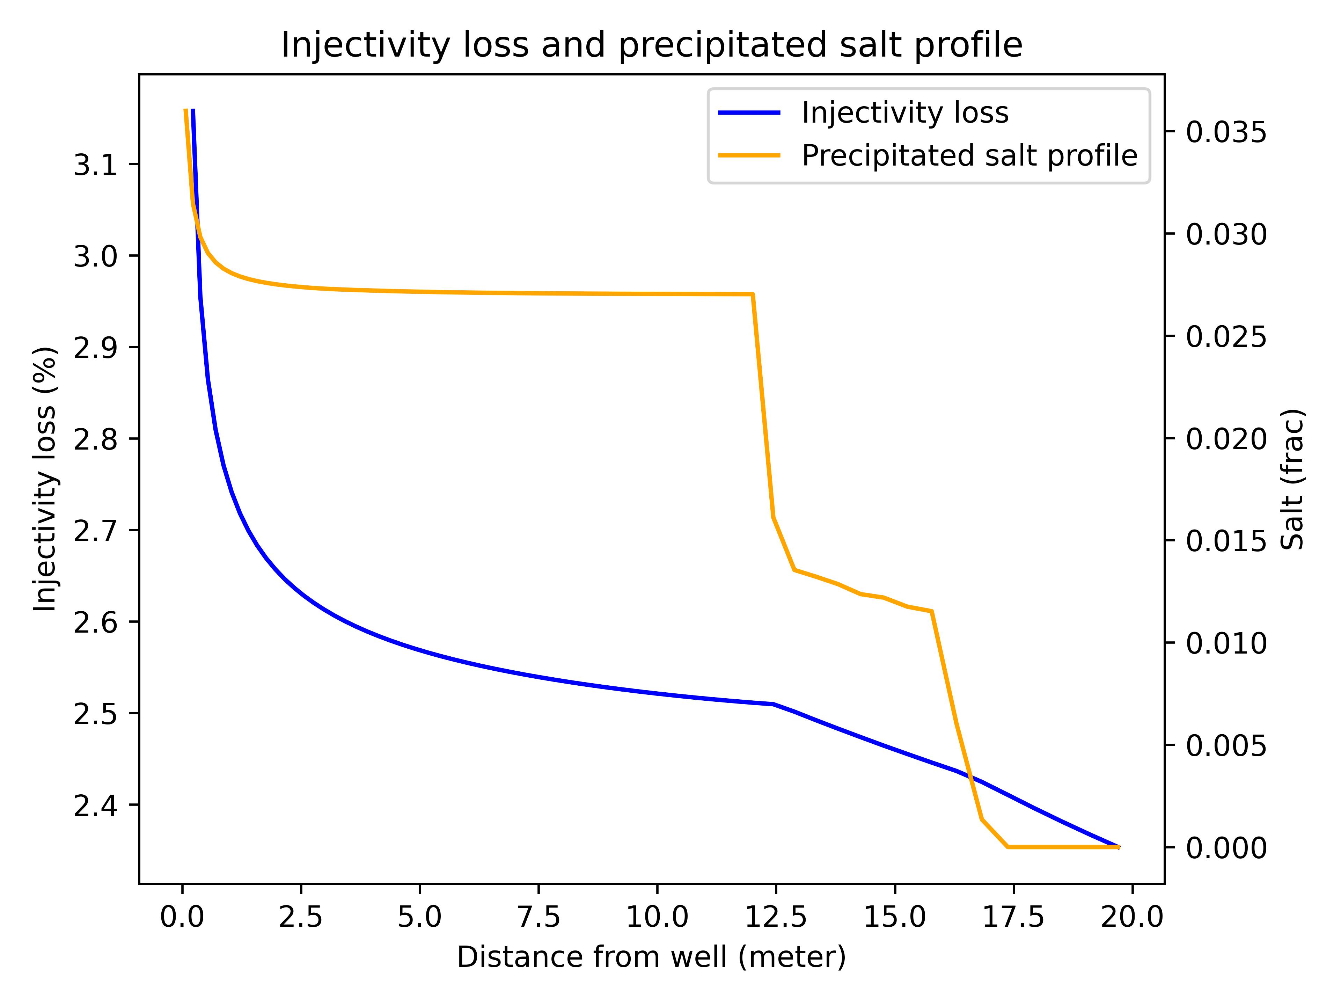


Zonation of salt precipitation due to heterogeneity contrast
$$\text{Ca}\text{ = 4}×10\text{−7}$$
$$\text{Ca}\text{ = 4}×10\text{−}\text{9}$$

Slide 13
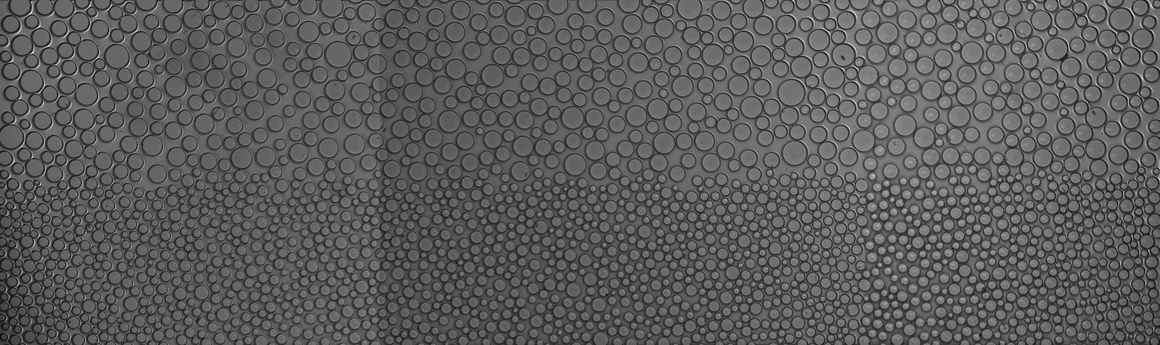
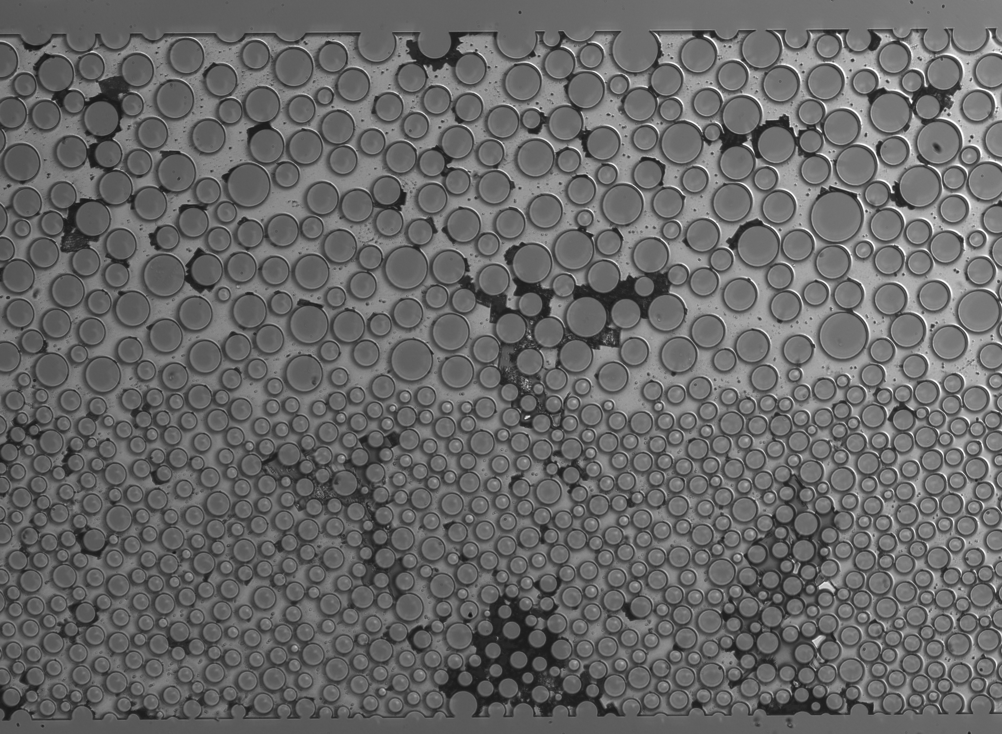
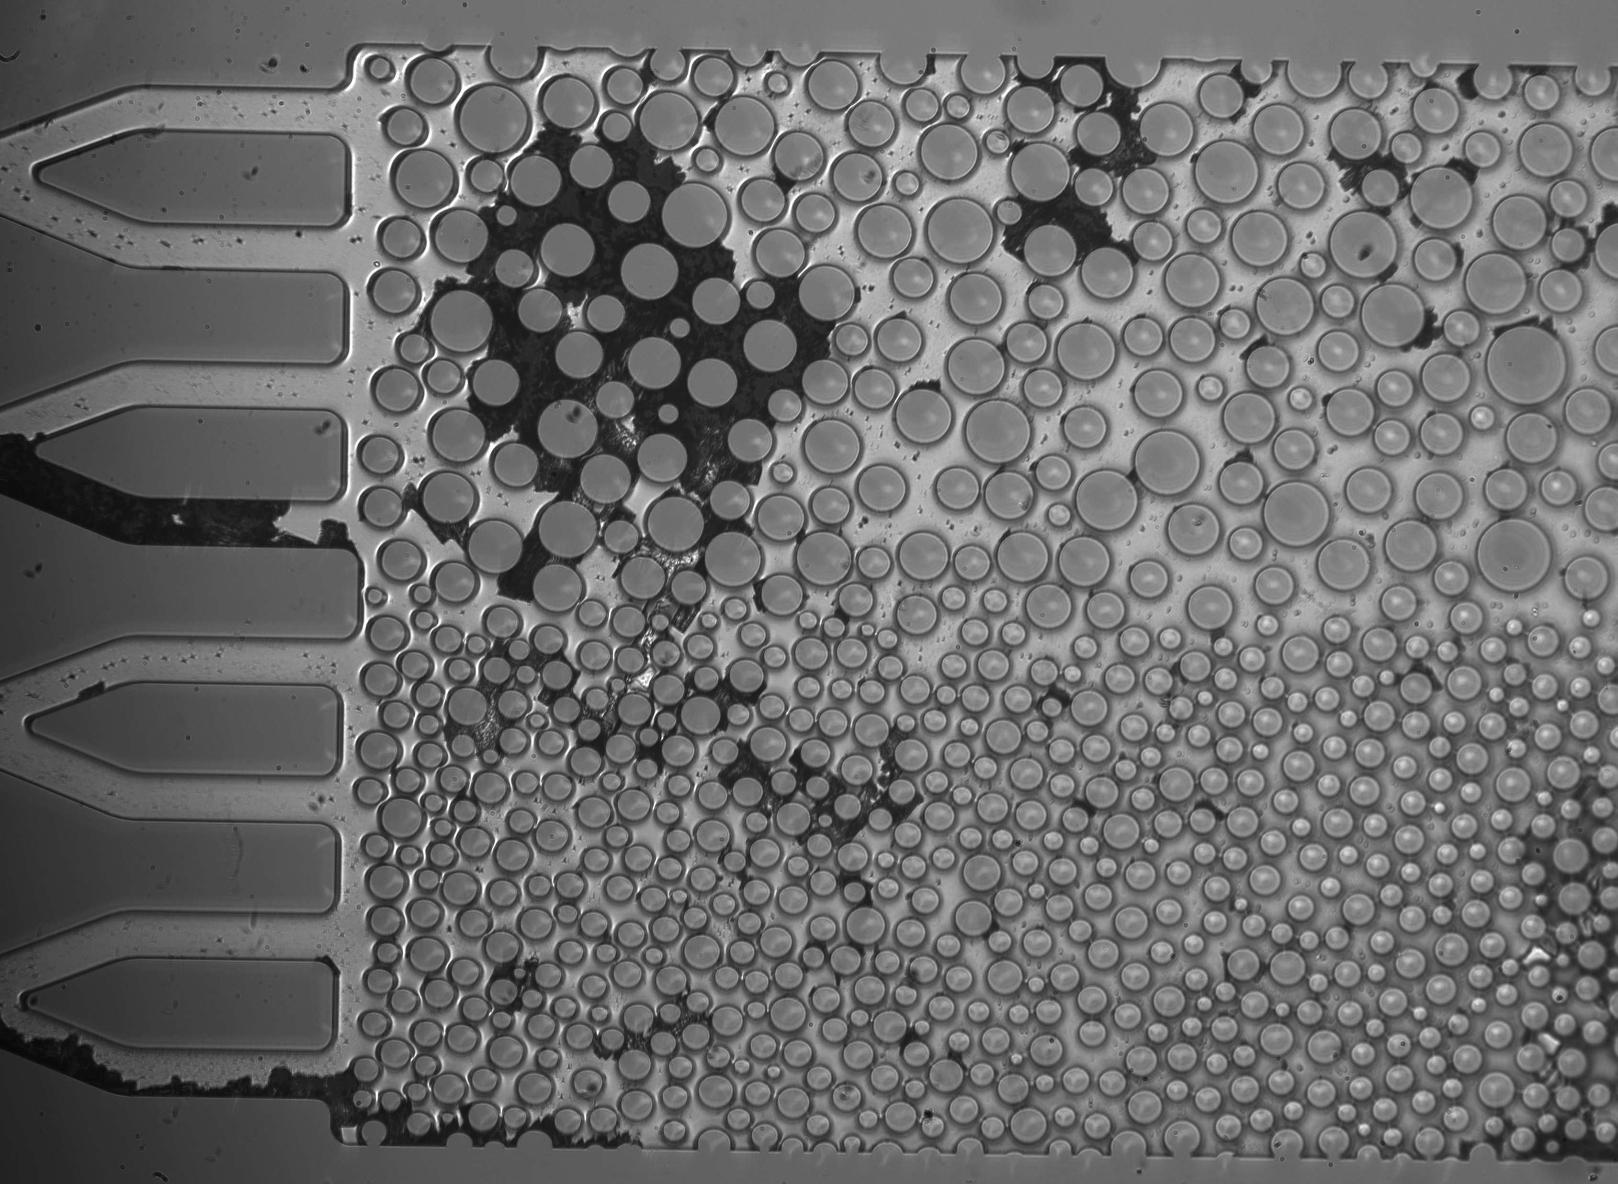
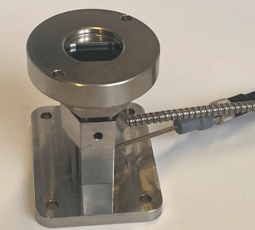
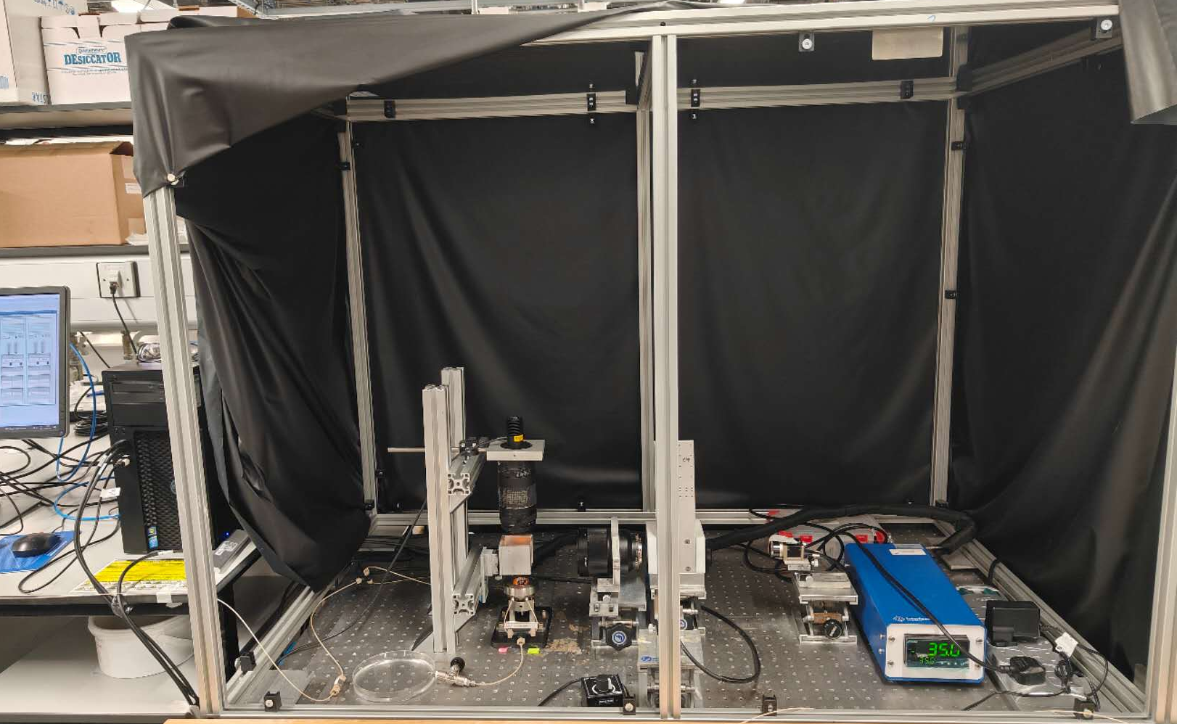

Salt precipitation in a micromodel $$P=50 bar CNaCl=200 kppm, T=35 °C, Ca=2.51×{10}^{−6}$$
Coarse region
Fine region
Flow direction (dry CO2 injection)
Single-crystalline salt
Single+Poly-crystalline salt
Poly-crystalline salt
SLOW
FAST
13

Slide 14
To summarise
Spatial heterogeneity and saturation discontinuities significantly enhance salt precipitation.
Equilibrium-based salt precipitation models are inadequate for field-scale simulations.
Limited understanding exists regarding the impact of salt precipitation on relative permeability and capillary pressure behaviour.

Slide 15


Thank You!

