Slide 1



Pore-scale Investigation Of CO₂ hydrate kinetics
Lifei Yan, Manon Schellart, Diederik Boersma, Denis Voskov, Rouhi Farajzadeh, Mahnaz Aghajanloo, Sadegh Esfahani, Sian Jones

Slide 2
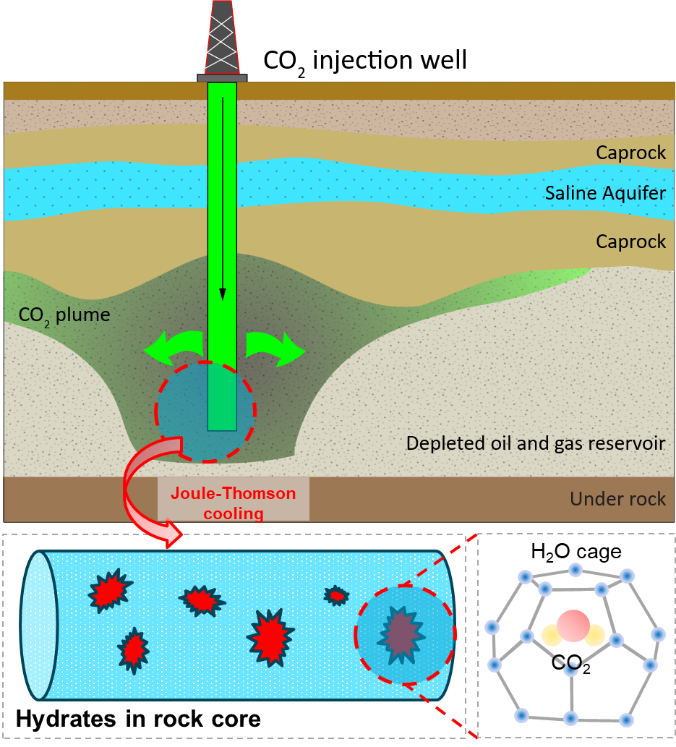
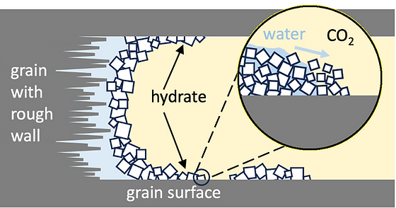
Motivation
Hydrate formation during CO₂ injection
How the CO2 hydrate blockage happens at pore-scale?
Fukuyama, D., et al. 2024
Yamada, Kenta, et al. 2024.c
CO₂ hydrate often appears inside the porous area at the favorable P/T conditions.
Notes:
In order to investigate the impact of rock permeability, different core with various inherent permeability were used as listed in this table. For all experiment consistent process were used for the 1wt% NaCl brine saturation.

Slide 3
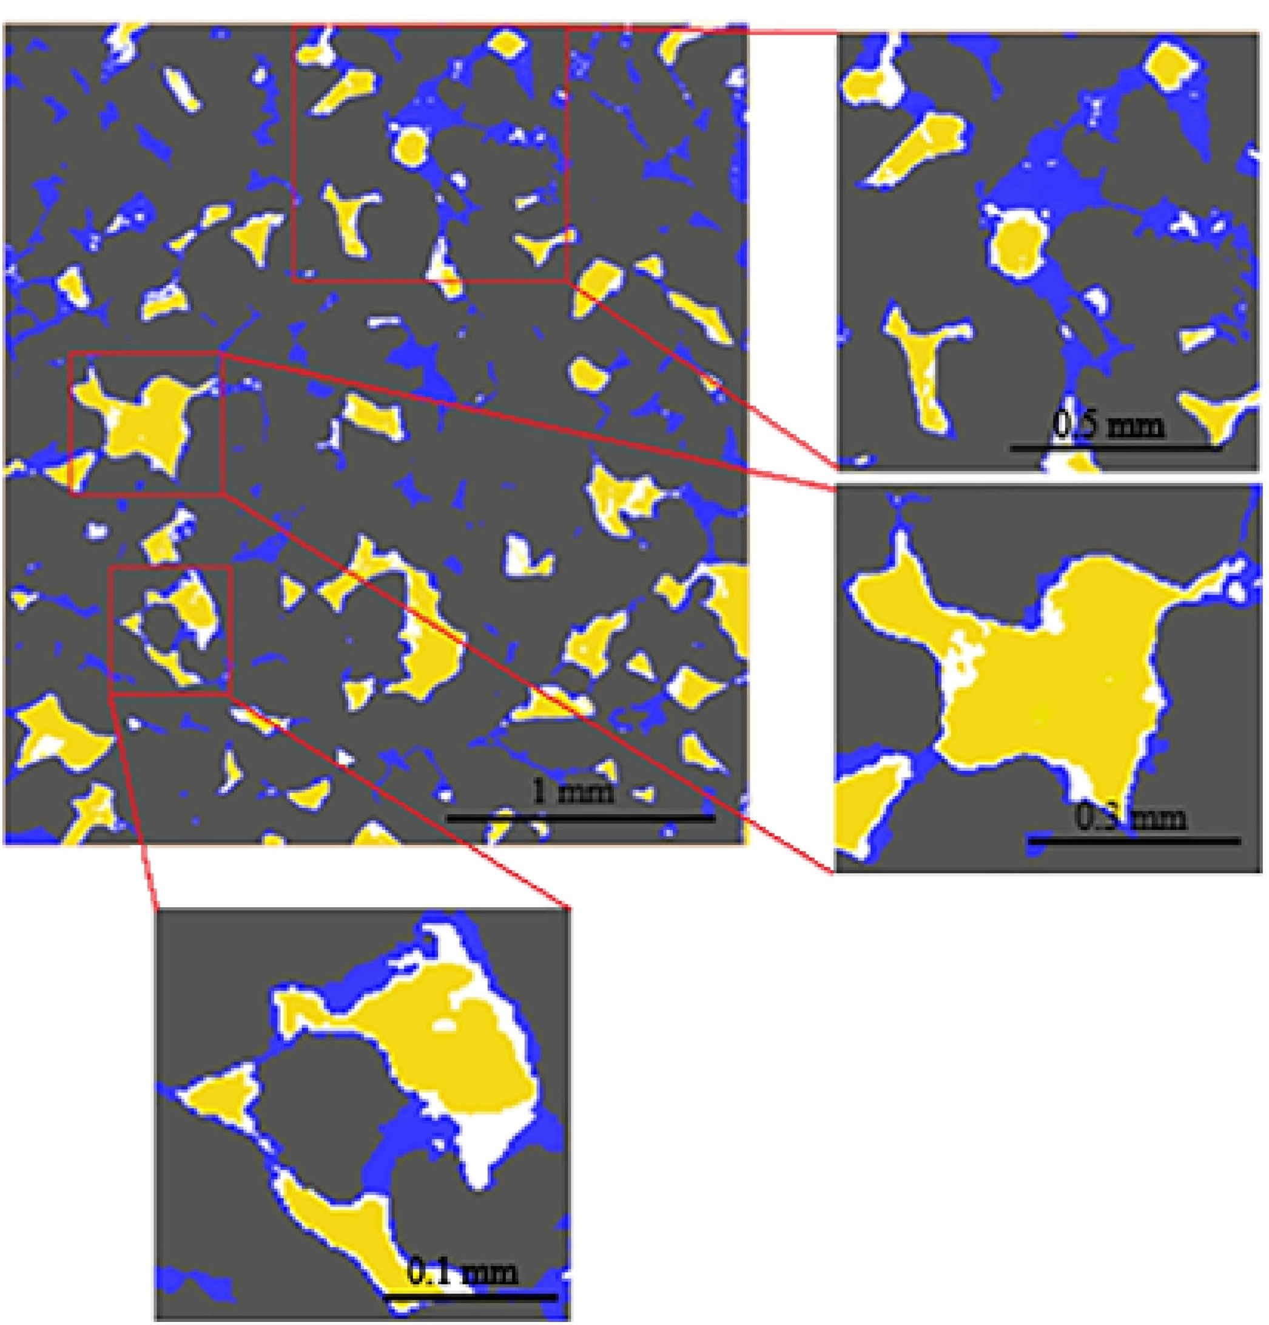
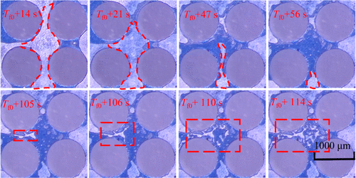
Motivation
Hydrate formation during CO₂ injection
Hydrate morphology has been well-investigated but not the kinetics.
Micro-CT image
Micro-model image
Tingting Luo, et al. 2026
Yellow-CO₂
Blue-Brine
White-Hydrate
Dhifaf Sadeq, et al. 2018
What are the kinetics of CO₂ hydrate in different porous media under various P/T conditions?
Notes:
In order to investigate the impact of rock permeability, different core with various inherent permeability were used as listed in this table. For all experiment consistent process were used for the 1wt% NaCl brine saturation.

Slide 4
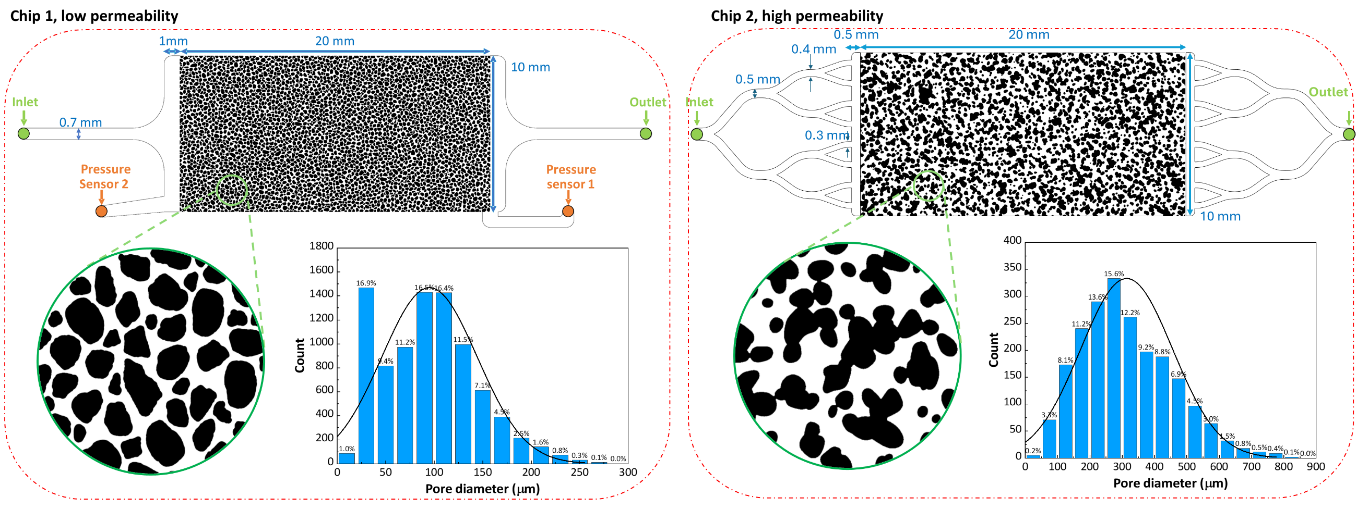
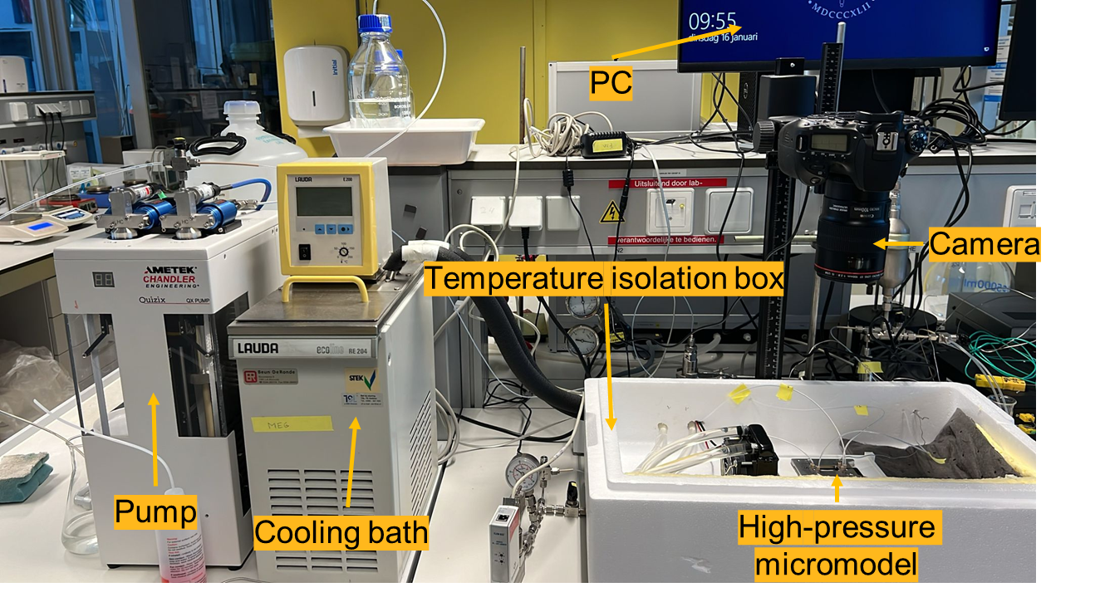
Micromodel Experiments: Setup
Experimental setup
Micromodels with two permeability patterns
Pore structure | Porosity | Permeability (Darcy) | Pore depth (µm) | Pore size (µm, > 95%) | Pore volume (µL) | Wettability
Chip 1 (small pore size) | 0.4 | 0.59 | 5 | 30~190 | 0.4 | water-wet (40˚)
Chip 2 (large pore size) | 0.56 | 7.21 | 20 | 75~575 | 2.24
Yan, et al., 2025a

Slide 5
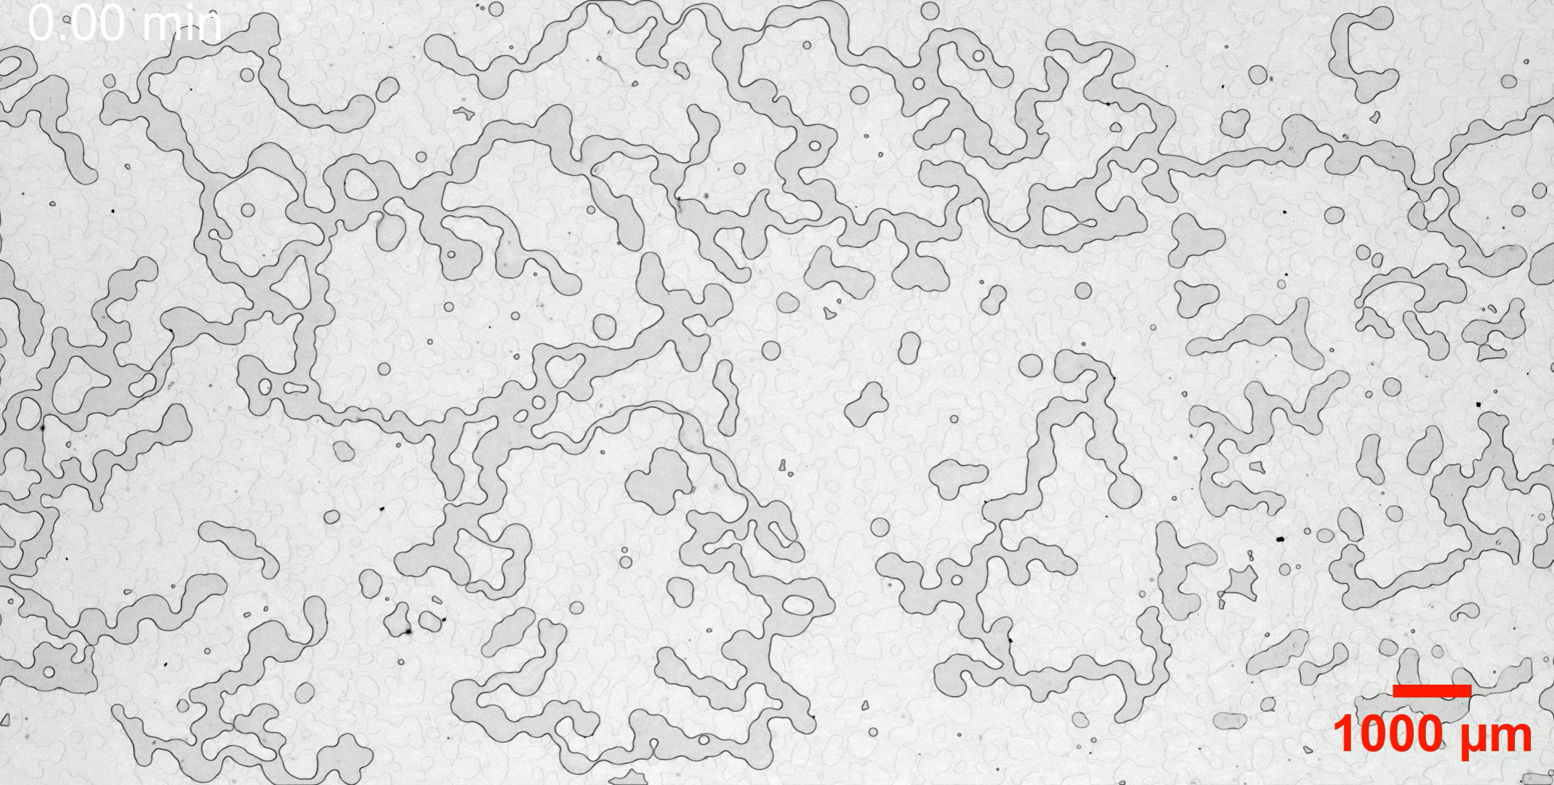
Micromodel Experiments: Results
Video of hydrate formation with high Sw
Inlet
Outlet

Slide 6
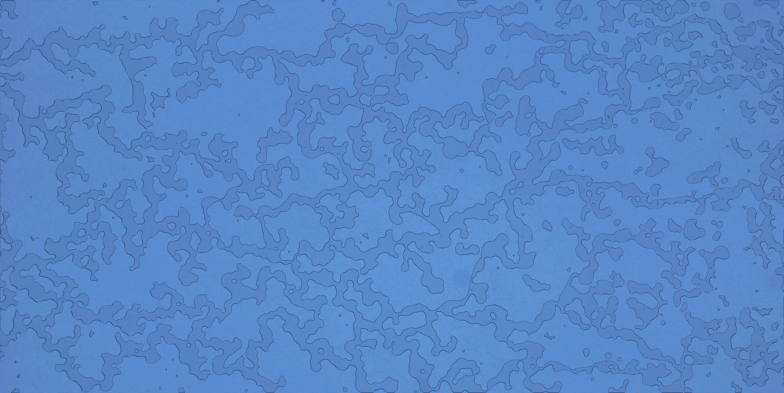
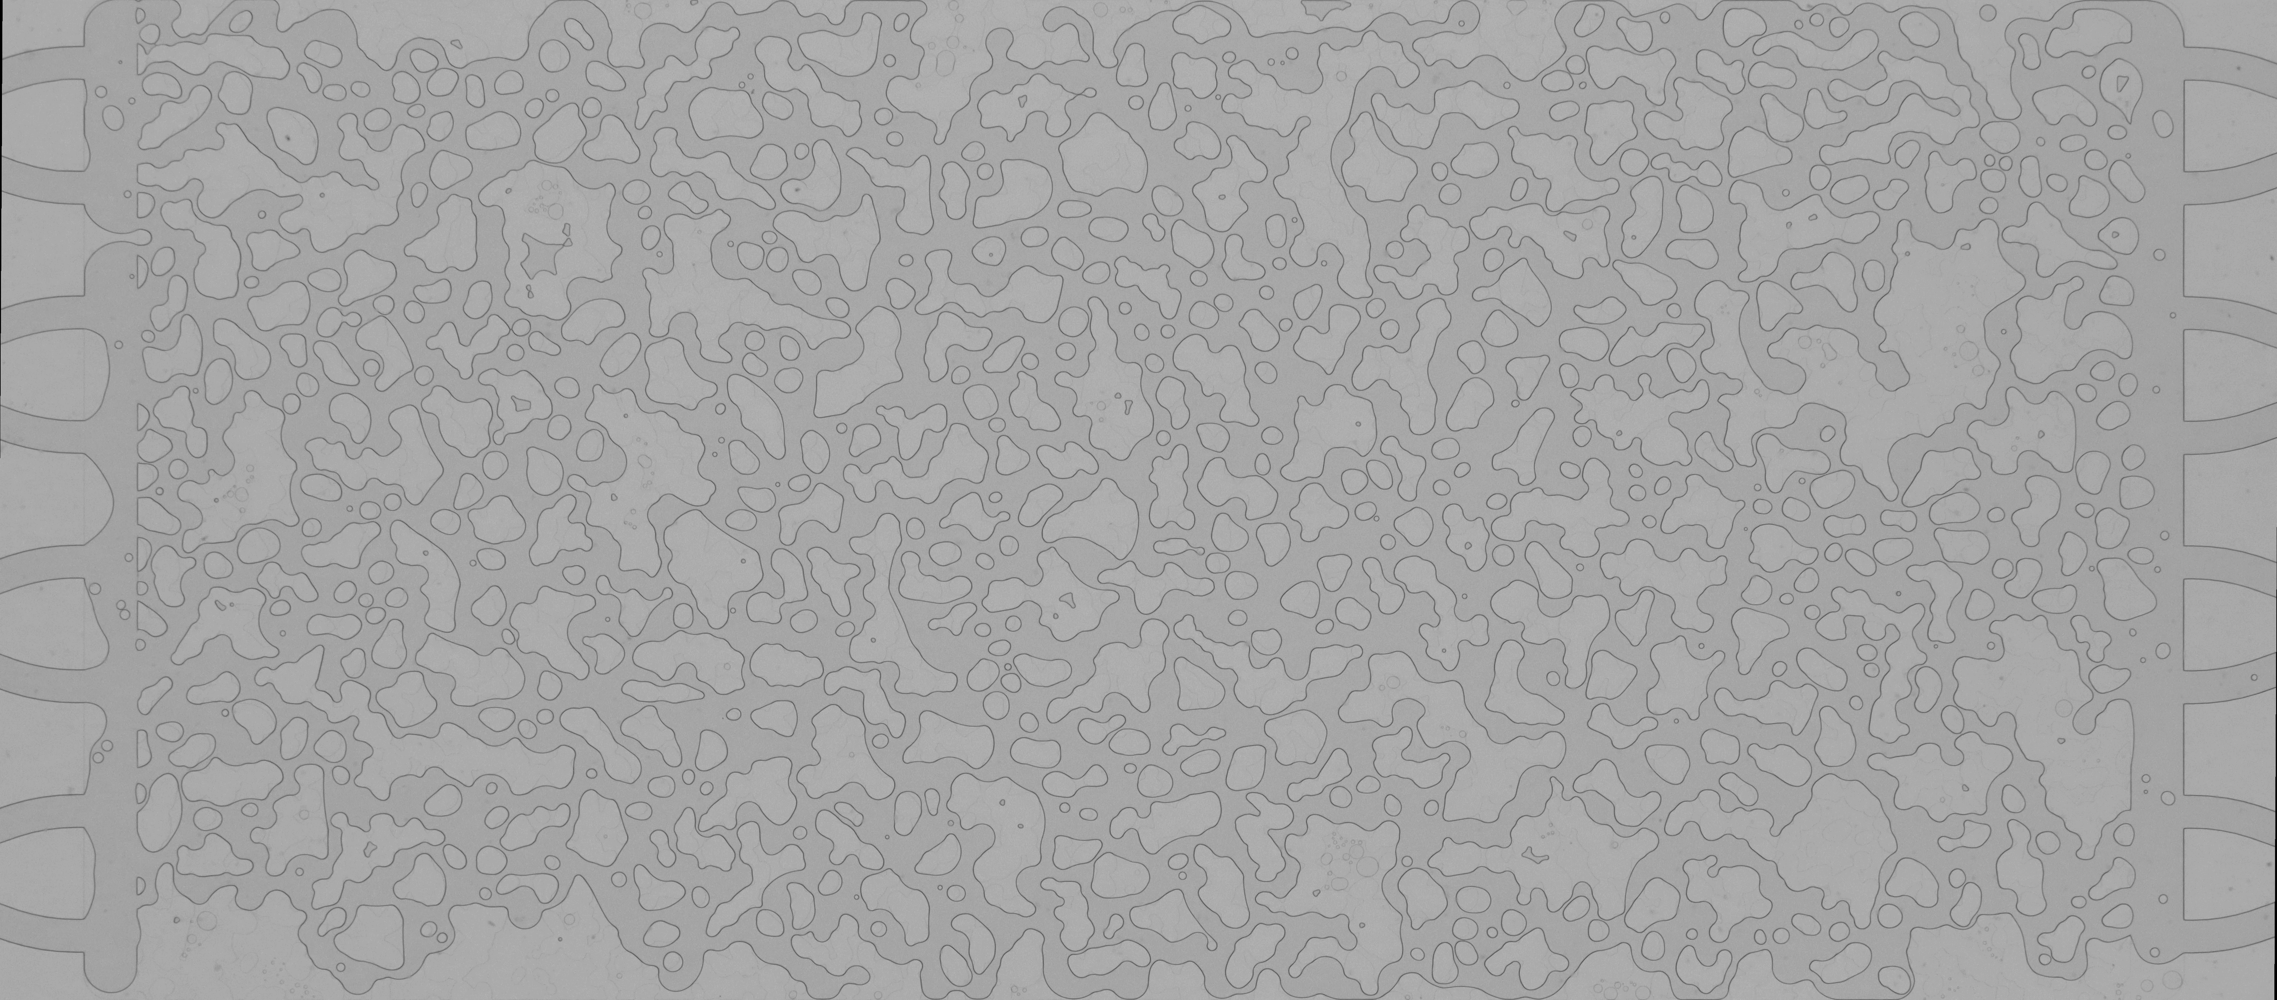
Micromodel Experiments: Results
Video of hydrate formation with low Sw
Inlet
Outlet

Slide 7
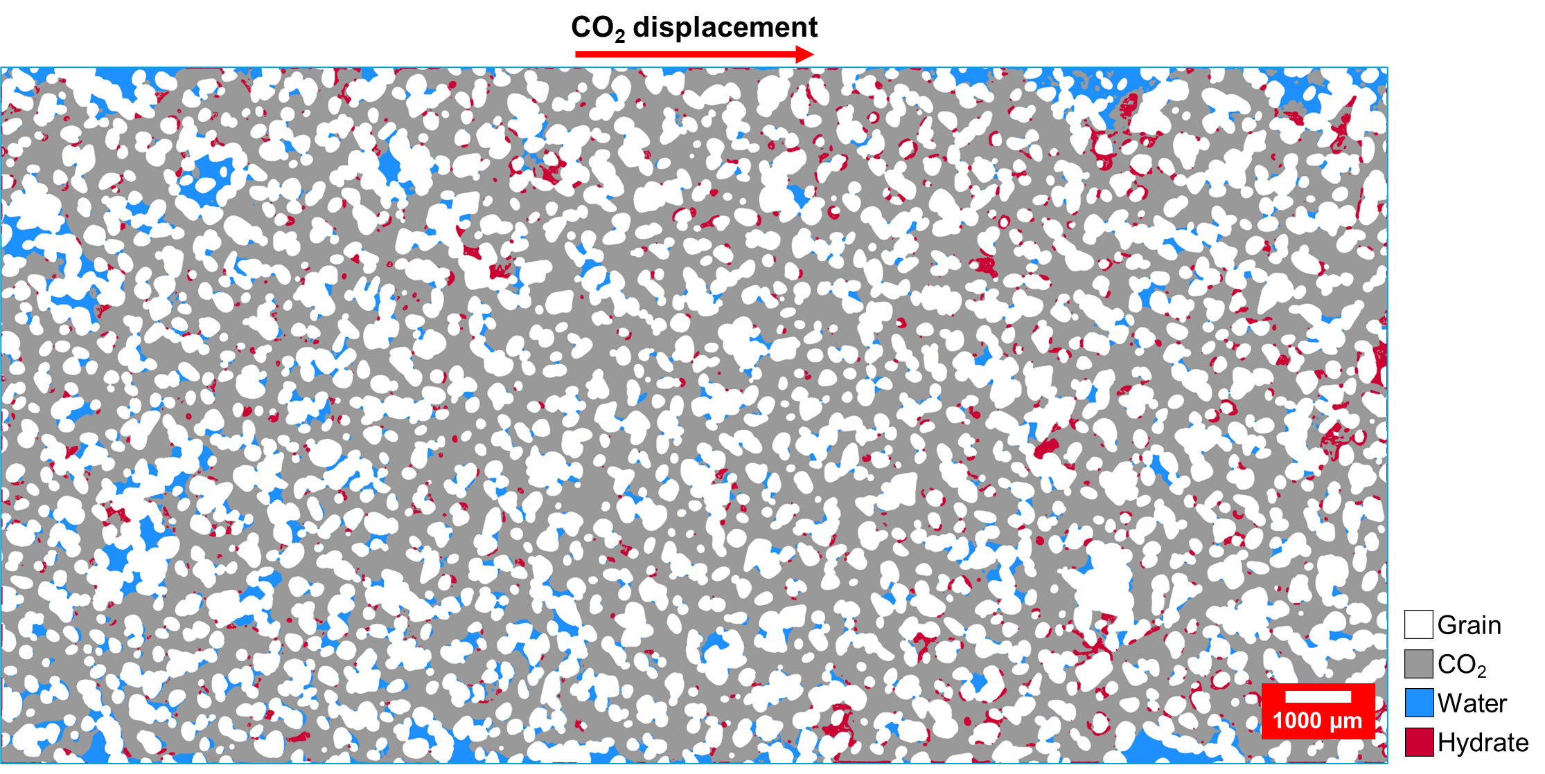
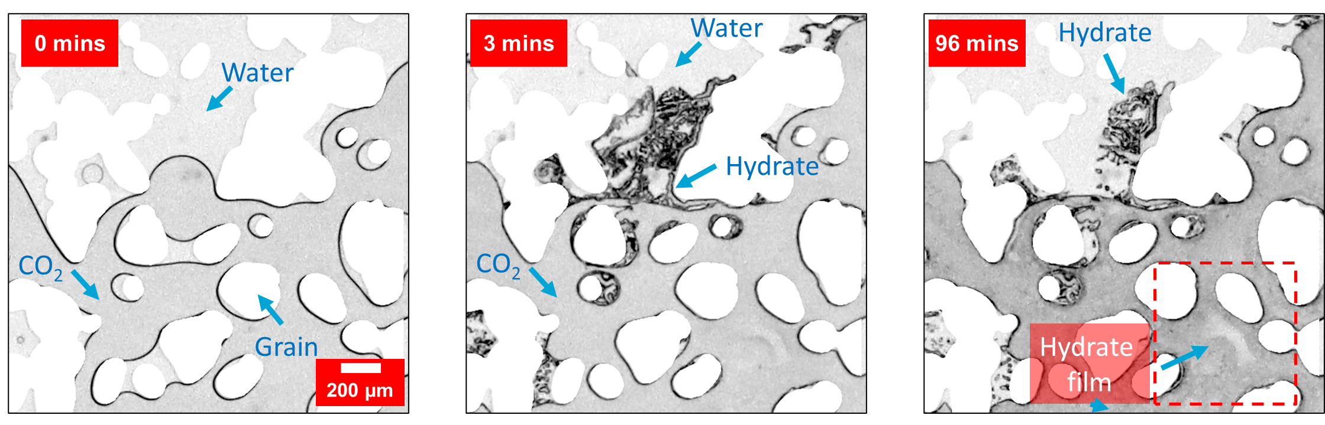
Micromodel Experiments: Results
Segmented phases at maximum hydrate formation
Zoom-in images of hydrate in pores
Hydrate formation induces pore blockage but highly depends on the local water saturation.

Slide 8
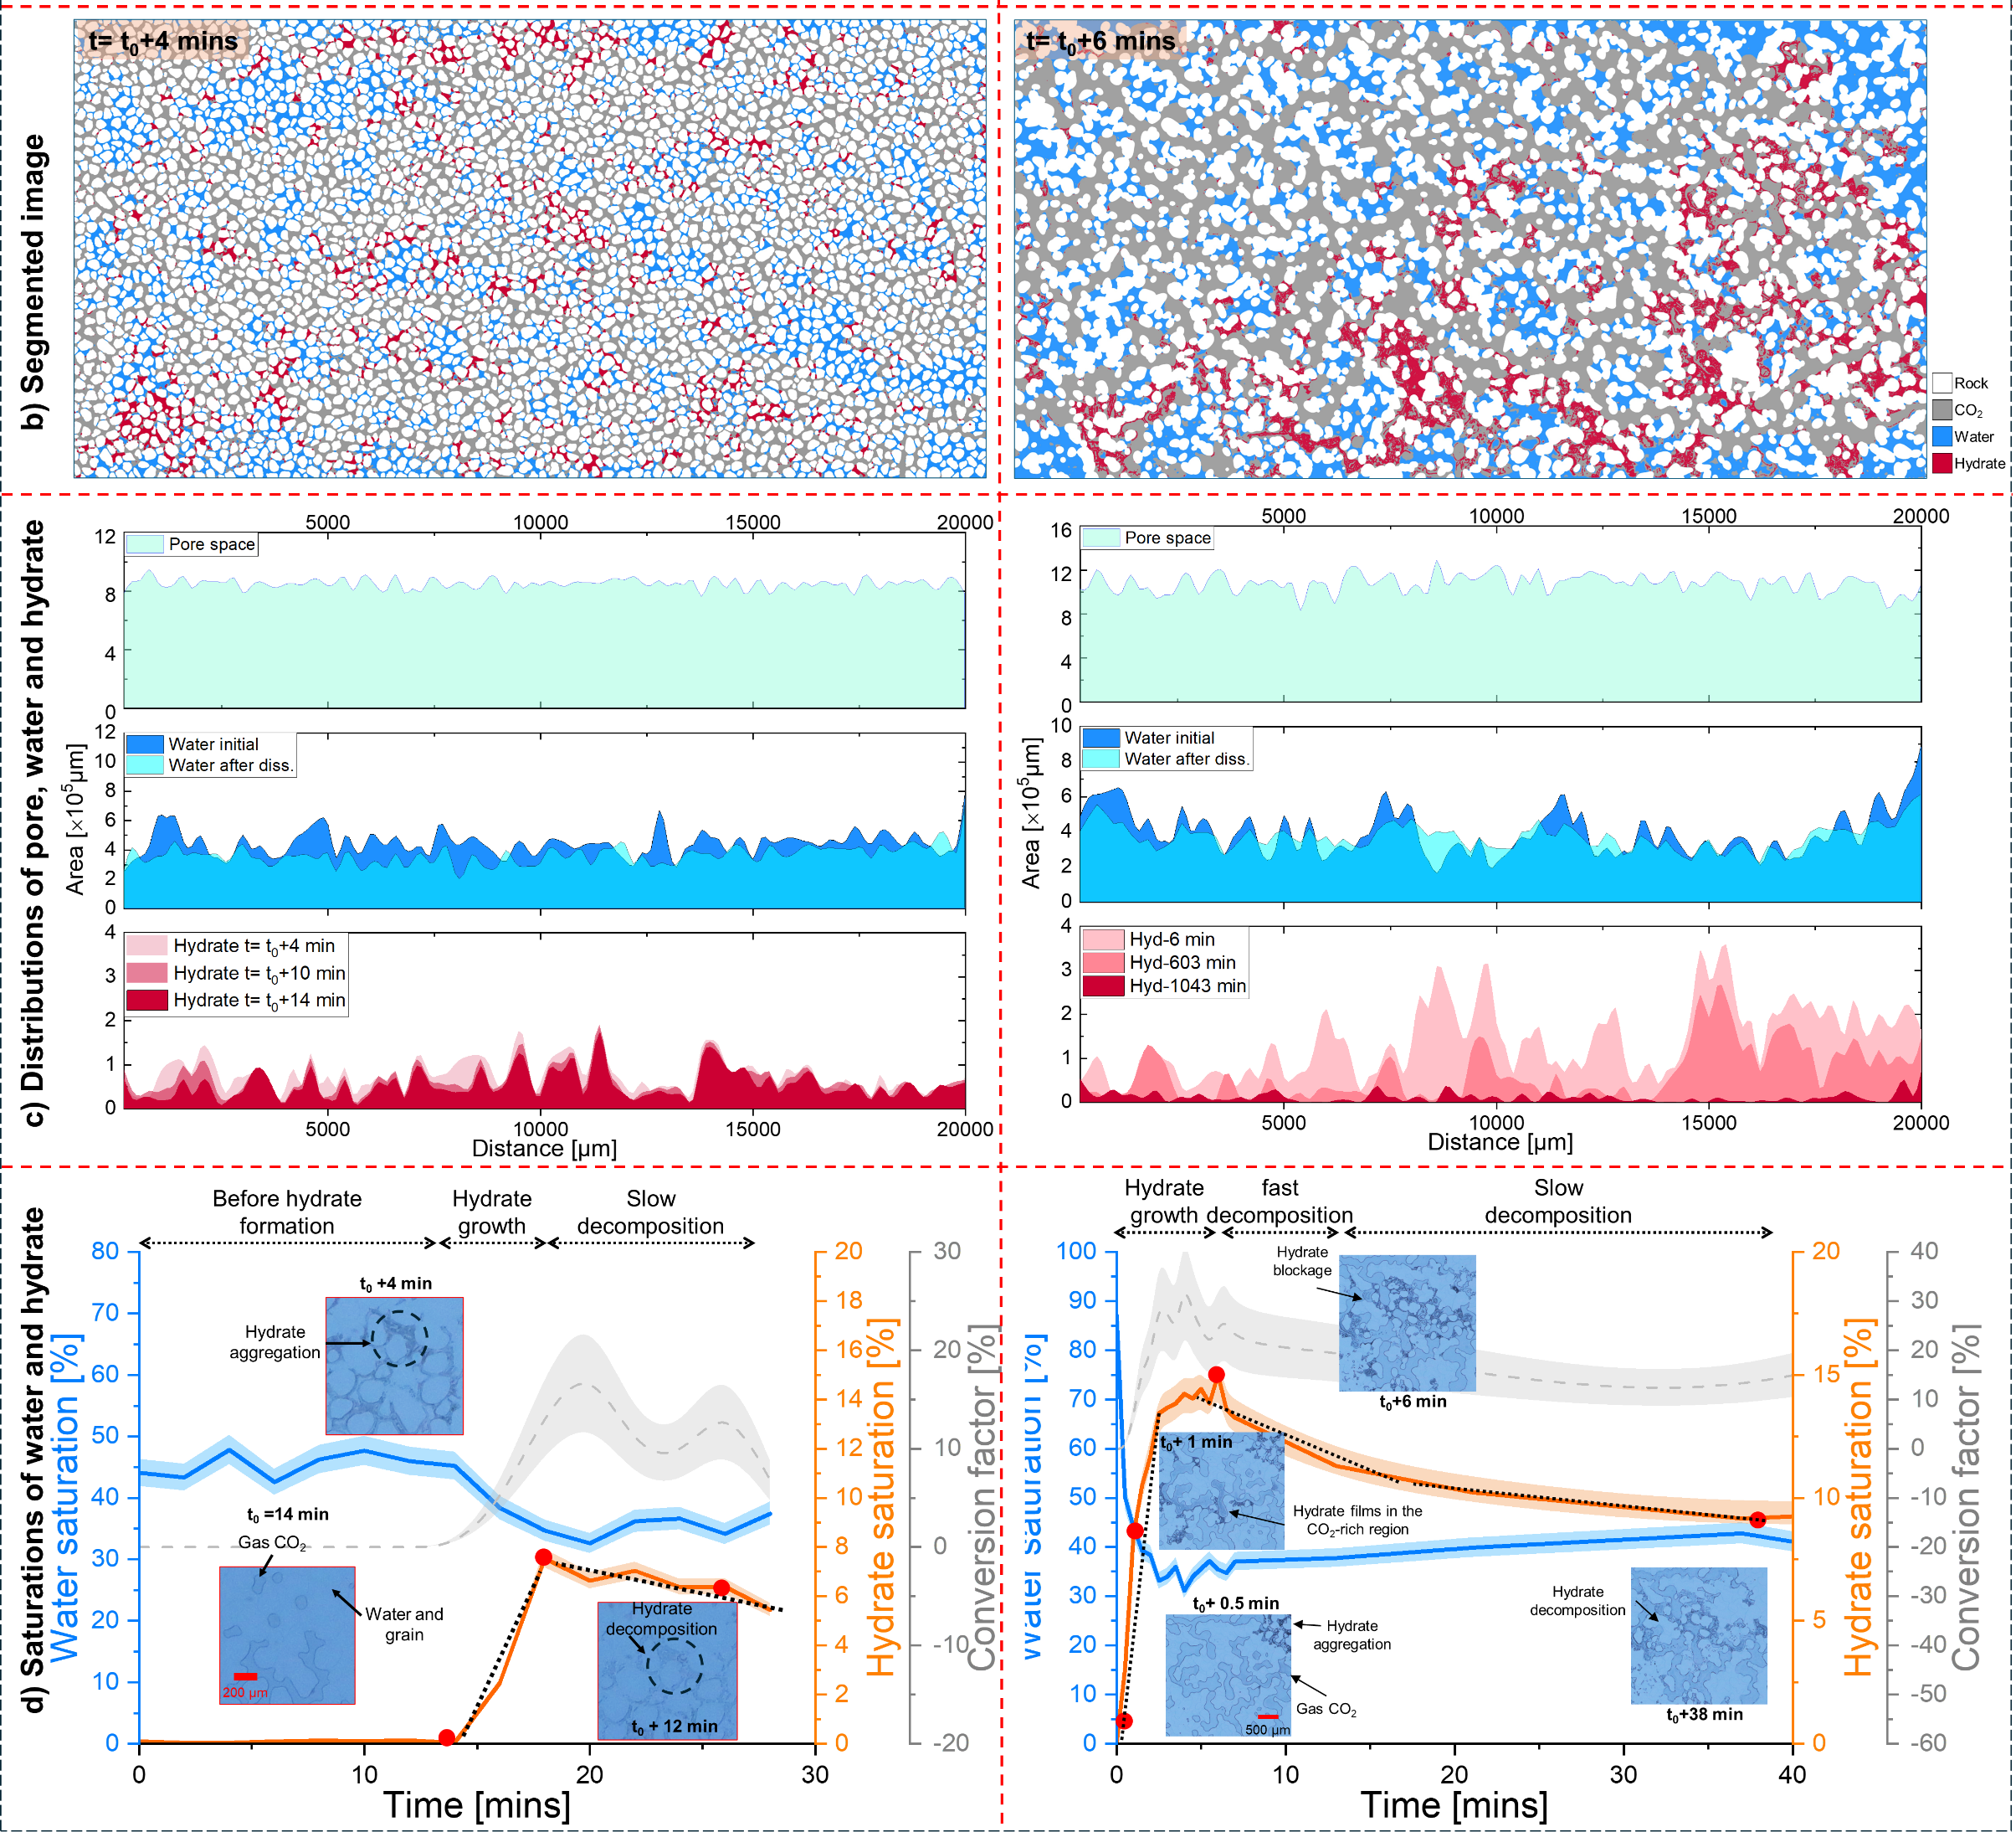
Micromodel Experiments: Results
Small pores
Large pores
Hydrate behaviors performs very different in different pore sizes.

Slide 9
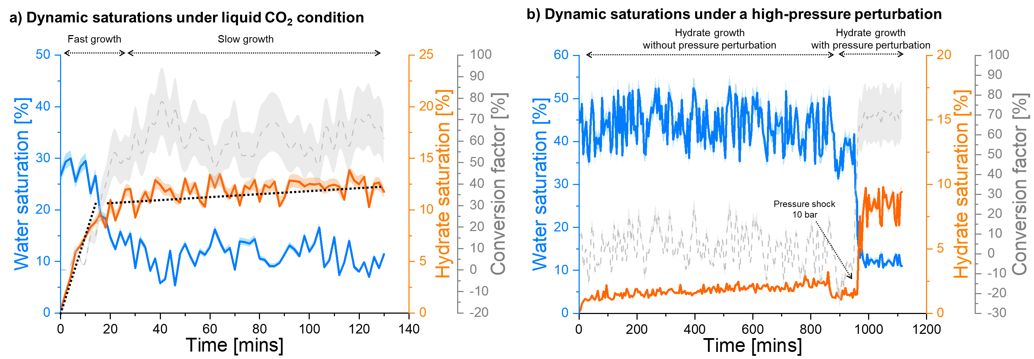
Micromodel Experiments: Results
Hydrate is not always stable after growth, which is determined by the environmental conditions, e.g., liquid CO2 condition that doesn’t show the slow decomposition.

Slide 10
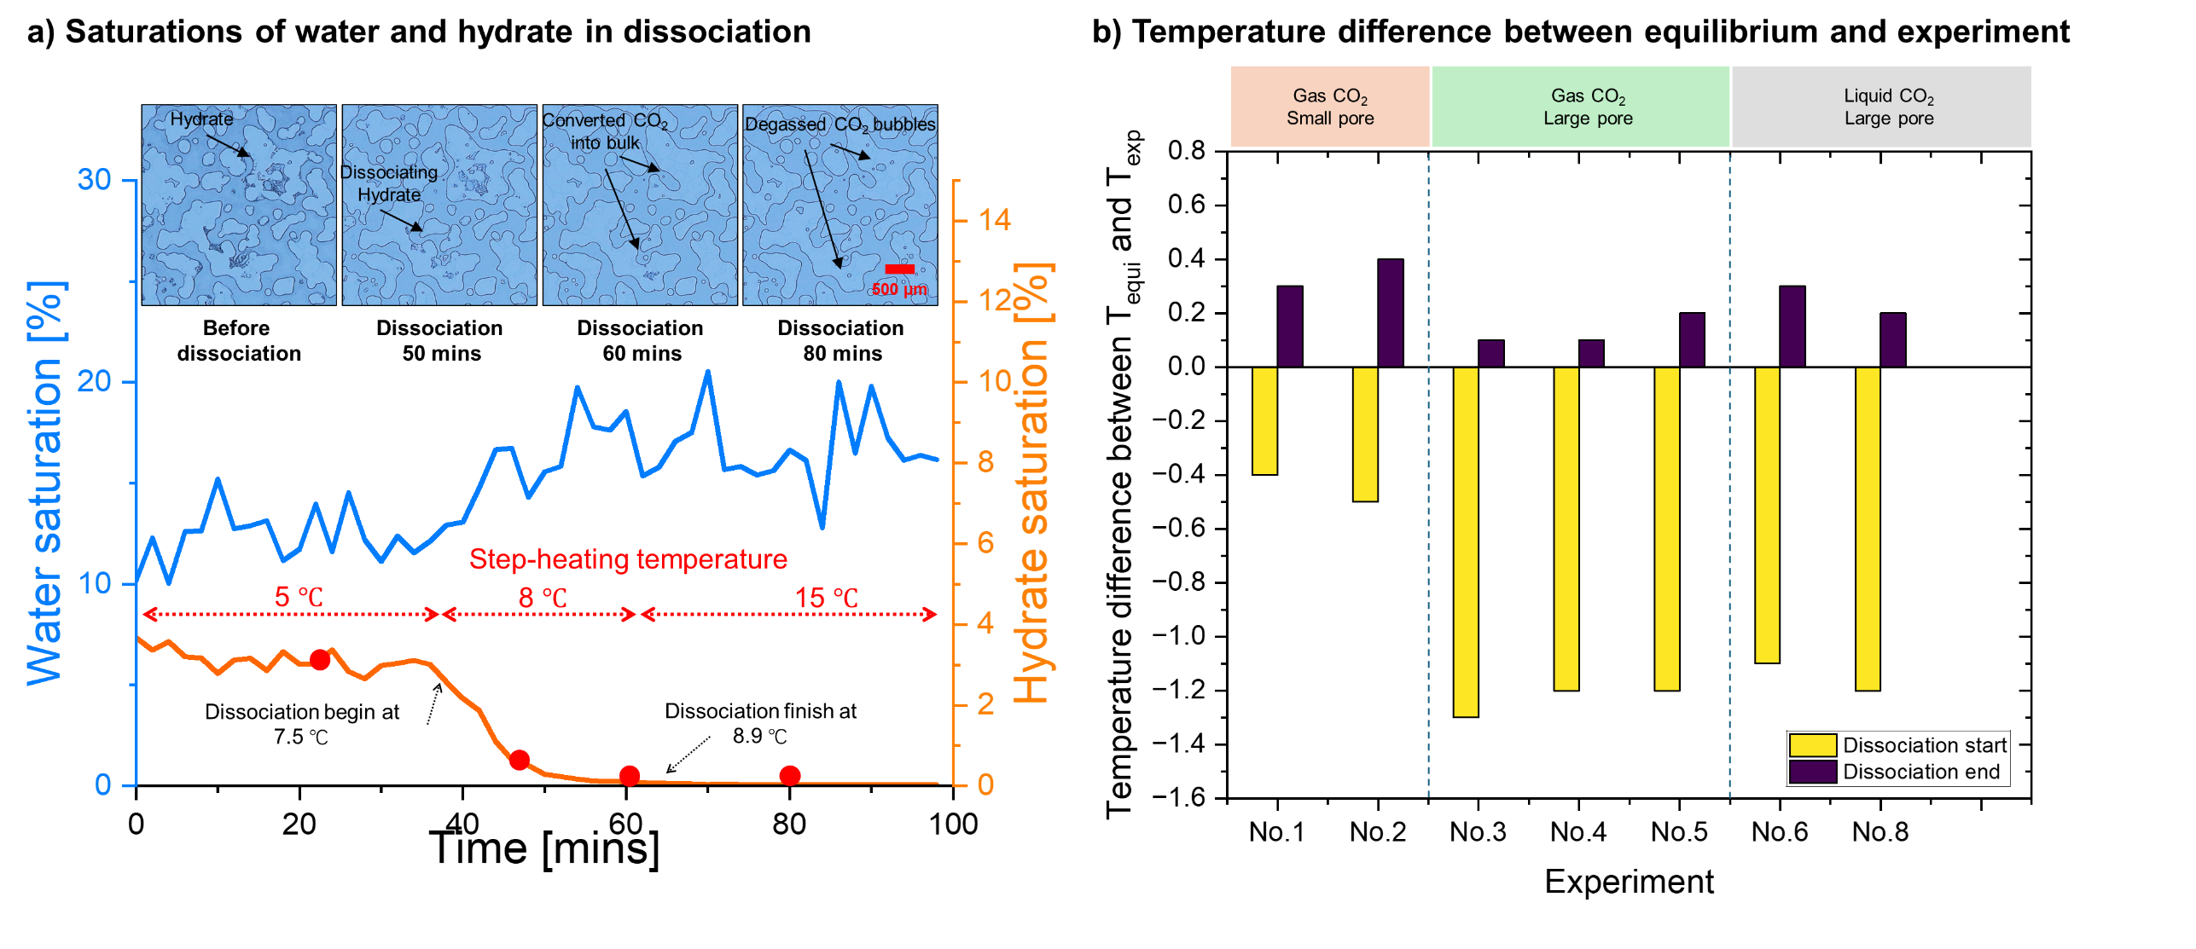
Micromodel Experiments: Results
Hydrate dissociation is a slow process in porous domain and is been influenced by the local pores.

Slide 11
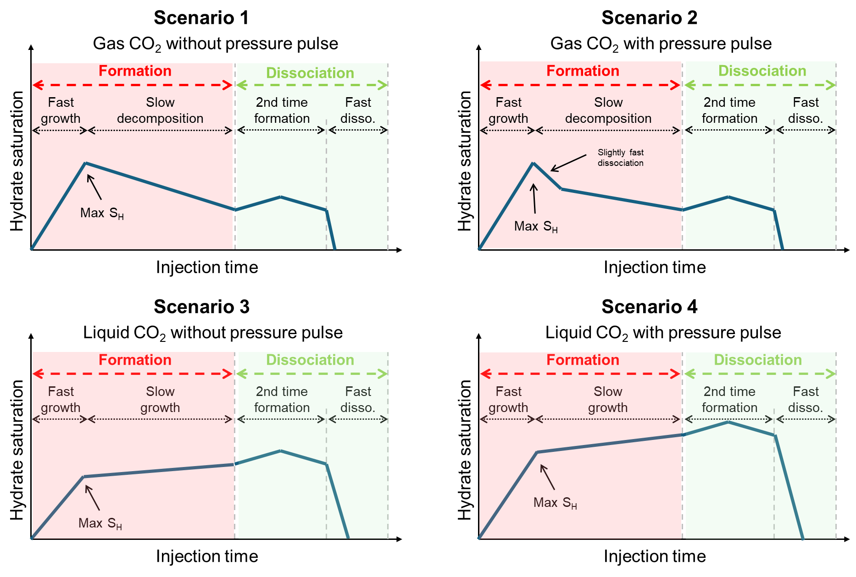
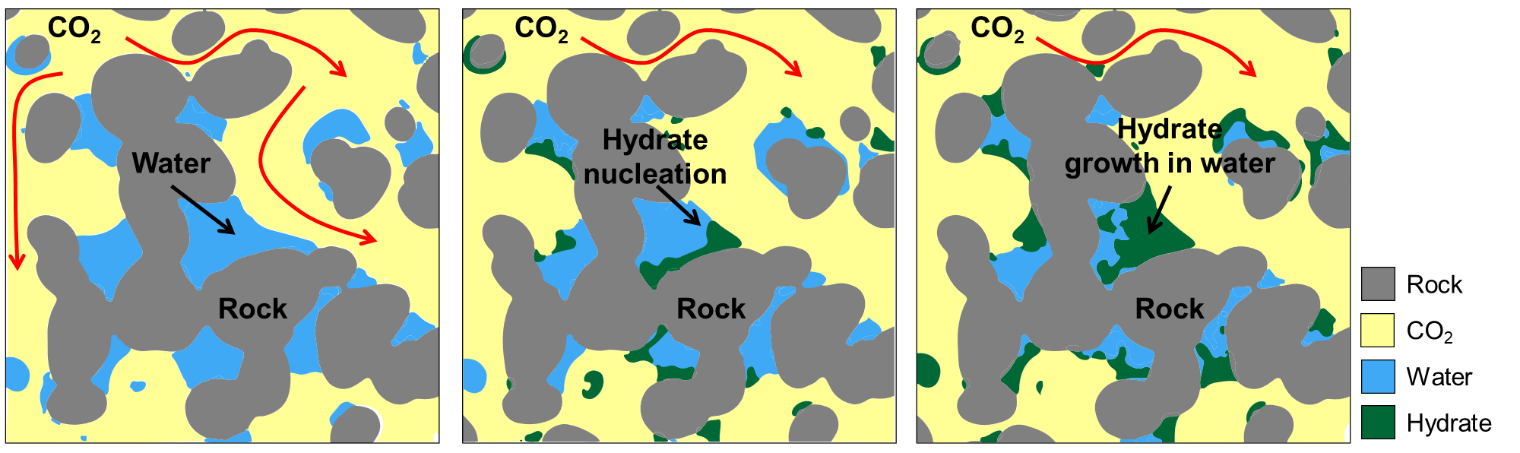
Micromodel Experiments: Results
Schematic of hydrate formation in pores
Hydrate behavior in pores under various environmental conditions.

Slide 12
Conclusions
Full-field microfluidics resolved CO₂ hydrate dynamics across porous networks.
Nine hydrate morphologies were observed under varying pore and pressure conditions.
Liquid CO₂ and pressure pulses accelerated growth and stabilized hydrates.
Behaviors of hydrate formation and dissociation in micromodels were systematically observed.

