Slide 1

InterPore 2026 · Oral Presentation
Methane Pyrolysis for Hydrogen Production：
Using Induction-Heated Porous Metal Foams
Multiphysics Simulation · Kinetic Inversion · Multi-Objective Optimization
Speaker : Zhuoran Wei | School of Energy Science & Engineering, Harbin Institute of Technology
Supervisor: Prof. Ruming Pan
May 2026
Notes:
Good morning, everyone.
My name is Zhuoran Wei, from Harbin Institute of Technology, China.
Today I will present our work on methane pyrolysis for hydrogen production,
using induction-heated porous metal foams.

Slide 2
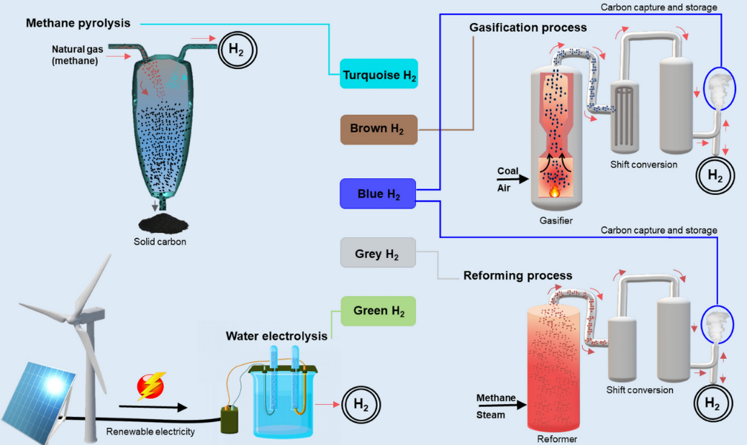
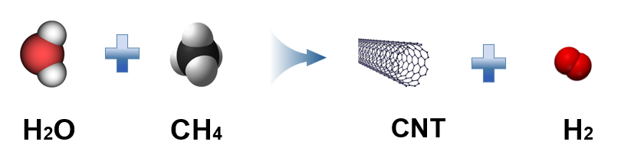
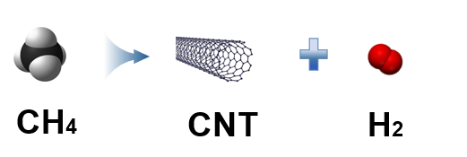
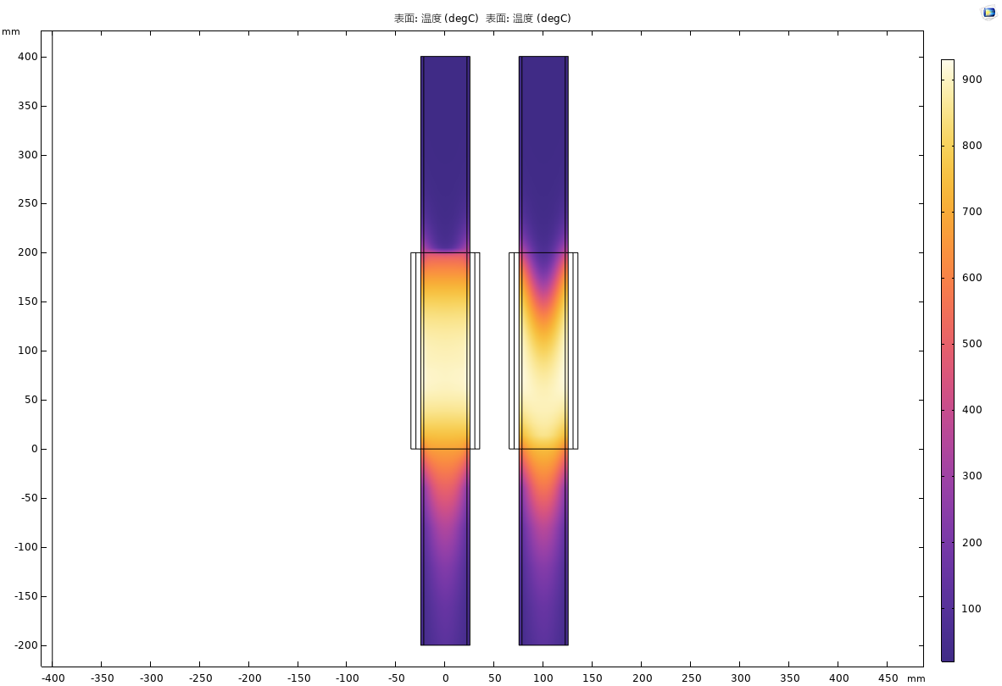
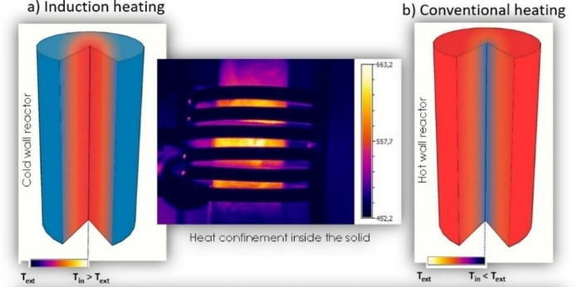
BACKGROUND
Why Methane Pyrolysis? Why Induction Heating ?
Hydrogen production technology
Steam methane reforming VS Methane catalytic cracking
› Zero CO/CO₂ emission
› Co-produce CNTs (teal hydrogen)
Traditional Joule heating
› Strongly endothermic (>700 °C)
› 96% of H₂ from fossil fuels
› slow, inefficient
› SMR (Steam methane reforming),emits 9–12 kg CO₂/kg H₂
› Carbon deposition deactivates catalyst
Solution: Induction Heating + Porous Metal Foam
Notes:
Let me start with the motivation.
Today, 96% of hydrogen comes from fossil fuels.
Steam methane reforming — SMR — is the most common method.
But it produces 9 to 12 kg of CO₂ per kg of hydrogen. That is not sustainable.
Our solution: induction heating combined with porous metal foam.

Slide 3
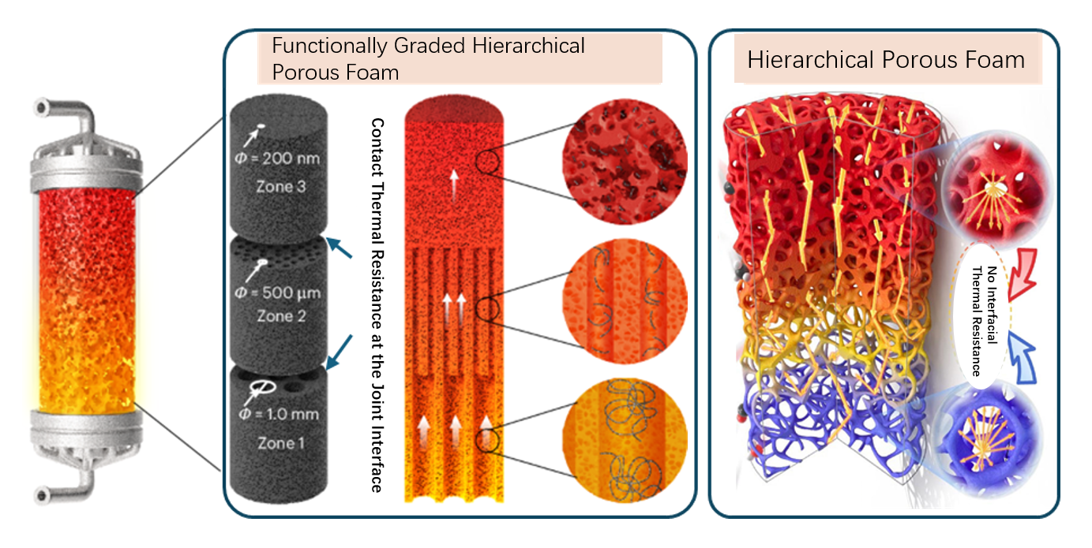
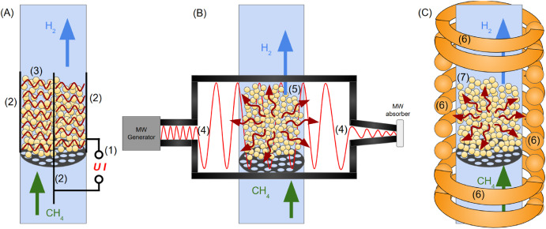
CONCEPT
Induction Heating + Porous Metal Foam
Porous Metal Foam (Fe/Ni)
plasma heating
microwave heating
Induction Heating
Conductive skeleton
✓ High-frequency AC field → eddy currents in conductive foam
doubles as IH susceptor
✓ Joule heat generated inside the catalyst (volumetric heating)
3-D open pores
enhance mass transfer & CH₄contact
✓ Fast startup · Precise temperature control
High surface area
✓ Powered by renewable electricity → near-zero carbon footprint
catalytic sites for CH₄cracking
Structural rigidity
maintains shape under carbon growth
Heat generated at the exact solid surface where catalysis occurs — a fundamental advantage
Notes:
We use a porous metal foam made of iron or nickel.
A high-frequency magnetic field creates eddy currents inside the foam — this generates heat inside the material.
The open pores let methane flow through. The high surface area provides catalytic sites.
Heat is generated exactly where the reaction happens. That is the key advantage.

Slide 4
RESEARCH OVERVIEW
Integrated Research Methodology
Experiment
Kinetic Inversion
3-D CFD
Optimization
IH-CH₄ platform
1-D PFR model
CCD design (27 pts)
COMSOL EPM model
700–1100 °C
DE algorithm
T, v, ε, PPI effects
EM + LTNE + Flow + Rxn
RSM surrogate
Arrhenius parameters
Carbon deposition
NSGA-II Pareto front
Complete chain: Experiment → Inversion → 3-D Multiphysics Simulation →
Multi-objective Optimization
Notes:
SLIDE 4 · Overview (30 sec)
Our research has four steps:
Experiment → Kinetic Inversion → 3-D Simulation → Optimization.
Let me go through each one quickly.

Slide 5
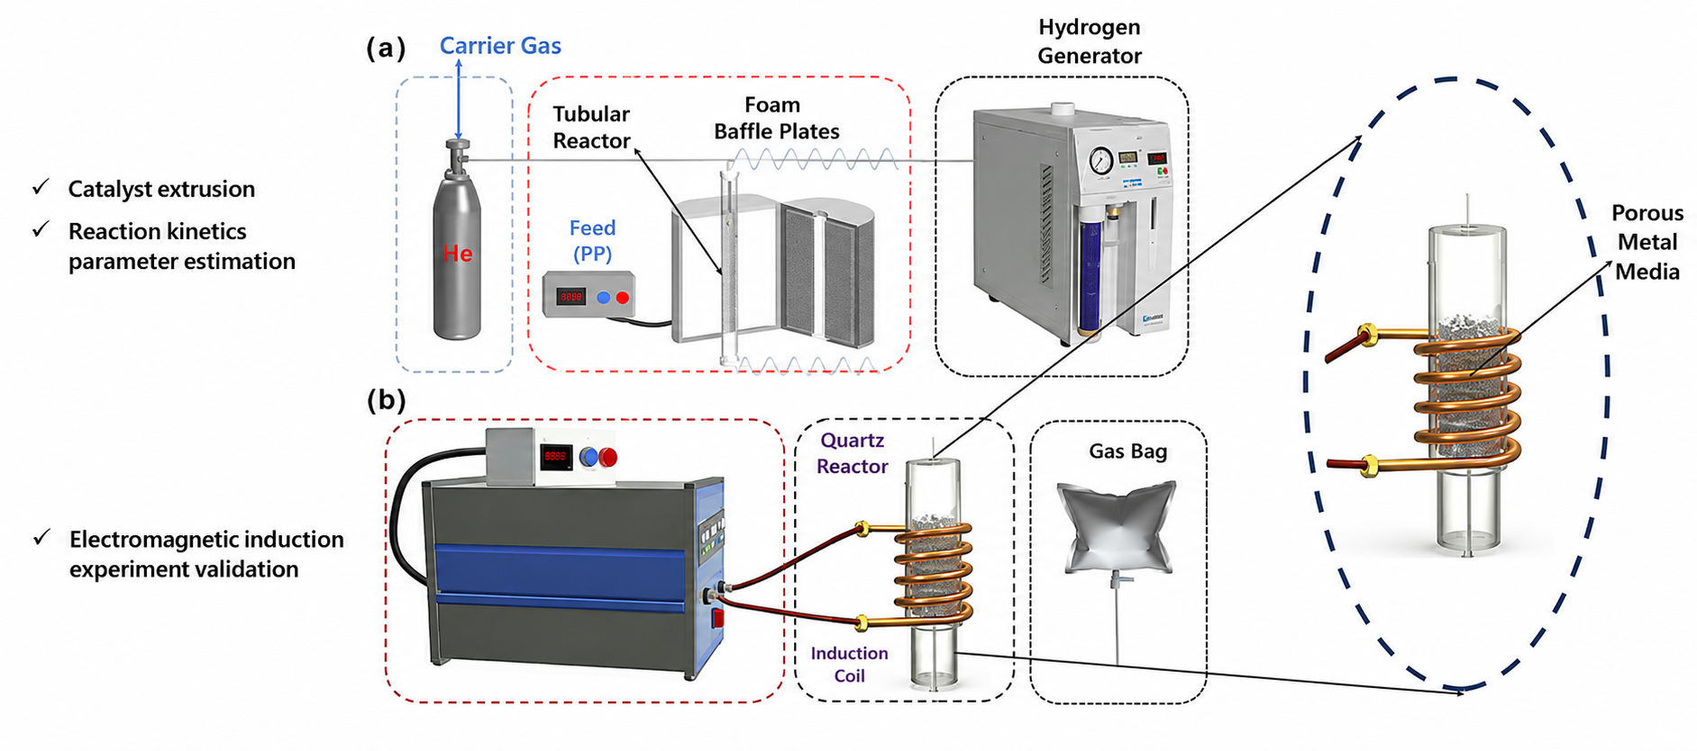
EXPERIMENT
Notes:
We built an induction-heating methane cracking platform.
We tested temperatures from 700 to 1100°C,
and studied the effect of temperature, flow rate, porosity, and pore size.

Slide 6
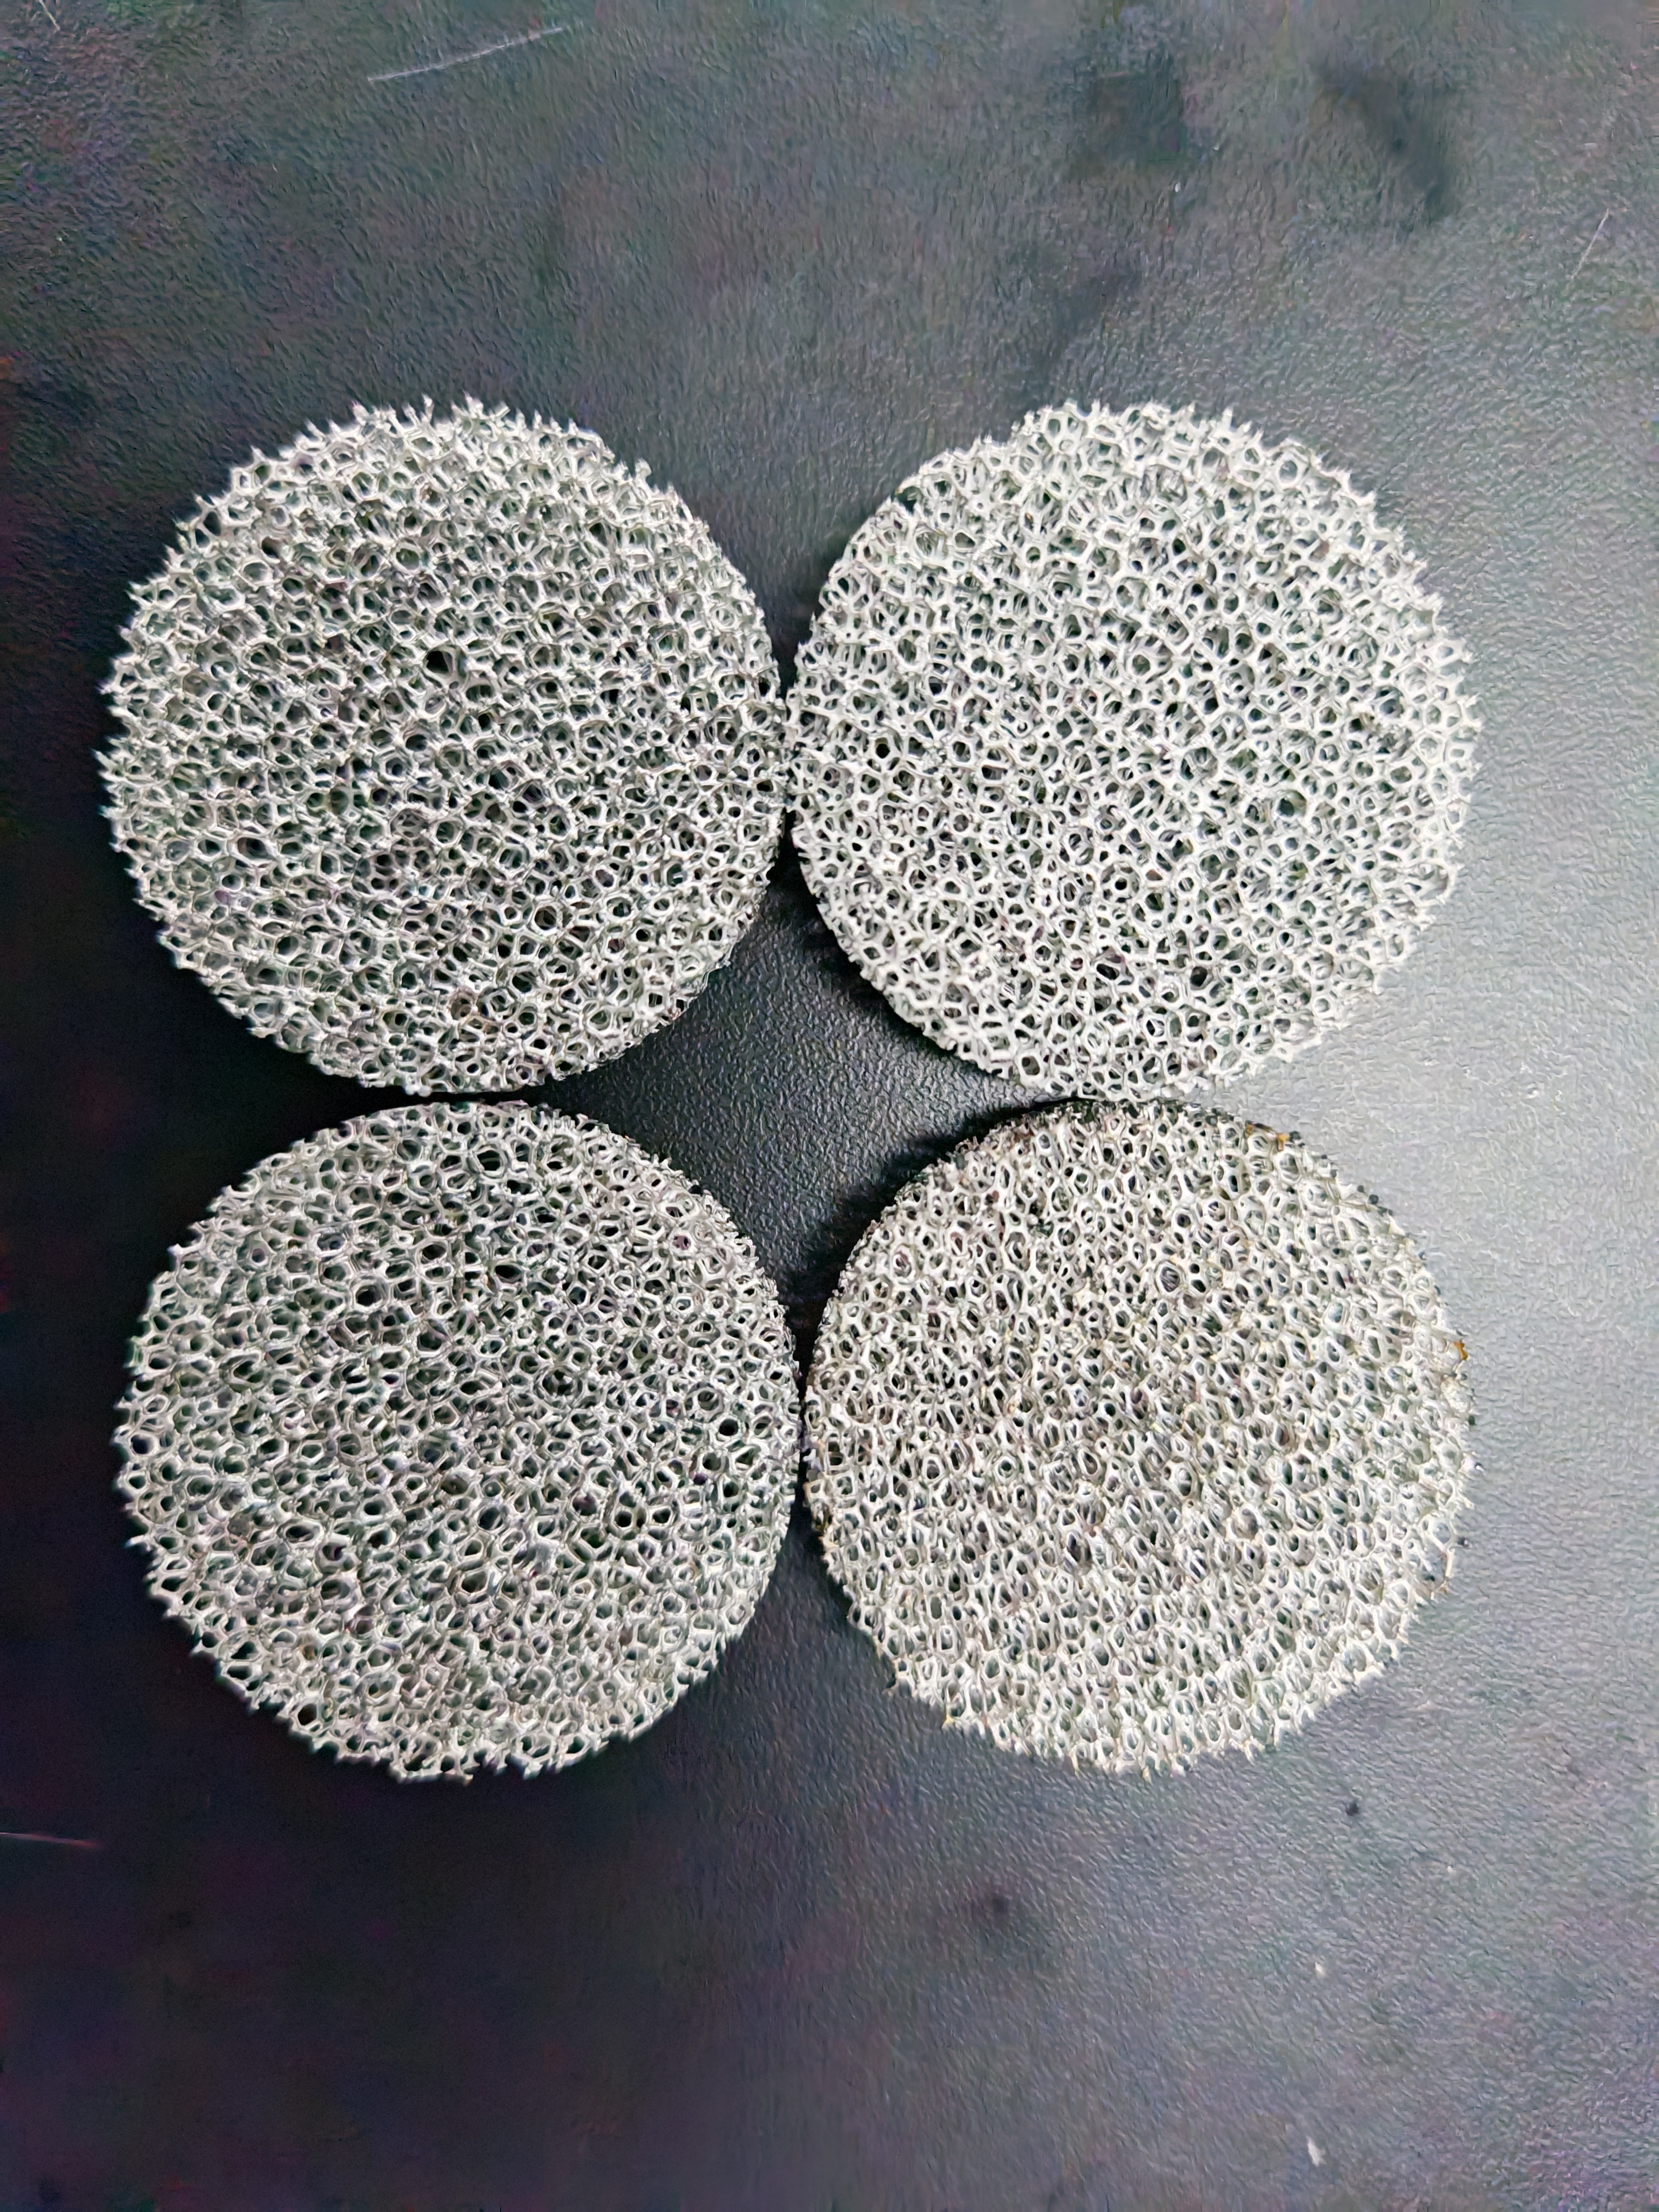
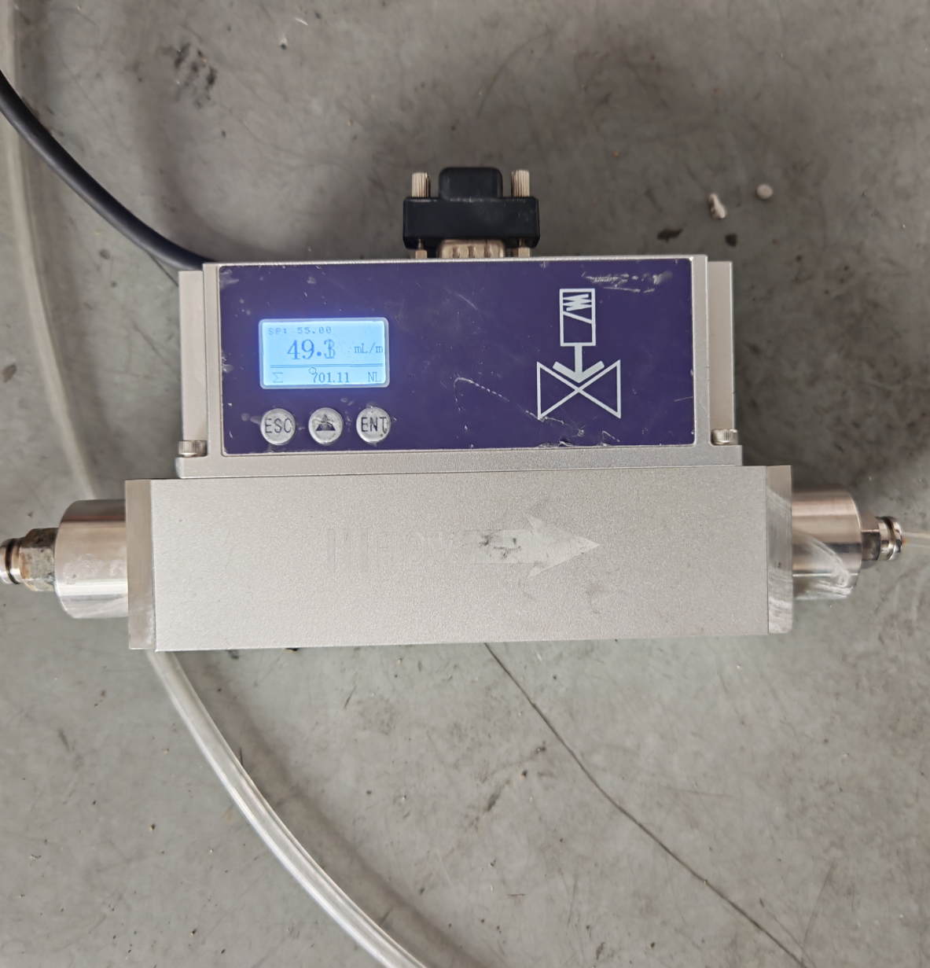
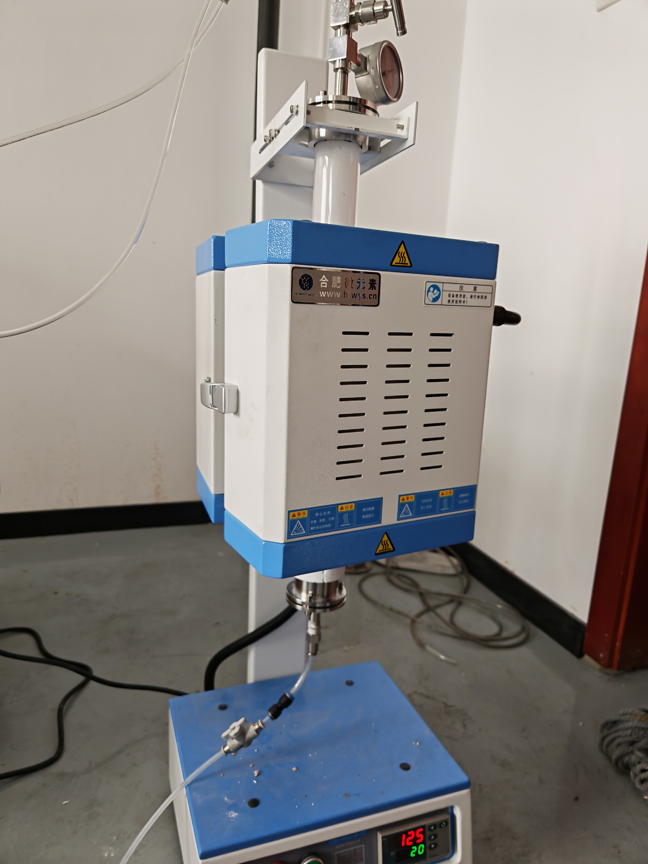
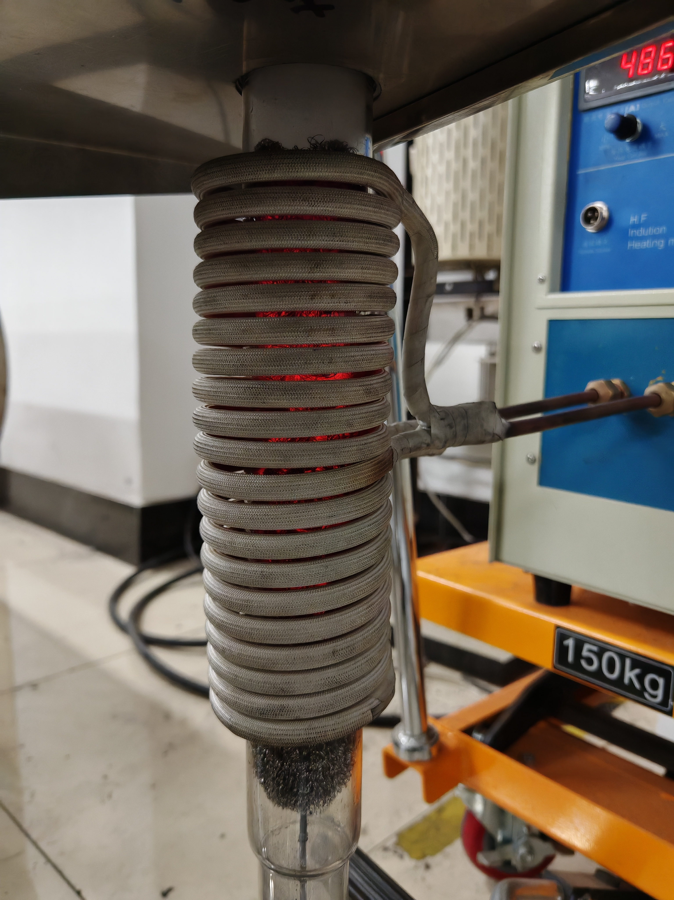
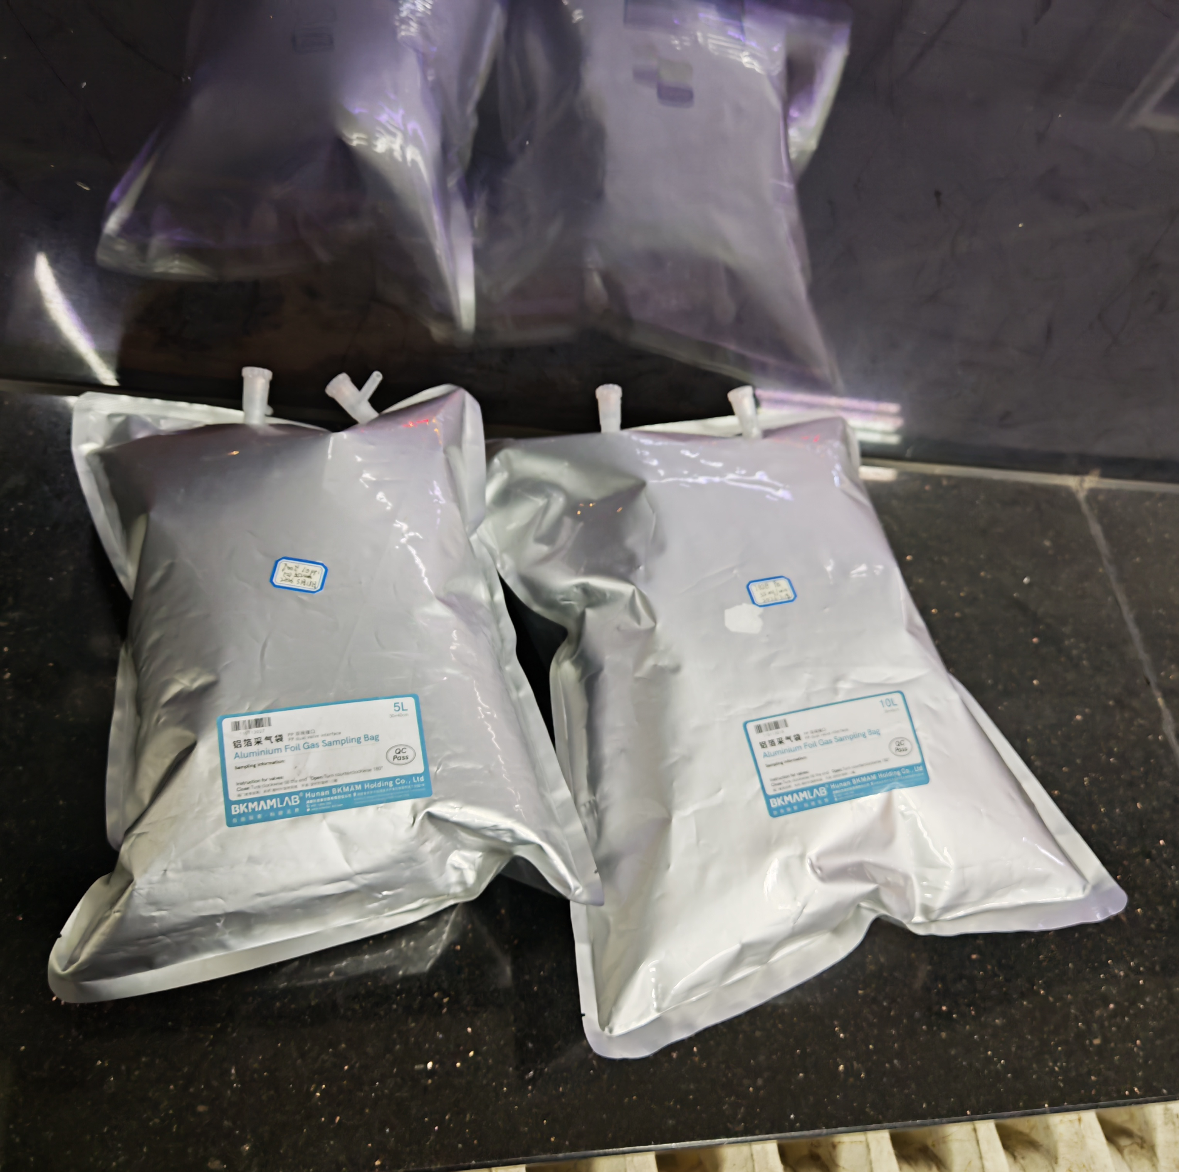
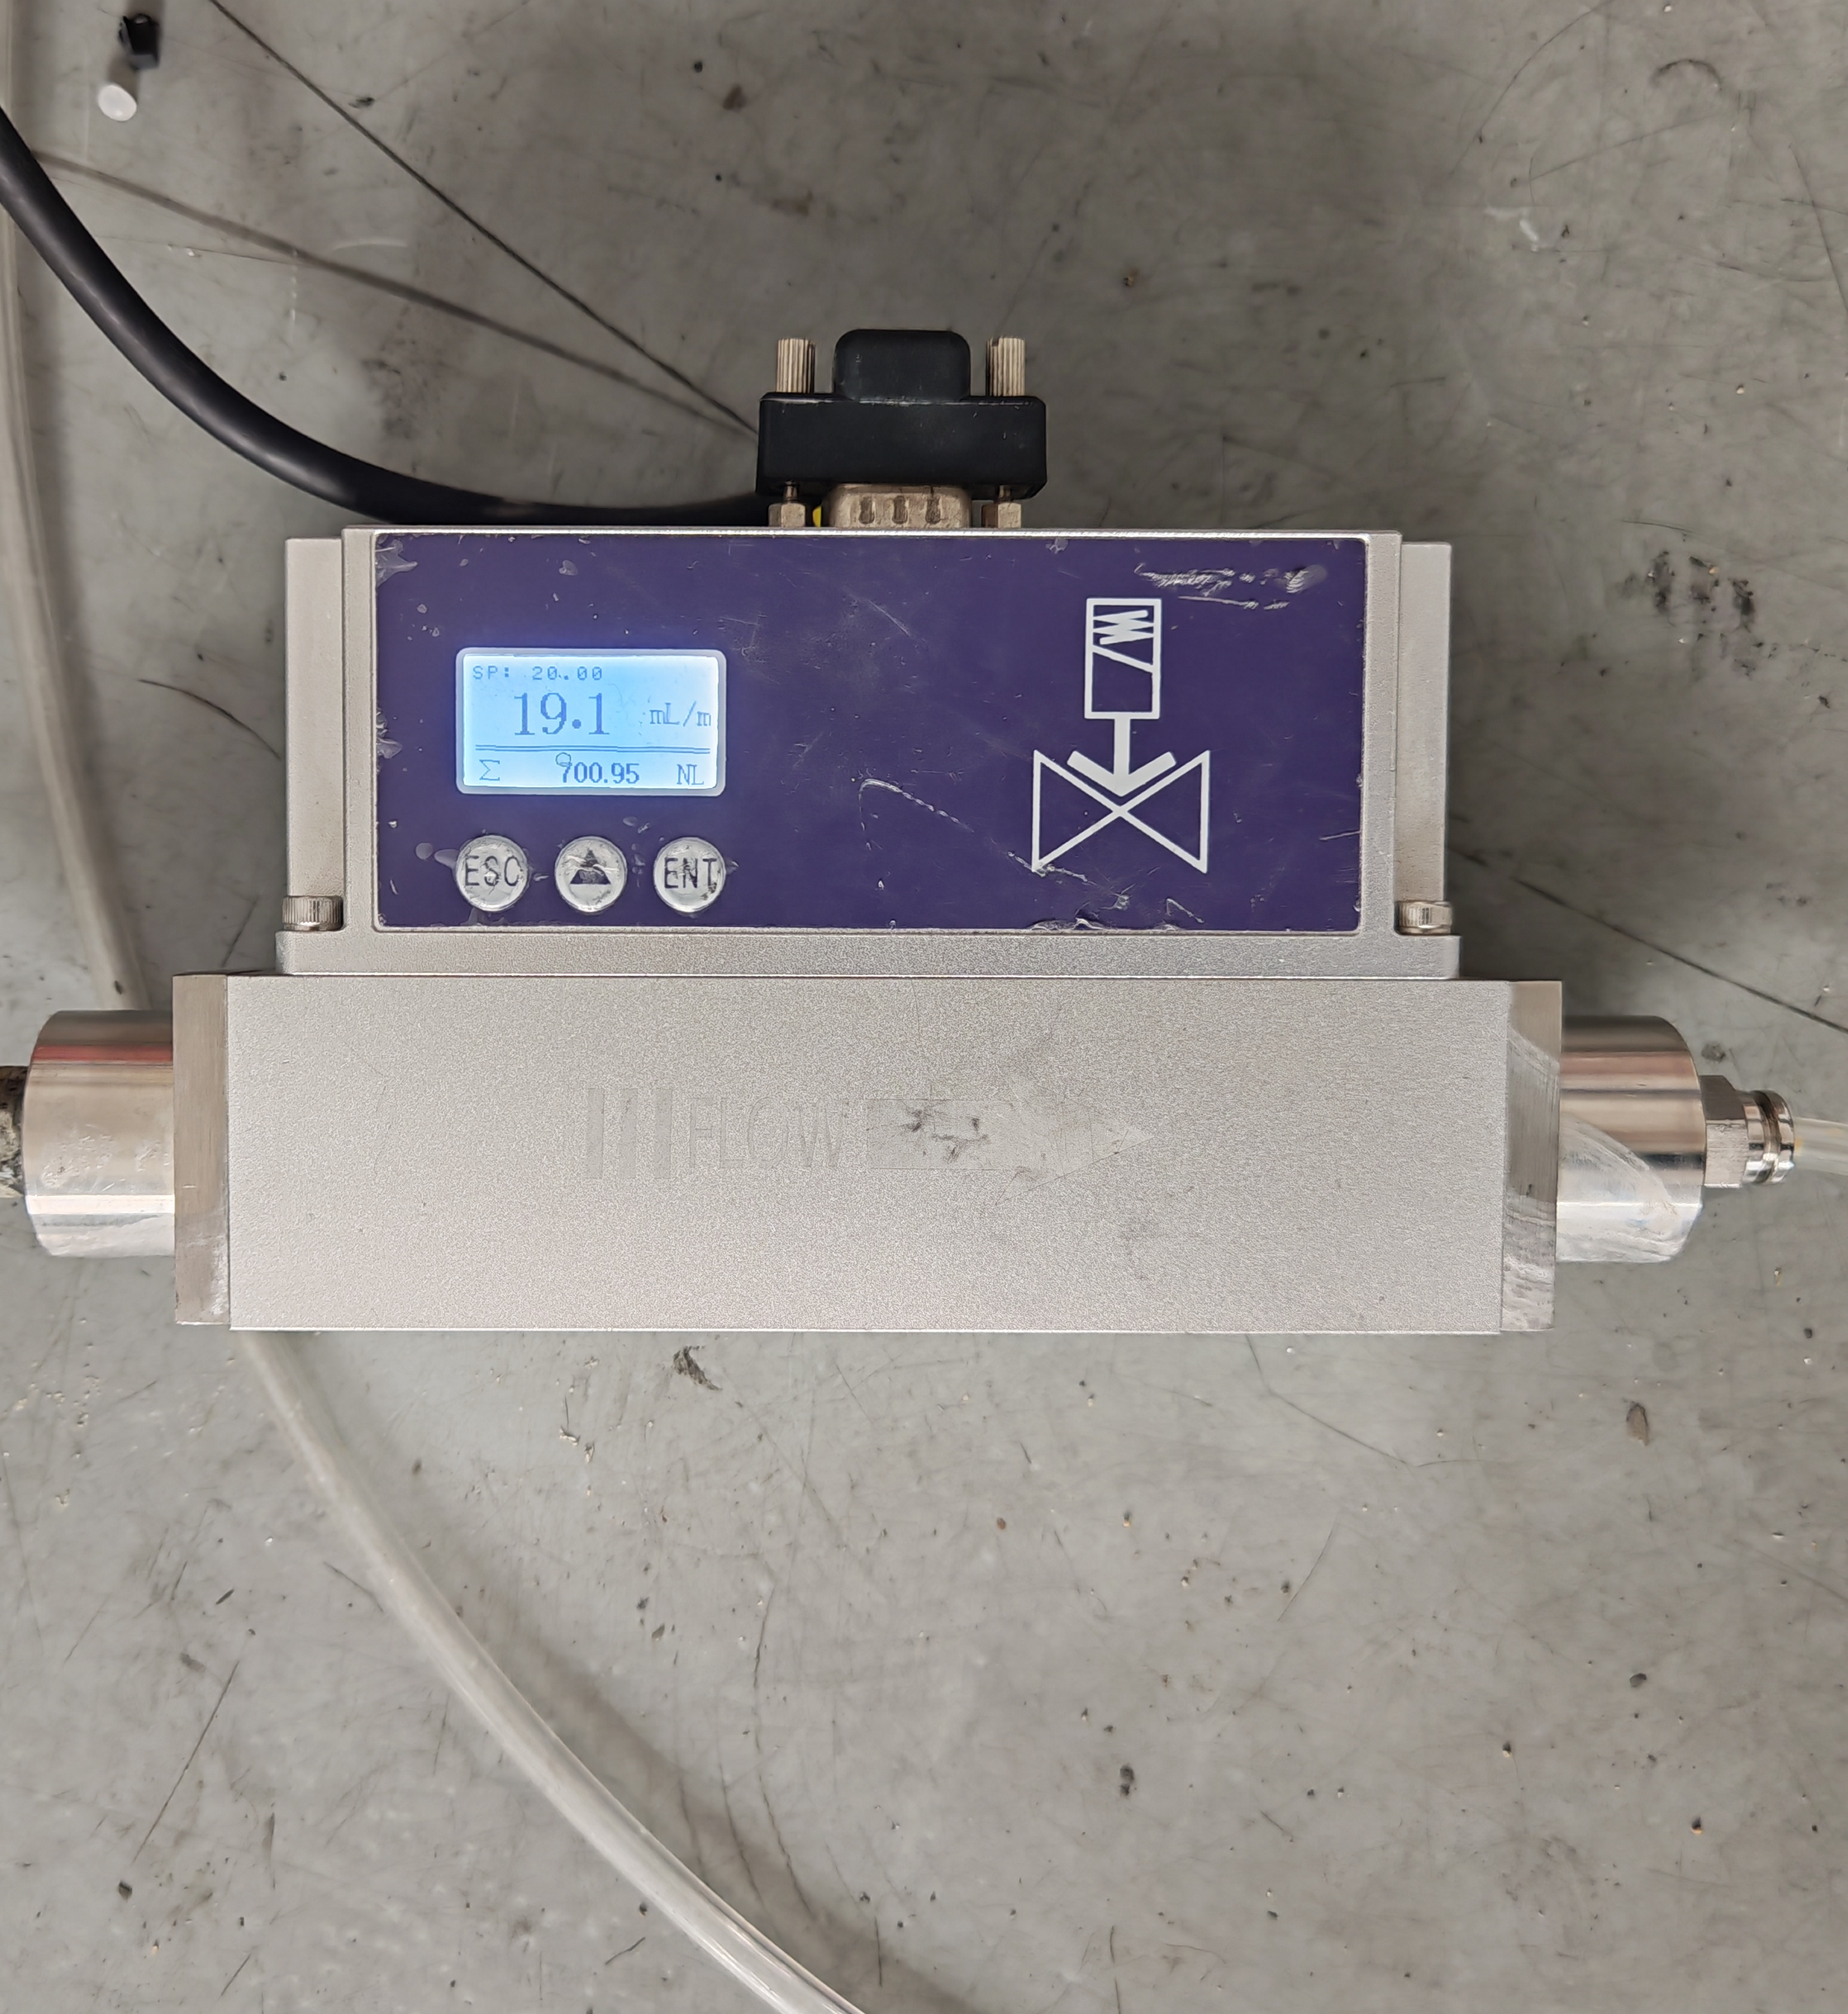
EXPERIMENT
Parametric Study: Effect of Operating Conditions
Catalyst Loading
Flow Control & Exhaust
Hydrogen Reduction
Methane Quantitative Feeding
Catalytic Decomposition
Gas Collection and Analysis

Slide 7
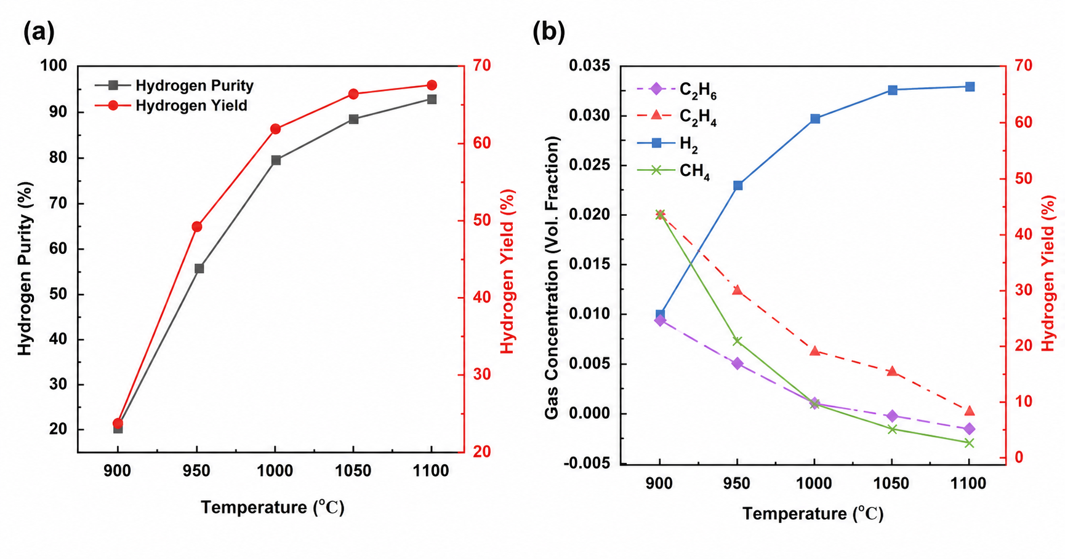
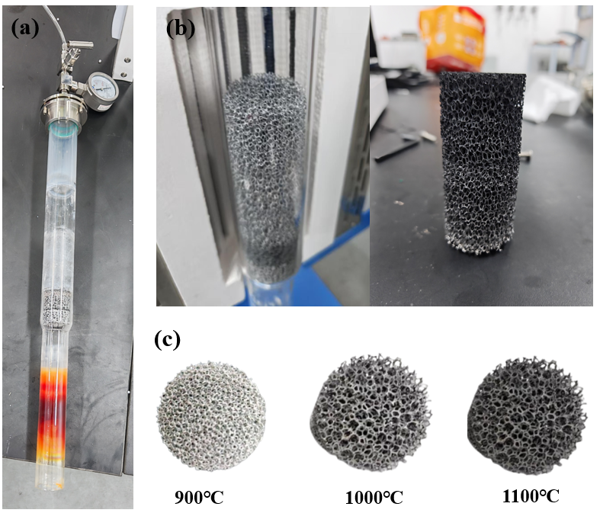
EXPERIMENT
Parametric Study: Effect of Operating Conditions
Temperature is the dominant variable: conversion surges from 11.6% → 70.6% at 900→1000 °C
Notes:
Temperature is the most important variable.
From 900 to 1000°C, conversion jumps from 11.6% to 70.6%.
This large change in a small temperature range shows that precise temperature control is critical.
Induction heating gives us exactly that.

Slide 8
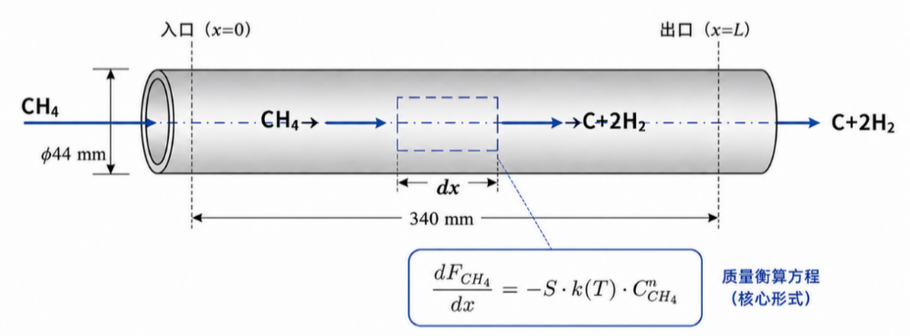
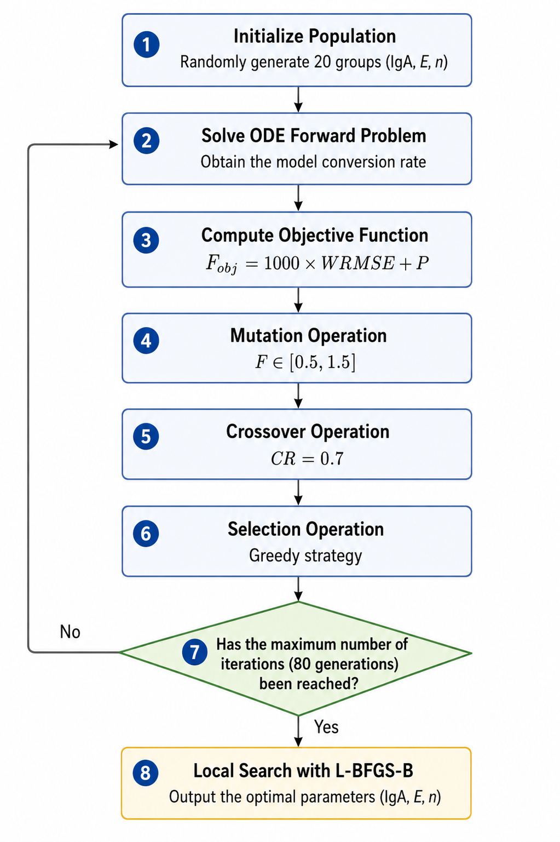
KINETIC INVERSION
1-D PFR Model + Differential Evolution Algorithm
Differential Evolution
Rate Law
r = A · exp(−Ea / RT) · C_CH₄ⁿ
› 1-D isothermal PFR with volume expansion correction
› Radau ODE solver for forward problem
› Differential Evolution (DE/rand/1/bin) for inverse problem
› Weighted RMSE objective, 80 generations × pop. 20
› Validated against 5 temperature data points (900–1100 °C)
Notes:
To simulate the reaction, we need kinetic parameters.
We used an inverse problem approach.
The rate law is: r = A × exp(−Ea / RT) × C_CH₄ⁿ
We set up a 1-D plug flow reactor model, as shown on the left.
Then we applied the Differential Evolution algorithm — shown on the right —
to find the best parameters that match our experimental data.
The algorithm runs for 80 generations with a population of 20.

Slide 9
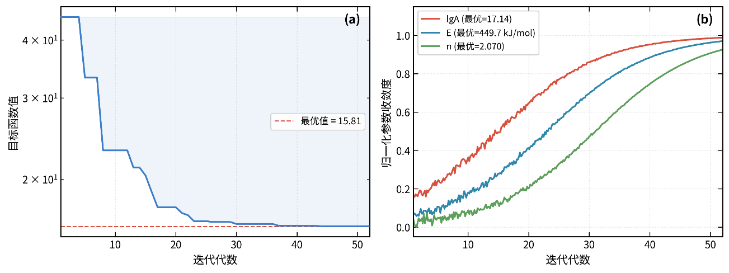
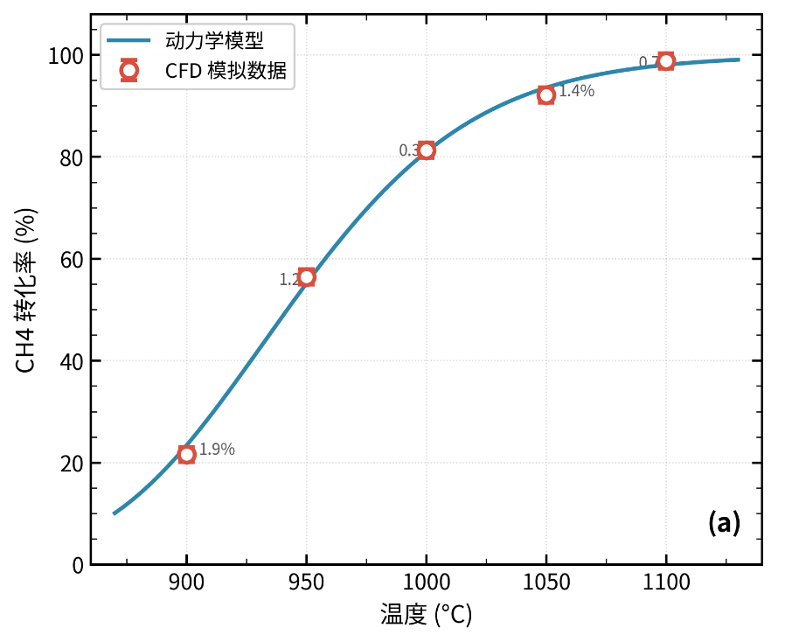
KINETIC INVERSION
Result
Inversion results of methane cracking reaction kinetic parameters
Parameters | Symbols | Units | Optimal Values
Pre-exponential factor logarithm | lg A | — | 17.1392
Pre-exponential factor A | A | min⁻¹ | 8.27 × 10¹⁸
Activation energy E | E | kJ · mol⁻¹ | 449.7
Reaction order n | n | — | 2.0701
Minimum objective function value F_obj | F_ obj | — | 15.81
Notes:
Let's look at the results.
Figure (a) shows the objective function converging to a minimum value of 15.81.
The convergence is clear and stable.
Figure (b) shows the three parameters — lgA, E, and n — all converging smoothly.
The key results are in the table below:
Activation energy E = 449.7 kJ/mol, reaction order n = 2.07.
Figure (c) on the right is the most important —
the blue line is our kinetic model, and the red circles are the CFD simulation data.
The maximum error is less than 2% across all five temperature points.
The model is validated and reliable.

Slide 10
3-D SIMULATION
COMSOL Multiphysics — Equivalent Porous Media (EPM) Model
Electromagnetic
LTNE Heat Transfer
AC/DC — Magnetic Fields
Local Thermal Non-Equilibrium
› Eddy current induction
› Separate T_solid / T_fluid
› Joule heat source Q_IH
› Inter-phase heat exchange coeff.
› Symmetry: 1/4 cylinder domain
› Radiation (Rosseland approx.)
Porous Flow
Chemical Reaction
Darcy–Forchheimer
Species Transport + Source
› Pressure-driven CH₄ flow
› CH₄ → C + 2H₂
› Porosity ε, permeability K
› Arrhenius rate (inverted params)
› Forchheimer inertia correction
› Carbon deposition tracking
Model validated against experimental conversion (all T-points, ΔX < 3%) and temperature field
Notes:
Our 3-D model couples four physics in COMSOL.
We treat the porous foam as an Equivalent Porous Media — one uniform medium with effective properties. This saves computation time while keeping the key physics.
The four modules are: Electromagnetics — computes the induction heating source. LTNE heat transfer — solid and gas have separate temperatures, because inside a porous medium they are not equal. Darcy-Forchheimer flow — for methane flowing through the pores. Chemical reaction — species transport and carbon deposition.
All four are fully coupled. Model error is less than 3%.

Slide 11
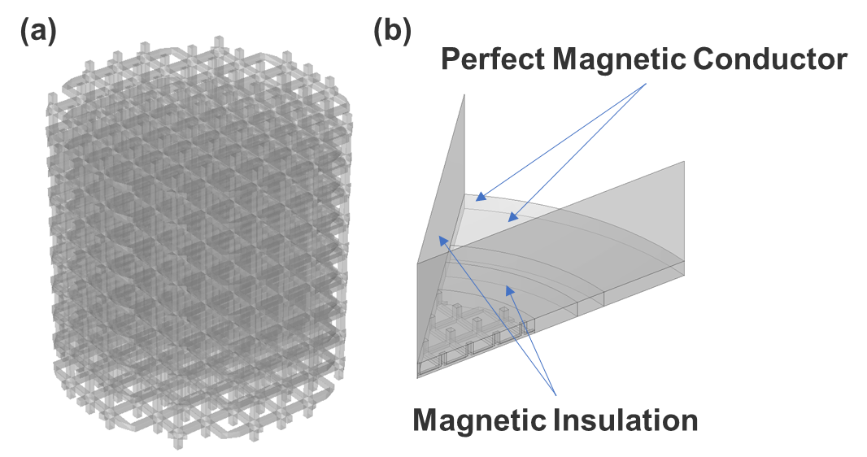

3-D SIMULATION
COMSOL Multiphysics — Equivalent Porous Media (EPM) Model
This figure verifies the accuracy of the Equivalent Porous Media (EPM) model by comparing the radial power density distribution with discrete porous and non-porous cases.
Notes:
This slide validates the electromagnetic part of our EPM model.
We compare the radial power density between the discrete porous model and the EPM model — for two pore sizes.
You can see the curves match well — low in the center, rising near the outer edge.
More importantly: compared to solid metal, the porous foam shows much deeper electromagnetic penetration. This is because the pores reduce the effective conductivity and permeability, which increases the skin depth.
This is the fundamental reason why porous foam is better for induction heating — the heat is generated deeper and more uniformly inside the material.

Slide 12
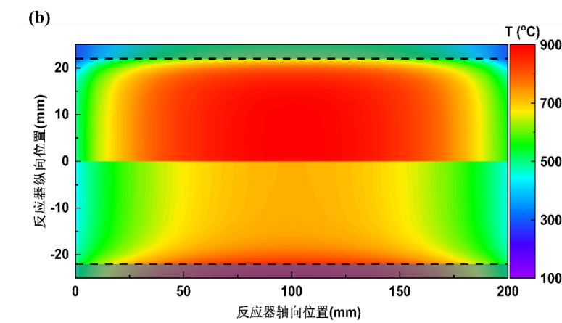
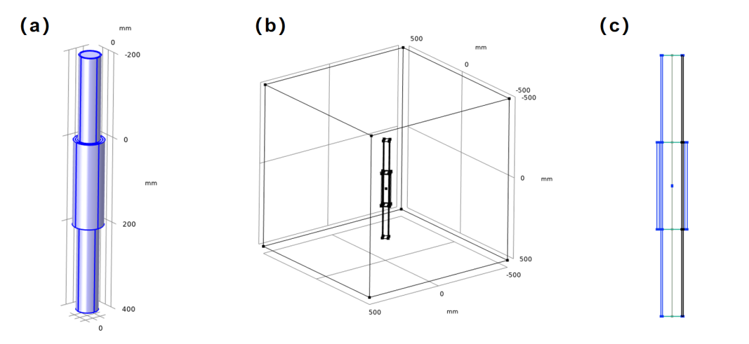
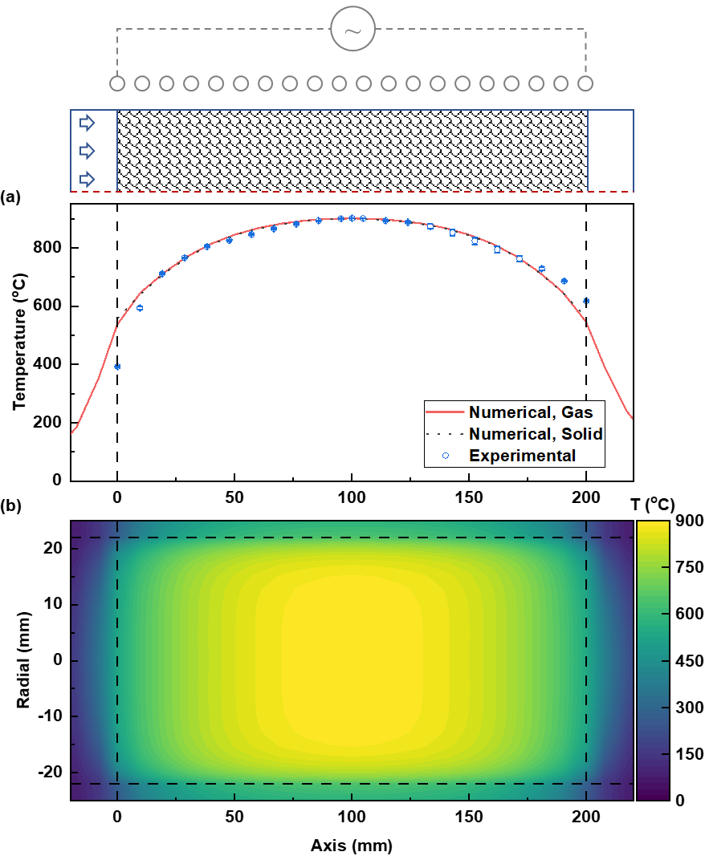
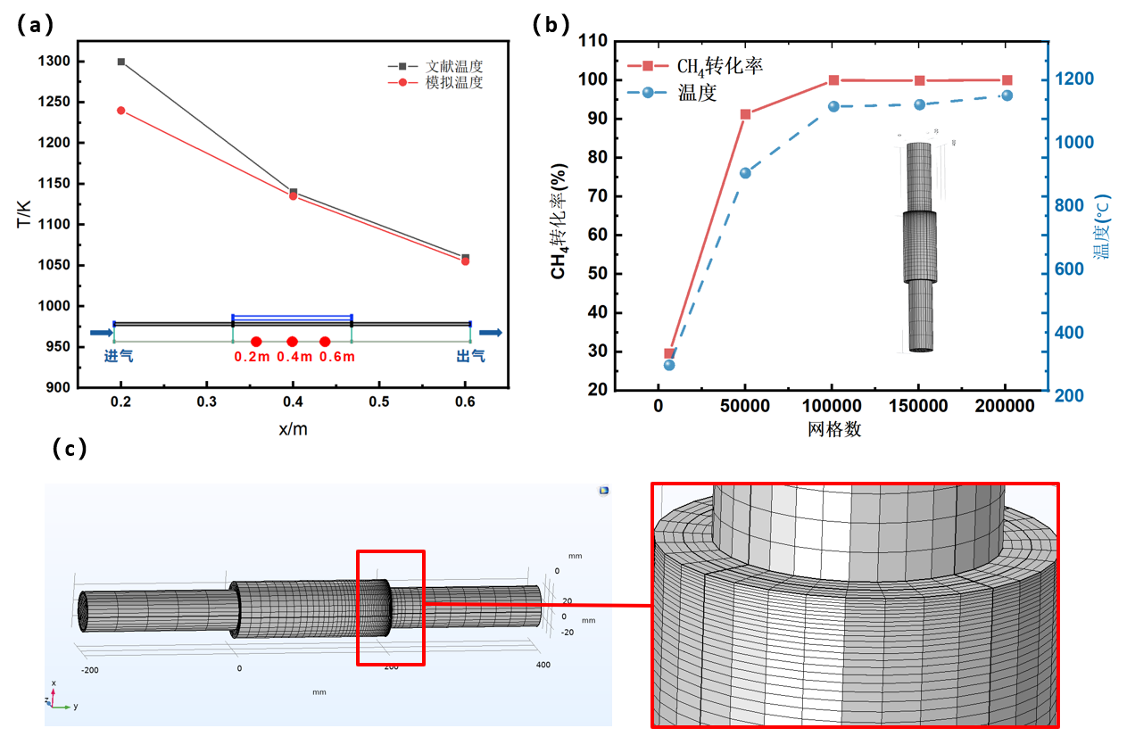

CFD RESULTS
Key Simulation Findings
Model validated against literature data ✔
Grid independence confirmed at >100k cells
Local mesh refinement in heating zone
Volumetric & uniform heating achieved
Stable 700–900°C in reaction zone
No severe hotspots observed
7 / 13
Notes:
This slide shows our main CFD validation results.
The bottom-left figure confirms grid independence at more than 100,000 cells.
The middle figure is critical — it compares the axial temperature profile from our simulation
against experimental measurements.
The numerical results for both gas and solid temperature match the experiments very well.
On the right is the 2D temperature distribution inside the reactor.
You can see a uniform red zone in the center — this is the reaction zone, stable at around 700 to 900°C.
No severe hotspots are observed.
This confirms that induction heating achieves truly volumetric and uniform heating.

Slide 13
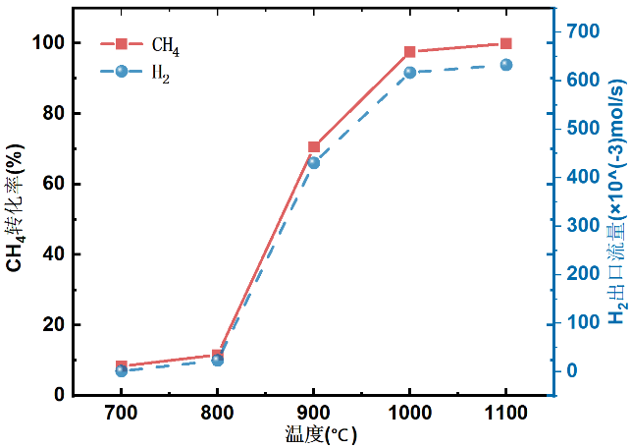
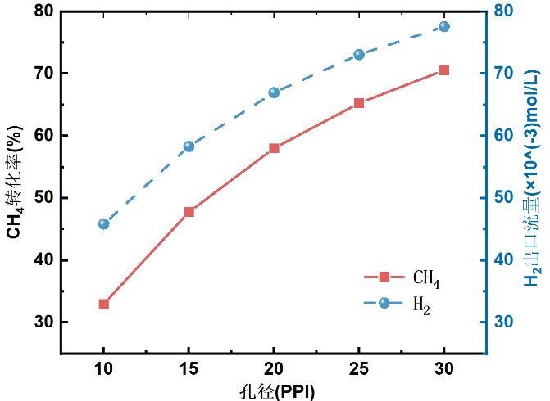
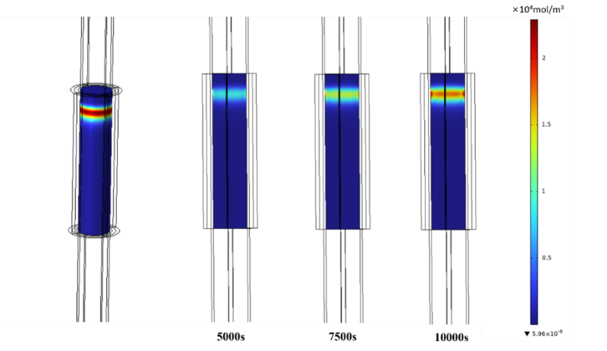
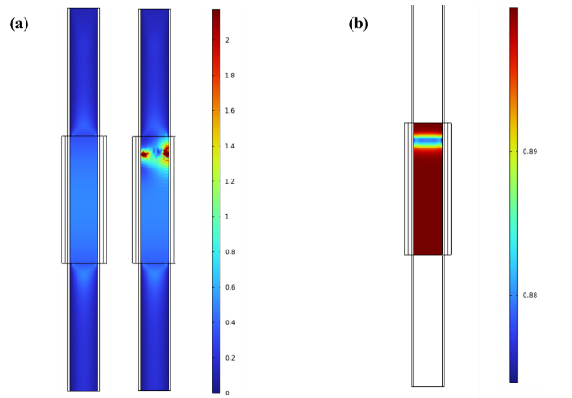
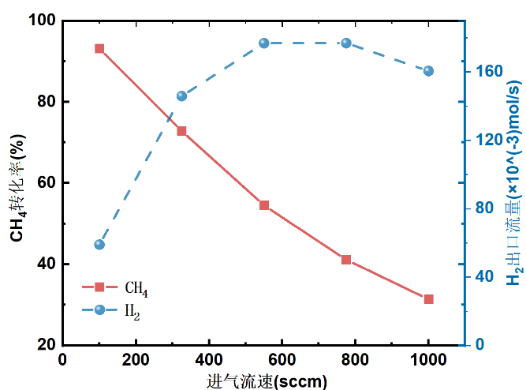
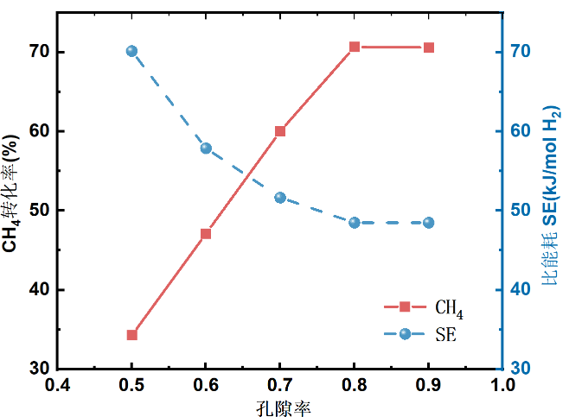
CFD RESULTS
CFD RESULTS
Key Simulation Findings
Temperature Effect
Pore Size (PPI) Effect
Carbon Deposition Evolution
Flow Rate Effect
Porosity & Energy Efficiency
Carbon layer grows with time
Deposition concentrated in heating zone
7 / 13
Notes:
This slide summarizes our parametric simulation results.
Top-left: PPI effect. Higher PPI means smaller pores and larger surface area.
As PPI increases from 10 to 30, methane conversion increases significantly.
More surface area means better catalytic contact.
Bottom-left: Flow rate effect.
Higher flow rate reduces conversion — less residence time for reaction.
But total hydrogen output first increases then decreases, showing an optimal flow rate exists.
Bottom-middle: Porosity and energy efficiency.
There is a clear trade-off — higher porosity improves conversion but reduces energy efficiency.
On the right: Carbon deposition evolution over time — at 5000, 7500, and 10000 seconds.
The carbon layer grows gradually, and deposition is concentrated in the heating zone.
This is important for predicting catalyst lifetime.

Slide 14
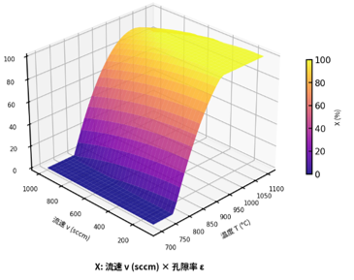
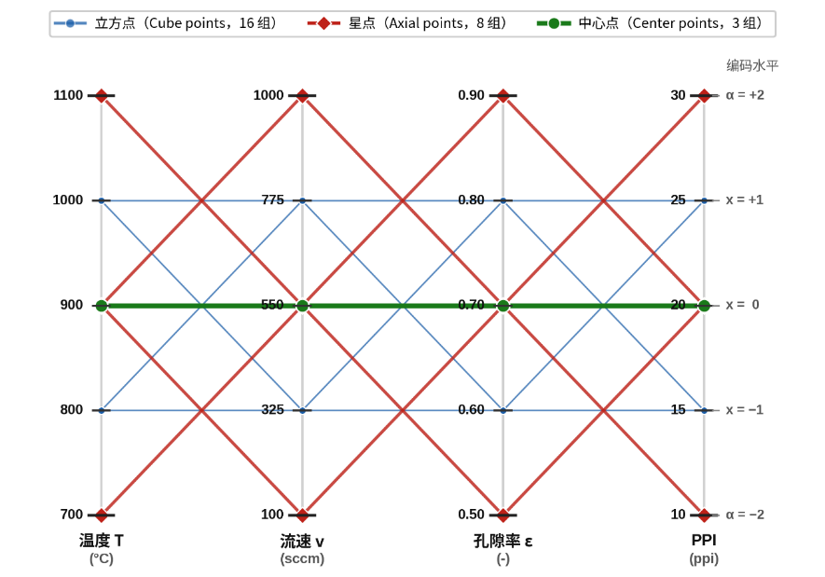
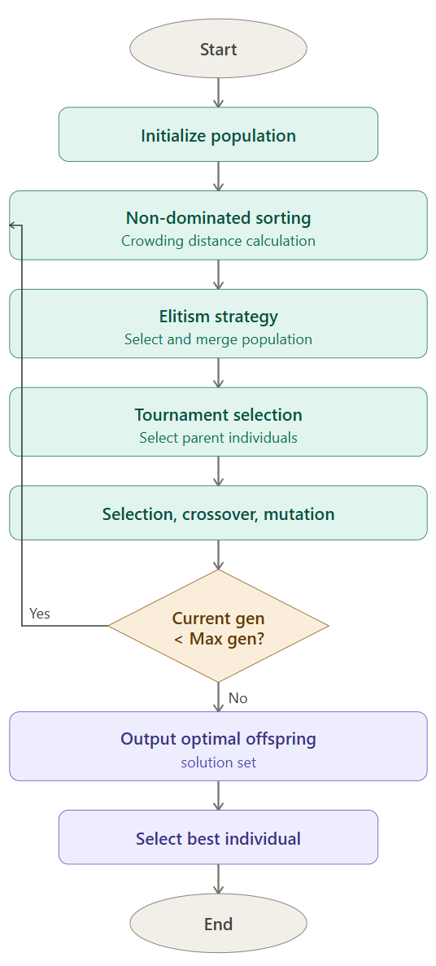
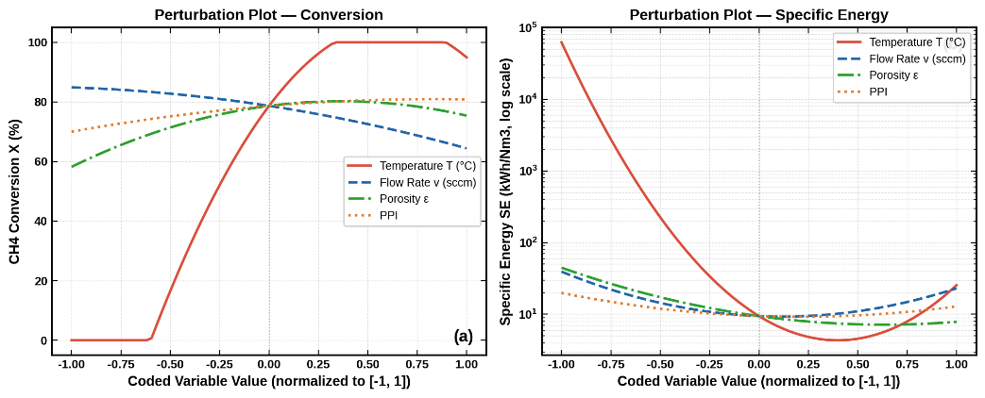
OPTIMIZATIONN
Design of Experiments: CCD
Response Surface Model, RSM
NSGA-II Multi-Objective Optimization
Effect on CH₄ conversionDominant factor: Temperature (strong positive correlation)
Effect on specific energy consumption
Dominant factor: Temperature (strong negative correlation)
Notes:
Now for the optimization.
We have two competing objectives:
maximize methane conversion, and minimize specific energy consumption.
We used a Central Composite Design with 27 points — shown on the left.
The variables are: temperature, flow rate, porosity, and pore size.
The response surface model on the middle clearly shows:
Temperature has a strong positive effect on conversion (curve rises steeply),
but a strong negative effect on energy consumption (curve falls steeply).
We then applied the NSGA-II algorithm (Non-dominated Sorting Genetic Algorithm II)— shown on the right — to find the Pareto-optimal solutions.

Slide 15
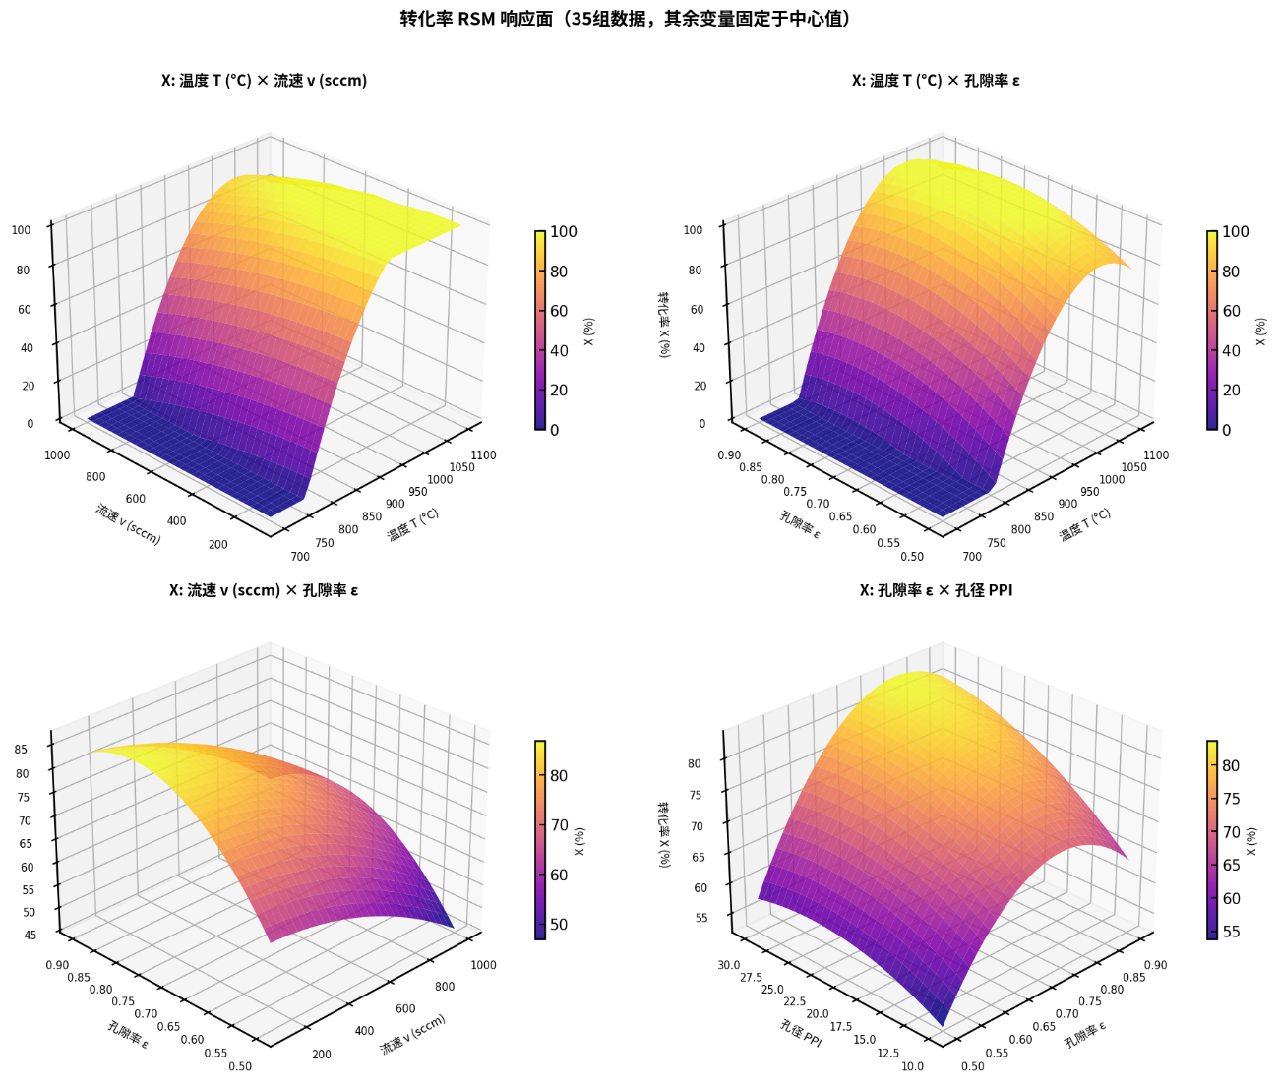
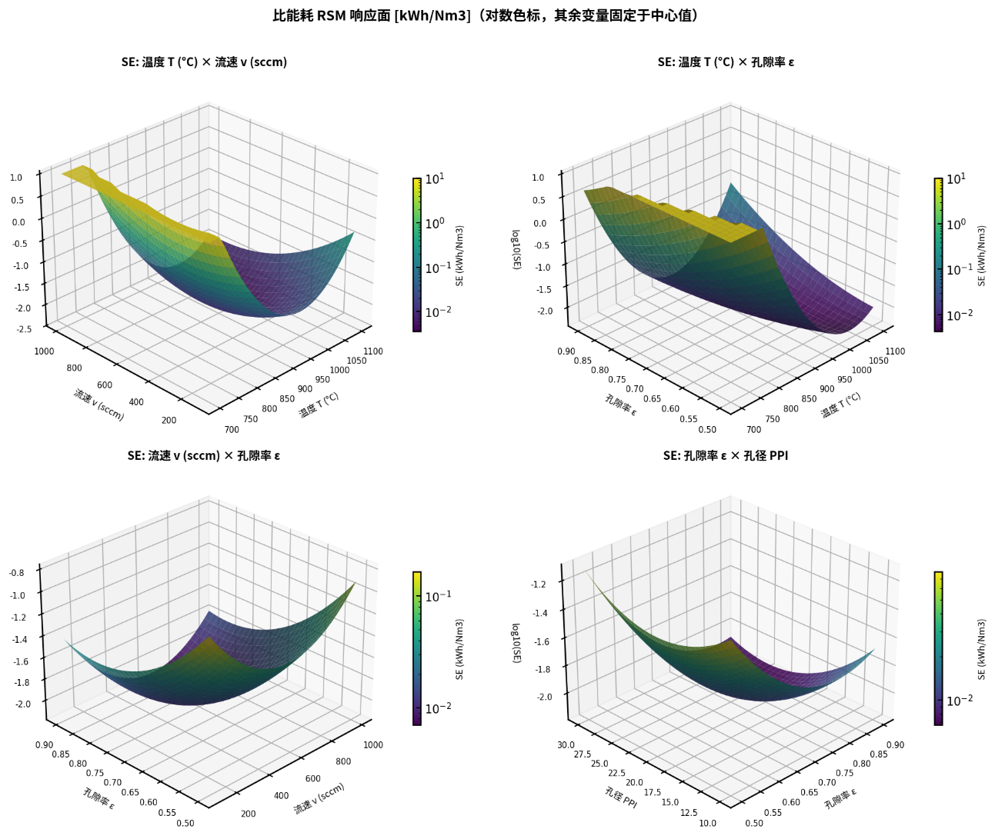
OPTIMIZATIONN
NSGA-II Multi-Objective Optimization
Notes:
These eight 3-D response surfaces show how conversion and specific energy change
with each pair of variables.
In all the conversion surfaces on the left, the temperature axis always shows the steepest rise —
confirming temperature as the dominant factor.

Slide 16
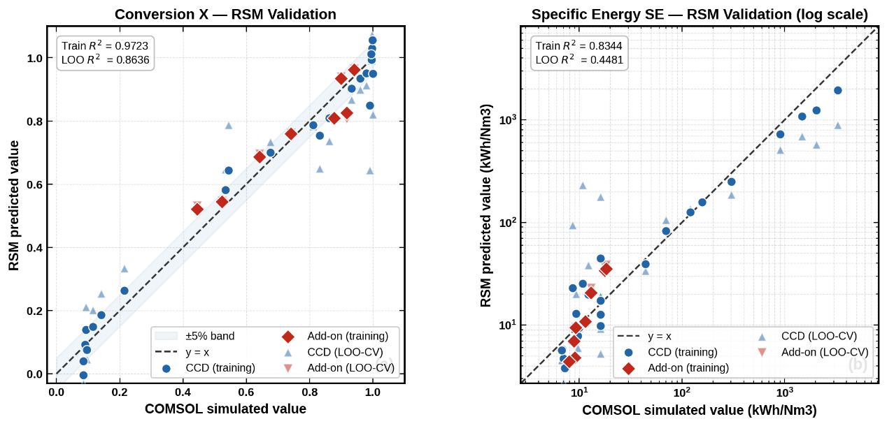
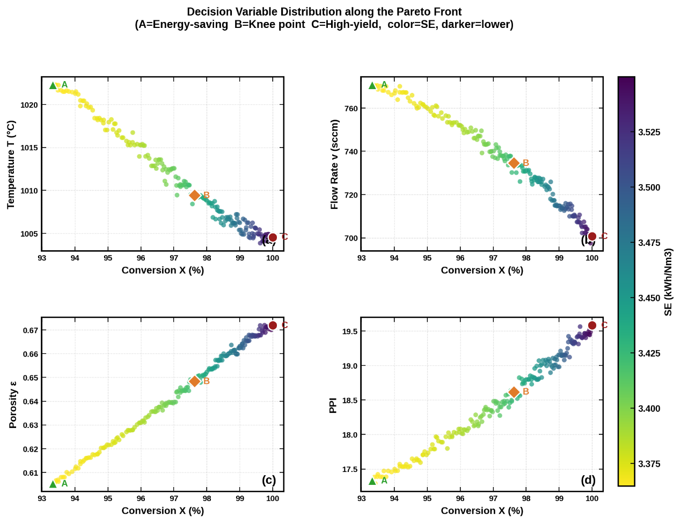
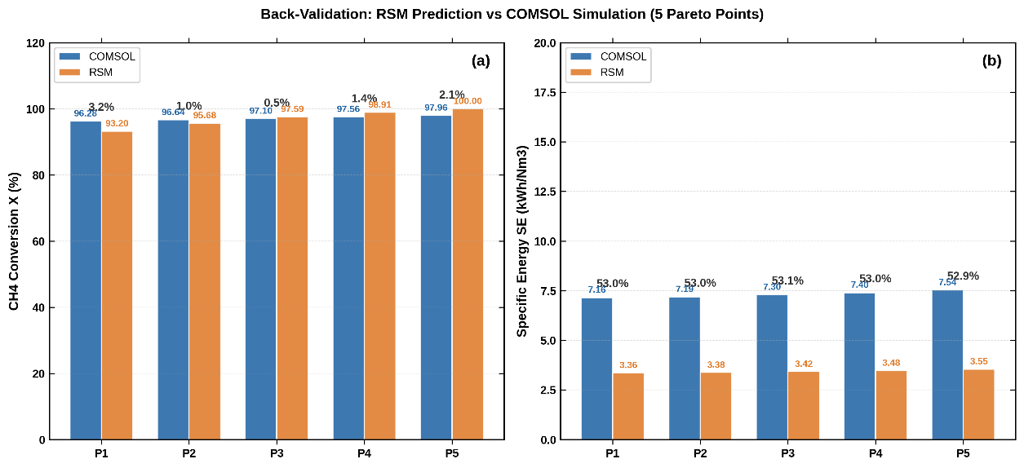
OPTIMIZATIONN
NSGA-II Multi-Objective Optimization
Notes:
The RSM model is validated against COMSOL simulation.
The R² value for conversion is 0.97 — very good accuracy.
The right side shows decision variable distribution along the Pareto front.
Three representative points are marked: A (energy-saving), B (knee point), and C (high-yield).

Slide 17
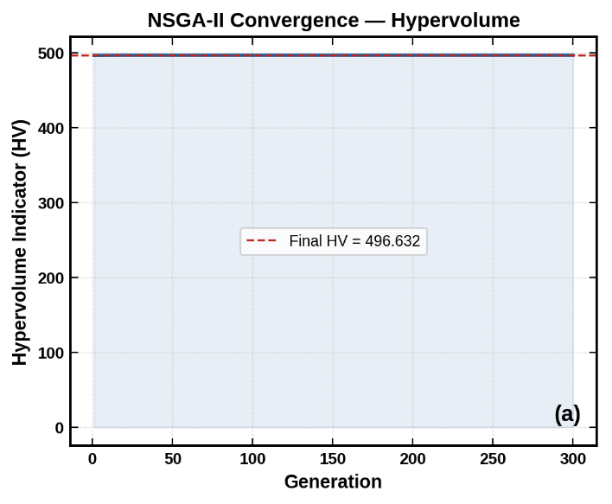
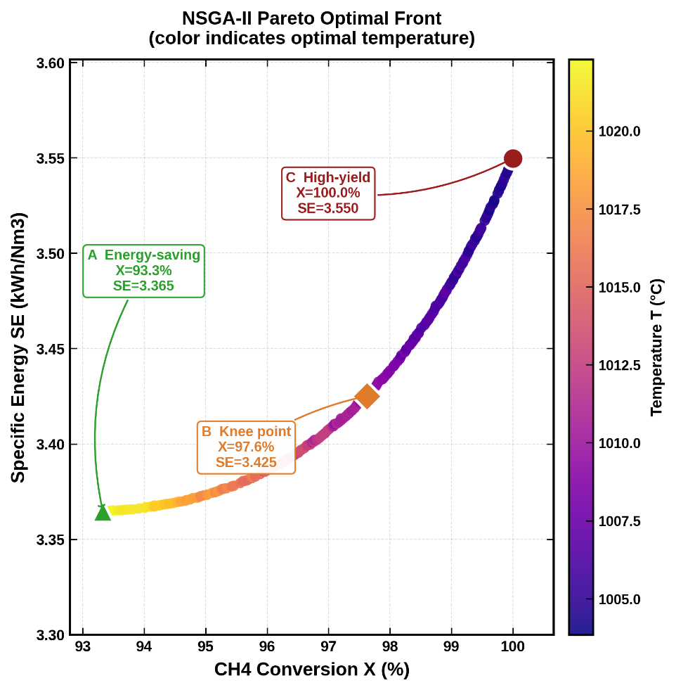
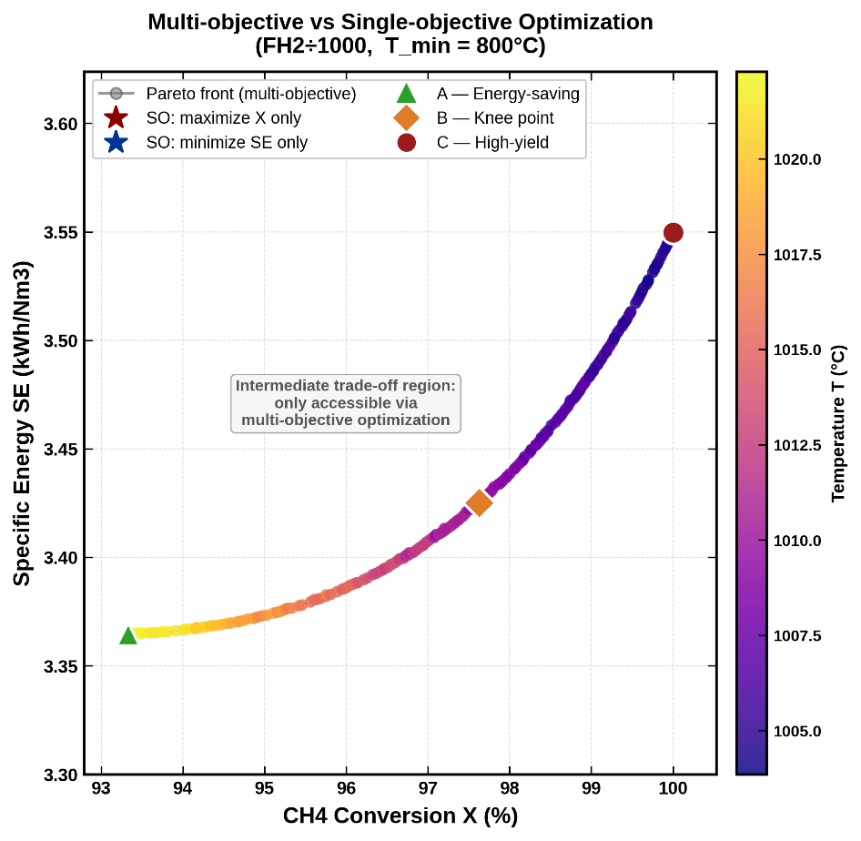
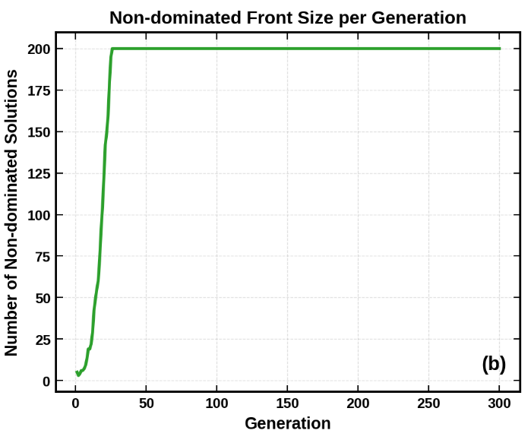
OPTIMIZATIONN
NSGA-II Multi-Objective Optimization
Notes:
This is our final result.
The left figure shows NSGA-II converging stably after about 50 generations.
The middle figure is the Pareto optimal front — the most important result.
The x-axis is methane conversion, the y-axis is specific energy consumption.
Color indicates temperature.
Three key operating points are identified:
Point A (Energy-saving): Conversion = 93.3%, Energy = 3.365 kWh/Nm³
Point B (Knee point): Conversion = 97.6%, Energy = 3.425 kWh/Nm³ — best trade-off
Point C (High-yield): Conversion = 100%, Energy = 3.550 kWh/Nm³
The right figure compares multi-objective versus single-objective optimization.
The shaded region in the middle — the intermediate trade-off zone —
is only accessible through multi-objective optimization.
Single-objective methods miss this region entirely.
This Pareto front gives engineers a clear map to choose operating conditions
based on their specific priorities.

Slide 18
InterPore 2026 · Oral Presentation
Thank you for your attention
Multiphysics Simulation · Kinetic Inversion · Multi-Objective Optimization
Speaker : Zhuoran Wei | School of Energy Science & Engineering, Harbin Institute of Technology
Supervisor: Prof. Ruming Pan
May 2026
Notes:
To summarize our work:
We built a complete research chain —
from induction-heating experiments,
to kinetic inversion,
to validated 3-D multiphysics simulation,
to multi-objective optimization.
The results show that induction-heated porous metal foam
is a highly promising platform for clean hydrogen production.
Thank you very much. I am happy to answer your questions.

