Slide 1
Impact of fluvial reservoir heterogeneities on underground hydrogen storage operations
Diya Sunil Kumbhat¹ and Anozie Ebigbo¹, Jan Niederau²
¹Chair of Hydromechanics, Helmut Schmidt University, Hamburg, Germany
²Fraunhofer IEG, Fraunhofer Institution for Energy Infrastructures and Geotechnologies, IEG, Aureliusstr. 2, 52062 Aachen, Germany

Slide 2
Introduction
Hydrogen to play a key role in all energy transition pathways to mitigate effects of climate change
The International Energy Agency predicts hydrogen production to reach 530 Mt by year 2050¹
Storage requirements for hydrogen set to increase.
Notes:
“Stored hydrogen is used to help balance both seasonal fluctuations in electricity demand and
imbalances that may arise between the demand for hydrogen and its supply by off‐grid
renewable systems.”
IEA: Bouckaert, S., Pales, A. F., McGlade, C., Remme, U., Wanner, B., Varro, L., ... & Spencer, T. (2021). Net zero by 2050: A roadmap for the global energy sector.
https://trid.trb.org/View/1856381

Slide 3
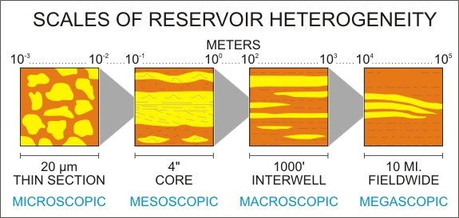
Introduction
Large scale underground hydrogen storage (UHS) in porous media cost effective and necessary
Geological reservoirs are inherently heterogenous.
Heterogeneity is determined by sedimentary processes and consequent diagenesis.
Different techniques are used to assess heterogeneities at various scales (e.g. forward modelling, geostatistics).
Accurate understanding of fluid flow behaviour in response to heterogeneities is important for maximising hydrogen recovery
Classification of heterogeneities in reservoirs according to scale. Kraus, et al. (1987).
Notes:
Underground hydrogen storage (UHS) is the storage of large-scale quantities of hydrogen in the porous subsurface. UHS can provide a reliable means of energy storage to buffer the spatio-temporal variability of renewable energy supply. Geological heterogeneities in the subsurface occur at multiple scales and can have varied effects on fluid flow. The cyclical nature of UHS necessitates the investigation of the effects of different types of geological heterogeneities. To this end this work explore the effects of large-scale geological heterogeneities on UHS operations and plume behaviour.

Slide 4
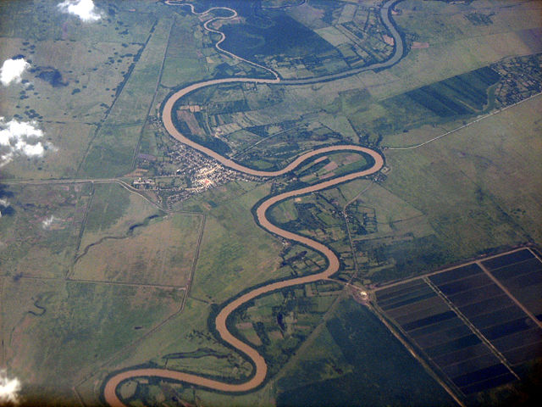
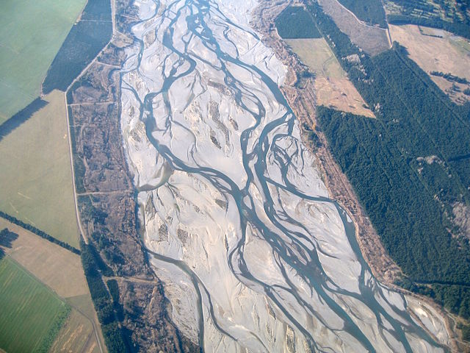
Fluvial reservoirs
Meandering and/or braided channels can act as porous storage mediums
Fluvial systems are characterised by a number of properties such as channel geometry, sinuosity, lateral migration, and avulsion history all control the connectivity and continuity of sand bodies.
The heterogeneities in the subsurface and their characterization will subsequently affect UHS, especially due to its cyclical nature of operations.
Goal is to examine the effect of fluvial
reservoir heterogeneities on UHS operations
Notes:
Information about fluvial reservoirs, occurences , why they are important?
https://opengeology.org/textbook/11-water/
FLUMY is a process-based (or "genetic") sequential simulation software developed to model meandering fluvial systems in 3DUnlike geostatistical approaches, FLUMY simulates the physical processes of channel migration, avulsion, and floodplain aggradation, producing geologically realistic facies architecturesIt generates stochastic realisations of fluvial stratigraphy that honour both process rules and conditioning data (e.g. well logs, seismic)

Slide 5
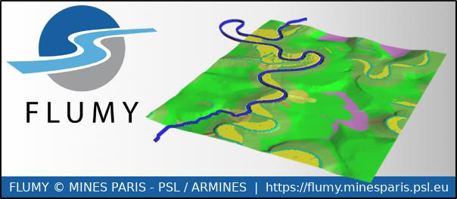
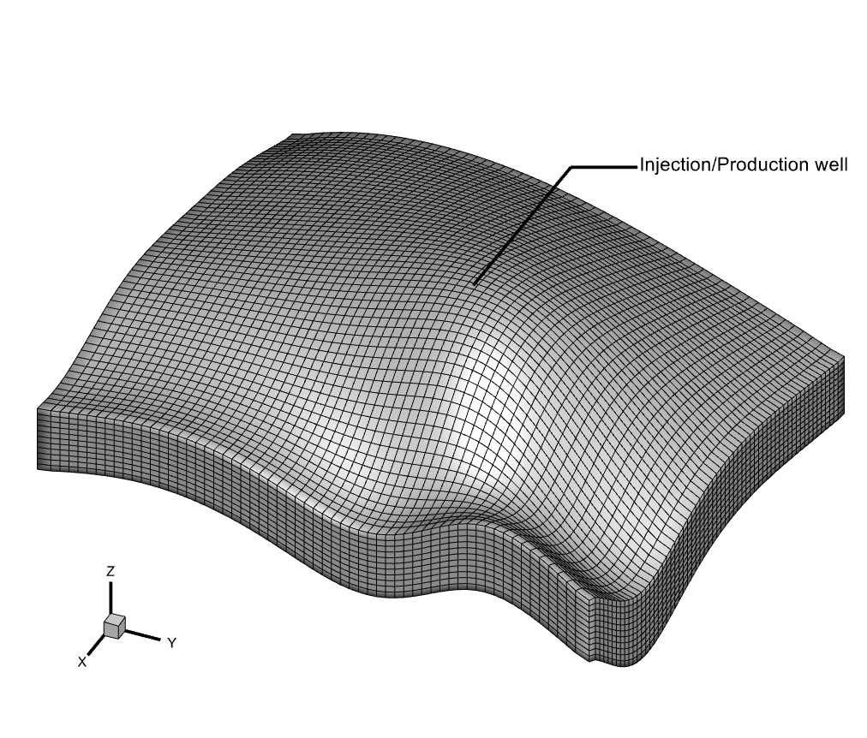
Methodology
FLUMY is a process based and stochastic simulation software for meandering channel systems and associated deposits².
To examine effects of horizontal channel connectivity, 9 scenarios with varying wavelengths and channel width are created.
These facies are upscaled to an anticlinal benchmark model³.
25 m
3050m
3050m
Notes:
FLUMY is a process-based model for meandering channels in both fluvial and turbidites environments. FLUMY combines first-order hydraulic equations to track the evolution of meandering channels and realistically build associated sediment accumulations.
FLUMY™
Process-based channelized reservoir models
Copyright © MINES PARIS - PSL / ARMINES
Free download from https://flumy.minesparis.psl.eu

Slide 6
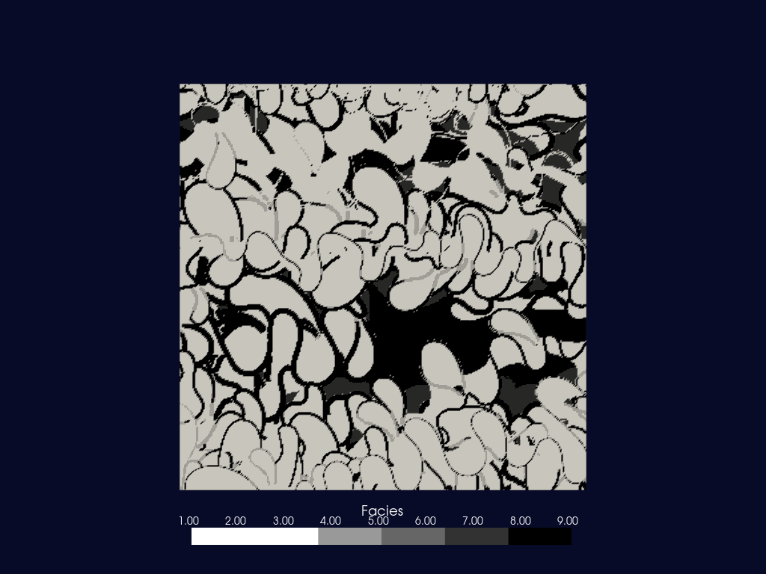
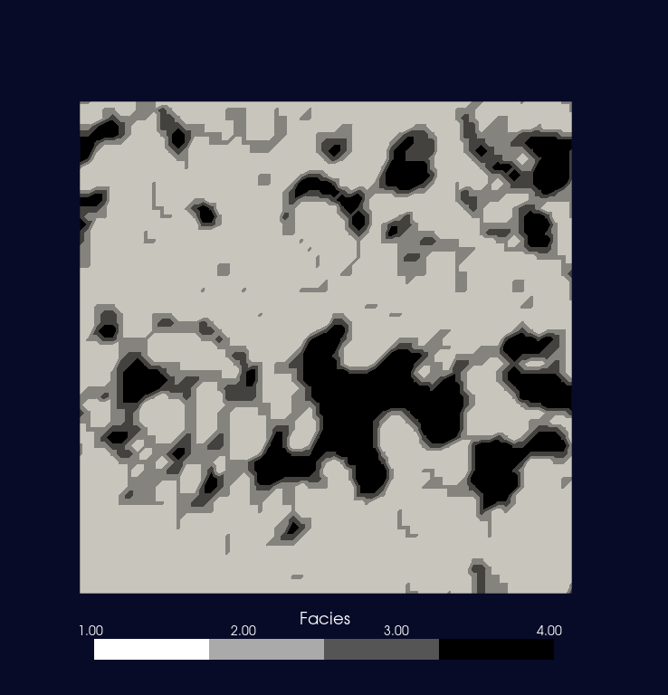
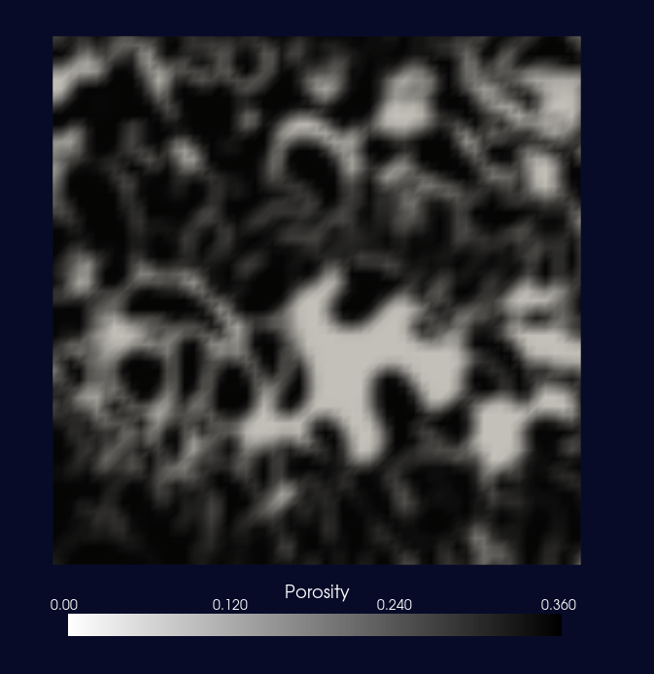
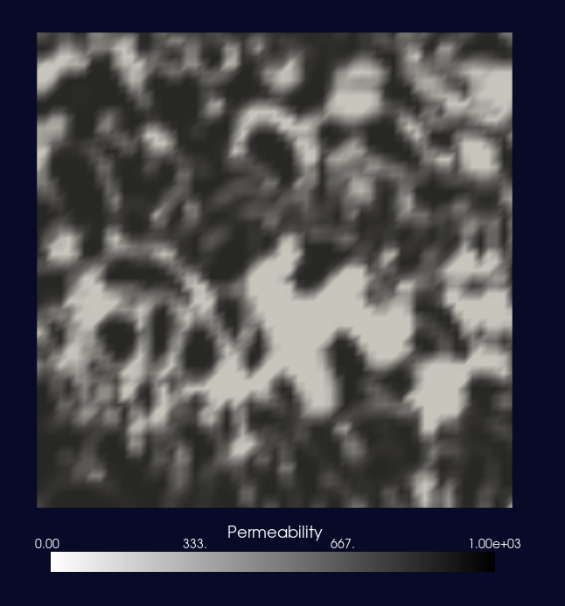
Methodology
FLUMY realization
Upscaled reservoir model
Porosity
Permeability
Arithmetic averaging
Geometric averaging
Notes:
FLUMY software is a modeling tool, both process-based and stochastic, for a meandering channel system and its associated deposits
at the scale of the reservoir.
The model is based on the evolution in time of the channel by migration, cut-off and avulsion, and on the deposition
of point-bar sand, mud plug, crevasse splays, overbank alluvium and organic matter.
Explain FLUMY output in terms of 9 facies
Show upscaled facies.
Summary of perm and por contrast

Slide 7
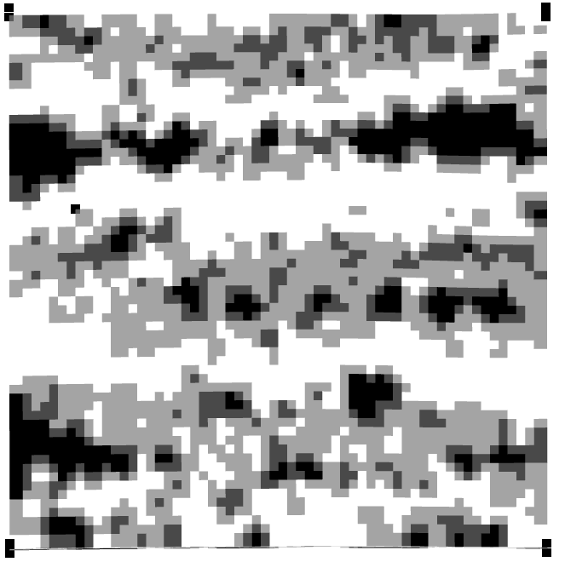
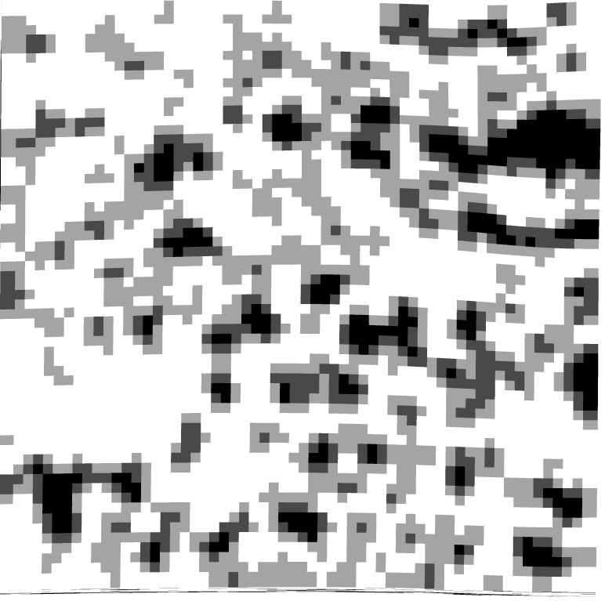
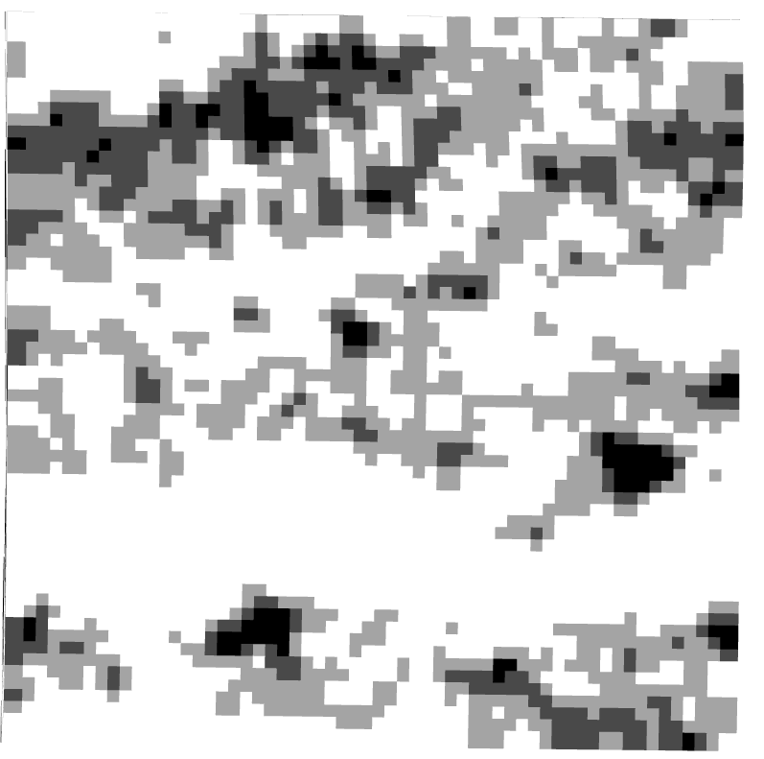


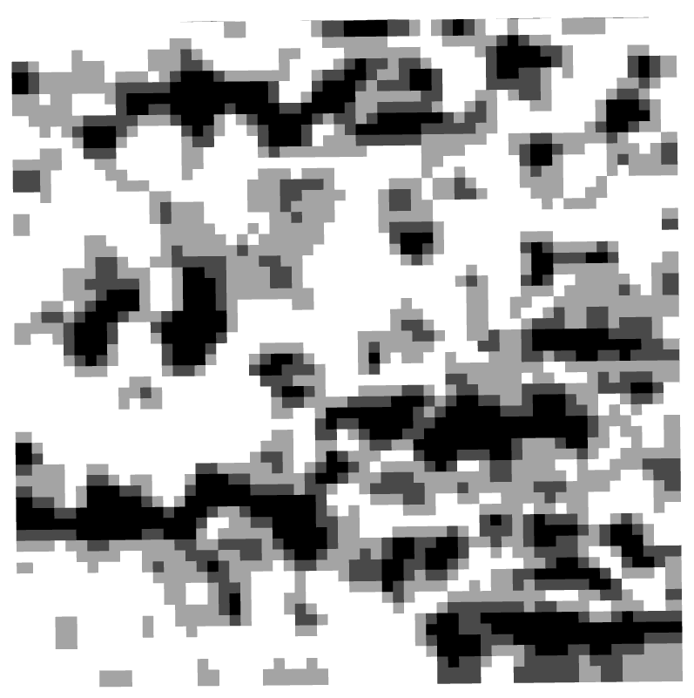
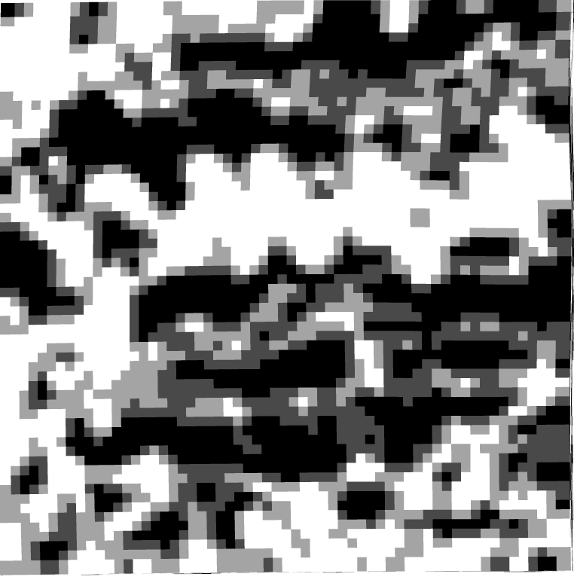
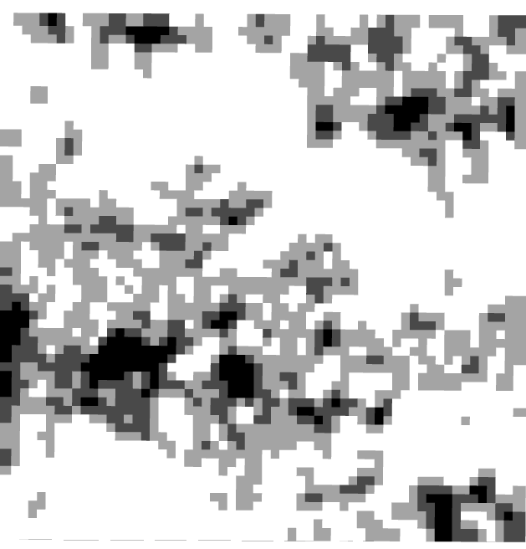
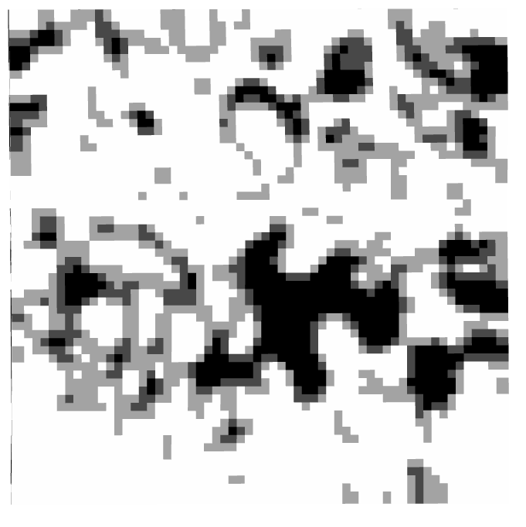
Increasing channel width
W = 25m, λ = 150m | W = 35m, λ = 150m | W = 45m, λ = 150m
W = 25m, λ = 250m | W = 35m, λ = 250m | W = 45m, λ = 250m
W = 25m, λ = 350m | W = 35m, λ = 350m | W = 45m, λ = 350m
Increasing channel wavelength
Notes:
Prelim results: Only these 9 scenarios examined. Ensemble in next step.

Slide 8
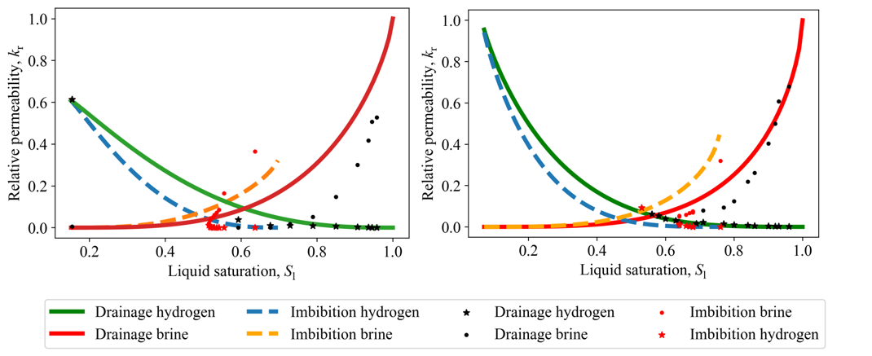

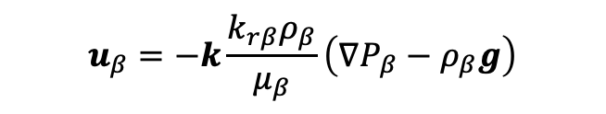

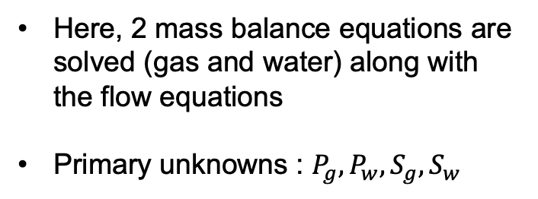

Methodology
$$u_{β}=−k\frac{k_{rβ}ρ_{β}}{μ_{β}}\left(∇P_{β}−ρ_{β}g\right)$$
Boon & Hajibeygi (2022) 10.1038/s41598-022-18759-8
$$S_{g }+ S_{w}=1$$
$$P_{c}=P_{g }− P_{w}$$
$$k_{rβ}\left(S_{w}\right) ; P_{c}\left(S_{w}\right)$$
Here, 2 mass balance equations are solved (gas and water) along with the flow equations
Primary unknowns : $P_{g},P_{w}, S_{g}, S_{w}$
Calibration to experimental relative permeability hysteresis dataset²

Slide 9
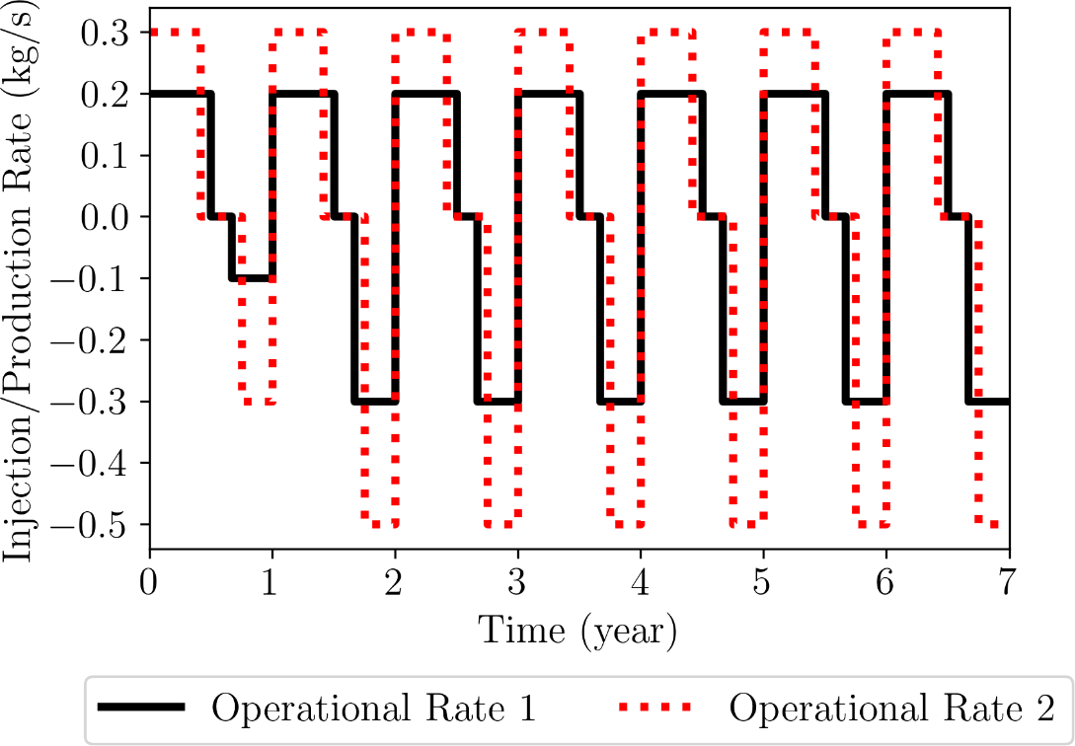
Methodology
TOUGH3⁴ simulator is used for studying injection and extraction process.
In order to model the thermodynamic behavior of the fluids the EWASG⁵ (Equation-of-State for Water, Salt and Gas) module has been applied.
Hydrogen injection and production was modelled assuming isothermal conditions.
The Hysteresis model⁶ in TOUGH3 is adapted from the Van Genuchten relative permeability model and calibrated in this study based on a published relative permeability experimental dataset⁷.

Slide 10
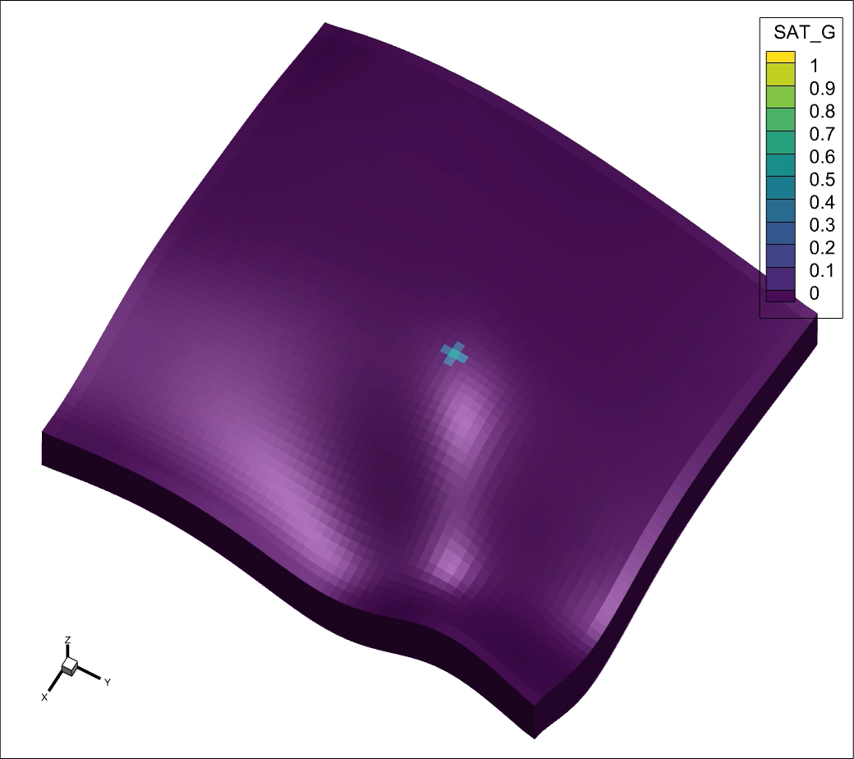
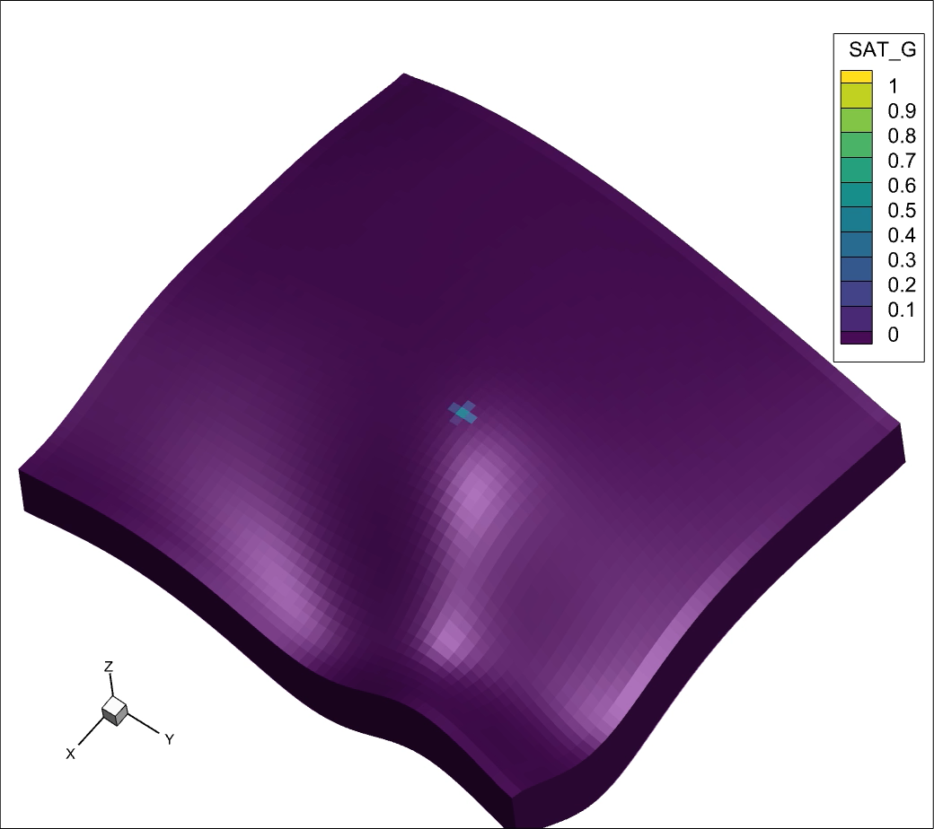
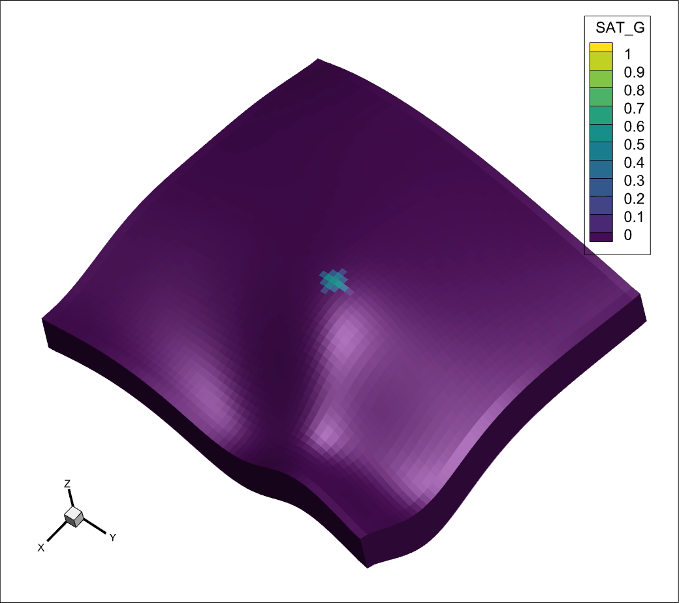
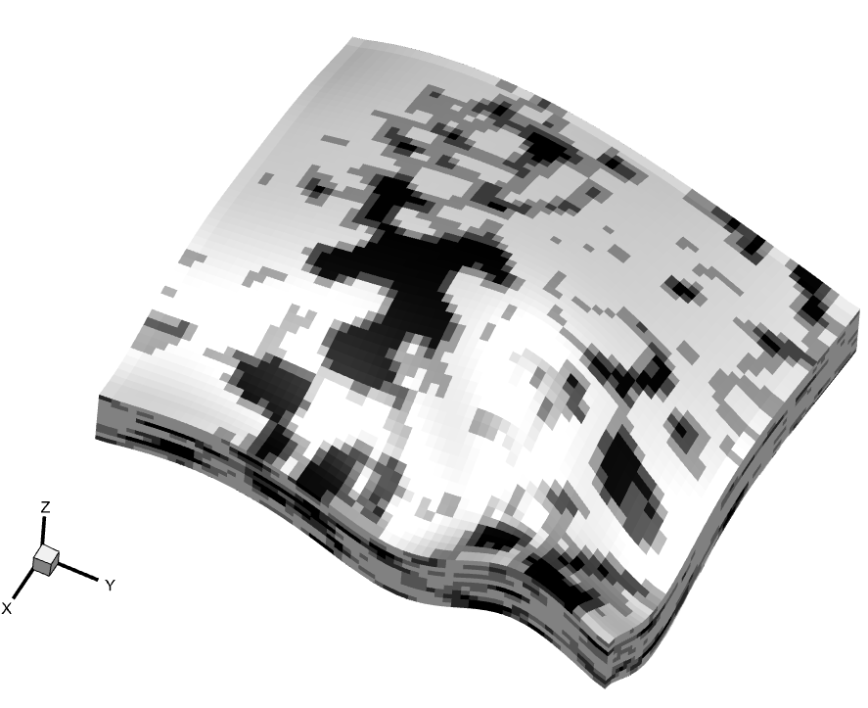
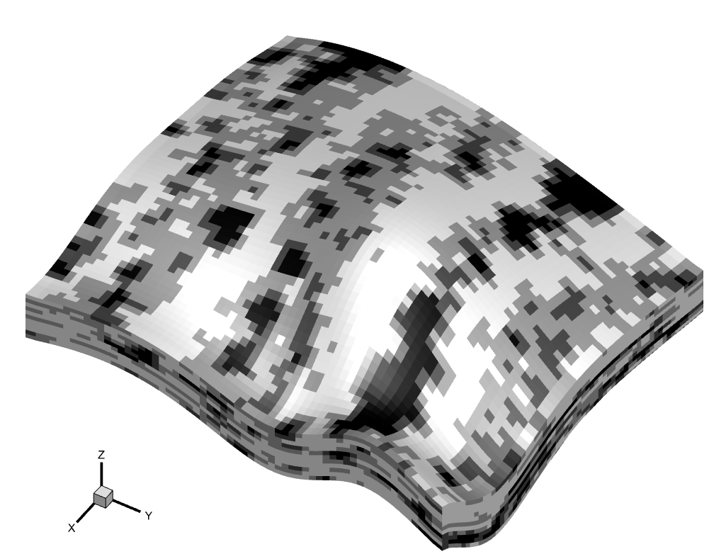
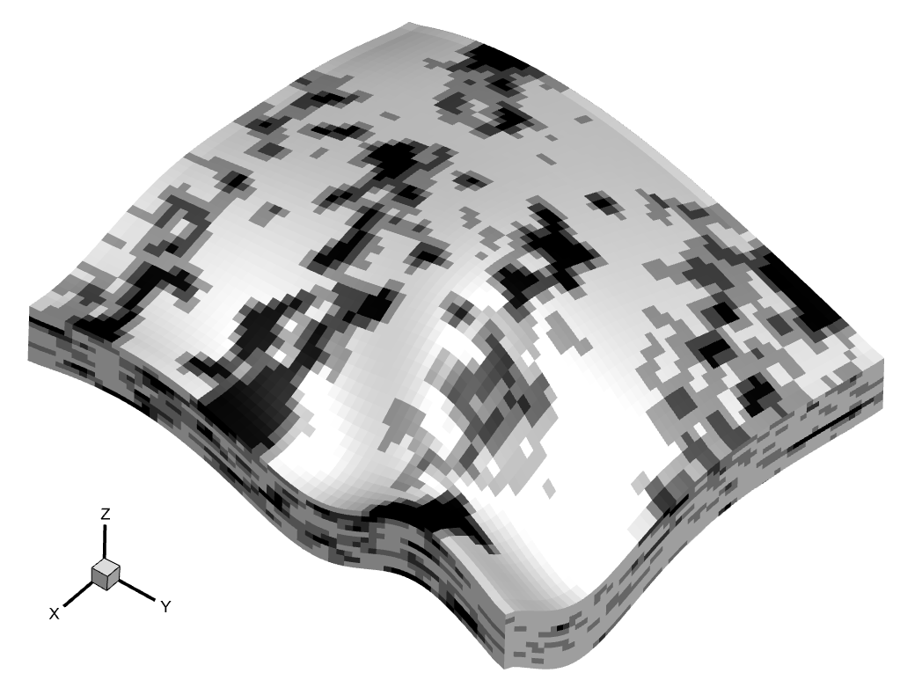
W = 25m, λ = 150m
W = 35m, λ = 250m
W = 45m, λ = 350m

Slide 11
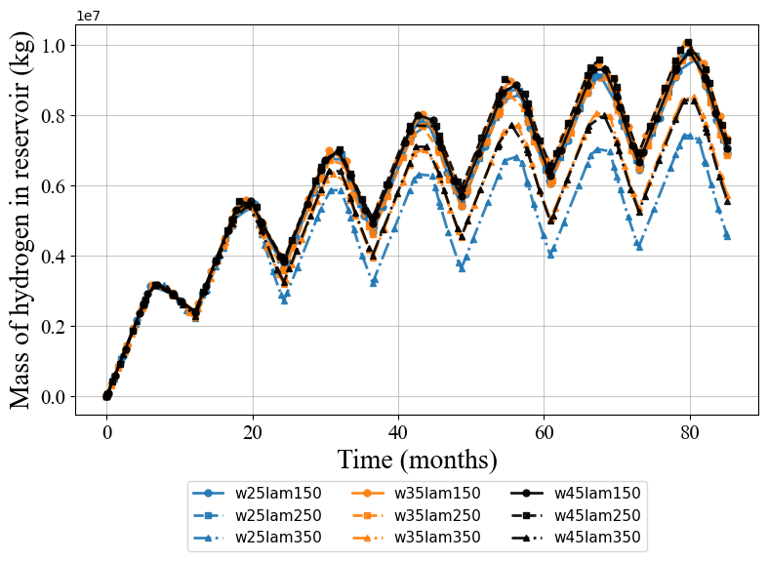
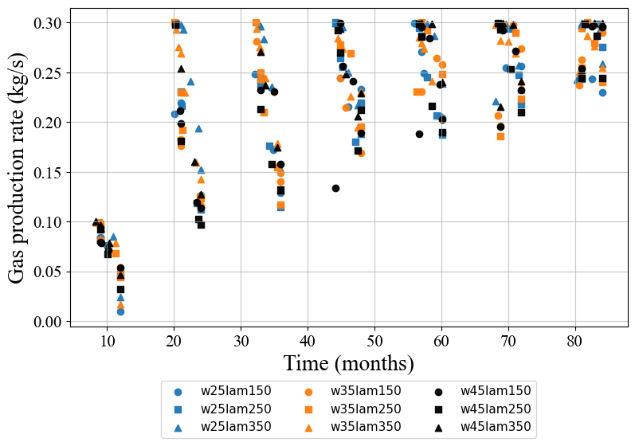
Preliminary findings
Gas production rate improves in later cycles.
Cases with larger channel wavelength show lower mass of remnant hydrogen in reservoir
Notes:
Cycle on cycle improvement in gas production rate
Larger differences in mass of H₂ in reservoir for the last few cycles.

Slide 12
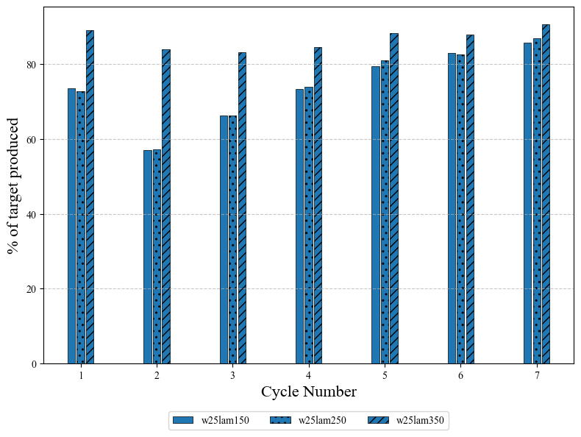
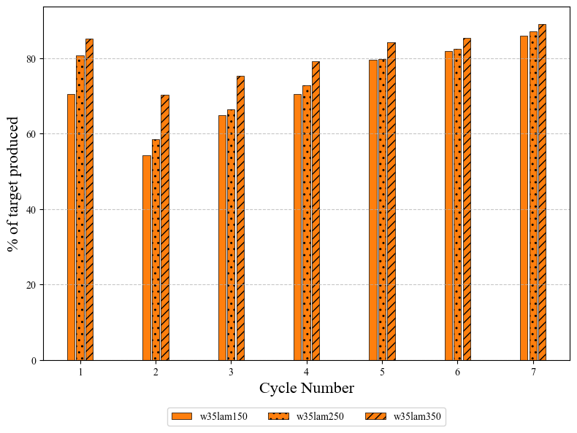
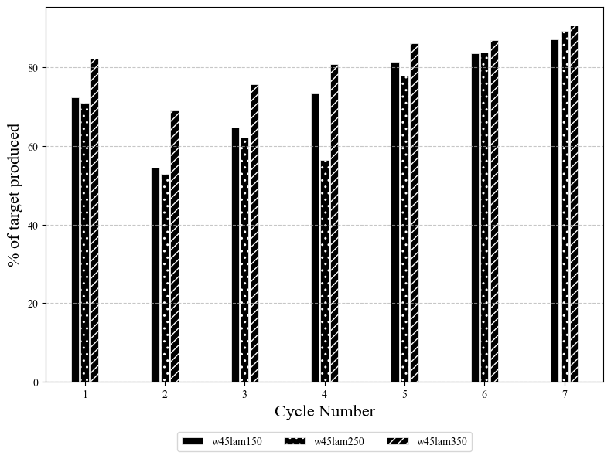
Increasing channel width
Better performance with increasing channel width and wavelength.

Slide 13
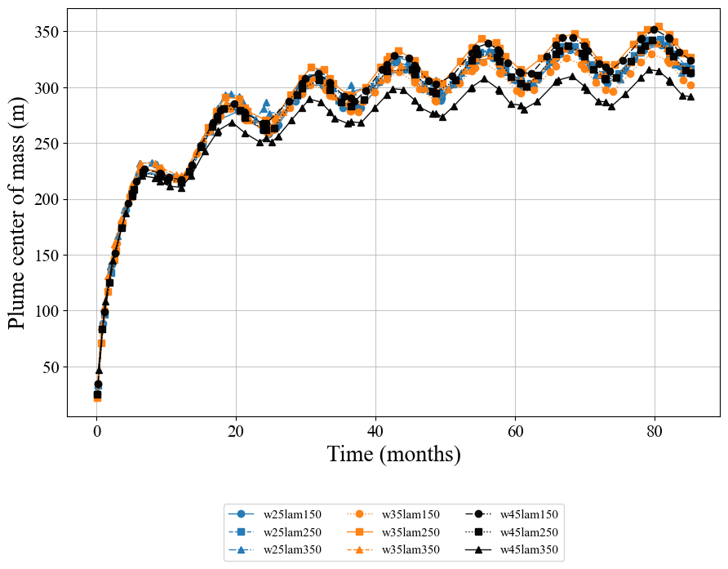
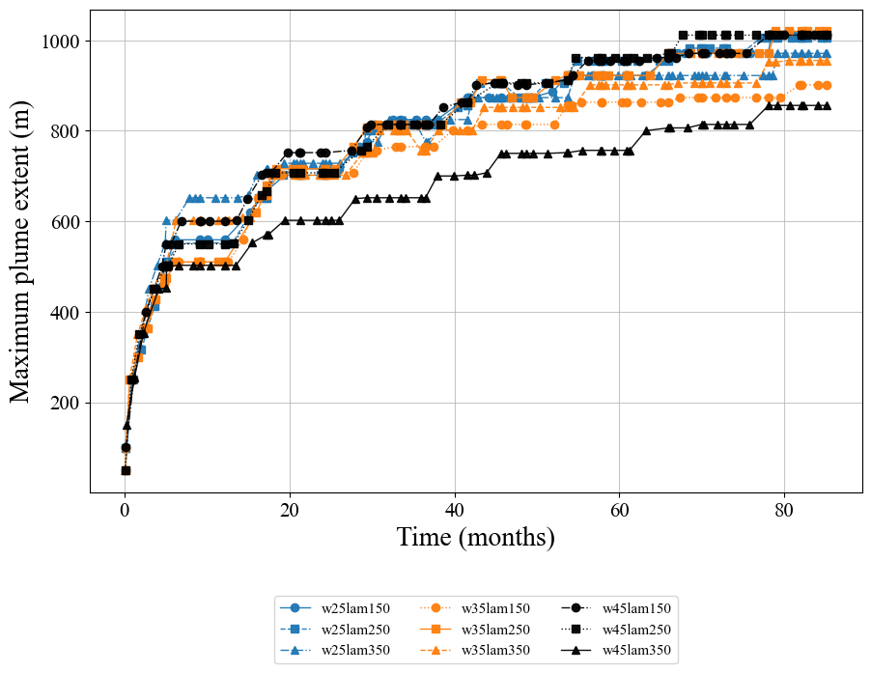
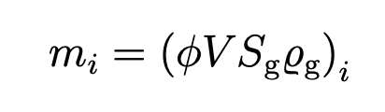
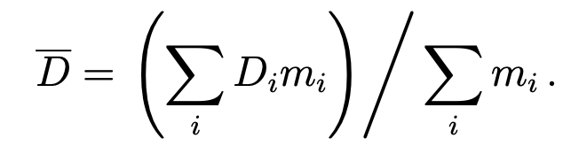
Effect on plume dynamics
Local heterogeneities control plume
center of mass and plume extent evolution

Slide 14
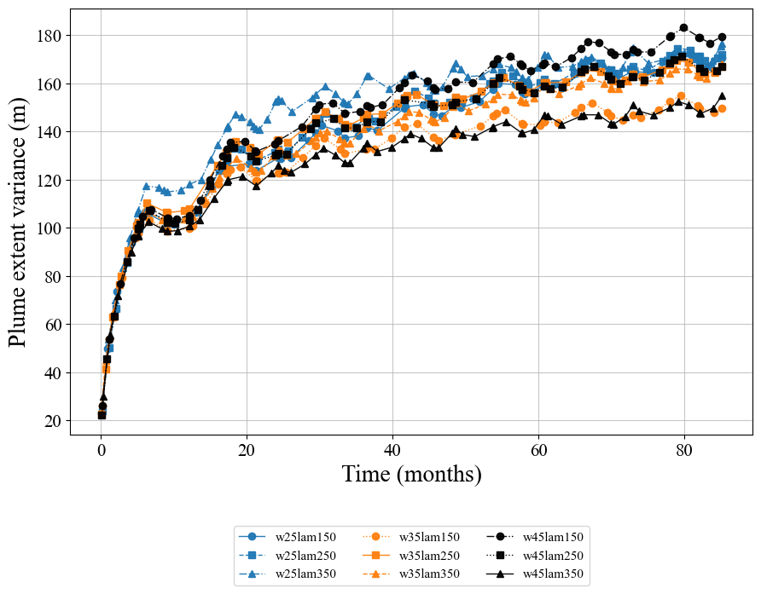
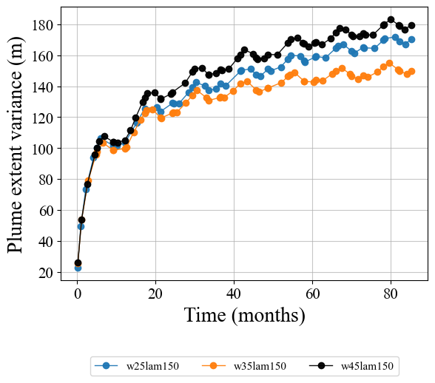
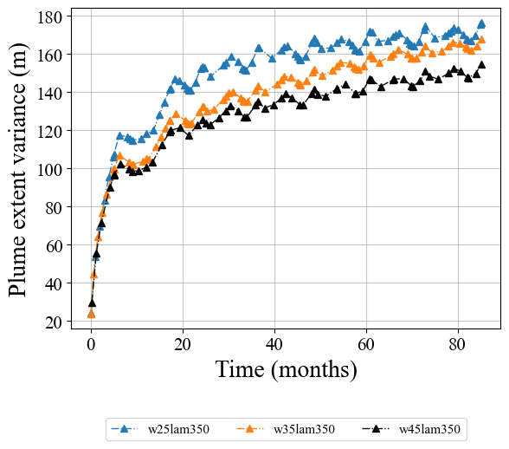
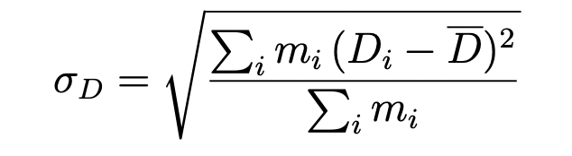
Effect on plume dynamics
Variance in plume extent affected by wavelength and channel width

Slide 15
Summary and next steps
Channel horizontal connectivity is improved by larger channel widths and wavelengths.
These physical fluvial properties indicate potential for better UHS efficiency
Next:
Validating findings with a larger ensemble of scenarios
Exploring effects of vertical channel connectivity on UHS operations

Slide 16
Thank you! Questions?

Slide 17
References
IEA: Bouckaert, S., Pales, A. F., McGlade, C., Remme, U., Wanner, B., Varro, L., ... & Spencer, T. (2021). Net zero by 2050: A roadmap for the global energy sector. https://trid.trb.org/View/1856381
FLUMY™ Process-based channelized reservoir models. Copyright © MINES PARIS - PSL / ARMINES. Free download from https://flumy.minesparis.psl.eu
Hogeweg, S., Strobel, G. & Hagemann, B. Benchmark study for the simulation of Underground Hydrogen Storage operations. Comput Geosci (2022). https://doi.org/10.1007/s10596-022-10163-5
Jung, Y., G. Pau, S. Finsterle, C. Doughty, TOUGH3 User’s Guide, Version 1.0, Report LBNL-2001093, Lawrence Berkeley National Laboratory, Berkeley, Calif., January 2018.
Battistelli, Alfredo, Claudio Calore, and Karsten Pruess. "The simulator TOUGH2/EWASG for modelling geothermal reservoirs with brines and non-condensible gas." Geothermics 26.4 (1997): 437-464.
Doughty, C. A. User's guide for hysteretic capillary pressure and relative permeability functions in TOUGH2. No. LBNL-6533E. Lawrence Berkeley National Lab.(LBNL), Berkeley, CA (United States), 2013.
Boon, M., Hajibeygi, H. Experimental characterization of /water multiphase flow in heterogeneous sandstone rock at the core scale relevant for underground hydrogen storage (UHS). Sci Rep 12, 14604 (2022). https://doi.org/10.1038/s41598-022-18759-8

Slide 18
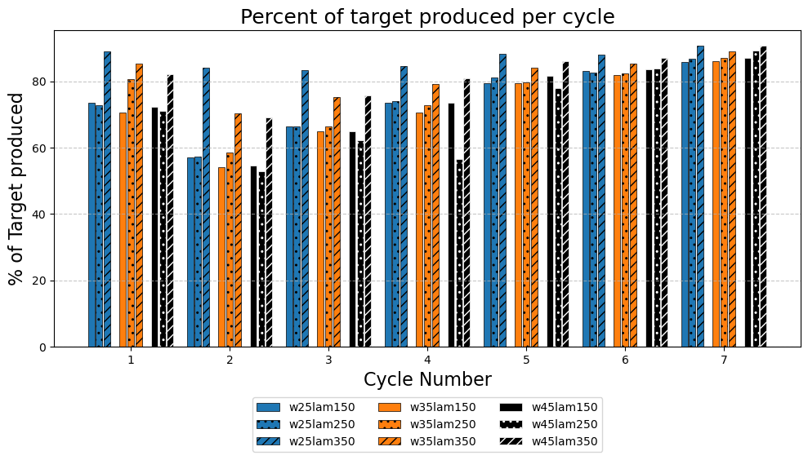
Preliminary findings
Reservoirs with larger channel wavelength and width seem to perform better in the long run

Slide 19
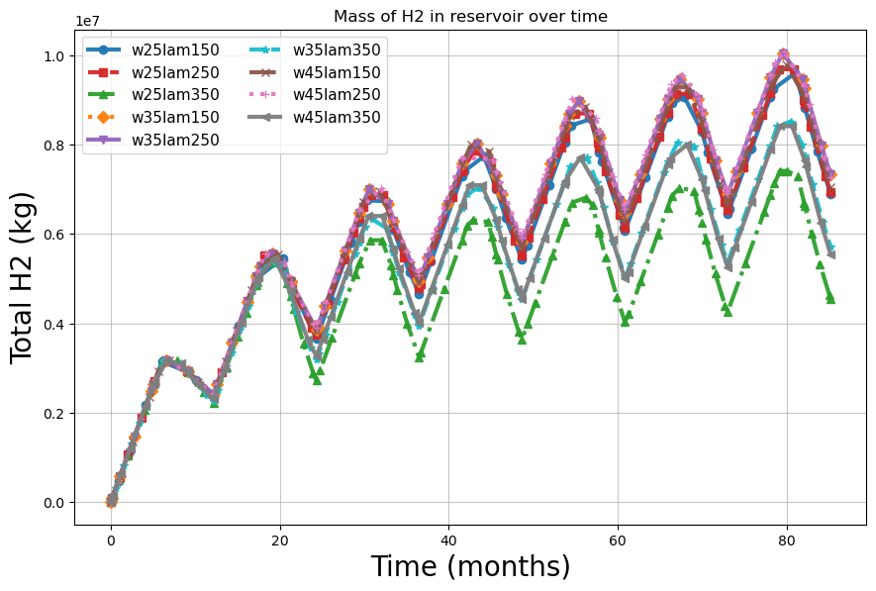
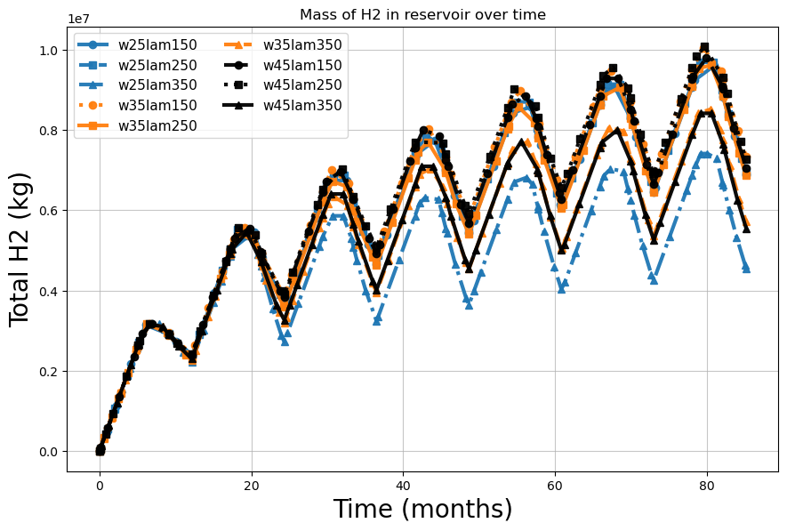

Slide 20
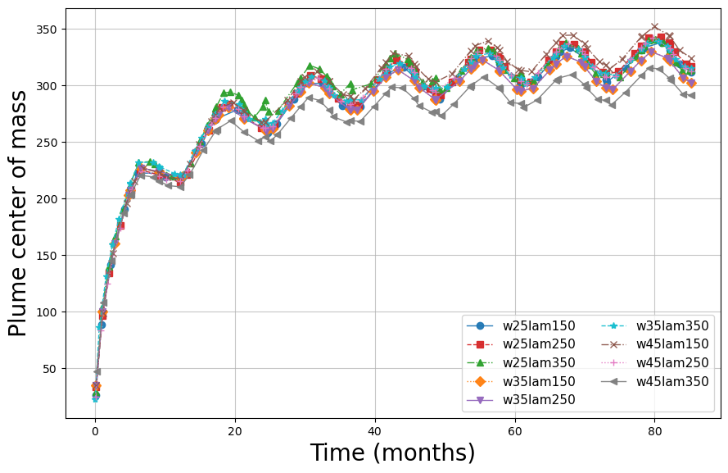

Slide 21
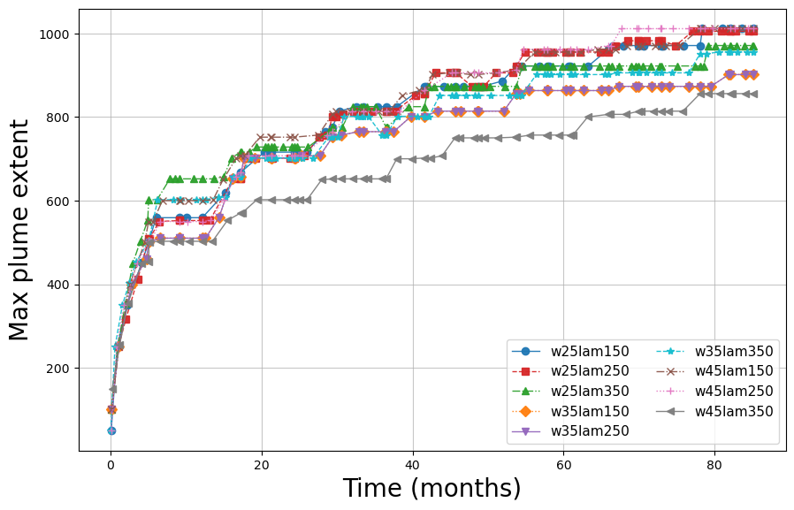

Slide 22
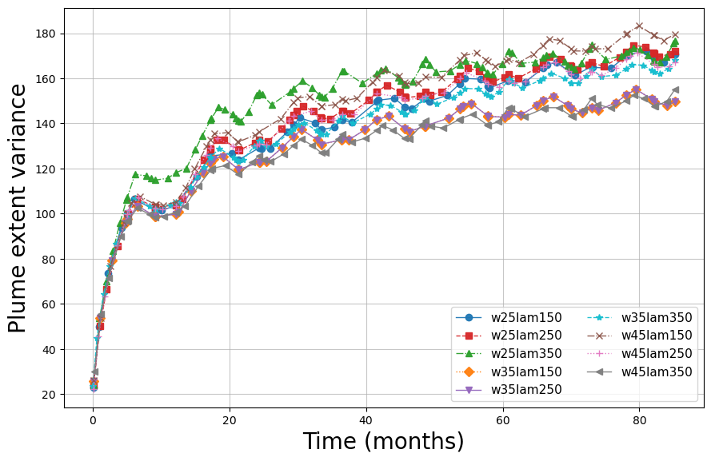
Larger discrepancies in plume extent variance at larger wavelengths

Slide 23
Methodology :FLUMY
9 | 8 | 7 | 6 | 5 | 4 | 3 | 2 | 1
Mud plug | Overbank | Levee | Crevass Splay 2 | Crevasse Spl Channel | Crevasse Splay 1 | Sand plug | Point bar | Channel lag
MP | OB | LV | CS2 | CCH | CS1 | SP | PB | CL
Non - channel
Channel
FLUMY realisation
Upscaled reservoir model
Porosity
Permeability
Artihmetic averaging
Geometric averaging
Notes:
FLUMY software is a modeling tool, both process-based and stochastic, for a meandering channel system and its associated deposits
at the scale of the reservoir.
The model is based on the evolution in time of the channel by migration, cut-off and avulsion, and on the deposition
of point-bar sand, mud plug, crevasse splays, overbank alluvium and organic matter.
Explain FLUMY output in terms of 9 facies
Show upscaled facies.
Summary of perm and por contrast

Slide 24
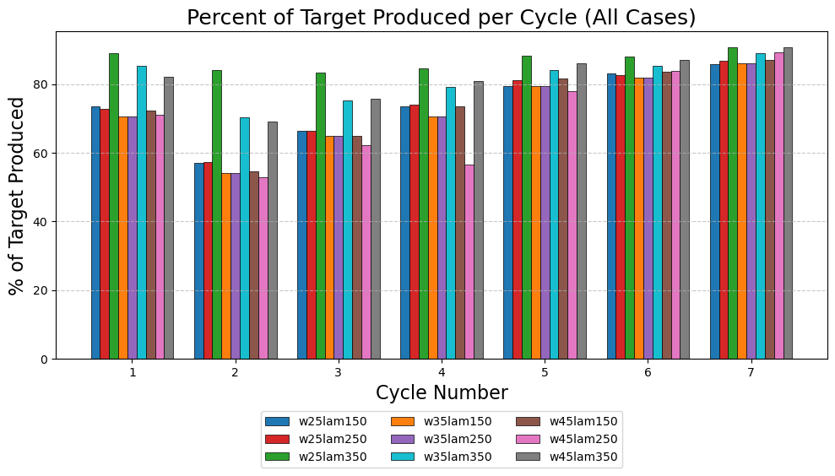

Slide 25
