Slide 1

Optimal Cushion Gas for Underground Hydrogen Storage: A Thermodynamic Perspective
Yuhang Wang¹, Li Rong¹, Ke Xu²
¹China University of Geosciences
²Peking University
19 May 2026

Slide 2
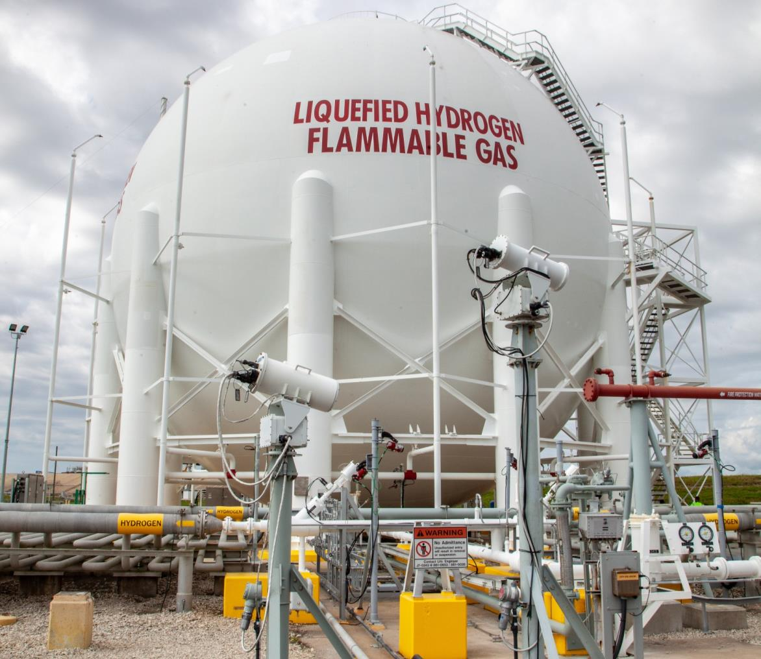
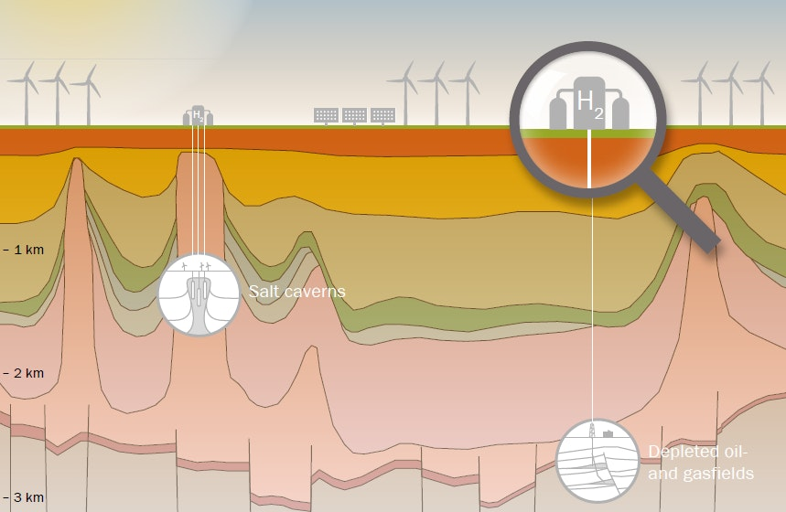
Introduction
Ca. 5–10 GWh
100–200 GWh
O (TWh)
https://en.wikipedia.org/wiki/Hydrogen_storage
https://www.iea.org/articles/proving-the-viability-of-underground-hydrogen-storage

Slide 3
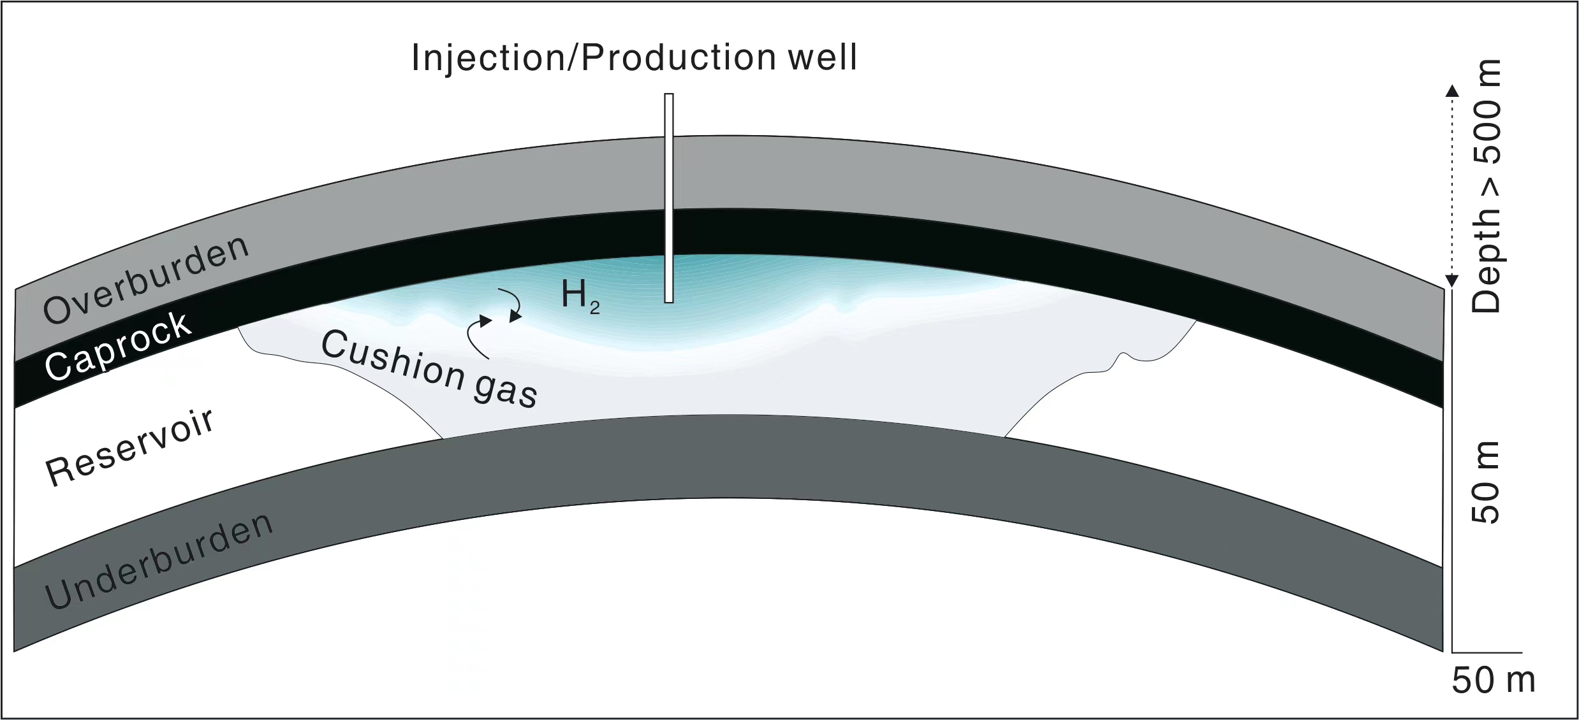
Introduction

Slide 4


Introduction
$$∇c_{H_{2}}$$
$$J=−D(x_{H_{2}},P,T)∇c_{H_{2}}$$

Slide 5
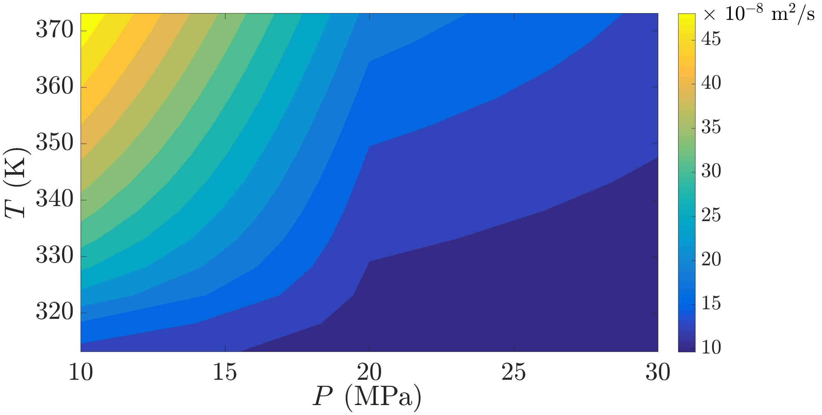

Introduction
Chapman and Cowling (1952)
$$D=\frac{3}{32nσ_{AB}^{2}}{\left[\frac{8kT}{π}\left(\frac{1}{m_{A}}+\frac{1}{m_{B}}\right)\right]}^{1/2}$$
$$∇c_{H_{2}}$$
$$J=−D(x_{H_{2}},P,T)∇c_{H_{2}}$$

Slide 6
Introduction
Chapman and Cowling (1952)
$$D=\frac{3}{32nσ_{AB}^{2}}{\left[\frac{8kT}{π}\left(\frac{1}{m_{A}}+\frac{1}{m_{B}}\right)\right]}^{1/2}$$
$$∇c_{H_{2}}$$
Ideal Gas System！
$$J=−D(x_{H_{2}},P,T)∇c_{H_{2}}$$
Gas in supercritical state under UHS conditions
In-situ diffusive measurement data is limited

Slide 7
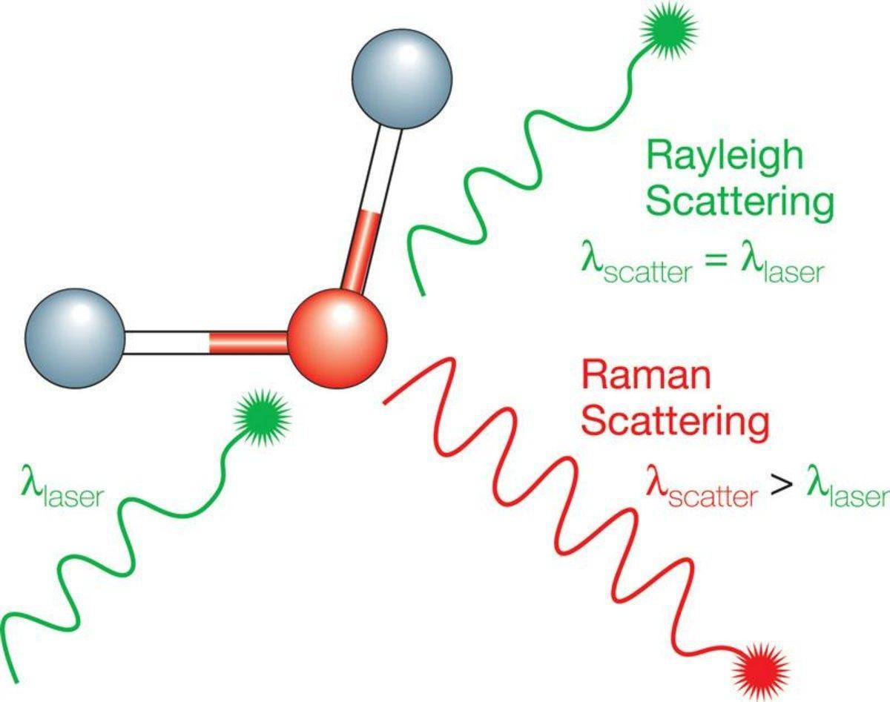
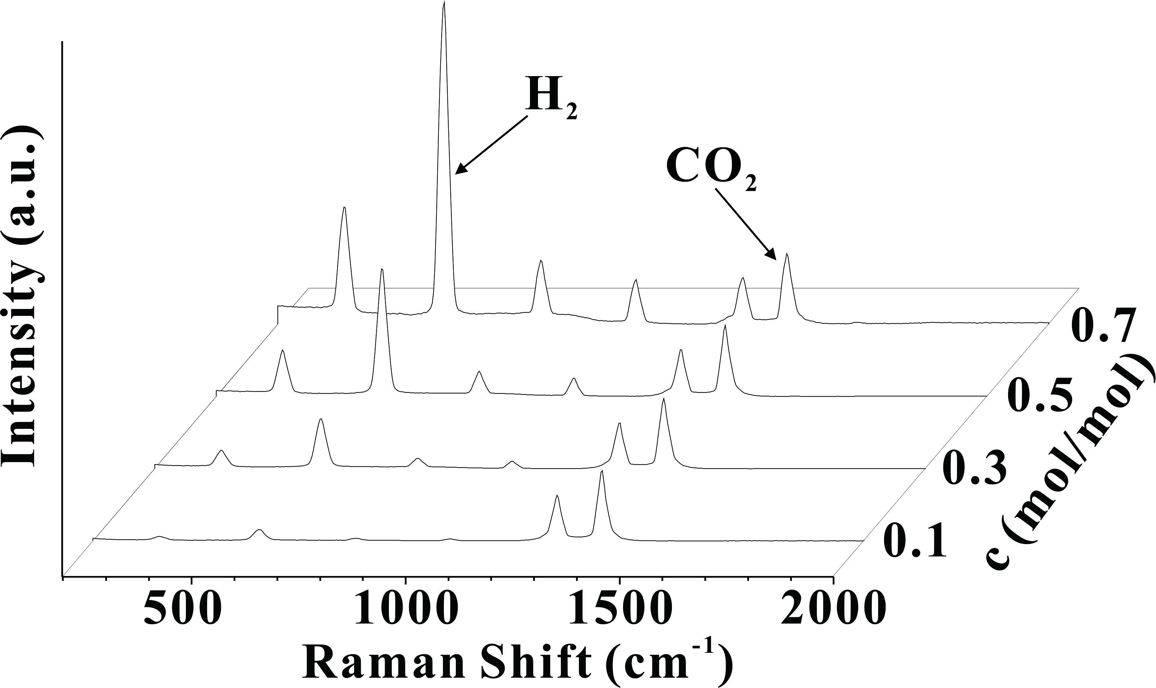
Raman Spectroscopy
Notes:
通过测量光与物质相互作用后发生的非弹性散射来提供物质的“指纹”信息，反应在拉曼位移上。
（在拉曼散射过程中，光子与分子发生能量交换，导致散射光的频率发生改变，称为拉曼位移）
通过波峰的比例可以直接获取混合气体中各组分的浓度信息

Slide 8
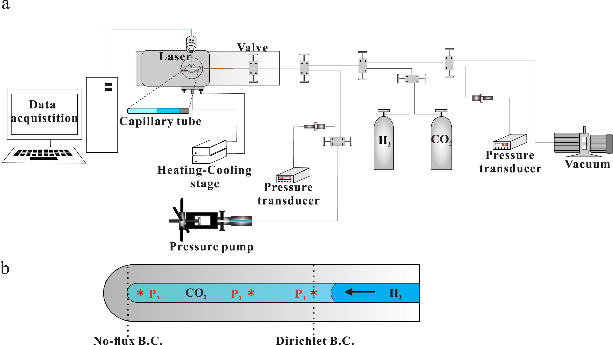
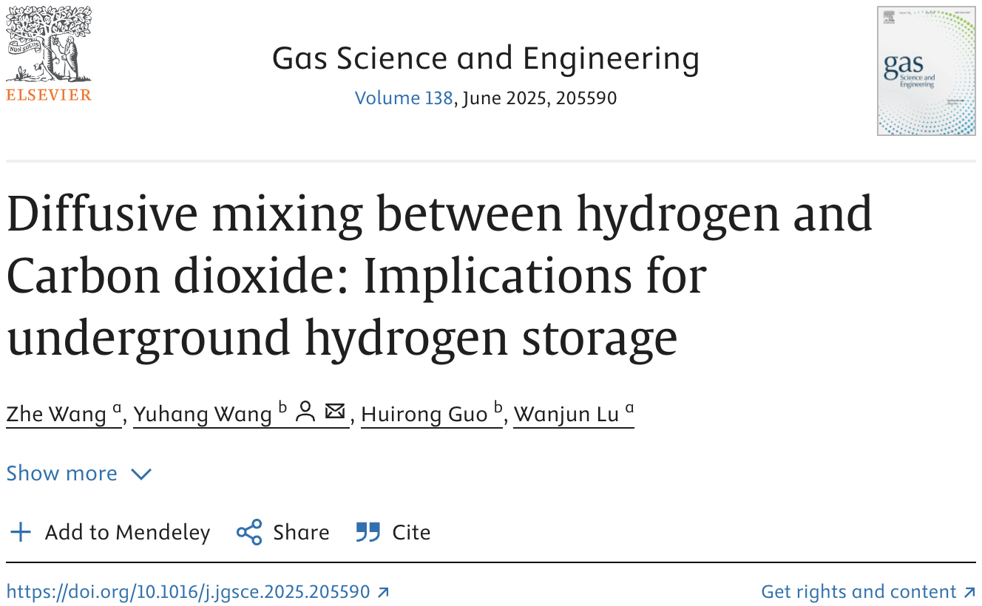
Experimental Set-up
Wang et al., 2025. Gas Sci Eng

Slide 9
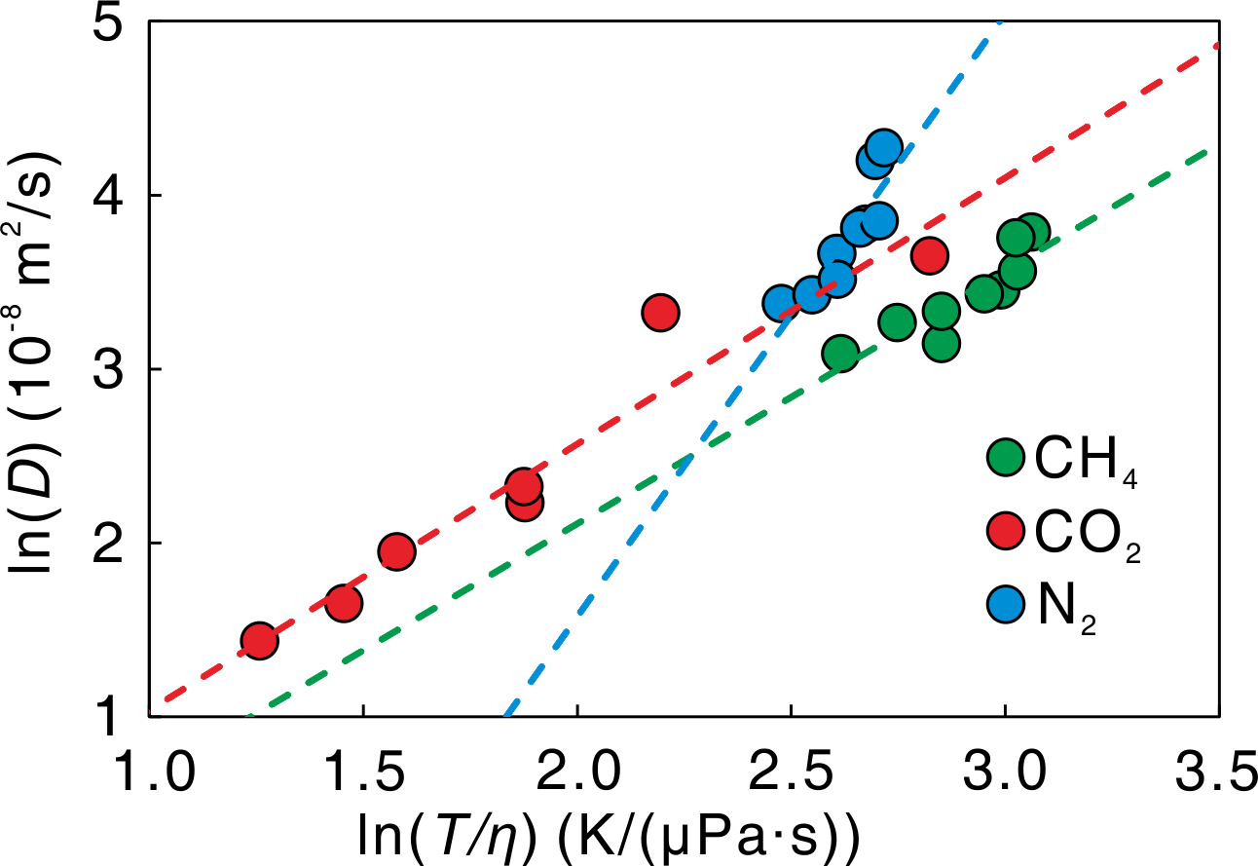
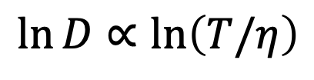
Diffusion Coefficient
$$\ln{D}∝\ln\left(T/η\right)$$
(under review)

Slide 10
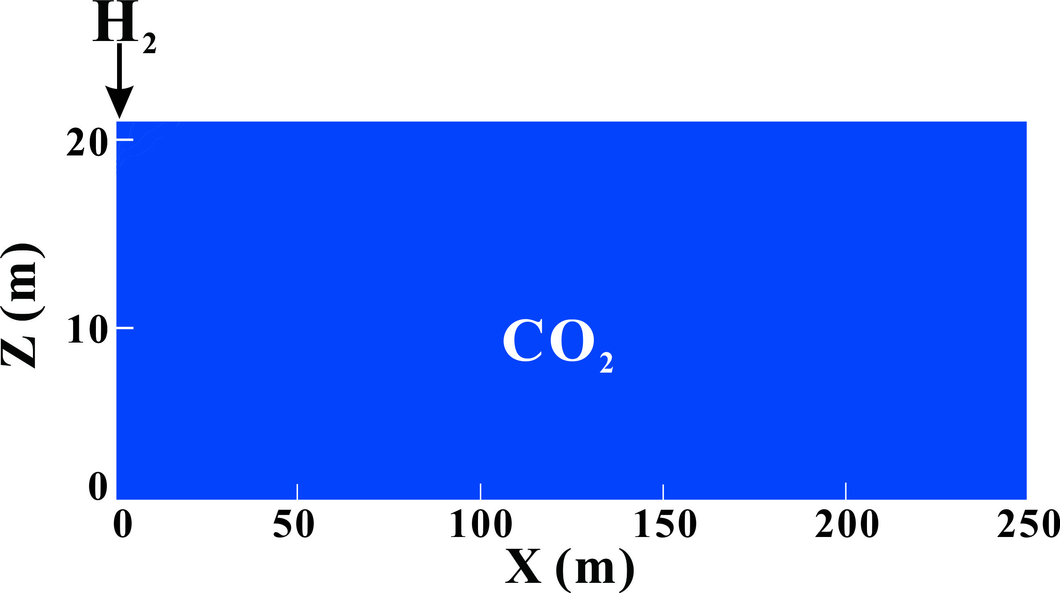


Pore-scale
Darcy-scale
Dispersion is determined by both molecular diffusion and convection
$$Ddisp=\left(\frac{1}{τ}+{Pe}^{n}\right)Ddiff$$
$$J=−Ddisp∇x_{i}$$
Modified from Oldenburg, 2003. Energy Fuels

Slide 11
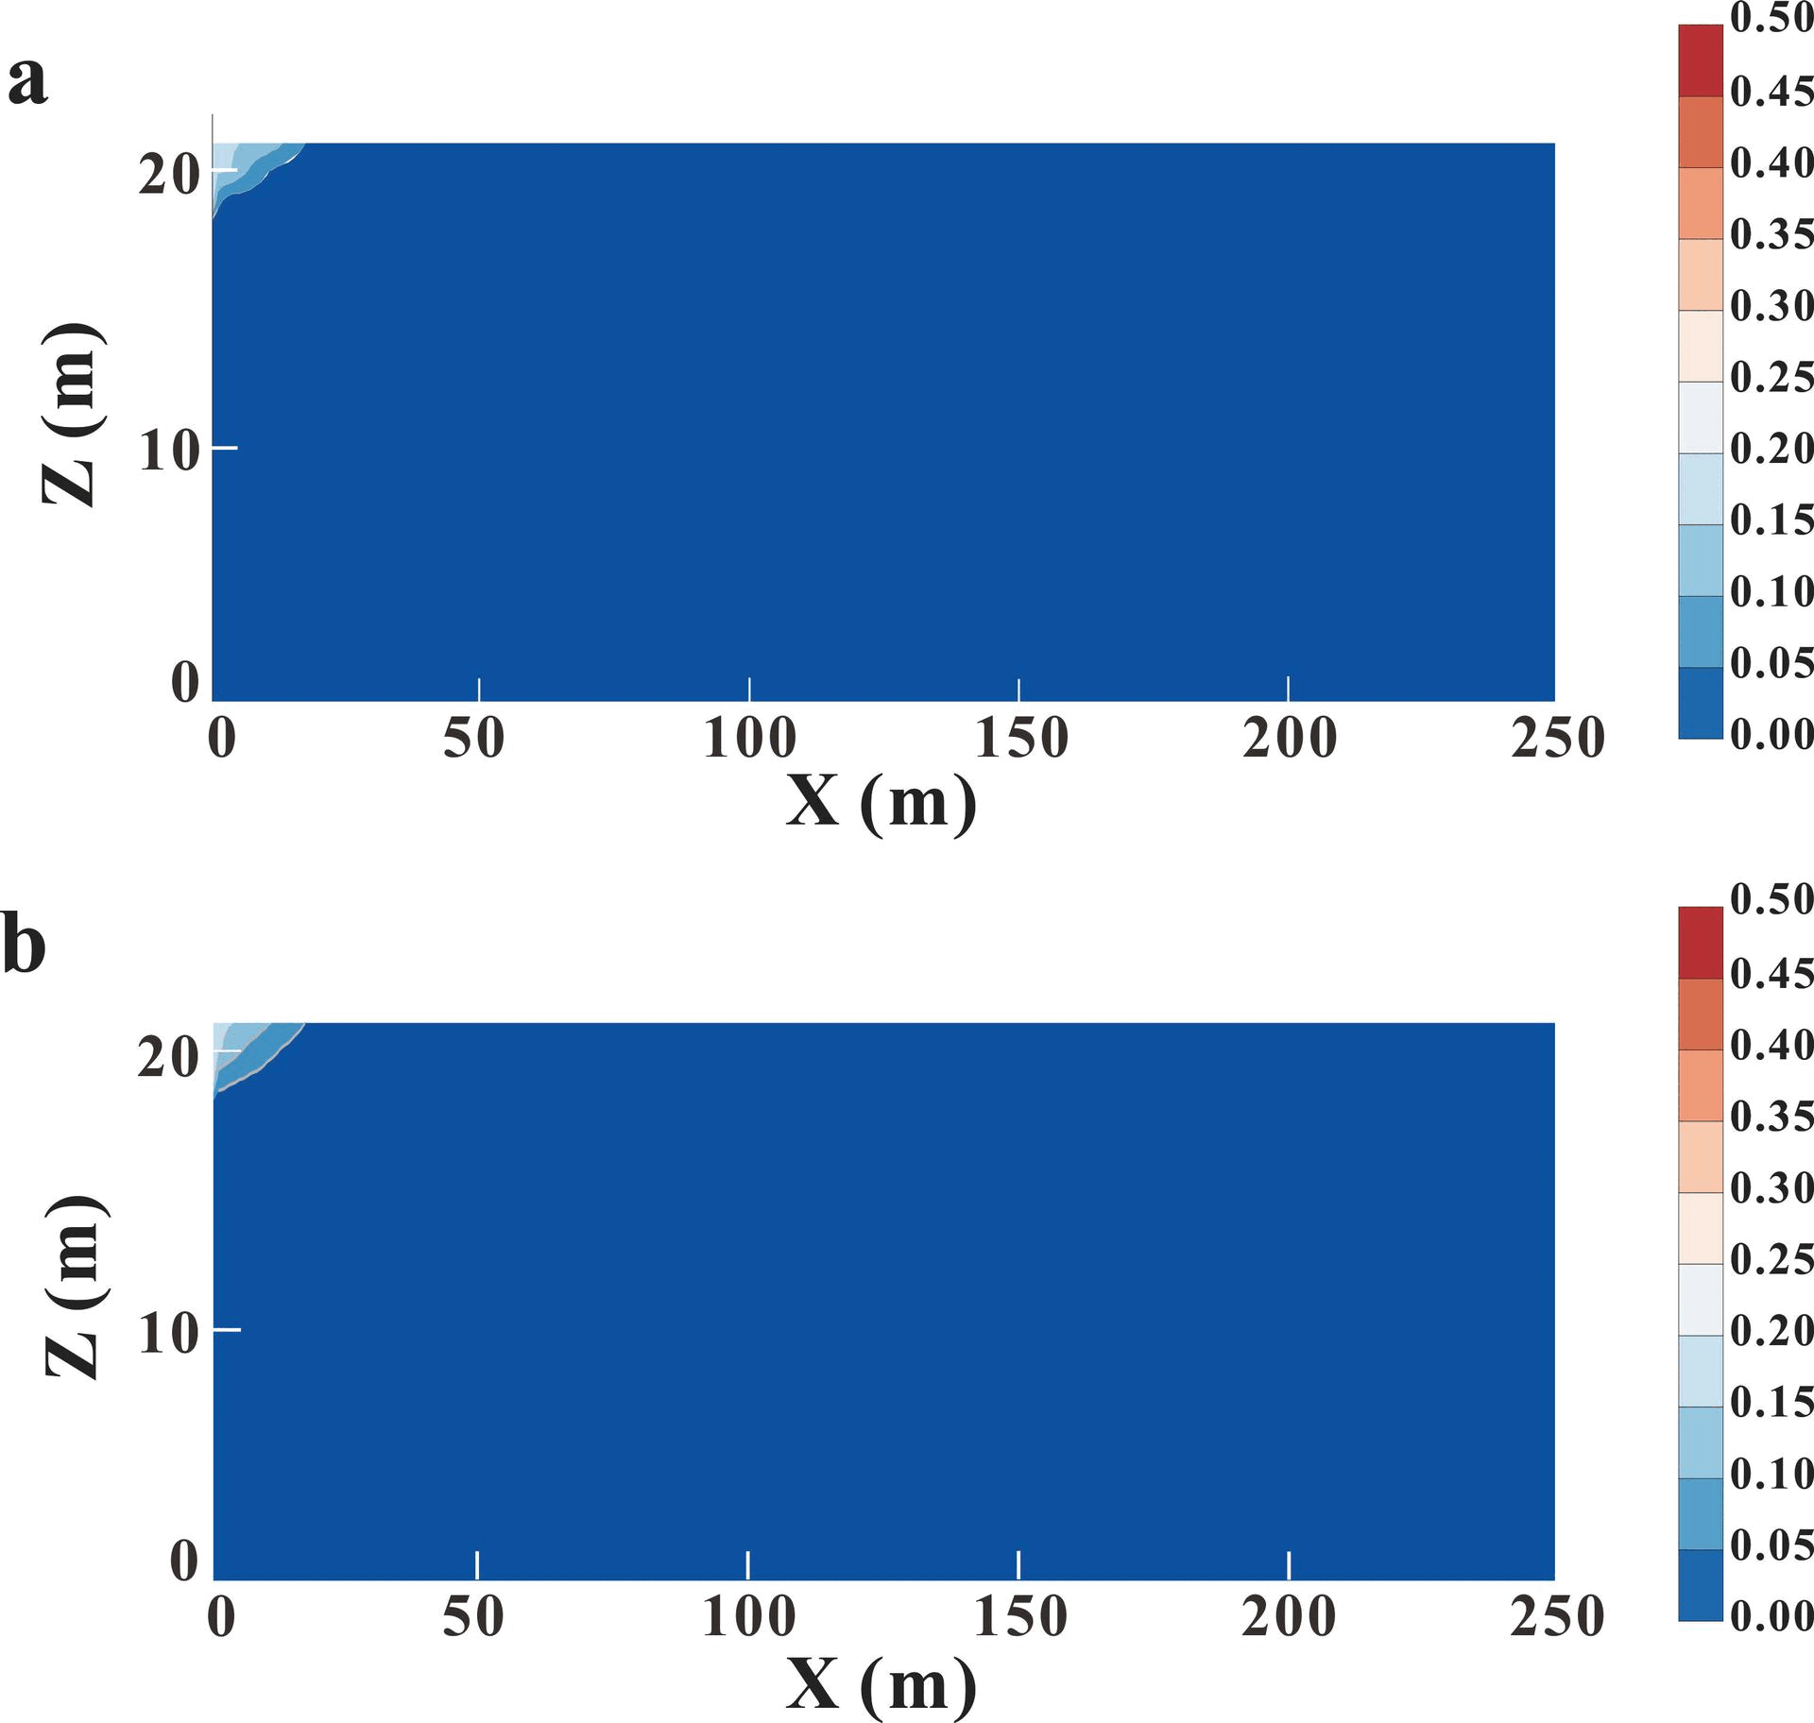
Pore-scale
Darcy-scale
no dispersion
with dispersion
Wang et al., 2025. Gas Sci Eng

Slide 12
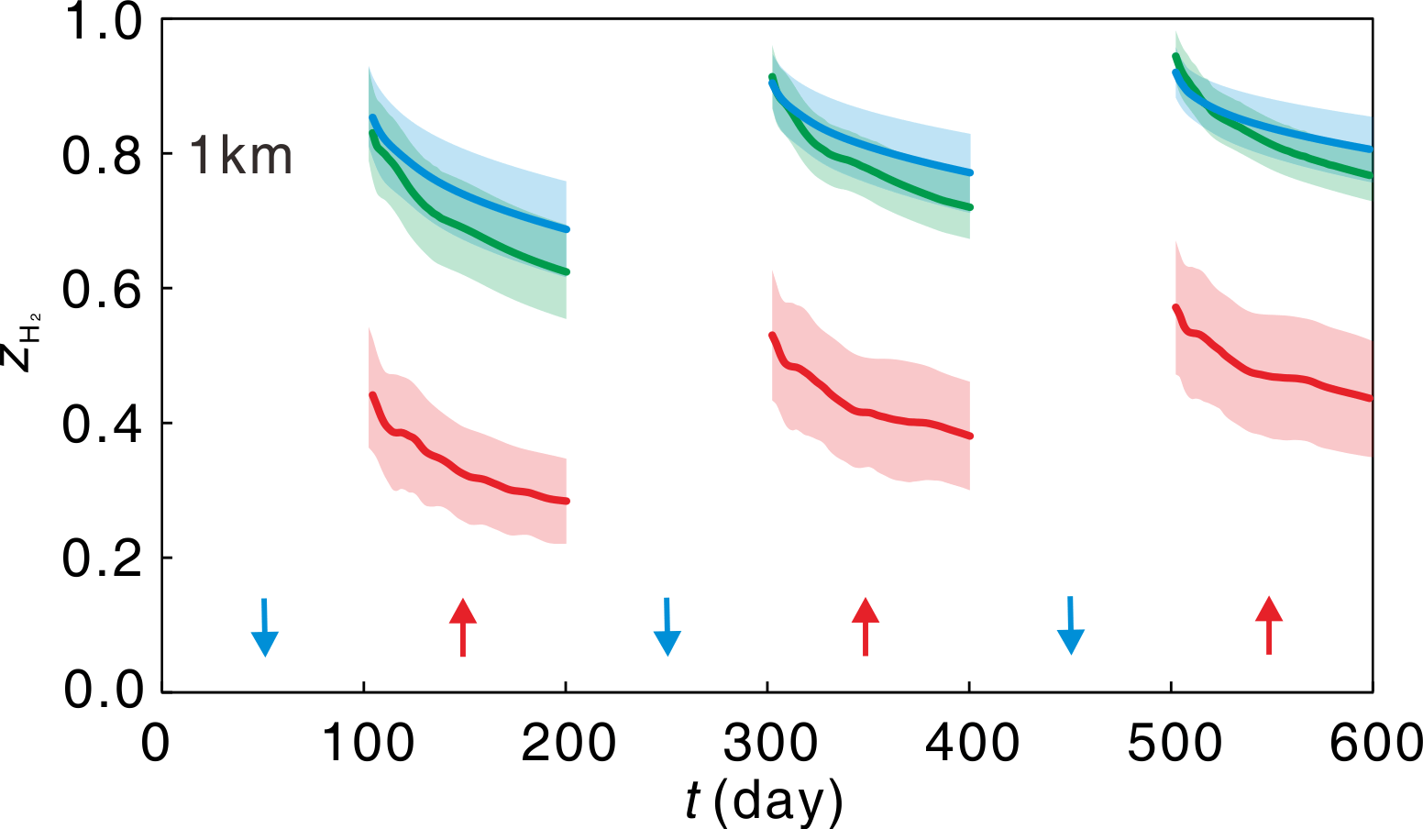
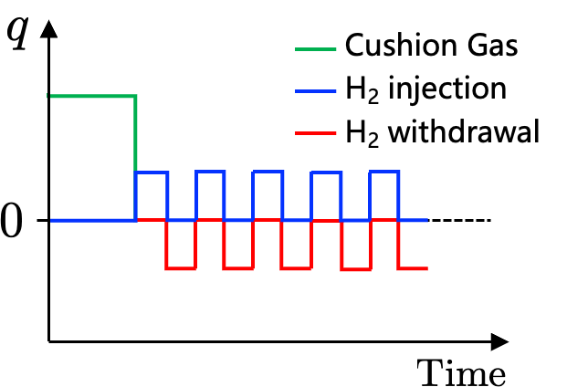
Withdrawal Purity
(under review)

Slide 13
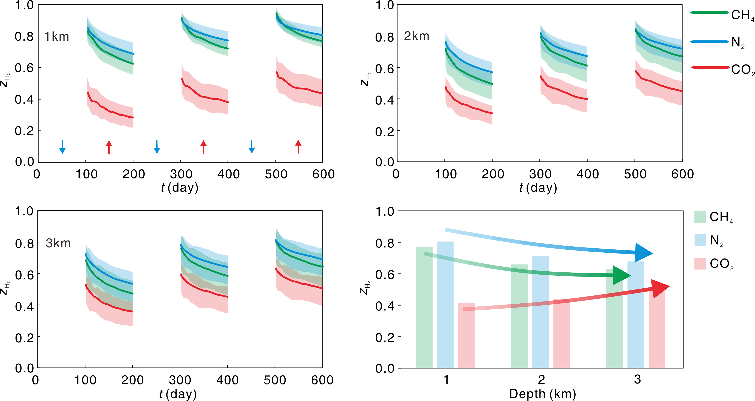
Withdrawal Purity
(under review)

Slide 14
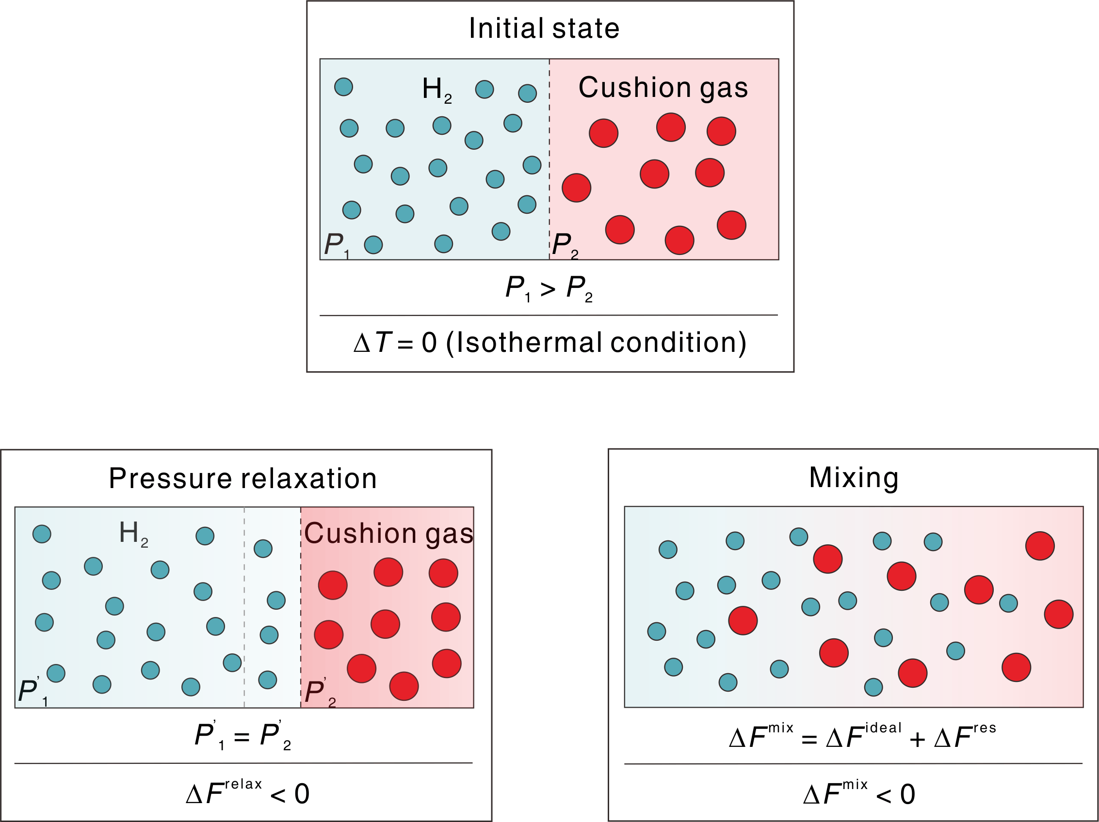
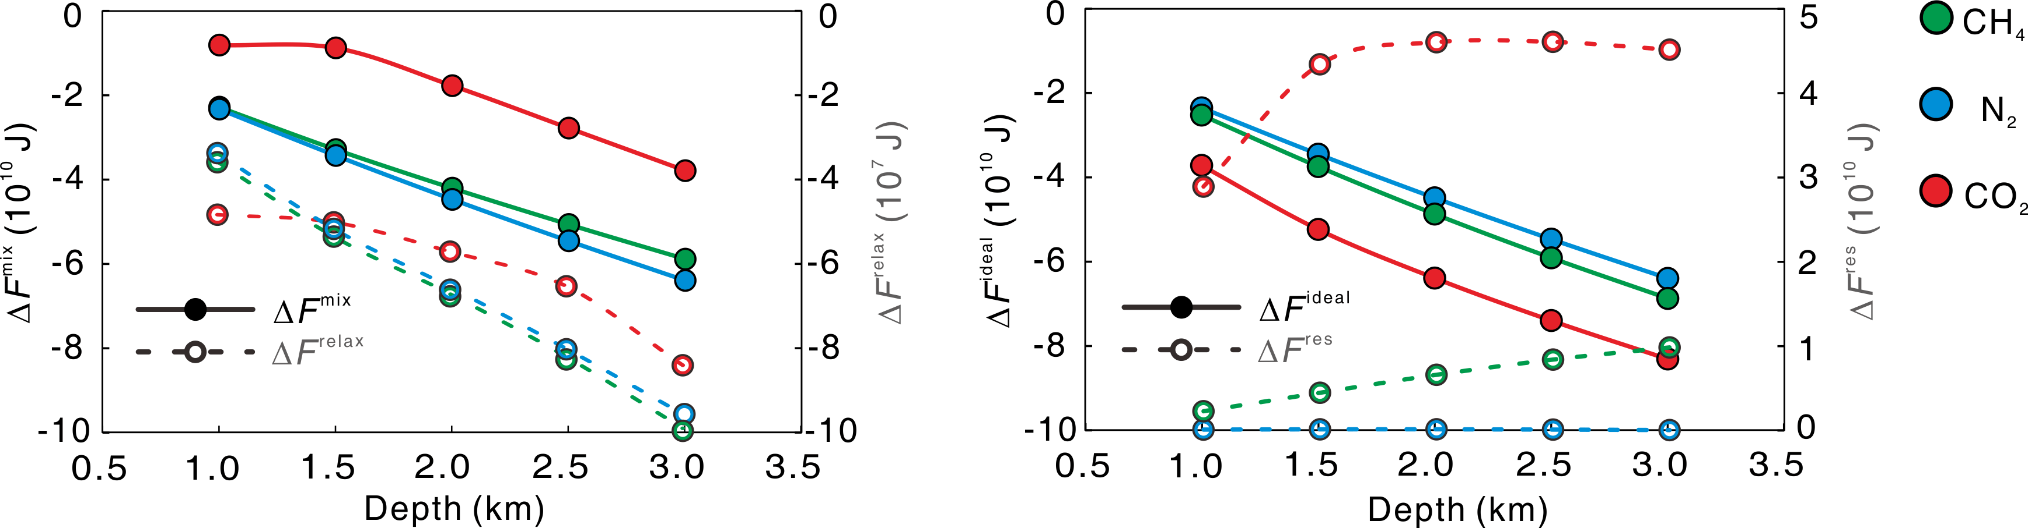


Thermodynamic Analysis
Change of Helmholtz free energy ($∆F$)
$$∆F^{relax}$$
$$∆F^{mix}$$

Slide 15
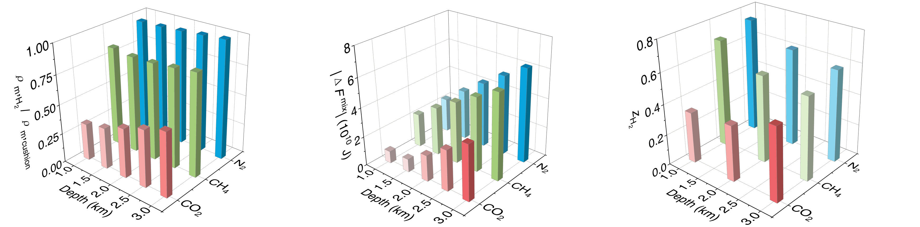
Thermodynamic Analysis

Slide 16
Thermodynamic Analysis

Slide 17
Thermodynamic Analysis
The performance governed by thermodynamic tendency and density contrast
Thermodynamic principles enable a simple and efficient assessment

Slide 18


no dispersion
Thank you!
Questions?
with dispersion
wangyuhang17@cug.edu.cn
Wang et al., 2025. Gas Sci Eng

