Slide 1
Lab Evaluation of Long-Distance Propagation of CO₂ Foam for Deep Mobility Control
InterPore Annual Conference, MS01, May 22, 2026
W. R. Rossen, Delft University of Technology, Netherlands
X. Jing, Nanjing University, China
J. Tang, United Arab Emirates University, UAE
H. Yu, L. Yu, China University of Geosciences, China
X. Zou, China National Petroleum University, China

Slide 2
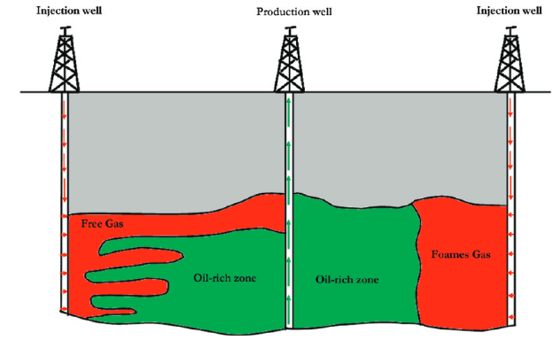
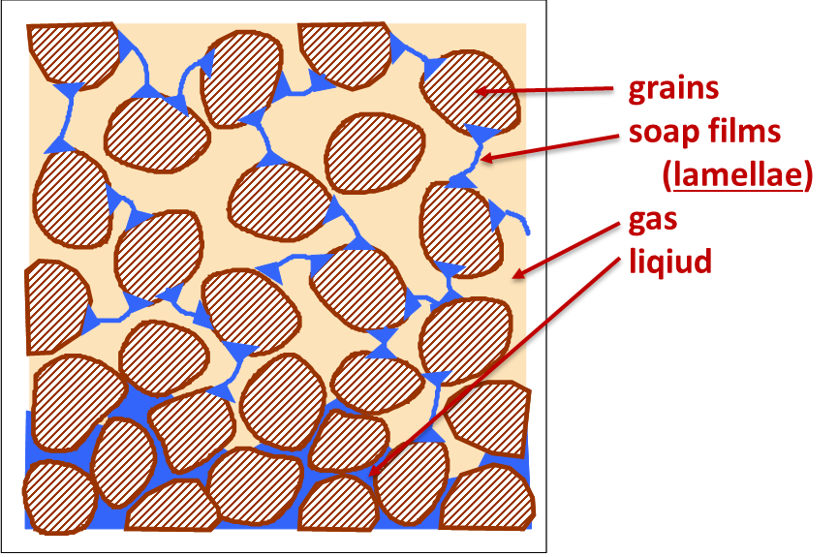
Foam Injection in subsurface applications
Foam can greatly increase the volume of CO₂ sequestered CCUS. It increases gas sweep by reducing gravity override and viscous fingering. Foam also increases residual gas trapping in the swept region, further reducing CO₂ accumulation below, and stress on, the caprock.
Foam improves gas sweep in CO₂ injection for enhanced oil recovery, improving economics and reducing carbon footprint of process. It also increases CO₂ storage in reservoir at end of process
No foam
Foam

Slide 3
Foam Generation and Propagation
Foam propagation far from the injection well is crucial to maximizing foam benefits
Foam propagation depends on convection of bubbles generated upstream, and generation of new bubbles at the displacement front
Laboratory experiments find separate minimum ∇p thresholds for foam generation, propagation and stability in place, as had been predicted by Population-Balance foam modeling

Slide 4
Foam Generation with N₂ and CO₂ foam
Previous studies find that the minimum ∇p for N₂ foam generation in steady gas-liquid flow is large, impractical far from injection well
Minimum ∇p for CO₂ foam generation is much smaller, but still could be problematic far from injection well
N₂
CO₂
Data from Gauglitz et al. (2002) and Tang et al. (2025).
(10⁻¹² m²)

Slide 5
Laboratory study of foam propagation
A multi-diameter core allows determination of the minimum velocities and ∇p for foam generation, propagation and collapse from a single coreflood.
Procedure: Determine threshold for foam generation in Section 1. Then greatly reduce injection rate. Increase injection rate in steps until foam propagates through Section 2; then again until it propagates through Section 3. Result: two measurements of ∇p_{min} for foam propagation.
Reduce injection rate in steps until foam collapses in Sections 3 and then 2: two measurements of ∇p_{min} for foam stability
T = 40°C; back-pressure 40 bar; co-inject gas and liquid

Slide 6
Cases examined
(alkyl polyglycide)
Surface tension w/ CO₂: APG, 4.5 mN/m; TDA-13, 1.1 mN/m)

Slide 7
Effect of Injected Gas Fraction (foam quality)

Slide 8
Effect of Permeability K

Slide 9
Effect of Surfactant and Surface Tension
APG
4.5 mN/m
TDA-13
1.1 mN/m

Slide 10
Conclusions
Threshold ∇p for CO₂ foam generation, propagation and stability are substantially less than those of N₂ foam. CO₂ foam propagation far from the injection well, at low ∇p, still appears to be problematic.
Surfactants with lower surface tension may be able to propagate at lower ∇p, if they maintain stable foam.
Lower surface tension may explain why gas mobility is greater for CO₂ foam than N₂ foam, an effect often ascribed to poorer foam stability with CO₂.
The threshold ∇p for foam generation is much lower at higher permeabilities. The thresholds for propagation and stability are not reduced as greatly.
The threshold ∇p for generation, propagation and stability all increase as gas fraction in foam (foam quality) increases

Slide 11
Discussion
These experiments were conducted under conditions ideal for strong foam. In optimizing surfactant choice for given field conditions, the roles of foam stability and surface tension on thresholds for foam generation, stability and foam mobility need further study.
Foam generation is easier with alternating injection of gas and surfactant slugs (SAG or FAWAG) than in steady flow, which is studied here. This may help foam placement further from injection wells.
Foam can also be created by snap-off at abrupt permeability boundaries far from an injection well without a minimum ∇p requirement. This might allow foam placement far from injection wells, if gas and surfactant can both be delivered there.
Results of this work, and detailed discussion, can be found in J. Tang et al., “Lab Evaluation of Long-Distance Propagation of CO₂ Foam for Deep Mobility Control,” paper SPE SPE-231572, presented at the SPE IOR Conference, April 21-23, 2026, https://doi.org/10.2118/231572-MS

Slide 12
References: Foam Applications
Rossen, "Foams in Enhanced Oil Recovery," in R. K. Prud'homme and S. Khan, ed., Foams: Theory, Measurements and Applications, Marcel Dekker, New York, 1996, pp. 413-464. https://doi-org.tudelft.idm.oclc.org/10.1201/9780203755709
Kovscek and Radke, 1994. “Fundamentals of Foam Transport in Porous Media” in Foams: Fundamentals and Applications in the Petroleum Industry, ACS Advances in Chemistry Series No. 242: Washington, DC, 1994; pp 115−163. DOI: 10.1021/ba-1994-0242
Føyen et al., International J. Greenhouse Gas Control 96: 103016 (2020) https://doi.org/10.1016/j.ijggc.2020.103016
Rossen et al., Geoenergy Sci. Eng. 239: 21292 (2024) https://doi.org/10.1016/j.geoen.2024.212929

Slide 13
References: Foam Generation in Steady Flow
Rossen and Gauglitz, AIChE J. 36, 1176-1188 (1990). https://doi.org/10.1002/aic.690360807.
Gauglitz et al., Chem. Eng. Sci. 57, 4037-4052 (2002). https://doi.org/10.2118/75177-MS
Kam et al., SPE Journal. 8, 417 (2003); 12, 35 (2007). https://doi.org/10.2118/77698-MS
Kam et al, SPE Journal 12 (March 2007), 35-48. https://doi.org/10.2118/90938-MS
Yu et al., I&EC Res. 58, 420-427 (2019). https://pubs.acs.org/doi/abs/10.1021/acs.iecr.8b03141
Tang et al., SPE Journal 30: 439-454 (2025). https://doi.org/10.2118/218255-PA

Slide 14
References: Foam Propagation
Friedmann and Jensen, paper SPE 15087, 1986.
Friedmann et. al., SPE Journal. 6 37–45, 1991, https://doi.org/10.2118/17357-PA.
Friedmann et al., SPE Journal 9 297–304, 1994, https://doi.org/10.2118/21780-PA.
Ashoori et al., SPE Journal 17, 1231 (2012). https://doi.org/10.2118/154024-PA.
Yu et al., SPE Journal 25, 3457–3471 (2020). https://doi.org/10.2118/201251-PA.

Slide 15
References: Foam Placement Without Direct Propagation
Blaker et al., 2002, SPE Res Eval & Eng 5: 317–323 (2002). https://doi.org/10.2118/78824-PA.
Shah et al., SPE Journal 24: 116-128 (2019). https://www.onepetro.org/journal-paper/SPE-190210-PA
Shah et al., SPE Journal 25: 451-464 (2020). https://doi:10.2118/195517-PA.
Almajid et al., Energy & Fuels 33.11: 11353-11363 (2019). https://pubs.acs.org/doi/abs/10.1021/acs.energyfuels.9b01842
Rossen et al., Geoenergy Sci. Eng. 239: 21292 (2024) https://doi.org/10.1016/j.geoen.2024.212929

Slide 16

Questions?
w.r.rossen@tudelft.nl

