Slide 1
“A Two-Step Screening Framework for Identifying Underground Hydrogen Storage Sites in Alberta’s Depleted Gas Reservoirs”
Khashayar Rahnama, U. Alberta
Mohammad Tavallali, S&P Global
Matthew Clarke, U. Calgary
Hossein Hejazi, U. Calgary
Morris R. Flynn, U. Alberta

Slide 2
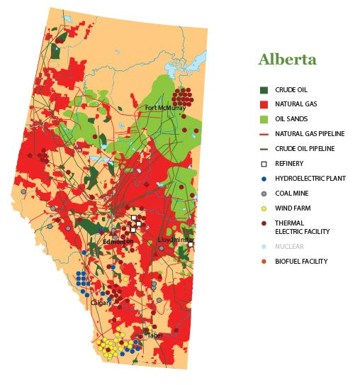
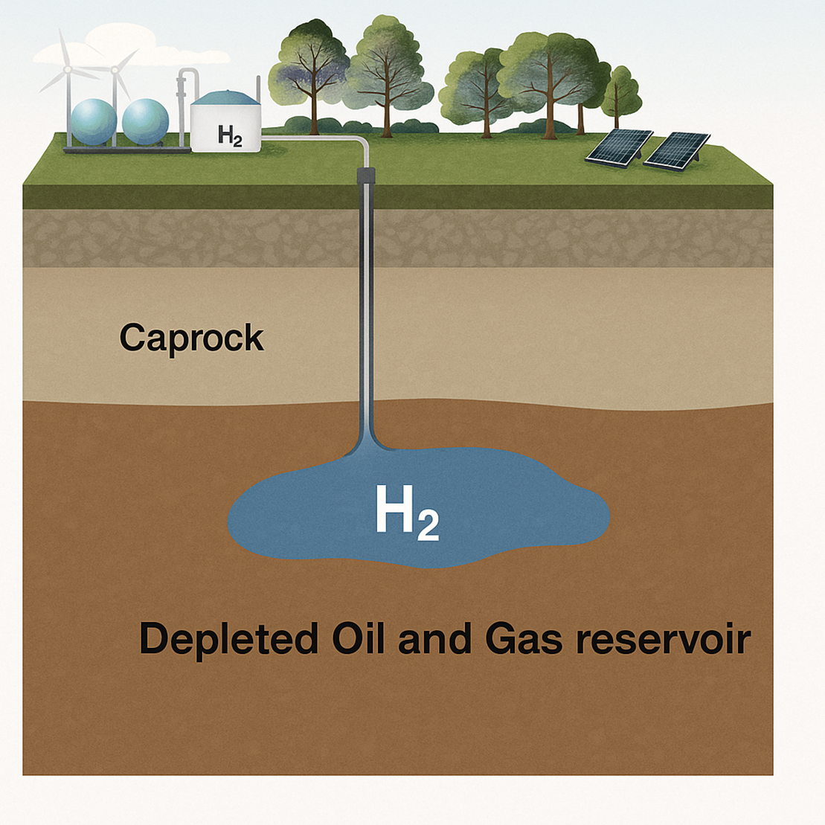

What is the importance of hydrogen storage?
To strengthen energy security and reduce reliance on fossil fuels, a rapid transition to a decarbonized energy economy is needed.
Despite its high specific energy, hydrogen’s low volumetric density necessitates large pressures and/or storage volumes.
Underground hydrogen storage (UHS) can exploit different storage mediums, the most promising being aquifers, salt caverns, and depleted oil and natural gas reservoirs. (Zivar, Kumar, & Foroozesh, 2021)
Image generated using AI
1

Slide 3
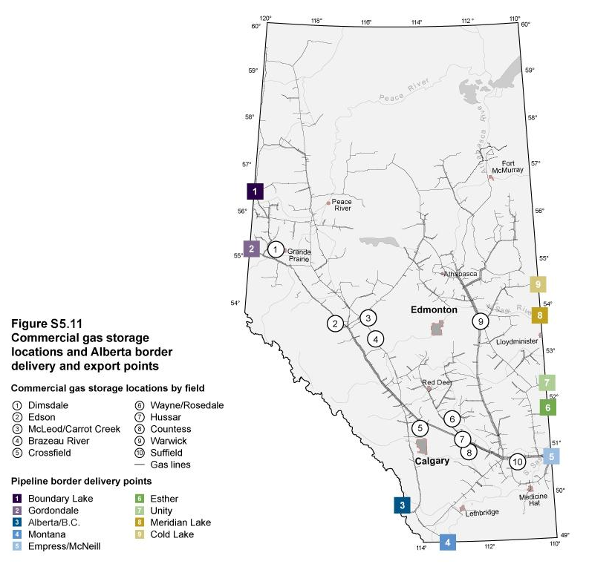
Regional context
Alberta is Canada’s largest energy-producing province, accounting for more than 60% of the nation’s total energy production
Although no UHS projects have yet been implemented in Alberta, the province has extensive experience with CO2 sequestration and natural gas storage.
To date, 9.8 and 6.2 million tons of CO2 have been permanently sequestered using CCS and CCUS, respectively.
Figure from AER-ST98
2
Notes:
It has been suggested that Alberta’s oil and gas reserves could sequester 5.2 and 41.5 gigatons of CO2, further underscoring the potential for UHS.

Slide 4
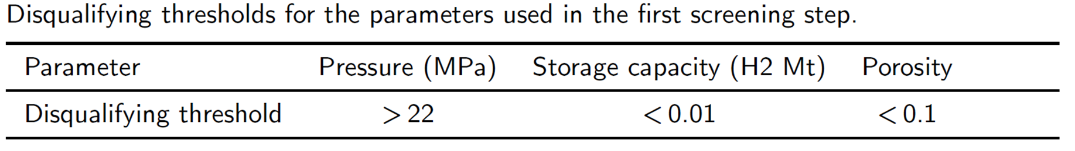
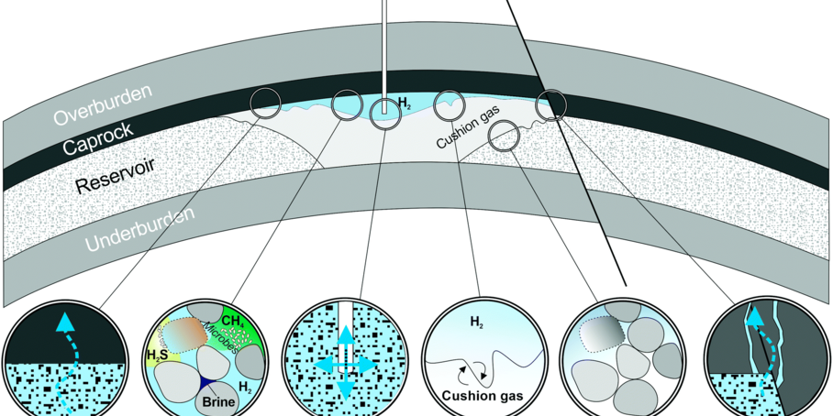
First step
We propose a two-step screening method where the first step acts as a disqualifying threshold and the second step ranks the reservoirs based on a score of 0 to 5.
The disqualifying threshold is based on the sensitivity study conducted by Okoroafor et al., focused on the hydrology of UHS in depleted gas reservoirs.
Q) What about the other processes, such as biotic and abiotic reactions, that affect the efficiency of UHS?
(Heinemann et al., 2021)
3

Slide 5
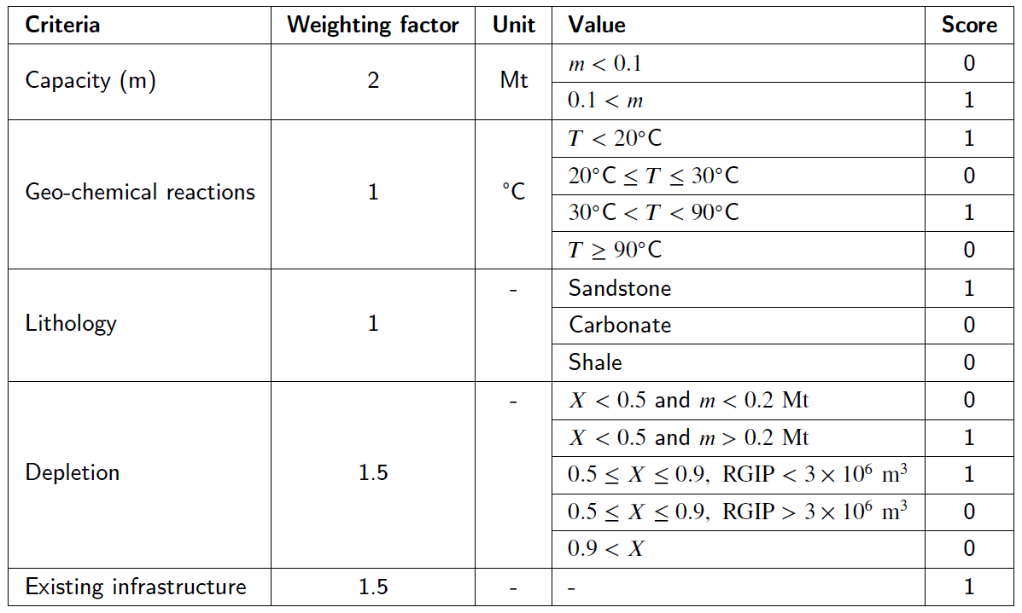
Second step
To further identify the “high quality” reservoirs, we propose a secondary criterion:
X is the recovery factor, and RGIP is the remaining in-place gas
4

Slide 6


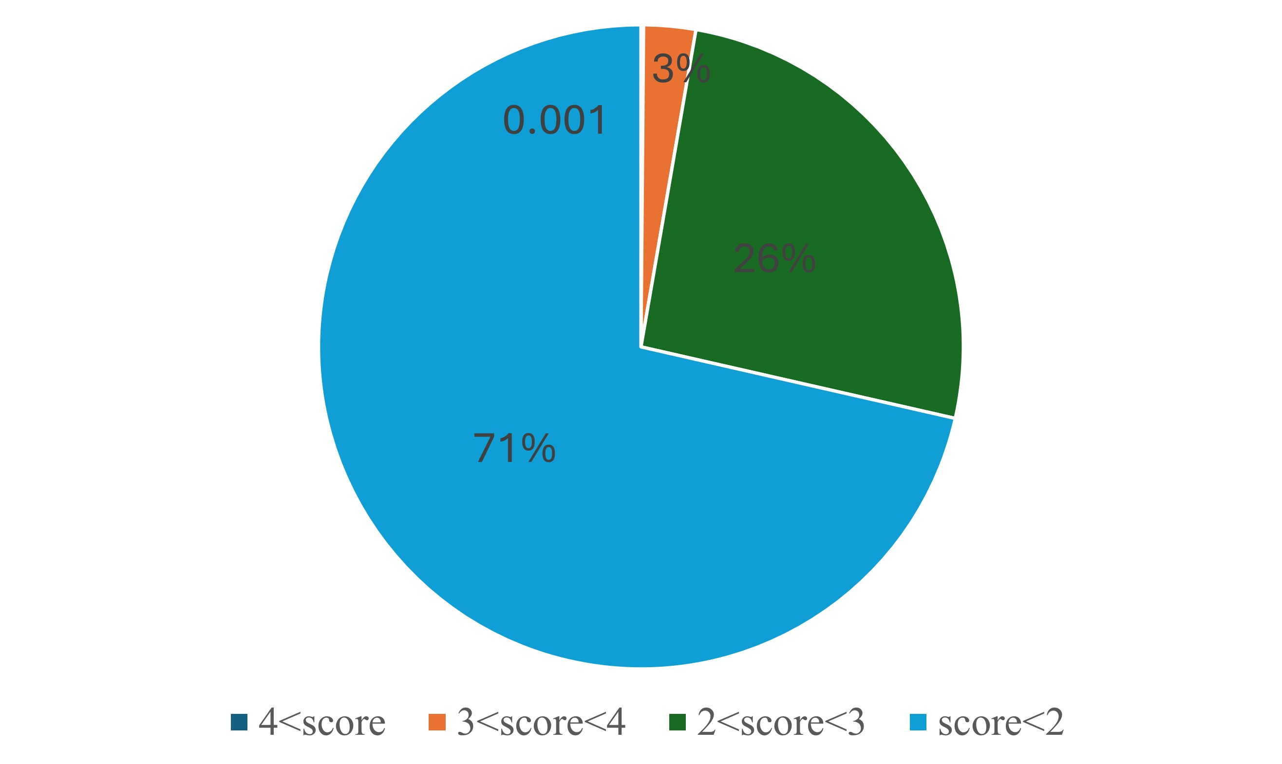
Results
Initial filtering and the first step:
Eliminating sites with comingled production
Disqualifying threshold
55,000 individual gas pools in Alberta
34,000 pools
2,200 pools
Second step:
The scoring distribution following the secondary screening criteria shows that 97% of sites received a score of 3 or lower.
Only 3% of sites - 64 reservoirs in total - achieved a score > 3, with two sites receiving a perfect score of 5.
A volumetric estimate indicates that the top 40 reservoirs that passed the two-step screening collectively roughly provide 16% of the province’s annual energy demand.
5
Notes:
an annual energy storage capacity of approximately 624 PJ,

Slide 7
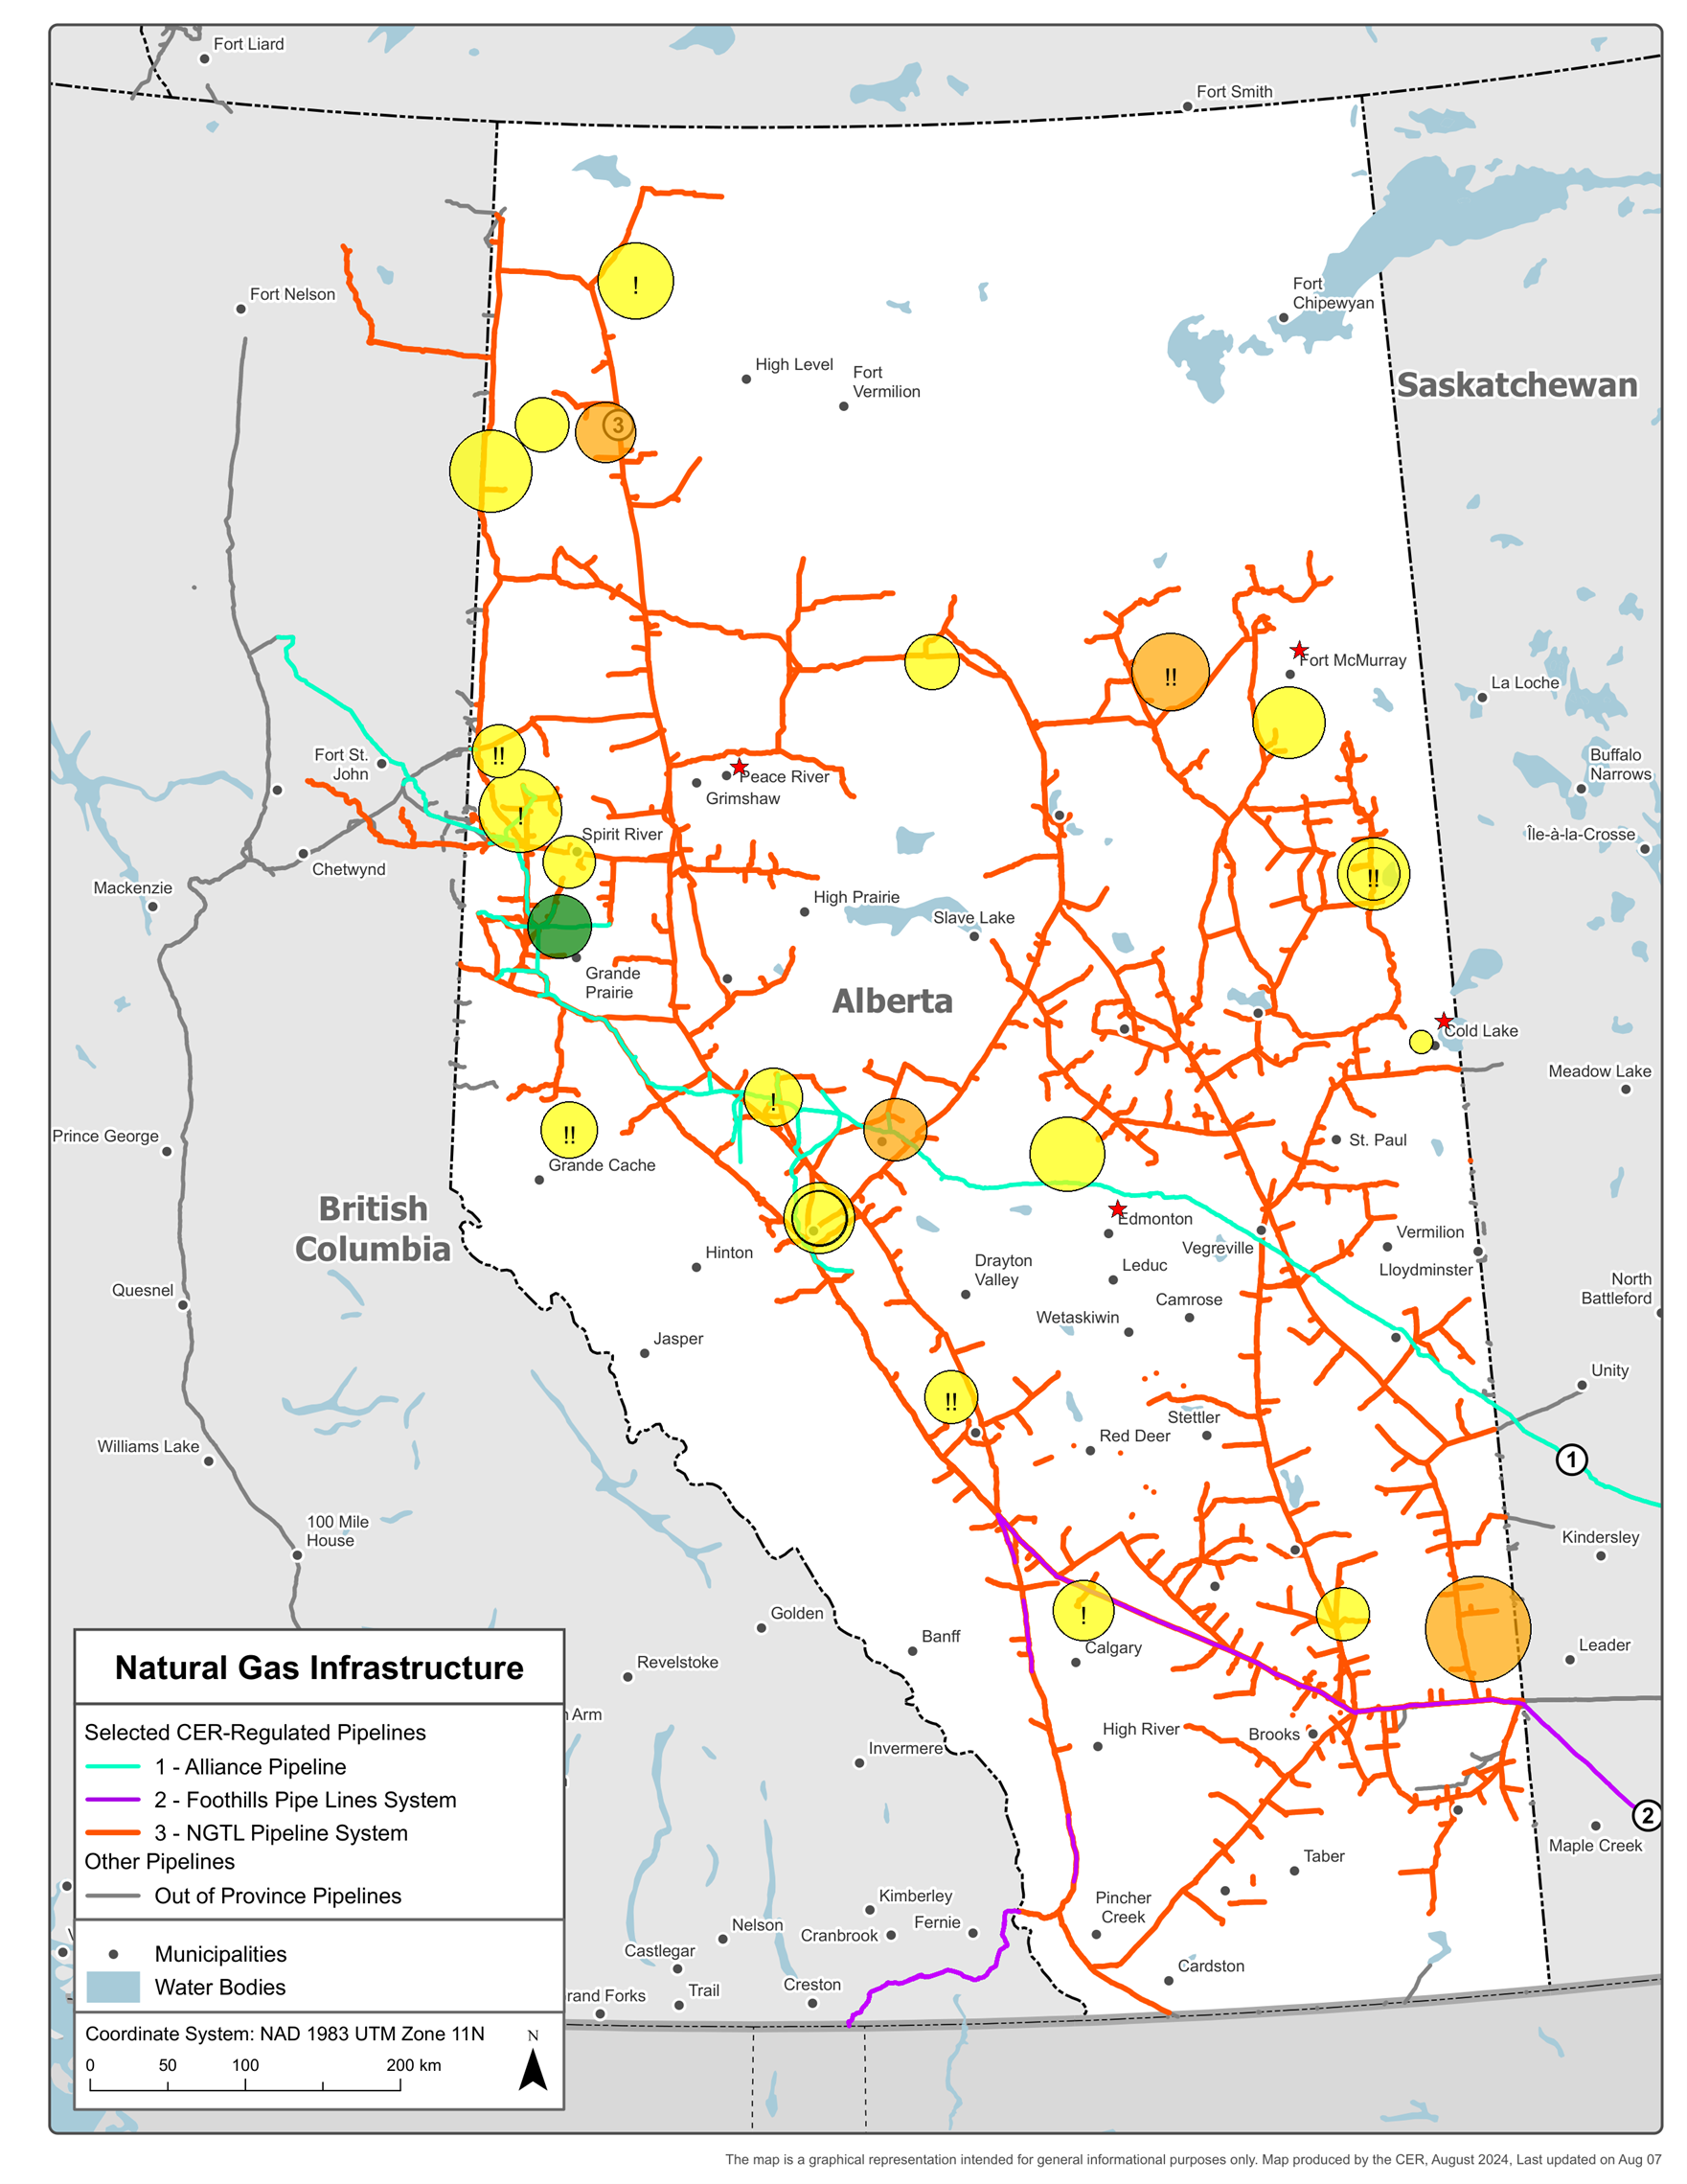
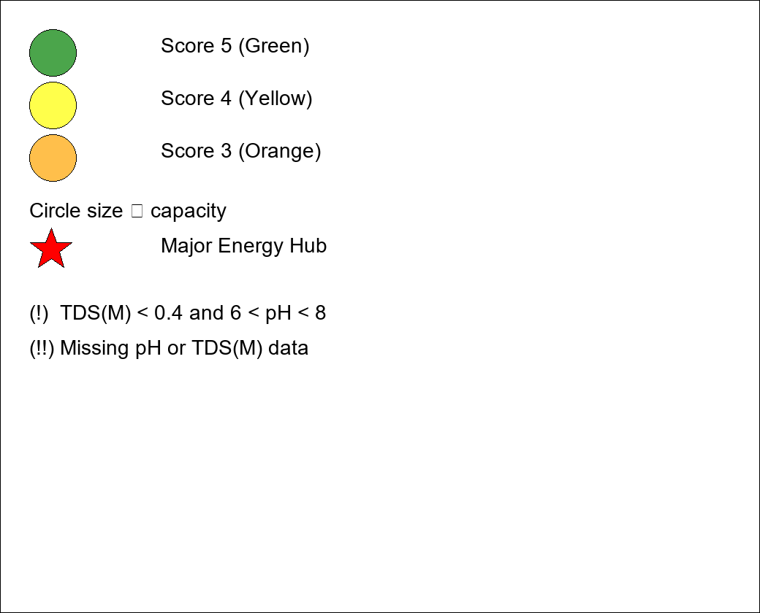
Refining the results
In the final screening step, we used well and pool data to obtain pool-based salinity, pH, and permeability information.
In this process, we removed pools with a depth of less than 1 km.
To further mitigate the risk of biotic reactions, we flagged sites with pH values in the range 6 < pH < 8 and salinity < 0.4 M as high risk for hydrogen consumption via microbial pathways.

Slide 8
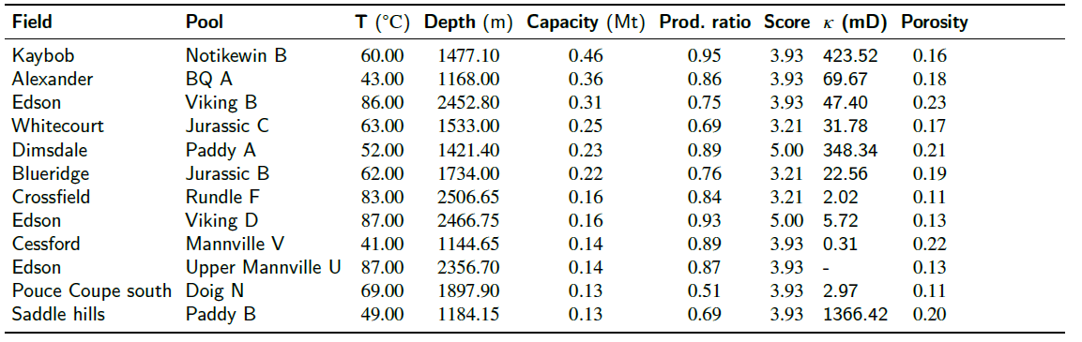
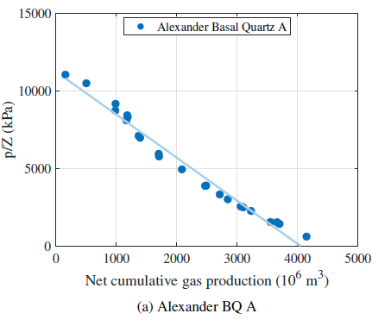
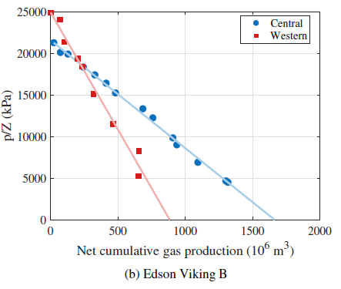
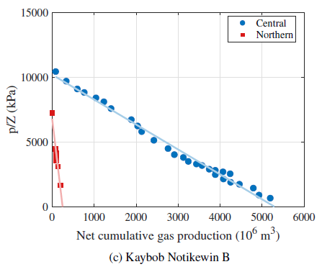
Shortlisted sites
The list 12 sites that passed the two-step screening that further have sufficient depth and low risk of biotic reactions.
Volumetric reservoirs
7
Notes:
an annual energy storage capacity of approximately 624 PJ,

Slide 9


Conclusion and future outlook
Supporting the transition to a hydrogen economy requires identifying the geological formations within the province that are most suitable for UHS.
This study applies a two-step screening algorithm to reduce Alberta’s large inventory of natural gas reservoirs.
By considering storage capacity, propensity for geochemical reactions, lithology, degree of depletion, and the risk of microbial consumption, a list of the top 12 candidate reservoirs in Alberta was identified and mapped.
A material balance investigation of the shortlisted reservoirs revealed that the reservoir, for the most part, can be regarded as volumetric.
The next primary objective in this project is to conduct a detailed numerical simulation of the candidate reservoirs to assess the efficiency of the UHS of the reservoirs.
Funding acknowledgment
8

Slide 10
References
Liu, J. (2018). Evaluation and remediation of potential environmental contaminants in Alberta oil and gas well sites. University of British Columbia.
Zivar et al. (2021). Underground hydrogen storage: A comprehensive review. International Journal of Hydrogen Energy, 46, 23436–23462.
Alberta Energy Regulator. (2025). ST98: Alberta Energy Outlook 2025. AER.
Heinemann et al. (2021). Enabling large-scale hydrogen storage in porous media — the scientific challenges. Energy & Environmental Science, 14, 853–864.
Thaysen et al. (2021). Estimating microbial growth and hydrogen consumption in hydrogen storage in porous media. Renewable and Sustainable Energy Reviews, 151, 111481.
Bachu (2006). The capacity for carbon dioxide storage in oil and gas pools in northeastern Alberta. Alberta Energy Research Institute.
Bachu (2017). Analysis of gas leakage occurrence along wells in Alberta, Canada, from a GHG perspective. International Journal of Greenhouse Gas Control, 61, 146–154.
Okoroafor et al. (2022). Toward underground hydrogen storage in porous media: Reservoir engineering insights. International Journal of Hydrogen Energy, 47, 33781–33802.
Canada Energy Regulator. (2024). Provincial and territorial energy profiles — Alberta. CER.

Slide 11
Questions and discussion
Khashi Rahnama (krahnama@ualberta.ca)

